Slide 1
Test Setup & Pre-Admin Spring/Summer 2022 EOC/EOG
Tuesday, 2/22/2022

Slide 2
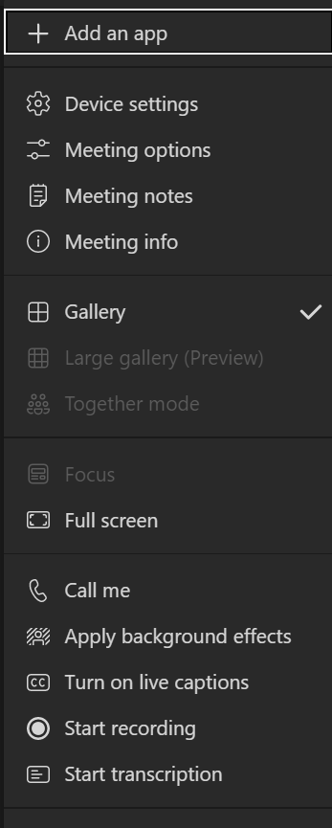
Welcome!
Post questions throughout the webinar using this link. This link will be on every slide.
Disconnect from the Meeting
Teams Toolbar Options
Show Participants
Team Notifications
More
Actions
View the content in Full screen
If you experience audio problems, enter your phone number to change audio from the computer to your phone. (option only available in the Teams app)
Live closed captions for yourself only (option only available in the Teams app)

Slide 3
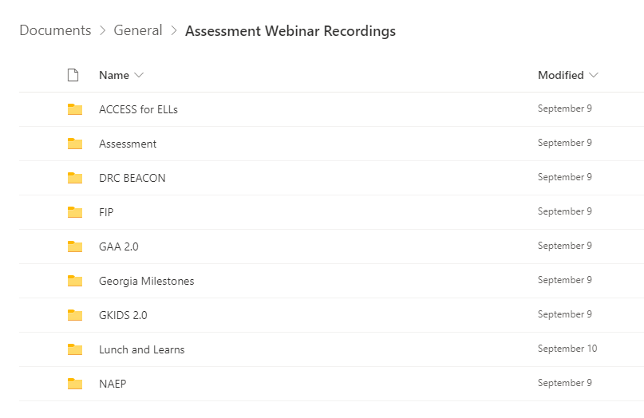
Webinar Recordings
PowerPoint presentations are posted to the Resources webpage no later than the day of the presentation.
Recordings are shared through a single link to a folder of prior webinars.
Recordings are available a day after the live session.
A Link to the recording folder is available in the Assessment Update.
Webinar Recordings

Slide 4
Agenda
Welcome!
Test Administration Protocols
Test Security
Student Participation
Georgia Milestones Overview
Assessment Scheduling
Training and Resources
Accessibility and Accommodations
Test Setup in the INSIGHT Platform
Data Imports
User Roles and Permissions
Student Management
Test Session Management
Reporting Groups and Online Readiness

Slide 5
General Test Security Training

Slide 6
Test Security
Policy, Administration, and Monitoring Resource Manuals
Student Assessment Handbook
Test Security
Roles and Responsibilities
Assessment Administration Protocol Manual
Communication Protocols
Incident Reporting Guide
Accessibility & Accommodations Manual
Allowable Accommodations Tables
Guidance in Choosing Appropriate Accommodations
Test Administration Manuals
Administration Guidance
Accessibility and Accommodations Guidance
Test Security Information
Monitoring of Assessments Guidance
Irregularities and Invalidations
Assessment Administration Protocols
Management of Related Secure and Non-secure test Materials
Test Examiner Administration Scripts
Accommodation Information Specific to Programs
Process for Making a Special Accommodations Request
Training Guidance
For Educators | Georgia Milestones Resources
Notes:
Each of our policy manuals – Student Assessment Handbook, Assessment Administration Protocol Manual, and Accessibility & Accommodations Manual are posted through the For Educators link on the Testing/Assessment website. Those links are posted here. The Test Administration Manual is posted on the Georgia Milestones Resources page. Each of these manuals should be resources used in planning and developing your local training sessions.

Slide 7
Roles and Responsibilities
Test Security – SAH pp. 18-19, 31-41
Superintendent/Charter Superintendent
Superintendent has ultimate responsibility for all testing activities within the local school system.
System Test Coordinator (STC)/Charter Administrator
STC is responsible for managing all testing activities and training within the local school system.
Principal/Administrator/Charter Administrator
Principal has ultimate responsibility for all testing activities within the school.
System Technology Coordinator
Establishes a technology plan for statewide testing including system requirements, devices, and testing schedules.
School Test Coordinator
Must hold a GaPSC-issued certificate and manages all testing activities and training for the school.
Test Examiner
Must hold a GaPSC-issued certificate and participate in all training and administration protocols and procedures for all state assessments.
Proctor
Participates in all training and follows procedures for monitoring the test environment
Student
Follows directions from the Test Examiner and works diligently during all test sessions
Additional roles and responsibilities are found in the SAH.
Notes:
The basic roles and responsibilities of the assessment team are posted here, and it is strongly recommended that you review your roles and the roles of your colleagues as presented in the SAH to determine tasks and activities for training and actual assessment.

Slide 8
GaPSC Certification is Required
All Test Examiners must hold Georgia Professional Standards Commission (GaPSC) certification. This is defined in the Student Assessment Handbook (p. 39-40) as:
[Test Examiners] must be GaPSC certified and adhere to the Georgia Code of Ethics for Educators. As required by State Board Rule 160-3-1-.07, certified educators (teachers, interpreters, counselors, administrators, and paraprofessionals) must administer all state-mandated assessments. The term Certified Educator in this statement is defined as those educators directly involved with the instruction of students, and who must hold a clearance certificate as defined by the GaPSC. Educators without Georgia certification from the GaPSC must not administer state assessments. Local systems must be mindful of certificate expiration dates and ensure that all examiners possess a valid/unexpired certificate at the time of test administration. The term Examiner refers to the person administering the assessment.
It is the responsibility of the School Test Coordinator (SchTC) to validate certification of all Test Examiners prior to test administration.
Any student assessments administered by an Examiner that does not hold valid certification will be invalidated.
Keep in mind that the decision to use an educator as a Test Examiner goes beyond the certification requirement. Districts and schools must consider the experience, training, and ability of the educator to adhere to the roles and responsibilities of an Examiner.
Notes:
Test Examiners must be GaPSC certified and adhere to the Georgia Code of Ethics for Educators. As required by State Board Rule 160-3-1-.07, certified educators, which include teachers, interpreters, counselors, administrators, and paraprofessionals, must administer all state-mandated assessments.
The term certified educator is defined as those educators directly involved with the instruction of students, and who must hold a clearance certificate as defined by the GaPSC. Educators without Georgia certification from the GaPSC must not administer state assessments. Local systems must be mindful of certification expiration dates and ensure that all examiners possess a valid/unexpired certificate at the time of test administration. STCs should not assume certification of Test Examiners and should check with local HR regarding the certification status of all potential Test Examiners.
Assessments administered by non-certified examiners which includes those whose certification has expired will be invalidated.

Slide 9
Who is Responsible?
Assignment
System/School Special Education, 504, and/or EL Coordinator
School Test Coordinator
Monitoring of Accommodations
Coding in Platforms
System Test Coordinator
School Test Coordinator
Monitoring
Everyone has a role
Students
Materials and Administration
School Test Coordinator
Test Examiner
Training
System Test Coordinator
School Test Coordinator
Test Examiner
Notes:
Irregularities can be avoided by checking and double-checking which accommodations are assigned to students. The process to ensure the appropriate application of accommodations goes beyond the IEP, IAP, and EL-TPC teams.
Each of these teams are responsible for clearly understanding how to appropriately select and administer approved accommodations based on those found in the Allowable Accommodations tables of the Student Assessment Handbook. At that point, communication must happen between these committees typically through a lead teacher or coordinator to the school and/or system test coordinator so that the accommodations may be coded properly in the online systems. We often find that irregularities in accommodations happen when information is not conveyed to the System or School Test Coordinator and then accommodations are entered incorrectly in the platform. In a minute, we will look at a report that is newly available to you to help track what has been entered into the platforms.
Training must occur for all personnel designated as examiners and proctors. This training must include a review of all materials expected for use by students during testing. Part of that training must include a review of the Student Test Ticket and Class Roster. Key information such as the verification of the student’s name, GTID, and accommodations assigned should be discussed with examples shown. This is one opportunity to discuss with Examiners what to look for on the ticket and roster and then compare it to what is needed for the accommodation – such as headphones, ensuring TTS is enabled or not in the platform, confirming student identity and so forth.
Each day of testing includes the distribution of any secure materials, supplies, test tickets and rosters. District and school protocol must require the accounting and inventory of all materials prior to and following all test sessions enabling another opportunity to ensure accommodations are correct for the Examiner’s testing group. Any error found must be reported immediately to the School Test Coordinator so that a determination may be made to determine if a new test ticket must be produced.
Please note:
Administering an assessment with an accommodation that is not in a student’s legal plan is an irregularity.
Administering an assessment without an accommodation that is in a student’s plan is an irregularity.
Administering an assessment without the proper accommodation equipment (e.g., earbuds, headphones) is an irregularity.
In many instances, such as those above, accommodations related irregularities may result in an invalidation of test scores.

Slide 10
Reporting of Testing Irregularities
SAH pp. 17-30
All personnel in the local system must follow protocol as they become aware of testing irregularities
Signs of any testing irregularity must be dealt with immediately
All irregularities must be reported to the GaDOE by completing the Testing Irregularity Form (TIF) in the MyGaDOE Portal.
After review, the Assessment Specialist will provide an IR or IV code that must be entered into the INSIGHT portal.
Test Examiner
System Test Coordinator
GaDOE
School Test Coordinator
TIF Approval and Code Assignment
Keep Principal Informed
Taiesha Adams: SP-4
Joe Blessing: SP-1
Missy Shealy: SP-3
Notes:
Irregularities may occur before, during, and after assessments occur. All test irregularities must be reported by the STC through the Test Irregularity Form in the MyGaDOE Portal to the assigned GaDOE Assessment Specialist. Once approved by the Assessment Specialist, STCs must enter the code assigned in the INSIGHT portal.
A systematic process for reporting should be established at the district to ensure appropriate personnel are notified.

Slide 11
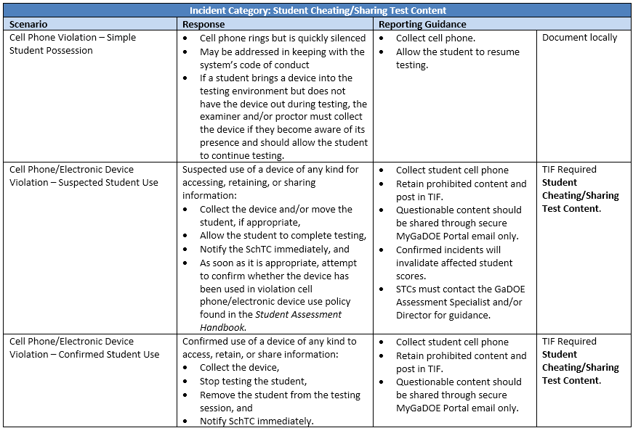
Assessment Administration Protocol Manual – Appendix N
SAH Cell Phone Guidance pp. 23-25; Calculator Guidance pp. 25-26
Notes:
When a testing irregularity has occurred, the district and/or school must report and provide documentation of that irregularity in the MyGaDOE Portal. To clarify the actions needed, an Incident Reporting Guide is found in the Assessment Administration Protocol Manual. The matrix outlines a scenario that may occur, a System Test Coordinator response, and reporting guidance for the Testing Irregularity Form in the MyGaDOE Portal. The manual only presents some of the possible scenarios that occur in the field and is intended to help simplify the process for reporting these incidents. Proactive processes should reduce or eliminate most scenarios that result in a testing irregularity or potential invalidation. STCs and School Test Coordinators must follow the designated process for reporting these irregularities in the MyGaDOE portal as found in the Student Assessment Handbook.
The use of cell phones and other devices in the testing environment has become more prevalent in recent reports in the Testing Irregularity Forms. Preparation for students must include the complete discussion of the consequences of cell phone or other device usage in the test sessions. In addition, it must be made clear to all personnel involved in managing assessments that they must not take pictures or videos of student screens, test items, test tickets and /or any other secure materials before, during, or after testing. Inappropriate use of a cell phone or device by a student will result in an invalidation of the assessment. Inappropriate use of a cell phone by staff may result in an ethics report to the GaPSC.

Slide 12
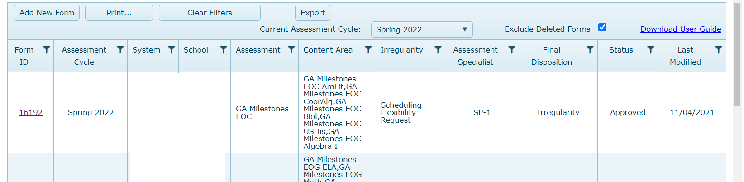
Entering Irregularities into the MyGaDOE Portal
MyGaDOE Portal Welcome Page
Testing Irregularity Form Summary Page
Refer to User Guide
Open for form review
Defaults to current active administration
Testing Irregularity Form User Guide
Notes:
Review slide content.

Slide 13
TIF Testing Irregularity Dropdown Options
Assessment Administration Protocol Manual – Appendix N
Testing Irregularity Dropdown Options
Accommodation Error Accommodation Error – TTS/Oral Reading Accommodations Error – Student Refusal
Examiner Not Certified/Trained
Mishandling of Test Materials
Possible Ethical Violation
Scheduling Flexibility Request
Student Cheating/Sharing Test Content
Test Administration Error – Adult Test Administration Error – Student
Testing Interruption
Notes:
Be reminded that within the Testing Irregularity Form, STCs are required to enter an irregularity category from a dropdown list. This list has been updated to include those shown here in the table. Note that For Documentation Purposes Only and Other have been removed along with several others intended to consolidate and simplify the irregularity category choices. Again, please review the Assessment Administration Protocol Manual – Appendix N for example scenarios and possible irregularity category choices.

Slide 14
Testing Irregularities Supporting Documentation
Training Session
PowerPoint Presentations
Sign-in Sheets
Handouts
TIF Incident Statements
School Test Coordinator
Examiner and/or Proctor
Student, if needed
Accommodation Error
Parent Contact
An invalidation may be requested by the district; however, determination will be made by the GaDOE based on administration protocols and the documentation provided.
Corrective Action Plan
Pattern of consistent misapplication of accommodations
Continued problem with distribution of test tickets
Continued problem with the application of Text-to-Speech as an accommodation
Consideration if a referral to Human Resources and/or the Georgia Professional Standards Commission (GaPSC) is warranted
Notes:
It is important for STCs and SchTCs to recognize that testing irregularities due to test administration errors or accommodations errors caused by STCs, SchTCs, Examiners, or Proctors must include a deeper look at the cause of these irregularities. Supporting documentation for these errors may be requested in the following areas: [Read slide]
A review of all training sessions and sign in sheets to ensure that the individual(s) responsible for the assignment, validation, and administration of the accommodation/s received appropriate training prior to the assessment.
Statements have been requested and received from the examiner and the SchTC describing the incident completely including the reporting process used. It is possible a statement from the student may be necessary as well.
Assurance that parents are aware of the testing irregularity and the GaDOE review of the TIF. An invalidation may be requested by the district; however, determination will be made by the GaDOE based on administration protocols and the documentation provided.
A review of patterns of consistent misapplication of accommodations such as the assignment of test-to-speech may indicate the need for a Corrective Action Plan, a referral to Human Resources, and/or the Georgia Professional Standards Commission is warranted.

Slide 15
Invalidations
SAH p. 17-30; Code of Ethics p. 18-19
The Assessment Administration Division will review all reports of irregularities and:
Issue irregularity and invalidation codes
Advise the local system as to whether a report of possible unethical conduct should be made to the Georgia Professional Standards Commission (GaPSC)
Determine if a reported irregularity invalidates any student assessments
Standard 10: Testing – An educator shall administer state-mandated assessments fairly and ethically.
Unethical conduct includes but is not limited to committing any act that breaches Test Security; and compromising the integrity of the assessment.
GaPSC Ethics Division (October 2019)
Notes:
In the case where the GaDOE determines that student records must be invalidated, STCs will be required to provide supporting documentation that may include student rosters; Test Examiners, Student, Test Coordinator, and Principal statements related to the event; and, documentation and sign-in sheets related to test security and ethical behavior training and test administration protocol trainings. Ethical behavior of educators is represented in the Georgia Professional Standards Commission Code of Ethics. Standard 10 is specific to the behavior of educators and assessments – Standard 10 – Testing. Educators shall administer state-mandated assessment fairly and ethically.
Examiners and proctors must not take pictures or videos of student screens, test items, test tickets and /or any other secure materials before, during, or after testing.
It must be understood that while it is true that an Examiner must hold GaPSC certification with a clearance certificate, the district and school must consider the experience and appropriateness of an individual to adhere to the role and responsibilities of the position of Examiner. This is a district decision, but we ask that the experience and appropriateness of the individual designated as Examiner be considered as well to avoid irregularities and significant errors in administration protocol.

Slide 16
Student Participation

Slide 17
Expectations for Participation in All Assessments
We do not anticipate any testing flexibility or waivers from the U.S. Department of Education (ED) in 2021-2022.
All students, including those receiving virtual instruction, are expected to participate in Georgia Milestones in-person this school year.
ED has indicated they will not waive the 95% participation requirement.

Slide 18
EOG Participation Requirements
Georgia Milestones | ELA | Mathematics | Science | Social Studies
End-of-Grade (EOG) | Grades 3 – 8 | Grades 3 – 8 | Grades 5 & 8 | Grade 8
 |  |  | Physical Science Grade 8 Only in lieu of Grade 8 Science EOG
Students must be assigned test sessions based on FTE enrollment.
Grade 8 students taking High School Physical Science must take the HS Physical Science assessment and are not required to take the Grade 8 Science EOG.
Students enrolled in required EOC courses must take the EOG according to grade level requirements.

Slide 19
8th Grade Science Flexibility Waiver Approved
Overview
The U.S. Department of Education has approved Georgia’s request to renew the state’s existing waiver that allows grade 8 students completing the high school Physical Science course to take the Physical Science assessment instead of the grade 8 science EOG assessment.
Grade 8 students enrolled in the high school Physical Science course shall participate in the Physical Science assessment. All other grade 8 students shall participate in the grade 8 science EOG assessment.
This is not a change for this year; this is a renewal/ continuation of last year’s assessment policy.

Slide 20
EOC Student Participation Requirements
SAH p. 69-70
End of Course Student Participation Requirements
Participating Students | American Lit | Algebra I/ Coordinate Algebra | Biology | US History
High School | EOC Required | EOC Required | EOC Required | EOC Required
AP/IB/DE If taking for core course credit | EOC Required | EOC Required | EOC Required | Exempt
Middle School If enrolled in EOC Course | EOC and EOG Required | EOC and EOG Required | EOC and EOG Required | EOC and EOG Required
2021-2022 EOC Courses
Notes:
The End of Course test is required for all students completing American Literature, Algebra I or Coordinate Algebra, Biology or US History. The End of Course is required for Advanced Placement (AP), International Baccalaureate (IB), and Dual Enrollment (DE) students in all content areas except US History.
▪ Students who are enrolled in an EOC-required course will take the related EOC assessment regardless of whether they are awarded high school credit for the course. The EOC shall count as a portion of the final grade.
▪Middle School students enrolled in an EOC course must also take the associated grade-level content EOG.
▪Remember, HS Physical Science is no longer an End-of-Course assessment and may only be administered to 8th grade students enrolled in HS Physical Science during the Spring End of Grade assessment window.

Slide 21
EOC Assessment Purposes
SAH p. 66, 69-74
Purpose | January-February Mid-Month | March Mid-Month | Spring Main | Summer Main | Details
Completion of Course | Yes | Yes | Yes | Yes | American Lit, Algebra I/Coordinate Algebra, Biology, and US History Credit Recovery Counts as 20% of grade
Makeup from Previous Administration | Yes | Yes | Yes | Yes | Unavoidably and unexpectedly absent on the regularly scheduled testing day(s). Counts as 20% of grade
Validation of Credit | Yes | Yes | Yes | Yes | Transfer students from home school, non-accredited entities Concurrently enrolled in a Georgia public school and a private school or non-traditional entity
Test Out | No | Yes | No | Yes | Must meet eligibility requirements
Retest | Yes | Yes | No | Yes | Grade conversion score less than 70 on previous administration
Notes:
These are the designated purposes for each EOC administration including completion of course, makeup from previous administration, retests, and validation of credit. Note that the Test Out opportunity is available in the March Mid-Month and Summer Main only and Retest is not available during the Spring Main.
This graphic is also found in the Student Assessment Handbook page 66.
Students enrolled in and completing EOC courses must take the corresponding End-of-Course test. The final grade in the course will be calculated using the EOC score as 20% of the final grade.
Students making less than a 70 on a previous administration of an EOC are eligible for retest. This is discussed further in the Student Assessment Handbook page 70.
Students who received a grade conversion score of 70 or above are not eligible to retest.

Slide 22
AP/IB/DE Frequently Asked Questions
Which EOCs can AP/IB/DE students exempt?
Students who pass the following AP, IB, or DE course are exempt from the EOC:
United States History
Are students taking AP/IB/DE American Literature and Composition and Biology for elective credit required to take the associated EOC? Students enrolled in AP/IB/DE American Literature and Composition and Biology who have previously earned core credit for the required courses shall not take the EOC a second time for elective credit in the associated AP/IB/DE course.
Can students take the EOC if they are exempt?
No. The intent of the SBOE rule amendment is to reduce high-stakes testing. Students who exempt the EOC by taking and passing a U.S. History course shall not take the EOC.
2021-2022 EOC A​P/I​B/DE FAQ
Notes:
Read content.
All students enrolled in and completing courses assessed by a Georgia Milestones EOC assessment must take the EOC as a final exam that counts as 20% of the final numeric grade, in accordance with State Board of Education Rule.

Slide 23
EOG and EOC – Data Validation
It is critical that student demographic data loaded into DRC INSIGHT be accurate and match the information in the district’s Student Information System (SIS), which is also uploaded to GaDOE through Student Record and Student Class.
To ensure the most accurate student data are included in the final assessment files, districts should take steps to validate student information as a part of the MSU upload process.
District leaders can use school leaders and teachers as data checkers (e.g., Local attendance rosters).
Some Common Data Errors to look for include:
Missing or Incorrect GTIDs
Duplicate Student Names
Incorrect Spelling or Hyphenation of Student Names
Reversals of Student First Name and Last Name
Missing or Incorrect Birthdates
Student Incorrectly Associated with “Service” School instead of their “Home” (FTE) School.
Reminder: Errors should be corrected in the SIS prior to uploading into INSIGHT.
Of note: Beginning in 2022-2023, Student Growth Percentiles (SGPs) will be calculated by the assessment vendor (DRC) using the final assessment files produced by DRC. SGP calculations will no longer use the matched assessment files resulting from Accountability’s Assessment Matching process.

Slide 24
Georgia Milestones Overview
Notes:
Taiesha

Slide 25
Summative Purpose for Assessment
The Georgia Milestones is a summative assessment and is considered an assessment of learning.
Takes place at the end of the year
Is used to assess instructional practices, to review curriculum mapping, and to evaluate academic programing in support of learning student needs
Measures student mastery of the Georgia Standards of Excellence (GSE)
There are no changes in the Georgia Milestones test design for 2021-2022.

Slide 26
Georgia Milestones
2021-2022 Testing Times – EOG and EOC
Content Area | Section | Typical Testing Time | Maximum Testing Time
ELA | 1 | 45-65 | 90
 | 2 | 40-60 | 80
 | 3 | 40-60 | 80
 | ELA Total | 125-185 | 250 minutes
Math | 1 | 30-50 | 65
 | 2 | 30-50 | 65
 | Math Total | 60-100 | 130 minutes
Science | 1 | 20-30 | 40
 | 2 | 20-30 | 40
 | Science Total | 40-60 | 80 minutes
Social Studies | 1 | 15-25 | 35
 | 2 | 15-25 | 35
 | Social Studies Total | 30-50 | 70 minutes
The typical testing time represents the range of time most students will use to complete the assessment. If needed, however, students are allowed up to the maximum testing time to complete the assessment. Examiners must adhere to the testing times prescribed in the Test Administration Manuals and scripts. Allowing too much or too little time may result in an invalidation (SAH p. 66).
Notes:
Based on analyses of prior years’ testing, we have determined the typical amount of time in which most students should complete testing. If needed, however, students are allowed up to the maximum time shown here. This is included in the Test Administration Manual. It should also be noted that there is no minimum time for testing. If all students have submitted the test, the examiner should complete the test section. Examiners must adhere to the testing times prescribed in the Test Administration Manuals and scripts. Allowing too much or too little time may result in an invalidation.

Slide 27
Item Types
English Language Arts
Item Types
Selected Response Constructed Response items Constructed Response Extended Constructed Response (Narrative Writing) | Extended Writing Response Evidence-Based Selected Response Drag and Drop/Paste Drop-down List
Unique Feature(s)
Reading and Evidence-Based Writing Section requires students to construct meaning, make inferences, draw conclusions, compare and contrast ideas as well as synthesize ideas and concepts across multiple texts Selected Response Constructed Response Extended Writing Response
Extended Writing Response requires students to develop an informative/explanatory or opinion/argumentative essay – citing evidence from text(s) and using standard language conventions, etc.
Professional Learning on Reading and Evidence-Based Writing (REBW) and Narrative Writing
Notes:
Item types found on the English language arts assessments include selected response (or multiple choice), constructed response, extended constructed response, extended writing response, evidence-based selected response, drag and drop/paste and drop-down list.

Slide 28
Item Types
Mathematics
Item Types
Selected Response Multi-Part Multi-Select Drag and Drop/Paste Keypad Input Drop-down List | Graphing Coordinate Grid Number Line Bar Graph Line Plot Line Graph Pictograph
Unique Feature(s)
No-Calculator Section Desmos Calculator
Notes:
These item types and features are included for mathematics. There are additional TE items and no constructed response items in Mathematics.

Slide 29
Item Types
Science and Social Studies
Item Types
Selected Response Multi-Part Multi-Select Drag and Drop/Paste Drop-down list
Unique Feature(s)
Science requires understanding of the core concepts, ideas, and practices of science to explain scientific phenomena Social Studies requires understanding of the past and its influence on the present and future – including the interconnectedness of history, culture, geography, economics, and government/civics
Notes:
These item types are included for science and social studies.

Slide 30
Allowable Calculators
Online (www.desmos.com/testing) or Hand-held
Content Area | Grade Level/Course | Type of Calculator
Mathematics | Grades 3-5 | Not Allowed
 | Grade 6 | Basic
 | Grades 7 and 8 | Basic or Scientific
 | Coordinate Algebra | Scientific or Graphing
 | Algebra I | Scientific or Graphing
Science | Physical Science | Basic¹ or Scientific
Districts may elect to use the online calculator in INSIGHT only.
Calculators are not permitted in grades 3–5 mathematics; and are not permitted on Section 1, Part A, of each mathematics test in grades 6–8 and high school.
One allowable hand-held calculator is permitted in online or paper testing environments.
To allow, or not allow, hand-held devices in an online or paper test setting is a district decision that should be consistent district wide (SAH p. 25).
SchTC and/or Test Examiners are required to confirm prior to testing and immediately after testing that all graphing calculators are cleared of any stored text.
Notes:
This slide shows the allowable calculators for Georgia Milestones. These will automatically be available in the online test. The online DESMOS calculator is available as a universal tool for all students during the appropriate sections of the content assessments. Practice opportunities are available in Experience Online Georgia and the practice tests. Local districts must clearly determine if a handheld calculator will be made available for students. Please remember, in grades 6-high school, it is not permissible to assign a calculator as an accommodation for the no-calculator subsection. Handheld calculators must not be assigned to any students during this section of the assessment. In addition, calculators are not allowed in grades 3-5 for the end-of-grade assessments. The use of a calculator in grade 3-5 is considered a conditional accommodation and must be restricted to only those students with IEPs who meet all eligibility criteria outlined in the Student Assessment Handbook.

Slide 31
Scratch Paper – EOG/EOC
Scratch paper may not contain any writing (other than student name) prior to starting a test session.
ELA
Section 1 Start with 2 sheets | Section 2/3 Start with 1 sheet
Allowable: Writers Checklist, test ticket
Mathematics
Sections 1 / 2 Start with 2 sheets | ¼” graph paper Allowed
Allowable: Formula Sheets, Graph Paper
Science
Sections 1 / 2 Start with 1 sheet
Allowable: Periodic Table, Physical Science Reference Sheet (HS Physical Science only)
Social Studies
Sections 1 / 2 Start with 1 sheet
Once scratch paper is used, it is considered secure testing material.
Only GaDOE posted documents as listed on Georgia Milestones Resources may be used as scratch paper.
Notes:
The following guidelines show how many pieces of clean scratch paper may be provided to students to start per section. Students can also ask for more scratch paper. Scratch paper of any kind may not contain student or teacher writing of any sort other than the student name prior to starting a test session. All scratch paper must be collected from students and is considered secure testing material.
Scratch paper may not contain any writing (other than student name) prior to starting a test session.
Once Scratch Paper is used, it is considered secure testing material.

Slide 32
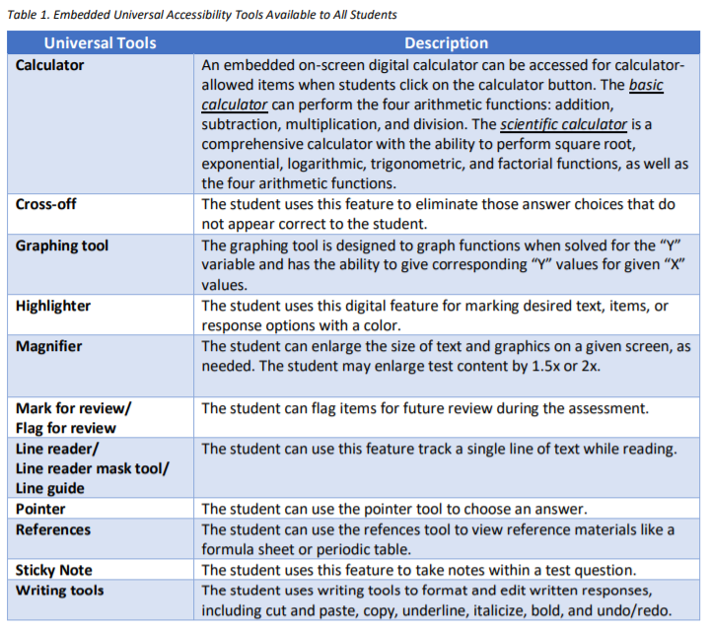
Universal Tools
SAH pp. 91-92
Mask Tool
Notes:
Universal tools are available to students participating in the Georgia assessment program to address their individual accessibility needs as they access instructional or assessment content. These supports are either embedded in the online test or provided by a test administrator at the local level during testing (e.g., scratch paper). The Masking tool is now available as a universal tool in the toolbar.

Slide 33
Assessment Scheduling
Develop Assessment Schedule

Slide 34
Georgia Milestones
Spring/Summer 2022
Spring/Summer 2022 EOG/EOC Pre-Admin and Test Set-up Training
2/22/2022
Interactive Reporting Overview and Training (Spring 2022 EOG and EOC)
3/22/2022
2022
Jan
Feb
Mar
Apr
May
Jun
Jul
2022
January 2022 EOC MM
1/17/2022 - 1/28/2022
February 2022 EOC MM
2/7/2022 - 2/18/2022
Spring 2022 EOG Test Setup Window
2/28/2022 - 5/27/2022
Spring 2022 EOC Test Setup Window
2/28/2022 – 6/3/2022
March 2022 EOC MM
3/7/2022 - 3/18/2022
Spring 2022 EOG
4/11/2022 - 5/20/2022
Spring 2022 EOC
4/18/2022 - 5/22/2022
EOG 2022 Summer Retest
5/9/2022 - 7/15/2022
EOC 2022 Summer
6/13/2022 - 7/15/2022
Notes:
This calendar shows the test administration and test setup windows along with the major Georgia Milestones trainings.

Slide 35
Scheduling Requirements
SAH pp. 67-68
Assign students to test sessions based on FTE enrollment.
Set testing dates across all schools within the district for each course or content assessment (e.g., course assessments must be administered on the same days across the district).
Develop a local testing window within 25 school days of the district’s last school day of the regular school year (EOG only).
Complete all test sessions on the same day or on consecutive days during the same week.
Administer Section 1 of ELA on a separate day prior to Sections 2 and 3 (may not be separated by a weekend).
Submit all Scheduling Flexibility Requests in advance in the MyGaDOE Portal (TIF) for review and approval. Approved scheduling flexibility requests are considered irregularities.

Slide 36
Scheduling Flexibility
Requires GaDOE Approval | Does Not Require GaDOE Approval
Flexible Scheduling Requests Hybrid Schedules Alternative Schools Face-to-Face different from Virtual learner schedules | Block Schedules Cohort A takes EOC (1 or 2 sections) on one day and Cohort B takes EOC (1 or 2 sections) on different day Mid-Month Administrations Standard course completion Make-ups
Use of Multiple EOC Administration Windows Due to district/school closures or quarantines | Scheduling two sections in the same day ELA (2&3) ELA Section 1 must be administered first and separate from Sections 2 and 3. Mathematics, science, and social studies (1&2)
Afternoon or Evening Administrations Must complete all test sessions by 8 p.m. ET Weekend sessions are not allowed | Multiple content assessments on the same day Science and Social Studies Make-up Sessions
Flexibility requests requiring GaDOE approval must be submitted as an irregularity in the MyGaDOE Portal.

Slide 37
Understanding Your Students
Hospital Homebound Students (SAH p. 4,7, 71)
Makeup Sessions (SAH p. 8)
Should administer assessment at the same time (if possible) and must use the same administration procedures being used in the school
Test materials must be checked out and returned the same day
Must be within the state and local testing window
May not be used for personal student activities
Contact your GaDOE Assessment Specialist, if unusual scenarios present that may require the use of your make-up days
Review guidance in the SAH; contact your GaDOE Assessment Specialist with questions or concerns
Notes:
We do understand attempting to schedule and administer assessments to a medically fragile students in their home or in a hospital setting during a pandemic is a sensitive and an immeasurably complicated matter. We ask local staff to consider the health and well-being of students and personnel first when attempting to schedule these sessions. All such sessions should be administered during the testing window.

Slide 38
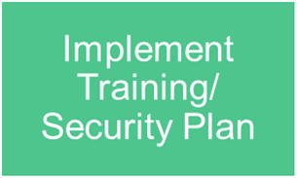
Training and Resources
Notes:
Georgia Milestones works in a Train the Trainer model. The system Test Coordinator trains the School Test Coordinator. The Test Examiner and classroom teacher prepares the students. Each level must understand their role and the required training in order to foster readiness and minimize issues of test security during assessment administrations.

Slide 39
Training Series
Training presentations are found at http://gadoe.org/milestones > Georgia Milestones Training Resources
Recordings are found in the Recordings Folder.
 | Date | Title | Time
Spring 2022 | 1/11/2022 | Technology Director Training for All Online Assessment Platforms (Live Repeat) | 10 – 11:30 a.m.
 | 2/22/2022 | Georgia Milestones Spring EOG/EOC Pre-Administration & Test-Setup | 10 – 11:30 a.m.
 | 3/22/2022 | Georgia Milestones Interactive Reporting Overview and Training | 10 – 11:30 a.m.
Notes:
We offer a series of webinars for Georgia Milestones that include the Technology Director Training, this Pre-Administration Training and the Interactive Reporting Overview and Training. PowerPoints are available before the webinar begins on the Georgia Milestones Training Resources page. Recordings are available within 24 hours in the Recordings folder which is also linked on the Assessment Updates.

Slide 40
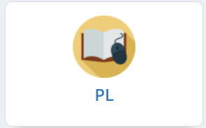
School Test Coordinator Training Course
To access Georgia Learns, log into SLDS and click the PL tab or tile within SLDS.
Click on the Georgia Learns PD Hub
Next you will see the Catalog tab. Locate the School Test Coordinator Course. Click Enter to enroll in the course and access the course.
How to Access Georgia Learns
Notes:
The School Test Coordinator Course has been updated in the new Georgia Learns platform. The School Test Coordinator training course is designed to walk school leaders through the state requirements for Georgia Milestones administration. There is a badge for completing the course and passing the quiz. This course is designed to give state information regarding the Milestones Assessment administration and coordinate with district specific guidance.

Slide 41
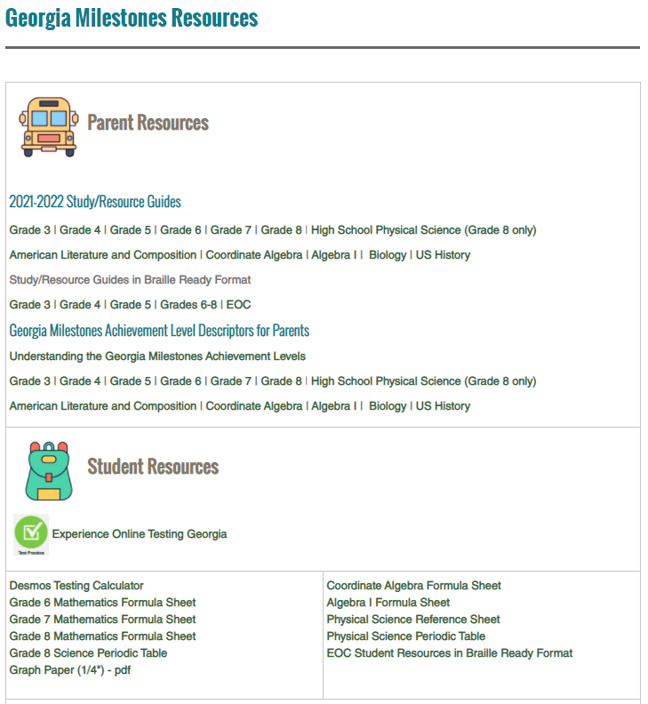
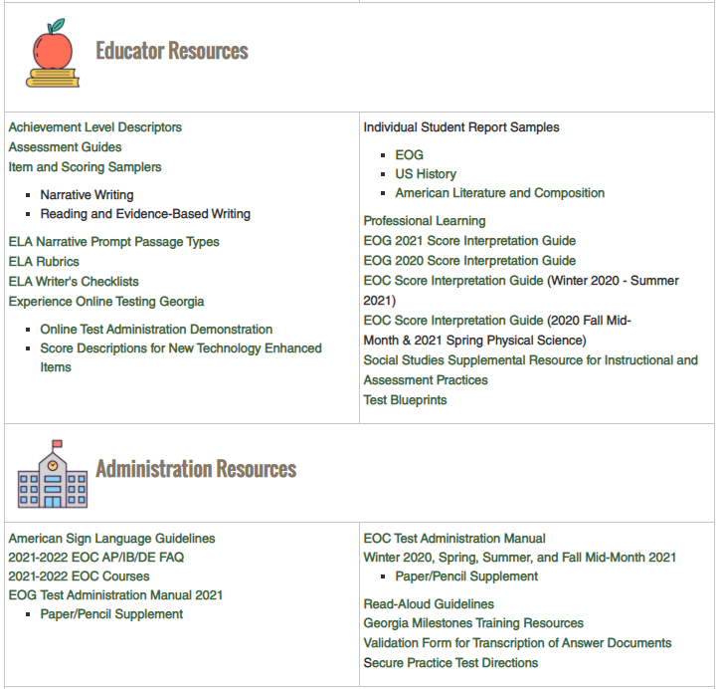
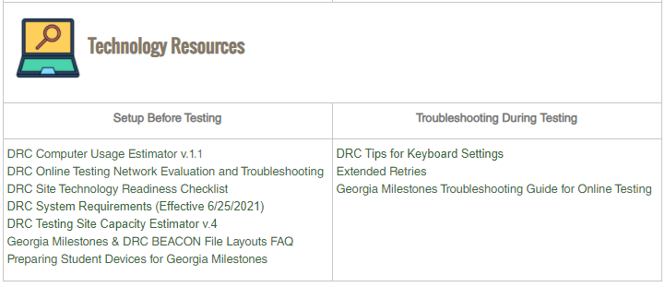
Georgia Milestones Resources
Notes:
Georgia Milestones has a wide variety of resources for Parents, Students, and Educators as well as for administration and technology implementation. There are numerous resources for gaining a better understanding of Georgia Milestones included Study/Resource Guides, sample formula sheets, Achievement Level Descriptors, Assessment Guides, Sample Rubrics and many more.

Slide 42
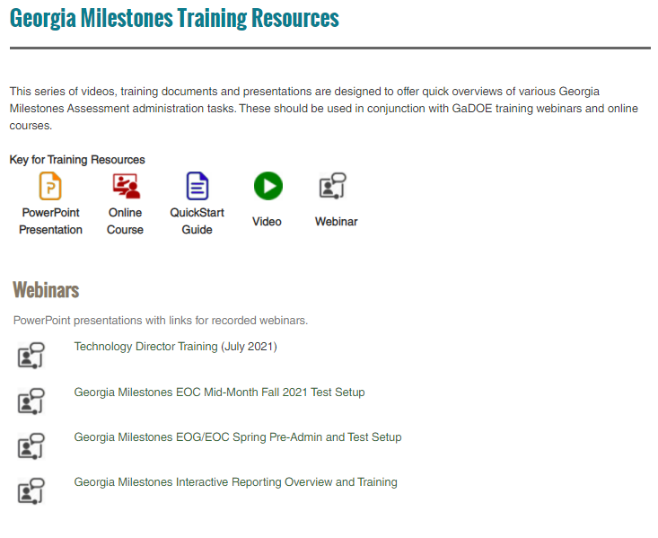
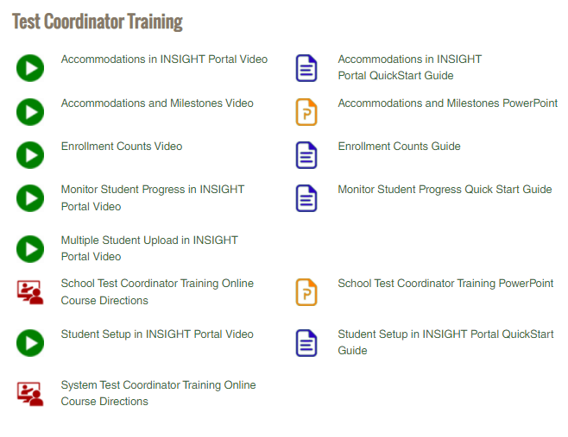
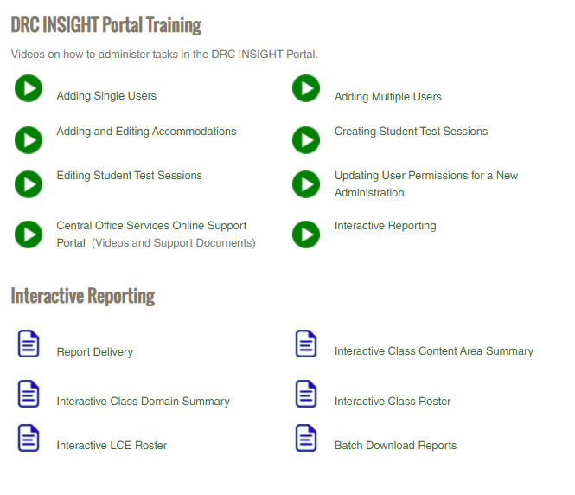
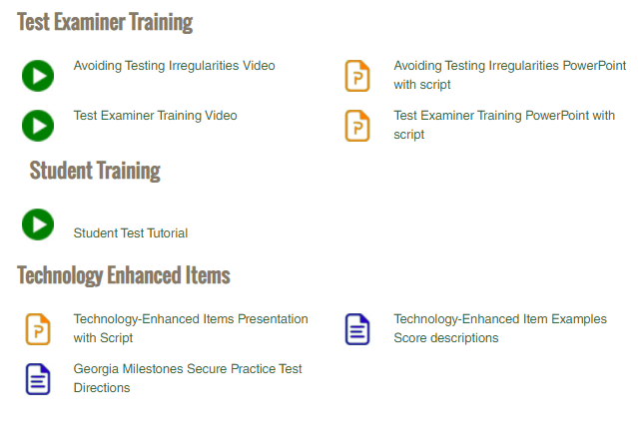
Georgia Milestones Training Resources
Georgia Milestones Training Resource Page
Notes:
A great deal of addition information, webinars, PowerPoint presentations, videos, and guides are found on the Georgia Milestones Training Resource Page and may be shared and utilized in setting up your local training. These resources are meant to supplement your local training guidance with GaDOE administration protocol.
New and Veteran STCs may want to review the INSIGHT portal videos later once this training today has completed as these videos are also intended to help you with completing some of the INSIGHT portal activities and tasks.

Slide 43
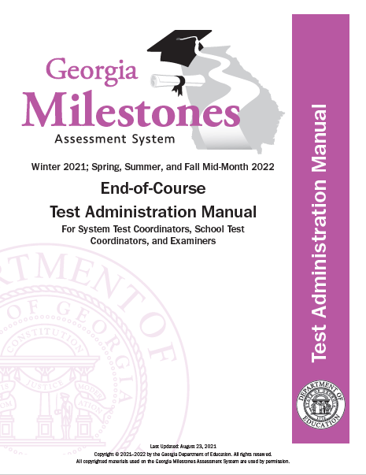
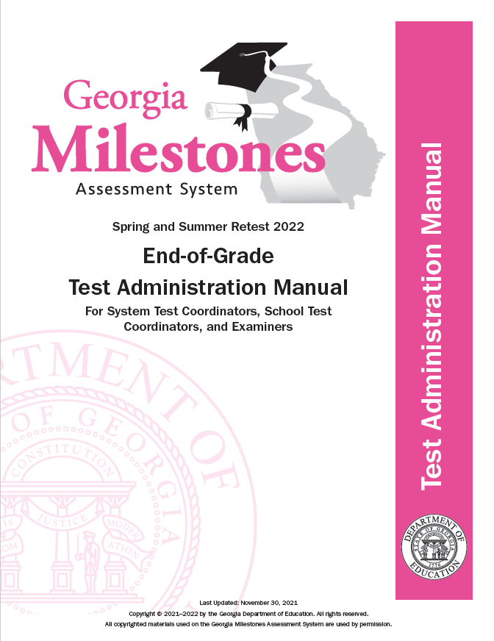
Test Administration Manual (TAM)
Train using online tools
Interactive Board technology, laptops, tablets
Use of personal cell phone not allowed
Print by Content Area Examiner Script in Appendix
Script for Test Monitoring App
Includes checklists for System Test Coordinators, School Test Coordinators and Test Examiners
EOG Scripts | EOC Scripts
English/Language Arts | American Literature
Mathematics | Algebra/Coordinate Algebra
Science/High School Physical Science | Biology
Social Studies | US History
ELA/Math Retest
Linked on the Georgia Milestones Resources page
Notes:
Test Administration Manuals are available digitally on the Georgia Milestones Resources webpage. Districts will need to think through and consider options for training Examiners. This slide illustrates some ideas and options that may be considered. System and/or School Test Coordinators may choose to present Test Administration Manuals digitally during training for review by coordinators and examiners prior to testing. One option for trainers would be to ask examiners to bring a laptop or iPad with the TAM downloaded for review and discussion during the training meeting.
Schools and districts can also print test examiner scripts by course. Test examiners can use devices such as laptops, tablets, and interactive boards to read scripts. However, personal cell phones are not allowed.

Slide 44
Communicating Test Results
SAH pp. 14-16
Embargoed until GaDOE Release
Summary Reports State District School |  | Shall not be discussed at public meetings or released to the public or the media by districts until the public release by the state. This public release is generally made by the State Superintendent. Local superintendents and STCs are notified of the public release of data.
Not Embargoed
Preliminary Reports Individual Student Reports Class Rosters |  | Preliminary individual student reports are not embargoed and can be shared with parents, students, teachers and staff as soon as they are received, by district decision.
How Reports Can Be Shared with Educators Interactive Reporting – District, School Administration, Teacher Printed reports (by district)
How Reports Can Be Shared with Parents/Guardians Parent Portal, SLDS Parent Portal, District Parent Portal
Earliest Expected Dates for Preliminary Reporting, Spring Main Admin
May 13, 2022 | EOG ELA 3,5,8 |  | May 24, 2022 | ELA 4, 6, 7
May 18, 2022 | Math, Science, Social Studies |  | May 19, 2022 | EOC All Courses
Notes:
Summary results of Georgia Milestones should not be released until the public release by the State Superintendent.
Preliminary Reports such as Individual Student Reports and Class Rosters are not embargoed and can be shared with parents, students, teachers and staff as soon as they are received.
The earliest expected Preliminary Reporting dates are shown. Please keep in mind that these are expected dates and are contingent on districts administering tests as stated on their schedules.

Slide 45
Accessibility and Accommodations
Notes:
We’ll now cover a few slides on Accessibility and Accommodations.

Slide 46
Accommodation Guidance
Accessibility & Accommodations Manual; SAH pp. 88-114
Accommodations are determined by IEP, IAP/504, or EL/TPC Committee
Accommodations should be a part of routine classroom instruction and assessment
Only approved accommodations may be used on state-mandated tests
Notes:
The provision of accommodations must adhere to the following requirements. Essentially,
Testing accommodations are assigned to students based on decisions made by the IEP, IAP/504, or EL/TPC Committee. Assigned accommodations are required by the student in order to access the assessment due to the student’s disability. Accommodations must be based upon individual student needs and not upon a category of disability, level of instruction, time spent in general classroom, EL status, or program setting. Therefore, they must be justified and documented in the student’s IEP, IAP/504 plan, or EL/TPC plan.
As with any accommodation, it is important that the student require the accommodation and use it regularly during routine instruction and assessment. Therefore, accommodations must not be introduced for the first time during the testing of a student.
Specifying a test mode is not an allowable accommodation. All students are expected to take the Georgia Milestones test online. However, paper forms are available for a student with a disability that prevents him/her from accessing a computer.
Neither accommodations or assessment designations should be determined by accountability concerns or influences
Only accommodations listed as approved in Georgia’s Student Assessment Handbook/Accessibility & Accommodations Manual may be used on state-mandated tests.

Slide 47
Special Accommodations Requests
SAH pp. 104-105
IEP Team
Identifies rare circumstance when student requires accommodation not on approved list
System Test Coordinator
Submits request through MyGaDOE Portal six weeks in advance
GaDOE
Reviews requests and submits questions or approvals
STC/Special Ed Director
Determines unique student need
Notes:
In RARE circumstances a student with a disability may need an accommodation that is not on the approved list in the SAH and Accessibility & Accommodations Manual. Special Education Directors and System Test Coordinators should determine if a student has a unique need that is not addressed by the list of Allowable Accommodations. If necessary, System Test Coordinators should submit a Special Accommodation Request no later than 6 weeks prior to the start of the test administration window. For the Spring Main Window, requests should be submitted by Monday, February 28 for EOG and March 7 for EOC. System Test Coordinators are encouraged call the Assessment Division to discuss questions regarding the accessibility needs of one or more students. If you have any questions about when or how to complete the special accommodations form, please feel free to contact me, Taiesha Adams.

Slide 48
Standard and Conditional Accommodations
Standard
Standard accommodations do not alter or encroach on the construct (target skill) measured
Conditional
These supports are more expansive accommodations that provide access for students with more severe disabilities who would not be able to access the assessment without such assistance.
SAH pp. 93-95, 101-104
Note: Most students are expected to participate in standard administrations, with less than 3% receiving a conditional administration (State Board Rule 160-3-1.07)​
Notes:
In the state of Georgia, accommodations fall into one of two categories: standard or conditional. Simply put, standard accommodations are those allowed for both assessment and instruction that do not change the target skill that is being tested. A conditional accommodation, on the other hand, is one that will change the nature of the task, or target skill.

Slide 49
Conditional Accommodations
SAH pp. 101-104
These supports are more expansive accommodations that provide access for students with more severe disabilities who would not be able to access the assessment without such assistance.
Signing ELA passages
SWD only
Oral reading of ELA passages
Grades 3-12
Grades 3-12
SWD only
Conditional Accommodations
Notes:
Conditional Accommodations are supports that encroach upon the construct being assessed. They are more expansive accommodations that provide access for students with more severe disabilities. Accommodations considered conditional for the Georgia Milestones Assessment:
Signing ELA passages (SWD only) and,
Oral reading of ELA passages (grades 3 – 12)
Most students are expected to participate in standard administrations, with less than 3% receiving a conditional administration (State Board Rule 160-3-1.07). Please remember that criteria for conditional accommodations must be met. The use of a conditional accommodation for ineligible students will result in a Participation Invalidation (PIV).

Slide 50
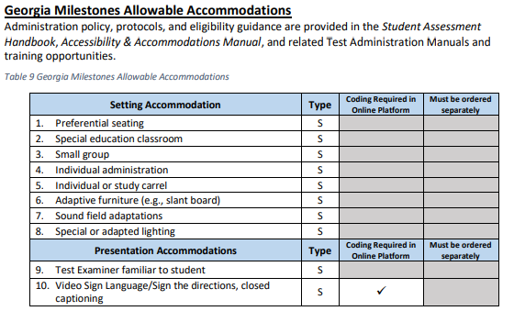
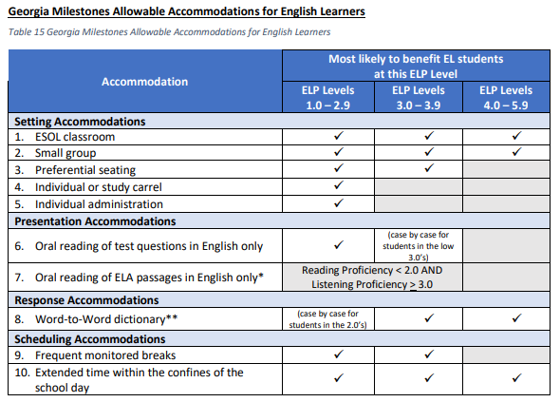
Allowable Accommodations Chart
SAH pp. 96-97, 111
Student Assessment Handbook pages 96 and 111.
Notes:
The Allowable Accommodations charts for students with disabilities and English Learners is for use by IEP, IAP/504, and EL/TPC teams when making accommodations decisions specifically for students regarding Georgia Milestones assessments. The policy, protocols, and eligibility guidance for these charts can be found in the Student Assessment Handbook, Accessibility & Accommodations Manual, and related Test Administration Manuals and training opportunities.

Slide 51
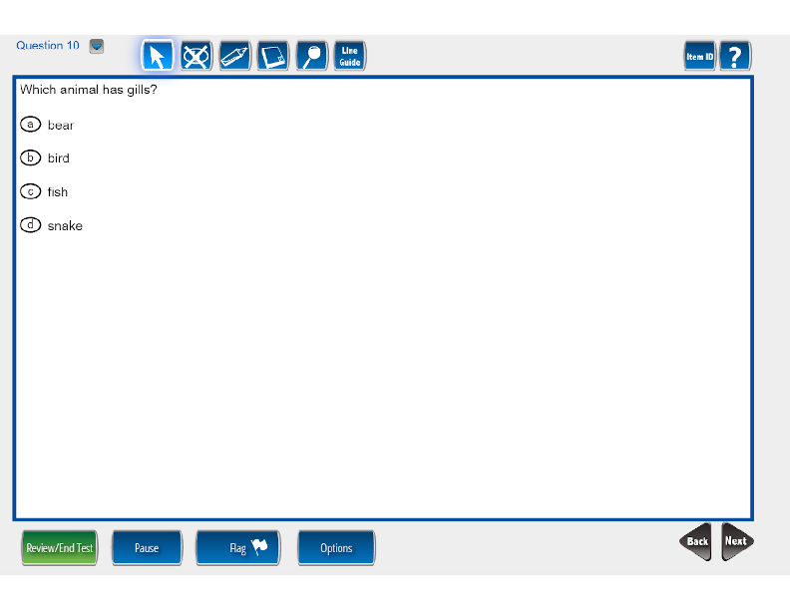
Online Tools in INSIGHT
Options for Large Print Accommodation
The Magnifier Tool increases the size of selected items 1.5x or 2x the standard size.
INSIGHT uses Scalable Vector Graphics
Allows for students to use many sizes of monitors, including larger monitors
No distortion of the content
iPad users can pinch to zoom in INSIGHT
Notes:
The delivery of accommodations in INSIGHT includes large print, read-aloud, and Video Sign Language. Students who need a larger sized version of Georgia Milestones can use the Magnifier tool that will increase test times one and a half or two times. Schools can also offer a larger monitor. The test will resize and give the students a larger version of the test.

Slide 52
Online Tools in INSIGHT
Options for Video Sign Language and Read Aloud
Notes:
Video Sign Language can be used so that a signed version of Georgia Milestones is presented to students. Students can play, pause, as well as move forward and backward as needed using online controls. For the read aloud accommodation, INSIGHT uses a recorded voice to present the reading of the test content. Technology directors need to check the TTS box for the content prior to the district window. Students should use Experience Online Testing Georgia to practice these options ahead of testing.

Slide 53
Collaborate with the Team
Student Accommodations
Prepare list of students requiring accommodations per IEP, IAP, or EL/TPC plan
Prepare appropriate testing schedules to allow for extended time and/or small group settings.
Verify accommodations have been entered properly into testing platforms and/or required documents.
Determine the local protocol for transcription of student answer documents into online testing platforms.
Determine training plans and test preparation for the Georgia Milestones.
Determine a monitoring and reporting system for verification of student accommodations in test sessions.
Notes:
Collaboration between general, special education, and ESOL educators must occur for successful student access. School districts should encourage meaningful collaboration among classroom teachers, school administrators, assessment officials, parents, and students to guarantee beneficial instruction and assessment of students.
It is also important to know which students require accommodations and which accommodations they should receive. Accommodations are assigned to students who are deemed eligible per an IEP, IAP/504, or EL/TPC Committee. If a student requires transcription of responses, the person transcribing response should follow instructions and complete the Validation Form in the Student Assessment Handbook.
For information on allowable accommodations for eligible students, please refer to the Student Assessment Handbook or the Accessibility & Accommodations Handbook. You may also contact the Assessment Administration division directly.

Slide 54
District/School Monitoring
Avoiding Accommodations Related Testing Irregularities
Administering an assessment with an accommodation that is not in a student’s legal plan is an irregularity.
Administering an assessment without an accommodation that is in a student’s plan is an irregularity.
Administering an assessment without the proper accommodation equipment (e.g., earbuds, headphones) is an irregularity.
In many instances, such as those above, accommodations related irregularities may result in an invalidation of test scores.
Notes:
Occasionally, errors in test administration do occur. However, with proper planning and monitoring, testing irregularities should be very minimum. In fact, it should be of uttermost importance to avoid accommodations related test irregularities as they can have far reaching consequences such as test invalidation or, in some instances, PSC referrals. With that in mind – review slide content.
Later in today’s presentation, we will discuss how districts can now monitor accommodations within INSIGHT using a new Accommodations Validation File.

Slide 55
Administering Georgia Milestones – Test Setup Data Imports Batch User MSU Rostering
Notes:
Data Imports – Batch User, MSU, and Rostering

Slide 56
Path A – Test Session Creation and Report Access
Path A – No Teacher access to interactive reports
Import MSU file to DRC INSIGHT Portal
Assign Student Accommodations
Manage Test Sessions
Print Test Tickets and Rosters
Students Test
Test Monitoring
Access and Interpret Reports – System and School Level Users
Import the Multiple Student Upload (MSU) file to add students and create test sessions, just as has always been done
Manage School and District (System) level user utilizing existing processes
Class reports will be organized by Test Session, same as they have been
Notes:
Districts that will not be providing Teachers access to teacher-level reports will follow a familiar path when preparing for testing and reporting.
The Multiple Student Upload file will need to be loaded into DRC INSIGHT in order to add students and test sessions to the system. Users will use Student Management to assign student accommodations, use Test Session Management to work with test sessions, print test tickets and rosters, utilize the Test Monitoring Application to monitor student testing, and access Interactive Reporting for system and school level reports. Class reports will be organized by Test Session as they have been in the past.

Slide 57
Path B – Test Session Creation and Report Access
Path B – Teacher access to interactive reports
Import 3 files to DRC INSIGHT Portal
Assign Student Accommodations
Manage Test Sessions
Print Test Tickets and Rosters
Students Test
Test Monitoring
Access and Interpret Reports – System/ School Level Users; Teachers
Import data files in the following sequence:
Users / Batch User Upload to create Teacher users
Students / MSU to add students and create test sessions
Reporting Groups / Roster upload to associate Teachers with Students
Notes:
Districts that will be providing Teachers access teacher-level reports will follow a similar path to those who are not introducing teacher-level reports, but there will be three import files instead of one. Districts providing Teachers access to teacher-level reports will need to submit the following import files in the following order:
1 – The Batch User Upload file will need to be submitted to create teachers who can be associated with their students in Rostering
2 – The Multiple Student Upload file will need to be loaded into DRC INSIGHT in order to add students and test sessions to the system
3 – The Rosters Upload needs to be loaded in order to create rosters for the teacher-level reporting groups
Users will use Student Management to assign student accommodations, Test Session Management to work with test sessions and print test tickets and rosters, utilize the Test Monitoring Application to monitor student testing, and access Interactive Reporting for system and school level reports. Teachers will have access to teacher-level reports in Interactive Reporting.

Slide 58
File Uploads
New
Layout | Purpose | File Format | Submission | Path A | Path B
Batch User | Facilitates user access to the DRC INSIGHT portal and assigns appropriate permissions | .csv | Uploaded to DRC INSIGHT portal | District and School | District, School, and Teachers
Multiple Student Upload (MSU) | Provides student demographic information. Creates test sessions. Creates reports. | .csv | Uploaded to DRC INSIGHT portal | District and School | District and School
Rosters (Report Access) | Establishes interactive reporting groups | .csv | Uploaded to DRC INSIGHT portal | Not Required | Teacher Rosters
Reminder, Batch User, MSU, and Roster files need to be loaded in sequential order
Teachers must be loaded as users in order to access DRC INSIGHT
Naming conventions of the Rosters is important, displays on screen for end users
Notes:
This table shows the data files that are required for the Georgia Milestones, including the purpose of each, the required file format, and the submission process.
To provide student demographic data (the blue row of this table), districts must submit the Multiple Student Upload (MSU) file. The MSU data files have the exact same layout as 2020-2021 and must be submitted in .csv format to the DRC INSIGHT portal.
One major advantage of the MSU process is that it will allow you to submit up-to-date student demographic information nearer to the testing window and provides an opportunity to update student information as needed.
As shown in the first orange row of this table, the Batch User data file, which facilitates user access to the DRC INSIGHT portal, may be used for Georgia Milestones, unless your district prefers to add users manually or copy existing users from a previous administration. If your district will be providing Teacher access to reports, the Batch User Upload must be used to create Teacher profiles.
Lastly, to establish groups for teacher-level reporting, the Rosters data file must be submitted. Naming conventions of Rosters is important as this information will display on screen for end users.

Slide 59
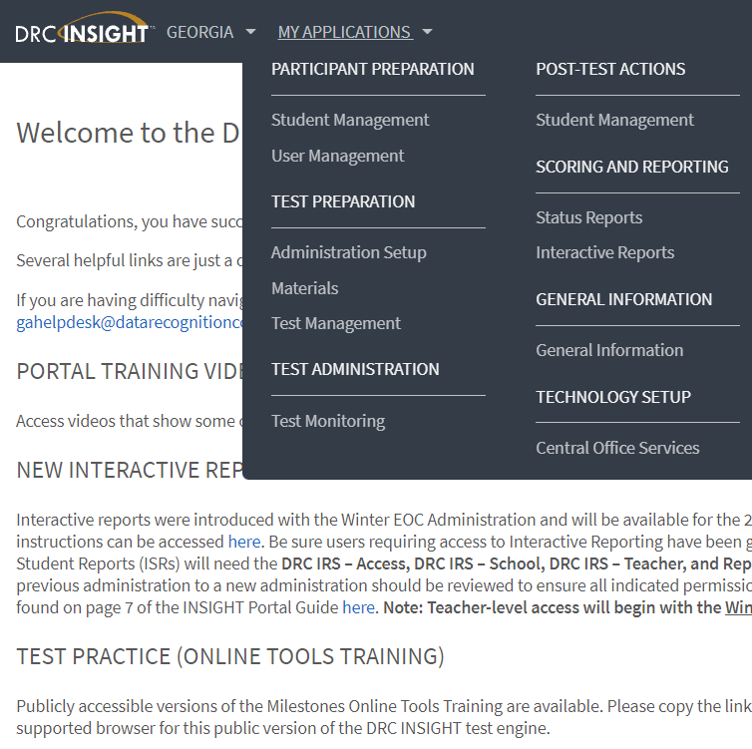
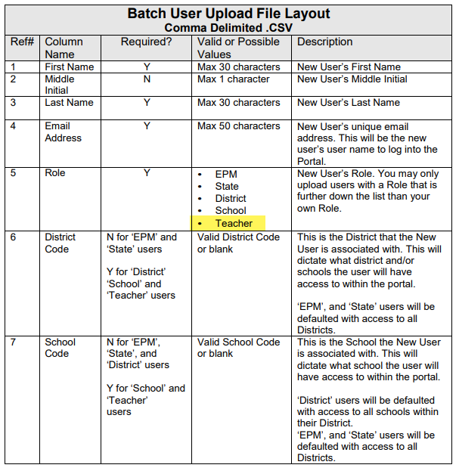
Batch User Upload
Path A and B: All users will receive an email when their profile is created or has been updated with access to a new administration.
Path B: Teachers MUST be identified with a role of “Teacher”.
Path B: Teacher profiles will be created for all users with a “Teacher” role listed in the Batch User Upload file.
Notes:
To access the Batch User layout and to submit this data file, navigate to User Management, then Upload Multiple Users. A sample .csv file is also available here. Please take special note that the Batch User data file must be used for creating teacher profiles and establishing teacher access to the Milestones assessments. Teachers must be identified in the Batch User Upload as a role of 'Teacher' in order to have a Teacher profile created.
All users will receive an email when their profile is created or has been updated with access to a new administration.

Slide 60
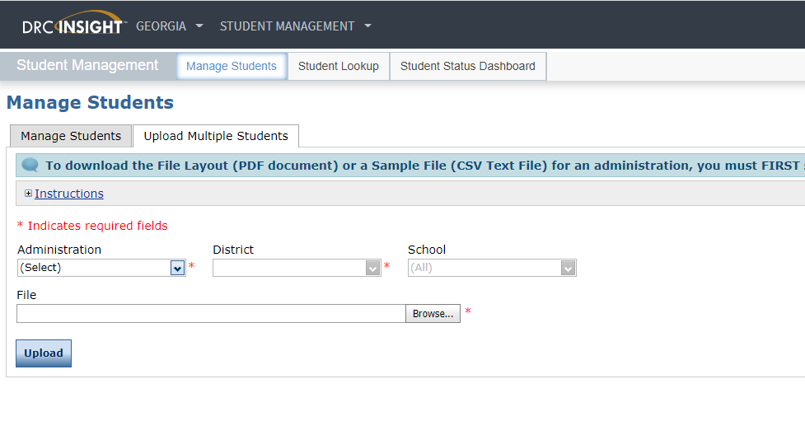
Multiple Student Upload
MSU is required for Georgia Milestones.
MSU data upload for Georgia Milestones Spring EOC and EOG opens 2/28/2022.
60
Notes:
To Access the Multiple Student Upload, select Student Management under the My Applications dropdown menu and navigate to the Upload Multiple Students tab.
Districts must upload student data directly to DRC INSIGHT using the MSU data file. Please be advised the window for uploading files for Districts planning for the Spring 2022 EOG and EOC administrations opens on Monday, February 28, 2022.

Slide 61
Multiple Student Upload – Test Sessions
Purpose Multiple Student Upload is used for grouping students for test administration and district and school level reports.
Suggested Naming Conventions <Teacher Last Name>, <Teacher First Name> when created by Multiple Student Upload Session names can be edited through the end of the Test Setup window Unique by District, School, Course
61
Notes:
The Multiple Student Upload is used for grouping students for test administration and reporting at the district and school level.
When Test Sessions are created via the Multiple Student Upload, the Test Session naming convention will be the <Teacher Last Name> followed by <Teacher First Name>. Test Session names can be edited through the end of the Test Setup window.

Slide 62
Report Access
Two paths to choose from based on preferences for who has access to Interactive Reporting:
Path A – Teachers will not have access to Interactive Reports – Reporting at District and School level only by test session
Path B – Teachers will be granted access to Interactive Reports by Roster file upload
Path A requires no change to file uploads
Path B involves changes to Batch User file and a new Roster file upload
New
Notes:
There are two paths to choose from for report access based on preferences of who has access to Interactive Reporting.
The Path A option is available for systems where teachers will not have access to Interactive Reports, and reporting is done at the District and School level by test session. This path requires no changes to file uploads.
Path B is available for systems where teachers will be granted access to Interactive Reports by the Roster file upload. This path involves changes to the Batch User File and a new Roster File upload.

Slide 63
Path B Teacher Access – Roster File Upload
New
Roster file uploads are used to group students into reporting groups and associate a user (Teacher) to those groups
Score reports are available to teachers for groups of students they are assigned to by the Roster file
After Rostering, preliminary and final reports are open to flow to teachers.
Starting in Spring 2022, Roster groups will also be available to school test coordinators.
Roster names are important for ease of use, suggested naming conventions for Student Group/Rosters follow:
<Teacher Last Name>, <Teacher First Name>,<Course Name>
<Teacher Last Name>, <Teacher First Name>,<Course Name>, <Class Period>
63
Notes:
Roster file uploads are used to group students into reporting groups and associate a user (Teacher) with those groups. Score reports are available to teachers for groups of students they are assigned to by the Roster file. After Rostering, preliminary and final reports are available to teachers.
Roster names are important for ease of use. Some suggested naming conventions are:
<Teacher Last Name>, <Teacher First Name>,<Course Name>
<Teacher Last Name>, <Teacher First Name>,<Course Name>, <Class Period>
Beginning with Spring 2022, Roster groups will also be available to school test coordinators.

Slide 64
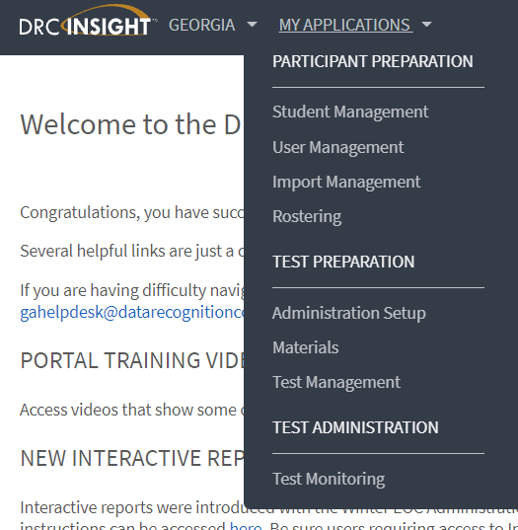
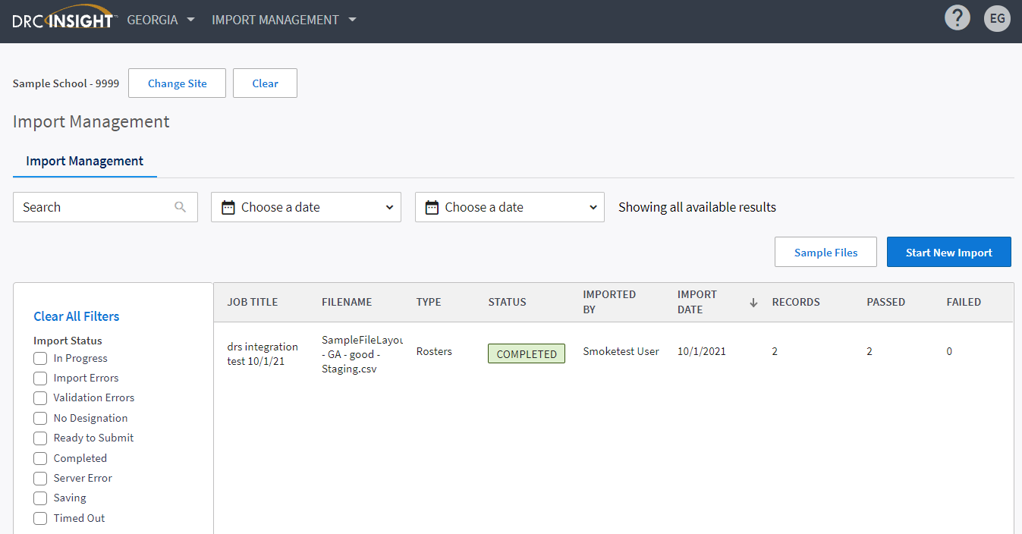
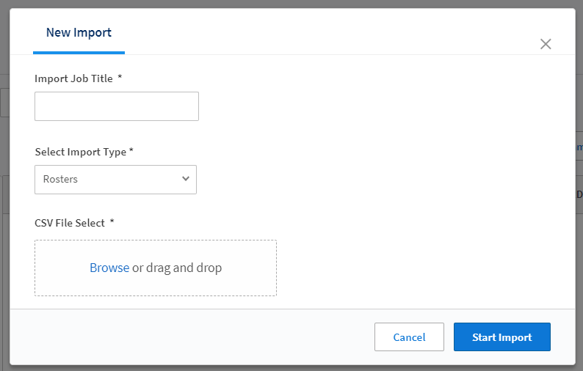
Path B (Teacher Access) – Roster File Upload
Roster files do not need to be uploaded prior to testing
Roster files may be uploaded later in the window when Teacher report access is desired
NOTE: Batch User Upload and Multiple Student Upload must be completed prior to testing
Online Help available for Import Management
64
Notes:
The Roster File Upload is what associates a teacher to their student(s) for teacher-level reporting. The Roster Upload may be completed later in the window when Teacher report access is desired, but keep in mind that the Batch User Upload and Multiple Student Upload must be completed prior to testing.
To access the Roster layout and to submit this data file, navigate to “Import Management,” then “Start New Import.” A sample .csv file is also available here. Online Help is available in the upper right of the screen within Import Management and provides a great resource for working with Roster Imports.

Slide 65
Path B (Teacher Access) – Roster File Upload
Rosters allow a teacher to view reports/data for all the students in that roster.​
Rosters should be uploaded after Teacher role and permissions have been populated
Batch User Uploads (run at 11 am, 1 pm, 3 pm, and 5 pm ET)
NOTE – Roster files can be uploaded at various levels (District, School, Class).
Contact DRC Customer Support if you have questions.​
Notes:
Rosters allow a teacher to view reports and data for all students in a particular roster. Rosters should be uploaded after the Teacher role and permissions have been populated via the Batch User Upload, and after students have been uploaded to the INSIGHT Portal using the Multiple Student Upload.
Batch User Uploads run at 11 am, 1 pm, 3 pm, and 5 pm ET, and can be uploaded at various levels (District, School, Class).
To access the Roster layout and to submit this data file, navigate to “Import Management,” then "Start New Import” A sample .csv file is also available here.

Slide 66
User Roles and Permissions
Notes:
User Roles and Permissions

Slide 67
User Administration – Roles and Responsibilities
System Test Coordinators
User Management
Student and Test Session Management
School Test Coordinators
Student and Test Session Management
Interactive Reporting
Status Reports and Interactive Reporting
Reports for assigned students via rostering
Teachers
Technology Coordinator
Central Office Services
Interactive Reporting Optional
Online Testing Software Downloads
67
Notes:
Responsibilities in the INSIGHT Portal will vary depending on a user's role.
At a high level, each role will use the INSIGHT Portal for the following:
System Test Coordinators will use the INSIGHT Portal to access User Management, Student and Test Session Management, Status Reports, and Interactive Reporting.
Technology Coordinators will use the INSIGHT Portal to access Online Testing Software Downloads and Central Office Services.
School Test Coordinators will use the INSIGHT Portal to access Student and Test Session Management and Interactive Reporting.
Teacher roles are optional for EOG and EOC Spring 2022 and would be used for Interactive Reporting (teacher-level reports). Teachers will only see reports for their assigned students via Rostering.

Slide 68
User Administration – Roles and Responsibilities
Copy User
Batch User Upload
Manual
Batch User Upload
Manual
Existing School District and Users
New Users
68
Notes:
Within the INSIGHT Portal, there are some options when creating user profiles for a new administration. For existing School and District users, profiles can be added by copying a user from a previous administration, via the Batch User Upload, or manually in the INSIGHT Portal.
New users will need to be added via the Batch User Upload file or manually through the INSIGHT Portal. NOTE: Teachers MUST be added through the Batch User Upload file to create the Teacher profile necessary for rostering and teacher-level reporting.

Slide 69
User Administration – Assign User Permissions
Only GaDOE approved STCs are given initial access to a new administration
Successfully upload the Batch User file
Assign permissions to new users
Option available to assign the same permissions to all the users within a role at one time
Click the “Assign Permissions” icon
69
Notes:
Only GaDOE approved STCs are given initial access to a new administration. STCs will then be responsible for adding any other District, School, and Teacher users who will need access to the INSIGHT Portal.
After uploading the Batch User file permissions will need to be added to the users. The option is available to assign the same permissions to all users within the same role at the same time by selecting the Assign Permissions button. Selecting this button will prompt selection of the permission set to be applied to the selected user role. The available permission sets are seen on the following slide.

Slide 70
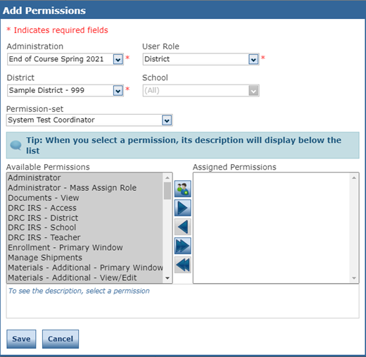
User Administration – Available Permission Sets
Permission Sets
System Test Coordinator
System Technology Coordinator
School Test Coordinator
School Technology Coordinator
Teacher
70
Notes:
When assigning permissions to new user profiles, there are a number of permission sets available that provide the recommended permissions based on the user role. System Test Coordinator, System Technology Coordinator, School Test Coordinator, School Technology Coordinator, and Teacher are all available permissions sets. Selecting a permission set will highlight in gray the recommended permissions for the selected role under the available permissions.

Slide 71
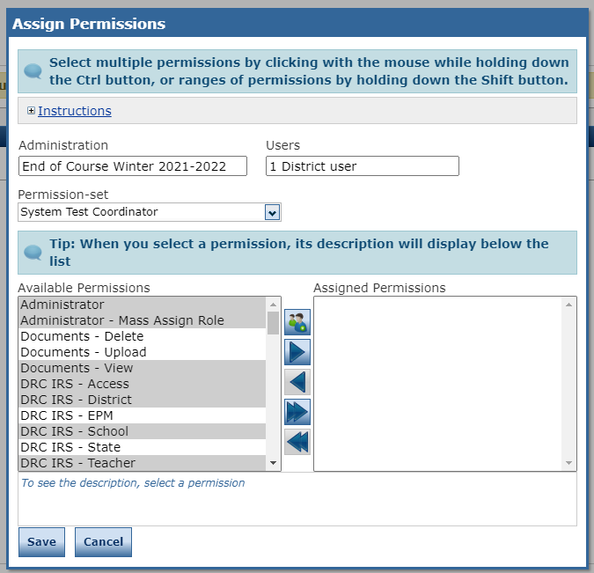
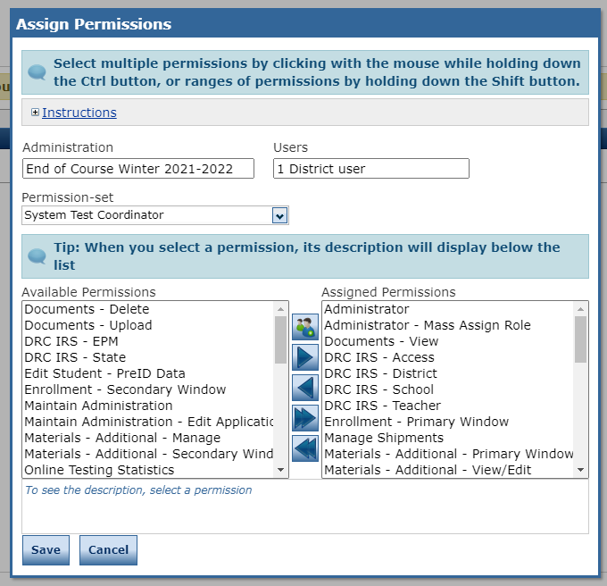
User Administration – Assign User Permissions
Select the role from Permission set dropdown
Defaulted permissions will highlight in Available Permissions box.
Click the Add Selected icon
Defaulted permissions for that role are moved into the Assigned Permissions box
Click Save ​
71
Notes:
To assign users permissions, select the desired role from the Permission Set dropdown and the recommended permissions will automatically be highlighted in gray. Select the Add Selected icon to move the highlighted permissions from the Available Permissions to Assigned Permissions. Select Save to apply these permissions to all of the users for a given role.

Slide 72
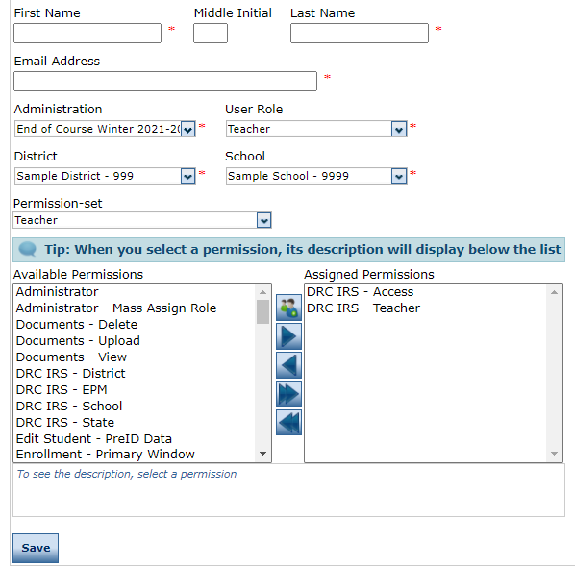
User Administration – Assign Teacher Permissions
Teacher level users must have appropriate permissions set to access their reports
Critically important to ensure security of and access to student data
Enables access to Interactive Reporting
72
Notes:
After uploading the Batch User Upload file, Teachers will need to have the appropriate permissions assigned to access teacher-level reports. Select the "Teacher" role from the Permission-set dropdown and DRC IRS – Access and DRC IRS – Teacher will be highlighted in gray. Use the move selected permissions button to assign these permissions to Teacher users. These two permissions are needed to enable teacher-level access to Interactive Reporting.

Slide 73
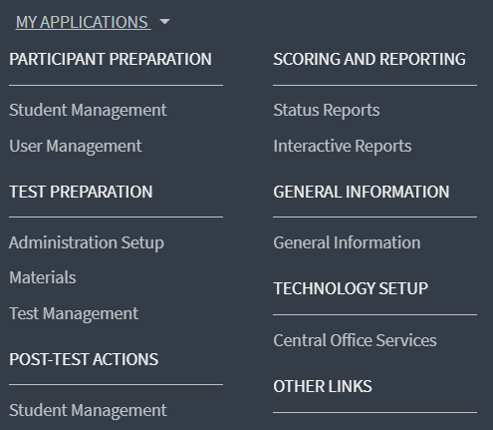
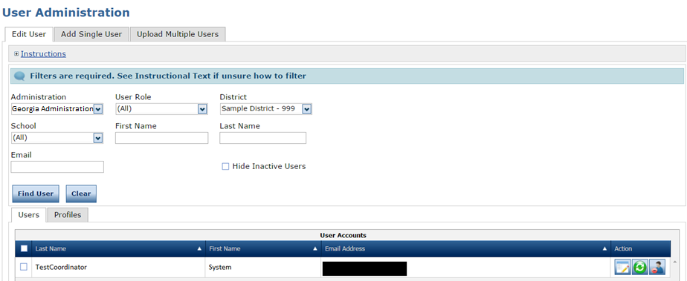
User Administration – Edit Existing User
73
Notes:
To edit an existing user, navigate to User Management under the My Applications dropdown. Within User Administration, search criteria can be used to filter down to the desired list of user profiles.

Slide 74
User Administration – Edit Existing User
View/Edit
Reset
Inactivate
74
Notes:
Following a search of existing users, there are several action buttons that can be used to edit a user. The View/Edit button allows access to an individual user's profile. The Reset button allows a user's profile to be reset, sending the user an email for initial login to the INSIGHT Portal. The Inactivate button is used to inactivate profiles for any users who no longer need access to the INSIGHT Portal.

Slide 75
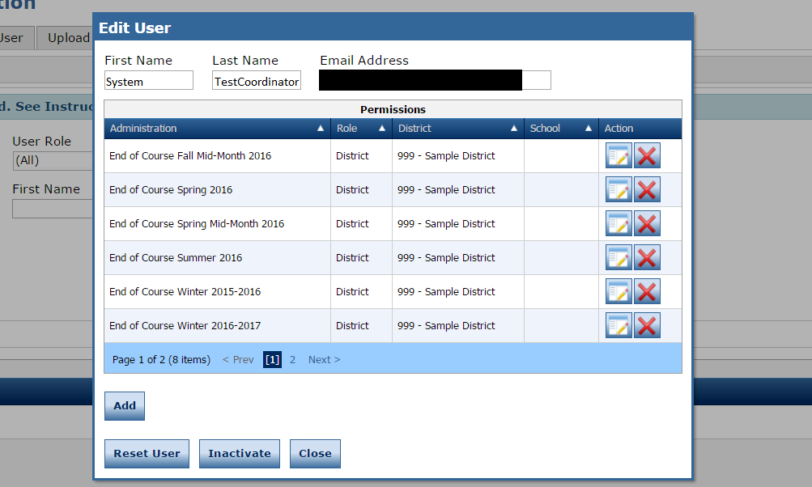
User Administration – Edit Existing User
View/Edit
Delete
75
Notes:
Selecting the View/Edit action button for a user will provide greater detail on which administrations, roles, district(s), and school(s) a user has access to. From here, the View/Edit action button can be used to look at permissions assigned for a particular administration, and the Delete button can be used to remove access to an administration.

Slide 76
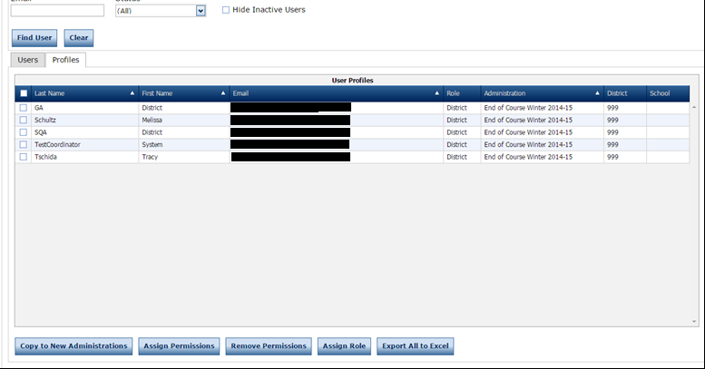
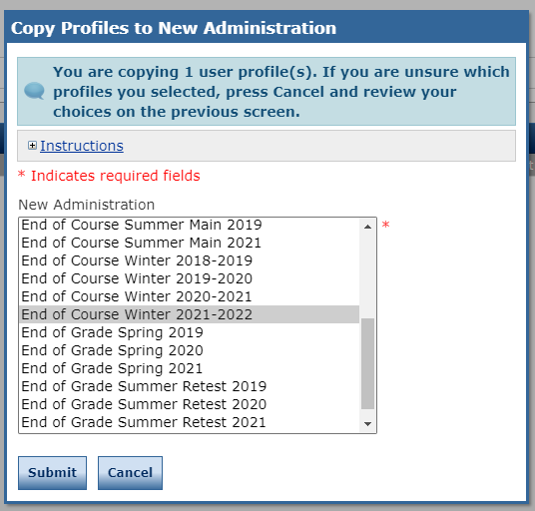
User Administration – Existing Users – Copy Profiles to New Administration
Using Copy to New Administrations only applies those permissions users had in previous administration
The following permissions will need to be added to District and School users, as applicable:
Test Monitoring – Access
Teachers – Search/View
Student Groups – Add/Edit
Student Groups – Search/View
Student Groups – Upload
76
Notes:
In addition to the Batch User Upload file, the Copy to New Administrations functionality is a great way to copy profiles for existing users to a new administration. This functionality will take users from a previous administration (i.e., EOC Spring 2021) and copy their existing permissions to the newly selected administration.
Within User Management, select the previous administration to copy user profiles from. After desired search criteria has been enabled, select the profiles tab. The checkboxes next to the users can be selected to indicate the profiles that will be copied to the new administration.
The next step is to select the Copy to New Administration button and then select the desired administration from the pop-up menu. Select Submit and the selected users will then have the new administration and existing permissions added to their profile. Using the Copy to New Administrations button only applies those permissions users had in the previous administration, so keep in mind any permissions that may need to be added to user profiles after copying them forward.
For EOG and EOC Spring, the following permission are new and will need to be added to District and School users, as applicable:
Test Monitoring – Access
Teachers – Search/View
Student Groups – Add/Edit
Student Groups – Search/View
Student Groups – Upload

Slide 77
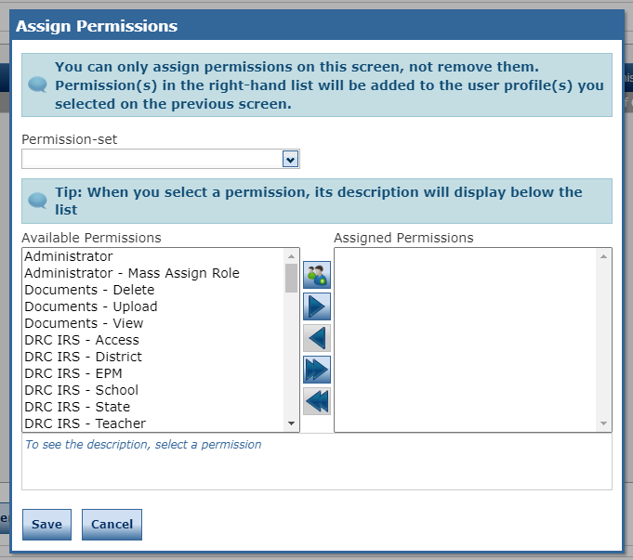
User Administration – Existing Users – Mass Assign Permissions
Mass assigning permissions can be used to apply any new permissions related to Test Monitoring and Rosters users may not have had in previous administrations
77
Notes:
User Management allows for the ability to mass assign permissions to existing users. After using the checkboxes to indicate which users permissions will be added to, select the Assign Permissions button to access a dropdown with available permissions. From here, desired permissions can be selected from the Available Permissions menu and moved to the Assigned Permissions menu. Selecting Save will add these permissions to all users who have been selected.

Slide 78
User Administration – Considerations
Copy to New Administrations duplicates the profiles of any existing district and school users as needed
Reference the Permissions Matrix in the User Guide
Provides recommended permissions for each role along with a description of each permission
Assign those permissions to appropriate district- or school-level personnel that assist in trouble-shooting
Example, Test Tickets - Unlock permission
DRC INSIGHT Portal – General Information – Documents – DRC INSIGHT Portal User Guide
https://ga.drcedirect.com/Documents/Unsecure/Doc.aspx?id=5fcc92ae-0fe8-4433-b912-21e6d2247d78
78
Notes:
The 'Copy to New Administrations' button within User Management can be used to duplicate the profiles of existing district and school users as needed. Along with the Batch User Upload, this is a great way to get existing users added to a new administration.
There is a DRC INSIGHT Portal User Guide available that provides a Permission Matrix as a reference. The Permissions Matrix is a table that shows each user role and the recommended permissions for that role, along with a description of what each permissions allows a user to do. The DRC INSIGHT Portal User Guide can be found by navigating to the DRC INSIGHT Portal – General Information – Documents.

Slide 79
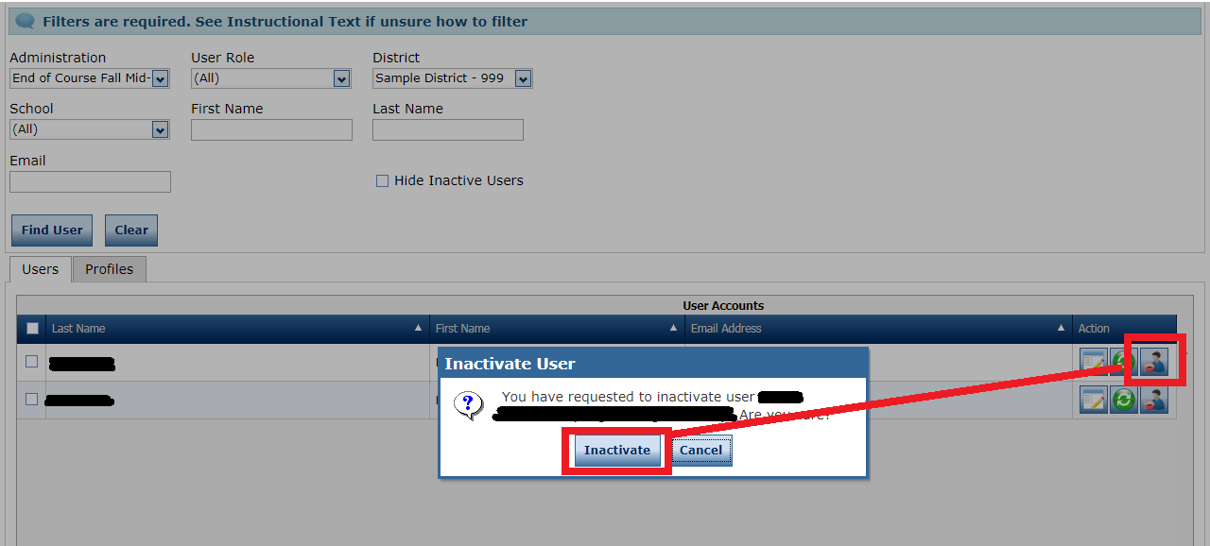
User Administration – Inactivate Users
Inactivate any users who no longer need access to the portal. This inactivates the user from logging in completely.
Districts should review prior administrations to verify that all legacy users are inactivated.
79
Notes:
It is important to inactive any users who no longer need access to the INSIGHT Portal. Inactivating a user will make it so the user profile can no longer log into the INSIGHT Portal. Districts should review previous administrations to verify all legacy users are inactivated.

Slide 80
Student Management
Notes:
Student Management

Slide 81
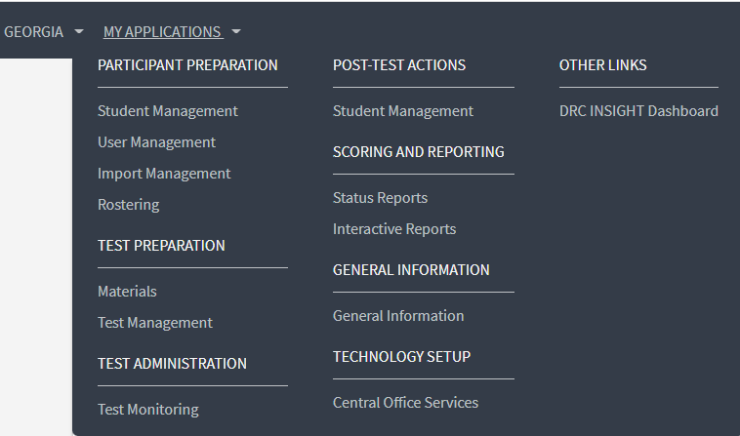
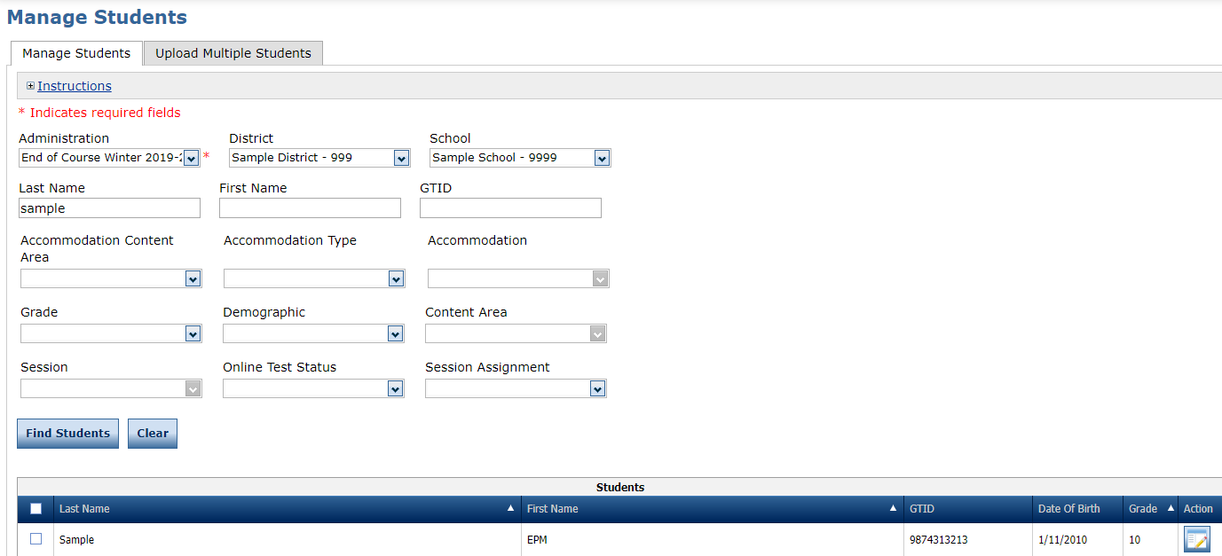
Student Management – Manage Students
Manage Students allows a user to manually add, edit, or view a student profile; mass assign accommodations or individually assign accommodations; or export a list of students
View/Edit
81
Notes:
Manage Students allows a user to manually add, edit, or view a student profile; mass assign accommodations or individually assign accommodations; or export a list of students.

Slide 82
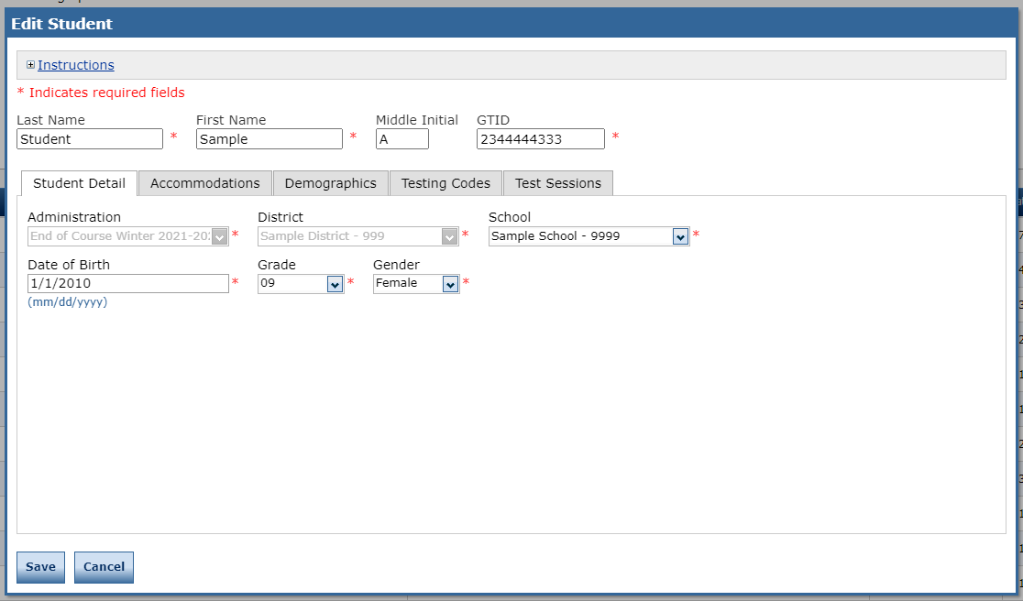
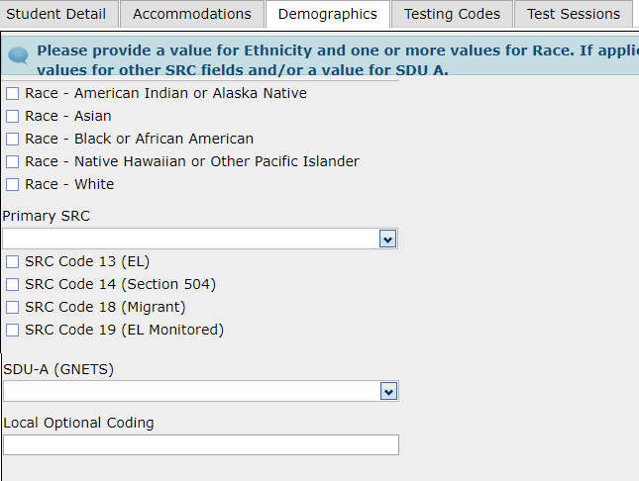
Student Management – View/Edit Student Detail
Edits to Student Detail and Demographics tabs highlighted in red should be made in the SIS and changed in INSIGHT by a new Multiple Student Upload.
82
Notes:
The View/Edit action button allows access to an individual student's profile. The Student Detail, Accommodations, Demographics, Testing Codes, and Test Sessions tabs provide information specific to the student.
Edits to Student Detail and Demographics tabs highlighted in red should be made in the SIS and changed in INSIGHT by a new Multiple Student Upload.

Slide 83
Physical Science – MSU Test Session Creation
Grade 8 students who have the EOG EOC Science field marked as 'N' or Blank in the MSU file will be added to a Grade 8 Science Test Session
Grade 8 students who have the EOG EOC Science field marked as 'Y' in the MSU file will be added to a Grade 8 HS Physical Science Test Session
83
Notes:
Grade 8 students who have the EOG EOC Science field marked as 'N' or blank in the MSU file will be added to a Grade 8 Science Test Session.
Grade 8 students who have the EOG EOC Science field marked as 'Y' in the MSU file will be added to a Grade 8 HS Physical Science Test Session.

Slide 84
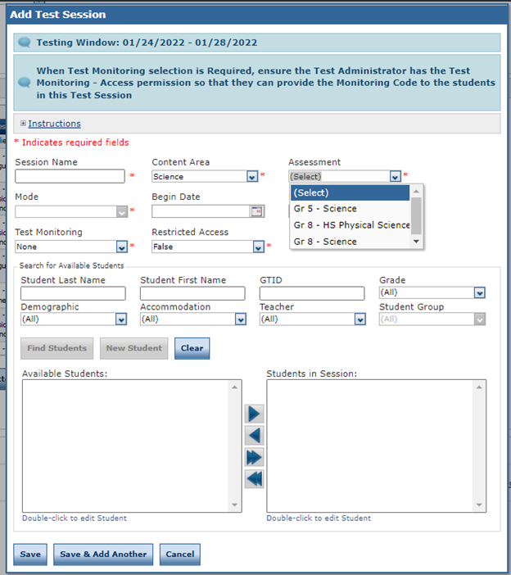
Physical Science – Manually Add Test Session
The MSU file is the recommended method for creating test sessions and for moving students to another test session.
If manually adjusting a test session, first remove students from any 'Gr 8 – Science' test sessions and then assign to their 'Gr 8 – HS Physical Science' test session
84
Notes:
The MSU file is the recommended method for creating test sessions and for moving students to another test session, but there may be circumstances where manually adding a test session are necessary. If manually adjusting a test session, first remove students from any 'Gr 8 – Science' test sessions and then assign to their 'Gr 8 – HS Physical Science' test session.

Slide 85
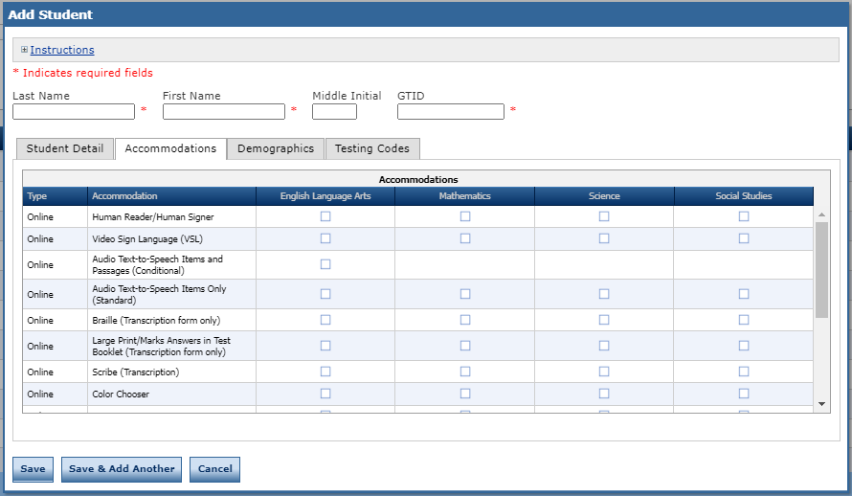
Assigning Accommodations
Selecting the appropriate accommodations under 'Science' on the Accommodations tab will assign them to students in Gr 8 Science or Gr 8 – HS Physical Science test sessions dependent on their test session.
85
Notes:
Assigning accommodations can be done for an individual student on the 'Accommodations' tab of the student profile.
Accommodations can be assigned for English Language Arts, Mathematics, Science, and Social Studies, as applicable. Selecting the appropriate accommodations under 'Science' on the Accommodations tab will assign them to students in Gr 8 Science or Gr 8 – HS Physical Science test sessions dependent on their test session.

Slide 86
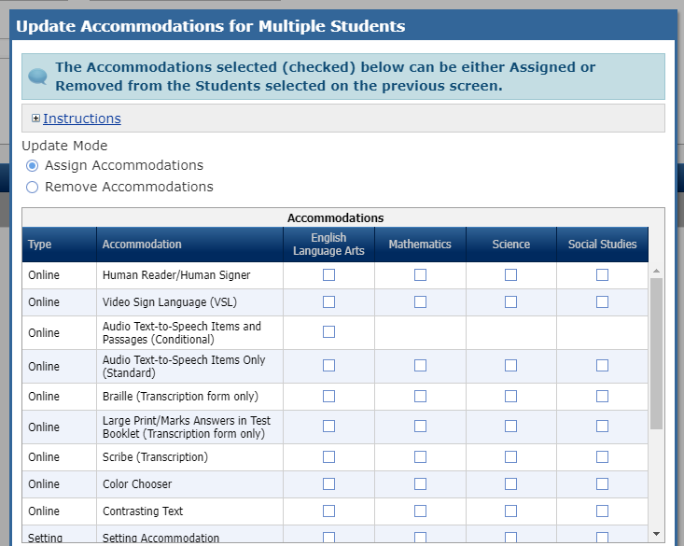
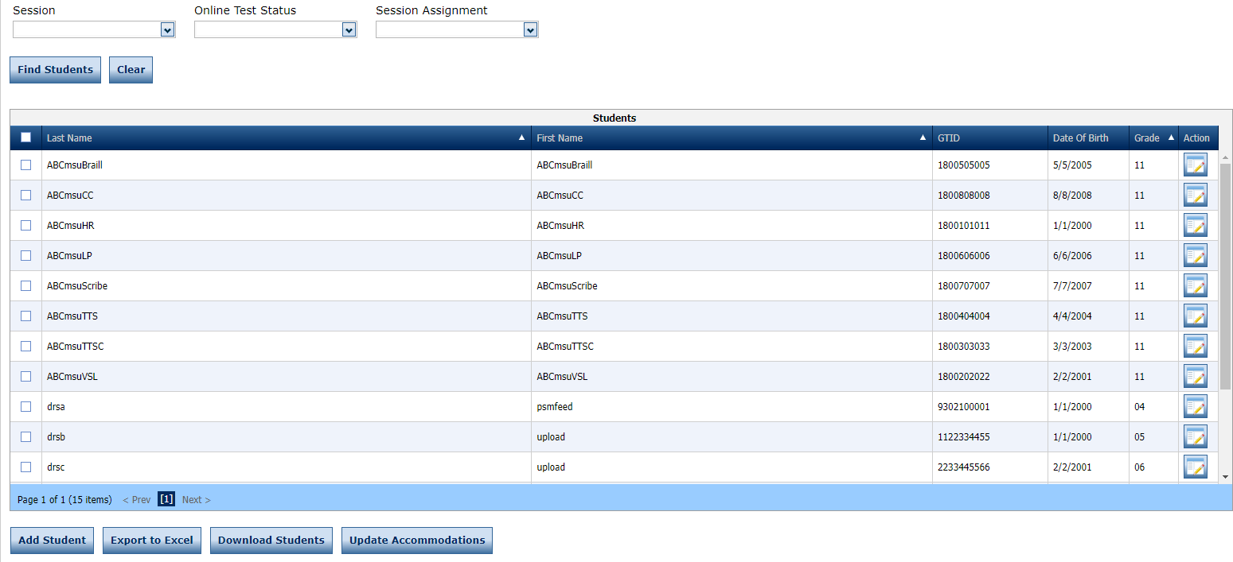
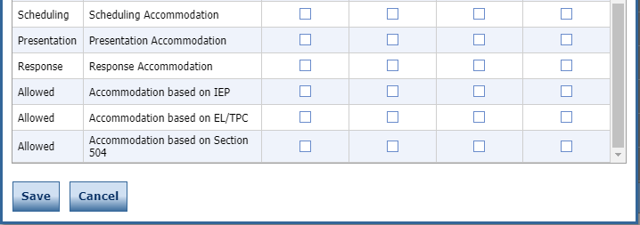
Student Management – Mass Assign Accommodations
86
Notes:
Mass assigning accommodations is a great way to add accommodations to a number of student profiles at the same time. Keep in mind that selected permissions will apply to all selected students, so this action will need to be done in groups (I.e. all TTS students at the same time, all VSL students at the same time, etc.). All of the Online accommodations, along with Scheduling, Presentation, Response, IEP, EL/TPC, and Section 504 are available to be mass assigned to students.
Select Student Management under the My Applications dropdown to access Manage Students. To mass assign accommodations, select the checkbox next to each student needing the permission and select the Update Accommodations button. This will provide a pop-up that allows for the selection of the available accommodations. Select the accommodation for the desired content area(s) and select Save.

Slide 87
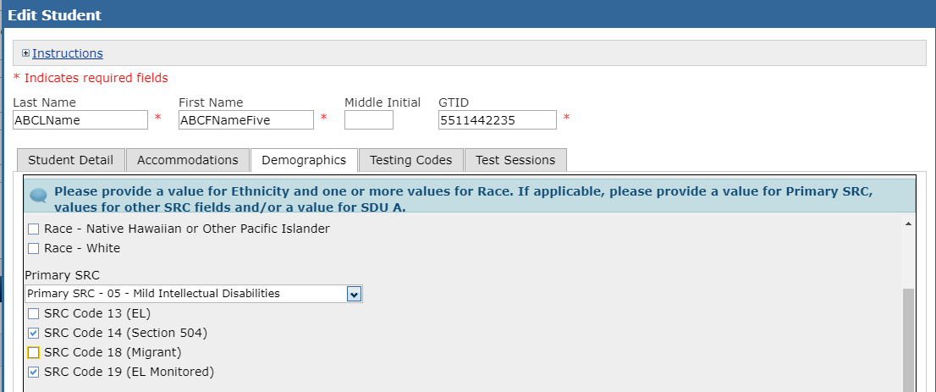
Student Management – Individual Assignment of Accommodations
Step 1: Under the Demographics tab, verify Primary SRC and SRC 13, 14, 18, 19 as applicable
Training Video and Quick Start Guide on entering Accommodations online can be found at: http://www.gadoe.org/Curriculum-Instruction-and-Assessment/Assessment/Pages/Milestones_Training.aspx
87
Notes:
When individually assigning accommodations to a student, the first step is to verify SRC Codes have been applied to the student profile. SRC codes are part of the Multiple Student Upload file and will already be part of the student profile if the fields were populated in the file prior to the upload.

Slide 88
Student Management – Individual Assignment of Accommodations
Steps 2 & 3: Under the Accommodations tab code the accommodation type and select basis of the accommodation (IEP, EL/TPC, 504)
All that apply for each content area
Select basis of accommodation
88
Notes:
The next steps when individually assigning accommodations are to code the accommodation type and select the basis for the accommodation (IEP, EL/TPC, 504). These steps are done on the Accommodations tab of the student profile.

Slide 89
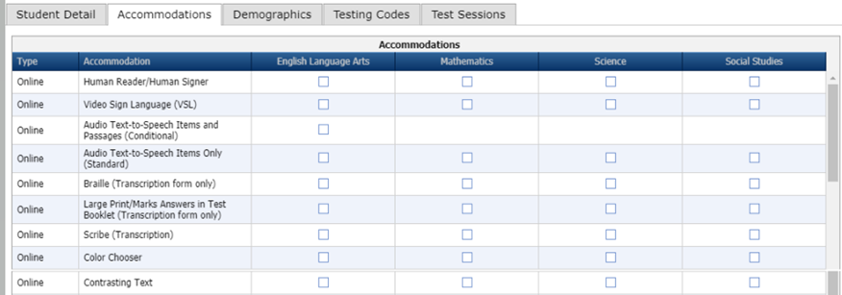
Student Management – Individual Assignment of Accommodations
Step 4: Under the Accommodations tab, activate/assign prior to student login
Assign online accommodations prior to student logging into test
IMPORTANT – Be sure to enter accommodations before printing test tickets!
Some accommodations require specific test forms, which are assigned when students are placed into test sessions and reassigned when accommodations are entered. If you enter accommodations after printing test tickets, be sure to check if the password has been regenerated and reprint as needed.
89
Notes:
The next step is to assign any of the Online accommodations to the student profile. It is important to keep in mind that these permissions MUST be assigned prior to printing test tickets and prior to a student logging into a test. Some accommodations require specific test forms which are assigned when students are initially placed into a test session, and then reassigned when accommodations are entered. If accommodations are entered after printing test tickets, test tickets will need to be reprinted to ensure students have the appropriate login information after accommodations have been added to their profile.
Keep in mind that the INSIGHT Portal allows for accommodations to be mass assigned to selected students, so when working with a large number of students this functionality can be a great way to save time. See slide 87 for information on mass assigning accommodations to a group of students.

Slide 90
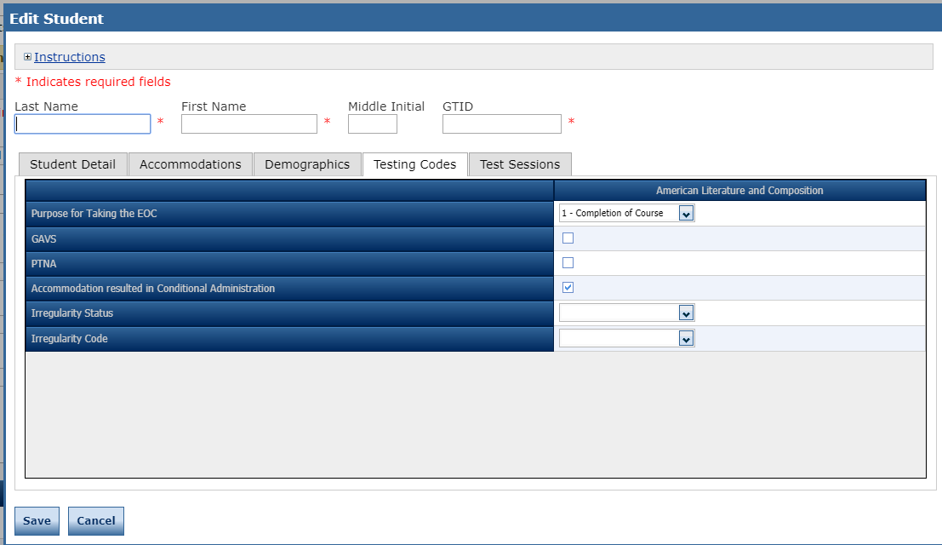
Student Management – Individual Assignment of Accommodations
Step 5: Under the Testing Codes tab select Conditional Administration if applicable
Select Conditional Administration, if applicable
Add Irregularity Status and Irregularity Code as directed by GaDOE, if applicable
90
90
Notes:
The last step in the accommodations process is to navigate to the Testing Codes tab and select the Conditional Administration if applicable. Note that this step cannot be done through the mass assignment of accommodations, so would need to be individually applied to student profiles as applicable, even if accommodations had been mass assigned to students.

Slide 91
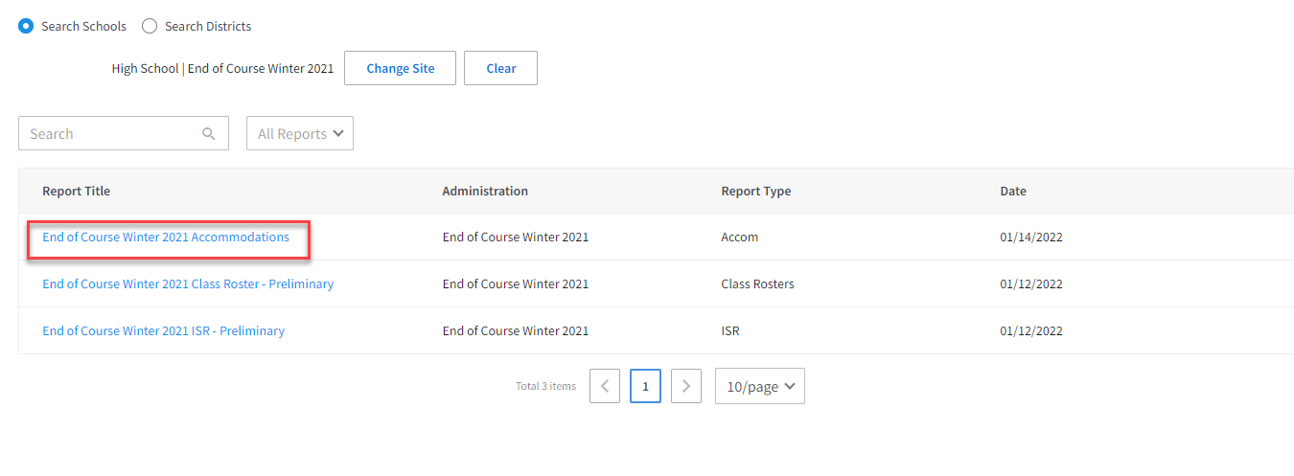
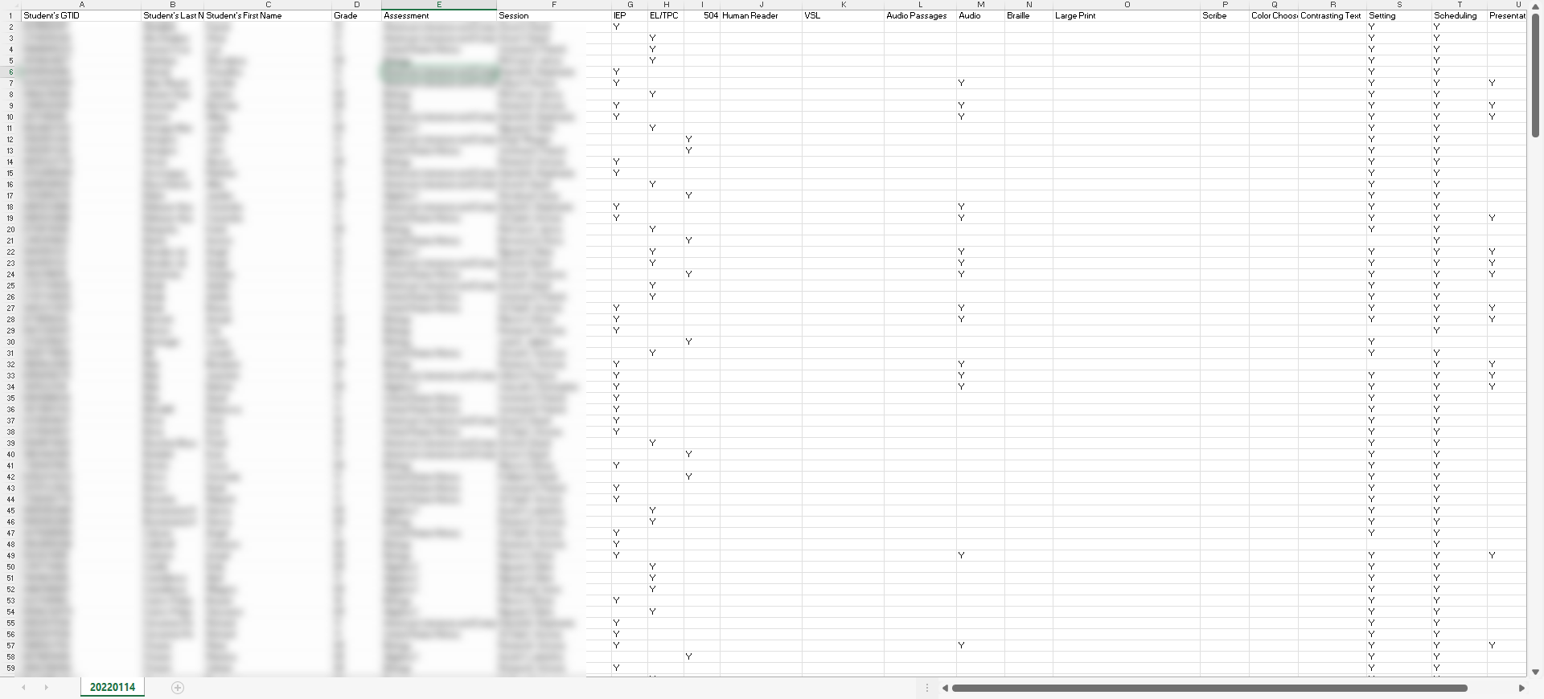
Monitoring of Accommodations New – Accommodations Validation File
New
Accommodations Validation File found in Report Delivery section of Interactive Reporting
91
91
Notes:
We're happy to announce that starting with the Spring 2022 EOC/EOG testing, districts can monitor accommodations within INSIGHT using a new Accommodations Validation File. To locate the report, district and school test coordinators should go to interactive reports, choose report delivery, then select the school and administration to download the report. This report is updated nightly to reflect any accommodations entered in INSIGHT.

Slide 92
Monitoring of Accommodations New – Accommodations Validation File
New
Student's GTID | Student Information
Student's Last Name | Student Information
Student's First Name | Student Information
Grade | Student Information
Assessment | Assessment Information
Session | Assessment Information
IEP | Accommodation based on:
EL/TPC
504
Human Reader | Accommodations presented in INSIGHT for student
VSL
Audio Passages
Audio
Braille
Large Print
Scribe
Color Chooser
Contrasting Text
Setting | Type of Accommodation
Scheduling
Presentation
Response
District Code | District and School Information
School Code
Available for system and school test coordinators
Updated every evening
Shows entries including student, school, district and accommodation information
Should be compared against district information from IEP, EL/TPC, and 504 plans prior to testing
92
92
Notes:
The Accommodations Validation File provides all data that is entered into the INSIGHT portal. Schools should compare entries into INSIGHT against district information from IEP, EL/TPC and 504 plans to ensure that all students have accommodations entered correctly before testing.

Slide 93
Student Management – Considerations Paper Testers Scribe/Transcription
Paper forms are available for those students who cannot access a computer due to their disability
All students must be assigned to an online test session
For Multiple Student Uploads, verify the Online Indicator field is set to “Y” for all students.
Form C1 must be assigned for LP and Scribe transcriptions. The Roster and Test Ticket will show ONL-TR.
Form BR must be assigned for Braille transcription.
Means of administration must be assigned prior to entering student responses
Large Print
Braille
Scribe
Scribe and Witness must complete the Validation Form for Transcription of Answer Documents (see SAH).
Contact GaDOE Assessment Specialist with questions.
93
Notes:
Paper test forms are available for those students who cannot access a computer due to their disability. All students, even if testing with a paper form, must be assigned to an online test session. Students testing with paper should have the Online Indicator field set to "Y" in Multiple Student Uploads to ensure the student is added to an online test session.
Verify paper tests have the appropriate form assigned prior to transcribing responses online.

Slide 94
Test Session Management
Notes:
Test Session Management

Slide 95
Test Management – Manage Test Sessions
Manage Test Sessions allows a user to manually add, edit, view, or delete a test session; view or print test tickets; or export test session details.​
Initial Test Sessions are created based on the Multiple Student Upload file
95
Notes:
To access Manage Test Sessions, select Test Management under the My Applications dropdown.
Initial Test Sessions are created based on the Multiple Student Upload file. These Test Sessions can be edited as needed within Manage Test Sessions.
Manage Test Sessions allows users to manually add, edit, view, or delete test sessions; view or print test tickets; or export test session details.

Slide 96
Test Management – Manage Test Sessions
View/Edit
Export Details
Copy
Edit/Print Ticket
Print All
Delete
96
Notes:
Manage Test Sessions provides the ability to View/Edit, Export Details, Copy a test session, Edit/Print Tickets, Print All tickets, Delete a test session, and allows for the addition of a test session not created via the Multiple Student Upload.

Slide 97
Test Management – Add Test Session
Add Selected
Remove Selected
Add All
Remove All
97
Notes:
Selecting Add Session provides a pop-up window that indicates the required fields needed to add the test sessions. At least one student will need to be in the test session before it can saved and created. Within Add Test Session, there is the option to add a new student via the New Student button. It is recommended that students are added via the Multiple Student Upload, but this provides flexibility and the option to add a single student directly to a test session.
Search criteria can be used to find available students to add to the new test session.

Slide 98
Test Management – View/Edit Test Session
Add Selected
Remove Selected
Add All
Remove All
98
Notes:
View/Edit Test Session is a similar screen to the Add Test Session screen but will show those students who are assigned to the test session. Students can be added or removed from the test session.

Slide 99
Test Management – Test Monitoring Application Setup
Test Monitoring | Result
None (default) | Will not be monitored on the dashboard.
Optional | Will only be monitored if Participants enter code.
Required | Will be monitored when Participants enter code. Note: If the session is set to Required the Test Monitor needs access to the Test Monitoring Application
Restricted Access | Result
True | Test Monitoring must be set to Required. When Continue is selected, the Participant is placed in a Waiting Room until the Test Examiner allows them to begin testing.
False (default) | Assessment begins once Continue is selected
Test Monitoring is available for practice in the Secure Practice Test with Response Transmission.
99
Notes:
The tables in this slide provide detailed information on setting up the Test Monitoring Application for a test session. Test Monitoring will default to 'None' and Restricted Access will default to 'False', and can then be adjusted dependent on a system's desired use of Test Monitoring.
The Test Monitoring Application is available in the Secure Practice Test with Response Transmission for sites who would like to practice using the application.

Slide 100
Test Management – Test Monitoring Application
Securely monitor students’ testing status with a Monitoring Code to link Student test to dashboard
Students in different rooms, test sessions, or locations
Displays Student’s Name, Assessment, Status, Navigation
Optional ability to control when students can start
Filter and sort results in near-real time
Additional information on the Test Monitoring Application can be found by clicking on the Help link.
Training video:
https://vimeo.com/showcase/tmaforadmins
100
Notes:
The Test Monitoring Application allows for student testing status to be securely monitored using a Monitoring Code to link the student test to the dashboard. Students in different rooms, test sessions, or locations can all be monitored using the same Monitoring Code.
(ZOOM IN) The dashboard will provide the Student's Name, Assessment, Status, and Navigation, and provides the optional ability to control when a student can start a test (see slide 102 for additional information).
A short, informational training video on Test Monitoring setup and functionality can be found here: https://vimeo.com/showcase/tmaforadmins

Slide 101
Test Management – Test Monitoring Application
101
What's new:
Horizontal Scroll to see additional columns
Participant ID to show Student ID
Accommodations added to the Column and Filter Panel
101
Notes:
A number of enhancements have been made to the Test Monitoring Application. A horizontal scrollbar has been introduced to allow ability to see additional columns, a 'Participant ID' field has been added to show Student ID, and 'Accommodations' have been added to the dashboard, as well as to the filter panel.

Slide 102
Test Management – Testing Status – Edit/Print Test Tickets
Use Print Selected to print individual tickets (or Print All to print all)
If a student submits prematurely from a test, the School or System Test Coordinator can unlock the test ticket to allow the student back in.
102
Notes:
The Edit/Print Test Tickets button within Manage Test Sessions allows for visibility into the testing status of the selected test session, and provides the ability to Print All test tickets for the test session, for Print Selected test tickets for specific students. The ability to Unlock a student's test ticket can also be found here, and can be used in instances such as a student prematurely submitting their test.

Slide 103
Test Tickets and Test Rosters
Test Tickets will print one to a page, and Each Test Ticket contains the student’s username and password for the test session. Note that the student will have a separate Test Ticket for each section of the test.
If a student received an accommodation, it will be noted here
The Student Test Roster contains a list of students and the usernames and passwords for each student
103
Notes:
Test Tickets will print one per page, and each Test Ticket will contain the student's username and password for the test session. Students will have a separate Test Ticket for each section of the test.
The Student Test Roster provides a list of students and the usernames and passwords for each student.
The Test Tickets and Student Test Rosters will also both list any online accommodations each student has been assigned. The Test Tickets and Student Test Rosters should be used to verify students have been assigned the appropriate accommodations prior to students logging into test.

Slide 104
Test Tickets and Test Rosters
To avoid a student testing under another student’s GTID, you must :
Print ALL Student Tickets.
Have students verify their name and test name are correct and sign the ticket next to their name.
If a change is made to a student record (e.g., adding an accommodation), create a new test ticket for that student, which will have a new login/password.
If an error is caught and corrected, give the student updated test tickets BEFORE they log in to the test.
104
Notes:
Test examiners should also verify the course, student name, GTID, username and password. This is an extremely important step to avoid test irregularities such as accommodation errors or students testing under another student’s GTID. Again, if changes are made to a student’s record, a new test ticket must be printed and new a login and password will be generated.

Slide 105
Test Sessions – Export Student Details
Session, Content Area and Assessment filters can be used to refine number of students exported
Use the Export Student Detail feature to export a CSV list of students who are in a specific test session.
Use the Export Student Detail button to export a CSV list of all students who are in all test sessions currently listed (for a school)
Notes:
The Export Student Details button within Manage Test Sessions will export a .CSV file of students who are in the specific test session that has been selected. The Export Student Detail button at the bottom right of the screen can be used to export a .CSV file for all students in all test sessions currently listed based on the search criteria that has been used.

Slide 106
Test Sessions – Export Student Details
Export Student Details will provide a means to check testing codes and coding of accommodations
106
Notes:
The Export Student Details export provides a way for districts and schools to ensure the proper testing codes and accommodations have been assigned to students.

Slide 107
Reporting Groups and Online Readiness
Notes:
Reporting Groups and Online Readiness

Slide 108
Reporting Groups
Path A: School and District users will view class reports organized by Test Session created by Multiple Student Upload.
Path B: Rostering – enables teachers to access reports for their assigned students and creates the teacher-level reporting groups
Roster Upload may be completed later in the window when Teacher report access is desired
Interactive Reporting training will be on Tuesday, March 22.
Online Help available for Import Management
108
Notes:
Rostering is used to enable teachers to access reports for their assigned students and is what creates the teacher-level reporting groups. The Roster Upload is something that can be completed later in the window when Teacher report access is desired. If Rosters have been created Teachers will have access to their teacher-level reports as soon as reports start posting to the INSIGHT Portal, so holding off on the Roster Upload can be used by sites that may want to delay Teacher access to reports.
Starting in Spring 2022, School Test Coordinators will also have access to reports by Roster.
Online Help is available within Import Management and provides a great resource for working with Roster Imports.
There is an Interactive Reporting training scheduled for Tuesday, March 22 that will go into greater detail on Rostering and Interactive Reporting.

Slide 109
Rosters – Preliminary Decisions Prior to the Roster Upload
Participate in the full Interactive Reporting Training to be held 3/22/2022.
Districts may wait to upload of the Roster file until after training on 3/22/2022
Districts must determine if teacher access will be available for Spring 2022 administration.
Preliminary reports flow immediately to teachers with rosters
User file must include teachers and permissioning for DRC Interactive Reporting (IRS)
Consideration of PII and FERPA must determine teacher of record and authority to view and be assigned as a teacher to a roster.
Naming conventions for rosters must be clear
Teacher users will be notified by email of access to INSIGHT, but they will not be able to see rosters until preliminary reporting begins
109
Notes:
There are some preliminary decisions to make prior to uploading Rosters.
Districts will want to participate in the full Interactive Reporting Training to be held on March 22, 2022. Districts may wait to upload the Roster file until after this training.
Districts must determine if teacher access will be available for Spring 2022 administrations, and think about the following:
Preliminary reports flow immediately to teachers with rosters
User file must include teachers and permissions for DRC Interactive Reporting (IRS)
Consideration of PII and FERPA must determine teacher of record and authority to view and be assigned as a teacher to a roster.
Naming conventions for rosters must be clear
Teacher users will be notified by email of access to INSIGHT, but they will not be able to see rosters until preliminary reporting begins

Slide 110
DRC INSIGHT Online Readiness
Meeting with Technology Director and Site Technology Technicians
Ensure technology staff are aware of the local assessment calendar
Determine Site Readiness
Review Bandwidth and Network Needs
Ensure installation of COS Service Devices
Ensure installation of DRC INSIGHT Secure Applications
Along with technology staff, participate in training webinars
Establish and review technology troubleshooting protocol
Review DRC INSIGHT Training PPT and recording
Resources found at: http://ga.drcedirect.com
Testing Status for Georgia at: https://status.drcedirect.com/GA
110
Notes:
Here are some of the major steps in ensuring online readiness using the DRC INSIGHT technology.
Meeting with Technology Director and Site Technology Technicians
Ensure technology staff are aware of the local assessment calendar
Determine Site Readiness
Review Bandwidth and Network Needs
Ensure installation of COS Service Devices
Ensure installation of DRC INSIGHT Secure Applications
Along with technology staff, participate in training webinars
Establish and review technology troubleshooting protocol
Review DRC INSIGHT Training recording
A number of resources can be found in the DRC INSIGHT Portal at: http://ga.drcedirect.com. Some of the documents available to assist in online readiness include the DRC INSIGHT System Requirements, the Technology User Guide (volumes I-IV), and a Site Technology Readiness Checklist.

Slide 111
Contact Information
DRC Customer Service Team
866-282-2249; GAHelpDesk@datarecognitioncorp.com
Hours: 7 a.m. to 8 p.m. ET
Georgia Department of Education Assessment Administration
Sandy Greene, Ed.D., Director of Assessment Administration, 470-579-5359; sgreene@doe.k12.ga.us
Taiesha Adams, Ed.D., 470-579-6299; taadams@doe.k12.ga.us (SP-4)
Joe Blessing, 470-579-6326; jblessing@doe.k12.ga.us (SP-1)
Missy Shealy, 470-579-5393; mshealy@doe.k12.ga.us (SP-3)

