Slide 1
Georgia Milestones Test Examiner Training
Developed by the Georgia Department of Education
This presentation is meant to work in coordination with local district and school training.
Notes:
Welcome to the Georgia Milestones Test Examiner Training. This training will go over preparation for testing, test security and requirements for test examiners of the Georgia Milestones. This training should work in coordination with your local district and school training.

Slide 2
Examiner’s Responsibilities & Activities
BEFORE TESTING
Notes:
Let’s get started with what you need to do before testing.

Slide 3
Are you ready?
Test Administration Manual
Time and location of tests
Equipment needed
Special Accommodations
Contacts for technical and testing issues
PSC Certification
Proctor for 30 or more students
Notes:
Start gathering everything you need for testing. You should study the test administration manual. You will need to know when tests are scheduled in your district and how long test times are for your administration. Make sure to have the proper equipment for your students including students with accommodations. You should have information on who to contact in case issues arise during testing. Remember, all test examiners must be PSC certified and a proctor is required for 30 or more students.

Slide 4
EOG Participation Requirements
Georgia Milestones | ELA | Mathematics | Science | Social Studies
End-of-Grade (EOG) | Grades 3 – 8 | Grades 3 – 8 | Grades 5 & 8 | Grade 8
 |  |  | Physical Science Grade 8 Only in lieu of Grade 8 Science EOG
Students must be assigned test sessions based on FTE enrollment.
Grade 8 students taking High School Physical Science must take the HS Physical Science assessment and are not required to take the Grade 8 Science EOG.
Students enrolled in required EOC courses must take the EOG according to grade level requirements.
Notes:
Students in grades 3 through 8 are required to take English, language arts, and mathematics. Student in grades 5 and 8 will take Science. Eighth grade students who take the physical science course will take the High School Physical Science assessment and are not required to take the grade 8 science EOG. Grade 8 students will also take the social studies assessment.

Slide 5
EOC Student Participation Requirements
End of Course Student Participation Requirements
Participating Students | American Lit | Algebra I/ Coordinate Algebra | Biology | US History
High School | EOC Required | EOC Required | EOC Required | EOC Required
AP/IB/DE If taking for core course credit | EOC Required | EOC Required | EOC Required | Exempt
Middle School If enrolled in EOC Course | EOC and EOG Required | EOC and EOG Required | EOC and EOG Required | EOC and EOG Required
EOC Courses can be found on the Georgia Milestones Resources Page
Notes:
The End of Course test is required for all students completing American Literature, Algebra I or Coordinate Algebra, Biology or US History. The End of Course is required for Advanced Placement (AP), International Baccalaureate (IB), and Dual Enrollment (DE) students in all content areas except US History.
▪ Students who are enrolled in an EOC-required course will take the related EOC assessment regardless of whether they are awarded high school credit for the course. The EOC shall count as a portion of the final grade.
▪Middle School students enrolled in an EOC course must also take the associated grade-level content EOG.
▪Remember, HS Physical Science is no longer an End-of-Course assessment and may only be administered to 8th grade students enrolled in HS Physical Science during the Spring End of Grade assessment window.

Slide 6
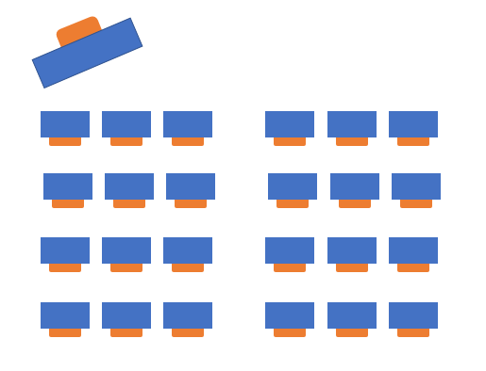
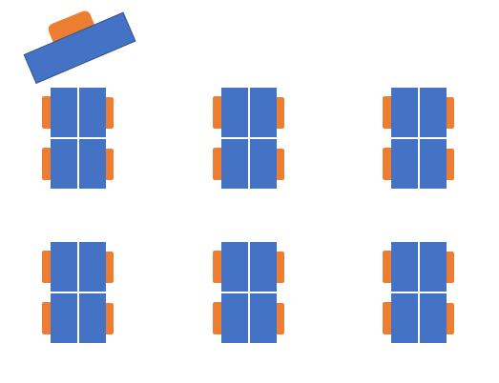
Testing Environment – Setup
Space and/or dividers between computers
Cover instructional materials
INSIGHT software on devices
Enough power to testing devices
Testing conditions, especially the supervision and seating arrangements of students, should be designed to minimize the potential for cheating. Any sign of cheating must be handled immediately. Examiners are to contact the School Test Coordinator if there are any questions or if cheating or security violations are suspected.
Notes:
Each testing setup is unique so make sure to preview your test environment before test day. Test administrators should consider how desks, tables or computers are distributed and the proximity of students. Physical barriers limit distractions and discourage cheating. Make sure all instructional materials are covered. If there is a question about whether materials should be covered, it is best to be safe and cover them. Make sure that INSIGHT is functioning on testing devices. You can check the system using the Secure Practice Test or Secure Practice Test with Response Transmission. Schools should have a plan to minimize background noise and for test monitors in the halls to manage any students. Make sure that there is a Do Not Disturb and No Electronic Devices Sign for the Door. You should also have a plan for gathering cell phones and other electronic devices so students do not use them during testing.

Slide 7
Testing Environment – Materials
Clock
Pencils
Blank scratch paper
Graph paper for EOG or EOC math
Calculators (if needed)
“Testing – Do Not Disturb” sign
“No Electronic Devices” sign
Test Administration Manual
Student Test Roster
Test Tickets
List of accommodations
Testing Device
Mouse (if needed)
Headsets for read aloud (if needed)
It is your responsibility to know what you should expect to receive for the student(s) you are responsible for testing.
Test materials must be kept secure at ALL times. While in the Examiner’s custody, secure test materials must be kept in a locked storage area when not being used for actual administration to students.
All school system personnel are prohibited from reviewing the contents of the Georgia Milestones assessments.
Notes:
Look through the Test Administration Manual to ensure you have all materials including scratch paper, student rosters, test tickets, a clock, and pencils. Test examiners should know ahead of time about any accommodations for students and should know how to help implement them in the test environment. Make sure you know of any district requirements such as hand-held calculators, or paper copies of ancillary materials.

Slide 8
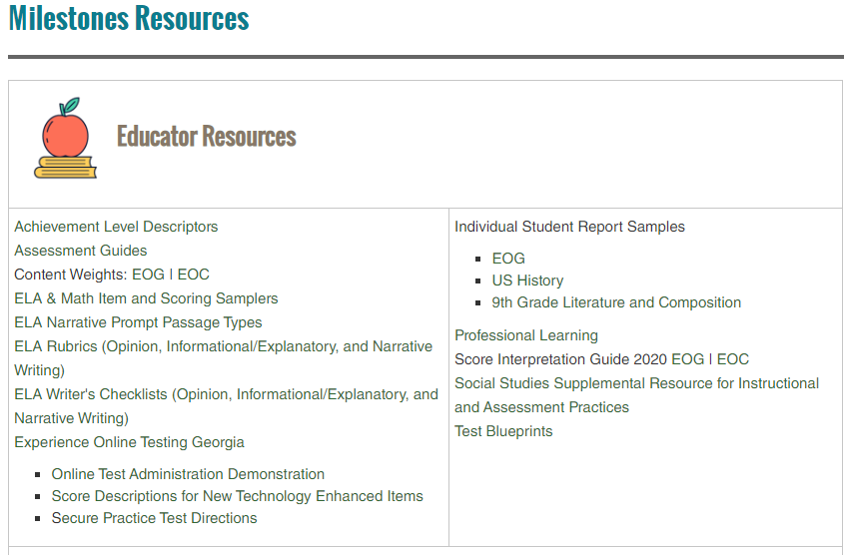
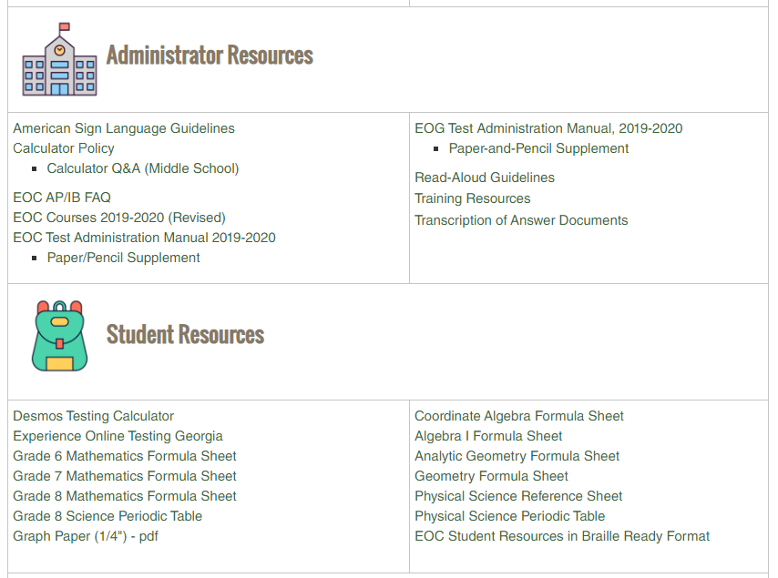
EOG-EOC Resources
https://www.gadoe.org/Curriculum-Instruction-and-Assessment/Assessment/Pages/Milestones_Resources.aspx
Notes:
There are numerous resources available for educators, administrators, students and technology leaders for preparation and implementation of Georgia Milestones on the Georgia Milestones Resources page.

Slide 9
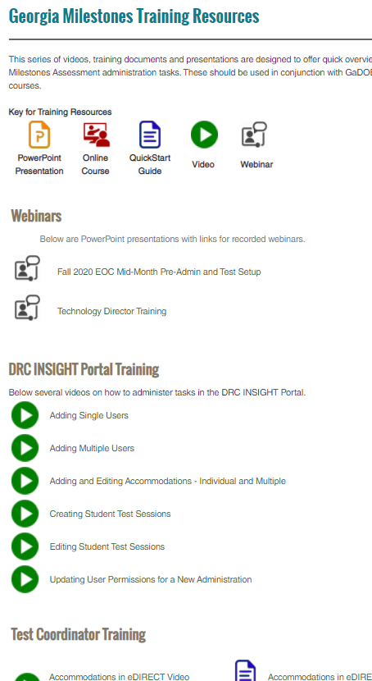
Training Resources
Georgia Milestones Training Resource Page
Training Types
 | Recorded Webinars
 | Videos
 | PowerPoints
 | QuickStart Guides
 | Online Courses
Training Topics
Webinars
DRC INSIGHT Portal Training
Test Coordinator Training
Test Examiner Training
Student Training
Notes:
There are a variety of resources offered for training. The Recorded Webinars are these presentations that are delivered from the GaDOE. The links will take you to the PowerPoints. Videos are short presentations that cover a series of topics. PowerPoint documents are offered so districts can redeliver topics. Most PowerPoints include the script for your redelivery. QuickStart Guides are short pdf documents with information to quickly guide users on training topics. Lastly, School Test Coordinator course can be accessed through the MyGaDOE portal, clicking on PLO and searching for the course.

Slide 10
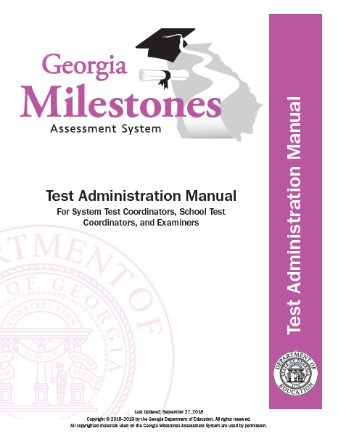
Test Administration Manual
Examiners use Parts 4–5 and Appendices B–I of the Test Administration Manual to administer the Georgia Milestones EOG assessments.
Read each manual that pertains to the test being administered prior to the day of testing so that time is available to ask all questions that arise.
Notes:
All test examiners should read the appropriate sections of the Test Administration Manual before testing. Manuals can be found on the Georgia Milestones Resources page.

Slide 11
Cell Phones
In the event an examiner confirms during testing that a student is using a device to access, retain, or share information, the examiner, must with minimal disruption:
collect the device,
stop testing that student,
remove the student from the testing session, and
notify the School Test Coordinator immediately.
In the event such actions are suspected, but not yet confirmed, the examiner must with minimal disruption:
collect the device,
allow the student to complete testing,
notify the School Test Coordinator immediately, and
as soon as it is appropriate, attempt to confirm if the device has been used in violation of the guidelines above.
Simple possession of a device (including the ringing of a phone during test administration) may be addressed in keeping with the system’s code of conduct and does not require an irregularity report.
The use, or intended use, of an electronic device to photograph, post, retain, or share information/images from any portion of a secure test may result in disciplinary action.
Notes:
Cell phones are not allowed in the test environment and should be collected before the test. If the student has a cell phone during testing or it rings, you should determine if the student accessed the device during the test. If you aren’t sure if the student accessed the device, notify your school test coordinator so they can investigate but allow the student to complete testing. If it is confirmed that the student used the device to access, retain or share test information, make sure to collect the device and stop testing the student. If a cell phone rings but nobody accessed the device, continue testing.

Slide 12
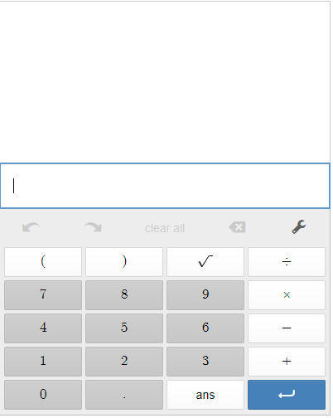
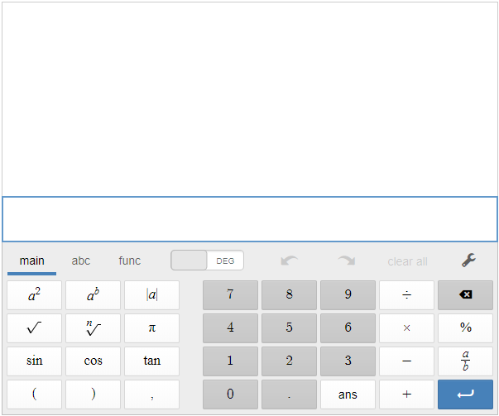
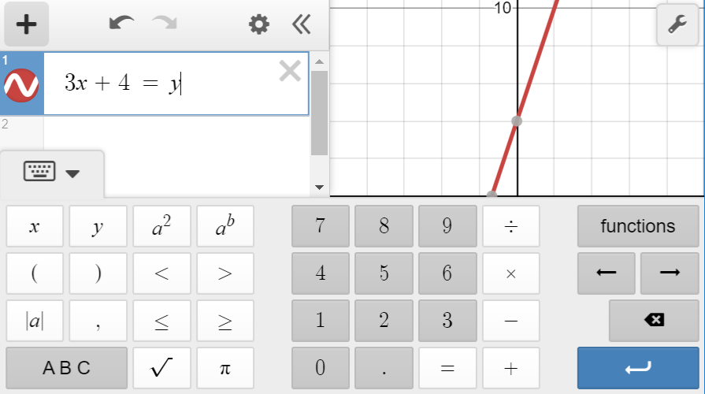
Calculators www.desmos.com/testing
Content Area | Grade Level/Course | Type of Calculator
Mathematics | Grades 3-5 | Not Allowed
 | Grade 6 | Basic¹
 | Grades 7 and 8 | Basic¹ or Scientific
 | Coordinate Algebra/Algebra I | Scientific or Graphing
Science | Physical Science | Basic¹ or Scientific
Calculators are not permitted on Section 1, Part A, of each mathematics test in grades 6–8 and high school. Calculators are not permitted at all in grades 3–5 mathematics. Clear text from calculator before and after testing.
Basic
Scientific
Graphing
Notes:
This table shows which Georgia Milestones Assessments allow calculator use. The calculators will be available through INSIGHT. Students do not have access to the calculator on test items in Mathematics Section 1 Part A that require students to demonstrate direct knowledge of computational skills. If your district allows handheld calculators, you should have a plan for distribution and collection of the calculators. Calculators with memory should be cleared before and after the assessment.

Slide 13
Scratch Paper – EOG/EOC
Scratch paper may not contain any writing (other than student name) prior to starting a test session.
ELA
Section 1 Start with 2 sheets | Section 2/3 Start with 1 sheet
Allowable: Writers Checklist, test ticket
Mathematics
Sections 1 / 2 Start with 2 sheets | ¼” graph paper Allowed
Allowable: Formula Sheets, Graph Paper
Science
Sections 1 / 2 Start with 1 sheet
Allowable: Periodic Table, Physical Science Reference Sheet (HS Physical Science only)
Social Studies
Sections 1 / 2 Start with 1 sheet
Once scratch paper is used, it is considered secure testing material.
Only GaDOE posted documents as listed on Georgia Milestones Resources may be used as scratch paper.
Notes:
The following guidelines show how many pieces of clean scratch paper may be provided to students to start per section. Students can also ask for more scratch paper. Scratch paper of any kind may not contain student or teacher writing of any sort other than the student name prior to starting a test session. All scratch paper must be collected from students and is considered secure testing material.

Slide 14
Georgia Milestones
Testing Times – EOG and EOC
Content Area | Section | Typical Testing Time | Maximum Testing Time
ELA | 1 | 45-65 | 90
 | 2 | 40-60 | 80
 | 3 | 40-60 | 80
Math | 1 | 30-50 | 65
 | 2 | 30-50 | 65
Science | 1 | 20-30 | 40
 | 2 | 20-30 | 40
Social Studies | 1 | 15-25 | 35
 | 2 | 15-25 | 35
There is no minimum time for testing. If all students have submitted the test, the examiner should complete the test section.
The Examiner must keep time during testing in accordance with the script. When time has been called, the Examiner must instruct the student to stop the test.
Notes:
The Examiner must keep time during testing in accordance with the script.
Based on analyses of prior years’ testing, we have determined the typical amount of time in which most student should complete testing. If needed, however, students are allowed up to the maximum time shown here.
There is no minimum time for testing. If all students have submitted the test, the examiner should complete the test section.

Slide 15
Testing Schedules
Assessments must be administered in the order determined by the System Test Coordinator.
ELA – Section 1 must be administered on a single day. Sections 2 and 3 must be scheduled on the same day or two consecutive days immediately following section 1 and may not be scheduled over a weekend.
Math, Science, Social Studies – must be administered such that both sections will be completed in a single day or over the course of two consecutive days.
Notes:
A few notes about testing schedules are….

Slide 16
Are Students Ready?
Orient students to testing via an online platform:
Experience Online Testing Georgia: http://www.gaexperienceonline.com
Available anywhere, anytime.
Can be used by students and parents and a script is available for use in the classroom.
Notes:
Students should be comfortable with the format of the Georgia Milestones assessment as well as the INSIGHT program and all available tools. Districts should set up practice sessions with students using the Secure Practice Tests. Teachers, students and parents can experience the format of the test and the INSIGHT program anywhere anytime through Experience Online Testing Georgia.

Slide 17
Item Types
English Language Arts
Item Types
Selected Response Constructed Response items Constructed Response Extended Constructed Response (Narrative Writing) | Extended Writing Response Evidence-Based Selected Response Drag and Drop/Paste Drop-down List
Unique Feature(s)
Reading and Evidence-Based Writing Section requires students to construct meaning, make inferences, draw conclusions, compare and contrast ideas as well as synthesize ideas and concepts across multiple texts Selected Response Constructed Response Extended Writing Response
Extended Writing Response requires students to develop an informative/explanatory or opinion/argumentative essay – citing evidence from text(s) and using standard language conventions, etc.
Notes:
Item types found on the English language arts assessments and presented to students include selected response (or multiple choice), constructed response, extended constructed response, extended writing response, evidence-based selected response, drag and drop/paste and drop-down list.

Slide 18
Item Types
Mathematics
Item Types
Selected Response Multi-Part Multi-Select Drag and Drop/Paste | Graphing (Bar graph, line graph, pictograph) Keypad Input Drop-down list
Unique Feature(s)
No-Calculator Section Desmos Calculator
Notes:
These item types and features are included for mathematics.

Slide 19
Item Types
Science and Social Studies
Item Types
Selected Response Multi-Part Multi-Select Drag and Drop/Paste Drop-down list
Unique Feature(s)
Science requires understanding of the core concepts, ideas, and practices of science to explain scientific phenomena Social Studies requires understanding of the past and its influence on the present and future – including the interconnectedness of history, culture, geography, economics, and government/civics
Notes:
These item types are included for science and social studies.

Slide 20
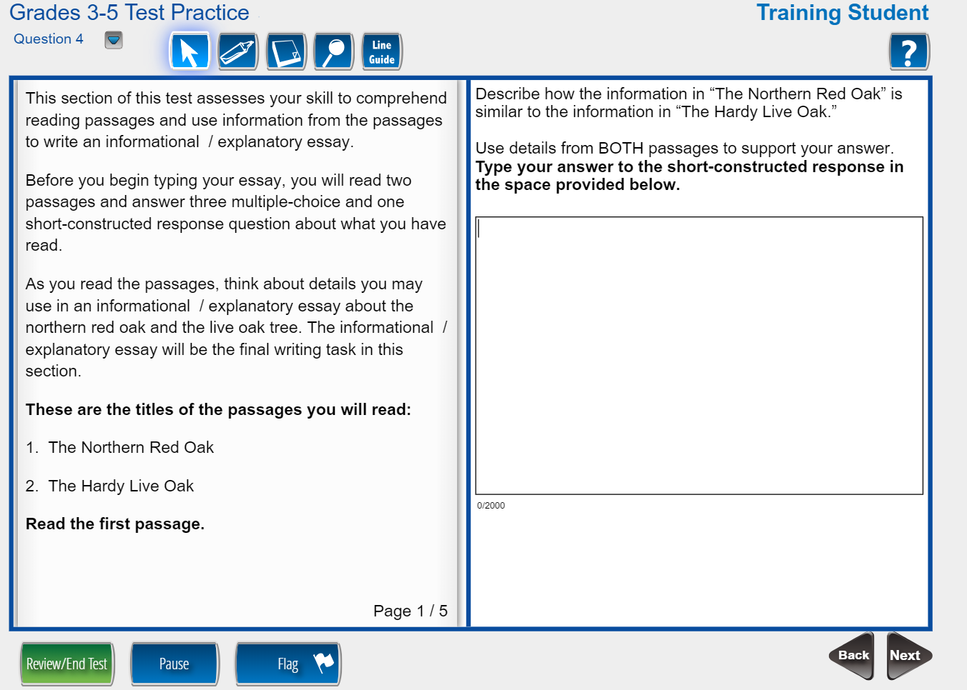
Are Students Ready?
Format of the test
Testing tools
Time and date of test
Different item types
Online calculators
Cut, copy, paste, undo, redo
Online reference Documents
Accommodations
Familiarity with device for testing
Closing out the test
Notes:
The format of the test includes different test item types, how they will be displayed, and how students interact with the items. Experience Online Testing Georgia allows students to use the Universal Testing Tools. Students should know how to use cut, copy, paste, undo and redo when responding to constructed response items.

Slide 21
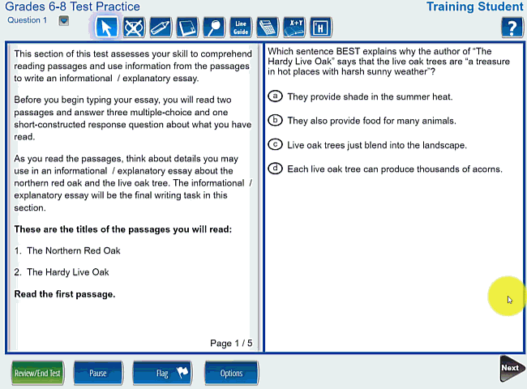
Item Types – Reading & Evidence Based Writing

Slide 22
Item Types – Bar Graph

Slide 23
Item Types – Drag and Drop

Slide 24
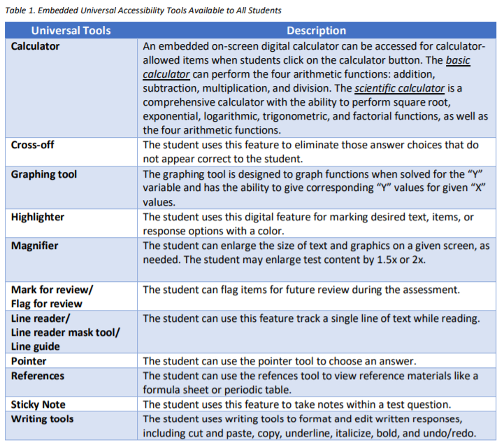
Universal Tools – All Students
Notes:
Universal tools are available to students participating in the Georgia assessment program to address their individual accessibility needs as they access instructional or assessment content. These supports are either embedded in the online test or provided by a test administrator at the local level during testing (i.e., scratch paper).

Slide 25
Online Tools Masking
Notes:
The masking tool is available to all online test takers as a universal tool.

Slide 26
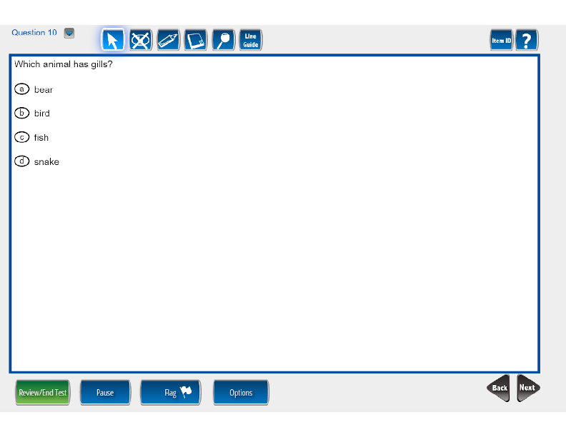
Online Tools Large text and graphics
INSIGHT uses Scalable Vector Graphics
Allows for students to use many sizes of monitors, including larger monitors
No distortion of the content
The Magnifier Tool increases the size of selected items 1.5x or 2x the standard size.
Notes:
Students who need larger print and other test content can use the Magnifier tool that is available for all students. The Georgia Milestones assessment scales to the size of the monitor therefore students who need the test to show larger can be given a larger monitor.

Slide 27
Online Tools Desmos Calculator
www.desmos.com/testing
Basic
Scientific
Graphing
Local districts must clearly determine if a handheld calculator will be made available for students.
Grades 6-high school may not assign a handheld calculator as an accommodation for the no-calculator subsection.
Notes:
The online DESMOS calculator is available as a universal tool for all students during the appropriate sections of the content assessments. Practice opportunities are available in Experience Online Georgia and the practice tests. Please remember, in grades 6-high school, it is not permissible to assign a calculator as an accommodation for the no-calculator subsection. Handheld calculators must not be assigned to any students during this section of the assessment.

Slide 28
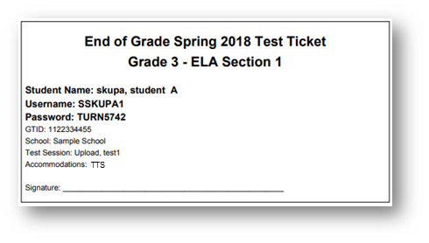
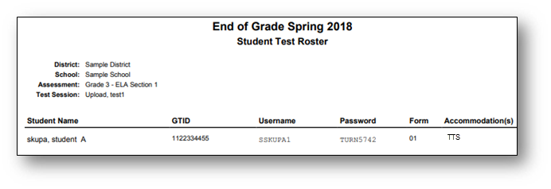
Test Tickets and Student Roster
Check
Test Subject
Test Section
Student Name
GTID
Test Session
Accommodations
Test Tickets will print one to a page, and Each Test Ticket contains the student’s username and password for the test session. Note that the student will have a separate Test Ticket for each section of the test.
Accommodation
TTS | Text-To-Speech
TTS-C | Text-To-Speech Conditional (with passages)
CC | Color Chooser
CT | Contrasting Text
VSL | Video Sign Language
If a student receives an accommodation, it will be noted here
To avoid a student testing under another student’s GTID, you must :
Have students verify their name and test name are correct and sign the ticket next to their name.
If a change is made to a student record (e.g. adding an accommodation), create a new test ticket for that student, which will have a new login/password.
Notes:
Examine each test ticket for correct name, content area, GTID, school, test section, test session and accommodations. Test scores will be invalidated if a student takes the wrong test or logs in with the incorrect test ticket. Accommodations show on both the ticket and the student roster. Test examiners should have a list of students and their accommodations. Some accommodations do not require INSIGHT to make a change and will not show on the accommodations listed on the ticket or roster. For example, additional time will not show on the ticket. The examiner is required to monitor the additional time.
Contact your school test coordinator before logging in if a student needs to receive one of the accommodations listed here and it isn’t on the ticket or roster.

Slide 29
Test Tickets
School Test Coordinator will provide Test Examiners with the secure materials needed to administer each assessment.
Student Test Roster
Contains a list of students and the usernames and passwords for each student
Requires verification of the listed accommodations for each student on the roster
Test Tickets for each student
Student should be given usernames and passwords only for the test and section they are scheduled to take.
Requires verification of the expected accommodations for each student on the Test Ticket and validated on the Student Test Roster
Requires verification of student identity

Slide 30
Questions about Accommodations
Do you know which students need accommodations?
Do you have all hardware students might need to implement an accommodation?
Have you made plans for students with extended time?
Note: Any departure from the list of allowable accommodations may alter the nature of the task being assessed, resulting in an invalid administration.

Slide 31
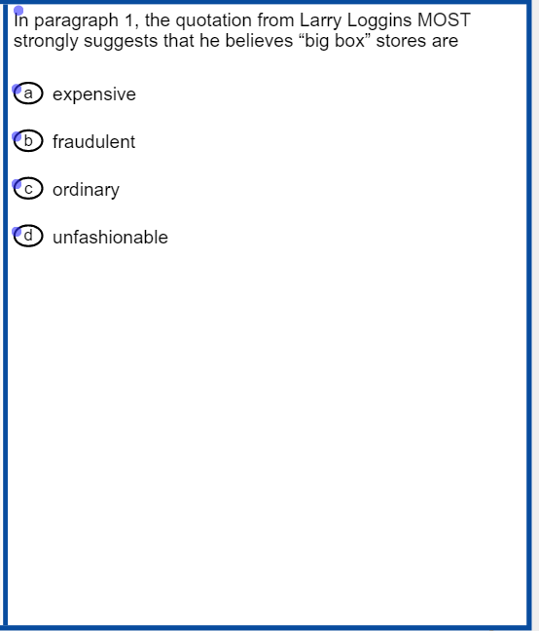
Accommodations Online Audio
Pre-recorded computer voice.
Audio plays automatically for each page.
Can be restarted for the whole page or at Start Points.
Each passage contains at least one Start Point per page
Notes:
For students with the read aloud also called Text To Speech accommodation the recorded voice will read the text. Students can pause or stop the read aloud. Students can also choose start points to read part or all of the text. Make sure that students who are allowed the read aloud accommodation know how to manipulate the online audio.

Slide 32
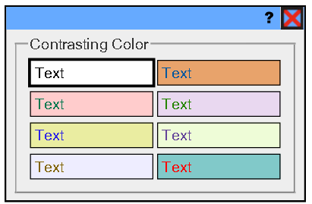
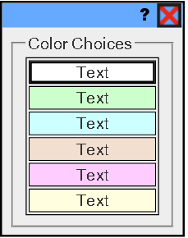
Accommodations Text and Background Colors
Contrasting Background and Text Color Options
Background Color Options
Notes:
Accommodations are presented online including contrasting colors which show different color text and background.

Slide 33
Accommodations Video Sign Language
Notes:
Video Sign Language can be used so a signed version of Georgia Milestones is presented to students. Students can play, pause as well as move forward and backward as needed using online controls.

Slide 34
Examiner’s Responsibilities & Activities
DURING TESTING
Notes:
Let’s get started with what the test examiner needs to do during the day of testing.

Slide 35
Immediately before administering…
Post a “Testing—Do Not Disturb” sign on testing location door.
Post a “No Electronic Devices” sign in the testing location.
Write the name of the school, system, and assessment to be administered on the board.
Write the Monitoring Code on the board if test sessions are using the Test Monitoring Application.
Make sure students have all test materials. (See the Student Test Materials section in Part 4 of this manual.)
Verify that students are assigned accommodations before testing by viewing Test Tickets.
Verify the identity of each student before distributing Test Tickets
Verify the identity of each student present for testing and record attendance.

Slide 36
Launching INSIGHT
Ensure INSIGHT has been launched.
Check student test tickets
Verify name and accommodations on test tickets.
Become familiar with student needs so that all accommodations are administered. Some accommodations are managed by test examiner and not INSIGHT.
Notes:
Before students start testing, the test examiner should click on the INSIGHT application and choose the correct assessment for the student. Check test tickets to verify accommodations and student information including GTID.

Slide 37
Student Login
Students should enter login information from their test ticket.
Stagger logins for a better student experience.
Notes:
Students will then use their test tickets to login to the system.

Slide 38
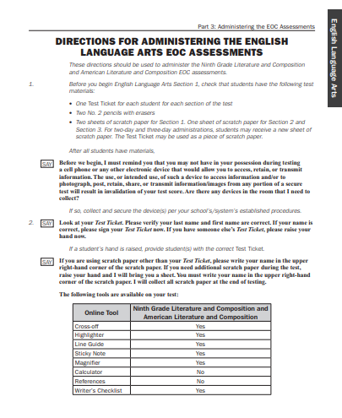
TAM Script
The Test Administration Manual (TAM) should be read in its entirely prior to testing.
Additionally, all documents given to you by your school testing coordinator (i.e., accommodations guidelines) should be read prior to testing.
Notes:
Make sure to familiarize yourself with all of the Test Examiner script found in the Test Administration Manual as well as any other documents that you need to distribute to students.

Slide 39
General Directions
Follow the exact script provided in this Test Administration Manual.
You may repeat any part of the directions exactly as printed as many times as needed. Directions may not be paraphrased.
Under no circumstances should you suggest answers or evaluate student work during the testing session.
All school system personnel are prohibited from examining the contents of the Georgia Milestones assessment.
Read aloud word for word the material that is printed in bold type and preceded by the word “Say.” The material in italicized type is information for you and should not be read to the students.
Under no circumstances should students be allowed to access other software applications or Internet sites in the testing environment.
There is no minimum time for testing. If all students have submitted the test the examiner should complete the test section.

Slide 40
Pause Functionality
During the test administration, if a student needs to leave the testing location for a short break (e.g., restroom break, office visit) the student should click on the Pause button in INSIGHT. A countdown, beginning with 20 minutes, appears on the screen notifying the student of the time left before the system automatically exits the test.
If the test is not resumed within 20 minutes, the student must log back in to finish the test. If it is still the same day that the student originally logged into the test, the student will log in again using the Test Ticket information to regain access to the test. On a subsequent day, the system requires the Student Test Ticket to be unlocked prior to the student logging back into the assessment.
Note: When a student logs back in after a test has timed out, all answer choices, sticky notes, or flags will be saved.

Slide 41
What happens if a student gets sick?
Student gets sick prior to starting the test.
Upon return to school student will complete the test in its entirety and test is scored as is; does not require MyGaDOE Portal entry.
Student gets sick after having completed Section 1 but before starting Section 2.
Upon return to school, student will complete Section 2 of the test and test is coded as an irregularity; requires MyGaDOE Portal entry.
Student gets sick while testing in either Section 1 or 2.
Test scores maybe invalidated by GaDOE; requires MyGaDOE Portal entry.
Notes:
Be prepared for student illness. If the student is sick prior to testing or between sections, make sure to plan for a makeup session. If a student gets sick in the middle of a section, please work with your school test coordinator to determine if scores can still be reported or if they will need to be invalidated.

Slide 42
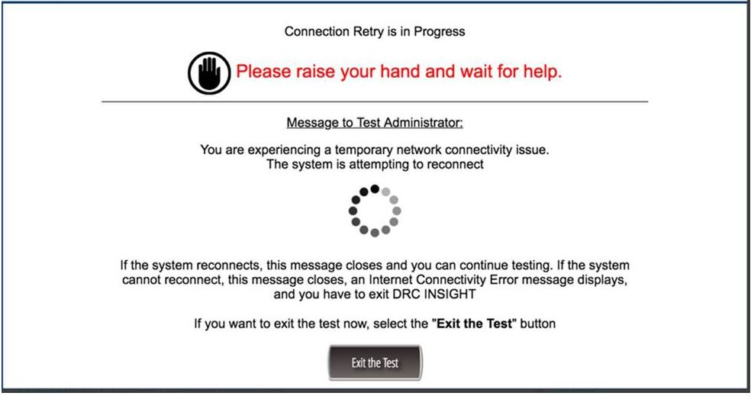
What happens if there are network issues?
If the system shows a message about connectivity issues, contact your school technology contact.
The system will allow the student to continue testing after network issues are resolved.
Work with your test coordinator to determine if students can continue testing.
Notes:
Sometimes network issues can interrupt testing. If the testing device looses connectivity, INSIGHT will continue to reconnect. If you see this message, contact your school technology coordinator. The INSIGHT system has a heartbeat that submits responses every 45 seconds as well as every time a student moves between test items. These safeguards minimize any loss of content when there is a network interruption.

Slide 43
Testing Irregularities
Examples of testing irregularities are included in the Test Administration Manuals. Examples of test irregularities include, but are not limited to:
A student becomes ill or leaves for an appointment during testing and cannot finish the test
A student leaves the test setting without an escort or monitor
A student doesn’t receive their accommodation
This may lead to an irregularity of an invalidation of test scores.
A student refuses accommodations
A student accesses an electronic device in the testing room
An adult provides inappropriate assistance to a student during testing
A student is provided with an inappropriate manipulative (e.g. calculator) during testing
An unused test ticket is missing
Note: Immediately report any irregularities to the school test coordinator.
Notes:
Many test irregularities can be avoided if the test examiner is actively monitoring the testing room. Errors during test administration can also be avoided by careful planning and following the testing script. Immediately report any irregularities to the school test coordinator.
Here are some things that can cause testing irregularities;
Student illnesses
Students leaving a test setting unaccompanied by an adult
Students who don’t’ receive their accommodation or receive the incorrect accommodation
Students accessing electronic devices during testing
Adults providing inappropriate assistance or
Lost test tickets

Slide 44
Improper Student Test Activity
Viewing other student’s test
Accessing unallowable aids or materials
Previewing content
Accessing cell phone, smart watch, ebooks, tablets
Recording responses in the incorrect location
If you are unsure about cheating, allow the student to complete the test section and report to the school test coordinator.
If cheating is confirmed, test scores will be invalidated by the GaDOE.
Notes:
The online testing environment can reduce sharing of test answers since students work through the test at their own pace. However, if not monitored correctly, students can review content on other computers. The test examiner should always be careful to be conscious of student behavior and ensure students are demonstrating their own knowledge of test content. Test examiners should intervene to stop cheating before it results in a test invalidation. If you are unsure about cheating, allow testing to continue and report to the school test coordinator. If cheating is confirmed, test scores will be invalidated.

Slide 45
What is Active Monitoring?
DO | Don’t
Actively walk around the testing room | Sit at your desk doing personal or other work
Monitor student progress | Answer test content questions
Assist students with technology | Point to test content
Check that students are in the correct test section | Review, take pictures or share test content
Check that students have the correct test ticket | Leave students or test materials unattended for any length of time
Check that students do not bring prohibited items in the testing environment (i.e., cell phones) | Allow students to have access to cell phones/other electronic devices
Do plan an activity for students to do after they finish testing (i.e., read a book) | Allow students to have access to any unauthorized materials.
Notes:
Test examiners should be actively monitoring during the entire testing time by walking around the room, assisting students with technology questions, and checking on students who are looking to gain information from other students. Test examiners should use testing time for monitoring and not doing other work. Test examiners should never point to test answers, share content knowledge or give students any advantage during testing. The test administrator may look at the test to see whether responses are entered and may not examine or comment on individual responses.

Slide 46
Improper Monitoring
Test examiners should never
Review test content
Review student responses
Memorize test content
Discuss test content with students, other staff members or anyone
Take photos of test content
Sharing test content through social media
Notes:
Ensuring the confidentiality of test content is critical to ensure the security of the test administration. Failure to maintain the security of testing materials and content can lead to the invalidation of testing and/or a referral to the Professional Standards Commission.

Slide 47
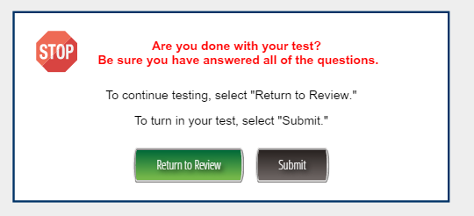
How to Exit the Test
Students must the Submit button to complete the test.
Notes:
Students must exit the test properly in order for the test to be submitted for scoring. When students are done with the test, they should click the Review/End Test button, review their test items then click End Test and Submit.

Slide 48
Reducing Irregularities
Notes:
Let's continue with best practices for reducing testing irregularities.

Slide 49
Getting Ready
Participate
in District Training
Read
Test Administration Manuals
Review
Student Assessment Handbook
Notes:
To get a complete understanding of the testing process and avoiding irregularities, it is important to:
Participate in district training
Read Test Administrator Manuals that apply to your school and
Review the Student Assessment Handbook

Slide 50
Reporting
Protocol
Examiner
or
Staff Person
contacts School Test Coordinator
School Test Coordinator informs
System Test Coordinator & Principal
System Test Coordinator contacts Assessment Division
Notes:
Testing Irregularities represent deviations from standard test security and test administration procedures.
Irregularities can occur inside and outside of the testing environment.
It is the responsibility of all personnel in the local system to follow reporting protocol as they become aware of testing irregularities.
The standard reporting protocol requires that any testing irregularity to be handled immediately. To ensure these matters are dealt with quickly the examiner or other staff person must tell the School Test Coordinator as soon as possible.
The School Test Coordinator must then let the System Test Coordinator know that a possible testing irregularity has occurred.
The System Test Coordinator is required to contact the Assessment Specialist in the Assessment Division.

Slide 51
Reporting
The School Test Coordinator must provide information to the System Test Coordinator that details:
What happened
Who was involved
To what degree was the student disadvantaged or advantaged
What information supports the district’s recommendation(s) or conclusions (e.g., written statements, video…)
Notes:
The System Test Coordinator uses the information that you provide when talking with the assessment specialist and to complete a testing irregularity form in the MyGaDOE Portal.
It is important to share details about what happened about:
Who was involved in the incident.
To what degree was the student or students involved in the situation disadvantaged or advantaged.
What evidence supports the district’s recommendation(s) or summary of the incident.
When incomplete information is submitted, the district’s Assessment Specialist may reject the testing irregularity form and ask the System Test Coordinator to answer key questions and provide additional documentation.

Slide 52
Documentation
School Test Coordinator tells the System Test Coordinator about an irregularity
A student left the classroom unsupervised
School Testing Coordinator was required to provide proper documentation
Notes:
The System Test Coordinator uses the information that you provide when talking with the assessment specialist and to complete a testing irregularity form in the MyGaDOE Portal.
It is important to share details about what happened about:
Who was involved in the incident.
To what degree was the student or students involved in the situation disadvantaged or advantaged.
What evidence supports the district’s recommendation(s) or summary of the incident.
When incomplete information is submitted, the district’s Assessment Specialist may reject the testing irregularity form and ask the System Test Coordinator to answer key questions and provide additional documentation.

Slide 53
Documentation
Ms. Smith allowed Malcolm Jacobs to walk unsupervised to the office prior to the break.
He was away for 10 minutes. Video shows he went straight to the office
While in the office, he did not have access to electronic equipment or test related content.
He completed his test before the examiner called time (see examiner’s statement).
Notes:
In this situation, we know that Malcom Jacobs was unsupervised during the test administration. Now we need to provide additional details to give a more complete description of the incident. (CLICK) Now we can see that he was away from the testing environment for 10 minutes. (CLICK) He did not have access to test related content because the video showed he went straight to the office. (CLICK) Finally, he completed the test in time so he wasn’t disadvantaged by the time he was away from the test. This gives the system Test Coordinator and the state assessment specialist all the information needed to determine how to respond to the situation.

Slide 54
Accommodation Error
Minimize Risks
Examiners should know what accommodations students are scheduled to receive prior to testing
Review daily schedules of students with extended time
Should sessions begin earlier to avoid conflicts with lunch and school dismissal
Examiners should ensure they have space for accommodated materials and assistive technology
Headsets
Braille Booklets
Large monitors
Adaptive keyboards
Notes:
Now let's talk about ways to avoid testing irregularities. Test Examiners should know exactly which accommodations students are scheduled to receive and how to implement the accommodation. Test Coordinators should also manage the testing schedules so that there are no conflicts with lunch or dismissal and that Test Examiners are aware of students that need extended time. In addition, Test Examiners should have all the materials needed for accommodations such as headsets, special booklets, large monitors or other forms of assistive technology.

Slide 55
Read-Aloud
Minimize Risk
Proper management of online sessions
Verify students have functioning headsets
Verify computer sound is working properly
Students should tell their examiner if sound is not working.
Verify the correct TTS accommodation appears on Test Tickets
Notes:
Let’s ensure that students who receive a read-aloud accommodation receive an error free administration. Test Examiners should check to make sure that headsets are working properly, and sound is functioning on the computer. Students should be told to raise their hand and tell the examiner if sound is not working. It is very important that Test Examiners verify that the correct TTS accommodation appears on test tickets.

Slide 56
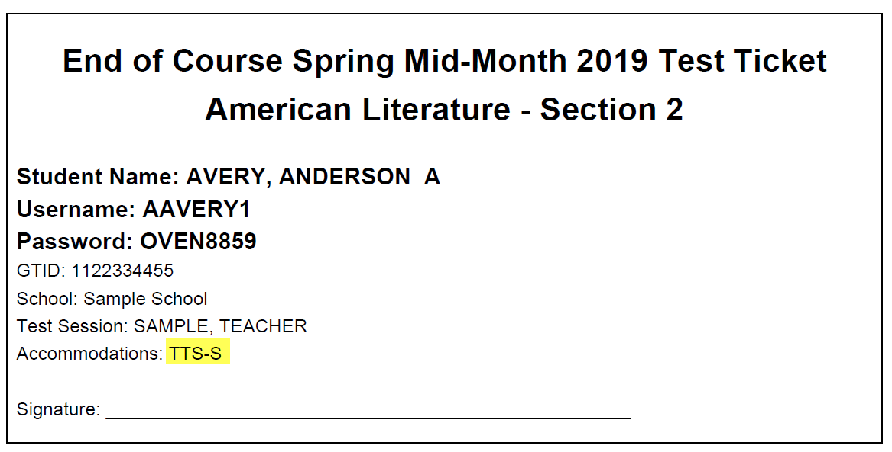
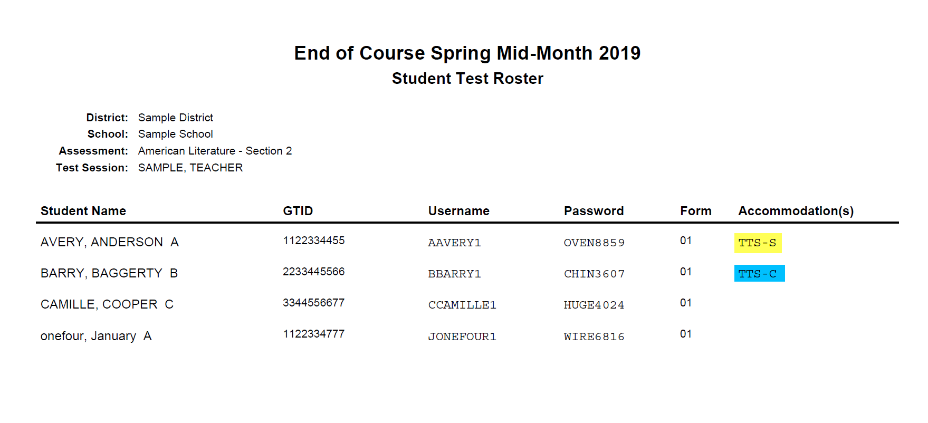
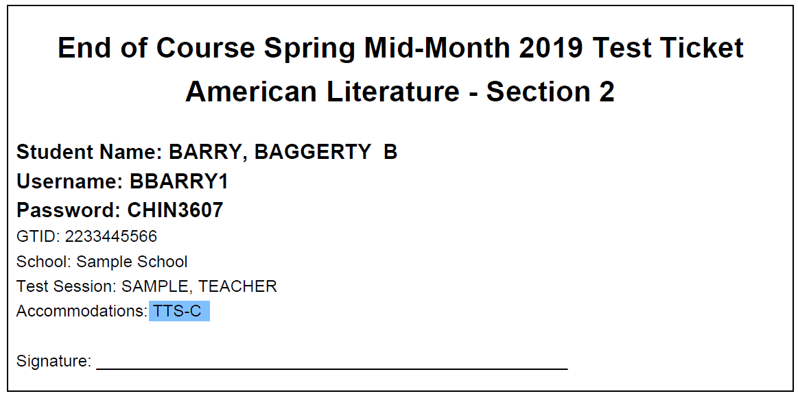
Read-Aloud
TTS-S = Standard Read-Aloud
TTS-C = Conditional Read-Aloud with passages
If an error is caught and corrected, give the student updated test tickets before they log in to the test.
Notes:
Test Examiners should know that the test roster and test ticket should show TTS-S for the standard read aloud accommodation and TTS-C for the conditional read-aloud that includes the passages. If the tickets are incorrect, the Test Examiner should stop testing and contact their Test Coordinator. The Test Coordinator will need to update the accommodation in INSIGHT, print out new test tickets and begin testing. IF the student begins testing before the error is discovered, the Test Coordinator will need to contact the System Test Coordinator.
Test Examiners should examine test tickets for all students to ensure that the name and GTID are correct for the student.

Slide 57
Cell Phones & Electronic Devices
Minimize Risk
Families should know that cell phones and smartwatches are prohibited in the testing environment
Actively monitor test sessions
Post “No Cell Phone” sign
Simple possession can be addressed per the system’s code of conduct
Devise a method to collect and redistribute these devices
Notes:
Cell phones and other electronic devices can interfere with testing and possibly give students access to test content during testing. In order to minimize this risk, schools should let families know that cell phones and smart watches are prohibited in the testing environment. Test Examiners should always be monitoring the test environment actively walking around the classroom at all times. The Test Examiner should display the No Cell Phone sign outside the classroom. If a Test Examiner notices that the student has a device but didn’t access the device, they can simply take the device and allow the student to continue testing. School Test Coordinators should have a school plan for collecting and redistributing electronic devices.

Slide 58
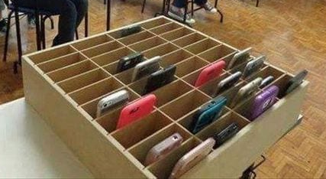
Districts Examples
Raffle Ticket Method
Label Plastic Bag
Assign a pair of raffle tickets to a student
Give the student a ticket and place the matching ticket in a bag with the phone
Return phones to students who have corresponding ticket after testing
Have students place their name on a bag
Students insert their phone into the bag
Return the phone to the respective student after testing
Notes:
One method for collecting cell phones is to place the cell phone in a plastic bag with a raffle ticket and give the student a matching raffle ticket. Another method would be to have students place their name on the plastic bag with the phone or device.

Slide 59
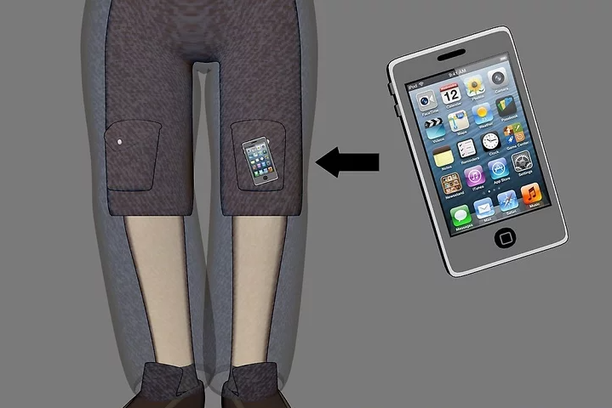
What to Do
Confirmed Cheating
Suspected Cheating
If confirmed, the examiner, must with minimal disruption:
collect the device,
stop testing that student,
remove the student from the testing session, and
notify the School Test Coordinator immediately.
If suspected, but not confirmed, the examiner must with minimal disruption:
collect the device,
allow the student to complete testing,
notify the School Test Coordinator immediately, and
when appropriate attempt to confirm whether the device has been used in violation of the guidelines.
Notes:
What to do if the Test Examiner confirms that the student accessed the electronic device during testing. If the examiner determines that the student used the device to cheat or share test content, the examiner should collect the device, and remove the student from the test environment. However, if the Test Examiner only suspects that the student cheated, they should collect the device and allow the student to complete testing. When appropriate, the Test Coordinator should investigate if the student was advantaged by having the device during testing.

Slide 60
Online Testing Interruption
Minimize risks
Ensure
Ensure other online, instructional activities will not compete for bandwidth with testing
Perform
Perform readiness checks prior to and, where applicable, during testing.
Ensure
Ensure test content, including TTS, has been downloaded to COS before testing.
Share
Share online troubleshooting tips with examiners
Provide
Provide contact information for local technology support
Watch
Watch weather forecasts to determine potential impact
Notes:
It is best to minimize risks caused by online testing interruptions before testing. Schools should ensure that other online activities will not compete for bandwidth necessary for testing. The district technology team should perform readiness checks and download test content including TTS to the COS before testing. Examiners should be aware of troubleshooting tips and have contact information for technology support. Finally, watch the weather to determine potential impact to testing.

Slide 61
What to Do
If you encounter connectivity issues
During testing, use the appropriate troubleshooting tools available to correct the issues. If problems persist your System Test Coordinator will use their best judgment as to whether to allow students to continue testing
Examiners should keep track of the amount of time students are owed
If appropriate, contact DRC Customer Service: 866-282-2249
Notes:
If you do encounter connectivity issues during testing, use the appropriate troubleshooting tools available to correct the issues. If problems persist, your System Test Coordinator should use their best judgement to determine whether to allow the student to continue testing. Examiners should keep track of time lost so when connectivity returns, students can have the balance of their time. If appropriate, call the help desk for additional assistance.

Slide 62
Failure to Follow Directions
Minimize Risks
Ensure students understand test directions
Examiners and students should understand how additional time is allocated in increments to actively engaged students.
Experience Online Testing Georgia
www.gaexperienceonline.com
Notes:
Let's talk about how to minimize irregularities regarding directions. Test Examiners and test takers should be given the opportunity to review the format of the test and the test directions. Examiners should review test manuals and contact their School Test Coordinator if there are any questions. Students should understand time limits and Test Examiners should make students aware of how much time is left during testing. Students, teachers and parents can go to Experience Online Testing Georgia and the Secure Practice Tests to become accustomed to the test.

Slide 63
Test Features
Tell students about the symbols they must follow.
No-Calculator Online Warning
No-Calculator Paper Warning
End of Test Section
Notes:
Let's look at the features that are built into the Georgia Milestones. Examiners should help students become familiar with these symbols. Examiners should let students in grades 6-12 know that they will see the no calculator symbol in section 1 part A. Once students go beyond this section, they will not be able to return. Students should also be aware of how to end a test when they are finished. Students should be comfortable with the online program and format of the test before logging in to take Georgia Milestones.

Slide 64
Examiner’s Responsibilities & Activities
AFTER TESTING
Notes:
Now that testing is over, what do you need to do?

Slide 65
Collecting Materials
Collect test materials from each student as they complete the test according to the directions in the Testing Administration Manual.
Student test tickets
Scratch paper (used/unused)
Student Testing Roster
Calculator (if applicable)
The School Test Coordinator will count all test materials returned by the Test Examiner—in your presence and verify that the counts match.
The School Test Coordinator will verify that all tests are properly submitted.
Notes:
Remember that test tickets, used scratch paper, and testing rosters are all secure test materials. Follow protocol to ensure that all materials have been returned and verified by the school test coordinator.
Examiners must account for all test materials before dismissing students from the testing room.
All individuals who have the responsibility for handling the Georgia Milestones assessments are accountable for all test materials assigned to them before, during, and after the test administration. Any discrepancies should be documented and reported to the School Test Coordinator.

Slide 66
Notes:
This concludes this portion of the Test Examiner training. Now, you should work with your school test coordinator to receive instructions specific for your district.

