Slide 1
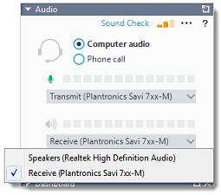
Welcome!
Check Audio
Expand the Audio pane.
Ensure that Mic & Speakers is
selected.
You will see separate icons for your microphone and speakers. Next to each is a volume meter.
  Test your microphone by speaking into it. If the volume meter next to the Mic icon does not show any green bars, then it is not properly picking up sound.
    Use the drop-down menu to select a different microphone.
  Test your speakers by listening for audio. If the volume meter next to the Speakers icon does not show any green bars, then it is not properly emitting sound.
    Use the drop-down menu to select different speakers.
    If you see green bars but do not hear any noise, try turning up the volume of your speakers.

Slide 2
FIP and TestPad Overview
September 15, 2021
Kelli Harris-Wright
Joe Blessing

Slide 3






Formative Assessment Resources
Notes:
Presenter: Joe Blessing and/or Kelli Wright-Harris
Georgia Department of Education offers a variety of formative assessment resources including BEACON, Keenville, GKIDS and of course FIP and TestPad which we will discuss today.

Slide 4
Formative Assessment Resources
Formative Instructional Practices (FIP)
Online professional learning for teachers, coaches, and leaders
TestPad (in SLDS)
Item and test content in TestPad
Benchmark development tool
Item and passage creation
Notes:
Presenter: Joe Blessing and/or Kelli Wright-Harris
FIP is an online learning resource to develop educators' knowledge of and skills to use formative assessment as a part of daily instruction. While TestPad is provides a bank of assessment items and benchmarks, and also offers the ability to develop and use your own items and passages for formative assessment. Both are at no cost to districts and schools.

Slide 5
Formative Instructional Practices Online Professional Learning www.gadoe.org/fip
Contact: kharris-wright@doe.k12.ga.us
Notes:
Formative Instructional Practices (FIP) will be discussed on slides 4 – 37.

Slide 6
Today’s Topics for FIP
Define Formative Instructional Practices Online Professional Learning (FIP), courses and learning options
Discuss FIP as an Option for District/School Improvement
Explain how FIP and TestPad can coordinate to support instruction
Share feedback from educators who participated in FIP
Share how to begin FIP
Share the importance of a balanced assessment system
Reminder about FIP webinar series

Slide 7
Let’s Talk About Georgia FIP

Slide 8
Formative Instructional Practices Defined
“It is not the instrument that is formative; it is the use of the information gathered.”
Chappius, J. (2019). Seven strategies of Assessment for learning. Portland: Pearson Education Assessment Training Institute
Formative Instructional Practices (FIP) are intentional behaviors that both teachers and students use to make decisions about learning. Formative instructional practices are the formal and informal ways that teachers and students gather and respond to evidence of student learning.
Georgia FIP is a blended model for professional learning. It provides Tier I evidenced-based processes and practice opportunities for educators to accurately use formative instructional practices in districts and schools.
GA FIP online professional learning has four foundational components:
Clear Learning Targets
Collecting, analyzing and using evidence of student learning
Effective Feedback
Student Ownership of Learning
Notes:
There are FIP in-course assessments that offer immediate feedback to the educator about their understanding and application of FIP course content
GA FIP Online Professional Learning also provides downloadable resources for PLC facilitators and participant handouts to support deepening course content.
There are ready-to-go agendas to guide PLC discussions about course content.
FIP resources support efficient planning for PLCs.
Educators earn certificates for course completion for hours spent in online learning courses.

Slide 9
FIP Series and Courses
(Download Handout)
Foundations for Understanding FIP (5 core courses)
Leading and Coaching FIP (1 course)
Creating Clear Learning Targets (6 courses)
Reaching Every Student (3 courses)
Designing Sound Assessments (10 courses)
Notes:
The handout lists the titles for all 25 courses, includes information on the types of FIP access codes and how STCs can locate school-unique access codes in their My GaDOE Portal account.

Slide 10
Options for FIP Implementation
Independent PL
Grade level or departmental PL
Vertically aligned elementary, middle and high school PL
Schoolwide PL
District-led PL
RESA-led PL

Slide 11
Learning Components
Recommended for Professional Learning Community (PLC)
Online Course Completion
Individually (earns certificate of course completion)
Confirming Learning (online monitoring of course completion by leaders)
Ensures that educators have completed the FIP course
Confirming Practice*
PLC leader facilitates reflection and discussion about educator practice in relationship to completed FIP course
Confirming Commitment*
Educators set goals and take action based on what they’ve learned from the course and PLC discussions
Reflection*
Educators gather to discuss what they learned from implementing selected goals, plan for refinement and practice using FIP processes again until accurate use can be observed with students and learning data show evidence of learning success

Slide 12
FIP for Improvement
FIP and TestPad for Instruction

Slide 13
Reflection and Acknowledgement
Teachers, schools, and school systems face unprecedented challenges when school reopens after pandemic-related closures. One of the central challenges will be figuring out how to meet the individual needs of students who had dramatically different experiences while schools were shuttered, and who will need dramatically different academic and non-academic interventions and supports as school begins. The priority should be on assessments closest to instruction that help teachers know what to do next.
If districts or schools purchase anything this fall it should be quality curricula and effective professional development to ensure that teachers know how to zero in on high-priority skills and content to meet individual needs.”
Lake, R. & Olson, L. (July 2020). Learning as we go: Principles for effective assessment during the COVID-19 pandemic. The Evidence Project. https://www.crpe.org/sites/default/files/final_diagnostics_brief_2020.pdf
Where is the “HOW?” Many of my fellow teachers and I understand the need for more rigor and challenging our students to help them achieve. We get it. What is lacking is the “how.” How is teaching with the new standards different from teaching with the old?
Teachers need models and training to
help them step back to the role of skilled
facilitators, to guide students to take
ownership of their own learning.
Marzano, R. J. and Toth, M. D. (2014). Teaching for rigor: A call for a critical instructional shift. West Palm Beach, FL: Learning Sciences International.
Notes:
In beginning the section on FIP for Improvement and FIP/TestPad for Instruction, it is very important to acknowledge that the current school year will be the most challenging in our careers as K-12 public school leaders and teachers. We have not lived through a pandemic in our lifetimes and we are learning as we go.
The two quotes on this slide serve as a recognition that even in a pandemic, we must support teachers and leaders in their efforts to be the best that they can be for students and parents. Concurrently, we acknowledge that compassion, flexibility and carefully designed and executed priorities will be the norm. This means that some plans and decisions may have to wait while others take precedent.
In terms of teaching and learning, the priority needs to be on ensuring that students access high quality curriculum and instruction because we provide professional development for teachers that equips them to be better for students. Better means instructional delivery to ensure that standards are taught in ways that makes sense to students in face-to-face and virtual settings and zeroing in on what students know, don’t know and must absolutely learn this year by using formative assessment well.

Slide 14

Why Consider FIP for Improvement?
The GSAPS assesses a school’s level of implementation in each of the five systems of GSCI:
Coherent Instruction: Districts and schools must have an established shared instructional guidance system (Structure 3: Use of a balanced blend of assessments)
Effective Leadership: A major support necessary for an effective instructional guidance system is leadership in the school and at the district level
Professional Capacity: In addition to effective leadership, schools, to improve, particularly in instruction, must have a coherent system to develop the capacity of the professionals in the school
Family and Community Engagement: A school must have an intentional explicit system for engaging the adults beyond the school in the core instructional work of the school
Supportive Learning Environment: A school must design a system that organizes the efforts in the school to meet the differing needs of all students
Source: (Page 1 of Process Guide for GaDOE’s GSAPS)
Organizing for School Improvement edited by Anthony Bryk (2010)
Notes:
Georgia’s System of Continuous Improvement (GSCI) – five components
Georgia School Assessment of Performance on Systems (GSAPS) – assesses a school’s level of implementation in each of the five systems of the GSCI
FIP Online Learning Courses directly support the five systems of GSCI

Slide 15
Example of Why FIP Works
Sample Issue: Assessment results, student work and teacher observation data indicate students are struggling with ELAGSE6RI8.
Grade 6
Strand: Reading Informational Text
Topic: Integration of Knowledge and Skills
Standard: Trace and evaluate the argument and specific claims in a text, distinguishing claims that are supported by reasons and evidence from claims that are not.
What does this really mean for teaching and formative assessment?

Slide 16
FIP Shows Educators How to Create Clear Learning Targets from Standards and the Learning Progression
Standard: Trace and evaluate the argument and specific claims in a text, distinguishing claims that are supported by reasons and evidence from claims that are not.
Learning progression begins with academic vocabulary.
Assess student learning at each progression to find gaps in understanding and provide revision opportunities as needed.
Advance learning when indicated.
Mastering the Standard
I can evaluate or judge the argument and its specific claims in a text. This means that I can tell whether the reasons and evidence provided for a claim are logical and sufficient (enough) to support the claim. R
I can determine whether a claim is supported by evidence or not. R
I can trace or follow an argument and specific claims in a text. This means that I can find the claim made, find the reasons and evidence that support. the claim and explain how the reasons and evidence link to the claim. R
I can find the reasons and evidence that support (back up) a claim. R
I can find a claim made in a text. K
I can define claim. K
I can define argument. K
Learning Target Types: Knowledge (K) – Skill (S) – Reasoning (R) – Product (P)

Slide 17
FIP Shows Educators How to Choose the Right Assessment to Match the Learning Target or Learning Goal
Selected Response: multiple choice, true/false, matching, fill-in-the blank
Written Response: construct short responses with one or a limited range of answers or extended responses of several sentences in length with greater number of acceptable answers
Performance Assessment: give demonstration or create a product
Personal Communication/Verbal Response: response by speaking aloud and can include asking/answering a question, a discussion, conference, oral exams or presentations

Slide 18
FIP Content Helps Teachers Gather the Right Information in the Right Way Efficiently
Notes:
This chart is directly from a FIP online course. It shows which assessment type works best for each of the four types of learning targets; knowledge, reasoning, skill or product. This is very important because educators need to make decisions about student learning progress that are accurate and reliable.

Slide 19
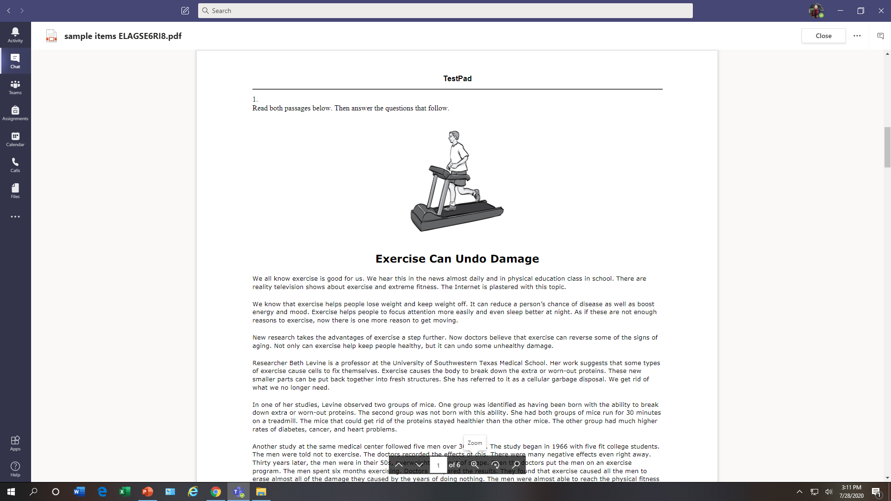
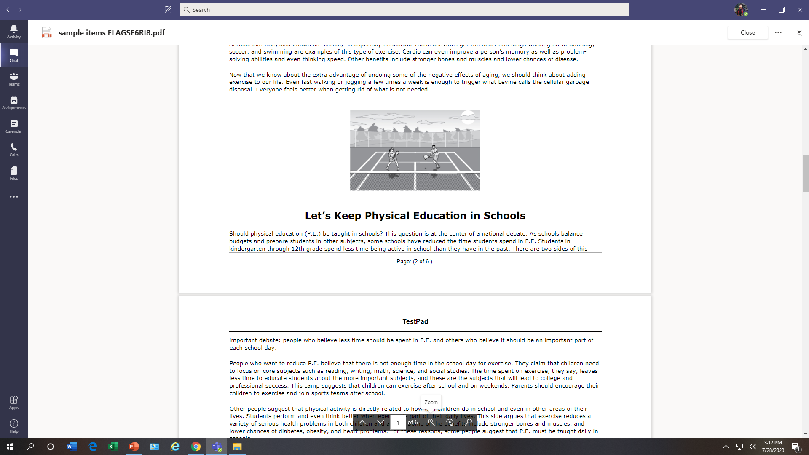
FIP and TestPad for Instructional Improvement
Standard: ELAGSE6RI8
Notes:
Teachers who learn to use FIP processes well with students can also pull a single formative assessment item from TestPad to assess how well students learned a standard that has been taught.
This is a sample TestPad item that can be to used to determine if students can apply the skills/concepts for the standard in a novel context. Depending upon the type of information that the teacher needs to know by using this assessment item, the resulting information could be used either formatively or summatively.
The slide shows a TestPad item for the same 6th grade ELA standard that was discussed on slide 15. It is a paired passage item that requires a written response assessment, which is, an appropriate way to evaluate skills and concepts related to reading for information and integration of knowledge and skills.

Slide 20
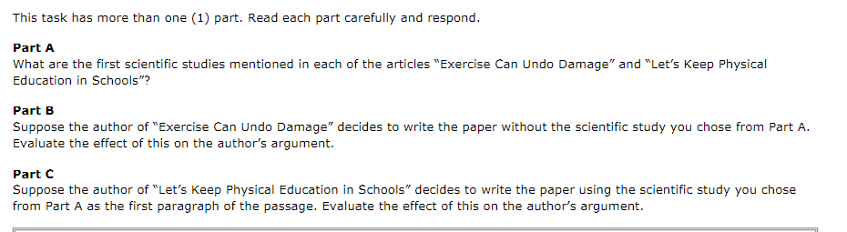
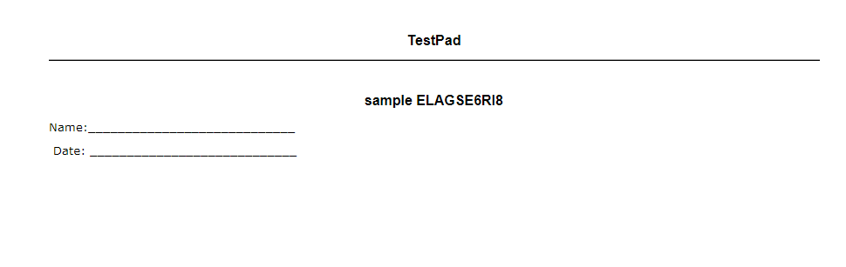
Item 1
Knowledge and Skills
Reasoning
Reasoning
Product
Notes:
The item requires that students read and use information from both passages to respond to a three-part task. The task requires students to use knowledge, skills and reasoning to respond appropriately in writing. Think back to our slide a few minutes ago where our standard ELAGSE6RI8 was deconstructed, ordered into a learning progression with each learning target or goal for lessons identified. AFTER instruction ends for all learning targets in the standard including use of daily formative assessment during each lesson, it is time to assess how well students can perform on the entire standard. Pulling and using a single TestPad item (for the standard that has been taught) can help us make this determination.

Slide 21
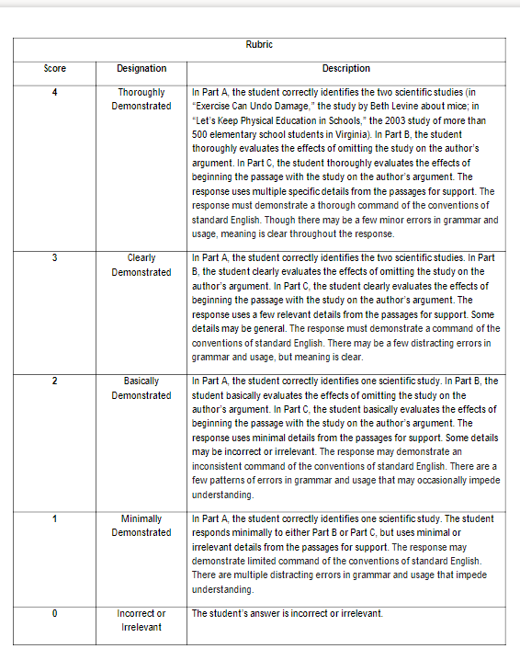
Task-specific Rubric
Notes:
To assist teachers in evaluating student responses to the TestPad item, a task-specific rubric is also provided that defines performance criteria from a score of 4 to indicate a thorough demonstration of the standard to a 0 to indicate incorrect or irrelevant performance.

Slide 22
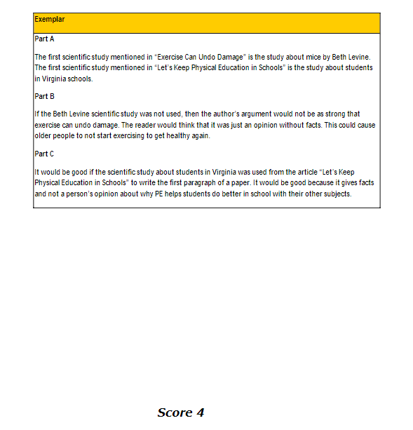
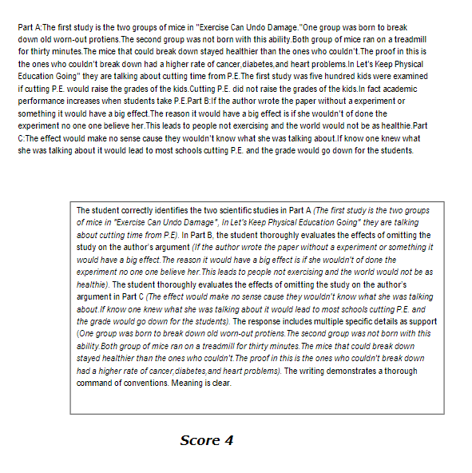
Exemplar Papers
Notes:
Exemplar papers with annotations are provided to show student work for the performance criteria (4 to 0).

Slide 23
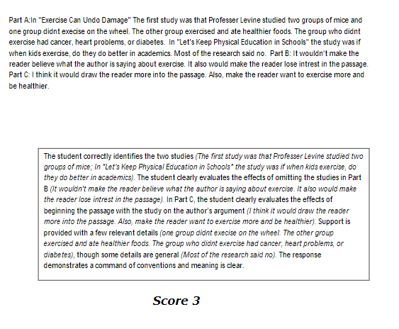
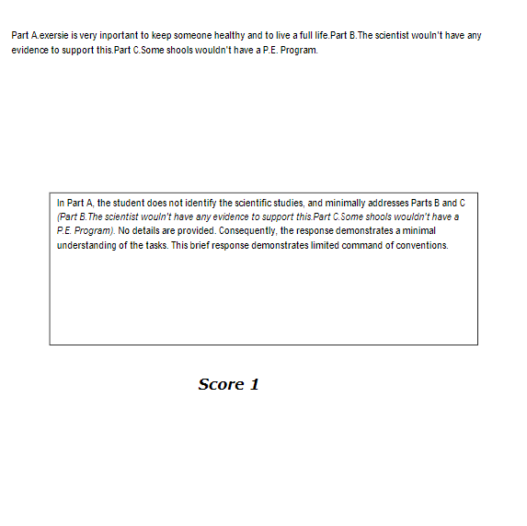
Part A

Slide 24
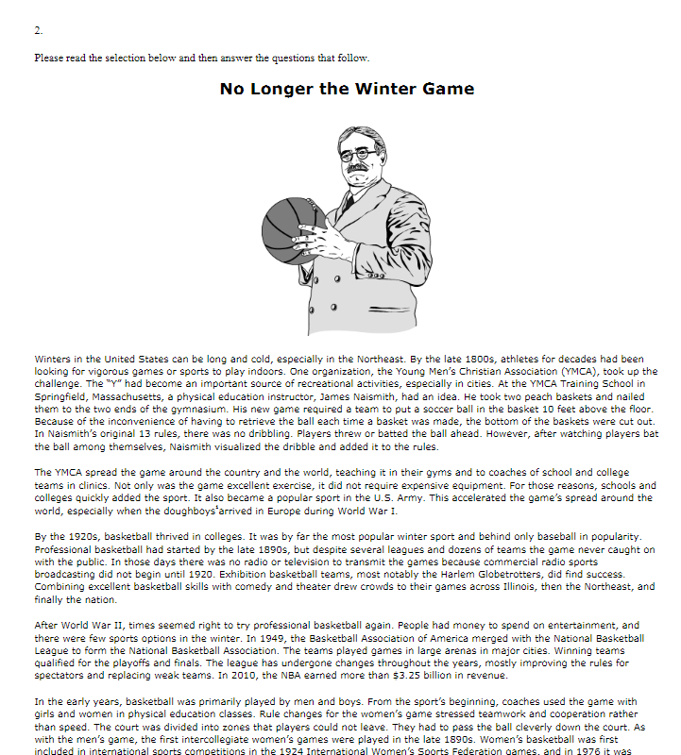
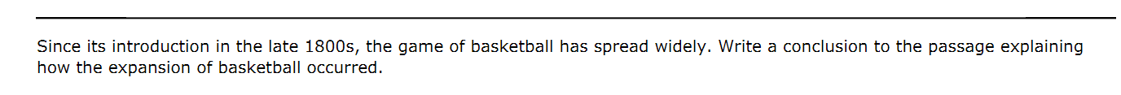
Teaching with TestPad Items
Standard: ELAGSE6RI8
Notes:
This particular TestPad item for standard ELAGSE6RI8 has two assessment options. Use of the paired passages item that was just discussed was the first assessment option. The second assessment item can be used for evaluation purposes too, BUT, it can also be used for instruction to teach students how to think to prepare to respond in writing.
This example passage is about the origins of basketball and how it grew to become popular. The assessment task is to write a conclusion to the passage explaining how the expansion of basketball occurred.

Slide 25
Teaching with TestPad Items
Standard: ELAGSE6RI8
1.
2.
3.
4.
Notes:
A teacher could post the item virtually or on a whiteboard to model how to think to prepare the written response. For example, to successfully answer, one skill that students need is how to identify and use chronology to organize the sequence to explain how basketball expanded.
To help students learn to identify the most important sequences in the passage to write an effective conclusion, the teacher could model a think-a-loud on how to skim the text to locate the sequence for the expansion of basketball. The teacher could use underlining and numbering as an organizing technique. This is just one example of how a TestPad item could be used as a teaching tool.

Slide 26
Educator Feedback About FIP RESA PLCs

Slide 27
FIP Survey FY’2020
10 Survey Questions (n = 366)
Please identify the Regional Education Service Agency (RESA) that supports your school district.
Please select one answer choice below that best describes your role as an educator.
How were you initially made aware of Georgia FIP online professional learning?
Please check the appropriate box to indicate your current status in GA FIP professional learning OR check ALL GA FIP online learning courses that you have completed.
Please rate your perception of the usefulness of the content in Georgia FIP to your classroom work with students.
Please rate your perception of the usefulness of learning about FIP through a professional learning community (PLC)?
Please list any changes that you've made in your work that are a direct result of participating in Georgia FIP professional learning. If you have not made any changes to your practice, write N/A.
If you serve as the Instructional Coach/Teacher-leader for Georgia FIP professional learning, please rate your experience using the Facilitators' Guides and Resources.
Please share any additional feedback about your experience with Georgia FIP professional learning in the comment box below. If you have not taken FIP courses, enter N/A.
What suggestions can you share that would enhance GA FIP professional learning?
Notes:
Data will be shared only for questions 2, 5 and 7, which are highlighted.

Slide 28
Historical Data from FIP Feedback Survey
Q5:
Please rate your perception of the usefulness of the content in Georgia FIP to your classroom work with students.
Year | Number of Survey Participants | Positive Perceptions on Usefulness of FIP
2017-2018 | 460 | 91%
2018-2019 | 504 | 94%
2019-2020 | 355 | 95%
Note: In FY’21, 701 educators participated in FIP PLCS at RESAs.

Slide 29
Q5 Sample Anecdotal Comments (174/366)
Coming into the classroom from a non-education background, this was an excellent resource to help give me the vocabulary of education and shed much needed light into some places I had just been feeling my way through in the dark.
This gave me a broader view of how to use formative practices in learning music theory.
The content was very useful in gearing my differentiated instruction and also setting clear learning targets.
I will implement these practices into all content areas in my classroom. I want to focus more on assessment for learning by using it to drive instruction and having students monitor their own learning and closing gaps that they see themselves.
Creating clear learning targets and providing appropriate formative and summative assessment help students understand what and why they are learning. The assessments tools help students and teachers identify their strengthens and weaknesses in order to move toward mastery of the standards.

Slide 30
Q7 Please list any changes that you've made in your work that are a direct result of participating in Georgia FIP professional learning. If you have not made any changes to your practice, write N/A.
366/366 with 104 as N/A
I have changed in the way I look at the end product that I have asked the student to create. I try to make sure what I am teaching will assist the students to the pathway of creating the end product.
I provide more detailed feedback to my students.
Georgia FIP helped me improve my lesson plans.
Creating assessment blueprints.
Focus on demonstration of mastery, clear and measurable learning targets, understanding the "why" behind instructional tasks and assignments.
I have begun incorporating learning targets throughout my instruction and not just at the beginning. I have become clearer with my expectations and have given my students more rubrics so they can track their progress towards those expectations. Next school year, I am looking forward to incorporating more self-assessment and reflection for my students.

Slide 31
Getting Started with FIP Professional Learning

Slide 32
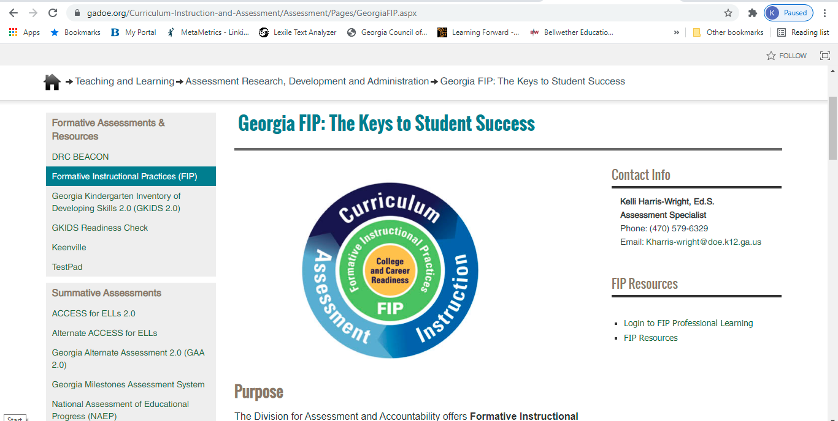
Accessing Georgia FIP Online Learning
K-12 public school educators can access courses at the GaDOE website for Georgia FIP when they have a unique access code and use their work email address to create an online learning account. Click the login link and have in hand your central office or school-unique FIP access code. Obtain access codes from the district-level Test Coordinator. Access codes are in the Test Coordinator’s GaDOE Portal Account.
https://www.gadoe.org/Curriculum-Instruction-and-Assessment/Assessment/Pages/GeorgiaFIP.aspx

Slide 33
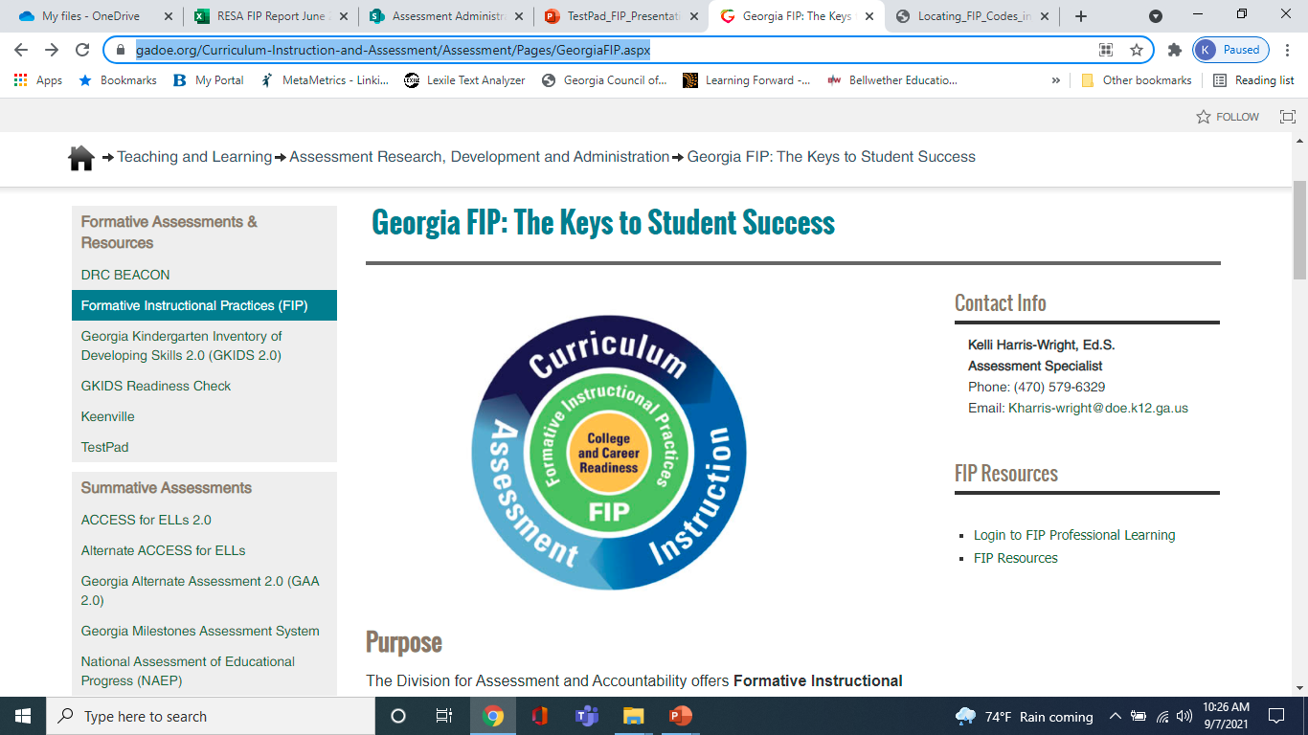
Where are the FIP Codes in the MyGaDOE Portal Account?
Go to the FIP webpage: https://www.gadoe.org/Curriculum-Instruction-and-Assessment/Assessment/Pages/GeorgiaFIP.aspx
Educators Resources: https://www.gadoe.org/Curriculum-Instruction-and-Assessment/Assessment/Documents/FIP/Locating_FIP_Codes_in_GaDOE_Portal_Account.pdf
2.

Slide 34
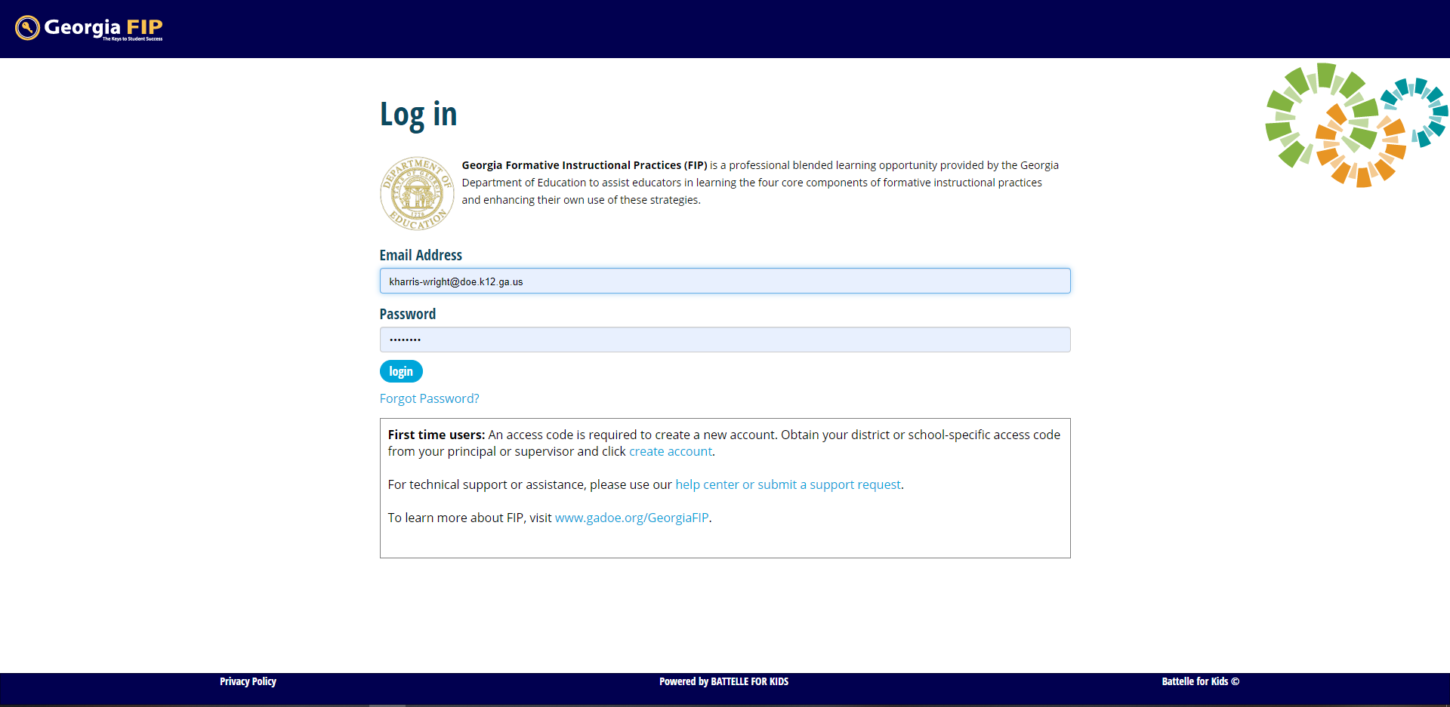
First Time Users Need to Create an Individual Online Learning Account

Slide 35
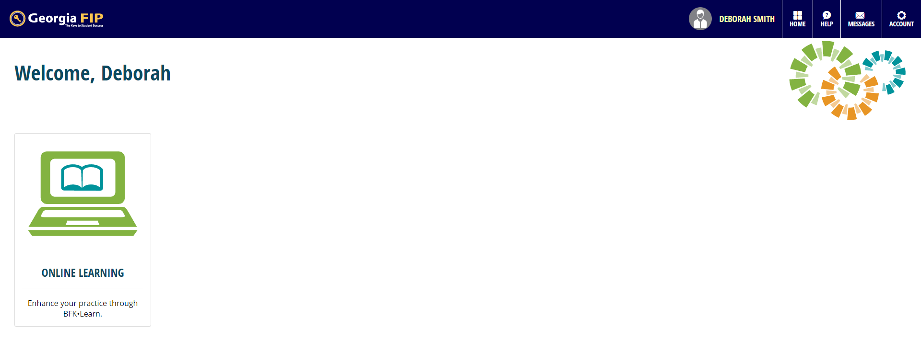
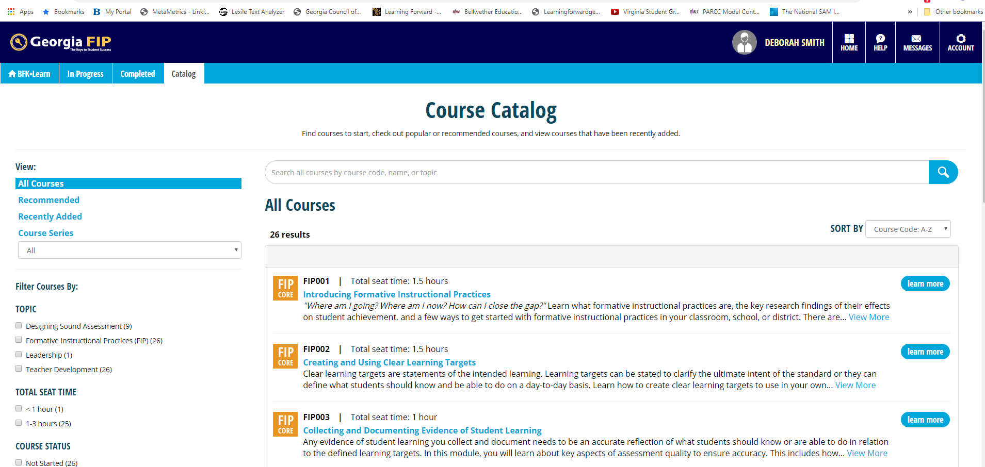
Landing Page for FIP Account and Course Catalog

Slide 36
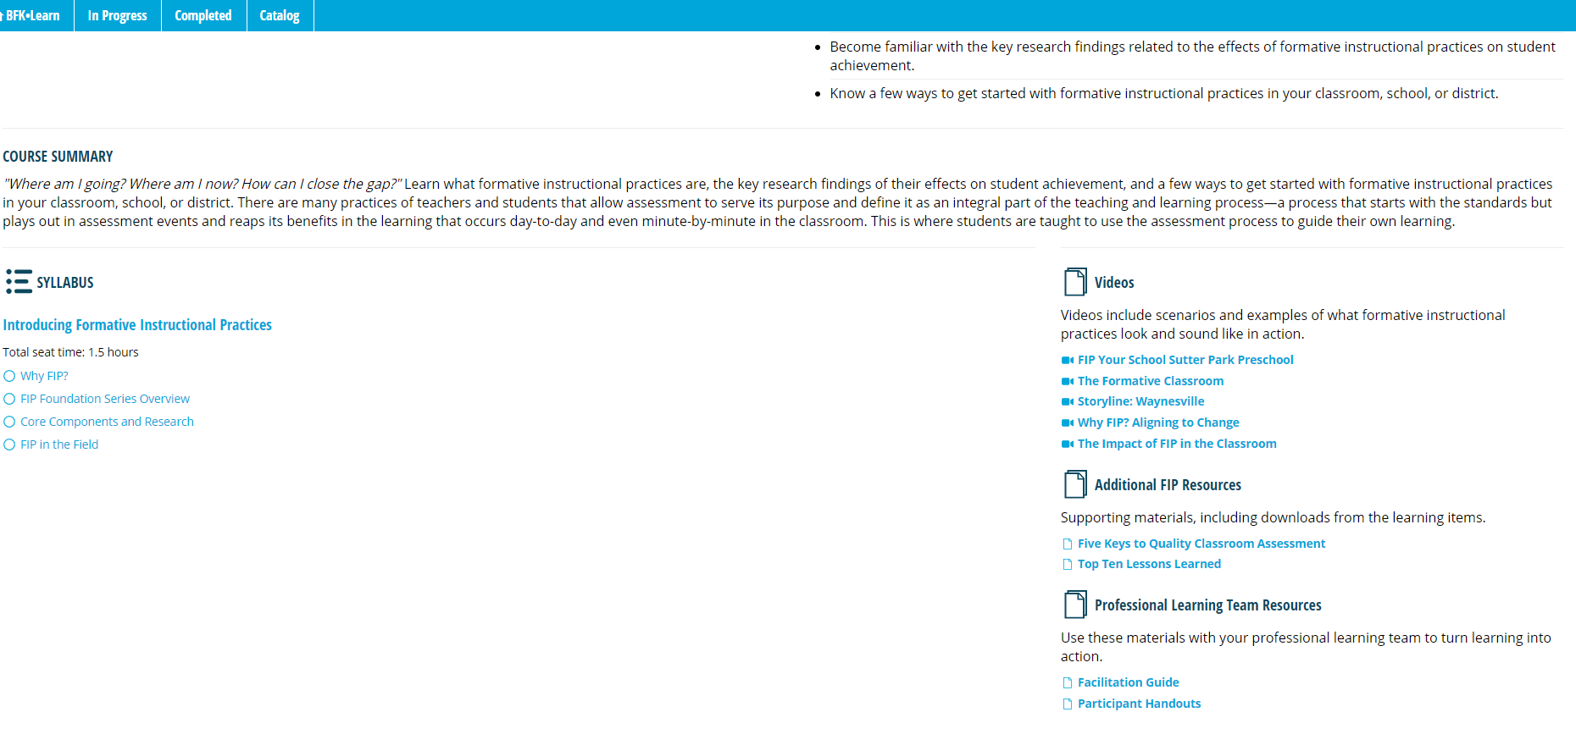
PLC Leader and Participant Resources for Each Course

Slide 37
Close Out Reflection:
Know the purpose for assessment and how will the results be used beforehand
Instructional
Tell me how well students are learning each day and where to adjust teaching to close gaps or offer more challenging learning Activities?
Georgia FIP
Predictive
Tell me how students are likely to perform on the end-of-year assessment?
TestPad
DRC BEACON Interim Assessment
Evaluative
Tell me which instructional program, approach, or teacher was most successful?
Georgia Milestones Assessment System
Formative
Daily
Formative
Periodically
Summative
District’s Testing Window
Adapted from: Gong, B., Marion, S. & Perle, M. (2007). A framework for considering interim assessments. Denver, CO: National Center for the Improvement of Educational Assessment.

Slide 38
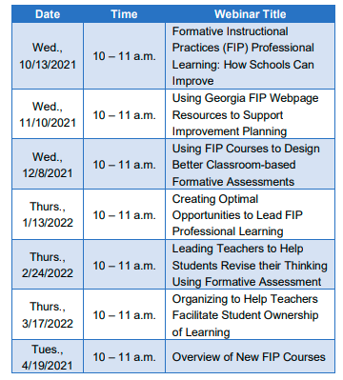
FIP Webinar Series for 2021-2022
Registration links to participate in the live FIP webinar sessions are published in the Assessment Newsletter

Slide 39
Georgia Department of Education
FIP Online Learning Team
Dr. Allison Timberlake
Deputy Superintendent
Assessment and Accountability
470.579.3021
atimberlake@doe.k12.ga.us
Dr. Sandy Greene
Director, Assessment Administration
470.579.5395
sgreene@doe.k12.ga.us
Kelli Harris-Wright, Ed.S.
Assessment Specialist, Georgia FIP
470.579.6329
kharris-wright@doe.k12.ga.us

Slide 40
TestPad Item Bank Content
TestPad includes a bank of test items and resources aligned to Georgia state standards.

Slide 41
Item Formats
Multiple Choice
Constructed-Response
  Extended Response
  Scaffolded
Constructed-response items require students to provide explanations/rationales, provide evidence, and/or to show work
Provide teachers with evidence of true student understanding of content and process
Notes:
TestPad has and item bank and item creator for a variety of test items including Multiple Choice and Constructed Response for deep levels of content.

Slide 42
TestPad State Developed Assessments
Formative Benchmarks
(20 benchmarks with 2 parts each)
  Aligned to the Georgia Standards
  ELA Grades 3-8, 9th Grade Lit, American Lit
  Mathematics Grades 3-8, Coordinate Algebra, Analytic Geometry
Notes:
Included in TestPad are a state developed benchmarks that system test coordinators can assign to schools. Assessments are aligned to Georgia Standards in ELA and Mathematics Grades 3-8 and some EOC Courses.

Slide 43
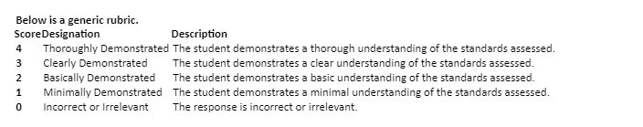
Example of Extended Response Item
ELA—Grades 9 – 10
9th/10th Grade ELA Standards RI.9.8; RI9.1; L9.1; L9.2; DOK 4
Passage Title: Juliette Gordon Lowe
Part A
Identify at least two arguments Juliette Gordon Low used as reasons to begin the Girl Scouts.
Part B
Evaluate whether or not these arguments are valid and whether there is enough evidence in the article to support them.
Be sure to complete ALL parts of the task. Use details from the text to support your answer. Answer with complete sentences, and use correct punctuation and grammar.
Notes:
Here is an example of a two part Extended Response item. Below the item is a generic rubric for teacher scoring.

Slide 44
Example of Extended Response Item
Math—Advanced Algebra
Advanced Algebra, Standards A.REI.2; A.REI.4; A.APR.6, A.REI.1; DOK 3
Notes:
Here is an example of a three part Mathematics item.

Slide 45
Example of Rubric
Mathematics—Grade 5
Rubric
Score | Designation | Description
4 | Thoroughly Demonstrated | The student successfully completes all elements of the item by demonstrating knowledge and application of measuring volumes by counting unit cubes, using cubic cm, cubic in, cubic ft, and improvised units (5.MD.4), applying the formulas V = l × w × h and V = b × h for rectangular prisms to find volumes of right rectangular prisms with whole number edge lengths in the context of solving real world and mathematical problems (5.MD.5b), and adding, subtracting, multiplying, and dividing decimals to hundredths, using concrete models or drawings and strategies based on place value, properties of operations, and/or the relationship between addition and subtraction; relating the strategy to a written method and explain the reasoning used (5.NBT.7).
3 | Clearly Demonstrated | The student shows clear understanding of the standards listed above, but one of the explanations or work shown is insufficient or weak Or All parts of the item are correctly done except for a minor computational error Or The student successfully completes two of the three parts of the item and partially completes the other part.
2 | Basically Demonstrated | The student shows basic understanding of the standards listed above, but two of the explanations or work shown are insufficient or weak Or The student successfully completes one of the three parts of the item and partially completes the other parts.
1 | Minimally Demonstrated | The student shows minimal understanding of the standards listed above and completes only one of the three parts Or The student partially completes two of the three parts.
0 | Incorrect or irrelevant | The response is incorrect or irrelevant to the skill or concept being measured.
Notes:
Mathematics rubrics are specific to the test item.

Slide 46
Exemplar Papers
Prototype answer – the “ideal” response
Set of responses from actual Georgia students, collected during item pilots
Samples scored by trained raters using rubric
Papers allow teachers to review and compare their own students’ work to the sample responses for each score point
  Helps standardize expectations of the standards
Score point and annotations provided for each sample item response
Note: The pilot was conducted using standard administration procedures in order to ensure that results were comparable across the state. When items/tasks are used during instruction, these administration rules do not have to apply and student results may vary; thus, teachers may want to modify the rubrics and even raise expectations. Rubrics and exemplars should remain focused on high expectations.
Notes:
Read content of page

Slide 47
Exemplar Paper
Mathematics—Grade 5
Notes:
This is an exemplar paper for a grade 5 Math test item. It shows the answers to the item.

Slide 48
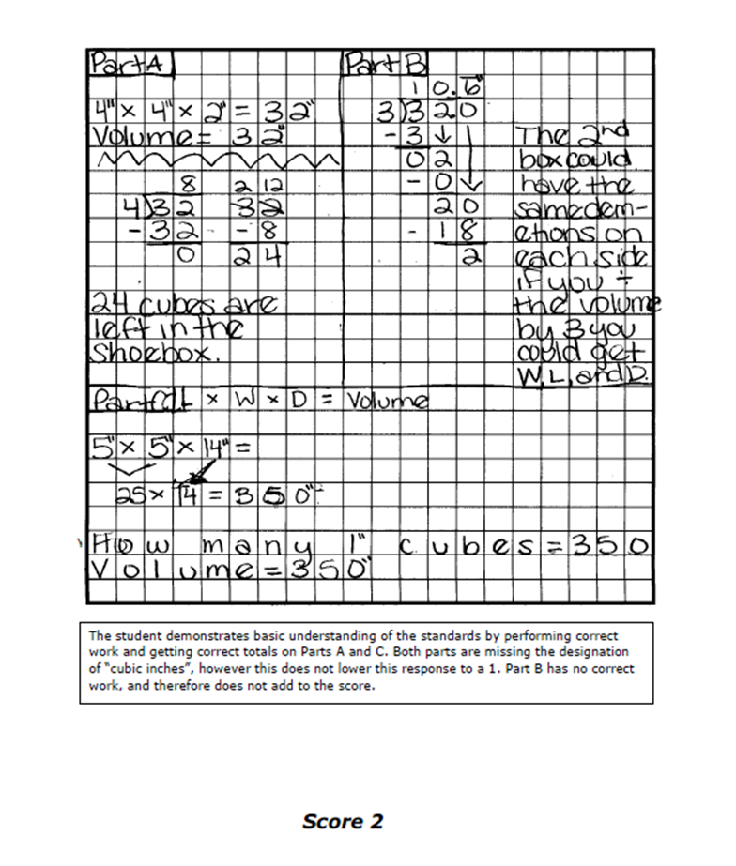
Student Exemplar Papers
Student Response
Scorer’s Annotation
Score based upon rubric
Notes:
This item shows the student response, the scorer’s annotation and score based on the rubric. Teachers can use these to help scoring Constructed Response items. Sample student work and scores with annotations are also a great professional development tool as you teach teachers how to score constructed response items as a school or district.

Slide 49
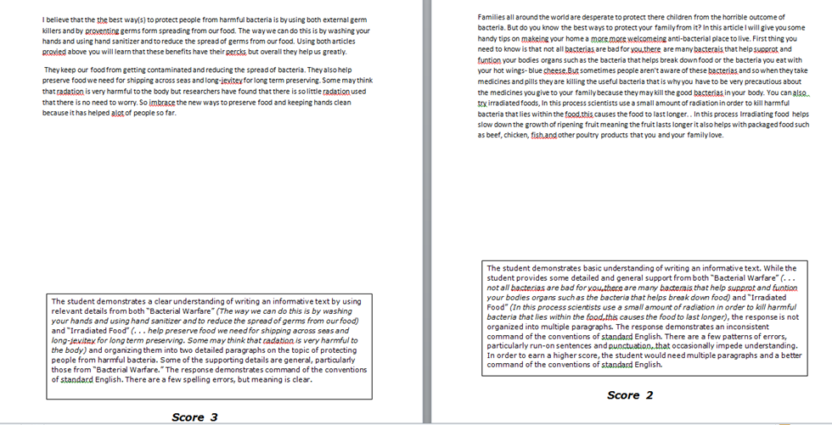
Student Exemplar Paper - ELA
Notes:
The ELA exemplar paper shows a sample essay, the score and scorer’s annotation so teachers can understand how the scorer determined the level of scoring.

Slide 50
TestPad
Joe Blessing
jblessing@doe.k12.ga.us
404-232-1208

Slide 51
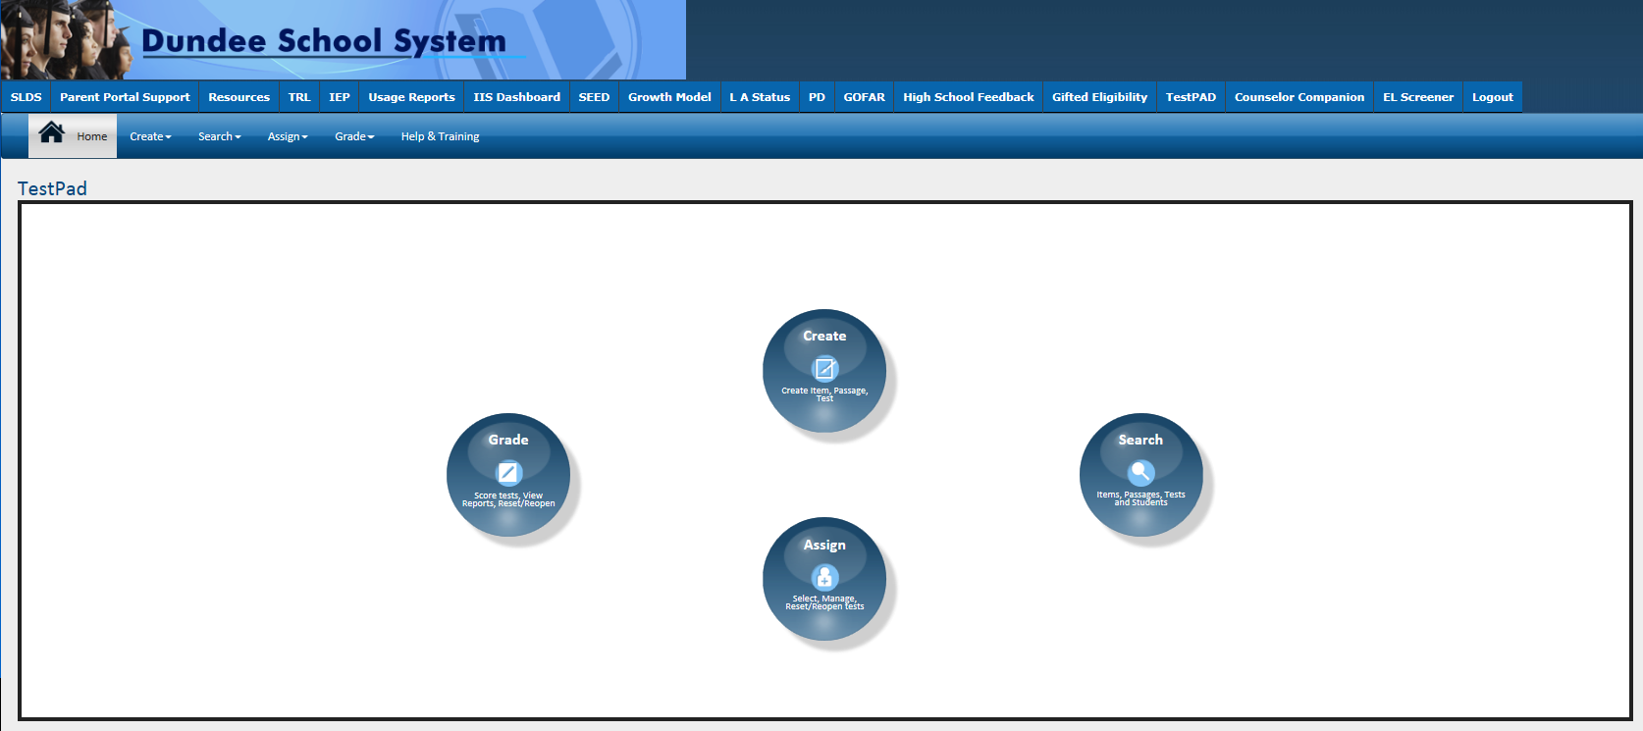
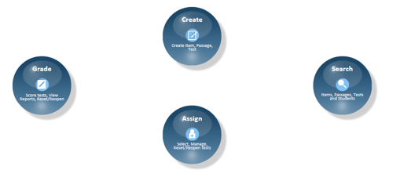
TestPad Landing Page
Notes:
TestPad can be found in the SLDS. There are four main sections: Create, Search, Grade and Assign

Slide 52
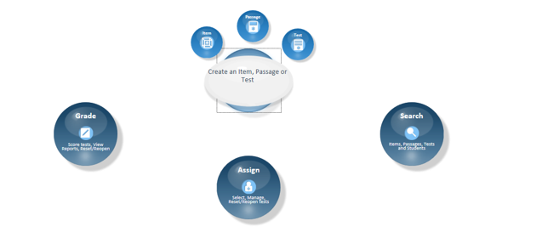
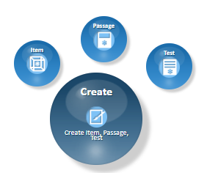
Create an Item
Notes:
The Create section allows users to create an Item, Passage or test

Slide 53
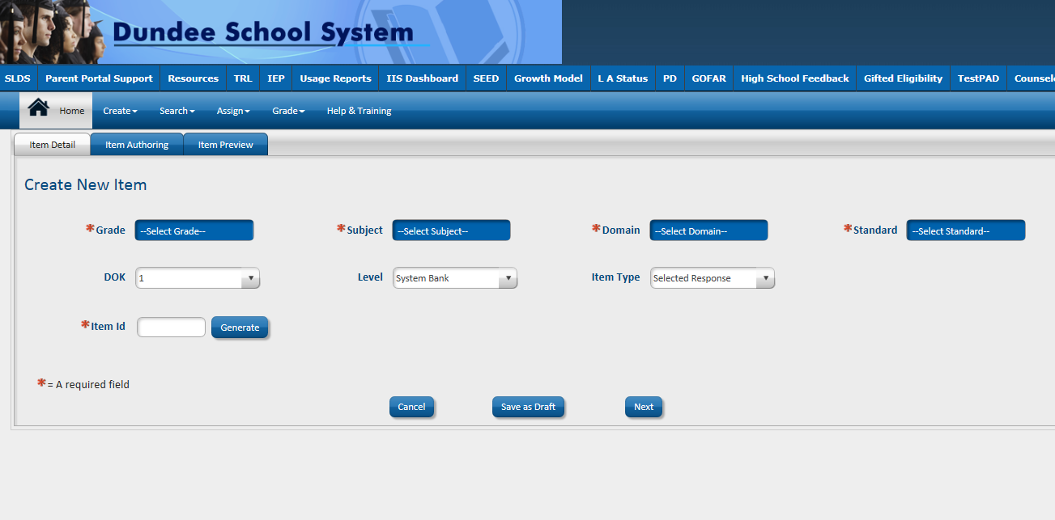
Item Creation – Item Detail Screen
Notes:
Users can create an item by entering Grade, Subject, Domain, Standard, DOK. Item bank level, and item type (selected response or constructed response. Item ID is automatically generated. Users can create items for tested or non-tested courses.

Slide 54
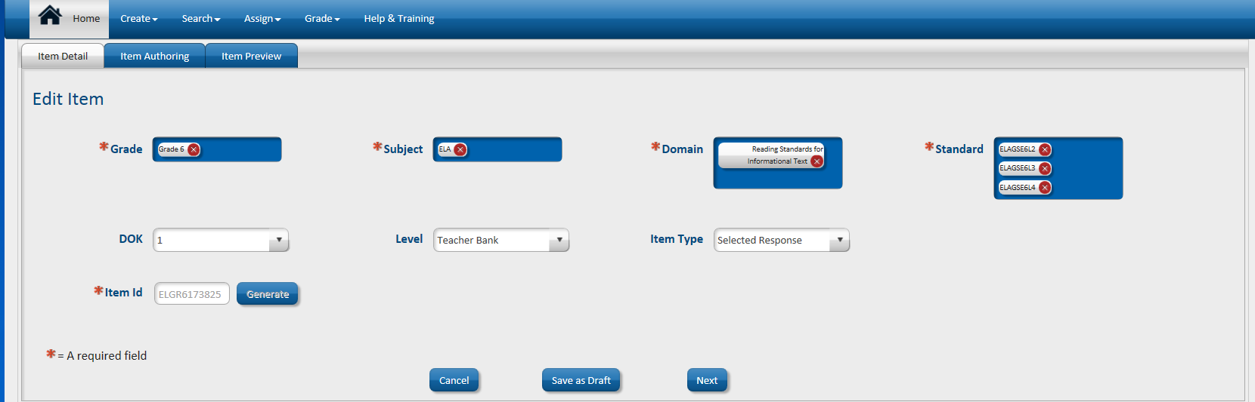
Item Detail Screen
Create New Item
Notes:
This is an example of a grade 6 ELA item.

Slide 55
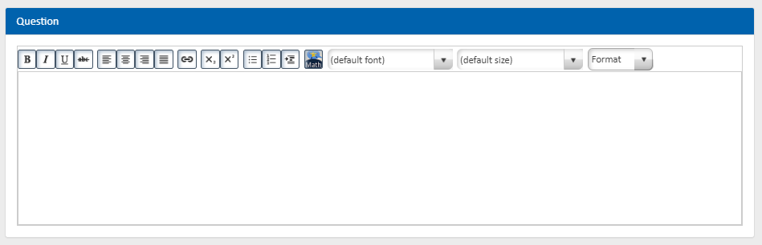
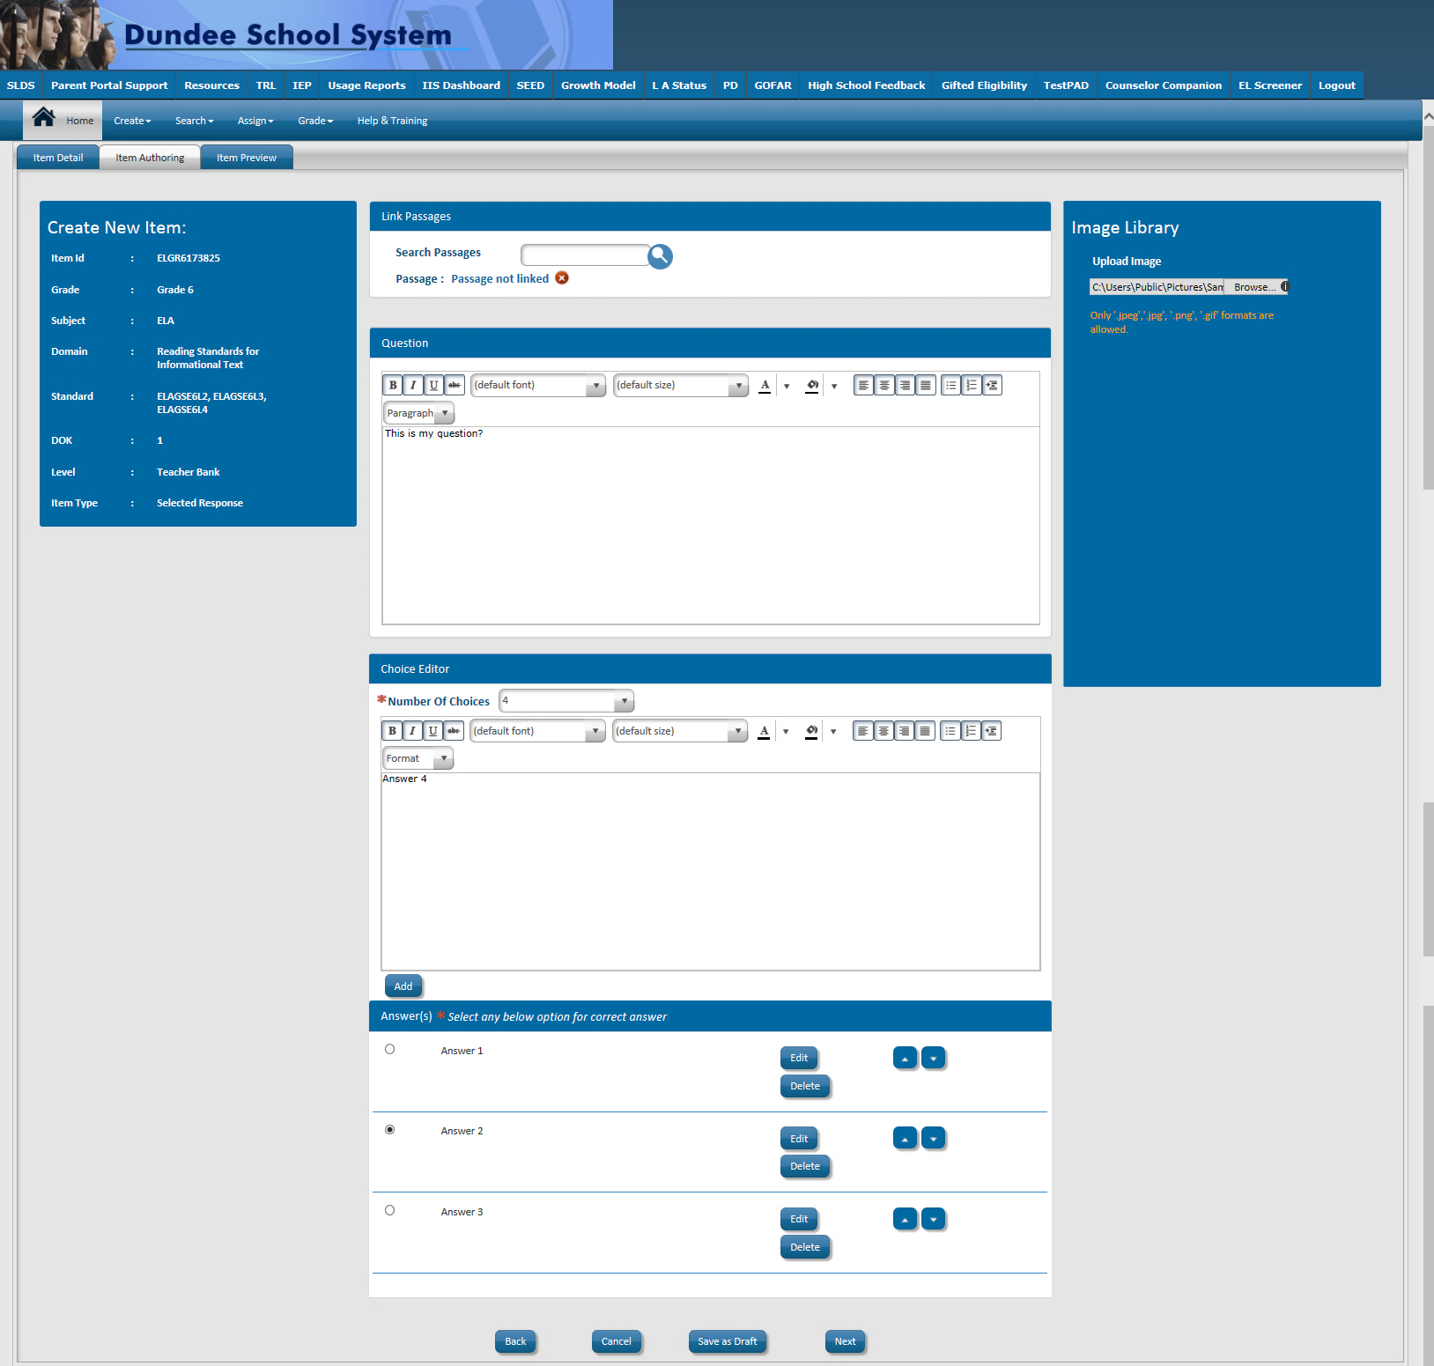
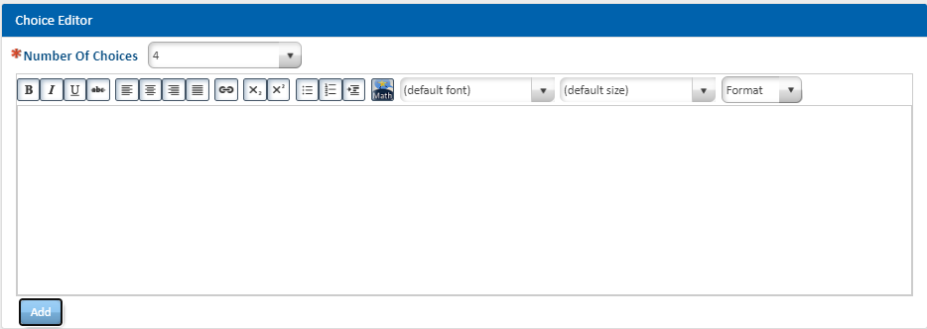
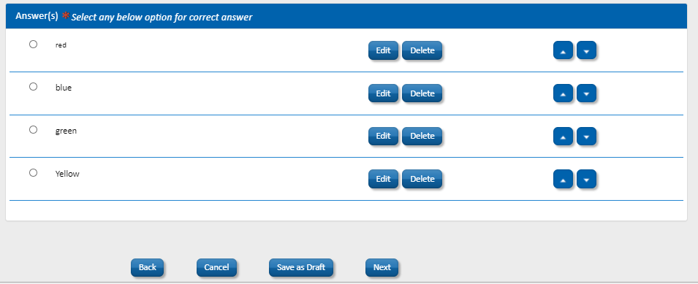
Item Creation – Item Authoring Screen

Slide 56
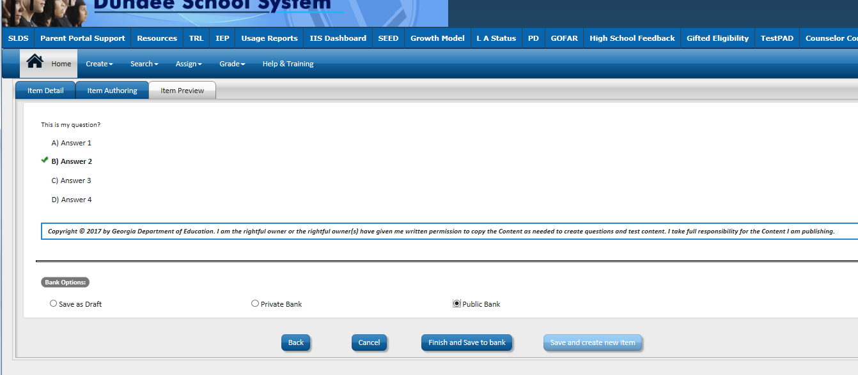
Item Creating – Item Preview Screen
Save as Draft, Private and Public Banks
Notes:
When creating an item, you can save as draft or into your own private bank or in the Public Bank for others to access.

Slide 57
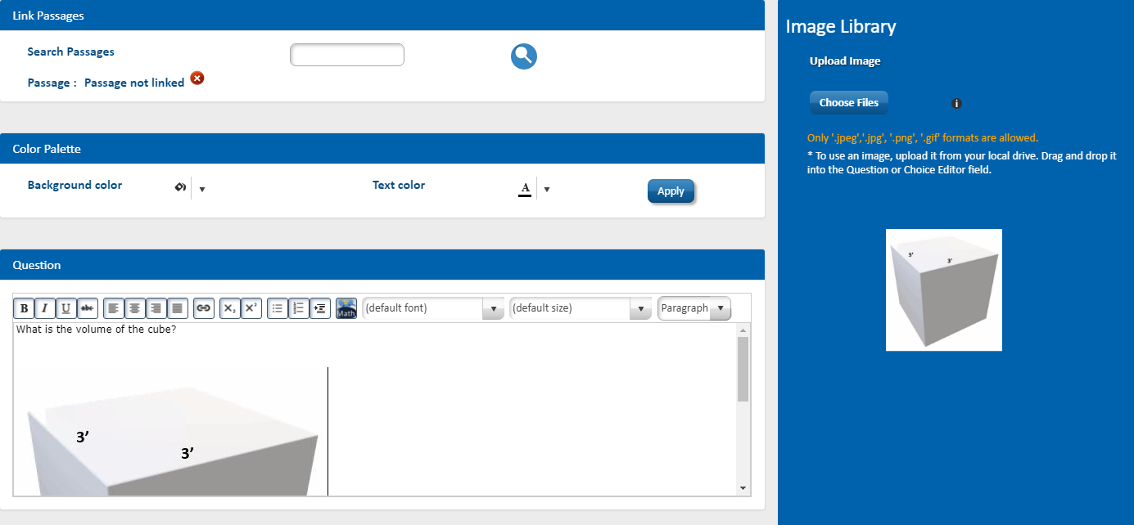
Item Creating – Insert Image
Click Choose Files
Select your file from your computer
Drag and drop the image to the Question
Notes:
Images are easily inserted by uploading the image from your computer or dragging and dropping into the image library.

Slide 58
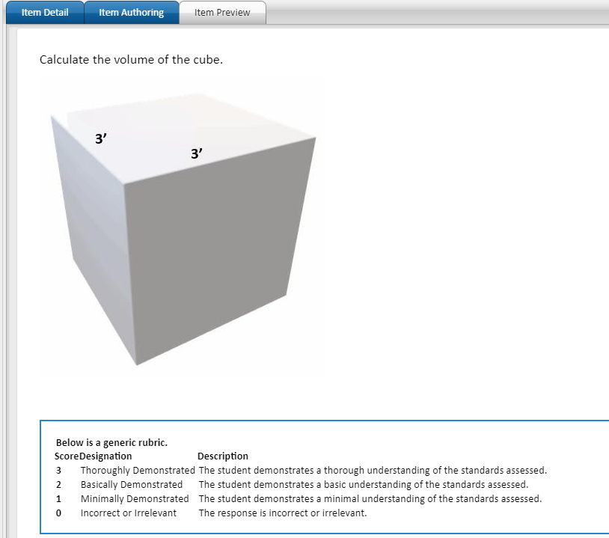
Item Creating – Item Preview Screen
Constructed Response Item
Notes:
After authoring, there is an item preview.

Slide 59
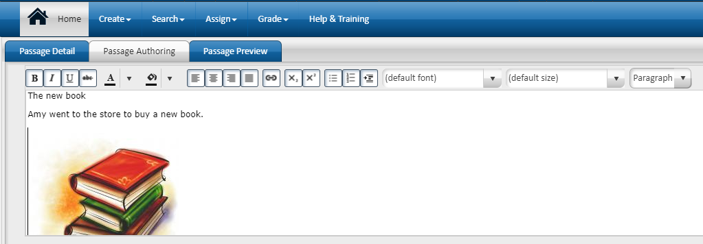
Create a Passage – Passage Authoring Screen
Notes:
Passages are created in a similar fashion. Text and images are added to the passage space.

Slide 60
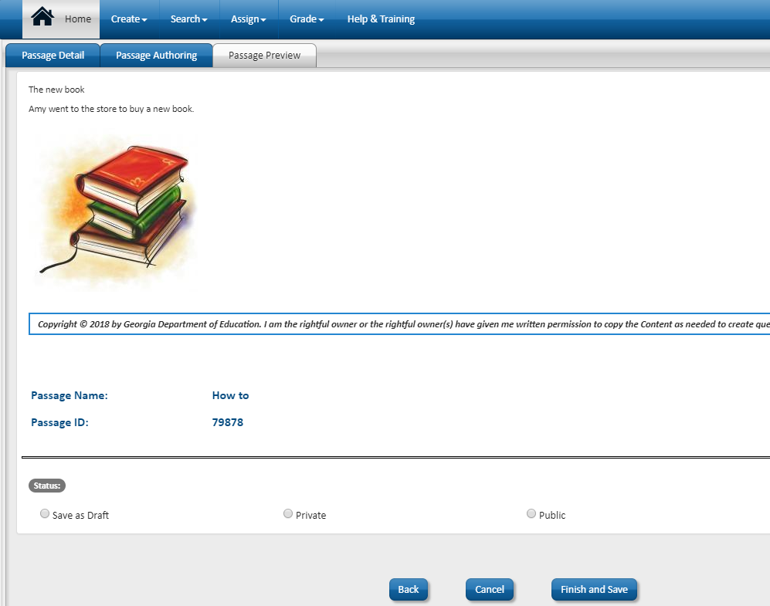
Create a Passage – Passage Preview Screen
Notes:
Passages then can be previewed and published. Users should remember the passage ID to easily attach to test items.

Slide 61
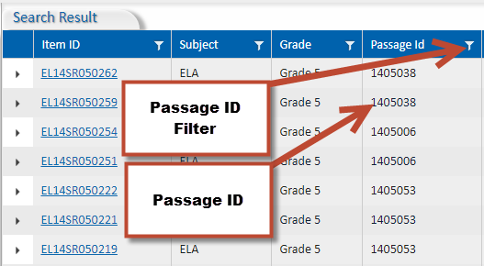
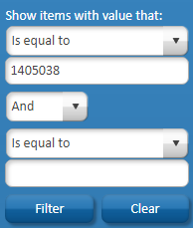
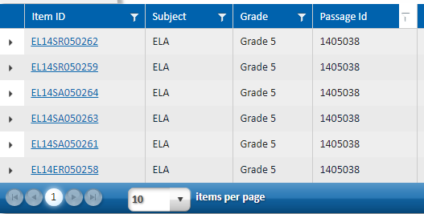
Passages in TestPad
To find more items with a passage, click on the Passage ID filter. Enter the Passage ID into the Is equal to box. Then click Filter.
You can now easily assign test items attached to the passage
Notes:
You can search for passages in TestPad by finding an item that has a passage attached, then filter for that passage ID. That way you can create a test with multiple items attached to a passage.

Slide 62
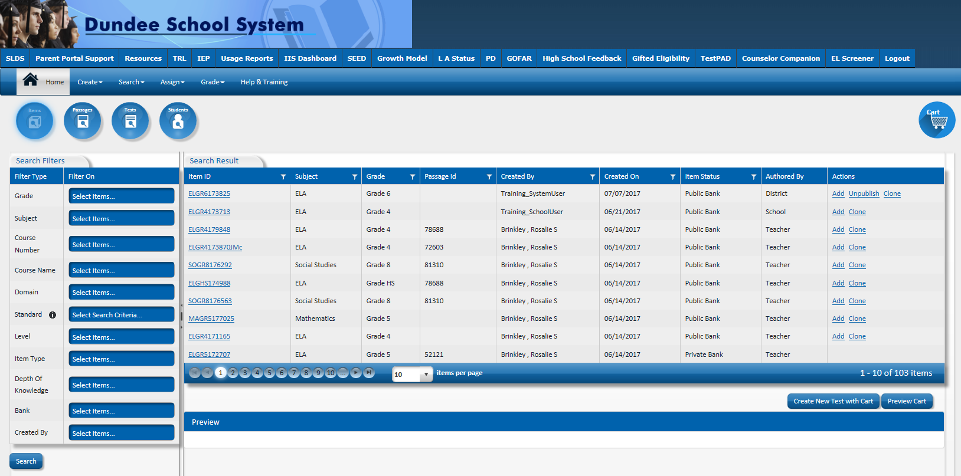
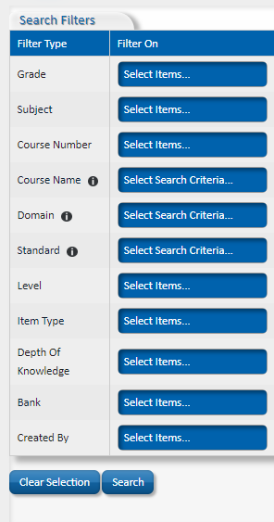
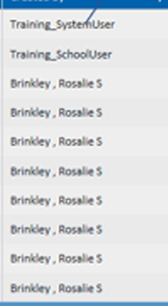
Item Bank
Standards for tested and non-tested courses
Items Created by state and users

Slide 63
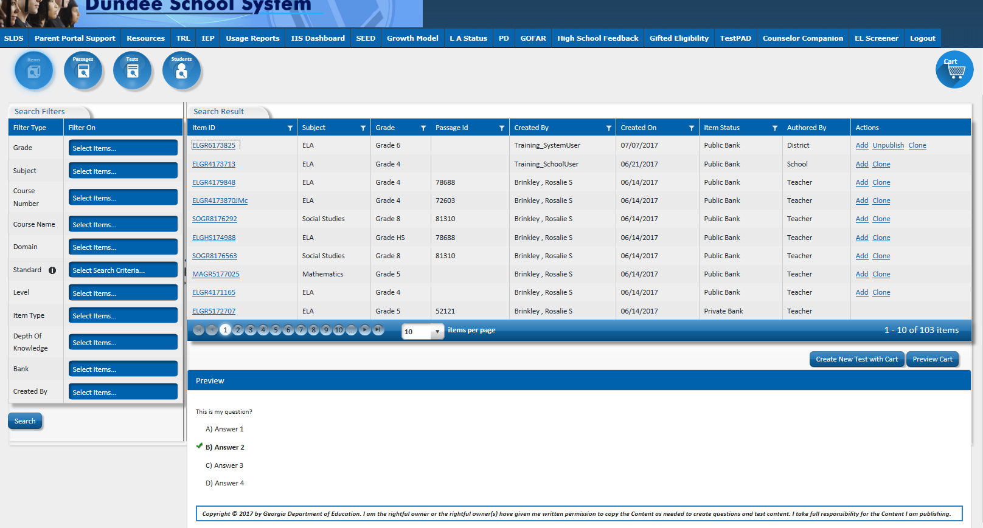

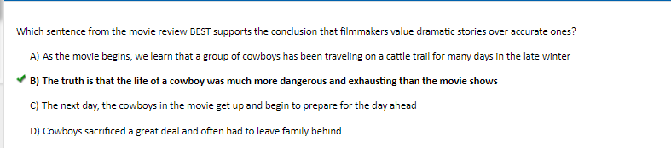
Preview an Item by Clicking on the Item ID

Slide 64
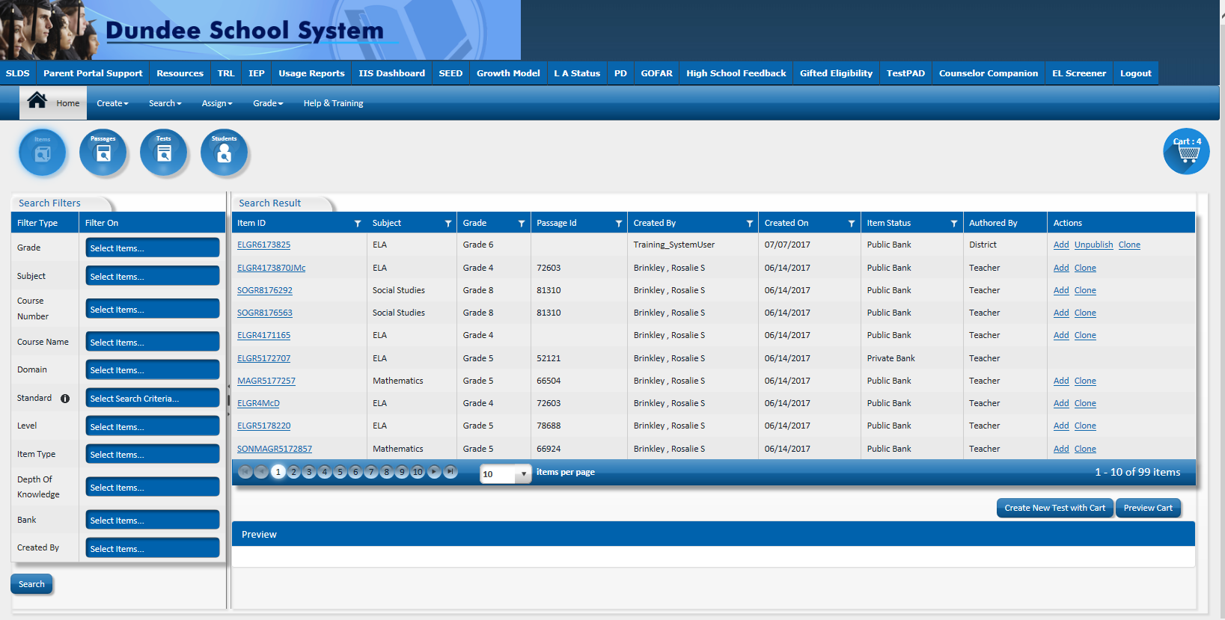
Add Items to a New Test
Notes:
Once you choose your item, you just click Add and they are added to the cart.

Slide 65
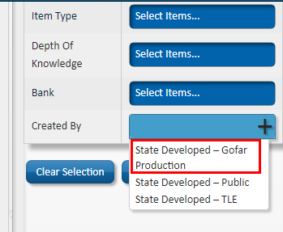
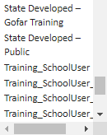
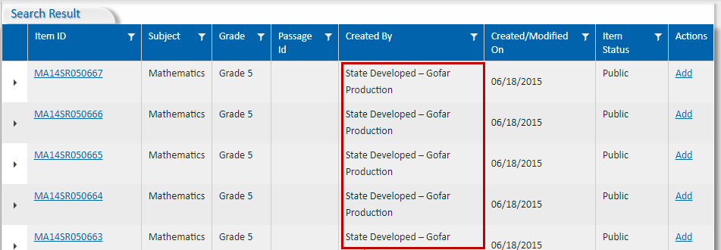
Using the Item Bank
Notes:
By selecting State Developed, you will only see items developed by the state. You can also choose other users if you want items by a certain author.

Slide 66
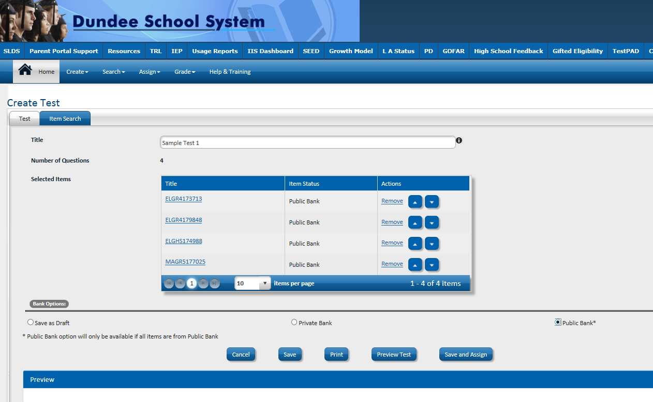
Create Test Screen
Notes:
Once you have your items, you can preview the test. You can also remove or reorder items on this screen.

Slide 67





Assign Test Screen
Notes:
There are 3 sections to the assignment process. The test information, test attributes and student information. Explain each of the attributes.

Slide 68

Manage Assigned Tests
Notes:
After tests are assigned, you can return to find the test and manage attributes or print the test roster.

Slide 69


Students Access TestPad via the SLDS Student Portal
Notes:
Students access TestPad via the SLDS Student portal

Slide 70

Students will see available TestPad assignments and can click “Take Assignment”
Notes:
Students will see only tests assigned to them. They just click on the assigned test.

Slide 71

Student View of TestPad Assignment
Notes:
Here is an example of how an item is presented for students in TestPad.

Slide 72

Reports are automatically generated as students turn in tests
Notes:
Reports are automatically generated for users as students complete tests.

Slide 73

Reports are automatically generated as students turn in tests
Notes:
This is an example of an item analysis report showing how student responded on each item.

Slide 74
Contact Information
TestPad Web Site
  http://www.gadoe.org/Technology-Services/SLDS/Pages/TestPAD-Training-and-Support.aspx
TestPad Training Site
  http://sldstrn.gadoe.org/SLDSDemoWeb/TP.aspx
Questions Regarding TestPad Content & School/System Usage
  Joe Blessing
  Program Manager - Georgia Milestones, TestPad
  404.232.1208
  jblessing@doe.k12.ga.us
Questions Regarding TestPad Functionality/Technical Support
  1-800-869-1011
  slds@doe.k12.ga.us

Slide 75
Educating Georgia

