Slide 1
Georgia Milestones
Testing Irregularities
Notes:
Welcome to the Georgia Milestones Testing Irregularities Video.

Slide 2
Topics
Reporting Protocol
Minimizing Risks & Handling Irregularities
Notes:
During this video, we will discuss the standard reporting protocol for irregularities. We will also talk about the occurrence of irregularities and how to handle these irregularities in your school.
This presentation is not designed to replace district-led test administration training or the other training requirements outlined in the Student Assessment Handbook.

Slide 3
Getting Ready
Participate in District Training
Read
Test Administrator Manuals
Review Student Assessment Handbook
Notes:
To get a complete understanding of the testing process and avoiding irregularities, it is important to:
Participate in district training
Read Test Administrator Manuals that apply to your school and
Review the Student Assessment Handbook

Slide 4
Reporting
Protocol
Examiner
or
Staff Person
contacts School Test Coordinator
School Test Coordinator informs
System Test Coordinator & Principal
System Test Coordinator contacts Assessment Division
Notes:
Testing Irregularities represent deviations from standard test security and test administration procedures.
Irregularities can occur inside and outside of the testing environment.
It is the responsibility of all personnel in the local system to follow reporting protocol as they become aware of testing irregularities.
The standard reporting protocol requires that any testing irregularity to be handled immediately. To ensure these matters are dealt with quickly the examiner or other staff person must tell the School Test Coordinator as soon as possible.
The School Test Coordinator must then let the System Test Coordinator know that a possible testing irregularity has occurred.
The System Test Coordinator is required to contact the Assessment Specialist in the Assessment Division.

Slide 5
Reporting
The School Test Coordinator must provide information to the System Test Coordinator that details:
What happened
Who was involved
To what degree was the student disadvantaged or advantaged
What information supports the district’s recommendation(s) or conclusions (e.g., written statements, video…)
Notes:
The System Test Coordinator uses the information that you provide when talking with the assessment specialist and to complete a testing irregularity form in the MyGaDOE Portal.
It is important to share details about what happened about:
Who was involved in the incident.
To what degree was the student or students involved in the situation disadvantaged or advantaged.
What evidence supports the district’s recommendation(s) or summary of the incident.
When incomplete information is submitted, the district’s Assessment Specialist may reject the testing irregularity form and ask the System Test Coordinator to answer key questions and provide additional documentation.

Slide 6
Documentation
School Test Coordinator tells the System Test Coordinator about an irregularity
A student left the classroom unsupervised
School Testing Coordinator was required provide proper documentation
Notes:
Let’s review the typical kind of incident description that would be rejected because it did not address key questions.
In this scenario, The School Test Coordinator tells the System Test Coordinator that an
Examiner allowed a student to leave the classroom unsupervised
The System Test Coordinator asked the School to summarize the incident and provide supporting documentation.

Slide 7
Documentation
Ms. Smith allowed Malcolm Jacobs to walk unsupervised to the office prior to the break.
He was away for 10 minutes. Video shows he went straight to the office
While in the office, he did not have access to electronic equipment or test related content.
He completed his test before the examiner called time (see examiner’s statement).
Notes:
In this situation, we know that Malcom Jacobs was unsupervised during the test administration. Now we need to provide additional details to give a more complete description of the incident. Now we can see that he was away from the testing environment for 10 minutes. He did not have access to test related content because the video showed he went straight to the office. Finally, he completed the test in time so he wasn’t disadvantaged by the time he was away from the test. This gives the system Test Coordinator and the state assessment specialist all of the information needed to determine how to respond to the situation.

Slide 8
Accommodation Error
Minimize Risks
Examiners should know what accommodations students are scheduled to receive prior to testing
Review daily schedules of students with extended time
Should sessions begin earlier to avoid conflicts with lunch and school dismissal
Examiners should ensure they have space for accommodated materials and assistive technology
Headsets
Braille Booklets
Large monitors
Adaptive keyboards
Notes:
Now lets talk about ways to avoid testing irregularities. Test Examiners should know exactly which accommodations students are scheduled to receive and how to implement the accommodation. Test Coordinators should also manage the testing schedules so that there are no conflicts with lunch or dismissal and that Test Examiners are aware of students that need extended time. In addition, Test Examiners should have all of the materials needed for accommodations such as headsets, special booklets, large monitors or other forms of assistive technology.

Slide 9
Read-Aloud
Minimize Risk
Proper management of online sessions
Verify students have functioning headsets
Verify computer sound is working properly
Students should tell their examiner if sound is not working.
Verify the correct TTS accommodation appears on Test Tickets
Notes:
Let’s ensure that students who receive a read-aloud accommodation receive an error free administration. Test Examiners should check to make sure that headsets are working properly and sound is functioning on the computer. Students should be told to raise their hand and tell the examiner if sound is not working. It is very important that Test Examiners verify that the correct TTS accommodation appears on test tickets.

Slide 10
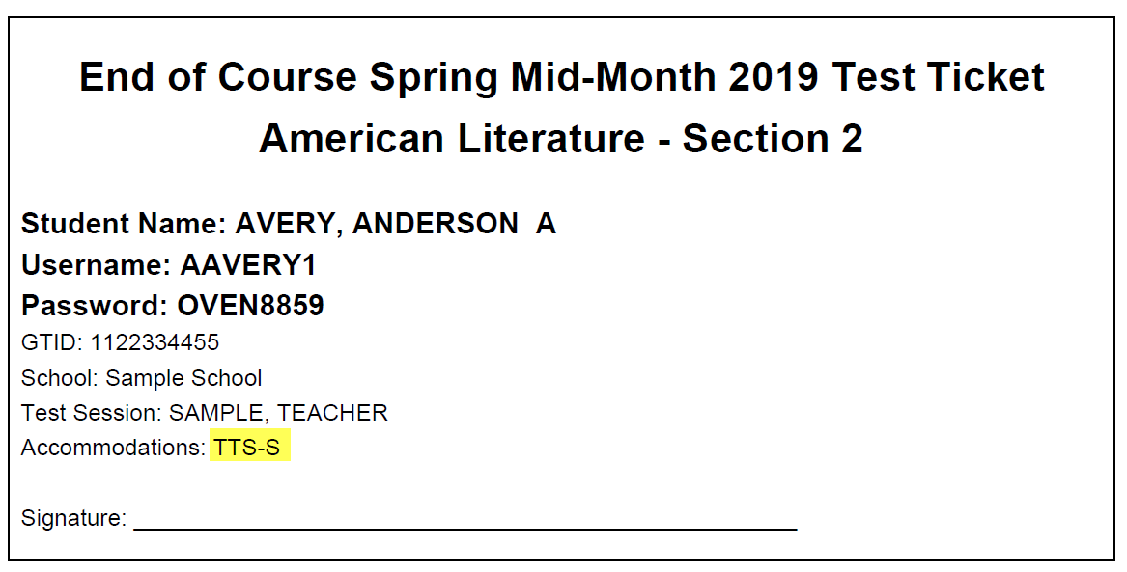
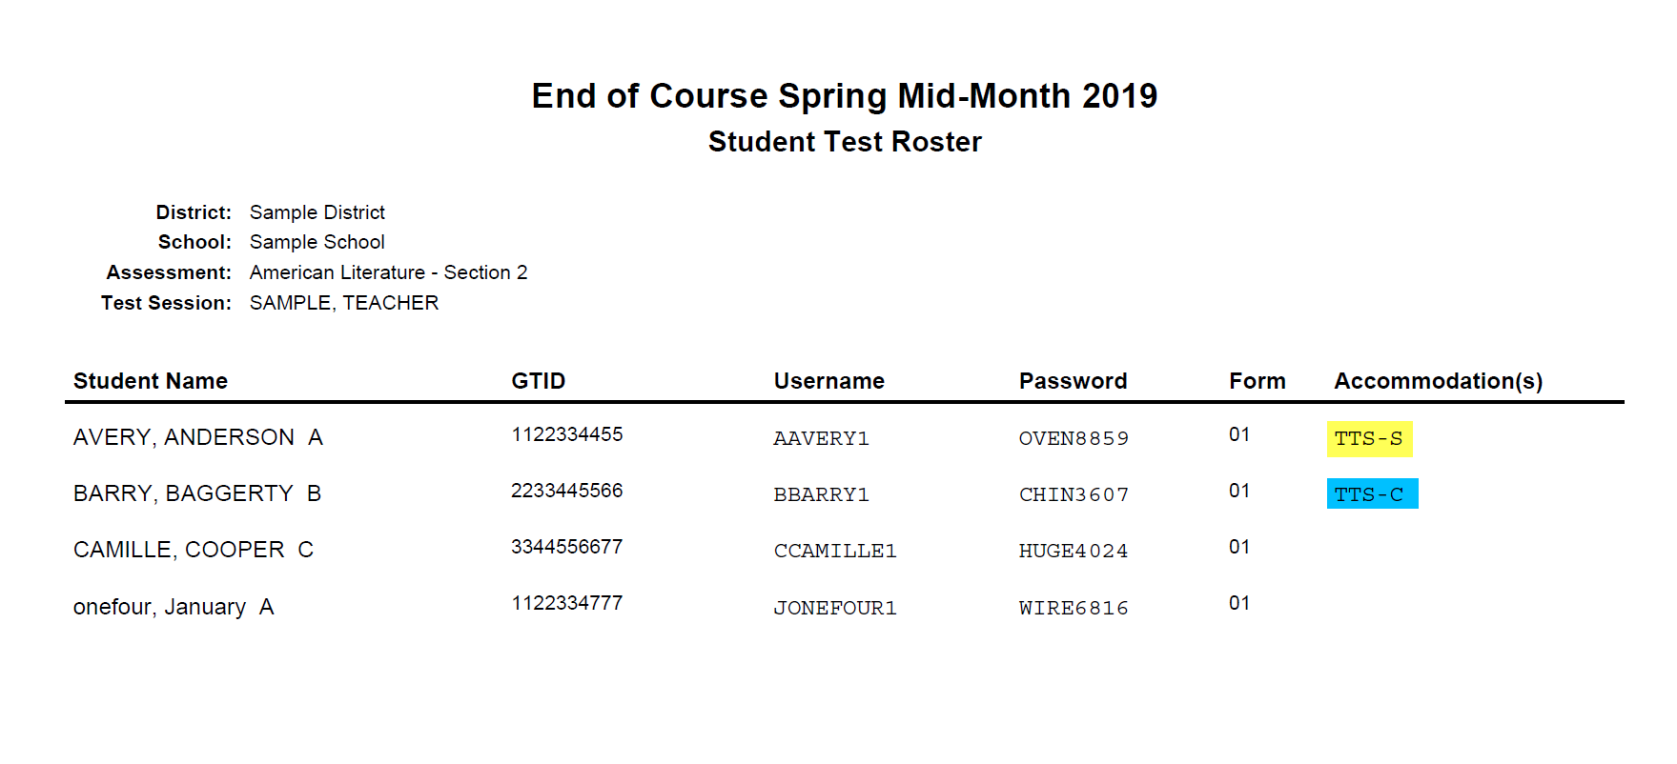
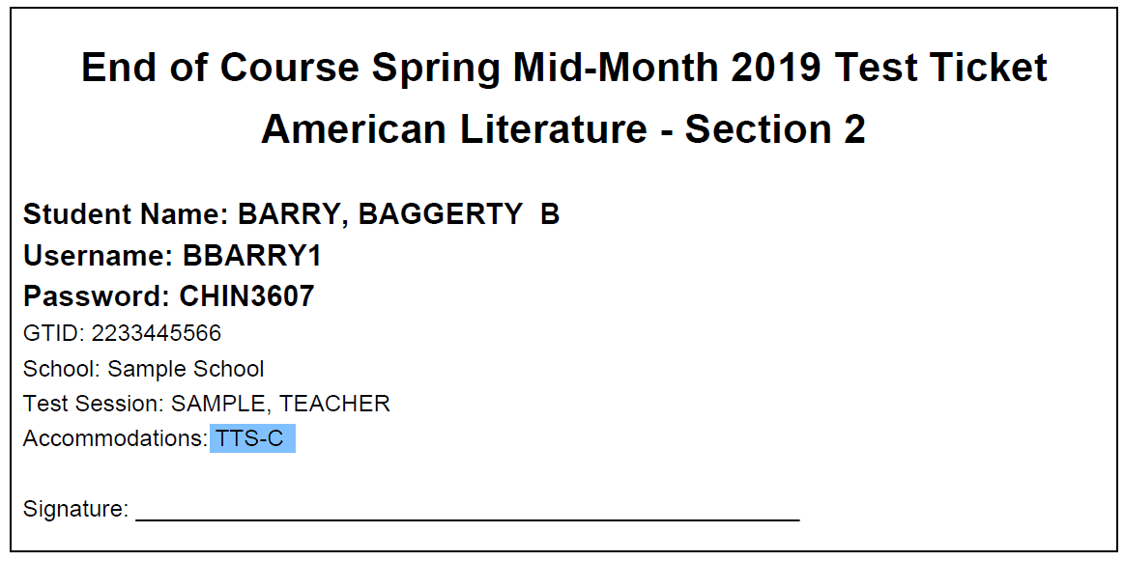
Read-Aloud
TTS-S = Standard Read-Aloud
TTS-C = Conditional Read-Aloud with passages
If an error is caught and corrected, give the student updated test tickets before they log in to the test.
Notes:
Test Examiners should know that the test roster and test ticket should show TTS-S for the standard read aloud accommodation and TTS-C for the conditional read-aloud that includes the passages. If the tickets are incorrect, the Test Examiner should contact their Test Coordinator. The Test Coordinator will need to update the accommodation in eDIRECT, print out new test tickets and begin testing. IF the student begins testing before the error is discovered, the Test Coordinator will need to contact the A ystem Test Coordinator.
Test Examiners should examine test tickets for all students to ensure that the name and GTID are correct for the student.

Slide 11
Cell Phones & Electronic Devices
Minimize Risk
Families should know that cell phones and smartwatches are prohibited in the testing environment
Actively monitor test sessions
Post “No Cell Phone” sign
Simple possession can be addressed per the system’s code of conduct
Devise a method to collect and redistribute these devices
Notes:
Cell phones and other electronic devices can interfere with testing and possibly give students access to test content during testing. In order to minimize this risk, schools should let families know that cell phones and smart watches are prohibited in the testing environment. Test Examiners should always be monitoring the test environment actively walking around the classroom at all times. The Test Examiner should display the No Cell Phone sign outside the classroom. If a Test Examiner notices that the student has a device but didn’t access the device, they can simply take the device and allow the student to continue testing. School Test Coordinators should have a school plan for collecting and redistributing electronic devices.

Slide 12
Districts Examples
Raffle Ticket Method
Label Plastic Bag
Assign a pair of raffle tickets to a student
Give the student a ticket and place the matching ticket in a bag with the phone
Return phones to students who have corresponding ticket after testing
Have students place their name on a bag
Students insert their phone into the bag
Return the phone to the respective student after testing
Notes:
One method for collecting cell phones is to place the cell phone in a plastic bag with a raffle ticket and give the student a matching raffle ticket. Another method would be to have students place their name on the plastic bag with the phone or device.

Slide 13
What to Do
Confirmed Cheating
Suspected Cheating
If confirmed, the examiner, must with minimal disruption:
collect the device,
stop testing that student,
remove the student from the testing session, and
notify the School Test Coordinator immediately.
If suspected, but not confirmed, the examiner must with minimal disruption:
collect the device,
allow the student to complete testing,
notify the School Test Coordinator immediately, and
when appropriate attempt to confirm whether or not the device has been used in violation of the guidelines.
Notes:
What to do if the Test Examiner confirms that the student accessed the electronic device during testing. If the examiner determines that the student used the device to cheat or share test content, the examiner should collect the device, and remove the student from the test environment. However if the Test Examiner only suspects that the student cheated, they should collect the device and allow the student to complete testing. When appropriate, the Test Coordinator should investigate if the student was advantaged by having the device during testing.

Slide 14
What to Do
If a student is too ill to begin testing, allow them to make-up their test
If a student gets sick between test sections, allow them to complete their test on a make-up day
If a student gets sick while testing, contact your System Test Coordinator
Notes:
Now lets look at what to do if a student becomes ill during testing. If the student is sick before a test or between test sections, simply require these students to take their test on a makeup day. No coding will be required. If a student gets sick in the middle of a test section, you should contact your system Test Coordinator for direction.

Slide 15
Online Testing Interruption
Minimize risks
Ensure other online, instructional activities will not compete for bandwidth with testing
Perform readiness checks prior to and, where applicable, during testing.
Ensure test content, including TTS, has been downloaded to COS before testing.
Share online troubleshooting tips with examiners
Provide contact information for local technology support
Watch weather forecasts to determine potential impact
Notes:
It is best to minimize risks caused by online testing interruptions before testing. Schools should ensure that other online activities will not compete for bandwidth necessary for testing. The district technology team should perform readiness checks and download test content including TTS to the COS before testing. Examiners should be aware of troubleshooting tips and have contact information for technology support. Finally, watch the weather to determine potential impact to testing.

Slide 16
What to Do
If you encounter connectivity issues
During testing, use the appropriate troubleshooting tools available to correct the issues. If problems persist your System Test Coordinator will use their best judgment as to whether to allow students to continue testing
Examiners should keep track of the amount of time students are owed
If appropriate, contact DRC Customer Service: 866-282-2249
Notes:
If you do encounter connectivity issues during testing, use the appropriate troubleshooting tools available to correct the issues. If problems persist, your System Test Coordinator should use their best judgement to determine whether to allow the student to continue testing. Examiners should keep track of time lost so when connectivity returns, students can have the balance of their time. If appropriate, call the help desk for additional assistance.

Slide 17
Staff Misconduct
Minimize Risks
Give Examiners manuals to review before testing
Remind examiners to follow the script in the Test Administrator’s Manual.
Inform examiners that they can answer students’ procedural questions
Handling Situation
Staff that become aware of misconduct should follow reporting protocol
A referral to the Georgia Professional Standards Commission for disciplinary action may result.
Notes:
Lets discuss ways to minimize irregularities caused by staff misconduct. Test Coordinators should ensure that all staff have been trained on proper testing procedures. You should give the Test Examiners access to the Test Administrator's Manual well before testing. The manual is posted online for easy access.
Examiners should follow the script as it is written. Examiners can answer procedural questions but they cannot do anything that would cue a student to the correct response. Examiners should review all of the content regarding security in the Administrator's Manual. Staff members should contact the Test Coordinator as soon as they become aware of suspected misconduct. The School Test Coordinator should contact the System Test Coordinator who will inform the Assessment Specialist at the Georgia Department of Education. Referrals to the Georgia Professional Standards Commission will be made if necessary.

Slide 18
Failure to Follow Directions
Minimize Risks
Ensure students and examiners understand test directions
Examiners and students should understand how additional time is allocated in increments to actively engaged students.
Experience Online Testing Georgia
www.gaexperienceonline.com
Notes:
Lets talk about how to minimize irregularities regarding directions. Test Examiners and test takers should be given the opportunity to review the format of the test and the test directions. Examiners should review test manuals and contact their School Test Coordinator if there are any questions. Students should have an understanding of time limits and Test Examiners should make students aware of how much time is left during testing. Students, teachers and parents can go to Experience Online Testing Georgia and the Secure Practice Tests to become accustomed to the test.

Slide 19
Test Features
Tell students about the symbols they must follow.
No-Calculator Online Warning
No-Calculator Paper Warning
End of Test Section
Notes:
Lets look at the features that are built into the Georgia Milestones. Examiners should help students become familiar with these symbols. Examiners should let students in grades 6-12 know that they will see the no calculator symbol in section 1 part A. Once students go beyond this section, they will not be able to return. Students should also be aware of how to end a test when they are finished. Students should be comfortable with the online program and format of the test before logging in to take Georgia Milestones.

Slide 20
Thank You
Notes:
In this video, we reviewed the steps School Test Coordinators and Test Examiners need to take to get ready for testing, We reviewed the standard reporting protocol that must be followed by school staff, and we looked at ways to avoid common irregularities.
If you have questions about the content of the video please let your System Test Coordinator know so that he/she can reach out to your district’s assessment specialist for clarification.
Thank you.

