Slide 1
Georgia Milestones School and District Reports
Notes:
The Georgia Milestones Assessment System offers a variety of reports for districts, schools, parents and students.

Slide 2
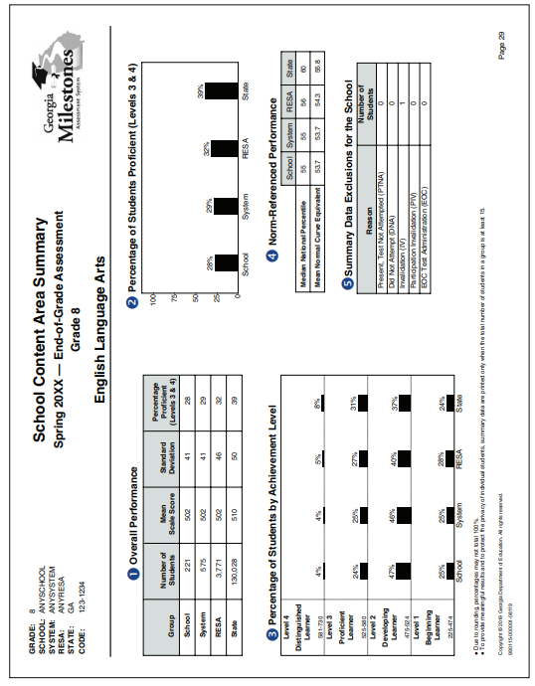
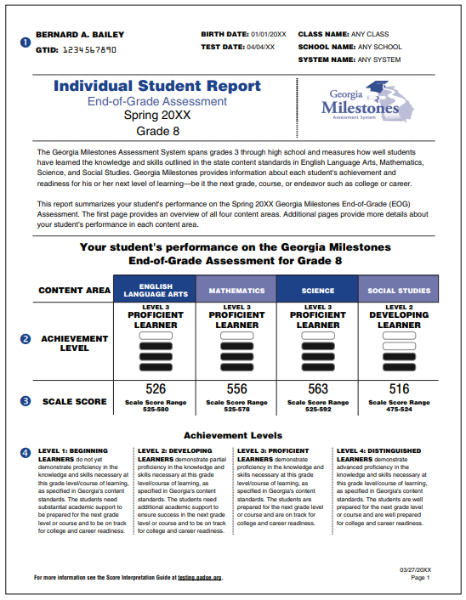
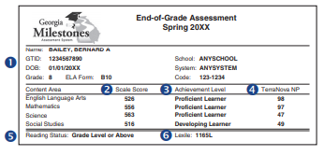
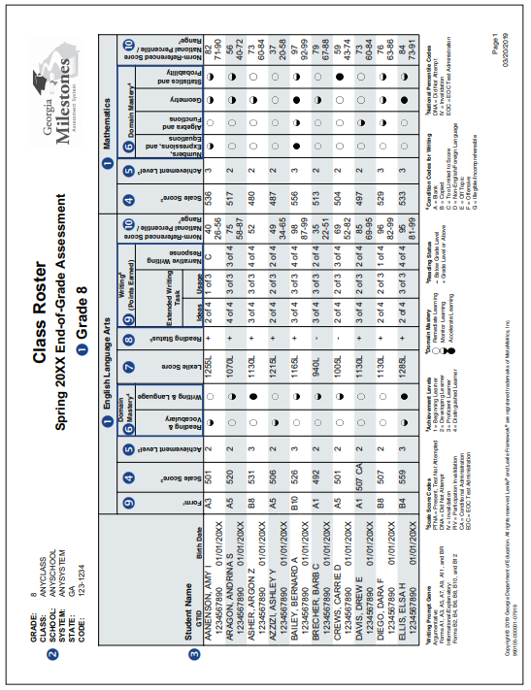
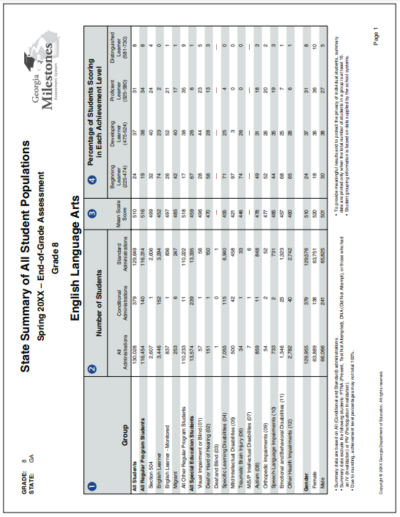
Georgia Milestones School and District Reports
Notes:
This presentation focuses on school and district level reports.

Slide 3
Spring Reporting Timeline
Embargo
Test Window Opens
Test Window Closes
Preliminary Reports
Final Reports
Public Release
Results in SLDS
Science and Social Studies begin 5 days after testing
ELA and Math begin 11 days after testing
Updated daily
Notes: Turnaround times are in effect after a representative state sample is achieved. Initial ELA reports may also be delayed if post-equating is necessary.
Available electronically approximately 3 weeks after window closes
Paper reports are delivered in mid-July
Note: To allow for comparison data with a representative group, final reports for midmonth EOCs are produced with the main administration.
Third week
of July
Student scores are loaded 2 weeks after the final electronic data file
Student PDF reports are posted late-July to mid-August
Note: 2018-19 is the first year that student ISRs will be loaded to the SLDS. These are expected to be in production soon.
Notes:
Georgia Milestones reports are delivered immediately after scoring. Science and Social Studies reports post 5 days after testing and ELA and Math reports post 11 days after testing. ELA and Math take additional time due to scoring of constructed response items. Final reports with comparison data are produced three weeks after the testing window closes. The Public Release is the third week of July. Scores are posted in SLDS 2 weeks after the data file is posted and PDF reports are posted in late July to mid-August.

Slide 4
Types of Reports
Student
Class
school
district
state
Individual Student Report
Student Score Labels
Class Roster and Summary
Remediation & Retest Roster
Content Area Summary
Population Summary
LCE Roster
Content Area Summary
Population Summary
District Data File
Content Area Summary
Population Summary
Notes:
Various reports are designed and distributed at the Student, Class, School, District and State Level

Slide 5
Report Format and Location
Report | Paper | Online
 |  | eDIRECT | MyGaDOE Portal | SLDS
Individual Student Report
Student Score Labels
Class Roster & Summary
Remediation & Retest Roster
Local Coding Error (LCE) Roster
Content Area Summary Reports*
Population Summary Reports*
District Data File
F
B
F
F
B
B
P
F
F
B
F
*Summary Reports are not produced for the EOG Retest.
P
Preliminary
F
Final
B
Both Preliminary and Final
Notes:
Reports are distributed through the eDIRECT and MyGaDOE portals. The Individual Student Reports are also shared in the SLDS for parent access. Paper reports are shipped directly to school districts.

Slide 6
General Report Information
Report | Scale Score and Achievement Level | ELA Lexile and Reading Status* | Extended Writing and Narrative Writing | Domain Mastery | National Percentile Rank
Individual Student Report | ✓ | ✓ | ✓ | ✓ | ✓
Student Score Labels | ✓ | ✓ |  |  | ✓
Class Roster & Summary | ✓ | ✓ | ✓ | ✓ | ✓
Remediation & Retest Roster* | ✓ | ✓
Content Area Summary Reports | ✓ | ✓ | ✓ | ✓ | ✓
Population Summary Reports | ✓
District Data File | ✓ | ✓ | ✓ | ✓ | ✓
*The Remediation & Retest Roster includes the reading status but not the Lexile score.
Notes:
Georgia Milestones shares a series of reports with a wide variety of information. Most reports include scale score and achievement levels, Lexile and reading status, extended and narrative writing information, along with domain mastery and national percentile rank.

Slide 7
Intended Audience
Report | Student/Parent | Teacher | School Administrators | System Administrators | Board Members
Individual Student Report | ✓ | ✓
Student Score Labels |  | ✓ | ✓
Class Roster & Summary |  | ✓ | ✓
Remediation & Retest Roster* |  | ✓ | ✓
Content Area Summary Reports |  |  | ✓ (School/System) | ✓ (School/System) (District/State) | ✓ (District/State)
Population Summary Reports |  |  | ✓ (School/System) | ✓ (School/System) (District/State) | ✓ (District/State)
District Data File |  |  |  | ✓
*The Remediation & Retest Roster includes the reading status but not the Lexile score.
Notes:
Each of the reports are intended for a specific audience. Students and Parents receive student scores on individual student reports. Teachers receive student and class level information. School administrators can view data from the student and class level data with comparisons with the district and state. System administrators can view compare schools within their district as well as district level information in comparison with state scores. There are also Content and Population summary reports that are appropriate for sharing with school board members.

Slide 8
Communicating Test Results
Summary Reports are embargoed until they are released by the GaDOE.
Do not share embargoed data at public board meetings or with the media until the GaDOE releases data for that program.
Do share with parents, students, teachers and staff related to the student as soon as they are received.
Notes:
District should not share embargoed data with the public. However, embargoed data can be shared with parents, students and staff related to the student. Districts can share Individual Student Reports with parents and class reports with teachers and school administration.

Slide 9
Communicating Test Results
Preliminary Reports Can Be Shared
Preliminary individual student data
Preliminary EOC student reports
counts as 20% of the course grade
may be reported to parents/guardians and students
Preliminary EOG student reports
promotion determinations for Grades 3, 5, and 8 based on state rule or local policy
may be reported to parents/guardians and students
Class rosters can be shared with teachers and administrators
Inform school and system level staff how results will be distributed to parents
Be sure summer school staff know reporting timelines
Notes:
Milestones EOG scores can affect promotion and retention decisions. EOC scores count as 20% of the grade. These reports can be shared with parents and students. Districts and schools should have a plan for sharing this information with identified parties.

Slide 10
EOG Sample School and District Reports
Notes:
Next, we will show some examples of Georgia Milestones reports.

Slide 11
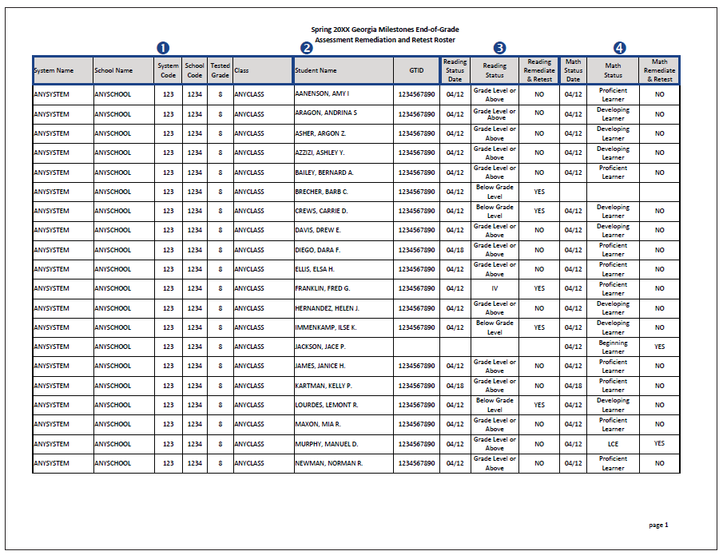
Remediation and Retest Roster
Reading status and remediation/retest status
System, school, and class information
Math achievement level and remediation/
retest status
Student names and GTIDs for all students in grades 3, 5, and 8
Notes:
Remediation and Retest Roster Reports are generated at the school level for all students who tested in grades 3, 5, and 8. These reports indicate whether or not a student could receive remediation in ELA and/or mathematics and be provided the opportunity to retest during the summer EOG administration.
To be eligible for a retest in ELA, students in grade 3, 5, and 8 must have a reading status designation of Below Grade Level. For students in grades 5 and 8, retest eligibility for mathematics is defined by attaining an achievement level designation of Beginning Learner.

Slide 12
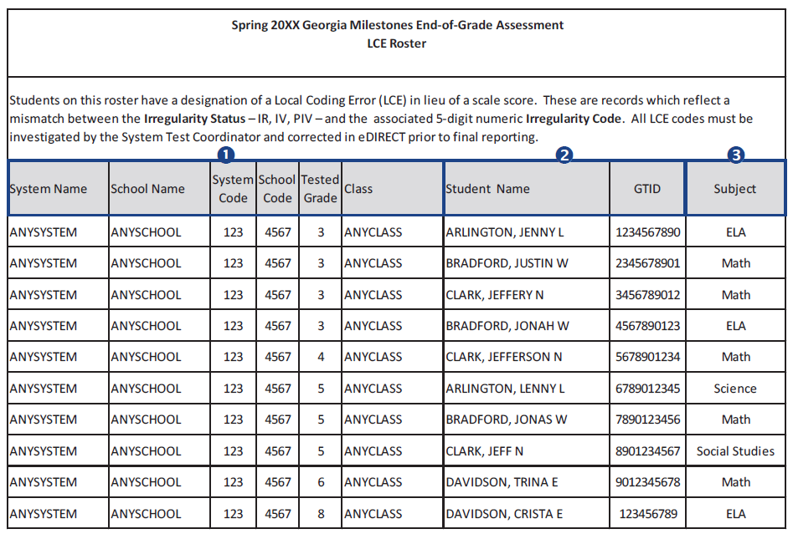
Local Coding Error (LCE) Roster
Subject area with the error code
System, school, and class information
Student names and GTIDs for cases with an error code
Notes:
LCE Roster Reports are generated at the system level and will include all students in the system who have an LCE. Students on this roster have a designation of a Local Coding Error (LCE) in lieu of a scale score. These are records which reflect a mismatch between the Irregularity Status—IR, IV, PIV—and the associated 5-digit numeric Irregularity Code. All LCE codes must be investigated by the System Test Coordinator and corrected in eDIRECT prior to final reporting. Students will remain on the LCE Roster until the LCE has been updated in eDIRECT. Otherwise, it will be replaced by an IV in the final report.

Slide 13
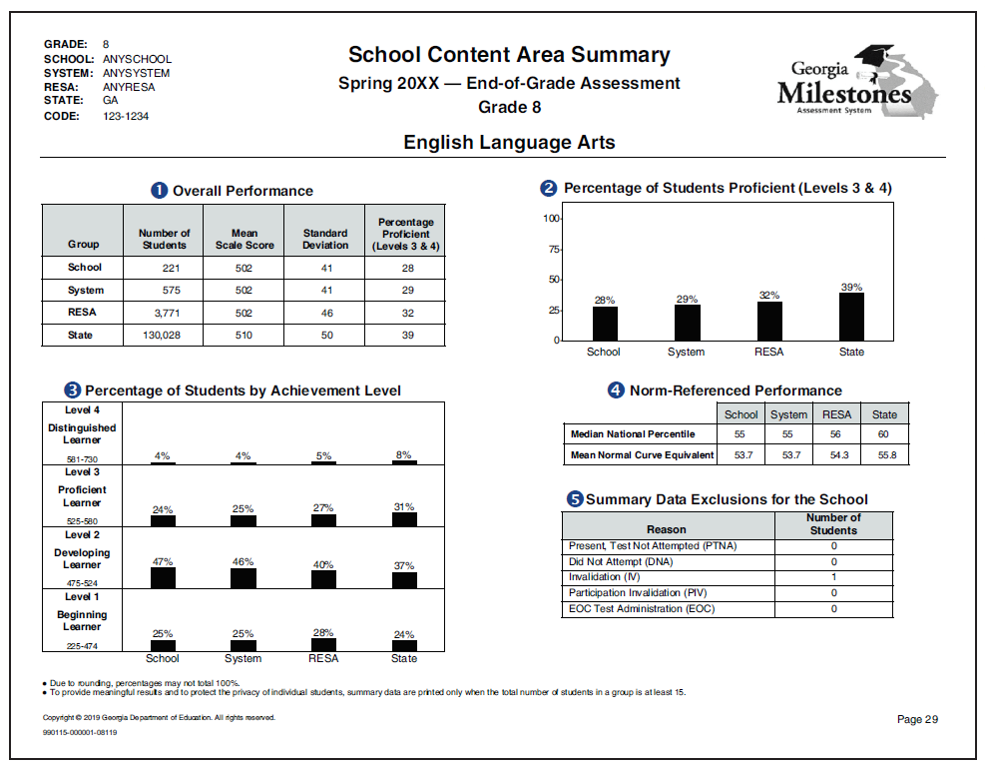
Content Area Summary (Page 1) School Level Example
School, system, and RESA
Grade and content area
Graph of the percentage of students at proficient and above for each reporting level
Mean scale score, standard deviation, and percentage of students proficient and above for the school, system, RESA, and state
National percentile rank and mean NCE for each reporting level
Number of students not included in summaries
Graph of the percentage of students at each achievement level for each reporting level
Notes:
Content Area Summary Reports are generated at the state, system, and school levels for each grade level and content area. Each of these reports contains similar information, but comparison data are presented at different levels of aggregation. The School Content Area Summary Report provides overall performance data and domain-level data for the school, system, RESA, and state. For percentage of students proficient, this school is 1% lower than the system, 4% lower than the RESA and 11% lower than the state.

Slide 14
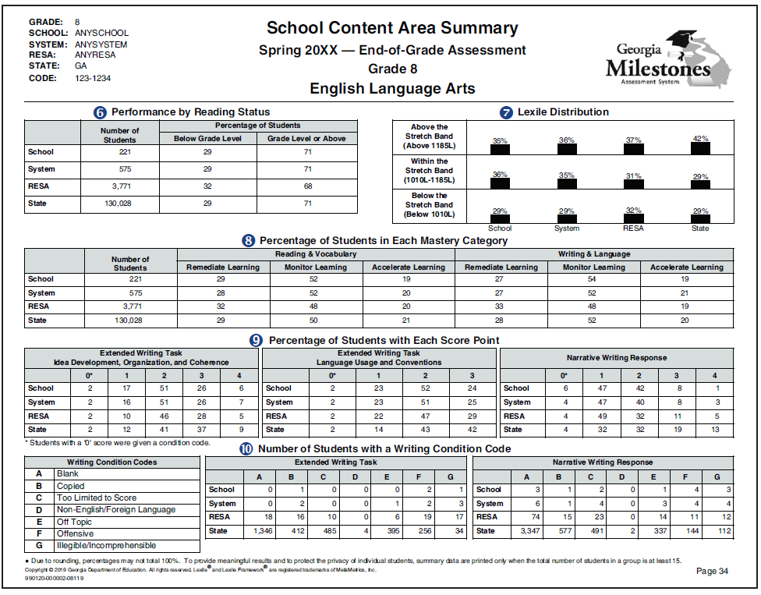
Content Area Summary (Page 2) School Level Example
Percentage of students in each Lexile stretch band for each reporting level (ELA only)
Reading status performance for each reporting level (ELA only)
Domain mastery performance for each reporting level
Percentage of students achieving each score point on the extended writing task and the narrative writing response for each reporting level
(ELA only)
Number of students receiving each type of condition code on the extended writing task and narrative writing response for each reporting level (ELA only)
Writing condition codes (ELA only)
Notes:
The second page of the Content Area Summary Report shows Reading Status, Lexile Distribution, Percentage of Students in each domain mastery category, Percentage of student with each score point. Number of students with a writing condition code. Also shown is the percentage of students achieving each score point on the extended writing task on the ELA assessment. For the Reading status, this school has 71 percent of the students at Grade Level or Above which is equal to the system and state but higher than the RESA.

Slide 15
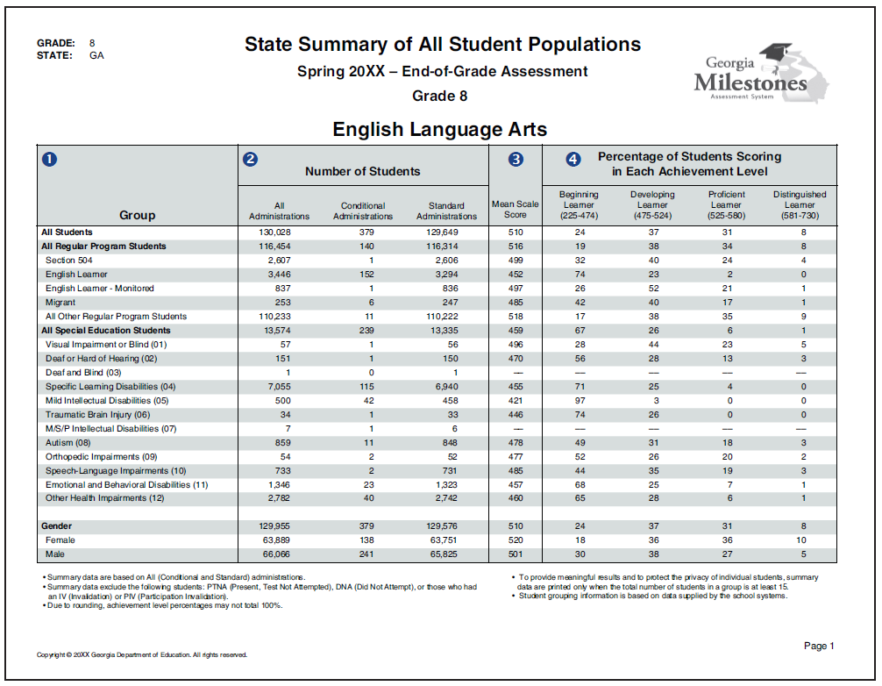
Population Summary (Page 1) State Level Example
Total number of students as well as the number of students with conditional or standard administrations
Grade and content area
Percentage of students in each achievement level
Reporting subgroup
Mean scale score
Notes:
Summary Reports of All Student Populations are generated at the school, system, and state levels. The reports are generated by grade level and content area and present summary statistics for all students as well as particular groups of students. These reports are produced for the spring main administration. This report shows data from an 8th grade ELA administration. There are 130,028 test takers with 129,649 standard administrations. The mean scale score is 510. Twenty four percent of students are in beginning learner, 37% in developing learner, 31 percent in proficient learner and 8% in distinguished learner. Additional information is available for reporting subgroups.

Slide 16
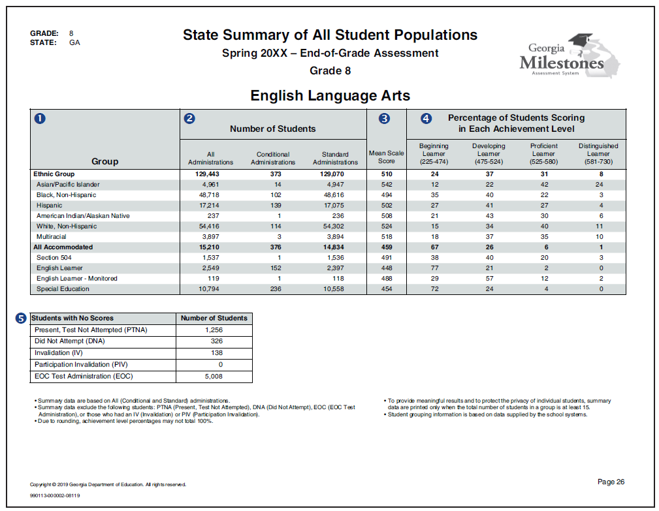
Population Summary (Page 2) State Level Example
Additional reporting subgroups
Number of students not included in summaries for each type of nonscore code
Notes:
Page 2 of the Population Summary Report continues with Group data along with numbers of students with nonscore codes. Students with no scores include Present, Test Not Attempted, Did Not Attempt, Invalidation, or Participation Invalidation.

Slide 17
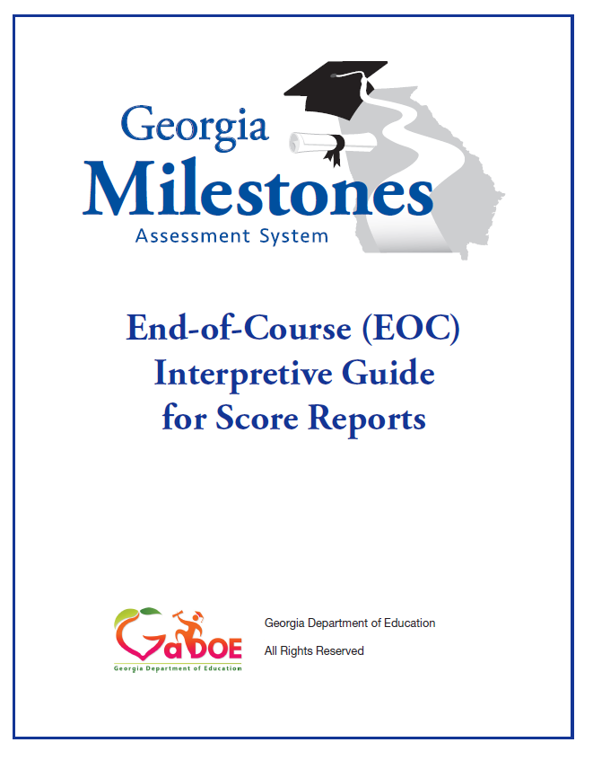
More Information on Scores
EOG
EOC
EOG Resources
EOC Resources
Notes:
More information on the Georgia Milestones score reports can be found on the EOG and EOC Score Interpretive Guides.

