Slide 1
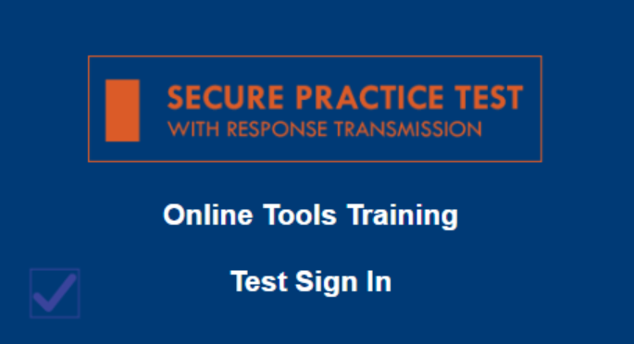
Where to Access TE Items
Experience Online Testing Georgia
Embedded by Grade Band
(3-5, 6-8, EOC) or
All TE Items
as a Separate Test
Secure Practice Test
Embedded by Grade Level
www.gaexperienceonline.com
Notes:
This demo will show the different types of new Technology Enhanced or TE items that will be field tested in the spring of 2019.
DO: Go to gaexperienceonline.com and log in.
SAY: I am going to log into Experience Online and show you just a few examples of the different types graphing and drag-and-drop items you may encounter on the test.

Slide 2
7
Notes:
Grade 6
Say: This is an example of a drag-and-drop item that asks you to order temperatures from coldest to warmest. Move the numbers that represent temperatures by clicking on a number and dragging it to the correct location.
Do: Drag the numbers into the boxes to incorrect locations (backwards).
SAY: If you think you have made an error, you can simply move the number outside of the box to remove it.
DO: Move two incorrect answers out of the boxes.
SAY: You can also replace a number by dropping another number on top of it.
DO: Replace numbers by dragging them on top of another.
SAY: The 'Reset All' tool allows you to remove all of the responses at once and start over.
DO: Click 'Reset All' to clear responses and insert correct responses again.

Slide 3
8
Notes:
Grade 6 Math
SAY: This next example is another drag-and-drop item that asks you to move and place equivalent expressions into the box. Notice you aren’t told how many equivalent expressions to place. In this example, you could place any where from one to all six expressions into the box. Given so, you must drag a response outside of the box to remove it. Placing an expression on top of another will not replace the response but rather add it to the box.
DO: Drag the correct expressions in the box.

Slide 4
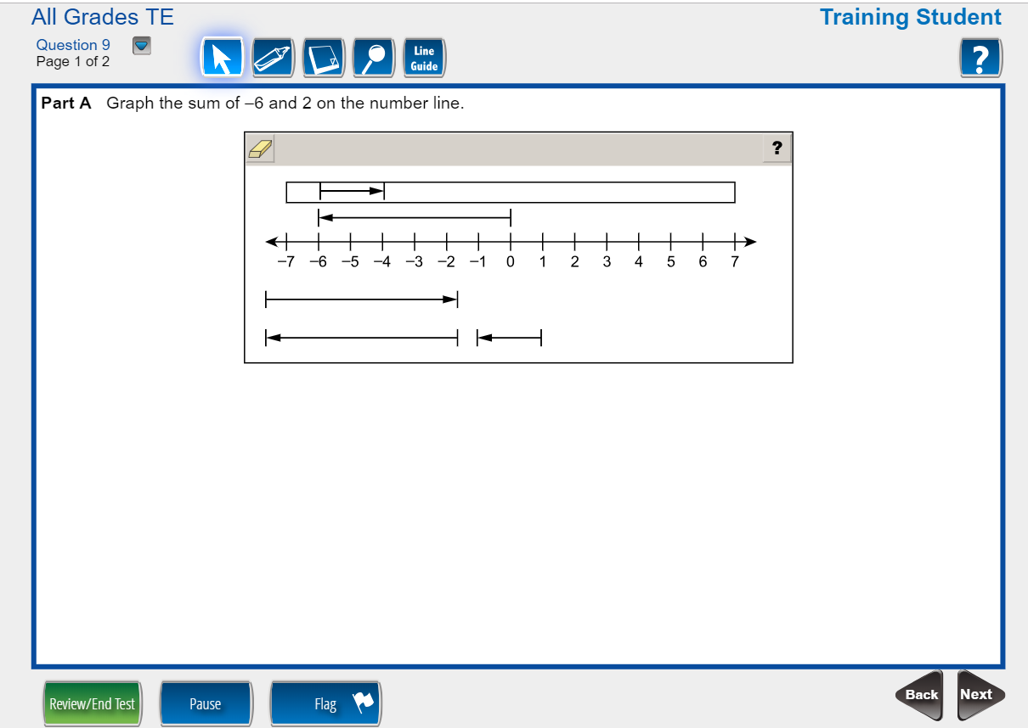
9a
Notes:
Grade 7 Math
Say: This example is a two part drag-and-drop item. The first part asks you to graph a sum on a number line by dragging and dropping the correct line into the correct location. To move the item, click on the desired arrow, and drag it to the correct location on the number line.
Do: Drag the correct line to an incorrect location on the number line.
SAY: You can move the line anytime by clicking and dragging it. You can remove the line by dragging it outside of the box, or replace it by dragging another line on top of it.
DO: Show moving the line outside of the box and replacing the correct line with another.

Slide 5
9b
Notes:
SAY: The second part of this item asks you to answer a standard multiple choice question. This was included to show you that some of the two-part Technology Enhanced items may have a second part that is different from the first.
Do: Enter the correct choice.

Slide 6
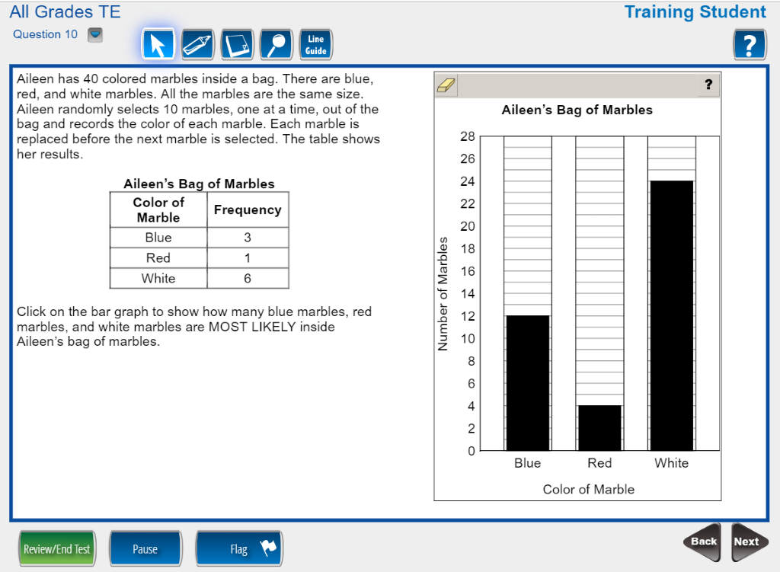
10
Notes:
Grade 7
Say: Here we have a graphing item that asks you to complete a bar graph. Simply click within the graph in order to create the bars. [Pause] Notice how the blue line appears as I hover over the graph. If you're using a touch screen, this line will not appear. Answers are easily changed by simply clicking in a new location within the graph.
DO: Enter the correct answers.
SAY: Remember, the 'Reset All' icon allows you to start over completely by removing all bars at once.
DO: Reset all then reenter correct answers.

Slide 7
11
Notes:
Grade Math 8
SAY: Here we have a graphing example with a different interaction than we've seen in the previous graphing examples. You are asked to graph a system of equations. Closed points are available to assist with graphing the line however it is not required that you use them. Notice again how a faint point appears as I hover around the graph. Click in the coordinate plane to drop the point.
DO: Enter a few points on the first line.
SAY: To graph a line, you should select the line from the drop down menu and graph the line by clicking and moving within the plane. It is easiest to graph the line by starting at a known point on the line then adjust until the line is in the correct location.
DO: Graph the correct lines.
SAY: Use the undo or eraser tools to undo their answers.
DO: Erase and redo the response.

Slide 8
12
Notes:
Grade 8
Say: Here is another example of a drag-and-drop item. Complete an equation by dragging exponents to the correct location.
Do: Enter the numbers to complete the equation making an error.
SAY: Remember, you can replace a number by either placing another number on top of it, or by dragging it outside of the response area.

Slide 9
18
Notes:
Grade 8 Science
Say: On this question, you are given the results of an experiment. Drag and drop labels to complete a table explaining the results.
Do: Drag the labels into the table.

Slide 10
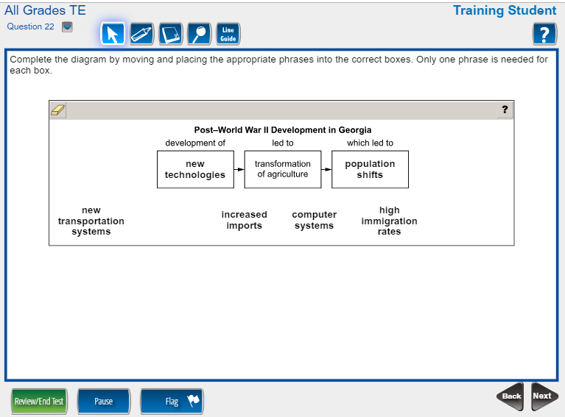
22
Notes:
Grade 8 Social Studies
SAY: This is a drag and drop social studies question. Enter a phrase into different boxes to complete the diagram.
DO: Enter the answers into the boxes. Replace phrases to show how students can easily replace their responses.

Slide 11
End of Demo
Notes:
SAY: These were just a few examples of the new Technology Enhanced item types that will be available on the Georgia Milestones.

