Slide 1
Georgia Milestones Test Examiner Training
Developed by the Georgia Department of Education
This presentation is meant to work in coordination with local district and school training.
Notes:
Welcome to the Georgia Milestones Test Examiner Training. This training will go over preparation for testing, test security and requirements for test examiners of the Georgia Milestones. This training should work in coordination with your local district and school training.

Slide 2
Examiner’s Responsibilities & Activities
BEFORE TESTING
Notes:
Let’s get started with what you need to do before testing.

Slide 3
Are you ready?
Test Administration Manual
Time and location of tests
Equipment needed
Special Accommodations
Contacts for technical and testing issues
Notes:
Start gathering everything you need for testing. You should study the test administration manual. You will need to know when tests are scheduled in your district and how long test times are for your administration. Make sure to have the proper equipment for your students including students with accommodations. You should have information on who to contact in case issues arise during testing.

Slide 4
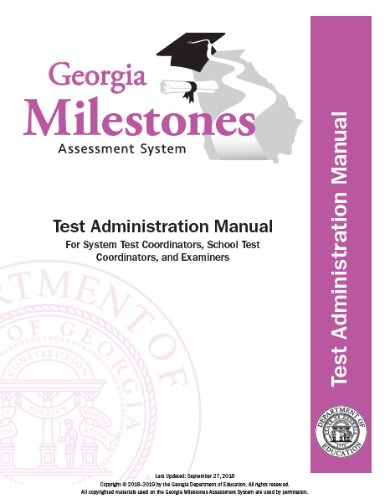
Test Administration Manual
Read each manual that pertains to the test being administered prior to the day of testing.
Read each manual early so that ample time is available to ask the STC all questions that arise.
Notes:
All test examiners should read the appropriate sections of the Test Administration Manual before testing.

Slide 5
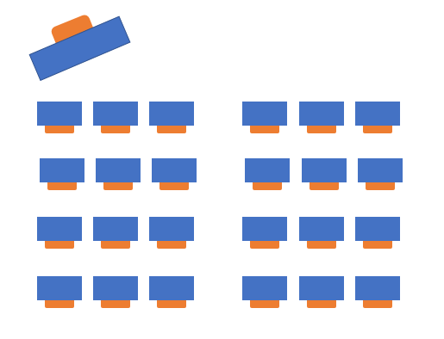
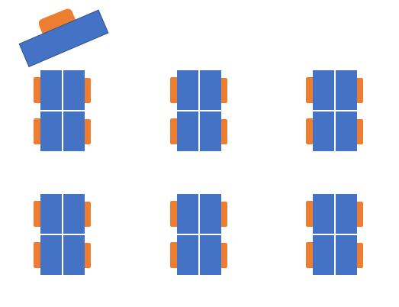
Testing Environment – Setup
Space and/or dividers between computers
Cover instructional materials
INSIGHT software on devices
Enough power to testing devices
Notes:
Each testing setup is unique so make sure to preview your test environment before test day. Test administrators should consider how desks, tables or computers are distributed and the proximity of students. Physical barriers limit distractions and discourage cheating. Make sure all instructional materials are covered. If there is a question about whether materials should be covered, it is best to be safe and cover them. Make sure that INSIGHT is functioning on testing devices. You can check the system using the Secure Practice Test or Secure Practice Test with Response Transmission. Schools should have a plan to minimize background noise and for test monitors in the halls to manage any students. Make sure that there is a Do Not Disturb and No Electronic Devices Sign for the Door. You should also have a plan for gathering cell phones and other electronic devices so students do not use them during testing.

Slide 6
Testing Environment – Materials
Clock
Pencils
Blank scratch paper
Graph paper for EOG or EOC math
Calculators (if needed)
“Testing – Do Not Disturb” sign
“No Electronic Devices” sign
Test Administration Manual
Student Test Roster
Test Tickets
List of accommodations
Testing Device
Mouse (if needed)
Headsets for read aloud (if needed)
It is your responsibility to know what you should expect to receive for the student(s) you are responsible for testing.
Notes:
Look through the Test Administration Manual to ensure you have all materials including scratch paper, student rosters, test tickets, a clock, and pencils. Test examiners should know ahead of time about any accommodations for students and should know how to help implement them in the test environment. Make sure you know of any district requirements such as hand-held calculators, or paper copies of ancillary materials.

Slide 7
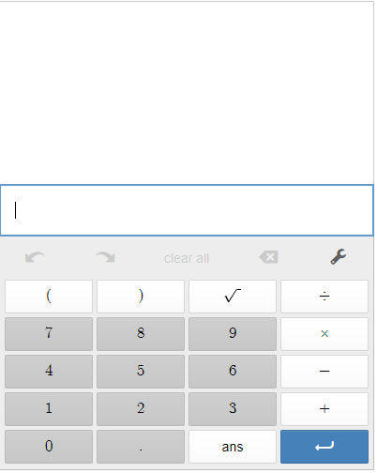
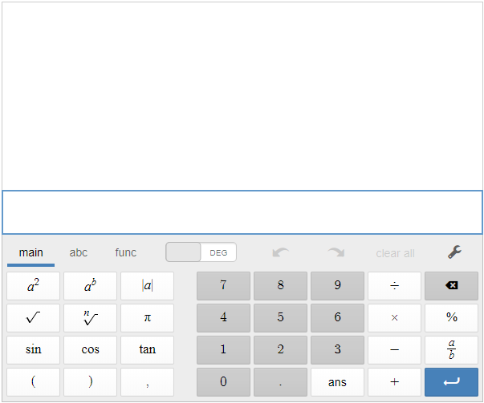
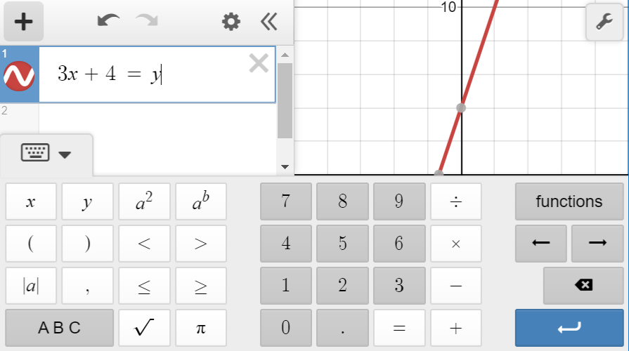
Calculators www.desmos.com/testing
Content Area | Grade Level/Course | Type of Calculator
Mathematics | Grades 3-5 | Not Allowed
 | Grade 6 | Basic¹
 | Grades 7 and 8 | Basic¹ or Scientific
 | Coordinate Algebra/Algebra I | Scientific or Graphing
Science | Physical Science | Basic¹ or Scientific
Calculators are not permitted on Section 1, Part A, of each mathematics test in grades 6–8 and high school. Calculators are not permitted at all in grades 3–5 mathematics. Clear text from calculator before and after testing.
Basic
Scientific
Graphing
Notes:
This table shows which Georgia Milestones Assessments allow calculator use. The calculators will be available through INSIGHT. Students do not have access to the calculator on test items in Mathematics Section 1 Part A that require students to demonstrate direct knowledge of computational skills. If your district allows handheld calculators, you should have a plan for distribution and collection of the calculators. Calculators with memory should be cleared before and after the assessment.

Slide 8
Item Types
English Language Arts
Item Types
Selected Response Constructed Response items Constructed Response Extended Constructed Response (Narrative Writing) | Extended Writing Response Evidence-Based Selected Response Drag and Drop/Paste Drop-down List
Unique Feature(s)
Reading and Evidence-Based Writing Section requires students to construct meaning, make inferences, draw conclusions, compare and contrast ideas as well as synthesize ideas and concepts across multiple texts Selected Response Constructed Response Extended Writing Response
Extended Writing Response requires students to develop an informative/explanatory or opinion/argumentative essay – citing evidence from text(s) and using standard language conventions, etc.
Notes:
Item types found on the English language arts assessments and presented to students include selected response (or multiple choice), constructed response, extended constructed response, extended writing response, evidence-based selected response, drag and drop/paste and drop-down list.

Slide 9
Item Types
Mathematics
Item Types
Selected Response Multi-Part Multi-Select Drag and Drop/Paste | Graphing (Bar graph, line graph, pictograph) Keypad Input Drop-down list
Unique Feature(s)
No-Calculator Section Desmos Calculator
Notes:
These item types and features are included for mathematics.

Slide 10
Item Types
Science and Social Studies
Item Types
Selected Response Multi-Part Multi-Select Drag and Drop/Paste Drop-down list
Unique Feature(s)
Science requires understanding of the core concepts, ideas, and practices of science to explain scientific phenomena Social Studies requires understanding of the past and its influence on the present and future – including the interconnectedness of history, culture, geography, economics, and government/civics
Notes:
These item types are included for science and social studies.

Slide 11
Georgia Milestones
2020-2021 Reduced Testing Times – EOG and EOC
Content Area | Section | Typical Testing Time | Maximum Testing Time
ELA | 1 | 45-65 | 90
 | 2 | 40-60 | 80
 | 3 | 40-60 | 80
Math | 1 | 30-50 | 65
 | 2 | 30-50 | 65
Science | 1 | 20-30 | 40
 | 2 | 20-30 | 40
Social Studies | 1 | 15-25 | 35
 | 2 | 15-25 | 35
There is no minimum time for testing. If all students have submitted the test, the examiner should complete the test section.
Notes:
Based on analyses of prior years’ testing and adjusted for the new test design, we have determined the typical amount of time in which most student should complete testing. If needed, however, students are allowed up to the maximum time shown here.

Slide 12
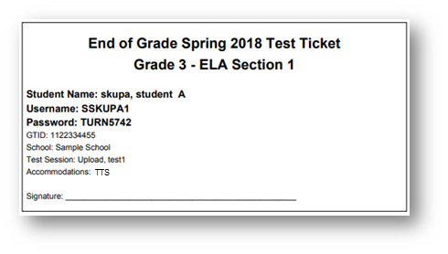
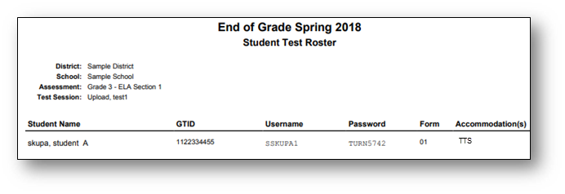
Test Tickets and Student Roster
Check
Test Subject
Test Section
Student Name
GTID
Test Session
Accommodations
Test Tickets will print one to a page, and Each Test Ticket contains the student’s username and password for the test session. Note that the student will have a separate Test Ticket for each section of the test.
Accommodation
TTS | Text-To-Speech
TTS-C | Text-To-Speech Conditional (with passages)
CC | Color Chooser
CT | Contrasting Text
VSL | Video Sign Language
If a student receives an accommodation, it will be noted here
To avoid a student testing under another student’s GTID, you must :
Have students verify their name and test name are correct and sign the ticket next to their name.
If a change is made to a student record (e.g. adding an accommodation), create a new test ticket for that student, which will have a new login/password.
Notes:
Examine each test ticket for correct name, content area, GTID, school, test section, test session and accommodations. Test scores will be invalidated if a student takes the wrong test or logs in with the incorrect test ticket. Accommodations show on both the ticket and the student roster. Test examiners should have a list of students and their accommodations. Some accommodations do not require INSIGHT to make a change and will not show on the accommodations listed on the ticket or roster. For example, additional time will not show on the ticket. The examiner is required to monitor the additional time.
Contact your school test coordinator before logging in if a student needs to receive one of the accommodations listed here and it isn’t on the ticket or roster.

Slide 13
Are Students Ready?
Orient students to testing via an online platform:
Experience Online Testing Georgia: http://www.gaexperienceonline.com
Secure Practice Tests in INSIGHT
Notes:
Students should be comfortable with the format of the Georgia Milestones assessment as well as the INSIGHT program and all available tools. Districts should set up practice sessions with students using the Secure Practice Tests. Teachers, students and parents can experience the format of the test and the INSIGHT program anywhere anytime through Experience Online Testing Georgia.

Slide 14
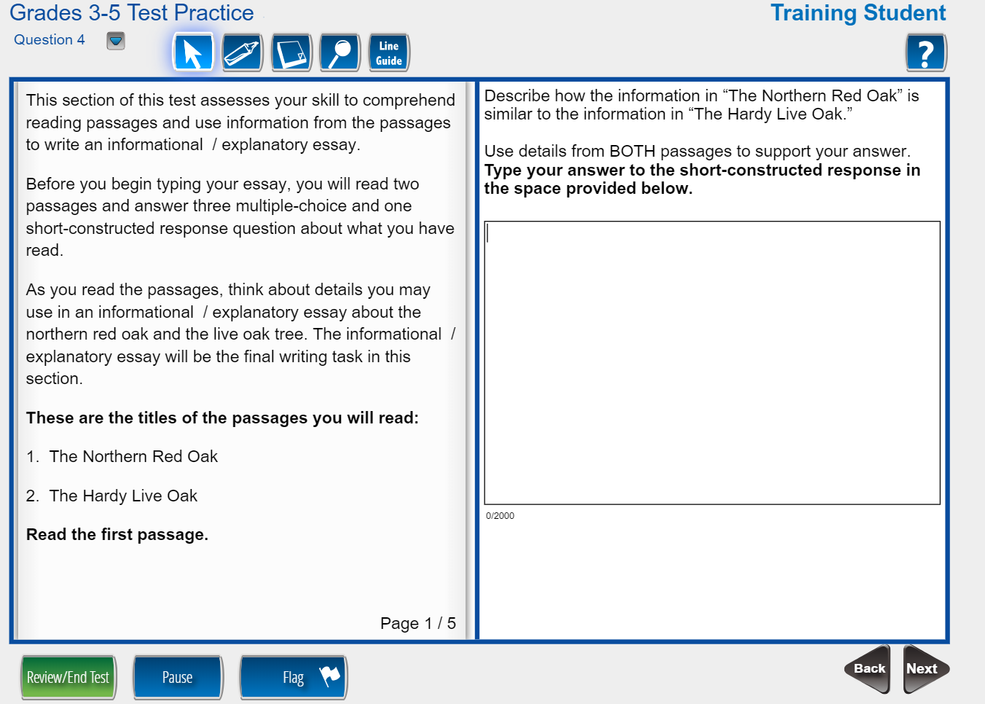
Are Students Ready?
Format of the test
Testing tools
Time and date of test
Different item types
Online calculators
Cut, copy, paste, undo, redo
Online reference Documents
Accommodations
Familiarity with device for testing
Closing out the test
Notes:
The format of the test includes different test item types, how they will be displayed, and how students interact with the items. Experience Online Testing Georgia allows students to use the Universal Testing Tools. Students should know how to use cut, copy, paste, undo and redo when responding to constructed response items.

Slide 15
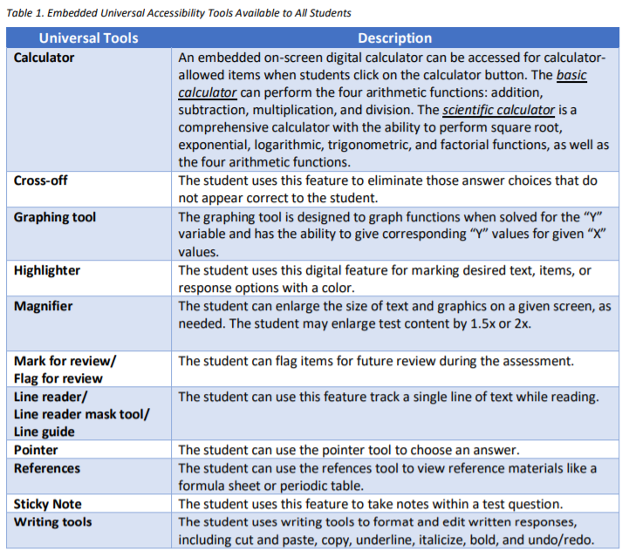
Universal Tools – All Students
Notes:
Universal tools are available to students participating in the Georgia assessment program to address their individual accessibility needs as they access instructional or assessment content. These supports are either embedded in the online test or provided by a test administrator at the local level during testing (i.e., scratch paper). Beginning with the 2020-2021 school year, the “line reader mask tool” also simply referred to as “masking” included in the list of embedded universal tools and will no longer be considered an accommodation.

Slide 16
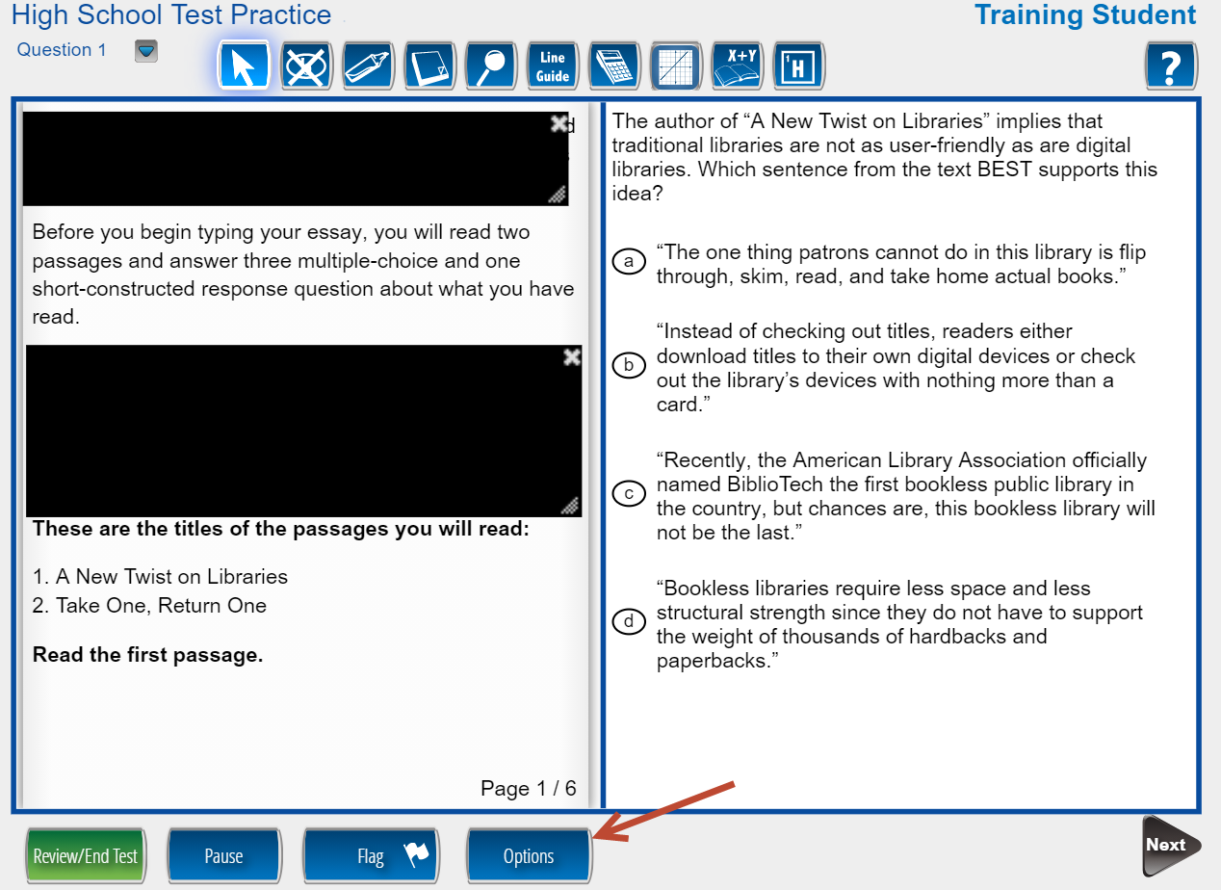
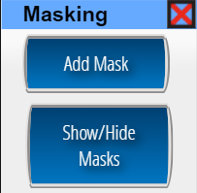
Online Tools Masking
Notes:
The masking tool will now be available to all online test takers and is no longer an online accommodation. To access this tool, students will click on the “Options” button, then select “Add Mask.” Like the Note Pad, students can hide and show the masks as needed while testing.

Slide 17
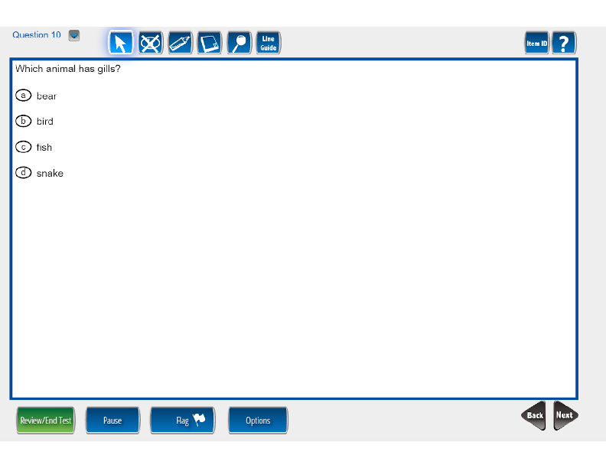
Online Tools Large text and graphics
INSIGHT uses Scalable Vector Graphics
Allows for students to use many sizes of monitors, including larger monitors
No distortion of the content
The Magnifier Tool increases the size of selected items 1.5x or 2x the standard size.
Notes:
Students who need larger print and other test content can use the Magnifier tool that is available for all students. The Georgia Milestones assessment scales to the size of the monitor therefore students who need the test to show larger can be given a larger monitor.

Slide 18
Online Tools Desmos Calculator
www.desmos.com/testing
Basic
Scientific
Graphing
Local districts must clearly determine if a handheld calculator will be made available for students.
Grades 6-high school may not assign a handheld calculator as an accommodation for the no-calculator subsection.
Notes:
The online DESMOS calculator is available as a universal tool for all students during the appropriate sections of the content assessments. Practice opportunities are available in Experience Online Georgia and the practice tests. Local districts must clearly determine if a handheld calculator will be made available for students. Please remember, in grades 6-high school, it is not permissible to assign a calculator as an accommodation for the no-calculator subsection. Handheld calculators must not be assigned to any students during this section of the assessment.

Slide 19
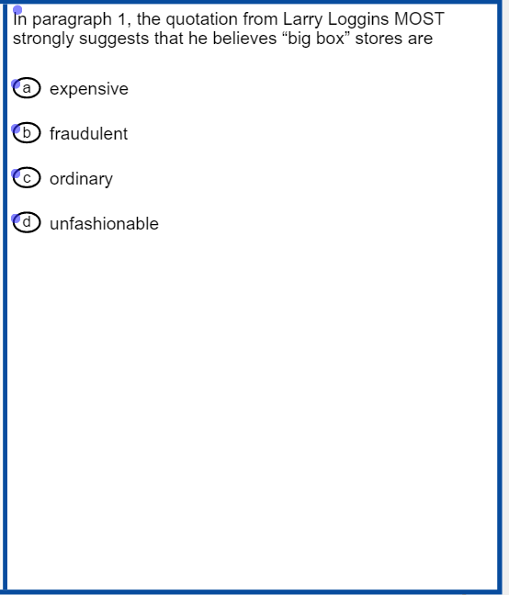
Accommodations Online Audio
Pre-recorded computer voice.
Audio plays automatically for each page.
Can be restarted for the whole page or at Start Points.
Each passage contains at least one Start Point per page
Notes:
For students with the read aloud also called Text To Speech accommodation the recorded voice will read the text. Students can pause or stop the read aloud. Students can also choose start points to read part or all of the text. Make sure that students who are allowed the read aloud accommodation know how to manipulate the online audio.

Slide 20
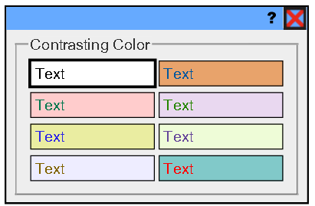
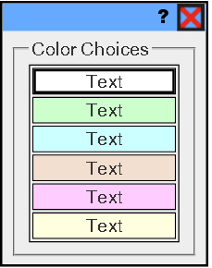
Accommodations Text and Background Colors
Contrasting Background and Text Color Options
Background Color Options
Notes:
Accommodations are presented online including contrasting colors which show different color text and background.

Slide 21
Accommodations Video Sign Language
Notes:
Video Sign Language can be used so a signed version of Georgia Milestones is presented to students. Students can play, pause as well as move forward and backward as needed using online controls.

Slide 22
Examiner’s Responsibilities & Activities
DURING TESTING
Notes:
Let’s get started with what the test examiner needs to do during the day of testing.

Slide 23
Launching INSIGHT
Ensure INSIGHT has been launched.
Check student test tickets
Verify name and accommodations on test tickets.
Become familiar with student needs so that all accommodations are administered. Some accommodations are managed by test examiner and not INSIGHT.
Notes:
Before students start testing, the test examiner should click on the INSIGHT application and choose the correct assessment for the student. Check test tickets to verify accommodations and student information including GTID.

Slide 24
Student Login
Students should enter login information from their test ticket.
Stagger logins for a better student experience.
Notes:
Students will then use their test tickets to login to the system.

Slide 25
What happens if a student gets sick?
Sickness during testing administration
Student gets sick prior to starting the test.
Upon return to school student will complete the test in its entirety and test is scored as is; does not require MyGaDOE Portal entry.
Student gets sick after having completed Section 1 but before starting Section 2.
Upon return to school, student will complete Section 2 of the test and test is coded as an irregularity; requires MyGaDOE Portal entry.
Student gets sick while testing in either Section 1 or 2.
Test scores maybe invalidated by GaDOE; requires MyGaDOE Portal entry.
Notes:
Be prepared for student illness. If the student is sick prior to testing or between sections, make sure to plan for a makeup session. If a student gets sick in the middle of a section, please work with your school test coordinator to determine if scores can still be reported or if they will need to be invalidated.

Slide 26
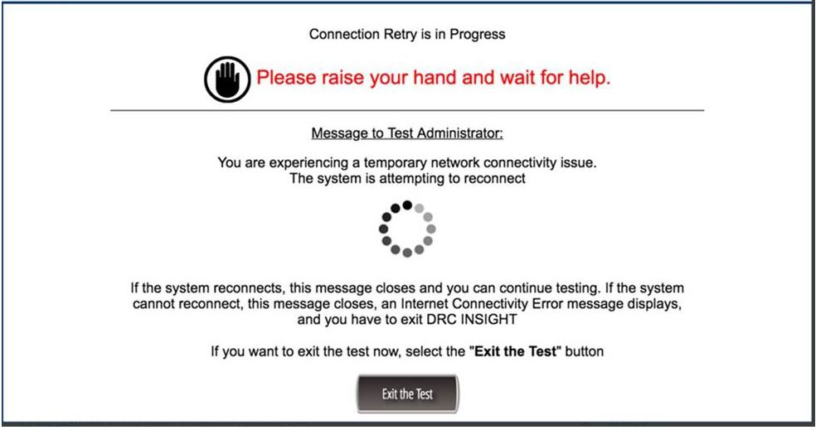
What happens if there are network issues?
If the system shows a message about connectivity issues, contact your school technology contact.
The system will allow the student to continue testing after network issues are resolved.
Work with your test coordinator to determine if students can continue testing.
Notes:
Sometimes network issues can interrupt testing. If the testing device looses connectivity, INSIGHT will continue to reconnect. If you see this message, contact your school technology coordinator. The INSIGHT system has a heartbeat that submits responses every 45 seconds as well as every time a student moves between test items. These safeguards minimize any loss of content when there is a network interruption.

Slide 27
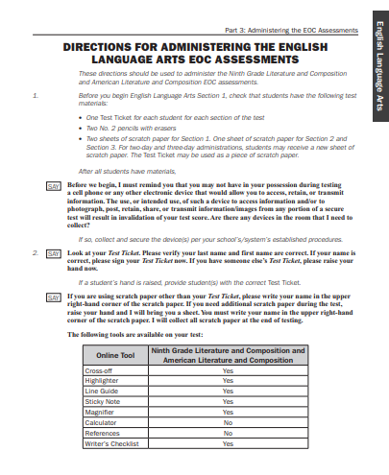
TAM Script
The Test Administration Manual (TAM) should be read in its entirely prior to testing.
Additionally, all documents given to you by your school testing coordinator (i.e., accommodations guidelines) should be read prior to testing.
Notes:
Make sure to familiarize yourself with all of the Test Examiner script found in the Test Administration Manual as well as any other documents that you need to distribute to students.

Slide 28
Testing Irregularities
Examples of testing irregularities are included in the Test Administration Manuals. Examples of test irregularities include, but are not limited to:
A student becomes ill or leaves for an appointment during testing and cannot finish the test
A student leaves the test setting without an escort or monitor
A student doesn’t receive their accommodation
This may lead to an irregularity of an invalidation of test scores.
A student refuses accommodations
A student accesses an electronic device in the testing room
An adult provides inappropriate assistance to a student during testing
A student is provided with an inappropriate manipulative (e.g. calculator) during testing
An unused test ticket is missing
Note: Immediately report any irregularities to the school test coordinator.
Notes:
Many test irregularities can be avoided if the test examiner is actively monitoring the testing room. Errors during test administration can also be avoided by careful planning and following the testing script. Immediately report any irregularities to the school test coordinator.
Here are some things that can cause testing irregularities;
Student illnesses
Students leaving a test setting unaccompanied by an adult
Students who don’t’ receive their accommodation or receive the incorrect accommodation
Students accessing electronic devices during testing
Adults providing inappropriate assistance or
Lost test tickets

Slide 29
Improper Student Test Activity
Viewing other student’s test
Accessing unallowable aids or materials
Previewing content
Accessing cell phone, smart watch, ebooks, tablets
Recording responses in the incorrect location
If you are unsure about cheating, allow the student to complete the test section and report to the school test coordinator.
If cheating is confirmed, test scores will be invalidated by the GaDOE.
Notes:
The online testing environment can reduce sharing of test answers since students work through the test at their own pace. However, if not monitored correctly, students can review content on other computers. The test examiner should always be careful to be conscious of student behavior and ensure students are demonstrating their own knowledge of test content. Test examiners should intervene to stop cheating before it results in a test invalidation. If you are unsure about cheating, allow testing to continue and report to the school test coordinator. If cheating is confirmed, test scores will be invalidated.

Slide 30
What is Active Monitoring?
DO | Don’t
Actively walk around the testing room | Sit at your desk doing personal or other work
Monitor student progress | Answer test content questions
Assist students with technology | Point to test content
Check that students are in the correct test section | Review, take pictures or share test content
Check that students have the correct test ticket | Leave students or test materials unattended for any length of time
Check that students do not bring prohibited items in the testing environment (i.e., cell phones) | Allow students to have access to cell phones/other electronic devices
Do plan an activity for students to do after they finish testing (i.e., read a book) | Allow students to have access to any unauthorized materials.
Notes:
Test examiners should be actively monitoring during the entire testing time by walking around the room, assisting students with technology questions, and checking on students who are looking to gain information from other students. Test examiners should use testing time for monitoring and not doing other work. Test examiners should never point to test answers, share content knowledge or give students any advantage during testing. The test administrator may look at the test to see whether responses are entered and may not examine or comment on individual responses.

Slide 31
Improper Monitoring
Test examiners should never
Review test content
Review student responses
Memorize test content
Discuss test content with students, other staff members or anyone
Take photos of test content
Sharing test content through social media
Notes:
Ensuring the confidentiality of test content is critical to ensure the security of the test administration. Failure to maintain the security of testing materials and content can lead to the invalidation of testing and/or a referral to the Professional Standards Committee.

Slide 32
Cell Phones
In the event an examiner confirms during testing that a student is using a device to access, retain, or share information, the examiner, must with minimal disruption:
collect the device,
stop testing that student,
remove the student from the testing session, and
notify the School Test Coordinator immediately.
In the event such actions are suspected, but not yet confirmed, the examiner must with minimal disruption:
collect the device,
allow the student to complete testing,
notify the School Test Coordinator immediately, and
as soon as it is appropriate, attempt to confirm if the device has been used in violation of the guidelines above.
Simple possession of a device (including the ringing of a phone during test administration) may be addressed in keeping with the system’s code of conduct and does not require an irregularity report.
Notes:
Cell phones are not allowed in the test environment and should be collected before the test. If the student has a cell phone during testing or it rings, you should determine if the student accessed the device during the test. If you aren’t sure if the student accessed the device, notify your school test coordinator so they can investigate but allow the student to complete testing. If it is confirmed that the student used the device to access, retain or share test information, make sure to collect the device and stop testing the student. If a cell phone rings but nobody accessed the device, continue testing.

Slide 33
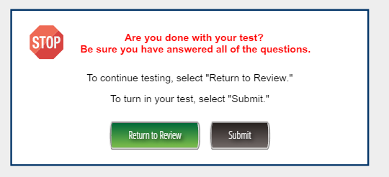
How to Exit the Test
Students must the Submit button to complete the test.
Notes:
Students must exit the test properly in order for the test to be submitted for scoring. When students are done with the test, they should click the Review/End Test button, review their test items then click End Test and Submit.

Slide 34
Examiner’s Responsibilities & Activities
AFTER TESTING
Notes:
Now that testing is over, what do you need to do?

Slide 35
Collecting Materials
Collect test materials from each student as they complete the test according to the directions in the Testing Administration Manual.
Student test tickets
Scratch paper (used/unused)
Student Testing Roster
Calculator (if applicable)
The School Test Coordinator will count all test materials returned by the Test Examiner—in your presence, and verify that the counts match.
The School Test Coordinator will verify that all tests are properly submitted.
Notes:
Remember that test tickets, used scratch paper, and testing rosters are all secure test materials. Follow protocol to ensure that all materials have been returned and verified by the school test coordinator.

Slide 36
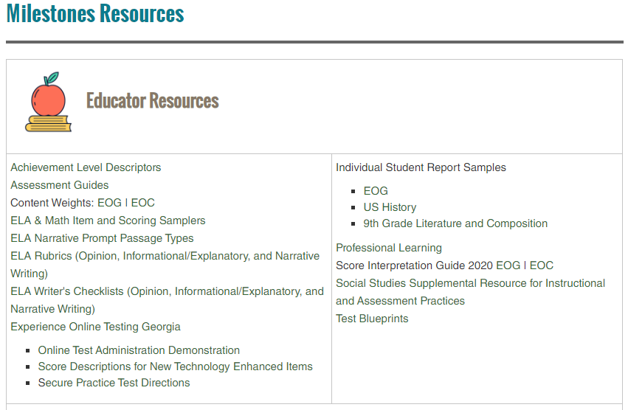
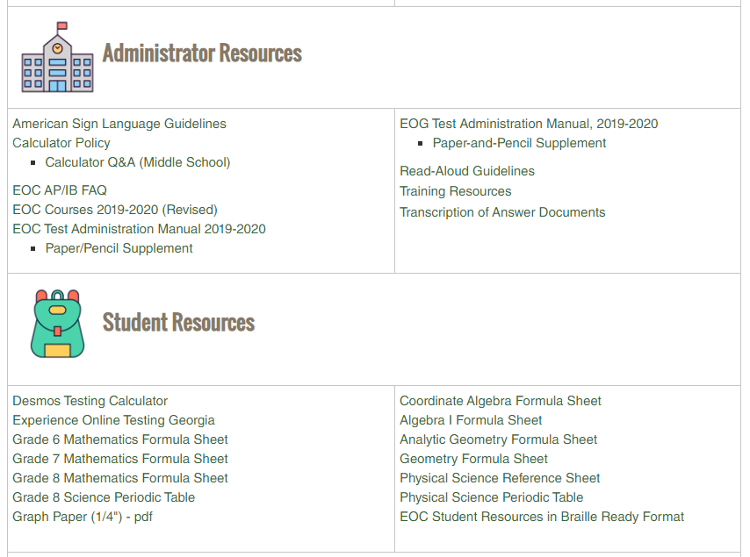
EOG-EOC Resources
https://www.gadoe.org/Curriculum-Instruction-and-Assessment/Assessment/Pages/Milestones_Resources.aspx
Notes:
The Georgia Milestones resources page has a new look. Our goal was to provide a cleaner, more organized page to help visitors find information a little easier. We hope that we’ve accomplished this for you.

Slide 37
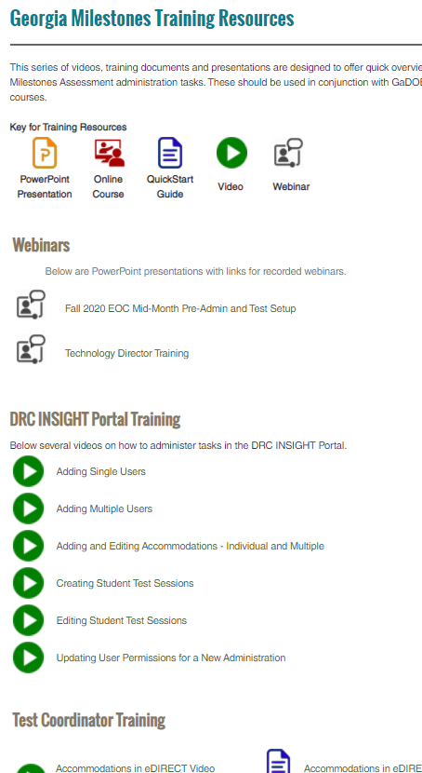
Training Resources
Georgia Milestones Training Resource Page
Training Types
 | Recorded Webinars
 | Videos
 | PowerPoints
 | QuickStart Guides
 | Online Courses
Training Topics
Webinars
DRC eDIRECT Training
Test Coordinator Training
Test Examiner Training
Student Training
Notes:
There are a variety of resources offered for training. The Recorded Webinars are these presentations that are delivered from the GaDOE. The links will take you to the PowerPoint. The first slide on the PowerPoints include links to the recorded webinars. Videos are short presentations that cover a series of topics. PowerPoint documents are offered so districts can redeliver topics. Most PowerPoints include the script for your redelivery. QuickStart Guides are short pdf documents with information to quickly guide users on training topics. Lastly, the System Test Coordinator and School Test Coordinator courses can be accessed through the MyGaDOE portal, clicking on PLO and searching for the course.

