Slide 1
Georgia Work-Based Learning 101 For Administrators and Counselors
GACTE 2017
Dwayne Hobbs, WBL Specialist
dhobbs@doe.k12.ga.us
404 606 2348

Slide 2
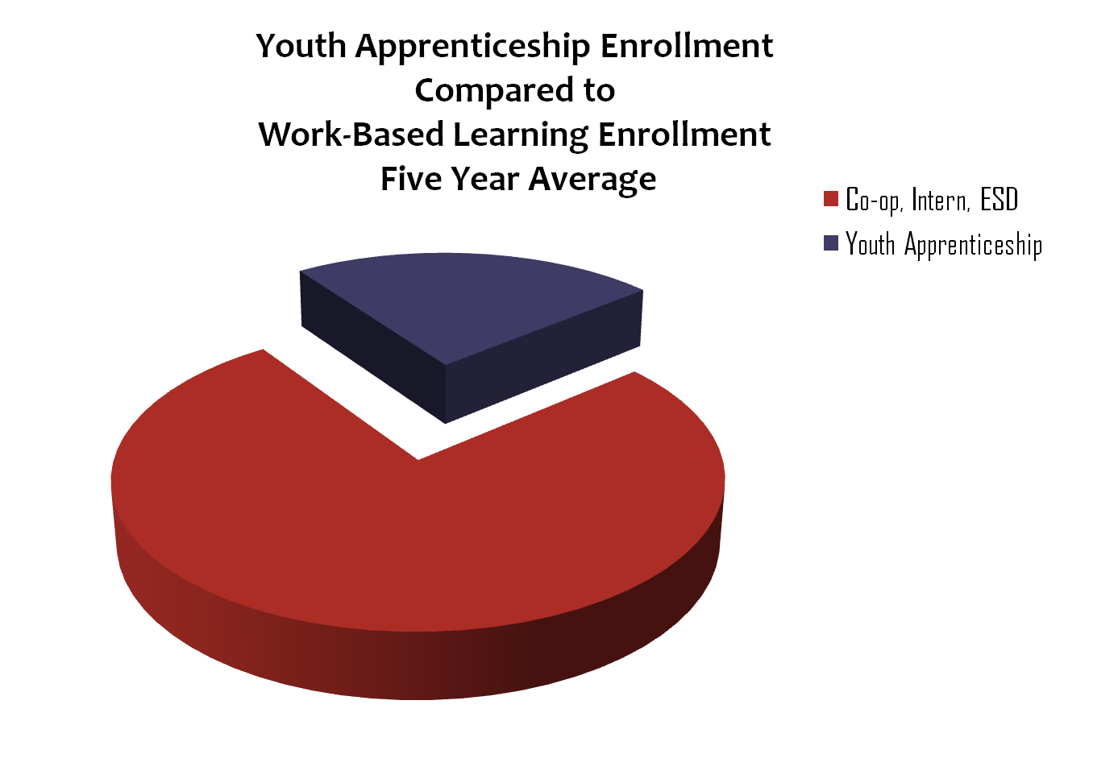
Student Enrollment in CTAE Classes FY16
(Students enrolled in one or more CTAE courses)
60% of all Students in Grades 9-12 Statewide (344,971 students)
94.9% Graduation Rate for CTAE Concentrators
(31%)
16,118
18,439
(69%)
330.094
344.971
Work-Based Learning and Youth Apprenticeship Program

Slide 3
WBL Student Enrollment in Full Time Equivalent (FTE) Segments
23026
21878
22786
23868
24627
21034
20928
22143
18387
19130

Slide 4
1%
5%
19%
42%
6%
3%
8%
3%
13%

Slide 5
9%
23%
4%

Slide 6
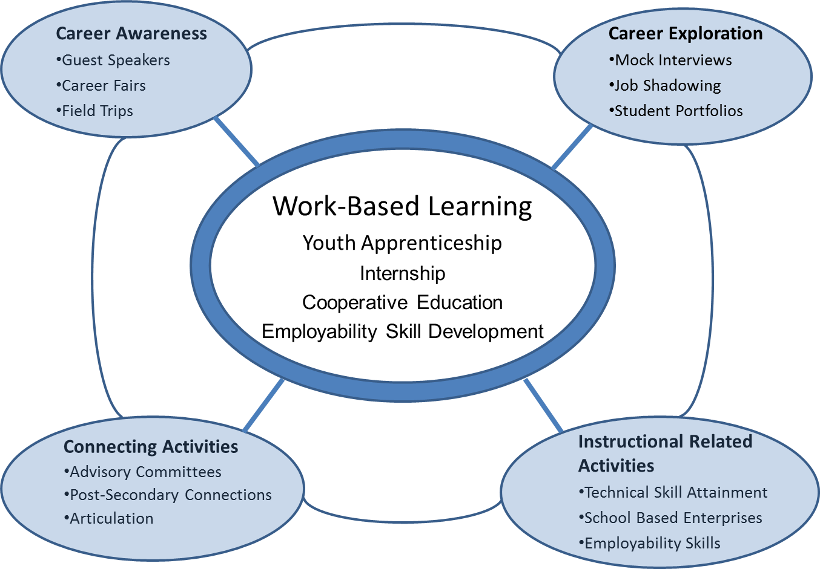
Career Related Education Model

Slide 7
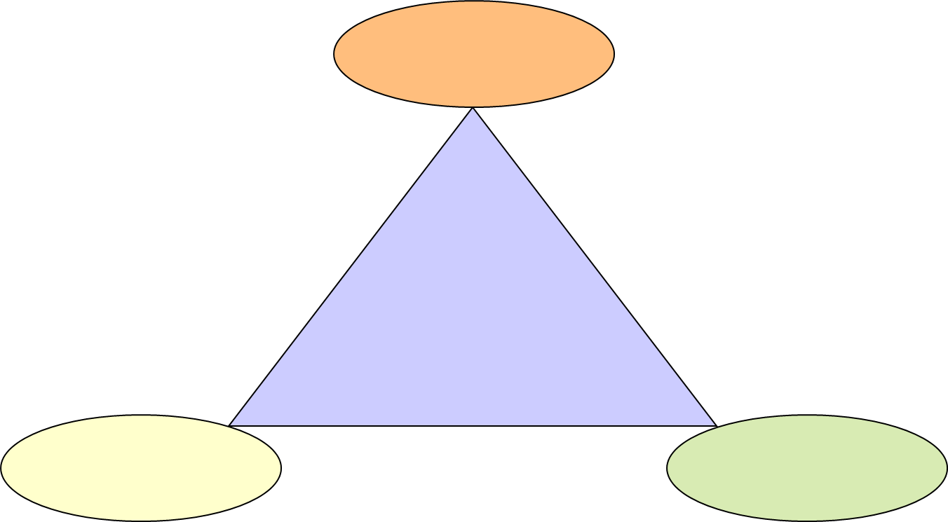
WBL Criteria
Student’s Career Goal
The
Three
Interlocking
Components of
Work-Based Learning
Related Coursework
Structured Work Experience

Slide 8
WBL Classifications
Students in Work-Based Learning are classified in one of four ways according to the alignment of their career-tech coursework with job placement and future postsecondary/career plans:
Youth Apprenticeship (YAP)
Internship
Cooperative Education (Co-op)
Employability Skills Development (ESD)

Slide 9
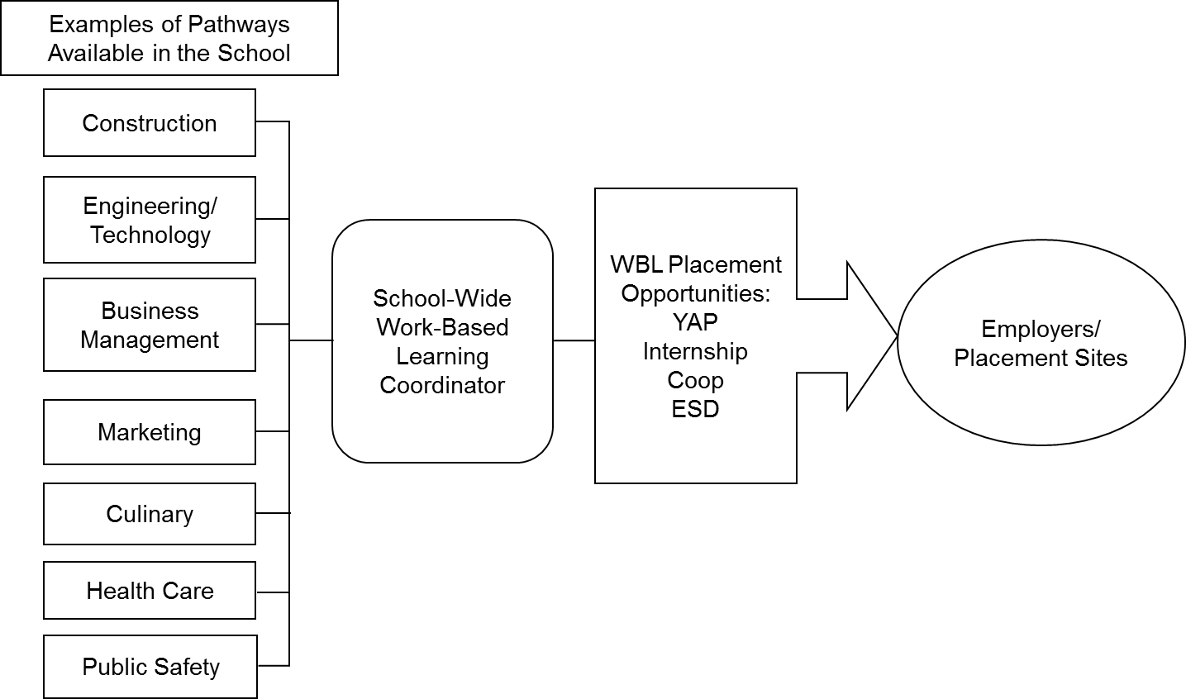
Georgia WBL Delivery Model
Notes:
Make this slide about the WBL policy and administration in GA:
i.e. HB 402
This graphic

Slide 10
Professional Learning Opportunities
WBL Basic Training Part A & B – New school level coordinators
WBL Refresher Update – repeated a minimum of every 5 years
WBL “Top Gun” Training - select group of the top 20 coordinators each year
Region meetings – six regions, 4 meetings per year
GACTE Conference – affiliate sessions
Annual WBL/YAP Conference – 3 day intensive sessions for 300+ participants

Slide 11
Challenges for WBL
Reluctance of employers to hire students under 18
Part time WBL coordinators. Low number of full time WBL coordinators
Lack of understanding of the Fair Labor Standards Act
72% of WBL Students get their own job.
29% for YAP
Level of Employability Skills that WBL possess.
Diversity of placements from all CTAE pathways in the school

Slide 12
Supports for WBL/YAP programs in Georgia
Professional Learning Opportunities
WBL Manual
And
Website
24 Standards for WBL Programs
Weighted Funding and Competitive Grants
GACTE Affiliate
State Executive Board
Region meetings
Data Collection on Program implementation
College and Career Readiness Performance Indicator

Slide 13
Work Based Learning Placement Opportunities
Youth Apprenticeship – Placement requires completion of one unit of related instruction; must include a post-secondary training component; 720 hours of on-the-job training; for high wage, high skill, high demand jobs
Internship - Placement requires completion of one unit of related instruction; may be paid or unpaid
Cooperative Education – Must be concurrently enrolled in the related CTAE course; must be a paid job
Employability Skill Development – Student is taking or has taken a CTAE course; must be a paid job; training plan based on application of identified employability skills
Great Promise Partnership (GPP)– Non-profit Foundations that works with GADOE under a MOU to place at risk students on WBL sites.
JROTC- Defined occupational categories and lists of businesses where JROTC students should be placed.

Slide 14
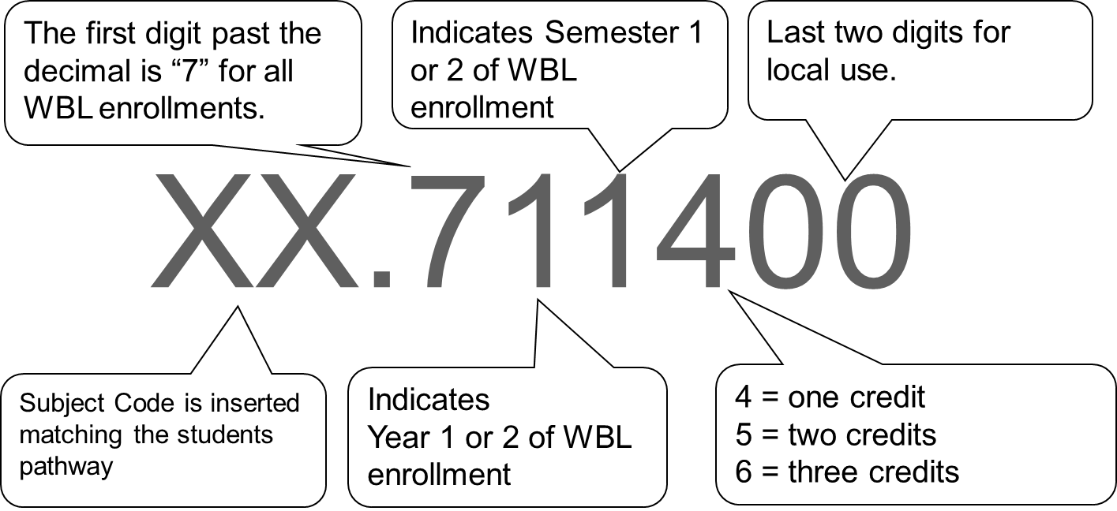
Work Based Learning numbers require insertion of the subject CIP code.

Slide 15
CIP | Cluster/Pathway Title | Funding Weight
01. | Agriculture | K
02. | AgriScience | K
03. | Natural Resources | K
06. | Business Management | K
07. | Business Computer Science | K
08. | Marketing | K
10. | Communication Technologies | K
11. | Information Technology | K
12. | Personal Services Occupations | K
13. | Education | K
20. | Family and Consumer Sciences | K
20. | Culinary Arts | K
21. | Engineering and Technology | K
25. | Healthcare Science | K
28 | Junior ROTC | K
35 | Great Promise Partnership (GPP) | K
43. | Public Safety | K
46. | Construction Technology | K
47. | Architecture, Construction, Communication & Transportation | K
48. | Precision Production Occupations | K
49. | Manufacturing & Engineering Sciences | K
26. | Life Sciences | K
40. | Physical Sciences | K
23. | Language Arts | K
27. | Mathematics | K
45. | Social Sciences | K
50. | Visual Arts | K
51. | Dance | K
52. | Theatre Arts | K
53. | Music | K
63. | Spoken Languages | K
Approved pathway options for WBL course numbers.

Slide 16
Admissions and Scheduling for WBL
Selective vs. Elective Programs
Application Process
Requirements and Coordination
Students Career Goal
Related Coursework Taken
Job Placement/Training Plan
Approval of Job Placement vs. Arranged Placement
Counselors can be vital in vetting students
Non-performing students
Alternate assignments in case of extended illness

Slide 17
WBL Standards
Standard 7: The local school system supports equitable Work-Based Learning opportunities by providing a school-wide WBL Coordinator, adequate resources, and a manageable workload.
Exemplary | 3 | Meets Expectation | 2 | Does Not Meet Expectation | 1 | Evidence
Include all criteria from "meets expectations” plus the following: The facilities are current and of sufficient size and quality to effectively meet instructional needs of the students. The teacher/coordinator has storage facilities and a private office with telephone. The WBL Coordinators has access to a computer, preferably a laptop. The WBL program has a generous budget for travel, equipment, and supplies. The WBL program is an integral part of the local plan for career education and is considered equal but of separate instructional design. An approved operating budget for the current fiscal year is on file, available to and controlled by the teacher/coordinator. The WBL coordinator is full time with minimal “other duties” that distract from the WBL mission. |  | Students in all CTAE classes have equal opportunity to participate in WBL placements. Student enrollment in WBL placements are in compliance with class size limitations or the recommended workload for WBL programs. The WBL coordinator is unencumbered and available for supervision during all periods that students are released from school to report to worksites. The facilities are adequate to effectively meet the instructional needs of the students. There is a classroom, storage facilities, and access to an office and telephone for WBL Coordinators. There is an adequate budget for travel, equipment, supplies and operation of the WBL program controlled by the local administrator. The WBL program is a part of the local plan for career education. |  | Students in all CTAE program areas do not have equitable opportunity to participate in WBL placements. Student enrollment in WBL placements exceed the state class size limitations or recommended workload for WBL programs. The facilities are not adequate to effectively meet the instructional needs of the students. There is no office and telephone for the WBL Coordinator. There is an inadequate budget available for salary, travel, equipment and supplies. The teacher/coordinator does not have access to an operating budget for the program. The WBL program is not a vital part of the local plan for career education. |  | Class rosters. WBL Coordinator job description. WBL Coordinator’s daily assignments. Copy of the WBL budget. WBL Coordinator’s inventory. WBL Coordinator’s travel/expense records WBL Coordinator’s office. List of students enrolled in WBL for each CTAE program area/pathway.

Slide 18
WBL Standards
Standard 1: A wide array of Career Related Education (CRE) activities are integrated into all CTAE classes to support work-based learning placements and help students become college and career ready.
Standard 2: Age-appropriate Career Awareness activities in the Career Technical and Agricultural Education class are designed to make students aware of career choices and promote college and career readiness.
Standard 3: Age appropriate Career Exploration Activities in the Career Technical and Agricultural Education classes are conducted with individuals or small groups of students to explore career options.
Standard 4: Instructional Related activities in The Career Technical and Agricultural Education class promote an understanding of the business and work environment and help students develop employability skills.
Standard 5: CTAE personnel are actively involved in the planning, coordinating, and implementing of connecting activities between the school and the business community
Standard 6: Work-based learning placements are appropriate and accurately identified as Employability Skill Development (ESD), Cooperative Education (Co-op), Internship, or Youth Apprenticeship (YAP).

Slide 19
WBL Standards
Standard 7: The local school system supports equitable Work-Based Learning opportunities by providing a school-wide WBL Coordinator, adequate resources, and a manageable workload.
Standard 8: Teachers/coordinators who supervise students on job placements are trained to provide quality programs at the local level.
Standard 9: An active advisory committee assists with the design, development, implementation, administration, and evaluation of the program.
Standard 10: A plan exists and is implemented to teach employability skills prior to the WBL placement.
Standard 11: Students involved in Work-Based Learning have a comprehensive program of study on file that integrates academic and college and career ready pathway courses.
Standard 12: Community resources are analyzed and partnerships are formed to create Work-Based Learning placement options.

Slide 20
WBL Standards
Standard 13: Clearly defined admission policies and procedures for identifying and enrolling students into the Work-Based Learning Program are established and implemented. A comprehensive orientation is provided to the Work-Based Learning students and parents/guardians prior to enrollment.
Standard 14: Work-based learning sites that provide occupational growth opportunities consistent with students' occupational interests and learning objectives are selected and mentors at the site are trained by the Work-Based Learning Coordinator. Integrated instruction is provided to the work-based learning student at the work site.
Standard 15: Work-Based Learning sites for students are in compliance with federal and state labor laws and local policies.
Standard 16: The Work-Based Learning coordinator has individual Educational Training Agreement with all required signatures on file for each WBL student.
Standard 17: Each student has an educational training plan that specifies a planned sequence of learning experiences and work tasks correlated with the student's career pathway.
Standard 18: Each Work-Based Learning student is evaluated on a regular basis by the work site supervisor/mentor to assess progress toward goals established in the student's Educational Training Plan.

Slide 21
WBL Standards
Standard 19: Work-Based Learning students are enrolled in State approved courses, and complete and accurate records and documentation for enrollment, assessment and awarding of credit are kept on file for each Work-Based Learning student.
Standard 20: Work-Based Learning personnel are available for supervision of students during periods that students are placed on Work-Based Learning sites and make regular supervisory visits.
Standard 21: Work-Based Learning Coordinators participate in the Transition and Career Partnership (TCP) and assist students with post-secondary opportunities.
Standard 22: A public relations and marketing plan is integrated into the goals and objectives of the Work-Based Learning program and is reactive to the changing needs of the students and the business/industry community.
Standard 23: A plan has been established and implemented to provide Work-Based Learning opportunities for At-Risk students and students with disabilities
Standard 24: A comprehensive evaluation of the program is conducted annually including follow-up of students and employers to determine the success of the WBL program and compliance with State standards.

Slide 22
Funding and Class Size
WBL has the same Class size requirements as all other CTAE classes. Total FTE segments are averaged across all periods assigned WBL. The challenge is balancing class size with a realistic workload.
Counting FTE segments
K-Weight and D-Weight funding
YAP Grant
85% salary & benefit
15% split between travel, supplies & equipment
Marketing and Public Relations efforts

Slide 23
Full Time vs. Part Time Coordinators
Job duties of WBL coordinators (pages 7-7 through 7-9 in the WBL Manual
Community Liaison; creating placements
Creating partnerships and relationships
Importance of Career Awareness and Exploration Activities
The WBL Coordinator is the teacher of record for WBL students and must be unencumbered from other duties during the periods the students are away from school
Results on quality of student placements

Slide 24
YAP Grant Requirement Highlights
Each system must apply for YAP Grant funds via the consolidated application process.
The YAP Coordinator position must be equal to grant amount must be reported on the system CPI report. (ie: coordinator must be dedicated 50% of the time for ½ position grant)
Coordinator must attend training every 5 years
Coordinator must attend all State sponsored Professional Learning events
Must submit Annual YAP Data Report
Funding continuance is dependent on meeting the grant requirements

Slide 25
YAP Annual Assessment
Each grant recipient must submit an Annual YAP Assessment to continue receiving funding.
YAP Assessment is completed and submitted on CTAERN.
Requires approved by the CTAE Director
Due date mid/late April

Slide 26
WBL Program Requirements
Age not grade. HB766
Good Attendance
Good Grade history
Good Discipline Record
Pathway Courses taken
Job placement
Reliable Transportation
Parental Consent or be 18 years of age

Slide 27
HOPE
WBL does NOT negatively impact college acceptance
Hope calculation includes WBL credit in Advanced Academic pathways where the first two digits are:
CIP | Cluster/Pathway Title | Funding Weight
26. | Life Sciences | K
40. | Physical Sciences | K
23. | Language Arts | K
27. | Mathematics | K
45. | Social Sciences | K

Slide 28
WBL Students are NOT High School Drop Outs
Graduation Rate for CTAE Concentrators 94.5%
WBL Graduation Rate
WBL Coordinator reported 16685 Seniors enrolled in WBL for the 2016-2017 school year
105 reportedly dropped out of school
105 is .629% of 16685
Graduation Rate for WBL Students 99.4%

Slide 29
WBL Certification Requirements
State Board Rule for Work-Based Learning (160-4-3-.14) approved in June 2011.
Work-Based Learning placement opportunities shall be conducted in accordance with the guidelines in the Georgia Work-Based Learning Manual, available from the division of Career, Technical and Agricultural Education.
Each Work-Based Learning Coordinator supervising students enrolled in State approved work-based learning courses shall meet one of the following requirements:
1. Hold a valid Work-Based Learning (WBL) endorsement (formerly DCT) issued by the Professional Standards Commission and have completed a State approved WBL training session within the past five years.
2. Hold a valid certificate in any Career, Technical and Agricultural Education field and have completed a State approved WBL training session within the past five years.
3. Serve as a coordinator for the Youth Apprenticeship Program (YAP) only and attend a State approved WBL training session within the past five years.

Slide 30
PSC Certification Requirements
PSC CAPS Rule – Any CTAE field or WBL endorsement is acceptable certification for a WBL teacher of record.
Endorsement Provider – for personnel not certified in a CTAE field is NWRESA

Slide 31
Professional Development
Region Meetings – 3 or 4 per year
Most important professional learning event for WBL.
Even though this is a challenge with part time coordinators find a way to enable them to attend.
GACTE – Technical updates on affiliate day
WBL/YAP Conference – November 1,2,3
Basic Training Part A and Part B – Always in June/January-February
WBL Update/Refresher Training – Always in June
Top Gun – Best of the Best by invitation only

Slide 32
Special Needs and At-Risk Students
CTI – Follows the same standards as all other students.
Least Restrictive Environment
Accommodations accounted for on the Training Plan
CCAE – May be served in the WBL program
Great Promise Partnership- Non profit agency that seeks to work with the business community and schools to serve at risk students.
MOU with GaDOE
Follows State Standards for WBL
Supervision of students responsibility of the school system
GPP staff not certified for student supervision, grading, or awarding of credit.

