Slide 1
#Beintentional with PROFICIENCY in the WL Classroom

Slide 2
A BIG QUESTION
Are your students speaking “proficiency”?
Resources to deepen your understanding of proficiency:
Podcasts: Talkin’ L2 with BVP and Inspired Proficiency with Ashley Uyaguari
Follow Meredith White ASAP specially on Twitter and YouTube!
Simply try a Google Search on language proficiency/performance indicators/communication modes.
Earn your badge via the Georgia Learns Platform open to everyone, not just Georgia residents.

Slide 3
1. #BeIntentional with your classroom space
Create word walls and anchor charts that facilitate comprehension of language (input) and the enrichment of the students’ output.
Include visual aids to often make reference to the proficiency timeline and the communication modes
Remove barriers that may impede communication and community building
Foster an environment that increases movement

Slide 4
Create word walls and anchor charts that facilitate comprehension of language (input) and the enrichment of the students’ output.
#BeIntentional with your classroom space
“
View your classroom walls as tools to support and enhance your students’ language acquisition.

Slide 5
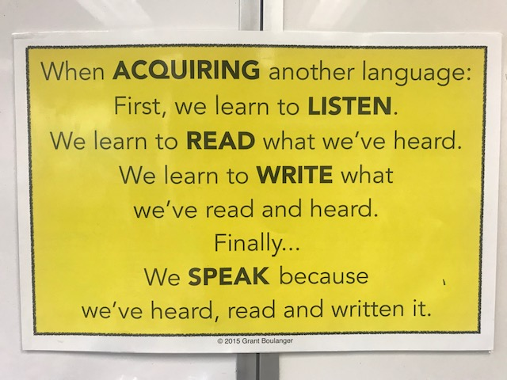
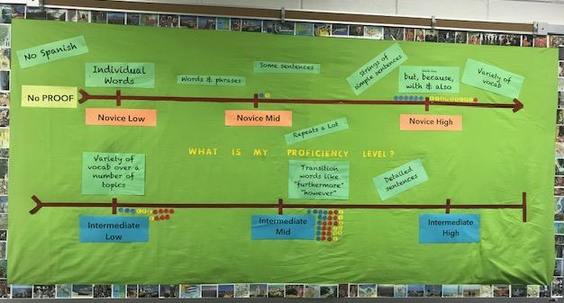
#BeIntentional with your classroom space
Poster credit to Grant Boulanger. Purchase poster here.
Include visual aids to often make reference to the proficiency path with performance indicators and the communication modes daily until it becomes natural to you.
Initial inspiration/replication credit to the Creative Classroom post by Kara Parker and Megan Smith and Mis Clases Locas blog post by Allison Wienhold.
You can download something similar for free as well at the
GA WL Professional Development Page here.

Slide 6
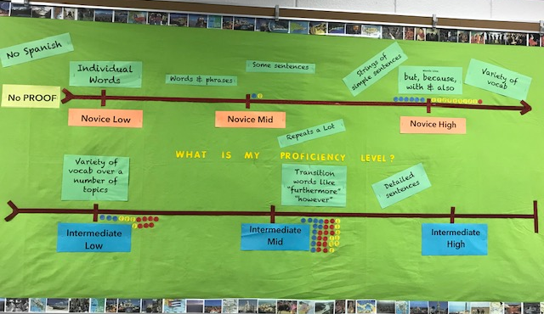
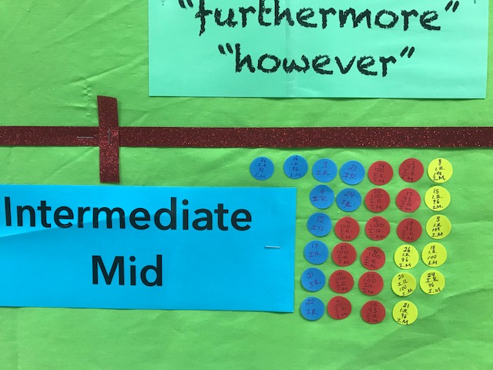
#BeIntentional with Constantly Challenging your Students
Blog Post, here

Slide 7
#BeIntentional with your classroom space
Remove barriers that may impede communication and community building.
Foster an environment that increases movement.

Slide 8
ACTFL’s 90%
Just like staying on the target language is so important during our classes, it is just as important to constantly make reference to all aspects of proficiency.

Slide 9
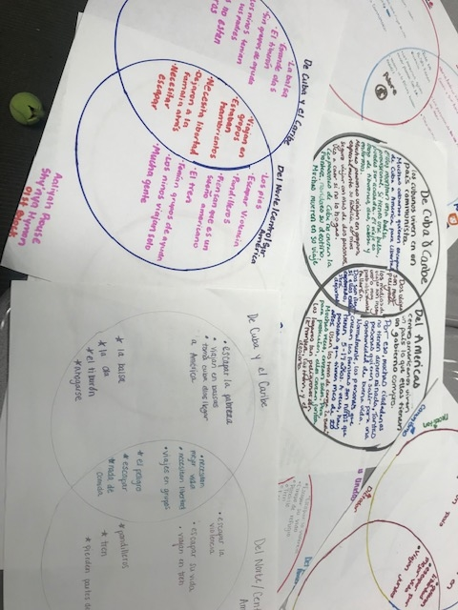
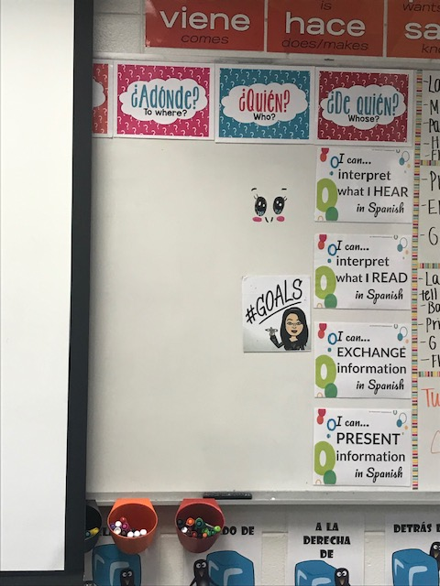
#BeIntentional with every activity!!!
Talk it up
Use a poster, such as this one, to point and guide students’ mindsets. Students want to know “how is this going to help me right now?”
Stop & Challenge
It is totally okay to stop in the middle of the activities to challenge students.
Make reference to proficiency path board. They will surprise you with their performance.
“I can posters” credits to Allison Wienhold and her blog Mis Clases Locas . Free download here.

Slide 10
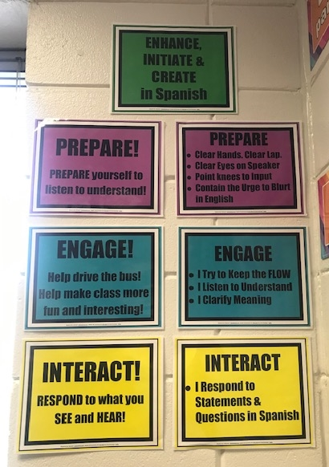
#BeIntentional with Keeping Up with the Proficiency
Talk
...but they won’t be quiet
Provide a grade for Interpretive / Interpersonal skills!
La Maestra Loca’s rubric, click here
Grant Boulanger’s rubric, click here
In this link, Allison Wienhold explains how she uses the rubric and the posters in her class.

Slide 11
#BEINTENTIONAL WITH CHALLENGING & SUPPORTING STUDENTS IN THEIR PROFICIENCY JOURNEY THROUGH CLASS ACTIVITIES/TASKS/GOALS
Can Do
Differentiation
Level Up opportunities
Photo credit: Kevin Smith at www.freeimages.com

Slide 12
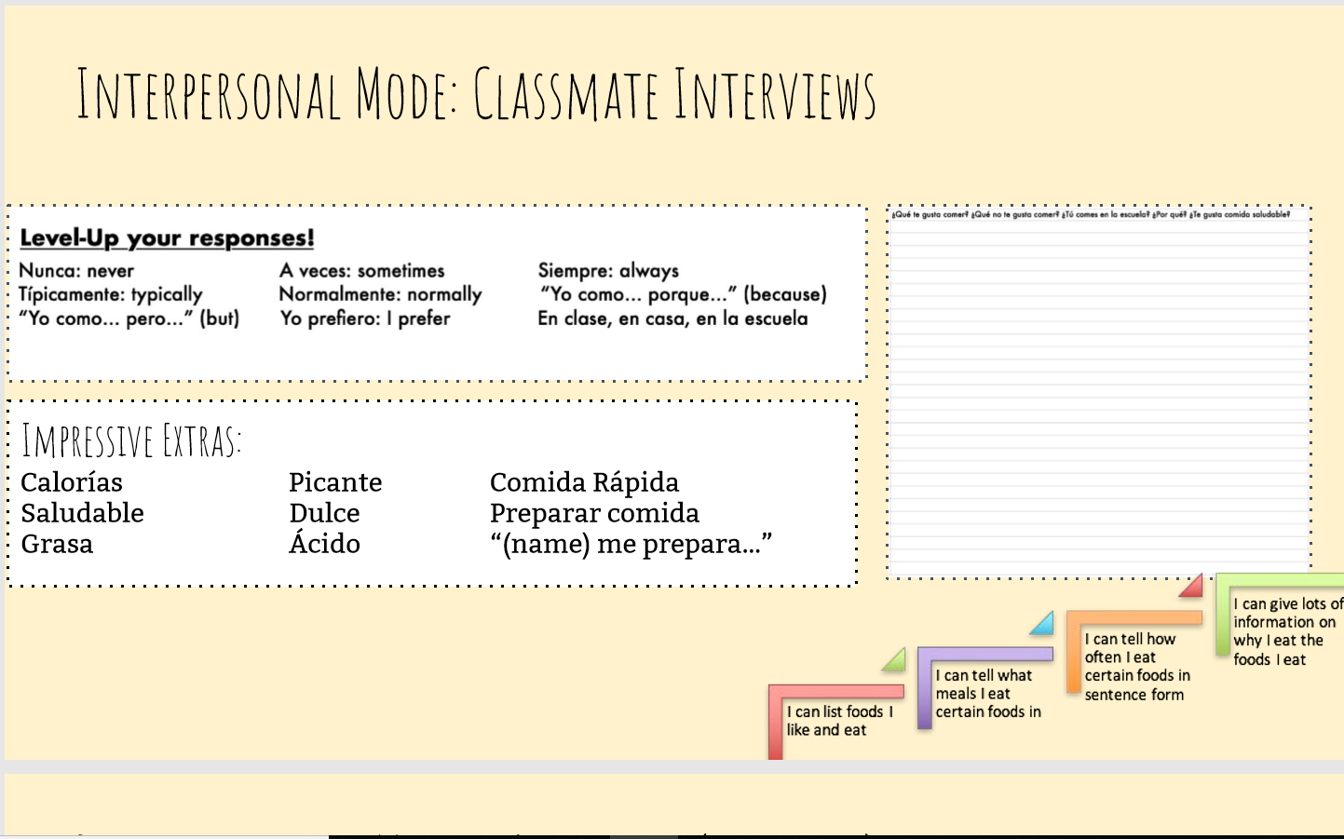
Meredith White's Example

Slide 13
Bethany Dew's Example

Slide 14
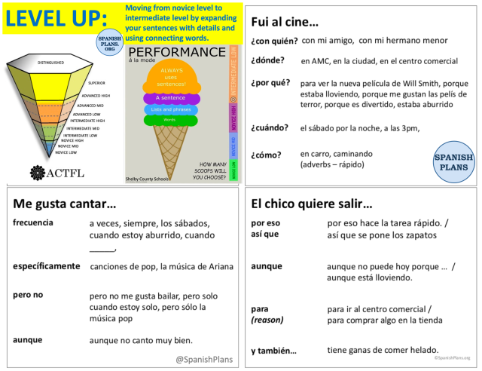
Justin @Spanish Plans' Example

Slide 15
Señora Chase's Example

Slide 16
Great
Resources!
FIND
THEM
HERE
Bethany Dew’s Weekend Chat blog post, here
Señora Chase’s ACTFL Proficiency Quick Quiz Rubrics, here
Meredith White’s Amazing Slides, here
Justin @SpanishPlan’s Leveling Up blog post, here
Joshua Cabral’s Generation Z blog post, here

Slide 17
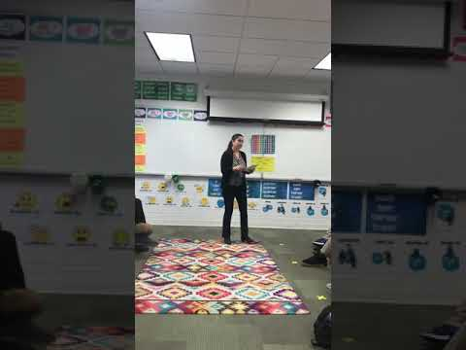
How to Introduce Activity to Students Video

Slide 18
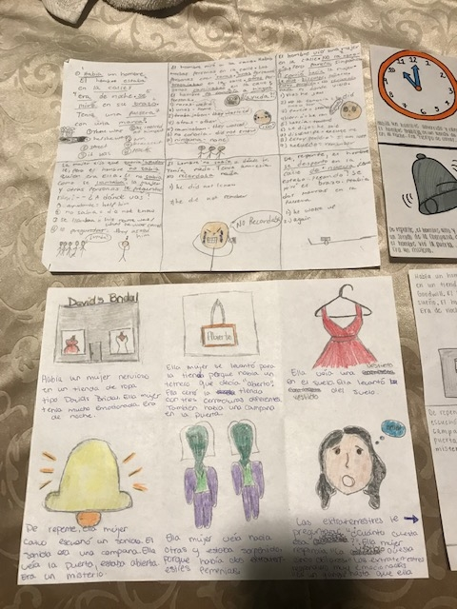
Story Boards

Slide 19
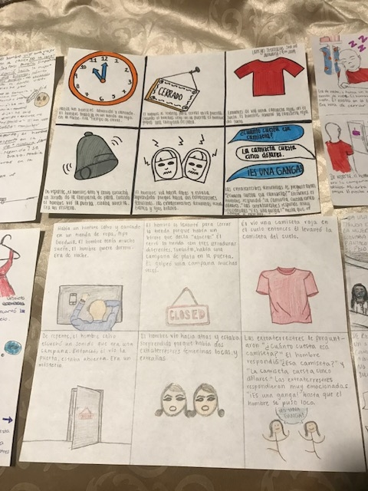
Story Boards

Slide 20
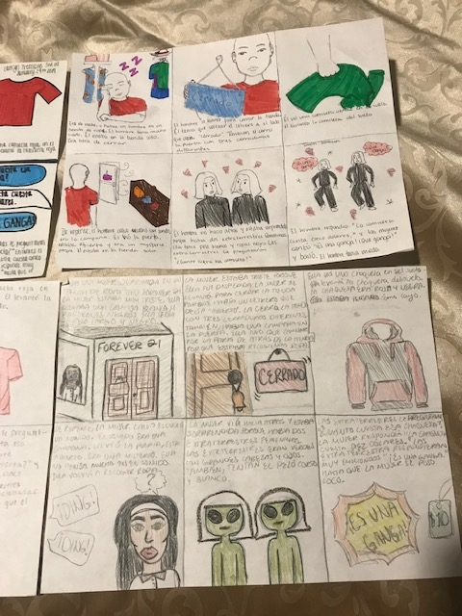
Story Boards

Slide 21
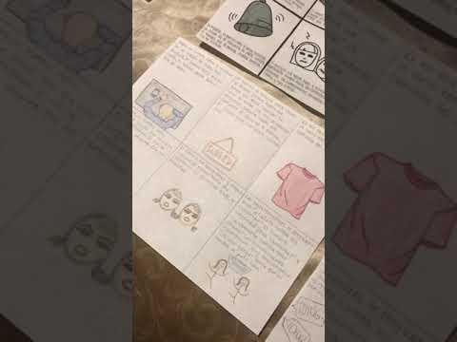
A Reflection
On Using Story Boards.

Slide 22
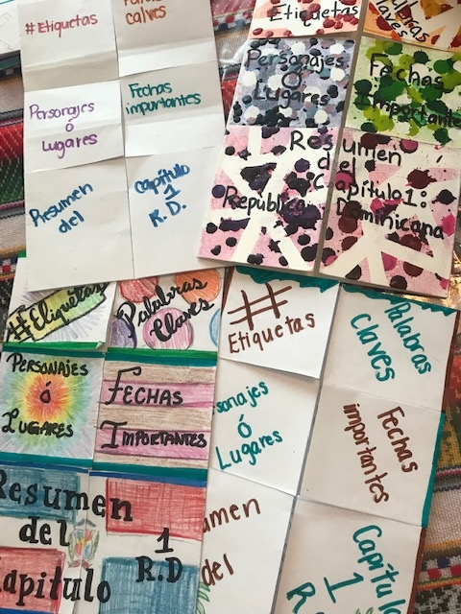
FOLDABLES!

Slide 23
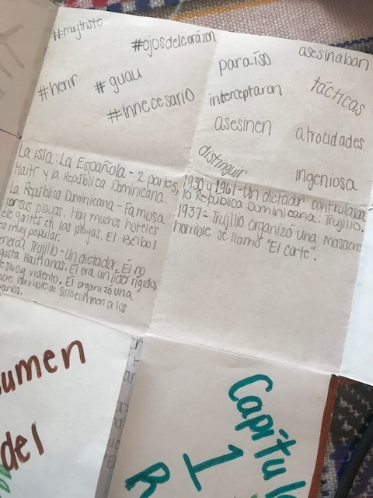
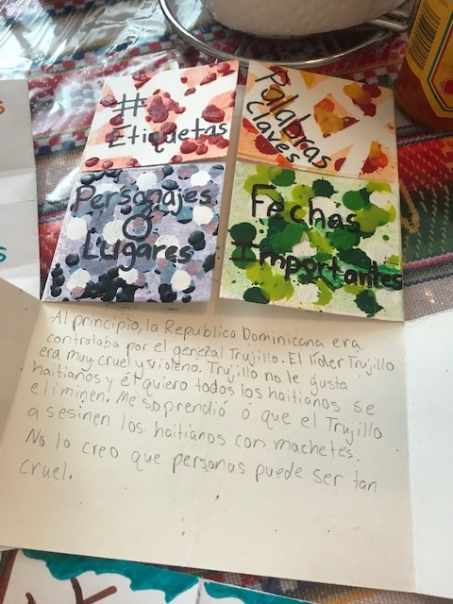
FOLDABLES!

Slide 24
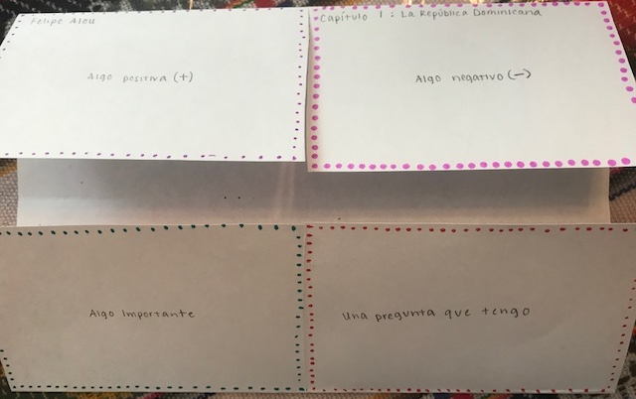
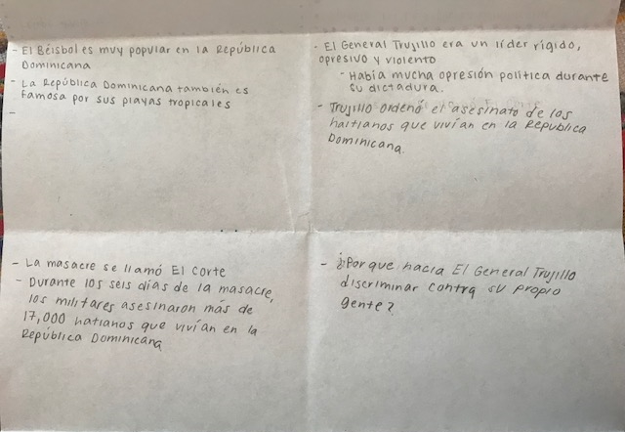
The Four Square Story Map
Idea from Martina Bex. Explanation and free template can be accessed here.
FOLDABLES!

Slide 25
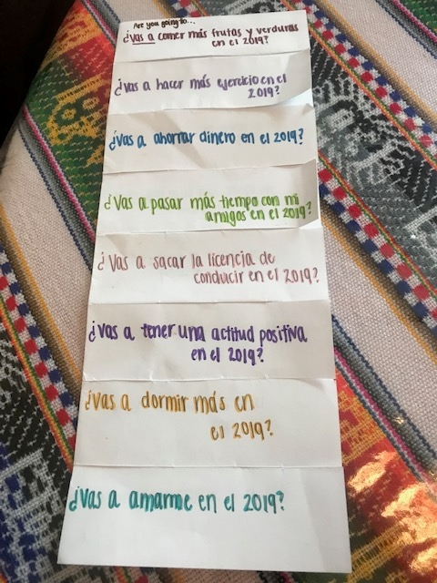
FOLDABLES!

Slide 26
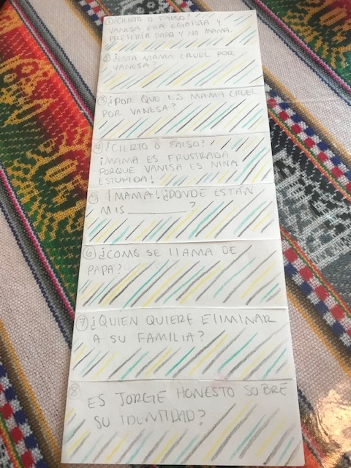
FOLDABLES!

Slide 27
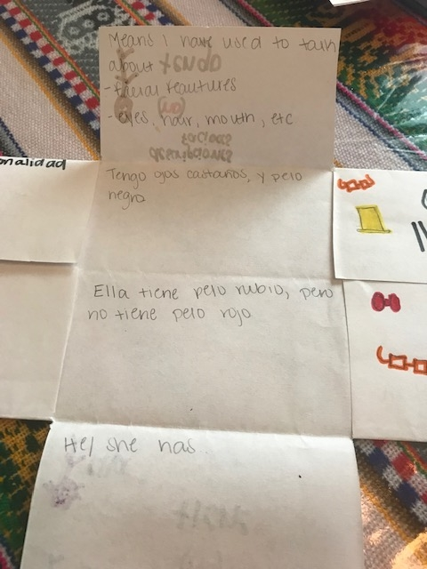
FOLDABLES TO SUPPORT GRAMMAR

Slide 28
Acquisition is SLOW!
12,000 - 14,000 hours
600 hours!
Let’s not think in terms of years, but in terms of hours
Time it takes for children to acquire basic language
Approximate time students spend on language courses while in high school (Level 1-4)
What do we expect of L2 learners in their ability and in their implicit system? - Bill Van Patten, Talkin’ L2 with BVP, Episode 20
Notes:
me of sequential language courses

Slide 29
#BEINTENTIONAL in creating success for your students through assessment
Create the assessment
Generate tools for success with the lower performers in mind, but which are available to everyone
Be prepared to be mind blown as you grade and provide feedback!

Slide 30
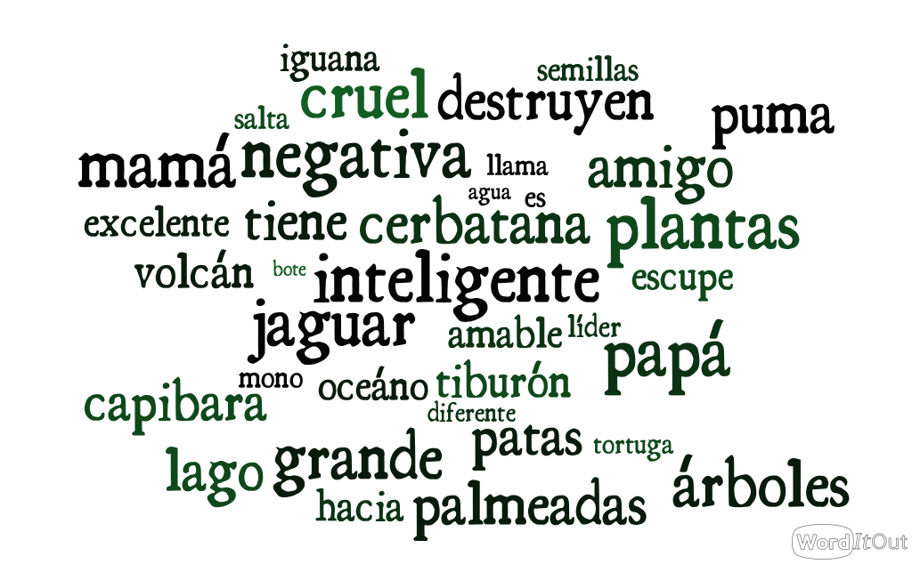
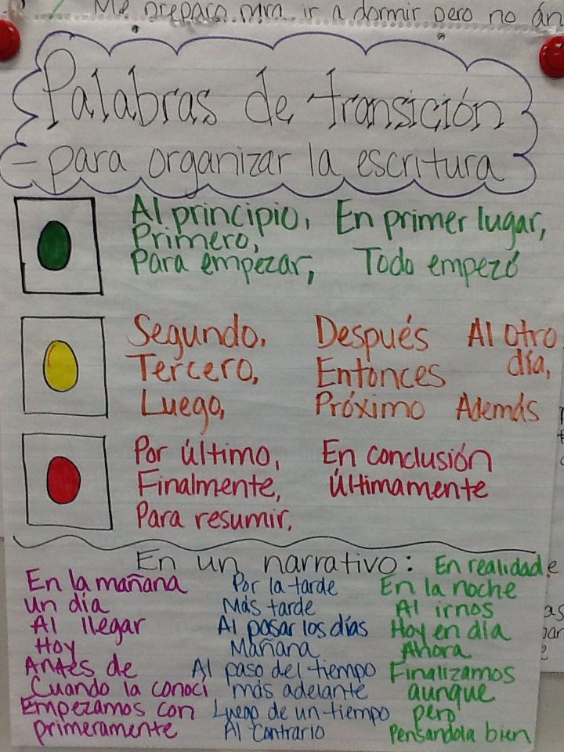
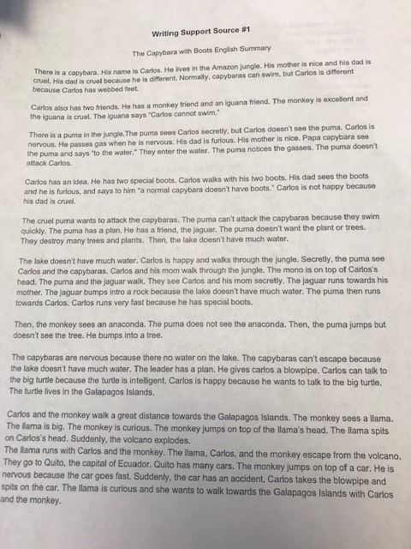
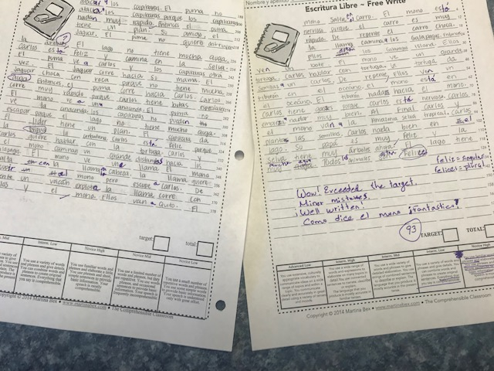
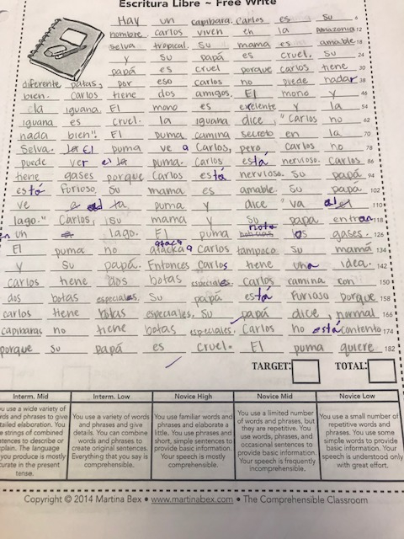
ASSESSMENT
SUPPORT

Slide 31
A Special Thanks
Special thanks to all the amazing educators who have instill so much knowledge in me and have contributed to my growth as an educator:
My school’s Principal, Mr. Alfred McGuire and Assistant Principal, Mr. Michael Soltysiak.
My school’s Administrative Secretary, Mrs. Carrie Early.
My district’s World Language Specialist, Dr. Mark Linsky
My amazing SCCPSS CI community: Maribel Gomez, Sarah Downey, Angela Williams, Hakim Azerzaq, and others
Meredith White, Bethany Dew, Anne Marie Chase, La Maestra Loca, Allison Wienhold, Grant Boulanger, Joshua Cabral, Carol Gaab, and so many more.
A special thanks to Ashley Uyaguari’s Inspired Proficiency Podcast, and the Talkin’ L2 Podcast Team because these podcasts have helped me grow so much during the past year.

Slide 32
Slide show credits:
Presentation template by SlidesCarnival
Classroom Photos by Bertha Delgadillo
Other Photographs by Unsplash & Death to the Stock Photo (license)
Dark wood background by The pattern library

Slide 33
Thank you!
FIND
ME
HERE
Bertha Delgadillo, M. Ed.
Twitter: profedelgadillo
Instagram: profesoradelgadillo
Blog: https://laprofesoradelgadillo.wordpress.com
E-mail: ahtreb_hdz@hotmail.com

