Slide 1
Writing Strategies for AP Language
Donna Springer
AP Language/Mill Creek High School

Slide 2
Before Writing…
Review of College Board essays for a particular prompt
Thesis practice for the prompt
Review of the prompt and what it asks

Slide 3
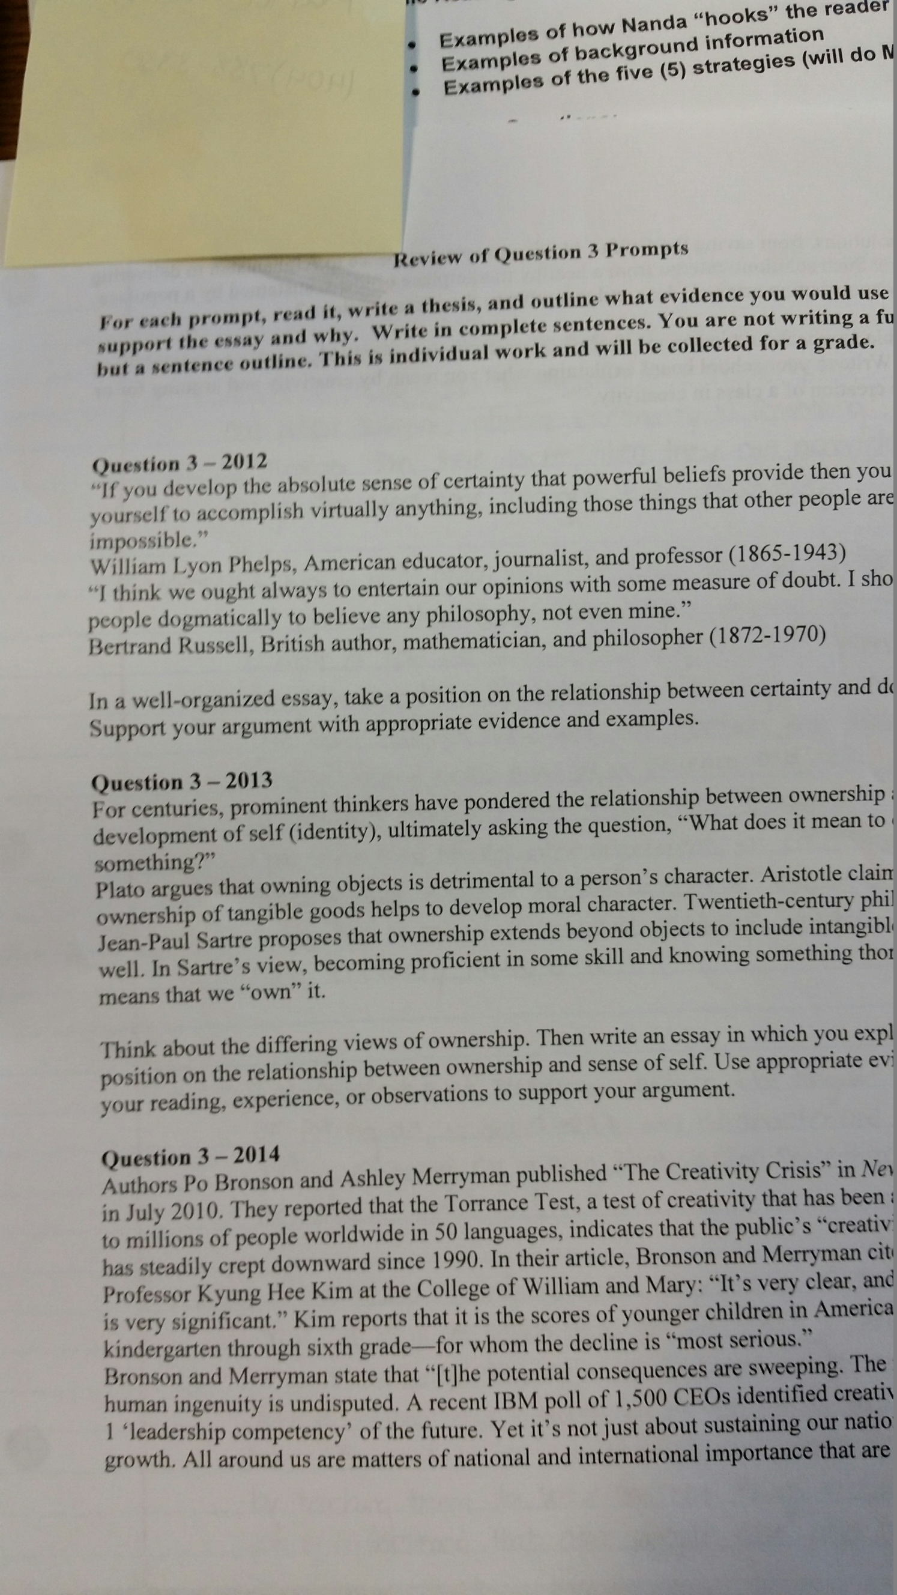

Slide 4
Prompt…
Use of a current prompt (synthesis, rhetorical analysis, or argument)
This assignment works for all three essays
The students write a first draft of the essay
For this example, I used 2015 prompt
I read the essays, but do not grade them, and I use parts of their essays for this assignment

Slide 5
Day 1
Students are given document 1
https://docs.google.com/document/d/1mAXAWP8RY9GeKTmxGgmOa6m4yPnibSWmGz0tHabWsRs/edit
The excerpts are from actual student essays
With a partner, students rewrite the excerpts for better fluency, use of vocabulary, use of evidence

Slide 6
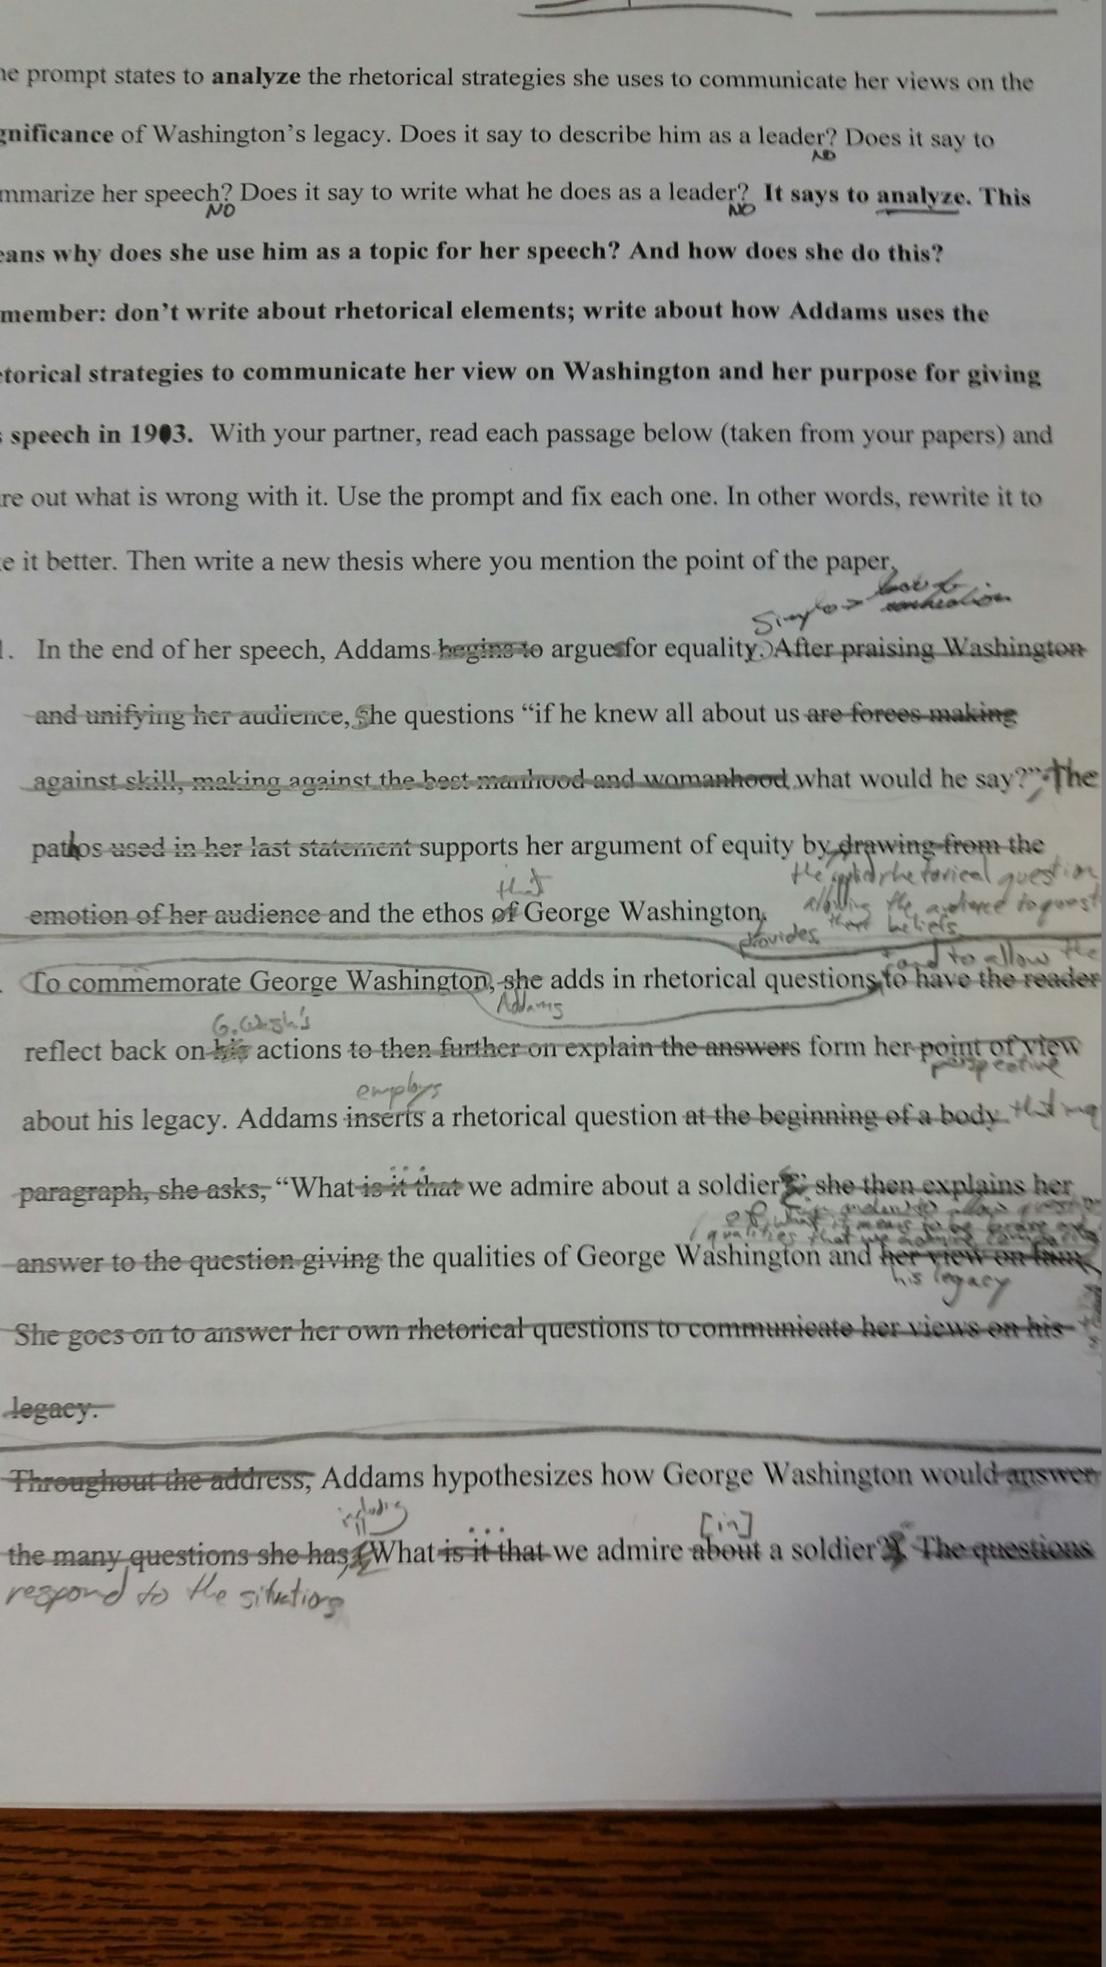

Slide 7
Day 2
Using the projector and an document camera, as a whole class, we correct each one
I write, as they offer suggestions for each example and, as a whole class, we discuss what we think needs to be improved and why

Slide 8
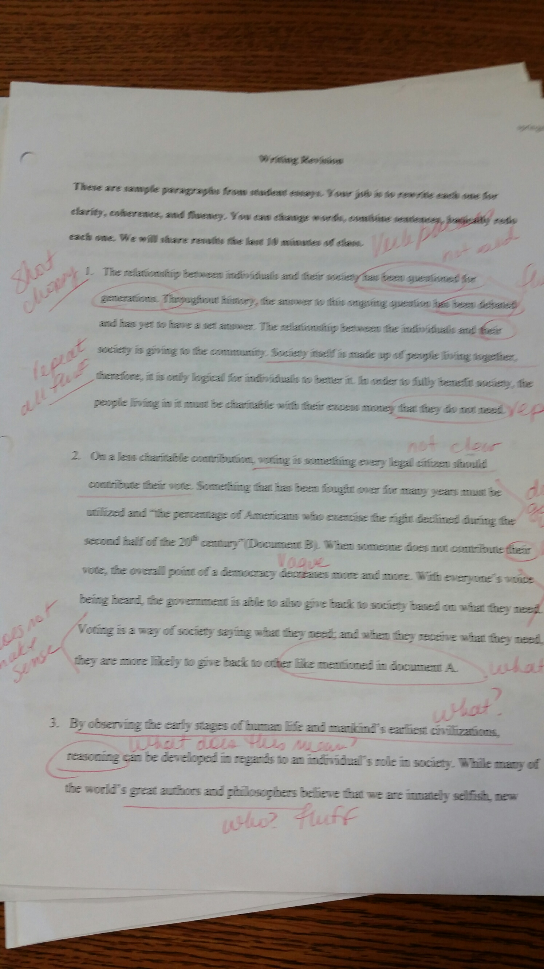

Slide 9
Day 3
They are given handout 2 – an actual student essay to color code
https://docs.google.com/document/d/1djMXH79VSINc_AcAR81ZgthecopjGVGCntxyjbHfbqc/edit
As you see on the handout, each color represents different aspects of the essay – thesis, vocabulary, sentence structure, fluency, textual support

Slide 10
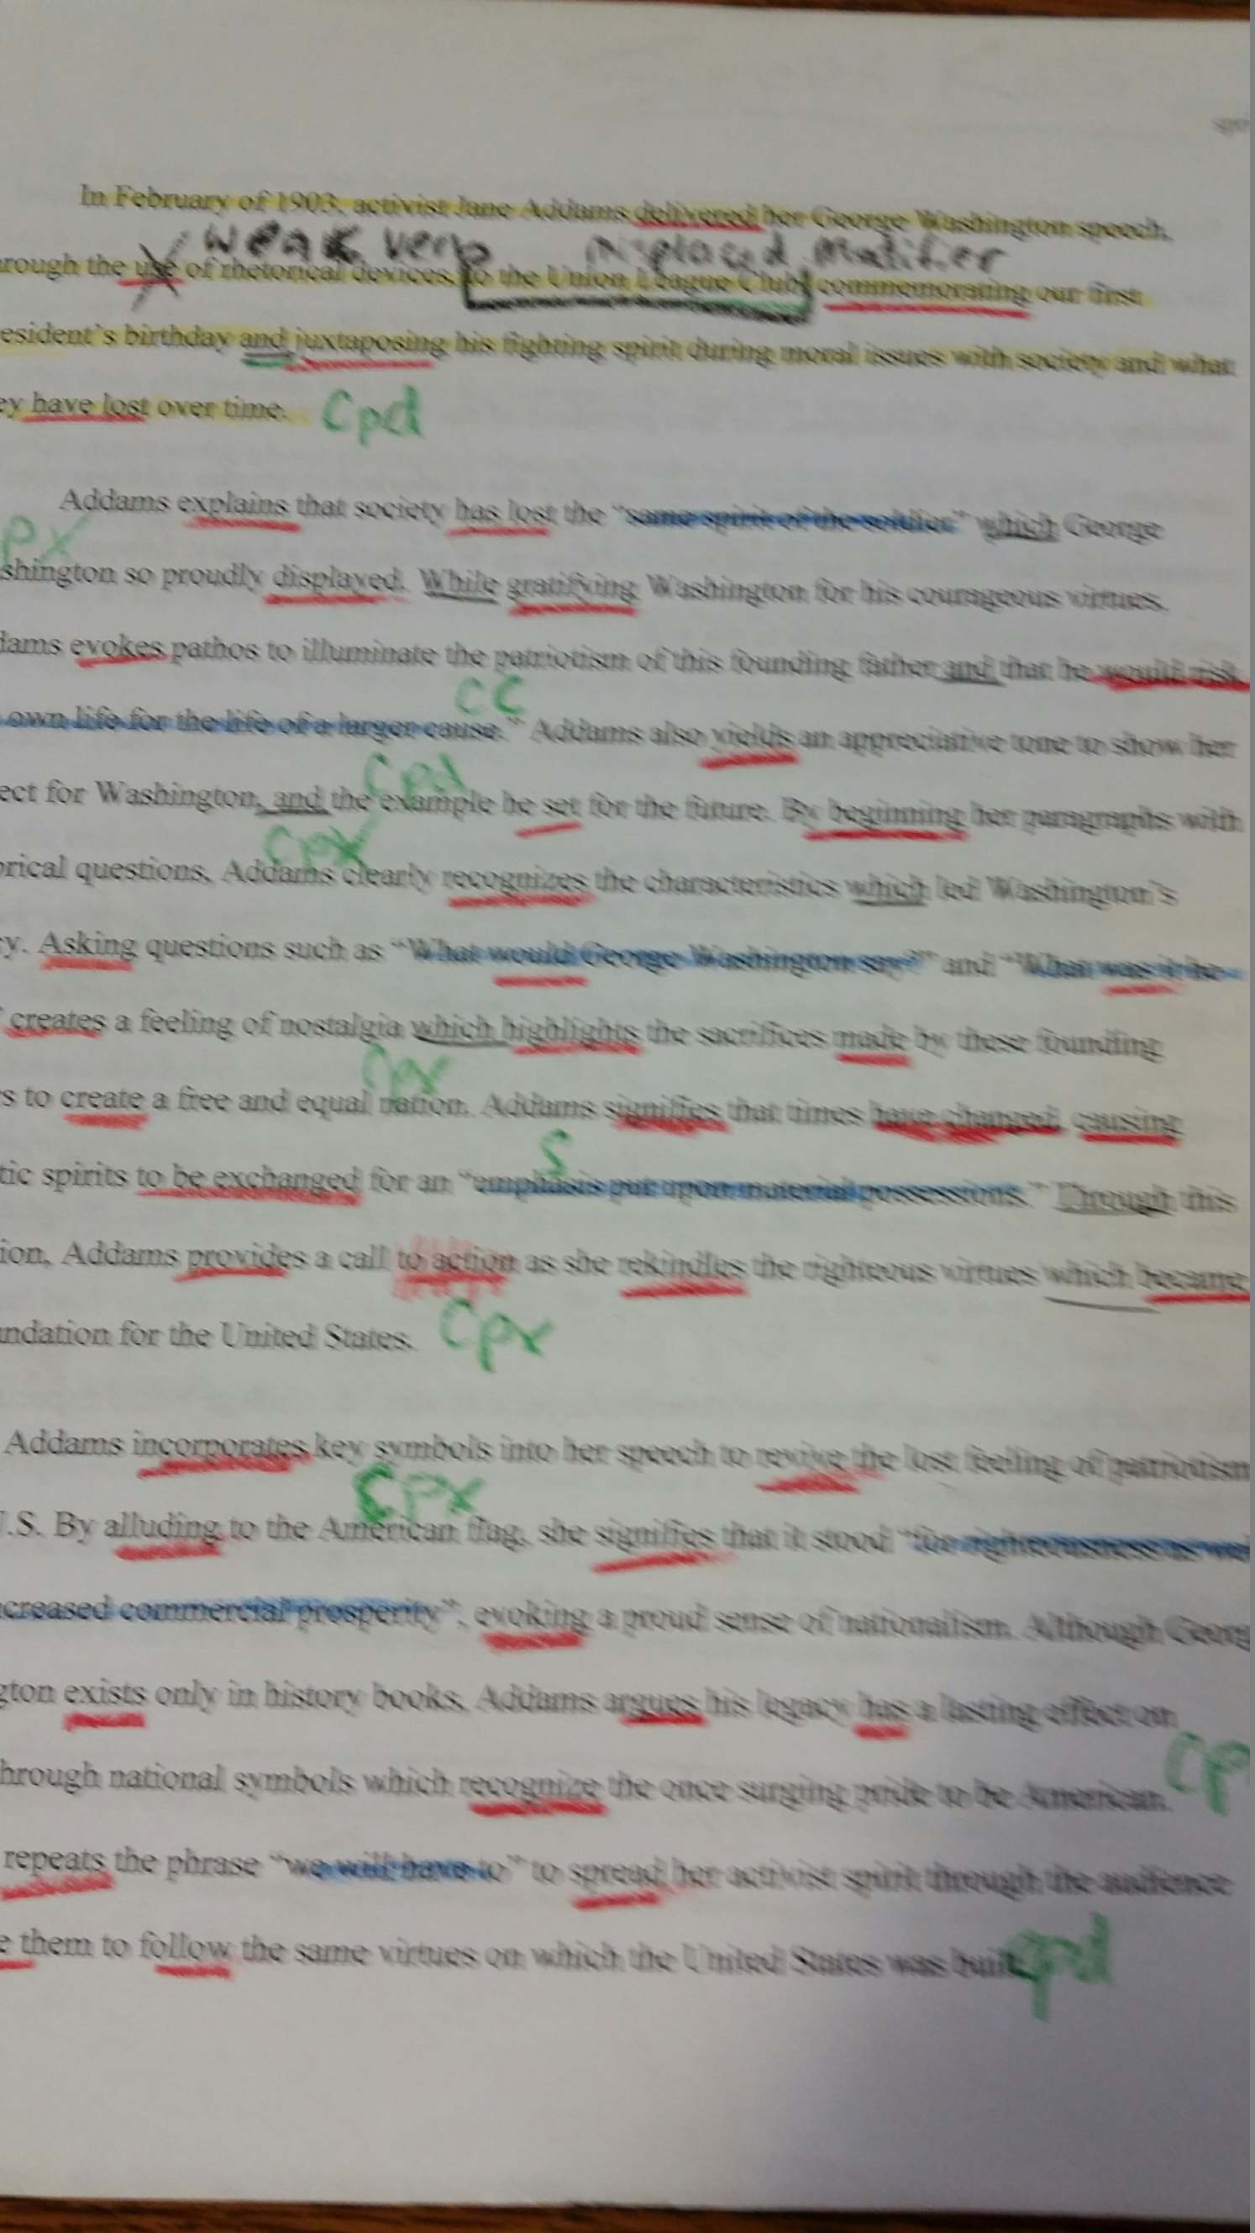

Slide 11
Day 4
Similar to the first assignment, I use the document camera to model the essay and color code it

Slide 12
Day 5
Students now color code their own essay
On day 6 they rewrite their essay

Slide 13
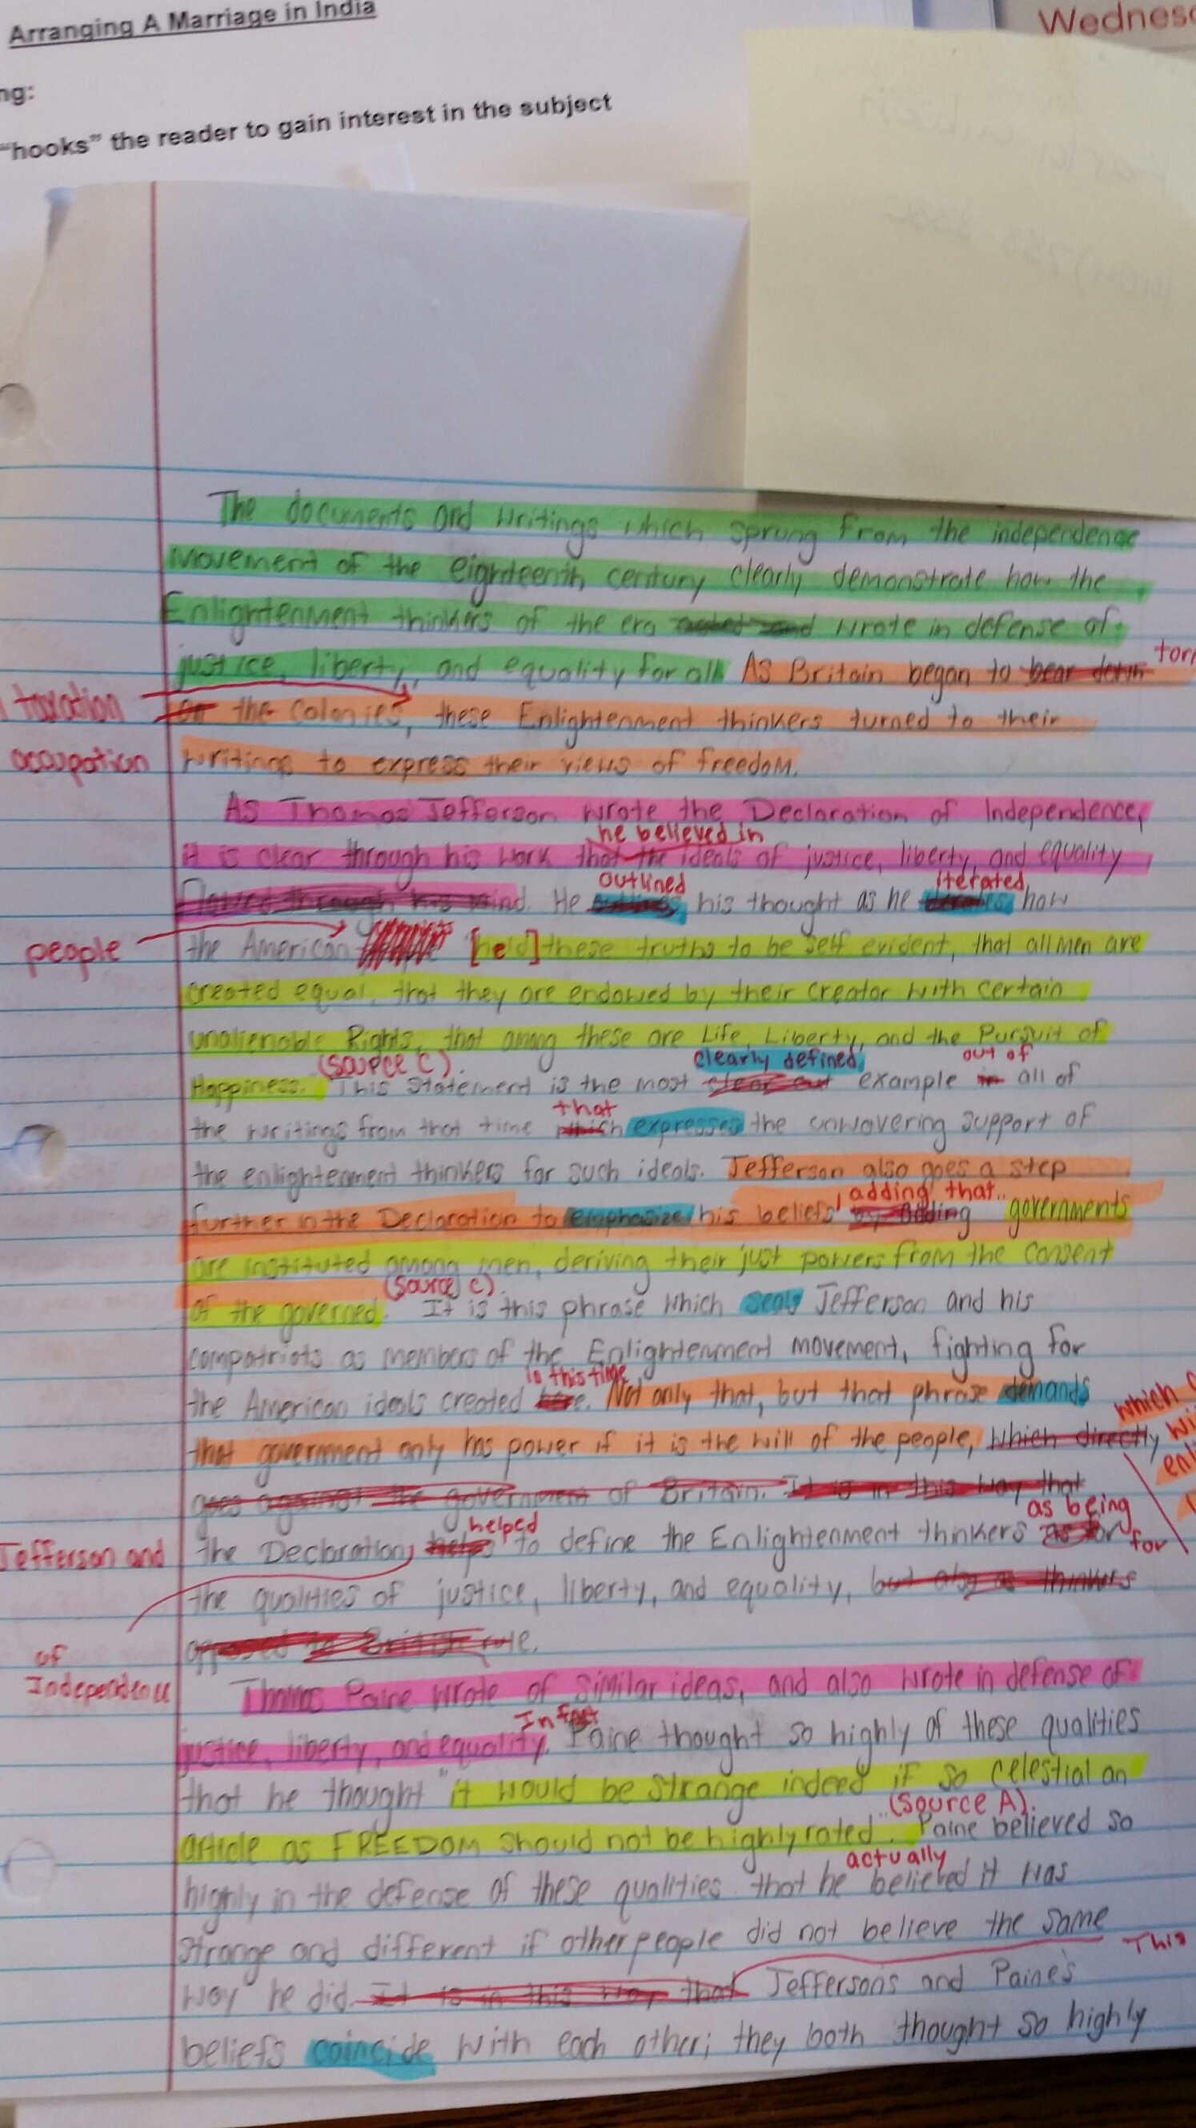

Slide 14
Key Points..
FOCUS ON THE THESIS AND HAVE THEM TELL ME WHAT MAKES IT GOOD OR NOT AND WHY.
I ALWAYS EMPHASIS AP CALIBER VERBS .
WE SPEND QUITE A BIT OF TIME ON LOOKING AT NOT ONLY A STUDENT’S ESSAY BUT THEIR OWN AND USING EXAMPLES FROM THEIR ESSAYS ON THE BOARD AS WELL TO REVIEW THE USE OF EVIDENCE AND WHAT CONSTITUTES GOOD EVIDENCE.
ALSO, I WORK WITH THEM ON HOW TO INCORPORATE THE EVIDENCE WELL AND NOT JUST WRITE A STATEMENT, USE A QUOTE, AND MOVE ON.

Slide 15
Key Points..
SENTENCE STRUCTURE IS ALSO VERY IMPORTANT.
I WANT THEM TO SEE THAT WRITING SIMPLE SENTENCES ONLY CREATES A MONOTONOUS ESSAY AND WILL NOT GET A GOOD SCORE.
I LET THEM, WITH SUBSEQUENT ESSAYS, REWRITE THEIR SENTENCES TO FORM MORE COMPLEX STRUCTURES.

Slide 16
Key Points…
I also handout the rubric from the College Board (which we have already discussed in a previous class) and have them use that to help with the color coding.
I’ve used this technique with all three essays for the first one they write. It has helped immensely so that by the time they write the second essay and subsequent essays they have a more solid foundation of what is expected on each one and their strengths and weaknesses.

Slide 17
Advanced color coding
After doing this basic color coding for the first essay, I use an advanced form for the 2nd essay.
https://docs.google.com/document/d/1oTRHVkfIoLV-uJPtyFpHXMTFoexW0DVfuUjS22IdBZE/edit

