Slide 1

Welcome!
The Road Ahead
Unlocking Georgia’s potential!

Slide 2
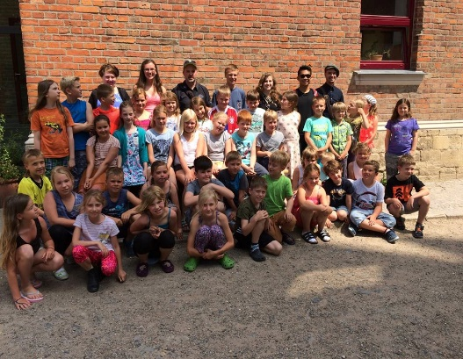
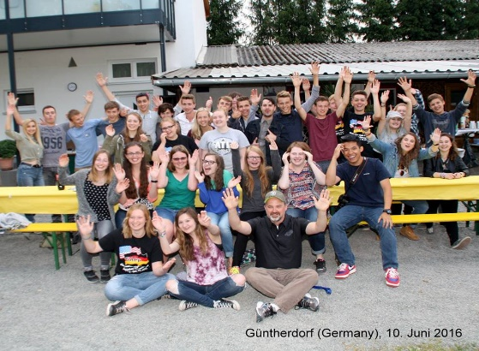
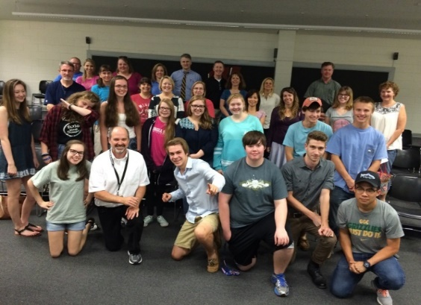
Mr. Patrick Wallace
Program Specialist: World Languages &
Global Workforce Initiatives
pwallace@doe.k12.ga.us
Facebook: Georgia Department of Education World Languages
Instagram: gadoeworldlanguages
Twitter: gadoeworldlang

Slide 3


Working together toward common goals!
World Language Programs K-12
World Language Virtual Programs K-12
International and Cultural Partners
Dual language Immersion Programs K-12
World Language
Professional Organizations
World Language Programs at
Universities, Colleges and Technical Colleges

Slide 4

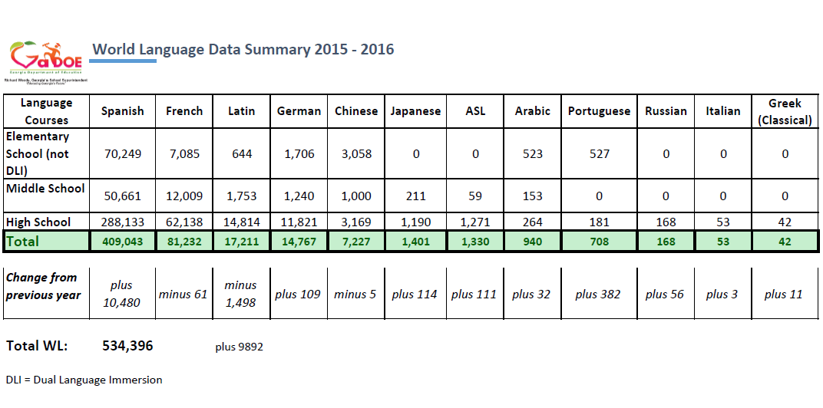
Richard Woods, Georgia’s School Superintendent
“Educating Georgia’s Future”
gadoe.org
Overview: The current Situation
Rising numbers & Expanded offerings
Biliteracy/Proficiency Targets

Slide 5
Richard Woods, Georgia’s School Superintendent
“Educating Georgia’s Future”
gadoe.org
World Languages – A critical Need
18.5% nationwide
5% nationwide took an AP WL exam in 2013 (8 courses)
= ca. 200.000 (increase of 17% in the past 5 years)
Biggest increases: Spanish and Chinese
30.21% in Georgia

Slide 6
Richard Woods, Georgia’s School Superintendent
“Educating Georgia’s Future”
gadoe.org
World Languages – A critical Need
Total: 524,504 (2015-2016)
Total Student Population: 1,736,416
Percentage: 30.21%
Students taking an AP WL exam (2013): 3671
Percentage: 0.93% of all WL students in GA (2013)
Source: GaDoE Data and CollegeBoard 2015

Slide 7
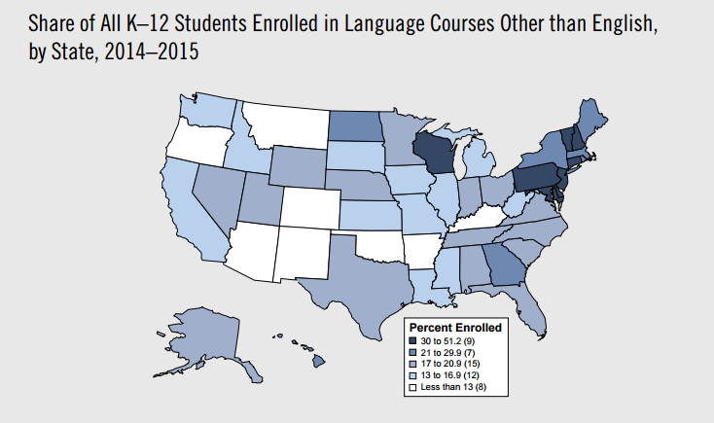
Source: American Academy of Arts and Sciences -The State of Languages in the US 2016

Slide 8
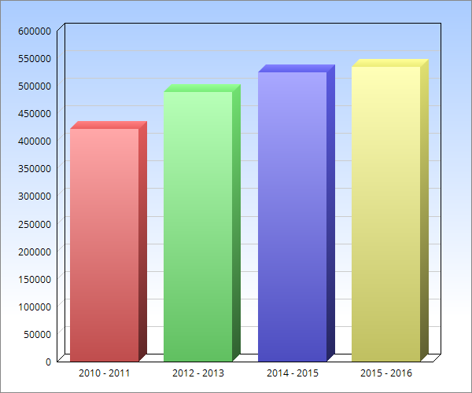
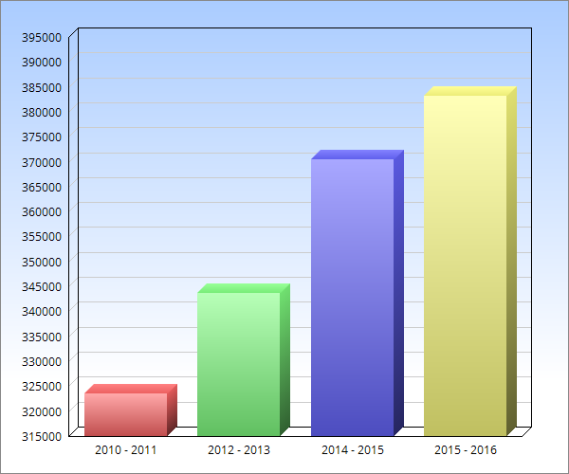
Growth of Overall Language
Offerings in Georgia (4 yrs)
Growth of High School Language
Offerings in Georgia. (4 yrs)

Slide 9
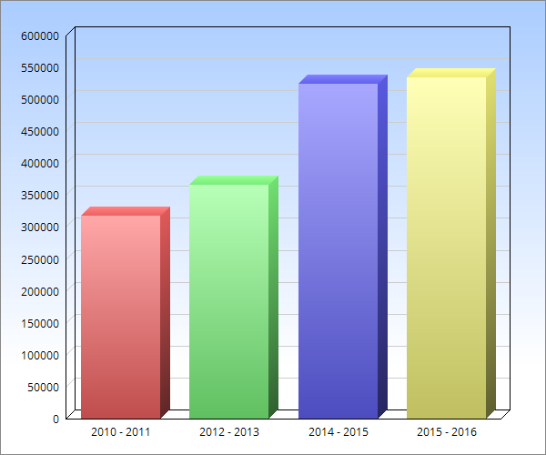
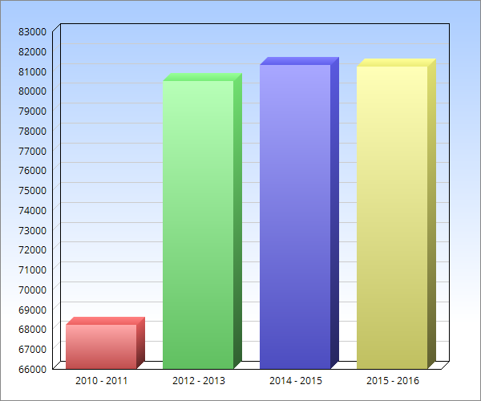
Growth of Spanish Language
Offerings in Georgia (4 yrs)
Growth of French Language
Offerings in Georgia. (4 yrs)

Slide 10
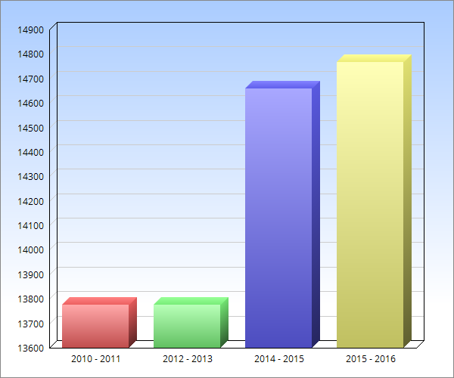
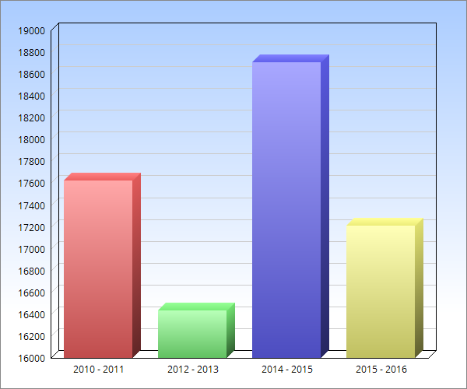
Growth of German Language
Offerings in Georgia (4 yrs)
Latin Language
Offerings in Georgia. (4 yrs)

Slide 11
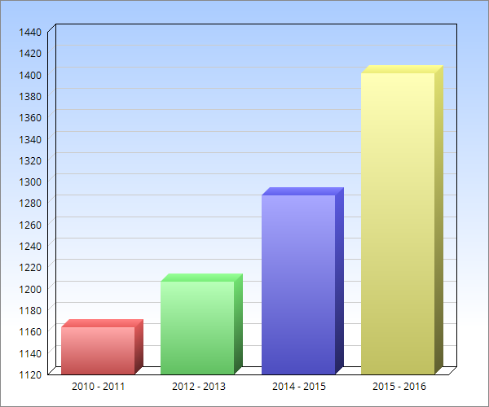
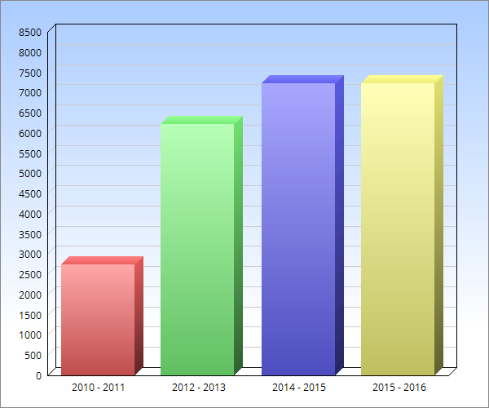
Growth of Japanese Language
Offerings in Georgia (4 yrs)
Growth of Chinese Language
Offerings in Georgia. (4 yrs)

Slide 12
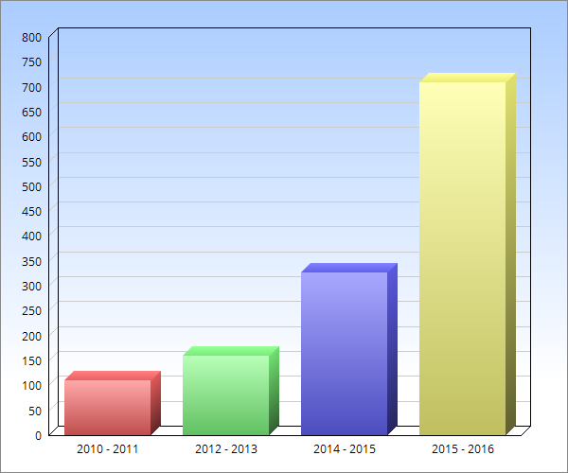
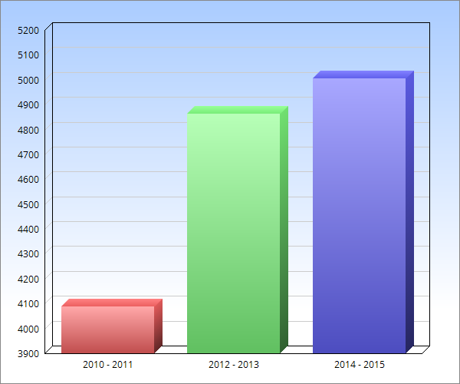
Growth of Portuguese Language
Offerings in Georgia (4 yrs)
Growth of AP Language
Offerings in Georgia. (3 yrs)

Slide 13
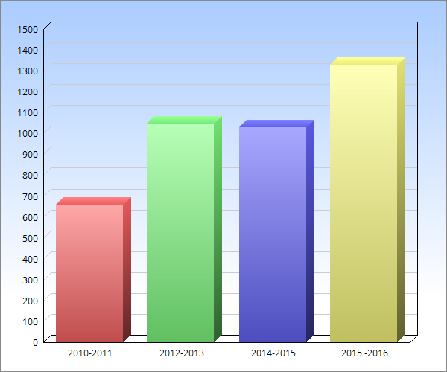
Growth American Sign Language
Offerings in Georgia (4 yrs)

Slide 14
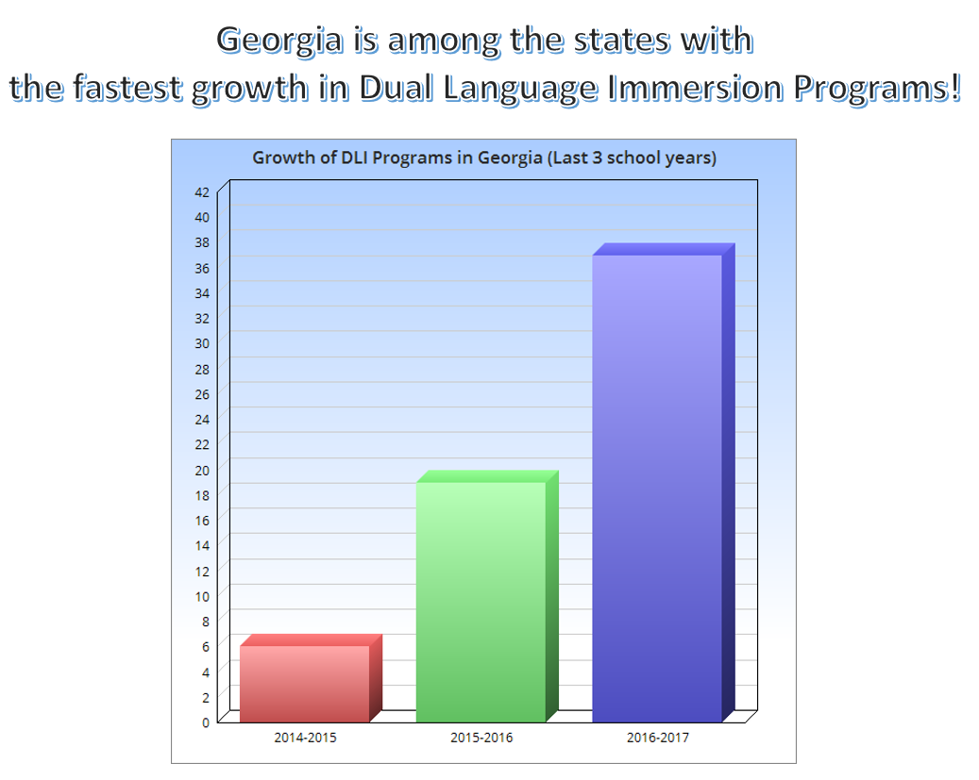

Slide 15

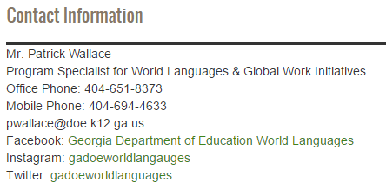
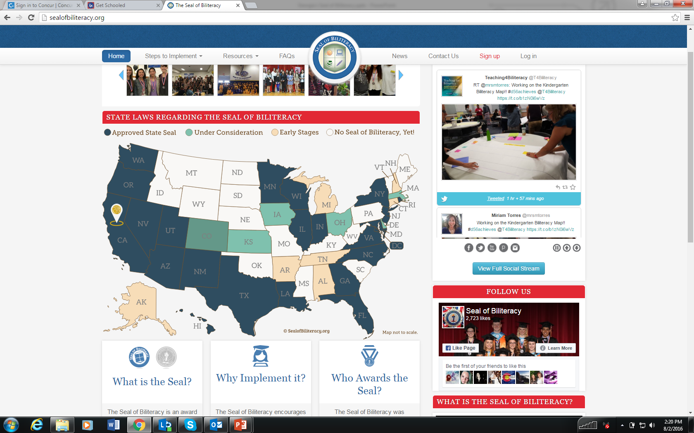
Richard Woods, Georgia’s School Superintendent
“Educating Georgia’s Future”
gadoe.org
Biliteracy Seal
22 states have passed a Seal of Biliteracy.
Rationale:
Help students realize that being biliterate is an asset!
Improve earnings potential for students.
Connect businesses with bilingual employees.
Promote World Language study/interest
Promotes higher academic achievement/participation in IB/AP.
Signal to University system of advanced language learners.

Slide 16
Richard Woods, Georgia’s School Superintendent
“Educating Georgia’s Future”
gadoe.org
Requriements for the Biliteracy Seal
(1) Completion of all English language arts requirements for graduation with an overall grade point average of 3.0 or above in those classes; and
(2) Proficiency in one or more languages other than English, demonstrated by passing a foreign language advanced placement examination with a score of 4 or higher or an international baccalaureate examination with a score of 5 or higher; provided, however, that for languages in which an advanced placement examination is not available, the Department of Education may provide a listing of equivalent summative examinations that local school systems may use in place of such an advanced placement examination.
Participation is voluntary

Slide 17
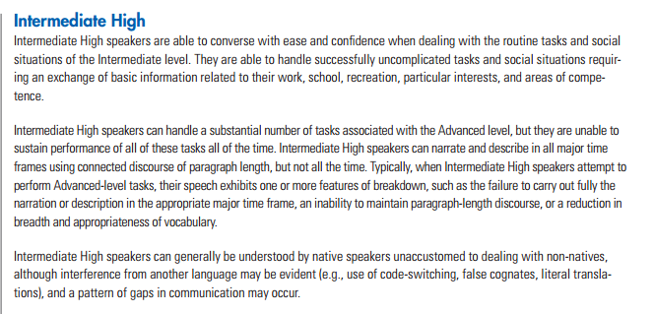
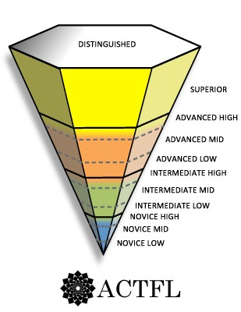
What proficiency level do students need to demonstrate?
The minimum target level should be Intermediate High based on the ACTFL Proficiency Guidelines.
For many languages, including English, specific assessments exist and provide a valid and reliable means of measuring students’ language proficiency. The evidence needs to evaluate students’ use of the language, not knowledge about the language.

Slide 18

Chart of approved proficiency exams that meet the minimum requirement
for Georgia’s seal of biliteracy
Please see the table below for approved proficiency exams and required minimum scores or proficiency levels. Please contact the Program Specialist for World Languages, Mr. Patrick Wallace at pwallace@doe.k12.ga.us, to inquire about languages that are not listed.
Further clarification on these tests can be found on the GaDOE Website for the Seal of Biliteracy
 | Test Name | Testing Organization | Minimum Qualifying Score
Tier 1 | AP Language Exams SL or HL Language B exam | College Board International Baccalaureate | 4 5 (SL or HL only)
Tier 2 (When Tier 1 test are not available at the school for tested language) | OPI,RPT, WPT or OPIc STAMP Test ACTFL - (AAPPL) ACTFL – (ALIRA) - Latin DELE – Spanish DSD – German DELF – French Youth Chinese Test (YCT) HSK – Chinese SLPI – ASL TOPIK - Korean | Language Testing International Avant-STAMP 4S Assessments Language Testing International Language Testing International Cervantes Institute German Educational Ministers Office International Centre for French Studies Hanban Hanban National Technical Institute for the Deaf National Inst. Internatl. Education (NIIED) | Intermediate High 6 Intermediate High Intermediate 4 B1 DSD Level 1 Level B1 Level 3 Level 3 Intermediate Plus 4

Slide 19

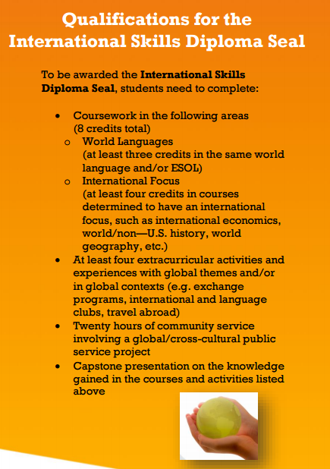
Richard Woods, Georgia’s School Superintendent
“Educating Georgia’s Future”
gadoe.org
The International Skills Diploma Seal

Slide 20

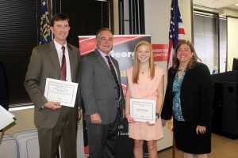
Congratulations!
The following Georgia Schools have been approved to offer the International Skills Diploma Seal to their students beginning this school year! This exciting program continues to expand!
Villa Rica High School – Carroll county
Bowden High School – Carroll County
McEachern High School – Cobb County
Kennesaw Mountain High School – Cobb County
Alexander High School – Douglas County
Chapel Hill High School – Douglas County
North Forsyth High School – Forsyth County
Whitewater High School – Fayette County
Riverwood International Charter School – Fulton County
Drew Charter Senior Academy – Charter School in Atlanta
H. V. Jenkins High School – Savannah/Chatham County
Islands High School – Savannah/Chatham County
New Hampstead High School – Savannah/Chatham County
Savannah Early College – Savannah/Chatham County
Putnam High School – Putnam County
Sequoyah High School – Cherokee County
Thomas County Central High School – Thomas County
The International Skills Diploma Seal is awarded to graduating high school students who complete an international education curriculum and engage in extracurricular activities and experiences that foster the achievement of global competencies. It is a signal to employers and higher education institutions that a student is prepared to participate in the global economy.

Slide 21

The International Skills Diploma Seal
Recent quotes from Student capstone presentations!
“The cultural walls are not as high as you think they are.”
“Each person brings a different story.”
“I thought I was culturally diverse. I am from India. Little did I know.”
“Culture is different within us every day.”
“How do my heritage traditions and my cultural heritage help my community?”
“I learned how different my Chinese culture is from the Chinese culture.”
“One way of doing things is not necessary the right way. There is not just one way of doing things.”
“Cultures can appreciate each other without being intimidated.”
“Even though we are in different places, we still have the same problems.”

Slide 22
Dual Language Immersion Programs
A brief History of DLI Programs in Georgia.
2007 – First DLI Charter School in Georgia is established at Unidos Dual Language School in Clayton County (Charter – now magnet school)
2008 – First non charter public DLI program is established at Beulah ES in Douglas County
- World Language Academy starts in Hall County Georgia (Charter)
2013-2014 = 6 schools
2015- 2016 = 19 schools
2016-2017 = 38 schools
2017-2018 = Increase is certain (How many…???)

Slide 23
Current DLI Programs
Atlanta Public Schools
Bolton Academy ES-Spanish (K)
E Rivers ES-Spanish (K-1)
Garden Hills ES-Spanish (K-1)
Morris Brandon ES-Spanish (K)
Perkerson ES-Spanish (K-3)
Sarah Smith ES - Spanish (K)​
Clarke County
Oglethorpe Avenue ES-Spanish (PreK-K)​
Clayton County
Unidos Magnet School-Spanish (PK-8)​
​Cobb County
Clarkdale ES-Spanish (K)
Dowell ES-Spanish (K)
Fair Oaks ES-Spanish (K)
Hollydale ES-Spanish (K)
Mableton ES-Spanish (K)
Nickajack ES-Spanish (K)
Norton Park ES-Spanish (K)
Riverside Primary-Spanish (K-1)
Russell ES-Spanish (K)
Smyrna ES-Spanish (K-1)​
Dalton Public Schools
Brookwood ES-German (K)​
DeKalb County
Ashford Park ES-German (K-3)
Barack H. Obama Elementary Magnet School of Technology​-Spanish (K)
Evansdale ES-French (K-3)
The GLOBE Academy Charter School - Chinese, French, Spanish (K-8)​
Rockbridge ES-French (K-3)​
Douglas County
Beulah ES-Spanish (K-5)​
Fulton County
International Charter School of Atlanta-Chinese, French, German, Spanish (K-5)
Oakley ES-Chinese (K-1)
Gwinnett County
Annistown ES-Spanish (K-2)
Baldwin ES-Spanish (K)
Bethesda ES-Spanish (K-2)
Camp Creek ES-Spanish (K)
Ivy Creek ES-Spanish (K)
Trip ES-French (K-2)
Hall County
McEver Arts Academy Charter School-Spanish (PK -3)
White Sulphur Elementary – Spanish (PK – K)
World Languages Academy Charter School-Spanish (PK-8)
Henry County
Dutchtown ES-Chinese (K-3)
Rockdale County
C.J. Hicks ES-Spanish (K)

Slide 24


Slide 25
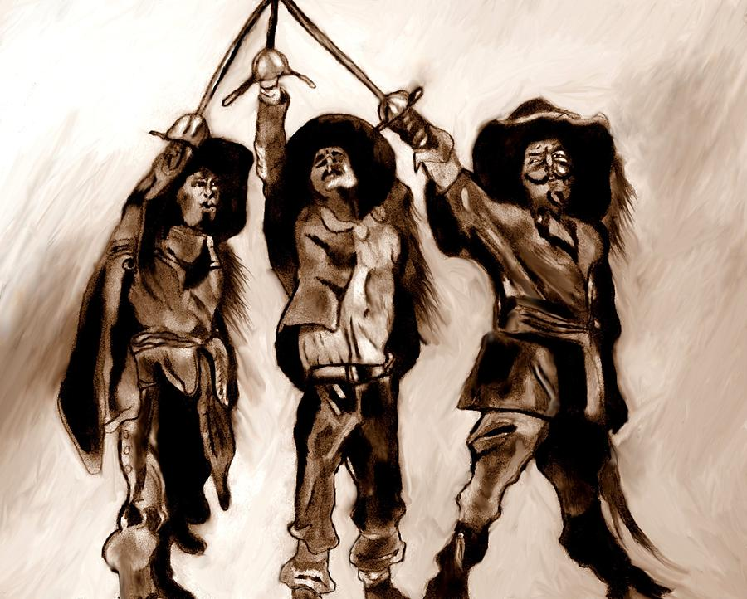
The year(s) ahead!

Slide 26
Where are the opportunities? – At first glance….
1) Greater opportunities for professional development for all World Language Teachers.
2) Greater cohesion and synergy among all partners engaged in World Language Education in Georgia.
3) Greater focus on moving toward proficiency in World Language Education.
4) Making the connection between cultural and linguistic competence and Workforce readiness.
5) The need to develop a strategy to address the critical WL teacher shortage in Georgia.
6) Increasing opportunities for cross cultural exchanges for teachers and students.
7) Moving toward greater collaboration with other subject disciplines and areas of K-12 education.
8) Increasing understanding of, engagement and participation with the ISDS and Biliteracy Seal Programs.
9) Understanding and supporting the growth of Dual Language Immersion Programs.
10) Developing language specific strategies to increase growth in all languages.
11) Raise awareness of World Language Education in Georgia.
12) Support and encourage growth of new languages and less commonly taught languages.
13) Build connective structures to encourage synergistic collaborations and share information.

Slide 27

Richard Woods, Georgia’s School Superintendent
“Educating Georgia’s Future”
gadoe.org

Slide 28
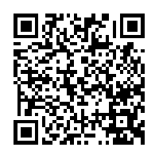
Presenter Survey
The Georgia Department of Education believes in continuous improvement and would appreciate your feedback to ensure the presentations we provide are of the highest quality and meet the needs of the specific audience. Access the QR code below to take the survey on your phone or tablet. All responses are anonymous.
http://www.gadoe.org/External-Affairs-and-Policy/communications/Pages/surveys/CI-3WVZ6RW.aspx

