Slide 1
Pizza Fun With Math TASK
Shonneka Smith-DuPriest
shonneka.smith-dupriest@clayton.k12.ga.us
Clayton County Public Schools
2nd-3rd Grade Gifted Virtual Lesson

Slide 2
About Me
Native of Michigan
Eastern Michigan, Central Michigan, Mercer University
20 Years Experience in Clayton County
Wife and Mother
Business Owner
Girl Scout Leader

Slide 3
GSE
MGSE3.OA.7 Fluently multiply and divide within 100, using strategies such as the relationship between multiplication and division (e.g., knowing that 8 × 5 = 40, one knows 40 ÷ 5 = 8) or properties of operations.
MGSE3.NF.1 Understand a fraction 1 𝑏 as the quantity formed by 1 part when a whole is partitioned into b equal parts (unit fraction); understand a fraction a b as the quantity formed by a parts of size 1 𝑏 . For example, 3/4 means there are three 1/4 parts, so 3/4 = 1/4 + 1/4 + 1/4 .

Slide 4
Materials
Use construction paper, crayons, pencils, scissors, glue, household items, craft materials and markers to create the actual pizza. You may use a real pizza box to keep it in.
Each student will need a task handout and rubric
Digital Resources - Jamboard
https://jamboard.google.com/d/1COo5l_XJrWrsMuMnscSPu21E3kQkj1mPhh4E-K-OF8I/viewer?f=0

Slide 5
Tasks
You will plan to create a pizza with a specific number of slices.
Each slice of pizza will have at least 3 toppings.
There should be equal groups of each topping on each slice of pizza.
You will create multiplication problems to represent how many of each topping is on your pizza, and explain your reasoning.
You will create division problems to show how you have displayed equal groups on each slice, and explain your reasoning.
You will come up with your own number of slices, your own topping names, and the amount of each you will use.

Slide 6
My Example
I can create a pizza with 4 slices.
My toppings will be pepperoni, olives and banana peppers.
There will be 12 pieces of pepperoni, 24 olives and 20 banana peppers on my pizza
You may NOT use my example numbers for your pizza.
Problems
12/4= 3 - If there are 12 pieces of pepperoni and 4 slices of pizza, each slice has 3 pepperoni.
4x3=12 – If I have 4 slices and each slice has 3 pieces of pepperoni, there are 12 pieces of pepperoni on my entire pizza.
24/4=6 If there are 24 olives on the entire pizza and the pizza has 4 slices, each slice will have 6 olives.
4x6=24 – If I have 4 slices and each slice has 6 olives, there are 24 olives on the entire pizza.
20/4=5 – If there are 20 banana peppers on the pizza and the pizza has four slices, each slice will have 5 banana peppers.
4x5=20 – If I have 4 slices and each slice has 5 banana peppers, there are 20 banana peppers on the entire pizza.

Slide 7
Create your Pizza
You now have time to use your creativity to design your pizza. Use the materials you have to make sure your pizza looks like you desire. Please take your time and work neatly. Also, make sure you have the correct number of each item to go on your pizza. When finished, you can place in a pizza box, our mount on a larger piece of construction paper.

Slide 8
Are you up for the challenge?
If the first set of tasks was very easy, then challenge yourself to create pizza for a larger group of people. Here is the new task.
If you had to make enough pizza for each classmate to receive ______________ pieces of pizza, how many pizzas will you need to make. Explain your answer.
How many of each topping will be needed altogether in order for you to have equal groups of each topping on each slice of pizza.
Which topping did you use the most of compared to the others.
Which topping was used the least.

Slide 9
Challenge Example
We have 26 classmates. If I had to make enough pizza for each classmate to receive 1 piece of pizza, I would need to make 7 pizzas.
I need 26 slices all together. There are 4 slices in each pizza. I will need 7 pizzas. I know this because 7x4=28. Now I have 28 slices. If I make 6 pizzas, that will only give me 24 slices and that is not enough. If I divide 28 by 4 each student will get their one slice, and I will have 2 slices left over. It’s okay to have leftovers.
28x3=84 - There are 84 pieces of pepperoni on the 7 pizzas altogether. Each slice still has 3 pieces of pepperoni. Each pizza still has 4 slices.
28x6=168 – There are 168 olives on the 7 pizzas altogether. Each slice still has 6 olives. Each pizza still has 4 slices.
28x5=140 – There are 140 banana peppers on the 7 pizzas altogether. Each slice still has 5 banana peppers. Each pizza still has 4 slices.
There are more olives on my pizza than pepperoni and banana peppers.
The topping that was used the least is pepperoni.

Slide 10
Let’s Add Fractions
If you were to eat one slice of your pizza, what is the fractional amount that you have left of the slices, and each topping?
What is the fractional of amount of what you ate?

Slide 11
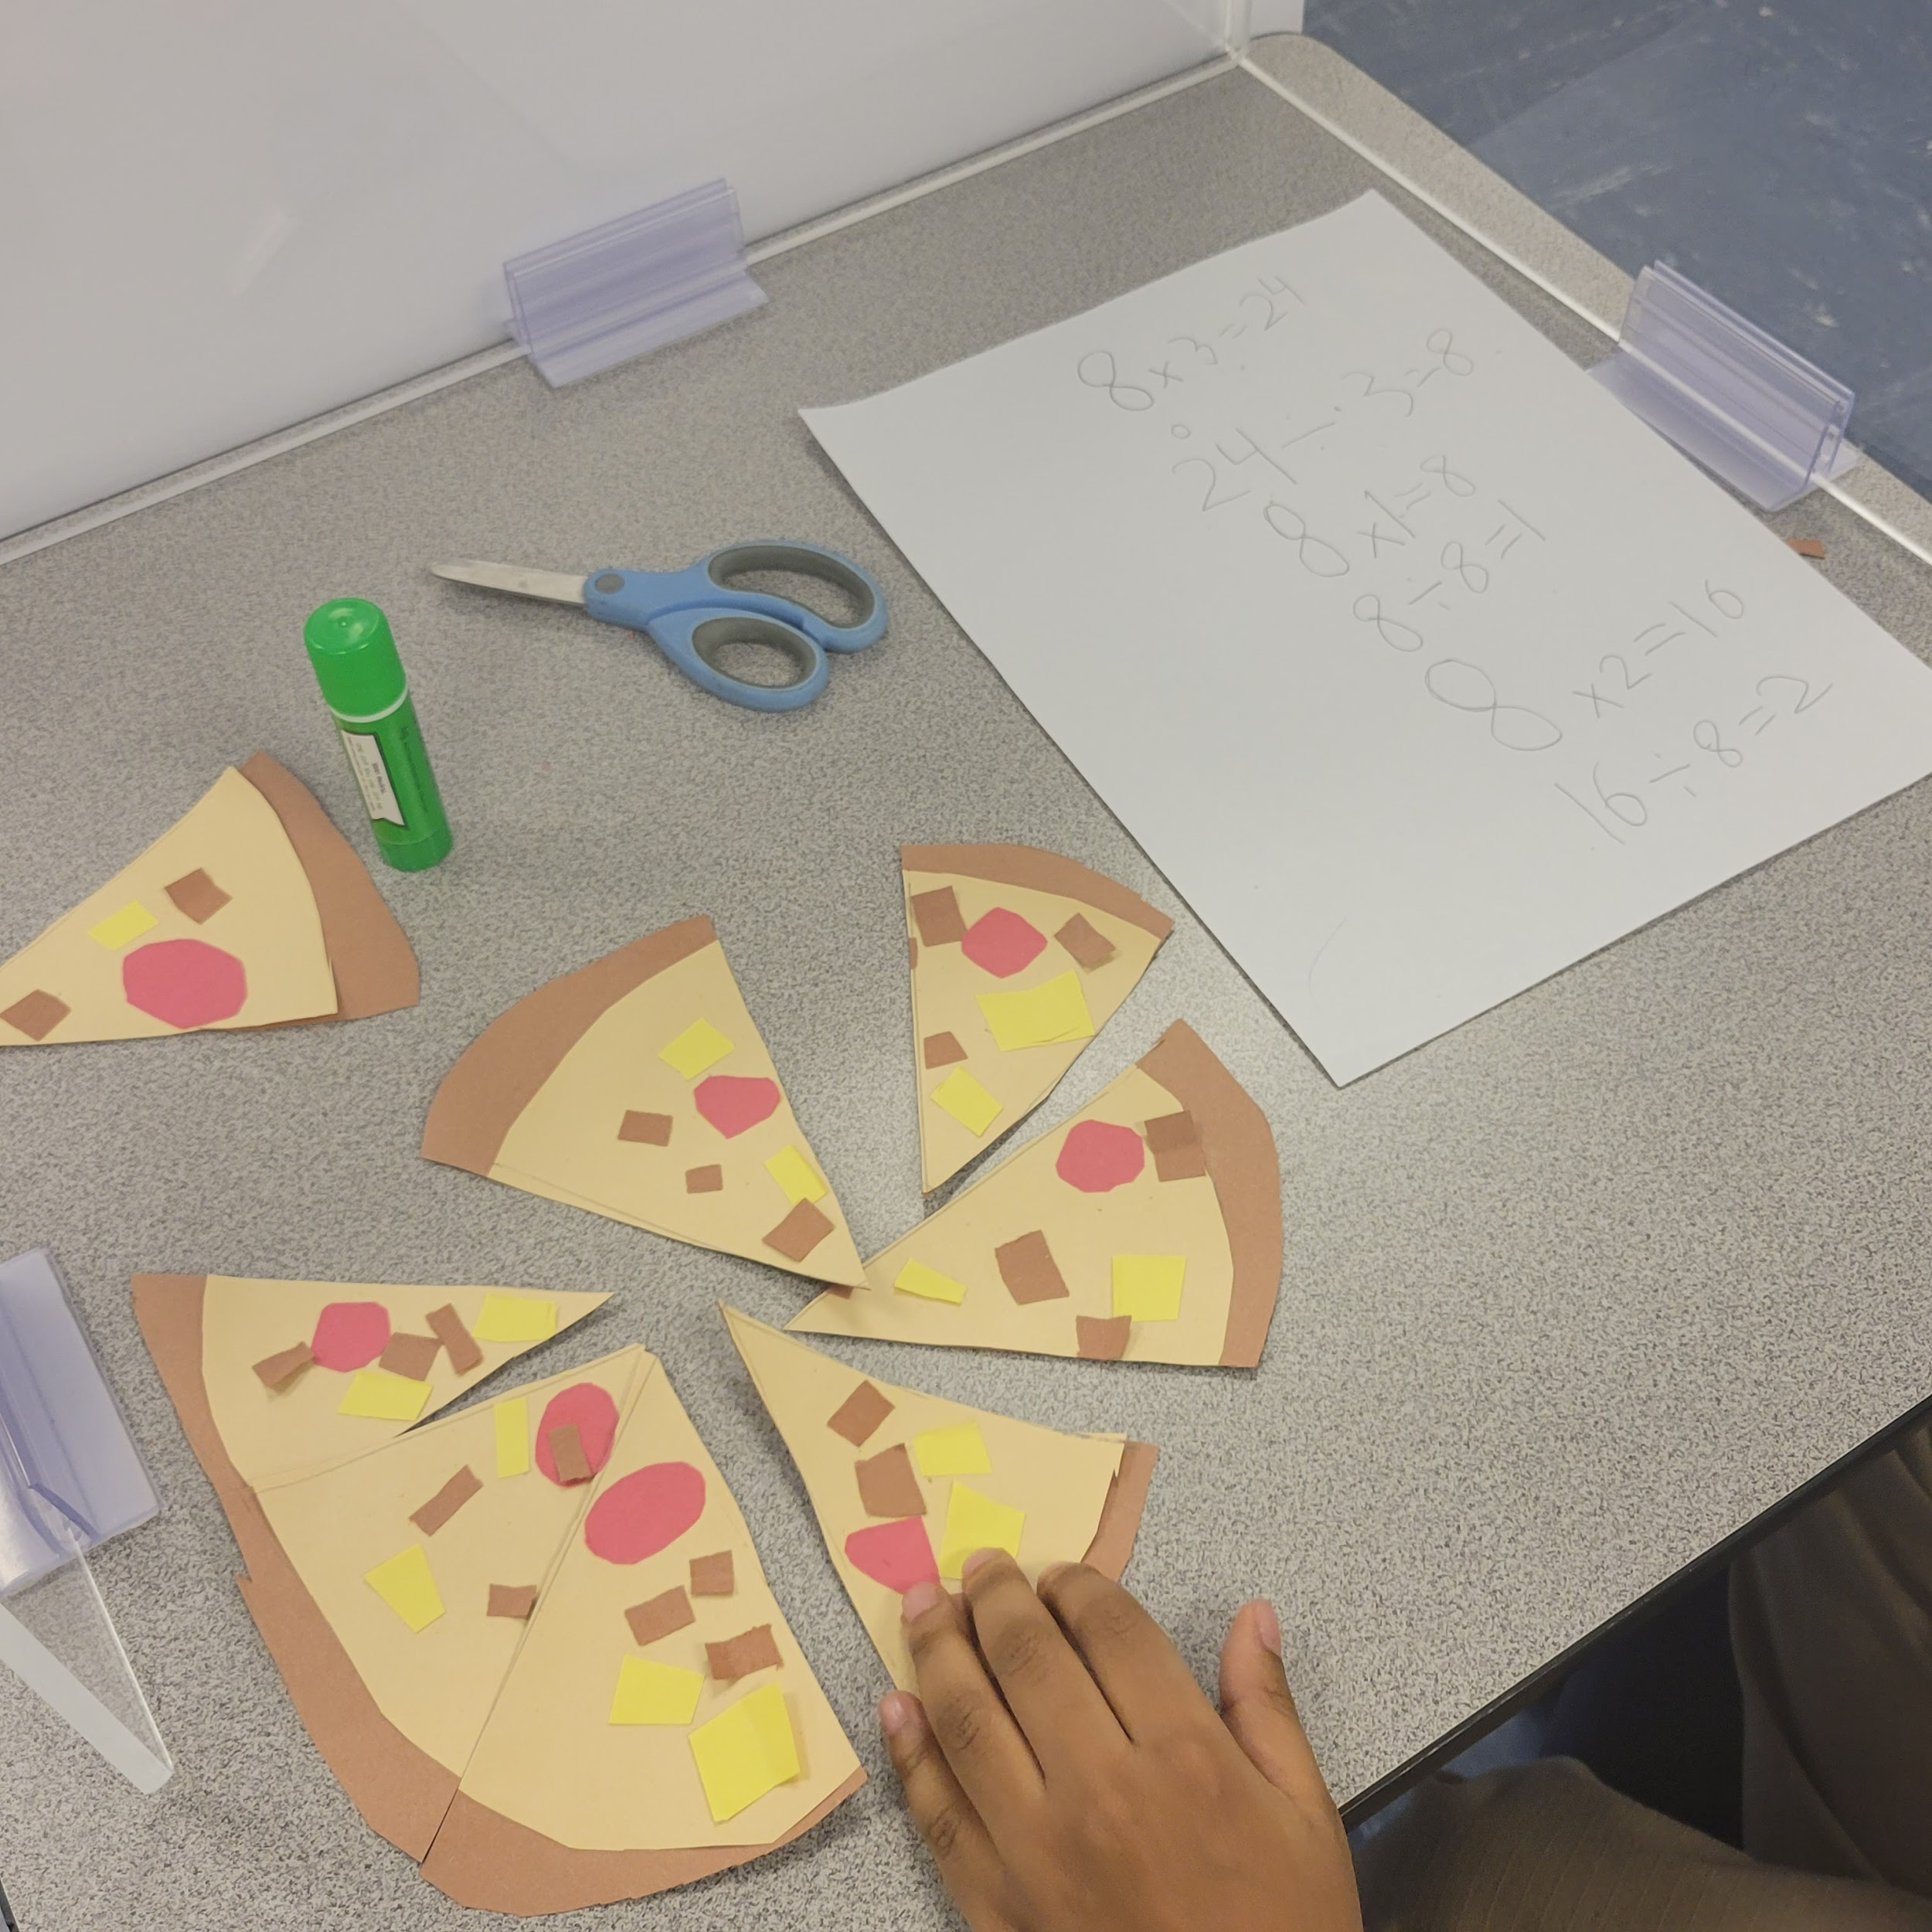
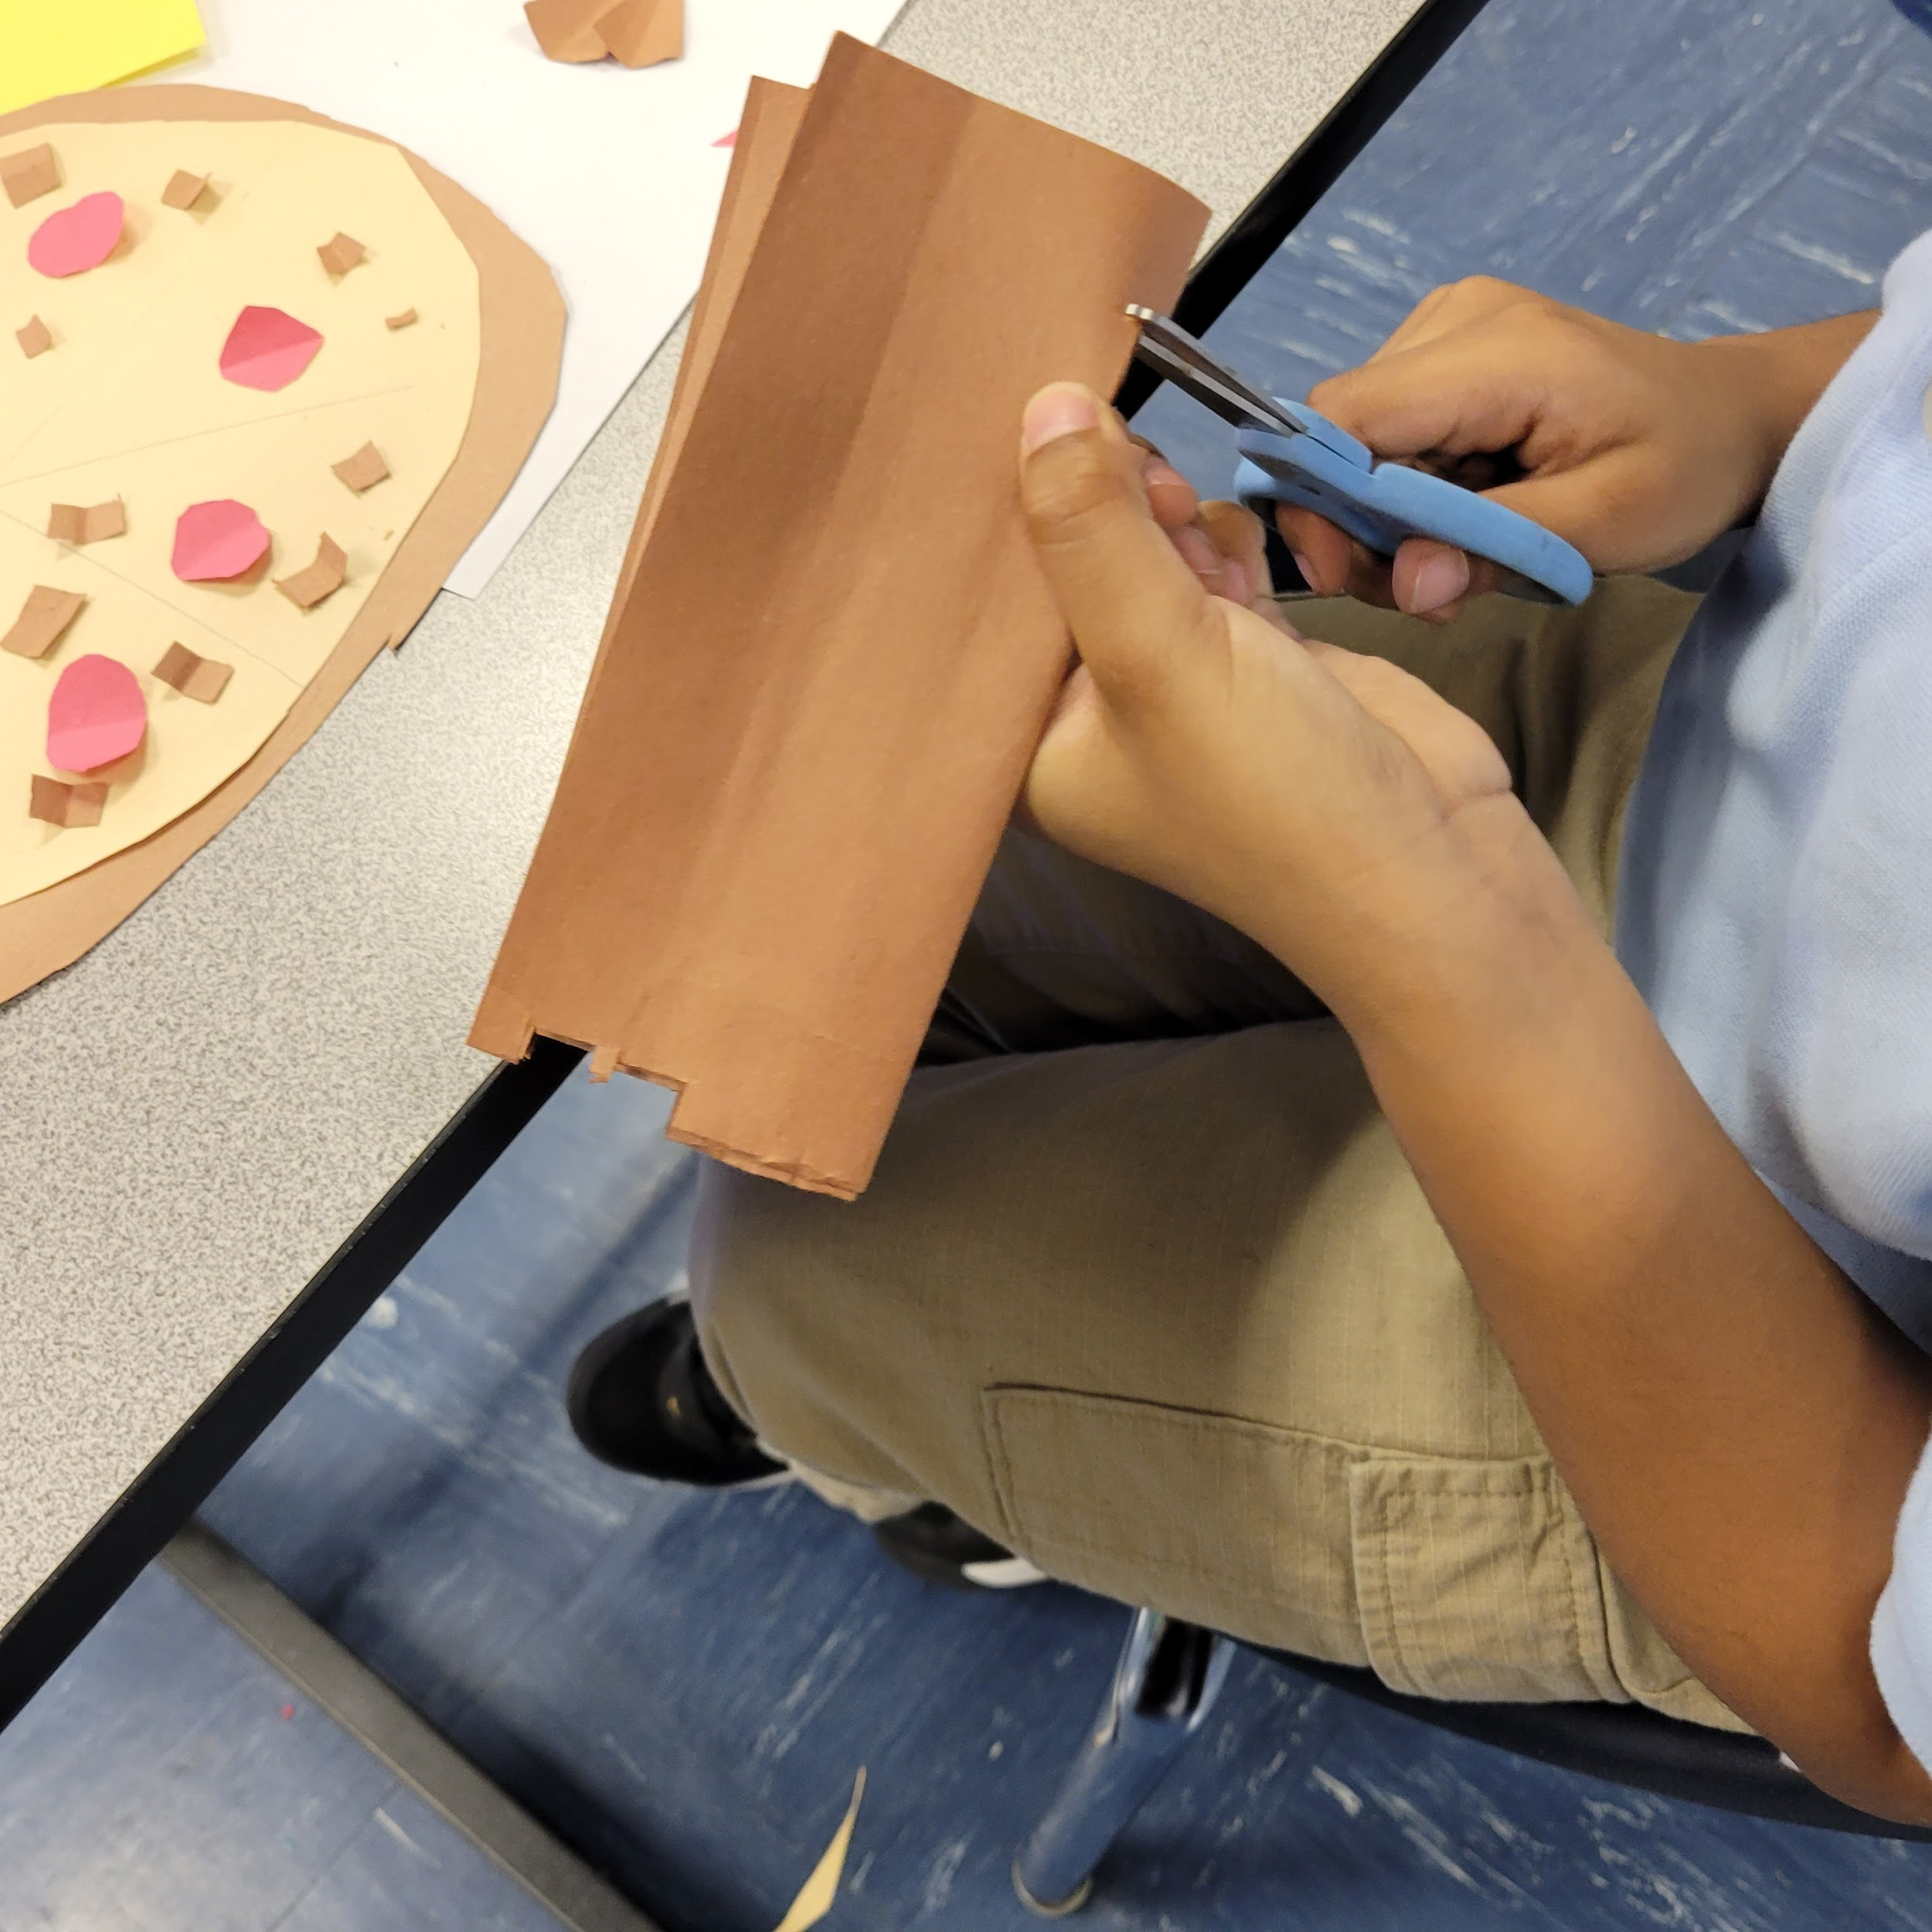
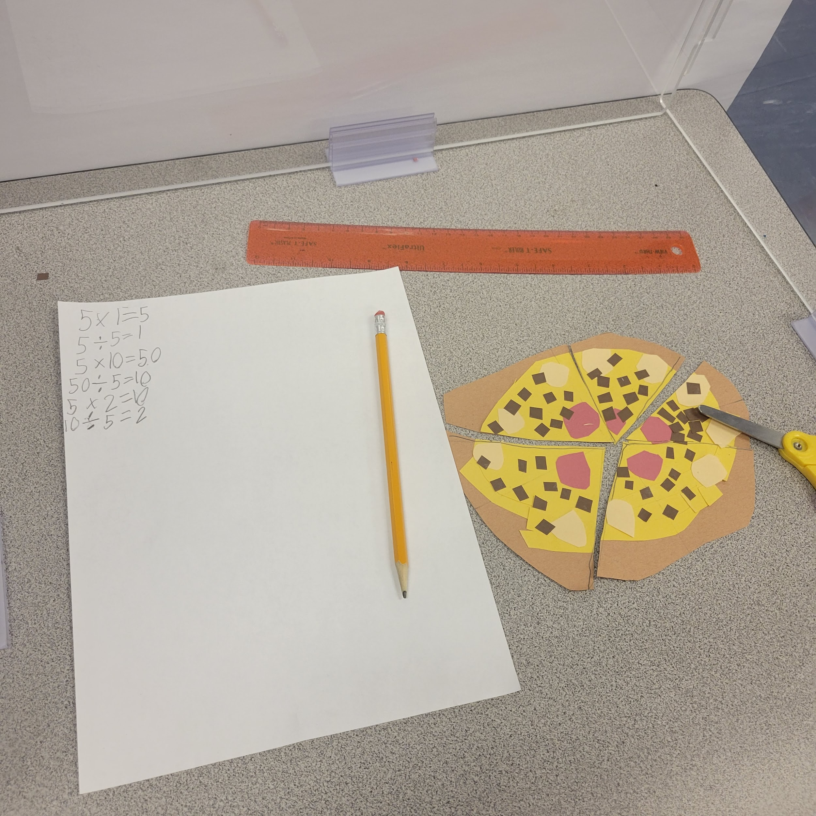
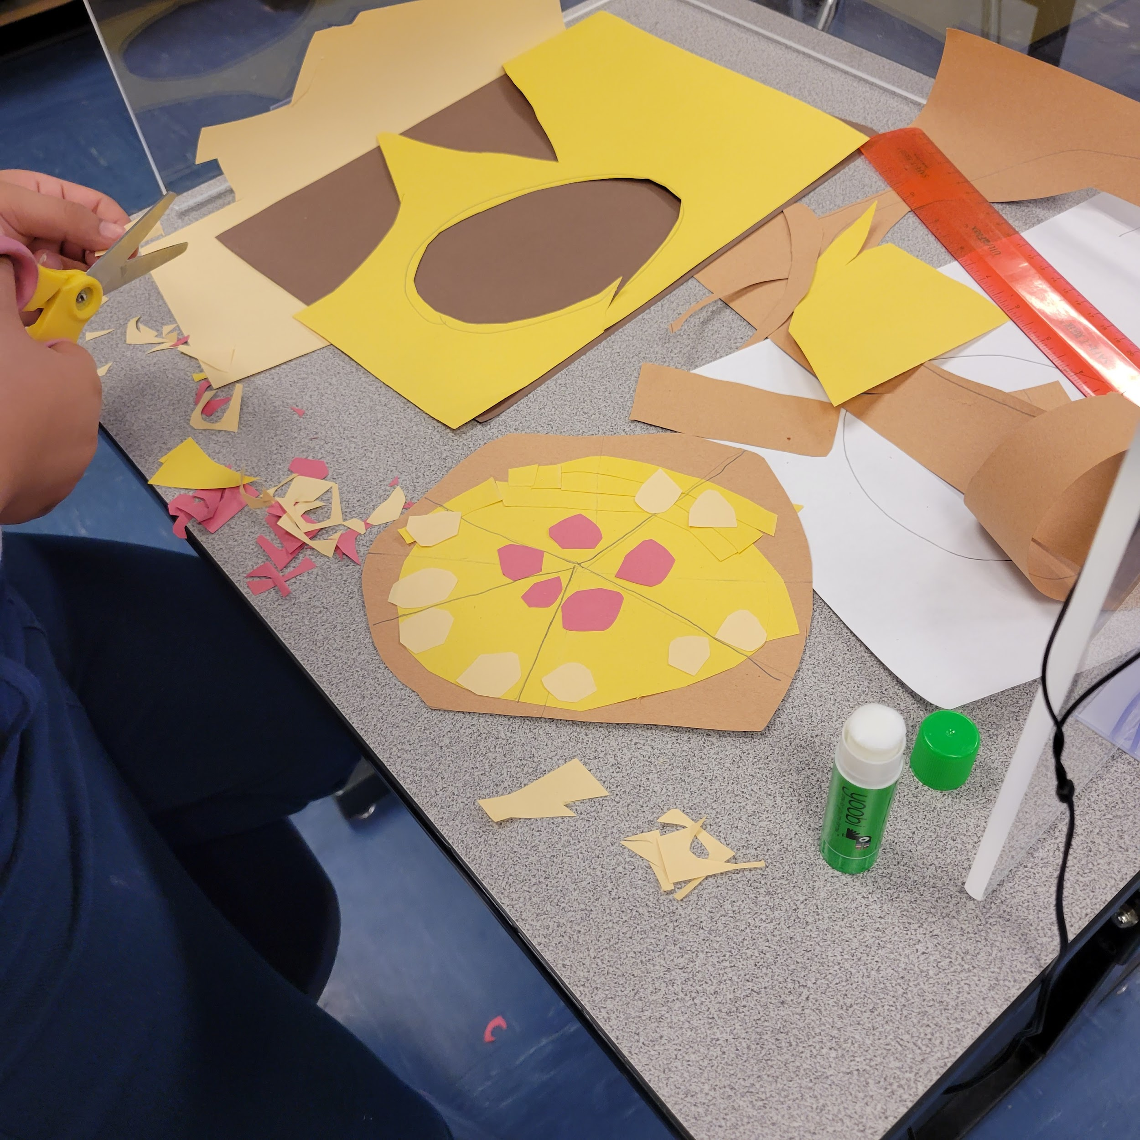
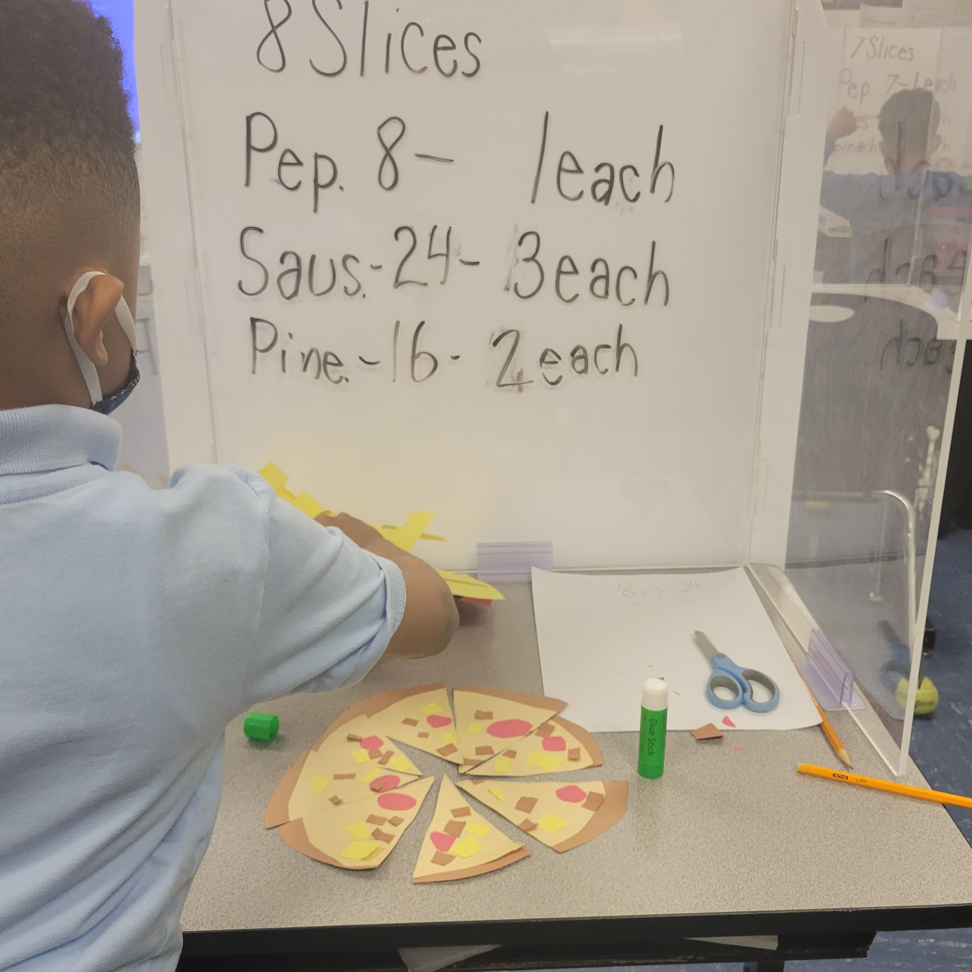
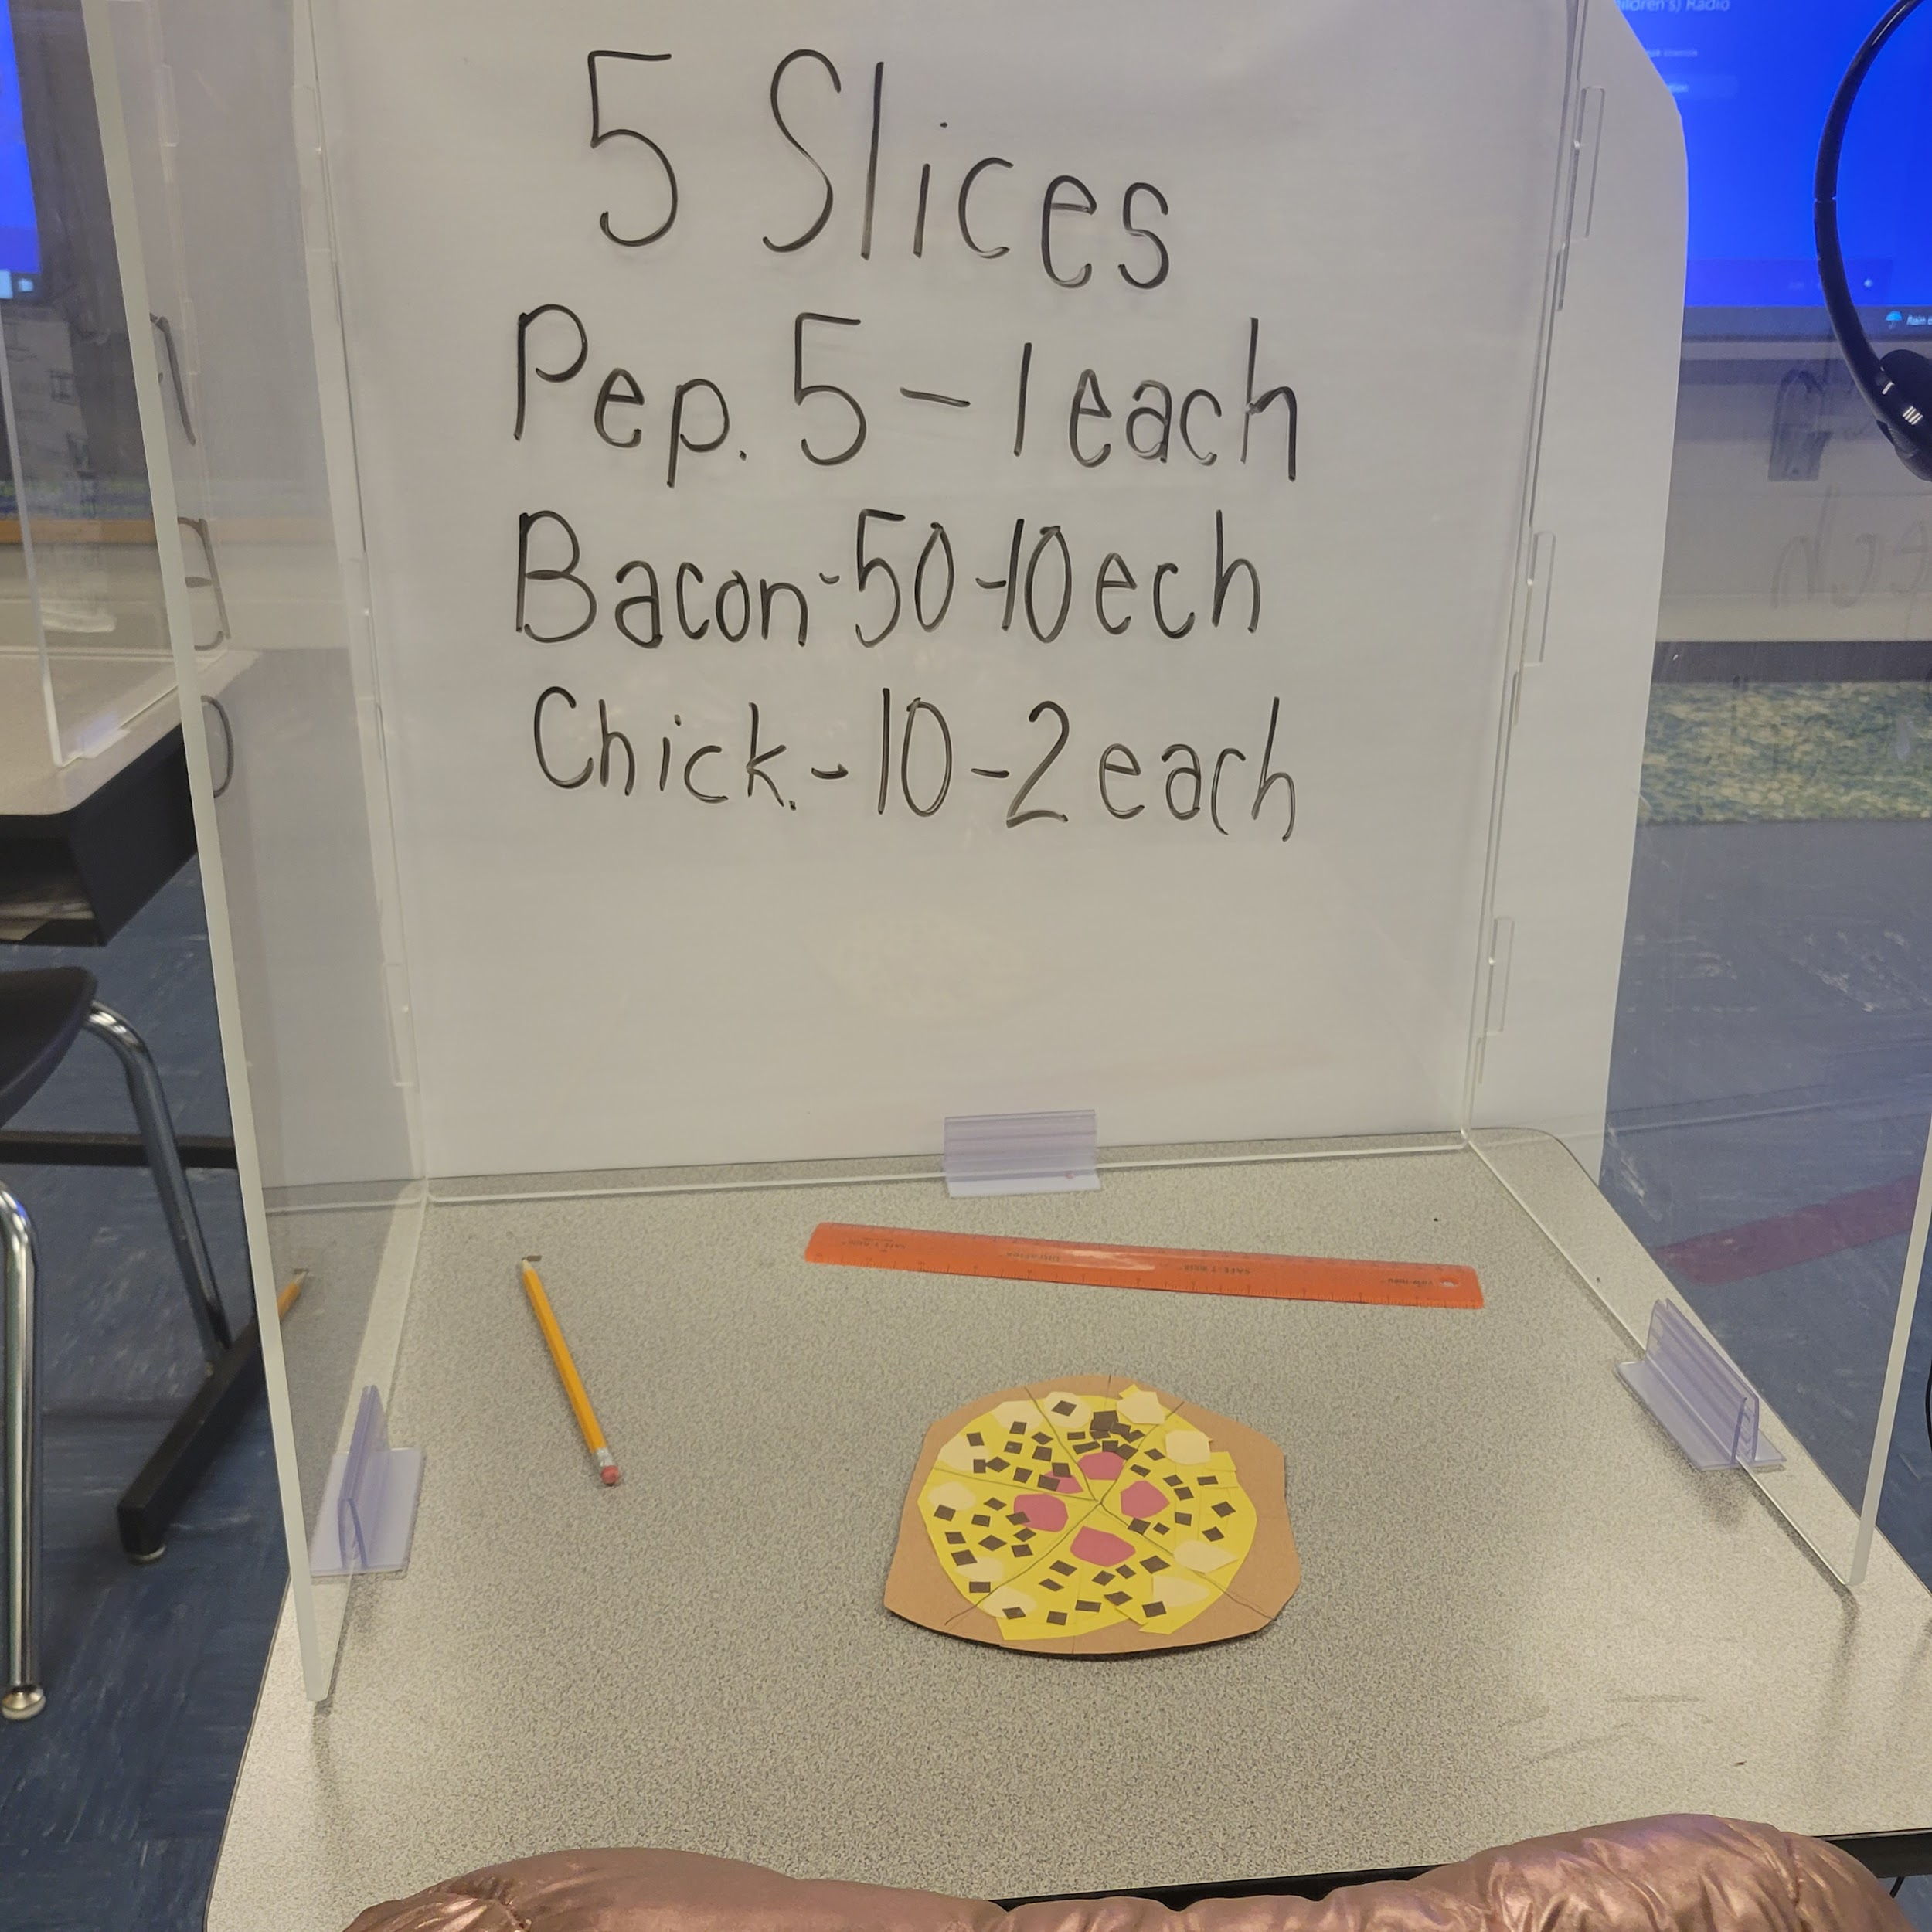
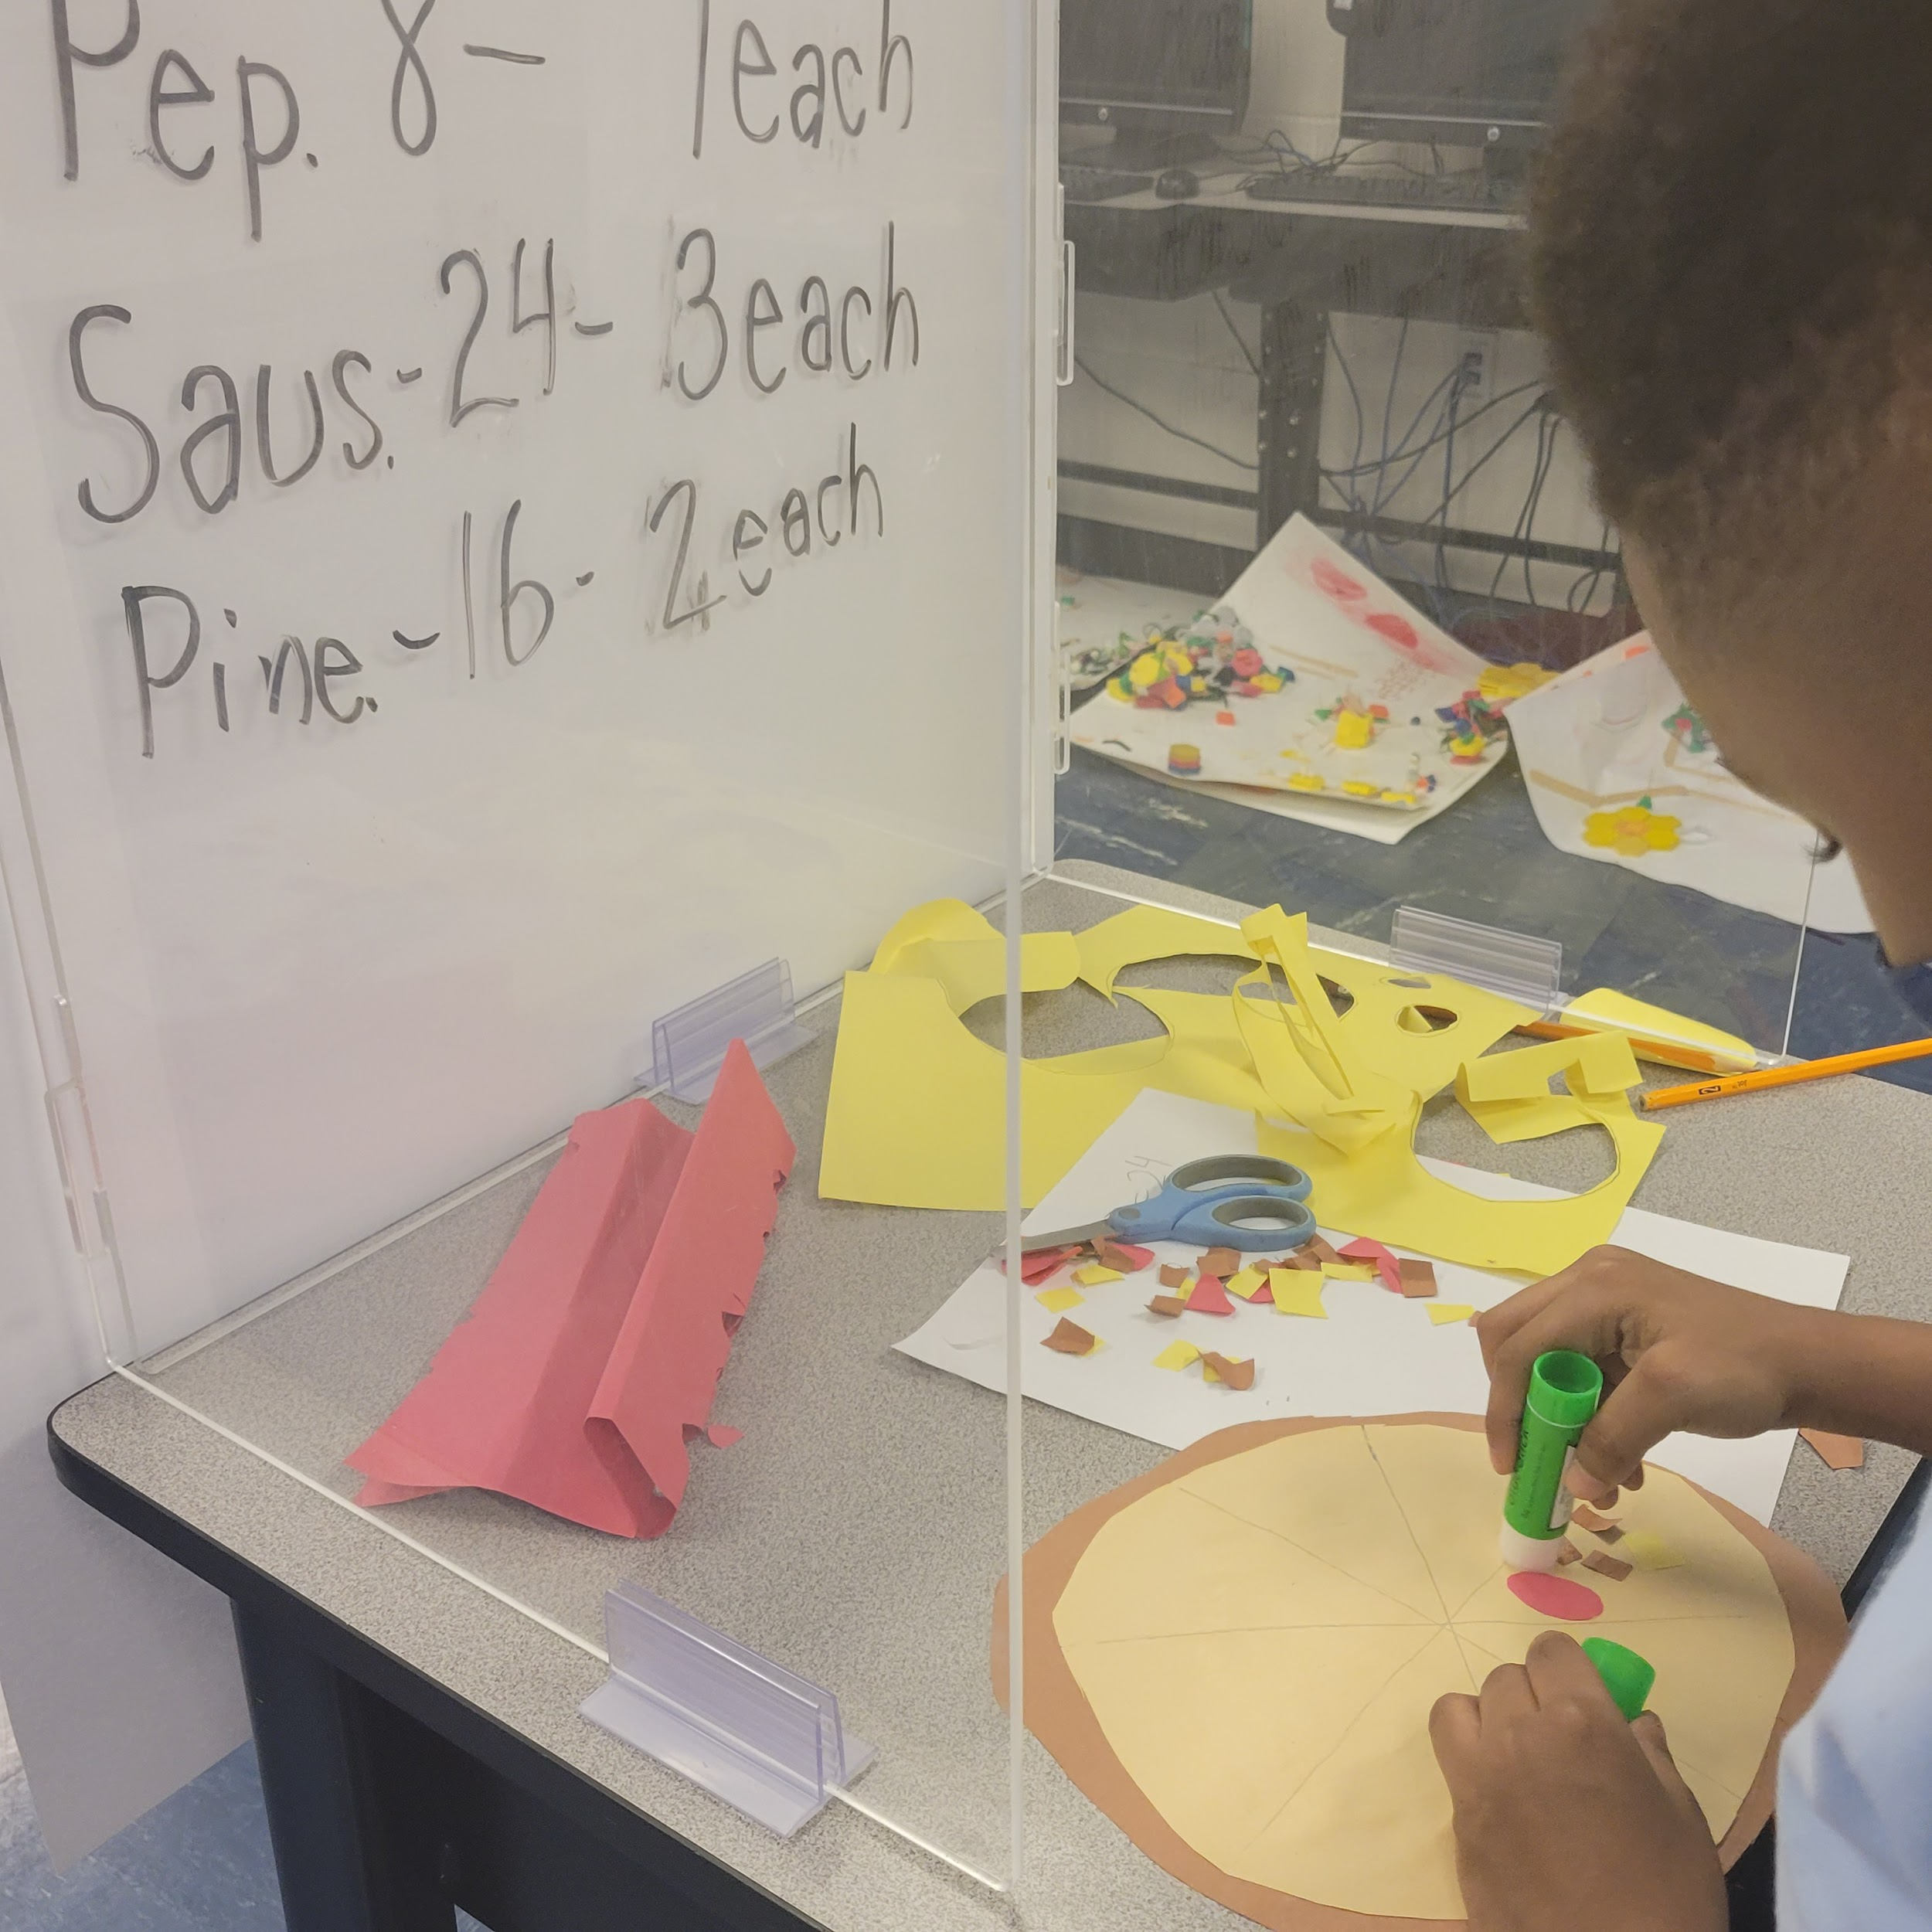
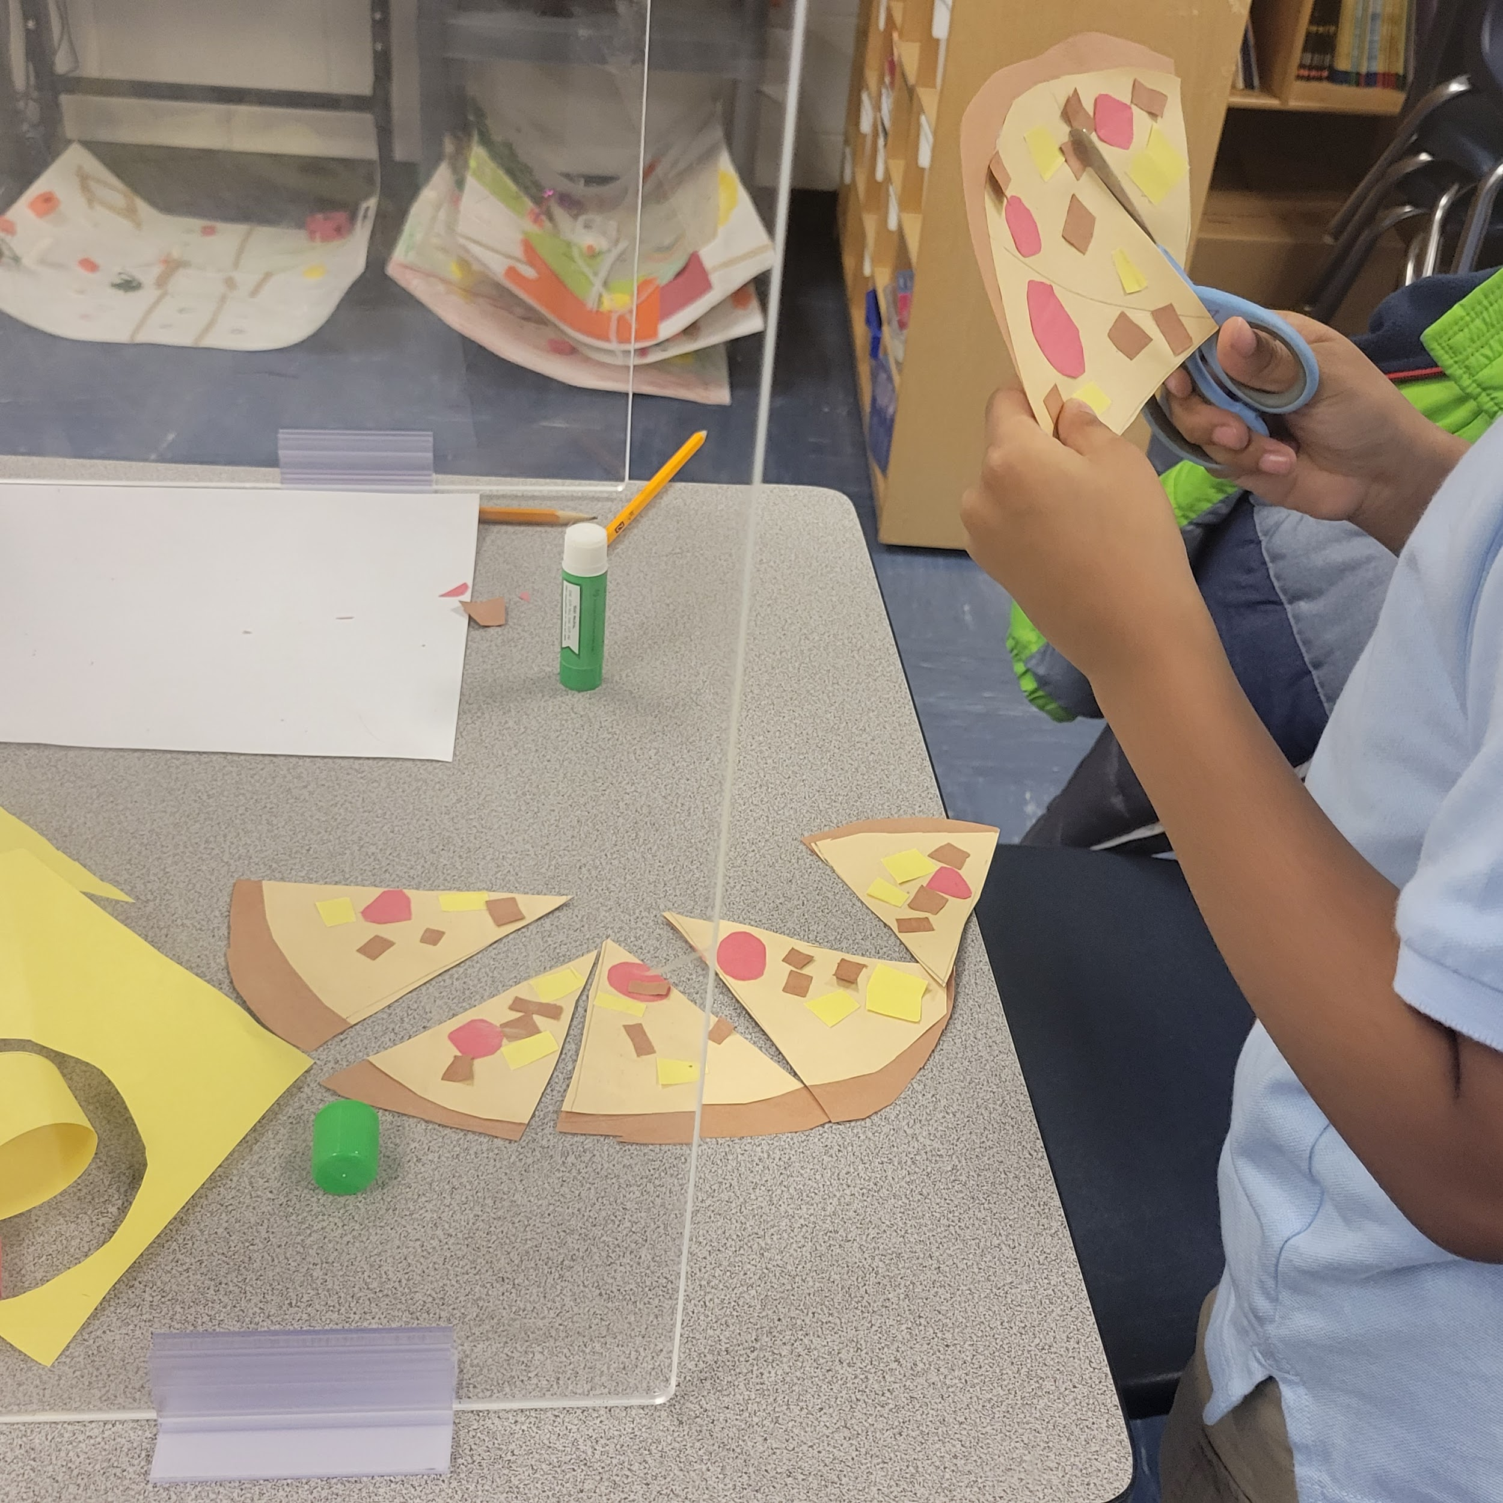
Student Work

Slide 12
Questions, Comments, Concerns
shonneka.smith-dupriest@clayton.k12.ga.us

