Slide 1
L4GA Webinar Building on Your Language Rich Community

Slide 2
Introductions
Bridget Ratajczak
Child Development Specialist, DECAL
Demetria Joyce
Instructional Learning Manager, DECAL
Meghan Welch, Ph.D.
Program Specialist, L4GA

Slide 3
GPRA Measure:
Government Performance Results Act
PPVT
Project Specific Measure:
PALS

Slide 4
PPVT
Peabody Picture Vocabulary Test
Pearson
Measures a student’s receptive vocabulary
Considers age

Slide 5
PALS
Phonological Awareness Literacy Screening
Screening for early literacy fundamentals
All teachers in VA use PALS

Slide 6
PALS
Phonological Awareness Literacy Screening
Name Writing
Upper-case Alphabet
Lower-case Alphabet
Letter Sounds
Beginning Sound Awareness
Print and Word Awareness
Rhyme Awareness
Nursery Rhyme Awareness

Slide 7
gelds.decal.ga.gov
Georgia Early Learning and Development Standards

Slide 8
What are the GELDS?
Notes:
So, as you have heard, the GELDS are the product of the alignment study and revisions project. As stated earlier, the project stemmed from the need for higher quality standards with a consistent alignment of not only Kdg.., but between the Birth-5 as well. So having completed studies and convening work groups, the GELDS “were born”. They replaced both the GELS and content standards and supports Birth-5 in a more consistent framework and allowed us to easily our standards to Kdg. Grade level standards. The GELDS are used as a guide for teachers, parents, and practitioners in the intentional integration of skills and concepts children need to make progress in all learning domains. Example: we work t ensure that teachers understand that they can support children on varying levels of abilities by selecting the appropriate standard(s) for the child. We talk more about that in a few slides. So as you can see, the GELDS Learning domains are: Physical Development and Health, Social and Emotional Development, Approaches to Play and Learning, Communication Language and Literacy, and Cognitive Development and General Knowledge, Cognitive Development and General knowledge are the only domains that have sub-domains and they are: Math, Science, Social Studies, Creative Development, and Thinking Skills). We’ll talk more about the structure in a moment.
Continuing with discussing the GELDS, they primarily address the question: What should children know and be able to do? The GELDS are not designed to say that these are standards that children know and do when they enter say a Pre-K classroom but, hopefully as they matriculate to the next age group. The GELDS are written a a continuum of skills, behaviors, and concepts that children develop throughout this Birth-5 time period. They are divided by age groups.. They are not an assessment tool or a curriculum. This can be a challenged for teachers to understand. Often, teachers and/or administrators, think that the GELDS are a curriculum. We work hard to educate the Early Learning Workforce in understanding the difference and how they support eachother. For our Georgia’s Pre-K program, every 3-5 years we conduct a Curriculum Review process whereby, we will invite vendors (and we are often contacted by vendors) to submit their comprehensive curriculum for review. We do not review supplemental curriculum only comprehensive. This review is typically conducted by University professionals, who use a rubric to measure several factors such as the support of the GELDS, does it include a family engagement pieced, does it support positive behaviors. From that point, we will publish an “approved curriculum listing” and Pre-K providers have the ability to select a curriculum for that list.

Slide 9
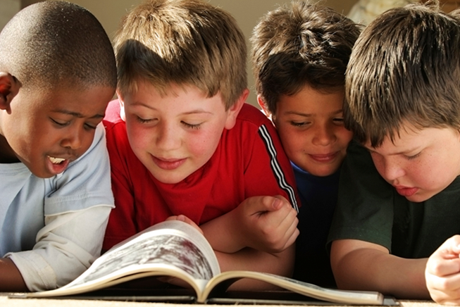
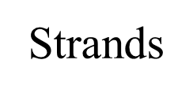
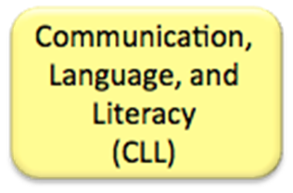
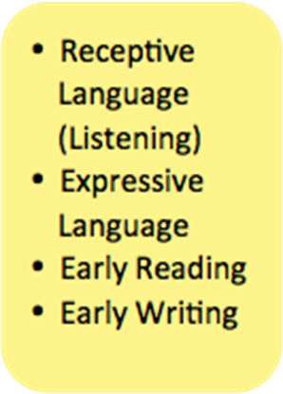
Communication Language and Literacy

Slide 10
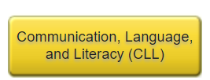
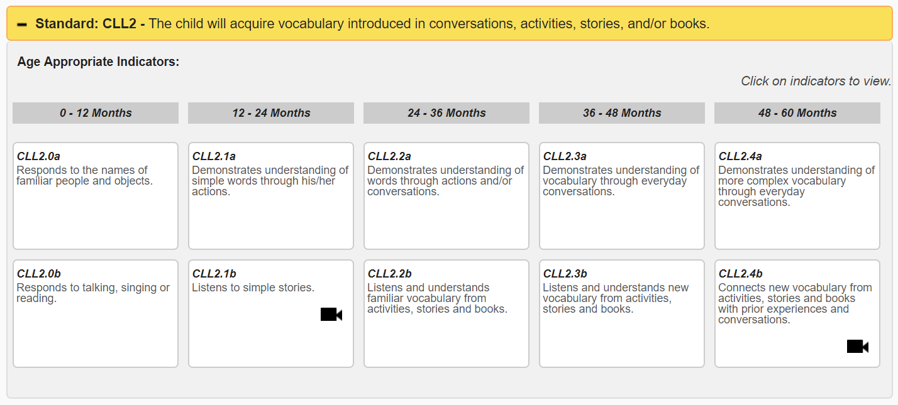
GELDS
PPVT: CLL2

Slide 11
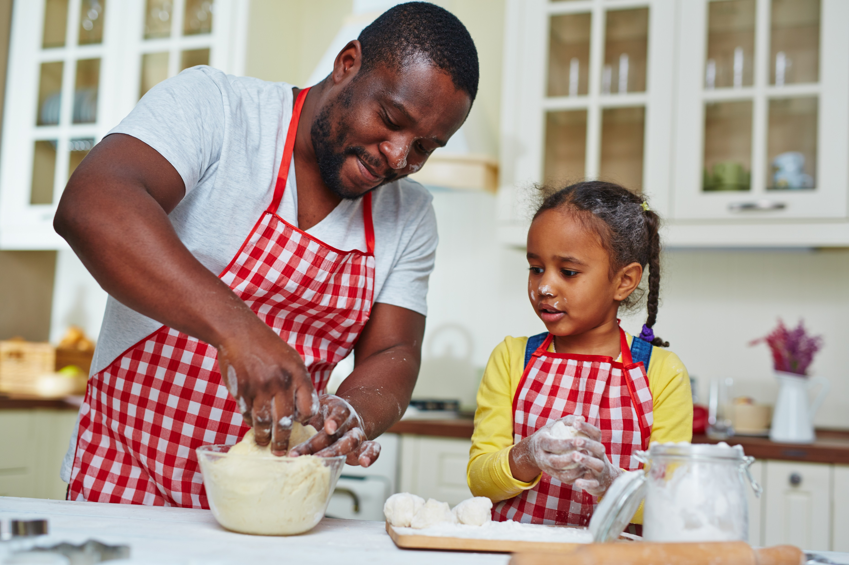
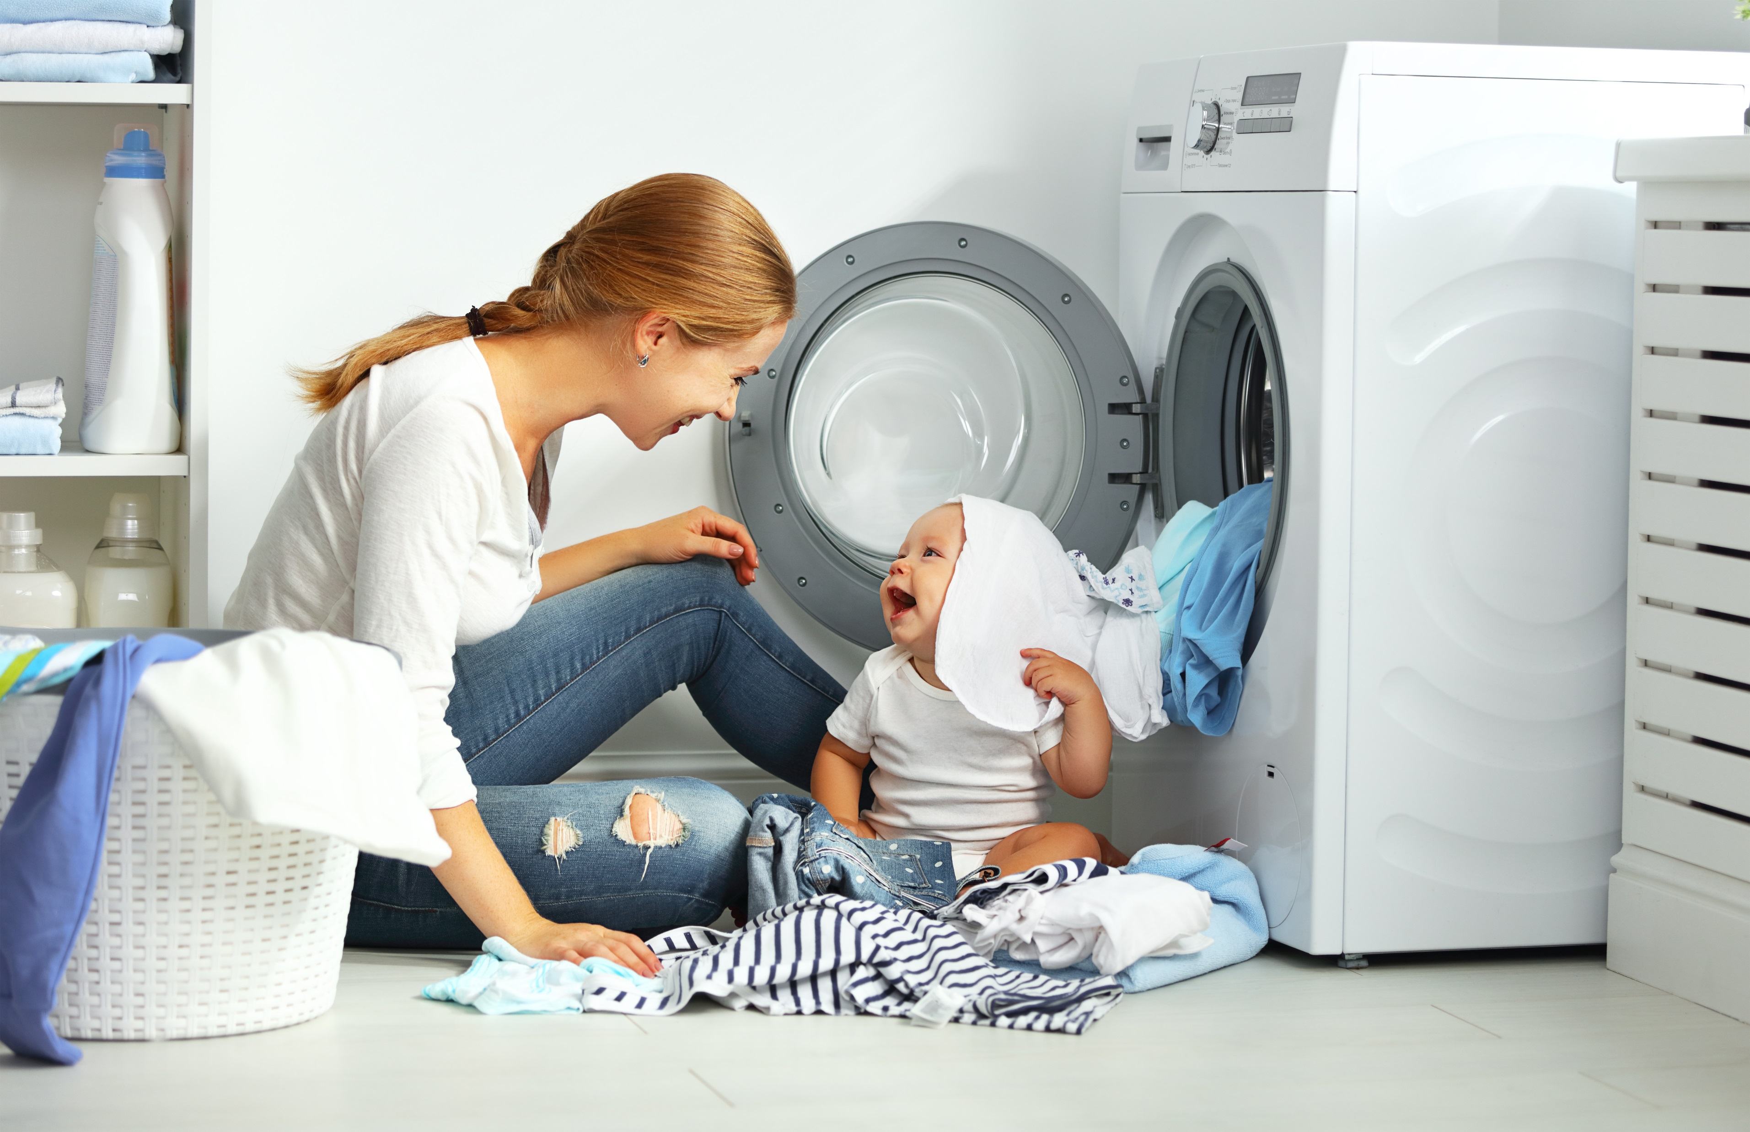
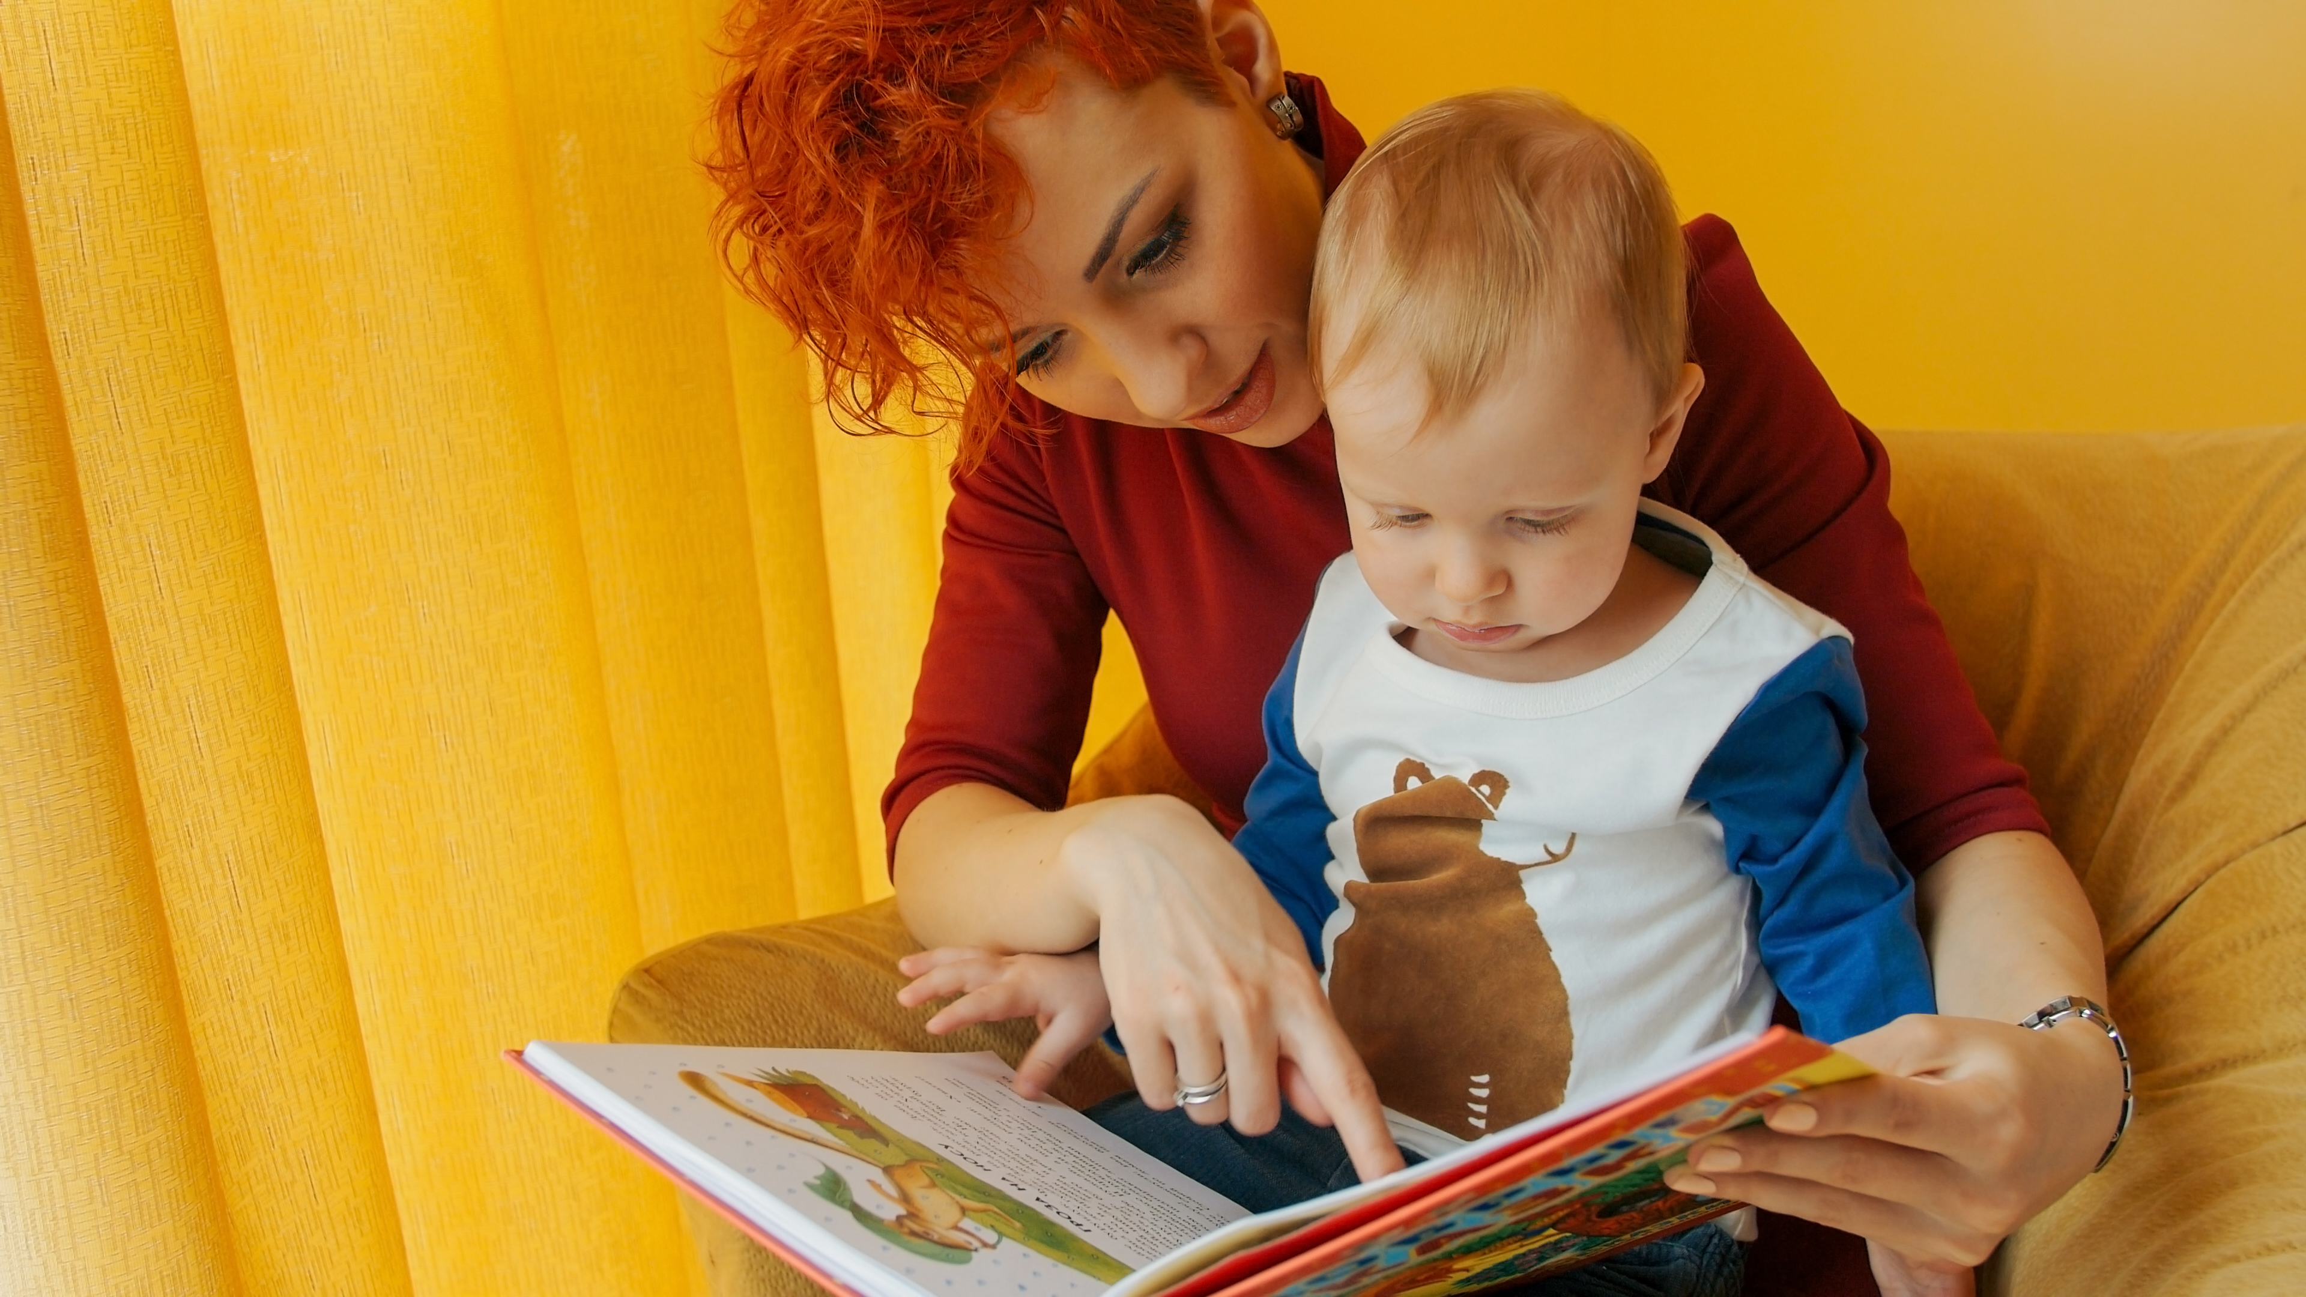
GELDS
PPVT: CLL2 for 0-3 in your community
Notes:
We develop a young child’s vocabulary by exposing them to language every day. A language rich community will build strong readers. Providing education to family members about the importance of speaking to young children, engaging them in conversations about their daily routines, is critical. Helping young families to understand that both conversing with and reading to young children- from birth on – is a critical element of building their brains and their vocabulary, which will help them be stronger readers, is critical.
When thinking about a language and literacy rich community-based program for birth-3 yr olds, it’s important to think about how to reach families. Where are they congregating? What are the daily routines they engage in? They shop for groceries, they may be doing laundry at the laundromat, they may be waiting at the bus stop, they may be in the waiting room at the doctor’s office, or the barber shop or hair salon. Then think about how you can reach them- how can you get information to them about the importance of talking to their babies and reading to their babies. Then, how can you get materials into their homes and their diaper bags that they can use with their children?

Slide 12
GELDS & PALS How they can work together?
PALS | GELDS
Name Writing | CLL9 The child will use writing for a variety of purposes
Alphabet Knowledge | CLL7 The child will demonstrate increasing knowledge of the alphabet.
Beginning Sound Awareness | CLL 6.4c (indicator specific) Isolate the initial (beginning sounds) in words with adult guidance.
Print and Word Awareness | CLL8 The child will demonstrate awareness of print.
Rhyme Awareness | CLL6 The child will develop early phonological awareness of units of sound
Nursery Rhyme Awareness | CLL64.b (indicator specific) Identifies and produces rhyming words.
Letter Sounds | CLL6 The child will develop early phonological awareness of units of sound

Slide 13
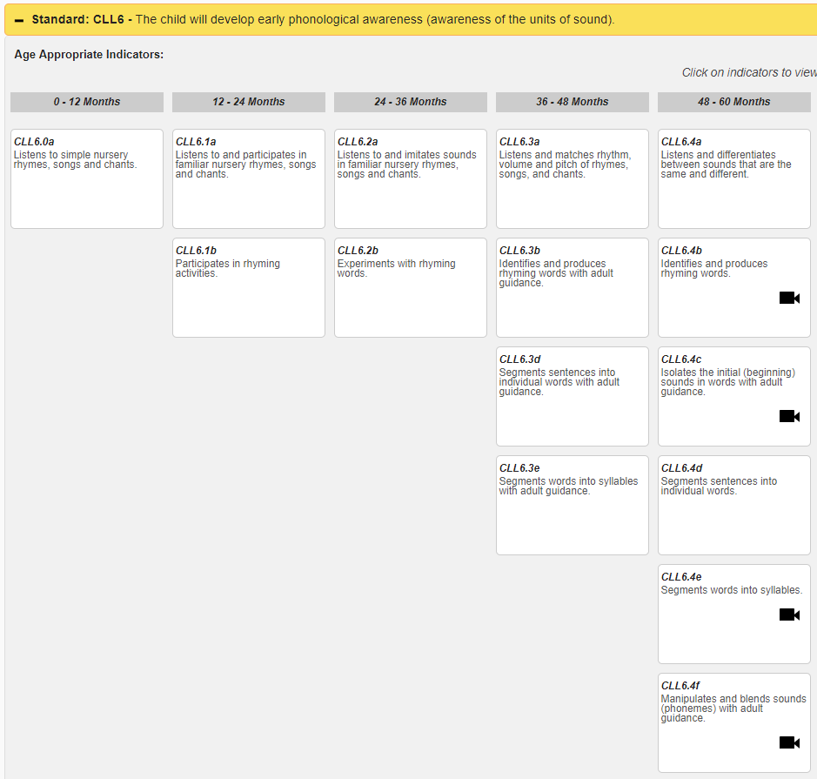
GELDS
PALS: CLL6
Letter Sounds
Beginning Sound Awareness
Rhyme Awareness
Nursery Rhyme Awareness

Slide 14
GELDS
PALS: CLL6 for 0-3 in your community
Letter Sounds
Beginning Sound Awareness
Rhyme Awareness
Nursery Rhyme Awareness
Notes:
We can encourage the development of these skills in our youngest learners by reading, singing, and talking to them.
When we sing songs, specially those that are repetitive and rhyming, we are helping young children to learn to differentiate between the different sounds that they hear.
At this age we aren’t specifically teaching letter sounds. Instead we are teaching children to listen to and differentiate different sounds. When an airplane flies overhead, we point it out and label it. When we hear a car horn, or a siren, wind blowing through the trees, even things like doors slamming, church bells ringing- different sounds they are hearing in their environment- labeling them, giving time for children to listen to them, discuss what they are, and where they came from- are all important things to do that help build on these skills.
Also, reading books that have rhyme, rhythm, and repetition help to build these skills.

Slide 15
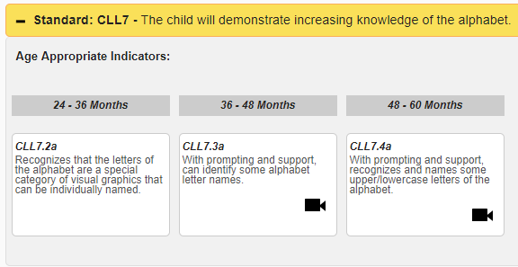
GELDS
PALS: CLL7
Upper and lower-case alphabet knowledge

Slide 16
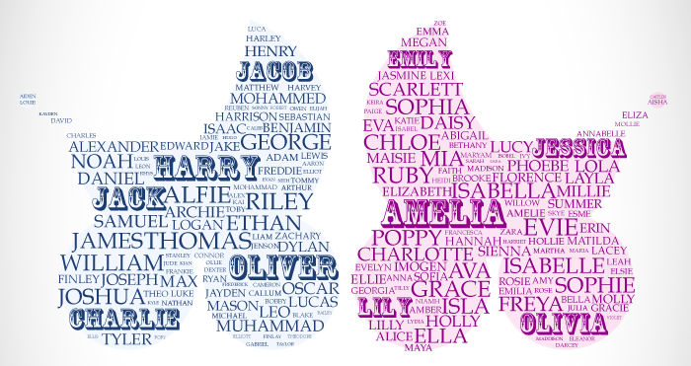
GELDS
PALS: CLL7 for 0-3 in your community
Upper and lower-case alphabet knowledge
Notes:
One way to help young children learn alphabet knowledge is to begin with their name. Print their name all around their environment, and help them to learn the different letters In their name. Point out the letters that they see in their daily routines and around their personal environments, and help them identify them in their environment. Most 3 yr olds will get very excited when they can find “My J” the first letter of their name.

Slide 17
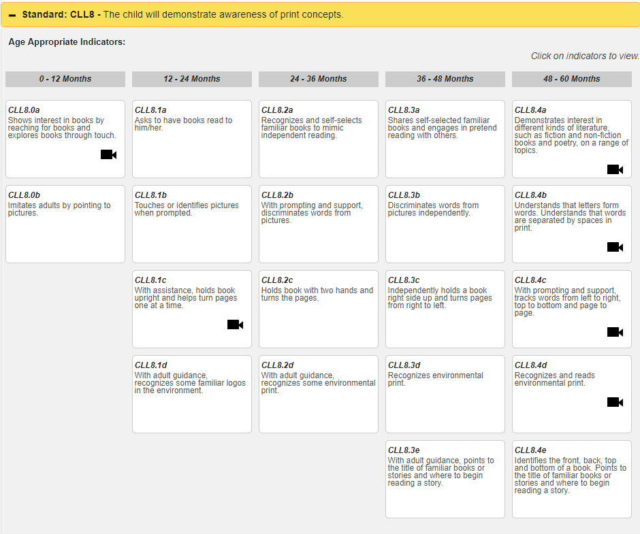
GELDS
PALS: CLL8
Print and word awareness

Slide 18
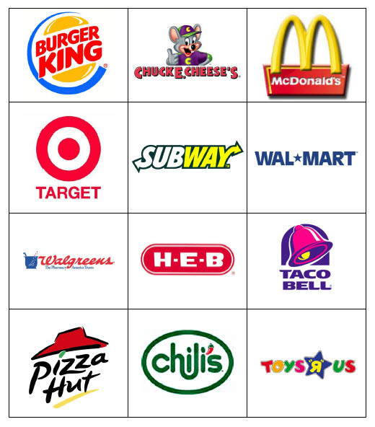
GELDS
PALS: CLL8 for 0-3 in your community
Print and word awareness
Notes:
We help our birth-3 yr olds learn about print and word awareness through environmental print. When the recognize the golden arches from their car seat, they are actually reading! No, they aren’t understanding that the specific letters that spell out McDonalds stand for specific sounds in the name, but they are decoding the symbol of the arches logo and the business that it stands for. Pointing out different familiar objects and symbols in a child’s environment, then discussing them and what they stand for, is the beginnings of print and word awareness. When in the grocery store having a list of items with pictures next to them, and engaging a child in the shopping experience by having them help find those items (even if it’s from the cart and they point to them) then checking them off the list, provides a rich literacy activity for the child, and keeps them engaged and happy during an otherwise often stressful activity.

Slide 19
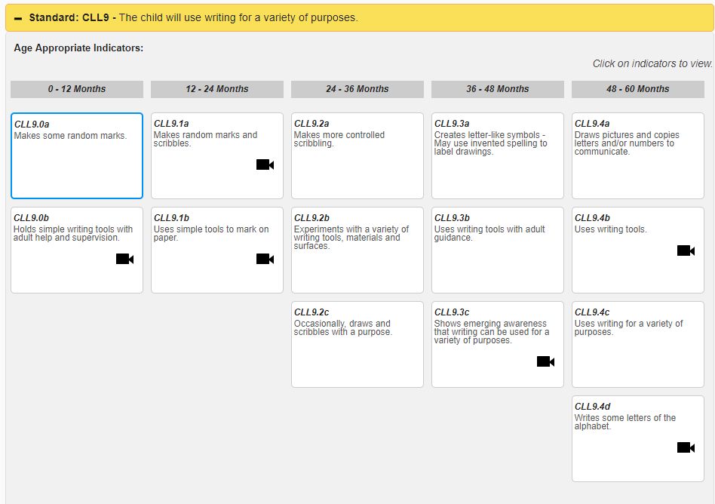
GELDS
PALS: CLL9
Name writing

Slide 20
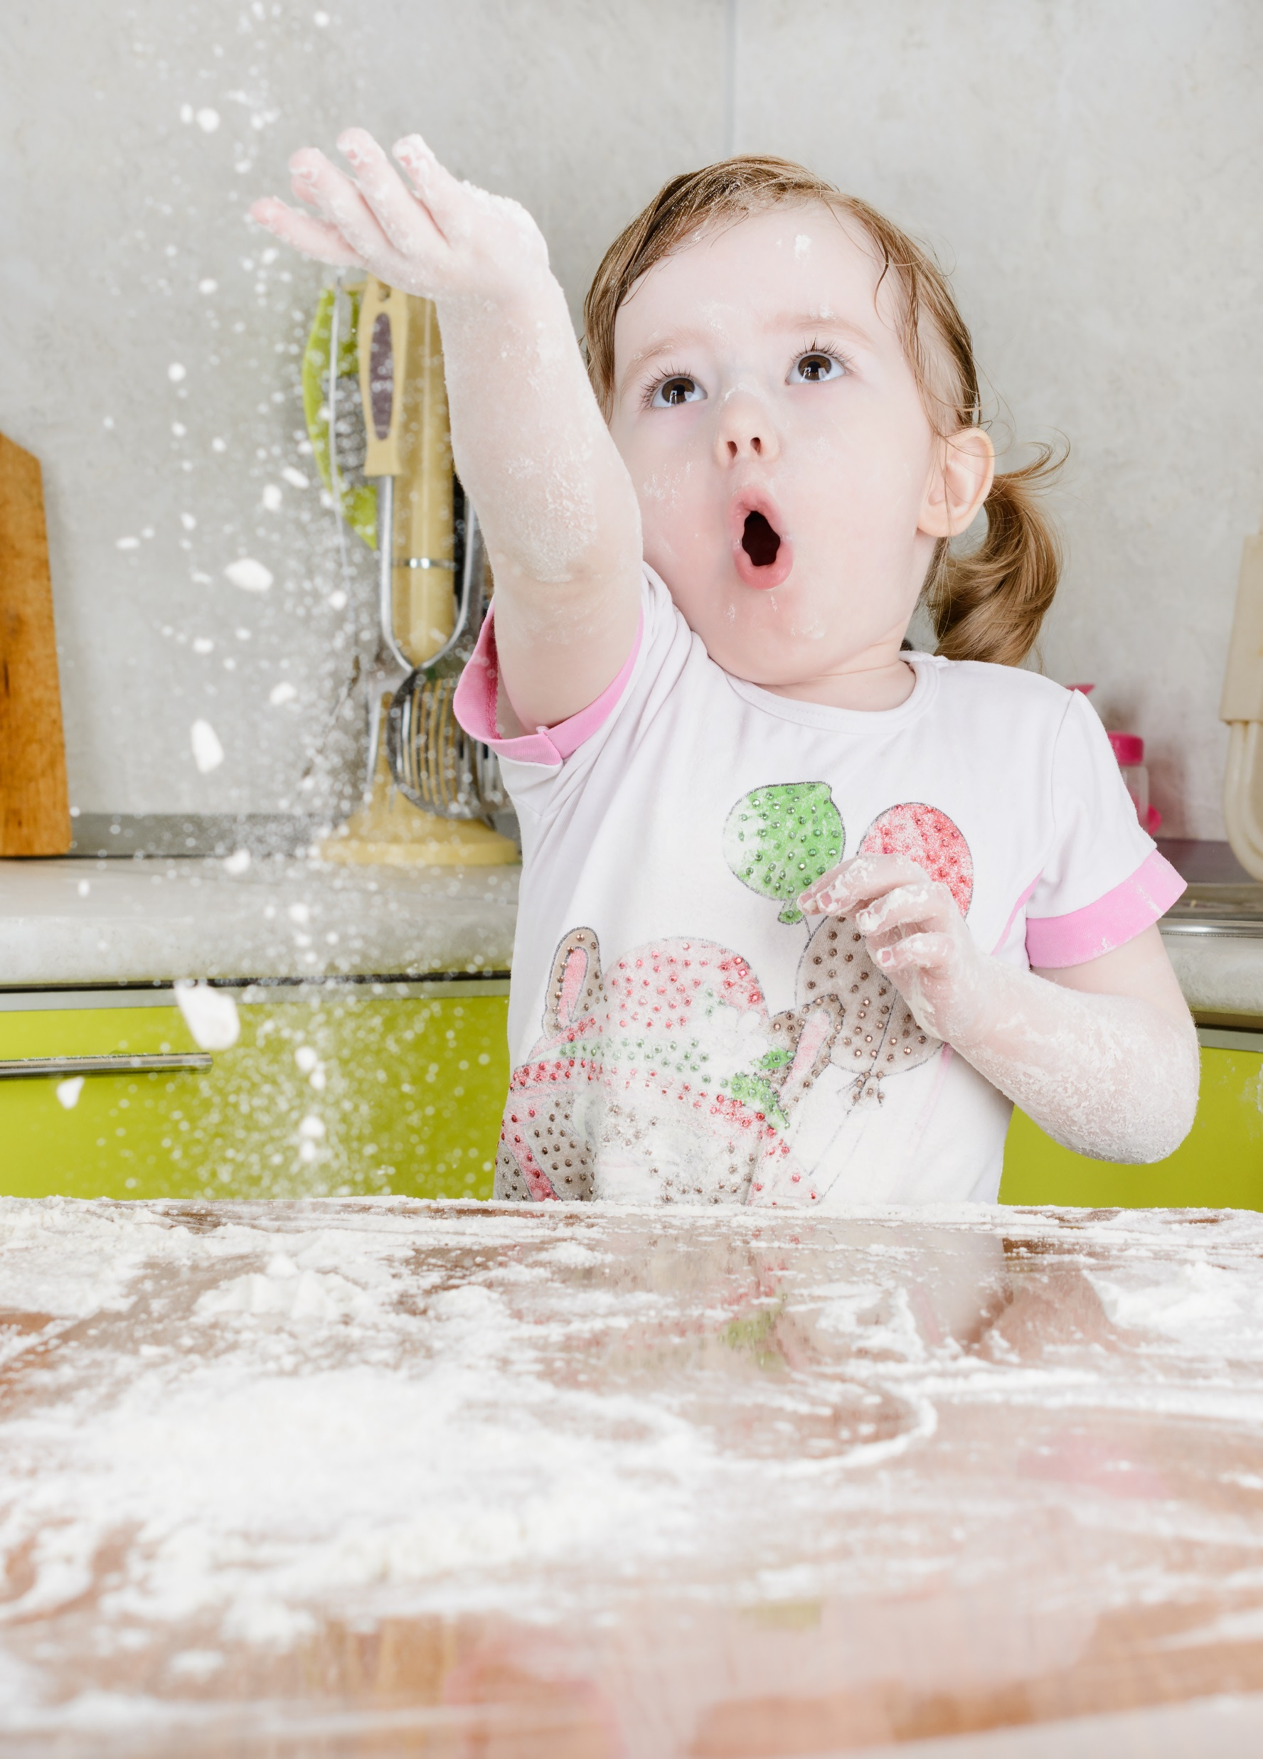
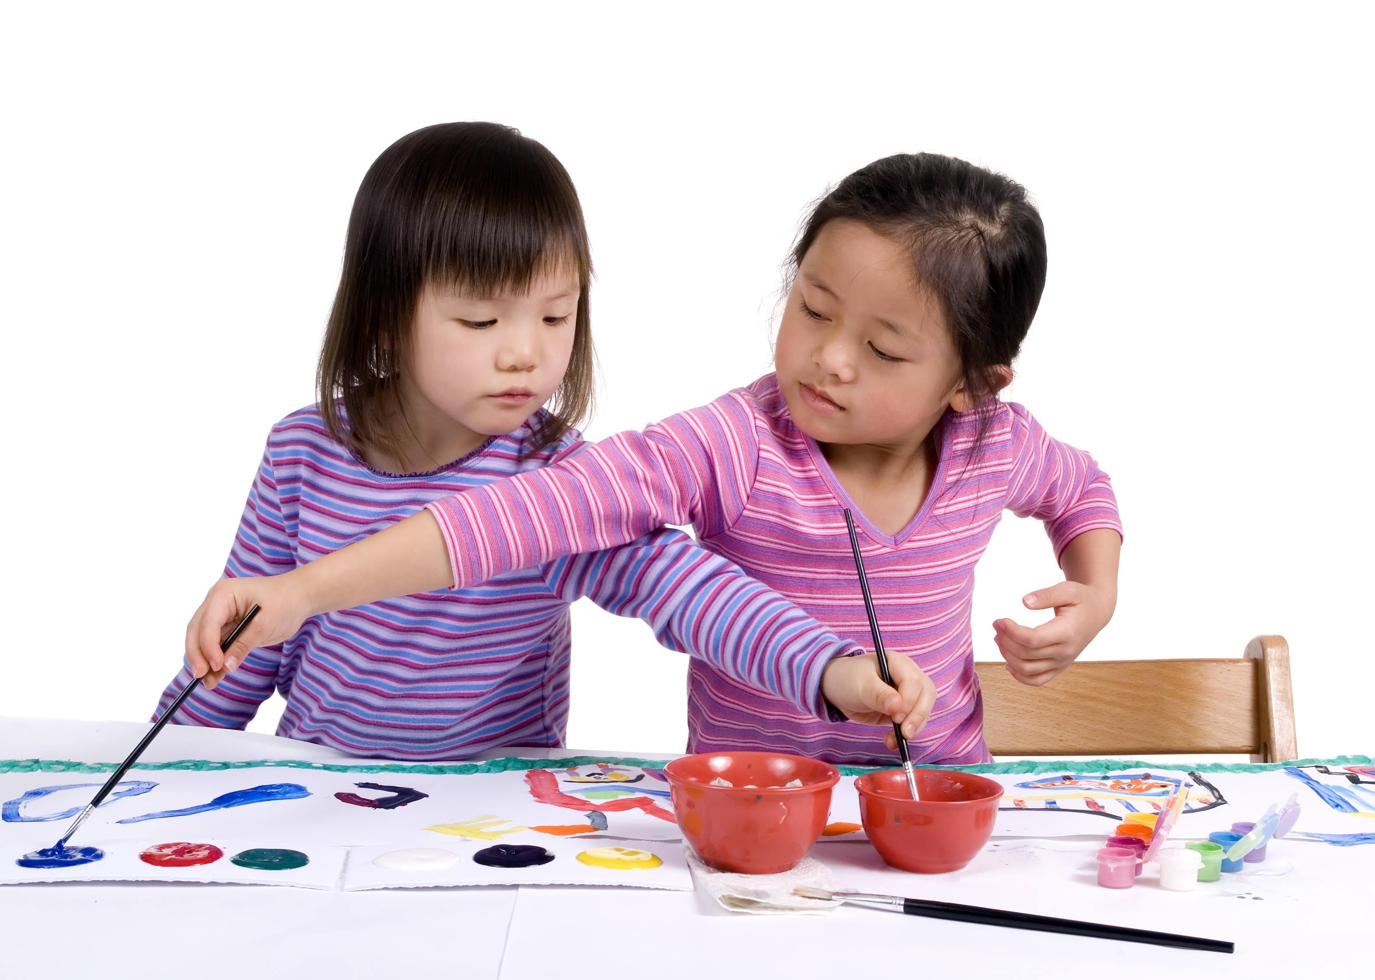
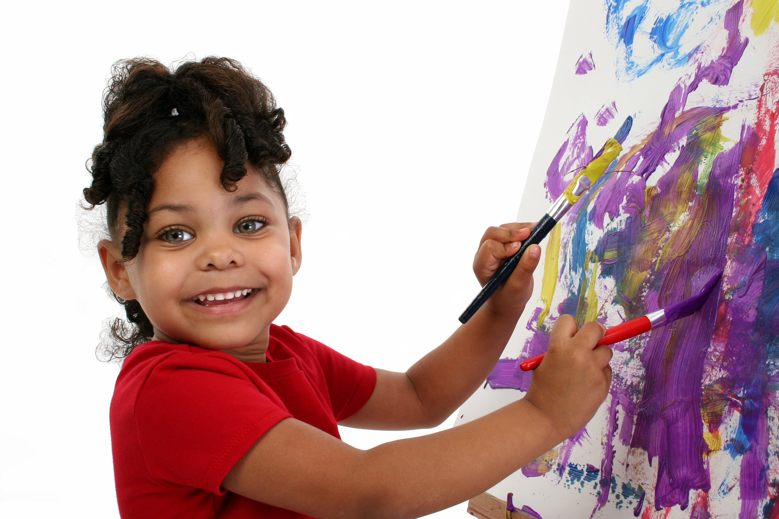
GELDS
PALS: CLL9 for 0-3 in your community
Name writing
Notes:
Name writing begins with exposure to manipulatives and art materials. Children need to build the muscles of their hands and fingers by playing with a variety of small objects and toys, exploring materials such as playdoh, goop, sand, and dirt. They need to manipulate fine objects such as spoons, scoops, and tongs, moving objects from one space to another. They also need to have lots of opportunities to explore with a variety of writing instruments on a variety of surfaces. Writing should be a part of their daily play and exploration routines. It will be messy, but that’s ok – children’s play and learning is often quite messy.

Slide 21
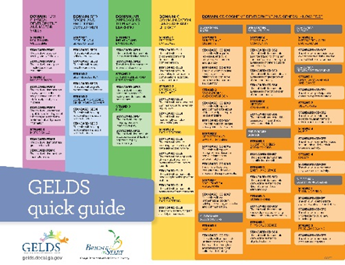
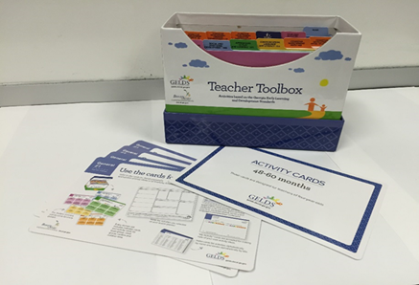
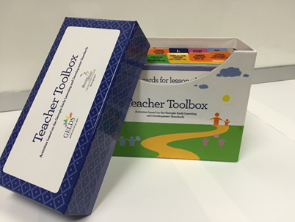
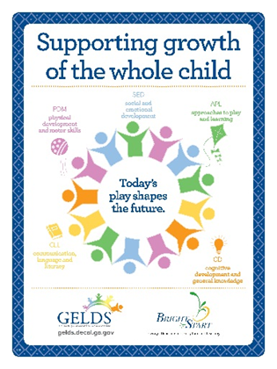
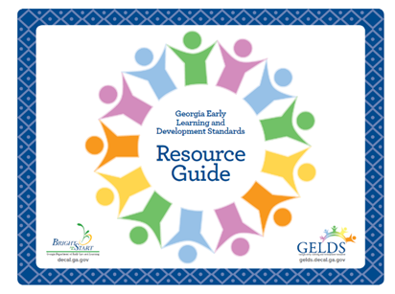
GELDS Resources
Notes:
Toolboxes
The toolboxes were designed in 4 packs- each pack representing a continuum of development designed for the following age groups:
0-36 months, 12-48 months, 24-60 months, 36-48 and Kdg correlations). Each pack contains activity cards, introductory cards, blank teacher cards, ,Bright idea cards, and an actity and book index

Slide 22
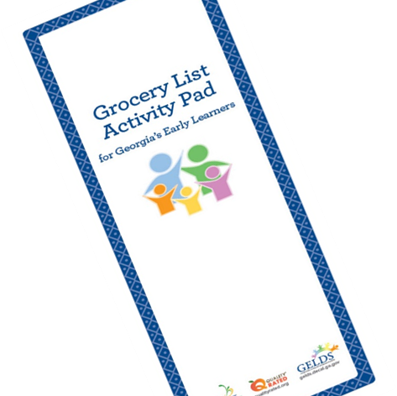
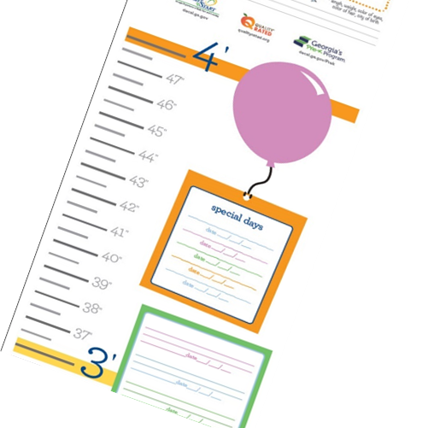
GELDS Family Engagement Resources
Notes:
Family engagement resources to support families understanding of the GELDS. We have grocery lists Activity pads, growth charts and placemat pads. All have characters and activities that support chldrens learning and development through play and interactions with families.

