Slide 1
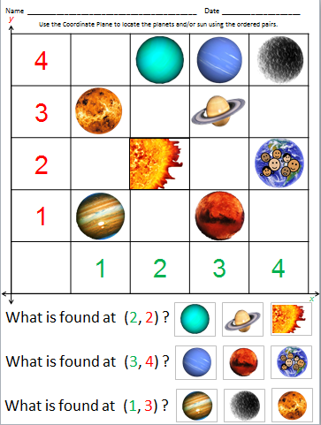
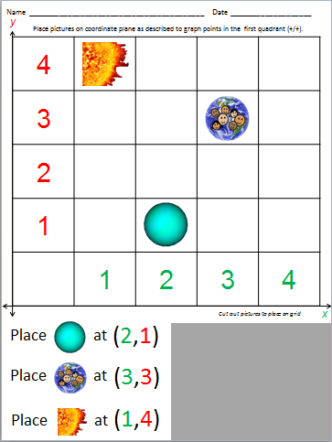
Geometry: Planets & Sun Coordinate Plane with blank templates
MGSE5.G.2 Represent real world and mathematical problems by graphing points in the first quadrant of the coordinate plane, and interpret coordinate values of points in the context of the situation.
Print and use the small coordinate plane sheets provided and/or create your own enlarged poster board size quadrant and use the planets/sun from the “Our Solar System: Sun & Planets” PowerPoint to fill in the coordinate plane.
-Students can interpret the value of points by locating the pictures that are on the coordinate plane at the given points.
-Students can graph points in the first quadrant (+,+) by placing pictures of planets/sun onto the coordinate plane using the ordered pairs given.
**Two sets of materials are provided – one set is color coded with green (x)axis and red (y) axis; other set uses black & white axis
Created by Jessie Moreau, M.Ed., NBCT
Gwinnett County Public Schools

Slide 2
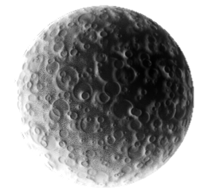
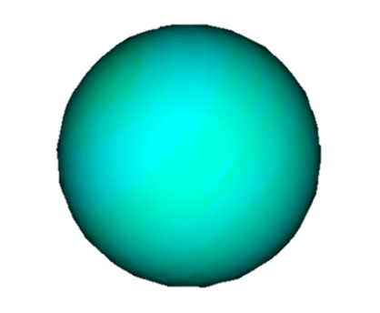
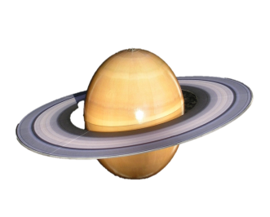
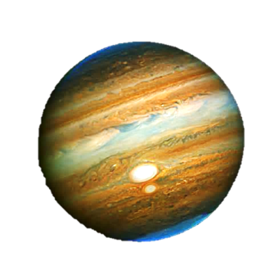
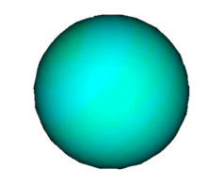
Use the Coordinate Plane to locate characters and/or items from the story.
Name __________________________________________ Date ____________________
y
4
3
2
1
 | 1 | 2 | 3 | 4
x
What is found at (2, 2) ?
What is found at (3, 4) ?

Slide 3
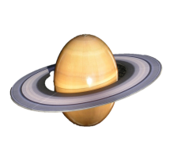
Use the Coordinate Plane to locate the planets and/or sun using the ordered pairs.
Name __________________________________________ Date ____________________
y
4
3
2
1
 | 1 | 2 | 3 | 4
x
What is found at (2, 2) ?
What is found at (3, 4) ?
What is found at (1, 3) ?

Slide 4
Use the Coordinate Plane to locate the planets and/or sun using the ordered pairs.
Name __________________________________________ Date ____________________
y
4
3
2
1
 | 1 | 2 | 3 | 4
x
What is found at (3, 3) ?
What is found at (4, 2) ?
What is found at (1, 1) ?

Slide 5
Place planets/sun on coordinate plane as described to graph points in the first quadrant (+/+).
Name __________________________________________ Date ____________________
y
4
3
2
1
 | 1 | 2 | 3 | 4
x
Cut out pictures to place on grid
(3,1)
Place at
(4,2)
Place at

Slide 6
Place pictures on coordinate plane as described to graph points in the first quadrant (+/+).
Name __________________________________________ Date ____________________
y
4
3
2
1
 | 1 | 2 | 3 | 4
x
Cut out pictures to place on grid
(2,1)
Place at
(3,3)
Place at
(1,4)
Place at

Slide 7
Use the Coordinate Plane to locate characters and/or items from the story.
Name __________________________________________ Date ____________________
y
4
3
2
1
 | 1 | 2 | 3 | 4
x
What is found at (2, 2) ?
What is found at (3, 4) ?

Slide 8
Use the Coordinate Plane to locate the planets and/or sun using the ordered pairs.
Name __________________________________________ Date ____________________
y
4
3
2
1
 | 1 | 2 | 3 | 4
x
What is found at (2, 2) ?
What is found at (3, 4) ?
What is found at (1, 3) ?

Slide 9
Use the Coordinate Plane to locate the planets and/or sun using the ordered pairs.
Name __________________________________________ Date ____________________
y
4
3
2
1
 | 1 | 2 | 3 | 4
x
What is found at (3, 3) ?
What is found at (4, 2) ?
What is found at (1, 1) ?

Slide 10
Place planets/sun on coordinate plane as described to graph points in the first quadrant (+/+).
Name __________________________________________ Date ____________________
y
4
3
2
1
 | 1 | 2 | 3 | 4
x
Cut out pictures to place on grid
(3,1)
Place at
(4,2)
Place at

Slide 11
Place pictures on coordinate plane as described to graph points in the first quadrant (+/+).
Name __________________________________________ Date ____________________
y
4
3
2
1
 | 1 | 2 | 3 | 4
x
Cut out pictures to place on grid
(2,1)
Place at
(3,3)
Place at
(1,4)
Place at

Slide 12
Name __________________________________________ Date ____________________
y
Use the Coordinate Plane to locate the requested items using the ordered pairs.
4
3
2
1
 | 1 | 2 | 3 | 4
x
What is found at (3, 3) ?
What is found at (4, 2) ?
What is found at (1, 1) ?

Slide 13
Place pictures on coordinate plane as described to graph points in the first quadrant (+/+).
Name __________________________________________ Date ____________________
4
3
2
1
 | 1 | 2 | 3 | 4
Cut out pictures to place on grid
(2,1)
Place at
(3,3)
Place at
(1,4)
Place at

Slide 14
Use the Coordinate Plane to locate the requested items using the ordered pairs.
Name __________________________________________ Date ____________________
y
4
3
2
1
 | 1 | 2 | 3 | 4
x
What is found at (2, 4) ?
What is found at (4, 2) ?
What is found at (4, 1) ?

Slide 15
Place pictures on coordinate plane as described to graph points in the first quadrant (+/+).
Name __________________________________________ Date ____________________
y
4
3
2
1
 | 1 | 2 | 3 | 4
x
Cut out pictures to place on grid
(4,1)
Place at
(2,2)
Place at
(3,4)
Place at

