Slide 1
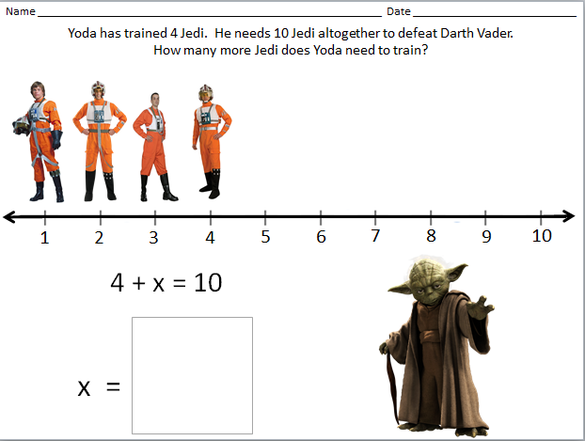
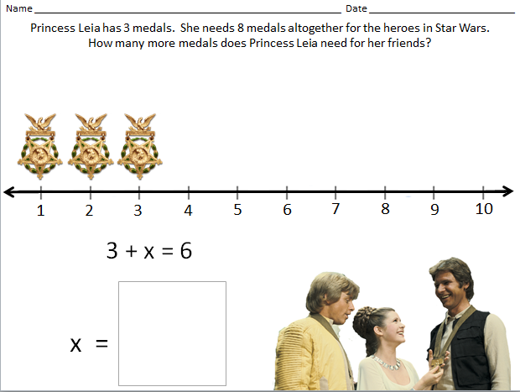
Star Wars® Algebra Word Problems
Created by Jessie Moreau, M.Ed., NBCT
Gwinnett County Public Schools

Slide 2
Star Wars ® Algebra Word Problems & Templates
Georgia Standards of Excellence
MGSE6.EE.7 Solve real-world and mathematical problems by writing and solving equations of the form x+p=q and px=q for cases in which p, q, and x are all nonnegative rational numbers.
MGSE7.NS.3 Solve real-world and mathematical problems involving the four operations with rational numbers.
MGSE.7.EE.4c. Solve real-world and mathematical problems by writing and solving equations of the form x+p = q and px = q in which p and q are rational numbers.
MGSE8.EE.7a Give examples of linear equations in one variable with one solution, infinitely many solutions, or no solutions. Show which of these possibilities is the case by successively transforming the given equation into simpler forms, until an equivalent equation of the form x=a, a=a, or a=b results (where a and b are different numbers).
High School:
MGSE9-12.A.CED.1 Create equations and inequalities in one variable and use them to solve problems. Include equations arising from linear, quadratic, simple rational, and exponential functions (integer inputs only).
(These equations are at a prerequisite level for linear equations and have one variable and have one solution.)

Slide 3
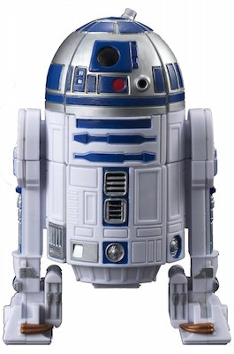
Name _____________________________________________________________ Date _____________________________
R2-D2 used 2 restraining bolts for energy on the Starfighter. There are 8 bolts altogether.
How many more restraining bolts can R2-D2 use throughout the Starfighter?
1
2
3
4
5
6
7
8
9
10
2 + x = 8
x =

Slide 4
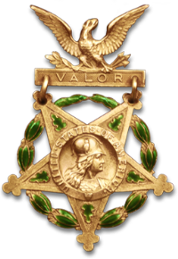
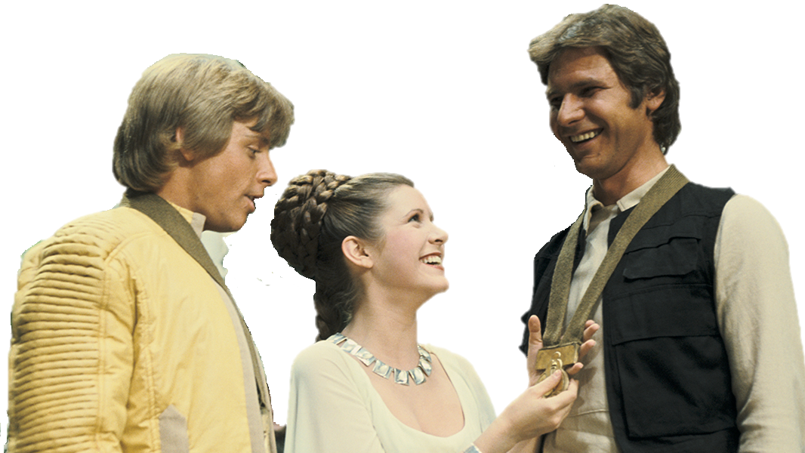
Name _____________________________________________________________ Date _____________________________
Princess Leia has 3 medals. She needs 8 medals altogether for the heroes in Star Wars.
How many more medals does Princess Leia need for her friends?
1
2
3
4
5
6
7
8
9
10
3 + x = 6
x =

Slide 5
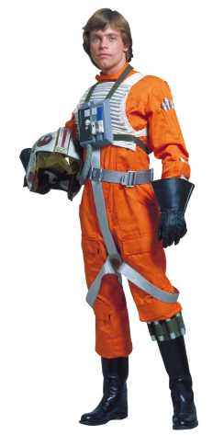
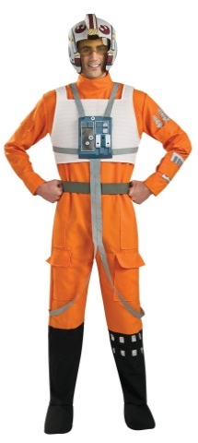
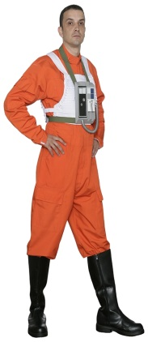
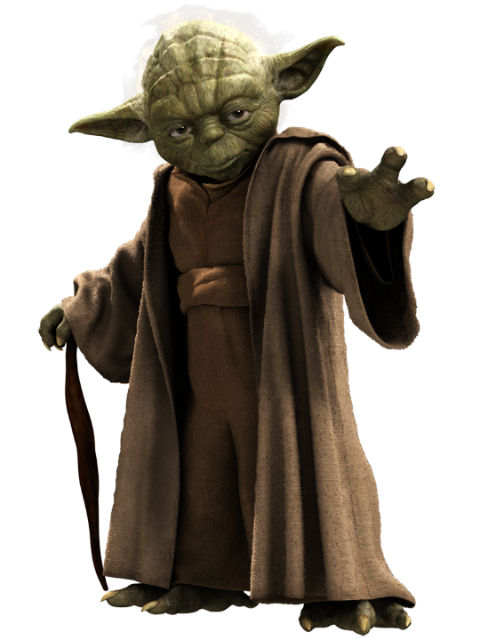
Name _____________________________________________________________ Date _____________________________
Yoda has trained 3 Jedi. He needs 10 Jedi altogether to defeat Darth Vader.
How many more Jedi does Yoda need to train?
1
2
3
4
5
6
7
8
9
10
3 + x = 10
x =

Slide 6
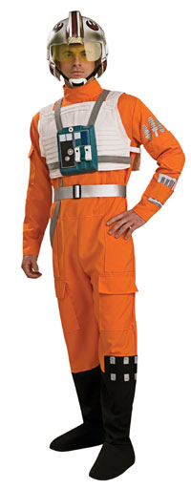
Name _____________________________________________________________ Date _____________________________
Yoda has trained 4 Jedi. He needs 10 Jedi altogether to defeat Darth Vader.
How many more Jedi does Yoda need to train?
1
2
3
4
5
6
7
8
9
10
4 + x = 10
x =

Slide 7
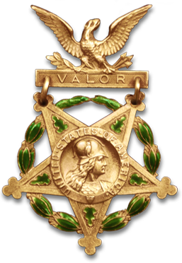
Photos to use with poster-sized number lines/equations.

Slide 8
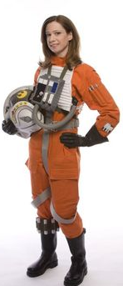
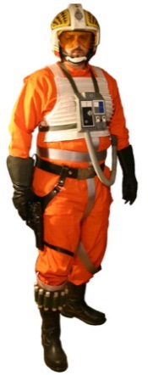
Photos to use with letter size worksheets for number lines/equations.

Slide 9
Photos to use with poster-sized number lines/equations.

Slide 10
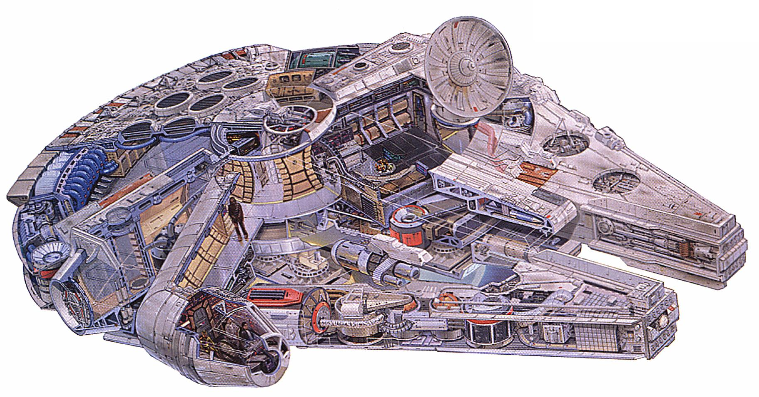
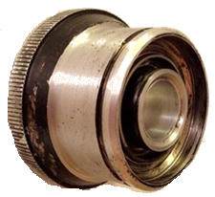

Slide 11
Photos to use with poster-sized number lines/equations.

Slide 12
Name _____________________________________________________________ Date _____________________________
Yoda has ___________. He needs ____________altogether.
How many more ____________does Yoda need to _____________?
1
2
3
4
5
6
7
8
9
10
______ + x = _______
x =

Slide 13
Name _____________________________________________________________ Date _____________________________
Yoda has trained 3 Jedi. He needs 9 Jedi altogether to defeat Darth Vader.
How many more Jedi does Yoda need to train?
______ + x = ______
x =
Princess Leia has 2 medals. She needs 10 medals altogether for the heroes in Star Wars.
How many more medals does Princess Leia need for her friends?
______ + x = ______
x =

Slide 14
Name _____________________________________________________________ Date _____________________________
R2-D2 used 1 restraining bolt for energy on the Starfighter. There are 7 bolts altogether.
How many more restraining bolts can R2-D2 use throughout the Starfighter?
1
2
3
4
5
6
7
8
9
10
+ x =
x =
Yoda has trained 2 Jedi. He needs 10 Jedi altogether to defeat Darth Vader.
How many more Jedi does Yoda need to train?
1
2
3
4
5
6
7
8
9
10
+ x =
x =

