Slide 1
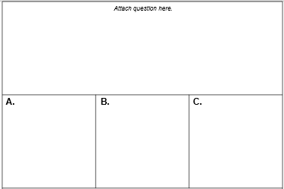
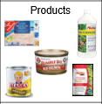
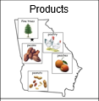
Three Choice Answer Sheet
EXAMPLE
Directions for creating Answer Sheet (slide 2)
Print sheet on cardstock or colored sheet of paper
Print as many as you need as these can be used for a variety of activities.
For repeated use:
Cut Answer Sheet in half to allow for the use of 2 separate questions or may keep whole for 2 questions per page
Laminate sheet(s)
Add hook/loop dot in each section to attach question & answer choices
Students then answer questions by selecting the response choices: A, B, or C.
Use included Question/Answer templates to insert graphics and text for specific content questions/answers.
Created by Jessie Moreau, M.Ed., NBCT, 2020

Slide 2
Attach question here.
A.
B.
C.
Attach question here.
A.
B.
C.

Slide 3
Type question here
Type question here
Type question here
Type question here
Questions: Type question, insert graphics. Print, cut, laminate and place in Question rectangle on Answer sheet.

Slide 4
Type text
Type text
Type text
Type text
Type text
Type text
Type text
Type text
Type text
Type text
Type text
Type text
Questions: Type question, insert graphics. Print, cut, laminate and place in Question rectangle on Answer sheet.

Slide 5
Type text
Type text
Type text
Type text
Type text
Type text
Type text
Type text
Type text
Type text
Type text
Type text
Answers: Type text; insert graphic. Print, cut, laminate and place in Answer Squares on Answer sheet.

