Slide 1
Special Education Law 101
Part 1
Special Education and School-Based Administrator Academy
Jamila C. Pollard, J.D., Senior Program Manager/Legal Officer
Scott R. Smith, Ed.D., Program Manager
Family Engagement and Dispute Resolution
Division for Special Education Services and Supports

Slide 2
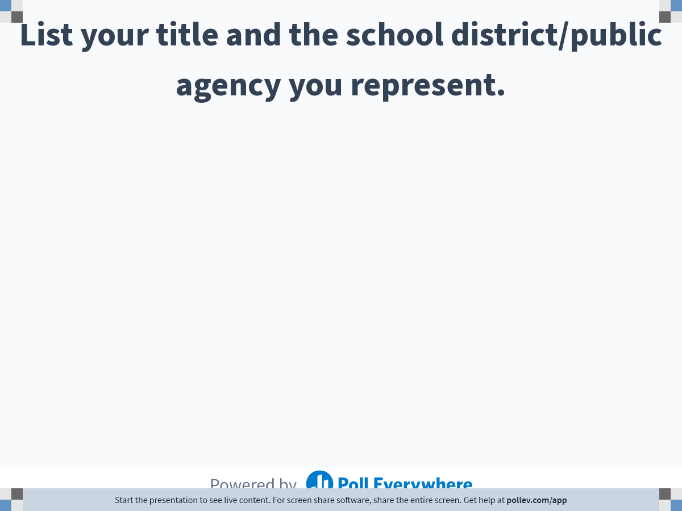
Notes:
Poll Title: List your title and the school district/public agency you represent.
https://www.polleverywhere.com/free_text_polls/NfYOBKKjOXkz5Iri425Et

Slide 3
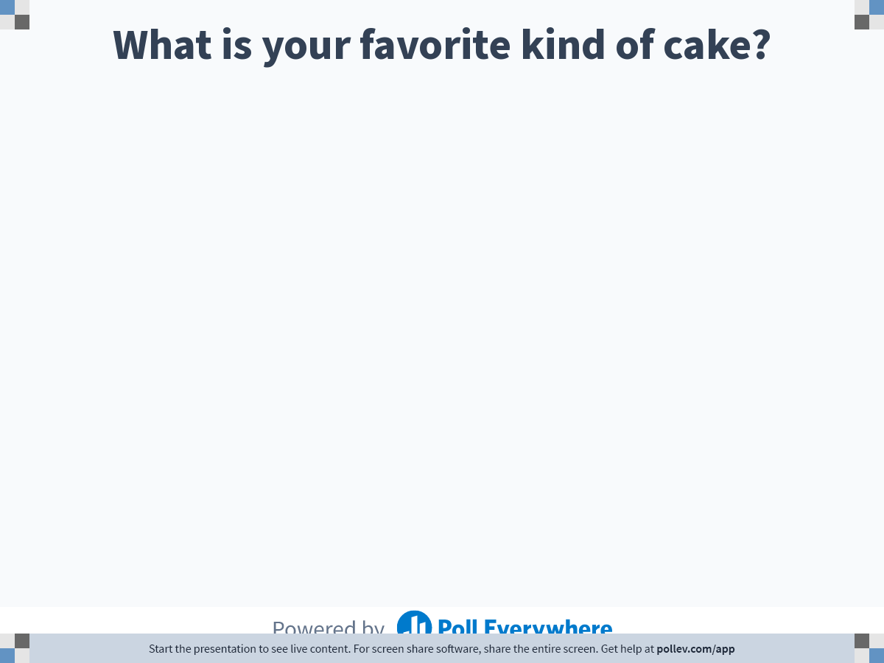
Notes:
Poll Title: What is your favorite kind of cake?
https://www.polleverywhere.com/free_text_polls/30yBYpS4p6nVjeK7njkma

Slide 4

Learning Targets
I can discuss some basic principles of special education law.
I can explain the special education process.
Notes:
Update based on changes

Slide 5
Sources of Law
Federal Statutes
  Individuals with Disabilities Education Act (IDEA) (formerly the Education for All Handicapped Children, Public Law 94-142)
  20 U.S.C. §§ 1401-1419
Federal Regulations
  34 C.F.R. §§ 300.1-300.818
State Statute
  O.C.G.A. § 20-2-152
State Regulations/Rules
  Ga. Bd. of Educ. R. 160-4-7-.01 through 160-4-7-.21
Notes:
Available online; explain acronyms

Slide 6
IDEA: Why it exists
Prior to 1975, the educational needs of millions of children with disabilities were not being met because of:
  the lack of appropriate educational services
  the lack of adequate resources to provide appropriate services
  children with disabilities were being excluded from school and/or excluded from being educated with peers
  disabilities going undiagnosed

Slide 7
IDEA: What is the purpose
To ensure that all children with disabilities have available to them a free appropriate public education (FAPE) that emphasizes special education and related services designed to meet their unique needs and prepare them for further education, employment, and independent living;
To ensure that the rights of children with disabilities and parents of such children are protected;
To assist States, localities, educational service agencies, and Federal agencies to provide for the education of all children with disabilities
To assess, and ensure the effectiveness of, efforts to educate children with disabilities.

Slide 8
IDEA: Who is covered
For IDEA Part B, students ages 3 through 21 who:
  Fall into at least one of thirteen (13) categories of disability AND
  Who, by reason thereof, need special education and related services
How do you know they “need special education and related services”?
  Most disabilities require an adverse impact or effect on educational performance (i.e., educational, developmental, or functional)
Notes:
13 categories – Autism, Intellectual Disability, Emotional Behavioral Disorder, Significant Development Delay, Other Health Impairment, Specific Learning Disability, Speech-language Impairment, Traumatic Brain Injury, Deaf/Hard of Hearing, Vision Impairment and Blindness, Deafblind, Orthopedic Impairment, Multiple Disabilities
Functional skills include “routine activities of everyday living” such as (1) dressing, eating, going to the bathroom; (2) social skills such as making friends and communicating with others; (3) behavior skills, such as knowing how to behave across a range of settings; and (4) mobility skills, such as walking, getting around, going up and down stairs.

Slide 9
IDEA: Who is responsible?
State Educational Agencies (SEAs): Georgia Department of Education
Local Educational Agencies (LEAs): Local school districts, state charter schools, Georgia Department of Juvenile Justice, Georgia Department of Corrections

Slide 10
IDEA: Basic Principles
Child Find
Evaluation/Eligibility
Free appropriate public education (FAPE)
Least Restrictive Environment (LRE)
Parental Involvement
Dispute Resolution

Slide 11
Overview of Special Education Process
Student struggling, such as failing grades, problem reading or paying attention, repeated suspensions, poor behavior, or fighting in school
MTSS/SST/RTI (Tiered Interventions to address the problems)
Evaluation
Eligibility Determination
If eligible, IEP Development (FAPE)
Services/Placement (FAPE/LRE)
Child Find
Referral to Special Education
Section 504
Parental Involvement and Dispute Resolution are a part of the Special Education Process
Notes:
504 – physical or mental impairment that substantially limits one or more major life activities; if eval requested by parent, give PWN to deny or refer to SPED

Slide 12
What is Child Find?
Affirmative requirement that local educational agencies (LEAs) locate, identify, and evaluate all children with disabilities who are in need of special education and related services residing in their jurisdiction, including homeless children, children who are wards of the State, and children in private schools.
This includes a child who is suspected of being a child with a disability and in need of special education. 34 C.F.R. § 300.111.
Notes:
Highlight – affirmative requirement of LEA – obligation on district; applies to any student in district regardless of homeschool status

Slide 13
Child Find Analysis
Does the LEA have reasonable suspicion that the child might be eligible under the IDEA?
  “Red flags”
If so, then did the LEA initiate the evaluation of the child within a reasonable period of time?
  LEA initiation starts with providing parental consent for evaluation
Notes:
What are red flags? Factors that when taken together and in light of the individual facts may show that the LEA had “reasonable suspicion.” Examples could be low or declining grades, not making progress in RTI or with 504 plan, interfering behaviors, suspensions/removals, outside evaluation, private diagnosis​

Slide 14
Interventions Prior to Referral
IDEA requires that children who are suspected of being a child with a disability and in need of special education are identified, located, and evaluated. 34 C.F.R. § 300.111.
IDEA does not require that a child receive scientific, research, or evidence-based interventions before being referred for consideration for eligibility for special education and related services. See 34 C.F.R. § 300.111.
However, per our State Child Find Rule, the implementation of a multi-tiered system of supports, including the use of scientific, research, or evidence-based interventions are required before referring a child for an initial evaluation for special education. See Georgia Rule 160-4-7-.03(2)(b).
Notes:
Fed – no GA - yes

Slide 15
Interventions Prior to Referral
However, if a parent or teacher requests an evaluation and interventions have not been provided prior to the referral, interventions may be provided while the child is being evaluated (within the 60-day timeline requirement).
Although a child’s receipt of interventions can provide a critical piece of information in helping to determine eligibility for special education, the lack of interventions must not be a reason for determining that a child is not eligible for special education services. (except for SLD)

Slide 16
OSEP 11-07, Response to Intervention (RTI) Memo, January 21, 2011
“The use of RTI strategies cannot be used to delay or deny the provision of a full and individual evaluation, pursuant to 34 C.F.R. §§ 300.304-300.311, to a child suspected of having a disability under 34 C.F.R. § 300.8. If the [local educational agency (LEA)] agrees with a parent who refers their child for evaluation that the child may be a child who is eligible for special education and related services, the LEA must evaluate the child ... If, however, the LEA does not suspect that the child has a disability, and denies the request for an initial evaluation, the LEA must provide written notice to parents explaining why the public agency refuses to conduct an initial evaluation and the information that was used as the basis for this decision.” (emphasis added)
Notes:
Office of Special Education Programs

Slide 17
OSEP 11-07, Response to Intervention (RTI) Memo, January 21, 2011
“Although the IDEA and its implementing regulations do not prescribe a specific timeframe from referral for evaluation to parental consent, it has been the Department’s longstanding policy that the LEA must seek parental consent within a reasonable period of time after the referral for evaluation, if the LEA agrees that an initial evaluation is needed.” (emphasis added).
Also, the IDEA states that “[t]he public agency must promptly request parental consent to evaluate the child to determine if the child needs special education and related services. . .” 34 C.F.R. § 300.309(c) (emphasis added).

Slide 18
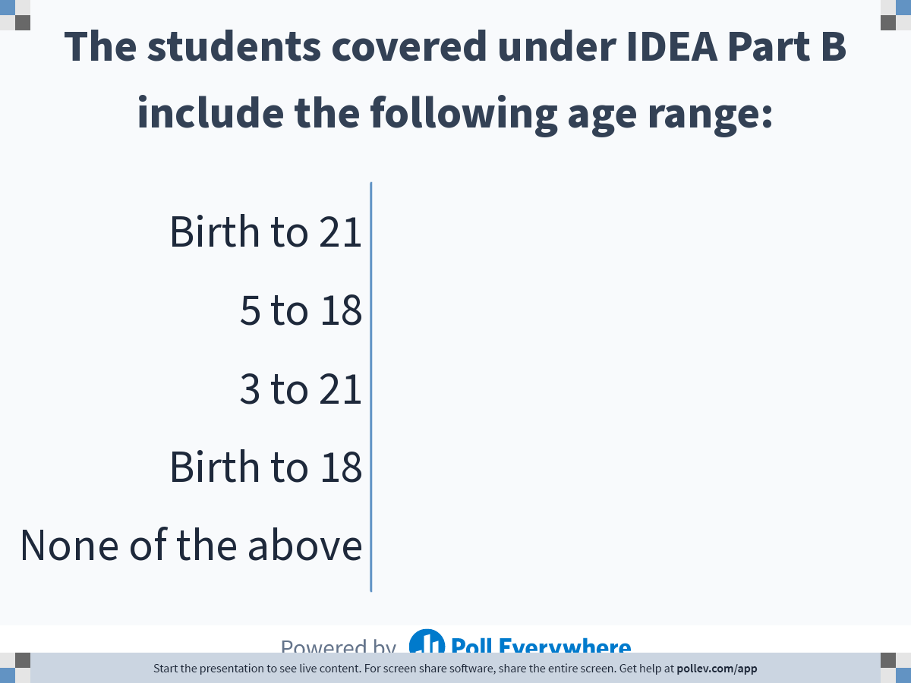
Notes:
Poll Title: The students covered under IDEA Part B include the following age range:
https://www.polleverywhere.com/multiple_choice_polls/SQnezp7eExoSVyhSnZkF0

Slide 19
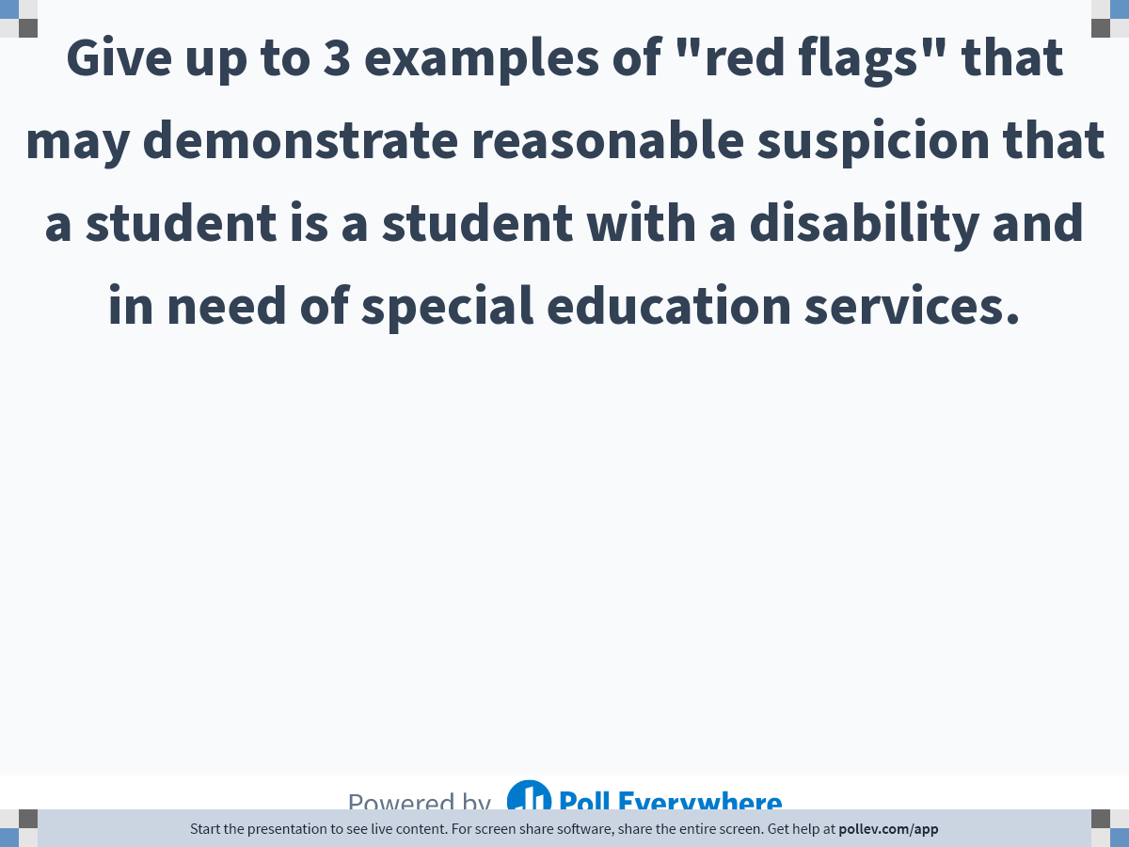
Notes:
Poll Title: Give up to 3 examples of "red flags" that may demonstrate reasonable suspicion that a student is a student with a disability and in need of special education services.
https://www.polleverywhere.com/free_text_polls/QHxe4K7F91mu58bjs6q23

Slide 20
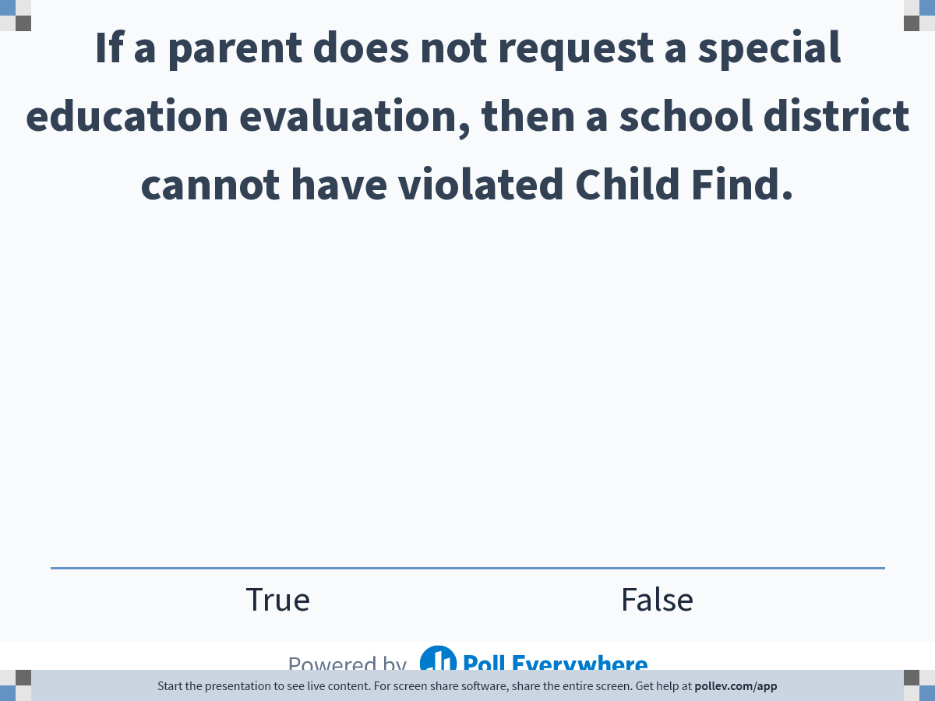
Notes:
Poll Title: If a parent does not request a special education evaluation, then a school district cannot have violated Child Find.
https://www.polleverywhere.com/multiple_choice_polls/vBRoYRQq3QvjKe8qS5RQk

Slide 21
Overview of Special Education Process
Student struggling, such as failing grades, problem reading or paying attention, repeated suspensions, poor behavior, or fighting in school
MTSS/SST/RTI (Tiered Interventions to address the problems)
Evaluation
Eligibility Determination
If eligible, IEP Development (FAPE)
Services/Placement (FAPE/LRE)
Child Find
Referral to Special Education
Section 504
Parental Involvement and Dispute Resolution are a part of the Special Education Process
Notes:
504 – physical or mental impairment that substantially limits one or more major life activities; if eval requested by parent, give PWN to deny or refer to SPED

Slide 22
Evaluations
Before an evaluation can begin, the LEA must obtain a signed, informed parental consent for evaluation.
The LEA has 60 calendar days after receiving parental consent to complete the initial evaluation.
Completion of the initial evaluation is defined as completion of the evaluation report(s).

Slide 23
Evaluations
The 60-calendar-day time period begins when an LEA employee receives the signed consent but excludes school holidays and other times when children are not in attendance for five or more consecutive school days, including the weekend days before and after the holiday period.
Any summer vacation period when the majority of the LEA’s teachers are not under contract does not count toward the 60-day time period.
If consent is received 30 days or more before the end of the school year (defined as the teachers’ last day under contract), the evaluation process must be completed within the 60-day time period.

Slide 24
Evaluations
An initial evaluation needs to look at the needs of the whole child, regardless of the reason for the referral.
  Informally and formally assess all areas related to any suspected disability, including, if appropriate, vision and hearing, health, social and emotional status, general intelligence, academic performance, communicative status, and motor abilities
  Use a variety of evaluation tools and strategies to gather relevant academic, functional, and developmental information about the child, including information provided by the parents
  Select assessment methods that, when administered to a child with impaired sensory, manual, or communication skills (to include English Learner (EL) barriers), the results accurately reflect the child’s aptitude or achievement level and are not culturally biased

Slide 25
Information Sources: Evaluations often use many of the following:
  Individually administered tests and tools
    Academic achievement
    Cognitive ability
    Social/Emotional/Behavioral
    Speech/Language
  Parent/Teacher/Child Questionnaires
    Social/Emotional/Behavioral
    Adaptive behavior
  Parent information and input
  Teacher input (verbal or written descriptions/analyzed classroom work samples)
  Schoolwide standardized testing results
  Medical information, as appropriate
  Classroom observations
  Prior testing done in private settings
  Prior testing done in other school settings, such as formative assessments from classroom progress monitoring

Slide 26
Can parents request an evaluation at any time?
Yes. If the LEA agrees to conduct the evaluation, then the LEA must provide the parent with a consent for evaluation form, and upon receipt of signed, informed consent, the LEA must conduct the evaluation.
If evidence of prior interventions has not been obtained, the evidence can be collected during the evaluation period. However, absence of evidence of prior interventions is not a reason to delay or deny the evaluation.
If the LEA decides not to conduct the evaluation, it must provide the parents with prior written notice and advise them of their parental rights to seek mediation or a due process hearing.

Slide 27
What happens to the 60-day evaluation time period when a child moves to another LEA before the evaluation is complete?
When a child has been referred for an evaluation and the child enrolls in a new LEA prior to the first LEA making a determination as to whether this is a child with a disability, the new LEA is required to move forward in completing the evaluation within a timely manner but may not be required to meet the original 60-day timeline. Specifically, the new LEA must make sufficient progress to ensure a prompt completion of the evaluation and work with the parent to mutually agree to a specific time when the evaluation will be completed. See 34 C.F.R. § 300.301(d)(2).

Slide 28
Reevaluations
Every three years, a reevaluation of a child with a disability is conducted unless the parent and LEA agree that a reevaluation is unnecessary.
A reevaluation can include a review of existing data and a determination that no other information is needed to determine the student remains eligible for special education and the student’s educational needs.
A reevaluation can include a comprehensive evaluation if additional data is needed.
A comprehensive evaluation MUST be conducted before determining a student is no longer eligible.

Slide 29
Independent Educational Evaluation (IEE)
Parents have a right to an independent educational evaluation (IEE) at public expense if they disagree with an LEA’s evaluation.
Without unnecessary delay, the LEA must grant the IEE or deny the IEE and file for a due process hearing to prove that their evaluation was appropriate.
This applies to any evaluation.
Notes:
Could be FBA

Slide 30
Eligibility Determination
After the evaluation is complete, a group of qualified professionals and the parent determine whether the child is a child with a disability under IDEA and the educational needs of the child.
LEAs are not required to make the eligibility determination during the 60-day initial evaluation timeline. However, the eligibility decision should be made within a reasonable period of time following the completion of the evaluation. See 71 Fed. Reg. 46637 (2006).
As a matter of best practice, within 10 calendar days of the completion of the evaluation report(s), an eligibility meeting should be held.
Development of the Individualized Education Program (IEP) can take up to 30 additional days. See 34 C.F.R. § 300.323(c)(1).

Slide 31
Eligibility Categories
Autism Spectrum Disorder
Intellectual Disability
Emotional Behavioral Disorder
Significant Development Delay
Other Health Impairment
Specific Learning Disability
Speech-language Impairment
Traumatic Brain Injury
Deaf/Hard of Hearing
Vision Impairment and Blindness
Deafblind
Orthopedic Impairment
Multiple Disabilities*
Notes:
There is an asterisk on Multiple Disabilities because this is an eligibility category listed in IDEA but not in our state rules.

Slide 32
What happens to children who are not found eligible for special education services?
One recommendation would be for the LEA to provide strategies in the general education setting to assist the child in meeting age-level expectations.
Another recommended practice would be to consider eligibility under Section 504 of the Rehabilitation Act of 1973 for those children who have a physical or mental impairment that substantially limits one or more major life activities. See 34 C.F.R. § 104.3(j)(1). General education classroom accommodations may be all that are needed to give equitable access to a child eligible under Section 504.

Slide 33
What happens to children who are not found eligible for special education services?
Another recommendation would be for the child to continue or begin, as appropriate, receiving Student Support Team (SST) services. The SST is responsible for helping design an individual plan for success. The substantial information that comes back from the comprehensive evaluation can assist the SST in this task.

Slide 34
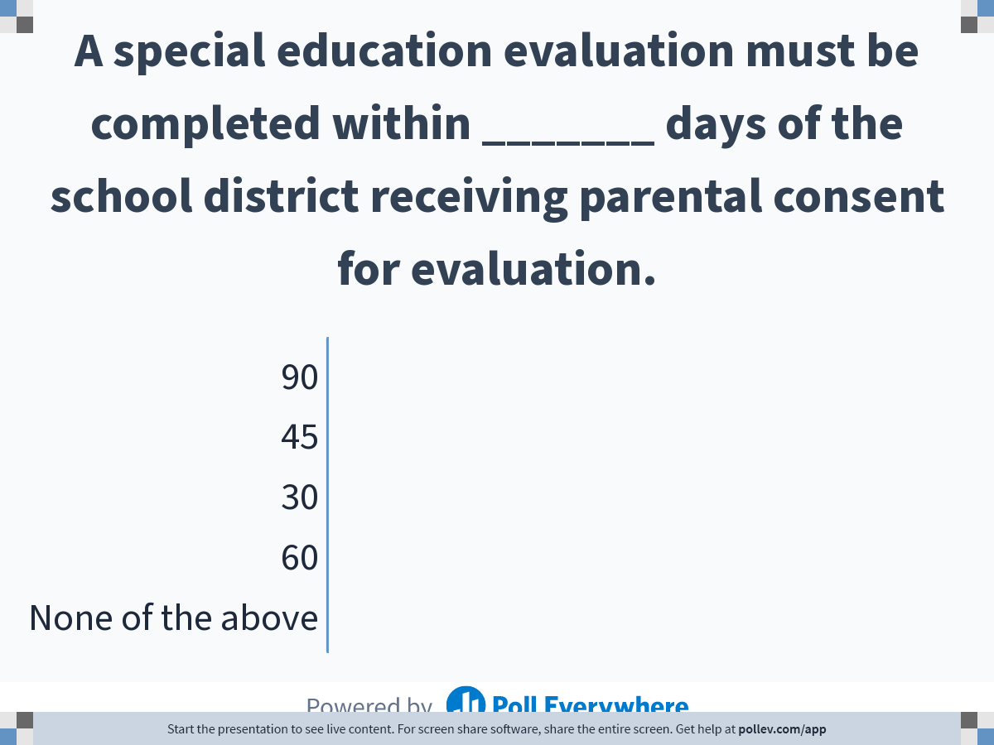
Notes:
Poll Title: A special education evaluation must be completed within _______ days of the school district receiving parental consent for evaluation.
https://www.polleverywhere.com/multiple_choice_polls/DIcUXh13T472fYgp5jVwD

Slide 35
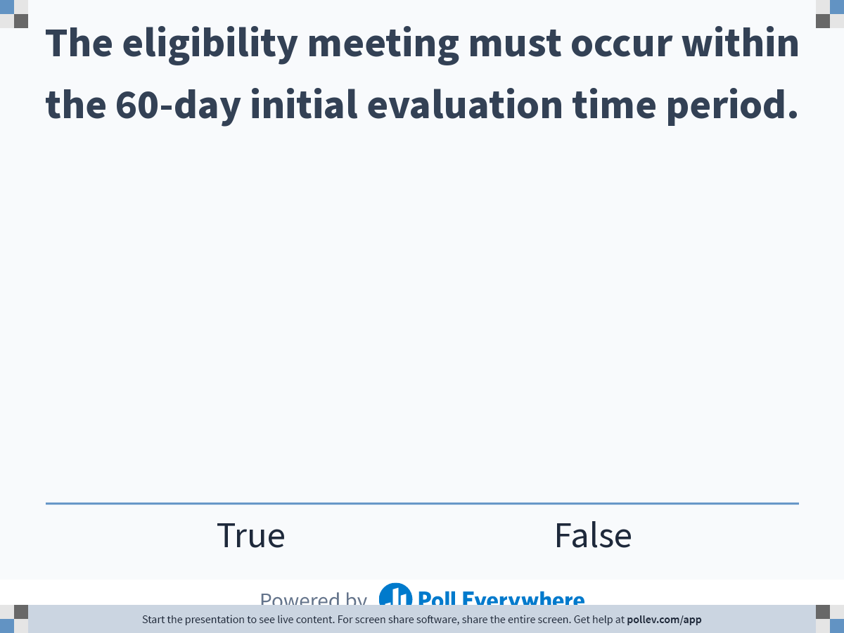
Notes:
Poll Title: The eligibility meeting must occur within the 60-day initial evaluation time period.
https://www.polleverywhere.com/multiple_choice_polls/n6rewcyePpEMtvcHwvBzK

Slide 36
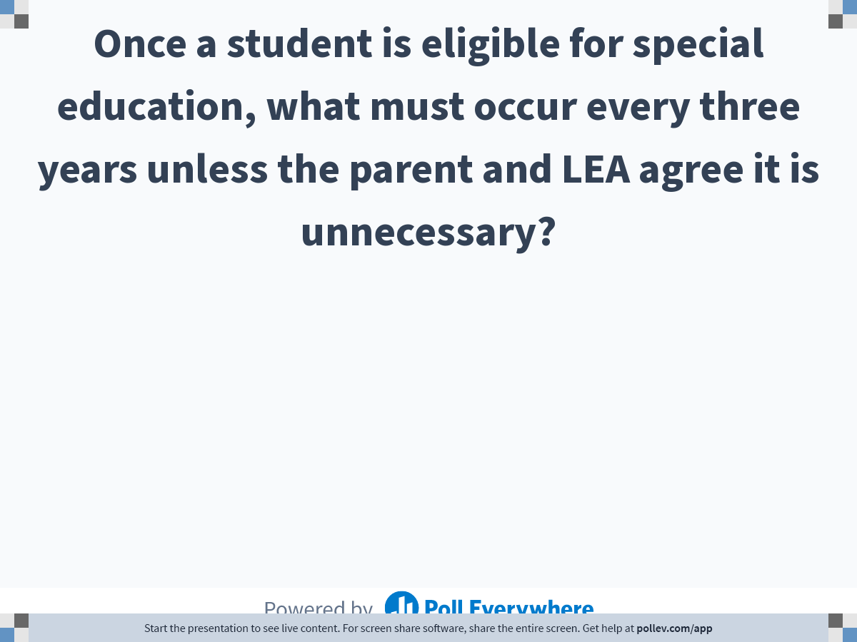
Notes:
Poll Title: Once a student is eligible for special education, what must occur every three years unless the parent and LEA agree it is unnecessary?
https://www.polleverywhere.com/free_text_polls/nVM435mU5IVtJiAmwt8Z4

Slide 37
Overview of Special Education Process
Student struggling, such as failing grades, problem reading or paying attention, repeated suspensions, poor behavior, or fighting in school
MTSS/SST/RTI (Tiered Interventions to address the problems)
Evaluation
Eligibility Determination
If eligible, IEP Development (FAPE)
Services/Placement (FAPE/LRE)
Child Find
Referral to Special Education
Section 504
Parental Involvement and Dispute Resolution are a part of the Special Education Process
Notes:
504 – physical or mental impairment that substantially limits one or more major life activities; if eval requested by parent, give PWN to deny or refer to SPED

Slide 38
IEP Development – IEP Team
At a minimum, the IEP Team must include:
  the parent (or the person acting as the parent under the IDEA);
  not less than one of the child’s regular education teachers, if the child is or may be participating in the regular education environment;
  not less than one of the child’s special education teachers or special education providers; and
  a LEA representative who meets the following requirements:
    is qualified to provide or supervise the provision of specially designed instruction to meet the unique needs of the child;
    is knowledgeable of the general education curriculum; and
    is knowledgeable about the availability of resources in the LEA;
  someone who can interpret evaluation results related to classroom instruction and settings

Slide 39
IEP Development – IEP Team
Other members required under certain circumstances:
  other individuals who have knowledge or special expertise regarding the child, including related services personnel;
  the child with a disability; or
  a representative of any agency that is likely to provide or pay for any transition services,

Slide 40
IEP Development – IEP Team
Two circumstances may allow a required member of the IEP Team to be excused:
  When an IEP Team member’s area of curriculum or related services is not being changed or discussed at that IEP Team meeting, the parent and the LEA may agree to excuse an IEP Team member from all or part of a meeting if the parent consents, in writing, to this excusal.
  When the IEP Team member’s area of curriculum or related services is being discussed at the meeting, the parent and the LEA may excuse an IEP Team member from all or part of a meeting if the parent consents, in writing, to the excusal and the excused person submits relevant, written input into the development of the IEP prior to the meeting.

Slide 41
IEP Development – Parent Participation
Parents must be notified early enough to ensure they have the opportunity to attend.
Meetings must be scheduled at a mutually agreed upon time and place.
Parents must receive notice of the purpose, time, location and who will be in attendance.

Slide 42
IEP Development – Parent Participation
Meetings can be held without a parent if the LEA is “unable to convince the parent that they should attend.”
In this case, the LEA must keep a record of its attempts to arrange a mutually agreed on time and place, such as –
  Detailed records of telephone calls made or attempted and the results of those calls;
  Copies of correspondence sent to the parents and any responses received; and
  Detailed records of visits made to the parent’s home or place of employment and the results of those visits.

Slide 43
IEP Development
Present levels of academic achievement and functional performance
Parental Concerns
Annual goals
Special Considerations (e.g. communication, vision, assistive technology, behavior)
Behavior Intervention Plan (BIP) if needed
Supplementary aids and services
Transition services
Assessment
Extended School Year
Special Education and Related Services

Slide 44
IEP Development – Services/Placement
Least Restrictive Environment (LRE)
  To the maximum extent appropriate, children with disabilities, including children in public or private institutions or other care facilities, are educated with children who are nondisabled; and
  Special classes, separate schooling, or other removal of children with disabilities from the regular educational environment occurs only if the nature or severity of the disability is such that education in regular classes with the use of supplementary aids and services cannot be achieved satisfactorily. 34 C.F.R. § 300.114(a)(2).

Slide 45
IEP Development – Services/Placement
Continuum of alternative placements
  Regular education classroom with no support
  Regular education classroom with supportive services (e.g. paraprofessional, interpreter)
  Regular education classroom with consultative services
  Regular education classroom with collaborative services (less than full segment daily)
  Regular education classroom with co-teaching services (full segment daily)

Slide 46
IEP Development – Services/Placement
Continuum of alternative placements
  Special education classroom (for any part of the day)
  Home-based (short-term; agreement from parent)
  Hospital/Homebound (medical certification required)
  Private schools
  Residential services

Slide 47
IEP Development
IEPs are reviewed annually, at a minimum
Revisions to an IEP can take place at any time (with or without a meeting – need parent approval)
Periodic progress reports on annual goals are required
Parents must receive copies of IEPs

Slide 48
IEP Team Members:
Regular Education Teacher
Regular Education Teacher
  Not less than one of the child’s regular education teachers, if the child is or may be participating in the regular education environment (for preschool children, this representative is someone who is currently providing preschool services to nondisabled preschool children)
Should there ever be a time when the regular education environment is not considered?
  LRE and educational benefits must be considered
    Possibility of participating
Notes:
No, generally speaking there should not be a time when the regular ed environment is not considered, therefore a regular ed. teacher should be in attendance.
There are examples of case law that show this point and they reference the LRE rule. (LRP IEP book pg 5.6) The court said as long as regular education is a possibility the participation of a regular education teacher in the creation of the IEP is required (LRE IEP book pg 5.7)

Slide 49
IEP Team Members:
Regular Education Teacher
If a child has never been in a regular education setting, do we need to have a regular education teacher present at the IEP Team meeting?
Yes. A regular education teacher of the child is required to participate in the meeting, if the child is or may be participating in the regular education environment. Federal regulations and State Special Education Rules require that the IEP Team consider the full continuum of services, which includes instruction in the regular education environment.

Slide 50
IEP Team Members:
Regular Education Teacher
Can an instructional coach or someone on the administrative team be the regular education teacher on the IEP Team?
  Do they have the qualifications?
  Do they currently teach the general education curriculum?
  Do they currently teach the child?

Slide 51
IEP Team Members:
Special Education Teacher
34 C.F.R. § 300.321 (a)(3) Not less than one special education teacher of the child, or where appropriate, not less than one special education provider of the child;
This should be the special education teacher who is or will be responsible for implementing the IEP.

Slide 52
IEP Team Members
If a teacher is dually certified both in special education and regular education, can he or she serve dual roles in the IEP Team meeting?
No. Under the IDEA, the IEP Team must include not less than one regular education teacher of the child and not less than one special education teacher of the child.
The determination of who can serve as the regular education teacher and the special education teacher in the IEP Team meeting is not based on that individual’s certification alone, but their relation to the child.

Slide 53
Do we need to do an excusal if the teacher does not stay the whole time?
Yes, an excusal would be needed if any of the required members leave before the meeting is over. LEAs should discourage the practice of having any required IEP Team member leave in the middle of the meeting. His or her role is important for the entire meeting, including the portion where placement and supports are discussed, which is often near the end of the meeting.

Slide 54
Do IEP Team members vote on IEP decisions?
No. There is no “majority vote” rule for IEP Team meetings. Decisions should be reached by consensus.
If the Team cannot reach consensus, the LEA must provide the parent with prior written notice of the LEA’s proposals or refusals, or both, regarding the child’s educational program. Parents are equal participants in the IEP process, but they do not have veto power over the IEP. If the parent disagrees with the Team’s decision, he or she can utilize the dispute resolution options.

Slide 55
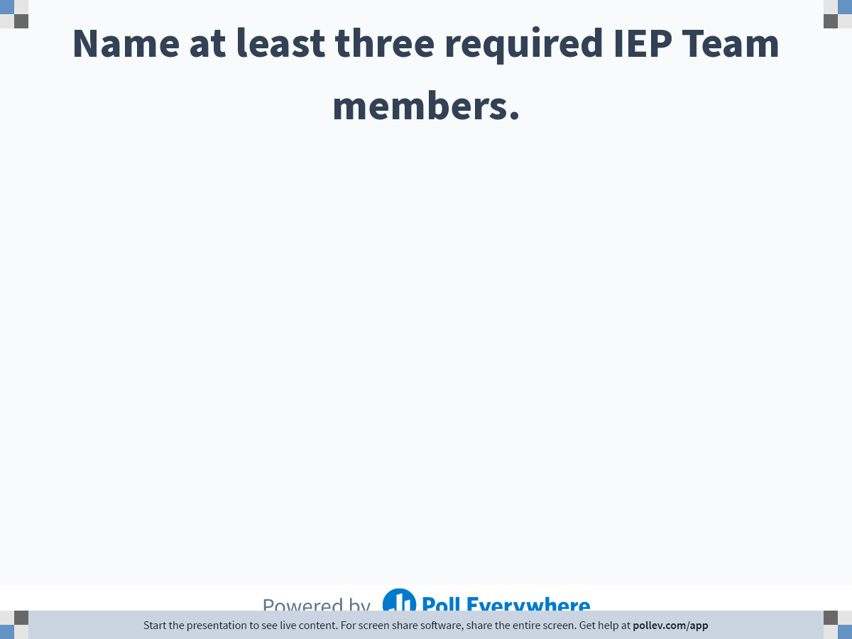
Notes:
Poll Title: Name at least three required IEP Team members.
https://www.polleverywhere.com/free_text_polls/TZXA49c1xYBPLJmTLItlC

Slide 56
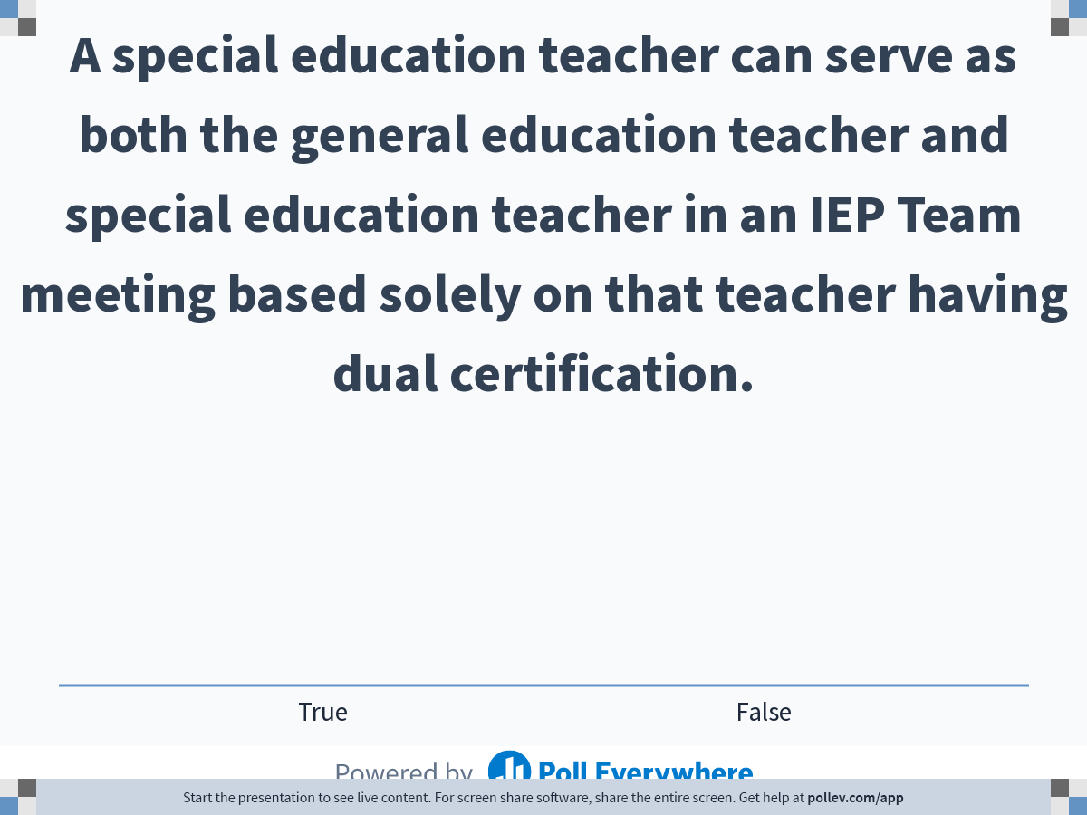
Notes:
Poll Title: A special education teacher can serve as both the general education teacher and special education teacher in an IEP Team meeting based solely on that teacher having dual certification.
https://www.polleverywhere.com/multiple_choice_polls/unxCc4nOhUfVvr2PUhetK

Slide 57


Slide 58
Special Education Law 101
Part 2
Special Education and School-Based Administrator Academy
Jamila C. Pollard, J.D., Senior Program Manager/Legal Officer
Scott R. Smith, Ed.D., Program Manager
Family Engagement and Dispute Resolution
Division for Special Education Services and Supports

Slide 59
Learning Targets
I can recite the Endrew F. substantive standard for a free appropriate public education (FAPE).
I can compare and contrast the three dispute prevention processes and the three dispute resolution processes.
Notes:
Update based on changes

Slide 60
Overview of Special Education Process
Student struggling, such as failing grades, problem reading or paying attention, repeated suspensions, poor behavior, or fighting in school
MTSS/SST/RTI (Tiered Interventions to address the problems)
Evaluation
Eligibility Determination
If eligible, IEP Development (FAPE)
Services/Placement (FAPE/LRE)
Child Find
Referral to Special Education
Parental Involvement and Dispute Resolution are a part of the Special Education Process
Notes:
504 – physical or mental impairment that substantially limits one or more major life activities; if eval requested by parent, give PWN to deny or refer to SPED

Slide 61
What is a FAPE?
§300.17 Free appropriate public education.
Free appropriate public education or FAPE means special education and related services that—
  (a) Are provided at public expense, under public supervision and direction, and without charge;
  (b) Meet the standards of the SEA, including the requirements of this part;
  (c) Include an appropriate preschool, elementary school, or secondary school education in the State involved; and
  (d) Are provided in conformity with an individualized education program (IEP) that meets the requirements of §§300.320 through 300.324.
    34 C.F.R. § 300.320 – Definition of IEP
    34 C.F.R. § 300.321 – IEP Team
    34 C.F.R. § 300.322 – Parent Participation
    34 C.F.R. § 300.323 – When IEPs must be in effect
    34 C.F.R. § 300.324 – Development, review, and revision of IEP
Notes:
34 C.F.R. 320 – Definition of IEP; 34 CFR 300.321 – IEP Team; 34 CFR 300.322 – Parent Participation; 34 CFR 300.323 – When IEPs must be in effect; 34 CFR 300.324 – Development, Review, Revision of the IEP

Slide 62
What is a FAPE?
FAPE
  Must be available to all eligible children, even if:
    They are suspended or expelled from school
    They have not failed or been retained in a course or grade
    They are advancing from grade to grade
  Individualized
    Reasonably calculated to enable the child to make progress appropriate in light of their circumstances

Slide 63
Relevant Court Cases and Guidance Documents
BOE Hendrick Hudson Central School District v. Rowley, 458 U.S. 176 (June 28, 1982)
Endrew F. v. Douglas County (CO) School District, 137 S.Ct. 988 (March 22, 2017)
U.S. Dep’t of Educ. Questions & Answers on Endrew F. (December 7, 2017)
Endrew F. v. Douglas County (CO) School District, 290 F. Supp. 3d 1175, U.S. District Court of Colorado (February 12, 2018)

Slide 64
BOE of the Hendrick Hudson Central School District v. Rowley, 458 U.S. 176 (June 28, 1982)
Amy Rowley, a first grade student with a hearing impairment, was taught in the general education classroom.
The IEP Team determined that the student required an frequency modulation (FM) system, a tutor for the deaf one hour a week, and speech-language therapy three hours a week.
The parent agreed with the IEP Team, but also insisted that the student required a sign language interpreter in all of her academic classes.
The district stated that the student was achieving educationally, academically, and socially without such assistance.

Slide 65
Rowley Standard for FAPE
(1) Has the district complied with the procedures of the IDEA?
(2) Is the IEP “reasonably calculated to enable the child to receive educational benefits”?
  For children receiving instruction in the regular classroom, this would generally require an IEP “reasonably calculated to enable the child to achieve passing marks and advance from grade to grade.”
  Schools need not maximize the potential of children with disabilities.
Notes:
The Rowley Court asked the first two questions above.

Slide 66
Endrew F. v. Douglas County (CO) School District, 137 S. Ct. 988 (March 22, 2017)
Endrew F., a student with autism, attended school in the district from preschool through fourth grade.
The district’s proposed IEP for fifth grade was, in the parent’s view, pretty much the same as his third and fourth grade IEPs. The parents removed him from the school and enrolled him in a private school that specializes in educating children with autism.
The private school developed a BIP and added substantive academic goals, and within months, the student’s behavior and academic progress improved significantly.

Slide 67
Endrew F. v. Douglas County (CO) School District, 137 S. Ct. 988 (March 22, 2017)
Parents filed for due process seeking tuition reimbursement, alleging that the student did not receive a FAPE under either the “some educational benefit” or “meaningful benefit” standard.
ALJ, District Court, and 10th Circuit Court of Appeals all denied relief, holding that the benefits the student received from the district were “more than de minimis” and this is all that was required.
  “More than de minimis” meaning more than trivial or minor educational benefit

Slide 68
Endrew F. v. Douglas County (CO) School District, 137 S. Ct. 988 (March 22, 2017)
U.S. Supreme Court rejected the “merely more than de minimis” (i.e. more than trivial) standard applied by the Tenth Circuit.
The U.S. Supreme Court held: To meet the substantive obligation under the IDEA, a school must offer an IEP reasonably calculated to enable to child to make progress appropriate in light of the child’s circumstances.
In determining the scope of FAPE, the Court reinforced the requirement that “every child should have the chance to meet challenging objectives.”

Slide 69
How did Endrew F. clarify the standard for determining FAPE and educational benefit?
The Court clarified that for all students, including those performing at grade level and those unable to perform at grade level, a school must offer an IEP that is “reasonably calculated to enable a child to make progress appropriate in light of the child’s circumstances.”
The Court said “[t]he goals may differ, but every child should have the chance to meet challenging objectives.”

Slide 70
Does the standard in Endrew F. apply prospectively to ALL IDEA cases?
Yes.
The Court rejected the “merely more than de minimis” standard and said the IDEA demands more.
Now, each child’s educational program must be appropriately ambitious in light of his or her circumstances, and every child should have the chance to meet challenging objectives.
This applies regardless of the child’s disability, the age of the child, or the child’s current placement.

Slide 71
Is there anything IEP Teams should do differently as a result of the Endrew F. decision?
IEP Teams must implement policies, procedures, and practices relating to:
  Identifying present levels of academic achievement and functional performance
  The setting of measurable annual goals, including academic and functional goals
  How a child’s progress toward meeting annual goals will be measured and reported

Slide 72
Is there anything IEP Teams should do differently as a result of the Endrew F. decision?
IEP Teams and other school personnel should be able to demonstrate that, consistent with the provisions of the child’s IEP, they are:
  Providing special education and related services and supplementary aids and services
  Making program modifications
  Providing supports for school personnel and
  Allowing for appropriate accommodations that are reasonably calculated to enable a child to make progress appropriate in light of the child’s circumstances and enable the child to have the chance to meet challenging objectives.

Slide 73
So what happened to Endrew F.?
On remand, the district court of Colorado determined that Endrew F.’s IEP did not satisfy the revised standard of FAPE
  5th grade IEP had the same annual goals as 2nd, 3rd, and 4th grade IEPs with only minor changes to the short-term objectives
  Even though the school district said that the student’s severe behavior problems prevented him from making greater progress, the judge noted that the district had not conducted a functional behavioral assessment (FBA) or developed a behavioral intervention plan (BIP)
  Judge said the district’s inability to properly address the student’s behavior negatively impacted his ability to make progress which cut against the reasonableness of the 5th grade IEP.
Parents entitled to recover reasonable private school costs and legal expenses.
Parties settled for $1.32 million after 7 years of litigation

Slide 74
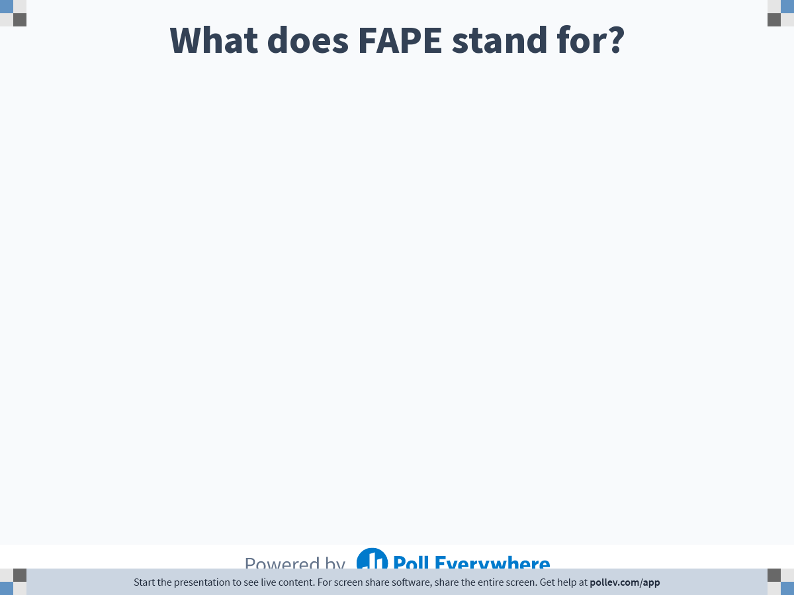
Notes:
Poll Title: What does FAPE stand for?
https://www.polleverywhere.com/free_text_polls/g4Hruw2UUO5CrskMeUXQm

Slide 75
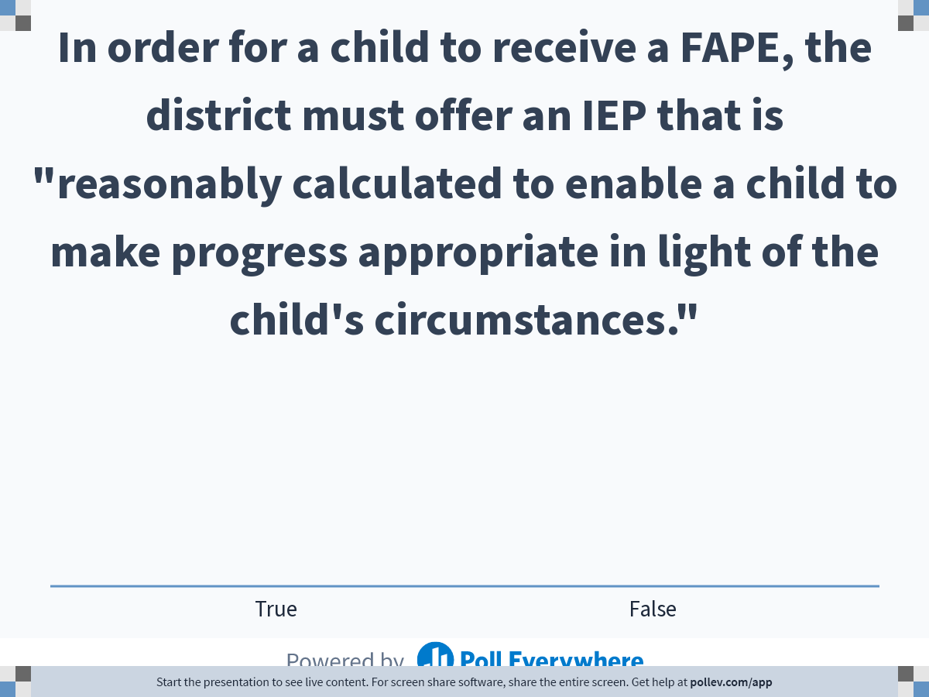
Notes:
Poll Title: In order for a child to receive a FAPE, the district must offer an IEP that is "reasonably calculated to enable a child to make progress appropriate in light of the child's circumstances."
https://www.polleverywhere.com/multiple_choice_polls/iKaJsUXpCfEGAKG5H6t9A

Slide 76
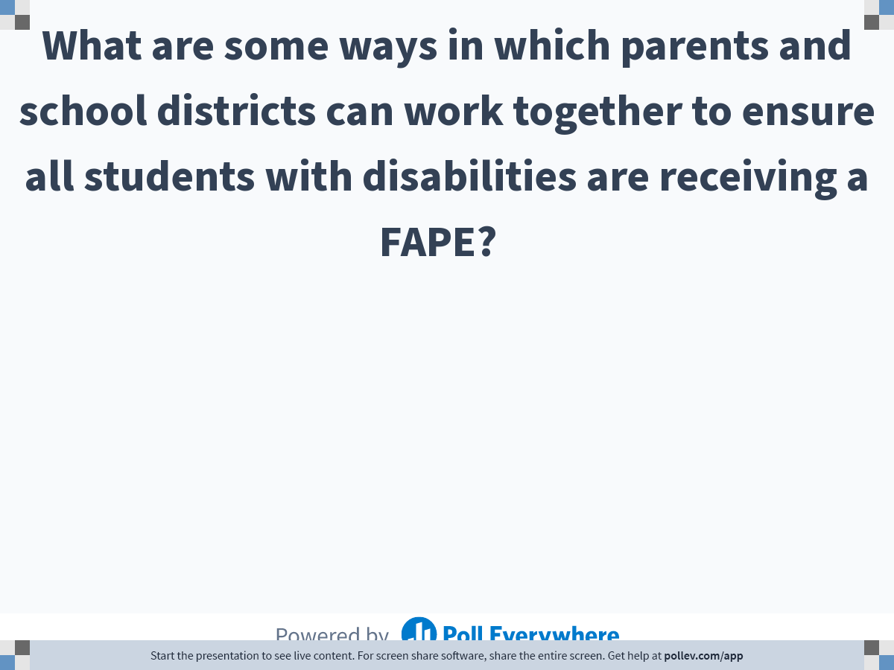
Notes:
Poll Title: What are some ways in which parents and school districts can work together to ensure all students with disabilities are receiving a FAPE? ​ ​
https://www.polleverywhere.com/free_text_polls/2g6VRWUJwXsjUn6YsbYer

Slide 77
Dispute Prevention and Resolution

Slide 78
Family Engagement and Dispute Resolution Unit
Providing a continuum of resources for Georgia families and school districts
Family Engagement
Georgia Parent Mentor Partnership
Dispute Prevention
Special Education Help Desk
IEP Facilitation
Dispute Resolution
Mediation
Formal Written Complaints
Collaboration with Parent2Parent of Georgia
Due Process Hearings/ Resolution Session Meetings
State Advisory Panel (SAP)
Procedural Safeguards (Parents' Rights)
Collaboration with Title I Family-School Partnership Program

Slide 79
A Continuum
Tension
Conflict
Dispute

Slide 80
What to do when tension or conflict arises?
First Recommendation: Utilize techniques and strategies at the school level to possibly prevent disputes
Second Recommendation: Contact your parent mentor and/or special education administrator in the district to assist in working out the differences
Final Recommendation: When a resolution cannot be worked out locally, utilize the GaDOE’s and IDEA’s dispute prevention and resolution processes
.

Slide 81
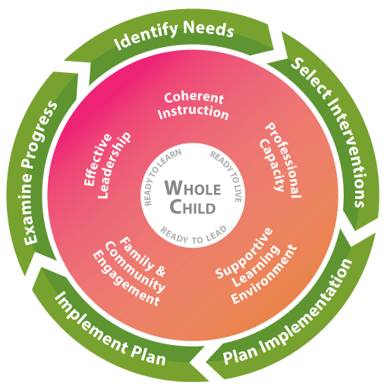
What Can Educators Do?
• Communicate, communicate, communicate
• Build trust
• Listen
• Eliminate jargon
• Structure IEP Team meetings
• Understand perspectives
• Reduce power imbalance
• Support family engagement
A major system of the complex school organization that develops quality links between local school professionals and the parents and community the school is intended to serve.

Slide 82
A Continuum of Dispute Prevention and Resolution Processes
Procedural Safeguards (Parents’ Rights)
Special Education Help Desk
IEP Facilitation
Mediation
Written Formal Complaint
Due Process Hearing
Resolution Sessions

Slide 83
Dispute Prevention Processes

Slide 84


Slide 85

Procedural Safeguards (Parents’ Rights)
What are they?
  Written notice provided to parents of students with disabilities, explaining the rights of parents and students under IDEA
What rights are explained?
  Independent Educational Evaluations
  Prior written notice
  Parental Consent
  Access to education records
  Mediation, Formal Written Complaints, Due Process Hearings
  Child placement during pendency of due process complaint
  Procedures for students subject to placement in interim alternative educational setting
  Requirements for unilateral placement by parents of children in private school at public expense
  Civil actions and Attorneys’ fees
Notes:
Different languages, fact sheets, mention P2P and Parent Mentors

Slide 86
Procedural Safeguards (Parents’ Rights)
When are they provided?
  One time a school year, except also given a copy: (1) upon initial referral or parent request for evaluation; (2) upon receipt of first State complaint and first due process complaint in a school year; (3) when a “change of placement” occurs under discipline procedures; and (4) upon request by a parent
Where can they be accessed electronically?
  On GaDOE website (may also be available on school district website)

Slide 87

Special Education Help Desk
What is it?
  A telephone and email information and support line designed to answer special education-related questions and provide individuals with useful information and resources
Who can use it?
  Anyone, including parents, teachers, school district administrators, and members of the community

Slide 88
Special Education Help Desk
What type of information is provided?
  Explanation of IDEA procedural safeguards (Parents’ Rights)
  Information about, access to, and assistance with the family engagement resources and dispute prevention and resolution processes
  Discussion of options for addressing concerns or disagreements about a student’s special education program
  Information relevant to the education of students with disabilities
  Information about other agency resources and materials

Slide 89
Special Education Help Desk
Who is providing the information and support?
  Members of the GaDOE’s Family Engagement and Dispute Resolution Unit
How do I access it?
  Call (404) 657-9968
  Email at SPEDhelpdesk@doe.k12.ga.us

Slide 90

IEP Facilitation
What is it?
  A voluntary, collaborative dispute prevention and resolution process used when members of an IEP Team agree that the presence of a neutral third party would help facilitate communication and problem solving
  It is the same as any other IEP Team meeting, except that a neutral facilitator joins the meeting

Slide 91
IEP Facilitation
Who can request it?
  Any parents or school districts in Georgia for IEP Team meetings.
Why would someone request it?
  To help the IEP Team overcome any pressure or anxiety associated with complex or controversial meetings
  To assist an IEP Team who has had a history of difficult interactions

Slide 92
IEP Facilitation
What will the facilitator do?
  Guide the discussions by asking student-focused questions
  Assist IEP Team members in the thoughtful, productive construction of a quality IEP
  Help create an agenda, group norms, and expected outcomes for the meeting
  Encourage full participation of all members of the IEP Team
Who are the facilitators?
  Our facilitators represent a diverse group of individuals with backgrounds including:
    parents of students with disabilities
    attorneys
    mediators
    former special education teachers and administrators
    college professors

Slide 93
IEP Facilitation
How do parties request an IEP Facilitation?
  Access the FIEP Team meeting request form the GaDOE’s website at www.gadoe.org/IEP-Facilitation.
  Complete and submit the FIEP Team meeting request form to the special education director in the district, who will complete and send to the GaDOE via email at SPEDhelpdesk@doe.k12.ga.us or fax at (770) 344-4458.
  For questions, parties can contact the Special Education Help Desk at (404) 657-9968.

Slide 94


Slide 95

Additional information about FIEP Team meetings
www.gadoe.org/IEP-Facilitation (GaDOE)
www.cadreworks.org (CADRE)
https://vimeo.com/180313121/6545e683ec (Illinois)
https://www.youtube.com/watch?v=C-bFi_zUuuA&feature=youtu.be (Florida)
http://www4.esc13.net/fiep/fiep-a-facilitated-iep-meeting (Texas)
Notes:
All FIEP related documents can be accessed on the Ga DOE website on the dispute resolution page.

Slide 96
Dispute Resolution Processes

Slide 97
Legally-Mandated Dispute Resolution Processes under the IDEA
Mediation (34 C.F.R. § 300.506)
Formal Written Complaints (34 C.F.R. §§ 300.151-300.153)
Due Process Hearing Requests (34 C.F.R. §§ 300.507-300.518)
  Resolution Sessions (34 C.F.R. § 300.510)
Code of Federal Regulations http://www.ecfr.gov/ Title 34 Subtitle B Part 300

Slide 98
Mediation
What is it?
  A voluntary process that brings parents and school districts together to resolve their disagreements using a skilled, impartial mediator
Who can request it?
  Parents or school districts
What is the time limit for requesting?
  None specified

Slide 99
Mediation
What issues can be resolved?
  Any matter under IDEA and the state special education rules
Who resolves the issues?
  Parents and school districts with assistance of a mediator
How are the issues resolved?
  Through a legally binding, written mediation agreement signed by both parties

Slide 100
Formal Complaints
What is it?
  A written complaint to the GaDOE alleging violations by the district or GaDOE that need to be investigated
Who can initiate it?
  Any person or organization
What is the time limit for filing?
  One year from the date of the alleged violation

Slide 101
Formal Complaints
What issues can be resolved?
  Alleged violations of IDEA and state special education rules
Who resolves the issues?
  GaDOE Division for Special Education Services and Supports
How are the issues resolved?
  Contracted investigator conducts investigation, interviews all relevant parties, reviews documents and records
  The GaDOE issues a written decision containing findings of facts and conclusions within 60 days of filing unless extended for exceptional circumstances
  If a finding of non-compliance is made, then appropriate corrective action is required

Slide 102

Due Process Hearing Request
What is it?
  A written document used to request a formal hearing before an administrative law judge (ALJ)
Who can initiate it?
  Parents or school districts
What is the time limit?
  Two years from when the parties knew or should have known of the alleged problem

Slide 103
Due Process Hearing Request
What issues can be resolved?
  Any matter related to the identification, evaluation, or educational placement, or provision of a free appropriate public education (FAPE) to the child
Who resolves the issues?
  An administrative law judge (ALJ)
How are the issues resolved?
  After the ALJ considers pleadings and evidence (including witness testimony) in a formal, judicial hearing, he/she issues a written decision within 45 days after the 30-day resolution period (unless extension granted)

Slide 104

Resolution Session
What is it?
  A meeting held between a parent and district to resolve issues listed in a due process hearing request
Who can initiate it?
  District must hold the meeting with the parent unless both parties agree in writing not to have the meeting or to use mediation instead
What is the time limit?
  Must occur within 15 days of the district receiving notice of the parent’s due process hearing request

Slide 105
Resolution Session
What issues can be resolved?
  The issues listed in the due process hearing request
Who resolves the issues?
  The parent and school district
How are the issues resolved?
  Through a written resolution agreement signed by both parties
  Legally binding after 3 business days

Slide 106
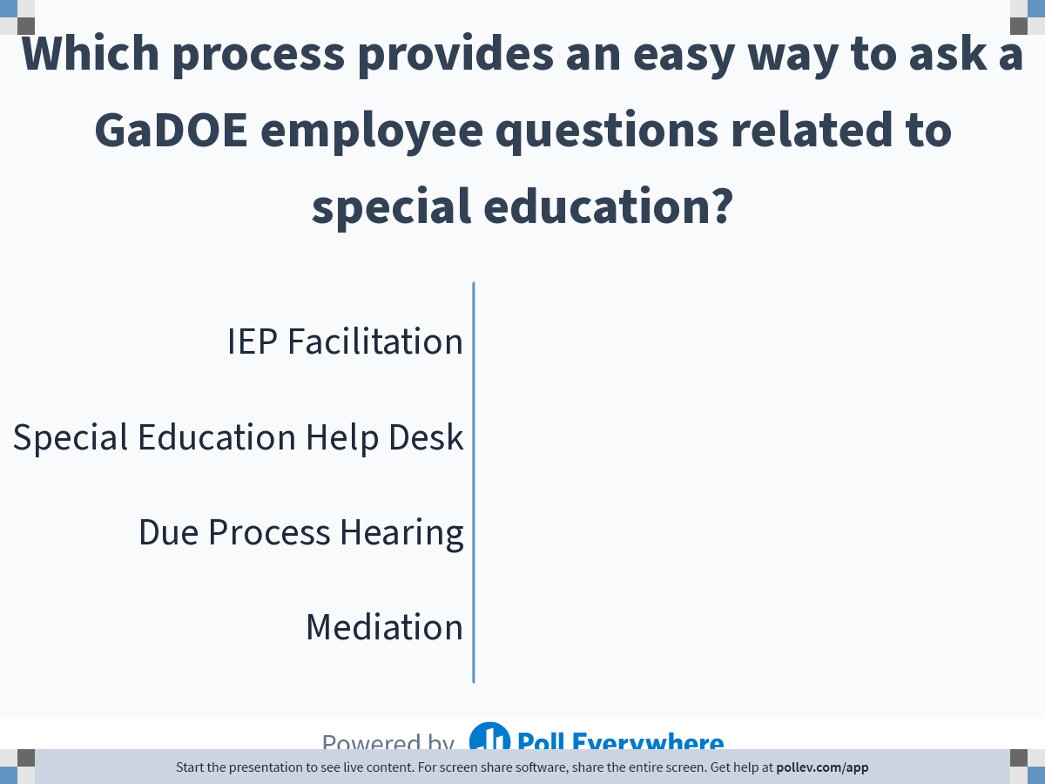
Notes:
Poll Title: Which process provides an easy way to ask a GaDOE employee questions related to special education?
https://www.polleverywhere.com/multiple_choice_polls/GKxGlpgcbbFs78nWAmM5L

Slide 107
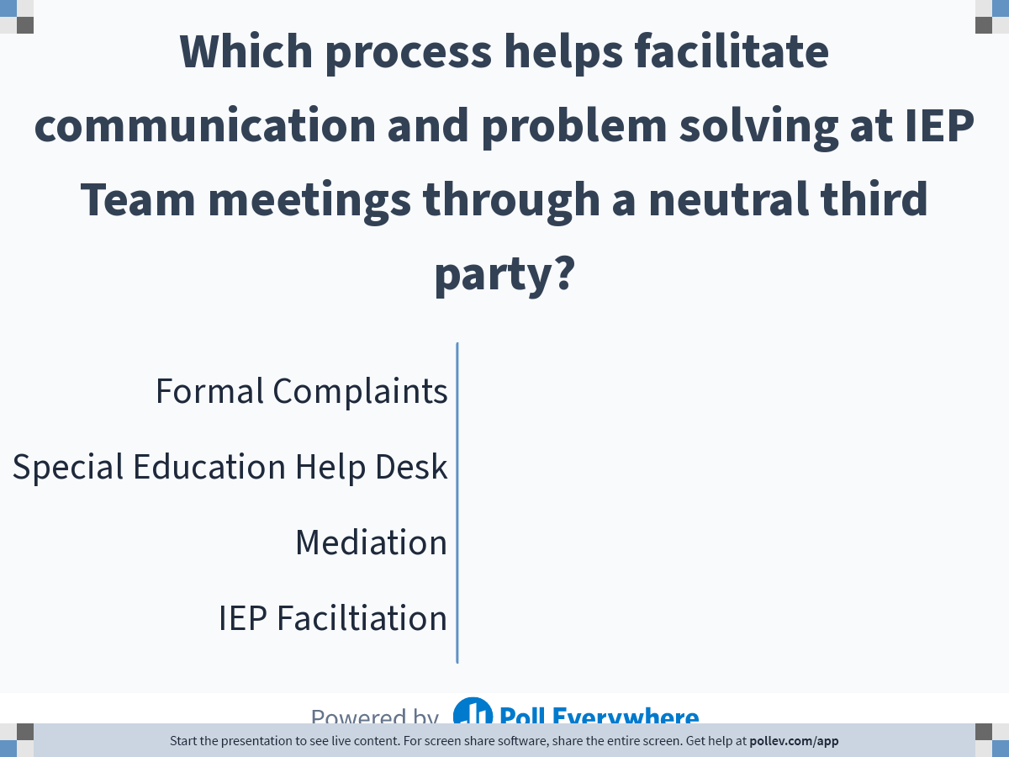
Notes:
Poll Title: Which process helps facilitate communication and problem solving at IEP Team meetings through a neutral third party?
https://www.polleverywhere.com/multiple_choice_polls/J2UG1TrAhHovJSSXG72LL

Slide 108
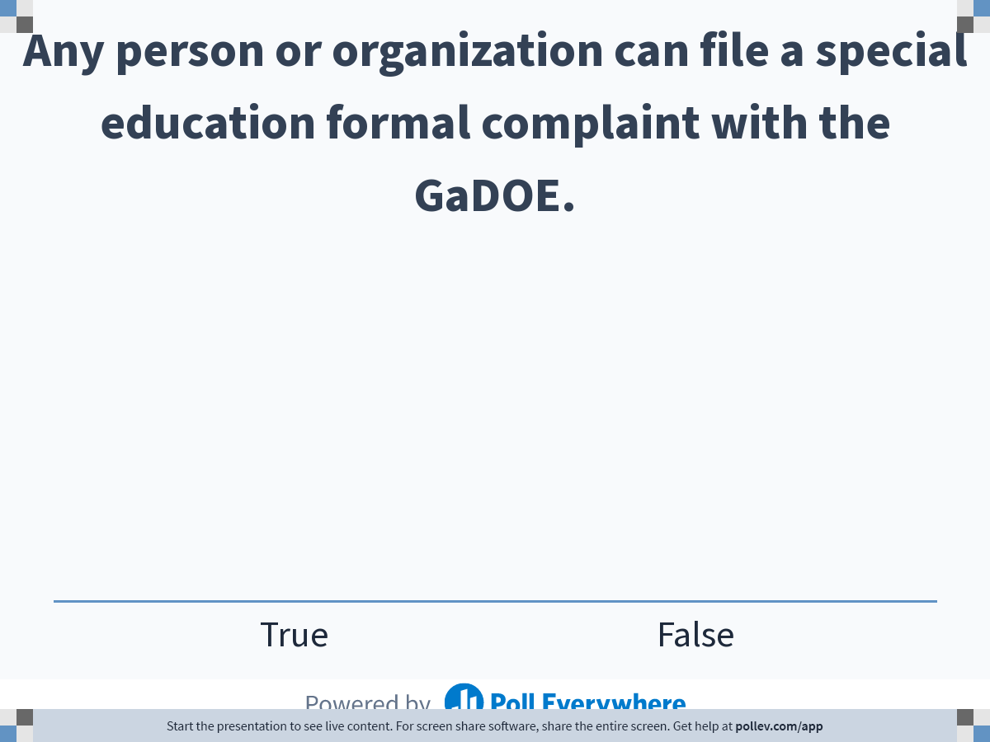
Notes:
Poll Title: Any person or organization can file a special education formal complaint with the GaDOE.
https://www.polleverywhere.com/multiple_choice_polls/X0YGhmOSCjLkpFt4SbhRS

Slide 109
GaDOE Dispute Prevention and Resolution Resources
Overview Link
  Dispute Resolution Comparison Chart
Formal Complaints, Mediation, and Due Process Hearing Links
  Forms and FAQs
Due Process Hearing Decisions (FY 2001-2020)
Dispute Resolution Parent Guides (IEP Facilitation, Mediation, Written State Complaints, Due Process Complaints/Hearings, Resolution Meetings)
  English and Spanish
Dispute Resolution Comparison Guide

Slide 110
Parent Resources
Parent Rights Link
  Parent Rights Videos (7)
    English and Spanish
    Parent Notice/Consent/Confidentiality
    Evaluations and IEEs
    LRE
    Private School Placement
    Discipline Procedures/Rights
    Dispute Resolution
    Surrogate Parent/Transfer of Rights
  Condensed Parent Rights
  Full Parent Rights
    Arabic, Chinese, English, Japanese, Korean, Spanish, Vietnamese
  Special Education Parent Supports and Legal Aid Providers

Slide 111
Parent Resources
Parent Information Fact Sheets
    IEP
    Mediation
    Person-Centered Planning
    Preparing your child with disabilities for kindergarten
    Reevaluations and IEEs
    Starting and Keeping your Child on a Path to Graduation
    Transition from Early Intervention to Public School
    Transition to Life after High School
    Assistive Technology
    Child Find*
    Discipline
    Due Process
    Eligibility Determinations*
    Extended School Year
    Initial Evaluation and Reevaluation*
    Formal Complaints
    FBAs and BIPs
    Helping your child with disabilities with homework
* Recently updated following changes to Implementation Manual
Notes:
Includes “Facts you should know”, “Tips for Families”, and “Where to go for more information.”

Slide 112
General Resources
IDEA Regulations
Georgia Board of Education Rules for Special Education
Implementation Manual
  Child Find
  Discipline
  Dispute Resolution
  Evaluation and Reevaluation
  FAPE
  IEPs
  Parents
  Private Schools
  Service Delivery and LRE
  Young Children
  Special Education Eligibility

Slide 114
Jamila Pollard jpollard@doe.k12.ga.us
(404) 670-2683
Scott Smith scsmith@doe.k12.ga.us
(404) 327-2892

