Slide 1
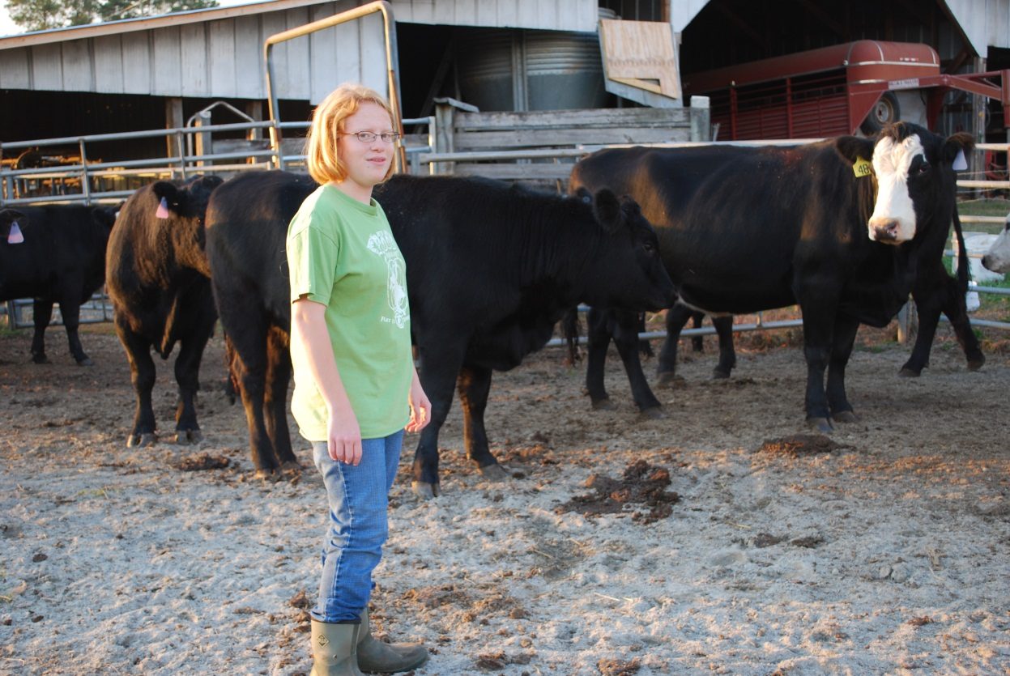
All About Me
By: Lauren
IEP Meeting Presentation
November 18, 2011

Slide 2
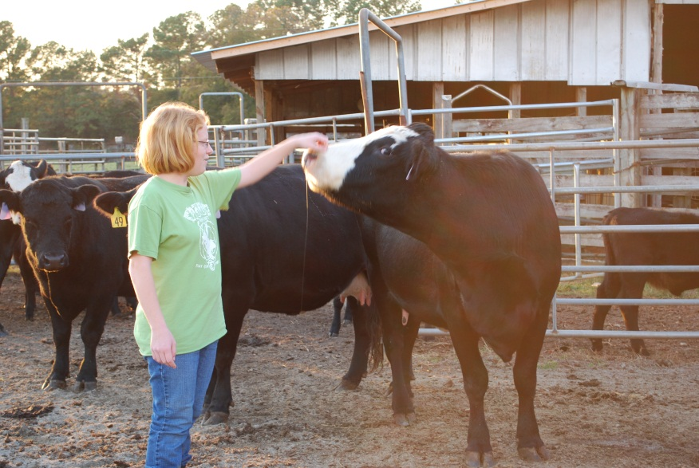
Lauren Bruce
I am 16 years old.
I was born on May 12, 1995.
I was Baptized on March 16, 2008.
I am very active with our youth group at Pleasant Hill Baptist Church.
I am in the 10th grade at Franklin County High School.
I am active with FFA and show pigs.
I have had several Grand Champion winners here at the Local Show and one Reserve Grand Champion at the State Livestock Show in Perry.

Slide 3
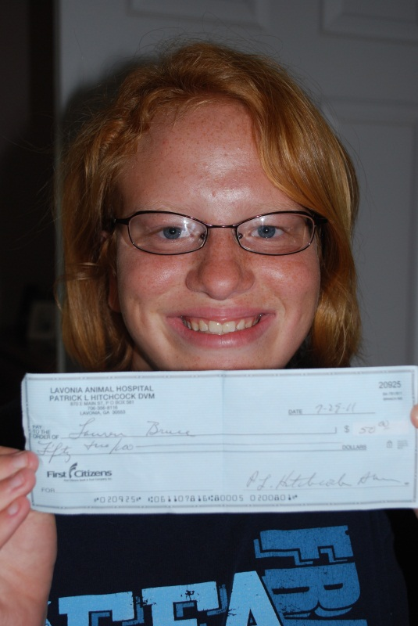
I Like….
Working on the farm.
Working at Lavonia Animal Hospital.
Texting my friends.
Showing pigs.
Shopping at Petsmart and Tractor Supply.
Playing with my two dogs, Patch and Bubbles.
Watching and spending time with our cows and pigs.
Listening to music.
Spending time with my family and friends
Camping.

Slide 4
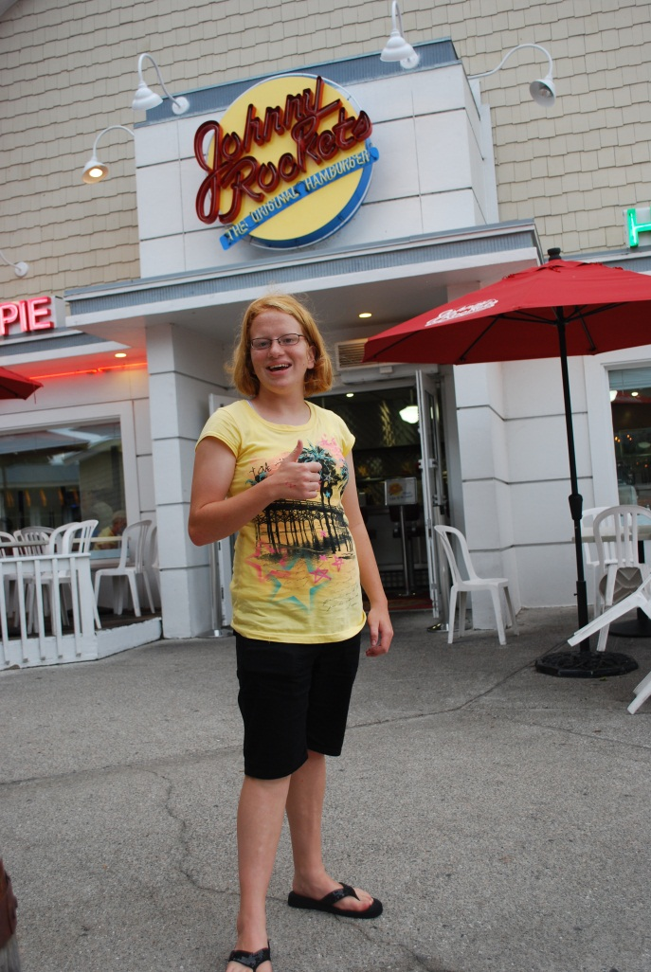
My Favorite Food Places are…
Fugi (Japanese Steak House)
McDonald’s
Wendy’s
Zaxby’s
Long Horn
Skin’s Hot Dogs

Slide 5
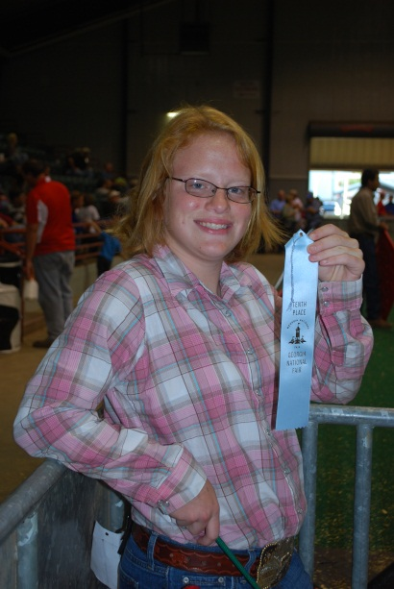
My Present Level
I have been seeing Dr. Linda Nathanson-Lippitt for several years.
I have to work very hard to stay on task, to talk in front of people, and to remember things.
I am easily “stressed” and I work hard to hold my tears during school.
I work very hard at homework. I usually review my classwork every night. I learn best when things are repeated over and over.
I am a hard worker.
My favorite subject is Ag.

Slide 6
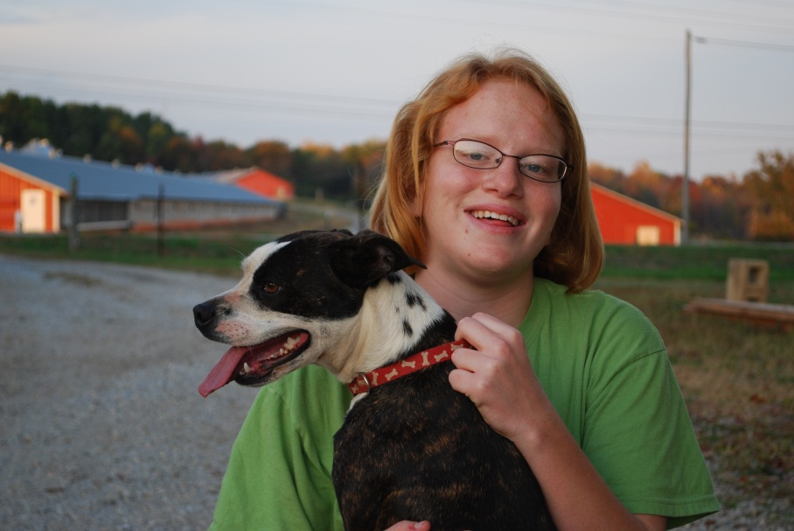
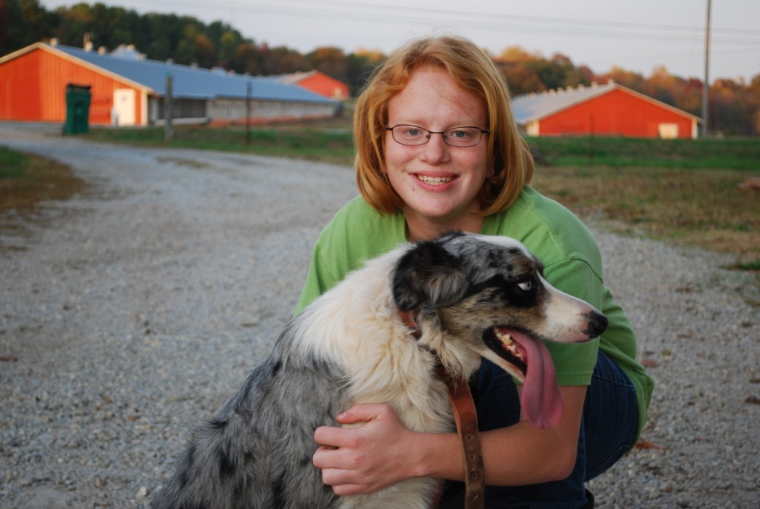
My Strengths
Doing my homework
Doing good in school
Not getting in trouble….lol!
Keeping up with my work
Studying
Making good grades
Not sleeping in class

Slide 7
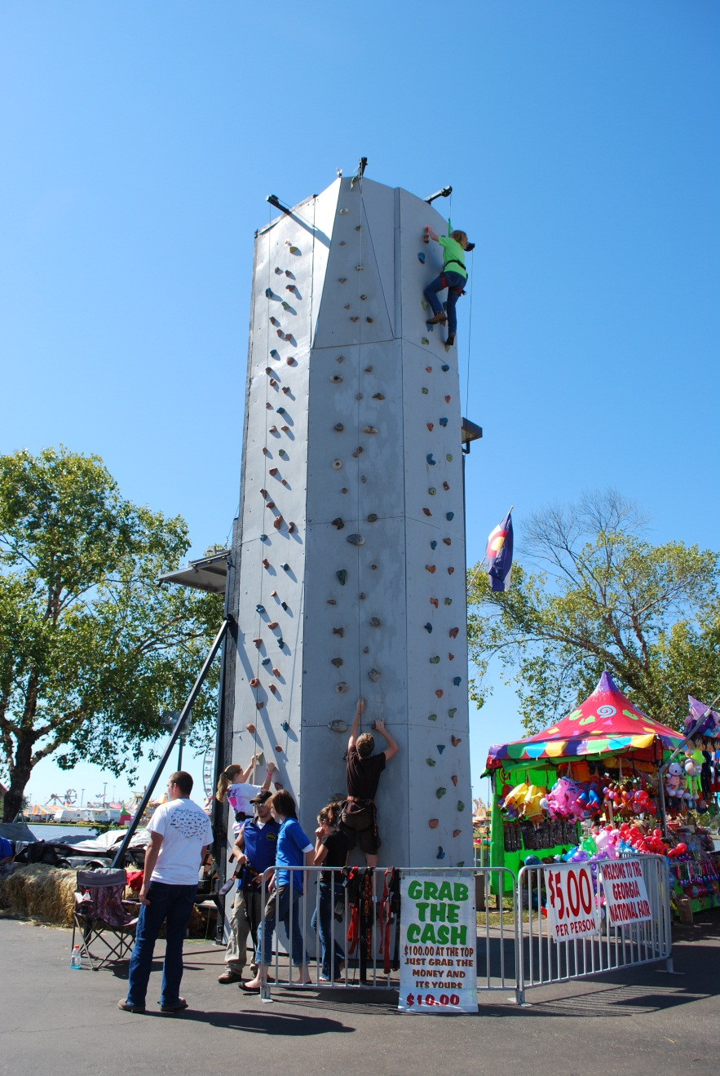
My Challenges
Taking notes
Reading
Staying focused
Talking in front of people
Being in the spot light
Not tearing up

Slide 8
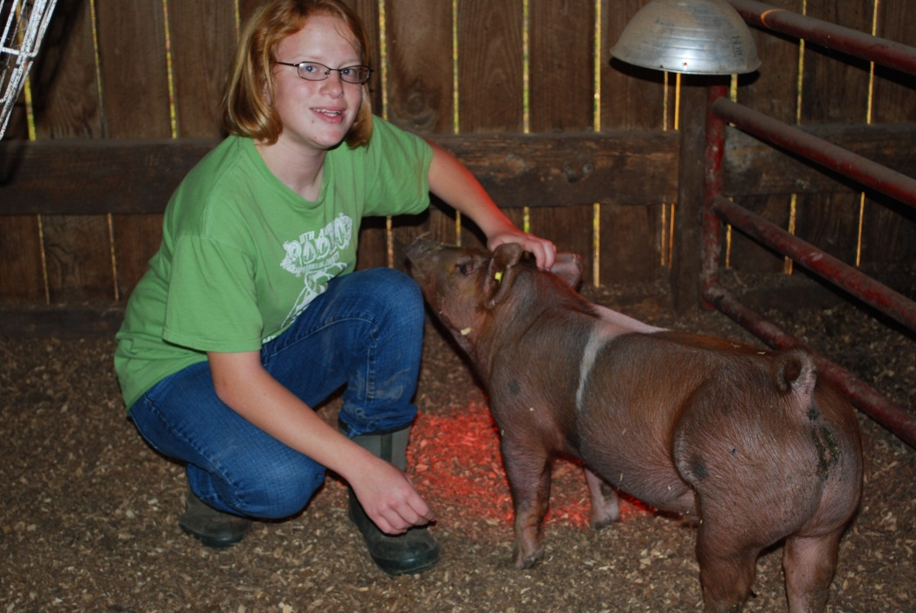
My Concerns
Making bad grades on tests
Getting behind in class or with class work
Not having enough time to finish work
Not getting my study guides in time
Worrying and stressing about school work

Slide 9
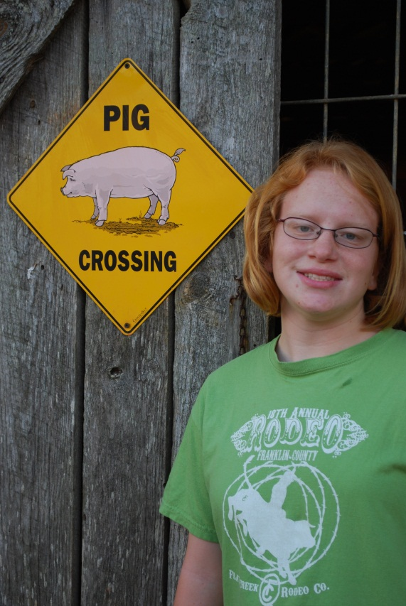
Things that help me in class
Co-teachers in my classes
Notes already filled out
Taking out into small groups
Taking tests in small groups
Tests being read to me
Study guides ahead of time
My friends encourage me
My friends make me happy when I am upset
Working at a slower pace
Using a calculator

Slide 10
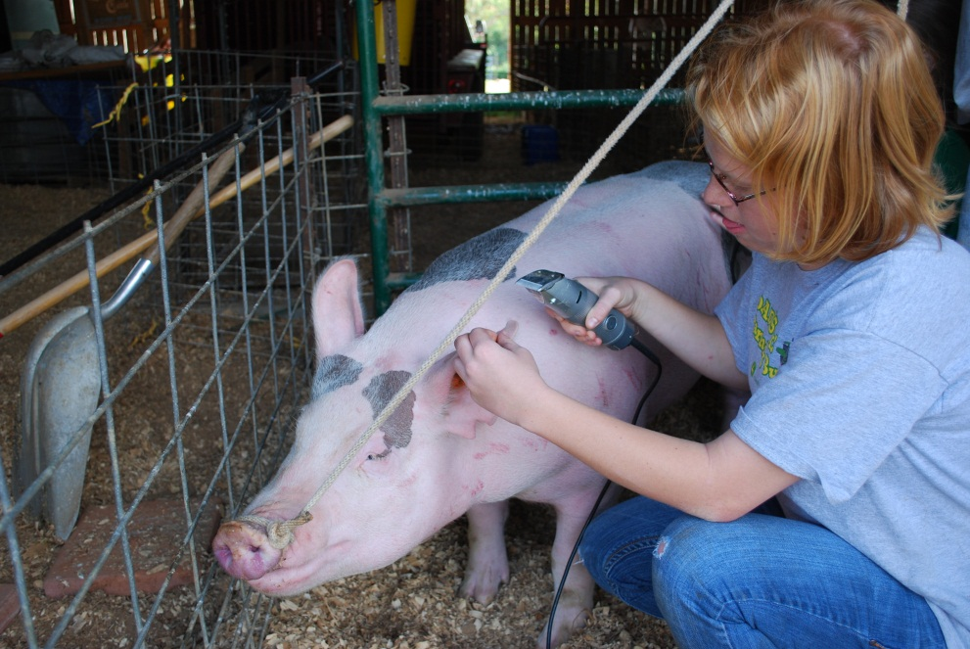
My Goals
Making good grades
Not tearing in class
Earn my High School Diploma
Attend college and earn a degree as a vet tech
Get married
Staying active in church
Going to church

Slide 11
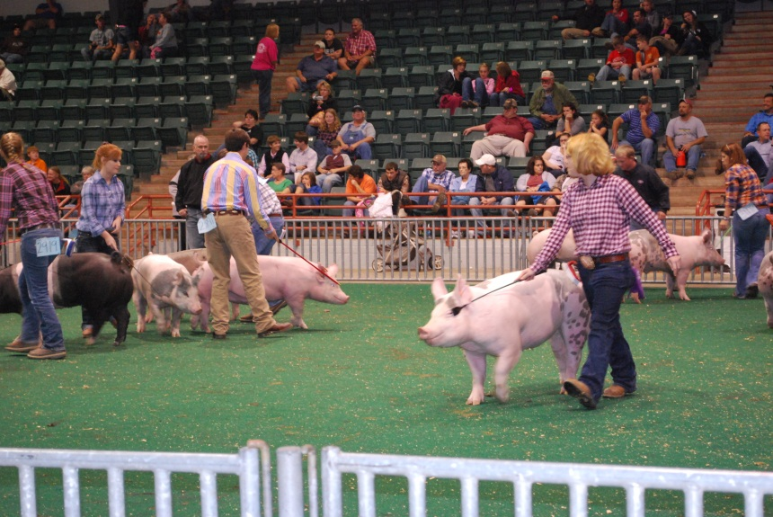
My nicknames
Copperhead – Dad named me Copperhead because I can strike very easily, I am very strong, and I have red hair.
Sissy – Mom named me Sissy when I became a big sister. I have a little sister named Kylie.
Lala – Rebecca Floyd family and Mrs. Lucy Floyd both call me Lala.

Slide 12
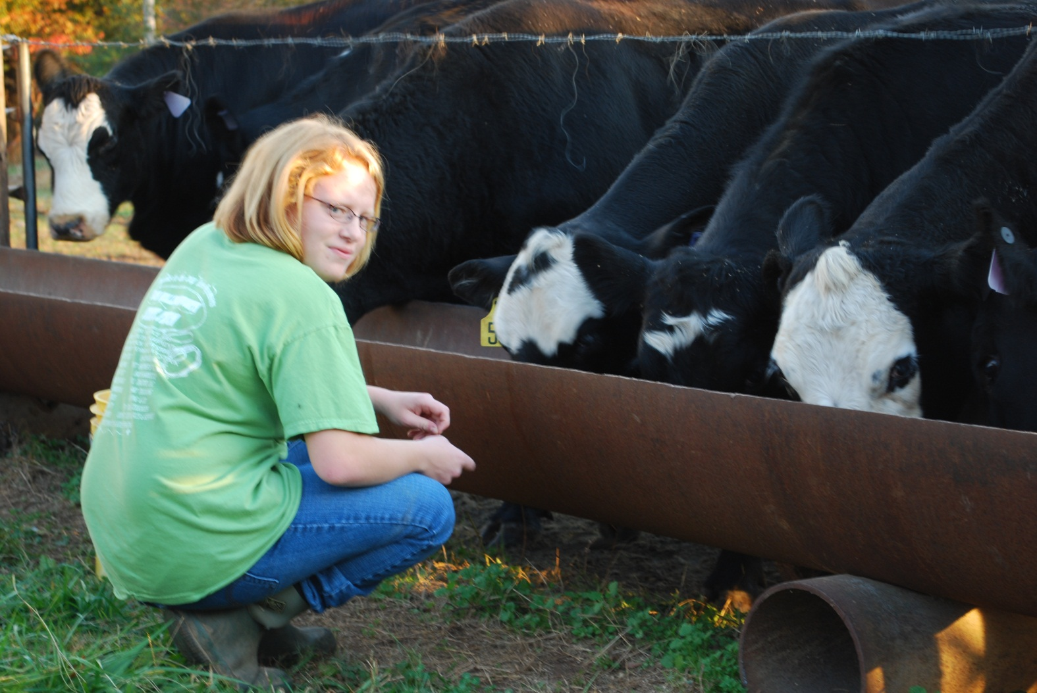
Thanks to everyone for coming to my IEP Meeting ☺

