Slide 1
Managing Your Federal Grant Award
Charter Schools Division
Georgia Department of Education
November 14, 2017

Slide 2
Agenda
Budget Submission and Approval
Monitoring
Reimbursement
Timeline

Slide 3
Timeline
Must expend funds within the grant period. The grant period started upon SBOE approval.
Review timelines found in the application.
Please make every effort to expend your Year 1 funds by August 30, 2018, if applicable.

Slide 4
Period of Performance for Planning, Implementation, and Dissemination
Planning
Up to $75,000
Performance period: October 1, 2017 through September 30, 2018 or the date the school opens, whichever comes first
Implementation
Up to $775,000
Initial start-up costs and implementation activities after opening
Dissemination
Up to $225,000
Disseminate best practices that improve student academic achievement among charter schools and traditional public schools
Performance period: October 1, 2017 through September 30, 2019 unless your school opened in 2015
Initial planning and project design costs prior to opening
Performance period: October 1, 2017 through September 30, 2018, can be extended for an additional year
If opened in 2015, October 1, 2017 through September 30, 2018

Slide 5
Budget Submission and Approval
State Charter Schools will submit budgets directly to the Consolidated Application (Con App)
Locally-approved charter schools will submit budgets to the local district for entry into Con App
CSD will review the budget within 30 days of submission

Slide 6
The Consolidated Application
What is the Con App?
The system by which the State manages disbursement of federal and state funds.
How do I get access to the Con App?
Every school must have a school code.
State Charter Schools will be able to access the Con App via the My GaDOE Portal.
Locally-approved charter schools do not have direct access. The local district, as the fiscal agent, has access on behalf of locally-approved schools.

Slide 7
Guidance for Submitting Budgets
Submission should be timely
The budget submitted should substantially align with your grant application and should not contain unallowable expenses
Cannot access grant funds until budget approval
Accuracy matters – budget amendments are required for 10% variances or more between function codes and can take valuable time to process

Slide 8
Drawing Down Funds
Once GaDOE CSD approves a budget in Con App, a school can draw down funds
State Charter Schools will submit invoices directly to Con App for GaDOE approval
Remember, these are reimbursement grants
Locally-approved charter schools will submit invoices to the local district for approval
Submit invoice to receive reimbursement after invoice is approved

Slide 9
Reimbursement Guidance
Expenses must be allowable
School’s responsibility
Expenses should align with your budget
Documentation should be correct
Only paid invoices should be reimbursed
A 10% or more variance between function codes requires an amendment
District and GaDOE check-and-balance

Slide 10
Grant Monitoring and the Monitoring Visit
What To Expect
The Monitoring Visit
The Grant Binder
The Monitoring Tool

Slide 11
Grant Monitoring and What to Expect
Mission - Ensure stewardship over Federal funds awarded by conducting:
Desk-based financial reviews
Approval of budgets and invoices
Resolution of audit reports
Audit reports are due to CSD by November 1 each year
On-site financial and programmatic reviews
Monitoring visit within the first 6 months of the grant with follow-up visits as needed
Technical assistance to grantees
As needed

Slide 12
The Monitoring Visit
Within the first 6 months and as needed
CSD will contact you to schedule your visit
Who should be present at the visit?
How should you prepare?
The Grant Binder
The Monitoring Tool
After the visit

Slide 13
Who should be present at the visit?
Required Attendees
Board Chair
Treasurer
School Leader
School's Business Manager
Preferred Attendees
Representative from local district
Representative from management company (if applicable)

Slide 14
How should you prepare?
Review and place the following documents in your grant binder:
Budget and Invoices
Most recent audit report
Grant application
Internal Control and Business Policies
Conflict of Interest Policy
Code of Conduct

Slide 15
The Grant Binder
Should contain your complete set of grant records
Binders should include:
Grant application, award letter and approved budget
Invoices for which the school received reimbursement and accompanying backup documentation
Academic performance data related to the project goals
Any previous monitoring reports
Inventory
Applicable policies and procedures
Charter Contract
Separate Grants, Separate Binders

Slide 16
The Grant Binder - Guidance
Organization is key
Source documentation is your friend
Example 1: If a school is reimbursed for professional development, in addition to the invoice, the binder should include itineraries or course descriptions.
Example 2: Invoices should be accompanied by a PO, proof and method of payment, and documentation showing shipment and receipt of goods.
Timely academic data
Inventory Management is crucial

Slide 17
Inventory Management
Subgrantees must track their inventory
Subgrantees must implement internal controls to track and manage equipment
Where is it, who has access, and how do you determine if equipment is missing or damaged?

Slide 18
Common Issues
Incomplete records in grant binder
Poor inventory management
Salary and taxes
Unallowable expenses
EMO fees
Office furniture v. classroom furniture
Cafeteria equipment
Extracurricular activities
Leases

Slide 19
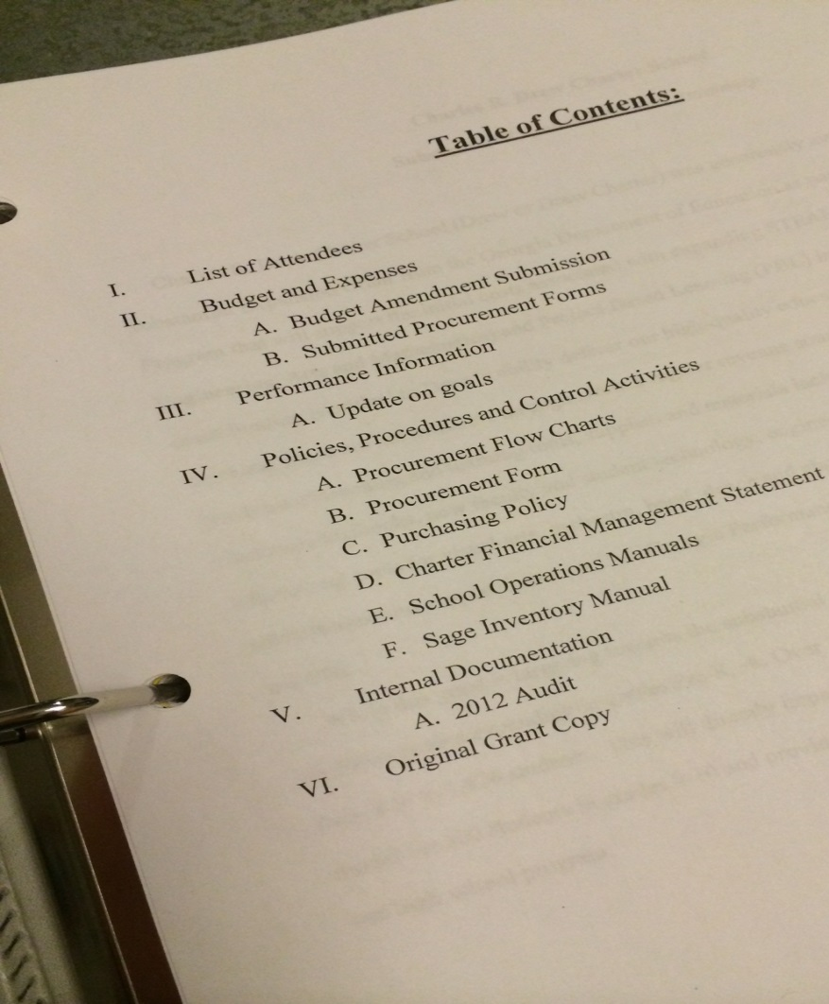
Grant Binder Examples Table of Contents

Slide 20
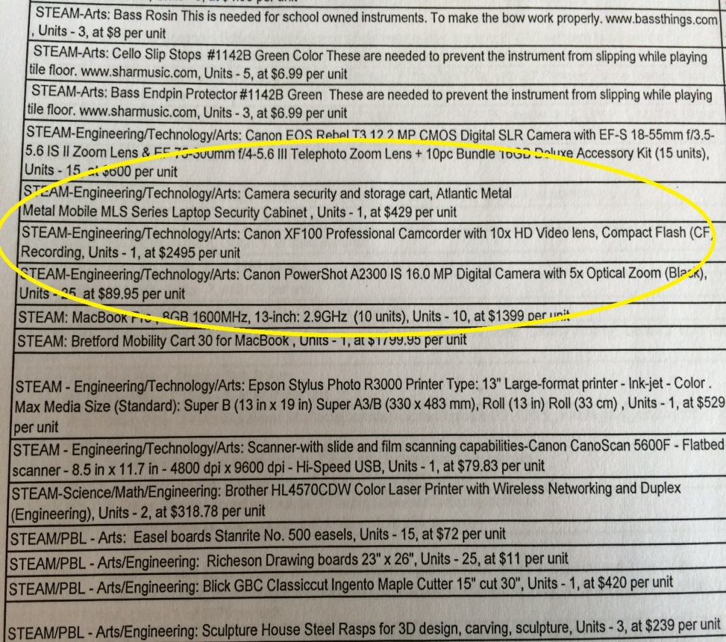
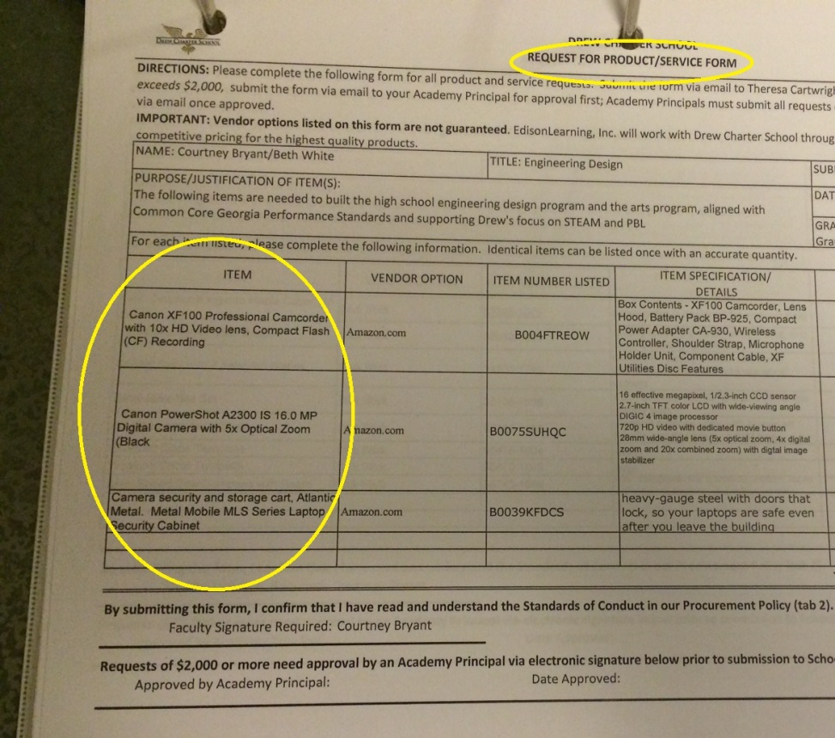
Grant Binder Examples Budget and Purchase Order

Slide 21
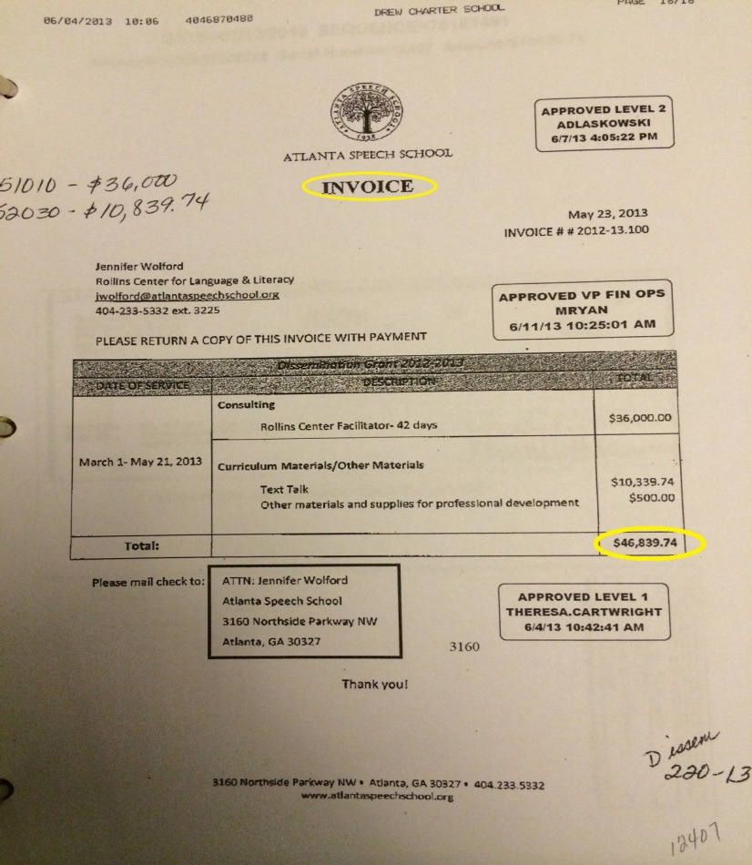
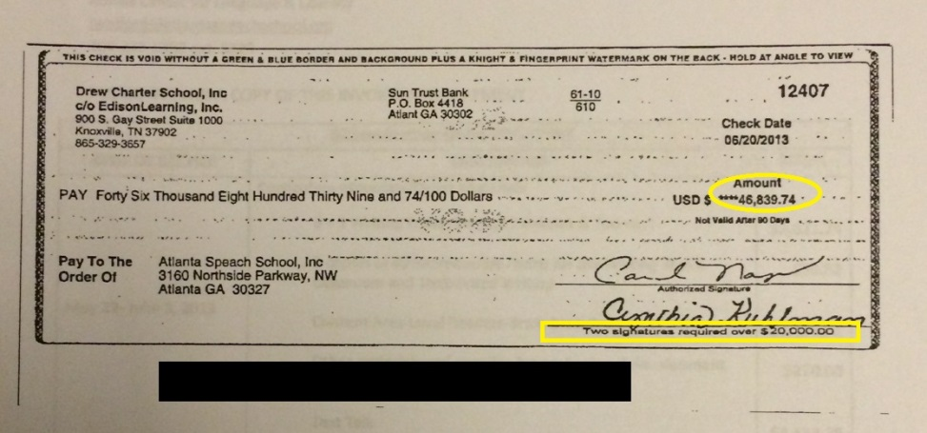
Grant Binder Examples Invoice and Proof of Payment

Slide 22
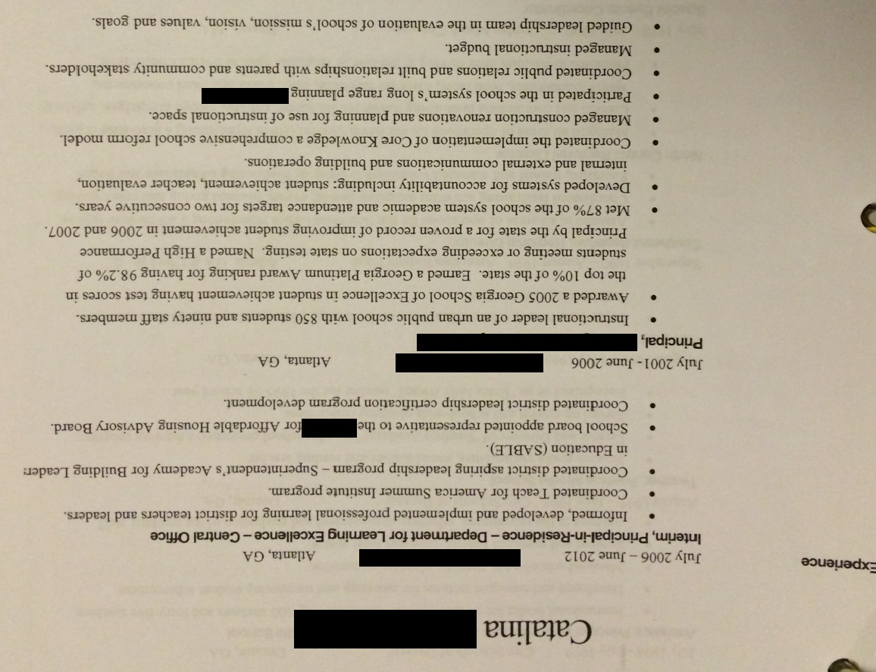
Grant Binder Examples Consultant Resume

Slide 23
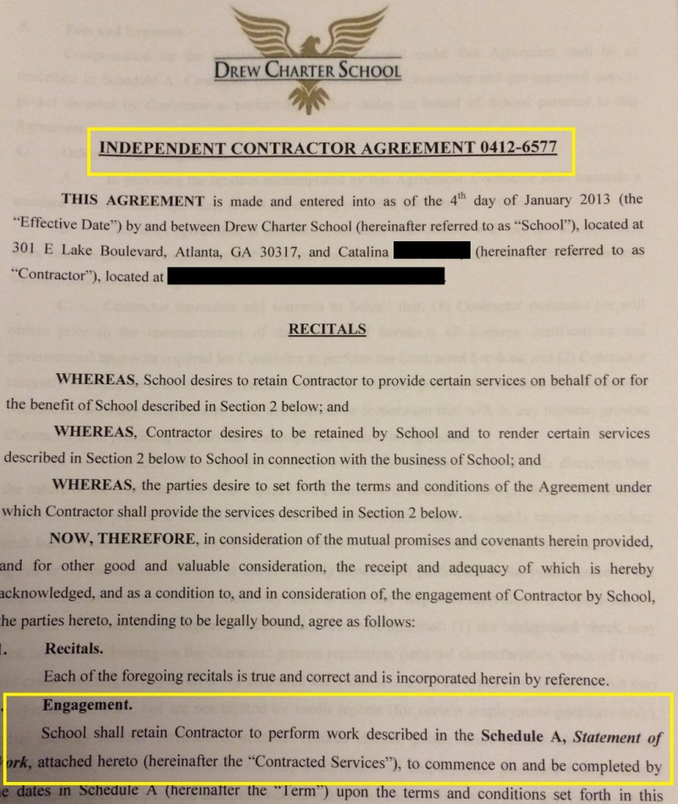
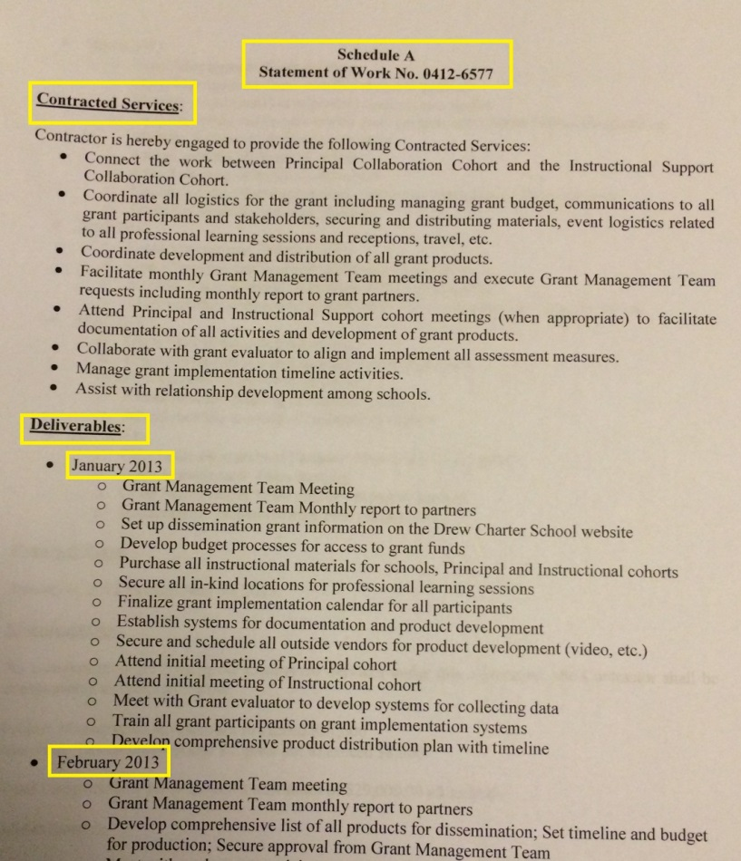
Grant Binder Examples Consultant Agreement and Statement of Work

Slide 24
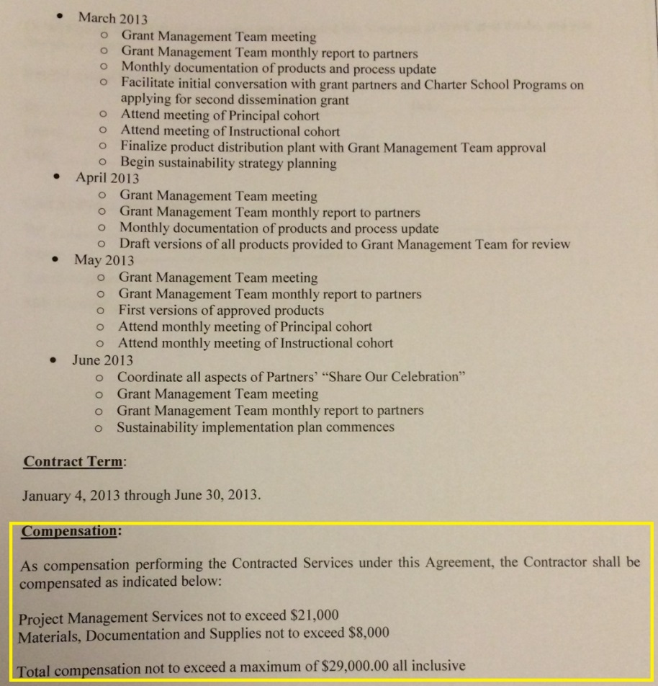
Grant Binder Examples Compensation Clause

Slide 25
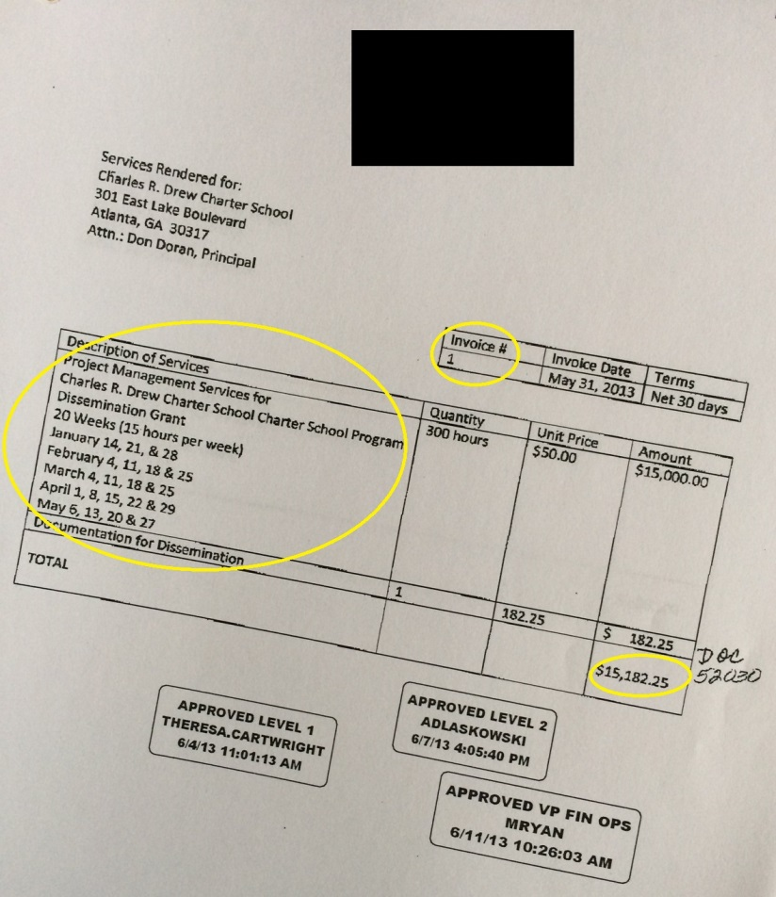
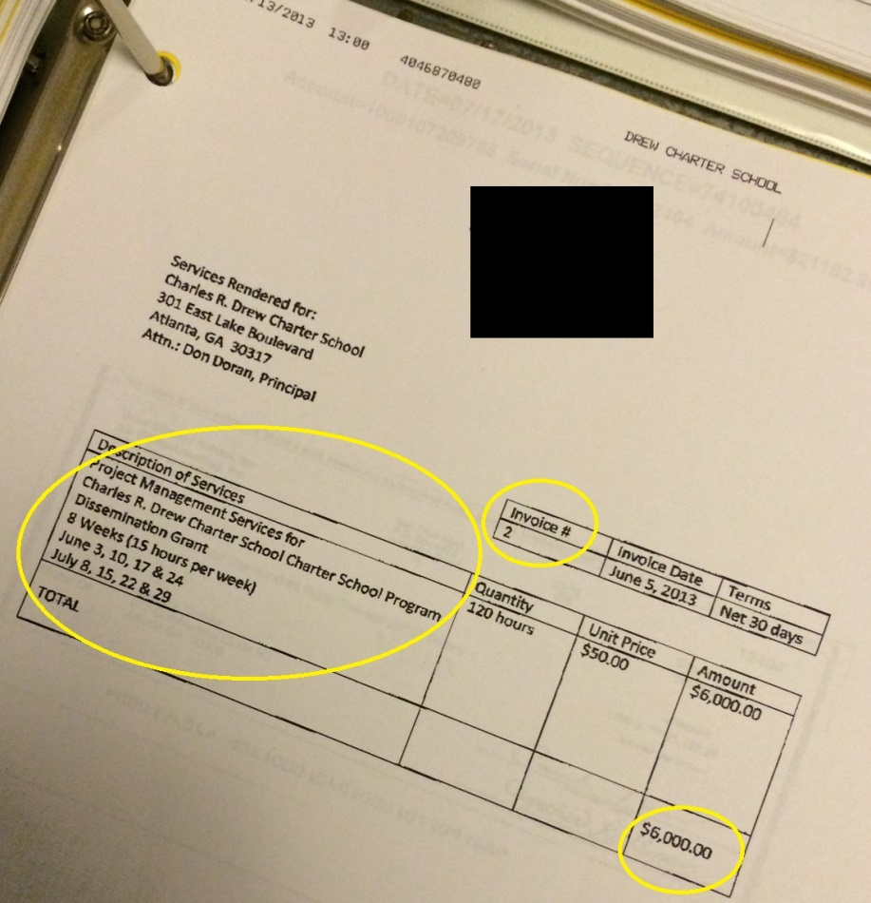
Grant Binder Examples Invoices

Slide 26
Grant Binder Examples Checks

Slide 27
Grant Binder Examples Inventory List

Slide 28
Grant Binder Examples Policies and Procedures

Slide 29
After the Monitoring Visit
Each school receives a summary of findings and recommendations
If the findings of the first visit warrant a follow-up visit, CSD will determine the appropriate time for a follow-up visit
If issues are not corrected, CSD will take steps to recoup grant money

Slide 30
Can you spot the potential issues?
Question: Achievement Charter School (ACS) wishes to purchase 15 computers at $300/each for a total of $4,500. ACS budgeted $7,000 for computers and plans to use the money they saved on Professional Development. After purchasing the computers, ACS submits the quote to their local district for reimbursement. The district reimburses ACS.

Slide 31
Can you spot the potential issues?
Answers:
1.) $7,000 * 10% = $700 and ACS is requesting to move $2,500 from the function code. Therefore, a budget amendment is required.
2.) A quote and not an invoice was submitted to the district.
3.) Refer to slide 10

Slide 32
District Flexibility and Charter Schools Division
Louis J. Erste
Associate Superintendent
lerste@doe.k12.ga.us
(404) 651-8734
Allen Mueller
Director
amueller@doe.k12.ga.us
(404) 657-2529
Kerry Pritchard
Accountability Manager
kpritchard@doe.k12.ga.us
(404) 558-9443
Francesca Black
Division Attorney
fblack@doe.k12.ga.us
(404) 656-0027
Latoya Satterwhite
Administrative Assistant
lsatterwhite@doe.k12.ga.us (404) 657-0515
Selena McBride
Grants & Financial Manager
smcbride@doe.k12.ga.us
(404) 657-2948

