Slide 1
From Awkward to Awesome: Promising Practices in Collaborative Efforts of Homeless Liaisons and Social Workers for Improved Student Outcomes
Dr. Danielle Jones, BCSD Homeless Liaison
Mrs. Angela Solomon, BCSD Social Work Coordinator

Slide 3
Introductions

Slide 4
Objectives
Participants will be empowered with skills to:
Recognize the value of collaboration
Promote effective collaboration
Improve student outcomes via collaboration

Slide 5
Why Collaborate?

Slide 6
Activity
www.playspent.org

Slide 7
Discussion
Do you see a need for collaboration in your school district?
How could this work in your school district?
What barriers to collaboration exist in your school district?
What do you think would be the benefits of collaboration?

Slide 8
Benefits of Collaboration
Increased access to services and resources
Increase in knowledge
Increased identification of barriers
Increase in responsive services
Improved student outcomes

Slide 9
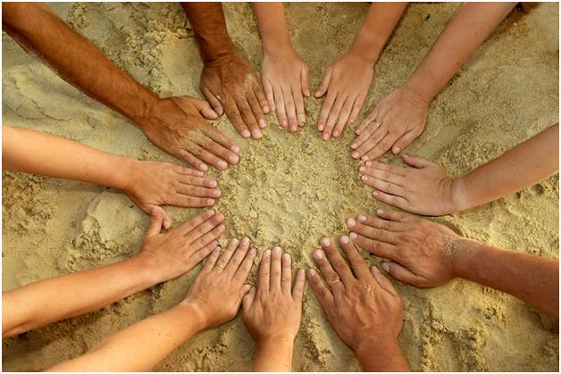
Improved Student Outcomes

Slide 10
Comparison of Total Discipline Referrals

Slide 11
Change in Elementary School Discipline

Slide 12
Change in Middle School Discipline

Slide 13
Change in High School Discipline

Slide 14
Grade Level Totals

Slide 15
Bullying (Consists of Cyberbullying (1,2); Physical Bullying (1,2,3) and Verbal/Non-Verbal (1,2,3)
 | Bullying - Cyberbullying 1 | Bullying - Cyberbullying 2 | Bullying - Physical 1 | Bullying - Physical 2 | Bullying - Physical 3 | Bullying Verbal/Non-Verbal 1 | Bullying Verbal/Non-Verbal 2 | Bullying Verbal/Non-Verbal 3 | Grand Total
Aug 2017 - Feb 2018 | 20 | 1 | 64 | 9 | 1 | 80 | 6 | 2 | 183
Aug 2016 - Feb 2017 | 23 | 0 | 198 | 38 | 8 | 147 | 21 | 11 | 446
SY 2016-2017 | 35 | 4 | 256 | 55 | 16 | 190 | 24 | 20 | 600

Slide 16
Bullying (Consists of Cyberbullying (1,2); Physical Bullying (1,2,3) and Verbal/Non-Verbal (1,2,3)

Slide 17
Referral Forms

Slide 18
A Perfect Fit.....
Angela Solomon, LCSW, Ed.S.
Danielle Jones, LPC, Ed.D.

Slide 19
Questions
&
Comments

Slide 20
Contact Information
Dr. Danielle Jones, Homeless Liaison
Danielle.Jones@bcsdk12.net
478-765-8633
Angela Solomon, Social Work Coordinator
Angela.Solomon@bcsdk12.net
488-765-8608

