Slide 1
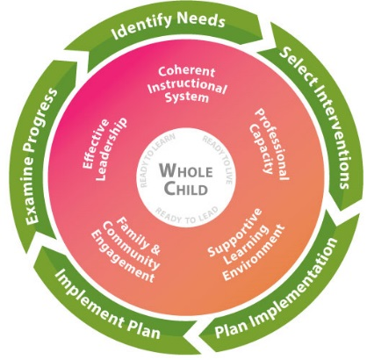
Title I, Part C Education of Migratory Children (MEP) Closing FY17 and Planning for FY18
May 18, 2017
9:30 AM

Slide 2
Against the Odds!!!
I graduated from the University of South Florida this past weekend with my Bachelor of Science in Industrial Engineering. With your support I have studied abroad in Italy, London and Paris and I have completed 4 internships. I am moving to Washington, D.C. to start a new journey and career with a company called Accenture. I am very excited and looking forward to new experiences. After a year with Accenture I will go to graduate school to pursue a Master's in Industrial Engineering. Thank you so much for your support and I am forever grateful. If there is anything that you need from me, please let me know.
Daniel Guzman-Ramos
http://news.usf.edu/article/templates/?a=7835&z=220

Slide 3
Against the Odds!!!
Law school
Medicine
Microbiologist

Slide 4
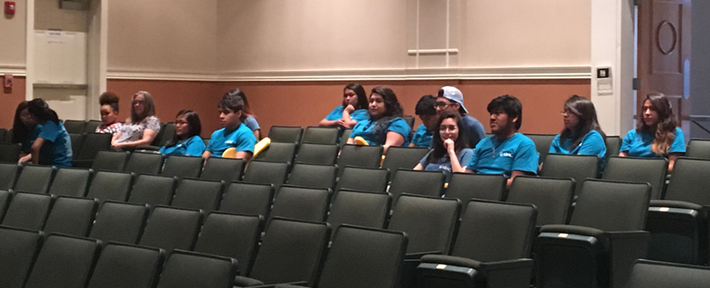
Former MEP students- making their way through college

Slide 5
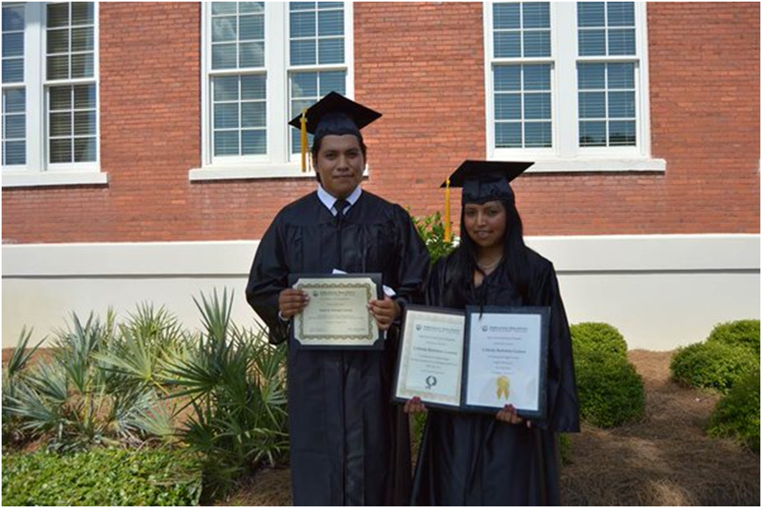
Former OSY/DO to High School Graduates

Slide 6
Agenda
Closing of FY17
District Comprehensive Needs Assessment
Planning for FY18
Updates and Reminders

Slide 7
Every Student Success Act (ESSA)
Reauthorization of the Elementary and Secondary Education Act of 1965
Every Student Succeeds Act (ESSA) of 2015
Law will be in place by – 7/1/17
US ED is providing regulations and guidance for implementation
Title I C portion has some changes and revisions; more information will be provided at a later date.
Chapter II Identification & Recruitment (Final-March 30, 2017)
National Certificate of Eligibility (COE) (Final-May 16, 2017)
Priority for Services (PFS)
FY17 – Title I C will continue with current requirements and procedures

Slide 8
FY18 MEP Allocations
MEP Funding Formula is based on 2015-2016 data
LEA preliminary allocation may be re-evaluated due to recent changes on the USED allocation
Final allocation notice in late July 2017 after SBOE approval
LEA allocation breakdown:
Preschool, K-12, and OSY/DO/NE

Slide 9
Closing of FY17

Slide 10
Closing out of FY17 - Implementation Plans (IPs)
Summer IPs were due on 5/1/2017.
School year IP evaluations must be submitted within the 2 weeks after plan ends.
All IPs submitted and approved must have an IP evaluation even if IP was not implemented.
Summer IP evaluations due as soon as plan is completed.
School year and summer IP evaluation data is collected by numbers of migrant students meeting the goal - PFS and non-PFS.
School year and summer IP evaluation data is prepared for GaDOE review in July 2017.
IP Evaluation Link available on MEP website

Slide 11
Closing out of FY17 - Supplemental Services (SS)
Supplemental Services Online Portal closed May 12.
Use the SS Tracking Form to document any new services provided between submission and the last day of school.
If new codes provided, mail the SS Tracking Form to the regional office on the last day of school.
Updates should be HIGHLIGHTED in yellow.

Slide 12
Closing out of FY17 – Summer SS Collection
No SS Online for summer; paper report process
Early June, a blank SS report will be loaded to the portal; all participants listed as of date of report.
New Participant Report will be loaded to the portal for your district each Monday – June/July.
Add new summer arrivals to your SS report.
Record any and all services provided.
Mail to the regional office at the end of your summer services.

Slide 13
Summer Academic Services
Increased migration during May-July.
Your district’s participants may only be in the county for the summer – never enroll in school (NE).
Provide services. Spread funds through the year so your summer participants are supported academically.

Slide 14
Planning for FY18

Slide 15
Title I Part C -MEP Is part of the Georgia’s Systems of Continuous Improvement 2017-2018

Slide 16
Support Structures Essential for School Improvement
Coherent Instructional System: District and schools must have an established, shared instructional guidance structure….Migrant staff instructional guidance.
Effective Leadership: A major support necessary for an effective instructional guidance structure is the leadership in the school and at the district level…. Migrant staff support.
Professional Capacity: In addition to effective leadership, schools, to improve particularly in instruction, must have a coherent structure to develop the capacity of the professionals in the school…. Migrant staff professional development.
Supportive Learning Environment: A school must design a structure that organizes all the efforts in the school to meet the differing needs of all students…. Include ALL Migrant participants.
Family & Community Engagement: A school must have an intentional, explicit plan and processes for engaging the adults beyond the school house in the core instructional work of the school…. Migrant Parents and agencies working with migrant families.
Source: Organizing for School Improvement edited by Anthony Bryk (2010)
Notes:
Terri Still
In prior needs assessments, you may have focused solely on looking at performance data and maybe survey data. But thinking about school improvement overall, it is important to know about and address these 5 “buckets” of information. Please refer to your handout.
(Pull up each bullet and read the red words. This is just a preview so when they see these concepts in future information, they will be able to make the connection.)
Here’s why this is important: If these 5 areas are weak or non-existent, then the effect of services implemented as a result of the needs assessment could be impacted. Also, when a needs assessment team chooses an intervention without considering these areas, the team could actually be making the wrong choice. Example: Teachers in school A do not follow the established curriculum. Students take the spring Milestones. The school needs assessment team review those results and chooses an intervention based on the results. If you think about that, you realize that those results do not give an accurate picture of learning in the school because kids may or may not have had the opportunity to learn the material assessed on the Milestones.
Within our needs assessment tool, GaDOE will provide guiding questions to help your needs assessment team work through these important concepts and determine if any gaps exist. Now let’s take a deeper look at each bucket so you see what it includes and the connection to school improvement and our single comprehensive needs assessment.

Slide 17
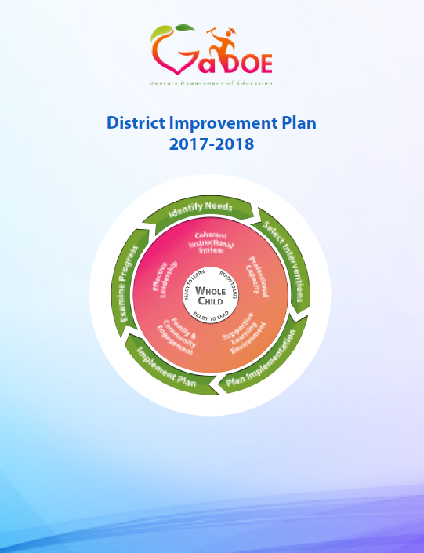
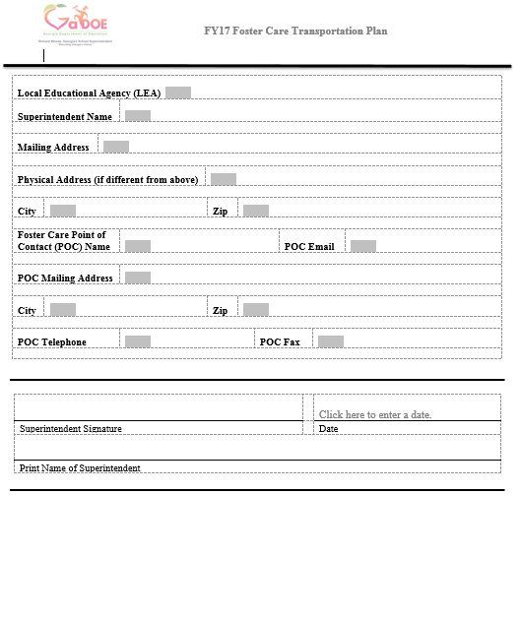
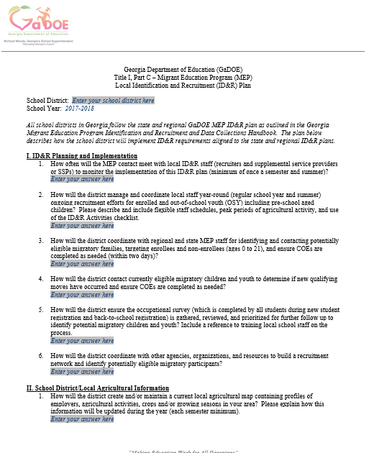
What is the CLIP for FY18? Part I – Annually Approved LEA Consolidated Application (Plan) due on July 31, 2017
Parent and Family Engagement Policy
District Improvement Plan
District CNA
Foster Care Transportation Plan
Title I Part C, ID&R Plan

Slide 18
Completing the CNA and Improvement Plan
All Federal programs coordinate together to complete this single district CNA
MEP staff must be involved
Meets the requirement of the needs assessment and service delivery plan (Sec. 1306)
Notes:
Omar

Slide 19
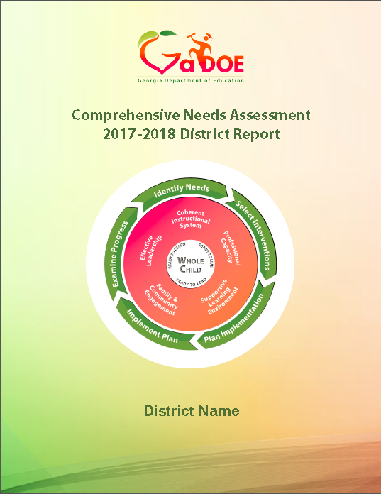
Completing the FY18 District CNA
The District CNA process should be happening NOW

Slide 20
Completing the CNA and Improvement Plan
The District CNA and District Improvement Plan must:
Ensure the needs of migrant children and youth (preschool age, K-12 enrolled, out-of-school youth and drop-outs) are included in all parts of the district level CNA and District Improvement Plan:
Data Analysis: PFS vs Non-PFS, Migrant Vs. Non-Migrant, Drop-out rates, IP evaluations data outcomes, Preschool assessment data, etc.
Identification of Need: Local needs and State GaMEP MPOs
Service Delivery: MEP IPs… data and link to the MEP program evaluation
Coordination of Services: Inclusion on other local, state and federal
Parent and Family Engagement: PAC meetings and other parental engagement activities

Slide 21
Page 69-70

Slide 22
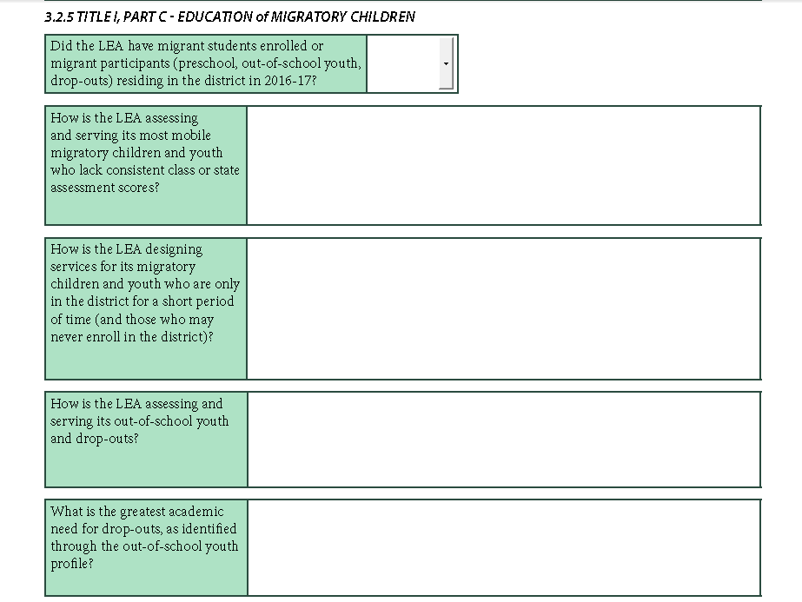
Pages 77-78

Slide 23
District Improvement Plan
MEP is embedded in all parts

Slide 24
District Improvement Plan Components
MEP children are included….
Notes:
LeMieux 25-36

Slide 25
District Improvement Plan Components
Notes:
Walk through each section

Slide 26
District Improvement Plan Required Questions
Section 4
MEP questions

Slide 27
Title I, Part C 4.l
Describe how the district will promote interstate and intrastate coordination of services and educational continuity through:
the use of the Title I, Part C Occupational Survey;
the timely transfer of pertinent school records, including information on health, when children move from one school to another; and
how the district will use the Migrant Student Information Exchange (MSIX). [Sec. 1308 (2)(A)]
We will look for:
A description explaining how all schools use the occupational survey during new student registration and back-to-school registration for returning students
How documents will be completed, collected, and reviewed
How documents will be submitted for further action based on the directions on the bottom of the form

Slide 28
Title I, Part C 4.l
Describe how the district will promote interstate and intrastate coordination of services and educational continuity through:
the use of the Title I, Part C Occupational Survey;
the timely transfer of pertinent school records, including information on health, when children move from one school to another; and
how the district will use the Migrant Student Information Exchange (MSIX).
We will look for:
A description of the district and school records transfer process for students moving in and out of the district
Description includes academic and health records
Description includes a timeline and process
Consortium LEAs include how coordination with the MEP Consortium staff at ABAC to support records transfer will occur, when needed.

Slide 29
Title I, Part C 4.l
Describe how the district will promote interstate and intrastate coordination of services and educational continuity through:
the use of the Title I, Part C Occupational Survey;
the timely transfer of pertinent school records, including information on health, when children move from one school to another; and
how the district will use the Migrant Student Information Exchange (MSIX).
We will look for:
A description of how the Migrant Student Information Exchange (MSIX) will be used in the records transfer process (both interstate and intrastate).
Description includes who in the LEA (district or school) will access MSIX when migratory children and youth enroll
Description includes how the information in MSIX, when available, will be used for enrollment and course placement decisions for migratory children and youth

Slide 30
Title I, Part C 4.m
Describe how the district will provide supplemental support services and outreach activities for migratory preschool children, out-of-school youth and drop-outs and their families, including informing such children and families of, or helping such children and families gain access to, other education, health, nutrition, and social services.
[Sec. 1304(a)(b)(1) (A)(B)(C)(D)]
We will look for:
Direct funded - narrative includes needs assessment, coordination of services, documentation of services, communication with families, and evaluation
Inclusion in other Federal programs and/or local initiatives
Assessment of needs for out-of-school youth; drop-outs; and preschool children
Outreach to families
Evaluation of funded services (regular school year and summer)
Consortium – narrative includes coordination with the MEP Consortium at ABAC for service delivery

Slide 31
Title I Part C – ID&R Plan
Identification and Recruitment (ID&R) Plan
ONLY direct funded districts and ABAC must submit the ID&R plan for approval as part of the CLIP
May 18 webinar to discuss ID&R plan development with direct funded districts
FY18 ID&R plan template is located on our website:
https://www.gadoe.org/SchoolImprovement/Federal-Programs/Pages/Gamep-Forms-andDocuments.aspx

Slide 32
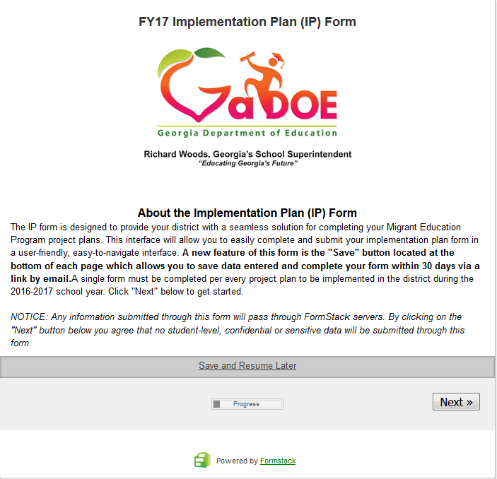
Connecting to our Implementation Plans (IP)
MEP Implementation Plan
District CNA
District Improvement Plan
FY18 Implementation Plan (IP) Form

Slide 33
Implementation Plan Forms
FY18 Implementation Plan (IP) Form

Slide 34
MEP CNA & SDP
The Georgia Migrant Education Program will improve
MPO #1: School Readiness
MPO #2: OSY and DO
MPO #3: Reading
MPO #4: Writing
MPO #5: Mathematics
MEP SDP: contains specific information
about each MPO.

Slide 35
MEP Implementation Goals
Title I, Part C staff at the district level will improve their professional competencies when working with migratory participants in small group, home-based, or inclusion settings by participating in online courses and local training related to instructional duties and responsibilities and transferring professional development to these instructional settings.
Migratory parents will be offered services that will impact successful parental engagement practices in order to assist their children to succeed in supplemental academic services provided by the MEP at the local or state level.

Slide 36
MEP Implementation Goals
For Local MEP Staff
Plan and deliver local professional development (online and/or in person) to SSPs in support to the instructional work with migratory participants.
For Parents
Plan and provide support to parents of migrant children that will impact successful parental engagement practices.

Slide 37
Planning for FY18
Implementation Plans (IPs) should be created based on your District CNA and District Improvement Plan.
Connected to MEP State’s measurable program outcomes (MPO).
Measuring progress:
Outcome must be measureable and connected to MPOs
MUST use Pre/post assessments; formative assessment to measure student progress based on the focus of the IP

Slide 38
Planning for FY18
IPs must reflect the migrant mobility patterns in your district(dates, frequency, time of service, etc.)
Consider large increases or decreases in MEP enrollments during certain months.
Plan your staffing needs based on these mobility patterns - not just the school year calendar.
Coordinate services with other LEA and community programs.
Late spring and summer – GA sees a large influx of migrant families moving in to the state
Provide summer services
Include Preschool, OSY and DOs

Slide 39
Planning for FY18
Supplemental Services
Academic
Support
Schedules for staff
Flexible to include time to provide services before and after school, evenings, and/or weekends.
Flexible to include recruitment (based on local ID&R plan) at different times and days during the week and varying intensity based on monthly migration patterns
Include specific and intentional time for OSY, DOs and PS
SSPs - inclusion or pull-out as the delivery model – can be flexible and/or combined and decided in coordination with the classroom's teacher.
Tutoring – before and after school, and/or weekends.
All migrant participants

Slide 40
Planning for FY18
Avoid making school day schedules that are not fluid and flexible:
PFS served first
Vary the number of times an SSP works with a child during the week
No required “seat-time” for supplemental services – duration and intensity of support can be adjusted to maximize impact of SSP on all participants in the district
If at all possible group migrant students to increase services to those needing support

Slide 41
Planning for FY18
Coordination of Services. Locate resources with other programs in the district or community
District Multi-Tiered System of Supports (MTSS) or Response to Intervention (RTI) Structures
Ensure you know who is being served or not being served by the MEP at your LEA; know the reasons why or why not and DOCUMENT.
Document services:
Local Supplemental Services Tracking Form
Optional Services Documentation Package

Slide 42
Planning for FY18
Participants outside the K-12 school building
Preschool
Enrolled in a PS/PK program is great. MEP can supplement that with tutoring or other support if needed.
Preschool Checklist
Home-based Instruction Protocol
Before your last day of school send copies of any Preschool assessment tools where the post-test administration has been completed for preschoolers served by MEP programs.
Mail these documents to:
Marisela Trejo
221 N. Robinson St. Lenox, GA 31637

Slide 43
Planning for FY18
OSY/DO
Start with the OSY/DO profile
Ensure the GOSOSY Student Services Plan is completed
Follow the plan to deliver services
Deliver services to the participant where they work/live or can gather.
Difficult group to find and contact; most needy and “off the radar” group of youth. You can help them. We can help them.
GOSOSY materials and resources

Slide 44
Planning for FY18
Evaluating the district MEP
Observe services
Complete the fidelity of implementation
Adjust focus or instruction (schedules)
Monitor performance within the IPs, in the classroom, and on local assessments.
PFS compared to Non-PFS compared to non-Migrant
Write narrative of your program evaluation (used for monitoring).
Share results with parents at all PAC meetings, district leadership teams, and other stakeholders
Celebrate success

Slide 45
Updates and Reminders

Slide 46
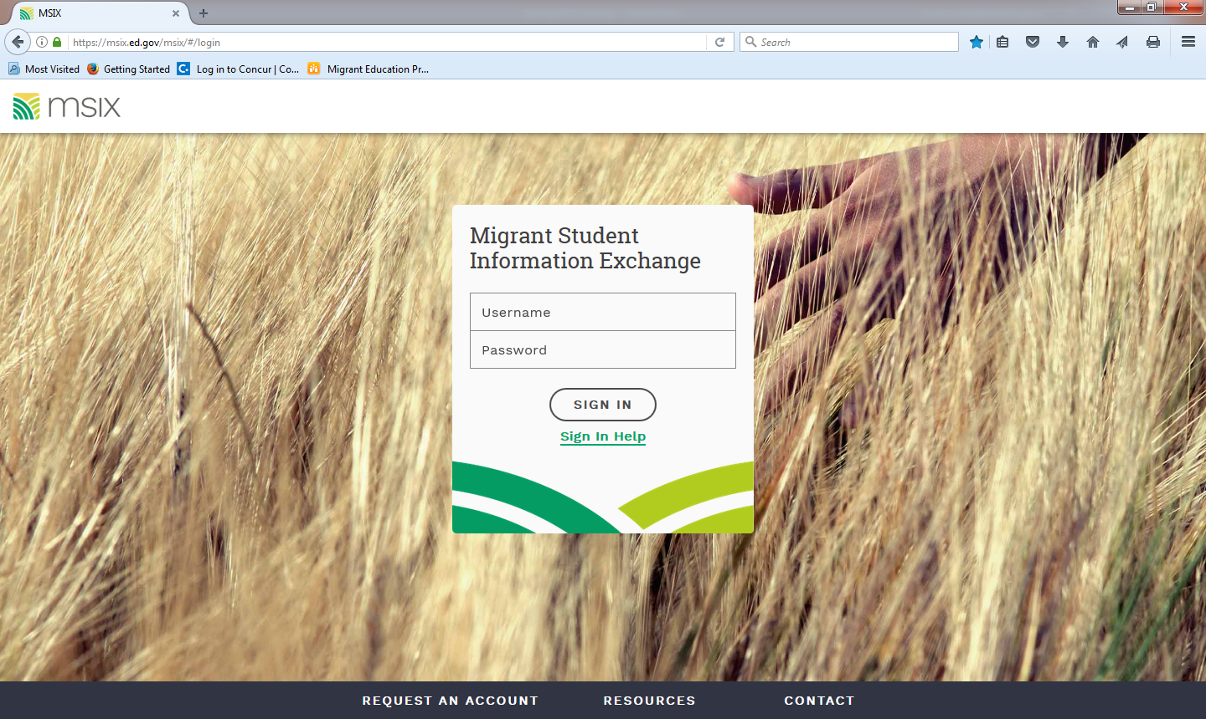
MEP Data Reporting
Student records clean-up is in process
Continue sending MSIX move notifications and departure forms at the same time.
Send a separate notification for each child in a family with more than one.

Slide 47
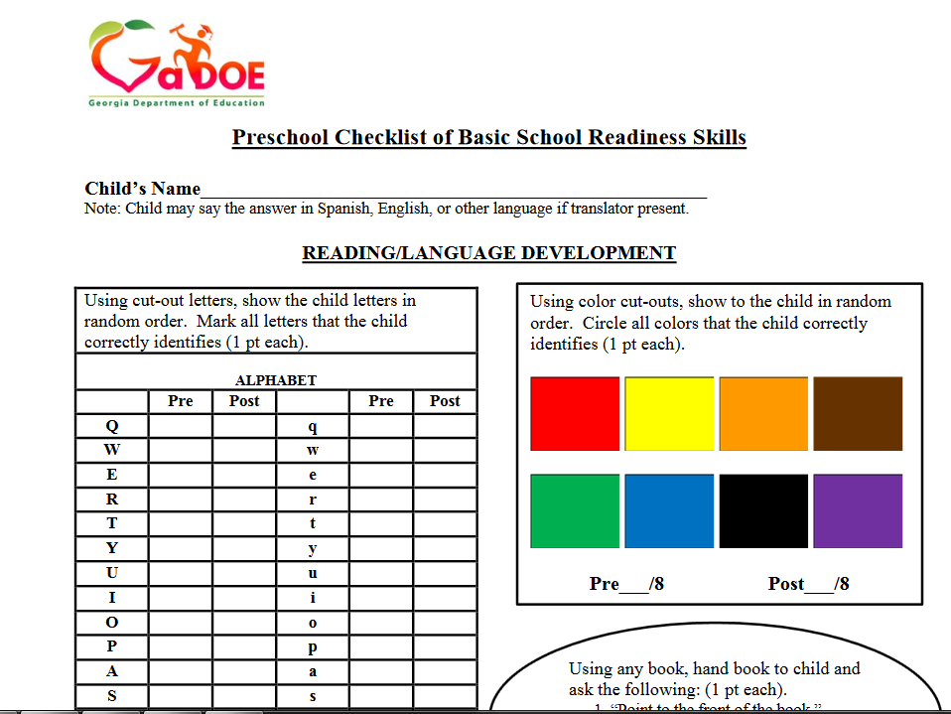
National Preschool Consortium Incentive Grant (CIG)
Preschool Assessment tools where the post-test administration has been completed for your preschoolers

Slide 48
National OSY Consortium Incentive Grant (CIG)
OSY profiles & the GOSOSY Data summary page completed

Slide 49
FY18 Mini-Conference
Region 1 North August 8 TBD
Region 1 South August 10 First District RESA
Region 2 August 09 Coastal Plains RESA

Slide 50
GaDOE Federal Programs Conference

Slide 51
Contact Information
Israel Cortez (jcortez@doe.k12.ga.us)
Margarita Munoz (mmunoz@doe.k12.ga.us)
Marisela Trejo (mtrejo@doe.k12.ga.us)
Omar Lopez-Nunez (olopez@doe.k12.ga.us)
Bernardo Sanchez-Vesga (bsanchez@doe.k12.ga.us)
Yesica Ordonez (yordones@doe.k12.ga.us)

