Slide 1
School Year 20-21: MSIX Promising practices
Migrant student information exchange (MSIX)
Cybersecurity and Account Management Webinar
February 24, 2022
Deloitte

Slide 2
PRIVACY REMINDER
The Migrant Student Information Exchange (MSIX) contains real and sensitive student data that should not be shared with those who do not need it.
Protecting a child’s Personally Identifiable Information (PII) is paramount when using MSIX.
If there is a PII incident,
contact the MSIX Help Desk immediately.
Notes:
MSIX does contain Personally Identifiable Information (PII), which is information that, alone or in combination, is linkable to a specific child that would allow a person to identify the child with reasonable certainty.
Please note that information or data in all screenshots are fictitious. We take great care in protecting sensitive information, and you should do the same when handling student data.

Slide 3
Agenda
1
MSIX Overview
2
Cybersecurity and Privacy Awareness Training
3
MSIX Account Management Reminders

Slide 4
MSIX Overview
MSIX is a web-based application that links State migrant systems to produce a single Consolidated Student Record containing the Migrant Education Program (MEP) minimum data elements (MDEs) to not only analyze national migrant trends, but also facilitate:
Credit Accrual
MEP Participation
Enrollment
Placement
Notes:
As you know, migratory children move from place to place, often on short notice, and families may not have time to gather their children’s education and health documentation before re-enrolling them in a new school district. This can delay enrollment or result in misplacement in grade or course level. MSIX ensures that a migratory children’s academic progress is documented in a central system accessible wherever they go.
To do this, MSIX is a web-based application that links State migrant systems to produce a single Consolidated Student Record composed of minimum data elements, or MDEs. This not only allows for the generation and analysis of national migrant trends, but primarily assists authorized personnel to make informed decisions on enrollment, grade or course placement in a new school, accrual of credits towards graduation, and participation in the Migrant Education Program.

Slide 5
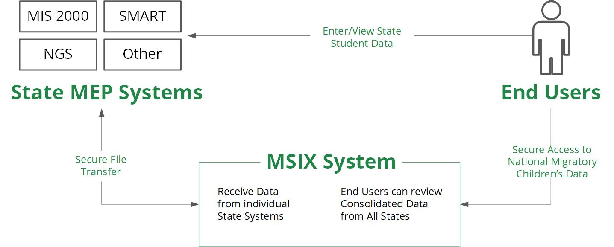
MSIX Overview | System Architecture
Notes:
This MSIX System Architecture graphic displays how data flows between the State system, MSIX, and end users.
MSIX receives data through secure file transfers from the State MEP Systems to create the consolidated student record viewed by end users. MSIX currently does not support direct data entry, so the data you see in MSIX is a consolidation of the data in your State system. As such, the State system remains the authoritative source of data, so it is a Promising practice to keep your State data is as accurate as possible and ensure that your State makes timely updates to MSIX so the data in MSIX is also as accurate as possible.

Slide 6
MSIX Overview | Secure Access
Notes:
To check that a website is safe:
Look for the “S” in HTTPS. HTTPS indicates that security is provided by an SSL certificate which protects sensitive information entered into the site as it travels from the site to a server.
Look for the padlock next to site address as indicated in the slide with the yellow arrow. A padlock indicates a secure site. A padlock with a yellow warning triangle indicates that the connection is only partially secure and a padlock with a red strike over it indicates that content is being delivered via an insecure protocol such as HTTP or FTP.

Slide 7
Cybersecurity and Privacy Awareness Training

Slide 8
Federal and U.S. Department of Education Cybersecurity References
Federal Information System Modernization Act of 2014 (FISMA)
National Institute of Standards and Technology (NIST) Special Publication (SP) 800-53A Revision 5
Federal Government
Department of Education
OCIO: 3-112 Cybersecurity Policy
MSIX System Security Plan
MSIX Privacy Impact Assessment
MSIX System of Record Notice
Interconnection Security Agreements
Memoranda of Understanding
MSIX Rules of Behavior
MSIX Specific
Notes:
There are many different directives and security policies that MSIX must follow to maintain a secure environment for hosting the data of migratory children. At the Federal Government level there is the Federal Information Security Modernization Act of 2014 (also known as FISMA).
FISMA codifies the Department of Homeland Security’s role in administering the implementation of information security policies for federal Executive Branch civilian agencies, overseeing agencies’ compliance with those policies, and assisting OMB in developing those policies.
Also, at the Federal Government level is the National Institute of Standards and Technology (NIST) Special Publication (SP) 800-53A which provides a catalog of security and privacy controls for federal information systems and organizations and a process for selecting controls to protect organizational operations (including mission, functions, image, and reputation), organizational assets, individuals, other organizations, and the Nation from a diverse set of threats including hostile cyber attacks, natural disasters, structural failures, and human errors (both intentional and unintentional). All Federal Government information systems are required to comply with FISMA and follow the NIST SP 800-53A.
The overarching cybersecurity policy for the Department of Education is OCIO:3-112. This policy specifies the process that manages information security and privacy risk specifically for IT systems at the U.S. Department of Education.
Finally, the MSIX specific security documents include the System Security Plan which documents how MSIX implements the security controls specified by NIST. The Privacy Impact Assessment (PIA) and System of Record Notice (SORN) document the PII contained in the MSIX system, why it is there, and how MSIX protects it. The Interconnection Security Agreements (ISAs) and Memoranda of Understanding (MOUs) are agreements made between the Department of Education and the State Education Agencies for exchanging the Minimum Data Elements (MDEs). Finally, the MSIX Rules of Behavior explains the policies and procedures MSIX Users are expected to follow when accessing the MSIX system.

Slide 9
Cybercrime Statistics
With employees around the world working remotely, more sharing of sensitive business information has migrated from conference room white boards and face-to-face conversations. This swell of digital activity has presented cybercriminals with numerous new openings for social engineering attacks.
Email threats rose by more than 64% during 2020
1
The (ITRC) reported in 2021 that cybercriminals remain less invested in taking large amounts of personal information instead manipulating poor consumer behaviors to perpetrate identity-related crimes against businesses using stolen credentials, such as logins and passwords. Criminals then utilize these stolen logins and passwords to perpetrate ransomware and phishing attacks.
2
60% of business endured a ransomware attack last year
There is a cyber-attack once every 39 seconds
3
According to a study from the University of Maryland, a typical computer is attacked in one way or another every 39 seconds. This could come in the form of a direct hacking attempt, a phishing attempt, or some other version of spam meant to infect your computer with malware.
Notes:
Did you know that email threats rose by more than 64% during 2020. With the COVID-19 pandemic, employees around the world began working remotely meaning that sharing of sensitive information moved from face-to-face in the office to digital platforms such as email, teams, and zoom. This huge increase in digital activity presented cybercriminals with numerous openings to conduct social engineering attacks.
This next one was a staggering statistic for me to learn -60% of businesses endured a ransomware attack last year. Cybercriminals remain focused on manipulating poor cyber hygiene to perpetrate identity-related crimes and steal credentials such as logins and passwords. These stolen logins and passwords are then used to launch ransomware and phishing attacks against businesses.
Finally, according to a study from the University of Maryland, a typical computer is attacked in one way or another every 39 seconds. This comes in the form of direct hacking attempts, phishing attempts, or some other type of spam meant to infect your computer with malware.
It is pertinent that all individuals have not only the appropriate cyber software such as anti-virus and spam filters but also practice proper cyber hygiene.

Slide 10
Avoid a Social Engineering Attack
DO
DON’T
Be suspicious of unsolicited phone calls, visits, or email messages from people asking about employees, computer systems, or internal information
Try to verify the identity of any unknown person who claims to be from a legitimate organization
Remember legitimate personnel will NEVER ask you for your password
Give your passwords to anyone
Enter your credentials into a website accessed by clicking a link in an email message
Allow an unknown individual remote access to your computer in response to an unsolicited telephone call or onscreen pop-up message
Notes:
The following are ways to avoid a social engineering attack:
Do…
Be suspicious of unsolicited phone calls, visits, or email messages from people asking about employees, computer systems, or internal information
Try to verify the identity of any unknown person who claims to be from a legitimate organization. If you receive an unsolicited email from a financial institution such as your bank, paypal, or even amazon asking you to call a number or click on a link from an email, the best thing you can do is look up that phone number or directly type that link into a browser that way you can confirm that you are using the correct one and not one that was maliciously sent to you trying to steal information or install malware onto your computer.
Remember legitimate personnel will NEVER ask you for your password –This includes the MSIX help desk. The Help Desk will NEVER ask you for your password so please do not send it to them or any other MSIX User administrator.
Don’t
Give your passwords to anyone
Enter your credentials into a website accessed by clicking a link in an email message
Allow an unknown individual remote access to your computer in response to an unsolicited telephone call or onscreen pop-up message

Slide 11
Email Security Best Practices
Do not open unexpected attachments even if you know the sender
Do not click on suspicious links within emails
Install and update anti-virus software on all devices
Learn how to recognize phishing
Messages that contain threats to shutdown accounts or devices
Requests for personal information (passwords or Social Security Numbers)
Words like “Urgent”
Forged email addresses
Poor writing or bad grammar
Don’t give your email address to sites you don’t trust
Report suspicious emails to your IT Department
Notes:
Do not open unexpected attachments even if you know the sender – if you weren’t expecting an attachment or link from the sender, use a new email or call them to confirm if the attachment or link is legitimate.
Do not click on suspicious links within emails – An example is if you receive an email from your bank telling you that your account has been frozen and to click a link to resolve the issue. You can manually type in the name of your bank or do a google search to visit the legitimate link to confirm if there are any actions that you need to take. Often, the links in these types of emails are malicious.
Install and update anti-virus software on all devices
Learn how to recognize phishing
Don’t give your email address to sites you don’t trust
Report suspicious emails to your IT Department

Slide 12
General Security - PA
Required Training
PA requires all staff to attend the annual OME Security Webinar
PA has developed a comprehensive Security Webinar and updates it annually based on new material provided by OME or annually at our State Conference and other times as needed
New Staff
New staff must review the material in this webinar with a data staff member when hired and prior to obtaining an MSIX login
New staff must then attend the next formal security presentation when it is available
Best Practices
Staff are constantly reminded of best practices related to securing data
Staff are trained in FERPA and that only those with an educational need may have access to student records (and only for those students they have need to access)

Slide 13
Annual Required Trainings
Secure Conduct Thinking secure when interacting with student data
In New York, security training is required for all staff on an annual basis. Staff are trained on the Three “C”s of Security
Secure Computers Ensuring all devices accessing student data are properly secured
Secure Communications Utilizing secure methods to connect and send data over the internet

Slide 14
Secure Conduct
In New York, staff are trained on how to think secure when using any technology. Some techniques we emphasize are:
Considering FERPA whenever student data is requested
Spotting a phishing scam via emails and phone calls
Noticing attempts at social engineering
Never sharing account credentials with anyone else
Using Multi-Factor Authentication (MFA) whenever possible

Slide 15
Understanding PII, SPII, and PHI
PII
SPII
PHI
Personally Identifiable Information
Any information about an individual that you can be used to distinguish or trace an individual's identity alone or when combined with other information linked or linkable to the specific individual.
Sensitive Personally Identifiable Information
PII is considered SPII if its improper release could result in harm, embarrassment, inconvenience, or unfairness to the individual whose name or identity is linked to the information.
Protected Health Information
PHI is any personal health information that can potentially identify an individual, that was created, used, or disclosed while providing healthcare services, whether it was a diagnosis or treatment.
Note: MSIX does contain PII but not SPII or PHI. Please do not input a child’s SPII or PHI into MSIX via file submission or using the correspondence feature.
Notes:
While individual data elements alone in MSIX are PII and not SPII, the whole student record can cause embarrassment, inconvenience, or personal harm. Particularly since MSIX contains records for Minors, extra caution should be exercised. Always password protect or encrypt data exported or screen captured from MSIX.
It is the responsibility of every MSIX user to protect the information maintained in MSIX.
When we say protect the information, this covers not just what’s on the screen, but also downloaded files, screenshots, emails, attachments, printed records, etc.
PII and SPII should only be shared with those with a specific need. They may be parents, students, counselors, registrars, etc. but make sure the information they receive is pertinent and the correct information for the specific request each time. Ask if the information they are seeking is the right information for the right person at the right time.
Please be aware that MSIX is permitted to store PII but SPII such as social security numbers or PHI such as health conditions are not permitted to be stored in MSIX. Please do not input this kind of data into MSIX either via comment in a file submission or via the correspondence feature on move notices or data requests.

Slide 16
Sharing PII
Stop and think:
Before sharing PII/SPII, ask yourself who you are sending it to and whether they “need to know” the information.
To prevent accidentally sending information to the wrong person, address your message carefully. Make sure you select the correct recipient.
Follow your State laws to ensure you are using approved transmission methods and required protections (e.g., encryption).
Never download or store PII on personally-owned equipment.
Do not upload PII to an unauthorized online storage site (e.g., Dropbox, wikis, etc.).
PII should never be accessed from public computers or kiosks found in hotel business centers or airports.
TIP! Do not send PII to the Help Desk without first speaking with a Help Desk representative.
Notes:
Did you know common PII incidents for MSIX involved PII sent via unsecured email to the Help Desk.
Emailing sensitive information should only be done after you stop and think about some of these key points.
What information should be shared? Who is the recipient? Do they have a ‘need to know’ for the specific information?
Ensure the email is going to the right person, and now a whole group of people. Are they inside your organization? Are they external partners?
Did you spell the email address correctly?
If PII needs to be shared, follow your State laws for approved transmission methods. This could include password protection or encrypting the attachment before sending it out.
Email is generally not a safe communication method. It can be easily intercepted without your knowledge.
Encryption tools available to each SEA/LEA differ. Each MSIX User must consult their local IT support team and SEA/LEA tools and policies for specific methods to encrypt and protect PII/SPII.
Here’s another TIP: The US Dept of ED does not routinely request PII from MSIX users. If the Department needs to review your data, we will provide a secure means to do so. This also goes for the MSIX Help Desk. Please do not send PII to the Help Desk. If they need access to data containing PII, they will work with you to send it in a secure manner.

Slide 17
PII in PA
PII, security/phishing, data breaches, strong passwords are explained
All computers used by staff working with PII are encrypted
Staff are reminded to never tape passwords to computers/keep with or near the computer or share them with others
Staff must lock computers whenever not at the computer and also warned about “shoulder surfing”
Staff must never email any PII unless it is encrypted and then the password must be sent via a different method (telephone/text/in person) and NOT simply via a separate email
Staff are reminded that paper records and external devices such as flash drives must also be secured
Staff are strongly reminded of THEIR personal role in all of this

Slide 18
Maintain Situational Awareness
Situational awareness is always being aware of your surroundings. It can prevent unauthorized access to sensitive information including PII.
Constantly remind yourself to stay aware, especially when you are in non-private areas (e.g., hallways, elevators, or open office spaces) or off-duty (e.g., during lunch, on coffee breaks, while on vacation or traveling, shopping, talking on the phone, etc.).
Sensitive information should only be discussed in private, controlled areas
Be aware of your surroundings and the people around you
Take care when reading or viewing sensitive information outside of the office. Unauthorized individuals may be able to reach or view the information as well
Be discreet when retrieving messages from smartphones and other media. Don’t include sensitive information in voicemail messages
Do not share sensitive information with anyone else unless he or she has a work-related need to know

Slide 19
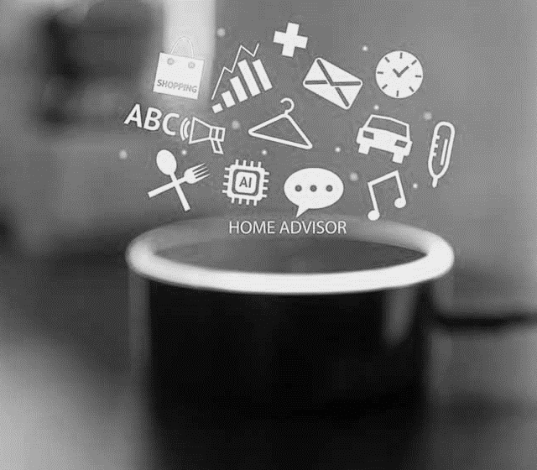
Digital Assistants: Best Practices
Digital assistants, like Siri on iPhones and iPads as well as smart speakers such as Amazon Echo and Google Home, are configured to constantly listen for commands.
Turn off your digital assistant when participating in conference calls.
Notes:
Digital assistants, like Siri on iPhones and iPads as well as smart speakers such as Amazon Echo and Google Home, are configured to constantly listen for commands.
When you participate in a conference call from home, your digital assistant may hear and record the sensitive information discussed
Turn off your digital assistant when participating in conference calls.

Slide 20
Home Wireless Networks: Best Practices
Keep it Secure
Secure your Wi-Fi network and your digital devices by changing the factory-set default password and username.
Understand the Security Features
Do not use Wired Equivalent Privacy (WEP), which can be hacked in minutes.
Hide the Identity
Turn off the identifier-broadcasting feature of your router. Create a guest wireless network just for your laptop.
Connect to VPN
Connect immediately after logging into your laptop
Notes:
Consider your Wi-Fi router the "front door" to your home network and configure it to lock out intruders. Secure your Wi-Fi network and your digital devices by changing the factory-set default password and username. Select a password that is as long as possible and unique to your router. Keep your router software up to date.
Learn about the security features available with your router and enable firewall services when available. The firewall service will provide a barrier between your Wi-Fi network and the internet, protecting your data and network from unsolicited connections or connection attempts. Configure your router to use strong encryption provided by Wi-Fi Protected Access 3 (WPA3) or at minimum protections provided by WPA2. Do not use Wired Equivalent Privacy (WEP), which can be hacked in minutes .
Consider hiding the identity of your wireless network by turning off the identifier-broadcasting feature of your router. Create a guest wireless network just for your ED laptop and other GFES. Isolating your ED GFES equipment helps protect it from personal devices and all IoT devices on your home network which may provide points of entry for cybercriminals.

Slide 21
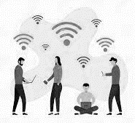
Public Wireless Networks: Best Practices
Use Caution
Be wary of connecting to any network that is identified as "Free Wi-Fi.“
Connect to VPN
Ensure VPN is connected as soon as possible and limit your activity to web browsing. Avoid accessing any services that require entering credentials (e.g., username and password) or personal information.
Use Hotspot
Another safer option for accessing the internet is to use your phone's hotspot.
Notes:
Use Caution: Coffee shops, airports, hotels, and other public places are increasingly providing Wi-Fi. Do not assume they are secure. Avoid connecting to unfamiliar public wireless networks, especially if they don't require a password. Be wary of connecting to any network that is identified as "Free Wi-Fi.“
Connect to VPN: If you must use a public Wi-Fi, and have access to your agency’s VPN, ensure it is connected as soon as possible and limit your activity to web browsing. Avoid accessing any services that require entering credentials (e.g., username and password) or personal information.
Use Hotspot: Another safer option for accessing the internet is to use your phone's hotspot (e.g., mobile Wi-Fi, 4G or 5G services).

Slide 22
Secure Computers
In New York, work devices that may access student data are configured to be as secure as possible
Full device encryption safeguards data on the computer
Antivirus protects against malicious programs
Secure cloud storage platforms prevent data loss

Slide 23
Secure Communications
In New York, all communications are required to be done through secure channels
VPNs are required for public WiFi, and mobile hotspots are encouraged instead when possible
Student data may never be sent as plaintext over email and instead must always be encrypted or sent through a more secure platform
Staff are trained on using separation of mediums when sharing encryption keys, so that an encrypted file and its password are never both be sent over email

Slide 24
MSIX Password Policy
Between 12 and 20 characters.
Include at least one character from each of the four main character classes:
Uppercase letters [A-Z]
Lowercase letters [a-z]
Non-alphanumeric special characters [!,@,#, etc.]
Numbers [0-9]
Users may not re-use any of their previous 24 passwords.
Passwords must be changed after 90 days of use.
Accounts will be locked after three (3) consecutive login attempts
Notes:
The MSIX password requirements are as follows:
your password length must be between 12 and 20 characters
passwords must include at least one character from each of the four main character classes including uppercase letters, lowercase letters, special characters, and numbers.
you may not re-use any of your previous 24 passwords.
Passwords must be changed every 90 days
Accounts will be locked after 3 consecutive login attempts.
This password policy is a requirement of the Department of Education. All Department of Education information systems using passwords are required to comply with this password policy.
A tip for users who choose to take action to change their password at the 15-day or 3-day expiration notice: uses can still use their current/active password to sign in and then reset their own password on the My Account Page within the MSIX application. This will allow the user an opportunity to review and/or update their Challenge Questions prior to requesting their own password reset.
Due to the continuing threat against Federal computer systems and the sophistication with which hackers and cybercriminals are operating, Multi-Factor Authentication may soon become a requirement for the MSIX system. Like what you may have seen implemented with your financial institutions and other websites you interact with daily, MFA will involve you entering your MSIX username and password along with a one-time code received via an app or text message. Any changes to authentication will be socialized by OME before implementation occurs.

Slide 25
Accessing MSIX
New users work with their User Administrator to complete the User Access Application, Cybersecurity Training, and acknowledge the MSIX Rules of Behavior to obtain access to MSIX.
Status | Time Frame/Conditions | Password Reset
Active | Day 1 – 90 days after account activation or password reset. | Initiate Password Reset using “Forgot Your Password?” on the MSIX Login Page. Answer Challenge Questions to obtain a One-Time Password (OTP) via email. Use the OTP to login to MSIX and reset your password.
Locked | Incorrect username/password combination entered 3 times. | Initiate Password Reset using “Forgot Your Password?” on the MSIX Login Page. Answer Challenge Questions to obtain a One-Time Password (OTP) via email. Use the OTP to login to MSIX and reset your password.
Expired | 91 days – 120 days after account activation or password reset. | Initiate Password Reset using “Forgot Your Password?” on the MSIX Login Page. Answer Challenge Questions to obtain a One-Time Password (OTP) via email. Use the OTP to login to MSIX and reset your password.
Disabled | 121 days after account activation or password reset or manually disabled at any time. | Contact User Administrator.
Deactivated | 1 year after account disablement or manually deactivated at any time. This is a permanent action. | Contact User Administrator to complete your State’s account application process to re-establish access.
Notes:
To gain access to MSIX, potential users must work with their State or Regional User Administrators to complete their State’s MSIX account application process which includes completing a user access application, completing basic cybersecurity training, and acknowledging the MSIX rules of behavior.
Before jumping into the account statuses, remember that passwords expire every 90 days and that you must reset your password prior to the 90 days to maintain access to MSIX!
Let’s review the list of potential MSIX account statuses.
First, you can have an Active account, which means you maintain normal access to MSIX and, if you have set your challenge questions, you can manage your own password. Your account is in an active status for the first 90 days after it has been activated or after you reset your password. If you continue to reset your password within 90 days, your account with remain in an Active status.
Your account can also be Locked, which happens when you enter your MSIX username and password combination incorrectly three times. If you have set challenge questions to your account, you will now be able to use the self-managed password feature to set a new password on your own when your account is locked.
Your account expires if you have not reset your password within 90 days. When your account is expired, if you have your challenge questions set, you can reset your password on your own and regain access to MSIX. The statuses of locked and expired can only set by the system based on either too many invalid login attempts or password age. MSIX User Admins cannot manually set an MSIX account to either locked or expired. The next two statuses we will talk about, disabled and deactivated, may either be set by the MSIX system or manually by a user administrator.
As some of you might remember, we implemented automatic account disabling and deactivation in March of 2019. A month after your account expires, if you haven’t taken action to reset your password, your account will become disabled, and you will not be able to self-manage your account. This means that you will have to reach out to your MSIX User Administrator to request a password reset.
If your account has been disabled for a year, MSIX will automatically deactivate your account. If this happens to your account and you need to access MSIX again, you will need to contact your MSIX User Administrator to complete your State’s account request process.
As a reminder to MSIX User Administrators, the automatic disabling and deactivation of MSIX user accounts is a failsafe. Please continue to manually disable and/or deactivate accounts in your State in a timely manner.
A couple of other tips for using the self-service password management feature:
You cannot use this feature until you have set challenge questions on your account.
When using the self-service password feature, if you type your username incorrectly you may see generic challenge questions and not the ones you had set to your page. If this is the case, please go back and check that you entered your username correctly. As a reminder, your username is NOT your email address.
If you typed your username correctly, but answered you challenge questions incorrectly, you will receive an email to the email address registered with your MSIX account letting you know that this has happened.
The Help Desk cannot reset passwords. You must contact your State or Regional user admin to reset your password if you are not able to complete the self-managed process.

Slide 26
Self-Managed Password Reset Process
1
4
Click on the “Forgot Your Password?” link on the MSIX login page and enter your username.
Confirm your challenge questions and responses.
2
5
Answer three of your five challenge questions to receive an email with your one-time password.
Now, you can set your new password!
3
6
Use your username and the one-time password from the email to log into MSIX.
Remember, you can view and edit the answers to your challenge questions on the “My Account” page at any time.
Notes:
How can you reset your own password?
If you forget your password or know you need to reset it, click on the “Forgot your password?” link on the MSIX Login Page and enter your username. If you cannot recall your username, you will need to contact your MSIX User Administrator for support.
2. Once you enter your username, you will be directed to answer 3 of your 5 challenge questions. If you answer your challenge questions correctly, you will receive an email with a one-time password. If you answer any of your challenge questions incorrectly, you will receive an email letting you know that you have entered your challenge question responses incorrectly and to attempt to answer them again. In addition, if you enter your username and answer challenge questions but your account is not in a self-manage password permissible state which can happen if you have not set challenge questions to your account, or if your account is disabled you will receive an email letting you know that you will need to contact your MSIX user admin for a password reset. Emails will be sent to the email address associated with the username you entered, if you do not receive an email from MSIX, you will need to contact your MSIX User Administrator as you may have entered your username incorrectly or your account may be deactivated.
3. Use your username and the one-time password from the email to login to MSIX.
4. You will be taken to a page with your challenge questions and responses populated. You may use this time to change your challenge questions and responses or update your responses to the selected challenge questions.
5. Once you confirm your challenge questions and responses, you will be taken to a page to set your new password. You may then use your username and newly set password to login to MSIX.
Remember that you can view and edit the answers to your challenge questions at anytime on the My Account page in MSIX.

Slide 27
MSIX Usage - PA
PA is a Regional Based Program
All PA staff who work with children/families must have MSIX accounts and usage is monitored and recorded in our database
Many attempts have been made to have district staff obtain accounts
Most district staff rely on the MEP, and our MEP staff are terrific at building relationships with schools
PA continues to encourage staff outside of the MEP to obtain accounts. There has been little success primarily because they rely on the Regional MEP staff who do a great job in working with them.
Districts in PA require formal transcripts and immunization records.

Slide 28
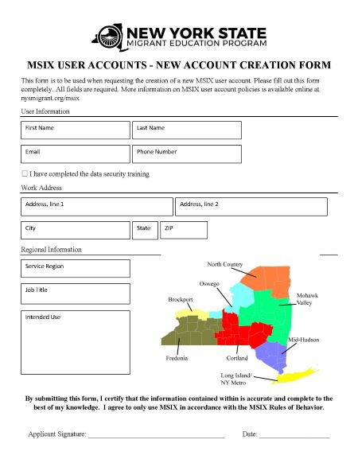
Annual MSIX Account Applications
In New York, access to MSIX must be reapplied for annually using a prepared form. This helps ensure that no disused account gets overlooked and that only the individuals still requiring access to MSIX can continue to do so.
Completion of our annual security training is
required for approval.

Slide 29
Principle of Least Privilege
This is the principle of granting the least amount of access necessary to perform one’s job duties. Following the Principle of Least Privilege better safeguards the system data against possible compromise.
In New York, student data is only
granted to the employees who
work with those students

Slide 30
Password Managers & Passphrases
In New York, the usage of password management software and strong passphrases is encouraged
Passphrases
A phrase or short sentence used in place of a password that is usually easier for the user to remember and more difficult for an attacker to guess
Password Managers
A program that generates and stores passwords in a secure vault

Slide 31
User Administrator Responsibilities
Reset passwords for disabled accounts.
Initiating a password reset for an active, locked, or expired account will give the user an opportunity to reset their challenge questions.
Create new accounts
New users will receive two emails: one with new username and a second with a one-time password.
After logging in using the one-time password, new users will be required to set up their challenge questions and set their password.
Disable or Deactivate accounts for MSIX users who no longer have a need to access the system.
TIP! Use the Account List Report to review user accounts within your State.
Notes:
We will conclude our webinar today with a reminder to user administrators about their responsibilities within MSIX:
Reset passwords for disabled accounts.
Initiating a password reset for an active, locked, or expired account will give the user an opportunity to reset their challenge questions.
Create new accounts
New users will receive two emails: one with new username and a second with a one-time password.
After logging in using the one-time password, new users will be required to set up their challenge questions and set their password.
Disable or Deactivate accounts for MSIX users who no longer have a need to access the system. The automatic disabling and deactivating of user accounts in MSIX is a failsafe. Please continue to manually disable or deactivate accounts in your State when the user no longer has a need to access. You should disable an account if the person is expected to return such as a seasonal employee or someone on a leave of absence. You should deactivate an account when the user no longer requires access to the system. Deactivation is a permanent action therefore you should update the email address by appending a “.old” to allow the email to be used again if the person were to ever return and need access.
A helpful hint for user administrators – the Help Desk generally sees a spike in calls regarding logins in August which corresponds with the new school year and many MSIX users returning after a summer off. User Administrators should be proactive with reviewing the MSIX Account List Report and providing password resets to those users who will need MSIX access during the school year but whose accounts have disabled due to a break in the summer months.

Slide 32
Thank You!
February 24, 2022

