Slide 1
Overview of Title I Budgets and Plans: How the Two Work Hand and Hand
Georgia Department of Education
13th Annual Title Programs Conference
June 15-19, 2015

Slide 2
SCHOOL IMPROVEMENT & DISTRICT EFFECTIVENESS

Slide 3
Presenters
Elaine Dawsey Ken Banter, EdD
GA Department of Education GA Department of Education
Title I Education Program Specialist Title I Education Program Specialist
Office of School Improvement Office of School Improvement
Federal Programs Division Federal Programs Division
edawsey@doe.k12.ga.us kbanter@doe.k12.ga.us
478-971-0114 478-960-2255

Slide 4
Purpose This session is designed particularly for Title I directors and principals of Title I schools. To develop effective internal controls and a viable Title I program, participants will receive an overview of the Title I plan components and budgeting process. The session will also share the use of Google Drive in developing budget templates. The session will also focus on a method to successfully implement and monitor a Title I, Part A budget.

Slide 5
Topics to be Covered Internal Controls Viable Title I Program Components of Title I Programs (Schoolwide and Targeted Assistance) Title I Budget Process Building your Title I budget from the Title I Program Plan Using Google Drive to create budget templates Advantages of Using Google Drive

Slide 6
What is Internal Control?
A Non-Technical Definition: An intentional practice or procedure, prescribed by management, designed to eliminate or minimize organizational errors and fraud.

Slide 7
Internal Control Principles
It is a process
It is established, maintained, and monitored by people at all levels
It must be cost effective
It is the responsibility of all employees involved in the process

Slide 8
Need for Internal Control
Achieve goals and objectives
Safeguard assets
Ensure accuracy and reliability of data
Promote operational efficiency
Compliance with laws and regulations

Slide 9
Purpose of Title I
The purpose of Title I funds is to enable schools to provide opportunities for at-risk and disadvantaged children to acquire the knowledge and shills contained in the challenging state content standards and to meet the challenging state performance standards developed for all children.

Slide 10
Title I Viable Program
Title I, Part A allocation to each school must be large enough for the school to run a viable Title I academic program.
The viable academic program must cover all the required ten components for a schoolwide program and the eight required components for a targeted assistance program.
US ED does not provide a specific dollar amount that qualifies as a viable amount.

Slide 11
Title I Viable Program
Policy letters from US ED have denied states to allow an allocation of only $30,000 to $40,000 to Title I schools meaning it was not a viable program.
The required components of the Title I program may have to be covered with state or local funds which may lead to supplanting issues.
Work with your Title I Education Program Specialist with your specific scenarios.
PROCEED WITH CAUTION: As you allocate Title I funds in FY16.

Slide 12
Title I Program Models
Targeted Assistance
Eligible Students
Targeted Resources
Schoolwide
Needs Assessment
Schoolwide Plan

Slide 13
Title I Targeted Assistance
Eight Required Components for Targeted Assistance
Description of Instructional Strategies
Grades and subject areas to be served.
Instructional strategies to be used
Scheduling models to be used
Supplemental instructional activities
Description of the method of selecting children with the greatest need
Pre-K through 2 selection criteria
Grades 3 – 12 selection criteria
Copy of multiple, educationally related, objective criteria worksheet for each subject and grade level of students being served.

Slide 14
Title I Targeted Assistance
Eight Required Components for Targeted Assistance
Description of provisions made to serve all eligible children
Description of provisions for instruction by highly qualified staff
Strategies planned to increase parental involvement
Procedures to be used for coordination for Title I resources with other resources
Process for reviewing the progress made by participating children
Procedures for ongoing and an annual evaluation of the goals in the TA plan

Slide 15
Title I Targeted Assistance
Schools that are ineligible for a schoolwide program (Section 1114)
Less than 40-percent poverty
Less than the district poverty average
Targeted Assistance requirements
Rank list students using multiple academic criteria
Limit the expenditures only to identified students (activities, teachers, parent)

Slide 16
Title I Targeted Assistance
Services may be delivered in a number of ways such as:
In-class instruction
Pull-out model
Extended day

Slide 17
Title I Targeted Assistance
Targeted Assistance program must be based on:
Improving achievement of participating children
Using effective instructional strategies that give primary consideration to extended-time strategies
Providing instruction by highly qualified and trained professional staff
Implement strategies to increase parent engagement in the education of their children.

Slide 18
Title I Schoolwide
Schoolwide Program Model
Section 1114 of Title I of the ESEA allows a school in which 40-percent or more of its students are from low-income families to use its Title I funds, along with other federal, state, and local funds, to operate a schoolwide program to upgrade the entire educational program in the school to improve the academic performance of all students, particularly the lowest-achieving students. [Section 1114(a)(1)]

Slide 19
Title I Schoolwide
10 Required Components for Schoolwide Programs
Comprehensive needs assessment
Schoolwide reform strategies
Instruction by highly qualified teachers
High-quality and ongoing professional development for teachers, principals, paraprofessionals, and other appropriate staff
Strategies to attract and retain highly-qualified teachers to high-need schools

Slide 20
Title I Schoolwide
10 Required Components for Schoolwide Programs
Strategies to increase parental involvement
Plans for assisting preschool children in the transition from early childhood programs
Measures to include teachers in the decisions regarding the use of academic assessments
Activities to ensure that students who experience difficulty mastering the proficient or advanced levels of academic achievement standards are provided with effective, timely additional assistance
Coordination and integration of federal, state, and local services and programs

Slide 21
Title I Schoolwide
Schoolwide Programs:
May upgrade the educational system of the entire school by consolidating federal funds into one account
Use all funds to implement the school’s school improvement plan
Build budgets to reflect the Title I Schoolwide Plan (consider referencing Schoolwide Plan in budget)
Limit their Title I expenditures strictly to those costs appropriate for Title I use of funds

Slide 22
Title I Schoolwide
The primary design of the Schoolwide Plan must address the following:
Conduct a comprehensive needs assessment
Develop and implement the schoolwide plan (ten required components)
Annually evaluate the plan to ensure that students demonstrate academic achievement and modify the plan based on this data

Slide 23
Title I Budget Process
Plan and Budget the Set-Asides: Required Set-Asides
1-percent for parental involvement if system allocation is $500,000 or more
5-percent for Flexible Learning Programs (FLP) for all Priority and Focus Schools in the district
5-percent for Professional Learning set-aside for highly qualified required PL
Services for homeless students in non-Title I schools
Services for students in private schools
Services for students in programs for Neglected and Delinquent
All carryovers from prior year (parental involvement, FLP, and private school participation)

Slide 24
Title I Budget Process
Plan and Budget the Set-Asides: Optional Set-Asides
Administrative
Indirect Costs
Summer School and/or Before/After School
Professional Learning (Districtwide)
Additional FLP
Pre-school Programs

Slide 25
Building Templates – Step I
Creating Excel Spreadsheet showing Set-Asides
Creating Excel Spreadsheet showing School Allocations
(Handouts)

Slide 26
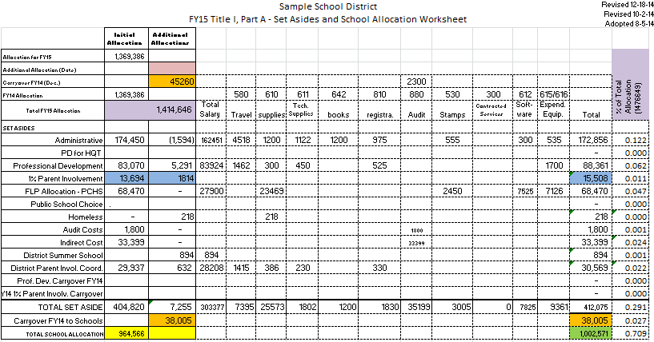
Set Aside Template Sample

Slide 27
Allocation Template Sample

Slide 28
Building Templates – Step 2
Creating Google Drive Budget Templates
Set-Asides
School Level Budget
View Sample Templates – See Handouts
Go to Google Drive live Documents

Slide 29
Assigning Rights to Templates – Step 3
Templates are active and can be edited in real time by assigned staff (Title I director, bookkeeper (District Level and School Level), principals, assistant principal, Parent Involvement coordinator)

Slide 30
Advantages
Real Time Document
Allows template creator to assign rights to edit or view
Allows template creator to protect cells or sheet
Allows for Interactive communication (Comments)
Builds transparency
Builds building-level capacity and ownership
Saves paper
Allows one to copy and paste from Drive to Portal
Strengthens Internal Controls

Slide 31
Things to Consider
Must have a Google Account
Google and Google Drive are free.
Provide training to others in using your templates
Pre-populate the Heading within the Description: ensures consistency and accuracy
Google Drive allows one to download the document as a Microsoft Excel or PDF document
The Original Budget and all Amendments can be all “Tabbed” within one Google Drive File
Once a budget is placed in the Portal, change the settings from “EDIT” to “VIEW” to allow no additional budget revisions
Google Drive also has apps similar to Word, PowerPoint, and Survey Monkey

Slide 32
Questions and Answers

Slide 33
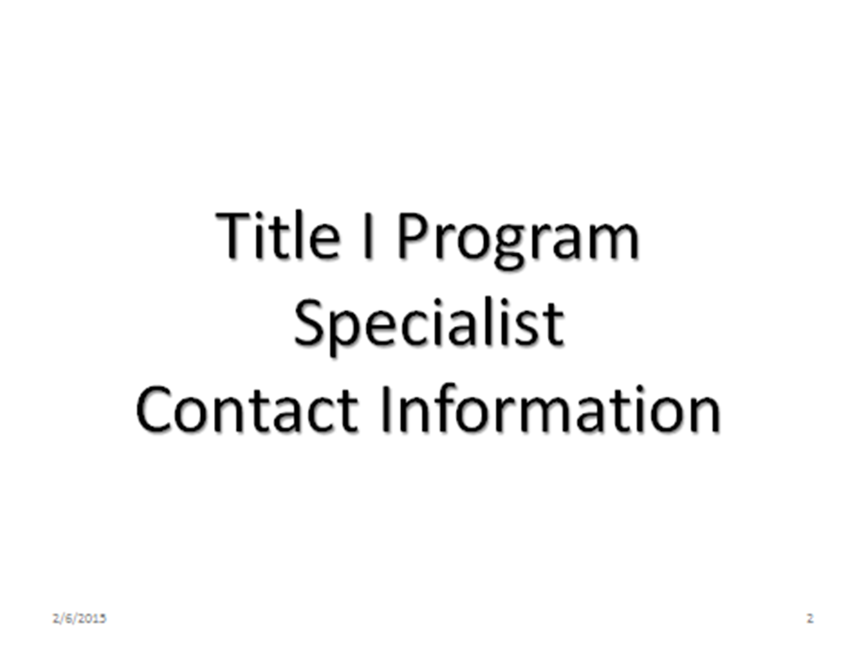

Slide 34
Area | Name | Office Telephone | Email
1 | Robyn Planchard | (404) 985-3808 | rplanchard@doe.k12.ga.us
2 | Randy Phillips | (770) 334-8390 | rphillips@doe.k12.ga.us
3 | Anthony Threat | (706) 615-0367 | anthony.threat@doe.k12.ga.us
4 | Evelyn Maddox | (404) 975-3145 | emaddox@doe.k12.ga.us
5 | Judy Alger | (229) 321-9305 | julager@doe.k12.ga.us
6 | Grace McElveen | (912) 334-0802 | gmcelveen@doe.k12.ga.us
7 | Jimmy Everson | (229) 723-2664 | jeverson@doe.k12.ga.us
8 | Marijo Pitts-Sheffield | (912) 269-1216 | mpitts@doe.k12.ga.us
9 | Kathy Pruett | (706) 540-8959 | kpruett@doe.k12.ga.us
10 | Elaine Dawsey | (478) 971-0114 | edawsey@doe.k12.ga.us
11 | Olufunke Osunkoya | (678) 704-3557 | oosunkoya@doe.k12.ga.us
12 | Bobby Trawick | (229) 246-1976 | btrawick@doe.k12.ga.us
13 | Ken Banter | (478) 960-2255 | kbanter@doe.k12.ga.us
14 | Tammy Wilkes | (478) 237-2873 | twilkes@doe.k12.ga.us

Slide 35
Presenters
Elaine Dawsey Ken Banter, EdD
GA Department of Education GA Department of Education
Title I Education Program Specialist Title I Education Program Specialist
Office of School Improvement Office of School Improvement
Federal Programs Division Federal Programs Division
edawsey@doe.k12.ga.us kbanter@doe.k12.ga.us
478-971-0114 478-960-2255

