Slide 1
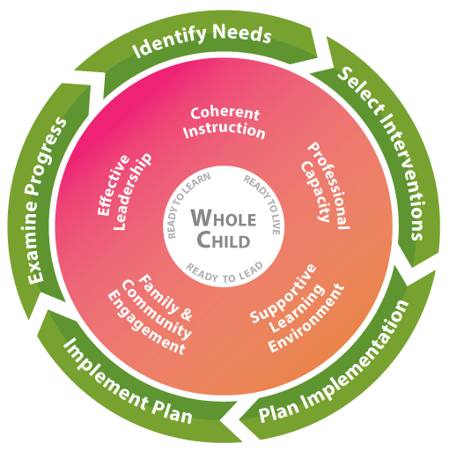

Slide 2
FY20 Budget Planning
Title I Regional Meeting
XXXX X, 2019
Presented by GaDOE Staff from the:
    The contents of this presentation were developed under a grant from the U.S. Department of Education. However, the contents do not necessarily represent the policy of the U.S. Department of Education, and you should not assume endorsement.

Slide 3
Georgia’s Systems of Continuous Improvement

Slide 4
Today’s Agenda
Resources
Overarching Budget Updates
Title I, Part A Budget
Parent Involvement
Questions

Slide 5
Who to ask?
Title I, Part A Managers and Area Specialists
Grants Program Manager and Specialists
Title I, Part C Manager and Regional Coordinators
Title II, Part A Manager and Program Specialists
Title III, Part A Manager and Program Specialists
IDEA Fiscal Manager and Specialists
Title IV, Part A Manager and Program Specialist
Title I, Part A School Improvement Grant Manager and Specialists
Family-School Partnership Manager and Specialists
State Ombudsman

Slide 6
New Directors’ Online Courses
The courses below are designed to provide foundational program information for each program for new federal program directors and contacts.
  Title I, Part A - New Directors' Online Course
  Title IV, Part A - New Directors' Online Course​
  Title II, Part A - New Directors' Online Course
  Rural Education - New Directors' Online Course
  Homeless Assistance - New Directors' Online Course
  Foster Care - New Directors' Online Course
  Navigating the Portal and the Consolidated Application
All courses are housed in the Statewide Longitudinal Data System (SLDS) in the Professional Learning platform.
Information is available here.

Slide 7

Federal Programs Handbook

Slide 8
Overarching Budget Updates
All Federal Programs

Slide 9
Fiscal Regulations and Guidance
Regulations:
Federal Programs Handbook, p. 32
EDGAR: Education Department Guidance and Regulations
  34 CFR Part 76 State-Administered Programs
  34 CFR Part 77 Definitions that Apply to Department Regulations
  34 CGR Part 81 The General Education Provisions Act
  2 CFR Part 200 Uniform Administrative Requirements, Cost Principles and Audit Requirements for Federal Awards
  2 CFR Part 3474 U.S. Department of Education Acceptance of Uniform Administrative Requirements
Guidance:
USGAO Standards for Internal Control in the Federal Government (2014)
OMB: FAQs on Uniform Administrative Requirements (09.2015)
U.S. Department of Education: FAQs on Uniform Administrative Requirements
U.S. Department of Education: Dear Colleague Policy Letters
U.S. Department of Education: Non-Regulatory Guidance

Slide 10
Program Assurances
Page 11 of the Federal Programs Handbook
Sec. 8306 of the Elementary and Secondary Education Act of 1965 (ESEA) as amended by the Every Student Success Act of 2015 (ESSA) requires that LEAs shall have on file with the State educational agency a single set of assurances, applicable to each program for which a plan or application is submitted.
Each LEA will acknowledge general assurances addressing all federal programs and specific program assurances where an allocation is received.
This acknowledgement occurs on the My GaDOE Portal annually.
The Superintendent’s sign-off on the consolidated application denotes agreement to each assurance.
Review annually. Some programs have updates for FY20.

Slide 11
Internal Controls
Page 26 of the Federal Programs Handbook
Internal controls can be defined as a process, implemented by an LEA, designed to provide reasonable assurance regarding the achievement of objectives in the following categories: effectiveness and efficiency in operations, reliability of reporting for internal and external use, and compliance with applicable laws and regulations (2 CFR §200.61).

Slide 12
Written Procedures
Page 26 of the Federal Programs Handbook
Required:
  Cash Management
  Allowability
  Equipment Management
  Conflict of Interest
  Procurement
  Conducting Technical Review of Proposals
  Compensation – Personal Services
  Travel
  Segregation of Duties
Some internal controls are captured in LEA board policies and some are informal and maintained in the LEA federal programs division’s written procedures.
Written procedures must include all federal programs – not just Title I Part A.
Written processes and procedures governing the LEA implementation of federal grants should be reviewed routinely and revised as needed.
Additional details available in CFR 200

Slide 13
Financial Management
Page 26 of the Federal Programs Handbook
Written procedures must include information about:
  Your accounting system(s)
  How budgets are loaded onto the system
  Process for comparing budgets to expenditures
  Process for drawing down funds
  Process and authorizations for budget revisions
  Period of performance and when obligations are made
  Process for carryover
  Process for completing the completion reports
Incorporate state agency requirements, if applicable

Slide 14
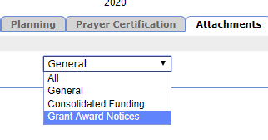
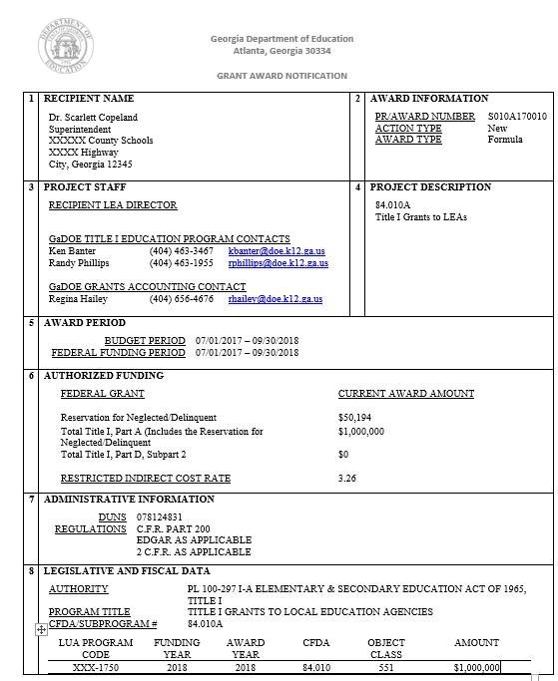
Creating Budgets –
Grant Award Notice (GAN)
Page 24 of the Federal Programs Handbook
GAN loaded to the attachments tab on the consolidated application in the MyGaDOE portal for each federal award
Useful information includes:
  Award Amount
  Award Period
  FAIN
  Restricted Indirect Cost Rate
  DUNS
  LUA Program Code
  CFDA
  Contact Information
  Important attachments

Slide 15
Creating Budgets -
Chart of Accounts
Page 34 of the Federal Programs Handbook
GA Code requires a statewide uniform computerized budget and accounting system.
Updated chart of accounts is found here.
Example from an expenditure report: 414-1750-2213-116
  414 (FUND: Government Funds),
  1750 (PROGRAM: Title I, Part A),
  2213 (FUNCTION: Instructional Staff Training),
  116 (OBJECT: Stipends)

Slide 16
Creating Budgets
District Develops Federal Program Budgets
District Plans for Federal Programs to Supplement the Action Steps
Identified needs are the core of the budget development and approval process
District Creates Action Steps to Address Needs
Needs Identified in the CNA

Slide 17
Budget Review
Page 24 of the Federal Programs Handbook
Budget for each program:
  LEAs must submit a program budget for each applicable program in the consolidated application each fiscal year.
  The budget must be approved by the appropriate program manager or specialist before funds are available through Georgia’s Grants Accounting Online Report System (GAORS).
  Budgets should be submitted as soon as the LEA CLIP is approved and no later than October 1.
  This will ensure the LEA implements its supplemental support services for children when, or very soon after, the school year begins.
  Amendments to original budgets are accepted throughout the year (see page 59).

Slide 18
Indirect Cost Rates – FY20 and Moving Forward
Page 40 of the Federal Programs Handbook
The indirect cost rate is calculated for a fiscal year (12 months) and must be applied to actual expenditures each fiscal year. Since federal funds are available for 15 months:
  July 2019 – June 2020 will apply the FY20 rate
  July 2020 – September 2020 will use the FY20 rate for budgeting until the FY21 rate is determined by GaDOE.
  LEAs will submit a budget amendment when the FY21 rate is determined. This will clearly separate FY20 from FY21 indirect costs.
    Once the FY21 rate is identified, the district can choose to apply the smaller of the two rates to the entire 15-month grant period.
We should have the FY21 rates by March 2020, and the district can do an amendment.
The district can cut-off the grant award period as of June 30, 2020 as long as 85% (Title I A Only) of the grant award has been expended and use only the FY 2020 rate to the 2020 grant award period.
Indirect costs are only drawn down after the rate has been appropriately applied to expenditures.
Notes:
Calculate only the 12 months of the fiscal year; this is the time frame you can apply the indirect cost rate to ; must be based on actual expenditures
Easiest method is to use the smaller indirect cost rate for the entire 15 months

Slide 19
Drawing Down Funds
Page 39 of the Federal Programs Handbook
Federal law is clear that the purpose of ESSA funds is to identify needs, plan interventions and implement resulting plans in order to have the greatest impact possible on students and staff in the most immediate time frame available.
GaDOE monitors drawdowns and will make contact with LEAs for updates on progress during the year.
October 31st | up to 27% funds used |  | April 30th | up to 67% funds used
November 30th | up to 33% funds used |  | May 31st | up to 73% funds used
December 31st | up to 40% funds used |  | June 30th | up to 80% funds used
January 31st | up to 47% funds used |  | July 31st | up to 87% funds used
February 28th | up to 53% funds used |  | August 31st | up to 93% funds used
March 31st | up to 60% funds used |  | September 30th | 100% funds used

Slide 20
Drawing Down Funds from GAORS
Page 37 of the Federal Programs Handbook
GAORS = Grants Accounting Online Reporting System
LEAs draw down federal funds on a reimbursement basis for all allowable expenditures incurred in their respective participating federal program.
GaDOE allows one drawdown per month (see page 37 for specifics)
Monthly drawdown must match incurred expenditures
LEAs must keep supporting documentation on file

Slide 21
Completion Reports
Page 36 of the Federal Programs Handbook
The GaDOE requires each LEA receiving Federal grant funds to submit a completion report no later than 30 days after the initial 15-month period of availability ends.
Completion reports are due on October 30.
Completion reports may be accessed online through the Grants Accounting Online Reporting System (GAORS).
A completion report defines the total amount of the original grant award and the total amount of funds that were expended by an LEA during the initial 15-month period of availability.
Grants Accounting uses completion reports to determine the amount of unexpended funds and the amount of funds available for carryover for each LEA.

Slide 22
Carryover Funds
Page 58 of the Federal Programs Handbook
Local Educational Agencies (LEAs) are permitted to carry over federal funds not expended within the fiscal year awarded to the next fiscal year.
While the law permits LEAs to carry over funds, LEAs are expected to expend the fiscal year allocation within that fiscal year.
An approved original budget is required before carryover funds can be applied.
Each federal program’s carryover procedures are outlined in the handbook.

Slide 23
Transferability of Funds Between Federal Programs
Page 60 of the Federal Programs Handbook
Under ESSA, LEAs may transfer funds they receive by formula under certain programs to other programs to better address local needs.
The ESSA amended the transferability authority by changing the programs from and to which an LEA may transfer funds and removing limits on the amount of funds that may be transferred.

Slide 24
Transferability of Funds Between Federal Programs
Page 60 of the Federal Programs Handbook
An LEA may transfer funds, to better address local identified needs, from the following programs:
Title II, Part A – Supporting effective instruction
Title IV, Part A – Student support and academic enrichment grants
ESEA section 5103(b)(2)

Slide 25
Transferability of Funds Between Federal Programs
Page 60 of the Federal Programs Handbook
An LEA may transfer funds, to better address local identified needs, to the following programs:
Title I, Part A – Improving the academic achievement of the disadvantaged
Title I, Part C – Education of migratory children
Title I, Part D – Prevention and intervention programs for children and youth who are neglected, delinquent, or at-risk
Title II, Part A – Supporting effective instruction
Title III, Part A – Language instruction for English leaners and immigrant students
Title IV, Part A – Student support and academic enrichment grants
Title V, Part B – Rural education
ESEA section 5103(b)

Slide 26
Transferability of Funds Between Federal Programs
Page 60 of the Federal Programs Handbook
An LEA does not have to apply for transferability authority; it already has that authority (ESSA section 5103(b))
An LEA must notify the state, in writing (email), of its intent to transfer funds, including the amount, to another program at least 30 days prior to the transfer and prior to submitting the budget for approval. Please send the notification to:
  Originating program’s manager or designee
  Receiving program’s manager or designee
  GaDOE’s Grants Accounting Department
    Regina Hailey (rhailey@doe.k12.ga.us)
    Della Kilpatrick (dkilpatr@doe.k12.ga.us)
If the transfer modifies any aspect of the LEA’s approved CLIP, the CLIP modifications must be submitted no later than 30 days after the transfer is made.
Email must also be attached to the general attachments tab on the portal for that fiscal year!

Slide 27
Transferability of Funds Between Federal Programs
Page 61 of the Federal Programs Handbook
Funds transferred into other eligible ESSA programs are subject to all rules and regulations of that ESSA program.
Equitable services requirements are not waived, and timely and meaningful consultation must occur prior to transferring funds from one program into another program.
LEAs should think about how the transfer of funds will impact any of their required set-asides and the Title I, Part A 85% drawdown requirement.
CLIPs will need to be updated to show the funds transfer and to ensure stakeholders are informed of LEA plans.

Slide 28
Consolidation of Administrative Funds
Page 44 of the Federal Programs Handbook
The Elementary and Secondary Education Act (ESEA), as amended by the Every Student Succeeds Act of 2015 (ESSA), allows a local educational agency (LEA) flexibility to consolidate funds for administration of one or more ESSA programs, upon approval of the Georgia Department of Education (GaDOE).
The authority for the consolidation of funds for local administration is found in ESSA Sec. 8201 and Sec. 8203.

Slide 29
Consolidation of Administrative Funds
Page 44 of the Federal Programs Handbook
Consolidating federal administrative funds may provide LEAs with greater flexibility in the administration of federal ESSA programs by:
allowing them to charge administrative costs to an administrative pool instead of assigning specific costs to specific programs.
not having to keep separate records, but rather do semi-annual certifications for employees whose job duties and responsibilities are allowable, and therefore included, under the consolidated administrative funds requirements.

Slide 30
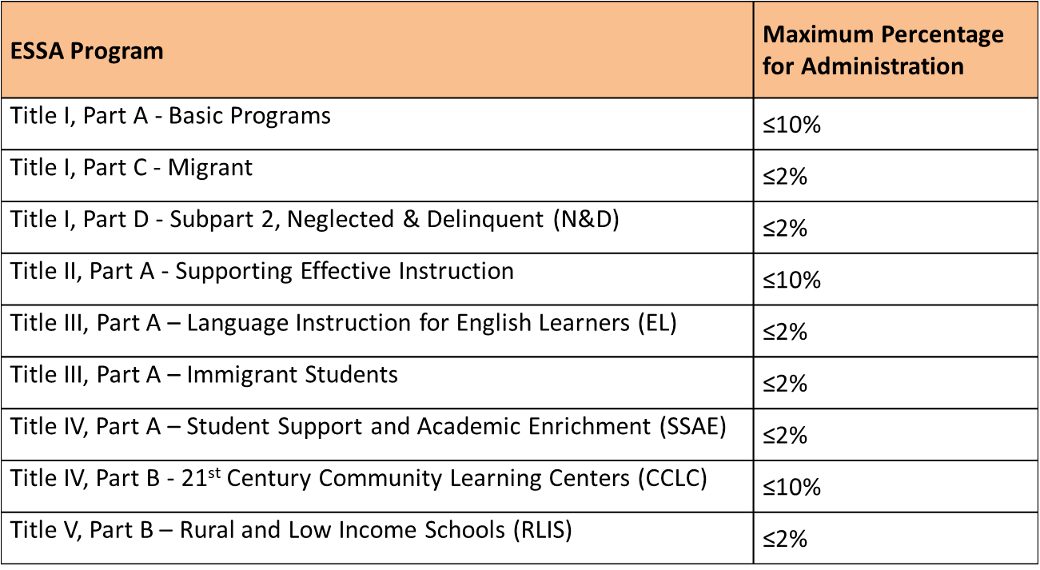
Consolidation of Administrative Funds
Page 44 of the Federal Programs Handbook

Slide 31
Consolidation of Administrative Funds
Page 44 of the Federal Programs Handbook
An LEA must notify the GaDOE of its intention to consolidate administrative funds each school year by August 1. Send the email notification to federalprograms@doe.k12.ga.us
The LEA will then complete the Consolidation of ESSA Administrative Funds – LEA Level, School Year 20XX – 20XX form.
The LEA will attach the fully completed form to the Attachments tab in the Consolidated Application portal for the appropriate fiscal year and complete a Consolidated Federal Administrative Funds budget within the Consolidated Application portal.
The GaDOE’s approval of the budget will serve as the overall approval of the request.

Slide 32
Procurement
Page 27 of the Federal Programs Handbook
Micro-purchase* (2 CFR §200.67, 48 CFR Subpart 2.1) | Up to $10,000
Small Purchase (2 CFR §200.320) | $10,001 - $250,000 | 2 price or rate quotations
Simplified Acquisition Threshold* (2 CFR §200.88, 48 CFR Subpart 2.1) | $250,001+ | RFP – sealed bids
*48 CFR Subpart 2.1 (Definitions) – Updated periodically for inflation
If a micro-purchase is questioned, a review of websites would be sufficient to establish the cost as reasonable. (USDE FAQs on 2 CFR Part 200, Subpart D Question 19, March 17, 2016)
USDE FAQs on 2 CFR Part 200, Subpart D Question 10, March 17, 2016 states that including vendors who are contractors in writing RFPs limits competition.

Slide 33
Capital Equipment Prior Approvals
Page 62 of the Federal Programs Handbook
Prior approval is needed for any individual item purchase over $5,000.00
Each program manager must approve prior to budget approval; documentation attached to budget in the Con App (program approval form; email from manager, etc.).
Contact your program specialist or manager for specifics.

Slide 34
GEPA 427
Page 21 of the Federal Programs Handbook
Section 427 of the United States Department of Education's General Education Provisions Act (GEPA) requires each applicant for funds (other than an individual person) to include in its application a description of the steps the applicant proposes to take in order to ensure equitable access to, and participation in, its federally-assisted programs for students, teachers, and other program beneficiaries with special needs. LEAs should complete the template, secure the superintendent’s signature, and load the document to the general attachments tab on the consolidated application by October 1. GaDOE will check to ensure a GEPA statement is provided by the LEA each fiscal year.

Slide 35
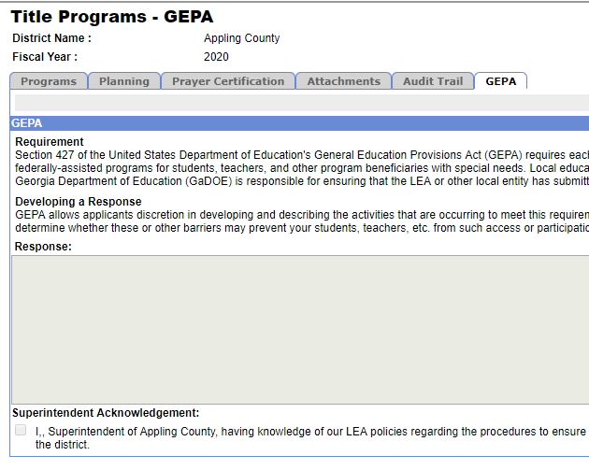
GEPA 427
LEAs should complete GEPA tab on the portal by October 1.
LEA Coordinator or Superintendent has the ability to enter the response. However, only the Superintendent will submit to GaDOE.
Notes:
Use this verbiage to get a sentence startere

Slide 36
Selecting Evidence-Based Interventions
Page 113 of the Federal Programs Handbook
LEAs must specify in the budget line item description whether the strategy/intervention is supported by a strong, moderate, or promising evidence base or demonstrates a rationale that is documented by a logic model on file with the LEA.
This requirement applies to these budget function codes: 1000, 2100, 2210, 2213, 2400, 2900.
Supporting documentation will be reviewed during monitoring visits.
Notes:
EB documentation to review during CFM; look at monitoring rubric; promising and logic model is looking for the logic model and how is it working?
EB documentation to review during CFM; look at monitoring rubric; promising and logic model is looking for the logic model and how is it working?
Look at CFM rubric to determine documentation needed for monitoring; logic model is the one where the LEA will need to show how the intervention is working

Slide 37
Parent Notices
Notice to Parents of Participating English Learners in Title I or Title III Supplemental Language Programs
  Evidence must include the notification in a format and language the parents can understand.
  Distribution of notification using at least one distribution method.
  Not later than 30 (calendar) days after the beginning of the school year; For newly identified ELs, notify during the first two weeks of the EL being placed in a supplemental language program
  Refer to Section 1112(e)(3)(A) and 1112(e)(4)
Templates available on the Parents of English Learners webpage at http://www.gadoe.org/School-Improvement/Federal-Programs/Partnerships/Pages/Parents-of-English-Learners.aspx

Slide 38
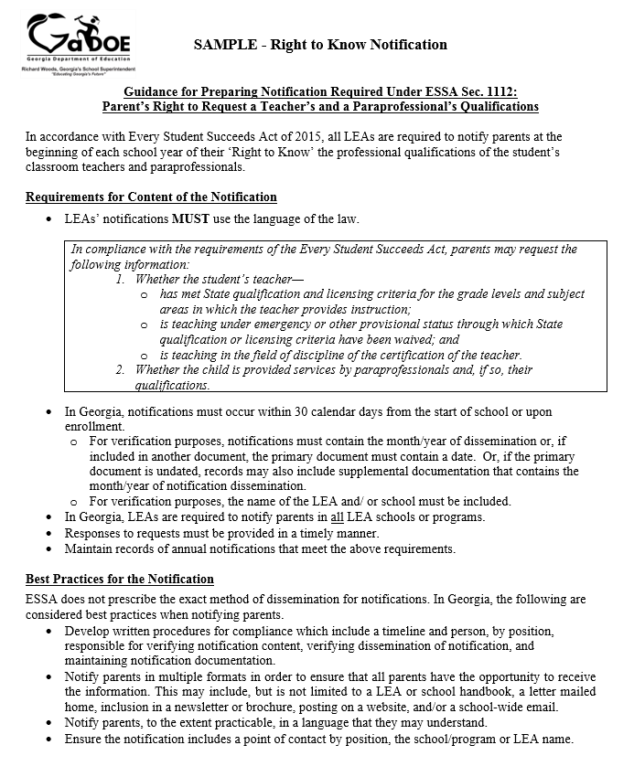
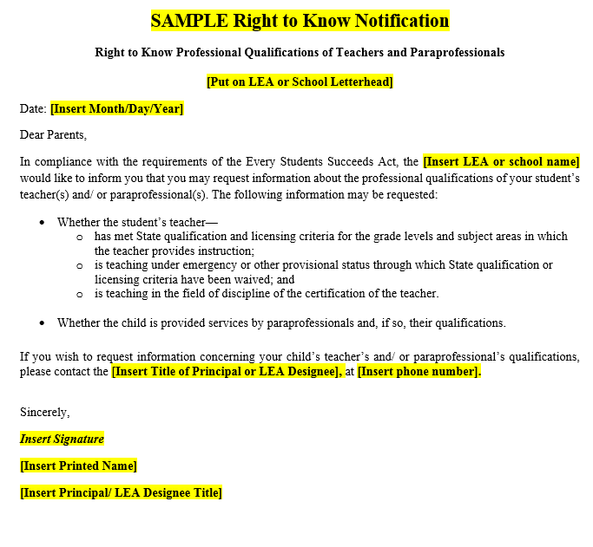
Parent Notices
Parent Right to Know Teacher and Paraprofessional Qualifications
Guidance and sample are available on the PQ webpage of the GaDOE website.
In Georgia, LEAs are required to notify parents in all LEA schools or programs.
LEA notifications MUST use the language of the law.
In Georgia, notifications must occur within 30 calendar days from the start of school or upon enrollment.
LEAs must maintain records of annual notifications.
Notes:
Talking Points:
These are the requirements for the Parents’ Right to Know Notification
What is different and what appears to be the same?

Slide 39
Parent Notices
Parent 20 Day Notification
When to Send
Traditional LEAs send notification when teachers do not meet GaPSC certification requirements
Charter/ Strategic Waiver LEAs
  Regular Education Teachers: When teachers do not meet LEA PQ requirements (as outlined in annual CLIP application)
  Special Education Teachers: When teachers do not meet GaPSC certification requirements
Guidance
Guidance and sample available on PQ webpage of the GaDOE website
In Georgia, notification requirements apply to ALL teachers in all LEA schools/programs.
Clearance certificate requirements are not subject to 20 Day Notification.
20 Day Notifications are not required for paraprofessionals and substitute teachers.
  In Georgia, notifications must occur within 10 business days following the four consecutive weeks.
Notes:
Talking Points:
These are the requirements for the Parents’ Right to Know Notification
What is different and what appears to be the same?

Slide 40
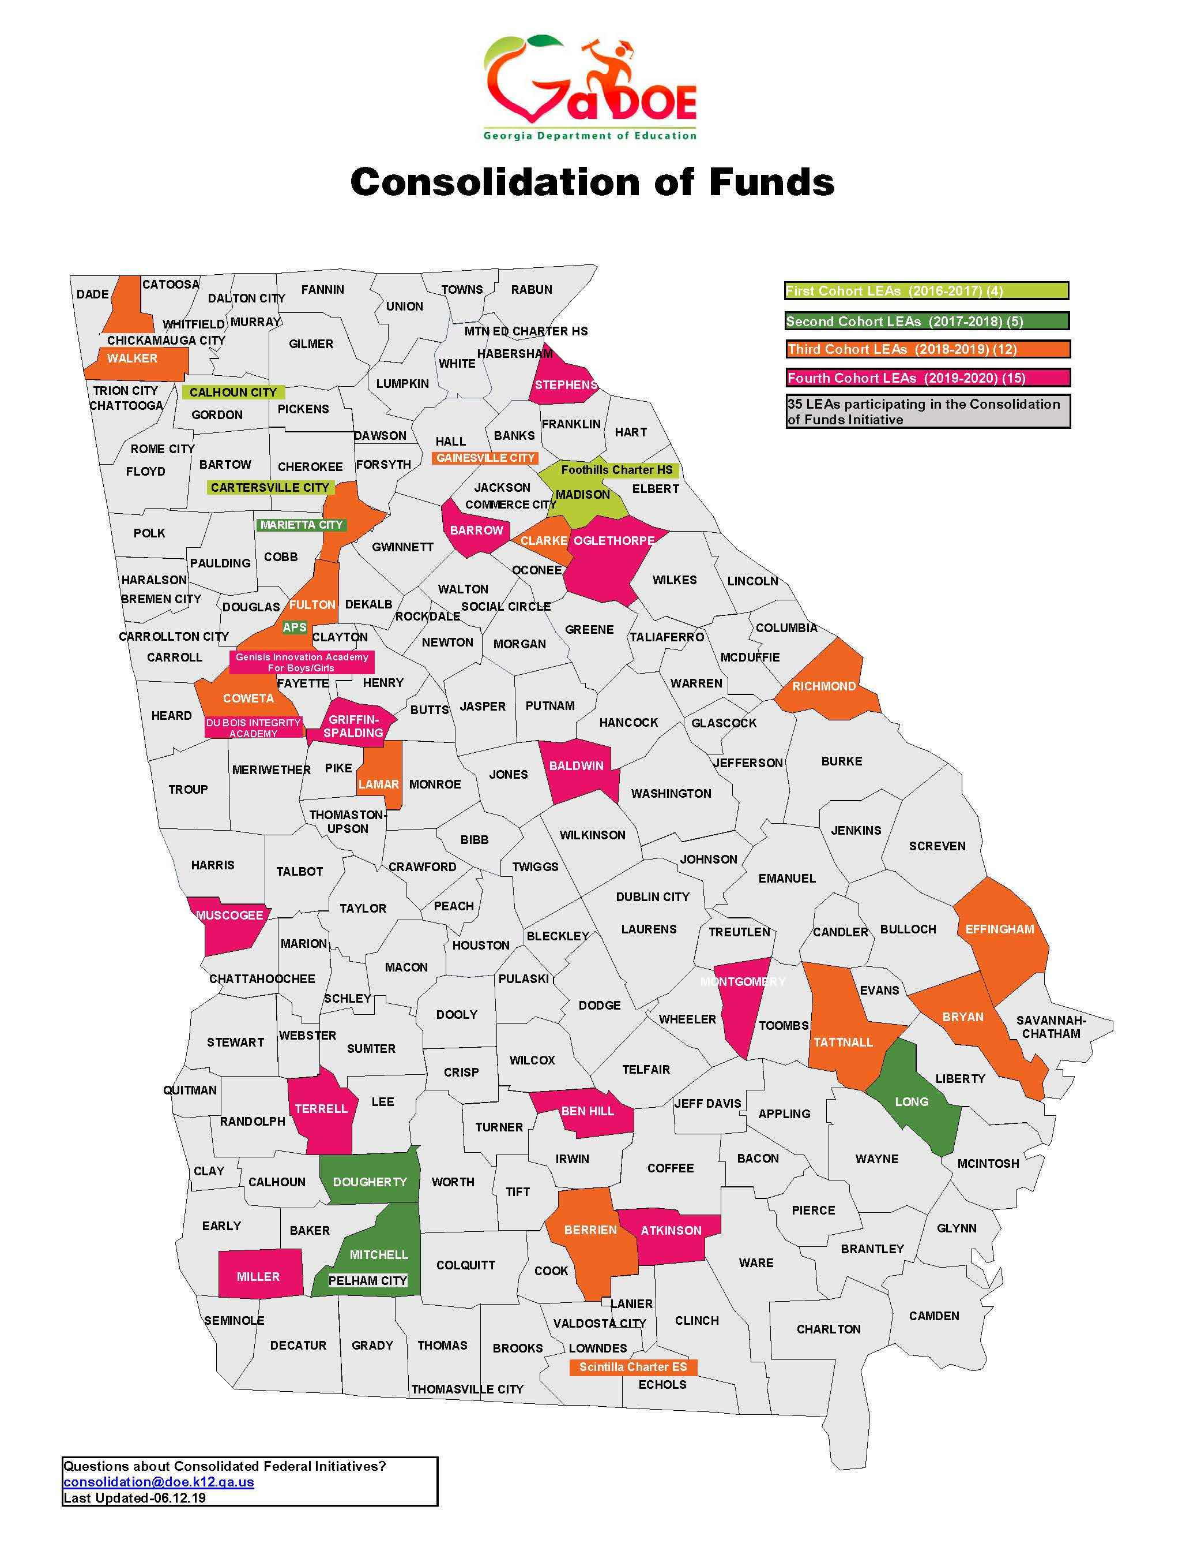
Consolidation of Funds Initiative
Interested?
If your district is interested in the Consolidation of Funds Initiative for FY21, please contact consolidation@doe.k12.ga.us to be included on our mailing list for virtual and in-person opportunities.
Already Involved?
Training opportunities will be announced via email and will be posted on the Consolidation of Funds webpage.

Slide 41
Consolidation of Funds Initiative
Consolidating Districts:
Must use placeholder 1000-881 for each program and school with the amount to be consolidated.
Must upload :
  A Schoolwide Plan for each school
    Naming Convention: “COF-SWP- Name of School or All Schools”
  An Intent and Purpose Statement for each school
  (Revised Form on Consolidation webpage)
    Naming Convention: “COF-I&P-Name of School or All Schools”
  A Fund 150 Budget for each school
    Naming Convention: “COF-150 Budget-Name of School or All Schools”
  Allocation Methodology – In Georgia, a District Level RAM/P
Questions?
  Refer to the Consolidation of Funds Manual, which is located on the Consolidation of Funds webpage, for additional information.
  Contact consolidation@doe.k12.ga.us
Notes:
Use COF attachment tab

Slide 42
FY20 Private Schools –
Equitable Services
Allocations
  Will be posted on the Ombudsman webpage following GaDOE July State Board of Education meeting
  Ensure private school allocations are labeled, present, and consistent in the budget process
Carryover –
  Obligation of Funds - Funds should be obligated by the LEA in the fiscal year for which the funds are received. (ESEA sections 1117(a)(4)(B) and 8501(a)(4)(B))
  There should be no carryover unless there are extenuating circumstances.
  Contact the State Ombudsman if you have unspent FY20 private school funds and need to request carryover for a private school(s). (ombudsman@doe.k12.ga.us)

Slide 43
Whom to ask?
Title I, Part A Managers and Area Specialists
Grants Program Manager and Specialists
Title I, Part C Manager and Regional Coordinators
Title II, Part A Manager and Program Specialists
Title III, Part A Manager and Program Specialists
IDEA Fiscal Manager and Specialists
Title IV, Part A Manager and Program Specialist
Title I, Part A School Improvement Grant Manager and Specialists
Family-School Partnership Manager and Specialists
State Ombudsman

Slide 44
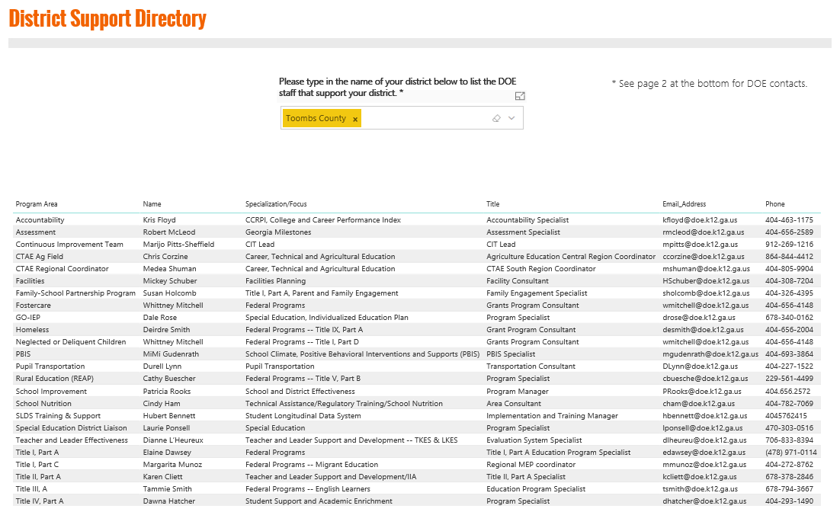
Transforming Our Agency
Where do we go to identify the GaDOE staff assigned to support our district?
gadoe.org/support

Slide 45
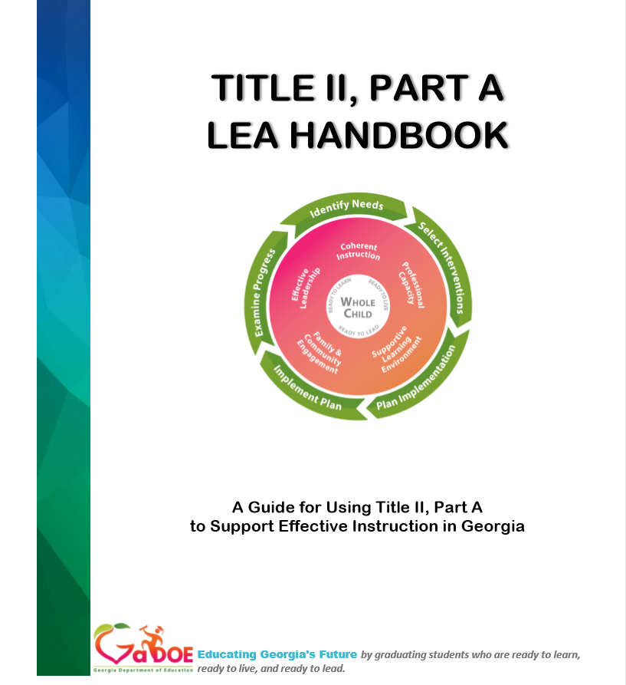



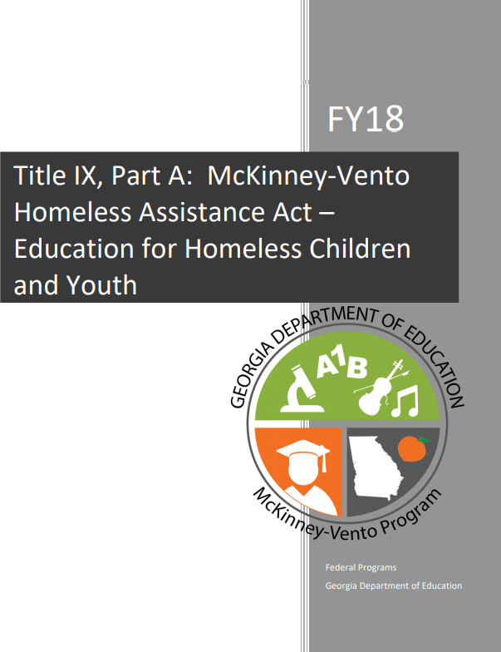

Federal Program Handbooks
Notes:
EB documentation to review during CFM; look at monitoring rubric; promising and logic model is looking for the logic model and how is it working?

Slide 46
Supplement Not Supplant

Slide 47
Supplement Not Supplant
Title I, Part A
Reminder: Supplement Not Supplant (SNS) is no longer determined at the school expenditure level for Title I, Part A
Supplemental activities are determined at the district level where there must be a methodology (RAM/P) that non-federal funds (state and local funds) are distributed to all schools across the district in a predetermined and equitable manner, so that federal funds have the opportunity to make a difference

Slide 48
Supplement Not Supplant
Title I, Part A
Ensures that the federal funds do not replace non-federal funds the school would otherwise receive if it were not operating a Title I program

Slide 49
Supplement Not Supplant
Equitable distribution of non-federal funds (state and local) requires that:
  Title I school funds can only supplement the amount of funds that would, in the absence of Title I funds, be available from non-federal sources including funds needed to provide services that are required by law for children with disabilities and English Learners ESEA Section 1118(b)(1)
  The basic funding of an LEA’s schools must be Title I neutral (without considering Title I funds)

Slide 50
What Is A Resource Allocation Methodology/Plan?
A Resource Allocation Methodology/Plan (RAM/P) is an individualized and a locally developed document that explains how an LEA plans to equitably allocate its state and local funds to operate all the schools in the district. For practicality, only expenditures that directly affect instructional practices in a school will be considered.
No federal funds should be included in these calculations in order to allow the LEA to demonstrate that it is meeting all supplement not supplant regulations regarding dispensing federal funds at the school level.

Slide 51
Why Are Resource Allocation Methodology/Plans So Important?
One condition of receiving Title I funds is that districts allocate state and local funds equitably to Title I and non-Title I schools BEFORE receiving and/or spending federal monies (Comparability & Supplement Not Supplant: Section 1118)
Under ESEA - LEAs are required to have a resource allocation methodology in place by July 1 of each year to meet Supplement Not Supplant regulations!

Slide 52
Updated Guidance on Resource Allocation Methodology/Plans
NEW
FY20 RAM/P IMPORTANT UPDATES Reminder:
  The United States Department of Education has released new non-regulatory guidance on Supplement not Supplant.
  One of the most notable changes answers the question, “Are there LEAs that, in whole or in part, do not need to have a methodology (RAM/P) to comply with ESEA section 1118(b)(2)?”

Slide 53
Updated Guidance on Resource Allocation Methodology/Plans
NEW
The answer is, “Yes” and will only apply in the following scenarios:
    An LEA need not have a RAM/P to comply with ESEA section 1118(b)(2) if it has—
      a. One school;
      b. Only Title I schools; or
A grade span that contains only: a single
school, non-Title I schools, or Title I
schools (i.e., no RAM/P is required for this
grade(span)
Notes:
One school : K-12 or charter school;
If all schools are Title I schools no RAM/P is needed

Slide 54
Updated Guidance on Resource Allocation Methodology/Plans
NEW
The Georgia Department of Education recommends the development of a RAM/P by all LEAs to efficiently monitor equitable funding at all schools and to facilitate the use of alternate comparability compliance.

Slide 55
Updated Guidance on Resource Allocation Methodology/Plans
NEW
Although select LEAs need not have a RAM/P to comply with ESEA section 1118(b)(2), it does not relieve the LEA of its requirement under ESEA section 1118(b)(1) and elsewhere to operate consistent with all federal, state and local requirements and to provide free public education, including for schools and grade spans meeting the conditions described above.

Slide 56
Updated Guidance on Resource Allocation Methodology/Plans
NEW
Please Note: If your LEA is consolidating funds (Fund 150), the LEA must still develop and implement a RAM/P even if any of the above scenarios exist. A RAM/P will help define which staff will receive Teaching & Experience (T&E) credit when funds are consolidated.
LEAs must attach the FY20 RAM/P to the General Attachments tab on the Consolidated Application by July 1st.

Slide 57
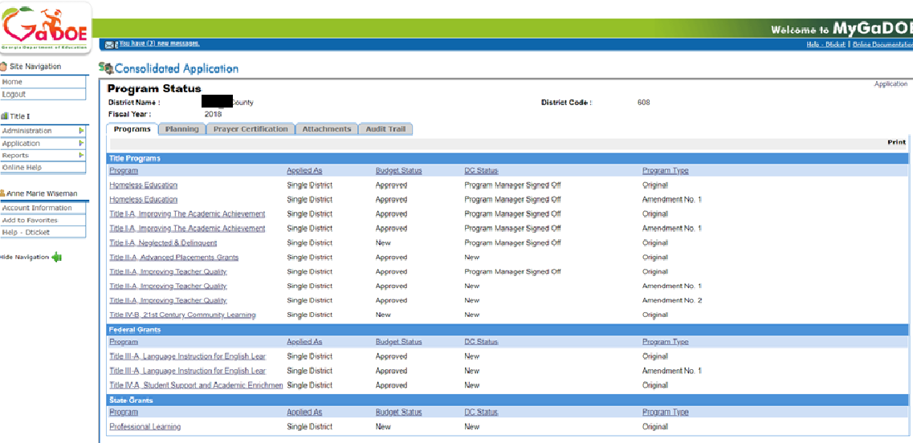
General Attachments Tab
Notes:
Talking Points:
Example of headings

Slide 58
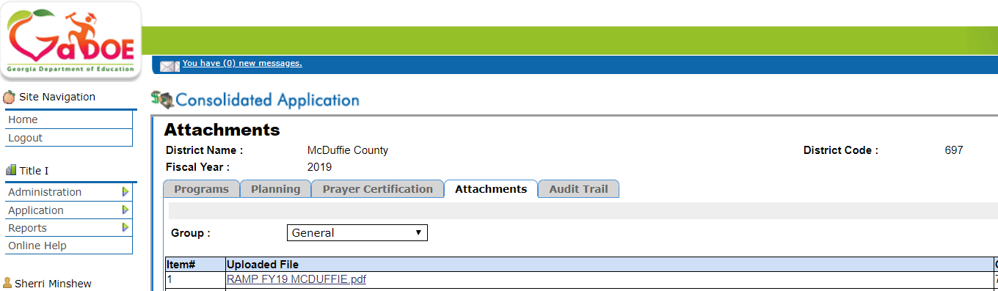
General Attachments Tab

Slide 59
Title I, Part A
Navigating the
Consolidated Application

Slide 60
Source of Budgeted Funds by Fiscal Year
The FY20 official allocation for the LEA will appear in the ConApp when each program is added
The FY20 allocation this year is made up from:
      FY20 Title I, Part A allocation
      Transferred funds from Title II or Title IV (if applicable)
      FY19 “LEA” Title I, Part A carryover amounts (will be added after Completion Reports are finalized-usually not until November)

Slide 61
Title I, Part A Carryover
LEAs may carry over up to 15% of unspent Title I funds from the prior year (85% of their Title I funds were spent)
FY19 carryover for Title I, Part A will be posted to the ConApp after the original FY20 budget is approved and the LEA has submitted the required Completion Report (after September 30th, but no later than October 31st)

Slide 62
Title I, Part A Carryover
For LEAs that have exceeded the 15-percent carryover limit and have not requested a carryover waiver within the last three years, a carryover waiver request may be completed, submitted, and approved by the Department
Carryover waiver requests are made using the worksheet located on the Federal Programs website. Submit this waiver/worksheet to Dr. Ken Banter (kbanter@doe.k12.ga.us)

Slide 63
Program Information - MOE
  Maintenance of Effort (MOE)
      An LEA must meet MOE per ESEA Sections 1118 and 8521
      Aggregate MOE for each fiscal year (FY17 and FY18) has been pre-populated
      Amount for the fiscal year ending June 30, 2018, must be 90-percent of amount for fiscal year ending June 30, 2017
      If the LEA fails to meet this requirement for one or more of the five immediately preceding fiscal years, allocation funds will be adjusted for all ESEA programs (Section 8521)
63

Slide 64
Program Information - MOE
  Maintenance of Effort (MOE)
      LEAs that did not meet MOE— the Department will request a waiver from US ED on each district’s behalf, if requested
          There is one district that did not meet MOE for FY20 (The district has been notified.)
          If the LEA fails to meet this requirement for one or more of the five immediately preceding fiscal years, its federal funds will be adjusted (Section 8521)
      An MOE waiver (located on the Title I website) is provided for charter schools that were not in existence during the comparison years
64

Slide 65
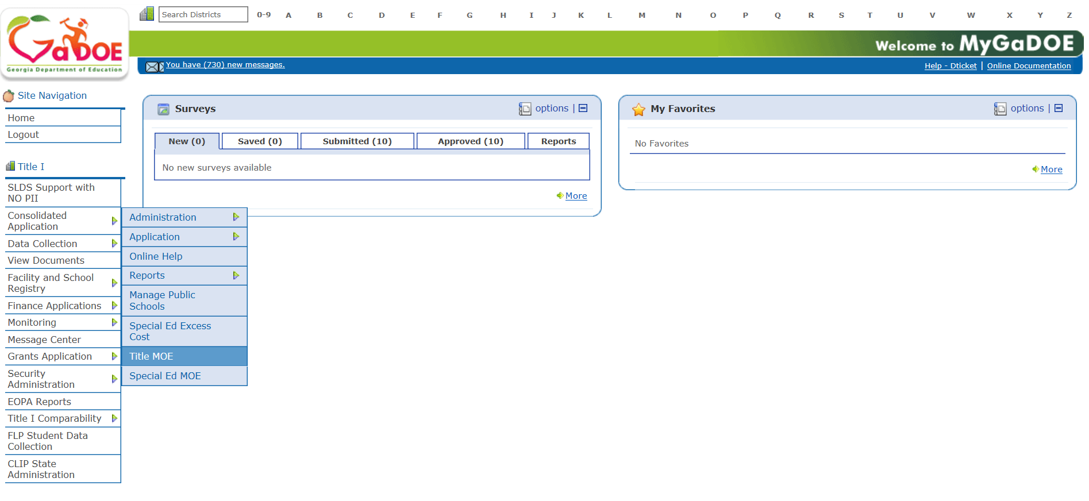
Program Information - MOE

Slide 66
Title I, Part A
Set-Asides

Slide 67
District Set-Asides
Set-asides are for district level activities only. These items/initiatives are budgeted first (before funds are allocated to Title I schools).
Some set-asides are required, and others are optional.
Activities that are included in the set-asides must be charged to the district’s facility code – for most districts this is 8010.
        Providing additional school level staff, technology, materials, and/or supplies to Title I schools should be through the school allocation and not district set- asides. Doing this could cause a school to be served out of rank order.

Slide 68
District Set-Asides
The set-aside page and the school allocation page link to one another, but they do not link to the budget detail pages.
The total amount of the set-asides plus the total amount allocated to schools from the school allocation tab must equal the district’s FY20 allocation.
There must be no unallocated funds.
If a required set-aside is not applicable, the set-aside must be listed, with zero dollars, and a statement must be included indicating why a set-aside is not applicable.
    Example: N&D Set-aside: There are no N&D programs or schools in the district. The district does not receive a set-aside.
68

Slide 69
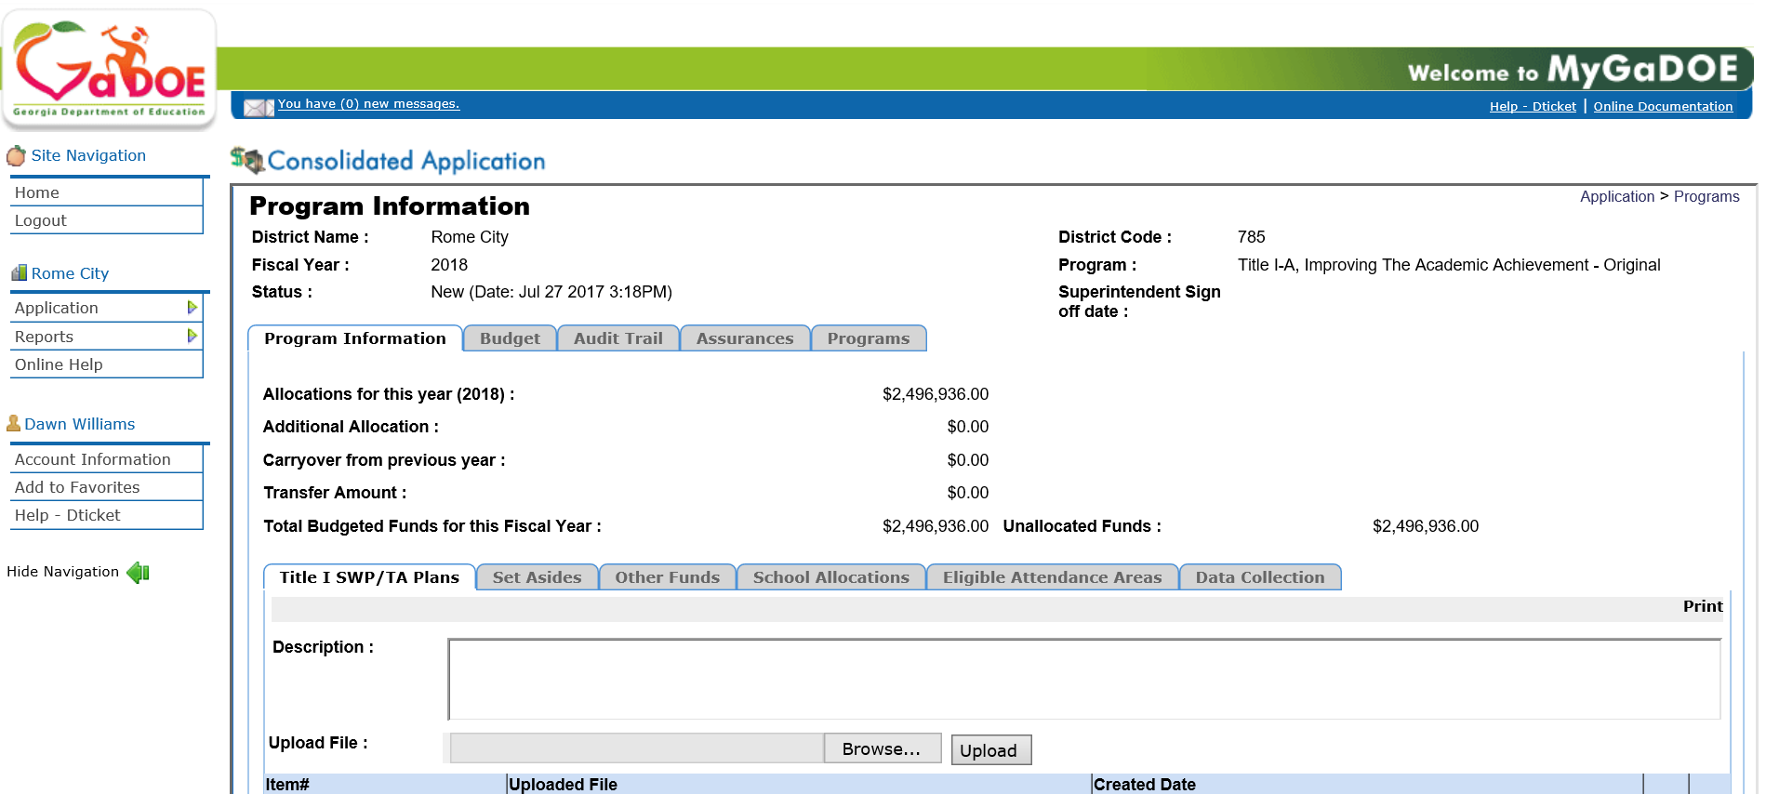
Set-Aside Tab

Slide 70
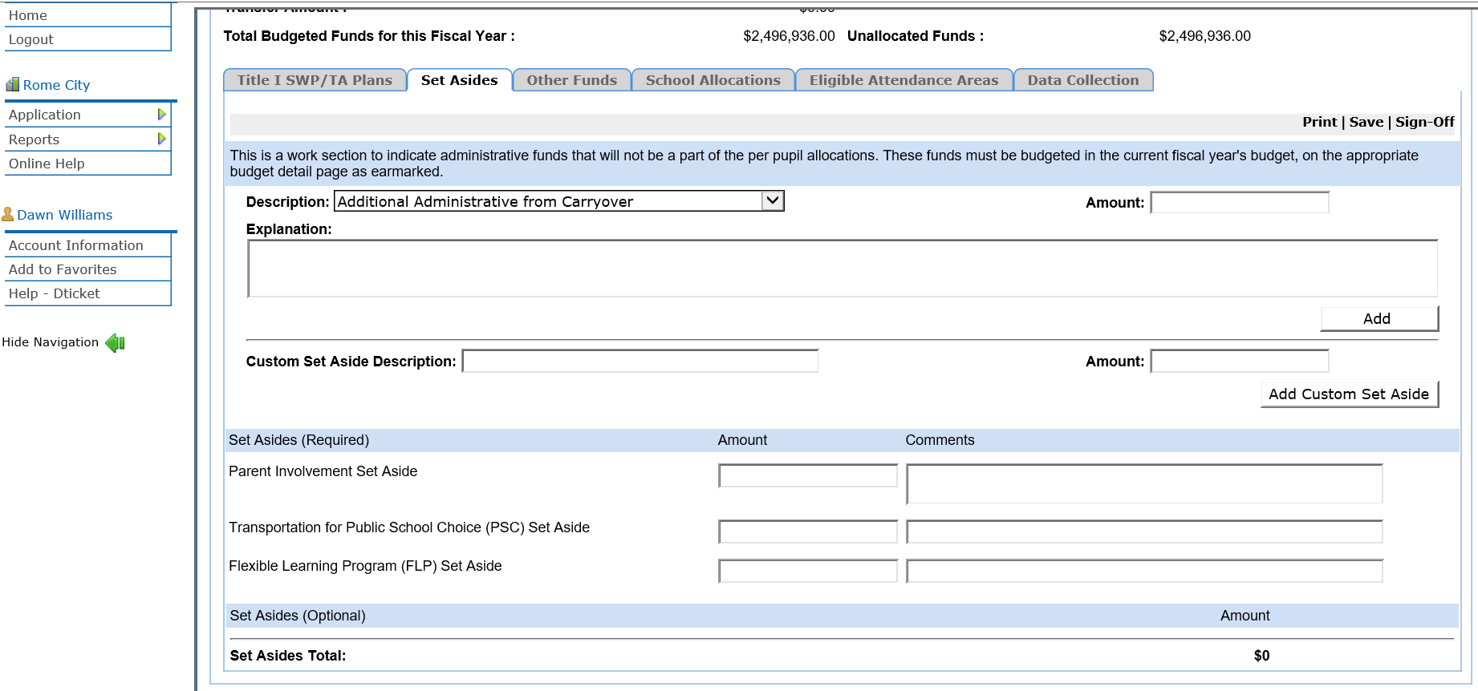
Set-Aside Tab

Slide 71
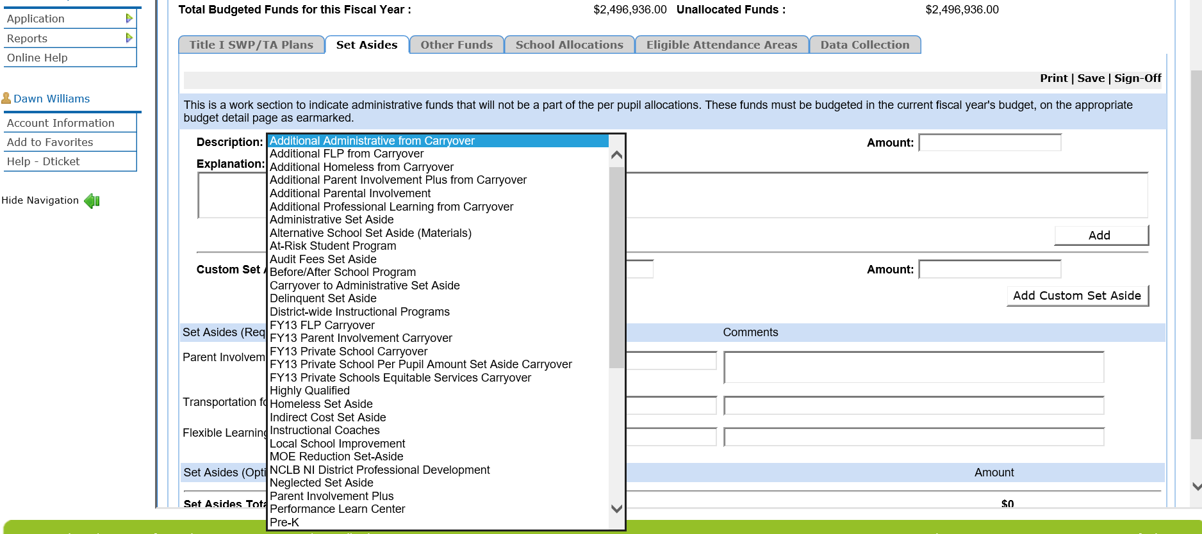
Set-Aside Tab
Notes:
Remind LEAs they can use their own verbiage. This list is from previous set-asides entered by an LEA.

Slide 72
District Set-Asides
Use the exact titles (all caps), below, to consistently name set-asides and add to the beginning of budget detail descriptions.
Required Set-asides:
  N&D Set-aside:
  Homeless Set-aside:
  1% Parent Involvement Set-aside:
  Private School Equitable Services Set-aside:
Optional Set-asides:
  Administrative Set-aside:
  Additional Parent and Family Engagement Set-aside:
  Parent and Family Engagement Carryover Set-aside:
  Indirect Cost Set-aside:
  Audit Cost Set-aside:
  Private School Equitable Services Carryover Set-aside:
  Extended Learning Set-Aside:
  Professional Learning Set-aside:
  School Improvement Initiatives Set-aside:
  Supplemental EL Language Support Set-aside:
  FOSTER CARE TRANSPORTATION SET-ASIDE:
  Consolidation of administrative funds set-aside:
Notes:
Use these exact titles for set-asides for sorting purposes.

Slide 73
Required District Set-Aside
  Neglected and Delinquent Children (N&D)
    The amount of the set-aside must be equal to or greater than the amount listed on the Department’s FY20 allocation sheet
    Services provided must be fully described
    Funds can support only those activities that lead to a Georgia high school diploma (not GED)
    Where appropriate, the set-aside is used to serve children in local institutions for delinquent children and to serve neglected or delinquent children in community day programs
73

Slide 74
Required District Set-Aside
Neglected and Delinquent Children (N&D)
  LEAs reporting neglected children on the annual N&D survey receive the Title I, Part A neglected reservation
  LEAs reporting delinquent children on the annual survey MAY receive the Title I, Part D, Subpart 2 allocation, if those LEAs reported delinquent numbers above the median of all reporting LEAs received the above allocation
  Those LEAs reporting delinquent numbers below the median are not eligible to receive the Title I, Part D, Subpart 2 allocation
74

Slide 75
Required District Set-Aside
Homeless
  Four possible methods to calculate the homeless set-aside:
    Identify homeless student needs and fund accordingly
    Obtain a count of homeless students and multiply by the district’s Title I, Part A per-pupil allocation (PPA)
    Reserve an amount greater than or equal to the district’s McKinney-Vento subgrant request
    Reserve a specific percentage of the district’s poverty level or its Title I, Part A allocation
  Copy the exact words above and paste into the description beside the required district set-aside for homeless
75

Slide 76
Required District Set-Aside
Homeless
  The GaDOE homeless coordinator must review the homeless set-aside prior to budget approval. Federal Program Directors should:
    Explain the method used to determine the set-aside amount and show the calculation in the Consolidated Application set-aside description
    Set-aside funds may be used to assist homeless students in all LEA schools
76

Slide 77
Required District Set-Aside
Homeless
  LEAs have the discretion to use set-aside funds to provide homeless students with services that are not ordinarily provided to other Title I students and that are not available from other sources
  In determining appropriate expenditures for the funds set-aside for homeless students, it is important to note that comparable services may not necessarily mean services that are identical to the services provided to non-homeless students (i.e. uniforms, expedited evaluations, eye glasses, transportation)
77

Slide 78
Required District Set-Asides
1% Parent and Family Engagement Set-Aside
  A district with a Title I, Part A allocation greater than $500,000 must reserve at least one percent of its allocation for parent and family engagement activities.
  If a transferability option is utilized, the 1% Parent and Family Engagement set-aside must be recalculated to reflect the increase in the Title I budget if the total amount with transferred funds exceed $500,000.

Slide 79
Required District Set-Asides
1% Parent and Family Engagement
  At least 90 percent of the required one percent set-aside must be distributed among the district’s Title I schools unless a school or all schools in the district decide to use their share of the reservation to support a district-level activity for parents
  If a school or all schools decide to give their share to support a districtwide activity the Districtwide Parent Activity-Project Assurance form, signed by each participating principal, must be attached to the Title I Attachments tab of the Consolidated Application

Slide 80
Required District Set-Asides
1% Parent and Family Engagement
  If 90 percent of the total one percent required set-aside is being distributed among Title I schools, the amount distributed for each school should be indicated in the Parent Involvement column on the School Allocation page
  This column should only include parent and family engagement funds that are distributed from the required one percent set-aside. Any additional parent and family engagement set-aside funds, or the parent and family engagement funds that schools use as part of their school allocation, should not be included in this column
Notes:
The column on school allocation page should total the 1% required PFE set-aside

Slide 81
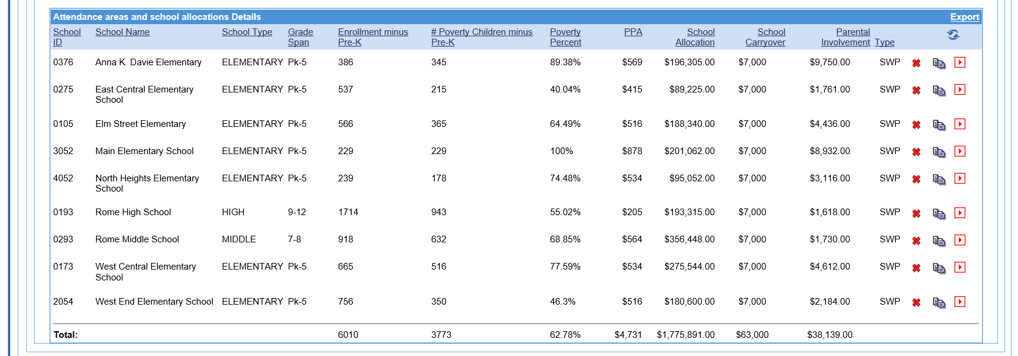
1% Parent and Family Engagement
Notes:
The column on school allocation page should total the 1% required PFE set-aside

Slide 82
Required District Set-Asides
1% Parent and Family Engagement
  The portion of the one percent required set-aside for parent and family engagement not expended at the end of the previous year (FY19) must be carried over to the present fiscal year (FY20) and added as a custom optional set-aside entitled Parent and Family Engagement Carryover Set-Aside (see next slide).

Slide 83
Required District Set-Asides
1% Parent and Family Engagement
  A custom optional set-aside entitled, Parent and Family Engagement Carryover Set-Aside, must be created. The amount and description must reflect one of the following situations:
    100% of required parent and family engagement set-aside was expended. (Enter $0 for the amount of the set-aside).
    The Parent and Family Engagement Carryover amount of $_____ will be budgeted as a carryover amendment with zero dollars budgeted at this time.
Keep documentation (expenditure details) of the calculation for carryover on file for monitoring
Notes:
Stress at regional meeting this is the exact verbiage to use

Slide 84
Required District Set-Asides
1% Parent and Family Engagement
  If the LEA sets aside more than the required one percent for parent and family engagement, the additional funds should be listed as a separate set-aside with an explanation of the additional initiatives to be funded. This set-aside is entitled: Additional Parent and Family Engagement Set-Aside.
  Parent and family engagement district set-aside expenditures should be budgeted in function code 2100 and expended at the district level (8010).
  Reminder: Parent and family engagement funds being budgeted as a part of the school’s allocation must be budgeted in 2100 and charged to the school’s facility code.

Slide 85
Required District Set-Asides
Private School Equitable Services Set-Aside
  Use the FY20 Title I Private School Proportionate Share Calculation Spreadsheet to assist in writing the description. (see next slide for data to be used for description)
  Set-aside description includes the breakdown for the total proportionate share for EACH participating private school to include Parent and Family Engagement, Administrative costs (optional) and Instructional/Professional Development

Slide 86
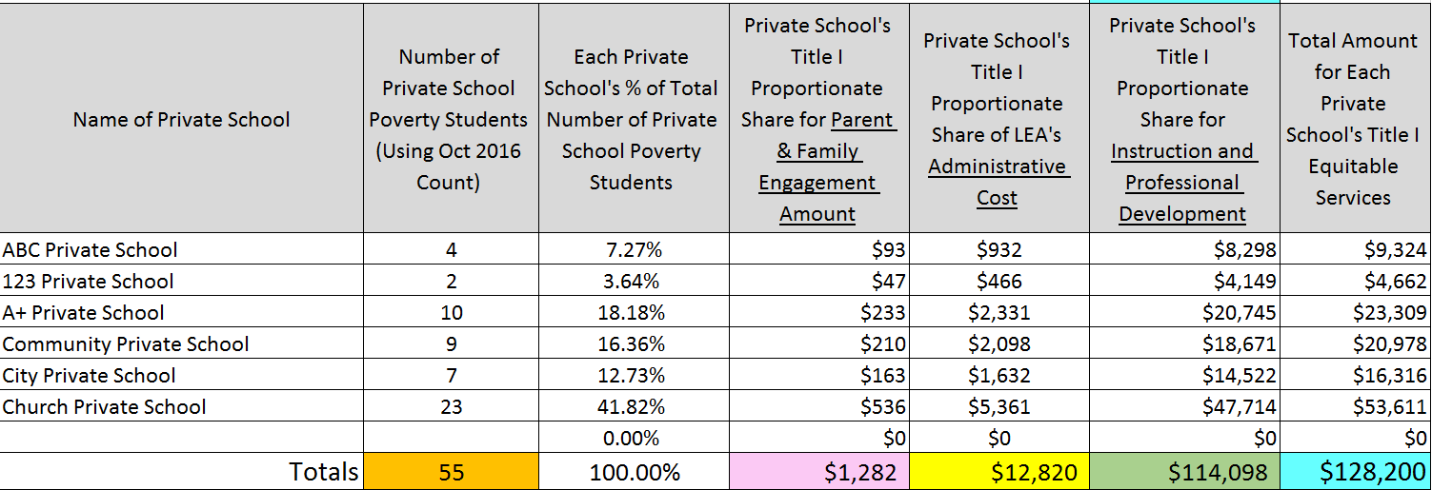
FY20 GaDOE Title I Private School
Proportionate Share Calculation Worksheet
Notes:
The exact total at the bottom of the column is what should appear in the budget description

Slide 87
Required District Set-Asides
Private School Equitable Services Set-Aside
  If funds are transferred, the private school proportionate share amounts must be recalculated to reflect the new allocation.
  If funds are transferred, a revised FY20 Title I Private School Proportionate Share Calculation Spreadsheet must be attached.
  No private school per pupil set-aside is calculated.

Slide 88
Optional Districtwide Set-Asides
Administrative Set-Asides
  All administrative expenditures should be charged to function code 2230 in the budget detail and should not exceed 10% of total allocation. If this set-aside exceeds the 10% threshold, a justification statement must be approved by your area specialist and attached to the Title I Attachment tab.
Audit Cost Set-Aside
  Charged to function code 2300 and object code 300
88

Slide 89
Optional Districtwide Set-Asides
Indirect Costs Set-Aside
  Must use the approved restricted indirect cost rate for the district
  Use embedded worksheet for Title I, Part A on the Data Collection tab
  Both the Title I director and the superintendent must sign off on the Data Collection tab. Area specialists will follow-up with approval sign-off.
  Should be charged to function code 2300, object code 880 in the budget
  May only be drawn down at the same percentage of actual Title I expenditures
89
Notes:
Stress the bottom bullet; get an example on here before regional meetings

Slide 90
Optional Districtwide Set-Asides
Extended Learning Set-Aside
  Examples: Districtwide summer school, before/after school tutoring, Saturday school.
  The description for these set-asides must specifically state that the set-aside is a districtwide or grade span supplemental initiative in Title I schools, not an activity for a selected number of schools. The district must indicate that summer school activities are beyond those that are required by local boards of education and/or the state.
90

Slide 91
Optional Districtwide Set-Asides
Extended Learning Set-aside
  When budgeting these activities, break down the expenditures by summer school, before/after school tutoring, etc.
  Charge a district employee with object code 199 in the budget detail
  Charge a contracted person object code 300 in the budget detail
  Charges should be made to facility code 8010 as with all district set-asides
  Maintain appropriate documentation of time and service provided
91

Slide 92
Optional Districtwide Set-Asides
Professional Learning Set-Aside
  Districtwide academic coaches, trainings, PLCs
    The description should specifically describe any districtwide or grade span supplemental professional learning initiative, NOT an activity for a selected number of schools.
    Districtwide academic coaches cannot serve individual schools. These individuals must serve district (or at a minimum grade span) schools throughout the district.
92

Slide 93
Optional Districtwide Set-Asides
Professional Learning Set-Aside
  Districtwide academic coaches, trainings, PLCs
    Maintain appropriate documentation of time and service provided
    Charges should be made to facility code 8010 as with all district set-asides
    Charge a district employee to object code 199 in the budget detail
    Charge a contracted person to object code 300 in the budget detail
93

Slide 94
Optional Districtwide Set-Asides
Additional Parent and Family Engagement Set-Aside Reminder
  If the LEA sets aside more than the required one percent for parent and family engagement, the additional funds should be described as a separate set-aside with an explanation of initiatives to be funded.
94

Slide 95
Optional Districtwide Set-Asides
Private School Equitable Services Carryover Set-aside
  Must be approved by Ombudsman for extenuating circumstances
  Approval is attached to Title I Attachment tab
School Improvement Initiative Set-aside
  Must be a district-wide initiative
95

Slide 96
Optional Districtwide Set-Asides
Supplemental Language Support for EL Students Set-aside
  Describe the Title I supplemental language support program that is beyond the general instructional and ESOL programs
Other Optional Set-asides
  Must be a district-wide initiative
  Discuss with area specialist for guidance
96

Slide 97
Optional Districtwide Set-Asides
Foster Care Transportation Set-Aside
  The Title I, Part A Foster Care Education requirements under the Every Student Succeeds Act (ESEA has no corresponding budget; however, because the requirements fall under Title I Part A, any proposed activities that require funding could come from Title I, Part A)
  If an LEA desires to use a portion of the Title I, Part A allocation to supplement academic activities, then the LEA should:
    Consult with the Title I area specialist
    Develop a rational method to determine reasonable amount
    Create a Foster Care Transportation Set-aside
97

Slide 98
Optional Districtwide Set-Asides
Consolidation of Administrative Funds Set-Asides
Use function code 2300 and object code 882 to report the amount of Title I, Part A that is being contributed into the Consolidation of Administrative Funds.
For example, if the LEA plans to consolidate $50,000 of Title I, Part A funds for federal administrative costs, the budget for Title I, Part A will include the following line item:
2230-882 - $50,000 to the consolidation fund 150
98

Slide 99
Title I, Part A
Eligible Attendance Area

Slide 100
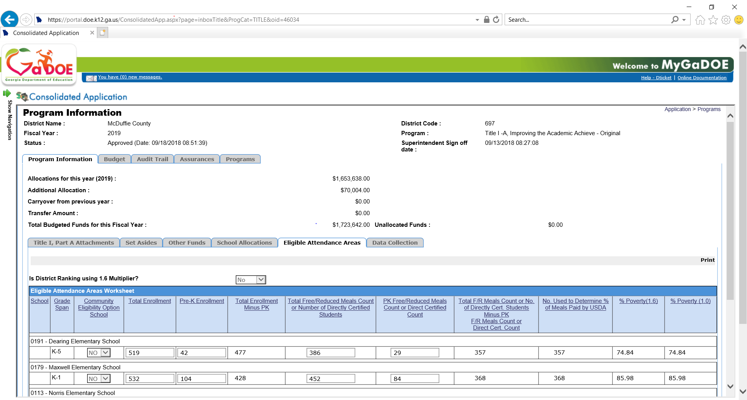
Eligible Attendance Areas

Slide 101
What is the Eligible Attendance Area Tab?
Purpose is to determine the rank order of schools
  Enrollment data is pre-populated into an embedded Eligible Attendance Area worksheet within the ConApp, but check for accuracy
  Pre-kindergarten enrollment and poverty data will need to be entered on the embedded worksheet
  Adjustments can be made to the pre-populated enrollment numbers for districts that have rezoned, added, or closed schools
  Poverty data must be entered by the LEA using documentation from the School Nutrition Program Director or FTE/SIS Clerk. This documentation must be attached to the ConApp.
  (Please use the Title I Specific Attachment Tab)

Slide 102
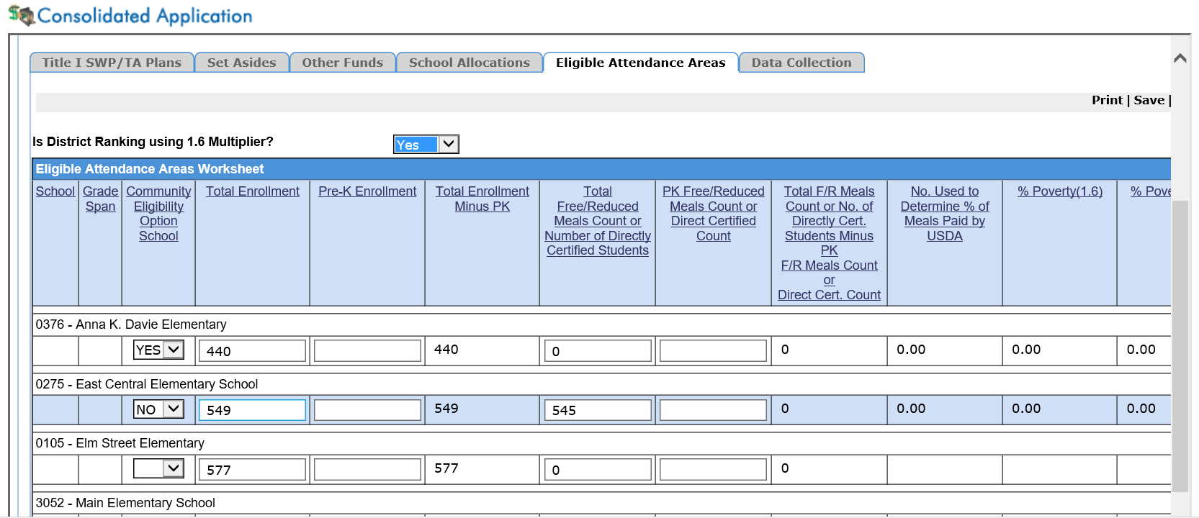
Eligible Attendance Areas

Slide 103
How to Complete the Eligible Attendance Area Embedded Worksheet
Data needed for Attendance Area Worksheet:
  List of all schools to include district charter schools, residential treatment facilities and virtual schools
  Enrollment numbers
  Poverty numbers
    Household Application/Free or Reduced Meal data
    Directly Certified Data (Title I Data - CEP SY19-20 form)
    Whichever form you use, attach to the ConApp
(Please use the Title I Specific Attachment Tab)

Slide 104
Eligible Attendance Area - Continued
To Locate Enrollment Data for All Districts
  Go to https://app3.doe.k12.ga.us/owsbin/owa/fte_pack_enrollgrade.entry_form
  From the pull-down menu, choose October 2, 2018
  (FTE 2019-1)
  Select your district from the drop-down box, then select
  Get Report
  This report shows the district enrollment by school and grade for the FY19 school year
  Verify the enrollment data for each grade with the pre-populated data on the embedded Eligible Attendance Area worksheet within the ConApp
  Be sure to subtract the Pre-K enrollment numbers

Slide 105
Eligible Attendance Area - Continued
FRM lunch data is no longer published for district/public access
Obtain the FRM report from LEA nutrition department or contact your area specialist for specific poverty information and attach to the ConApp
The number of Pre-K students qualifying for FRMs at each school is entered on the Eligible Attendance Area worksheet and is automatically subtracted from the total number of students eligible for FRMs at the school

Slide 106
Eligible Attendance Area- Continued
To locate Direct Certification Poverty Data for districts using Community Eligibility Provision (CEP)
  The district Title I coordinator must secure the count of direct certified (SNAP or TANF) students for each participating CEP school in the district from the district school nutrition program director (See following slide for form)
  The district Title I coordinator must also secure the October 2018 count of direct certified Pre-K students
106

Slide 107
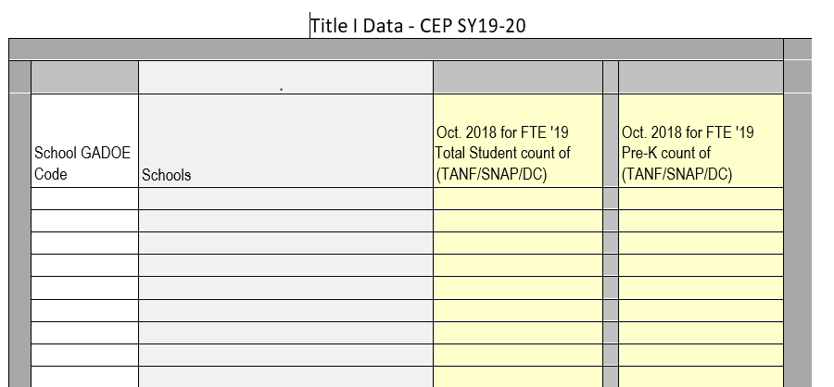
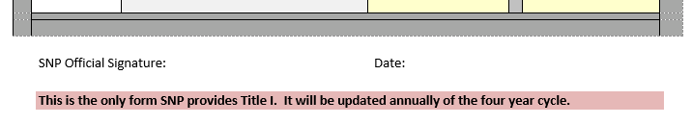
Eligible Attendance Area – (CEP)
Should be total Poverty including Pre-K
** The numbers entered for Direct Certified Students must match the numbers on the Title I Data – CEP SY19-20 provided and signed by the school nutrition director. This report is uploaded to the Title I Attachments tab.

Slide 108
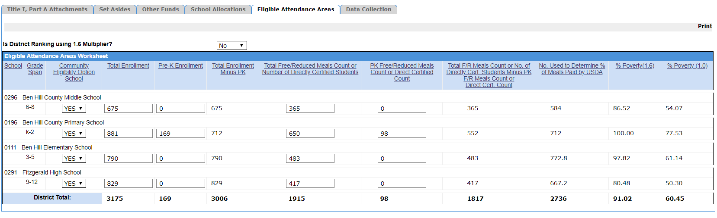
Eligible Attendance Area
Embedded Worksheet

Slide 109
Eligible Attendance Area - Continued
Rezoning/Opening New School
  When rezoning or the opening of a new school occurs in an LEA:
    The LEA must track each student from the “old” school using the enrollment data (Oct. 2, 2018 FTE Count) and poverty data (FRM from Oct. 2018 to the student’s “new” school
    Or
    Wait and use the FY20 Oct. FTE count (Oct. 1, 2019 and FY20 FRM data (Oct. 2019)
  Attach supporting documentation for such changes to the Title I Attachment tab:
    Narrative explaining the rezoning process
      Eligible Attendance Area Worksheet indicating changes
      CEP Data Form for Title I
      Supporting documentation is attached to the Title I Attachment tab
      Seek assistance from area specialist and the handbook for detailed instructions

Slide 110
Eligible Attendance Area
Rezoning and CEP
  As with schools using FRM data, when rezoning or the opening of a new school occurs in an LEA, the LEA must ensure that the direct certified FRM data reported for the schools is accurate
  The School Nutrition office at the GaDOE has developed a mechanism to assist LEAs that are rezoning schools or opening new schools. LEAs that are rezoning schools or opening new schools should consult with their LEA School Nutrition office to receive updated data for CEP.
110

Slide 111
Eligible Attendance Area Worksheet
Rezoning and CEP
    Attach supporting documentation to the Title I Attachment tab for such changes:
      Narrative explaining the re-zoning process
      Eligible Attendance Area Worksheet indicating changes must be attached
      Revised CEP Data Form for Title I
111

Slide 112
Title I, Part A
School Allocations

Slide 113
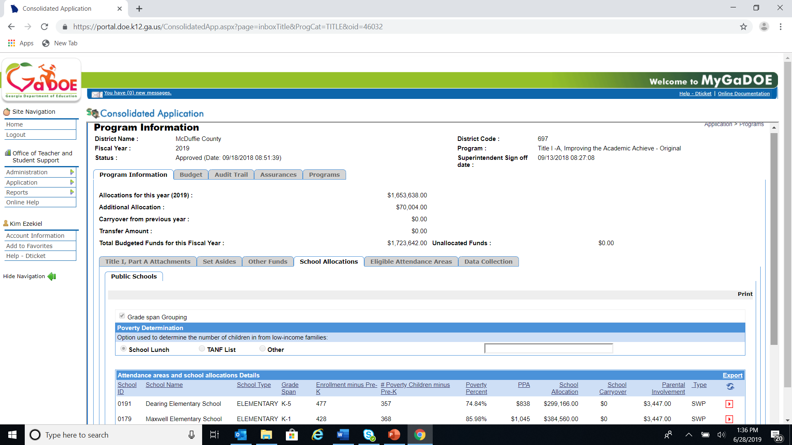
School Allocations Tab

Slide 114
School Allocations Tab
  Grade Span Grouping (Check if Applicable)
  Poverty Determination
      Check the box that applies:
        School Lunch
        Temporary Assistance to Needy Families (TANF)
        Other
      If the LEA is using the Community Eligibility Provision (CEP) option and/or free and reduced meal (FRM), select the box for School Lunch
114

Slide 115
School Allocations Tab

Slide 116
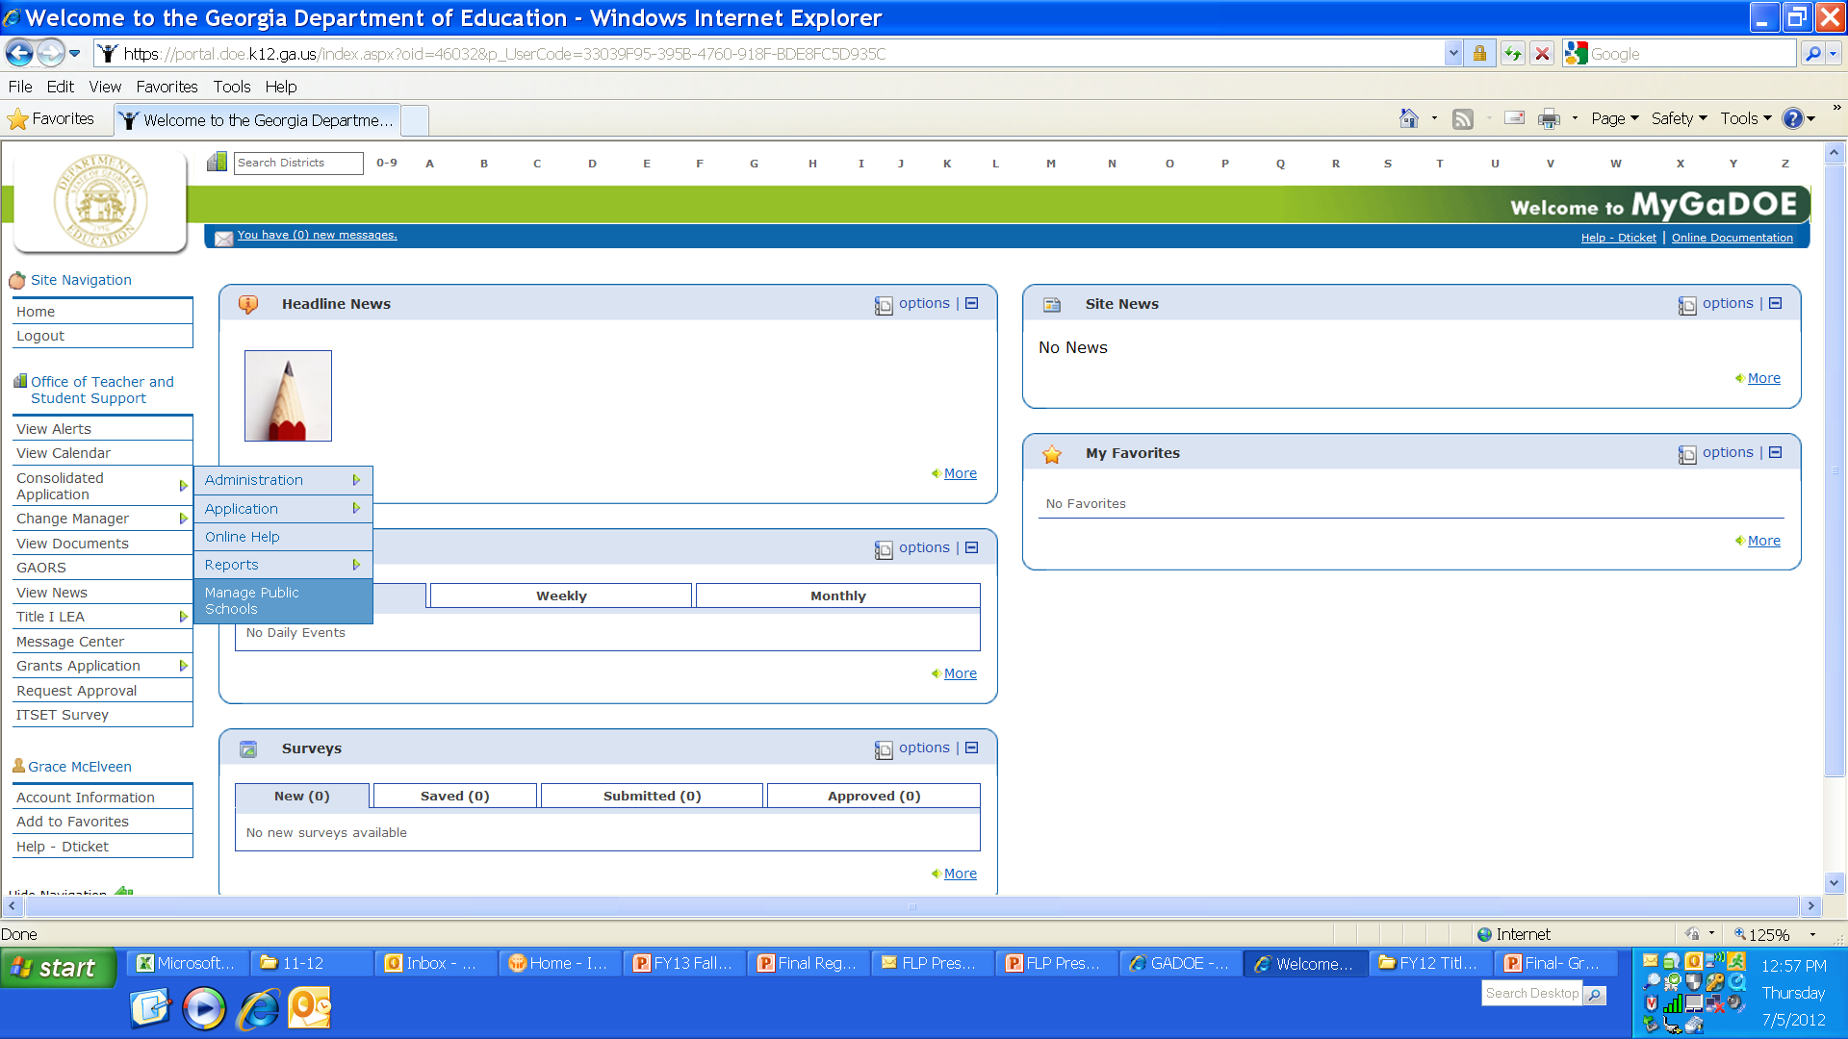
Public School Allocations
Must list all schools, public, district charter schools, N&D programs, residential treatment facilities and virtual schools operating as a school
Manage Public Schools page
116

Slide 117
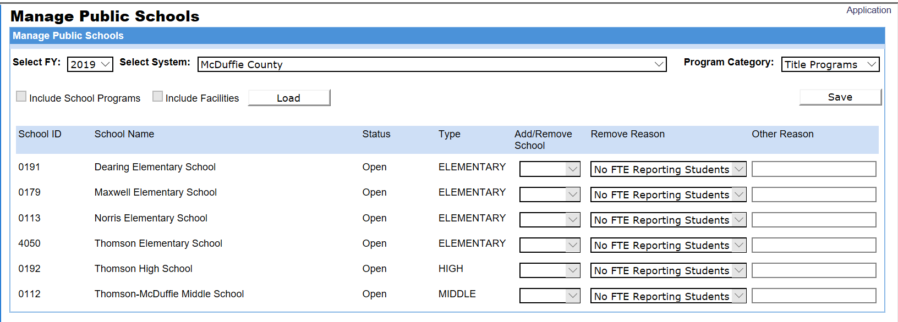
Managing Public Schools Page

Slide 118
Public School Allocations
School Type: Indicate elementary, middle, high or other (N/D or Alternative Program)
Grade Span: Check for actual grades in the school
(should not include pre-kindergarten)
Enrollment: For each public school, residential treatment facility and virtual school operating as a school, or attendance area, verify the total number of children enrolled in public school (grades K-12)
  The number of children enrolled in N&D programs should be zero
Number poverty children: number of children enrolled from low-income families
  The number of poverty children for N&D programs should be zero
118

Slide 119
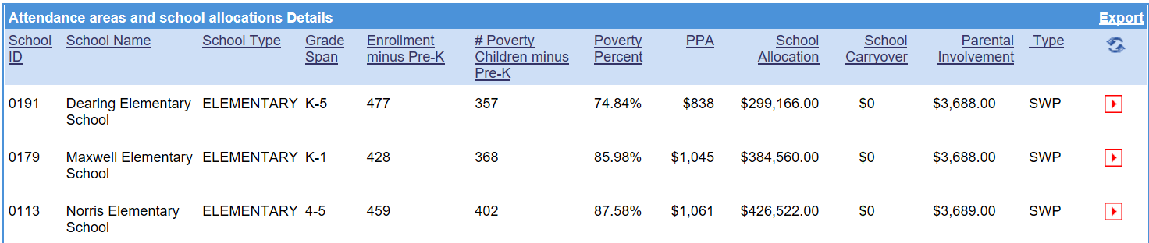
School Allocations Tab - Example

Slide 120
Public School Allocations
Per-Pupil Amount (PPA)
Must allocate funds to schools in rank order or rank order
by grade span grouping
Schools above 75-percent poverty must be ranked and served first, even if grade span grouping
ESSA Section 1113(a)(3)(B) - LEAs MAY serve high schools above 50% poverty as part of the above stated 75% threshold grouping
All attendance areas with 35-percent or greater poverty
or which are above the average poverty for the district may be served
Must indicate amount allocated per poverty child
Re-check the poverty percentage and rank order to verify that no schools were skipped
120

Slide 121
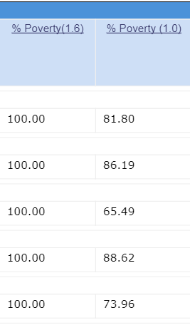
Public School Allocations
Rank order option for schools using CEP that have poverty rates at 100%
The district may group these schools as a separate “grade span” and use the 1.0 percentage of poverty prior to determine rank order within this group alone
3
2
5
1
4

Slide 122
125-Percent Rule
If schools with less than 35-percent poverty are served, calculate participating school allocation:
District allocation divided by number of low-income children in the district times 125-percent. The district must allocate at least this amount per low-income child in every school being served.
Formula
District Allocation ÷ Total District Free/Reduced Count
=
Per Pupil Amount X 1.25 = Minimum Per Pupil Amount
122

Slide 123
Public School Allocations
Type: List schools as Schoolwide Program (SWP) or Targeted Assistance (TA) Program if receiving Title I funds, or N&D programs. All non-Title I schools in the district are listed as None (accuracy is very important).
  Schools listed as SWP must have been SWP prior to FY19 or have an approval letter from the Title Programs Division on file at the district
  THIS PORTION OF THE SCHOOL ALLOCATION TAB MUST BE COMPLETED (NOT NECESSARILY SUBMITTED) NO LATER THAN SEPTEMBER 15, 2019
Staff: The number of staff paid with Title I funds (reported in whole numbers, not fractions or FTE) should match budget detail. The Other staff column are school-level staff other than teachers or paraprofessionals. Other positions must be defined in the budget. Job descriptions may be requested to be attached to the ConApp (the Title I Attachment tab) for clarification. Do not include unfilled positions at this time. Make adjustments when filled via an amendment.
123

Slide 124
Public School Allocations
Estimated Participants
TA – estimated number served in reading and/or mathematics
SWP – must serve both reading and mathematics; number of participants must equal total school enrollment minus pre-kindergarten
N&D programs – estimated number served in reading and/or mathematics
Special Note:
Schools may serve subjects other than reading and math with Title I funds. Our requirements only include reporting reading and math. Any subject served must be identified in the District/School CNA and Improvement Plan(s).
124

Slide 125
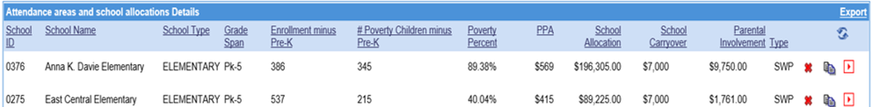
Application Tools
May sort all column headings within the application. Click once to sort in ascending order, click twice to sort in descending order
Sort order cannot be saved or printed in that format. The program returns to the default sort order when you leave the School Allocations tab
School Allocation pages can be exported to Excel allowing for filters and/or sorting
125

Slide 126
Title I, Part A
Budgeting Details

Slide 127
Budget Details
All budgeted items must be based on a comprehensive needs assessment and be adequately addressed in the CLIP and School Level Plans (SWP, TA or SIP)
    Schools’ identified needs and their plans drive the budget
    LEAs and their Title I schools must be able to justify that all expenditures are directly related to the needs assessment
    The plans/budget must include a viable instructional program for each Title I school being served
127
Notes:
Clarify viable program: Instruction, PFE, and PL

Slide 128
Budget Details
All costs must be:
  Allowable, allocable, reasonable & necessary
    Supplement Not Supplant addressed via RAM/P
  Conform with grant terms
  Legal under federal, state and local law; be consistent with federal, state, and local policies and procedures that apply to the grant
  Consistently treated concerning identification as a direct or indirect cost; cannot charge direct costs to a program if similar charges are indirect under state programs
  In accordance with Generally Accepted Accounting Principles (GAAP)
  Not used to meet cost sharing or matching requirements of any other grant program
  Adequately documented
128

Slide 129
Budget Details
Costs Must be Necessary and Reasonable
  Must be necessary for the performance or administration of the grant or follow sound business practices
  Fair market prices
  Act with prudence under the circumstances
  No significant deviation from established prices
  An identified need and written in plans
  Practical aspects of necessary
    Do I really need this?
    Is this the minimum amount I need to spend to meet my need?
  Practical aspects of reasonable
    Do I have the capacity to use what I am purchasing?
    Did I pay a fair rate?
    If I were asked to defend this purchase, would I be comfortable?
129

Slide 130
Budget Details
Questionable expenditures may need further explanation during the approval process
Evidenced-based initiatives ONLY
LEAs requesting to use Title I funds for field trips must submit an Educational Field Trip Budget Approval form to the LEA’s Title I area specialist for approval prior to budgeting the field trip. The approval form must be attached to the Title I Attachment tab.
There should be no un-budgeted funds
The Budget Detail pages are not linked back to either the Set-Asides tab or the School Allocations tab

Slide 131
Budget Details
Be sure that the correct amount for each set-aside appears and is clearly labeled in the budget along with the appropriate function and object codes
Do not budget items for capital expense (object code 700) unless prior approval has been obtained from a
Title I program manager
  A copy of the prior approval communication from the GaDOE (Title I program manager) must be attached to the Title I Attachment tab
131
Notes:
Check spacing

Slide 132
Budget Details
Districts have the option to budget expenditures by individual schools or by combining schools by grade spans for one-line item. However, it should be evident in the budget detail how the funds are to be used and at which school(s).
Districts that combine schools together in detailed expenditure entries should provide one of the following:
  Very detailed descriptions delineating each school’s amount
  A copy of each school’s budget attached to the Title I Attachment tab
132

Slide 133
Budget Details
Title I employee benefits may be combined into a single line item rather than being entered separately for every category and function
  Benefits would be combined and listed under Object Code 200
  Budget separately by function 1000, 2210, 2213, 2230, etc.
  Each function entry must list the specific benefits included (i.e. FICA, TRS, state health, dental, vision, life insurance)
  LEA must break out these expenditures in their detailed expenditure reports to verify amounts budgeted for monitoring and/or auditing purposes
133

Slide 134
Budget Details
Clearly identify each set-aside at the beginning of the description in the budget detail
Adequate examples:
N&D SET-ASIDE: After school tutoring for the children at Flowering Branch Children’s Shelter
Professional Learning set-aside: Differentiated Instruction training for all the Title I district’s schools
Private School Equitable Services Set-aside: St. James: After school tutoring
Inadequate examples:
After school tutoring
Homeless transportation
134

Slide 135
Budget Details
Use the exact titles (all caps) below to consistently name set-asides and add to beginning of budget detail descriptions.
Required Set-asides:
  N&D Set-aside:
  Homeless Set-aside:
  1% Parent Involvement Set-aside:
  Private School Equitable Services Set-aside:
Optional Set-asides:
  Administrative Set-aside:
  Additional Parent and Family Engagement Set-aside:
  Parent and Family Engagement Carryover Set-aside:
  Indirect Cost Set-aside:
  Audit Cost Set-aside:
  Private School Equitable Services Carryover Set-aside:
  Extended Learning Set-Aside:
  Professional Learning Set-aside:
  School Improvement Initiatives Set-aside:
  Supplemental EL Language Support Set-aside:
  FOSTER CARE TRANSPORTATION SET-ASIDE:
  Consolidation of administrative funds set-aside:
Notes:
Use these exact titles for set-asides for sorting purposes.

Slide 136
Budget Details
  All budget descriptions must be clear and specific. There must be enough description to explain how the funds will be used
  Do not use these words: such as; will include; including, but not being limited to; and, etc.
Do not use acronyms and/or abbreviations that may be unfamiliar and may not clearly delineate the intent of the budgeted item
See next slide for more examples…
136

Slide 137
Budget Details
Note: All explanations must be clear and specific
Adequate Examples | Inadequate Examples
Supplies: writing utensils, notebooks, poster board, staples, markers, and tape | Supplies: writing utensils, staples, etc. Supplies such as writing utensils and staples.
Salaries for 10 teachers at 5 Title I schools: 2 reading teachers at AES, 1 reading and 1 math at EES, 1 third grade teacher (self contained) at ALES, 3 math intervention teachers at CMS, and 2 at DES (2nd and 3rd) | Salaries for 10 teachers at 5 Title I schools. $30,000 for salary for 10 teachers
Computers: 5 at HES for Math Lab, 5 at MES classrooms, and 10 at CES for Literacy Lab | $20,000 for computers
137

Slide 138
Budget Details
Caution Flags
Instructional coaches – where budgeted (district set-aside vs. school allocation)
Instructional coaches used in TA programs must be necessary and reasonable. Must also be able to document that the coach works only with those teachers who teach Title I served students
Split-funded instructional coaches (or any other federal funded position) with assistant principals or counselors
138

Slide 139
Budget Details
Caution Flags
Data administrators
Attendance clerks/data clerks
Behavioral specialists, psychologists, etc. (based on CNA)
Stipends for cell phones
139
Notes:
GaDOE received a finding from USDE because an LEA paid stipends to use their personal cell phone for Title I use. To cover a portion of their cell phone bill. LEAs can issue a cell phone if it is used 100% for Title I.

Slide 140
Budget Details
Caution Flags
Field trips without approval form
Gifted or Advanced Placement training without supporting evidence of how the strategies will be used to support the most at-risk students
Rental of facilities - Is it reasonable and/or necessary for the
Title I funded intervention?
140

Slide 141
Title I Budget Codes
Before/after school tutoring by employee - 1000-199
Before/after school contracted tutoring - 1000-300
Software (District Owned) - 1000-612
Software license (Not District Owned) – 1000-532
Schoolwide consolidation of funds - 1000-881
Instructional/Academic coach - 2213-191 (if not instructing students)
Instructional/Academic coach - 2210-191 (if instructing students)
External consultant -2213 (instructional) 2210 (non-instructional)
Conference/Workshops – 2213 (instructional) 2210 (non-instructional)
141

Slide 142
Title I Budget Codes
Title I director - 2230-190
Homeless liaison – 2100 or 2230-191
Administrative travel - 2230-580
Indirect cost - 2300-880
Audit cost - 2300-300
Bus transportation (energy) - 2700-620
Bus transportation (driver) - 2700-180
Student transportation (non-district: Example - for Homeless) 2700-511
Parent and Family Engagement coordinator - 2100-177
Teacher supplement for Family Engagement - 2100-199
Parent notification letters - 2100-530
Child care for parent meetings (non-employee) - 2100-595
Employee benefits - may be combined into object code 200 or budgeted individually
142

Slide 143
Title I Budget Codes
Child care for parent meetings (employees) - 2100-199
Light snacks for parent meeting from a vendor - 2100-595
Light snacks for parent meeting purchased from a corner grocery store - 2100-610
Professional learning for teachers regarding effective family engagement practices - 2210-595
Costs for parents to attend Department sponsored parent events - 2100-595
Costs for renting vehicles - 1000/2210/2230- 442
Costs for renting computers/copiers - 1000/2210/2230 - 443
143

Slide 144
Budget Summary/Budget Report Features on Con App
The Budget Report feature may be used to download an Excel Budget Report. Use this format to:
  Verify budget matches school allocations and set- asides
  Verify budget matches Parent and Family Engagement set-asides
  Verify budget matches private school allocations and equitable services (if applicable)
  Review the Directions for Using Report Feature handout on our Title I website
144

Slide 145
Budget Summary/Budget Report Features on Con App
The Budget Summary may be printed for both Title I,
Part A, and Schoolwide Consolidation of Funds
from the Reports tab of the ConApp.
Use this format to:
  Check the total expenditures by function and/or object code
  Verify that the total amount in function codes 2230 match the amounts set-aside for administration, and 2300 for audit and indirect costs
  Verify that there is budget detail under function code 2100 (Parent and Family Engagement)
145

Slide 146
Prior to Budget Approval
The state homeless coordinator must review the homeless set-aside to ensure compliance
All outstanding audit and monitoring findings must be cleared. This includes any audit findings for School Nutrition Program (SNP)
The budget may be held if there are unresolved
complaints about the LEA
Must have an approved CLIP
146

Slide 147
Title I Program Attachments Tab
All Title I specific documentation, as requested by your area specialist to help document allowability of budgeted expenditures, will go on this tab
    Please refer to the FY20 Title I Budget Review Checklist located under “Other Resources” on the GaDOE Federal Programs, Title I, Part A website for a complete list of attachments
  Area specialists may request a school’s SWP/TAP plan be uploaded for review if additional information is required to support budgeted items

Slide 148
Attachments (when applicable)
The following is a list of attachments for Title I, Part A:
  Justification, signed by superintendent and Title I director if administrative set–aside exceeds 10% of total Title I allocation
  Poverty data from FRL001 Eligibility Report
  School Nutrition CEP Data Form for Title I (signed by nutrition director)
  Eligible Attendance Area Worksheet if LEA has rezoned, opened new schools, and/or attendance area changed including supporting enrollment and poverty data
  Reconfiguration explanation if LEA has rezoned, opened new schools or attendance area change
148

Slide 149
Attachments - Continued
(when applicable)
  Districtwide Parent Activity-Project Assurance form signed by all principals involved and noting amount (by school) returned to district
  Schoolwide Waiver Approval Letter from GaDOE
  Schoolwide Approval Letter for new SWP schools
  Carryover Calculation Worksheet for Parent and
    Family Engagement and Private Schools
    FY19 Private School Carryover Approval Notification from Ombudsman
      If FY19 private school carryover, plan for using funds is attached
149

Slide 150
Attachments - Continued
(when applicable)
  Grandfather Rule explanation if LEA is using it to serve a school below 35%
  Maintenance of Effort Waiver Letter from USDE if MOE is not met
  Maintenance of Effort Waiver for State Commissioned Charter Schools not in existence the previous two years
  Educational Field Trip Request Approval Form, if funds are budgeted for educationally-related field trips
    Must have prior approval of area specialist
  Job descriptions for newly funded positions or at the request of area specialist
  Capital Outlay Approval email from program manager for expenditures in object code 700
    Must have prior approval of program manager

Slide 151
Attachments - Continued
(when applicable)
  Transferability Letter if LEA is transferring funds into Title I, Part A
    If funds are transferred, the revised calculation worksheet for private school proportionate share amounts
  Private School Proportionate Share Worksheet that includes all required school budget data
  Resource Allocation Methodology/Plan RAM/P to the General Attachments tab
  If LEA is consolidating federal administration funds, the Consolidation of ESEA Administrative Funds form is attached
Notes:
RAM/P – attach unless the LEA has only one school, has all title I schools, one school per grade span. However, recommend all LEAs complete RAM/P if comparability issues arise.
If Consolidating Funds (Fund 150), the LEA must attach a RAM/P for T&E purposes

Slide 152
Budget Checklist
Use the budget checklist
  https://www.gadoe.org/School-Improvement/Federal-Programs/title-i/Pages/OtherResources.aspx
Area Specialists use the checklist to provide feedback on any revisions

Slide 153
Schoolwide Consolidation of Federal Funds (Fund 400)
  Attach the Schoolwide Consolidation of Funds Worksheet to the Program Information tab within the schoolwide application. (Please note: You are not required to consolidate funds in a schoolwide program)
  Object code 881 must be used with any function code for moving funds to Schoolwide Consolidation of Funds
  Be sure the budget From Program and To Program columns indicate that the funds have been moved from Title I, Part A to Schoolwide Consolidation of Funds. If this has not been done, the funds will not move to the Schoolwide Consolidation of Funds budget
153

Slide 154
Schoolwide Consolidation of Federal Funds Budget Details (Fund 400)
The total amount of funds moved to Schoolwide Consolidation of Funds must equal the total allocation of the schoolwide schools
Parent and Family Engagement funds distributed to Title I schools from the district set-aside are not consolidated in Schoolwide Consolidation of Funds (Fund 400)
154

Slide 155
Consolidation of Funds (Fund 150)
Attach to the pull-down tab to the General Attachments tab
  School Level Consolidation Budget Worksheet
  Intent and Purpose for each school
  Schoolwide Plan
See Consolidation Federal Initiatives Manual or website for specific function and object codes

Slide 156
Title I, Part A General Program Information
Comparability
  All districts with overlapping grade spans must demonstrate comparability by July 1
  Because demonstrating comparability is a prerequisite for receiving Title I, Part A funds, there is no waiver for the comparability requirement
  Data is collected from two reports from October
    Certified/Classified Personnel Information (CPI) codes
    FTE Enrollment data
  To avoid any surprises or the requirement to refund money to the Department, consider a “trial run” early in the school year using the old Excel spreadsheet found on the Title I website to identify possible problem areas

Slide 157
REMEMBER!
All Title I, Part A expenditures and services must:
  Be addressed in the school/district comprehensive needs assessment, CLIP and Title I plan(s) [SWP, TAP, or SIP]
  Provide a viable instructional program for each school being served
  Address the academic needs of the students at-risk of failing state academic assessment in the school/district
  Be supplemental, allowable and allocable
  Be reasonable and necessary
  August 15 is the due date for the Letter of Intent for a school to become Schoolwide in FY21.

Slide 158
Title I, Part A
Parent and Family Engagement

Slide 159
Budget Considerations
Parent and Family Engagement
Before logging into the portal’s Consolidated Application, ensure you and your colleagues have discussed the following:
Which family engagement activities are aligned to the:
  Comprehensive Needs Assessment?
  Annual evaluation of your parent and family engagement policy?
  District / School Improvement Plan?

Slide 160
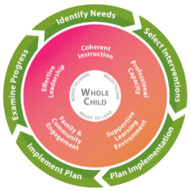
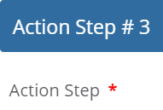
Example from a District Improvement Plan (DIP)
Increase the percent of students achieving a Lexile measure at or above the Lexile Mid-point in Grades 3-9 and American Literature from 63% in 2019 and 68% in 2020 as measured by the GA Milestones Assessment.
Show how to access online literacy resources in the parent portal to families of students in Grades 3-9 to practice at home with their child by hosting Literacy Nights and emailing links.

Slide 161
Examples for the Budget
Budget For Literacy Nights:
Translation of invitation and
meeting materials
Childcare
Transportation
Spanish and American Sign Language Interpreters at Literacy Night
Show how to access online literacy resources in the parent portal to families of students in Grades 3-9 to practice at home with their child by hosting Literacy Nights and emailing links.

Slide 162

Budget Considerations
Parent and Family Engagement
Technology Training: Funds for technology training to assist parents in learning how to use the Internet to communicate with the school, access the parent portal including the Statewide Longitudinal Data System (SLDS), or use other online student academic achievement resources (may include education about the harms of copyright piracy)
Technology Resources: Funds for technology resources or software used to assist schools in better communicating with parents regarding Title I information

Slide 163

Budget Considerations
Parent and Family Engagement
Transportation and Childcare: Funds for transportation and childcare to enable Title I parents to participate in Title I school-related meetings and training sessions (e.g., Annual Title I Parent Meeting)
Translation/Interpretation: Funds for translation of Title I-specific parent communications/meetings (e.g., invitations and language interpreters at parent input meetings in the spring)

Slide 164

Budget Considerations
Parent and Family Engagement
Literacy: Funds for family literacy services to assist parents who do not have a high school diploma or who have low literacy levels to improve their own reading skills in order to be better equipped to support their children’s learning (other reasonably available sources of funding for such services being exhausted). GED preparatory classes may be funded by Title I, Part A funds. For student scholarship information, contact the Certified Literate Communities or an Adult Education Program Administrator at the Technical College System of Georgia.

Slide 165
Budget Considerations
Parent and Family Engagement
Building Capacity of Parents of English Learners (ELs): Each LEA receiving Title I, Part A funds shall implement an effective means of outreach to parents of English learners to inform the parents regarding how the parents [in Title I schools] can—
  (I) be involved in the education of their children; and
  (II) be active participants in assisting their children to—
    (aa) attain English proficiency;
    (bb) achieve at high levels within a well-rounded education; and
    (cc) meet the challenging State academic standards expected of all students.
    - Section 1112(e)(3)(C)
GaDOE Parents of EL webpage at http://www.gadoe.org/School-Improvement/
Federal-Programs/Partnerships/Pages/Parents-of-English-Learners.aspx
Notes:
Kim - Note: “Recommendations” regarding topics related to their child’s English language proficiency

Slide 166

Inviting All Title I Parents—
Including Outreach to Parents of ELs
Parent Input Meetings in Title I schools with agenda items:
Parent and Family Engagement Policy
School-Parent Compact
Building School Staff Capacity
1% set-aside for family engagement
Use multiple ways of inviting parents in an understandable language!
Building Parent Capacity in Title I schools with agenda items:
Using the Parent Portal
Sharing Social Media posted in English & other languages
Forwarding websites in English & other languages
Annual Title I Meeting with agenda items:
English Language Development Standards
WIDA Assessments
Notes:
Kim

Slide 167
Budget Considerations
Parent and Family Engagement
Building Capacity of School Staff: Funds for materials or consultant costs to educate teachers, specialized instructional support personnel, principals, other school leaders, and other staff with the assistance of parents…
in the value and utility of contributions of parents, and
in how to reach out to, communicate with, and work with parents as equal partners,
implement and coordinate parent programs, and
build ties between parents and the school as it relates to increasing student academic achievement

Slide 168
Budget Considerations
Parent and Family Engagement
Academic Parent-Teacher Teams (APTT): During FY20, five additional school systems will be trained to implement APTT. Payment to WestEd is not applicable in FY20; however, existing APTT schools will need to include items in their Title I budget for APTT meetings. There is a total of 23 APTT school systems across the state implementing APTT in more than 60 schools.
  For a list of APTT schools, visit
  http://www.gadoe.org/School-Improvement/Federal-Programs/Pages/APTT.aspx
  or http://www.bit.ly/apttgeorgia

Slide 169
Budget Considerations
Parent and Family Engagement
National ESEA Conference: February 5-7, 2020 in Atlanta
State School Superintendent’s Parent Advisory Council (PAC): If a current PAC member is representing your school system in FY20, consider supporting his/her attendance at the National ESEA Conference.
No Georgia Family Engagement Conference and no Regional Network Meetings in FY20
Other Options:
  National Family and Community Engagement Conference: May 27-29, 2020 in Los Angeles
  School-Parent Compacts online course in GA Learns at http://www.galearns.org (It’s free! And more courses this Fall)

Slide 170
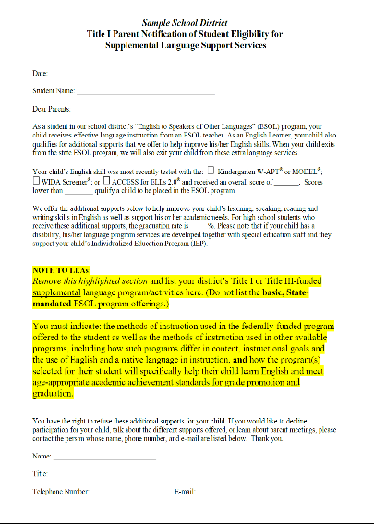
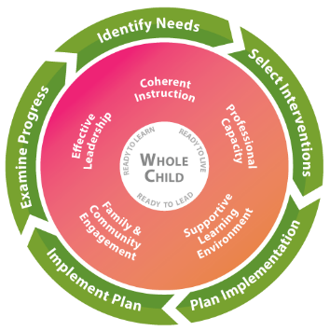
Budget Considerations
Parent and Family Engagement
Required District Set-Asides for Parent and Family Engagement
Supplemental English language services for participating ELs
Refer to the presentation by Title I, Part A

Slide 171

Family-School Partnership
Program Updates
Visit http://partnerships.gadoe.org

Slide 172


Family-School Partnership Program Updates
Distribution Prior to November 1:
    School-Parent Compacts
    District Parent and Family Engagement Policy
    School Parent and Family Engagement Policy
Annual Title I Meeting Prior to November 1 (Dissemination of information only)
2019-2020 Systemic Family Engagement Guide (aka “The Handbook”) at http://partnerships.gadoe.org
Power Tips Videos for family engagement strategies

Slide 173

What questions do you have?

Slide 174
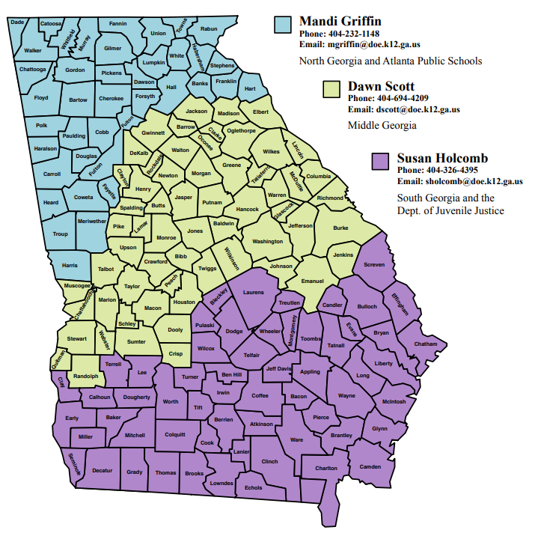
Questions?
For questions about family engagement activities, contact your family engagement specialist.
For questions about using Title I funds for family engagement activities, coordinate with your federal programs director contact your Title I area specialist.
To receive monthly updates, email Mandi Griffin at mgriffin@doe.k12.ga.us.

Slide 175
Title I, Part A Program Specialists’ Contact Information
Area | Name | Office Number | Email
Metro 1 | Robyn Planchard | (678) 378-1532 | rplanchard@doe.k12.ga.us
Metro 2 | Olufunke Osunkoya | (678) 378-1325 | oosunkoya@doe.k12.ga.us
Metro 3 | Karen Cliett | (678) 217-1751 | kcliett@doe.k12.ga.us
NW1 | Anne Marie Wiseman | (678) 217-2021 | amwiseman@doe.k12.ga.us
NW2 | Sherri Minshew | (678) 340-8388 | sminshew@doe.k12.ga.us
NW3 | Clarice Howard | (678) 340-0370 | choward@doe.k12.ga.us

Slide 176
Title I, Part A Program Specialists’ Contact Information
Area | Name | Office Number | Email
NE1 | Tammy Wilkes | (678) 217-1677 | twilkes@doe.k12.ga.us
NE2 | Grace McElveen | (678) 340-5055 | gmcelveen@doe.k12.ga.us
NE3 | Kathy Pruett | (678) 340-9388 | kpruett@doe.k12.ga.us
SE1 | JaBra Harden Fuller | (678) 340-9493 | jharden@doe.k12.ga.us
SE2 | Marijo Pitts-Sheffield | (678) 340-5369 | mpitts@doe.k12.ga.us
SE3 | Elaine Dawsey | (678) 217-6981 | edawsey@doe.k12.ga.us
SW1 | Kelly Roberts | (678) | kelly.herman-roberts@doe.k12.ga.us
SW2 | Kim Ezekiel | (678) 340-8443 | kezekiel@doe.k12.ga.us

