Slide 1
Supporting Priority and Focus Schools with Title I, Part A, 1003(a) School Improvement Funds 13th Annual Title Programs Summer Conference June 2015
Joann Hooper
Paulette Richmond
Patty Rooks
Gary Wenzel
Division of School and District Effectiveness
(404) 463-1861

Slide 2
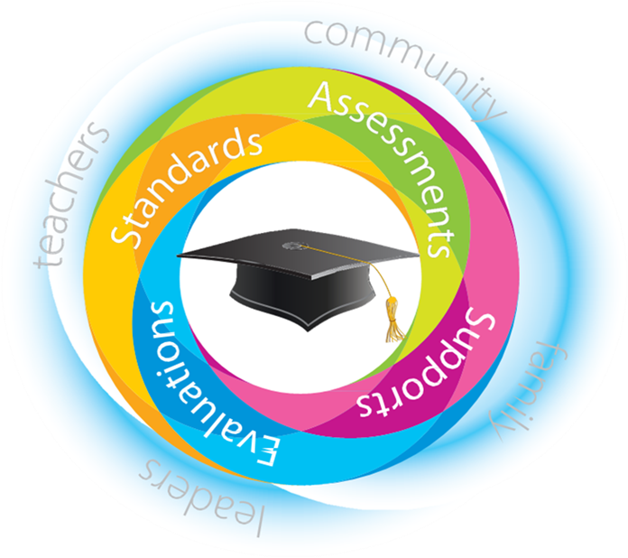
Our Collective Work

Slide 3
1003(a) School Improvement Funds
Purpose
The Title I, Part A, Section 1003(a) school improvement grants provide financial resources to local educational agencies (LEA) on behalf of Title I schools identified as Alert, Focus, or Priority. These grants are awarded to support the development and implementation of school improvement plans required by the Elementary and Secondary Education Act (ESEA) and Georgia’s ESEA Flexibility Waiver approved by the United States Department of Education.

Slide 4
Today’s Session
During this session participants will explore tools and strategies to plan, implement and monitor the use of 1003(a) funds to improve teaching and learning in priority and focus schools. Guidelines for creating a culture of shared accountability that begins with the comprehensive needs assessment will be discussed. This session is for all districts with priority and focus schools.

Slide 5
Standards
Planning and Organization 2: Uses a data-driven and consensus-oriented process to develop and implement a school improvement plan that is focused on student performance.
Planning and Organization 3: Monitors implementation of the school improvement plan and makes adjustments, as needed.

Slide 6
Scenario
Your Superintendent was informed that the district now has a Priority and a Focus School. Along with these designations, the following must be considered:
Title I, Part A, 1003(a) School Improvement funds
Additional 1003(a) Assurances
GaDOE/RESA School and District Effectiveness team
QCIS, Indistar®
School Improvement Process
School Improvement Plan
Budget and justification of expenses for 1003(a) funds
Allowable expenses related to the Priority or Focus Status that comply with Title I regulations

Slide 7
Task
In a group of four to five (no more than five), each person assumes one of the following roles: two principals (one priority and one focus), Title I Director and School Effectiveness Specialist. Using the data, funding and other information provided, respond to the questions on the handout.

Slide 8
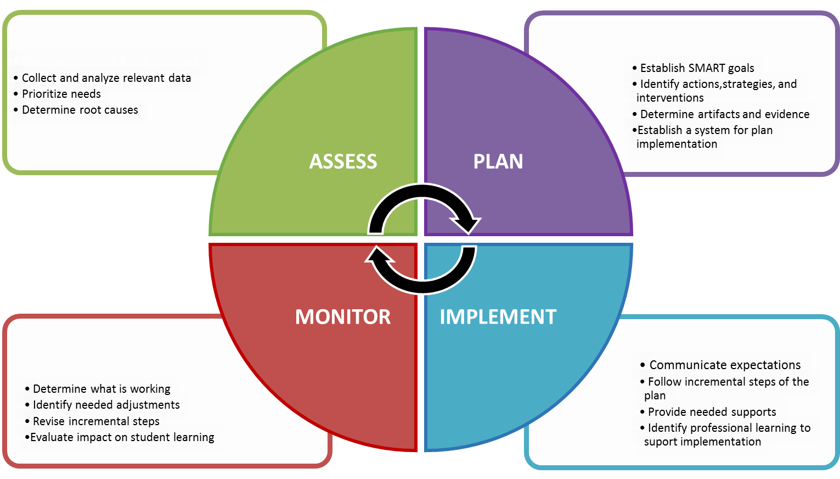
School Improvement Process Adapted from The W. Edwards Deming Institute

Slide 9
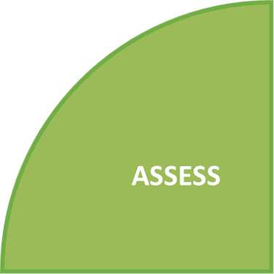
Consider the following …
Table Talk: Review of multiple measures of data, comprehensive needs assessment and root cause analysis

Slide 10
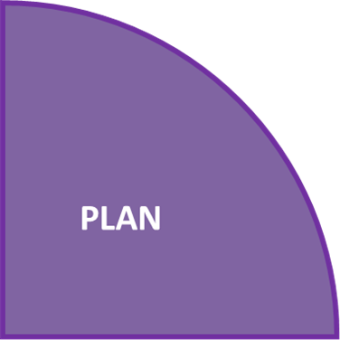
Consider the following …
Table Talk: Review braiding and blending of federal funds

Slide 11
Consider the following …
Table Talk: Review School Improvement Plan, budget and allowable expenses

Slide 12
Consider the following …
Table Talk: Review plan for professional learning (for staff and technical support to principals)

Slide 13
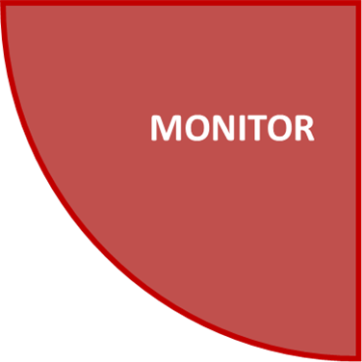
Consider the following …
Table Talk: Review processes that exist to monitor progress and drawdown reports

Slide 14
Summarizing our work

Slide 15
Indistar®
“Indistar® is a web-based system implemented by a state education agency, district, or charter school organization for use with district and/or school improvement teams to inform, coach, sustain, track, and report improvement activities. Similar to a global positioning system (GPS), Indistar® tells you where you are and helps you get to where you want to be — every child learning and every school improving.”
www.indistar.org

Slide 16
QCIS, Indistar® GA School Performance Standards
Curriculum 1: Uses systematic, collaborative planning processes so that teachers can have a shared understanding of expectations for standards, curriculum, assessment, and instruction
Curriculum 3: Uses a process to review curriculum documents to ensure alignment to the intent and rigor of the standards and revises as needed
Assessment 2: Uses a balanced system of assessments including diagnostic, formative, and summative to monitor learning and inform instruction
Assessment 3: Uses common assessments aligned with the required standards to monitor student progress, inform instruction, and improve teacher practices
Instruction 4: Uses research-based instructional practices that positively impact student learning
Instruction 8: Establishes a learning environment that empowers students to actively monitor their own progress

Slide 17
QCIS, Indistar® GA School Performance Standards
Instruction 9: Provides timely, systematic, data-driven interventions
Planning and Organization 1: Shares a common vision/mission that defines school culture and guides the continuous improvement process
Planning and Organization 2: Uses a data-driven and consensus-oriented process to develop and implement a school improvement plan that is focused on student performance
Planning and Organization 3: Monitors implementation of the school improvement plan and makes adjustments, as needed
Professional Learning 6: Monitors and evaluates the impact of professional learning on staff practices and student learning
Leadership 6: Establishes and supports a data-driven school leadership team that is focused on student learning

Slide 18
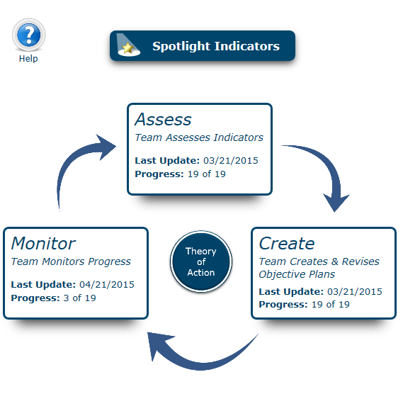
QCIS, Indistar®

Slide 19
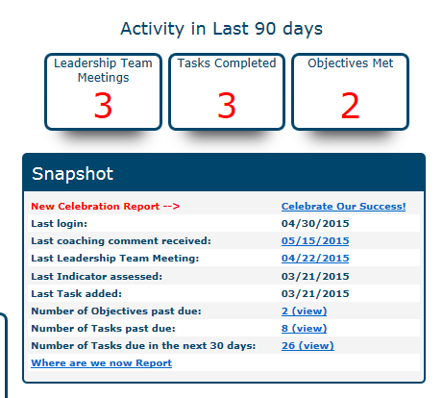
QCIS, Indistar®

Slide 20
QCIS, Indistar®

Slide 21
QCIS, Indistar®

Slide 22
Review Test Site Indistar®

Slide 23
For our students
Title I, Part A, 1003(a) School Improvement funds provide supplemental resources and academic opportunities for students most at-risk for not meeting standards.
Spend 100% of 1003(a) funds.

Slide 24
Questions

Slide 25
Supporting Priority and Focus Schools with Title I, Part A, 1003(a) School Improvement Funds 13th Annual Title Programs Summer Conference June 2015
Joann Hooper
Paulette Richmond
Patty Rooks
Gary Wenzel
Division of School and District Effectiveness
(404) 463-1861

