Slide 1
Student Success: Imagine the Possibilities
Title 1 Conference
June 17, 2015
Debbie Gay
Special Education Director
dgay@doe.k12.ga.us

Slide 2
Foundational Belief
Education should be a single comprehensive system with a continuum of services based on every student’s individual needs.
Notes:
SWDs are general education students who receive special education services.
Special education is one of many services, not a location.
A Multitiered System of Supports (MTSS) should be the foundational framework for providing instruction and behavior supports for all students.
The IDEA should provide sufficient protections and process to ensure equity of opportunity for students with disabilities.
Specially designed instruction should be based on a student’s needs and not on a disability category.
Students with disabilities must have appropriate access, instruction and accommodations to fully participate in all learning opportunities, including virtual offerings..
Closing the achievement gap of students with disabilities in core academic subjects is a priority.

Slide 3
Foundational Belief
Focus on student outcomes that lead to equality of opportunity, full participation, economic self-sufficiency and independent living.
Notes:
Opportunity
The curriculum and instructional strategies must address the diverse needs of students with disabilities and includes academic, socio-emotional, work readiness, transition services and independent living skills as appropriate.
Students with disabilities must have the same access to elective courses and after-school activities as their nondisabled peers.
Students with disabilities must have the same access to career counselors, guidance counselors and concurrent college enrollment as their nondisabled peers.

Slide 4
Recent Changes in OSEP Reporting Requirements
In prior years, OSEP focused on the degree to which LEAs complied with special education law
OSEP now places greater focus on improved student performance:
“Results Driven Accountability”

Slide 5
What is Results Driven Accountability? (RDA)
The primary focus of Federal and State monitoring activities shall be on…
20 U.S.C. 1416(a)(2)
Sec. 616(a
improving educational results and functional outcomes for all children with disabilities
ensuring that States meet… the program requirements, with… emphasis on those most related to improving results
Notes:
Although improving results were always an important intent of IDEA, monitoring systems primarily focused on program requirements, the so called “compliance” to IDEA. Results Driven Accountability is a change in OSEP policy to reflect a more balanced approach in the monitoring of the implementation of IDEA by introducing more prominently a results component to the primary focus of Federal and State monitoring activities.

Slide 6
State Systemic Improvement Plan A 6-Year Plan, Activities by 3 Phases
Year 1 - FFY 2013 Delivered by April 2015 | Year 2 - FFY 2014 Delivered by Feb 2016 | Years 3-6 FFY 2015-18 Feb 2017- Feb 2020
Phase I Analysis of Data and Identification of Evidence-based Practices | Phase II Implementation Plan | Phase III Implementation and Evaluation
Data Analysis Analysis of State Infrastructure State-identified Measurable Results Selection of Coherent Improvement Strategies Theory of Action | Infrastructure Development Support for LEA Implementation of Evidence-Based Practices Evaluation. | Results of Ongoing Evaluation Extent of Progress Revisions to the SPP
Notes:
The proposed SSIP is to be developed in 3 phases
Items on each phase are not organized in a specific order states should follow.
Phase 1—February, 2015
Phase 2—February, 2016
Phase 3—February, 2017 through February, 2020
Data Analyses: In order to improve results, States must assess the capacity of their current infrastructure systems and their ability to enhance this infrastructure to increase the capacity of EIS programs and providers to implement, scale up, and sustain evidence-based practices that will result in improved outcomes for infants and toddlers with disabilities and their families. The data and infrastructure analysis should use multiple data sources, including SPP/APR indicators and 618 State-reported data, to identify systemic approaches that will lead to improved results for infants and toddlers with disabilities and their families across key measures: early childhood outcomes and family involvement.
Identification of the Focus for Improvement: A description of improvement strategies on which the State will focus that will lead to a measurable child-based result. The State must include in the description how the data analysis led to the identification of the area on which the State will focus. The State must demonstrate how addressing this area of focus for improvement will build the capacity of EIS programs and providers and supports to improve the identified result for infants and toddlers and their families with disabilities. (For example, the State might be working to improve the validity and representativeness of their data on early childhood outcomes and family involvement.)
Infrastructure to Support Improvement and Build Capacity: A description of how the State analyzed the capacity of its current system to support improvement and build capacity in EIS programs and providers to implement, scale up, and sustain evidence-based practices to improve results for infants and toddlers with disabilities and their families, and the results of this analysis. State system components include: governance, fiscal, quality standards, professional development, data, technical assistance, and accountability.
The description must include:
strengths of system
how components of system are coordinated
areas for improvement within and across components of the system
an analysis of initiatives in State, including initiatives in general education and other areas beyond special education, which can have an impact on children and youth with disabilities
how decisions are made within State system and representatives (e.g., agencies, positions, individuals) that must be involved in planning for systematic improvements in the State system
Theory of Action: Based on the data analysis and infrastructure analysis, the State must describe the general improvement strategies that will need to be carried out and the outcomes that will need to be met to achieve the State-identified, measurable improvement in results for infants and toddlers and their families with disabilities. The State must include in the description the changes in the State system, and EIS program and provider practices, that must occur to achieve the State-identified, measurable improvement in results for infants and toddlers with disabilities and their families. States should consider developing a logic model that shows the relationship between the activities and the outcomes that the State expects to achieve over a multi-year period.
Evaluation Plan: A description of how the State will evaluate the implementation of its SSIP. The plan must include the methods that will be used to collect and analyze data related to specific activities and outcomes of the SSIP. The description must also include how the State will use the results of the evaluation to examine the effectiveness of the implementation of the plan and the progress toward achieving intended outcomes, and make modifications to the SSIP as necessary.

Slide 7
Year 1 - FFY 2013
Delivered by April 2015
Phase I Analysis of Data and Identification of Evidence-based Practices
Data Analysis Analysis of State Infrastructure State-identified Measurable Results Selection of Coherent Improvement Strategies Theory of Action

Slide 8
Enrollment by Subgroups
What percent of total enrollment is SWD?
Does this create a concern for over-identification?

Slide 10
Visual Impairment | 655
Other Health Impairment | 28,294
Deaf | 659
Hearing Impairment | 1,183
Orthopedic Impairment | 865
Specific Learning Impaired | 62,131
Emotional/Behavioral Disorder | 12,952
Profound Intellectual Disability | 656
Severe Intellectual Disability | 1,401
Moderate Intellectual Disability | 4,961
Mild Intellectual Disability | 10,005
Significant Developmental Delay | 22,201
Traumatic Brain Injury | 417
Autism | 14,913
Speech/Language Impairment | 29,490
Deaf/Blind | 23
Blind | 159
Total Primary | 190,965
8.9% of Total SWD Enrollment
.987% (<1%) of Total Student Enrollment
Remember, “adverse education impact” does not equate to “Intellectual Disability!”
Of these categories, which students demonstrate subaverage general intellectual functioning?

Slide 11
Is it about equitable access (e.g., medical evaluation)?
Why might there be more white students identified OHI?
The identification of MID has more subjectivity.
Consider the differences between MOID and MID.

Slide 12
2014 Total Enrollment by Grades
There are fewer students by 12th Grade!
Is this trend true for SWD?
Is dropout impacting enrollment in the higher grades?

Slide 13
Graduation Rate
How equitable are opportunities by subgroups?

Slide 14
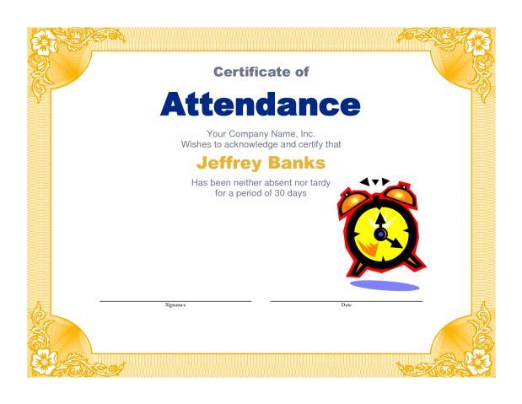
Special Ed Diplomas
Students who completed HS with their peers but received
Special Education Diplomas
1,777 SWD received special education diploma or certificate
Special Education Diploma

Slide 15
Black Students with Disabilities represented over half of all SWD who received a Special Education Diploma.
Special Education Diplomas
Black Students represented over half of Total Enrollment who received a Certificate of Attendance!
Certificate of Attendance

Slide 16
Dropout Rate
4.1% (3,944)
SWD

Slide 17
Georgia's Student Health
and Safety Survey
33.9% of students, ranging from 6th through 12th grades (199049 out of 587,043), answered "yes" they thought about dropping out of school.
Won't Drop Out | 387,994
Bored | 72,947
Family Reasons | 30,662
Being Bullied | 26,276
Other | 69,164
Total | 587,043

Slide 18
2014 Cohort Longitudinal Data

Slide 19
2014 Cohort Longitudinal Data

Slide 20
Infrastructure Analysis
To support improvement and build capacity in LEAs, including system strengths, coordination, and needed improvements in these areas:
Build regional capacity to support local districts in a region
Fiscal
Stakeholder engagement
Professional development
Data analysis skills
Monitoring for Fidelity of Implementation
Analysis of state activities and how they can align to the SSIP
state and local improvement plans
state initiatives

Slide 21
Major Barriers to Graduation for SWD Access to the General Curriculum Specialized Instruction Positive School Climate
Access to the General Curriculum
Specialized Instruction
Positive School Climate

Slide 22
P-12 Pipeline

Slide 23
Georgia State Identified Measurable Result (SIMR)
During 2013-2014, 39.46% of SWD (ages 14 and older) graduated from high school with a general education diploma as measured by the Annual Graduation Event Rate for 50 local school districts that were identified to receive Intensive Technical Assistance through the SSIP coherent improvement strategies.
By 2018-2019 school year, Georgia will meet a rigorous target of 50% of SWD earning a general diploma as measured by the Annual Graduation Rate.

Slide 24
State Leadership and Implementation Team
GLRS Regional Team
Super Regional Team (School Improvement)
District Leadership and Implementation Team
District Leadership and Implementation Team
District Leadership and Implementation Team
District Liaison
District Liaison
District Liaison
School Leadership and Implementation Team
School Leadership and Implementation Team
School Leadership and Implementation Team

Slide 25
Differentiated Technical Assistance (TA) Model for Local Districts
Universal TA for
All Districts
Incidental Benefits of the SSIP
Collaborative Communities
Grey Area: Fluid Alignment of PL and Provision of Targeted TA
Incidental Benefits
Intensive TA
(50 Districts)
SSIP SIMR

Slide 26
Review Data and Tell Your Story
Implement, Monitor and Evaluate
Develop or Revise Actionable Steps
Identify Barriers
Stakeholder Engagement

Slide 27
Authentic Engagement Critical
Stakeholder engagement extends to parents, students and community.
Stakeholder engagement is ongoing.
Stakeholders continuously contribute to the work.

Slide 28
Engaging Economically Disadvantaged Student with Disabilities Student Success June 17,2015 Ann Cross
Gordon County Schools
Calhoun, Georgia
Rigor, Relevance, Relationships, Results

Slide 29
Expected Outcomes
As a result of this activity, the participant will:
List four risk factors of poverty that impair student achievement
- Name seven factors crucial to engaging disadvantaged students with learning disabilities
- Identify three strategies to promote student engagement

Slide 30
Gordon County
Calhoun- Northwest Georgia
Size C system - Approximately 771 Students with IEPs
3 ESS Administrators
1 Parent Mentor/Social Worker
10 schools; College and Career Academy
75% Free and Reduced /Economic Disadvantaged
9.9 Unemployment Rate

Slide 31
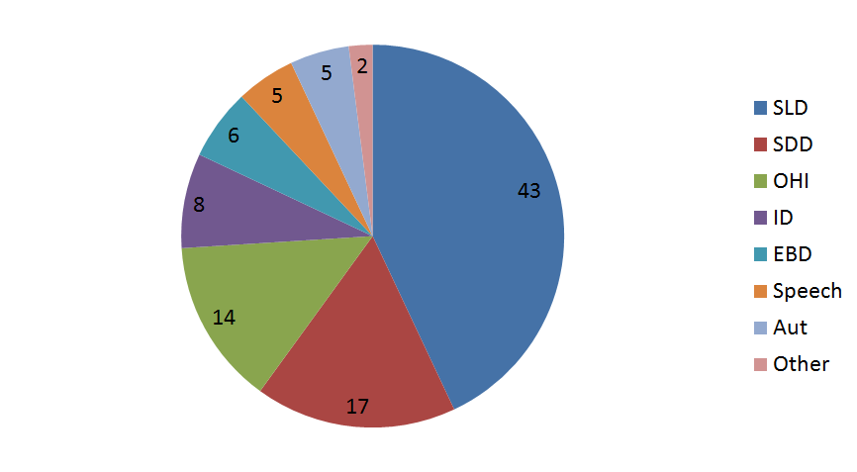
Gordon County FY15 Special Education Composition

Slide 32
Which Way Are We Headed?

Slide 33
Root Cause
We talked, asked questions, and LISTENED
What do you think are root causes in your district for lack of student achievement or low graduation rate?

Slide 34
Root Cause
NO expectation
for SWDs to succeed and graduate with a regular education diploma

Slide 35
Root Causes
75% of students with disabilities were economically disadvantaged and unengaged in school

Slide 36
Root Cause
Lack Of Parent Participation
2012
33% IEP Attendance
51% Parent Survey Satisfaction

Slide 37
Root Cause
Teacher Turnover and Lack of Content Knowledge
Best ESS teachers moved to General Education and 68% of NEW ESS came from alternative backgrounds other than ESS and Content Knowledge

Slide 38
Mindset: Culture Change

Slide 39
Possibilities
The first pre-requisite for change is your belief in it-- and your willingness to change yourself first. We can help kids rise above their predicted path of struggle if we see them as possibilities, not as problems.
Jensen, Eric, Teaching with Poverty in Mind, p 65

Slide 40
Educators must stop using IQ and Socio- Economic status as an EXCUSE for giving up on children or having no expectations for them.
Instead- provide positive, enriching, experiences that build academic operating systems.
Brains don’t change from more of the same.
We must believe that change is possible.
- Ed Jenson, “Embracing the Mindset Change”, 2010

Slide 41
What is Poverty?
The Office of Management and Budget for the USA, 2012, defines poverty based upon a persons’ ability to purchase basic needs- food, shelter, clothing, and other essentials.
The USA defines six types of poverty
~ Situational ~ Generational ~Absolute
~ Relative ~ Urban ~ Rural

Slide 42
Four Risk Factors of Poverty that Impair Student Achievement
Emotional and Social Changes
Acute and Chronic Stressors- Higher Absenteeism
Cognitive Lags- Especially Memory and Executive Functioning
Health and Safety Issues
~Jensen,2009

Slide 43
The Emotional Keyboard
Hardwired
Must Be Taught

Slide 44
The Emotional Keyboard
Hardwired Emotions
Sadness
Must be Taught
Joy
Disgust
Anger
Surprise
Fear
Forgiveness
Empathy/Sympathy
Patience
Shame
Gratitude
Cooperation
Optimism
Compassion

Slide 45
Children of Poverty
Social/Emotional Development is lacking due to more loneliness, aggression, isolation, and deviance in the peer relationship
Often face dropout, employment, marital, and other relationship struggles in life.
Hill, Bromell, Tyson, and Flint, 2007 suggest school plays a significant role in potential transformation of a poverty mentality. School can change the brain in the way it thinks and responds or not.

Slide 46
Be A Champion Everyday
“Every child deserves a champion — an adult who will never give up on them, who understands the power of connection, and insists that they become the best that they can possibly be.”
~ Rita Pierson

Slide 47
High Poverty Schools Making It Happen
Support the Whole Child
Hard Data is Analyzed
Accountability
Relationship Building
Enrichment Mindset- Explicit Strategy Teaching
~ Reeves, 2003

Slide 48
Building A SWD Operating System
Champion Mindset
Hopeful Efforts
Attentional Skills
Memory Skills
Processing Skills

Slide 49
Plan to Win- Champion Mindset
Believing is 99% of the battle
Discuss struggling students weekly
With the Student, Set Learning Targets
Implement ASPIRE- Student Led IEP
Praise, Praise, Praise for the small things
WHATEVER IT TAKES MENTALITY

Slide 50
Setting A Higher Standard
The future belongs to those who believe in the beauty of their dreams.
~Eleanor Roosevelt

Slide 51
Making It Happen-Champion Mindset
Refuse to let your “WHO” fail
Pictures with Data- Assigned Mentors
Know and Believe- Goal Setting accounts more than IQ to student achievement

Slide 52
Plan to Win- Hopeful Effort
Listen to students
Look at what's on their backpack or shirt
(That's what interest them)
Talk, Talk about how to reach dreams
(Tailgate at Red Bud)
Refer to their dreams often
Write about the student’s dreams often
Keep the dream/hope before them daily

Slide 53
Plan to Win- Attention Skills
Students from poverty must be taught attention skills
Students with strong attention skills possess the ability to stay focused, shift and transition, and resist impulse
Build Attention by project based learning, inquiry, music training, drama, and theater arts.

Slide 54
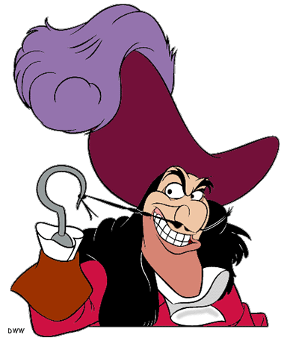
Attention Skills
Hattie, 2008, Highly effective teachers raise their odds of gaining student attention and of success by ensuring students want to participate, will engage, and choose to learn.
Build a HOOK

Slide 55
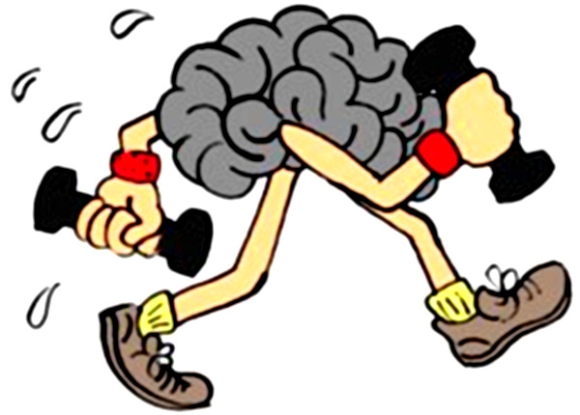
Memory Skills
Turn to your partner and discuss:
How you remember information?
How do you teach students to remember information?

Slide 56
Plan to Win- Memory Skills
Short Term Memory
Holding important information for a short time
Working Memory
Stored as sounds and images
Critical to academic success
Greater predictor of academic success than IQ, (Fukuda&Vogel, 2009)
Chunking and scaffolding improves short term memory
Key to reading and math problem solving

Slide 57
Plan to Win- Memory Skills
Salminen, Strobach, and Shubert, 2012 research showed building memory takes only 5-10 minutes a day for 8-12 weeks. The study was with students who have ADHD diagnosis and learning disabilities.

Slide 58
Plan to Win- Processing Skills
Mental work ( collect, sort, summarize, calculate, organize, and analyze)
Must be taught- not innate skills
Impacts reading, writing, and math

Slide 59
Processing Strategies
Visual Supports
Show and Shout Game
Scramble Stories or Words
Scaffolding
Anchor Charts
Assistive Technology
Explicit Strategy Teaching

Slide 60
Eric Jenson
Seven Engagement Factors

Slide 61
Why is it hard to get them across the stage?
Health and Nutrition
Vocabulary
Effort and Energy
Mind- Set
Cognitive Capacity
Relationships
Stress Level

Slide 62
The Problem Of Good Teaching
“The problem is not that we do not have enough good teachers. The problem is we have way too many. There is too much ‘good teaching’. This good teaching has become totally acceptable, and some teachers have been doing this same job for years. Good has become marginalized. To create a major improvement in learning within a system or district or even a state, we need programs that will move large numbers of good teachers to become great teachers.”
Stephen G. Barkley, Quality Teaching in a Culture of Coaching, p20.

Slide 63
Fixed Mindset or Growth Mindset
There is no such thing as an unmotivated student, there are only students in unmotivated states, sitting in demotivating classrooms
Students who grow up in poverty tend to feel less control over their lives, which results in a deadly “Fixed Mindset” where they perform where they believe they are not where they could be.
Student’s expectations of where they think they are is a robust predictor of achievement. ( Hattie, 2008)
If you teach children as they are, they will be. Teach as you want them to be and they will perform above expectations.

Slide 64
Changing a Fixed Mindset
Make it their idea
Manage Risk – Keep it low ( Closing Question)
Build the Learner’s Mindset ( Preview School)
Provide Ongoing Positive Feedback
Get a trial size effort and celebrate.

Slide 65
Mindset/Relationships
EXCLUSIVE | INCLUSIVE
Who has ever traveled outside our state? | How many of you would like to travel to other states?
Who saw the Avengers last weekend? | I was thinking of a movie I say this weekend. Have you ever thought about a scene from a movie you’ve seen before?
How many of you completed your homework last night? | If you meant to do your homework and didn’t stand up. If you did your homework stand up in your desk and shout.
Raise your hand if you’ve been to Disney World? | Raise your hand if you’ve ever seen something that just blew your mind.
The way a teacher talks to a student greatly affects a student’s mental ability to
Engage in learning or turn off to learning. (Mindset,Dweck,2006)

Slide 66
Turn Impossibilities to Possibilities
Alice and the White Queen were talking in Alice’s Adventures in Wonderland by Carroll, 1993.
Alice: “There’s no use trying, one can’t believe impossible things.”
White Queen: “ When I was your age, I always did it for half an hour a day. Why, sometimes I’ve believed as many as six impossible things before breakfast.” (p.37).
For impossible things to happen, you, the teacher, have to believe and envision them first. Remember NO Excuses!! Only believe every child can and will learn.

Slide 67
Turn Impossibilities to Possibilities
For impossible things to happen, you, the teacher, have to believe and envision them first.
Remember NO Excuses!!
Only believe every child can and will learn.
Sierra
BEN
Zoe
Joel
Anna

Slide 68
Turn Impossibilities to Possibilities
REFLECTION
Who are your impossibilities?
What are your next steps to turn them into possibilities?

Slide 69
Where are we now?

Slide 70
Graduation Rate

Slide 71
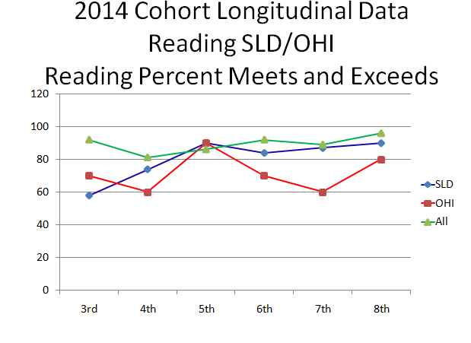

Slide 72
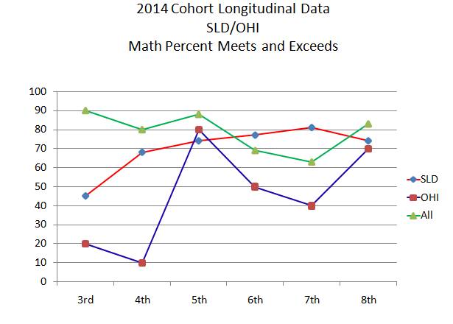

Slide 75
Implemented in 2014-2015
Poverty Study
Inclusive Homerooms
Students Using Technology
Explicit Strategy Teaching for Processing
ASPIRE Student Led IEP (Parent Mentor)
Principals Supporting
Implementing UDL with Co-teaching
PLAN to WIN for every school

Slide 76
Engaging Students
“You're off to Great Places!
Today is your day!
Your mountain is waiting,
So... get on your way!”
― Dr. Seuss, Oh, The Places You'll Go!

Slide 77
Contact Information
Ann Cross, Director Exceptional Student Services- across@gcbe.org
Alecia Segursky- asegursky@gcbe.org
Melissa Gravley- mgravley@gcbe.org
Gordon County Schools
706-629-4474
,

