Slide 1
Connections for Classrooms Georgia 2014-2015 Technology Grants & Related Funding
Unified Infrastructure Funding to Enable
Digital and Blended Learning

Slide 2
What?

Slide 3
Energize Digital Learning
To energize digital and blended learning in Georgia during the 2014-15 school year, the GaDOE and GOSA will provide grants to provide advanced broadband infrastructure and technology systems to Georgia schools.
This effort complements the PeachNet expansion in partnership with the University System of Georgia.

Slide 4
Streamline Investments
To serve as your partners and technology advocates, a cross-departmental team is streamlining investments to help ensure high-capacity digital access to your schools and into your classrooms.
• Georgia Department of Education • Governor’s Office of Student Achievement
• Board of Regents • Georgia Department of Community Affairs
• Georgia Technology Authority • Governor’s Office of Planning and Budget

Slide 5
Education Technology Funding
2014
$1,400,000
PeachNet Expansion
2014
$7,000,000
Broadband Connections
2014
$25,000,000
Broadband and Connectivity Systems
2015
$14,000,000
Broadband and Connectivity Systems
2015
$2,915,000
PeachNet Expansion and
E-Rate Support

Slide 6
Education Technology Funding
2 funding sources
working together
to create end-to-end systems that support Digital Learning
2014
$25,000,000
Broadband and Connectivity Systems
2015
$14,000,000
Broadband and Connectivity Systems
Greatest Student Impact
Statewide Availability of Advanced Education Technology

Slide 7
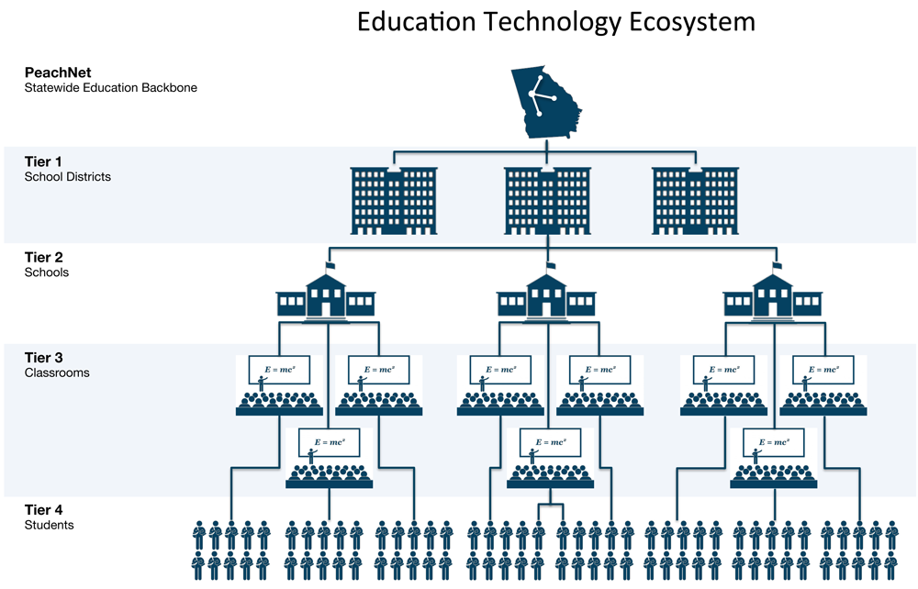
Education Technology Funding
Creating end-to-end systems
Ex: Firewalls, Routers, CIPA filters, etc.
Ex: Firewalls, Routers, Cabling, etc.
Ex: WiFi Routers, Repeaters, etc.
Student devices not
generally available with
this funding

Slide 8
Why?

Slide 9
Goal
To empower students, teachers and schools in the pursuit of an exceptional, leading-edge digital learning environment in Georgia.

Slide 10
When?

Slide 11
Tentative Timeline
December
October
Potential Round 2
Application (if applicable)
August
GOSA and GaDOE
Reimbursements
are Available
Application Period Closes
June
Application Period Begins
October +
Progress & Success Tracking
October
Awards Notifications
are Made

Slide 12
How?

Slide 13
Process Goals
Conduct a straightforward process to encourage statewide participation
Support well-considered programs to ensure a powerful impact on digital learning capability

Slide 14
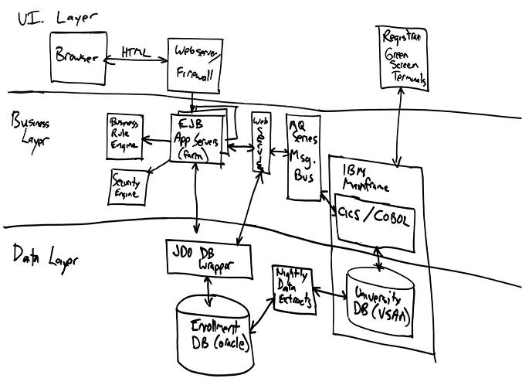
Grant Process
NOW!
June
Oct
u Plan Technology
v Apply for Grant
w Accept Award
Oct
y GoSA Reimburse
z Status & Success
< 6m
x Purchase/Install
Oct
y GaDOE Reimburse

Slide 15
Award Considerations
Broad student impact
Aligned with district and state learning strategy
Facilitates end-to-end high-capacity broadband connectivity
Supported by a well-considered implementation plan
Demonstrates project and procurement readiness
Impact
Feasibility
Strategy
Aligned with district technology plans
Supportive of future-forward Digital Learning plans
Sustainability
Captures multi-year maintenance cost and financial coverage
Matching funds commitment
Level of eligible E-Rate participation
Commitment
Demonstrates district commitment and resource availability

Slide 16
Proposed Application Materials
Application Helpers
Sample Scoring Rubric
Sample Completed Application
Application Instructions
Program Guidelines
FAQs
Application Form
Several narrative questions to showcase the program and its estimated impact
Nominal collection of multiple-choice questions to highlight alignment to key goals

Slide 17
Proposed Application Materials
Equipment and Services Spreadsheet (template)
Itemizes equipment and service requests
Application Supplements
District Strategic Plan
District Technology Plan
Current-State Technology Inventory
Applicable Vendor Quotes/RFI Responses
Implementation Project/Action Plan

Slide 18
Input!
Please help with your thoughts, suggestions and questions on this proposal

