Slide 1





Schools On Deck: Preparing for the Return of Students
Notes:
TS
As children will be allowed to return to group and organizational activities, it is now our time to step up to the challenge of taking care of the vulnerable.
So many people have helped us weather this storm. But as the national conversation turns to ending “shelter-in-place”, who will be called on next to lookout for the wellbeing of children? It will be those YSO, faith communities, daycares who receive these kids out of isolation. This is a different kind of transition that requires a unique preparation.
Cheryl doing intro/housekeeping
Tiffany doing trauma signs/symptoms/how to address
Angie doing signs/symptoms of abuse types
Julia doing disclosures and resources

Slide 2

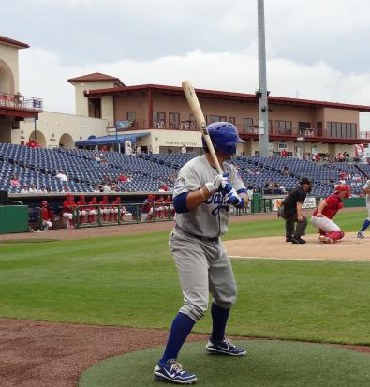
You’re On Deck
You may be among the first to have the opportunity to interact with students out of isolation.
You may also have students who have been interacting with others for a while.
Notes:
TS
In baseball, the batter that is next up stands in the “on-deck” circle. He/she steps out of the dugout and into the circle and prepares to be the next one to bat. You and your organization are “on-deck”. You may be among the first to have the opportunity to receive these kids out of isolation. The return of kids to your program after this unprecedented lockdown is different than restarting your programs in the fall or when your program year begins. Kids aren’t returning after a summer break. They are coming out of isolation. Prepare now to be the next ones to step up and answer the call.

Slide 3
COVID-19 Lockdown
The Impact on Kids
Patterns of mobility and connectedness are changing
Mobile & Socially Connected
Home at night/out in day
Interacted with other adults in charge
Interacted with peers face-to-face
Homebound and Socially Separated
Home night and day
Exclusive supervision by parents/caregivers
Interaction with friends limited and online
Notes:
TS
The impact of the lockdown will be different for every child. It is impossible to even try to predict how the children we serve will respond when they are allowed to return to group activities. Each child’s environment and individual resilience skills are different. The impact on the child will be based in large part on the resilience of the parents/caregivers and their access to resources that help them cope. The impact will be as varied as the number of children you serve. What these children share in common is having had to make a major adjustment in their daily routine when the lockdown started and now a second major adjustment as things begin to open back up.
Home and Outside: We all have felt the impact of being homebound. The loss of mobility over time is hard. For kids, it probably isn’t as difficult. In fact for some it has been great. At home with mom and dad all day long. No school, etc. At least for a while it seemed good.
Interaction with other adults in charge: How difficult will it be for a child who has been under a parents authority for 24 hours a day for 90 days when a different adult is in charge?
Interaction with peers: Children may have to learn how to be in groups again (re-learn how to share, how to resolve conflict, etc.).
This is the first major transition these kids have had to make. (This sentence seems weirdly placed. Should we move it or adjust the wording?) For this transition the adults who were helping them navigate to the new normal was a parent or caregiver. With this second transition back to a more mobile daily existence they will be dependent on different adults to help them make that transition.
Patterns of mobility and connectedness continue to be influx and this is very confusing to children. Some have been in camp interacting with others but can’t go back to school. Teens may rebel, potential for discord in the home.

Slide 4

Current Stressors for Youth
Fear and worry about the virus
Disrupted sleep schedules
Confusion about changing expectations
Adjustment to new routines
Loss
Possible strain at home:
    Financial impact of caregiver job loss
    Food insecurity
    Abuse/neglect
Strong4Life Team at Children’s Healthcare of Atlanta
Notes:
Keep in mind that younger kids may have more fear type reactions to the virus, especially if the parents kept the news on all day or if they overheard adults talking and processing their own stressors.
Older kids worry more about family stability-will the family have enough income, will a parent lose a job or find one if laid off.
Am I in school now or is this play time? Is mom the boss of me? Is dad? Is my big sister? What will tomorrow look like and what is expected of me? There is a documented rise in anxiety in kids, even the most resilient kids. It is helpful for parents to reach out and we will provide some resources at the end for educators to share with parents.
Loss: those final days of school, family vacation, seeing grandma, maybe there was a death in the family, no birthday party, etc.

Slide 5
As You Prepare Keep In Mind
The ability of a child to cope and adjust is directly related to the presence of a trusted adult
Educators/School Staff need to become the trusted adults outside of the home to help kids adjust
Notes:
TS
So think about those parents/caregivers these kids have been dependent on. Mom’s have added to their job description: educator, counselor, playmate while having to deal with their own challenges of coping during the lockdown.
Re-opening your organization after COVID-19 it not like restarting your program in the fall after a summer break. They aren’t moving from a summer of fun activities and vacation trips. They are coming out of isolation. The transition for them will be different and some will need help navigating the transition. They will need help recalibrating to a second major change in 6 months.

Slide 6
As You Prepare Keep In Mind
Look for:
  Proximity to trauma
  Pre-existing problems
  Protective factors present
Ask parents to provide info: “What’s one thing you want us to be aware of?”
Notes:
TS
Ask parents in an email or via index card or a packet asking parents what they should be aware of regarding their kids. Sample handout/checklist Here are some questions that will help us be ready for your child. - Inventory

Slide 7
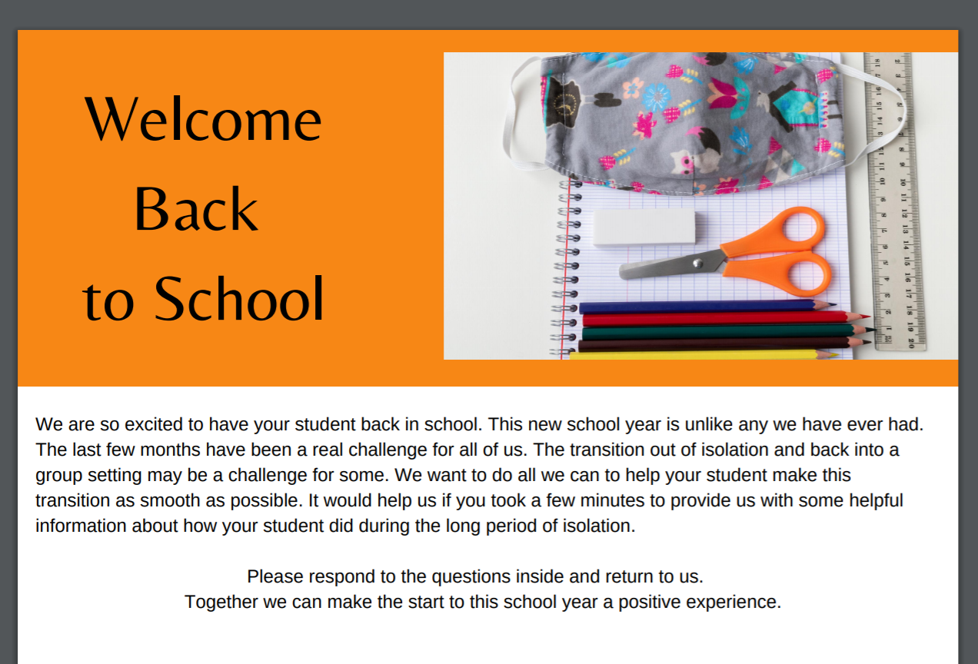
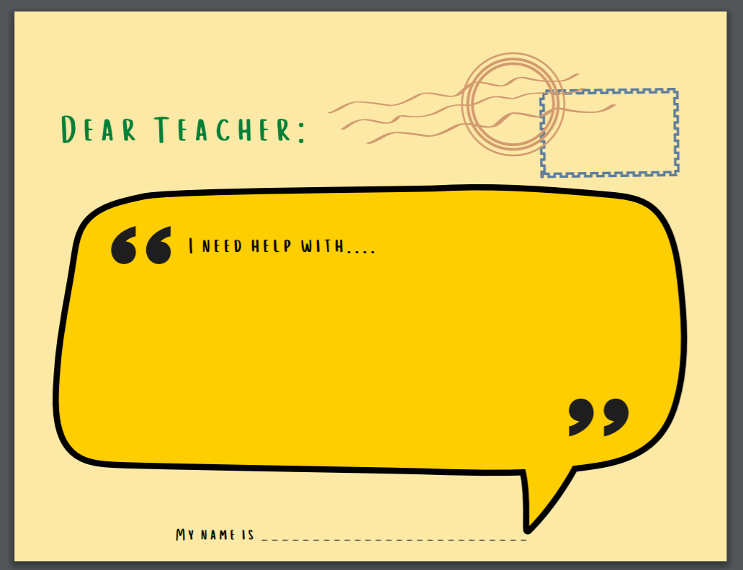
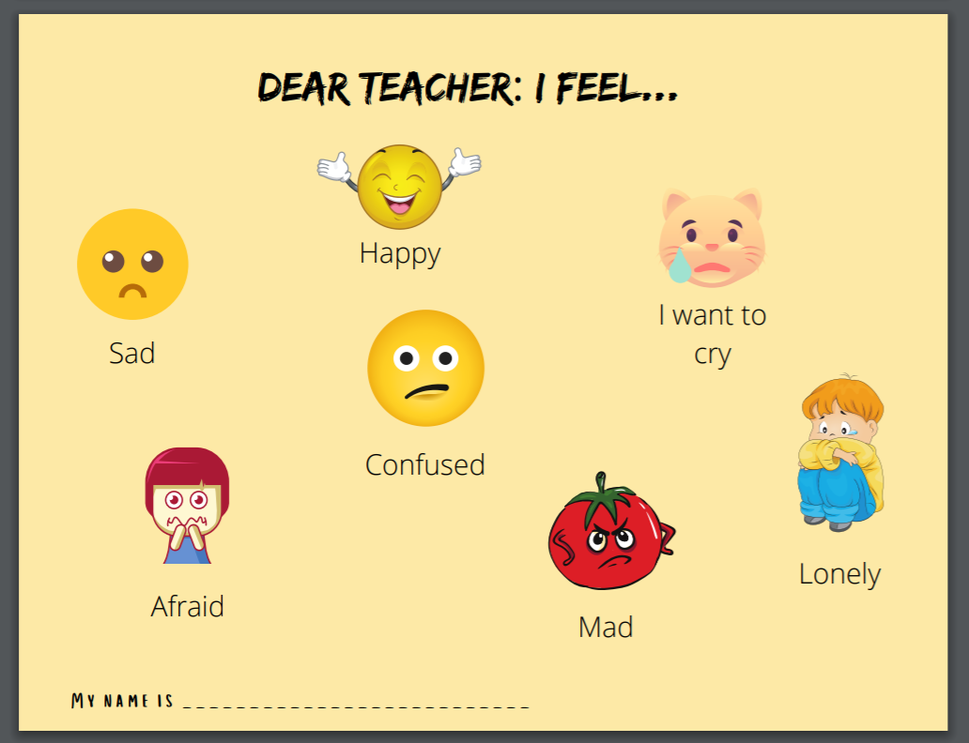
Family Check-In
Notes:
TS

Slide 8

What We Do Know
An increase in isolation can increase a child’s risk for stress, trauma, and even abuse.
Notes:
TS

Slide 9


Child Abuse and Stressful Times
During the last recession, rates of abusive head trauma in children
Increased from 9 to 15 per 100,000 children (between 2004 and 2009)
Doubled in children 2-years-old and younger
-Pediatrics, Official Journal of the American Academy of Pediatrics, October & April 2011
For every 1% increase in the 90-day mortgage-delinquency rate there was a
3% annual increase in the rate of child abuse requiring hospital admission (between 2000 and 2009)
5% annual increase in the rate of traumatic brain injury suspected to be caused by child abuse (between 2000 and 2009)
-American Association of Neurological Surgeons
Notes:
TS

Slide 10
Children Are at an Increased Risk
Children are most often abused by family, caregivers and people in authority
Isolation increases stress. Some adults take it out on the most vulnerable
Children are online more, which increases risk of exposure to pornography and online predators
The duration of COVID-19 has compounded already toxic environments for some children
All this leads to an exponential increase in risk of abuse and trauma
Notes:
TS
Safety is such a basic need for children. When it is threatened, our children can be harmed and often pay a heavy price. Our preparation for their return and our diligence in checking on their well-being after they return will, for some, be critical in restoring a sense of safety and protection.

Slide 11
Stress and Parenting during COVID-19
A majority of parents (52%) said financial concerns and social isolation (50%) are getting in the way of their parenting.
About 1 in 5 parents (20%) said they had spanked or slapped their child or children at least once in the past two weeks, and 12% had a few times or more.
The rates of shouting, yelling and screaming at children are high, with 4 out of 10 parents saying they had done this a few times or more in the past two weeks.
When asked whether or not these behaviors are an increase over their usual behaviors, 19% said they are yelling or screaming more and 15% said they increased their use of discipline since the pandemic.
Shawna Lee & Kaitlin Ward, March 2020 https://news.umich.edu/coronavirus-causing-conflict-between-parents-children/
Notes:
TS
Safety is such a basic need for children. When it is threatened, our children can be harmed and often pay a heavy price. Our preparation for their return and our diligence in checking on their well-being after they return will, for some, be critical in restoring a sense of safety and protection.

Slide 12
Common Responses to Stress and Trauma
Confusion or disorientation
Difficulty concentrating
Irritability/Physical Complaints
Mood swings
Feeling sad or hopeless
Feeling disconnected or numb
Nightmares
Notes:
TS

Slide 13

As Children Return to School Keep This in Mind…
Children will need time to acclimate returning to a group setting.
This may take several days for some or a bit longer for others.
Pay attention to those who take longer to adjust.
Notes:
TS
Kids returning to your organization after COVID 19 is not like returning in the fall after summer break. This is different because the isolation we are experiencing is elevating the risk to your children in ways we have never before had to face. The combination of a total lockdown across the spectrums and the length of time this isolation will occupy means exponential increase in risk factors for kids and more opportunity for maltreatment to occur. Bottom line… Follow your gut! If a child seems ”off”, look deeper. Children do not always show obvious signs of maltreatment. You have to look for clues and red flags. Engage with courage and diligence.

Slide 14

Engage Through Intentional Conversation
Start with general “check-in” questions
Not just one conversation
If there are red flags, circle back to that child and follow up
Frequent check-ins through the day
Include writing or drawing activities
Notes:
TS
You may want to assign adults to specific children to make sure no child is missed.
Don’t just check in first day. Check in several times a day for as long as it takes to have a sense the child is doing well.
Morning meetings:
Not talking about essay assignments
Did anyone do anything new around your house? Find a new hobby? Find a new trail?
Compare and contrast type of question – What did you most enjoy about school at home? What frustrated you the most about school at home?
Older youth - How has this experience (school at home/pandemic) changed how you view the future?
Include writing or drawing activities that would provide children a way to communicate when they are having trouble finding words.
Listen for clues on how they are doing?

Slide 15
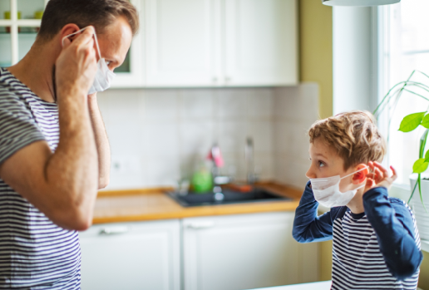
Worries and Fears
Be honest and direct
Keep it developmentally appropriate
Give frequent reminders about safety
Strong4Life Team at Children’s Healthcare of Atlanta
Notes:
TS
You are going to have some kids with worries and fears. If there is anxiety or something beyond what you are comfortable with, work with the counselor/administration.
Giving reminders of safety might help children deal with their worries.

Slide 16
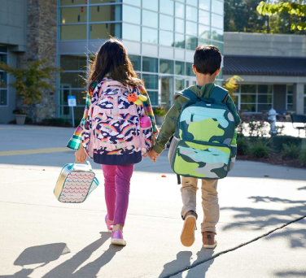
Building Resilient Kids
Resilience is the ability to handle life’s ups and downs.
Having the ability to adapt well to adversity, trauma, tragedy, threats, or even everyday sources of stress, can help children manage feelings of anxiety and uncertainty.
Children who are resilient, are better able to:
Cope with challenges
Manage stress
Make healthy choices
Strong4Life Team at Children’s Healthcare of Atlanta
Notes:
TS
4 C’s suggestions
Mindyeti.com
The Imagine Project – journaling
Calm Corner/Rest and Return Spaces
Positive communication with parents – let parents know when kids are doing well socially and emotionally in addition to academically – especially important now. Class Dojo, Email, Text

Slide 17



Be Mindful
Be aware of your own feelings
Be patient with:
Yourself
Coworkers
Your Students
Practice:
Pause
Breathe
Respond
Strong4Life Team at Children’s Healthcare of Atlanta
Notes:
TS

Slide 18
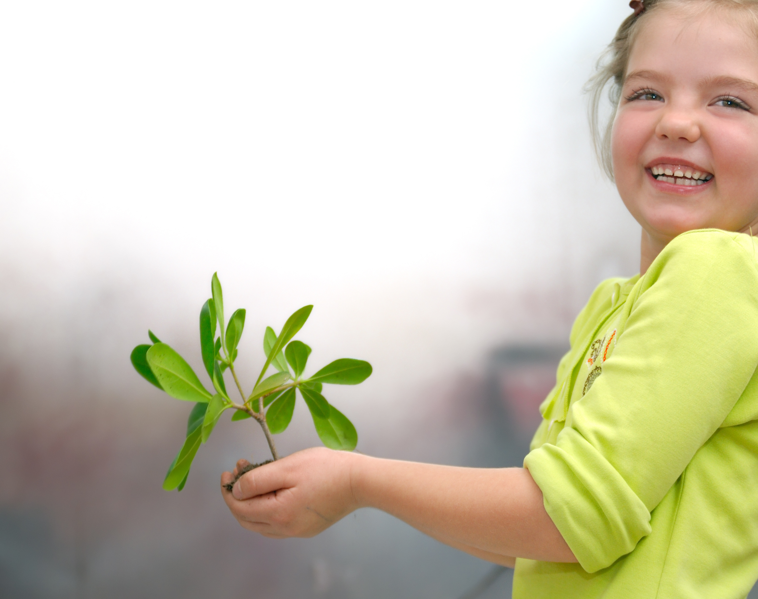
Primary Objectives
You are gathering information and impressions of a student’s wellbeing.
You may discover that a child needs help and support.
When you have a reasonable suspicion that abuse has occurred, follow your protocol and make a report.
Notes:
AB

Slide 19
Prepare Now for Your Specific Role
Know
Know the basic signs of abuse and trauma and their corresponding behavioral indicators
Equip
Equip your team to talk with children about abuse and how to react responsibly to suspicions or a disclosure.
Review
Review your mandated reporter protocol and identify your designated reporter, as appropriate.
Notes:
AB
Many schools have one person who is considered the mandated reporter.

Slide 20

General Signs of Maltreatment
Panic Attacks
Fear
Anger
Withdrawal/Lack of eye contact
Less interaction with others
Notes:
AB
These are signs that may be more easily recognized
Lack of interest in activities previously enjoyed
Easily startled
Fatigue/Exhaustion
Insomnia
Vague complaints of aches and pains throughout body
Panic Attacks
Fear
Anger
Withdrawal/Lack of eye contact
Less interaction with others

Slide 21
General Signs of Maltreatment
Lack of interest in activities previously enjoyed
Easily startled
Fatigue/Exhaustion
Insomnia
Vague complaints of aches and pains throughout body
Notes:
AB
These are signs that may be more easily recognized
Lack of interest in activities previously enjoyed
Easily startled
Fatigue/Exhaustion
Insomnia
Vague complaints of aches and pains throughout body
Panic Attacks
Fear
Anger
Withdrawal/Lack of eye contact
Less interaction with others

Slide 22
Signs of Online Abuse
Pay attention to language and terms that indicate exposure
1
Listen for language that is not age appropriate
2
Look for behaviors that mimic what they might have seen
3
Listen for clues they have made a new friend online
4
Notes:
AB
Children are always at risk when they are online; however during this time of isolation they have an increased risk of exposure to pornography and accessibility to online predators.
Elaborate on virtual learning/online access

Slide 23
Physical Abuse
Physical Abuse is defined as:
Any non-accidental physical injury suffered by a child as the result of the acts or omissions of a person responsible for the care of a child
Important Points to Remember:
Injuries are often unexplained or explanation is vague
Consistent history is often a determining factor
Corporal punishment is legal, physical abuse or injury is not
  Lasting marks or injuries are reportable
Notes:
AB

Slide 24
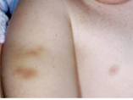
Physical Abuse
Bruises
Unexplained
Pattern (shape resembles object like hand)
Location
  Ears, soft part of cheek, neck, inner thighs/genitals, trunk, buttocks, hands/feet
Burns
Injuries are often unexplained or explanation is vague
Consistent history is often a determining factor
Corporal punishment is legal, physical abuse or injury is not
  Lasting marks or injuries are reportable
Notes:
AB

Slide 25
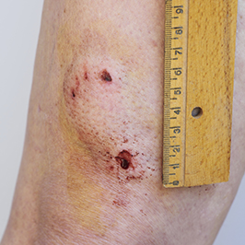
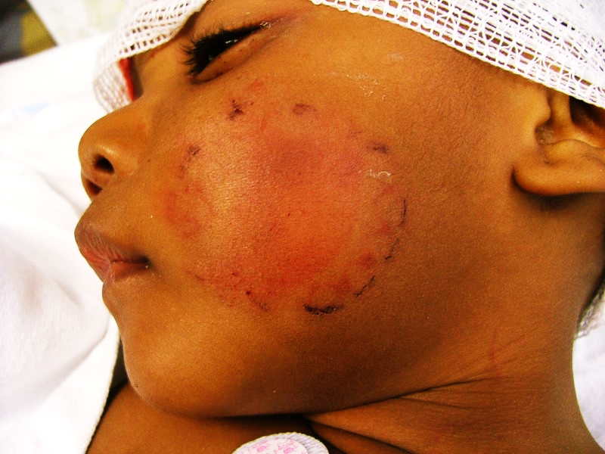
Physical Abuse
Bites
Adult vs. Child
Human vs. Non-Human
  Non-human bite typically leads to tearing of the skin
Emotional Indicators
Feels deserving of punishment
Wary of adult/physical contact
Frightened of parents/afraid to go home
Self-destructive behaviors
Wears clothing to cover body – inappropriate for weather
Dog bite
Human bite
Notes:
AB

Slide 26
Sexual Abuse
Sexual Abuse is defined as:
Exploitation of a child for the sexual gratification of an adult or older/more powerful child
Forcing, coercing or persuading a child to engage in any type of sexual act
Commercial sexual exploitation of children (sex trafficking)
It includes non-contact acts
Exhibitionism
Exposure to pornography
Voyeurism
Communicating in a sexual manner by phone or internet
Notes:
AB

Slide 27
Sexual Abuse
Physical Indicators
Difficulty walking or sitting
Torn, stained or bloody underclothes
Pain, swelling or itching in the genital area
Bruises, bleeding or laceration in external genitalia area
Presence of STI or other infections
Behavioral Indicators
Inappropriate sex play or advanced sexual knowledge
Sudden school difficulties
Difficult peer relationships
Self-imposed isolation, avoid physical contact
Sudden massive weight change (loss or gain)
Notes:
AB

Slide 28
Sexual Abuse
Emotional Indicators
Withdrawal
Fear
Depression
Unexplained anger
Nightmares
Excessive worrying about siblings
Notes:
AB

Slide 29
Neglect
Neglect is defined as:
The failure to provide parental care or control, subsistence, or other care or control necessary for a child’s physical, mental, or emotional health or morals; the failure to provide adequate supervision necessary for such child’s well-being, or the abandonment of a child by his or her parent, guardian, or legal custodian.
Most common form of child maltreatment
Can be difficult to identify
Parents who abuse substances (alcohol & drugs) and/or have inadequate parenting skills are responsible for many of the neglect cases
Many cases go unreported and is a much larger problem than statistics indicate
Notes:
AB

Slide 30
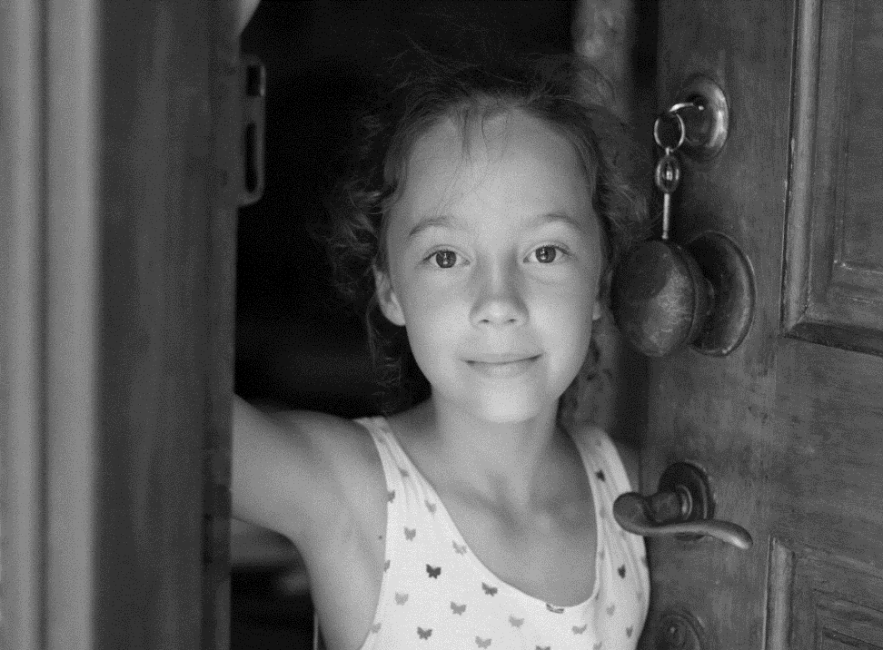
Neglect
Different Types of Neglect
Failure to provide:
Physical- adequate food, shelter, clothing, hygiene and/or supervision
Medical- necessary medical or mental health treatment
Educational- learning or special educational needs
Emotional- love, affection, security, and emotional support that result in serious cognitive, affective, or other behavioral health problems
There is no legal requirement for a parent to provide any medical treatment, if that treatment is against the parent’s religious beliefs.
Notes:
AB
”No child who in good faith is being treated solely by spiritual means through prayer in accordance with the tenets and practices of a recognized church or religious denomination by a duly accredited practitioner thereof, shall, for that reason alone, be considered to be an abused child.”

Slide 31
Neglect
Physical Indicators
Consistent hunger/ underweight
Consistent lack of supervision
Unattended physical/medical needs
Failure to thrive/poor growth
Poor hygiene
Inappropriate dress
Emotional Indicators
Self-destructive behaviors
Begging, stealing food
Constant fatigue, listlessness
Assuming adult responsibilities
Says no caretaker at home
Frequently absent / tardy
Not participating in online work/activity
Notes:
AB

Slide 32
Emotional/Psychological Abuse
Emotional/Psychological Abuse is defined as:
Failure to provide psychological care and spousal abuse in front of a child
Excessive or aggressive parental behavior that places unreasonable demands on a child to perform above his/her capabilities
It frequently occurs as verbal abuse, but also includes
  Rejection
  Terrorizing
  Shameful forms of punishment
  Withholding physical/emotional contact
A pattern over time
Notes:
AB

Slide 33

Child Endangerment
Child (<18) witnesses DV/Family Violence Battery
Driving under the influence with a child <14 in the vehicle
Child is present where methamphetamine is manufactured
Prenatal substance use resulting in infant withdrawals, substance in meconium, or other medical diagnosis
Notes:
AB

Slide 34
Types of Disclosures
Indirect Hints: “My uncle wears funny underwear.”
Disguised disclosure: “I know someone who is being hurt.”
Disclosure with strings attached: “I’ll tell if you promise not to say anything.”
Notes:
JN

Slide 35
When A Child Discloses Abuse
Find a quiet place to talk
Reassure the child
”I believe you”
“I’m proud of you for telling me”
“What happened to you is not your fault”
“Abuse is wrong. I am sorry this happened to you”
Listen calmly and don't overreact
Don’t ask leading questions, only open ended
”What happened next?”
“Tell me more.”
Once the disclosure is made, stop asking questions
Notes:
JN

Slide 36

What Not to Say
“Why didn’t you stop him/her?”
“Why are you telling me this?”
“Are you sure this happened?”
“Are you telling me the truth?”
“Let me know if this happens again.”
“What did you do to make this happen?”
Notes:
JN

Slide 37
Scenario
Fabian, an 8 year old boy, began crying in class after the teacher told him that he was going to send a note home about his poor class behavior. Fabian told the teacher that he was afraid of his father and is sure that he is going to get “beat up” after his father gets the note. Fabian also said that his father punches him with a closed fist and tells him to “get up and fight like a man.” The teacher doesn’t see any visible bruises or marks on Fabian. Fabian also said that his mother hasn’t lived with them for a long time and his father’s girlfriend just moved out. He thinks she left because his father was mean to her too. The Principal called the father and asked him to come to school to discuss the matter. When the father arrived, Fabian began crying and urinated in his pants. When the father walked into the office, it appeared that he kicked Fabian’s leg as he passed, although it is unclear if it was intentional. The meeting with the father was uneventful as the father sat quietly and mostly listened without reaction. After the meeting was over, the father was observed dragging Fabian by the arm across the parking lot.
What type of disclosure is this? How would you handle it?
Notes:
JN
Discussion Points
1. The child’s fearfulness of the father should be a red flag. The child also discloses that he is going to get “beat up” when he brings the note home. This is enough information to suspect child maltreatment and to make a mandated report. If the school has information on the mother they should include that and who is the legal guardian.
2. The child is especially vulnerable (possible abuse due to father’s behavior and child’s age and limited ability to defend himself).
3. The school should make the report to DFCS because the child discloses he is fearful of his parent. They should not call the father in and try to investigate the situation, that is DFCS’ job.
4. Does the school have information about the child’s mother? May need to get some family history from her if she is available and a legal parent.
5. If school officials haves any knowledge about domestic violence in the home, this should also be reported to DFCS.
6. After witnessing the further negative reactions from the child when the father is at school and the physical manner in which the father interacts with his son, school officials would make another mandated report and possibly a call law enforcement to immediately intervene.

Slide 38
Prevention Resources for Professionals
Implement Sexual Abuse & Assault Prevention training virtually - https://www.gadoe.org/schoolsafetyclimate/Pages/Child-Abuse-and-Child-Protection.aspx
Participate in online prevention trainings
  Darkness to Light's Stewards of Children training – free at www.FlipTheSwitchCampaign.org
Darkness to Light's Safe Online Learning: For Teachers - www.d2l.org/safe-digital-learning-plans/
Notes:
JN
Many of the programs within the Technical Assistance Resource Guide have adapted their programs to a virtual platform. This would be a great way to remind students of safety strategies and to dig a little deeper for those students you may be concerned about. Post the child abuse hotline number on your Google Classroom.

Slide 39
Prevention Resources for Parents
Participate in online prevention trainings
  Darkness to Light's Talking to Children about Safety from Sexual Abuse –free using code TALK2020
  www.d2l.org/education/additional-training/talking-with-children/
Help parents create a COVID-19 Family Safety Plan
  Example from Stop It Now! www.stopitnow.org/sites/default/files/documents/files/create_family_safety_plan.pdf
  Talk to children about safe touch, consent and personal boundaries
Maternal Health
  Healthy Mothers, Healthy Babies provides perinatal education and pregnancy/post-partum resources throughout Georgia https://hmhbga.org/
Notes:
JN

Slide 40
Prevention Resources for Parents
Talk with children
  Hot Chocolate Talk from Committee for Children – What to Say at Every Age https://www.cfchildren.org/resources/child-abuse-prevention/
  Protecting Children During a Crisis – www.D2L.org
  Blog for Parents about Online Safety – NetSmartz https://www.missingkids.org/blog/2020/child-online-safety
Notes:
JN

Slide 41



Prevention Resources for Kids
CHILDHELP
For kids who want to report or disclose via text or chat.
Live Chat Line: www.childhelp.org/childhelp-hotline/
Text or Call 1-800-422-4453
Georgia Crisis &
Access Line
27/4 Crisis Line
1-800-715-4225
Telephonic crisis intervention
Dispatch mobile crisis team
link to urgent services
notOK
suicide prevention app
Allows youth to enter contacts and send immediate alerts and location when they are not ok.
https://www.notokapp.com/
Notes:
JN

Slide 42
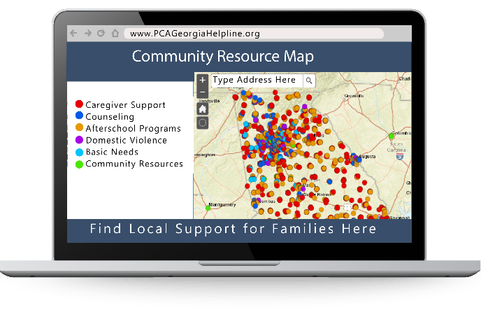
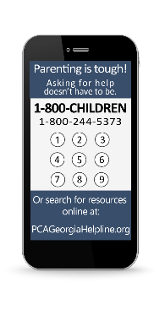
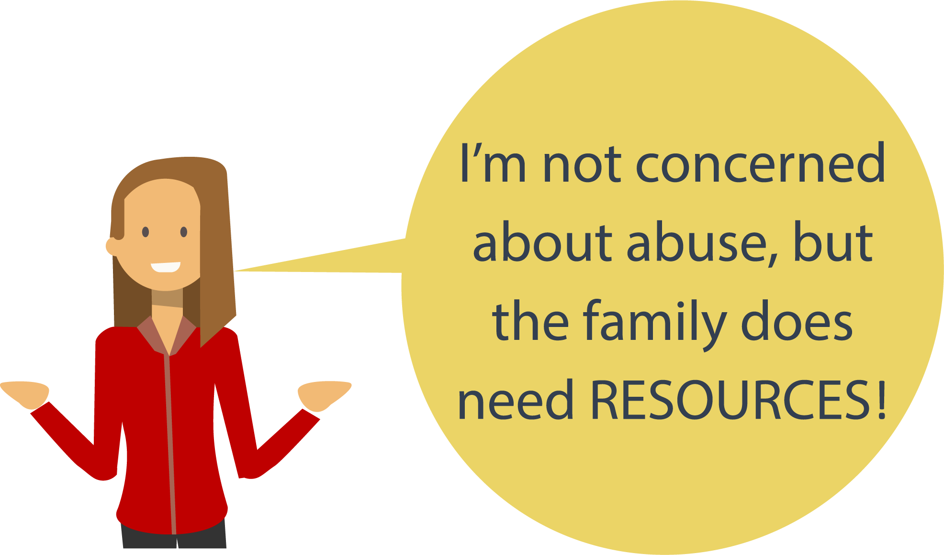
1-800-CHILDREN
(1-800-244-5373) Se Habla Español
Why People Call
Caregiver Support, Counseling
Community Programs
Domestic Violence
Housing and Basic Needs
Afterschool and Child Programs
www.PCAGeorgiaHelpline.org
Sometimes a family may just need RESOURCES!
The Helpline Serves
Professionals that work with families
Parents and Grandparents
Relatives or Other Caregivers
Crime Victims or Survivors of Abuse
Faith Communities
Connects Families to Supportive Programs and Resources in your Community
Notes:
JN
The 1-800-CHILDREN number is a great option when there is not a concern for abuse or neglect but simply a need for resource linkage. Children need stable and nurturing relationships and environments as they develop from infancy into adulthood.
It takes parents, caregivers and RESOURCES to make that happen. The 1-800-CHILDREN Helpline is a free statewide helpline that will give parents and caregivers information they can use wherever they live in Georgia. The Helpline is open Monday through Friday from 8:00 a.m. until 6:00 p.m. and it is staffed by trained professionals. The helpline provides information to parents, grandparents, or others helping to raise children. It is a safe place for those concerned about the wellbeing of children to discuss options.
Take Note:
See Appendix M for half sheet fliers for the 1-800-CHILDREN Helpline.

Slide 43
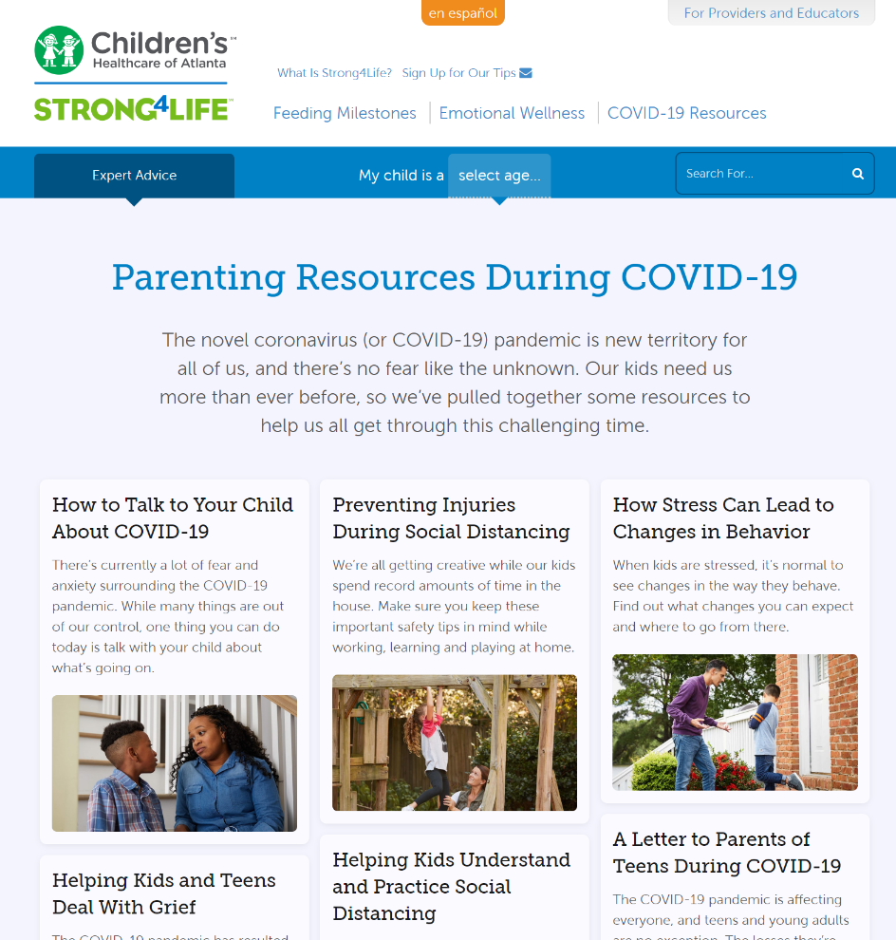
Strong4Life.com/COVID19
Strong4Life.com/Reopening
Notes:
AB

Slide 44
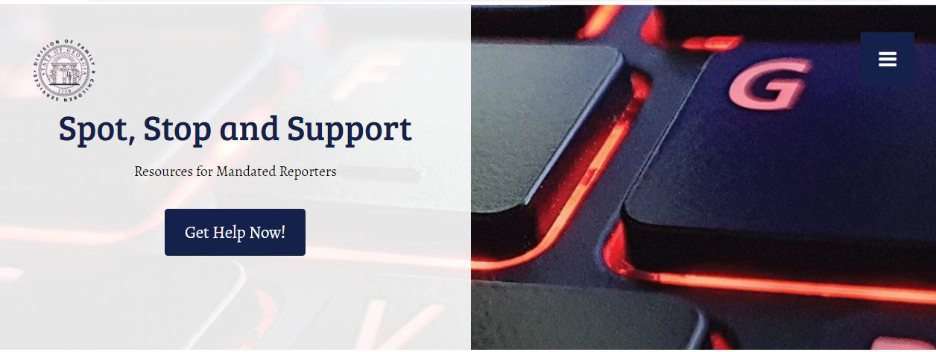
Spotstopandsupport.constantcontactsites.com
Notes:
JN

Slide 45

Remember This…
Connections Matter!
The most important factor in helping a child overcome adversity is the presence of just one caring adult.
Notes:
JN

Slide 46
Evaluation Survey
Complete the evaluation link below, also sent via email, to receive a certificate of attendance.
https://www.surveymonkey.com/r/SchoolsonDeck
Notes:
JN

Slide 47
Thank You
Cheryl Galloway-Benefield
Program Manager - Safe and Supportive Schools
Georgia Department of Education
cbenefield@doe.k12.ga.us
Notes:
JN

Slide 48
Thank You
Tiffany Sawyer
Director of Prevention Services
Georgia Center for Child Advocacy
tiffanys@gacfca.org
Notes:
JN

Slide 49
Thank You
Angie Boy, DrPH
Program Manager, Prevention and Training
Stephanie V. Blank Center for Safe and Healthy Children
angela.boy@choa.org
Notes:
JN

Slide 50
Thank You
Julia Neighbors, JD
Executive Director
Prevent Child Abuse Georgia
jneighbors@gsu.edu
Notes:
JN

