Slide 1
David J Schonfeld, MD, FAAP Director, National Center For School Crisis And Bereavement Children’s Hospital Los Angeles
Talking to and supporting our children
during the pandemic
schonfel@usc.edu
SchoolCrisisCenter.org | GrievingStudents.org
1-877-536-NCSCB (1-877-536-2722)

Slide 2
Starting the conversation
Start the conversation with children – start by asking them what they have heard, how they are feeling, and what questions or concerns they have
Provide basic information, without a lot of detail
Let their questions or concerns guide what and how much you share
Don’t try to cover everything in one conversation

Slide 3
Children/adults may have limited understanding
Limited information – they weren’t told about it
Misinformation – they were told incorrect information
Misinterpretations or misconceptions – they were told correct information, but misunderstood it (either because they got the facts wrong or they didn’t understand what it meant)
Ask children to explain what they heard and ask them to explain what it means as well

Slide 4
Avoid using fear
Trying to “reassure” people by telling them it could be worse is likely to make them think it will get worse
Find out your children’s own fears, concerns, skepticism
You can’t reassure your children if you don’t know what they are afraid of or concerned about

Slide 5
Be honest
Don’t pretend everything is OK – children pick up when adults are not genuine and honest
Children may pick up on concerns primarily of adults
Provide appropriate reassurance, but don’t give false reassurance
Don’t tell children that they shouldn’t be worried; help them learn to deal with uncertainty and fear
Include positive information; present a hopeful perspective

Slide 6
Establish a predictable routine
Goal is to restore a sense of predictability
We likely won’t know what is going to happen next during this pandemic until it happens
Children may be particularly sensitive to changes in routine; communicate with them when changes do become necessary
For children with autism spectrum disorder, predictability and routine is particularly important

Slide 7
Some children may need more assistance
The pandemic and discussion about the impact on families may remind children of other difficulties – events in the past, ongoing challenges, or concerns about future losses or crises
Children who were anxious or depressed before the pandemic will likely need more support
Reach out to your mental health and pediatric healthcare provides to get advice and support

Slide 8
Strategies for dealing with distress
Reading or hobbies that promote healthy distraction
Journaling, blogging, art, music to help express feelings
Exercise, yoga
Appropriate use of respectful humor
Relaxation techniques, mindfulness, self-hypnosis and guided imagery
Cognitive behavioral therapy

Slide 9
Allow input by children
Help children identify steps they can take personally to protect their own health and to help others
Ask them what they would like to do at home
If they can contribute to the response, they are less likely to feel helpless

Slide 10
Watch your media consumption
Make sure it is a healthy diet; don’t consume too much
Keep informed through focused/periodic attention to trusted sources of information
American Academy of Pediatrics: http://bit.ly/2PNTuwX
Centers for Disease Control and Prevention: https://www.cdc.gov/coronavirus/2019-nCoV/index.html
If you aren’t getting reassured or learning practical actions to take, then disconnect from media
Limit amount of media exposure – this is a good time to unplug and connect instead with children and family

Slide 11
Remember to take care of yourself
All adults likely will have concerns about their own health and those of family/friends – don’t just focus on needs of your children
Children may need to focus first on their own needs, before able to think of needs of others
While crisis can bring out the best in people, it also brings out their stress – we likely won’t be at our best all the time
Be patient with your children, other adults, and yourself

Slide 12
What you are doing is of value
Just because we don’t know everything, doesn’t mean we know nothing of value
You know strategies that have helped in the past to decrease your children’s distress – try them now
Contact your pediatric healthcare provider; reach out to resources in school/community when needed
Celebrate positive contributions you make
Set reasonable expectations
The curriculum has changed – teaching children how to cope → helping them learn life skills that will make them more resilient

Slide 13
www.schoolcrisiscenter.org

Slide 14
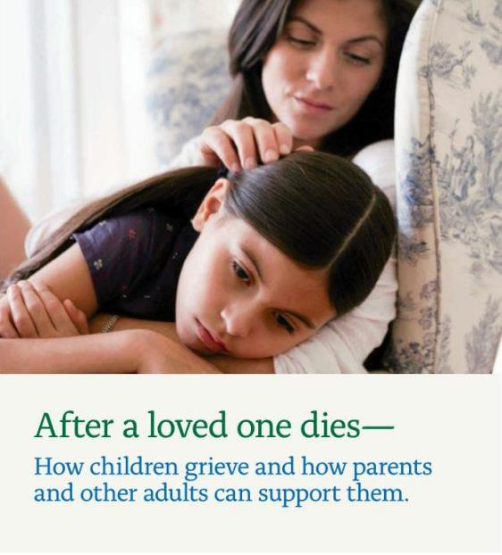
www.grievingstudents.org
Order Free Materials (download)

