Slide 1

End of Course Assessment (EOC)
Spring 2015
Pre-Administration Workshop
March 17- 19, 2015
This PowerPoint is available at:
http://www.gadoe.org/Curriculum-Instruction-and-Assessment/Assessment/Pages/Georgia-Milestones-Assessment-System.aspx

Slide 2
AGENDA
Program Overview
Participants
Score Reports and Grading
Administration Windows
Scheduling
Testing Modes
Testing Accommodations
Test Security and Irregularities
Before, During, and After Testing
EOC Important Dates and Resources

Slide 3
Program Overview
Results of the EOC measures, according the legislated and identified purposes, must:
provide a valid measure of student achievement of the state content standards across the full achievement continuum;
serve as the final exam for the course, contributing 20% to the student’s final course grade (Not applicable in 2014-2015);
provide a clear signal of the student’s preparedness for the next course and ultimately after secondary endeavors (college and career);
allow for the detection of the progress made by each student from one assessed course to the next;
support and inform educator effectiveness measures; and
inform state and federal accountability measures at the school, district, and state levels.

Slide 4
Program Overview
Test Construction
  Test items that contribute to achievement scores are aligned to the state-adopted content standards
  Continued field testing of content for future administrations
  Norm-referenced (NRT) items included to allow for national comparison; some NRT items are aligned to state-adopted content standards and will contribute to the criterion-referenced (CRT) proficiency score. Those that are not aligned will not contribute to the CRT score or accountability/teacher effectiveness measures
  EOC Assessment Guides are available in the Georgia Milestones section of the Testing/Assessment Website

Slide 5
Program Overview
  9th Grade Literature & Composition
  American Literature & Composition
  Coordinate Algebra
  Analytic Geometry
  Physical Science
  Biology
  US History
  Economics/Business/Free Enterprise

Slide 6
Course ID | 2014-2015 Course Name | Corresponding EOC
23.06100 | 9th Literature and Comp | 9th Grade Literature
23.05100 | Am Literature and Comp | American Literature
23.05300 | AP Language Comp (American Lit Comp) | American Literature
23.06120 | IB English B, Year One | American Literature
23.06130 | IB English B, Year Two | American Literature
23.06800 | IB English A Literature, Year One | American Literature
23.06900 | IB English A Literature, Year Two | American Literature
23.07300 | IB English A Language & Literature, Year One | American Literature
23.07310 | IB English A Language & Literature, Year Two | American Literature
26.01200 | Biology I | Biology
26.01400 | AP Biology | Biology
26.01800 | IB Biology, Year One | Biology
26.01900 | IB Biology, Year Two | Biology
40.01100 | Physical Science | Physical Science
45.08100 | General US History | US History
45.08200 | AP US History | US History
45.08700 | IB History of Americas, Year One | US History
45.08930 | IB History of Americas, Year Two | US History
45.06100 | Economics/Business/Free Enterprise | Economics
45.06200 | AP Macroeconomics | Economics
45.06300 | AP Microeconomics | Economics
45.06500 | IB Economics, Year One | Economics
45.06600 | IB Economics, Year Two | Economics
27.09710 | Coordinate Algebra | Coordinate Algebra
27.09750 | Accelerated Coordinate Algebra/Analytic Geometry A | Coordinate Algebra
27.09720 | Analytic Geometry | Analytic Geometry
27.09760 | Accelerated Analytic Geometry B/Advanced Algebra | Analytic Geometry

Slide 7
Participants*
Enrolled in EOC Course(s)
Enrolled in specified courses/programs
Validation of Coursework
High School students
AP/IB Course enrollees in EOC associated courses
GAVS
Credit Recovery
Transfer students from home school, non-accredited entities
Middle School students (enrolled in an EOC course regardless of whether credit is being earned)
Includes: Students with Disabilities (SWD) and English Learners (EL)
No First Year in US School deferrals for EL students on EOCs
Students simultaneously enrolled in a GA public school and a private school or non-traditional entity
Dual Enrollment students
*See Student Assessment Handbook pages 75-76.

Slide 8
Scores, Reports, and Grading
The applicable provisions of State Board Rule 160-4-2-.13 (Statewide Passing Score) were waived by the State Board of Education for the 2014-2015 school year.
Local school systems may determine their own policies and procedures for calculation of final course grades in EOC courses through the Summer Semester of 2015 (July 31, 2015).
  It is important that students know that they WILL RECEIVE SCORES. Individual score reports and electronic results (that will be loaded to your local system’s Student Information System and the SLDS). In short, their scores – once produced – will become part of their school/test record and history.
  The test itself has NOT been “waived” for 2014-2015 . . . Only its role as the final exam.
In future years, the Georgia Milestones EOC will contribute 20% to the student’s final course grade.

Slide 9
Scores, Reports, and Grading
Score reports will be available in Fall of 2015.
  Produced at the student, class, district, and state levels.
  Provide students’ criterion-referenced proficiency designations for each test.
      These designations will tell the degree to which students have mastered the standards within each course using four performance levels.
  Provide domains scores.
  NRT scores will be presented as national percentile ranks.
  Only the criterion-referenced proficiency designations will be used in the educator effectiveness measures and for state and federal accountability.

Slide 10
Administration Windows
Test Administration | Administration Windows
Spring Main | April 27 – June 5, 2015
Summer Main | June 15 – July 17, 2015*
Fall Mid-Month | August 3 – 21, 2015* September 14 – 25, 2015* October 12 – 23, 2015 November 9 – 20, 2015
Winter Main | November 30, 2015 – January 8, 2016
*Test-out administrations are available.

Slide 11
Administration Times
Content Area/Course | Test Section(s) | Minimum Time Per Section(s) | Maximum Time Per Section(s)
English Language Arts | 1 and 2 | 60 | 70
English Language Arts | 3 | 70 | 90
Mathematics | 1 and 2 | 60 | 80
Science | 1 and 2 | 50 | 70
Social Studies | 1 and 2 | 50 | 70
A section may not be stopped until the minimum allotment of time has expired. If students are still productively engaged with the test content, the maximum amount of time, per section, may be given in 10 minute increments.
Note: These maximum time limits do not apply to those students who have the accommodation of extended time.

Slide 12
Scheduling Considerations
Diligent attention must be given to the development of a schedule that protects the security and integrity of the test administration.
EOC may be scheduled at any time during the state testing window.
  Systems may elect a one-day administration (with a second-day required for ELA Section 3) or;
  A two-day administration (with a third day for ELA Section 3)
  All schools in the system must follow the same schedule as closely as possible.
  Each course area (EOC) should be scheduled for completion during the same week as its start date. The exception is ELA Section 3.

Slide 13
Scheduling Considerations
Make-up Days
The purpose of the make-up days is to administer the tests to students who were unexpectedly absent during the regularly scheduled administration.
  Includes sick days, verified court dates, etc.
  Does not include personal vacations, school field trips.
  When in doubt, contact GaDOE.
Make-ups must only be administered during the district’s window.

Slide 14
Scheduling Considerations
Make-up days/sessions must be designated within the local testing window.
The last day of the local testing window should be scheduled as a makeup day to capture any remaining students who need to complete testing.
In addition to designated makeup days, makeup sessions can be scheduled in the morning or afternoon, as time permits on other days during the local window.

Slide 15
Scheduling Considerations
Schools must adhere to the testing times prescribed in the Examiner’s Manual.
  Additional time is required for disseminating materials, completing forms, and other test protocols.
  A section may not be stopped until the minimum allotment of time has expired.
  If students are still productively engaged with the test content at the end of the section, the maximum amount of time, per section, may be given in 10 minute increments.
  Allowing too much or too little time may result in an invalidation.

Slide 16
Scheduling Considerations
When scheduling tests, consider the optimum time to administer the tests.
  Consider logistics, including time and staffing.
  During one-day test administrations, lunch should not serve as the break between sections I and II. To do so would allow for potential breaches of test security.

Slide 17
Testing Modes
End of Course measures may be administered via paper-and-pencil or online.
  Paper-and-pencil assessments will be available during all main administrations.
  Online assessments are available for all administrations (required for mid-month administrations).
Examiners will have to keep track of administration time for both testing modes.

Slide 18
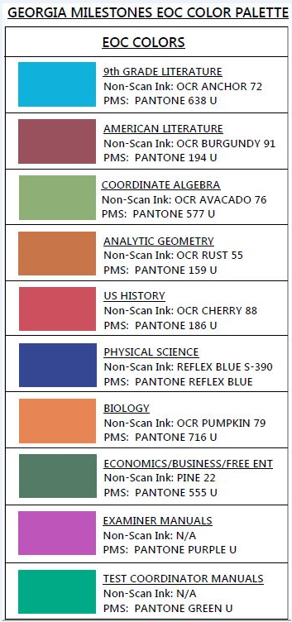
Paper-and-Pencil
Color Families for Test Booklets and Answer Documents
Test booklets and answer documents will have a new color pallet scheme.
  Will be in both light and dark variation (50% and 100%) to denote different core forms.
  NOTE: This color variation is to assist in matching up the correct answer document with the appropriate test booklet.

Slide 19
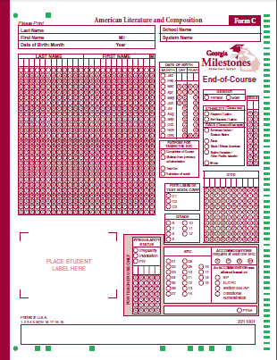
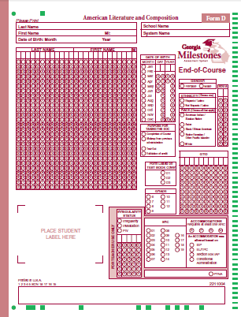
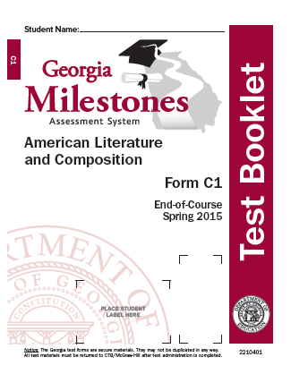
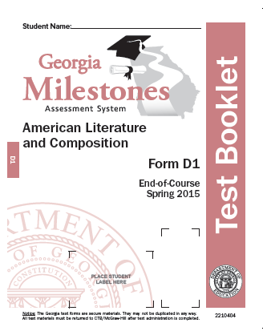
English Language Arts
Form numbers for English Language Arts booklets MUST be matched to answer document that have the same form.

Slide 20
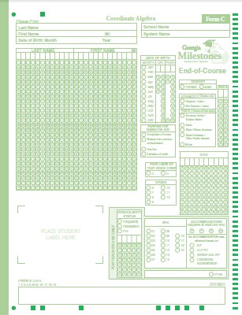
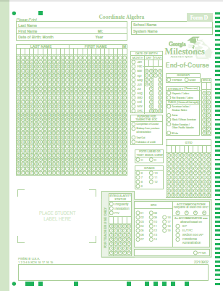
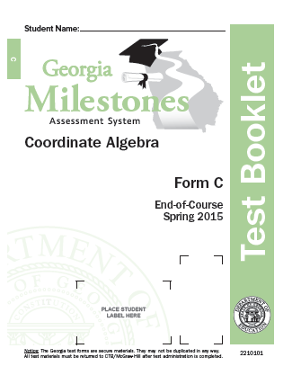
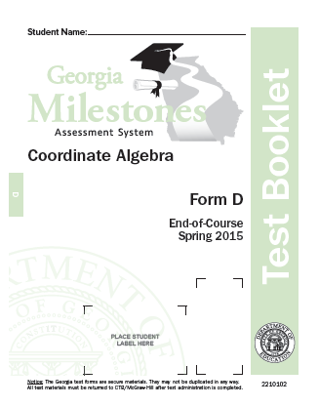
Mathematics
Form numbers for Mathematics booklets MUST be matched to answer document that have the same form.

Slide 21
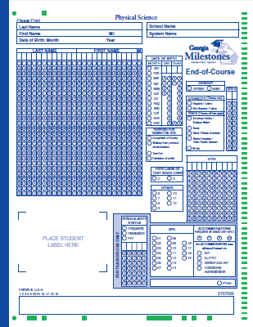
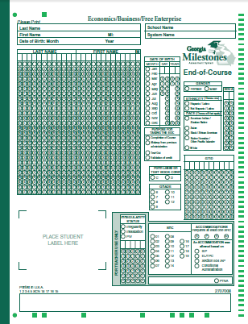
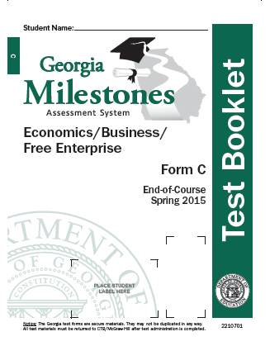
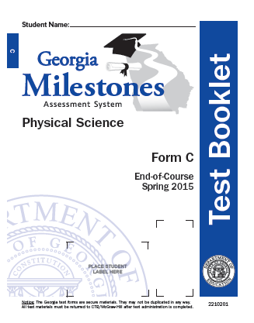
Science and Social Studies
Have one answer document.

Slide 22

Answer Document
Ink pens are NOT allowed on the EOC and EOG.
This includes ELA Section 3.
Responses written in ink cannot be scored.

Slide 23
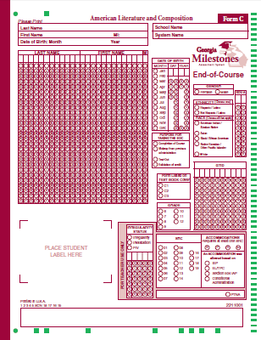
Answer Document
Print Name, School and System
Enter Date of Birth
Do not submit documents with student labels misplaced.
All demographic information must be bubbled for students who do not have labels.
Affix Student Label

Slide 24
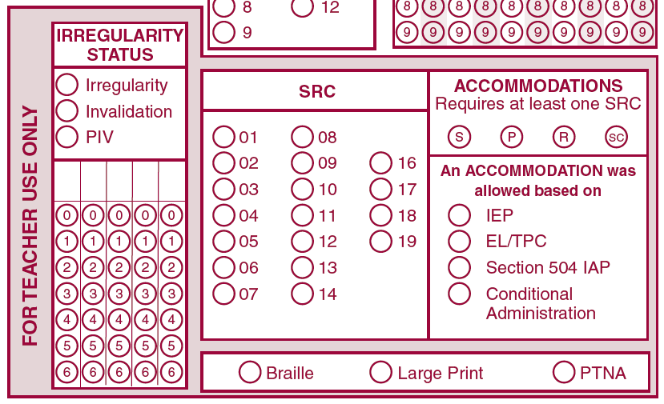
Answer Documents
FOR TEACHER USE ONLY
Complete Following Sections Only if Applicable
SRC must be coded for students with IEP, EL/TPC, or 504 IAP, with or without accommodations
Types of accommodations:
  S – Setting
  P – Presentation
  R – Response
  SC – Scheduling
Identify basis of accommodations:
  IEP, EL/TPC, or 504 IAP

Slide 25
Answer Documents
FOR TEACHER USE ONLY
If applicable, code Braille or Large Print.
The PTNA option should only be bubbled by the Examiner if a student is present and can not or will not take a test. If a student answers one question on any section of the test, PTNA should NOT be bubbled.

Slide 26

Answer Documents
Complete the following sections only if applicable
State Directed Use (SDU A)
SDU A – Code for Georgia Network for Educational and Therapeutic Support (GNETS) and Georgia Virtual School (GAVS)

Slide 27
Pre-Code Window
For Online Testing
The Test Administration System (TAS) will contain data from the State Pre-ID File ONLY if the system marked students as “Yes” in the State Pre-ID File’s (February 2015) Online Indicator field.
The Pre-Code window will be open from March 2 – 27.
  Systems will have the opportunity to add/edit student information.
  The window closes at 8:00 p.m. ET on March 27.
  Pre-Code files will be loaded immediately after this window closes
Details will be provided in upcoming technical training session.

Slide 28
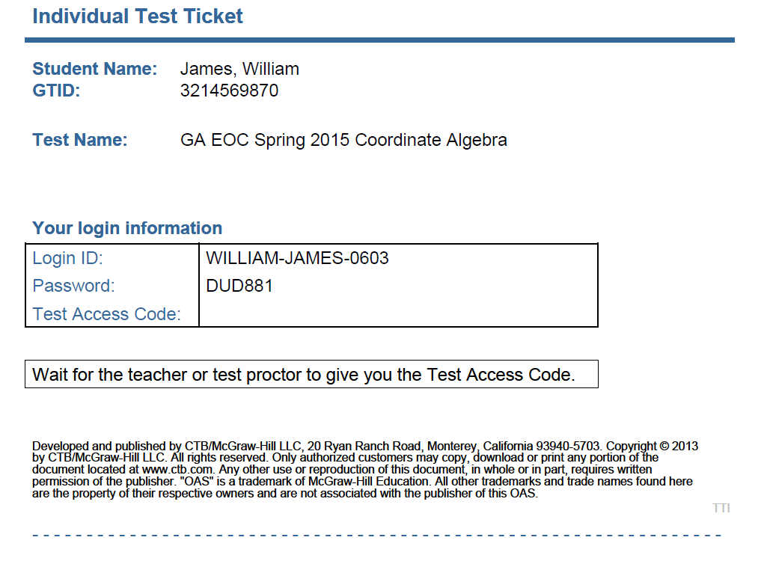
Test Tickets
To avoid a student testing under another student’s GTID, you must :
Print ALL Student Tickets.
Have students verify their name and test name are correct and sign the ticket next to their name.

Slide 29
Online Tools for All Students
Blocking Tool
Highlighter
Eraser
Mark for Review
Online Calculator – if allowable
Option Eliminator

Slide 30
Scratch Paper
Blank scratch paper (including notebook paper) should be provided to students taking the following EOCs regardless of administration mode:
Ninth Grade Literature: Section 3 only
American Literature: Section 3 only
Coordinate Algebra*
Analytic Geometry*
Physical Science
Economics
* ¼” graphing paper may be provided only in the indicated courses. http://www.gadoe.org/Curriculum-Instruction-and-Assessment/Assessment/Pages/Georgia-Milestones-Assessment-System.aspx

Slide 31
Calculator Policy
Content Area | Grade Level/Course | Type of Calculator
Mathematics | Coordinate Algebra EOC | Graphing² or Scientific
 | Analytic Geometry EOC | Graphing² or Scientific
Science | Physical Science EOC | Scientific or Basic¹
Social Studies | Economics EOC | Scientific or Basic¹
¹Basic four-function calculator with square root and percentage functions.
²Graphing calculator with functionalities consistent with TI-84 or similar models.
Calculators are not permitted on certain designated sections of each mathematics test.

Slide 32
Calculator Policy
System Test Coordinators, School Test Coordinators, and Test Examiners must ensure all calculator policies are implemented and followed.
Given that many models of graphing calculators possess the ability to store text, and may prevent that feature from being disabled, it is required that System and School Test Coordinators, and Test Examiners, confirm prior to testing and immediately after testing (before dismissing students) that all graphing calculators are cleared of any stored text.
  A failure to confirm that text is cleared may raise school-wide (and possibly system-wide) security concerns.
  A failure to take these steps constitutes an irregularity that must be reported to GaDOE.
  Failure to clear memory both BEFORE and AFTER will result in an automatic invalidation.

Slide 33
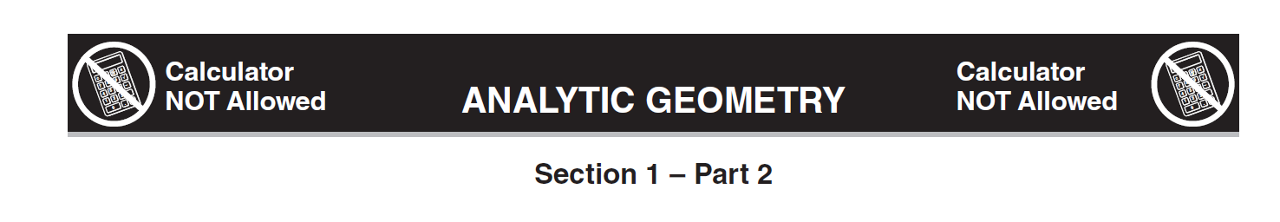
Mathematics
Transition to Non-Calculator Sub-Section
All Non-Calculator pages have this unique heading.
This heading should be readily visible from a distance.
The Examiner’s Manual will also inform the examiner as to the item numbers that comprise the non-calculator section.
This ICON will appear in the online test as well.

Slide 34
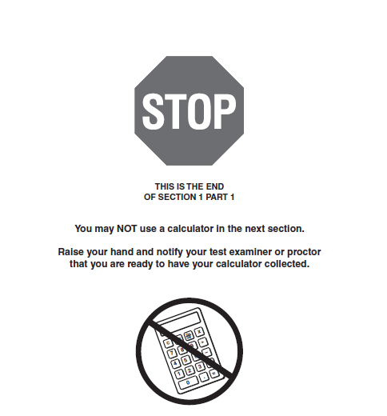
Mathematics
Transition to Non-Calculator Sub-Section
This language will appear in the online test as well.

Slide 35

Mathematics
Transition to Non-Calculator Sub-Section
Stop sign and guidance to turn in calculator at then end of Section 1, Part 1 from paper-and- pencil answer document

Slide 36
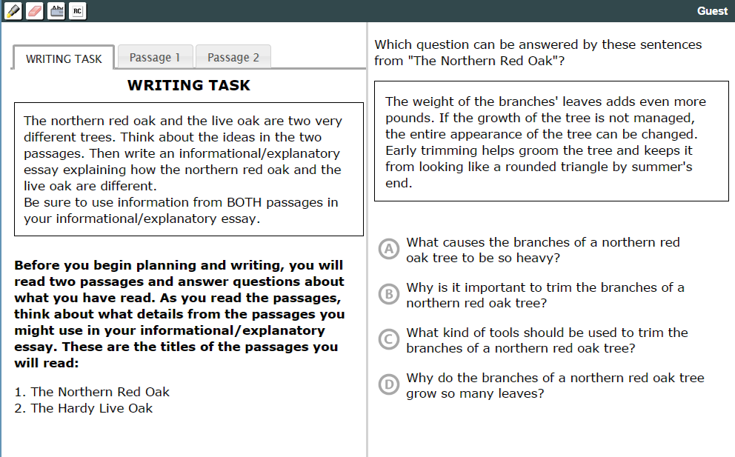
ELA Section 3 Online Items 56, 57, 58 Multiple Choice
ELA Section 3
Introduces the topic
Passages are accessed by clicking the corresponding passage tab
Question is always displayed while viewing WRITING TASK, Passage 1, or Passage 2 tabs
WRITING TASK tab is same for questions 56-59
Item 59 is a constructed response item
Screenshots are from Experience Online Testing Georgia

Slide 37
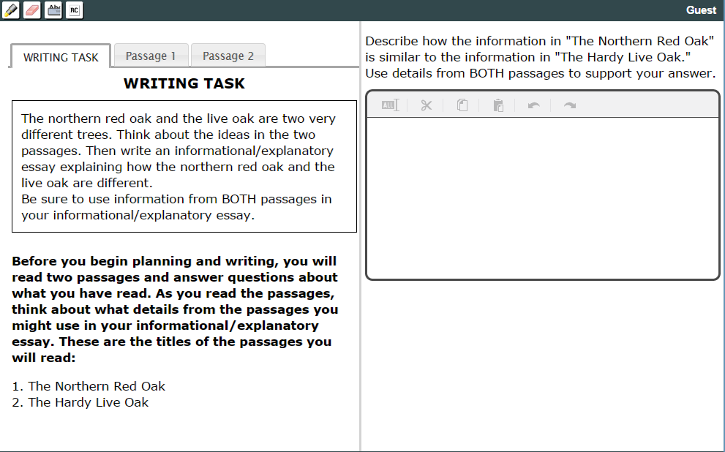
ELA Section 3 Online Item 59 Constructed Response
ELA Section 3
Note that WRITING TASK, Passage 1, and Passage 2 have not changed, but this is a Constructed Response Item
The student can refer to any of the 3 tabs while typing a response

Slide 38
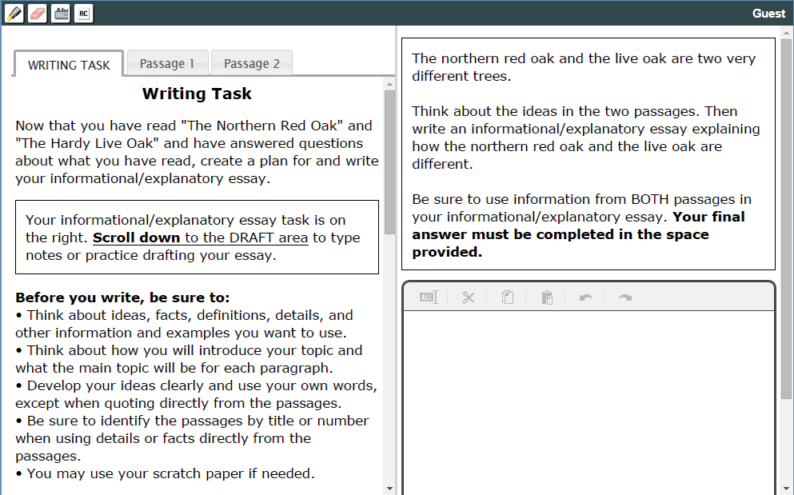
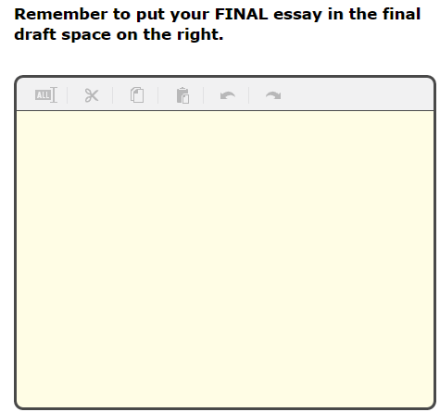
ELA Section 3 Online Item 60 Extended Writing Task
ELA Section 3
The WRITING TASK tab has now changed to guidance for the Extended Writing Task; Passage 1 and 2 are still the same
This is the DRAFT area referenced here
It is accessed by scrolling here
The student can draft here and copy and past into final answer space
DRAFT area and passages are not visible simultaneously

Slide 39
Accommodations
  Students who receive accommodations for instructional and classroom assessment purposes may also be eligible for accommodations during testing.
      Accommodations provided for statewide assessment must be listed on IEP, IAP, or EL TPC and should be consistent with the student’s instructional program.
Oral reading/signing of reading Passages is now a conditional accommodation for 9th Grade Literature and American Literature EOCs.
Georgia Milestones scribing procedures and requirements are posted in the Student Assessment Handbook on Pages 138-139.
  Care must be taken to ensure that all student in read-aloud groups receive a common test form.

Slide 40
Accommodations
Mode of administration (online/paper-and-pencil) should be considered – some accommodations are not applicable for a particular mode
  For example, Braille students should test via paper-and-pencil instead of through an online administration.
To avoid an irregularity, please ensure that students who should receive accommodations are properly identified prior to testing.
If a student is provided a Conditional Accommodation for which they are not eligible, this will result in a Participation Invalidation (PIV).

Slide 41
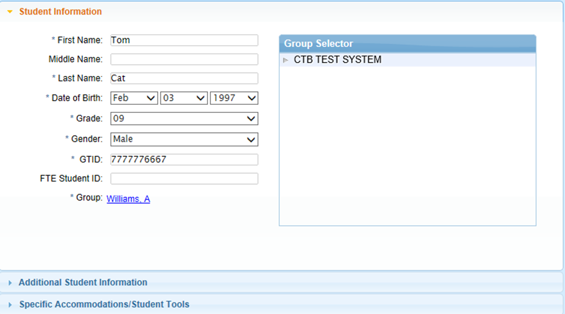
Accommodations
Assigning Accommodations in TAS
This screen in TAS is accessed from the Groups/Manage Students tab, Student List option, and then double clicking on the row with the selected students name.
Specific Accommodations/Student Tools options to assign and activate accommodations students access while testing online

Slide 42
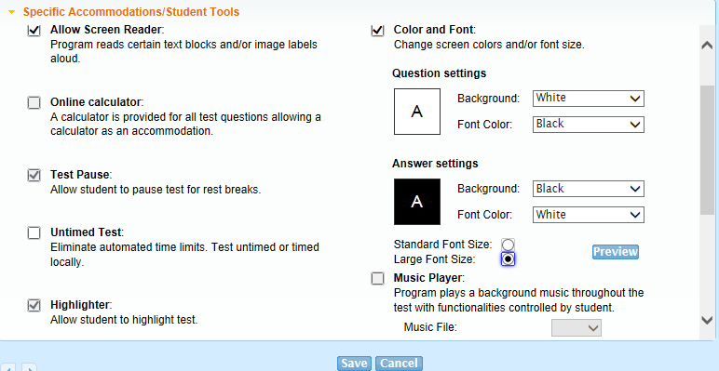
Accommodations - Online
Assigning Accommodations in TAS
These are the only two accommodations options that will need to be assigned in TAS. All other permissible tools/accommodations will preset as default tools for all students.
Note: The Color and Font option has to be selected to activate settings options or to select Large Font Size

Slide 43
Accommodations - Online
Coding Accommodations in TAS for Data File
This screen in TAS is accessed from the Groups/Manage Students tab, Student List option, and then double clicking on the row with the selected students name.
Select Additional Student Information to code the accommodations the student received for the inclusion in Data File

Slide 44
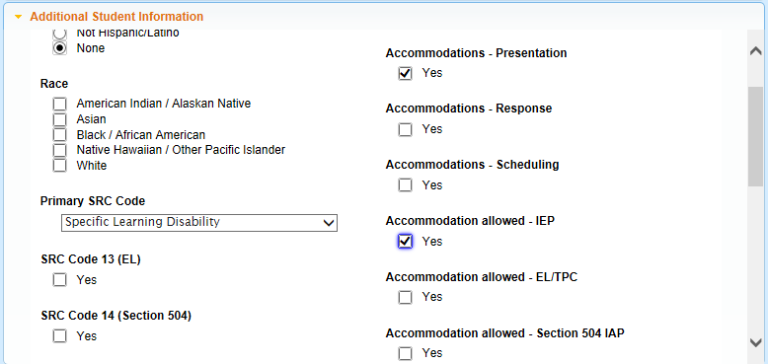
Accommodations - Online
Coding Accommodations in TAS for Data File
This entry is coded as a student with a Specific Learning Disability who tested with a Presentation Accommodation that is based on an IEP. This information will be included in the Data File
This screen parallels the For Teacher Use Only section of a paper-and-pencil student answer document

Slide 45

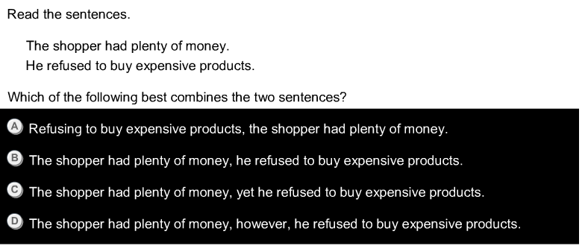
Accommodations - Online
Comparisons for Color and Font Options:
Regular Font versus Large Font
Black text with white background
White text with black background

Slide 46
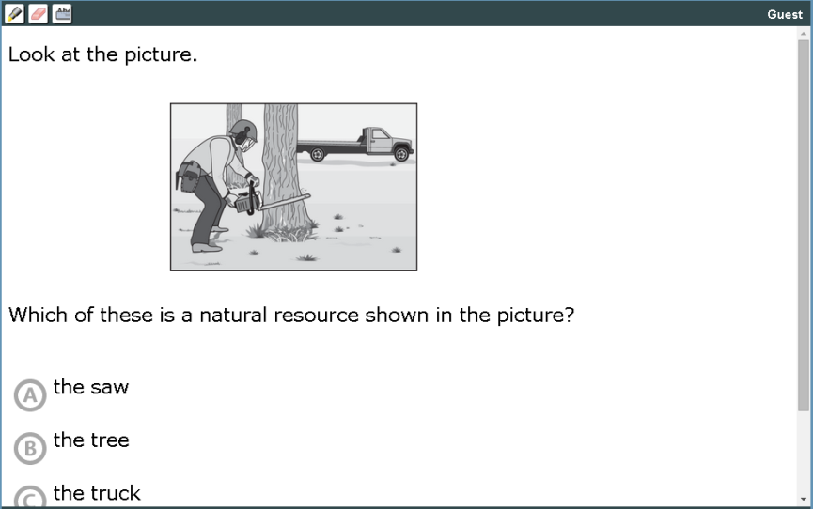
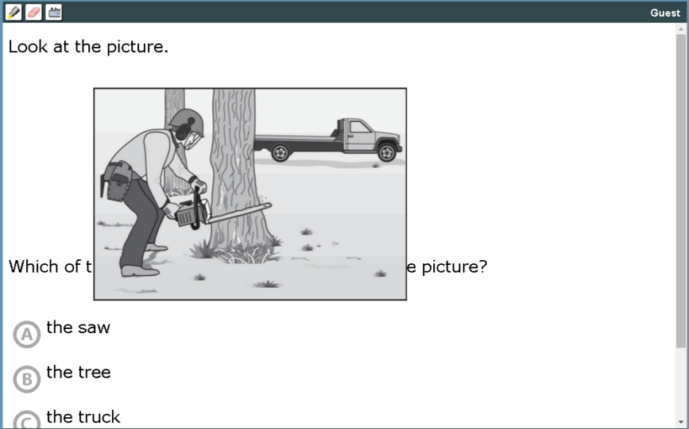
Accommodations - Online
When Large Font is enabled images will “Zoom” when hovered over

Slide 47
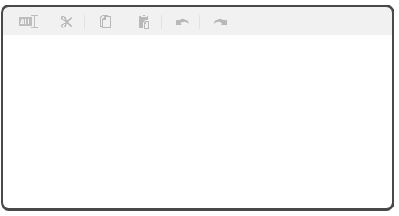
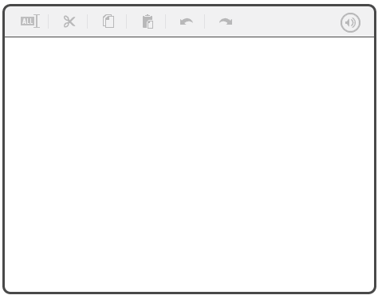
Accommodations - Online
The Large Font accommodation also applies to student response spaces
With the Screen Reader activated, clicking the Audio Icon will read aloud what the student has typed.
Without Screen Reader
With Screen Reader
Regular Font
Large Font
Audio Icon

Slide 48
Security
Maintaining test security and test integrity is critical.
All Examiners who administer a state assessment must hold a valid Georgia PSC-issued certificate.
Everyone involved in the testing process must be properly trained and informed of their roles and responsibilities for test security.
  Attendance at training must be mandatory and well-documented.
  Untrained examiners must not be allowed to test.
Students and teachers need to understand test protocols and the ramifications of not following testing procedures.
The school principal must be made aware of any issues involving testing or test security.
Violations may result in invalidation of students’ tests and/or referral to the Georgia Professional Standards Commission for disciplinary action.
Notes:
.

Slide 49
Security
Student test booklets and online test tickets must be kept stored in a secure place accessible only by the principal and the test coordinator except when actually in use for test administration.
Test materials must not be removed from their secure storage location for reasons other than the preparation of materials for testing, actual test administration, and the completion of tasks as prescribed by test manuals.
Student test booklets must remain in their shrink-wrapped packages as late as possible to avoid security concerns prior to the first day of testing. The only exception is where a pack must be broken to count out for a class when an intact package is not sufficient, create read-aloud groups of the same form, and to ensure the correct placement of Pre-ID labels due to form color families (see slides 19-21). In those cases, this must occur as late as possible to avoid security concerns.
Distribute testing materials as close to the actual testing time as possible.
Testing materials should only be issued to persons who have been carefully advised of their responsibilities for test security.
  Only staff members who have been trained on the proper management of secure test materials should handle such materials.

Slide 50
Security
All persons receiving testing materials must sign a checkout sheet when they receive the materials. This sheet should show date and time.
All testing materials issued to persons administering tests must be counted carefully when given out and when returned.
  If a problem occurs, School Test Coordinator should be notified immediately.
Test Coordinators and/or Examiners should keep a record of all students tested for each EOC administration.
  In addition to student’s name and EOC administered, please remember to include form numbers for each student in your documentation. Please be sure to keep copies of these records.
Students must write their names on the cover of their test booklet and any scratch paper.

Slide 51
Security
Please follow all instructions in the test manuals exactly.
  Do not add anything to, or delete anything from, the directions in the test manual. This violates standardized test conditions and may invalidate scores.
All testing materials must be collected and returned immediately after the testing session.
  Please be reminded that test tickets and used scratch paper are considered secure materials and must be handled as such.
  Examiners are responsible for turning test tickets used scratch paper in and coordinators are responsible for verifying that they do.
    For example, if an examiner is administering the EOC multiple times during a day, the collection/checking-in of secure materials should occur multiple times during that day. In other words and by way of this example, examiners should not be in possession of their morning session materials until the end of the school day.
Please see Pages 26-40 of the Student Assessment Handbook for additional information.

Slide 52
Cell Phones & Electronic Devices
Students are not permitted to use, or bring into the testing environment, any electronic device that could allow them to access, retain, or transmit information (e.g., cell phone, smartphone, PDA, electronic recording device, camera, playback device, etc.). Announcements must be made prior to testing that such devices are not allowed in the testing environment and that possession or improper use of such devices during testing may result in disciplinary action in accordance with the system's student code of conduct and/or test invalidation.
Script has been added to the Examiner’s Manual regarding this topic. This script, as with all script, MUST be read to students.

Slide 53
Cell Phones & Electronic Devices
In the event an examiner confirms during testing that a student is using a device to access, retain, or share information, the examiner, must with minimal disruption:
  collect the device,
  stop testing that student,
  remove the student from the testing session, and
  notify the School Test Coordinator immediately.
In the event such actions are suspected, but not yet confirmed, the examiner must with minimal disruption:
  collect the device,
  allow the student to complete testing,
  notify the School Test Coordinator immediately, and
  as soon as it is appropriate attempt to confirm whether or not the device has been used in violation of the guidelines above.
Simple possession of a device (including the ringing of a phone during test administration) may be addressed in keeping with the system’s code of conduct and does not require an irregularity report to the GaDOE.

Slide 54
Testing Irregularities
All personnel in the local system must follow protocol as they become aware of testing irregularities.
Signs of any testing irregularity must be dealt with immediately.
  Test Examiner > School Test Coordinator > System Test Coordinator > GaDOE Assessment Specialist
The school principal must also be made aware of any instances of testing irregularities.
Reports to GaDOE of testing irregularities from persons other than the STC (or designee), will be referred to the STC to ensure proper reporting protocols are followed.
Do not include identifiable student information such as, social security numbers, GTID, or FTE numbers in emails sent to GaDOE.

Slide 55
Testing Irregularities
All irregularities must be coded, documentation completed and submitted on the Testing Irregularity Form in the MyGaDOE Portal.
When entering the documentation into the Portal, please:
  Select the appropriate “Administration Cycle” – For example, Winter 2015.
  Select the appropriate “Administration” - For example EOC Main.
  Include the form number of the test that needs to be coded as an Irregularity or Invalidation.

Slide 56
Testing Irregularities
When entering the documentation into the Portal, please:
  Clearly indicate if a score should be invalidated if that is known at the time of the entry, or counted as an irregularity.
    If tests needs to be invalidated, please select from drop down menu the reason for invalidation.
  Describe in detail the circumstances surrounding the reason for invalidating the test.

Slide 57
Testing Irregularities
In addition to entering irregularities into the Portal once Irregularity, Invalidation, or Participation Invalidation codes are received, you MUST:
  Grid and bubble student answer documents (if the test was administered via paper-and-pencil) OR
  Enter code into TAS (if the test was administered online)
Once received, codes can be used on all future irregularities but documentation must be entered into the Portal.
Only the GaDOE may invalidate assessments.

Slide 58

Testing Irregularities
If an irregularity occurs:
Fill-in the appropriate irregularity or invalidation field.
Grid the 5-digit irregularity code.

Slide 59
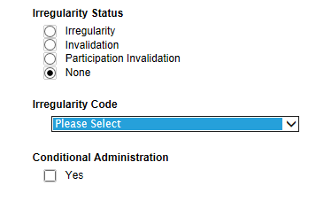
Testing Irregularities
For the affected course:
From the Student List in TAS, select the student to be coded
Access the Additional Student Information screen
Select the Irregularity Status
Select the Irregularity Code provided by GaDOE from the dropdown option
If a Conditional Administration, click the Yes box.
Incorrect coding may result in no reports being sent.

Slide 60
Testing Irregularities
Some examples of irregularities:
Cheating
  Following an investigation and confirmation, student test scores will be invalidated by GaDOE.
  If the incident involves improper conduct on the part of staff, a referral to the Georgia Professional Standards Commission for disciplinary action may result.
Using a prohibited device will result in an invalidation by GaDOE.

Slide 61
Testing Irregularities
Some examples of irregularities:
Sickness during testing administration
  Student gets sick prior to starting the test
    Upon return to school student will complete the test in its entirety and test is scored as is; does not require Portal entry
  Student gets sick after having completed Section I but before starting Section II
    Upon return to school, student will complete Section II of the test and test is coded as an irregularity; requires Portal entry
  Student gets sick while testing in either Section I or II
    Test scores maybe invalidated by GaDOE; requires Portal entry

Slide 62
Testing Irregularities
Some examples of irregularities:
Accommodations
  Students given the wrong accommodation or not given their accommodation
    Test scores may be invalidated by GaDOE
    School or system notifies parent (as soon as possible)
    Requires Portal entry
  Students refuse their accommodations
    School or system notifies parent (prior to the beginning of testing, if at all possible)
    Test scores are coded as an irregularity; requires Portal entry
    Please fill in the Accommodations code on student answer document or in the Test Administration System since the school attempted to provide the accommodation
    These irregularities might be prevented by involving students in the discussion of their accommodations.

Slide 63
Testing Irregularities
Some examples of irregularities:
Testing the wrong student or subject area
  Students given the wrong EOC
    Test scores are invalidated by GaDOE; requires Portal entry
  Student testing under wrong GTID
    Contact GaDOE as soon as possible
      Much easier to fix during the administration or within the first 48 hours after the close of the administration

Slide 64
Avoiding Testing Irregularities
Adhere to test security policies, protocols and procedures.
Reinforce the use of active monitoring in testing environments.
Immediately report any possible testing irregularities.
Properly identify all students who should receive accommodations prior to testing.
Students’ IEP/IAP/TPC plans should be regularly reviewed to determine if accommodations are still appropriate or needed.
If a student is suspected of cheating, but there is no proof of his or her action, allow the student to complete the section and/or entire test.
  An invalidation can always occur after all of the facts are collected.
In the event of an evacuation or other unexpected event, have a plan in place to quickly secure testing environments and/or materials.

Slide 65
Avoiding Testing Irregularities
For Online Testing
Systems must complete all suggested readiness checks prior to and, where applicable, during testing.
If you encounter connectivity issues
  prior to the start of testing, use the appropriate troubleshooting tools available to correct the issues. If problems persist, use your best judgment as to whether or not to allow students to begin testing
  during testing, use the appropriate troubleshooting tools available to correct the issues. If problems persist use your best judgment as to whether or not to allow students to continue testing.
  Student Test Tickets must be used to verify student name and GTID prior to testing.
  CTB Call Center-866-282-2249

Slide 66
Before Testing
System Test Coordinators
Receipt of Materials
Materials will be delivered approximately 2 weeks before test administration dates.
Use the “Customer Sign-Off” area of the packing list(s) to inventory materials, and sign System Shipment Verification Form.
  Braille and Large-Print test booklets will ship separately.
  For any discrepancies, contact CTB at www.ctb.com/ga.
Store all test materials in a secure/locked area.
Sufficient overage will be packed in each school’s boxes.
The shipping labels and the original boxes are to be used when returning test materials to CTB Scoring Center.
Additional orders will not be approved and shipped until the system has received their initial shipment.

Slide 67
Before Testing
System Test Coordinators’ Responsibilities | Paper | Online
Review Test Coordinator’s Manual (TCM) Test Examiner’s Manuals, both Paper-and-Pencil (P/P TEM) and Online (OL TEM) |  | 
Review the Online Practice Test Directions document |  | 
Organize training sessions for School Test Coordinators |  | 
Organize system security plan |  | 
Receive EOC Paper-and-Pencil (P/P) administration materials and verify that all boxes have been received and develop a process to verify that all numbers from System and School Packing Lists are correct | 

Slide 68
Before Testing
System Test Coordinators’ Responsibilities | Paper | Online
Training sessions should include Adding/Editing Students and Test Sessions (TAS) Printing, sorting, and distributing Test Tickets (TAS) Review of the Online Examiner's Manuel Managing and coding accommodations (TAS) |  | 
Distribute EOC P/P materials and Pre-ID labels to School Test Coordinators Training sessions for P/P administrations should include a review of the administration procedures from the P/P TEM | 

Slide 69
Before Testing
System Test Coordinators’ Responsibilities | Paper | Online
Distribute EOC P/P materials and Pre-ID labels to School Test Coordinators If needed, please order additional materials as soon as possible once you have received your initial shipment. Test Materials Adjustment (TMA) window opens on April 7, 2015 | 
Verify School Test Coordinators have scheduled Secure Practice Tests Online Practice Test Directions from Georgia Milestones Website and ctb.com Examiners will find directions to help familiarize students with the Screen Reader in the Appendix. |  | 

Slide 70
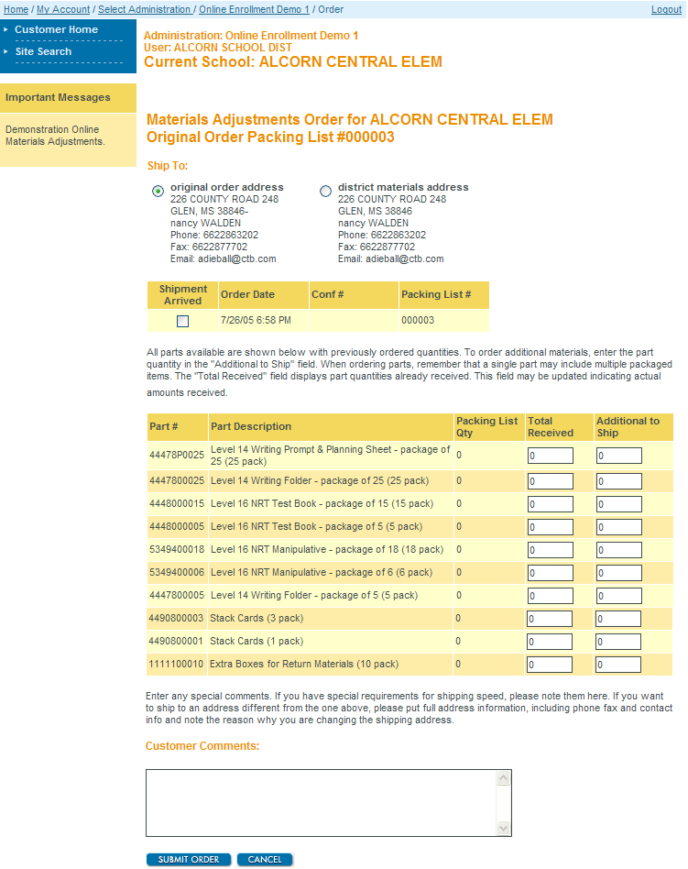
Before Testing: TMA
TMA Link: www.ctb.com/ga and then click on the Test Coordinator Assessment Management Tab
Choose the shipping address
Click to fill Total Received column
Modify if your shipment was short
Enter the quantity you want in addition to what you have received
Enter any special requests for shipping and delivery

Slide 71
Before Testing
Pre-ID Labels
School Test Coordinator Kit
Three (3) barcode labels for each student
Visible information includes:
  Student name and GTID
  School and System names and codes
  Grade
  Student Date of Birth and gender
  Ethnicity and race
  Barcode number
Retain a copy of the Pre-ID File from Cycle 3 Data Collections as a resource for all student information collected but not visible on the label, ex. Title I, EL.
Notes:
71

Slide 72
Before Testing
GNETS Students – Paper-and-Pencil
System Test Coordinators within the area served should coordinate the source of paper-and-pencil testing materials with the GNETS School Test Coordinator
GNETS sites who manage their own materials should coordinate with their students’ home school systems regarding the GIS and the shipping of scorable materials
GIS should be provided for students served by GNETS by the students’ home system and students’ answer sheets should be returned under a Group Information Sheet (GIS) coded for their home system and school
Ideally, scorable materials for GNETS students will be returned with those of the student’s home system

Slide 73
Before Testing
GNETS Students – Paper-and-Pencil
Each GNETS site testing online will need to have the Secure Testing App installed on workstations that students will use for testing
The School Test Coordinator at each online GNETS site should be familiar with the contents of this Pre-Admin Webinar and the upcoming TAS training though collaboration with a designated System Test Coordinator within the service area
Test sessions (including the Secure Practice Test) for GNETS students testing online will need to be setup by the System Test Coordinator from the students’ home school/system

Slide 74
Before Testing
GNETS Students – Online
The GNETS School Test Coordinator should collaborate with the students’ home districts for assigning testing accommodations and coding program and accommodation information
The GNETS School Test Coordinator should work with the System Test Coordinator within the service area to receive by a secure means Individual Student Test Tickets and Summary Test Tickets, (ex. return receipt mail, UPS/FEDEX, courier, hand delivery, attachment in MyGaDOE email, transfer via secure FTP folder)

Slide 75
Before Testing
School Test Coordinator
Complete School Inventory Checklist provided in TCM on page 49; when School Testing Coordinators verify their school’s packing list, a signed copy should be provided to the System Test Coordinator
Boxes are labeled for each school and include:
  School Packing List and School Security Checklist
  School/Group Lists
  Group Information Sheets (GIS)
  Test Coordinator’s Manuals and Test Examiner’s Manuals
  Test booklets and answer sheets
  Stack Cover Cards and paper bands
Schools receive an overage of materials
  If additional materials are needed, School Test Coordinators contact the System Test Coordinator
Retain boxes for return shipping
Notes:
75

Slide 76
Before Testing
School Test Coordinators’ Responsibilities | Paper | Online
Read Test Coordinator’s Manual (TCM) and Test Examiner’s Manuals (TEM) |  | 
Organize training sessions for Test Examiners |  | 
Organize training for assessment of students with accommodations |  | 
Organize school security plan and monitor test administration |  | 
Manage students and test sessions in the Test Administration System (TAS) Assign and code accommodations in TAS Print and sort by testing location Individual Student Test Tickets and Summary Test Tickets |  | 

Slide 77
During Testing
Examiners should check to see if students are responding in correct spaces
For mathematics, examiners should collect student calculators before the student begins Section 1, Part 2
For ELA, examiners should check to see if students are responding to item 60 in the correct location.
Examiners should check to be sure students are in the correct section of the test; not going ahead or going back

Slide 78
After Testing
School Test Coordinator
Verify that Test Examiners have returned all materials
  The System Test Coordinator must order make-up test materials administered outside of the system’s scheduled window
Inventory scorable and non-scorable materials separately
Complete the School Security Checklist and place in the first box of scorable materials
System Test Coordinators must make copies of any pages that indicate missing or non-returned materials and place these copies in the security checklist envelope for each school; System Coordinators will retain all original school security checklists
Verify that VOID is written across every voided Test booklet and Answer Sheet; return voided documents with non-scorables

Slide 79
After Testing
School Test Coordinator
If directed by the System Test Coordinator, destroy all soiled documents (biohazard); record as soiled on the School Security Checklist
Verify that each GIS is filled out correctly
Complete the School/Group List (SGL)
Arrange all scorable documents with the student name face-up
Secure each classroom’s scorable materials with a paper band using a Stack Cover Card for each bundle and a GIS for each class

Slide 80
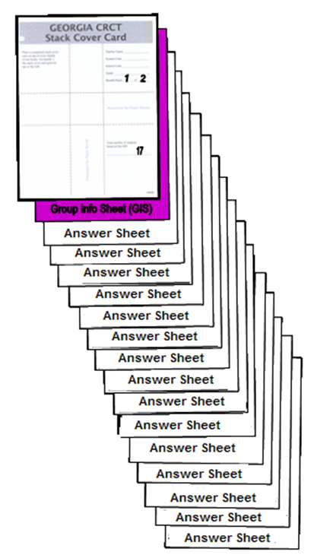
After Testing:
Packing Scorable Materials
Packing Scorable Materials:
Band together by classroom:
  [Top of Stack]
Stack Cover Card
  One per band
Completed GIS
  One per class
One class of Student Answer Sheets [Bottom of Stack]

Slide 81
After Testing
School Test Coordinator
Use original shipping boxes for return shipment; if additional boxes are required, notify the System Test Coordinator to order them through CTB Customer Service
Pack scorable and nonscorable materials separately
Account for all scoreable and nonscorable materials then concentrate on processing scorable materials for return for scoring
All nonscorable materials must be returned to the System Test Coordinator within one week of the last day of the system’s scheduled test window

Slide 82
After Testing
System Test Coordinator
Return Materials to CTB.
Completed Answer Documents with Group Information Sheet
Test Booklets
  Test booklets (used and unused) are bar-coded and scanned upon receipt.
  Check each test booklet to ensure there are no Answer Documents in the books.
It is critical to the success of the EOC that all documents are returned immediately after test administration. Promptly returning your materials helps ensure timely results can be returned to your system.
  Failure to return secure testing materials may result in referral to the Georgia Professional Standards Commission (PSC).

Slide 83
After Testing
System Test Coordinator
  Do NOT return the following materials to CTB:
    Manuals, unused/voided answer documents, scratch paper and Summary and Individual Test Tickets. These must be securely destroyed AT THE SYSTEM LEVEL immediately following the end of your local window.
  Please KEEP the test booklet Security Checklist for your records.

Slide 84
After Testing
System Test Coordinator
Packing Return Shipment
System Test Coordinators prepare materials for pick-up; details in the School and System Test Coordinator’s Manual
Reminders:
Do not consolidate materials from more than one school in the same box
Use one label per box
  Use PURLE Return Shipping Labels for scorable materials
  Use Yellow Return Shipping Labels for nonscorable materials
Identify the sequence of boxes by filling in the line on the purple scorable label that reads “SCH BOX __ OF __”
On the same purple label, fill in the total number of boxes for the entire system in the space provided “SYS BOX __OF__”
Identify the sequence of boxes by filling in the line on the yellow nonscorable label that reads “SCH BOX __ OF __”
On the same yellow label, fill in the total number of boxes for the entire system in the space provided “SYS BOX __OF__”
Securely seal all boxes

Slide 85
After Testing
System Test Coordinator
Scorables
If your local window extends beyond 7 days, schedule weekly shipments.
Scorable materials may be shipped in multiple shipments, but nonscorable materials should be returned in one shipment.
Shipments of 21 boxes or less will be handled by FEDEX and each box will require an individual FedEx shipping/tracking label in addition to the to the purple return shipping label.
  Any shipment of 21 or more boxes will be handled by ADS and must be palletized.

Slide 86
After Testing
System Test Coordinator
Nonscorables
ADS will contact systems five business days before the scheduled pick-up to verify return shipments
  The pickup date for nonscorable materials is the tenth business day following the scheduled completion of testing unless noted in the EOC Enrollment System
  Please give a two weeks notice if you need to change pick up dates

Slide 87
Important Dates
Task | Start Date | End Date
Test Administration System (TAS) Available | April 6
Spring Main EOC paper materials shipments begin | April 6
Test Materials Adjustment | April 7
Spring 2015 Main Administration | April 27 | June 5
Summer 2015 Main Administration | June 15 | July 17

Slide 88
Resources
Student Assessment Handbook
Test Coordinator’s Manual (TCM) & TCM Errata Sheet
Examiner’s Manual & Online Examiner’s Manual
Assessment Guides
Coordinate Algebra and Analytic Geometry Formula Sheets
Graph Paper (1/4”) – sample posted
Physical Science Periodic Table
Physical Science Reference Sheet
Accountability Content Completer Presentation
Allowable Accommodations Charts (SWD and EL)
Technology Guidelines (v. 1.2)

Slide 89
Contact Information
CTB Customer Service Team
  Phone: (866) 282-2249
  Fax: (866) 282-2251
  Email: GeorgiaHelpDesk@ctb.com
  Hours: 8:00am to 6:00pm (Eastern)
  Georgia Department of Education
  Regarding testing irregularities and/or interruptions
  Mary Nesbit-McBride (404) 232-1207; mmcbride@doe.k12.ga.us
  General Georgia Milestones questions and those related to online test administration, paper-and-pencil test material supply needs, etc.
  Michael Huneke (404) 232-1208; mhuneke@doe.k12.ga.us
  Robert McLeod (404) 656-2589; robert.mcleod@doe.k12.ga.us
  General test administration information
  Phone: (800) 634-4106 or (404) 656-2668

