Slide 1
Melissa Fincher, Ph.D. Deputy Superintendent, Assessment & Accountability mfincher@doe.k12.ga.us
2014 Fall GACIS: Mathematics & Science

Slide 2
Georgia Milestones
Grades 3 – 8
End of Grade (EOG) in language arts, mathematics, science, social studies
High School
End of Course (EOC) in 9th Grade Literature & Composition, American Literature & Composition, Coordinate Algebra, Analytic Geometry, Physical Science, Biology, US History, and Economics

Slide 3
Georgia Milestones: Unique Features
Blended: Criterion-Referenced and Norm-Referenced
Georgia Milestones will provide:
criterion-referenced performance information in the form of four performance levels, depicting students’ mastery of state standards
norm-referenced performance information in the form of national percentiles, depicting how students’ achievement compares to peers nationally
Note: To provide norm-referenced information, some norm-referenced items may not align to Georgia’s content standards. Only aligned NRT items will contribute to proficiency designations.

Slide 4
Georgia Milestones: Embedded NRT
Each content area/course test will contain 20 norm-referenced items.
The 20 NRT items will provide a national percentile score to provide a barometer of national comparison.
Approximately 10 of these items have been reviewed by Georgia educators for alignment to the grade level/course content standards.
Only those NRT items judged to be aligned by Georgia educators will contribute to the criterion-referenced proficiency designations of students.
The remaining 10 or so items, while not necessarily aligned to the grade level/course content standards, will not contribute to the proficiency designation.
The NRT items were selected to reflect the full TerraNova subtest for each content area.

Slide 5
Georgia Milestones: Embedded NRT
Teachers and students should be aware that the tests will include a small number of NRT items (10) for which students have not had direct instruction.
These items will contribute only the NRT score and will not contribute to the criterion-referenced score and proficiency designation that is used in promotion/retention, course grade, student growth, educator effectiveness measures, or accountability (CCRPI).
The content and skills measured within these items reflect more global concepts within the content area (such as, reading comprehension, language, mathematics, science, or social studies) that students encounter during the course of their matriculation. This is particularly true in science and social studies.
Georgia Milestones will included norm-referenced items that are not directly aligned to the grade level or course standards. These items will not impact student scores.

Slide 6
Georgia Milestones
It is important to remember that Georgia Milestones is primarily a criterion-referenced test, reflecting the content standards for each grade and course
teachers should teach the Georgia state-adopted content standards and not the NRT standards
Remember: All important uses of the test results – for both students and educators – will be based on the criterion-referenced scores and proficiency determinations.

Slide 7
Georgia Milestones
General Test Parameters
ELA will consist of 3 sections, 1 of which will focus mainly on writing
Mathematics will consist of 2 sections
Science will consist of 2 sections
Social Studies will consist of 2 sections
Each section will be approximately 70 minutes.

Slide 8
Georgia Milestones
General Test Parameters: Mathematics
Criterion-Referenced
Total Number of Items: 53 / Total Number of Points: 58
Breakdown by Item Type:
50 Selected Response (worth 1 point each; 10 of which are aligned NRT)
2 Constructed Response (worth 2 points each)
1 Constructed Response (worth 4 points)
Norm-Referenced
Total Number of Items: 20 (10 of which contribute to CR score)
Embedded Field Test
Total field test items: 10
Total number of items taken by each student: 73

Slide 9
2013-2014 Student Achievement by Administration Mode: Mathematics
Course | Mode | Total | Mean Scale Score | Performance Level
 |  |  |  | Does Not Meet Expectations | Meets Expectations | Exceeds Expectations | Meets/Exceeds Expectations
Coordinate Algebra | Online | 55,292 | 401.0 | 52.5% | 35.3% | 12.2% | 47.5%
 | Paper/Pencil | 84,257 | 391.0 | 64.5% | 29.1% | 6.3% | 35.5%
 | Total | 139,549 | 395.0 | 59.7% | 31.6% | 8.7% | 40.3%
Analytic Geometry | Online | 48,904 | 401.2 | 52.5% | 35.6% | 11.9% | 47.5%
 | Paper/Pencil | 68,515 | 390.5 | 64.9% | 29.2% | 6.0% | 35.1%
 | Total | 117,419 | 395.0 | 59.7% | 31.8% | 8.5% | 40.3%

Slide 10
Georgia Milestones Calculator Policy
Content Area | Grade Level/Course | Type of Calculator
Mathematics | Grades 3 – 5 EOG | Not Allowed
 | Grade 6 EOG | Basic¹
 | Grades 7 – 8 EOG | Scientific² or Basic¹
 | Coordinate Algebra EOC | Graphing³ or Scientific²
 | Analytic Geometry EOC | Graphing³ or Scientific²
Science | Physical Science EOC | Scientific² or Basic¹
Social Studies | Economics EOC | Scientific² or Basic¹
¹Basic four-function calculator with square root and percentage functions.
²Scientific calculator with functionalities consistent with TI-30XS MV or similar models.
³Graphing calculator with functionalities consistent with TI-84 Plus SE or similar models.
Calculators are not permitted on certain designated sections of each mathematics test.

Slide 11
Online BASIC Calculator
This is a BASIC calculator!
A basic calculator is permitted in Grade 6

Slide 12
Online Scientific Calculator: TI-30XS MV
A scientific calculator is permitted in Grades 7 and 8 EOG; Physical Science EOC; Economics EOC

Slide 13
Online Graphing Calculator: TI-84
A graphing calculator is permitted in Coordinate Algebra and Analytic Geometry EOC

Slide 14
Mathematics
Grade 5

Slide 15
Extended Response Item 5.G.3

Slide 16
Rubric
Score | Description
4 | The student successfully completes all parts of the item by understanding that attributes belonging to a category of two-dimensional figures also belong to all subcategories of that category (5.G.3).
3 | The student demonstrates clear understanding of the standards listed above by correctly answering all parts of the task, but the explanation or work shown for one part is weak or incomplete Or The student answers all parts with correct explanation or work shown, but makes one minor calculation error or omission Or The student answers three parts correctly with explanation or work shown.
2 | The student demonstrates a basic understanding of the standards listed by answering two parts correctly with explanation or work shown Or The student answers three or four parts correctly without explanation or work shown.
1 | The student demonstrates minimal understanding of the standards listed by answering one or two parts correctly without explanation or work shown.
0 | The response is incorrect or irrelevant to the skill or concept being measured.

Slide 17
Exemplar Response

Slide 18
Student Response Score 3
Parts A and B are both correct, but the explanations are weak. The student needs to include a discussion of the angles.

Slide 19
Student Response Score 3
Part C is also correct, but again the explanation is weak. The student needs to include a discussion of the angles.
Part D is correct with explanation.

Slide 20
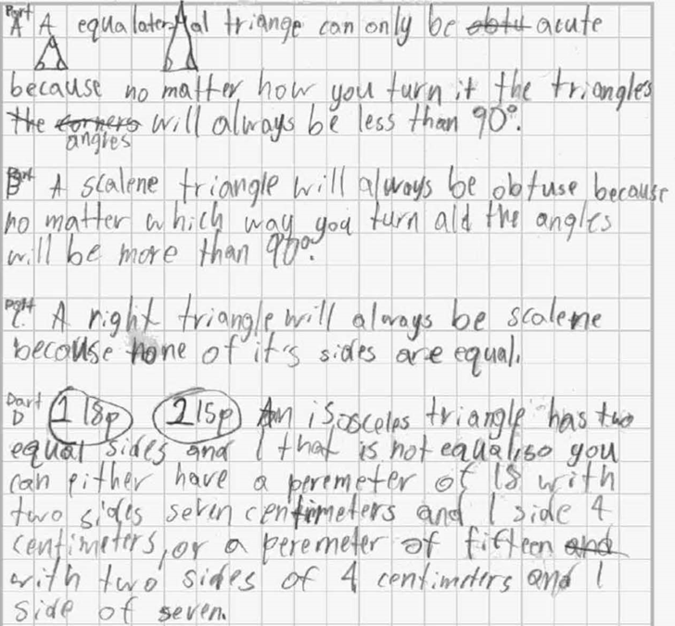
Student Response Score 2
Part A is correct, with a partially correct explanation.
Part B is incorrect. A scalene triangle can also be acute.
Part C is incorrect. A right triangle can also be isosceles.
Part D is correct, with explanation.

Slide 21
Student Response Score 1
Part A is incorrect. An equilateral triangle cannot be obtuse.
Part B is incorrect. A scalene triangle can be either acute or obtuse.
Part C is correct, but without explanation.
Part D is partially correct (18 cm is correct, but 53 cm is not).

Slide 22
Georgia Milestones
General Test Parameters: Science
Criterion-Referenced
Total Number of Items: 55 / Total Number of Points: 55
Breakdown by Item Type:
55 Selected Response (worth 1 point each; approximately 10 of which are aligned NRT)
Norm-Referenced
Total Number of Items: 20 (approximately 10 of which contribute to CR score)
Embedded Field Test
Total field test items: 10
Total number of items taken by each student: 75

Slide 23
2013-2014 Student Achievement by Administration Mode: Science
Course | Mode | Total | Mean Scale Score | Performance Level
 |  |  |  | Does Not Meet Expectations | Meets Expectations | Exceeds Expectations | Meets/Exceeds Expectations
Biology | Online | 62,320 | 436.2 | 21.1% | 39.9% | 39.0% | 78.9%
 | Paper/Pencil | 68,553 | 423.5 | 29.9% | 42.5% | 27.7% | 70.1%
 | Total | 130,873 | 429.6 | 25.7% | 41.2% | 33.1% | 74.3%
Physical Science | Online | 42,162 | 458.8 | 13.9% | 30.2% | 55.9% | 86.1%
 | Paper/Pencil | 42,640 | 440.9 | 19.8% | 36.4% | 43.8% | 80.2%
 | Total | 84,802 | 449.8 | 16.9% | 33.3% | 49.8% | 83.1%

Slide 24
Science
Grade 4

Slide 25
Extended Response Item S4E2a; S4E2c

Slide 26
Rubric
Score | Description
4 | The student response thoroughly demonstrates understanding of the day/night cycle of Earth [S4E2.a] by explaining the day/night cycle of the earth occurs because of the rotation of Earth, AND explaining the length of the day depends on the tilt of Earth and that when the southern hemisphere is tilted away from the sun the days will be shorter there, AND an understanding of how the revolution of Earth around the sun and its tilt affect seasons on Earth [S4E2.c] by explaining that the seasons change because of the tilt of Earth, AND explaining that sun is more directly overhead year round at the equator, causing seasonal changes to be less than other places on Earth.
3 | The student response clearly demonstrates understanding by correctly answering 3 out of 4 parts of the item or answering 2 parts partially correct and 2 parts correctly.
2 | The student response basically demonstrates understanding by correctly answering 2 out of 4 parts of the item or answering 4 parts partially correct.
1 | The student response minimally demonstrates understanding by correctly answering 1 out of 4 parts of the item or answering 2 parts partially correct.
0 | The student response is missing, irrelevant or incomprehensible.

Slide 27
Exemplar Response

Slide 28
Student Response Score 3
Part A the rotation on earth spins earth one time a day and when it moves the sun is on one side and there is dark on the other side and when it gets on the dark side the sun goes down but on the sun side is rises up
Part B at the south pole when it is tilted a away it gets colder and darker
Part C when the earth is tilted toward the sun the side that is tilted toward the sun gets summer and the side that gets tilted the other way gets winter
Part D if ithe earth is tilted toward the sun summer sould be in the middle of the earth and the other side should in winter sould be in the middle to
Part A is correct.
Part B is correct (it gets colder implies it is winter, and darker implies there is less sunlight).
Part C is correct.
Part D is correct, but with no explanation.

Slide 29
Student Response Score 2
Part A-The Earth spins around every 24 hours, so one side gets Sun, and when the Earth turns, the Sun looks as if it is rising and setting.
Part B-The South Pole has no daylight because it is pointed away from the Sun.
Part C-When the Earth tilts away from the Sun,the Earth has Winter.When it is pointed toward the sun, it has Summer.
Part D-Near the Equator because the Earth has zones,The Polar Zone(cold),The Temperate Zone(mild), and The Tropical Zone (hot and near the Equator).The Tropical Zone hardly ever changes, so seasons show the least in The Tropical Zone.
Part A is correct.
Part B is incorrect. There would be less daylight at the South Pole, but not no daylight.
Part C is correct.
Part D is correct, but with no explanation.

Slide 30
Student Response Score 1
part A
Because it spins around the sun making it look like the sun is spining
part B
The south pole is tilted to the sun so they get sunlight but the north pole does not
part C
When we are tilted to the sun we have summer and when we are not we have winter
part D
Near the south pole because the sun is not near it
Part A is incorrect.
Part B is incorrect. The student has described how daylight is affected when the South Pole is tilted toward the sun, not away from the sun.
Part C is correct.
Part D is incorrect.

