Slide 1
Overview of Georgia’s K-12 Student Assessment Program
State Charter School Commission Presentation
July 30, 2019
8: 30 a.m. – 12 p.m.

Slide 2
Agenda
Introductions
Assessment Staff
State Charter Staff
Test Development
Assessment Overview
Creating a Testing Plan
Assessment Administration Resources
Accommodations and Special Populations
Test Security
Accountability
Questions

Slide 3
Introductions

Slide 4
Test Development

Slide 5
Georgia Milestones
Test Development Process
Test Planning and Specifications
Item Development
GaDOE
Reviews
Item Review
Field Testing
Rangefinding (Constructed-Response Items)
Handscoring (Constructed-Response Items)
Data Review
Operational
Testing
Standard Setting/
Validation

Slide 6
Committee Selection Process
District Nominations (January)
Educator Application & Availability Survey (February)
Initial Committee Invitations (late March – April)
Rolling schedule based on meeting dates
6-10 participants per grade/content area or course
Balanced representation
Gender
Ethnicity
Region
Experience
Special populations

Slide 7
Expense Reimbursement for Educator Meetings
Expenses paid directly (by testing contractor)
Hotel accommodations, if applicable
Parking, if applicable
Breakfast, lunch, and snacks are provided at the meeting
Expenses reimbursed to participant (from testing contractor)
Dinner (reimbursed at current state rate) for those staying overnight
Mileage (reimbursed at current state rate)
Expenses reimbursed to school or district (from testing contractor)
Substitute teacher expense, if applicable
Participants are provided a reimbursement form to return to their school/district.
Participants are paid an honorarium if a meeting occurs during off-contract time (e.g. spring break, summer break, etc.)
Typically $125 per day
In lieu of substitute reimbursement

Slide 8
Assessment Overview

Slide 9
Assessment Philosophy
The primary purpose of schools is teaching and learning.
Assessment and accountability play a significant role, but importantly – that role is supporting, with the primary focus being teaching and learning.

Slide 10
Overview
Formative
GKIDS Readiness Check
GKIDS
Keenville
GOFAR
FIP
K
Summative
ACCESS for ELLs
GAA
Georgia Milestones EOG/EOC
12

Slide 11
Innovative Assessment Pilot Program
Georgia was approved to implement two of the innovative assessment models described in the state’s application – the Georgia MAP Partnership and the Putnam County Consortium.
The approval letter, application and other information can be found on the Testing/Assessment webpage under the Assessment Innovation and Flexibility Resources link.

Slide 12
Required State Assessments
Assessment | Content | Students
ACCESS for ELLs 2.0 | Reading, Writing, Listening, and Speaking | K-12 English Learners in the ESOL program
Alternate ACCESS | Reading, Writing, Listening, and Speaking | English learners with significant cognitive disabilities that are severe enough to prevent meaningful participation in the ACCESS for ELLs 2.0 assessment.
Georgia Alternate Assessment 2.0 (GAA 2.0) | English/Language Arts, Mathematics, Science, and Social Studies in grades 5 and 8 and high school English/Language Arts and Mathematics, grades K, 3, 4, 6, and 7 | Students with significant cognitive disabilities
Georgia Kindergarten Inventory of Developing Skills 2.0 (GKIDS 2.0) | English language arts (ELA) , Mathematics, Science (optional) , Social Studies (optional), Approaches to learning , Personal and Social Development, Motor skills (optional) | All Kindergarten Students
GKIDS 2.0 Readiness Check | Foundations of School Success, English/Language Arts, Mathematics | All Kindergarten Students
Georgia Milestones Assessment System End of Grade and End of Course | English/Language Arts, Mathematics, Science, and Social Studies, grades 5 and 8 and high school English/Language Arts and Mathematics, grades 3, 4, 6, and 7 | All 3-8 and high school students except those that don’t qualify for GAA 2.0
National Assessment of Educational Progress (NAEP) | National assessments in different subjects | Selected Students in grades 4, 8, and 12 or ages 9, 13, and 17

Slide 13
ACCESS for ELs 2.0/Alternate Access
ACCESS for ELLs 2.0 measures the English language proficiency levels and progress of ELs in the domains of speaking, listening, reading, and writing.
Alternate ACCESS measures how EL students with significant cognitive disabilities develop the language proficiency needed to participate in classroom instruction.
Test Window – January 15 – March 6, 2020

Slide 14
ACCESS for ELs 2.0/Alternate Access
For Kindergarten, ACCESS for ELLs 2.0 uses a stand-alone paper-pencil kit.
Tests for students in grades 1-12 are organized in the following grade-level clusters:

Slide 15
ACCESS for ELs 2.0/Alternate Access Resources
WIDA Secure Portal
Manuals
Training History
WIDA AMS
Test Demo
Presentations
TestPractice
Sample Items
DRC Customer Service
help@wida.us

Slide 16
Georgia Alternate Assessment (GAA) 2.0
The purpose of the GAA 2.0 is to ensure that students with significant cognitive disabilities are:
provided access to the state-mandated content standards.
given an opportunity to show what they know and can do.
Only students meeting GAA 2.0 Eligibility Criteria may participate in the assessment.
http://www.gadoe.org/Curriculum-Instruction-and-Assessment/Assessment/Pages/GAA_2.aspx

Slide 17
Georgia Alternate Assessment (GAA) 2.0
Test Design
A standardized, scripted assessment
Measures student achievement aligned with access points in English language arts, mathematics, science, and social studies
Gives students differing levels of complexity and support
Informs classroom instruction by providing information related to individual student’s areas of strength and improvement

Slide 18
Georgia Alternate Assessment (GAA) 2.0
Sample Tasks (ELA & Math)
Teacher Booklet
Student Booklet
http://www.gadoe.org/Curriculum-Instruction-and-Assessment/Assessment/Pages/GAA_2.aspx

Slide 19
Georgia Alternate Assessment (GAA) 2.0
Results from the assessment will help inform classroom instruction by providing information related to individual student’s areas of strength and improvement.
Provides scale scores that reflect each test participant’s level of academic achievement.

Slide 20
Georgia Alternate Assessment (GAA) 2.0
Date | Event
Test Administration Procedure: Part 1 | August 20 & 22, 2019
Test Administration Procedures: Part 2 | October 1 & 3, 2019
GAA 2.0 Nextera Training | January 16 & 23, 2020
GAA 2.0 Pre-Administration and Nextera Online Platform Training | February 18 & 20, 2020
Administration Window | March 23 – May 1, 2020

Slide 21
Georgia Milestones
Designed to provide information about how well students are mastering the state-adopted content standards in the core content areas of English Language Arts, Mathematics, Science, and Social Studies.
Designed to provide students with critical information about their own achievement and their readiness for their next level of learning
be it the next grade, the next course, or the next endeavor (college or career).

Slide 22
Georgia Milestones
EOG | EOC
Grades 3–8 English Language Arts Mathematics Grades 5 and 8 Science Social Studies | Ninth Grade Literature & Composition American Literature & Composition Coordinate Algebra Analytic Geometry Algebra I Geometry Biology Physical Science United States History Economics/Business/Free Enterprise

Slide 23
Georgia Milestones
Administration Windows (2019-2020)
End of Course
Fall Mid-Month | August 5 | August 23
 | September 9 | September 20
 | October 7 | October 18
 | November 4 | November 15
Winter | November 18 | January 8
Spring Mid-Month | January 14 | January 25
 | February 13 | February 24
 | March 9 | March 20
Spring | April 20 | May 29
Summer | June 15 | July 17
End of Grade
Spring | April 6 | May 15
Summer Retest | May 11 | July 17

Slide 24
Participants EOG
Students to be Tested
Makeup Testing
Retest
Testing includes all students enrolled in grades 3 through 8, except for those participating in the GAA 2.0.
Make-up tests must be given within the system’s scheduled local administration window; the last day of the local window should be scheduled as a makeup day.
Students who are not on Grade Level for Reading in Grades 3,5,8
Students who score in the Beginning Learner achievement level in mathematics in Grades 5,8
For Grades 3, 5, or 8 – a new student who has not tested should participate in the EOG content assessment(s) for that grade level for locally required promotion/retention rules, if the state window is still open.
Promotion/Retention rules based on Georgia Milestones results are determined locally.
Advanced middle school students enrolled in an EOC MUST take the required EOC assessment.
Those middle school students enrolled in an ELA, mathematics, or science EOC course should not take the corresponding grade-level EOG.

Slide 25
Participants EOC
Enrolled in EOC Course(s)
Enrolled in Specified Courses/Programs
Validation of Credit
Counts as 20% of grade.
AP/IB Course enrollees in EOC associated courses
GaVS **
Credit Recovery
Transfer students from home school, non-accredited entities
Includes: Students with Disabilities (SWD) and English Learners (EL)
Students concurrently enrolled in a GA public school and a private school or non-traditional entity
Dual Enrollment students*
*Dual Enrollment Students are exempt from designated EOCs. See Student Assessment Handbook (SAH) for guidance.
** Coordinators must tag GAVS students under Testing Codes in eDIRECT.

Slide 26
Participants EOC
Retest
Demonstrating Subject Area Competency (“Testing-Out”)
Grade conversion score less than 70 on previous administration
Students must meet eligibility requirements
Available during Mid-Month and Summer Main administrations only
See Student Assessment Handbook (SAH) for administration parameters
Testing-Out is available during the August, September, and March Mid-Month administrations and the Summer Main administration
See SAH for guidance

Slide 27
Participants EOC
Dual Enrollment
Required of All Students | Allowed Exemption
Ninth Grade Literature & Composition | American Literature & Composition
Coordinate Algebra/Algebra I | Physical Science
Analytic Geometry/Geometry | US History
Biology | Economics
Note: For exempt EOCs, the college grade is factored into CCRPI.

Slide 28
Georgia Milestones
Georgia Milestones is administered 100% online
Online administrations allow for flexible scheduling, different item types, ease of administration, accessibility tools and rapid return of scoring.
Online administrations allow for additional scheduling flexibility for EOG.
Paper forms are available for those students who cannot access the online assessment due to their disability.

Slide 29
Georgia Milestones
Scheduling Flexibility
May Do | May Not Do
May schedule same grade level and content across the testing window | May not schedule same grade level students and content testing on different dates than posted window
May use one-day or multiple-day administration | May not begin a content area on Friday and complete on a Monday
ELA Section 1 must be scheduled on one day. | May not be scheduled on a Friday.
Once a content has begun, it must be completed before a new content is started | May not schedule a content area (ex. ELA) on the same day as a different content area (ex. Math)
Check with your Assessment Specialist with questions

Slide 30
Online Readiness
Meeting with Technology Director and Site Technology Technicians
Ensure technology staff is aware of the local assessment calendar
Determine Site Readiness
Review Bandwidth and Network Needs
Ensure installation of Central Office Services
Ensure installation of INSIGHT
Along with technology staff, participate in training webinars
Establish and review technology troubleshooting protocols

Slide 31
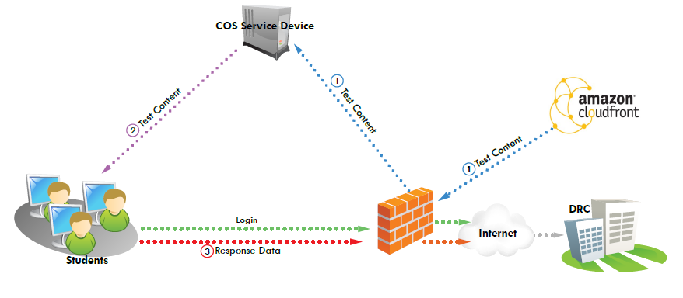
Technology Setup
COS serves as a server for caching test content for both Georgia Milestones and ACCESS for ELLs 2.0.
Each student has INSIGHT software for testing.
Responses go directly to DRC.
Districts Manage COS and INSIGHT devices for Milestones and ACCESS in eDIRECT.

Slide 32
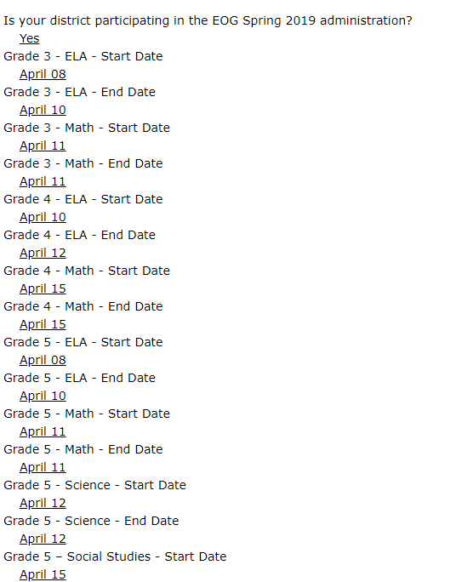
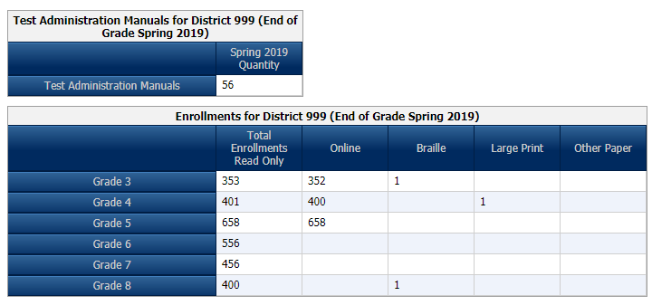
Georgia Milestones
Enrollment Counts
Critically important to provide accurate and complete information
Ensures appropriate materials are available for students at the time needed
Ensures DRC can plan appropriately for rapid scoring and reporting of results
Winter Enrollment numbers are pre-populated from 2018
http://ga.drcedirect.com

Slide 33
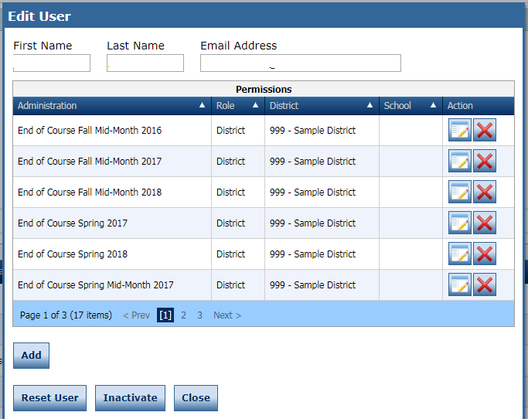
eDIRECT Accounts
District STCs are responsible for ensuring eDIRECT accounts are current.

Slide 34
Georgia Milestones
EOG Resources
EOC Resources
Milestones Presentations
Milestones Training Videos
eDIRECT

Slide 35
Georgia Kindergarten Inventory of Developing Skills (GKIDS) 2.0
GKIDS 2.0 platform is open for the current school year.
Email address for primary system test coordinator has been setup and account is ready to be activated; system test coordinator may set up school coordinators; school coordinators set up teacher user accounts.
Teachers should contact the school coordinator first and then the system test coordinator for assistance with GKIDS 2.0.
Teachers should enter student performance data in a timely manner.
Students who transfer from a school/classroom should be released through the GKIDS 2.0 website so they can be acquired by the new teacher.
GTID issues should be addressed with the school student database contact and/or the GaDOE Technology Services Division.
Systems/schools should establish a reporting schedule for the year in addition to the end of year state deadline.
Teachers are responsible for students’ end of year reports prior to the end of the administration window in May.
GKIDS 2.0 Intercom Customer Support available for questions.

Slide 36
GKIDS 2.0
Academic Domains
Math
ELA
Science (Optional)
Social Studies (Optional)
Non-Academic Domains
Approaches to Learning
Personal/Social Development
Motor Skills (Optional)

Slide 37
GKIDS 2.0
Readiness Check
Developed with our partners at the Department of Early Care & Learning (DECAL)
Augments the Georgia Kindergarten Inventory of Developing Skills (GKIDS) and is administered during the first six weeks of kindergarten
Designed to highlight knowledge and skills critical for student success in learning, solely to guide instruction
Aligned to the Georgia Early Learning Development Standards (GELDS) and correlated to the Georgia Standards of Excellence for kindergarten
Assesses 20 essential concepts and skills
Required to be completed the first six weeks of the school year; not accessible after the end of the six-week window

Slide 38
GKIDS 2.0
Administration Schedule
July 8, 2019 – October 21, 2019 | GKIDS 2.0 Readiness Check data should be entered based on the school's academic calendar.
February 11, 2020 | Mid-year checkpoint (Webinar only, no datafile provided)
July 8, 2019 – May 18, 2020 | Entries may be entered in GKIDS 2.0 platform for the current school year.
June 10, 2020 | GKIDS 2.0 Website closes for the 2019-2020 school year.

Slide 39
GKIDS 2.0
Resources
Administration Manual
Platform User Guide
Optional Resources Guide
System Admin Upload Roster File

Slide 40
National Assessment of Educational Progress (NAEP)
Managed through the US Department of Education
National assessment since 1969
Representative sample in each state
Measure achievement in 4th, 8th, and 12th grades OR ages 9, 13 and 17
State and national results in various subjects
School and teacher questionnaires
Results released as The Nation’s Report Card

Slide 41
NAEP
2020 Assessment
Administration Schedule
Age 13: October 14 – December 20, 2019
Age 9: January 6 – March 13, 2020
Age 17: March 16 - May 22,2020
Assessed Subjects
Mathematics
Reading

Slide 42
NAEP Resources
Results
https://nces.ed.gov/nationsreportcard/
NAEP Data Explorer
https://nces.ed.gov/nationsreportcard/naepdata/
NAEP Questions Tool
https://nces.ed.gov/nationsreportcard/nqt/

Slide 43
Keenville
Overview
Keenville is a series of interactive challenges that actively engage students and assess key literacy and numeracy skills in real-time.
Keenville offers the opportunity to:
integrate assessment alongside instruction;
support and empower teachers with information to differentiate instruction; and
hook students into the fun of learning.

Slide 44
Keenville
Benefits
Engages students in an ongoing formative assessment that is integrated with the learning process
Integrates cross-curricular content
Provides ongoing, timely feedback on student performance and progress
Empowers teachers to differentiate and target standards to individual students
Can be expanded over time

Slide 45
Keenville
What is Assessed?
Academic Domains
Math – Early Numeracy Skills,
ELA – Early Literacy Skills,
Integration of science, social studies, fine arts, physical education/health/nutrition, CTAE, etc., within texts.
Grade Levels
Grades 1 and 2
Most games also include Kindergarten and Grade 3 standards to support student enrichment or remediation needs.

Slide 46
Keenville
Access
Keenville will be accessed by all users via the Statewide Longitudinal Data System (SLDS).
Accessing SLDS requires users to log into the district’s Student Information System (SIS).
All users will need SIS login credentials to access Keenville via the SLDS.
Contact your district SIS Administrators for further access, logins, and passwords as these are directed by your local district.

Slide 47
For additional information and resources, visit
keenville.gadoe.org
Notes:
Additional information and resources, including the Keenville User Guide, can be found at keenville.gadoe.org.

Slide 48
Formative Assessment Resources
Formative Assessment Toolbox: Item and test content in TestPad (GOFAR is discontinued)
TestPad: Benchmark Development Tool for use with GaDOE test items and item creation
Formative Instructional Practices (FIP): online and blended model of professional learning for teachers, coaches, and leaders: gadoe.org/GeorgiaFIP

Slide 49
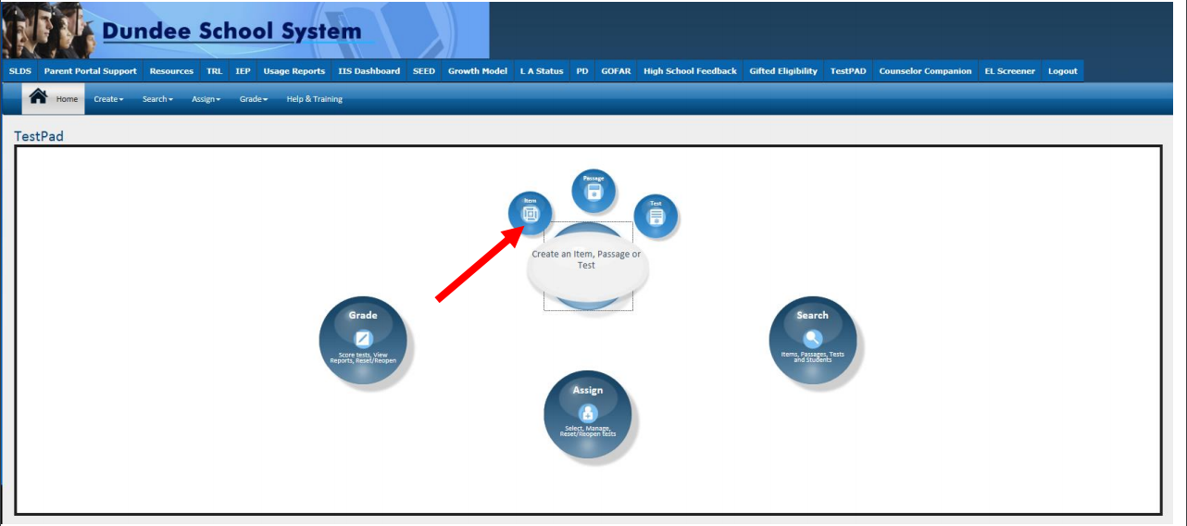
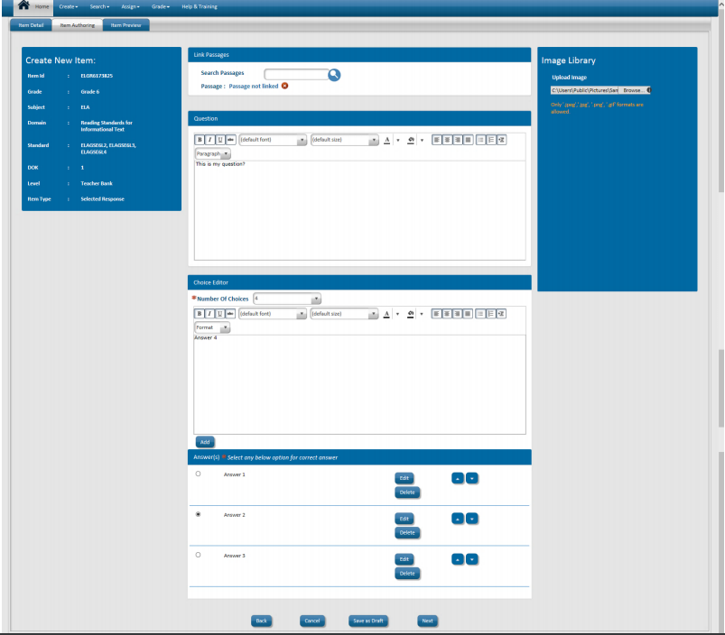
TestPad
Create and manage tests
Create Test Items, Passages and Rubrics

Slide 50
Creating a School Testing Plan

Slide 51
Testing Plan
Testing Plan
Completed Plan Template
Copies of Communications
Training Materials and sign-ins
Testing Schedule

Slide 52
School Testing Plan
Before > During > After
Communications
Test Security
Accommodations
Technology
Training

Slide 53
Communications
Audiences: Staff, Parents, Students
Testing Dates
Testing Rules
Communications during testing
Remediation and Retest
Reports

Slide 54
Test Security
Testing materials
Forms
Hallways
Plans for irregularities
Emergency protocols

Slide 55
Technology
Testing devices
Software on testing devices
Centralized software (if needed)
Wired and wireless networks
Firewalls and security

Slide 56
Training
Training for test examiners
Training for accommodations
Training for other school staff
Maintaining records
Training students on testing tools

Slide 57
Sampling the Tests
ACCESS for ELLs 2.0 sample items
https://wbte.drcedirect.com/WIDA/portals/wida
GAA 2.0 Sample Tasks
http://www.gadoe.org/Curriculum-Instruction-and-Assessment/Assessment/Pages/GAA-2.0-Sample-Tasks.aspx
Georgia Milestones Technology Enhanced Items
http://www.gaexperienceonline.com/
Keenville
MyGaDOE portal in the SLDS
TestPad
http://sldstrn.gadoe.org/SLDSDemoWeb/
Let’s Go

Slide 58
Break
10 Minutes

Slide 59
Assessment Administration Resources

Slide 60
Assessment Administration Resources
GaDOE Notification of New Test Coordinators
Superintendent should email Sandra Greene identifying the new test coordinator. sgreene@doe.k12.ga.us
A new account will be created in eDIRECT for Georgia Milestones. Test Coordinator will receive login credentials via email.
District security officer assigns the Test Coordinator Charter School Administrator role in the MyGaDOE portal.
You will receive testing emails
Test Coordinator = System Test Coordinator (STC) = Assessment Director = Charter School Administrator (these are ALL the same role)

Slide 61
Assessment Administration Resources
New Test Coordinators
Superintendent to email Sandra Greene at
sgreene@doe.k12.ga.us
Security Officer to assign Charter School Administrator role in the MyGaDOE portal
Milestones:
eDIRECT account is created
GKIDS:
Account is created
ACCESS 2.0: Wida.us account is created
eDIRECT account is created
Emails are sent from testing division
GAA 2.0: Nextera account is created

Slide 62
Assessment Administration Resources
Testing/Assessment Resources
Assessment Webinar memos posted at: www.gadoe.org/Assessment (then select For Educators...)

Slide 63
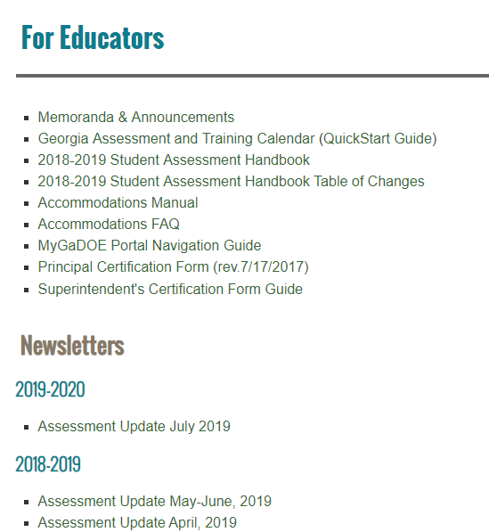
Assessment Administration Resources
Program Management Guidance Resources

Slide 64
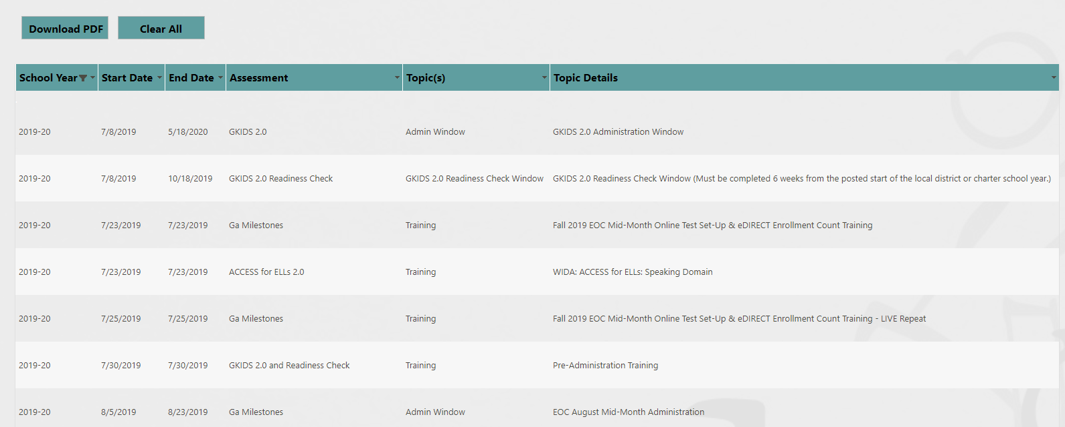
Assessment Administration Resources
Georgia Assessment and Training Calendar

Slide 65
Assessment Administration Resources
State Testing Windows
Assessment | Testing Window | Population | Report Expectations
ACCESS for ELs 2.0 | 1/15/2020-3/6/2020 | EL Students | Mid-May
Georgia Milestones EOC Winter 2019 | 11/18/2019-1/8/2020 | All Students in Specific Courses | Preliminary, varies based on test dates and administration mode
Georgia Milestones EOC Spring 2020 | 4/20/2020-5/29/2020 plus mid-months and summer admins | All Students in Specific Courses | Preliminary, varies based on test dates and administration mode
Georgia Milestones EOG Spring 2020 | 4/6/2020-5/15/2020 plus retest | All Students Grades 3-8 | Preliminary, varies based on test date and administration mode
Georgia Alternate Assessment 2.0 | 3/23/2020-5/1/2020 | 1% of Georgia Milestones Students | June
GKIDS 2.0 | 7/8/2019-5/18/2020 | Kindergarten Students | Late May 2020
NAEP | 10/14/2019-5/22/2020 Different assessment window for each group | Selected Schools and Students (ages 9, 13 and 17) | Fall 2020
Keenville | All Year | 1-2 Students | Teacher discretion throughout the year

Slide 66
Assessment Administration Resources
Assessment Update Newsletter
Provides monthly assessment updates
Provides training links and dates
Provides assessment tasks to remember
Provides accountability updates

Slide 67
2019-2020 Lunch and Learns
Assessment
Date | Time | Link
10/11/2019 | 12 – 1 p.m. | https://attendee.gotowebinar.com/register/5642156411990485763
11/8/2019 | 12 – 1 p.m. | https://attendee.gotowebinar.com/register/4957934724071414787
1/10/2020 | 12 – 1 p.m. | https://attendee.gotowebinar.com/register/4957934724071414787
2/14/2020 | 12 – 1 p.m. | https://attendee.gotowebinar.com/register/2238460938046554883
3/13/2020 | 12 – 1 p.m. | https://attendee.gotowebinar.com/register/3658502195551822339

Slide 68
Assessment Administration Resources
MyGaDOE Portal Login Page

Slide 69
Assessment Administration Resources
MyGaDOE Portal
MyGaDOE Portal Welcome Page
Testing Irregularity Form
Superintendent’s Test Certification
Special Accommodation Request
Assessment Rescore Request

Slide 70
Assessment Administration Resources
MyGaDOE Portal Online Forms
https://portal.doe.k12.ga.us/login.aspx
Special Accommodations Request Form
Guidance appears in Student Assessment Handbook
Last year, this online form replaced the need to submit requests via email
IMPORTANT: Email/Call Taiesha Adams or Mary Nesbit-McBride to notify GaDOE of request
Superintendent’s Certification Form
Tests administered January 1 – June 30: Submit no later than July 31
Tests administered July 1 – December 31: Submit no later than January 31
IMPORTANT: Email/Call Sandy Greene with questions
Assessment Rescore Request Form
IMPORTANT: Email/call appropriate GaDOE Assessment Specialist to discuss applicable fees and notify GaDOE of request
Also used for transcription requests
Testing Irregularity Form
Used to document any testing irregularity during any testing session
Contact GaDOE Assessment Specialist to discuss questions regarding irregularities and potential invalidations

Slide 71
MyGaDOE Portal & Contractor Accounts
Assessment | Vendor | When | Contact
MyGaDOE Portal | Georgia Department of Education https://portal.doe.k12.ga.us/login.aspx | ASAP | District Security Officer identified within the MyGaDOE Portal
ACCESS for ELLs 2.0 | WIDA (for WIDA.us) Data Recognition Corporation (DRC) (for the WIDA Assessment Management System, WIDA AMS) https://wida.wisc.edu/ https://wida.drcedirect.com | October 2019 | WIDA Customer Service (866) 276-7735 help@wida.us DRC Customer Service (855) 787-9615 WIDA@datarecognitioncorp.com
GAA 2.0 | Questar | Sent to STCs in October by Questar | Questar Customer Service GA@QuestarAI.com (866) 997-0698
GKIDS | Georgia Center for Assessment (GCA) https://gkids.gadoe.org | ASAP | Georgia Center for Assessment (GCA) (888) 392-8977
Georgia Milestones | Data Recognition Corporation (DRC) https://ga.drcedirect.com | ASAP | Data Recognition Corporation (DRC) (866) 282-2249 gahelpdesk@datarecognitioncorp.com

Slide 72
Embargoed Data
Do not share embargoed State, System, or School-level data at public board meetings or with the media until the GaDOE releases data for that program.
Do share individual student information with parents, students, teachers and staff related to the student as soon as they are received. Preliminary student reports may be shared according to local policies.

Slide 73
Accommodations and Special Populations

Slide 74
Accommodations
Students eligible for accommodations include:
Students with Disabilities
Students with Individualized Educational Programs (IEP)
Students served under Section 504
Only in the rarest of circumstances would a 504 student qualify for a conditional accommodation
English Learners
Students qualifying for language assistance services (ESOL)
EL students who are also SWD
Students who have exited language assistance services in the last two years (EL-Monitored). EL-M students are ineligible for conditional accommodations based on language proficiency

Slide 75
Accommodations
Accommodations allow access…
they are practices and procedures in the areas of presentation, response, setting, and scheduling that provide equitable instructional and assessment access for students with disabilities
Accommodations reduce or eliminate the effects of a student’s disability or limited English proficiency
Accommodations provide access for demonstration of achievement
Do not guarantee proficiency
and therefore should not be selected solely as mean to help ensure proficiency

Slide 76
Assessment Accommodations
Conditional Accommodations
Standard Accommodation
Universal Test Design
Standard Accommodations: Provide access to the assessment without altering the construct measured by the assessment.
Conditional Accommodations: Provide access for students with more severe disabilities who would not be able to access the assessment without such assistance.
Special Accommodations

Slide 77
Accommodations
Test Administration
Accommodations must be required by the student in order to access the assessment
Accommodations must be provided during, and be informed by, routine instruction and assessment in the classroom (both before and after the state tests are administered)
Specifying testing mode (online or paper) is not considered an accommodation. Paper forms are available for those students who cannot access the online assessment due to their disability.

Slide 78
Conditional Accommodations
Conditional accommodations are never intended to be available for all students
The guidance is designed to protect the accommodations for students who truly require them
Anytime an accommodation is considered it is important to reflect what the test is designed to measure
The goal is meaningful (i.e., valid) measurement of student achievement
It is important to consider the long-term effects of inappropriate accommodation use
Accommodations should foster independence, not dependence

Slide 79
English Learner Students – Screeners & Assessments
Dr. Margaret (Meg) Baker
Program Manager
ESOL Language Program
Title III, Part A Language Program

Slide 80
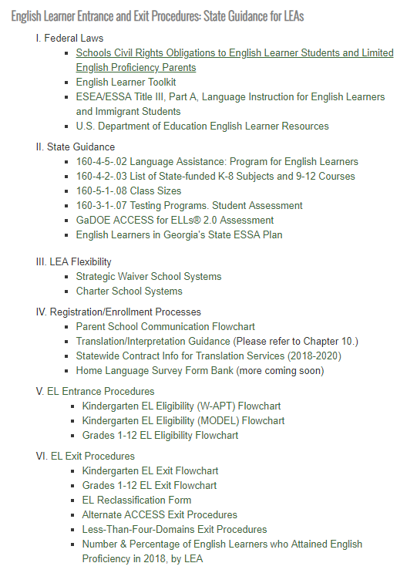
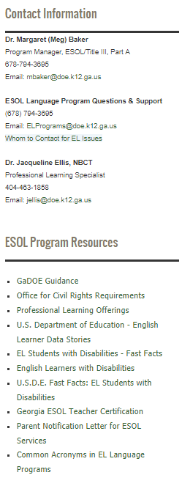
ESOL
Resources

Slide 81
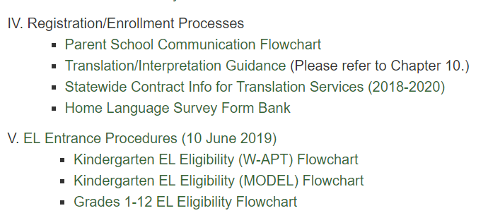
READ, Understand, & Implement
ESOL
EL Entrance Procedures
EL Entrance Procedures

Slide 82
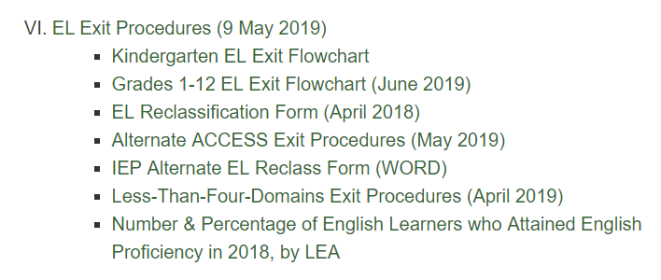
ESOL
EL Exit Procedures
READ, Understand, & Implement
English Learner (EL) Exit Procedures

Slide 83
Simple Summary
EL Entrance and Exit Procedures
EL Entrance Procedures
EL Exit Procedures
One-time HLS
One-time ELP Screener
Eligibility Criteria
Parent Notification Timelines (30 days/10 days)
Annual ELP Assessment
All EL students (Title I)
Continuing Eligibility
Parent Notification
Annual ELP Assessment
All EL students (Title I)
Exit Criteria
EL Reclassification Team Decision & Form
Parent Notification

Slide 84
Do all EL students need to be tested on the ACCESS for ELs?
Yes.
Under the ESEA, all K-12 EL students must be annually assessed for English Language Proficiency (ELP), including those whose parents refuse their participation in language services such as ESOL or Title IIIA. [Section 1111(b)(2)(G); 34 C.F.R. §§ 200.5(a)(2), 200.6(h)]
Students who reach full English proficiency, as determined by statewide standardized EL exit procedures, are no longer tested on the ACCESS.
Federal Programs’ Title I, Part A will be monitoring LEA’s EL ACCESS Participation Rate

Slide 85
EL Exit Flowchart
For Kindergarten EL Students
No changes – Same as 2018!
Do Not Exit
Exit
Overall < 5
Listening < 5
Speaking < 5
Reading < 5
Writing < 4.5
Overall > 5
Listening > 5
Speaking > 5
Reading > 5
Writing > 4.5

Slide 86
EL Exit Flowchart
For EL Students in Grades 1-12
No changes to criteria!
Do Not Exit
Exit
Overall < 4.3
Overall CPL > 5
Overall 4.3 – 4.9
Consider for Exit – EL Reclassification Form
Required in 2019!

Slide 87
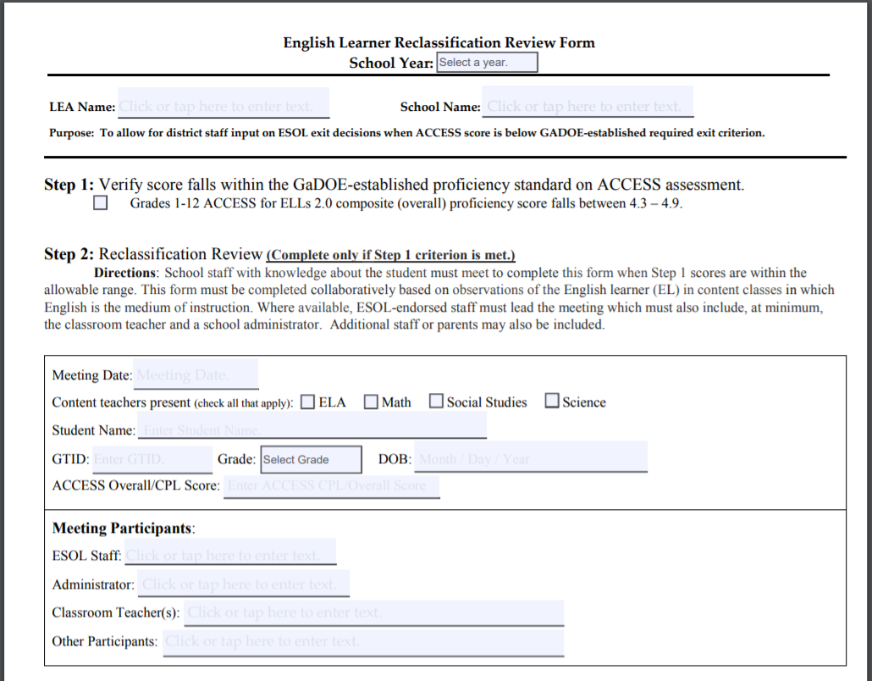
LEA Flexibility
Considering EL Students for Reclassification
Using this form, the EL Reclassification Team will decide whether to exit the EL student or not.
The final decision (whether or not to exit) must be recorded on the EL Reclassification Form, which must be maintained in the student’s permanent/cumulative file.
(DO NOT PURGE!)

Slide 88
Alternate ACCESS Exit Procedures
Threshold for Considering EL Exit
Alternate ACCESS Overall CPL P2 (Emerging) for two consecutive years with IEP Team recommendation
Or any other Alternate ACCESS Overall CPL – the same score - for three consecutive years with IEP Team recommendation.
New

Slide 89
Alt ACCESS Rubric
EL Reclassification/IEP Team Rubric
Alt ACCESS Rubric
Alternate EL Exit Criteria |  | Evidence Reviewed | Justification
Is an ESOL or 2nd language acquisition specialist a member of the EL Reclassification Team? | Yes No | Name: _____________________ Role: ______________________
Is the EL student eligible for Georgia’s Alternate Assessment 2.0? (See GAA 2.0 Eligibility Criteria) | Yes No | GAA 2.0 Eligibility Criteria: Year Eligible: ________________
Has the EL student performed at Alternate ACCESS Overall Composite Proficiency Level (CPL) P2 for two consecutive years? | Yes No | Language Assessment Results: Test Year__________ CPL _____ Test Year__________ CPL _____
Has the EL student performed at Alternate ACCESS CPL ______ for three consecutive years? (specify CPL) | Yes No | Language Assessment Results: Test Year__________ CPL _____ Test Year__________ CPL _____ Test Year__________ CPL _____
Is the EL student’s rate of language acquisition primarily attributed to the student’s disability rather than to English language proficiency? | Yes No | Anecdotal Notes & Observations Benchmark or Progress Monitoring Data Adaptive behavior skills assessment Academic Achievement & Functional Performance
Is English language proficiency no longer a barrier to full participation in the student’s individualized program of instruction, as specified in IEP goals? | Yes No | Anecdotal Notes & Observations Benchmark or Progress Monitoring Data Adaptive behavior skills assessment Academic Achievement & Functional Performance
EL Reclassification / IEP Team Rubric
(Only to be used with Alternate ACCESS Exit Procedures)
Student Name: ________________ GTID _________
Note: If an EL Student Exit is being considered, the IEP Team must review the six (6) criteria below and select Yes or No as applicable to the student. A Yes answer for Criteria #5 and #6 requires a justification that contains evidence that the student meets the criteria. The Team’s final determination must consider the performance of English-only students in similar settings that have similar characteristics to the EL student being evaluated for reclassification (e.g. disability, grade level, educational background, etc.).
EL Reclassification / IEP Team Review Determination:
Exit from EL Status
Do not exit from EL status; student should remain coded as an English Learner.
Administrator Signature: __________________________Date: ___________________
Parent Signature: _______________________________ Date: ___________________

Slide 90
Less-Than-Four-Domains Exit Procedures
Less Than Four Domains Exit Procedures
The state has established that an English Learner (EL) with disabilities whose disability precludes assessment of one or more language domains should be considered for exit from English learner status when the student has met the following state-established criteria using a GaDOE-provided Designate Composite Proficiency Level (D-CPL).
New
Note: Students who are deaf, blind, and non-verbal would be considered as having a disability that precludes assessment in one or more language domains. Beyond these reasons, the Assessment Director should seek counsel from the GaDOE Assessment Division who would consult with Special Education and EL Learner Programs.

Slide 91
Use D-CPL to Apply Appropriate Exit Criteria
After receiving the DOE-generated D-CPL, the appropriate standardized, statewide EL exit criteria for the ACCESS for ELLs® 2.0 or the Alternate ACCESS Threshold for considering EL Exit would then be applied to determine whether the EL student will exit EL status or not.
ACCESS for ELLs® 2.0 Exit Criteria Flowchart
Alternate ACCESS Threshold for Considering Exit

Slide 92
Break

Slide 93
Test Security

Slide 94
Test Security
Guiding Principles
The primary goal of assessment security is to protect the integrity of the assessment and to assure that results are accurate and meaningful.
State assessments are an important and a required tool used to monitor state, district, school, and student achievement results.
For assessments to yield fair, accurate, and valid results, they must be administered under the same standardized conditions to all students.

Slide 95
Code of Ethics for Georgia Educators
Standard 10: Testing – An educator shall administer state-mandated assessments fairly and ethically.
Unethical conduct includes but is not limited to:
committing any act that breaches Test Security; and
Compromising the integrity of the assessment.
GaPSC Ethics Division: https://www.gapsc.com/Ethics/CodeOfEthics.aspx

Slide 96
Test Security
Prevention
Detection
Investigation
Remediation
Assessment Administration

Slide 97
Test Security
Security Hierarchy
Superintendent
Test Examiner
Student
School Test Coordinator
Principal
System Test Coordinator (STC)
The successful implementation of the statewide student assessment program requires a concerted effort by many individuals at the local level.

Slide 98
Test Security
Prevention – Roles and Responsibilities
Superintendent
Superintendent has ultimate responsibility for all testing activities within the local school system.
System Test Coordinator (STC)
STC shares the responsibility for all testing activities within the local district or charter school as the Superintendent’s designee.
Principal/Administrator
Principal has ultimate responsibility for all testing activities within the school.
System Technology Coordinator
Acquires and maintains current information on the statewide testing program, including technology requirements for testing programs, training manuals, and testing schedules.
Coordinates with the STC for the appropriate implementation of computer-based test administrations.

Slide 99
Test Security
Prevention – Roles and Responsibilities
School Test Coordinator
Must hold a GaPSC-issued certificate
Test Examiner
Must hold a GaPSC-issued certificate
Proctor
Participates in all training and follows procedures for monitoring the test environment
Shares responsibility with the Principal for all testing activities within the school as the Principal’s designee.
Participates in all training and follows procedures for testing as given in specific Examiner’s Manual’s and documentation related to all state-mandated assessments
Responsible for the correct delivery of assigned accommodations
With examiner supervision, ensures that students are managing test materials appropriately
Ensures only GaPSC-certified personnel manage or handle secure test materials

Slide 100
Test Security
Prevention – Student Assessment Handbook
Security Breaches
Staff or student interference in student responses
Testing Irregularities
Irregularities in Security Procedures
Irregularities in Test Administration
Invalidations related to Student Behavior
Staff or Student sharing of any secure test material (social media, texting, email, etc.)
Failure to follow security regulations for distribution and return of secure test materials. Lost test materials are considered a breach of test security
Staff failure to follow assessment administration directions from the Examiner’s Manual, including an exact word-for-word reading of the Examiner’s script
Cell Phones/ Electronic Devices
Students are not permitted to use, or to bring any electronic device that could allow them to view, access, retain, or transmit information
Districts and schools must have a plan to collect and secure such devices, so they are not accessible during testing.
Notes:
Security Breaches are any action that compromises test security or leads to the invalidation of an individual student’s or a group of students’ test scores.
copies, reproduces, or uses in any manner (including social media sites, texting, and/or email any portion of secure items, test tickets, passwords, or test booklets

Slide 101
Test Security
Prevention – Student Assessment Handbook
Distribution/ Storage of Secure Test Materials
All online or paper/pencil test materials must be stored in a secure, locked location with restricted access when not in use.
Test Security Information for School Test Coordinators
Test security information provided for test coordinators, examiners, and proctors.
General Assessment Administration Guidance
Provides general guidance for the following:
System Test Coordinator must implement an accounting and inventorying system between the central location and the schools for all secure test materials.
Consult the Test Coordinator’s Manual for each test regarding details in managing secure test materials.
May be copied and included as part of the documentation for local test security training.
Scheduling, Test Environment
Pre-Administration, During and Post-Test Preparation
Homebound/Hospitalized Students
Make-up Sessions, Emergency/Unexpected Situation
Transferring Student Records, Accessing Assessment Data Files
Notes:
Security Breaches are any action that compromises test security or leads to the invalidation of an individual student’s or a group of students’ test scores.
copies, reproduces, or uses in any manner (including social media sites, texting, and/or email any portion of secure items, test tickets, passwords, or test booklets

Slide 102
Student Assessment Handbook
Test Security Information | Where to find it
Security Breaches – Examples | Page 9
Testing Irregularities | Page 10
Security Procedures Test Administration Student Behavior | Page 11 Page 12 Page 12
Cell Phone/Electronic Device Use | Page 13
Distribution and Storage of Secure Test Materials | Page 18
Test Security Information for School Test Coordinators/Teachers/Examiners | Pages 20-22
Roles and Responsibilities | Pages 23-30
General Assessment Administration Guidance | Pages 70-80
Accommodations Guidelines | Pages 81-99
*Pages listed are from the 18-19 SAH

Slide 103
Test Security
Prevention – Local Testing Calendar Scheduling Considerations
All local district testing windows must be within posted state testing windows and must be consistent with guidance found in the Student Assessment Handbook.
Requests for exceptions outside of allowed flexibility must have prior approval by the GaDOE.
The order of administration is determined by the guidance provided in the System Test Coordinator’s or Test Administration Manual for each assessment.
In scheduling each assessment, districts/schools must adhere to the testing times prescribed in the Examiner’s Manuals.
Determine the plan for communication of local testing windows to parents/guardians and other stakeholders, including school-level leaders and educators.

Slide 104
Test Security
Prevention – Local Training Plan
System Test Coordinator
Participation in all GaDOE webinars and training sessions
Review of resources available for System Test Coordinators
School Test Coordinator
Participation in all District-level training sessions
Test Examiners, Proctors
Participation in all School-level training sessions
Test Security
Test Security
Test Administration
Pre-, During, and Post-Test Administration Activities
Test Administration
Pre-, During, and Post-Test Administration Activities
Student Test Preparation Training
All training documentation including presentations, handouts, and sign-in sheets must be kept on file locally.
The state may request copies of these materials to ensure that the training was appropriate and adequate.
Provide professional ethics and security training to all staff, both veteran and new staff.
School Test Coordinators are responsible for training of all test examiners and proctors.

Slide 105
Test Security
Prevention – Accommodation Guidance
Testing accommodations are assigned to students based on decisions made by the IEP team. Assigned accommodations are required by the student in order to access the assessment due to the student’s disability.
Accommodations must be provided during, and be informed by, routine instruction and assessment in the classroom (both before and after the state tests are administered)
For instance, the amount of extended time a student is given for a state assessment should be informed by the amount given during routine, daily instruction and classroom/local assessment experiences.
Specifying testing mode (online or paper) is not allowed as an accommodation. Paper forms are available for those students who cannot access the online assessment due to their disability.
Neither accommodations or assessment designations (such as a student’s assignment to the GAA 2.0) should be influenced by accountability concerns or influences.

Slide 106
Test Security
Prevention – Special Accommodation Requests
In rare instances, the GaDOE will consider a request for use of an accommodation that is not included in the Student Assessment Handbook, on a student by student basis.
Include detailed information for each student.
See the SAH for the required information that must be submitted.
Should be based upon the needs of individual students, requests that are identical for multiple students are not appropriate and will not be reviewed.
STC should screen requests prior to submitting to GaDOE
Submit in one batch six (6) weeks or more prior to test administration
Use the Online Special Accommodations Request in the MyGaDOE Portal

Slide 107
Test Security
Prevention – Training Considerations
Test Preparation Activities to Consider
All students should be familiar with test-taking strategies and with the types of formats and scoring used on the tests (writing prompts; multiple-choice questions; extended-response questions; technology-enhanced items; and online tools, etc.)
Use of items from Assessment Guides, Study Guides, and other GaDOE posted Resources that are parallel to state assessment items should be part of an instructional program that leads to long-term learning
Communicate to students, parents, and the public what state assessments entail, when and how the tests will be administered, and how the results will be appropriately used.
All rooms used for test administrations must be conducive to a proper test environment. For example, the room should be quiet, orderly, comfortable, and have adequate lighting and ventilation.

Slide 108
Test Security
Prevention – Training for Test Examiners
Training Considerations for Test Examiners
Test Examiners must be GaPSC certified.
Test Examiners must adhere to protocols for management of secure test materials.
Test Examiners are responsible for the review of rosters and secure test tickets for: Verification of student names and GTID Verification of student accommodations
Test Examiners are responsible for the administration of the assessment: Thorough Review of the Examiner’s Manual and Script Word-for-Word reading of the Script directly from the Examiner’s Manual Account for time allowed for test section completion Verification of student accommodations Verify Text-to-Speech applied in online sessions prior to starting Verify hand-held calculators are not available to students during no-calculator section

Slide 109
Test Security
Prevention – Training for Test Examiners
Training Considerations for Test Examiners
Test Examiners may NOT review or memorize test content.
Test Examiners may NOT discuss test content with students before, during, or following test sessions.
Test Examiners may NOT post or discuss any portion of a test item or writing prompt to social media, email, or text.
Test Examiners are responsible for reporting irregularities to the School Test Coordinator.

Slide 110
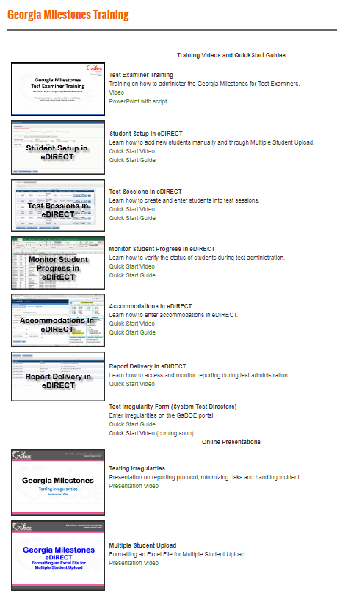
QuickStart Videos and Guides
Test Examiner Training
Student Setup
Test Sessions
Monitor Student Progress
Accommodations
Report Delivery
Online Presentations
Testing Irregularities
Multiple Student Upload
Can be found off the EOG Resources or EOC Resources pages.
http://www.gadoe.org/Curriculum-Instruction-and-Assessment/Assessment/Pages/Milestones_Training.aspx

Slide 111
Test Security
Prevention – Are Students AND Teachers Ready?
Orient students to testing via an online platform:
Experience Online Testing Georgia: http://www.gaexperienceonline.com
Secure Practice Tests in INSIGHT
Notes:
Students should be comfortable with the format of the Georgia Milestones assessment as well as the INSIGHT program and all available tools. Districts should set up practice sessions with students using the Secure Practice Tests. Teachers, students and parents can experience the format of the test and the INSIGHT program anywhere anytime through Experience Online Testing Georgia.

Slide 112
Test Security
Prevention – Practices to Avoid
Test Preparation Practices to Avoid
Use of secure test questions or questions that are similar to or altered versions of secure test questions
Reveal, copy, or reproduce any secure state assessment questions, materials, or student responses to secure questions
Copies, reproduces, or uses in any manner (including social media sites, texting, and/or email) inconsistent with test security regulations all or any portion of secure online testing forms, test tickets, passwords, or test booklets
Reads, reviews, notates, photographs, shares, transmits test items whether online or paper, before, during (unless specified in the IEP, IAP, or EL/TPC), or after testing
Questions students about test content after the test administration

Slide 113
Test Security
Detection – IV, IR, PIV Definitions
Invalidation (IV): Testing anomaly that warrants nullifying scores.
Irregularity (IR): Testing anomaly that warrants a report and coding, but test scores stand. An invalidation may be necessary following the review of a reported irregularity.
Participation Invalidation (PIV): Testing anomaly, usually related to an ineligible conditional accommodation, that warrants nullifying scores.

Slide 114
Test Security
Detection – Examples of Security Breaches
Before, During, and After
Lost or stolen materials
Educators logging into tests to view questions or change responses
During
Students giving or receiving unauthorized assistance from other students during test administration
Teachers providing answers or providing assistance to students during testing
After
Changing responses on the computer
Reconstructing assessment materials through memorization
Memorized test items or answers being posted online
Students accessing non-allowable resources (notes, textbooks, the internet)
Taking photos of test items and sharing them on the internet or social media
Obtaining unauthorized access to secure assessment materials
Hacking into computers

Slide 115
Test Security
Investigation – Irregularities
Irregularity (IR): Testing anomaly that warrants a report and coding, but test scores stand. An invalidation may be necessary following the review of a reported irregularity.
All personnel in the local system must follow protocol as they become aware of testing irregularities
Signs of any testing irregularity must be dealt with immediately
All irregularities must be reported to the GaDOE by completing the Testing Irregularity Form (TIF) in the MyGaDOE Portal.
Test Examiner
System Test Coordinator
GaDOE
School Test Coordinator
Keep Principal Informed
TIF

Slide 116
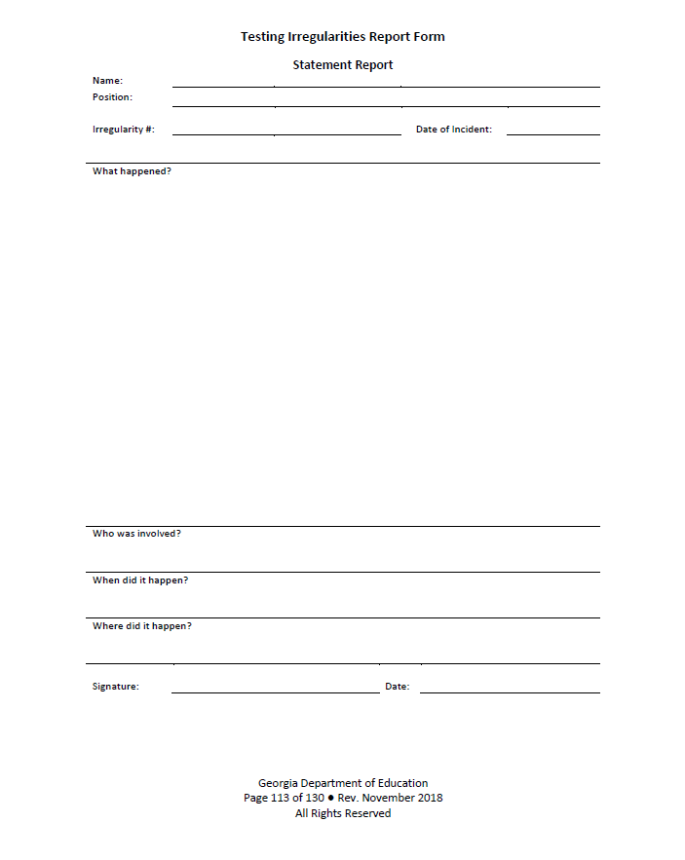
Irregularities
Investigation – Steps for Reporting a Test Irregularity
School Test Coordinator:
Communicate with the Principal and STC about a possible testing irregularity
STC will provide guidance regarding investigation if necessary
Statements should be provided by all parties involved in the irregularity… Details, Details, Details…
Return all documentation to the STC in the manner and at the time prescribed

Slide 117
Test Security
Investigation – Entering Irregularities into the MyGaDOE Portal
MyGaDOE Portal Welcome Page
Testing Irregularity Form Summary Page
Refer to User Guide
Open for form review
Defaults to current active administration
Link to User Guide

Slide 118
Test Security
Remediation – Avoiding Test Irregularities
Adhere to test security policies, protocols and procedures.
Reinforce the use of active monitoring in testing environments.
Immediately report any possible testing irregularities.
Properly identify all students who should receive accommodations prior to testing including a regular review of IEP/IAP/TPC plans to determine if accommodations are still appropriate or needed.
If a student is suspected of cheating/cell phone use, but there is no proof of his or her action, allow the student to complete the section and/or entire test.
An invalidation can always occur after all of the facts are collected.

Slide 119
Test Security
Remediation – Invalidations
Invalidation (IV): Testing anomaly that warrants nullifying scores.
Only the GaDOE may invalidate assessments
The Assessment Administration Division will review all reports of irregularities
Issue irregularity/invalidation codes
If appropriate, advise the local system as to whether a report of possible unethical conduct should be made to the Georgia Professional Standards Commission (GaPSC)
In the event of an evacuation or other unexpected event, the safety and well being of students takes priority.

Slide 120
Accountability

Slide 121
Accountability
Point of Contact
Named by school superintendent
Receives key communications from GaDOE accountability team
Participates in monthly Accountability Lunch and Learn webinars
Relays key information to administration at local level
Needs district level CCRPI access in the MyGaDOE portal

Slide 122
2019 Accountability Lunch and Learns
Date | Time | Link
February 13 | 12:00 p.m. | https://attendee.gotowebinar.com/register/501329319315286274
March 20 | 12:00 p.m. | https://attendee.gotowebinar.com/register/4390581222712608514
April 17 | 12:00 p.m. | https://attendee.gotowebinar.com/register/2677462941800440066
May 15 | 12:00 p.m. | https://attendee.gotowebinar.com/register/4766228270830704386
June 19 | 12:00 p.m. | https://attendee.gotowebinar.com/register/4224844138476612098
July 17 | 12:00 p.m. | https://attendee.gotowebinar.com/register/5130118241112988418
August 21 | 12:00 p.m. | https://attendee.gotowebinar.com/register/7463493021486207490
September 18 | 12:00 p.m. | https://attendee.gotowebinar.com/register/2513586231238654210
October 16 | 12:00 p.m. | https://attendee.gotowebinar.com/register/2542338460305020162
November 20 | 12:00 p.m. | https://attendee.gotowebinar.com/register/8107452792836907009

Slide 123
2019 CCRPI Calendar
Activity | Start | End
GAA Participation Application | December 2018 | January 17, 2019
Assessment Matching 1 | March 5, 2019 | August 15
Live Portal Data | April 24 | Static when SR and SC close
Student Record and Student Class Close | Ongoing | June
Assessment Matching 2 | August | August 29
Non-Participation Application | July 2 | August 29
Summer Graduate Collection* | July 2 | August 15
Cohort Withdrawal Update* | July 2 | August 15
Graduation Rate Public Release* | - | September
CCRPI Public Release | - | Late October
* High Schools Only

Slide 124
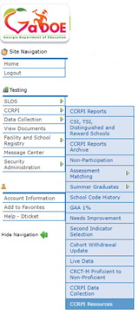
CCRPI Resources in MyGaDOE Portal
• Webinar recordings, PPTs, and user guides are available in the CCRPI Resources section of the MyGaDOE portal.
Detailed calculation guides
User guides
Webinar recordings
Other resources not appropriate
for the public site

Slide 125
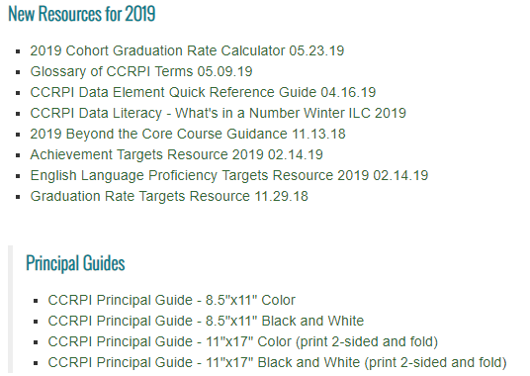
CCRPI Resources on Public Site
Accountability webpage
CCRPI Resources for Educators webpage

Slide 126
GaDOE Assessment and Accountability Specialist Contacts
Assessment Specialists
Taiesha Adams, Ed.D., (404) 656-5975; taadams@doe.k12.ga.us
Bobbie Bable, (404) 657-6168; babble@doe.k12.ga.us **
Joe Blessing, (404) 232-1208; jblessing@doe.k12.ga.us **
Kelli Harris-Wright, (404) 463-5047; harris-wright@doe.k12.ga.us
Robert McLeod, Ed.D., (404) 656-2589; rmcleod@doe.k12.ga.us
Mary Nesbit-McBride, Ph.D., (404) 232-1207; mnesbit@doe.k12.ga.us
Accountability Specialists
August Ogletree, Ph.D., (404) 463-6675; aogletree@doe.k12.ga.us

Slide 127
How Did We Do?
Survey Link
https://tinyurl.com/statecharter19

Slide 128
Thank you!
Allison Timberlake, Ph.D. Deputy Superintendent for Assessment & Accountability atimberlake@doe.k12.ga.us (404) 463-6666
Jan Reyes, Ed.D. Director of Assessment Development jreyes@doe.k12.ga.us (404) 463-6665
Sandy Greene, Ed.D. Director of Assessment Administration sgreene@doe.k12.ga.us (404) 656-0478
Paula Swartzberg
Director of Accountability
pswartzberg@doe.k12.ga.us
(404) 463-1539
testing.gadoe.org
accountability.gadoe.org

