Slide 1

End of Grade Assessment (EOG)
Spring 2015
Pre-Administration Workshop
March 3 - 5, 2015
This PowerPoint is posted on the Georgia Milestones Assessment System Website under Presentations
http://www.gadoe.org/Curriculum-Instruction-and-Assessment/Assessment/Pages/Georgia-Milestones-Assessment-System.aspx

Slide 2
AGENDA
Training Materials
Georgia Milestones EOG Overview
Up to this Point
Pre-Administration
Test Administration
Post Testing Activities
Contact Information
Thank You
Notes:
2

Slide 3
TRAINING MATERIALS
Source for Materials and Resources Referenced
Georgia Department of Education website: http://www.gadoe.org/Curriculum-Instruction-and-Assessment/Assessment/Pages/Georgia-Milestones-Assessment-System.aspx
CTB website at: http://www.ctb.com/ga
Train the Trainer Model for system training
Notes:
3

Slide 4
Training Materials
Posted to both the GaDOE and CTB websites
Paper and Pencil | Online
School and System Test Coordinator’s Manual (TCM)
Middle Grades Math Formula Sheet (DOE site only)
Paper-and-Pencil Examiner’s Manual End-of-Grade (PP TEM) Grades 3 and 6 Student Answer Documents Sample Packing List Shipment Verification Form Sample Security Checklist School/Group List (SGL) Group Information Sheet (GIS) Stack Cover Cards Pre-ID Barcode Label |  | Online Examiner’s Manual End-of-Grade (OL TEM) Online Practice Test Directions Sample Student Test Ticket Sample Summary Test Ticket Link to Experience Online Testing Georgia

Slide 5
Georgia Milestones
EOG Overview
Will cover the following:
Administration Dates
Main Administration
Retest Waiver for 2015
Test Construction
Notes:
5

Slide 6
Administration Dates
Georgia Milestones
EOG Overview
System testing dates were submitted in January through the Online Enrollment System
  Main Administration:
    March 30 – May 1, 2015
    9 consecutive school day window
Notes:
6

Slide 7
Main Administration
Students to be tested and Makeup Testing
Georgia Milestones
EOG Overview
Students to be Tested:
  Includes all students enrolled in grades 3 through 8, except for those participating in the GAA or who have an EL deferment for English Language Arts and Social Studies. EL deferred students MUST have participated in the 2015 ACCESS for ELLs.
Make-up Testing:
  Make-up tests must be given within the system’s scheduled local administration window; the last day of the local window should be scheduled as a makeup day.
  No makeup testing required outside of the system’s scheduled window
Notes:
7

Slide 8
Retest Waiver 2015
Georgia Milestones
EOG Overview
  Retest Administration:
  Promotion/Retention requirements waived for Grades 3, 5, or 8 for 2014-2015.
  No retest this year.

Slide 9
Georgia Milestones
EOG Overview
Test Construction
Structure and Order
Paper/Pencil and online administration modes available for all content areas
For paper/pencil administrations, there will be one test booklet and one 16 to 20 page answer document by grade containing all 4 EOG content areas
ELA Section 3 will assess writing (in all grades) and must be scheduled for a day separate from and following ELA Sections 1 and 2
Administration Order: English Language Arts, Mathematics, Science, Social Studies

Slide 10
Georgia Milestones
EOG Overview
Test Construction
Content Areas and Item Types
Content Areas
  ELA, Math, Science and Social Studies
Item types
Content Area | Selected Response | Constructed Response (2 points) | Extended Constructed Response (4 points) | Extended Writing Response (7 points)
English Language Arts |  |  |  | 
Mathematics |  |  | 
Science | 
Social Studies | 
Notes:
10

Slide 11
Georgia Milestone
EOG Overview
Test Construction
Technology Enhanced Field Test Items – Online Only
Students testing online may encounter a few basic technology-enhanced items.
These Expression & Equation Entry (EEE) items will include a keypad palette that can be customized to include numbers, operators, symbols/variables, or key mathematical templates (such as fractions, square root).
Some EEE items may require students to solve a problem and enter a numerical answer such as 60.
These items are field test only and will not contribute to the students’ scores.
Experience Online Testing Georgia will be revamped to include a few sample EEE items and reflect the updated online environment.

Slide 12
Georgia Milestones
EOG Overview
Test Construction
Item Alignment
Test Items that contribute to achievement scores are aligned to the state-adopted content standards
Continued field testing of content for future administrations
Norm-referenced (NRT) items included to allow for national comparison; some NRT items are aligned to state-adopted content standards and will contribute to the criterion-referenced (CRT) proficiency score. Those that are not aligned will not contribute to the CRT score or accountability/teacher effectiveness measures
EOG Assessment Guides are available in the Georgia Milestones section of the Testing/Assessment Website

Slide 13
Georgia Milestones
EOG Overview
Test Construction
Score reports will be available in Fall of 2015
  Produced at the student, class, district, and state levels
  Provide students’ criterion-referenced achievement designations for each test
      Designations will indicate the degree to which students have mastered the standards within each content area using four achievement levels.
  Provide domain scores
  NRT scores will be presented as national percentile ranks.
  Only the criterion-referenced achievement designations will be used in the educator effectiveness measures and for state and federal accountability

Slide 14
Up to This Point
Introduction of the Georgia Milestones Assessment System EOG during Fall 2014
Georgia Milestones EOG Assessment Guides
Series of Lunch and Learn Webinars (October 2014 – April 2015) to apprise systems of Georgia Milestone’s features and progress
Enrollment counts submitted to CTB to designate the number of Online and Paper and Pencil test takers
Pre-ID Cycle 3 submitted to GaDOE Data Collections - All students included in this file will receive both a Pre-ID Label AND be loaded into the CTB Test Administration System (TAS) Database
Statewide Online Readiness Tests

Slide 15
Pre-Administration
System Test Coordinator Responsibilities
Receiving Your Materials Shipment
Test Materials Adjustments Application
Security Considerations
School Test Coordinator Responsibilities
Materials Distribution to Schools
Examiners Training
Pre-ID Labels
GNETS - Guidance and Coding
Accommodations
Notes:
15

Slide 16
Pre-Administration
System Test Coordinator Responsibilities
Paper and Pencil | Online
Review Test Coordinator’s Manual (TCM) Test Examiner’s Manuals, both Paper and Pencil (PP TEM) and Online (OL TEM)
Review the Online Practice Test Directions document
Organize training sessions for School Test Coordinators (SchTC)
Organize system security plan
Receive EOG Paper and Pencil (P/P) administration materials and verify that all boxes have been received and develop a process to verify that all numbers from System and School Packing Lists are correct | Training sessions should include Adding/Editing Students and Test Sessions (TAS) Printing, sorting, and distributing Test Tickets (TAS) Review of the Online Examiner's Manuel Managing and coding accommodations (TAS)

Slide 17
Pre-Administration
System Test Coordinator Responsibilities
Paper and Pencil | Online
Distribute EOG PP materials and Pre-ID labels to School Test Coordinators If needed, please order additional materials as soon as possible once you have received your initial shipment. Test Materials Adjustment (TMA) window opens on March 17, 2015 Training sessions for PP administrations should include a review of the administration procedures from the PP TEM | Verify the SchTCs have scheduled opportunities for students to participate in the Secure Practice Test Online Practice Test Directions from Georgia Milestones Website and ctb.com In particular, students who will utilize the Screen Reader should be provided access to this practice experience using the Screen Reader Student Orientation from the Appendix of the Online Practice Test Directions

Slide 18
Pre-Administration
Receiving Materials
Materials delivered by ADS or FedEx (< 20 boxes)
System Shipment includes:
  System Packing List
  School Packing Lists – schools should verify and turn in a signed copy to System Test Coordinator
  Shipment Verification Form
  System Security Checklist - hard copy included with shipment; electronic copy available at www.ctb.com/ga
  Return Shipping Labels
  System Overage materials (see next slide)
Notes:
18

Slide 19
Pre-Administration
Receiving Materials
Paper and Pencil Overage
System Test Coordinators will use system overage materials to provide additional materials to those schools that exhaust School Overage materials; verify counts on packing list
  Test Coordinator’s Manuals and Test Examiner’s Manuals
  Test booklets and Answer Sheets
  Stack Cover Cards and paper bands
SysTC should develop a system to account for overage materials distributed to schools
Notes:
19

Slide 20
Pre-Administration
Test Materials Adjustment (TMA)
Ordering Additional Materials
TMA application used to order additional materials for Spring 2015 administration
The TMA application allows you to:
  Place orders for additional materials online
  View exactly what materials were shipped to you
Connecting to TMA application:
  Go to the www.ctb.com/ga website and select the Test Coordinator Assessment Management Tab
  Click the Login link and enter your username and password
  Click the Test Materials Adjustment link
TMA windows:
  Spring: March 17 – April 24
  Special make up requests can be processed via the HelpDesk: GeorgiaHelpDesk@ctb.com or 866-282-2249)
Notes:
20

Slide 21
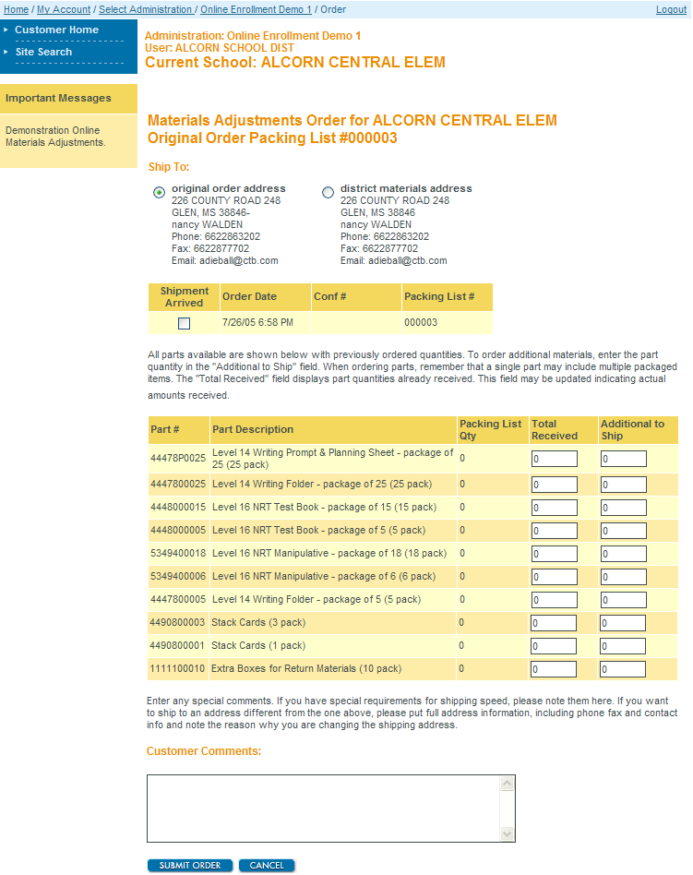
Pre-Administration - TMA
TMA Link: www.ctb.com/ga and then click on the Test Coordinator Assessment Management Tab
Choose the shipping address
Click to fill Total Received column
Modify if your shipment was short
Enter the quantity you want in addition to what you have received
Enter any special requests for shipping and delivery

Slide 22
Pre-Administration
Security Considerations
All Systems must adhere to the 9 consecutive school day test window unless an extension of the testing window has been previously approved by GaDOE
Keep materials in secure storage (limited key access) before, during, and after testing
Scratch paper is secure testing material and must be collected and counted at the end of each test session and returned to the SchTC. At the close of the testing window, the SchTC must return all scratch paper to the SysTC for secure destruction
Each classroom must have adequate staff to monitor testing
  30 or more students require a proctor in addition to an examiner
All examiners must be a Georgia certified educator
Testing Irregularities: Contact GaDOE for instruction; you may be asked to complete the online Test Irregularities form on MyGaDOE Portal
Notes:
22

Slide 23
Pre-Administration
Security Considerations
Paper Pencil
SchTCs use School Security Checklists and have a system that includes signing materials out to and in from Test Examiners each day; all materials are returned to the SchTC for secure storage at the end of each day
School Security Checklists are also available as electronic (Excel) files through www.ctb.com/ga
Student Test Booklets are presorted into class packs of 20 and 5 and must remain in their shrink-wrapped packages as late as possible to avoid security concerns until the first day of testing. The only exception is where a pack must be broken to count out for a class when an intact package is not sufficient or to create read-aloud groups of the same form. In those cases, this must occur as late as possible to avoid security concerns
Security wafer seals on all test books must not be broken until testing begins
Notes:
23

Slide 24
Pre-Administration
Security Considerations
Online
Individual Student Test Tickets and Summary Test Tickets are secure testing materials in the same way that test booklets are secure. They should be signed out to Examiners immediately prior to testing and signed back in immediately following the close of a test session.
TAS users with the roles of Administrator, Administrative Coordinator, Coordinator, and Proctor can at a minimum print Individual Student Test Tickets and Summary Test Tickets and thus have access to secure test material using a Student ID to log in to the Secure Testing App.
Notes:
24

Slide 25
Pre-Administration
School Test Coordinator Responsibilities
Paper and Pencil | Online
Test Coordinator’s Manual (TCM) and Test Examiner’s Manuals (TEM)
Organize training sessions for Test Examiners
Organize training for assessment of students with accommodations
Organize school security plan and monitor test administration
Receive EOG Paper and Pencil materials from SysTC and verify that all boxes have been received and material counts match those on the School Packing List Notify System Test Coordinator if additional materials are required | Manage students and test sessions in the Test Administration System (TAS) Assign and code accommodations in TAS Print and sort by testing location Individual Student Test Tickets and Summary Test Tickets
Notes:
25

Slide 26
Pre-Administration
Materials Distribution to Schools
Paper and Pencil
School Test Coordinators
  Complete School Inventory Checklist provided in TCM on page 48; when School Testing Coordinators verify their school’s packing list, a signed copy should be provided to the System Test Coordinator
Boxes are labeled for each School and include:
  School Packing List and School Security Checklist
  School/Group Lists
  Group Information Sheets
  Test Coordinator’s Manuals and Test Examiner’s Manuals
  Test booklets and answer sheets
  Stack Cover Cards and paper bands
Schools receive an overage of materials
  If additional materials are needed, School Test Coordinators contact the System Test Coordinator
Retain boxes for return shipping
Notes:
26

Slide 27
Pre-Administration
Materials Distribution to Schools
Online
School Test Coordinators
  Test Coordinator’s Manuals and Online Examiner’s Manuals
Notes:
27

Slide 28
Pre-Administration
Examiner Training
Preparation for Testing and Documentation
Paper and Pencil | Online
Train School Test Coordinators from the Administering the Tests section Georgia Milestones Paper and Pencil or Online Examiner’s Manual (TEM)
Ideally, School Test Coordinators train examiners from the copy of the TEM that examiner uses to test (make electronic version available if training is prior to receipt of materials)
Examiners should sign a roster verifying they attended training
Examiners must certify on the Examiner’s Certificate that prior to the first testing session, the TEM was thoroughly reviewed; make examiners aware of options for accessing TEM
Confirm that examiners understand that timing varies for each EOG subject area
 | The Examiner should administer the Secure Practice Test prior to administering the operational test, ideally to his/her designated testing group. This is critical for accommodated students.

Slide 29
Pre-Administration
Examiner Training
Responsibilities During Administration
Paper and Pencil | Online
Students take one content area per day
All sections from a single content area must be administered the same day The exception is ELA Section 3
Students take stretch breaks between Sections I and II
Monitoring for cheating – Circulate and Check
Students can write in the test books; highlighters are not allowed Monitor for going ahead or looking back; verify student is in the correct section of the Student Answer Document | Online Tools for all students Blocking Ruler/Tool Highlighter Eraser Mark for Review Online Calculator – if/where allowable Option Eliminator Pre-Writing/Notes field for ELA

Slide 30
Pre-Administration
Examiner Training
Order and Timing
Content Area/Course | Test Section(s) | Minimum Time Per Section(s) | Maximum Time Per Section(s)
English Language Arts | 1 and 2 | 60 | 70
English Language Arts | 3 | 70 | 90
Mathematics | 1 and 2 | 60 | 80
Science | 1 and 2 | 50 | 70
Social Studies | 1 and 2 | 50 | 70
A section may not be stopped until the minimum allotment of time has expired. If students are still productively engaged with the test content, the maximum amount of time, per section, may be given in 10 minute increments.
Note: These maximum time limits do not apply to those students who have the accommodation of extended time.

Slide 31
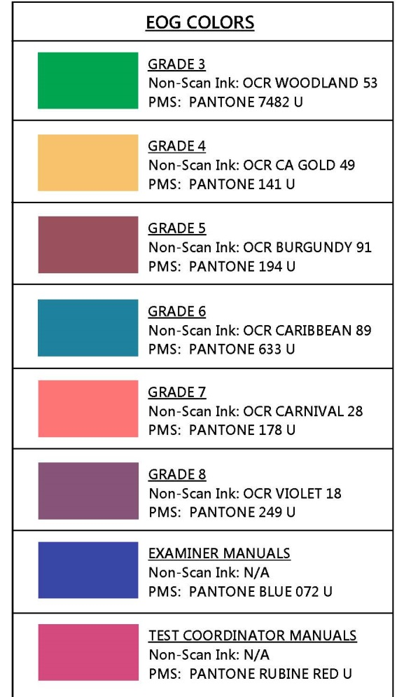
Pre-Administration
Examiner Training
Color Families for Test Booklets and Answer Documents
Test booklets and answer documents will have a new color pallet scheme.
  Will be both in light and dark variation (50% and 100%) to denote different core forms.
  NOTE: This color variation is to assist in matching up the correct answer document with the appropriate test booklet.

Slide 32
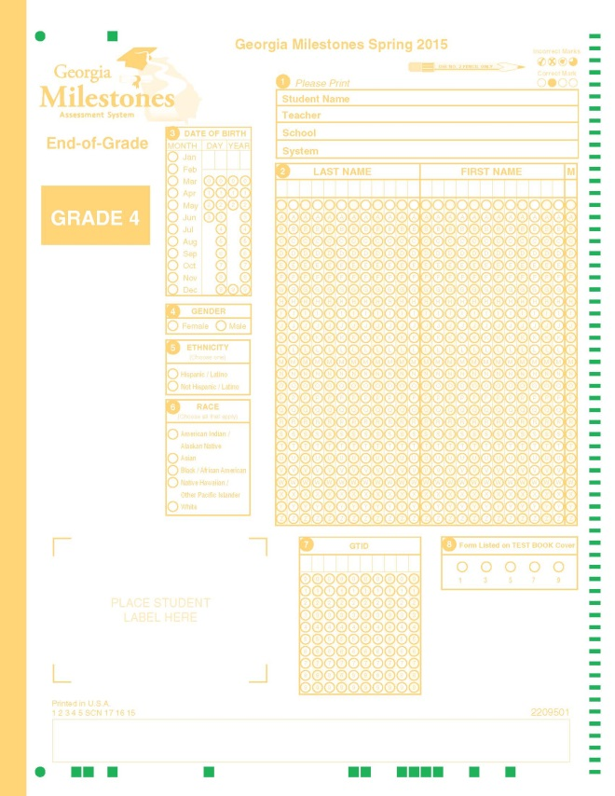
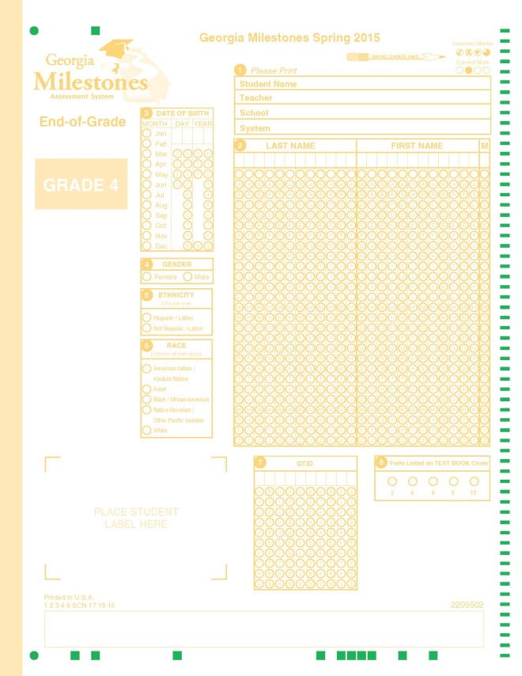


Pre-Administration
Examiner Training
Color Families for Test Booklets and Answer Documents
Grade 4 Example
100% Gradation
50% Gradation

Slide 33
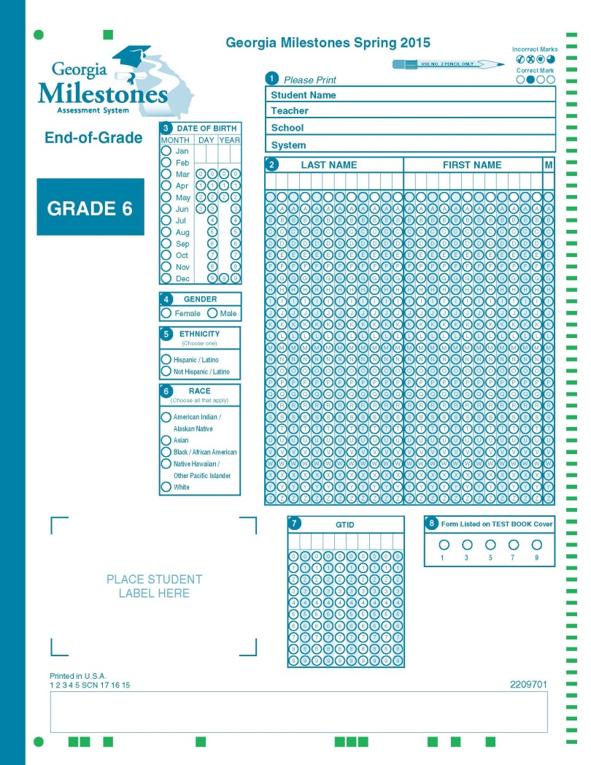
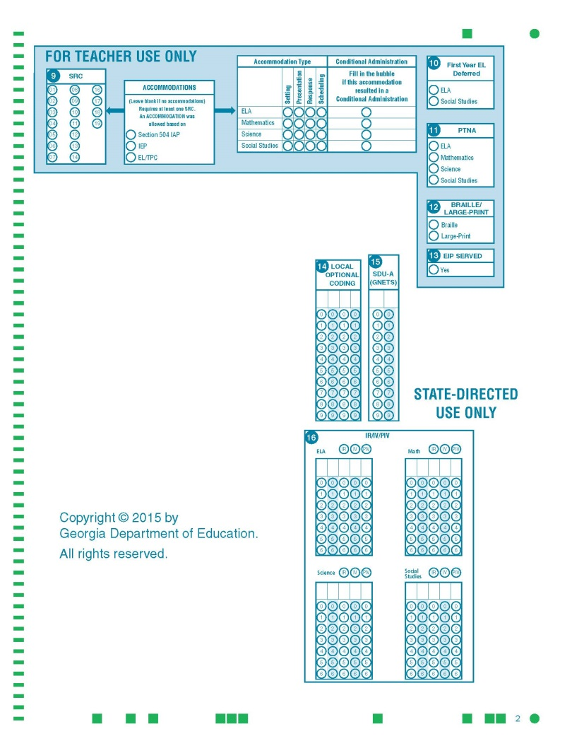
Pre-Administration
Examiner Training
Student Answer Document takes the form of a 16-20 page booklet
Pages 1 and 2 are still used for student information and coding

Slide 34
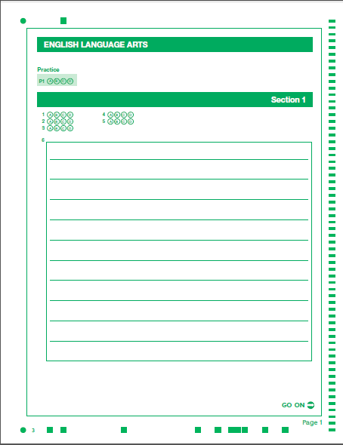
Pre-Administration
Examiner Training
Example of a constructed response answer space
Standard selected response bubbles
Link to Grades 3 and 6 Answer Document
Lines for constructed response items

Slide 35
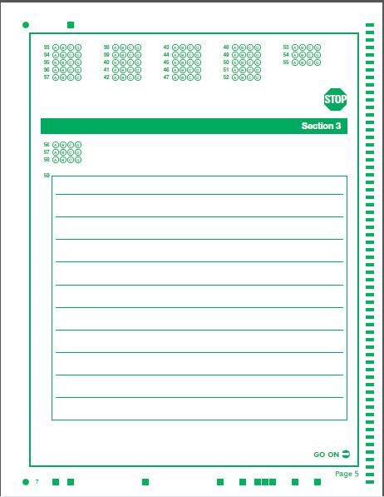
ELA Section 3
Paper and Pencil
Pre-Administration
Examiner Training
7th page of the Ans Doc
Page 5 of ELA
#56 is first of 3 selected response items
#59 is a Constructed Response item – not the final Writing Task.

Slide 36
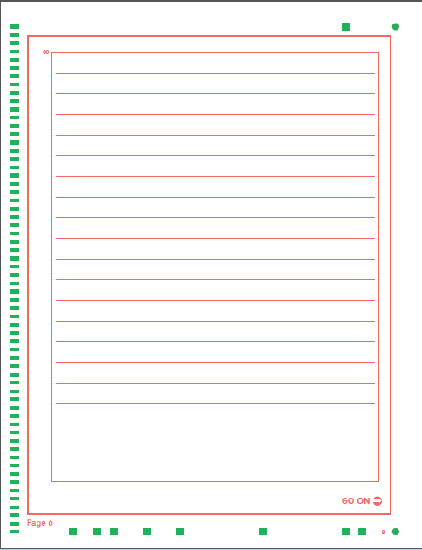
ELA Section 3
Paper and Pencil
Extended Writing Task
Pre-Administration
Examiner Training
Item 60
There are approximately 4 lined pages available to respond to the Extended Writing Task
Page 6 of ELA
8th Page of Answer Document

Slide 37
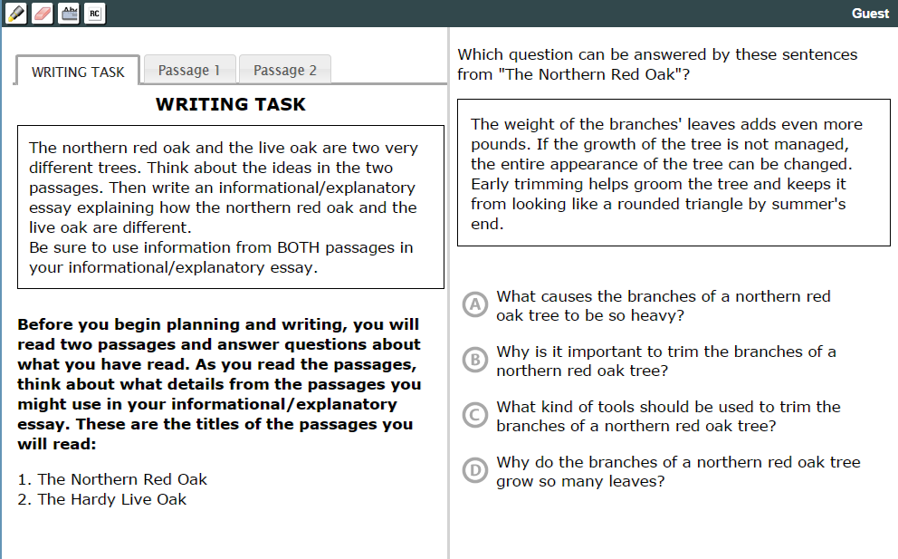
ELA Section 3 Online Items 56, 57, 58 Multiple Choice
Pre-Administration
Examiner Training
Introduces the topic
Passages are accessed by clicking the corresponding passage tab
Question is always displayed while viewing WRITING TASK, Passage 1, or Passage 2 tabs
WRITING TASK tab is same for questions 56-59
Item 59 is a constructed response item
Screenshots are from Experience Online Testing Georgia

Slide 38
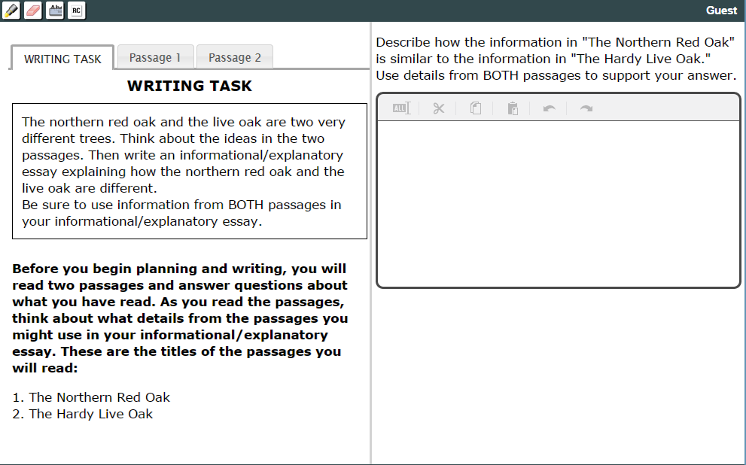
ELA Section 3 Online Item 59 Constructed Response
Pre-Administration
Examiner Training
Note that WRITING TASK, Passage 1, and Passage 2 have not changed, but this is a Constructed Response Item
The student can refer to any of the 3 tabs while typing a response

Slide 39
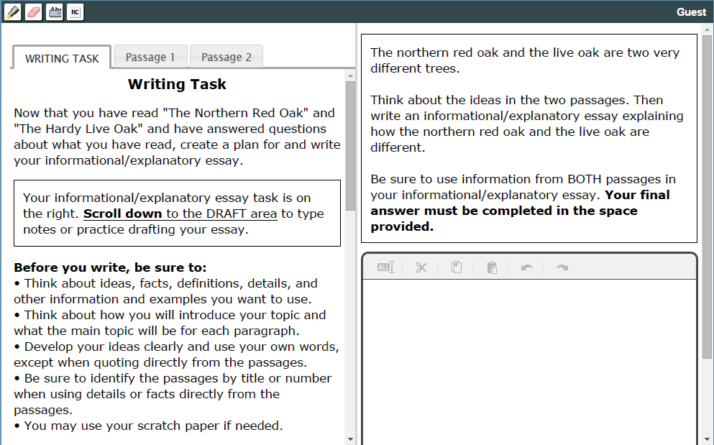
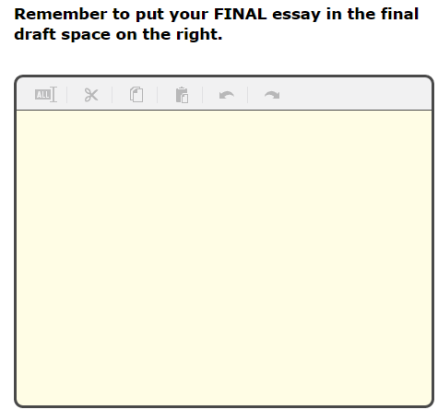
ELA Section 3 Online Item 60 Extended Writing Task
Pre-Administration
Examiner Training
The WRITING TASK tab has now changed to guidance for the Extended Writing Task; Passage 1 and 2 are still the same
This is the DRAFT area referenced here
It is accessed by scrolling here
The student can draft here and copy and past into final answer space
DRAFT area and passages are not visible simultaneously

Slide 40
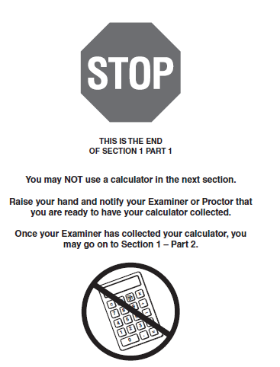

No Calculator Warning
Pre-Administration
Examiner Training
Stop/No Calculator Warning
Paper and Pencil and Online
Calculator NOT Allowed Banner
Paper and Pencil and Online
Stop sign and guidance to turn in calculator at then end of Section 1, Part 1 from Paper and Pencil answer document

Slide 41
Pre-Administration
Pre-ID Labels -Paper and Pencil Only
School Test Coordinator Kit
Three (3) barcode labels for each student
Visible information includes:
  Student name and GTID
  School and System names and codes
  Grade
  Student birthday and gender
  Ethnicity and race
  Barcode number
Retain a copy of the Pre-ID File from Cycle 3 Data Collections as a resource for all student information collected but not visible on the label, ex. Title I, EIP, EL.
Notes:
41

Slide 42
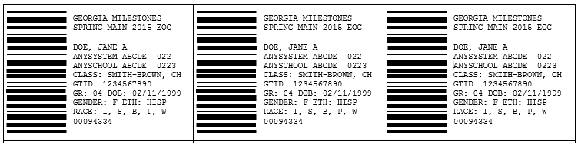
Pre-Administration
Pre-ID Labels -Paper and Pencil Only
Three barcode labels for each student
Verify SRC coding from the Pre-ID Label roster
Do not use if inaccurate
Barcodes override bubbling
Extra labels for test booklet and replacement answer document
TCM
EOG Answer document
EOG Test booklet
Spare for replacement Answer Document

Slide 43
Pre-Administration
Pre-ID Labels – Paper and Pencil Only
Pre-ID info is provided to CTB by GaDOE; if Pre-ID Label is incorrect:
  Examiners must notify School Test Coordinator
  School Test Coordinator must update school student records
  Do not use incorrect Pre-ID labels
  Barcode info overrides bubbled info
  Barcode label may be used if the only inaccurate information is the grade or teacher name
Pre-ID label should match info for student being tested EXACTLY; be aware of similar names
Pre-ID label should be applied prior to testing
Notes:
43

Slide 44
Pre-Administration
Pre-ID Label - Paper and Pencil Only
No Label or Incorrect Label
If a student does not have a Pre-ID label or the information or the label is incorrect the student information must be bubbled onto the answer document.
The SchTC should determine if the student information is to be completed by the student on the first day of testing or by some other means.
The SchTC should follow guidance in the TCM for completing student information if it is to completed by someone other than the student.
When completing student information, fill in the text boxes first, then bubble the corresponding letters/numbers
SRC and other student program information should be coded as this information will appear in the Student Record data; the system Student Record Coordinator is the suggested resource for this information

Slide 45
Pre-Administration
Pre-ID Labels - Paper and Pencil Only
Pre-ID Label applied incorrectly
  If answers have been bubbled:
    Following guidance in the TCM and TEM, transcribe student answers and demographics onto a replacement answer sheet
    Write VOID over the original answer sheet, and return with non-scorable materials for local secure destruction
  If answers have not been bubbled:
    Write VOID on the original answer sheet and retain and securely destroy locally as outlined in the TCM
Student transfers
  Not applied to an answer document:
    Securely destroy the barcode label `
  Applied to an answer document:
    Write VOID over the original answer sheet, and return it with non-scorable materials
Notes:
45

Slide 46
Pre-Administration
GNETS Students – Paper and Pencil
SysTCs within the area served should coordinate the source of Paper and Pencil testing materials with the GNETS SchTC
GNETS sites who manage their own materials should coordinate with their students’ home school systems regarding the GIS and the shipping of scorable materials
GIS should be provided for students served by GNETS by the students’ home system and students'’ answer sheets should be returned under a Group Information Sheet (GIS) coded for their home system and school
Ideally, scorable materials for GNETS students will be returned with those of the student’s home system

Slide 47
Pre Administration
GNETS Students – Paper and Pencil
Contact CTB Customer Service for guidance if GNETS scorable materials ship after those of the home system
The home school system will receive Pre-ID labels for their students served by the GNETS program provided these students were included in the Pre-ID file extract. The home system and the appropriate GNETS personnel should collaborate to see that these labels are applied to the GNETS students’ Student Answer Document
In order to receive results for GNETS Programs, an identifier code needs to be bubbled on each student’s answer document in the box marked GNETS or coded in the Additional Student Information screen in TAS
Codes and instructions are included in the TCM, Pages 53 and 65

Slide 48
Pre-Administration
GNETS Students – Online
Each GNETS site testing online will need to have the Secure Testing App installed on workstations that students will use for testing
The SchTC at each online GNETS site should be familiar with the contents of this Pre-Admin Webinar and the upcoming TAS training though collaboration with a designated SysTC within the service area
Test sessions (including the Secure Practice Test) for GNETS students testing online will need to be setup by the SysTC /SchTC from the students’ home school/system

Slide 49
Pre-Administration
GNETS Students – Online
The GNETS SchTC should collaborate with the students’ home districts for assigning testing accommodations and coding program and accommodation information
The GNETS SchTC should work with SysTCs within the service area to receive by a secure means Individual Student Test Tickets and Summary Test Tickets, ex. return receipt mail, UPS/FEDEX, courier, hand delivery, attachment in MyGaDOE email, transfer via secure FTP folder
The GNETS SchTC should train Examiners using the OL TEM and applicable information from this Pre-Admin Webinar

Slide 50
Pre-Administration
GNETS Students – Online
GNETS students should participate in the Secure Practice Test
It is important that GNETS student who are assigned the Screen Reader are oriented to its functionality
At the close of the testing window Test Tickets should to be returned by secure means to the students’ home school system’s SysTC
SysTC for student’s home system should code the GNETS Facility Code in the Additional Student Information screen in TAS

Slide 51
Pre-Administration
Accommodations
General Guidance
Accommodations must
  be required for the student in order to access and participate in assessment
  be provided during routine instruction and assessment in the classroom
Accommodations may not
  alter, explain, simplify, paraphrase, or eliminate any test item, reading passage, writing prompt, or choice option
  Provide verbal or other clues or suggestions that hint or give away the correct response to the student
See page 136 of the SAH for guidance for an requesting an accommodation not included in the list of approved accommodations

Slide 52
Pre-Administration
Accommodations
Student Roster and Examiner Training
The SchTC should collaborate with case managers or other comparable staff to develop a testing roster of students who have an IEP, EL-TPC, or IAP that prescribes testing accommodations. The roster should also itemize, by student, the accommodations required for testing.
The SchTC or designee should provide an training session in addition to the general Examiner training session for Examiners who will be testing accommodated students. It is important for the Examiner to understand how the student is to access accommodations and to know how to monitor and provide guidance during test administration.
A training roster that includes Examiner signatures should be kept by the SchTC as a record of the training session.

Slide 53
Pre-Administration
Accommodations
Paper and Pencil
Refer to the Student Assessment Handbook and the Accommodations Manual plus for specific accommodations guidance for Paper and Pencil administrations
Braille must be a paper and pencil administration
Students with the Large Print accommodation are not limited to a Paper and Pencil administration; The EOG is available online with the Large Font accommodation enabled

Slide 54
Pre-Administration
Accommodations
Paper and Pencil
Human reader for “oral reading” accommodation is allowable only if the student’s disability inhibits/prohibits the use of the online Screen Reader; a special accommodation request is required.
For pre-approved “oral reading” administrations by a human reader, the directions to be followed by the Examiner are located at Georgia Milestones Assessment System Read-Aloud Guidelines.

Slide 55
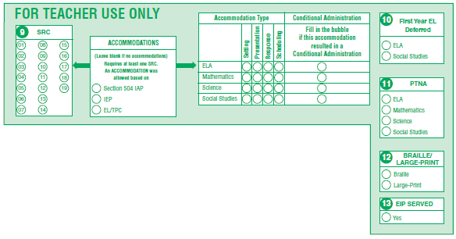
Pre-Administration
Accommodations
Paper and Pencil - Coding Accommodations for the Data File
Student Answer Document – Page 2
Bubble current SRC; if current SCR does not match the code on the SRC roster, discard the label and bubble all demographic information ..
If an Accommodation Type is bubbled; ACCOMMODATIONS must be bubbled also

Slide 56
Pre-Administration
Accommodations for Online Administration
These slides are included to provide a quick comparison of the approach to implementing and coding accommodations for an Online administration to that of a Paper and Pencil administration
Detailed training for Online accommodation procedures is scheduled for March 16 and 23, 2015 (Test Administration System Webinars)

Slide 57
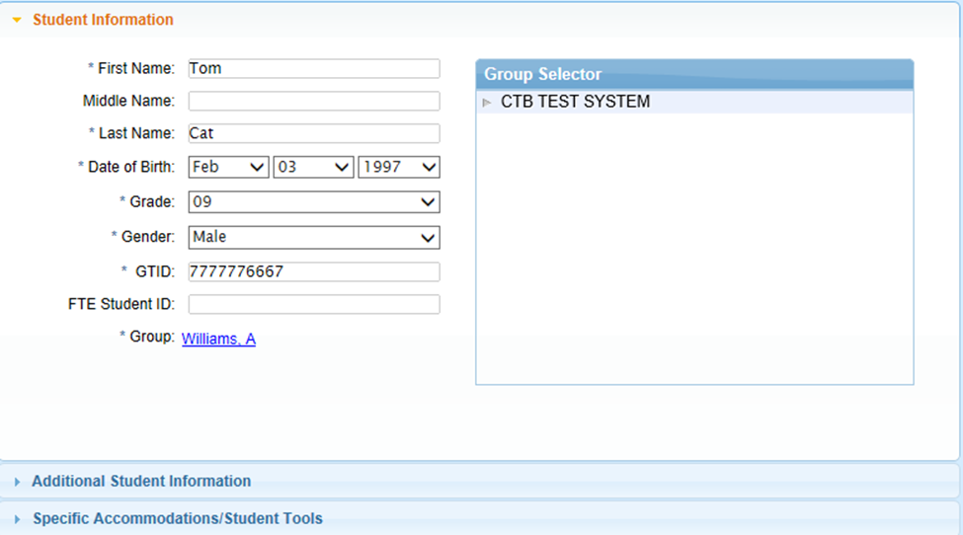
Pre-Administration
Accommodations - Online
Assigning Accommodations in TAS
This screen in TAS is accessed from the Groups/Manage Students tab, Student List option, and then double clicking on the row with the selected students name.
Specific Accommodations/Student Tools options to assign and activate accommodations students access while testing online

Slide 58
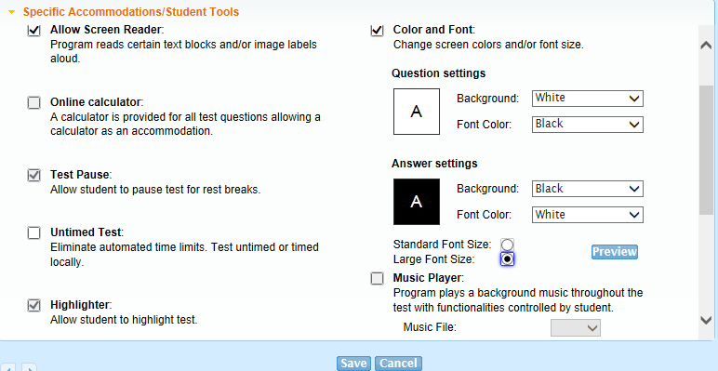
Pre-Administration
Accommodations - Online
Assigning Accommodations in TAS
These are the only two accommodations options that will need to be assigned in the TAS. All other permissible tools/accommodations will preset as default tools for all students (refer to slide 16)
Note: The Color and Font option has to be selected to activate settings options or to select Large Font Size

Slide 59

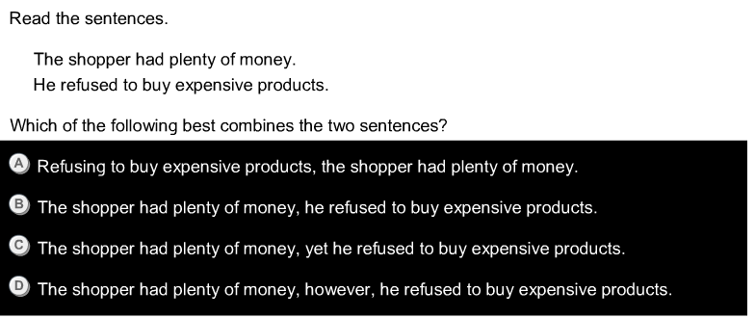
Pre-Administration
Accommodations - Online
Comparisons for Color and Font Options:
Regular Font versus Large Font
Black text with white background
White text with black background

Slide 60
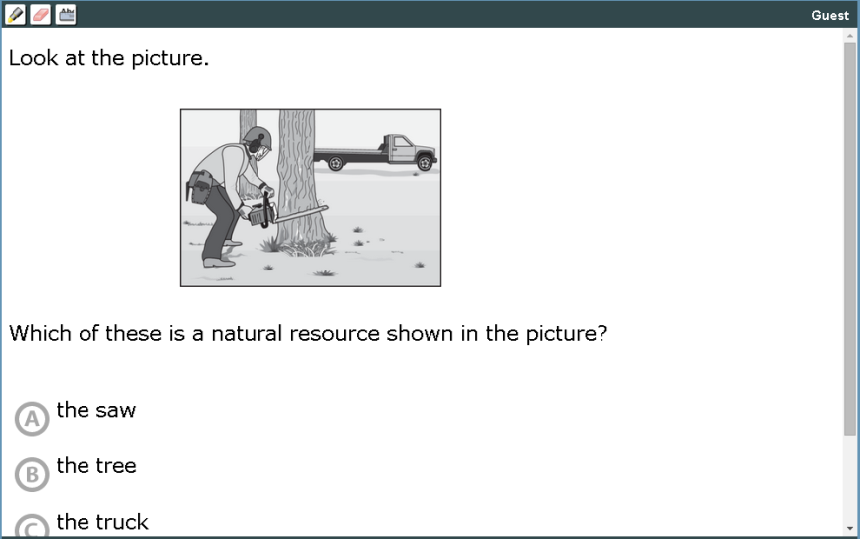
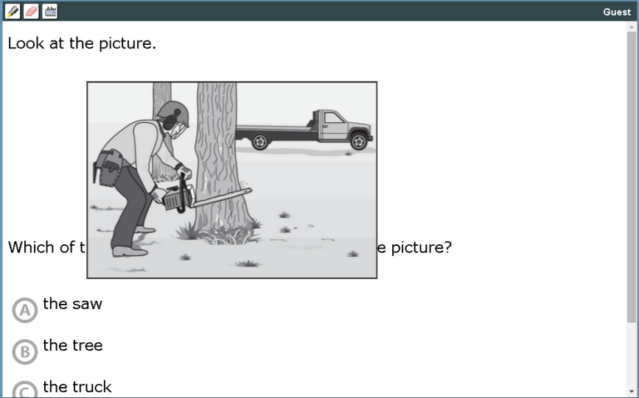
Pre-Administration
Accommodations - Online
When Large Font is enabled images will “Zoom” when hovered over

Slide 61
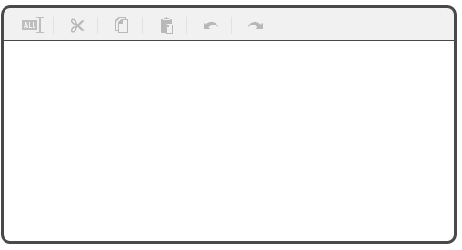
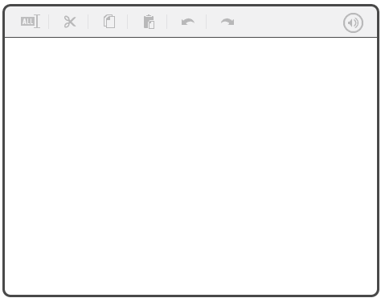
Pre-Administration
Accommodations - Online
The Large Font accommodation also applies to student response spaces
With the Screen Reader activated, clicking the Audio Icon will read aloud what the student has typed.
Without Screen Reader
With Screen Reader
Regular Font
Large Font
Audio Icon

Slide 62
Pre-Administration
Accommodations - Online
Coding Accommodations in TAS for Data File
This screen in TAS is accessed from the Groups/Manage Students tab, Student List option, and then double clicking on the row with the selected students name.
Select Additional Student Information to code the accommodations the student received for the inclusion in Data File

Slide 63
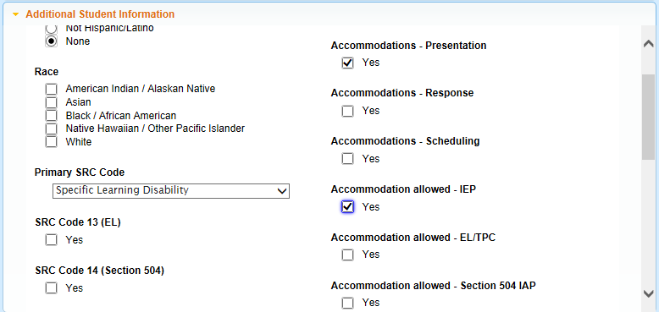
Pre-Administration
Accommodations - Online
Coding Accommodations in TAS for Data File
This entry is coded as a student with a Specific Learning Disability who tested with a Presentation Accommodation that is based on an IEP. This information will be included in the Data File
This screen parallels the For Teacher Use Only section of a Paper and Pencil Student Answer Document

Slide 64
Test Administration
Testing Site and Test Materials
Paper and Pencil | Online
Remove or cover instructional materials that may prompt student responses
Arrange seating to promote individual work
Post a sign on the outside of the classroom door: Testing: Do Not Disturb
In addition to the Test Examiner, a proctor is required for 30 or more student
Examiner Materials: Class roster Paper and Pencil Examiner’s Manual Test Booklets and Answer sheets Scratch paper for ELA Section 3 and Math Calculators for Grades 6 – 8 Math Two No.2 pencils with erasers per student Timing device | Examiner Materials: STA installed and tested Class roster Online Examiner’s Manual Individual and Summary Test Tickets Scratch paper for ELA Section 3 and Math Calculators for Grades 6 – 8 Math if students are to use handheld device Two No.2 pencils with erasers per student Timing device

Slide 65
Scratch Paper
Test Administration
Testing Site and Test Materials
EOG
Two sheets of blank scratch paper (including lined notebook paper) should be provided to students taking the following EOGs regardless of administration mode:
Language Arts Section 3 only
Mathematics
Graph paper is not allowable as scratch paper for the EOG

Slide 66
Calculator Policy (EOG)
Test Administration
Testing Site and Test Materials
Content Area | Grade Level/Course | Type of Calculator Allowed
Mathematics | Grades 3 – 5 EOG | Not Allowed Only eligible students with the Conditional Accommodation of Use of Calculator may use a Basic¹ device
 | Grade 6 EOG | Basic¹
 | Grades 7 – 8 EOG | Scientific² or Basic¹
¹Basic four-function calculator with square root and percentage functions
²Scientific calculator with functionalities consistent with TI-30XS MV or similar models
³Graphing calculator with functionalities consistent with TI-84 Plus SE or similar models
For the 2014-2015 school year, students who test online may use a hand-held calculator, in addition to the calculator provided online
Calculators that graph or store text are not allowed for the EOG
Calculators are not permitted on designated no-calculator sections of the mathematics test

Slide 67
Test Administration
Administration Procedures
On each day of testing students will report to testing sites and the SchTC will distribute testing materials to Examiners.
Examiners should follow instructions for test administration received during the Examiner’s training and written in the Examiner’s Manual
Examiners should report any testing irregularities to the SchTC or designee as soon as possible.

Slide 68
Test Administration
Be Watchful
Paper and Pencil | Online
Glancing at a student’s answer document/test booklet/workstation display to confirm students are responding in the correct place is an acceptable practice while monitoring
For Mathematics - if the student is using a hand-held calculator be sure it is collected before the student moves to Section 1, Part 2 (Grades 6-8). Refer to the related screenshots in Examiner Training
For ELA Section 3 – be sure students are writing the response to Item 60, the Extended Writing Task, in the correct response area. Refer to the related screen shots in Examiner Training. This is on the 8th page of the answer document and Page 6 of the English/Language Arts section. | For ELA section 3 – be sure students are completing item 60, the Extended Writing Task, in the correct response area. Refer to the related screenshots in Examiner Training of the online layout for ELA Section 3
Monitor to be sure the student is in the correct section of the test booklet and answer document; no going ahead or going back

Slide 69
Test Administration
Irregularities
Events and circumstances, or departures from standardized testing procedures are irregularities
  They may have an impact on student performance that is not possible to define
  They are reported and student scores are flagged simply to say, “There is something different about the conditions under which this score was obtained. Use caution in interpreting the score.”

Slide 70
Test Administration
Irregularities
All test administration irregularities must be reported by Examiners to the School Test Coordinator
The School Test Coordinator sends irregularities to the System Test Coordinator for verification and to obtain the correct code
The System Test Coordinator contacts the GaDOE immediately for direction
If instructed to do so by GaDOE, the System Test Coordinator will investigate and complete the Testing Irregularities Documentation Form provided online on the MyGaDOE Portal
Improperly coded irregularities may default to the holding of test scores

Slide 71
Test Administration
Irregularities - Coding
Irregularity (IR)
Irregularities in Test Administration:
  Materials being distributed inappropriately
  Directions not being followed
  Improper monitoring of test administration
  Student “going ahead” or “going back”

Slide 72
Test Administration
Irregularities - Coding
Invalidation (IV)
Some irregularities are so serious that they result in invalidation of student scores
  Content being disclosed, coached, or distributed
  Cheating
  Test Administrator altering responses during or after testing

Slide 73
Test Administration
Irregularities - Coding
Participation Invalidation (PIV)
Federal regulations stipulate that when inappropriate accommodations are used, students may not be considered participants in accountability determinations
In addition to irregularities (IR) and invalidations (IV), systems will be required to code Participation Invalidations (PIV) for students who receive a Conditional Accommodation for which a student is not eligible
In the EOG, a potential PIV occurs when a student receives, inappropriately, the Conditional Accommodations of oral Reading of Reading Passages and/or Use of Calculator (Gr. 3-5)

Slide 74
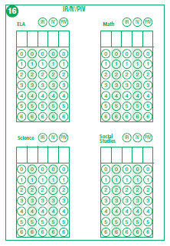
Test Administration
Irregularities – Coding Paper and Pencil
For the affected content:
Paper and Pencil Student Answer Document – page 2
Bubble IR, IV, or PIV
Enter the 5 digit code supplied by GaDOE and fill in associated bubbles
Incorrect coding may result in no reports being sent.

Slide 75
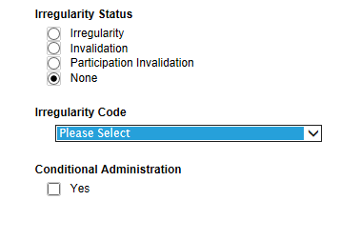
Test Administration
Irregularities – Coding Online
For the affected content:
From the Student List in TAS, select the student to be coded
Access the Additional Student Information screen
Select the Irregularity Status
Select the Irregularity Code provided by GaDOE from the dropdown option
If a Conditional Administration, click the Yes box.
Incorrect coding may result in no reports being sent.

Slide 76
Test Administration
Irregularities - Documenting
MyGaDOE Portal Entries
Provide narrative in the “Comment” section to help elaborate on the irregularity (or in the “Reason for Invalidation” section if applicable). Please do this even if the matter has been discussed with GaDOE staff by phone or email.
If you are reporting an irregularity for which it is known an invalidation will result – make sure to indicate “Yes” in the Invalidation drop-down box.
Please include in the comments the Form # involved (if relevant to the irregularity).
Names of students and their GTIDs must be provided in the appropriate Portal field(s)/uploaded file(s).
If the space in the comments field is not sufficient, upload statements and other documents that provide necessary details on the event.
Make sure you indicate the correct “Assessment Cycle” (Spring 2015) in that field.
In an event that involves multiple students – some of whom may be IR and some who may be IV, please enter them as two separate records.
After submitting an irregularity in the Portal, be sure to return to the Portal later to check on its status and to review GaDOE feedback.

Slide 77
POST-TEST ACTIVITIES
Will cover the following:
Test Examiner Responsibilities
School Test Coordinator Responsibilities
System Test Coordinator Responsibilities
Packing Return Shipment
Return Shipment Pick-up
Returning Make-up Materials
Return Shipment Errors

Slide 78
POST-TEST Activities
Scorable and Non-Scorable Materials
Paper and Pencil
Scorable Materials
Completed Group Information Sheet (GIS)
Used Student Answer Sheets
Non-scorable Materials
Used Student Test Booklets
Large Print and Braille Test booklets
Unused and Voided Test booklets and Answer sheets
Scratch Paper
Test Examiner’s Manual
Notes:
78

Slide 79
POST-TEST ACTIVITIES
Test Examiner Responsibilities
Collect and account for all testing materials in the testing site after each day’s testing
Return all test materials the School Test Coordinator at the conclusion of testing each day
Additionally, at the conclusion of the final day of testing
  Notify the School Test Coordinator of any students who did not take all or part of the test
  Notify the School Test Coordinator if student answers need to be transcribed onto a Student Answer Document

Slide 80
POST-TEST ACTIVITIES
School Test Coordinator
Online
All test materials – Test Tickets and scratch paper - should be collected from Test Examiners and secured after each administration session
After the final day of testing
  Where applicable, verify that the demographic and coding information has been correctly entered in the Additional Student Information screen of TAS
  If instructed by the System Test Coordinator, code Irregularities and complete Local Option Coding in TAS
  Coordinate with the SysTC the turning in of scratch paper and the disposition of Test Tickets

Slide 81
POST-TEST ACTIVITIES
School Test Coordinator
Paper and Pencil
All test materials should be collected from Test Examiners and secured after each administration session
Review answer documents
  Where applicable, verify that the demographic and coding information is correctly bubbled
  If instructed by the System Test Coordinator, complete Local Option Coding (Section 14) and code Irregularities
  Complete/Verify For Teacher Use Only (Sections 9–13)

Slide 82
POST-TEST ACTIVITIES
School Test Coordinator
So that systems are prepared to address non-participants during Accountability processing note:
Collect by school and by subject: the names of each student who should have tested but was a non-participant
Categorize their non-participation as one of the following four choices: Medical Emergency, Illness, Other, or Unknown
You may direct questions on the definition of
non-participant and the above categories to your system’s GaDOE Accountability Specialist

Slide 83
POST-TEST ACTIVITIES
School Test Coordinator
Paper and Pencil
Verify that Test Examiners have returned all materials
Inventory scorable and non-scorable materials separately
Complete the School Security Checklist and place in the first box of scorable materials
System Test Coordinators must make copies of any pages that indicate missing or unreturned materials and place these copies in the security checklist envelope for each school; System Coordinators will retain all original school security checklists
Verify that VOID is written across every voided test booklet; return voided test booklets with non-scorables.
Unused and voided answer documents should be returned to the SysTC and retained and securely destroyed locally

Slide 84
POST-TEST ACTIVITIES
School Test Coordinator
Paper and Pencil
Collect scratch paper to be return to the SysTC for secure local destruction
Following the system’s protocols, package any biohazard materials to be returned to the SysTC for secure local destruction
Verify the completion of transcriptions and the scribing accommodation
Verify that each GIS is filled out correctly
Complete the School/Group List (SGL)
Arrange all scorable documents with the student name face-up
Secure each classroom’s scorable materials with a paper band using a Stack Cover Card for each bundle and a Group Information Sheet for each class (Refer to illustration on page 56 of the TCM ) and following slide

Slide 85
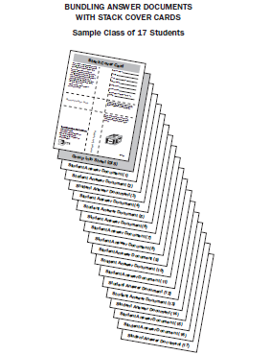
POST-TEST ACTIVITIES
School Test Coordinator
Paper and Pencil
Packing Scorable Materials
Band together by classroom
  [Top of Stack]
Stack Cover Card
  One per band
Completed GIS
  One per class
One class of Student Answer Sheets (Gr 3–8)
  [Bottom of Stack]

Slide 86
POST-TEST ACTIVITIES
School Test Coordinator
Paper and Pencil
Packing Return Shipment
Use original shipping boxes for return shipment; if additional boxes are required, notify the System Test Coordinator to order them through CTB Customer Service
Pack scorable and non-scorable materials separately
Account for all scoreable and non-scoreable materials then concentrate on processing scorable materials for return for scoring
All non-scorable materials must be returned to the System Test Coordinator within one week of the last day of the system’s scheduled test window
Improper packaging may delay your score reports; detailed instructions are provided in the After Testing section of the TCM

Slide 87
POST-TEST ACTIVITIES
System Test Coordinator
Irregularities
Irregularity Reporting and Coding
Document Irregularities on the MyGaDOE Portal
Paper and Pencil
Either code or verify coding of irregularities on page 2 of the Student Answer Document
Online
Either code or verify coding of irregularities on the Additional Student Information screen in TAS

Slide 88
POST-TEST ACTIVITIES
System Test Coordinator
Paper and Pencil
Packing Return Shipment
System Test Coordinators prepare materials for pick-up; details in the School and System Test Coordinator’s Manual
Reminders:
Do not consolidate materials from more than one school in the same box
Use one label per box
  Use WHITE Return Shipping Labels for scorable materials
  Use Yellow Return Shipping Labels for non-scorable materials
  Note: You will not need any additional shipping labels to return your materials
Identify the sequence of boxes by filling in the line on the white scorable label that reads “SCH BOX __ OF __”
On the same white label, fill in the total number of boxes for the entire system in the space provided “SYS BOX __OF__”
Securely seal all boxes
See page 44 of TCM if it is necessary to palletize scorable or non-scorable materials.

Slide 89
POST-TEST ACTIVITIES
System Test Coordinator
Paper and Pencil
Return Shipment Pick-up
Assessment Distribution Services (ADS) will contact systems five business days before the scheduled pick-up to verify return shipments
  The pick-up date for scorable materials is the fifth business day following the scheduled completion of testing unless noted in the EOG Enrollment System
  The pickup date for non-scorable materials is the tenth business day following the scheduled completion of testing unless noted in the EOG Enrollment System
  Please give a two weeks notice if you need to change pick up dates

Slide 90
CONTACT INFORMATION
Shipping Information
Materials Order Shipments
  Your initial shipment of EOG materials will be delivered by Assessment Distribution Service (ADS) or for small quantities, FedEx Ground; for information, contact:
    CTB Customer Service
      Phone: (866) 282-2249
      Fax: (866) 282-2251
      Email: GeorgiaHelpDesk@ctb.com
      Hours: 8:00am to 6:00pm (Eastern)
  Deliveries will be made at least two weeks prior to first day of testing, taking spring break into account and based on dates provided to CTB through the Online Enrollment System

Slide 91
CONTACT INFORMATION Shipping Information
Return Shipments
  Assessment Distribution Service (ADS)
    Phone: (800) 840-9965
    Email: info@ship-ADS.com
    The default scorable materials pick-up date is five business days from the last day of the scheduled test window unless otherwise selected through the enrollment system
    The non-scorable materials pick-up date is 10 business days from the last day of the scheduled test window unless otherwise selected through the enrollment system
    The Pickup Schedule is provided in the TCM on page 45

Slide 92
CONTACT INFORMATION
CTB Customer Service Team
  Phone: (866) 282-2249
  Fax: (866) 282-2251
  Email: GeorgiaHelpDesk@ctb.com
  Hours: 8:00am to 6:00pm (Eastern)
  Georgia Department of Education
  Regarding testing irregularities and/or interruptions
  Robert McLeod (404) 656-2589; robert.mcleod@doe.k12.ga.us
  General Georgia Milestones questions and those related to online test administration, paper/pencil test material supply needs, etc.
  Michael Huneke (404) 232-1208; mhuneke@doe.k12.ga.us
  Mary Nesbit-McBride (404) 232-1207; mmcbride@doe.k12.ga.us
  Test administration information
  Phone: (800) 634-4106 or (404) 656-2668

Slide 93

Thank you for your efforts in making the first year of Georgia Milestones a success!

