Slide 1
Melissa Fincher, Ph.D. Deputy Superintendent, Assessment & Accountability mfincher@doe.k12.ga.us

Slide 2
Georgia Milestones
Grades 3 – 8
End of Grade (EOG) in language arts, mathematics, science, social studies
High School
End of Course (EOC) in 9th Grade Literature & Composition, American Literature & Composition, Coordinate Algebra or Algebra I*, Analytic Geometry or Geometry*, Physical Science, Biology, U.S. History, and Economics
*Inaugural Administration Winter 2015

Slide 3
Georgia Milestones
Comprehensive
single program – an assessment system – not series of tests (e.g., CRCT; EOCT; Writing Assessment)
Coherent
consistent expectations and challenge to position Georgia students to compete with peers nationally and internationally
consistent signal about student preparedness for the next level, be it the next grade, course, or college/career
consistent signal about student achievement both within system (across grades and courses) and with external measures (NAEP; PSAT; SAT; ACT)
Consolidate
combine reading, language arts, and writing into a single measure to align to the standards
The Department has worked with the University and Technical College Systems, as well as business and industry representatives, to define college and career readiness.

Slide 4
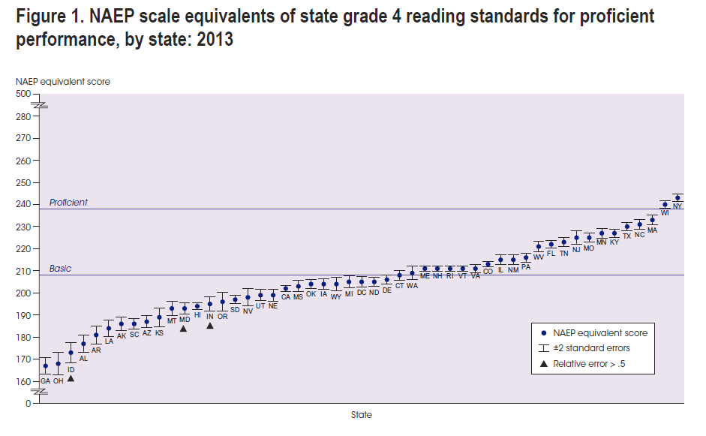
Grade 4 Reading: CRCT vs NAEP

Slide 5
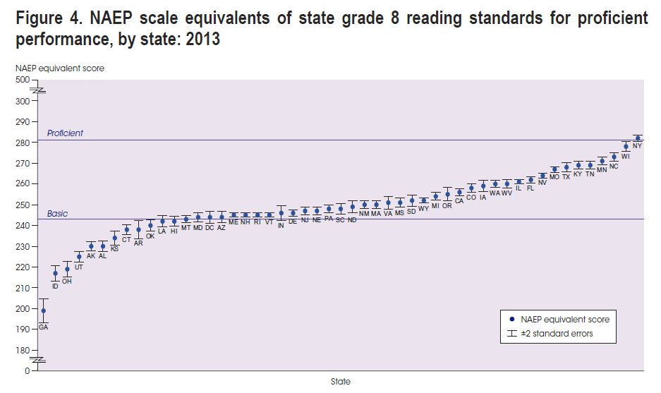
Grade 8 Reading: CRCT vs NAEP

Slide 6
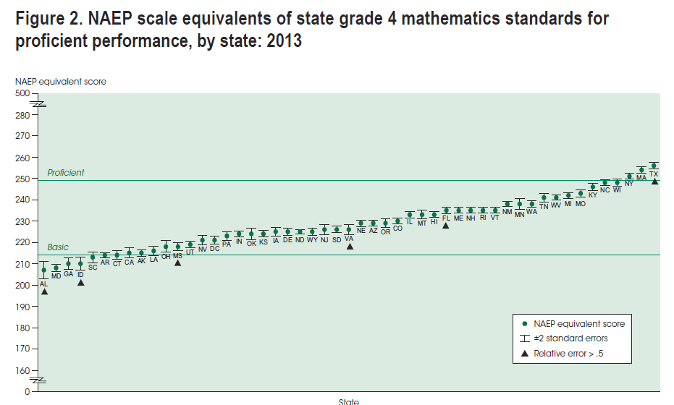
Grade 4 Mathematics: CRCT vs NAEP

Slide 7
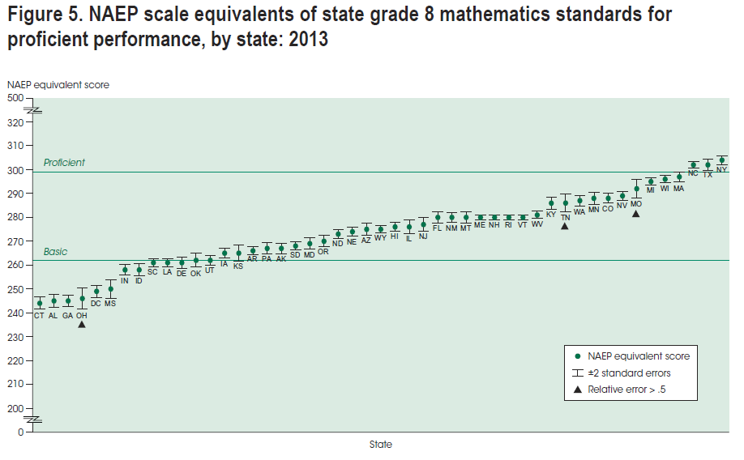
Grade 8 Mathematics: CRCT vs NAEP

Slide 8
Georgia Milestones by the Numbers….
Online Administrations
Spring EOG: ~224,000
Winter EOC: ~130,000
Spring EOC: ~550,000
Feedback Surveys
EOG Online Students: 83,557 192 districts
EOC Online Students: 13,007 199 districts
EOG/EOC Teachers: 16,446 175 districts

Slide 9
Summary of Challenges Encountered
Long delays in syncing between Test Administration System (TAS) and Secure Testing Application (STA)
Long delays and interruptions for students using screen reader application
To investigate the impact of these delays, a forensic analysis is being completed by an independent third party.
A mode comparability study is also being conducted.

Slide 10
Summary of Feedback
Feedback has been received from multiple sources – administrators, teachers, and students.
Major ‘take-aways’ include:
too much time allotted for science and social studies
scratch paper needed for the Science EOG, particularly for students testing online
more space is needed on answer documents for constructed-response items
reconsider placement of the no-calculator section in mathematics (grades 6 – high school); inform students of the number of items within this section

Slide 11
Important ‘Take-Aways’ from Rangefinding
English Language Arts & Mathematics:
Read the question and answer what is asked
Answer all parts/components of the question
English Language Arts
Incorporate evidence from text, with attribution, to support answer
If two texts are provided, cite evidence, with attribution, from both texts
Students tended to summarize passages rather than answer question asked
Be wary of teaching students formulaic response strategies;
students can have a tendency to ramble and lose sight of the question.

Slide 12
Teacher Comments from Rangefinding
‘I think it would be good for teachers to know that the scoring process is not punitive. Rating is based on looking at what the student did correctly. Also – elements of grammar are not judged too harshly.’
‘Teachers need to know that paired texts are paired….It would calm panic for them to see that constructed response items are not needlessly complicated/convoluted.’
‘I was pleased that the DOE listens to us as teachers.’

Slide 13
Results of Student Surveys for Georgia Milestones Online Test Takers

Slide 15
Student Survey: End-of-Grade

Slide 16
Student Survey: End-of-Course

Slide 17
Student Survey: End-of-Course

Slide 18
Student Survey: End-of-Grade

Slide 19
Student Survey: End-of-Course

Slide 20
Student Survey: End-of-Grade

Slide 21
Student Survey: End-of-Course

Slide 22
Student Survey: End-of-Grade

Slide 23
Student Survey: End-of-Course

Slide 24
Student Survey: End-of-Grade

Slide 25
Student Survey: End-of-Course

Slide 26
Student Survey: End-of-Grade

Slide 27
Student Survey: End-of-Course

Slide 28
Student Survey: End-of-Grade

Slide 29
Student Survey: End-of-Course

Slide 30
Student Survey: End-of-Grade

Slide 31
Student Survey: End-of-Course

Slide 32
Student Survey: End-of-Grade

Slide 33
Student Survey: End-of-Course

Slide 34
Student Survey: End-of-Grade

Slide 35
Student Survey: End-of-Course

Slide 36
Student Survey: End-of-Grade

Slide 37
Student Survey: End-of-Course

Slide 38
Student Survey: End-of-Grade

Slide 39
Student Survey: End-of-Course

Slide 40
Scoring & Reporting
Scores will be issued in October
Scores will consist of the following:
Scale Scores
Achievement Levels designating proficiency
For ELA, grade level reading determination and writing rubric scores
For other content areas, domain mastery signals
For embedded norm-referenced items, national percentile ranks
Note: It is anticipated that scoring and reporting will occur approximately two-weeks after receipt of student responses/answer documents beginning in 2015-2016.

Slide 41
Achievement Levels
Beginning Learners do not yet demonstrate proficiency in the knowledge and skills necessary at this grade level/course of learning, as specified in Georgia’s content standards. The students need substantial academic support to be prepared for the next grade level or course and to be on track for college and career readiness.
Developing Learners demonstrate partial proficiency in the knowledge and skills necessary at this grade level/course of learning, as specified by in Georgia’s content standards. The students need additional academic support to be prepared for the next grade level or course and to be on track for college and career readiness.
Proficient Learners demonstrate proficiency in the knowledge and skills necessary at this grade level/course of learning, as specified in Georgia’s content standards. The students are prepared for the next grade level or course and are on track for college and career readiness.
Distinguished Learners demonstrate advanced proficiency in the knowledge and skills necessary at this grade level/course of learning, as specified in Georgia’s content standards. The students are well prepared for the next grade level or course and are well prepared for college and career readiness.

Slide 42
ESEA Waiver Update
Newly Approved:
Middle school students who enroll in mathematics and/or science high school courses assessed by the EOC no longer have to take the grade-level EOG in the corresponding content area.
For example, Joe, a grade 8 student is enrolled in Algebra I rather than grade 8 math. Joe takes the Algebra I EOC at the end of the course and does not take the grade 8 mathematics EOG. Joe does take the grade 8 EOG in ELA, Science, and Social Studies.
This flexibility is approved in mathematics and science only.

Slide 43
FIP: Formative Instructional Practices
Foundation of Formative Instructional Practices
Leading and Coaching
FIP in Action
Reaching Every Student
Creating Clear Learning Targets
Designing Sound Assessments*
Implementing Evidence-Based Grading*
*Available in Fall 2015

Slide 44
FIP: Designing Sound Assessments
Creating and Using Rubrics
Creating and Using Master Rubrics
Creating and Using Assessment Blueprints
Creating and Using Written Response Assessments
Creating and Using Verbal Response Assessments
Creating and Using Performance Assessments
Creating and Using Selected Response Assessments
Designing and Critiquing Sound Assessments: Putting the Pieces Together

