Slide 1
Fall 2014 Pre-Administration Webinar Georgia High School Writing Test September 3 & 4, 2014 Recorded Session 9/3/14 Link Recorded Session 9/4/14 Link Wednesday, September 24, 2014, Main Administration Thursday, September 25, 2014, Make-up Administration
Webinar Etiquette
Please use the Audio Setup Wizard in the Tools Menu to configure and test your audio settings before the presentation begins.
To eliminate interference from background noise in your area, please leave the Talk Button on mute if you are not speaking.
Due to the number of participants, we request that questions be submitted via Chat.
You will receive a prompt to download this PowerPoint. You can also go to Window, File Transfer to download any files sent through this webinar.
Please log-in with your name and the name of your district beside it (e. g., Michael Huneke – GaDOE). If you have already logged-in, please place your name and district in the chat box.
The timer above indicates when we will begin.

Slide 2
Rule Amendment: 160-3-1-.07 Testing Programs – Student Assessment Adopted: August 21, 2014
The GHSWT remains a diploma requirement for those enrolled in grade nine for the first time prior to July 1, 2013 (this year’s juniors and seniors for the most part).
Students enrolled in grade nine for the first time on or after July 1, 2013 no longer must pass the GHSWT and SHOULD NOT be assessed using the GHSWT (this year’s freshmen and sophomores for the most part).
Subject | BST | QCC | GPS
Writing | July 1, 1987 – June 30, 1991 | July 1, 1991 – June 30, 2005 | July 1, 2005 – June 30, 2013* * As a result of amendments to State Board of Education rule 160-3-1-.07 on August 21, 2014

Slide 3
Georgia High School Writing Test (GHSWT)
GHSWT was fully aligned to GPS in fall 2007.
GHSWT Writing Assessment Connections Resource Guide
The guide helps make the connections between the CCGPS and the writing assessment
Includes optional activities for teachers to use for instruction in the classroom
Schools receive Individual Student and Summary Reports.
Scale score
Performance Level
Does Not Meet (DNM), Meets (M), and Exceeds (E)
The Main Administration GPS writing prompt is released after each administration along with samples of student writing and commentary.

Slide 4
GHSWT: 2014-2015
The assessment is a test of persuasive writing.
The assessment is scored analytically, using a 5 point rubric evaluating four domains of writing. Each domain contributes a pre-determined weight to the total score.
Ideas (40%) Organization (20%)
Style (20%) Conventions (20%)
Scale scores range from 100 - 350.
100-199 = Does Not Meet
200-249 = Meets the Standard
250-350 = Exceeds the Standard

Slide 5
GHSWT: 2014-2015
Each administration includes GPS and QCC versions. Form numbers indicate which is GPS, which QCC.
Students who tested for the first time in September 2007 continue to take a GPS version of the writing assessment.
Students who tested for the first time prior to September 2007 continue to take the QCC form (Fall 2013, 30 students tested with the QCC form).

Slide 6
GHSWT – 2014-2015
Examiners must monitor testing to ensure that students receive the correct form.
GPS forms will be scored with the GPS-based rubric and reported on the GPS scale (100 – 350: 200 Pass).
QCC tests will be scored on the QCC-based rubric and reported on the QCC scale (400-600: 500 Pass).
Reports will indicate which version of the test students took.

Slide 7
Administration Windows and Deadlines for Answer Documents Fall 2014 GHSWT
Delivery of Materials: Sept. 5-12, 2014
Additional Materials may be ordered: Sept. 5-22, 2014
Testing Dates:
Wednesday, Sept. 24: Main administration
Thursday, Sept. 25: Make-up administration
(for students unavoidably absent on Sept. 24th and is a different topic)
DOCUMENT DEADLINES
Scorable @ GCA Oct. 1, 2014
Paper reports in systems Nov. 17 – 21 , 2014
Please note that late return of answer documents can impact scoring of the system and potentially other systems. If one system sends in their answer documents late, it could delay results for the entire state.

Slide 8
Administration Windows and Deadlines for Answer Documents Spring 2015 GHSWT
Enrollment on TestTime: November 17-28, 2014
Delivery of Materials : Feb. 10-13, 2015
Additional Materials may be ordered: Feb. 10-23, 2015
Testing Dates:
Wednesday, Feb. 25: Main administration
Thursday, Feb. 26: Make-up administration
(for students unavoidably absent on Feb. 25th and is a different topic)
DOCUMENT DEADLINES
Scorable @ GCA March 4, 2015
Paper reports in systems April 6-10, 2015
Please note that late return of answer documents can impact scoring of the system and potentially other systems. If one system sends in their answer documents late, it could delay results for the entire state.

Slide 9
Administration Windows and Deadlines for Answer Documents Summer 2015 GHSWT
Enrollment on TestTime: April 13-24, 2015
Delivery of Materials : June 1-5, 2015
Additional Materials may be ordered: June 1-15, 2015
Testing Dates:
EARLIER DATE: Wednesday, June 17: Main administration
There is NO Make-up administration
DOCUMENT DEADLINES
Scorable @ GCA June 23, 2015
Paper reports in systems July 13-17, 2015
Please note that late return of answer documents can impact scoring of the system and potentially other systems. If one system sends in their answer documents late, it could delay results for the entire state.

Slide 10
GHSWT: 2014-2015
Who should take the Fall (Main) administration?
All 11th grade students (GPS)
Students who have taken but not passed the test (GPS or QCC)
Twelfth grade students new to the school/system who have not tested (GPS)
Students who have left school with a Certificate or Special Education diploma (GPS or QCC)
PLEASE NOTE: Students who are not classified as eleventh graders, but who meet specific criteria are eligible to take the GHSWT in their third year of enrollment for the fall assessment window.
This includes students who:
(1) have accumulated at least nine Carnegie units (or twelve Carnegie units if the school is operating on a block schedule in which students may earn up to eight units per year) or 135 quarter hours, and
(2) have not achieved a passing score on the graduation assessments.
If these students present themselves for testing, they must be tested.
These students are not required to test until they are classified as eleventh grade students; however, if they do not take advantage of the third year opportunity, they may have to wait until the fall administration of the following year to begin testing.

Slide 11
GHSWT: 2014-2015
Who should take the Spring and Summer administrations?
All 11th grade students who enrolled after the Fall administration (GPS)
Students who have taken but not passed the test (GPS or QCC)
Twelfth grade students new to the school/system who have not tested (GPS)
Students who have left school with a Certificate or Special Education diploma (GPS or QCC)
From the Retest Manuals (page 6)
It is expected that the System Test Coordinator will have implemented preregistration procedures for all retesters. This administration of the GHSWT is for students who have failed previous administrations of the GHSWT, and for 11th and 12th graders who enrolled after the fall administration of the GHSWT. Students who took the GHSWT as 11th graders in the 2006-07 school year or earlier who were instructed and assessed on the QCC will retest on a QCC version of the test.

Slide 12
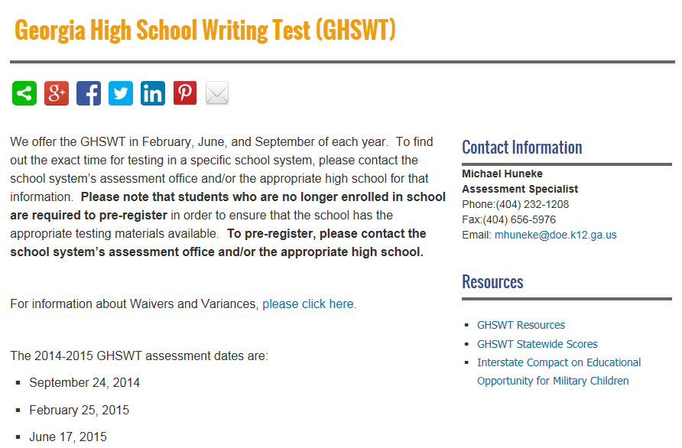
Registration Process
Please note the GaDOE webpage to help with the registration process in your school system. If your system has not implemented a pre-registration process, your system should to do so as soon as possible.
State Board rule (160-3-1-.07) requires that districts/schools have a pre-registration process for the GHSGT and GHSWT for those wanting to retest at the next administration window. (this is not new)

Slide 13
Materials to be Received
Class packs include writing topic pages, planning/prewriting, and drafting pages in shrink wrap packages of 25 and 5.
Answer documents are packaged separately.
Schools will receive a 10% overage and there will be no system overage.
Different colored paper is used to denote
GPS Main administration prompt (Lavender)
GPS Make-up prompt (Yellow)
QCC-prompt (White)

Slide 14
Materials to be Received
System/School Coordinator’s Manual*
Examiner’s Manual* (1 manual for every 25 students)
Pre-coded building transmittal forms
Pre-ID Labels – sent in separate shipment
Additional materials may be ordered order online via TestTime at https://gcap.tsars.uga.edu/materials/
*All parties involved in test administration must read manuals.

Slide 15
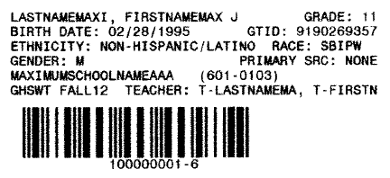
Materials to be Received
Pre-ID Label
FALL 14

Slide 16
Planning for the GHSWT Administration
Announce the assessment date.
Have School Coordinators prepare rosters of eligible students by form (GPS or QCC).
Include GTID numbers;
Include accommodations for eligible students.
Secure appropriate testing space and proctors.
Arrange testing schedule allowing approximately two hours for administration. (Students have 100 minutes to complete writing.)
Account for and secure test materials at all times.

Slide 17
Administration Schedule
Distribute Answer Documents 5-10 minutes
Complete Answer Documents 10 minutes
Distribute Writing Topic Pages 5-10 minutes
Planning/Prewriting 15 minutes
Drafting 35 minutes
Revising and Editing 25 minutes
Final Draft 20 minutes
Proofreading 5 minutes

Slide 18
Administration Schedule
Students unable to test on the established date must wait until the next scheduled administration.
Avoid scheduling the administration after an assembly or special event.
Make certain the school administration is aware of the testing schedule.

Slide 19
Administration
An advanced announcement should be made to students about the date and purpose of the test.
If it is not the usual practice to furnish pencils and pens, students should be instructed to bring two number 2 pencils and a blue or black pen. The final draft must be written in pen.
It is important to give classroom teachers advance notice of the testing date so they may adjust lesson plans and schedules.

Slide 20
Administration
System Test Coordinators must ensure that all school coordinators, examiners, proctors, administrators, and other staff are trained. Documentation shall be kept on file.
Prompts are secure and must be kept under lock and key, with restricted access, until time of administration.
Prompts should not be distributed during trainings!
Examiners must account for all testing materials before dismissing students from the testing site.
Non-scorable materials must be collected, counted, and destroyed by the System Test Coordinator.

Slide 21
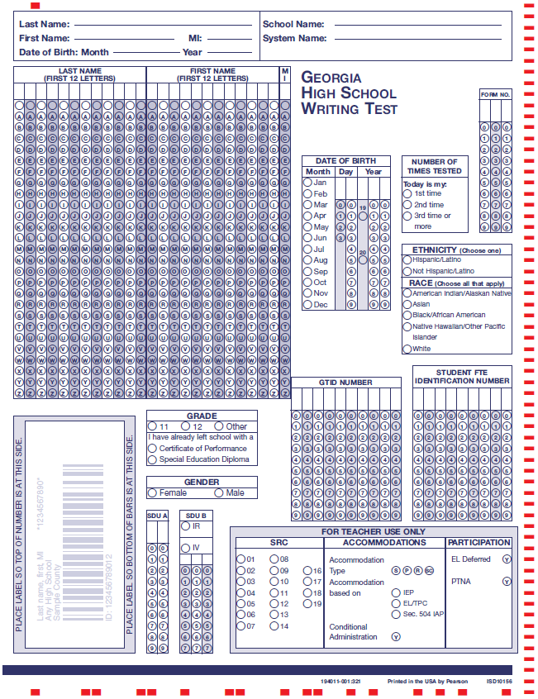
2014-2015 Answer Document
Old answer documents will not scan!
DO NOT USE OLD ANSWER DOCUMENTS!
Complete for all students
Complete for students without a Pre-ID label
(All students for Spring and Summer Administrations)
Complete when applicable
SDUA: Code as Directed by page 9 in the Coordinator’s Manual
SDUB: Code as Directed by GaDOE
SRC, Accommodations & Participation: Code as Directed in the Coordinator’s Manual starting on page 6
Do Not Bubble FTE
Pre-ID Label goes here! Fall administration only!
Note: The black timing tracks on the edge must be clean of stray marks to be able to be scanned.
DO NOT CODE CONDITIONAL UNLESS APPROVED BY THE GADOE!

Slide 22
Student Directions in Answer Document

Slide 23
GHSWT Answer Document
Student GTID numbers must be included on the answer documents. School Test Coordinators should provide examiners with student rosters that include both GTID numbers, Special Education or EL status, and information about accommodations.
Students must enter the form number of the test they take in the correct space on the answer document (page 1 and 3).
Barcode labels are provided only for the Fall administration. They will include GTID.
Students should always write their name, DOB, school name, and system name in the spaces at the top of the answer document.
A script including directions for completing the answer document for students with barcode labels and those without labels appears in the Examiner’s Manual and should be followed exactly.
Students must enter and bubble all demographic information on the answer documents in retest administrations (February and June).

Slide 24
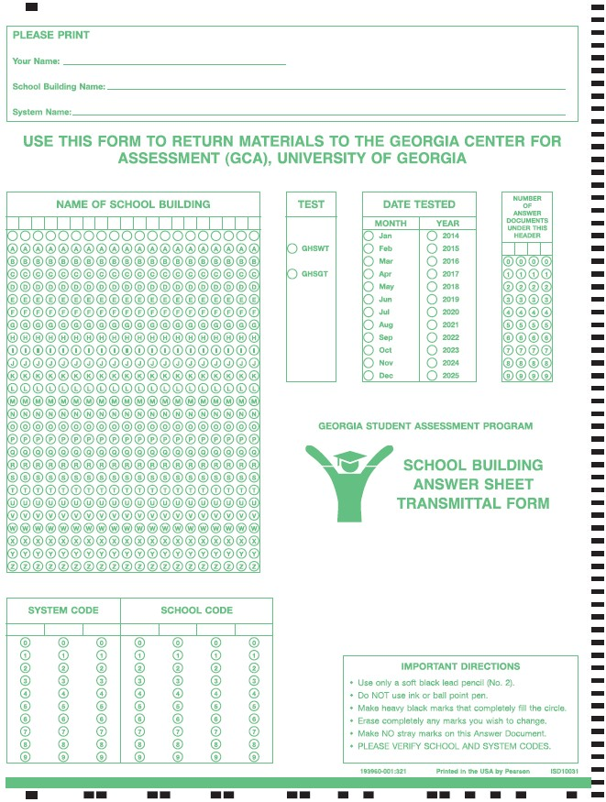
School Building Answer Sheet Transmittal Form
Print information
Bubble in building Name
Bubble Assessment (GHSWT)
Bubble “Sep” and “2014” or “Feb” or “Jun” and “2015”
Bubble number of answer documents sending in and paper banded to transmittal form (right justify)
Bubble in System Code
Bubble in School Code

Slide 25
Testing Students With Disabilities, 504 Plans, or EL Test Participation Plans
State required coding (SRC)
Use the SRC section on the Answer Document to code eligible students with disabilities, English Learner (EL) students, Title I students, and migrant students. These codes should be provided by site test coordinator.
The type of accommodation provided should be coded in the Accommodations box: S indicates setting; P indicates presentation; R indicates response; and SC indicates scheduling.

Slide 26
Accommodations
The SRC, Accommodations, and SDU boxes on page 1 of the Answer Document should be filled in by you or the School Coordinator. The State-Directed Use Only (SDU B) section should be used only when instructed by the GaDOE.
If the assessment resulted in a conditional accommodation, code the appropriate box on the answer document. Do not code conditional accommodations unless you have received permission. Doing so could delay scores. Conditional administrations are not eligible for a high school diploma.

Slide 27
Accommodations
For students who require accommodations, Coordinators should consult the Student Assessment Handbook and the Accommodations Manual for Students with Disabilities.
Any accommodations not included in these guides must be approved by the GaDOE at least 4 to 6 weeks prior to the assessment.
This information should be submitted to the Assessment and Accountability Division by calling the main number at (404) 656-2668 or submitting the form by fax at (404) 656-5976.

Slide 28
Accommodations
Eligible students may be provided accommodations based on an emergency Section 504 Plan to allow participation in the assessment.
A word processor may be used with the spell/grammar check function disabled. The printed essay should include the student’s GTID and form number in the upper right hand corner and be placed inside the Answer Document. GCA will score the printout as the final draft. The file must be deleted from the computer.
One other option is the use of a scribe. Scribing instructions are in the Student Assessment Handbook.

Slide 29
Accommodations
Prompts may be read aloud to students only if this accommodation is specified in an IEP, IAP/504, or TPC Plan.
Writing materials for visually impaired students may be enlarged by the System Test Coordinator in a secure manner, must be accounted for, and returned to the System Test Coordinator.
Prompts may be communicated via sign language.
EL students may use word-to-word dictionaries if in their TPC plan.

Slide 30
Braille Availability
Braille versions of the Writing Topic Page and the Testing Directions from page 2 of the Answer Document (Response Folder) will be available upon request.
Systems that require Braille testing materials should have contacted Jeff Barker (888-392-8977 or jabarker@uga.edu) at the Georgia Center for Assessment. Additional orders may still be made. If requested by September 12, 2014, delivery should occur no later than September 19, 2014.

Slide 31
Word Processor and Enlarged Copies
A word processor is not allowed for the GHSWT unless it is a part of the student’s IEP or IAP/504 and is a part of the regular instructional program accommodations.
If a word processor is used, place the print out inside the answer document with the student’s GTID and form number in the upper right hand corner of the print out.
System Test Coordinators may enlarge a copy of the writing topic for students requiring a large print version as prescribed in a student’s IEP or 504/IAP .
If pages 3 and 4 of the Answer Document is enlarged, please place the enlarged copy inside the answer document with the student’s GTID and form number in the upper right hand corner of the enlarged paper.

Slide 32
Irregularities (IR)
Events and circumstances that depart from standardized testing procedures are irregularities.
They may have an impact on student performance that is not possible to define.
They are reported and student scores flagged simply to say, “There is something different about the conditions under which this score was obtained. Use caution in interpreting the score.”

Slide 33
Some Examples of Irregularities
Irregularities in Security:
Irregularity due to content being disclosed, coached, or distributed
Irregularity due to cheating
Irregularity due to someone altering responses during or after testing
Irregularity due to lost test materials
Irregularities in Test Administration:
Irregularity due to materials being distributed inappropriately
Irregularity due to directions not being followed
Irregularity due to accommodations not being given

Slide 34
Invalidations (INV)
Irregularities that significantly affect student performances or compromise the integrity of the testing may result in invalidation of student scores.
Cheating, altering responses, or disclosing content early are examples of irregularities resulting in invalidations.

Slide 35
Reporting Irregularities and Invalidations
Irregularities MUST be handled and reported
promptly.
wrong test version of the test
wrong accommodations
cheating

Slide 36
Reporting Irregularities and Invalidations
Procedures for reporting are in the Student Assessment Handbook.
Examiner provides full report to School Coordinator
School Coordinator reports to System Coordinator
System Coordinator contacts GaDOE
Coding is decided
Codes for IR, IV, and PIV will be different
STC reports in the MyGaDOE portal (include statements)

Slide 37
Entering IRs into the MyGaDOE Portal
In the MyGaDOE Portal, find the “Surveys” section and click on “More”
https://portal.doe.k12.ga.us/login.aspx
Click on “View Summary” next to Testing Irregularity Form
Click on “Add New Record”
Click on “Start”

Slide 38
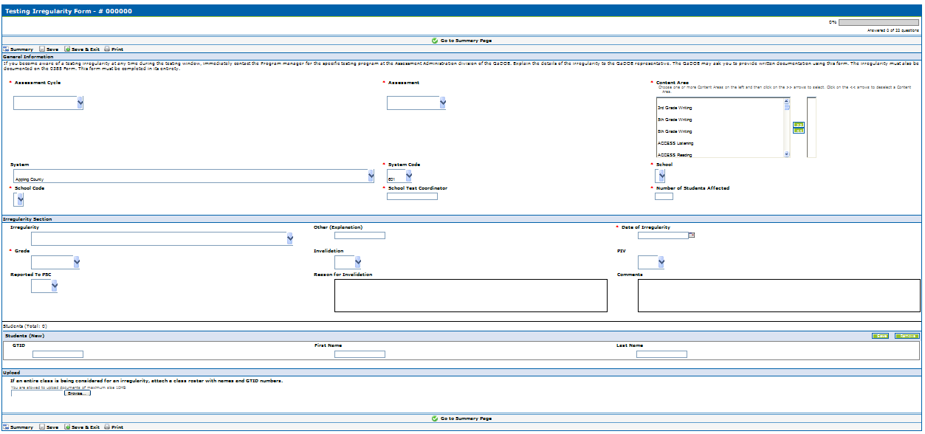
Entering IRs into the MyGaDOE Portal
Pick Assessment Cycle
Pick the Assessment
Pick the Content Area(s)
Pick your system
Pick your system code
Pick the school
Pick the school code
Type the STC
Type the number of students
Select an IR
Explain only if “Other”
Pick date of IR
Select Grade of Student
IV - Yes or No
PIV - Yes or No
PSC - Yes or No
Explain why the IR is an IV
Explain what happened here
Enter student(s) GTID here. First and last name will populate automatically and you may add more students if needed.
Attach a class list and/or statement(s)/evidence by browsing and selecting file on your computer. You may only attach one document so multiple items will need to be zipped or combined into one document..
Fill out the irregularity form and then click on “Save & Exit”
Click on “Submit for Approval”

Slide 39
CODE OF ETHICS FOR GEORGIA EDUCATORS
The Professional Standards Commission (PSC) adopted a new Code of Ethics for Georgia Educators in July 2009.
All educators should review the Code of Ethics prior to testing.
The PSC also adopted a hierarchy of consequences, recommended by System Test Coordinators, that is published on their web site at http://www.gapsc.com/.

Slide 40
PSC Testing Standard
Standard 11: Testing - An educator shall administer state-mandated assessments fairly and ethically.
Unethical conduct includes but is not limited to:
1. committing any act that breaches Test Security;
and
2. compromising the integrity of the assessment.

Slide 41
Breach of Professional Ethics Professional Standards Commission
Gives examinees access to test questions prior to testing;
Copies, reproduces, or uses in any manner inconsistent with test security regulations all or any portion of secure test booklets (prompts);
Coaches examinees during testing, or alters or interferes with examinees’ responses in any way;
Makes answers available to examinees;
Fails to follow security regulations for distribution and return of secure test materials as directed, or fails to account for all secure test materials before, during, and after testing;
Uses the secure test booklets (prompts) for any purpose other than examination; or
Participates in, directs, aids, counsels, assists, encourages, or fails to report any of these prohibited acts.

Slide 42
Characteristics of a Quality Investigation
Examiner should notify Principal and School Test Coordinator of incident.
School Test Coordinator should notify System Test Coordinator.
Request detailed written statements from all parties involved if necessary.
Follow up on details (connect the dots)
Follow district procedures regarding misconduct.
Provide a written summary of incident and investigation findings.
Consult with GaDOE as needed.
System Test Coordinator is responsible for reporting to GaDOE.
Note:
Report to GaDOE immediately, before investigation.
Final documentation should be entered into portal.

Slide 43
Testing Security Requires:
Advanced Planning
Clear and concise communication about roles and responsibilities
Solid logistical procedures
Documented training

Slide 44
Test Security Reminders
Be familiar with the Student Assessment Handbook and test administration manuals
Follow all protocols
Principal’s Certification Form is now required and must be maintained at the system for 5 years
Report problems in a timely manner
Including referrals to PSC

Slide 45
Test Security Reminders
The writing assessment materials are secure test documents.
Tests should be kept under lock and key except during the time materials are being prepared, during actual administration with students, and when completing post-administration tasks required by the manual(s).
During the actual test administration, test materials must remain in the testing room.
Examiners must account for all testing materials BEFORE dismissing students from the testing room each day.
All administered prompts are test secure materials.
The prompts are not to be shared with anyone or reproduced in any fashion.
The prompts are not to be used as practice writing assignments for students. Released prompts and sample papers are available for this purpose on the GaDOE website.

Slide 46
Keys To Test Security
Lock tests up!
Count and recount/Sign-in and Sign-out
Material counts must be verified before students leave the test setting
Don’t let them out of your sight
Make students put their names on the Test Materials and sign for them
Students must sign-in . . . including their name and Form Number
No peeking
Do not copy
Monitor students

Slide 47
PLANNING FOR TEST ADMINISTRATION
Conducive Environment
Seating spaces and writing surfaces are large enough
Seating arranged to prevent cheating.
NO cell phones, PDAs, or other electronic devices in the exam room.
Take any discovered devices away immediately . Return them at a later time
No. 2 Pencils - Each student should be told to bring two No. 2 pencils with erasers on days tests are to be administered. However, there should be a supply of extra pencils and erasers available for students who forget.
Blue or Black ink pen - Each student should be told to bring a pen as responses must be completed in pen (blue or black ink) on pages 3 and 4 of the Answer Document
Keep a timing device visible - You should have a clock or watch to keep track of time during test administration.

Slide 48
PLANNING FOR TEST ADMINISTRATION Roles and Responsibilities
Refer to Student Assessment Handbook for detailed information.
Superintendent has ultimate responsibility for all testing activities within the local school system. The System Test Coordinator shares this responsibility as the Superintendent’s designee.
Principal has ultimate responsibility for all testing activities within the school.
Emphasis: The Principal must complete the Principal’s Certification Form after each administration.

Slide 49
PLANNING FOR TEST ADMINISTRATION Roles and Responsibilities
System Test Coordinator
Liaison between system and GaDOE
Conduct local system trainings of School Coordinators
Coordinate ALL administration activity
Know and enforce responsibilities of all other roles
Adhere to the state testing calendar and local calendars/schedules
Implement plans for ordering and receipt of materials, distribution, test security, administration, collection and return shipments, receipt and dissemination of reports and data
Detailed list of responsibilities in SAH

Slide 50
PLANNING FOR TEST ADMINISTRATION Roles and Responsibilities
School Test Coordinator
Must hold a PSC-issued certificate (per Student Assessment Handbook)
Count and secure all test materials
Materials distribution/return, signing out and signing in materials
Attend and then redeliver training
Plan for all aspects of the school’s test administration, monitor test administration environment
Receive/verify test material counts after testing each day
Collaborate effectively with local system colleagues who have a role in the success of your system’s testing program.
Detailed list of responsibilities in SAH

Slide 51
PLANNING FOR TEST ADMINISTRATION Roles and Responsibilities
Examiner
Must hold a Georgia PSC-issued certificate (teachers, counselors, administrators, paraprofessionals) . . . This is required per SBOE Rule 160-3-1-.07. GaDOE is compelled to invalidate when this does not occur (!).
Security/verification of test materials
Control of testing environment and active monitoring
Accuracy of demographic/student information on answer documents
Correct delivery of assigned accommodations
Follows procedures for testing as given in Examiner’s Manuals, including reading all directions/script to students
Test materials are not to be used for any purpose other than test administration
Detailed list of responsibilities in SAH

Slide 52
PLANNING FOR TEST ADMINISTRATION Roles and Responsibilities
Proctor
Must be trained
With examiner supervision, ensures that students are managing test materials appropriately
Active monitoring
Detailed list of responsibilities in SAH

Slide 53
PLANNING FOR TEST ADMINISTRATION
PROCTORS
When 30 or more students are to be tested in one room, the assistance of a Proctor is required. At least one Proctor is required for each additional 30 students. If students are tested in groups of less than 30, a Proctor is highly recommended.
Proctors must be trained in appropriate test procedures before testing begins. Tasks which they must perform should be clearly specified. They may help in distributing and collecting materials, assisting students with coding on the Answer Document, observing students from different points in the room while tests are being administered, and answering students’ questions concerning the test directions. To prevent the neglect of any students in large groups, Proctors may be assigned to specific areas of the room during test administration. Proctors must not explain the test items or coach students in any way.

Slide 54
Reminders
Follow directions and time limits given in manual.
“It is recommended that the GHSWT be administered in the morning beginning about 9:00 on the designated day” (page 10 in the Examiner’s Manual).
Students should read the topic page carefully for directions about the genre and topic.
Students should use the Writing Checklist.

Slide 55
Reminders
Make certain students are writing final drafts on pages 3 and 4 of answer document.
Be certain to use the main prompt on Day 1 ONLY.
The make-up prompt is for Day 2 ONLY.
Check to make certain students code the form number on their answer document on pages 1 and 3.

Slide 56
Reminders
Word processors are not allowed in grade 11 unless they are a part of the student’s IEP or IAP/504 Plan and are a part of the regular instructional program.
Eleventh graders must use blue or black ink pens for the final draft.
ALL responses must be written in English.
Examiners may read or clarify directions only.

Slide 57
Georgia Writing Assessments
Assessment resources located at
http://www.gadoe.org/ci_testing.aspx?PageReq=CITestingWA11
Assessment and Instructional Guides
Rubrics
Domain Descriptions
Samples
Interpretive Guide
Coordinator’s Manual and Examiner’s Manual
CCGPS GHSWT Connections Resource Guide

Slide 58
An Effective Assessment Provides Critical Information
¤ Students
¤ Parents
¤ Teachers
¤ School and System Administrators
¤ Community Members
The integrity of the assessment process is critical to all we do.

Slide 59
2014-2015 GHSWT Dates
Fall
Wednesday, September 24, 2014 (Main)
Thursday, September 25, 2015 (Make-up)
Spring
Wednesday, February 25, 2015 (Main)
Thursday, February 26, 2015 (Make-up)
Summer
Wednesday, June 17, 2015 (Main—No Make-up)

Slide 60
Contact Information
GaDOE
Michael Huneke
404-232-1208
mhuneke@doe.k12.ga.us
GCA
Jeff Barker
888-392-8977
jabarker@uga.edu

