Slide 1
Georgia Assessment Overview and FAQs
Joint Session of the Senate and House
Education Committees
January 10, 2017

Slide 2
Assessment & Accountability
The primary purpose of school is teaching and learning.
Assessment and accountability plays an important role, but importantly – that role is supporting with the primary focus being teaching and learning.
2

Slide 3
Assessment Foundations
All assessments rely on a relatively small number of exercises to permit the user to draw inferences about a student’s mastery of larger domains of knowledge and skill.
Formative: takes place during instruction to provide feedback to teaching and learning; used by both students and teachers.
Interim: takes place after a sequence of instruction to evaluate students’ knowledge and skills relative to a specific set of academic goals, typically within a limited timeframe.
Summative: takes place at the end of instruction to certify mastery or assign grades; typically used for accountability.
Georgia Milestones are summative assessments.

Slide 4
Assessment FAQs
What tests are state mandated?
Kindergarten students participate in an ongoing formative measure called the Georgia Kindergarten Inventory of Developing Skills (GKIDS). [Grade K]
The Georgia Milestones Assessment System is the primary assessment program consisting of End of Grade (EOG) and End of Course (EOC) measures. [Grades 3 – HS]
Students with significant cognitive disabilities participate in the Georgia Alternate Assessment (GAA) in lieu of Georgia Milestones.
English language learners (EL students) must take the ACCESS for ELLS test on an annual basis to measure their English proficiency. [Grades K – 12]
When selected, students in identified grades (typically 4 and 8) must also participate in the National Assessment of Educational Progress (NAEP).
4

Slide 5
Assessment FAQs
What is the purpose of the state-mandated testing program?
To measure student achievement of the state-adopted content standards and inform efforts to improve teaching and learning.
How should the results of the assessment program be utilized?
As a gauge of the quality of education provided to students across the state.
To identify strengths and weaknesses in instructional practice(s) and help establish priorities in planning educational programs.

Slide 6
Assessment FAQs
How many state-mandated tests does a student take each year?
Depending on the grade level, elementary and middle school students will take 2 or 4 tests (EOG).
In high school, the number of tests (EOC) taken by a student is dependent on his/her course enrollment.
Depending on the grade-level, students take 1 to 4 fewer tests than in previous years.

Slide 7
State-Mandated Tests 2016 -2017
Grade | # State Tests | Test/Content Area
K | 1 | GKIDS
3 | 2 | GM EOG: ELA and Math
4 | 2 | GM EOG: ELA and Math
5 | 4 | GM EOG: ELA, Math, Science, Social Studies
6 | 2 | GM EOG: ELA and Math
7 | 2 | GM EOG: ELA and Math
8 | 4 | GM EOG: ELA, Math, Science, Social Studies
High School | 7 or 8* | GM EOC: 9th Grade Lit; American Lit; Coordinate Algebra or Algebra I; Analytic Geometry or Geometry; Physical Science**; Biology; US History; Economics
*Dually enrolled students are no longer required to take certain EOCs.
**High school students may take either Physical Science or Physics; there is no EOC for Physics.
7

Slide 8
Assessment FAQs
Has the number of state-mandated tests increased or decreased since implementing Georgia Milestones?
With the implementation of Georgia Milestones in 2014-2015, the number of state-mandated tests has decreased from 43 (2013-2014) to 24 (2016-2017).

Slide 9
Assessment FAQs
What tests are required by the state?
What tests are required by the federal government?
Grade | State Required | Federally Required
K | GKIDS | ―
1 | [Literacy / math formative under development] | ―
2 | [Literacy / math formative under development] | ―
3 | GM EOG: ELA / Math | ELA / Math | Science
4 | GM EOG: ELA / Math | ELA / Math
5 | GM EOG: ELA / Math / Science / Social Studies | ELA / Math
6 | GM EOG: ELA / Math | ELA / Math | Science
7 | GM EOG: ELA / Math | ELA / Math
8 | GM EOG: ELA / Math/ Science / Social Studies | ELA / Math
High School (9-12) | GM EOC: ELA (9th Grade Lit / American Lit) / Math (Coordinate Algebra or Algebra I / Analytic Geometry or Geometry) / Science (Physical Science / Biology) / Social Studies (US History / Economics) | ELA / Math | Science
Note: Georgia Milestones is used for fulfill federal testing requirements for ESEA/ESSA.

Slide 10
Assessment FAQs
How many additional tests do local districts give?
On average, there are 5 tests being administered per district, in addition to those required by the state.
The most frequently reported number of additional tests was 4.
Elementary schools had an average of 2 tests per district.
Middle schools had an average of 1 test per district.
High schools had an average of 2 tests per district.
Based on a local assessment inventory conducted by GaDOE in Fall 2015 with all districts participating.
10

Slide 11
Assessment FAQs
Why was Georgia Milestones needed and developed?
The former assessment programs were outdated and did not provide coherent information about the achievement of Georgia’s students.
The former testing programs sent discrepant signals about the achievement of Georgia’s students.
2013
NAEP – Grade 4: 34% at/above proficient
CRCT – Grade 4: 93% met/exceeded
2015
NAEP – Grade 4: 34% at/above proficient
GM ELA – Grade 4: 37% proficient/distinguished

Slide 12
Where Does Georgia Stand? 2015 Grade 4 NAEP Reading
Lower Performing
(14)
Similar Performing
(22)
Higher Performing
(15)
Arkansas
South Carolina
Alabama
Michigan
West Virginia
Louisiana
Arizona
Hawaii
Nevada
Mississippi
Alaska
California
District of Columbia
New Mexico
Pennsylvania Illinois
Washington Oklahoma
Ohio Idaho
Montana National Public
North Dakota Kansas
Colorado South Dakota
Maine Oregon
Delaware Tennessee
Iowa Texas
Wisconsin
Minnesota
Maryland
Missouri
New York
Georgia
Massachusetts
Department of Defense
New Hampshire
Vermont
New Jersey
Virginia
Connecticut
Wyoming
Kentucky
Indiana
Florida
Nebraska
Utah
North Carolina
Rhode Island
Note: National Public is included for reference only and is not included in the jurisdiction count.

Slide 13
Where Does Georgia Stand? 2015 Grade 4 NAEP Mathematics
Lower Performing
(4)
Similar Performing
(19)
Higher Performing
(28)
California
District of Columbia
New Mexico
Alabama
Oklahoma Arkansas
Maryland West Virginia
Missouri Louisiana
Idaho Mississippi
Delaware Nevada
Rhode Island
Hawaii
Oregon
Arizona
Illinois
South Carolina
New York
Georgia
Alaska
Michigan
Massachusetts Pennsylvania
Minnesota Wisconsin
New Hampshire Vermont
Indiana Florida
Department of Defense Utah
Wyoming Maine
Virginia Kentucky
New Jersey Colorado
Washington Montana
North Dakota Kansas
Texas Tennessee
Nebraska Connecticut
North Carolina National Public
Ohio South Dakota
Iowa
Note: National Public is included for reference only and is not included in the jurisdiction count.

Slide 14
Where Does Georgia Stand? 2015 Grade 8 NAEP Reading
Lower Performing
(5)
Similar Performing
(18)
Higher Performing
(28)
Hawaii
Louisiana
New Mexico
Mississippi
District of Columbia
Ohio West Virginia
Rhode Island Nevada
Tennessee California
Michigan Arkansas
National Public Alabama
Florida
New York
Arizona
Oklahoma
Delaware
Georgia
Texas
North Carolina
South Carolina
Alaska
Department of Defense Indiana
New Hampshire Iowa
Massachusetts Colorado
Vermont Maryland
Connecticut Kentucky
New Jersey Oregon
Minnesota Washington
Montana South Dakota
Wisconsin North Dakota
Utah Missouri
Nebraska Virginia
Wyoming Illinois
Pennsylvania Kansas
Idaho
Maine
Note: National Public is included for reference only and is not included in the jurisdiction count.

Slide 15
Where Does Georgia Stand? 2015 Grade 8 NAEP Mathematics
Lower Performing
(8)
Similar Performing
(15)
Higher Performing
(28)
Nevada
Oklahoma
West Virginia
New Mexico
Mississippi
Louisiana
Alabama
District of Columbia
Illinois Florida
Rhode Island Arkansas
North Carolina
National Public
Missouri
Alaska
New York
Delaware
Hawaii
Georgia
Tennessee
Michigan
Kentucky
South Carolina
California
Massachusetts Utah
New Hampshire Colorado
Minnesota Ohio
New Jersey Maine
Department of Defense South Dakota
Vermont Connecticut
Wisconsin Kansas
North Dakota Texas
Virginia Idaho
Montana Pennsylvania
Indiana Maryland
Wyoming Arizona
Washington Oregon
Nebraska
Iowa
Note: National Public is included for reference only and is not included in the jurisdiction count.

Slide 16
Assessment FAQs
Who developed Georgia Milestones?
The Assessment Division oversees the development of the state assessment program, including Georgia Milestones. In spring 2013, a contract was awarded to CTB McGraw-Hill through a competitive bid process managed by the Department of Administrative Services (DOAS). CTB was acquired by Data Recognition Corporation (DRC) in June 2015.
The test development process relies heavily on the inclusion of Georgia educators as subject matter experts. Committees of Georgia educators, including faculty members from the Technical College System of Georgia and the University System of Georgia, have directly informed the development of the Georgia Milestones program.
All aspects of the state testing program are vetted with our Technical Advisory Committee (TAC), comprised of 6 national measurement experts.

Slide 17
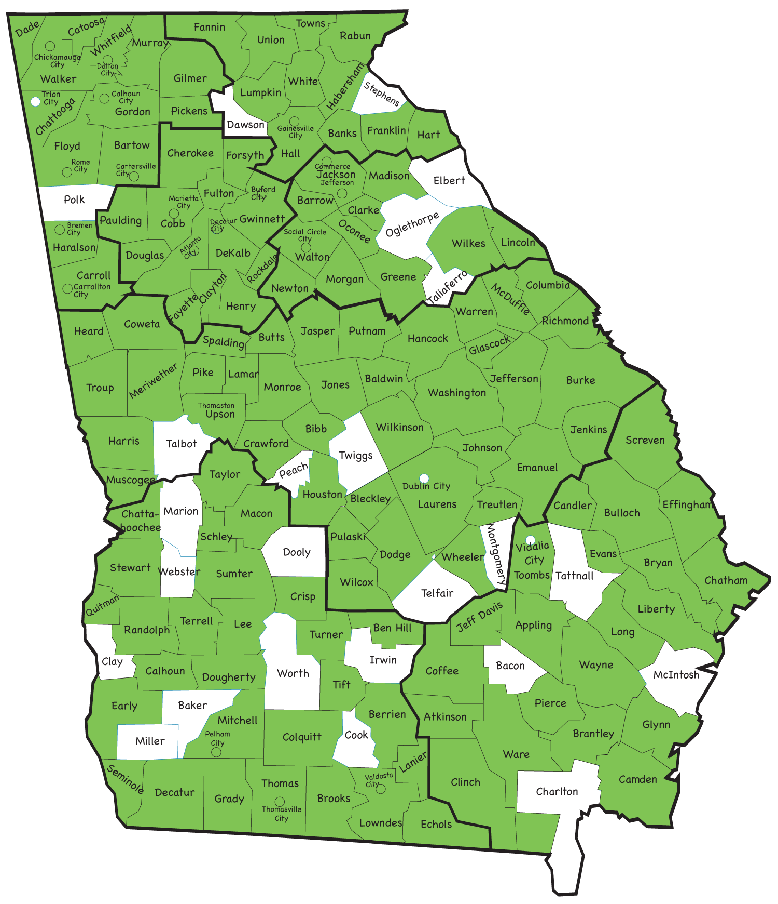
Georgia Milestones Educator Involvement
Statewide Schools
Georgia Cyber Academy
Georgia Virtual School (GaVS)
State Schools
Higher Ed
Technical College System of Georgia
University System of Georgia

Slide 18
Assessment FAQs
When do districts receive student scores?
Student scores are posted electronically on a daily basis, along with a district data file. Reports and data files are updated, daily, throughout the testing window.
Content areas that include open-ended items take longer to score than machine scored multiple-choice items.
Final score reports, including summary reports, are posted after the state window has closed and all student data has been processed. This is necessary because the final reports include comparative data at the school, district, and state level.

Slide 19
Assessment FAQs
How many tests were administered in Spring 2016?
Approximately 3. 9 million tests administered, scored and reported.
Remember, each grade-level EOG consisted of 4 tests.
How many tests were administered online?
When including the Winter 2015 EOC administration, 75% of tests were administered online during the 2015-2016 administration.
Georgia Milestones | Spring 2015 | Spring 2016
End of Grade | 30% | 55%
End of Course | 71% | 91%
Total | 53% | 73%
19

Slide 20
Assessment FAQs
How many test sections were interrupted in Spring 2016?
End of Grade [Each student has 9 sections across the 4 content area tests]
Number of test sections without interruption: 93.5%
Number of test sections interrupted: 6.5%
Number of test sections interrupted more than once: 1.98%
End of Course [Each test has 3 (ELA) or 2 (math, science, social studies) sections]
Number of test sections without interruption: 97.3%
Number of test sections interrupted: 2.7%
Number of test sections interrupted more than once: 0.39%
It is important to note the cases quantified above include test-administration errors that were not due to some type of software or hardware malfunction.

Slide 21
Assessment FAQs
What steps have been taken to implement Senate Bill 364?
The grades 3, 4, 6, and 7 Georgia Milestones EOG in Science and Social Studies have been discontinued.
Released test items in these grades/content areas have been made available for local formative use.
The testing calendar for the Spring 2018 EOG administration has been changed to allow districts to test later in the spring.
The Spring 2018 window opens one week later than has been the case in past years (April 9, 2018). It will close two weeks later than in the past (May 18, 2018 – within one week of Memorial Day).
GaDOE has begun development of an innovative and developmentally appropriate formative assessment for grades 1 and 2 in literacy and mathematics.
21

Slide 22
Assessment FAQs
What recommendations are being made as a result of ESSA?
Stay the course – Georgia has made significant improvements to its assessment program and should continue on its current path. Georgia Milestones includes more informative item types, provides information on student mastery of state content standards as well as a national comparison, and provides a more accurate picture of student performance based on high expectations than previous programs.
Focus on providing more, high-quality formative assessments that can be used to guide instruction and improve student performance.
Explore opportunities to innovate, both in formative and summative ways.
22

