Slide 1
Assessment Update
State Board of Education
June 13, 2019

Slide 2
Spring 2019 Update
Georgia Milestones
Spring 2019 Testing Volume
Approximately 2.82 million tests administered, scored, and reported
Online Testing
This spring, districts assessed 100% of students online.
Peak concurrency saw 205,417 students testing simultaneously.
We topped last year’s peak concurrency on 10 different days.
There have been no major statewide issues.
Georgia Milestones | Peak Concurrency Date | Peak Concurrency Simultaneous Students
Spring 2019 | Tuesday, April 23, 2019 | 205,417 = 45.69% increase
Spring 2018 | Tuesday, April 24, 2018 | 141,000

Slide 3
Spring 2019 Update
Georgia Milestones
State Testing Windows (Spring 2019)
EOG: April 8 – May 17
EOC: April 22 – May 31
141,000 (2018 peak)
EOG only
205,417 (2019 peak)
EOG and EOC
EOC only

Slide 4
GAA 2.0
Georgia Alternate Assessment 2.0
The Georgia Alternate Assessment (GAA) 2.0 is the state’s alternate assessment for those students with significant cognitive disabilities who cannot participate in the general statewide assessment program, even with maximum allowable accommodations.
The GAA 2.0 has been developed to ensure that students with the most significant cognitive disabilities are provided access to the state academic content standards and given the opportunity to demonstrate achievement of the knowledge, concepts, and skills inherent in the standards.
The GAA 2.0 was administered for the first time from March 25 – May 3, 2019.

Slide 5
GAA 2.0
Georgia Alternate Assessment 2.0
Following the Spring 2019 administration, GaDOE collected educator feedback to determine areas of potential program improvement.
More than 1,000 educators from across the state provided feedback.

Slide 6
GAA 2.0
Georgia Alternate Assessment 2.0
Preliminary analyses suggest the following overall themes:
Training
sample tasks, videos, and supplemental resources would support the training and preparation process
Administration rules
provide more detailed information
Layout and format
present question/answer options on same page, reduce flipping, color code books and answer documents, indicate page turns in script, more visuals
Content
simplify vocabulary, reduce complexity where possible, reduce length of scenarios and questions, replace text with visuals

Slide 7
GAA 2.0
Georgia Alternate Assessment 2.0
Next steps:
Data Review and Content and Bias Review (June 10-13)
Standard Setting (July 8-12)
Vertical Articulation/Policy Review Meeting (July 16)
State Board of Education adoption of achievement standards (July 18)
Score reporting begins late August

Slide 8
GKIDS 2.0
GKIDS 2.0
Operational Statewide in 2019-2020!
A progression-based formative assessment, integrated into classroom work, that is aligned to the state content standards.
A big idea describes the integration of concepts and skills from the kindergarten standards that are most important for success in first grade.
A learning progression shows where the student is in the learning continuum of content and reasoning development regarding the big idea from the GSE.
Provides the big picture of what is to be learned across the year, relates standards across grades and increased reasoning of standards within the grades, and supports instructional planning.
Provides teachers with one source of real-time information to adjust instruction
Identifies what a student already knows, what the student needs next, and allows teachers to monitor growth

Slide 9
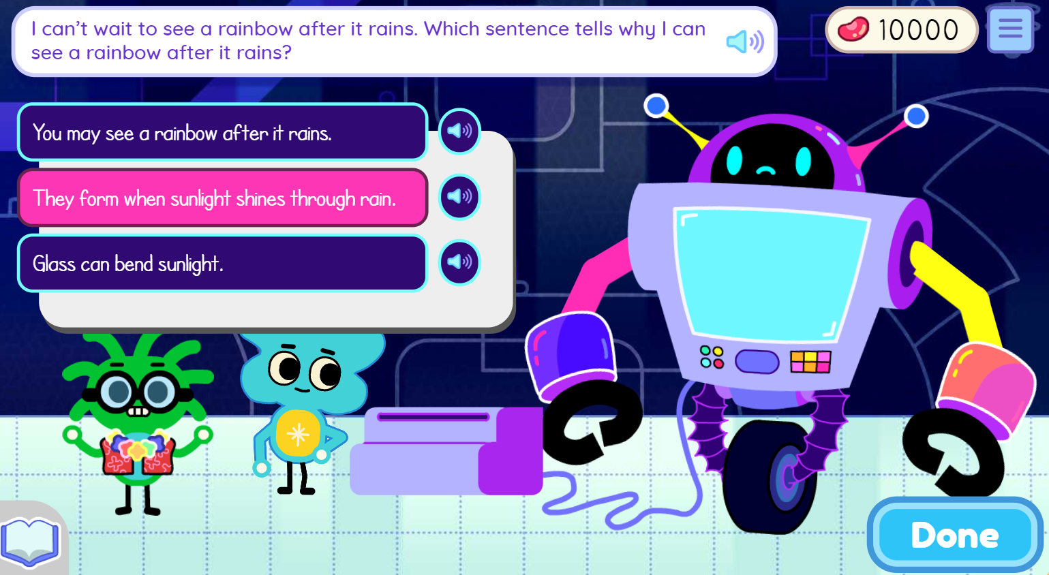
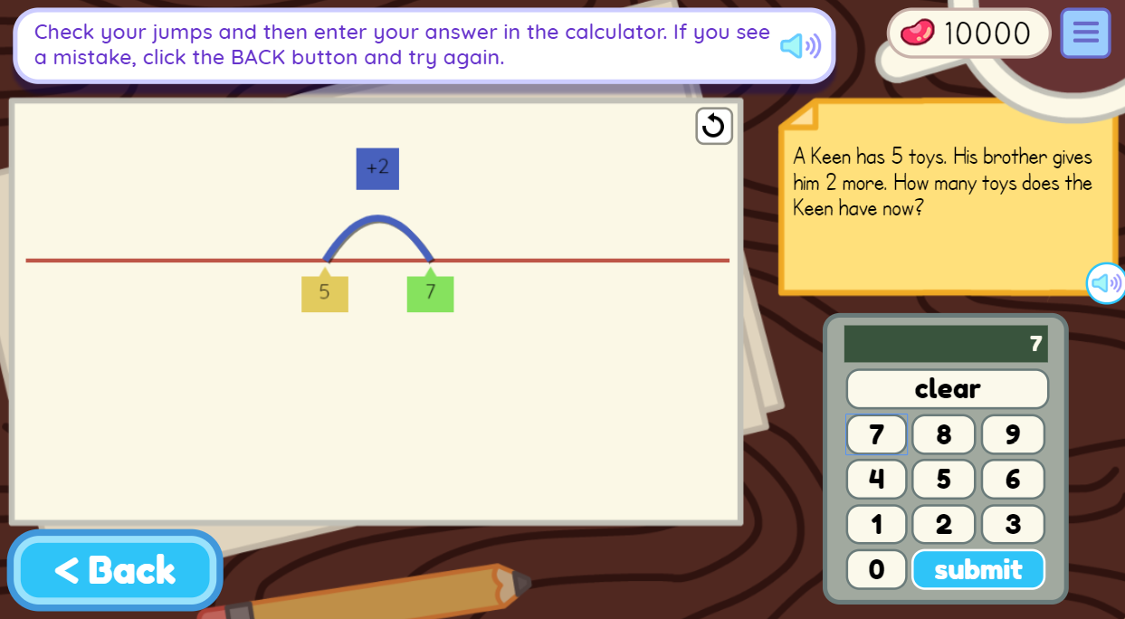
Welcome to Keenville!
Keenville
Keenville is Georgia’s game-based, formative assessment in literacy and mathematics for grades 1 and 2.
It is accessible via the Statewide Longitudinal Data System (SLDS).
New games and dashboards will arrive this spring and summer.
Keenville will be fully operational for the 2019-2020 school year!

Slide 10
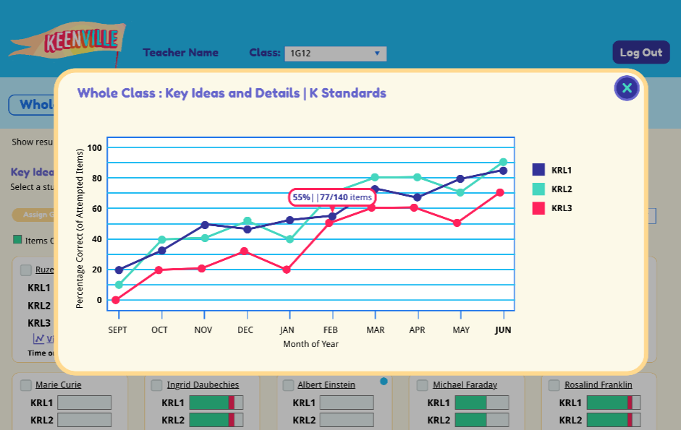
Main Features
Keenville
Designed to engage students through features such as an avatar builder; earning rewards; decorating their house; and fun sights, sounds, and reactions.
Students receive ongoing support through motivational prompts and feedback.
Games often include Georgia-specific themes and integrate other standards and initiatives, such as science, arts, and nutrition.
Teachers can access interactive dashboards that provide real-time data to help guide instruction and enhance instructional practices.
Each game is designed with multiple levels of learning to:
identify students’ current level of knowledge, skill, and concept development.
provide students, with varying abilities, access to content based on their learning needs.

Slide 11
What’s in Keenville?
Keenville
English Language Arts
Mathematics
16 games that focus on:
Literary reading comprehension
Informational reading comprehension
Phonics and word recognition
Language acquisition
15 games that focus on:
Addition/subtraction
Time, money, and measurement
Graphing, line plots, and data
Sorting 2D/3D shapes and fractional parts to whole
Repeat addition to multiplication building arrays
Reading and recognizing numbers and numerals

Slide 12
A Few ELA Games…
Keenville
In Keenbot, students read about science phenomena and teach Keenbot to help make him the smartest robot in Keenville.
In Harbor Phonics, students use phonics skills to create words.

Slide 13
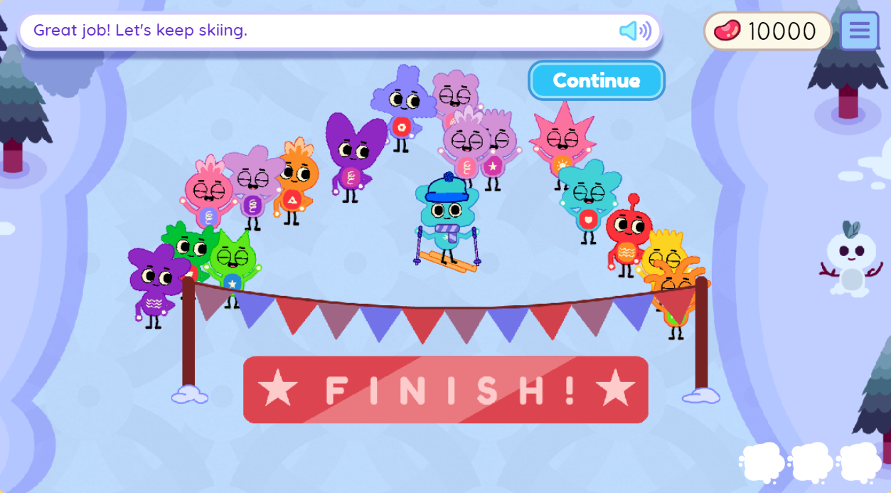
A Few More ELA Games…
Keenville
In Keenville Action News, students use their reading comprehension skills to create news stories for the nightly news in Keenville.
In Downhill Skiing, students ski through flags to group words that fit in the same category.

Slide 14
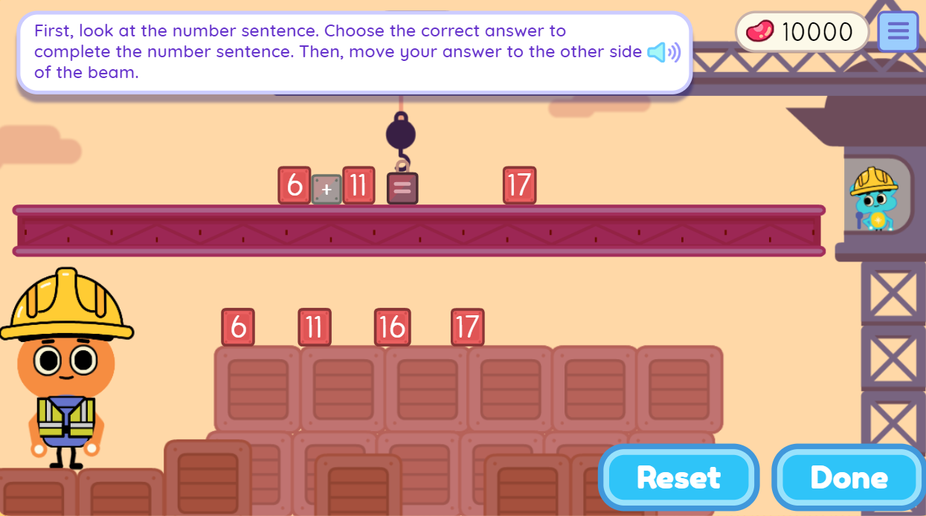
A Few Mathematics Games…
Keenville
In Guitar Maker, students sort shapes to determine what the Peachlings like to make their guitars.
In High-Rise Builders, students solve expressions and show the strategies they used to get their answers.

Slide 15
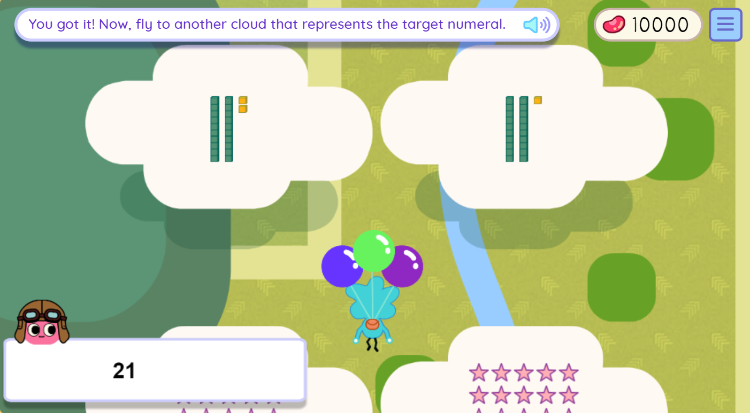
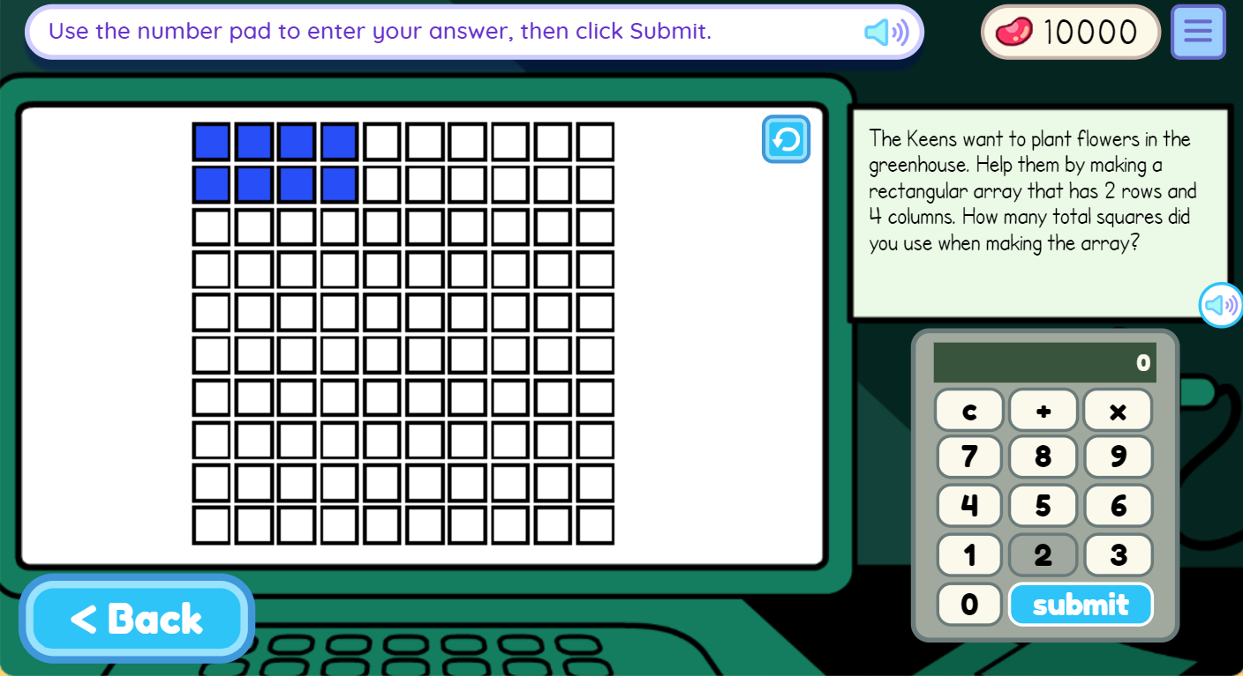
A Few More Mathematics Games…
Keenville
In Cloud Hopper, students fly through clouds to find target numbers that are represented in multiple ways.
In Intergalactic Fair, students solve math problems using arrays to help make the Keenville Intergalactic Fair a success.

Slide 16
Thank you!

