Slide 1
Best Practices for Online Assessments
GaDOE FY2019 Data Conference
August 22, 2018

Slide 2
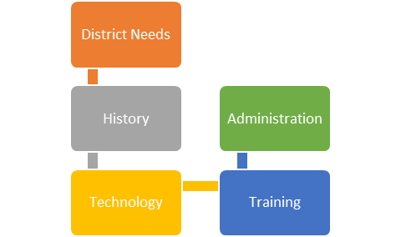
Agenda
Advantages of Online Testing
District Needs
History
Technology
Administration
Training

Slide 3
Advantages of Online Testing
Improved student experience
Increased interactivity
Standard administration of accommodations
Reduced irregular test administration
Reduced stress on district, school, and teachers
Improved test security
Matches Georgia Standards of Excellence for use of technology in writing
Example: ELAGSE3W6: With guidance and support from adults, use technology to produce and publish writing (using keyboarding skills) as well as to interact and collaborate with others.
Reflects technology use found in college and career

Slide 4
Georgia Milestones Online

Slide 5
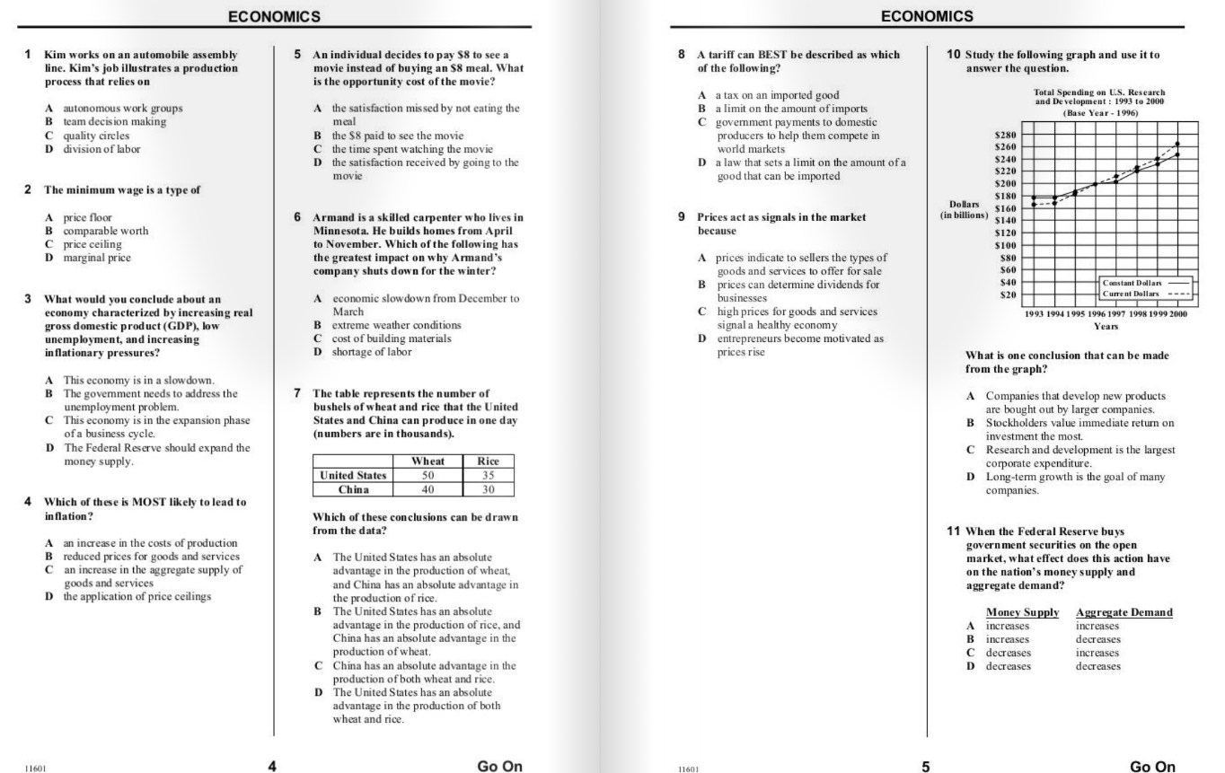
Paper/Pencil
Multiple items on page
Transfer of responses to answer document

Slide 6
Online
Zoom available for all students
Calculators and reference documents
Interactive supports
Different item types
One test item per page

Slide 7
Online Tools All Students
TOOL | ICON | CONTENT AREA
Periodic Table |  | EOG and EOC Science
Reference/Formula Sheet |  | EOG and EOC Math, EOC Science
Highlighter |  | ALL
Sticky Note |  | ALL
Flag |  | ALL
Line Guide |  | ALL
Online Calculator |  | Grades 6–8 and EOC Mathematics; EOC Science; EOC Economics
Graphing Tool |  | EOC Mathematics only
Cross-off Tool |  | ALL

Slide 8
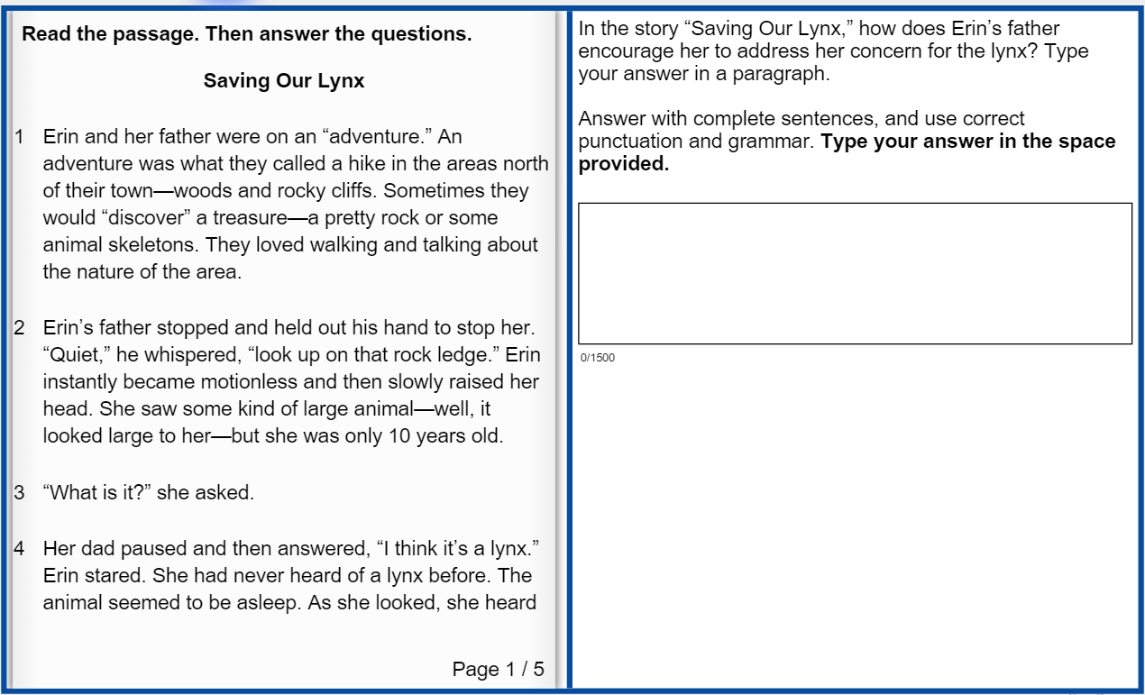
ELA Section 1 Online Item 4, 2 point Constructed Response
ELA Section 1, Reading and Evidence-Based Writing
Online Test Takers
The left side of the screen with the Reading Passage and the right side of the screen with the test items and Writing Task function independently.
Students can refer to either passage or Writing Task while typing a response.
Shortcut keys for Text Entry Boxes
Ctrl + C = Copy
Ctrl + X = Cut
Ctrl + V = Paste

Slide 9
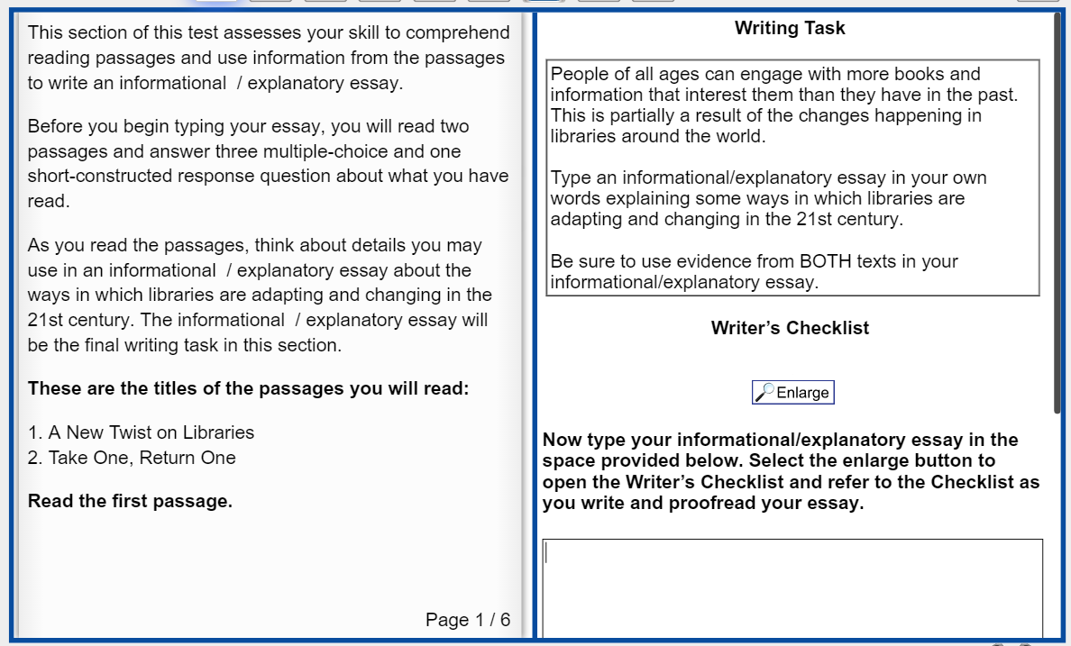
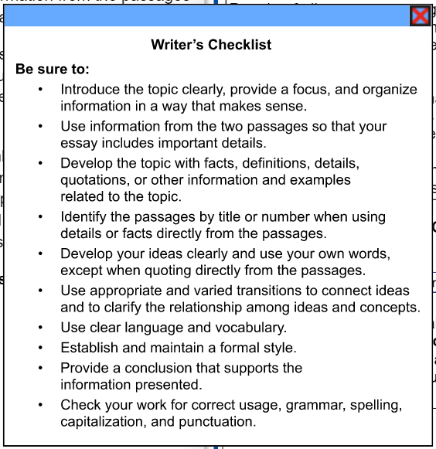
ELA Section 1, Reading and Evidence-Based Writing - Item 5
The Extended Writing Task is displayed on right side of the screen.
Turning pages requires clicking on the left or right side of the Reading Passage
Top of response field displays at bottom of screen

Slide 10
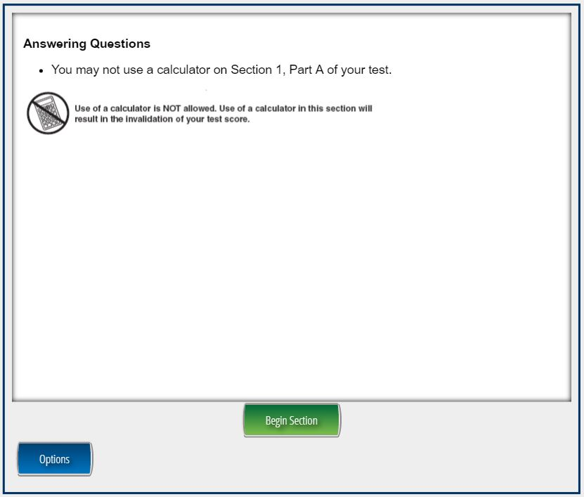
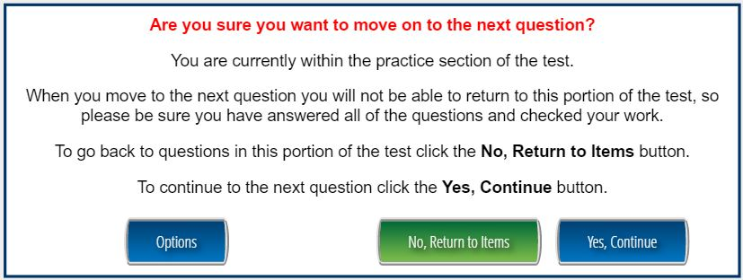
Mathematics Section 1, Part A, Online
The Examiner’s Manual will identify the item numbers that comprise the Section 1, Part A.
The section is preceded by instructions indicating that calculator use is not allowed in this section.
At the end of the section, the student will be stopped before proceeding to the calculator use section.

Slide 11
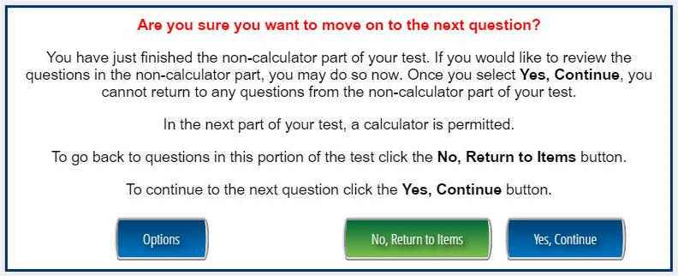
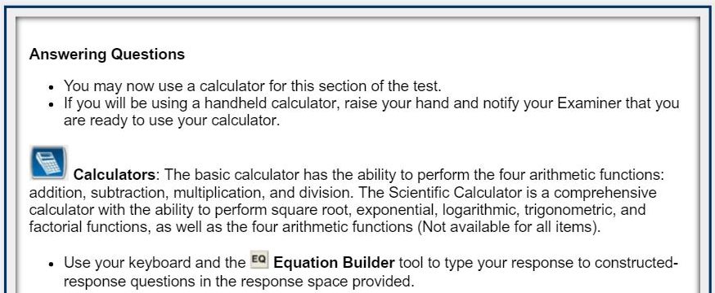
Mathematics EOG – Grades 6-8
Transition to Section 1, Part B

Slide 12
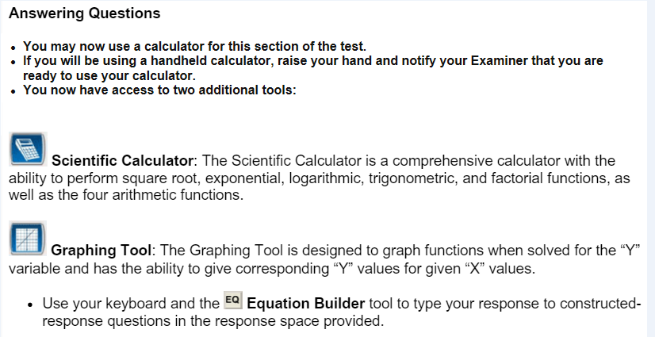
Mathematics EOC
Transition to Section 1, Part B

Slide 13
ACCESS Online
Sample items: https://wbte.drcedirect.com/WIDA/portals/wida

Slide 14
ACCESS Online Listening

Slide 15
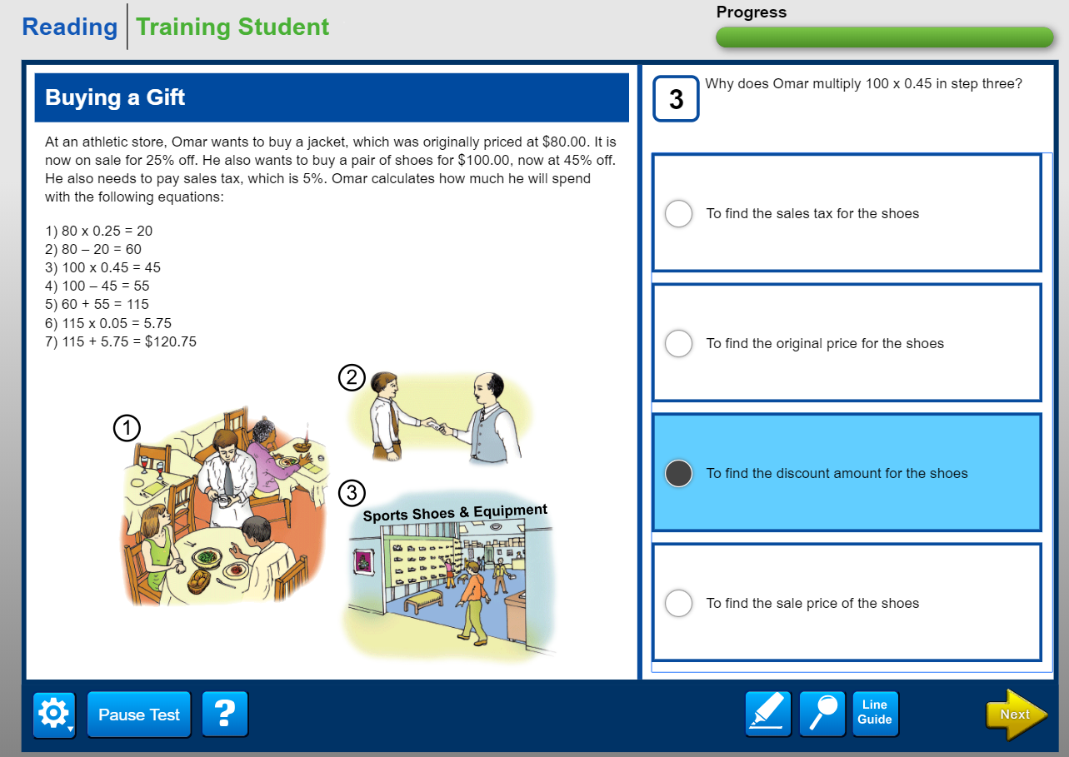
ACCESS Online Reading

Slide 16
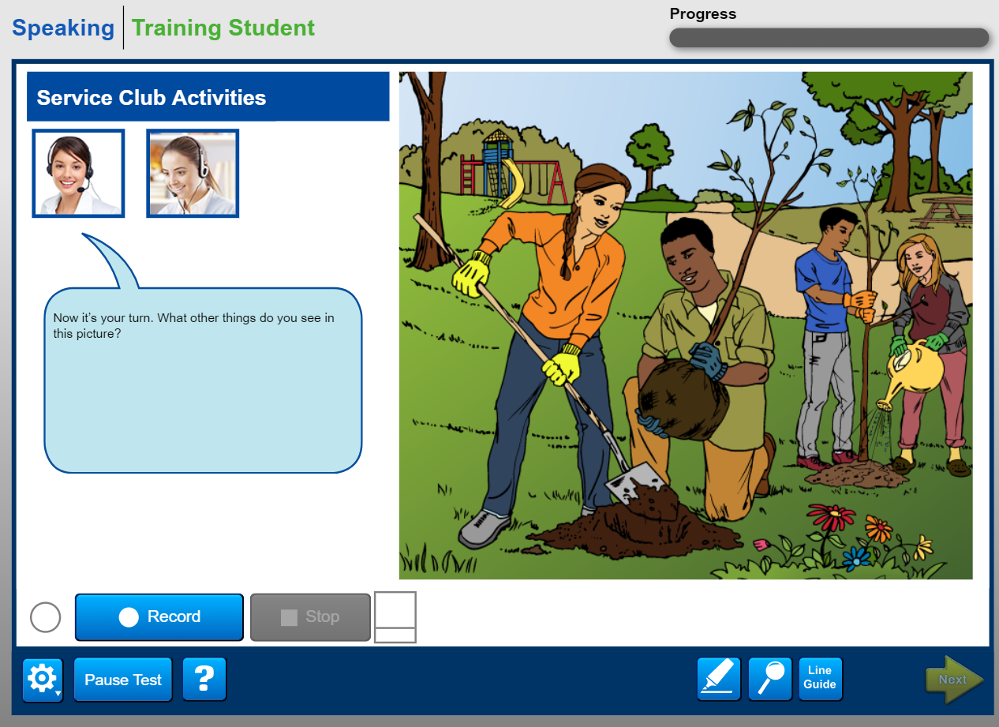
ACCESS Online Speaking

Slide 17
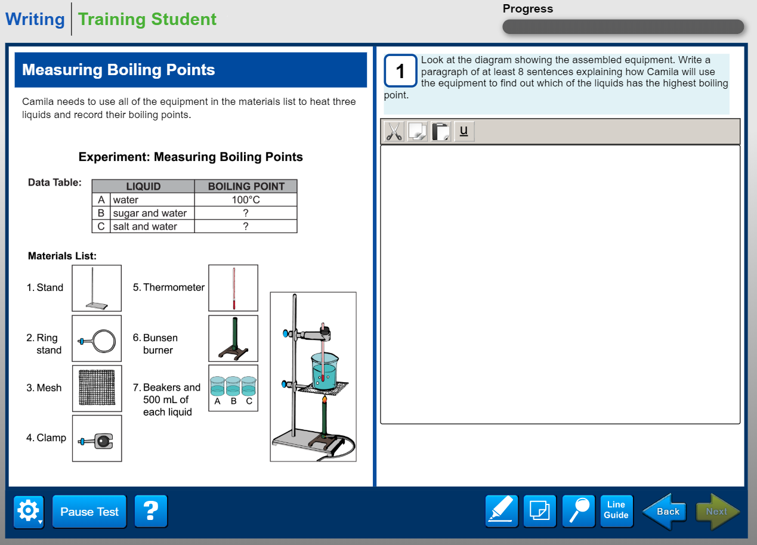
ACCESS Online Writing

Slide 18
Keenville
Notes:
In the town of Keenville, a fun, whimsical place that will engage students with exciting challenges and provide teachers with real-time feedback.

Slide 19
Keenville
Notes:
Upon entering the game, students are introduced to the game features. They will proceed through a tutorial that is not scored and will be able to experience the features without risk of incorrect responses.
You can see in the examples provided, that students are given step by step instructions. The last picture shows positive feedback for following instructions well and getting the correct answer.

Slide 20
Path for Successful Online Assessments
District Needs
History
Technology
Training
Administration

Slide 21
District Needs
District Needs
History
Technology
Training
Administration

Slide 22
Georgia Online Assessment Overview
Assessment | Vendor | Management System | Local Content Caching | Response Source
ACCESS for ELLs 2.0 | WIDA/DRC | AMS | Central Office Services* | Student login to INSIGHT*
Georgia Milestones | DRC | eDIRECT | Central Office Services* | Student login to INSIGHT*
Georgia Alternate Assessment 2.0 | Questar | Nextera | None | Teacher through website
GKIDS | Georgia Center for Assessment | GKIDS Data Entry and Reporting Website | None | Teacher through website
NAEP | NCES | None | None | Student login
Keenville | Georgia Center for Assessment | SLDS | None | Student login
*Software installation required

Slide 23
State Testing Windows
Assessment | Testing Window | Population
ACCESS for ELLs 2.0 | 1/16/2019-3/8/2019 | EL Students
Georgia Milestones EOC | 4/22/2019-5/31/2019 plus mid-months and summer admins | All Students in Specific Courses
Georgia Milestones EOG | 4/8/2019-5/17/2019 plus retest | All Students Grades 3-8
Georgia Alternate Assessment 2.0 | 3/25/2019-5/3/2019 | 1% of Georgia Milestones Students
GKIDS | 7/9/2018-5/13/2019 | Kindergarten Students
NAEP | 1/28/2019-3/8/2019 | Selected Schools and Students
Keenville | All Year | 1-2 Students

Slide 24
Dividing the Work
System Test Coordinator | Technology Coordinator | Student Information Coordinator
Develop and communicate the system testing calendar Provide test management and administration training Coordinate adding local user profiles to the test management system | Verify infrastructure utilized for testing meets minimum requirements Install, configure, and update software | Verify student information is correct and up to date Coordinate providing student demographic information for loading into test management systems

Slide 25
Getting Ready for GKIDS & Readiness Check
System Test Coordinator | Technology Coordinator | Student Information Coordinator
Provide test management and administration training Coordinate adding local user and student profiles to the test management system Coordinate local student assessment entry timelines Verify mid-year and year-end entry of student assessment data | Verify teachers workstations can successfully access GKIDS Data Entry and Reporting Website Coordinate with System Test Coordinator a process to verify testing infrastructure functions correctly | Verify student information is correct and up to date Coordinate creating the Student Roster File for upload through the GKIDS website.

Slide 26
Getting Ready for Keenville
System Test Coordinator | Technology Coordinator | Student Information Coordinator
Develop a district Keenville administration plan Verify with district SLDS Coordinator that the Student/Class file is being transmitted Coordinate with Technology Coordinator that teachers and students have access to the local student information system and SLDS | Review technical requirements for Keenville and verify student workstation meet requirements Verify the Internet is accessible in sites where students will access Keenville Coordinate transmission of the Student/Class file | Verify student information is correct and current Coordinate transmission of Student/Class file

Slide 27
Getting Ready for NAEP
System Test Coordinator | Technology Coordinator | Student Information Coordinator
Act as a liaison between the NAEP assessment team and the school test coordinators | No local technology involvement needed; student testing devices provided by NAEP test administrator | No local input needed; student information provided by GaDOE technology group

Slide 28
Getting Ready for the Georgia Alternate Assessment 2.0
System Test Coordinator | Technology Coordinator | Student Information Coordinator
Develop and communicate the system testing strategy Provide test management and administration training Coordinate adding local user and student profiles to the test management system | Verify teachers workstations can successfully access the GAA 2.0 teacher input platform Coordinate with System Test Coordinator a process to verify testing infrastructure functions correctly | Verify student information is correct and up to date Coordinate providing student demographic information for loading into the GAA test management system

Slide 29
Georgia Milestones and ACCESS for ELLs 2.0 Online

Slide 30
History 2017-2018 Recap
District Needs
History
Technology
Training
Administration

Slide 31
Georgia Milestones Online Testing

Slide 32
Total tests taken online Spring 2018 (EOC and EOG)
EOC and EOG by Test
 | Total | Online | Paper | % Online
EOC | 768,827 | 761,489 | 7,338 | 99%
EOG | 2,139,858 | 1,767,408 | 372,450 | 83%
Totals | 2,908,685 | 2,528,987 | 379,788 | 87%
EOC by Test and EOG by Student
Total Tested | Online Tested | Paper Tested
1,570,750 | 1,415,333 | 155,417
 | 90% | 10%

Slide 33
EOG and EOC Online Tests completed by Week Spring 2018

Slide 34
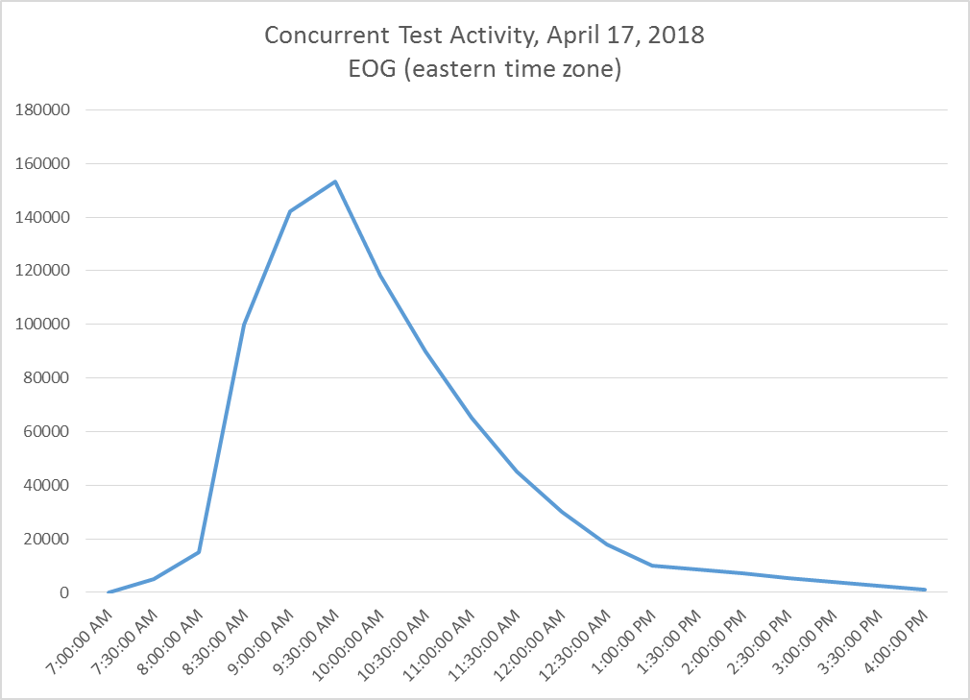
Concurrent Test Activity, April 17, 2018 EOG Spring 2018

Slide 35
OS Breakdown 2017-18 EOG and EOC Spring

Slide 36
Getting Ready for Milestones and ACCESS for ELLs 2.0
System Test Coordinator | Technology Coordinator | Student Information Coordinator
Develop and communicate the system testing calendar Provide test management and administration training Coordinate adding local user profiles into eDIRECT or AMS Coordinate setting up student test sessions in eDIRECT Establish a process to verify testing infrastructure functions correctly | Install and configure Central Office Services for content management Install and configure INSIGHT on student testing devices Coordinate with System Test Coordinator a process to verify testing infrastructure functions correctly | Verify student information is correct and up to date Coordinate providing student demographic information to Data Collections during the Pre-ID transmission window

Slide 37
Lets Get Started
Determine District Needs
Update Bandwidth
Familiarize Students with Test Format
Implement Secure Practice Test
Reevaluate System Setup
Review System Requirements
Purchase Machines

Slide 38
Technology
District Needs
History
Technology
Training
Administration
Hardware
Firewall
Central Office Services
Bandwidth

Slide 39
Testing and the Hardware Puzzle
Labs
Laptops
Peripherals
Tablets
Servers
One-to-One

Slide 40
Central Office Services (COS)

Slide 41
Benefits of COS Service Devices
Creating separate features, referred to as Content Management and Content Hosting, allows for additional flexibility.
Download only the content appropriate for a specific testing site.
Download content once for use by multiple COS Service Devices.
More testing devices supported per service device without manipulating settings on machine
500 testing devices per TSM
900+ testing devices per COS Service Device
All configuration and management of COS Service Devices completed in the COS-DTK page in eDIRECT
Ability to manage multiple testing programs on a single device.
Can support Georgia Milestones and WIDA ACCESS on the same device
Supports silent installations.

Slide 42
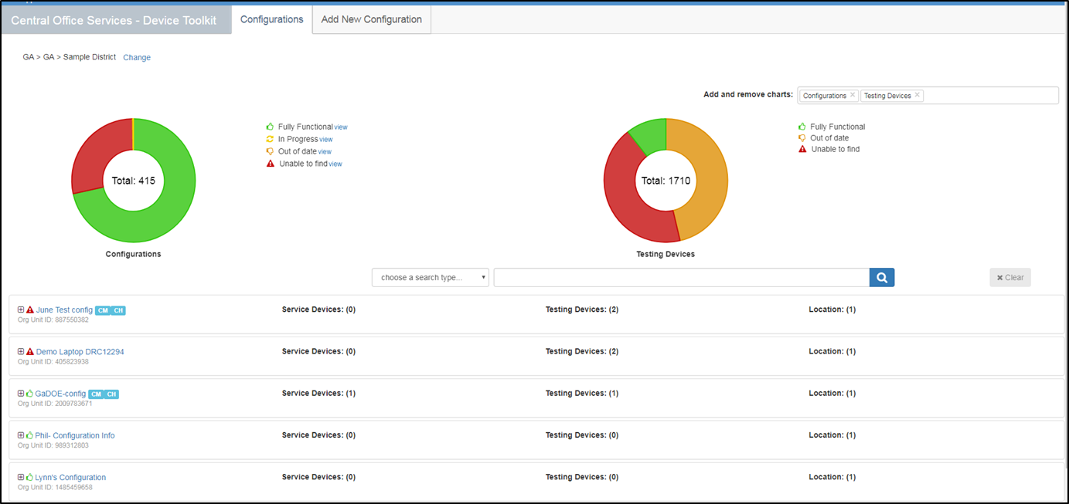
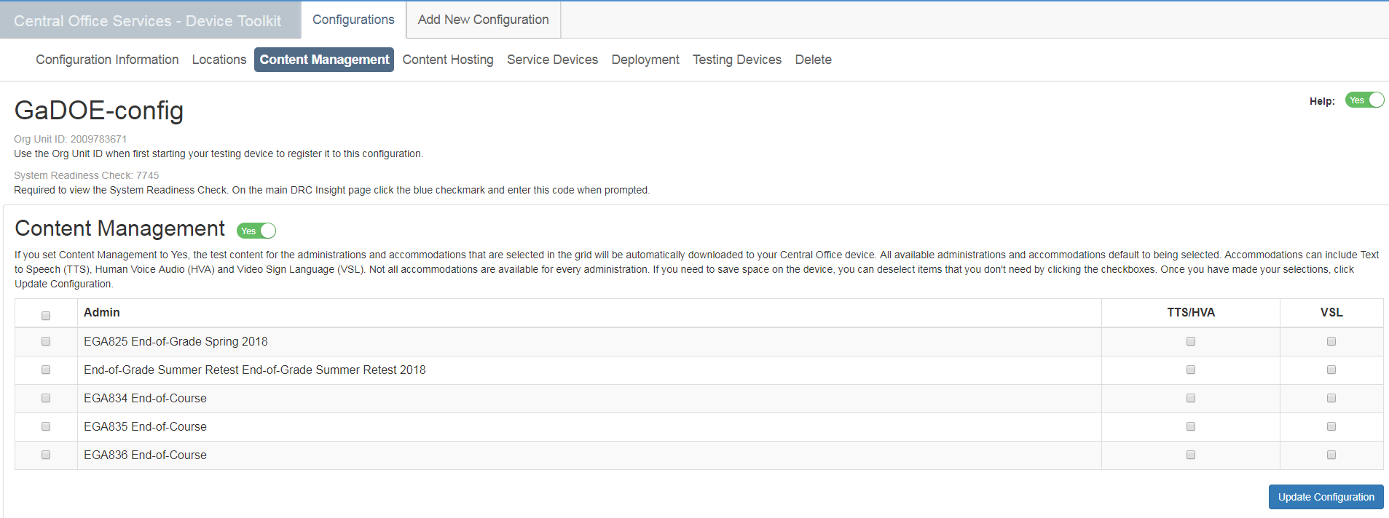
COS-DTK Dashboard

Slide 43
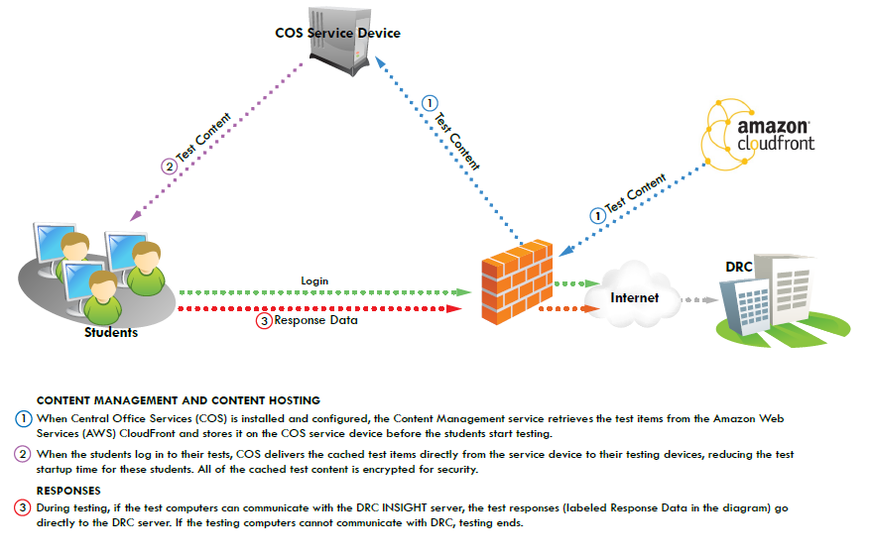
COS Service Device

Slide 44
Wireless Considerations
If the site is using wireless connectivity, complete a wireless site survey to assess sufficient wireless coverage in testing areas. The areas to review in this survey include:
Device Density
Radio Frequency Interference
Connection Consistency
2.4 GHz vs. 5 GHz Bands

Slide 45
Network Considerations
Connection and bandwidth requirements are greatest at the beginning of the test .
Are the firewall and filters on the computer network configured correctly?
Verify that there is available capacity for the number of students taking the test at the same time.
Take into account competing network bandwidth.
Estimated available bandwidth needed from testing client to COS Service Device
Up to 450 Concurrent Testers: 200 Mb
Up to 900 Concurrent Testers: 400 Mb
Over 900 Concurrent Testers: 800 Mb
Consider using traffic shaping to give DRC INSIGHT testing traffic priority over other network traffic

Slide 46
Administration
District Needs
History
Technology
Training
Administration
Scheduling
Testing

Slide 47
Spring/Summer Testing Overlap
Spring 2019 GAA 2.0
Spring 2019 EOG
Spring 2019 EOC
Summer Retest 2019 EOG
Nov 7
Summer 2019 EOC
Dec 20
6 days
Today
2019
February
March
April
May
June
July
August
2019
18 days
24 days
16 days
Spring 2019 GAA 2.0
March 25 – May 3, 2019
25 days
Spring 2019 EOG
April 8 – May 17, 2019
Spring 2019 EOC
April 22 – May 31, 2019
Summer Retest 2019 EOG
May 13 – July 19, 2019
Summer 2019 EOC
June 17 – July 19, 2019

Slide 48
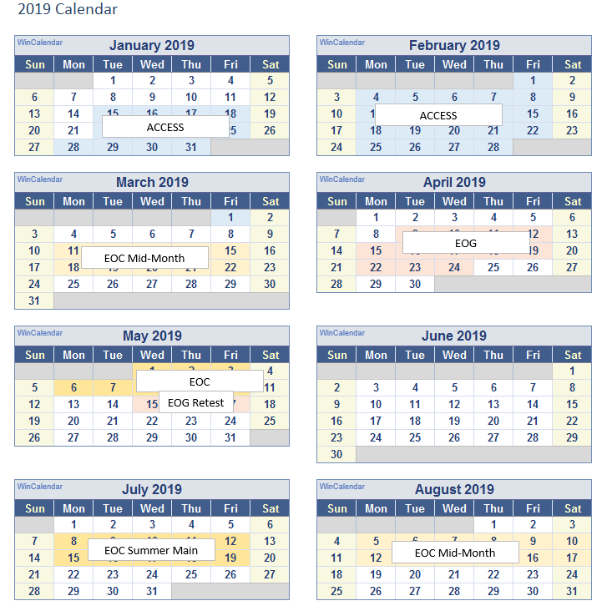
Sample District Schedule

Slide 49
Georgia Milestones EOG Scheduling Flexibility
The local testing calendar can encompass the entire state testing window.
The system sets the order of administration for EOG grade level content. Each grade level can be scheduled independent of other grades.
The local calendar can be scheduled around spring break; however, if a grade-level content test starts before spring break, it must be completed before spring break.
*See the Student Assessment Handbook for additional details.

Slide 50
Georgia Milestones EOG Scheduling Flexibility Example
 | Monday | Tuesday | Wednesday | Thursday | Friday
April 8-12 | ELA 3, 5, 8 | ELA 3, 5, 8 | Math 3, 5, 8 | Makeup
April 15-19 | ELA 4, 6, 7 | ELA 4, 6, 7 | Math 4, 6, 7 | Makeup
April 22-26
April 29-May 3
May 6-10 |  |  | Science 5, 8 | Social Studies 5, 8 | Makeup
May 13-17
*EOG Retest window starts May 13

Slide 51
Georgia Milestones EOG Scheduling Flexibility Example
 | Monday | Tuesday | Wednesday | Thursday | Friday
April 8-12 | Math Section 1 | Math Section 2 | Makeup
April 15-19 | ELA Section 1 | ELA Section 2 | ELA Section 3 | Makeup
April 22-26
April 29-May 3 | Social Studies Section 1 | Social Studies Section 2 | Makeup
May 6-10 | Science Section 1 | Science Section 2 | Makeup
May 13-17
Spring Break
*EOG Retest window starts May 13

Slide 52
Training
District Needs
History
Technology
Training
Administration
Student Training
Teacher Training

Slide 53
Test Practice for Online Administrations
Secure Practice Test
Tickets found in pdf format in General Information of eDIRECT
Test taken through INSIGHT platform
Online calculator and equation builder
Available year-round
Practice Test with Response Transmission
Students scheduled and tests printed through Test Administration of eDIRECT
Test taken through INSIGHT platform
Online calculator and equation builder
Responses are sent
Available through April 6.
Experience Online Testing Georgia
No tickets needed
Test taken online at www.gaexperienceonline.com
Students, parents and teachers can all access this website
Sample of Section One ELA is presented
Online calculator and equation builder
Available year-round from anywhere on the web

Slide 54
COS Service Device
Response Data is only checked through Secure Practice Test with Response Transmission

Slide 55
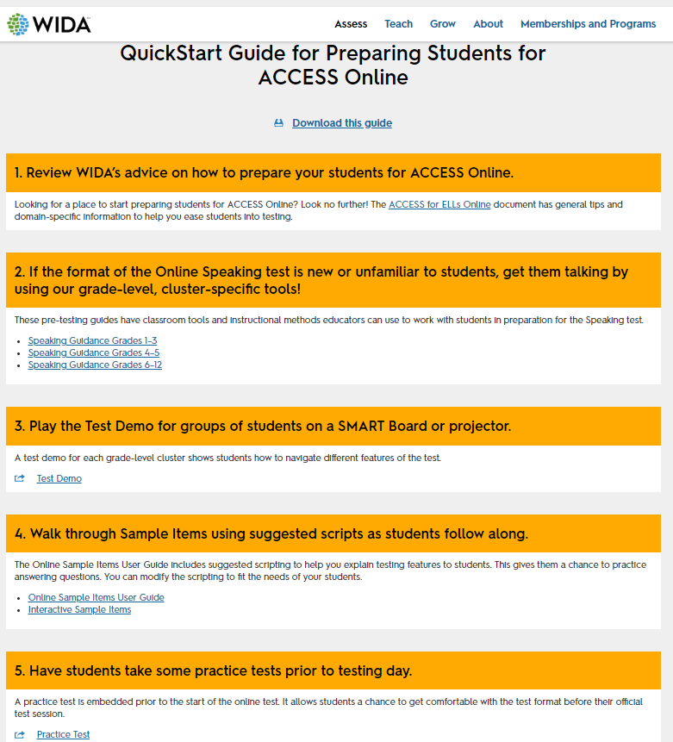
Preparing for ACCESS https://wida.wisc.edu/assess/access/preparing-students

Slide 56
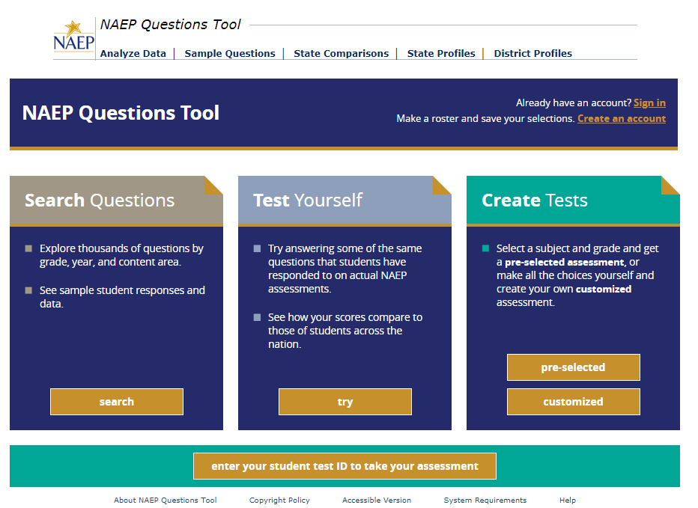
Preparing for NAEP https://nces.ed.gov/nationsreportcard/nqt

Slide 57
Contact Information
DRC Customer Service Team
Phone: (866) 282-2249
Email: GAHelpDesk@datarecognitioncorp.com
Hours: 7 am to 8 pm (Eastern)
Georgia Department of Education
Director of Assessment
Sandy Greene (404) 656-0478; sgreene@doe.k12.ga.us
Assessment Specialists (by district assignment)
Joe Blessing (404) 232-1208; jblessing@doe.k12.ga.us
Robert McLeod (404) 656-2589; rmcleod@doe.k12.ga.us

