Slide 1
CCRPI Overview and FAQs
Joint Session of the Senate and House Education Committees
January 10, 2017

Slide 2
CCRPI Overview
College and Career Ready Performance Index (CCRPI)
Georgia’s tool for annually measuring how well schools, districts, and the state are preparing students for college and careers
Provides a comprehensive roadmap to help educators, parents, and community members promote and improve college and career readiness for all students
Created under Georgia’s Elementary and Secondary Education Act (ESEA) Flexibility Waiver as an alternative to No Child Left Behind’s Adequate Yearly Progress (AYP)
Designed to include multiple indicators in order to provide a more comprehensive picture of school and district performance

Slide 3
CCRPI Components
Four main components, encompassing multiple indicators, are combined for a total CCRPI score on a scale of 0 to 100, with a possibility of 10 additional points
Achievement
Progress
Achievement Gap
Challenge Points
Informational components
Performance Flags
School Climate Star Rating
Financial Efficiency Star Rating

Slide 4
CCRPI FAQs
Why is CCRPI so complex?
Schools, districts, and other stakeholders desired a more comprehensive accountability system, including multiple indicators, than AYP’s all-or-nothing system with a narrow focus on test scores.
Significant feedback was sought during the development process. The final product included multiple indicators – both main and “extra credit” indicators – requested by districts and other stakeholders.
In order to calculate CCRPI, data is used from 8 sources (38 data collections elements and 40 data files) and 5 additional data collection applications.

Slide 5
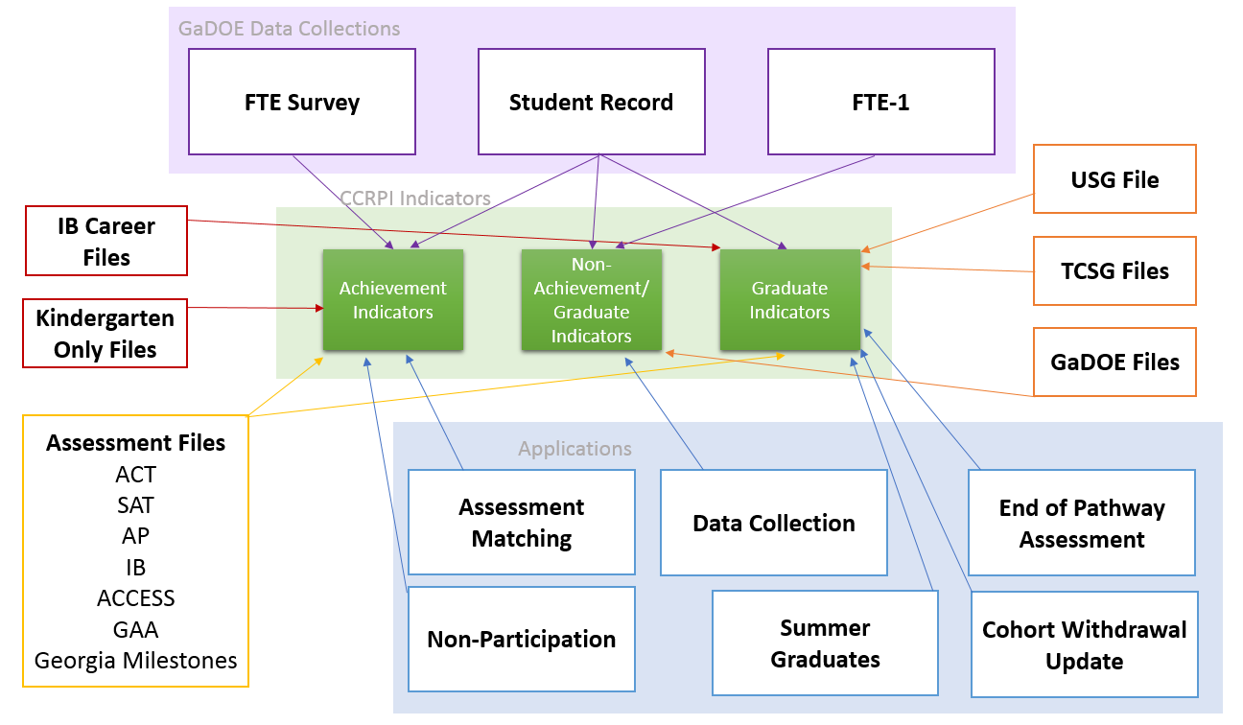
CCRPI Data Sources

Slide 6
CCRPI FAQs
Is there a plan to simplify CCRPI?
Yes! The Every Student Succeeds Act (ESSA) provides Georgia with an opportunity to review four years of CCRPI implementation and make improvements.
The GaDOE has collected significant stakeholder feedback on CCRPI through a survey of school and district leaders; 8 public feedback sessions; and a publicly-available feedback survey. Additional sessions were held with various stakeholder groups.
An ESSA Accountability Working Committee, comprised of school and district leaders as well as other stakeholders, has been working to make recommendations for improving CCRPI.

Slide 7
CCRPI FAQs
What will CCRPI look like under ESSA?
CCRPI will be simplified. It will include fewer indicators, be organized into more streamlined components, and utilize more straightforward calculations that are easier to communicate to the public.
CCRPI will focus on universal goals and outcomes instead of encouraging specific programs. This retains local flexibility to implement the programs and policies important to local communities that will lead to improved opportunities and outcomes for their students.
Goals and targets will be clearer and more attainable. They will be aligned with flexibility contract goals to the extent possible.
A new reporting system will be developed that is more visually pleasing and easier to navigate, communicate, and use for comparative and improvement purposes.

Slide 8
CCRPI FAQs
Is there any flexibility to the adjusted cohort graduation rate calculation?
Federal law and associated regulations require states calculate an adjusted cohort graduation rate and use it in their accountability systems.
Students who graduate with a regular high school diploma can count in the numerator of the graduation rate.
Students who can be removed from a cohort include those who: transfer to another school/program that will lead to a regular diploma, emigrate to another country, transfer to a prison/juvenile facility and enroll in a program that will lead to a regular diploma, or are deceased. All other students, including unknowns, may not be removed from the cohort.
Written documentation is required to support the use of withdrawal codes.
The GaDOE is exploring if there is any additional flexibility under ESSA.

Slide 9
CCRPI FAQs
Why does CCRPI change so often?
2012 was the pilot year for CCRPI. After it was released, feedback was received and, in coordination with GOSA, changes were made and the 2012 CCRPI was recalculated. That calculation remained in place through 2014.
In 2015, the implementation of a new assessment system – Georgia Milestones – required modifications to CCRPI.
Some changes, such as indicators moving from “extra credit” to main indicators, had been communicated since CCRPI’s inception and were implemented as planned. Such indicators were phased in over time to 1) provide districts with the opportunity to prepare and 2) establish data collection procedures.
Remaining changes are due to outside influences. For example, Senate Bill 364, which reduced science and social studies testing, required changes to the 2017 CCRPI.
The implementation of ESSA will require additional changes for 2018.

Slide 10
CCRPI FAQs
Why are CCRPI scores released so late?
CCRPI calculations depend on the multiple data sources previously identified. All of the data necessary to calculate the current CCRPI are not available until early October.
The two major dependencies are assessment data and graduation rate data with their related activities.
Statewide assessment files are received in mid-summer, at which point they are matched to student enrollment records. Districts then have an opportunity to complete matches, correct matches, and provide non-participation reasons.
Summer graduates are collected at the end of summer. Additionally, districts have an opportunity to update cohort withdrawal reasons. This information is used in graduation rate calculations. The number of graduates is also used as the basis for additional high school indicators.

Slide 11
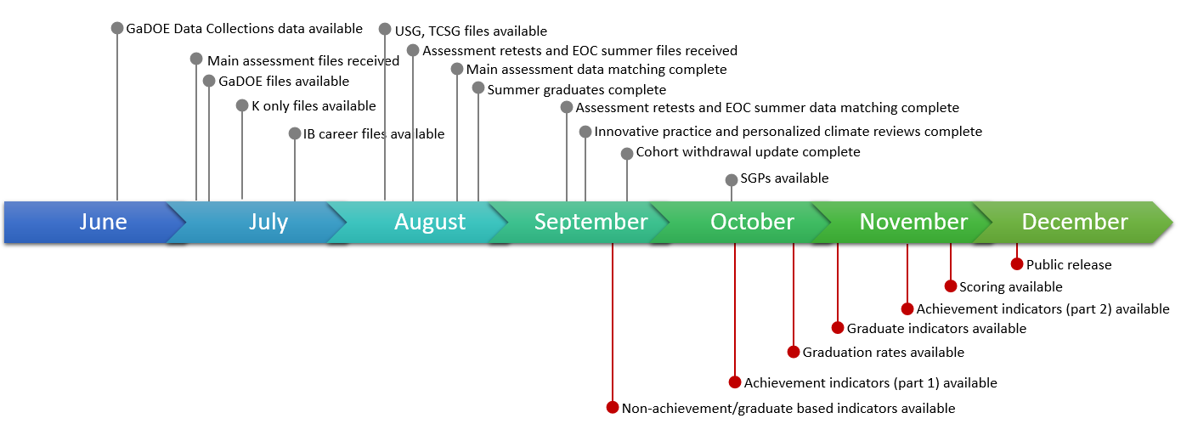
2016 CCRPI Timeline
Note: Changes planned for 2017 and 2018 can improve this timeline.

Slide 12
CCRPI FAQs
What is being done to improve the CCRPI timeline?
Calculate a simplified CCRPI under ESSA, beginning in 2018
This will 1) reduce the calculation and verification time and 2) reduce the amount of data districts must provide.
Streamline and modify the timeline for data collection applications
This will 1) provide districts with more time to complete the applications, 2) simplify the data collection process, and 3) provide all necessary data earlier.
Calculate some indicators in real-time with data collection applications
This will 1) improve data quality, 2) decrease correction requests, and 3) complete some calculations earlier.
The GaDOE is exploring these options and plans to start implementing some of them in 2017. More information will be communicated to districts as soon as it is available.

Slide 13
CCRPI FAQs
What are additional barriers to releasing CCRPI earlier?
Georgia Milestones retest scores and summer End of Course (EOC) scores
Achievement indicators cannot be calculated (and, subsequently, student growth cannot be calculated) until all statewide assessment files have been received, matched to student enrollment records, and districts have completed the Assessment Matching and Non-Participation applications.
For main assessments, this process is complete in mid-August. For retests and summer EOCs, this process is complete in mid-September.
Utilizing retest scores and summer EOC scores adds one month to the CCRPI timeline.

Slide 14
CCRPI FAQs
What are additional barriers to releasing CCRPI earlier?
Using summer graduates in graduation rates
Information on summer graduates is not available until the end of August. Districts then provide updated cohort withdrawal information, enabling graduation rates to be calculated beginning in October.
In 2016, there were 2,358 summer graduates. Eliminating summer graduates would reduce the 2016 state graduation rate from 79.4% to 77.6%.
Instead of eliminating the use of summer graduates, the data collection process could be modified to enable all necessary data (summer graduates and updated withdrawal reasons) to be collected by the end of August. Graduation rates could be available shortly thereafter.

Slide 15
CCRPI FAQs
What are additional barriers to releasing CCRPI earlier?
Correction requests
Districts submit data to the GaDOE through a year-long data collections process. There are multiple opportunities for districts to review the data submitted before the district superintendent certifies that the data are accurate in June. Historically, the GaDOE has received numerous requests for data corrections once CCRPI has been calculated.
Accepting and processing data corrections delays reporting to districts and the public.

Slide 16
Conclusion
Despite its challenges, CCRPI has been an improvement over Adequate Yearly Progress (AYP).
CCRPI goes beyond proficiency rates, to include information on student growth, attendance, career education, coursework, pathway completion, school climate, and others – all of which can be used for school improvement.
ESSA provides an opportunity to review five years of CCRPI implementation and make needed improvements. District, school, and stakeholder feedback is a critical component of revisions to the CCRPI that are currently underway.
The goal is to calculate a simplified, streamlined CCRPI that provides an accurate picture of school and district performance and plays a supporting role in assisting schools, districts, and the state to reach their mission of offering a holistic education to every child and preparing them for college, career, and life.

