Slide 1
Overview of Georgia’s K-12 Student Assessment Program
State Charter School Commission Presentation
January 17, 2019
9 a.m. – 12 p.m.

Slide 2
Agenda
Introductions
Assessment Staff
State Charter Staff
Test Development
Assessment Administration Resources
Accommodations and Special Populations
Test Security
Assessment Overview
Accountability
Questions

Slide 3
Introductions

Slide 4
Test Development

Slide 5
Test Development Activities District Nominations
Each year, the GaDOE seeks nominations of highly-qualified educators to participate in various test development activities.
Memos emailed/posted yesterday (January 10) for both Georgia Milestones and Georgia Alternate Assessment (GAA) 2.0
Deadline for nominations: February 1
http://www.gadoe.org/Curriculum-Instruction-and-Assessment/Assessment/Pages/Memoranda--Announcements.aspx
Georgia Milestones
Rangefinding: June
Item & Data Review: July
Georgia Alternate Assessment (GAA) 2.0
Content & Bias Review: June
Standard Setting: July

Slide 6
Georgia Milestones Test Development Process
Test Planning and Specifications
Item Development
GaDOE
Reviews
Item Review
Field Testing
Rangefinding (Constructed-Response Items)
Handscoring (Constructed-Response Items)
Data Review
Operational
Testing
Standard Setting/
Validation

Slide 7
Test Development Activities Georgia Milestones
 | Content Area | Grade Levels/Courses | # of nominees requested
End of Grade | English Language Arts | 3, 4, 5, 6, 7, 8 | 4
 | Mathematics | 3, 4, 5, 6, 7, 8 | 4
 | Science | 5, 8 | 2
 | Social Studies | 5, 8 | 2
End of Course | English Language Arts | Ninth Grade Literature, American Literature | 4
 | Mathematics | Coordinate Algebra, Analytic Geometry, Algebra I, Geometry | 4
 | Science | Biology, Physical Science | 2
 | Social Studies | United States History, Economics | 2
Total |  |  | 24

Slide 8
Test Development Activities Georgia Alternate Assessment (GAA)
Content Area |  | Grade Levels/Courses | # of Special Education nominees requested | # of General Education nominees requested
English Language Arts |  | Kindergarten, 3, 4 | 2 | 1
 |  | 5, 6, 7
 |  | 8, High School
Mathematics |  | Kindergarten, 3, 4 | 2 | 1
 |  | 5, 6, 7
 |  | 8, High School
Science |  | 5, 8, High School | 1 | 1
Social Studies |  | 5, 8, High School | 1 | 1
Total |  |  | 6 | 4

Slide 9
Committee Selection Process
Educator Application & Availability Survey (February)
Initial Committee Invitations (late March – April)
Rolling schedule based on meeting dates
6-10 participants per grade/content area or course
Balanced representation
Gender
Ethnicity
Region
Experience
Special populations

Slide 10
Expense Reimbursement for Educator Meetings
Expenses paid directly (by testing contractor)
Hotel accommodations (participants 50+ miles from the meeting location)
Parking, if applicable
Breakfast, lunch, and snacks are provided at the meeting
Expenses reimbursed to participant (from testing contractor)
Dinner (reimbursed at current state rate) for those staying overnight
Mileage (reimbursed at current state rate)
Expenses reimbursed to school or district (from testing contractor)
Substitute teacher expense, if applicable
Participants are provided a reimbursement form to return to their school/district.
Participants are paid an honorarium if a meeting occurs during off-contract time (e.g. spring break, summer break, etc.)
Typically $125 per day
In lieu of substitute reimbursement

Slide 11
Assessment Administration Resources

Slide 12
DOE Notification of New Test Coordinators
Superintendent should email Sandra Greene identifying the new test coordinator. sgreene@doe.k12.ga.us
A new account will be created in eDIRECT for Georgia Milestones. Test Coordinator will receive login credentials via email.
District security officer assigns the Test Coordinator Charter School Administrator role in the MyGaDOE portal.
You will receive testing emails
Test Coordinator = System Test Coordinator = Assessment Director = Charter School Administrator (these are ALL the same role)

Slide 13
New Test Coordinators
Superintendent to email Sandra Greene at
sgreene@doe.k12.ga.us
Security Officer to assign Charter School Administrator role in the MyGaDOE portal
Milestones:
eDIRECT account is created
GKIDS:
Account is created
ACCESS 2.0: Wida.us account is created
eDIRECT account is created
Emails are sent from testing division
GAA 2.0: Nextera account is created

Slide 14
Links to Key Online Resources
Georgia Department of Education Webpage
Assessment Main Page
Accountability Main Page
Curriculum and Instruction
Special Education Services and Supports
MyGaDOE Portal Login

Slide 15
Test Coordinator Testing/Assessment Resources
Assessment Webinar memos posted at: www.gadoe.org/Assessment (then select For Educators...)

Slide 16
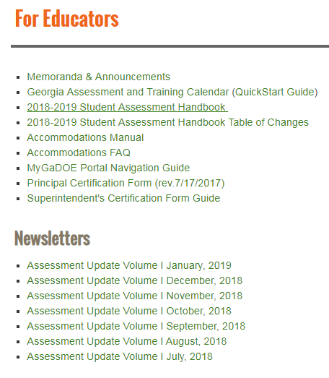
Program Management Guidance Resources

Slide 17
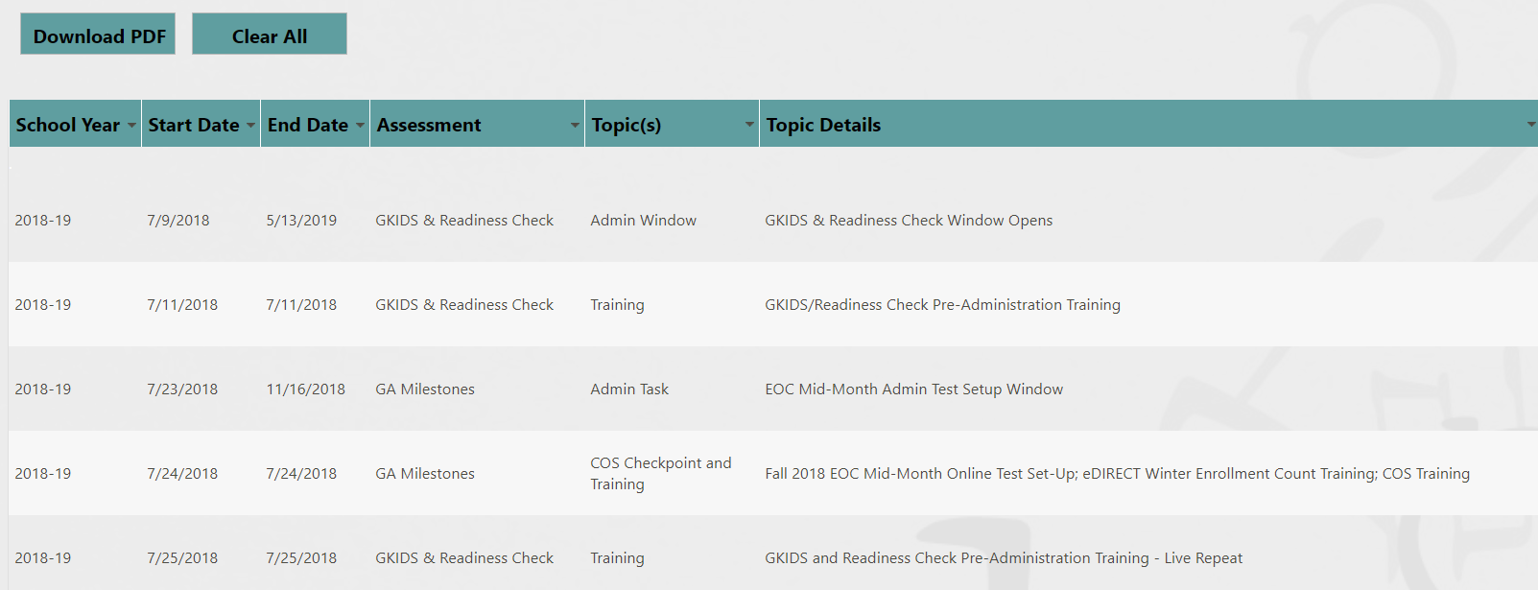
Georgia Assessment and Training Calendar

Slide 18
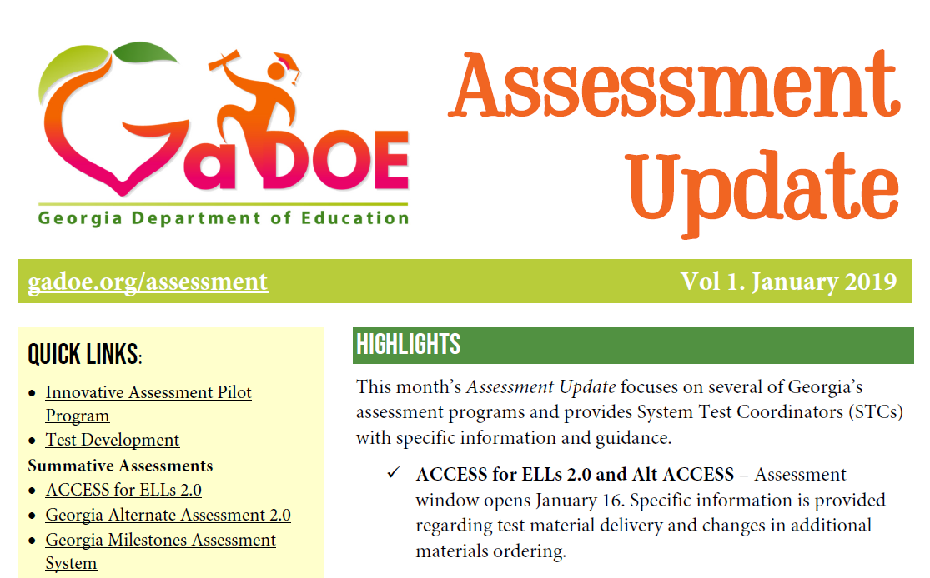
Assessment Update Newsletter
Provides monthly assessment updates
Provides training links and dates
Provides assessment tasks to remember
Provides accountability updates

Slide 19
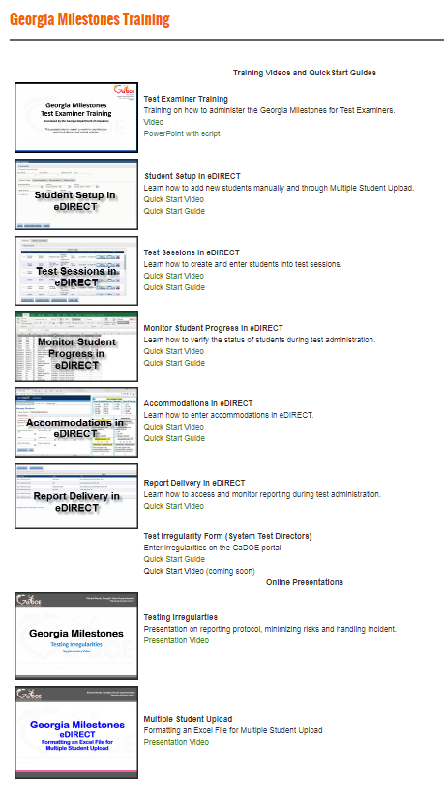
QuickStart Videos
and Guides
Test Examiner Training
Student Setup
Test Sessions
Monitor Student Progress
Accommodations
Report Delivery
Online Presentations
Test Examiner Training
Testing Irregularities
Multiple Student Upload
Can be found off the EOG Resources or EOC Resources pages.
http://www.gadoe.org/Curriculum-Instruction-and-Assessment/Assessment/Pages/Milestones_Training.aspx

Slide 20
MyGaDOE Login Page

Slide 21
MyGaDOE Portal
MyGaDOE Portal Welcome Page
Testing Irregularity Form
Superintendent’s Test Certification
Special Accommodation Request
Assessment Rescore Request

Slide 22
MyGaDOE Portal Online Forms https://portal.doe.k12.ga.us/login.aspx
Special Accommodations Request Form
Guidance appears in Student Assessment Handbook
Last year, this online form replaced the need to submit requests via email
IMPORTANT: Email/Call Taiesha Adams to notify GaDOE of request
Superintendent’s Certification Form
Sandy Greene is the point of contact
Tests administered January 1 – June 30: Submit no later than July 31
Tests administered July 1 – December 31: Submit no later than January 31
Assessment Rescore Request Form
IMPORTANT: Email/call appropriate GaDOE Assessment Specialist to discuss applicable fees and notify GaDOE of request
Also used for transcription requests
Testing Irregularity Form

Slide 23
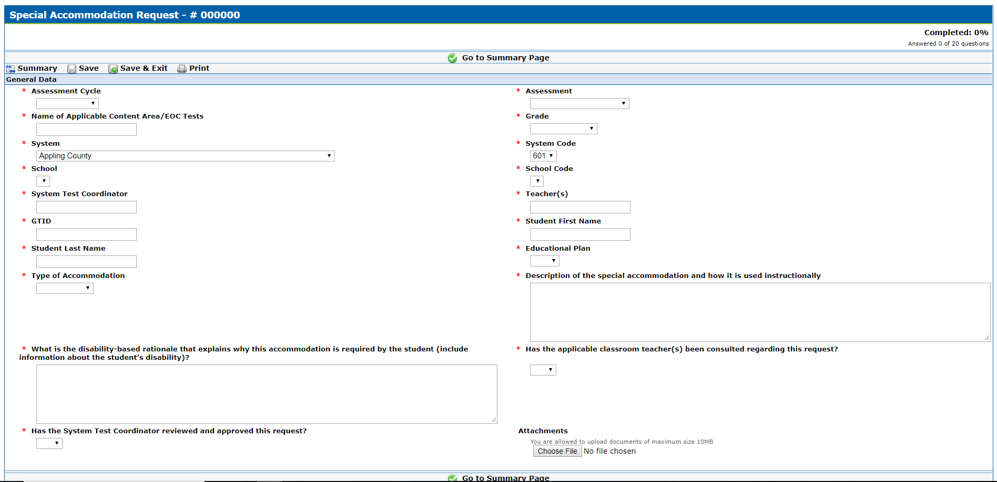
Entering Special Accommodation Request
All fields are required
From the Summary Page, you can:
Edit
Save & Exit
Submit for Approval
Delete Response
Be very descriptive! Clearly identify the accommodation being requested.
Upload any supporting documentation here (i.e. IEP, IAP/504 Plan)

Slide 24
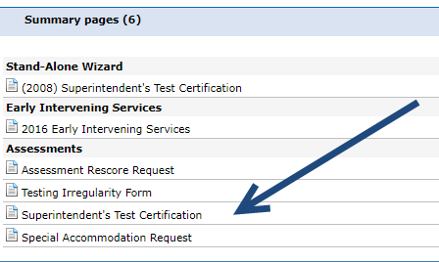
Entering the Superintendent Test Certification

Slide 25
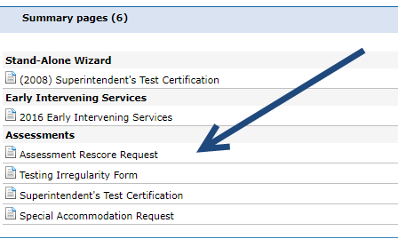
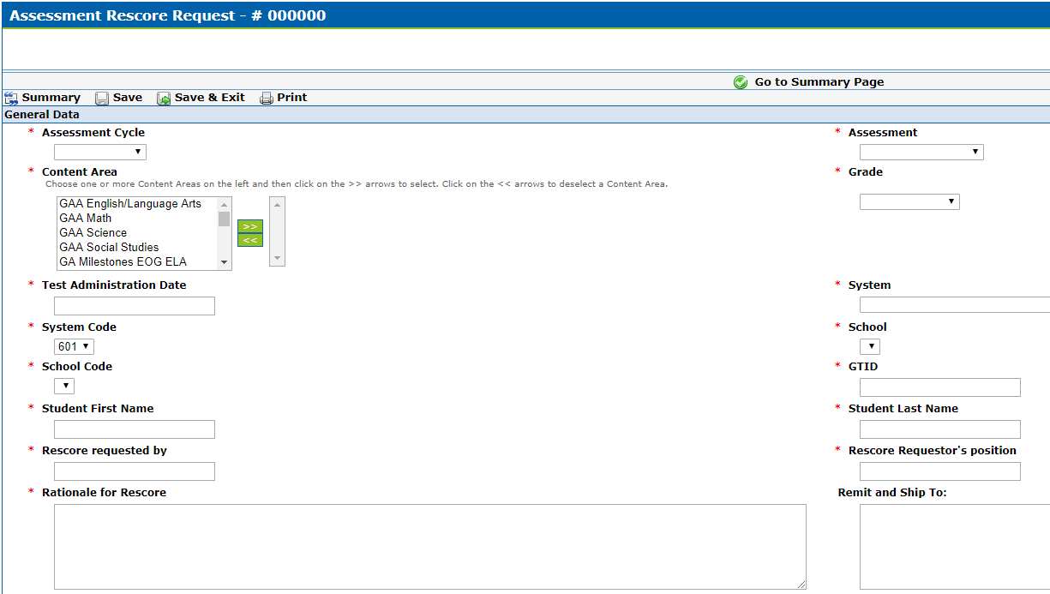
Entering the Assessment Rescore Request

Slide 26
Entering Irregularities into the MyGaDOE Portal
Testing Irregularity Form Summary Page
Refer to User Guide
Open for form review
Defaults to current active administration
Link to User Guide

Slide 27
MyGaDOE Portal & Contractor Accounts
Assessment | Vendor | When | Contact
MyGaDOE Portal | Georgia Department of Education https://portal.doe.k12.ga.us/login.aspx | ASAP | District Security Officer identified within the MyGaDOE Portal
ACCESS for ELLs 2.0 | WIDA (for WIDA.us) Data Recognition Corporation (DRC) (for the WIDA Assessment Management System, WIDA AMS) https://wida.wisc.edu/ https://wida.drcedirect.com | October 2017 | WIDA Customer Service (866) 276-7735 help@wida.us DRC Customer Service (855) 787-9615 WIDA@datarecognitioncorp.com
GAA 2.0 | Questar | Sent to STCs in October by Questar | Questar Customer Service GA@QuestarAI.com (866) 997-0698
GKIDS | Georgia Center for Assessment (GCA) https://gkids.tsars.uga.edu/start | ASAP | Georgia Center for Assessment (GCA) (888) 392-8977
Georgia Milestones | Data Recognition Corporation (DRC) https://ga.drcedirect.com | ASAP | Data Recognition Corporation (DRC) (866) 282-2249 gahelpdesk@datarecognitioncorp.com

Slide 28
Accommodations and Special Populations

Slide 29
Accommodations
Accommodations allow access…
they are practices and procedures in the areas of presentation, response, setting, and scheduling that provide equitable instructional and assessment access for students with disabilities
Accommodations reduce or eliminate the effects of a student’s disability or limited English proficiency
Accommodations provide access for demonstration of achievement
Do not guarantee proficiency
and therefore should not be selected solely as mean to help ensure proficiency

Slide 30
Accommodations
Students eligible for accommodations include:
Students with Disabilities
Students with Individualized Educational Programs (IEP)
Students served under Section 504
Only in the rarest of circumstances would a 504 student qualify for a conditional accommodation
English Learners
Students qualifying for language assistance services (ESOL)
EL students who are also SWD
Students who have exited language assistance services in the last two years (EL-Monitored). EL-M students are ineligible for conditional accommodations based on language proficiency

Slide 31
Accommodations – Test Administration
Accommodations must be required by the student in order to access the assessment
Accommodations must be provided during, and be informed by, routine instruction and assessment in the classroom (both before and after the state tests are administered)
Specifying testing mode (online or paper) is not a standard accommodation. Paper forms are available for those students who cannot access the online assessment due to their disability.

Slide 32
Planning for Accommodations
Know the test accommodations identified in students’ IEPs, IAPs, and EL/TPC plans allowed for each student as specified prior to the administration of all testing sessions.
Ensure that examiners are familiar with the proper way to deliver the necessary accommodations.
Make provision for administration of accommodations during testing (i.e. small groups, extended time, materials for visually impaired students, Word to Word (EL) Dictionary needs)
Accommodation errors should be reported as a testing irregularity.

Slide 33
Assessment Accommodations
Conditional Accommodations
Standard Accommodation
Universal Test Design
Standard Accommodations: Provide access to the assessment without altering the construct measured by the assessment.
Conditional Accommodations: Provide access for students with more severe disabilities who would not be able to access the assessment without such assistance.
Special Accommodations
Link to Accommodations Manual

Slide 34
Conditional Accommodations
These accommodations were never intended to be available for all students
The guidance is designed to protect the accommodations for students who truly require them
Anytime an accommodation is considered it is important to reflect what the test is designed to measure
The goal is meaningful (i.e., valid) measurement of student achievement
It is important to consider the long-term effects of inappropriate accommodation use
Accommodations should foster independence, not dependence

Slide 35
Break
10 Minutes

Slide 36
Test Security

Slide 37
Professional Ethics
In the pursuit of fair and ethical testing for all students and stakeholders, the following areas shall be addressed before, during, and after testing:
Test Security
Test Preparation
Test Administration
Test Data
Notes:
Test Security - Test materials shall be secured before, during, and after testing and scoring to ensure fair assessment of all students.
Test Preparation - The test should reflect the state-adopted content standards being taught, and should be developmentally appropriate for the age and level of the test-taker. Educators should be trained on proper administration procedures and testing practices. Tests should be administered in the appropriate environment.
Test Administration - Policies and procedures should be developed to implement fair and ethical testing procedures and practices. All eligible students should be assessed.
Test Data - Test scoring should be reliable and valid. Curriculum improvement should be guided by adequate data analyses.

Slide 38
Code of Ethics for Georgia Educators
Standard 10: Testing – An educator shall administer state-mandated assessments fairly and ethically.
Unethical conduct includes but is not limited to:
committing any act that breaches Test Security; and
Compromising the integrity of the assessment.
GaPSC Ethics Division: https://www.gapsc.com/Ethics/CodeOfEthics.aspx

Slide 39
Security Hierarchy
Superintendent
Test Examiner
Student
School Test Coordinator
Principal
System Test Coordinator (STC)

Slide 40
Roles and Responsibilities
Superintendent
Superintendent has ultimate responsibility for all testing activities within the local school system.
The System Test Coordinator shares this responsibility as the Superintendent’s designee.
Principal
Principal has ultimate responsibility for all testing activities within the school.
Detailed list of responsibilities in SAH

Slide 41
Roles and Responsibilities
System Test Coordinator (STC)
Acts as the point of contact between the system and GaDOE
Participates in all scheduled training provided by GaDOE Assessment Division
Develops and implements local test security and administration training plan
Coordinates ALL administration activity
Familiarizes self with the responsibilities of all other roles
Establishes local testing calendar in compliance with GaDOE guidance
Develops and implements plan for receipt, distribution, and return of secure materials
Obtains and maintains current user accounts in test management systems
Detailed list of responsibilities in SAH

Slide 42
Roles and Responsibilities
System Technology Coordinator
Acquires and maintains current information on the statewide testing program, including technology requirements for testing programs, training manuals, and testing schedules
Coordinates with the System Test Coordinator for the appropriate implementation of online assessment administrations
Attends or views GaDOE assessment technology trainings and webinars
Works with the System Test Coordinator to ensure that all schools have technology ready for online testing
Performs readiness checks and installation of software for the system and local testing devices
Detailed list of responsibilities in SAH.

Slide 43
Roles and Responsibilities
School Test Coordinator
Must hold a GaPSC-issued certificate (per Student Assessment Handbook)
Inventory and secure all test materials in a secure, locked location with restricted access and confirms access is restricted by accounting for keys
Materials distribution/return, signing out and signing in materials
Attend and then redeliver training
Plan for all aspects of the school’s test administration, monitor test administration environment
Collaborate effectively with local system colleagues who have a role in the success of your system’s testing program.
Detailed list of responsibilities in SAH

Slide 44
Roles and Responsibilities
Examiner
Must hold a GaPSC-issued certificate
Use of an uncertified examiner will result in invalidation.
Security/verification of test materials
Control of testing environment and active monitoring
Correct delivery of assigned accommodations
Follows procedures and directions for testing as given in Examiner’s Manuals
Reads script from the Examiner’s Manuals word-for-word as directed
Test materials are not to be used for any purpose other than test administration
Detailed list of responsibilities in SAH
Notes:
Certified educators (teachers, counselors, administrators, and paraprofessionals) must administer all state-mandated assessments. The term Certified Educator in this statement is defined as those educators directly involved with the instruction of students, and who must hold a clearance certificate as defined by the GaPSC.

Slide 45
Roles and Responsibilities
Proctor
Must be trained
With examiner supervision, ensures that students are managing test materials appropriately
Helps prepare test materials for distribution to students
Reports any unusual circumstances to Examiner immediately
Active monitoring
Detailed list of responsibilities in SAH

Slide 46
Training Plan
System Test Coordinators (STCs), in collaboration with System Technology Coordinators, must develop and implement a district plan regarding training and technology needs for each assessment program.
Maintain detailed attendance records with the name of each participant, responsibility, date of training, and name of assessment.
Develop a specific plan for implementing accommodations for identified students.

Slide 47
Student Assessment Handbook
Test Security Information | Where to find it
Security Breaches – Examples | Page 9
Testing Irregularities | Page 10
Security Procedures Test Administration Student Behavior | Page 11 Page 12 Page 12
Cell Phone/Electronic Device Use | Page 13
Distribution and Storage of Secure Test Materials | Page 18
Test Security Information for School Test Coordinators/Teachers/Examiners | Pages 20-22
Roles and Responsibilities | Pages 23-30
General Assessment Administration Guidance | Pages 70-80
Accommodations Guidelines | Pages 81-99

Slide 48
Common Irregularities & How to Avoid Them
Accommodations Error
Student did not receive read aloud accommodation
Student did not receive extended time accommodation
Examiner/Proctor Failure to Follow Instructions/Error
Examiner distributed test ticket to wrong student
Administered test out of order
Student Failure to Follow Instructions
Student accesses or has access to a cell phone or other electronic device, calculator, notes, study guide, etc.;
Student began test/another section before time or continued working after time was called

Slide 49
Assessment Overview

Slide 50
Assessment Philosophy
The primary purpose of schools is teaching and learning.
Assessment and accountability play a significant role, but importantly – that role is supporting, with the primary focus being teaching and learning.

Slide 51
Overview
Formative
GKIDS Readiness Check
GKIDS
Keenville
GOFAR
FIP
K
Summative
ACCESS for ELLs
GAA
Georgia Milestones EOG/EOC
12

Slide 52
Overview
Georgia Milestones
CRCT
EOCT
Georgia Writing Tests (3,5,8, HS)
GHSGT
Notes:
Historically, Georgia’s student assessment program consisted of a series of summative assessments.Georgia High School Graduation Tests, CRCT, EOCT, Writing Assessments (3, 5, 8, HS), etc.
With Georgia Milestones, an effort was made to build toward a comprehensive summative assessment program that communicates a similar signal of student performance across grade levels.
More recently, efforts are being made to develop and/or enhance the use of formative assessments to provide more timely feedback and to support instruction prior to the summative assessment system.

Slide 53
Innovative Assessment Pilot Program
In accordance with SB 362 which established Georgia’s innovative assessment pilot program, Georgia submitted its application for the federal Innovative Assessment Demonstration Authority (IADA) to the U.S. Department of Education (USED) in December 2018.
It is expected that USED will respond within 90 days of that submission.
The application and other information can be found on the Testing/Assessment webpage under the Assessment Innovation and Flexibility Resources link.

Slide 54
ACCESS
ACCESS for ELLs 2.0 measures the English language proficiency levels and progress of ELs in the domains of speaking, listening, reading, and writing.
Alternate ACCESS measures how EL students with significant cognitive disabilities develop the language proficiency needed to participate in classroom instruction.

Slide 55
ACCESS
For Kindergarten, ACCESS for ELLs 2.0 uses a stand-alone paper-pencil kit.
Tests for students in grades 1-12 are organized in the following grade-level clusters:

Slide 56
ACCESS
Dates | Testing Specifics
10/10 – 11/28/2018 | Test materials ordering available in AMS (LEAs)
10/10 – 11/28/2018 | LEAs load Pre-ID file into AMS
12/6/2018 – 3/8/2019 | WIDA AMS test setup available
1/7/2019 | Districts receive test materials
1/16 – 3/8/2019 | Test Window
1/7 – 3/1/2019 | Additional test materials ordering window in AMS
3/15/2019 | Deadline for shipping test materials to DRC

Slide 57
ACCESS Resources
WIDA Secure Portal
Manuals
Training History
WIDA AMS
Test Demo
Presentations
TestPractice
Sample Items
DRC Customer Service
help@wida.us

Slide 58
Georgia Alternate Assessment (GAA) 2.0
The purpose of the GAA 2.0 is to ensure that students with significant cognitive disabilities are:
provided access to the state-mandated content standards.
given an opportunity to show what they know and can do.
Only students meeting GAA 2.0 Eligibility Criteria may participate in the assessment.
http://www.gadoe.org/Curriculum-Instruction-and-Assessment/Assessment/Pages/GAA_2.aspx

Slide 59
Georgia Alternate Assessment (GAA) 2.0
Test Design
A standardized, scripted assessment
Measures student achievement aligned with access points in English language arts, mathematics, science, and social studies
Gives students differing levels of complexity and support
Informs classroom instruction by providing information related to individual student’s areas of strength and improvement

Slide 60
Georgia Alternate Assessment (GAA) 2.0 Sample Tasks (ELA & Math)
Teacher Booklet
Student Booklet
http://www.gadoe.org/Curriculum-Instruction-and-Assessment/Assessment/Pages/GAA_2.aspx

Slide 61
Georgia Alternate Assessment (GAA) 2.0
Results from the assessment will help inform classroom instruction by providing information related to individual student’s areas of strength and improvement.
Provides scale scores that reflect each test participant’s level of academic achievement.

Slide 62
Georgia Alternate Assessment (GAA) 2.0
Date | Event
Test Design Webinar | August 21 & 23, 2018
Orientation to the New Assessment | October 22 & 24, 2018
GAA 2.0 Nextera Installation | January 16 & 23, 2019
GAA 2.0 Pre-Administration and Nextera Online Platform Training | February 25 & 27, 2019
Administration Window | March 25 – May 3, 2019

Slide 63
Georgia Milestones
Designed to provide information about how well students are mastering the state-adopted content standards in the core content areas of English Language Arts, Mathematics, Science, and Social Studies.
Designed to provide students with critical information about their own achievement and their readiness for their next level of learning
be it the next grade, the next course, or the next endeavor (college or career).

Slide 64
Georgia Milestones
Georgia Milestones will be administered 100% online in the 2018-2019 school year.
Online administrations allow for flexible scheduling, different item types, ease of administration, accessibility tools and rapid return of scoring.
Online administrations allow for additional scheduling flexibility for EOG.
Paper forms are available for those students who cannot access the online assessment due to their disability.

Slide 65
Central Office Services (COS)
Replaces the content caching feature currently found in the Testing Site Manager (TSM) software.
Requires download of only the content appropriate for a specific testing site
Allows download of content once for use by multiple COS Service Devices.
Supports up to 950 testing devices per service device without manipulating settings on machine
Allows configuration and management of COS Service Devices in the COS-Device Toolkit in eDIRECT
Ability to manage Georgia Milestones and WIDA ACCESS on the same device

Slide 66
Georgia Milestones
EOG | EOC
Grades 3–8 English Language Arts Mathematics Grades 5 and 8 Science Social Studies | Ninth Grade Literature & Composition American Literature & Composition Coordinate Algebra Analytic Geometry Algebra I Geometry Biology Physical Science United States History Economics/Business/Free Enterprise

Slide 67
Participants EOG
Students to be Tested
Makeup Testing
Retest
Testing includes all students enrolled in grades 3 through 8, except for those participating in the GAA 2.0.
Make-up tests must be given within the system’s scheduled local administration window; the last day of the local window should be scheduled as a makeup day.
Students who are not on Grade Level for Reading in Grades 3,5,8
Students who score in the Beginning Learner achievement level in mathematics in Grades 5,8
For Grades 3, 5, or 8 – a new student who has not tested should participate in the EOG content assessment(s) for that grade level for locally required promotion/retention rules, if the state window is still open.
Promotion/Retention rules based on Georgia Milestones results are determined locally.
Advanced middle school students enrolled in an EOC MUST take the required EOC assessment.
Those middle school students enrolled in an ELA, mathematics, or science EOC course should not take the corresponding grade-level EOG.

Slide 68
Participants EOC
Enrolled in EOC Course(s)
Enrolled in Specified Courses/Programs
Validation of Credit
Counts as 20% of grade.
AP/IB Course enrollees in EOC associated courses
GaVS **
Credit Recovery
Transfer students from home school, non-accredited entities
Includes: Students with Disabilities (SWD) and English Learners (EL)
Students concurrently enrolled in a GA public school and a private school or non-traditional entity
Dual Enrollment students*
*Dual Enrollment Students are exempt from designated EOCs. See Student Assessment Handbook (SAH) for guidance.
** Coordinators must tag GAVS students under Testing Codes in eDIRECT.

Slide 69
Participants EOC – continued
Retest
Demonstrating Subject Area Competency (“Testing-Out”)
Grade conversion score less than 70 on previous administration
Students must meet eligibility requirements
Available during Mid-Month and Summer Main administrations only
See Student Assessment Handbook (SAH) for administration parameters
Testing-Out is available during the August, September, and March Mid-Month administrations and the Summer Main administration
See SAH for guidance

Slide 70
Participants EOC – continued
Dual Enrollment
Required of All Students | Allowed Exemption
Ninth Grade Literature & Composition | American Literature & Composition
Coordinate Algebra/Algebra I | Physical Science
Analytic Geometry/Geometry | US History
Biology | Economics
Note: For exempt EOCs, the college grade is factored into CCRPI.

Slide 71
Georgia Milestones Administration Windows
End of Course
Fall Mid-Month | August 6 | August 24
 | September 10¹ | September 21
 | October 19¹ | October 19
 | November 5¹ | November 16
Winter | November 26 | January 4
Spring Mid-Month | January 14 | January 25
 | February 11 | February 22
 | March 11 | March 22
Spring | April 22 | May 31
Summer | June 17 | July 19
End of Grade
Spring | April 8 | May 17
Summer Retest | May 13 | July 19

Slide 72
Georgia Milestones Scheduling Flexibility
May do | May Not Do
May schedule same grade level and content across the testing window | May not schedule same grade level students and content testing on different dates than posted window
May use one-day or multiple-day administration | May not begin a content area on Friday and complete on a Monday
ELA Section 1 must be scheduled on one day. | May not be scheduled on a Friday.
Once a content has begun, it must be completed before a new content is started | May not schedule a content area (ex. ELA) on the same day as a different content area (ex. Math)
Check with your Assessment Specialist with questions

Slide 73
Georgia Milestones EOG Scheduling Flexibility Example
 | Monday | Tuesday | Wednesday | Thursday | Friday
April 8-12 | ELA 3,5,8 | ELA 3,5,8 | Math 3,5,8 | Makeup
April 15-19 | ELA 4,6,7 | ELA 4,6,7 | Math 4,6,7 | Makeup
April 22-26
April 29-May 3
May 6-10 |  |  | Science 5,8 | Social Studies 5,8 | Makeup
May 13-17
*EOG Retest window starts May 13

Slide 74
Georgia Milestones EOG Scheduling Flexibility Example
 | Monday | Tuesday | Wednesday | Thursday | Friday
April 8-12 | Math Section 1 | Math Section 2 | Makeup
April 15-19 | ELA Section 1 | ELA Section 2 | ELA Section 3 | Makeup
April 22-26
April 29-May 3 | Social Studies Section 1 | Social Studies Section 2 | Makeup
May 6-10 | Science Section 1 | Science Section 2 | Makeup
May 13-17
Spring Break
*EOG Retest window starts May 13

Slide 75
Advantages of Online Testing
Improved student experience
Standard administration of accommodations
Reduced irregular test administration
Reduced stress on district, school, and teachers
Improved test security
Matches Georgia Standards of Excellence for use of technology in writing
Example: ELAGSE3W6: With guidance and support from adults, use technology to produce and publish writing (using keyboarding skills) as well as to interact and collaborate with others.
Reflects technology use found in college and career

Slide 76
Online Readiness
Meeting with Technology Director and Site Technology Technicians
Ensure technology staff is aware of the local assessment calendar
Determine Site Readiness
Review Bandwidth and Network Needs
Ensure installation of Central Office Services
Ensure installation of INSIGHT
Along with technology staff, participate in training webinars
Establish and review technology troubleshooting protocols

Slide 77
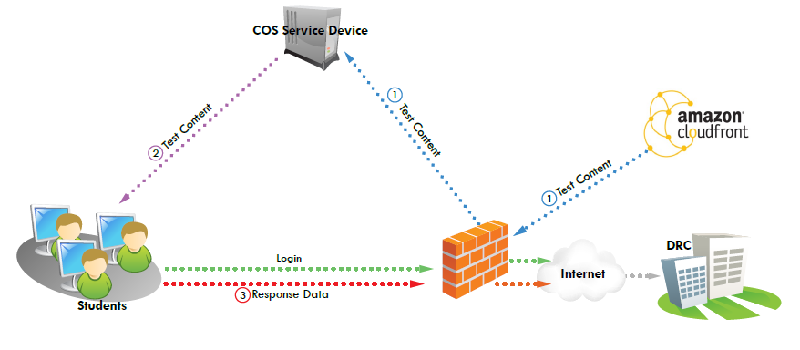
Technology Setup
COS serves as a server for caching test content for both Georgia Milestones and ACCESS for ELLs 2.0.
Each student has INSIGHT software for testing.
Responses go directly to DRC.
Districts Manage COS and INSIGHT devices for Milestones and ACCESS in eDIRECT.

Slide 78
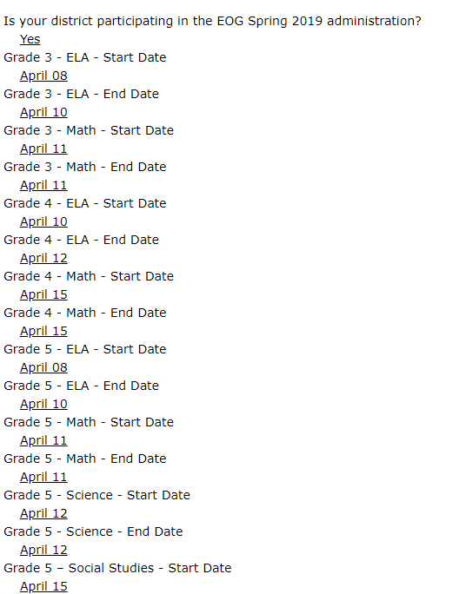
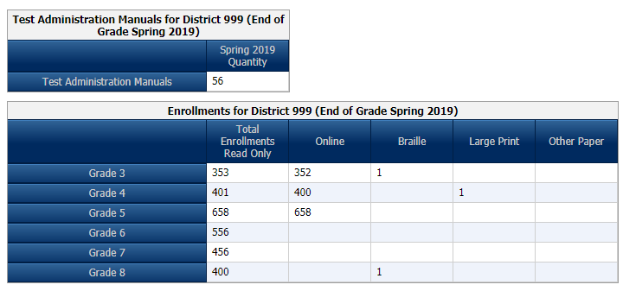
Georgia Milestones Enrollment Counts
Critically important to provide accurate and complete information
Ensures appropriate materials are available for students at the time needed
Ensures DRC can plan appropriately for rapid scoring and reporting of results
http://ga.drcedirect.com

Slide 79
Georgia Milestones Preliminary Individual Student Report Timelines for Winter EOC
Administration | ELA/Math Online | Sci/SS Online
EOC Mid-Month and Winter Main | 10 Business Days | 5 Business Days
EOG and EOC Spring Administrations | Schedule to be shared at a later date. | 5 Business Days
EOG Summer Retest | 5 Business Days | Not tested
*Consider Winter graduates
Spring timelines will be shared later.

Slide 80
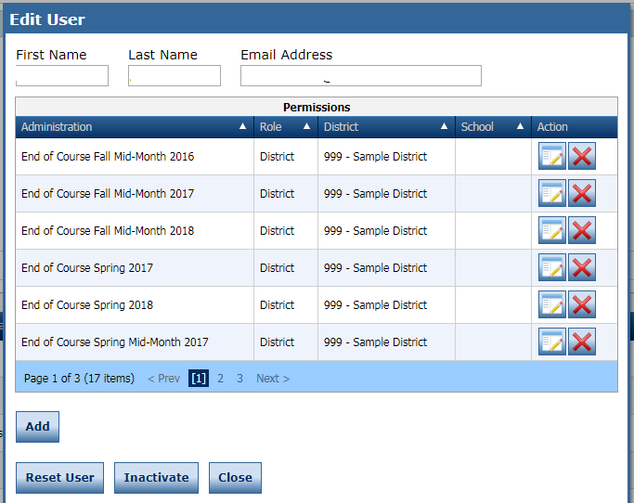
eDIRECT Accounts
District System Test Coordinators are responsible for ensuring eDIRECT accounts are current.

Slide 81
Georgia Milestones
EOG Resources
EOC Resources
Milestones Presentations
Milestones Training Videos
eDIRECT

Slide 82
Georgia Kindergarten Inventory of Developing Skills (GKIDS)
GKIDS continues in its current form in 2018-2019.
Teachers should contact the school coordinator first and then the system test coordinator for assistance with GKIDS.
Teachers should enter student information into the website in a timely manner.
Students who transfer from a school/classroom should be released through the GKIDS website so they can be acquired by the new teacher.
GTID issues should be addressed with the school student database contact and/or the GaDOE Technology Services Division.
There is not a state-mandated baseline or end of year summary of required elements.
Teachers are responsible for students’ end of year reports prior to the end of the administration window in May.
A mid-year data file will again be available in January 2019.

Slide 83
Georgia Kindergarten Inventory of Developing Skills (GKIDS)
Academic Domains
Math
ELA
Science (Optional)
Social Studies (Optional)
Non-Academic Domains
Approaches to Learning
Personal/Social Development
Motor Skills (Optional)

Slide 84
GKIDS Readiness Check
Developed with our partners at the Department of Early Care & Learning (DECAL)
Augments the Georgia Kindergarten Inventory of Developing Skills (GKIDS) and is administered during the first six weeks of kindergarten
Designed to highlight knowledge and skills critical for student success in learning, solely to guide instruction
Aligned to the Georgia Early Learning Development Standards (GELDS) and correlated to the Georgia Standards of Excellence for kindergarten
Assesses 20 essential concepts and skills

Slide 85
GKIDS: Administration Schedule
January 30, 2019 | Mid-Year GKIDS student data file posted to systems in the MyGaDOE Portal
May 13, 2019 | Deadline for entry of student assessment data by teachers.
June 10, 2019 | GKIDS Website closes for the 2018-2019 school year.

Slide 86
GKIDS: Resources
Administration Manual
Assessment and Instructional Guide
Reference Guide and FAQs
Parent Brochure
Roster Upload Directions and File Layout

Slide 87
National Assessment of Educational Progress (NAEP)
Managed through the US Department of Education
National assessment since 1969
Representative sample in each state
2019 school lists sent to districts in June
Measure achievement in 4th, 8th, and 12th grades
State and national results in various subjects
School and teacher questionnaires
Results released as The Nation’s Report Card

Slide 88
National Assessment of Educational Progress (NAEP)
Trends in International Mathematics and Science Study (TIMSS)
International assessment since 1995
Digitally based field test in 2018 to prepare for 2019 assessment
More than 60 countries/education systems will participate in 2019
Measure 4th and 8th grade math and science achievement
School and teacher questionnaires

Slide 89
National Assessment of Educational Progress (NAEP)
2019 Assessment
Administration Schedule
NAEP: January 28 – March 8, 2019
TIMSS: April 1 – May 31, 2019
Assessed Subjects
Grades 4 and 8 – State/TUDA Reading and Mathematics
Grades 4 and 8 – Pilot Reading and Mathematics
Grades 4, 8, and 12 – National Science
Grade 12 – National Mathematics and Reading
Grade 12 – High School Transcript Study

Slide 90
National Assessment of Educational Progress (NAEP)
Testing Modes — January 28 to March 8, 2019
Grade | Subject | Format
 |  | Tablet | Paper/Pencil
Grades 4 and 8 | Mathematics | ✓
 | Mathematics (Pilot) | ✓
 | Reading | ✓
 | Reading (Pilot) | ✓
 | Science | ✓ | ✓
Grade 12 | Mathematics | ✓ | ✓
 | Reading | ✓ | ✓
 | Science | ✓ | ✓

Slide 91
NAEP Resources
Results
https://nces.ed.gov/nationsreportcard/
NAEP Data Explorer
https://nces.ed.gov/nationsreportcard/naepdata/
NAEP Questions Tool
https://nces.ed.gov/nationsreportcard/nqt/
TIMSS
https://nces.ed.gov/timss/

Slide 92
Keenville: Overview
Keenville is a series of interactive challenges that actively engage students and assess key literacy and numeracy skills in real-time.
Keenville offers the opportunity to:
integrate assessment alongside instruction;
support and empower teachers with information to differentiate instruction; and
hook students into the fun of learning.

Slide 93
Keenville: Benefits
Engages students in an ongoing formative assessment that is integrated with the learning process
Integrates cross-curricular content
Provides ongoing, timely feedback on student performance and progress
Empowers teachers to differentiate and target standards to individual students
Provides summative measures – Lexiles and Quantiles
Can be expanded over time

Slide 94
Keenville: What is Assessed?
Academic Domains
Math – Early Numeracy Skills,
ELA – Early Literacy Skills,
Integration of science, social studies, fine arts, physical education/health/nutrition, CTAE, etc., within texts.
Grade Levels
Grades 1 and 2
Most games also include Kindergarten and Grade 3 standards to support student enrichment or remediation needs.

Slide 95
Keenville: Resources
Training presentations and resources are posted to keenville.gadoe.org
Available resources will include:
User Guide
Introduction to Keenville 1st and 2nd grade Teachers
How to Assign Games to Students

Slide 96
Keenville: Access
Keenville will be accessed by all users via the Statewide Longitudinal Data System (SLDS).
Accessing SLDS requires users to log into the district’s Student Information System (SIS).
All users will need SIS login credentials to access Keenville via the SLDS.
Contact your district SIS Administrators for further access, logins, and passwords as these are directed by your local district.

Slide 97
Formative Assessment Resources
Formative Assessment Toolbox: Item and test content in GOFAR and TestPad
GOFAR: Benchmark Development Tool for use with GaDOE test items
TestPad: Tool for item creation
Formative Instructional Practices (FIP): online and blended model of professional learning for teachers, coaches, and leaders: gadoe.org/GeorgiaFIP

Slide 98
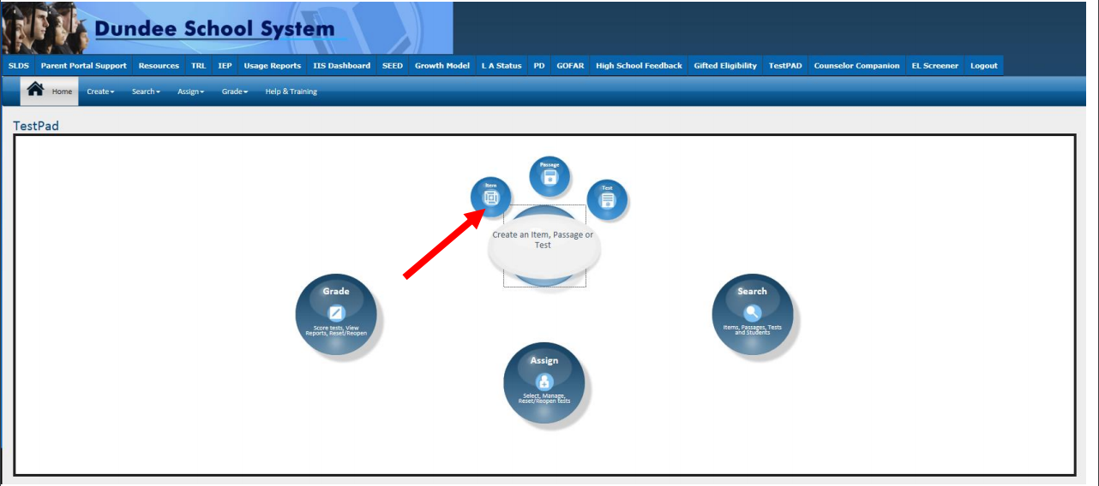
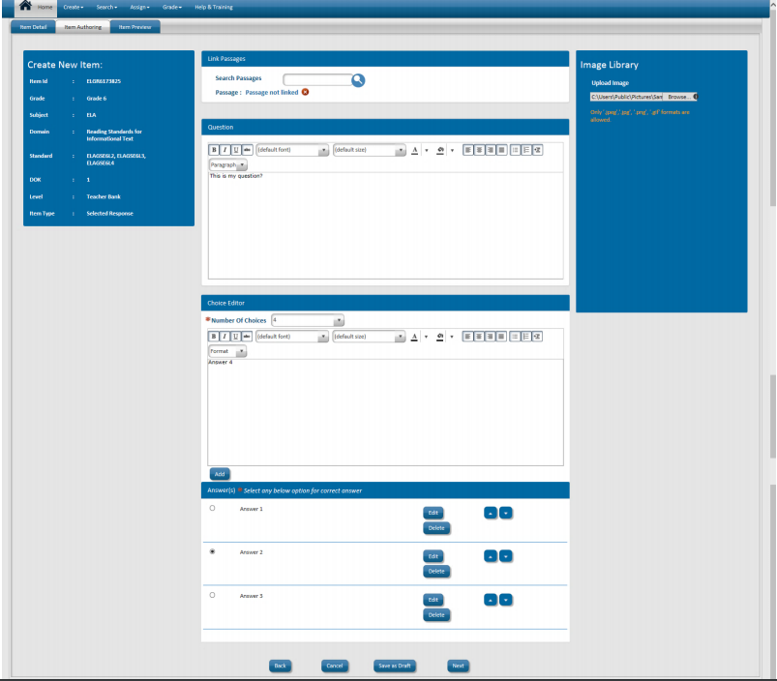
GOFAR and TestPad
New Interface
Create Test Items, Passages and Rubrics

Slide 99
Sampling the Tests
ACCESS for ELLs 2.0 sample items
https://wbte.drcedirect.com/WIDA/portals/wida
GAA 2.0 Sample Tasks
http://www.gadoe.org/Curriculum-Instruction-and-Assessment/Assessment/Pages/GAA-2.0-Sample-Tasks.aspx
Georgia Milestones Technology Enhanced Items
http://www.gaexperienceonline.com/
Keenville
MyGaDOE portal in the SLDS
TestPad
http://sldstrn.gadoe.org/SLDSDemoWeb/
Let’s Go

Slide 100
Accountability

Slide 101
2018 CCRPI Resources
CCRPI Overview Video
Navigating the CCRPI Report Tutorial (video)
Family Guide to CCRPI (Spanish version coming soon)
Principal Guide to CCRPI
2018 CCRPI Calculator Updated 11.15.18
CCRPI Report User Feedback Survey
2018 CCRPI Data Files – www.gadoe.org/CCRPI
New

Slide 102
New Resources for 2019
2019 Beyond the Core Course Guidance 11.13.18
Tentative 2019 CCRPI Calendar
Activity | Start | End
GAA Participation Application* | December, 2018 | January, 2019
Assessment Matching I | February | August
Live Portal Data | March/April | Static when SR and SC close
Student Record and Student Class Close | Ongoing | June
Assessment Matching 2 | August | August
Non-Participation Application | July | August
Summer Graduate Collection | Mid June | Early August
Cohort Withdrawal Update | Mid June | Early August
Graduation Rate Public Release | - | September
CCRPI Public Release | - | Late October

Slide 103
Accountability Point of Contact
Named by school superintendent
Receives key communications from GaDOE Accountability Team
Participates in monthly Lunch and Learn webinars
Relays key information to administration at local level
Needs district level CCRPI access in the MyGaDOE portal

Slide 104
2019 Lunch and Learns
Date | Time | Link
February 13 | 12:00 pm | https://attendee.gotowebinar.com/register/501329319315286274
March 20 | 12:00 pm | https://attendee.gotowebinar.com/register/4390581222712608514
April 17 | 12:00 pm | https://attendee.gotowebinar.com/register/2677462941800440066
May 15 | 12:00 pm | https://attendee.gotowebinar.com/register/4766228270830704386
June 19 | 12:00 pm | https://attendee.gotowebinar.com/register/4224844138476612098
July 17 | 12:00 pm | https://attendee.gotowebinar.com/register/5130118241112988418
August 21 | 12:00 pm | https://attendee.gotowebinar.com/register/7463493021486207490
September 18 | 12:00 pm | https://attendee.gotowebinar.com/register/2513586231238654210
October 16 | 12:00 pm | https://attendee.gotowebinar.com/register/2542338460305020162
November 20 | 12:00 pm | https://attendee.gotowebinar.com/register/8107452792836907009

Slide 105
Thank you!
Allison Timberlake, Ph.D. Deputy Superintendent for Assessment & Accountability atimberlake@doe.k12.ga.us (404) 463-6666
Jan Reyes, Ed.D. Director of Assessment Development jreyes@doe.k12.ga.us (404) 463-6665
Sandy Greene, Ed.D. Director of Assessment Administration sgreene@doe.k12.ga.us (404) 656-0478
Paula Swartzberg
Director of Accountability
pswartzberg@doe.k12.ga.us
(404) 463-1539
testing.gadoe.org
accountability.gadoe.org

Slide 106
GaDOE Assessment and Accountability Specialist Contacts
Assessment Specialists
Taiesha Adams, Ed.D., (404) 656-5975; taadams@doe.k12.ga.us - Georgia Milestones
Bobbie Bable, (404) 657-6168; babble@doe.k12.ga.us - NAEP, GKIDS
Joe Blessing, (404) 232-1208; jblessing@doe.k12.ga.us - Georgia Milestones, GOFAR/FIP
Kelli Harris-Wright, (404) 463-5047; harris-wright@doe.k12.ga.us - FIP
Robert McLeod, Ed.D., (404) 656-2589; rmcleod@doe.k12.ga.us - Georgia Milestones
Mary Nesbit-McBride, Ph.D., (404) 232-1207; mnesbit@doe.k12.ga.us - ACCESS for ELLs 2.0, GAA 2.0
Accountability Specialists
August Ogletree, Ph.D., (404) 463-6675; aogletree@doe.k12.ga.us

Slide 107
Assessment & Accountability Contact Information
Assessment and Accountability Contacts
Georgia Milestones Assessment Specialists by Assigned School District
Accountability Specialists by Assigned School District
Toll-Free 800-634-4106 and 404-656-2668
http://gadoe.org/assessment

Slide 108
How Did We Do?
Survey Link https://www.surveymonkey.com/r/StateCharter

