Slide 1
Overview of Georgia’s K-12 Student Assessment Program
State Charter School Commission Presentation
July 23, 2020
9 a.m. – 12 p.m.
https://attendee.gotowebinar.com/register/8384655078289089806
Notes:
Sandy

Slide 2
GaDOE Presenters
Assessment Administration
Sandy Greene, Ed.D., Director
Taiesha Adams, Ed.D., Assessment Specialist (Milestones, BEACON)
Bobbie Bable, Assessment Specialist (GKIDS, NAEP)
Joe Blessing, Program Manager (Milestones, BEACON, TestPad)
Mary Nesbit-McBride, Ph.D, Assessment Specialist (ACCESS for ELs, GAA)
Assessment Development
Jan Reyes, Ed.D., Director
Lisa Hardman, Assessment Specialist (K-5 Assessments)
Accountability
August Ogletree, Ph.D., Accountability Research Specialist
ESOL & Title III, Part A Language Programs
Meg Baker, Ed.D., Program Manager

Slide 3
Agenda
Introductions
Assessment Staff
State Charter Staff
Quick Reference Information
Test Development
Test Security
Assessment Overview
Creating a Testing Plan
Accommodations and Special Populations
ESOL
Accountability
Contacts and Questions

Slide 4
Quick Reference Information
Notes:
Sandy

Slide 5
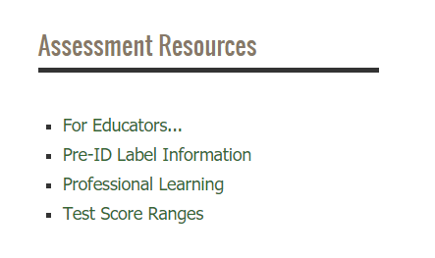
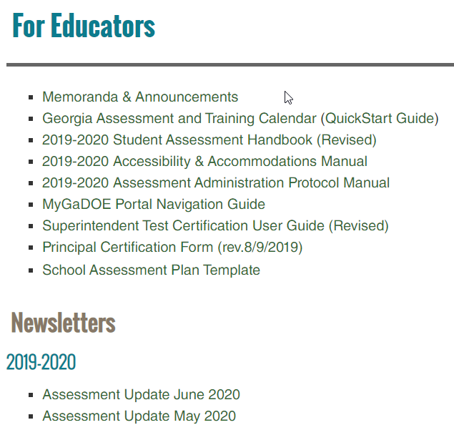
Assessment Administration Resources
testing.gadoe.org
Notes:
The Assessment website includes resources for all of the state testing programs. The For Educators section has specific information for System Test Coordinators.

Slide 6
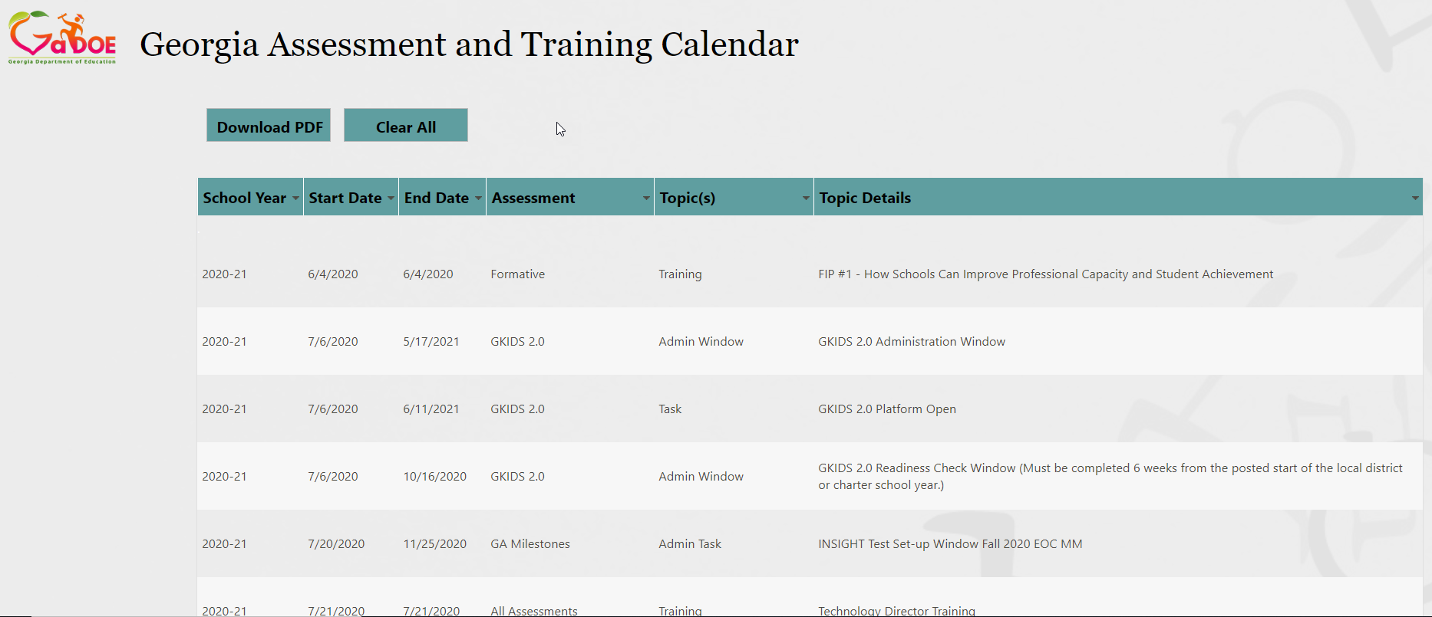
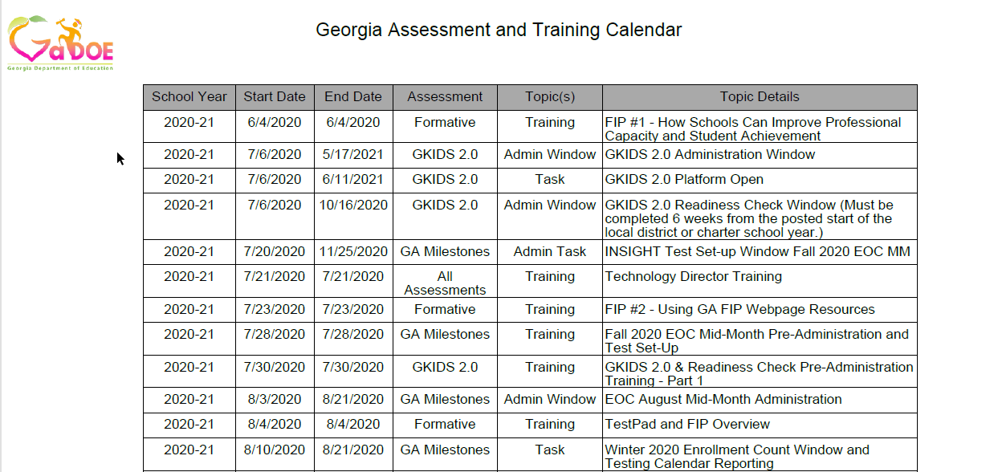
Assessment Administration Resources
Allows filtering by assessment, date, task, and topic
Downloadable PDF
Notes:
The Georgia Assessment and Training calendar allows filtering by each column. Results can be exported to a PDF.

Slide 7
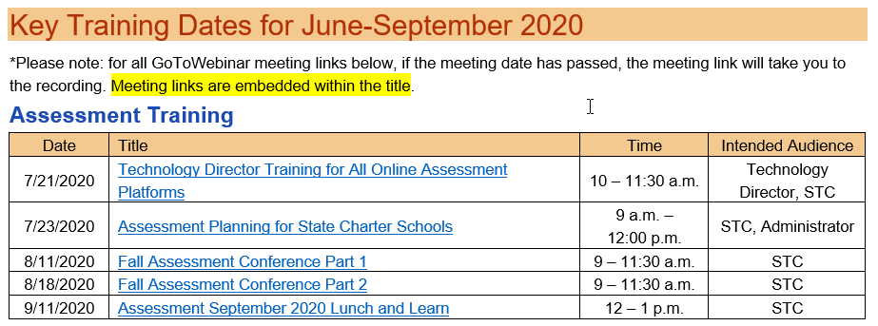
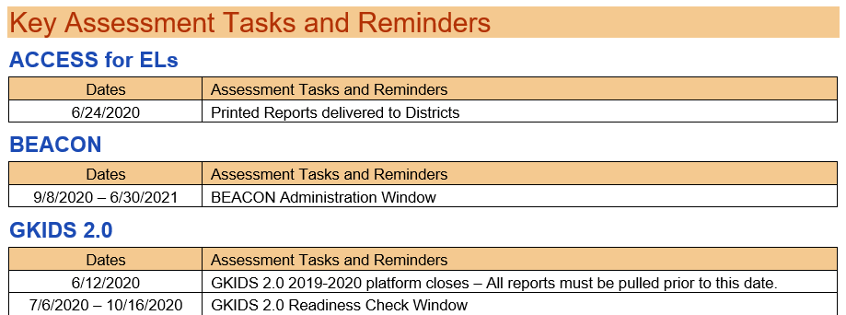
Assessment Administration Resources
Notes:
The assessment updates include relevant content for all testing programs including upcoming training, tasks and announcements.

Slide 8
2020-2021 Lunch and Learns
Assessment
Date | Time | Link
Friday, 9/11/2020 | 12 – 1 p.m. | September 2020 Assessment Lunch and Learn
Friday, 10/16/2020 | 12 – 1 p.m. | October 2020 Assessment Lunch and Learn
Friday, 11/13/2020 | 12 – 1 p.m. | November 2020 Assessment Lunch and Learn
Notes:
Lunch and Learns are webinars that give current information about the statewide testing program.

Slide 9
Assessment Administration Resources
MyGaDOE Portal Login Page
Notes:
The MyGaDOE portal offers a variety of assessment resources and is the secure location for receiving confidential information from this office.

Slide 10
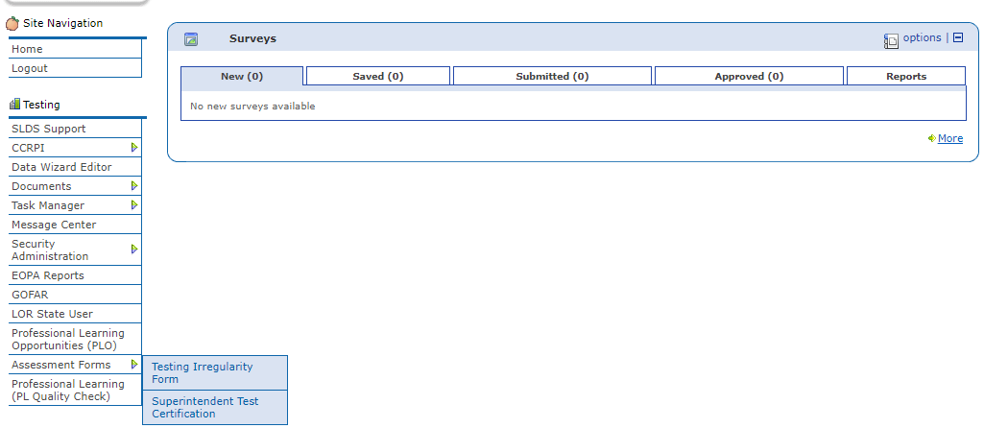
Assessment Administration Resources
MyGaDOE Portal
MyGaDOE Portal Welcome Page
Testing Irregularity Form
Superintendent’s Test Certification
Special Accommodation Request
Assessment Rescore Request
Notes:
Please note the location of the Testing Irregularity Form in the left hand menu. Soon the Rescore Request will be added to this drop down. Currently Rescore Request and Special Accommodation Requests are made through the More box.

Slide 11
Assessment Administration Resources
MyGaDOE Portal Online Forms
https://portal.doe.k12.ga.us/login.aspx
Special Accommodations Request Form
Guidance appears in Student Assessment Handbook
Last year, this online form replaced the need to submit requests via email
IMPORTANT: Email/Call Taiesha Adams or Mary Nesbit-McBride to notify GaDOE of request
Superintendent’s Certification Form
Tests administered January 1 – June 30: Submit no later than July 31
Tests administered July 1 – December 31: Submit no later than January 31
IMPORTANT: Email/Call Sandy Greene with questions
Assessment Rescore Request Form
IMPORTANT: Email/call appropriate GaDOE Assessment Specialist to discuss applicable fees and notify GaDOE of request
Also used for transcription requests
Testing Irregularity Form
Used to document any testing irregularity during any testing session
Contact GaDOE Assessment Specialist to discuss questions regarding irregularities and potential invalidations
Notes:
Read screen content

Slide 12
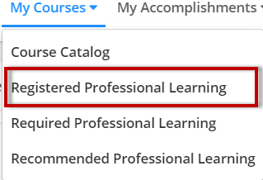
Online Training Courses
System Test Coordinator Training Course
Georgia Milestones Spring School Test Coordinator Course
Log into SLDS
Click on PL
To find the course, you choose “Course Title” search box, enter “test coordinator” and click the magnifying glass.
Register for the course.
Find the course under Registered Training.
When you have finished the course and received 100% on the quiz, you can print your certificate.
Quick Start Guide for accessing the course can be found on Training Resources page.
Notes:
We now offer two online Moodle training courses through the SLDS. The System Test Coordinator training course allows new and veteran system coordinators a location to access the training and resources for implementing all the state testing programs. The School Test Coordinator training course is design to walk school leaders through the state requirements for Georgia Milestones administration. There is a quiz and a certificate for completing the course and passing the quiz.

Slide 13
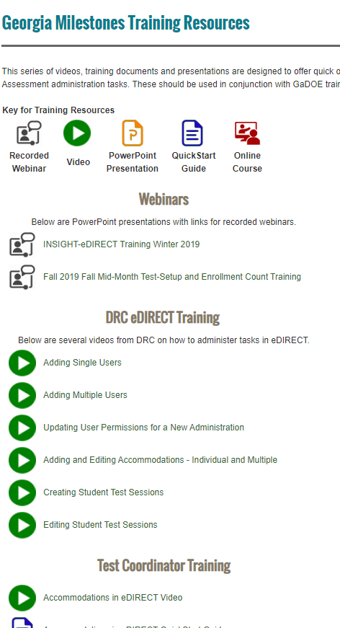
Training Resources
Georgia Milestones Training Resource Page
Training Types
 | Recorded Webinars
 | Videos
 | PowerPoints
 | QuickStart Guides
 | Online Courses
Training Topics
Webinars
DRC eDIRECT Training
Test Coordinator Training
Test Examiner Training
Student Training
Notes:
There are a variety of resources offered for training. The Recorded Webinars are these presentations that are delivered from the GaDOE. The links will take you to the PowerPoint. The first slide on the PowerPoints include links to the recorded webinars. Videos are short presentations that cover a series of topics. PowerPoint documents are offered so districts can redeliver topics. Most PowerPoints include the script for your redelivery. QuickStart Guides are short pdf documents with information to quickly guide users on training topics. Lastly, the System Test Coordinator and School Test Coordinator courses can be accessed through the MyGaDOE portal, clicking on PLO and searching for the course.

Slide 14
Test Development
Notes:
Sandy

Slide 15
Georgia Milestones
Test Development Process
Test Planning and Specifications
Item Development
GaDOE
Reviews
Item Review
Field Testing
Rangefinding (Constructed-Response Items)
Handscoring (Constructed-Response Items)
Data Review
Operational
Testing
Standard Setting/
Validation

Slide 16
Committee Selection Process
District Nominations (January)
Educator Application & Availability Survey (February)
Initial Committee Invitations (late March – April)
Rolling schedule based on meeting dates
6-10 participants per grade/content area or course
Balanced representation
Gender
Ethnicity
Region
Experience
Special populations

Slide 17
Expense Reimbursement for Educator Meetings
Expenses paid directly (by testing contractor)
Hotel accommodations, if applicable
Parking, if applicable
Breakfast, lunch, and snacks are provided at the meeting
Expenses reimbursed to participant (from testing contractor)
Dinner (reimbursed at current state rate) for those staying overnight
Mileage (reimbursed at current state rate)
Expenses reimbursed to school or district (from testing contractor)
Substitute teacher expense, if applicable
Participants are provided a reimbursement form to return to their school/district.
Participants are paid an honorarium if a meeting occurs during off-contract time (e.g. spring break, summer break, etc.)
Typically $125 per day
In lieu of substitute reimbursement

Slide 18
Test Security
Notes:
Sandy

Slide 19
Test Security
Guiding Principles
The primary goal of assessment security is to protect the integrity of the assessment and to assure that results are accurate and meaningful.
State assessments are an important and a required tool used to monitor state, district, school, and student achievement results.
For assessments to yield fair, accurate, and valid results, they must be administered under the same standardized conditions to all students.
Guiding Principles

Slide 20
Code of Ethics for Georgia Educators
Standard 10: Testing – An educator shall administer state-mandated assessments fairly and ethically.
Unethical conduct includes but is not limited to:
committing any act that breaches Test Security; and
Compromising the integrity of the assessment.
GaPSC Ethics Division: https://www.gapsc.com/Ethics/CodeOfEthics.aspx

Slide 21
Test Security
Policy, Administration, and Monitoring Resource Manuals
Student Assessment Handbook
Test Security
Roles and Responsibilities
Assessment Administration Protocol Manual
Assessment Communication Protocols
Resource documents and Incident Reporting Guide
Accessibility & Accommodations Manual
Allowable Accommodations Tables
Guidance in Choosing Appropriate Accommodations
Test Administration Manuals
General Administration Guidance
General Accessibility and Accommodations Guidance
Detailed Test Security Information
School, District and State Monitoring of Assessments
Irregularities and Invalidations
Assessment Administration Guidance specific to each program
Detailed Guidance for Management of Related Secure and Non-secure test Materials
Test Examiner Administration Scripts
Accommodation Information Specific to Programs
Process for Making Special Accommodations Requests
Training Guidance
testing.gadoe.org
For Educators link

Slide 22
Test Security
Roles and Responsibilities
Superintendent
Superintendent has ultimate responsibility for all testing activities within the local school system.
System Test Coordinator (STC)
STC shares the responsibility for all testing activities within the local district or charter school as the Superintendent’s designee.
Principal/Administrator
Principal has ultimate responsibility for all testing activities within the school.
System Technology Coordinator
Acquires and maintains current information on the statewide testing program, including technology requirements for testing programs, training manuals, and testing schedules.
Coordinates with the STC for the appropriate implementation of computer-based test administrations.
Manages and Reviews test security and test administration training plans

Slide 23
Test Security
Roles and Responsibilities
School Test Coordinator
Must hold a GaPSC-issued certificate
Test Examiner
Must hold a GaPSC-issued certificate
Proctor
Participates in all training and follows procedures for monitoring the test environment
Shares responsibility with the Principal for all testing activities within the school as the Principal’s designee.
Participates in all training and follows procedures for testing as given in specific Examiner’s Manual’s and documentation related to all state-mandated assessments
Responsible for the correct delivery of assigned accommodations
With examiner supervision, ensures that students are managing test materials appropriately
Ensures only GaPSC-certified personnel manage or handle secure test materials
Implements training plan as determined by the System Test Coordinator

Slide 24
Visualizing the State Testing Windows – Yearlong
September 2020 EOC MM
January 2021 EOC MM
9/8/2020
1/11/2021
October 2020 EOC MM
February 2021 EOC MM
10/12/2020
2/8/2021
August 2020 EOC MM
November 2020 EOC MM
March 2021 EOC MM
8/3/2020
11/9/2020
3/8/2021
Jul
Sep
Nov
2021
Mar
May
Jul
2021
Today
GKIDS 2.0
7/6/2020 - 5/17/2021
Milestones Secure Practice Test Window
10/5/2020 - 5/7/2021
Winter 2020 EOC
11/30/2020 - 1/6/2021
ACCESS for ELs 2.0
1/13/2021 - 3/5/2021
NAEP (selected schools)
1/25/2021 - 3/5/2021
Spring 2021 GAA 2.0
3/22/2021 - 4/30/2021
Spring 2021 EOG
4/5/2021 - 5/14/2021
Spring 2021 EOC
4/19/2021 - 5/28/2021
Summer Retest 2021 EOG
5/10/2021 - 7/16/2021
Summer 2021 EOC
6/14/2021 - 7/16/2021

Slide 25
Test Security
System Test Coordinators
Review Materials and Guidance
Develop a District and/or School Plan
Train All Personnel
Administer and Monitor
Communicate to Stakeholders
Notes:
Plan time for:
Review Policy and Administration Protocols – through yr
Develop a District/School Assessment Plan - fall
Participate in all GaDOE training in test security and administration protocol – through yr
Review the Test Administration Manuals – when received/posted
Train Test Examiners and Proctors – prior to window
Ensure orientation and practice opportunities for students – through yr
Provide communication to parents/guardians and stakeholders – before and after
Develop and implement a monitoring process to ensure test security and appropriate accommodations – through the assessment period – before, during and after.

Slide 26
Test Security
Irregularities
Irregularity (IR): Testing anomaly that warrants a report and coding, but test scores stand. An invalidation may be necessary following the review of a reported irregularity.
All personnel in the local system must follow protocol as they become aware of testing irregularities
Signs of any testing irregularity must be dealt with immediately
All irregularities must be reported to the GaDOE by completing the Testing Irregularity Form (TIF) in the MyGaDOE Portal.
Test Examiner
System Test Coordinator
GaDOE
School Test Coordinator
Keep Principal Informed
TIF
Notes:
(Read content of screen) Irregularities may occur before, during, and after assessments occur. The line of contact occurs with the one who discovers the irregularity, such as the test examiner, who then contacts the school test coordinator who contacts the system test coordinator who uses the Testing Irregularity form to contact the GaDOE. Schools should keep the principal informed. After the GaDOE responds, the communication chain is reversed from the GaDoe to the Test Examiner.

Slide 27
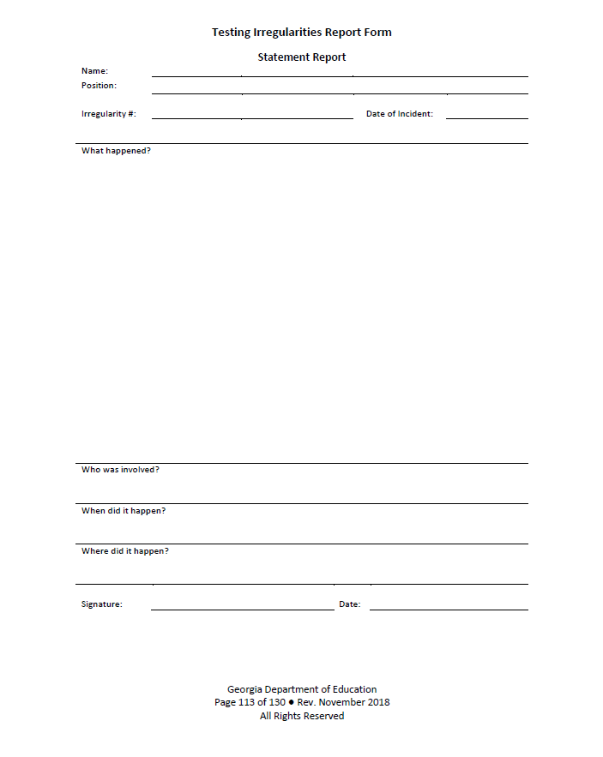
Irregularities
Steps for Reporting a Test Irregularity
System/School Test Coordinator:
Communicate with the Principal about a possible testing irregularity
STC will provide guidance regarding investigation if necessary
Statements should be provided by all parties involved in the irregularity… Details, Details, Details…
Return all documentation to the STC in the manner and at the time prescribed
Notes:
Found as an optional form in the Student Assessment Handbook.

Slide 28
Test Security
Entering Irregularities into the MyGaDOE Portal
MyGaDOE Portal Welcome Page
Testing Irregularity Form Summary Page
Refer to User Guide
Open for form review
Defaults to current active administration
Link to User Guide

Slide 29
Test Security
Invalidations
The Assessment Administration Division will review all reports of irregularities
Issue irregularity/invalidation codes
If appropriate, advise the local system as to whether a report of possible unethical conduct should be made to the Georgia Professional Standards Commission (GaPSC)
Invalidation (IV): Testing anomaly that warrants nullifying scores.
Only the GaDOE may invalidate assessments
Notes:
Read screen content.

Slide 30
Test Security
Security Hierarchy
Superintendent
Test Examiner
Student
School Test Coordinator (SchTC)
Principal
System Test Coordinator (STC)
The successful implementation of the statewide student assessment program requires a concerted effort by many individuals at the local level.

Slide 31
Assessment Overview
Notes:
Sandy

Slide 32
Assessment Philosophy
The primary purpose of schools is teaching and learning.
Assessment and accountability play a significant role, but importantly – that role is supporting, with the primary focus being teaching and learning.

Slide 33
Overview
Formative
GKIDS Readiness Check
GKIDS
Keenville
DRC BEACON
TestPad
FIP
K
Summative
ACCESS for ELLs
GAA
Georgia Milestones EOG/EOC
12
Notes:
The state assessment program includes a variety of formative and summative assessments and resources for all grades including (read content on slide)

Slide 34
Formative Assessments
Grade | Content Assessed | Assessment Description | Window | Administered Online
K | Academic Domains Non-Academic Domains | GKIDS and GKIDS Readiness Check are intended to provide ongoing information about kindergarten students’ developing skills. | Throughout the school year Readiness Check must be completed in the first 30 days of school | gkids.gadoe.org
1 – 2 | ELA Math | Keenville (optional formative resource) is a game-based formative assessment for students allowing measurement of student progress toward grade-level expectations | Throughout the school year | Statewide Longitudinal Data System (SLDS) – requires student, teacher and administrator access
3-8 | ELA Math | DRC BEACON (optional formative resource) | Throughout the school year Computer-adaptive | DRC INSIGHT
Notes:
Read slide content

Slide 35
Summative Assessments
Grade | Content Assessed | Assessment Description | Window | Administered Online
3-8 | End of Grade | GA Milestones is a summative measure of student achievement used in the state accountability system (CCRPI). | EOG – Annually EOC – Mid-Month and 3 Main Administration periods | DRC INSIGHT
Middle/ High | End of Course
4, 8, HS | Reading and Math, other HS content | NAEP assessments are administered to a sample of students across the state and nation | Annually | Students provided devices by NAEP test coordinator
3-8, and 11 | Alternate assessment | GAA 2.0 is administered to assess achievement of students with significant cognitive disabilities. Paper-based assessment. | Annually | Nextera Admin Nextera TDS
K – 12 1 – 12 | English language proficiency assessment | ACCESS for ELLs is administered to English learners Alternate Access is administered to English learners with significant cognitive disabilities. Paper-based assessment | Annually | WIDA DRC INSIGHT Portal (WIDA AMS)

Slide 36
SB 367 - Pending
During its 2020 legislative session, the General Assembly passed SB 367. This bill is currently awaiting the Governor’s signature. Should Governor Kemp sign SB 367 into law, it will require several adjustments to current assessment requirements including:
eliminating grade 5 social studies;
eliminating one EOC per content area; and
requiring that districts administer EOG assessments within 25 school days of the district’s last school day of the regular school year.
Upon signature of the law, the State Board of Education is tasked with determining which EOCs will remain and which will be eliminated.
Additionally, the Assessment Division will review the state EOG administration window for Spring 2021 to determine if any adjustments are necessary to assist districts in complying with the 25-day requirement.
Notes:
Read slide content. Th waiver has not

Slide 37
Georgia’s Request for a Waiver
Georgia is seeking a waiver of the high-stakes assessment and accountability requirements of the Every Student Succeeds Act for the 2020-2021 school year.
While we await a ruling form the U.S. Department of Education, it is necessary that we proceed with current assessment and accountability requirements.
2021 Georgia's Assessment and Accountability Waiver Request

Slide 38
Georgia Kindergarten Inventory of Developing Skills (GKIDS) 2.0
GKIDS 2.0 is a progression-based formative assessment, integrated into classroom work, that is aligned to the state content standards.
GKIDS 2.0 is a state-mandated assessment.
GKIDS 2.0 includes the GKIDS Readiness Check.
Administration window is unique to a district an is based on the district’s start date and closes 6 weeks (30 school days) from that date.
The ability to enter student data is not available after the end date of the district’s GKIDS Readiness Check administration window.
Notes:
Bobbie

Slide 39
Georgia Kindergarten Inventory of Developing Skills (GKIDS) 2.0
GKIDS 2.0 platform location for GKIDS 2.0 and GKIDS Readiness Check data entry: gkids.gadoe.org
Access to the platform:
Current superintendent-approved System Test Coordinators have been set up and account is ready for activation.
System test coordinator may set up school coordinators, and school coordinators set up teacher user accounts.
Support:
Teachers should contact the school coordinator first and then the system test coordinator for assistance with GKIDS 2.0.
System and School Test Coordinators may utilize GKIDS 2.0 Intercom Customer Support within the platform for questions
System Test Coordinators may contact the GaDOE Assessment Specialist for support.

Slide 40
Georgia Kindergarten Inventory of Developing Skills (GKIDS) 2.0
Data Entry:
Students who transfer from a school/classroom should be released through the GKIDS 2.0 website so they can be acquired by the new teacher.
GTID issues should be addressed with the school student database contact and/or the GaDOE Technology Services Division.
Teachers should enter student performance data in a timely manner.
Reporting:
Systems/schools should establish a reporting schedule for the year in addition to the end of year state deadline.
Teachers are responsible for students’ end of year reports prior to the end of the administration window in May.

Slide 41
GKIDS 2.0
Administration Schedule
Date Range | Task
July 6, 2020 – October 19, 2020 | GKIDS 2.0 Readiness Check data should be entered based on the school’s academic calendar.
January 28, 2021 | Mid-year checkpoint (Webinar only, no datafile provided)
July 6, 2020 – May 14, 2021 | Entries may be entered in GKIDS 2.0 platform for the current school year.
June 11, 2021 | GKIDS 2.0 Website closes for the 2020-2021 school year.

Slide 42
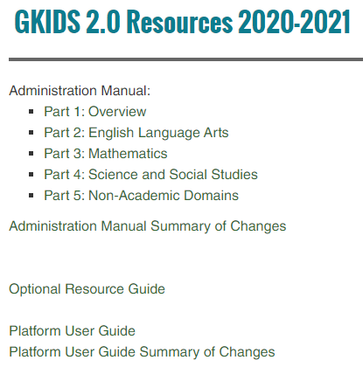
Customer Support — GKIDS 2.0
Platform Questions and Resources:
GKIDS 2.0 Platform Login: gkids.gadoe.org
Platform User Guide found under GKIDS 2.0 Resources
Chat is available through the Intercom Support Desk link in the GKIDS 2.0 platform on the user's dashboard from 8 a.m. to 5 p.m.,
Monday through Friday.

Slide 43
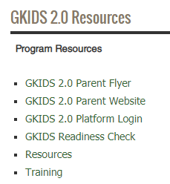
GKIDS 2.0 Training
Notes:
Instructions on how to register for the new GKIDS 2.0 teacher training course are available on the GKIDS 2.0 webpage.

Slide 44
GKIDS 2.0 Teacher Training
Readiness Check is a part of the GKIDS 2.0 Teacher Training course.
New kindergarten teachers need to complete all modules within the course.
Returning kindergarten teachers should view all new and revised modules.
Overview of GKIDS 2.0 – revised
Providing Support for Students – new
GKIDS 2.0 Data Collection Platform
General Navigation - revised
Entering Student Performance Data: Progressions – revised
Progression Reports – revised

Slide 45
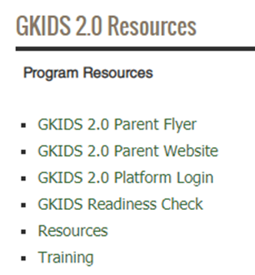
GKIDS 2.0
Resources and Manuals
Administration Manual
Platform User Guide
Optional Resources Guide
Parent Website
System Admin Upload Roster File
Training Courses and Checklists
https://www.gadoe.org/Curriculum-Instruction-and-Assessment/Assessment/Pages/GKIDS-2.0-Training.aspx

Slide 46
National Assessment of Educational Progress (NAEP)
Managed through the US Department of Education
National assessment since 1969
Representative sample in each state
Measure achievement in 4th, 8th, and 12th grades OR ages 9, 13 and 17
State and national results in various subjects
School and teacher questionnaires
Results released as The Nation’s Report Card
Notes:
Bobbie

Slide 47
NAEP
2021 Assessment
Administration Schedule
January 25 – March 5, 2021
Assessed Subjects – Grades 4 and 8
Mathematics
Reading
Resources
Results: https://nces.ed.gov/nationsreportcard/
Data Explorer: https://nces.ed.gov/nationsreportcard/data/
Questions Tool: https://nces.ed.gov/NationsReportCard/nqt/

Slide 48
ACCESS for ELLs & Alternate Access
ACCESS for ELLs measures the English language proficiency levels and progress of ELs in the domains of speaking, listening, reading, and writing.
Tasks replicate the language needed to communicate in school.
Alternate ACCESS measures how EL students with significant cognitive disabilities develop the language proficiency needed to participate in classroom instruction.
Test Window – January 13 – March 5, 2021
Test Administration Manuals will be available digitally
Notes:
Mary
ACCESS for ELLs is a secure large-scale English language proficiency assessment administered to K through 12th grade students who have been identified as English language learners. ACCESS for ELLs measures language development in the domains of Listening, Reading, Writing, and Speaking. ACCESS for ELLs assesses students’ English language proficiency in five ELD standards. This assessment is given annually to monitor students' progress in acquiring academic English--the language students need to communicate in school.
There is also an Alternate form of the ACCESS for ELLs test so that ELLs in grades 1-12 with significant cognitive disabilities can show what they can do and understand.
Alternate ACCESS for ELLs aligns with the WIDA Alternate English Language Proficiency levels. Information about participation criteria and test administration of the Alternate ACCESS test can be found on the WIDA website under the Assessment tab.
The test administration window for ACCESS and Alternate ACCESS is January 13 – March 5, 2021.

Slide 49
ACCESS for ELLs & Alternate ACCESS
Resources
WIDA Resources
Family Engagement
Accessibility Guidance
Score Interpretation
Test Demo
WIDA Screener
ACCESS
Sample Items
WIDA AMS
User Management
Material Management
Reporting
Screener Scoring
WIDA Secure Portal
Test Administration Manuals
Webinar Recordings
Technology Resources
Notes:
There are many helpful resources of ACCESS and Alternate ACCESS on the web. The first two links are open to the public. You will find resources aimed at helping educators communicate information about the assessment to teachers and families. Teachers should use the test demo link to assess applications designed to familiarize students with the testing platform and format of test items.
WIDA AMS link is secure, so you will need login credentials to assess the information you will need to manage district uses, order test material, obtain score reports for ACCESS and Screener. You will also need login credentials to access the WIDA Secure Portal. The WIDA Secure Portal houses test administration manuals, training modules, webinar recordings.

Slide 50
English Learners and their English Language Proficiency (ELP) Screeners & Assessments
Dr. Margaret (Meg) Baker,
Manager
ESOL Language Program
Notes:
Meg

Slide 51
EL Entrance/Exit Procedures Summary
Transfer Students?
Check previous records!
EL Entrance Procedures
(for students New to US Schools or upcoming Kindergarten)
EL Language Program – State Guidance
One-time Home Language Survey (Only 3 questions)
One-time ELP Screener
Eligibility Criteria
Parent Notification Timelines (30 days/10 days)
Annual ELP Assessment
All EL students (Title I)
Continuing Eligibility
Parent Notification
EL Exit Procedures
Annual ELP Assessment
All EL students (Title I)
Apply state Exit Criteria: ACCESS CPL > 5.
EL Reclassification Team Decision & Form, if LEA criteria is 4.3-4.9
Parent Notification

Slide 52
ELP Screener Options 2020-2021
Traditional/School Buildings Open | Hybrid with Limited/Staggered Use of School Buildings | Distance/Remote Learning due to Targeted, short-term, or extended closures
Kindergarten W-APT WIDA Model (Kinder only) WIDA Online Screener - Gr. 1 (2nd sem.) – Gr. 12 | Kindergarten W-APT WIDA Model (Kinder only) WIDA Online Screener - Gr. 1 (2nd sem.) – Gr. 12 WIDA Remote Screener* for K-12, as needed | WIDA Remote Screener* for grade level clusters K-1, 2-3, 4-5, 6-8, 9-12, as needed
Preventative practices and proactive protocols would include individual administration of the ELP screener following the health and safety considerations and recommendations as expressed in GaDOE’s K-12 Restart and Recovery guidelines at https://www.georgiainsights.com/coronavirus.html.
*Watch for guidance on identification of ELs using the WIDA Remote Screener.
Notes:
On May 18 of this year, USED’s Office of Elementary & Secondary Education published a Fact Sheet on Providing Services to ELs during periods of school closures. If the school district is operating via remote learning, then they must screen new students to determine EL status, to the extent possible.
In the spring, the Georgia Department of Education provided guidance on an informal interview screening process to be used temporarily to identify EL students for ESOL services. This method is no longer valid, now that WIDA is providing us with a standardized WIDA Remote Screener for K-12 to be used statewide as needed.
We know that your situation, just like ours, is a fluid situation as you wrestle with the important decisions about how to restart school and how to ensure a continuity of learning for all students, including English learners. Therefore, we are showing you’re the screener options in three categories.
If your school buildings are open and you are able to screen face-to-face, you should use the screeners on the green side of this chart.
If you are opening in a hybrid or stagger manner, and some potential English learners needed to be screened cannot come to your building, then please use the screener options in the yellow column.
If your schools are operating completely online or distance, then use the screener option in the peach column.
The reminder at the bottom directs you to the Georgia Insights website where the Georgia Department of Education provides school systems with updated and current information.

Slide 53
Must all EL students be tested on the ACCESS for ELLs?
Yes.
Under the ESEA, all K-12 EL students must be annually assessed for English Language Proficiency (ELP), including those whose parents refuse their participation in language services such as ESOL or Title IIIA. [Section 1111(b)(2)(G); 34 C.F.R. §§ 200.5(a)(2), 200.6(h)]
Students who reach full English proficiency, as determined by statewide standardized EL exit procedures, are no longer tested on the ACCESS.
Your STC should have marked the Non-Participation reason in the CCRPI application. Your Title III ELP Assessment Participation Rate Report will be in the ConAPP, Title III Reports section.
Notes:
You may want to ensure you are provisioned to see the Title III Reports in ConAPP.

Slide 54
Resources for your ESOL Language Programs

Slide 55
Georgia Alternate Assessment (GAA) 2.0
The purpose of the GAA 2.0 is to ensure that students with significant cognitive disabilities are:
provided access to the state-mandated content standards.
given an opportunity to show what they know and can do.
Only students meeting GAA 2.0 Eligibility Criteria may participate in the assessment.
http://www.gadoe.org/Curriculum-Instruction-and-Assessment/Assessment/Pages/GAA_2.aspx
Kindergarten students will no longer be assessed with GAA 2.0.
Notes:
Mary
The Georgia Alternate Assessment was designed to ensure that students with significant cognitive disabilities in grades 3 through 12 are provided access to state-mandated content standards and are given an opportunity to demonstration what they have learned in the classroom. Participation is limited to those students whose IEP teams have determined meet the eligibility criteria posted on the GAA 2.0 website.
Beginning this fall, Kindergarten students with significant cognitive disabilities will take GKIDS instead of GAA 2.0.

Slide 56
Georgia Alternate Assessment (GAA) 2.0
Date | Event
GAA 2.0 Test Administration Procedures | October 8, 2020
GAA 2.0 Nextera Platform Training | January 21, 2021
GAA 2.0 Pre-Administration Webinar | February 18, 2021
GAA 2.0 Administration Window | March 22 – April 30, 2021
Notes:
Read slide content

Slide 57
Georgia Alternate Assessment 2.0
Web-based Resources
Teacher Resources
Sample Tasks
Vocabulary Lists
Extended Content Standards
Test Blueprints
Test Administration Manuals
Forms
Learner Characteristics Inventory (LCI)
Eligibility Criteria
Technology
Nextera Set-up and Installation Guide
Notes:
Read slide content

Slide 58
Georgia Milestones
Georgia Milestones is designed to provide information about how well students are mastering the state-adopted content standards in the core content areas of English Language Arts, Mathematics, Science, and Social Studies.
Georgia Milestones is designed to provide students with critical information about their own achievement and their readiness for their next level of learning
Notes:
Taiesha
Read slide content

Slide 59
Georgia Milestones
EOG | EOC
Grades 3–8 English Language Arts Mathematics Grades 5 and 8 Science Social Studies | Ninth Grade Literature & Composition American Literature & Composition Coordinate Algebra Analytic Geometry Algebra I Geometry Biology Physical Science United States History Economics/Business/Free Enterprise
Notes:
Please read the listed courses

Slide 60
Georgia Milestones
Georgia Milestones is administered 100% online
Online administrations allow for flexible scheduling, different item types, ease of administration, accessibility tools and rapid return of scoring.
Online administrations allow for additional scheduling flexibility for EOG.
Paper forms are available for those students who cannot access the online assessment due to their disability.
Test Administration Manuals will be available digitally.
Notes:
Read content of slide.

Slide 61
Georgia Milestones
Scheduling Flexibility
May Do | May Not Do
May schedule same grade level and content across the testing window | May not schedule same grade level students and content testing on different dates than posted window
May use one-day or multiple-day administration | May not begin a content area on Friday and complete on a Monday
ELA Section 1 must be scheduled on one day. | May not be scheduled on a Friday.
Once a content has begun, it must be completed before a new content is started | May not schedule a content area (ex. ELA) on the same day as a different content area (ex. Math)
Check with your GaDOE Assessment Specialist with questions
Notes:
Read content of slide.

Slide 62
Georgia Milestones
Georgia Milestones Resources
Educator Resources
Administrator Resources
Student Resources
Technology Resources
Milestones Training Resources
Webinars
DRC INSIGHT Portal Training
Test Coordinator Training
Test Examiner Training
Student Training
DRC INSIGHT Portal
Participant Preparation
Test Preparation
Post-Test Action
Scoring and Reporting
General Information
Technology Setup
Notes:
A variety of resources are available including The Georgia Milestones Resources, Training Resources and the DRC INSIGHT portal.

Slide 63
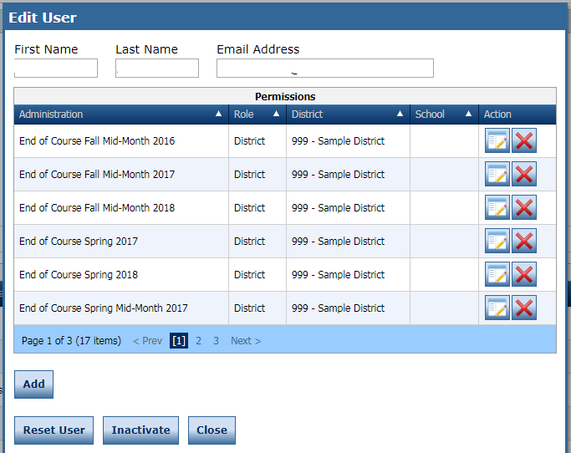
INSIGHT Portal Accounts
District STCs are responsible for ensuring eDIRECT accounts are current.
Notes:
Read slide content

Slide 64
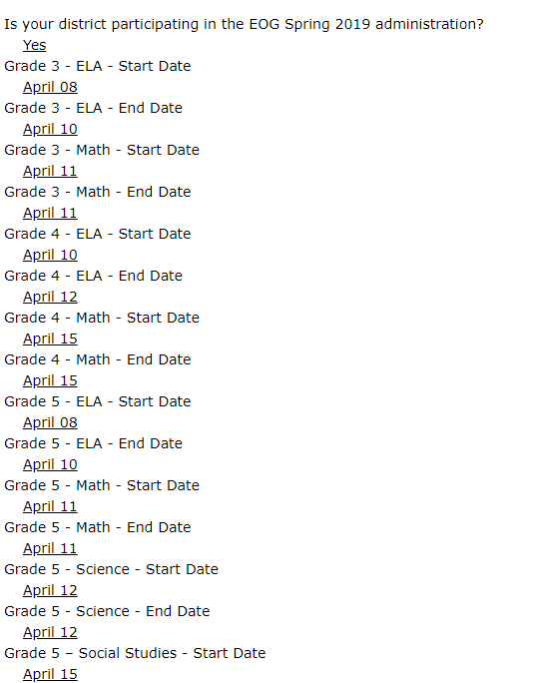
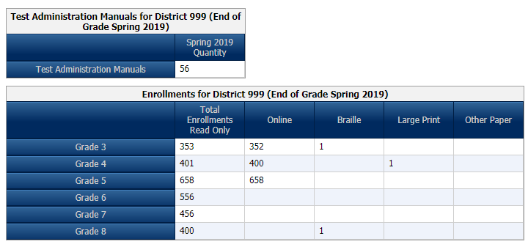
Georgia Milestones
Enrollment Counts
Critically important to provide accurate and complete information
Ensures appropriate materials are available for students at the time needed
Ensures DRC can plan appropriately for rapid scoring and reporting of results
Winter EOC Enrollment numbers are pre-populated from 2019
Enrollment Counts window: 8/10-8/21
http://ga.drcedirect.com
Notes:
Enrollment counts are necessary for the winter and spring main testing windows. Districts enter the number of test takers and numbers of paper test materials. The Enrollment Counts Window for Winter 2020 EOC opens from 8/10/2020 through 8/21/2020.

Slide 65
Accommodations and Special Populations
Notes:
Taiesha

Slide 66
Accessibility and Accommodations
Resources
Resource | Purpose | Location
Student Assessment Handbook | Policy Guidance | For Educators
Accessibility & Accommodations Manual | Types of Support Guidance in Choosing Supports | For Educators
Assessment Administration Protocol Manual | Monitoring Procedures before, during, and after assessments | For Educators
Test Administration Manuals | Specific test administration protocols by assessment | Program Sites

Slide 67
Accommodations
Students eligible for accommodations include:
Students with Disabilities
Students with Individualized Educational Programs (IEP)
Students served under Section 504
Only in the rarest of circumstances would a 504 student qualify for a conditional accommodation
English Learners
Students qualifying for language assistance services (ESOL)
EL students who are also SWD
Students who have exited language assistance services in the last two years (EL-Monitored). EL-M students are ineligible for conditional accommodations based on language proficiency

Slide 68
Accommodations
Accommodations allow access…
they are practices and procedures in the areas of presentation, response, setting, and scheduling that provide equitable instructional and assessment access for students with disabilities
Accommodations reduce or eliminate the effects of a student’s disability or limited English proficiency
Accommodations provide access for demonstration of achievement
Do not guarantee proficiency
and therefore should not be selected solely as mean to help ensure proficiency

Slide 69
Assessment Accommodations
Conditional Accommodations
Standard Accommodation
Universal Test Design
Standard Accommodations: Provide access to the assessment without altering the construct measured by the assessment.
Conditional Accommodations: Provide access for students with more severe disabilities who would not be able to access the assessment without such assistance.
Special Accommodations

Slide 70
Accommodations
Test Administration
Accommodations must be required by the student in order to access the assessment
Accommodations must be provided during, and be informed by, routine instruction and assessment in the classroom (both before and after the state tests are administered)
Specifying testing mode (online or paper) is not considered an accommodation. Paper forms are available for those students who cannot access the online assessment due to their disability.

Slide 71
Conditional Accommodations
Conditional accommodations are never intended to be available for all students
The guidance is designed to protect the accommodations for students who truly require them
Anytime an accommodation is considered it is important to reflect what the test is designed to measure
The goal is meaningful (i.e., valid) measurement of student achievement
It is important to consider the long-term effects of inappropriate accommodation use
Accommodations should foster independence, not dependence

Slide 72
Online Readiness
Are Students AND Teachers Ready?
Orient students to testing via an online platform:
Experience Online Testing Georgia: http://www.gaexperienceonline.com
Secure Practice Tests in INSIGHT
Notes:
Taiesha
Students should be comfortable with the format of the Georgia Milestones assessment as well as the INSIGHT program and all available tools. Districts should set up practice sessions with students using the Secure Practice Tests. Teachers, students and parents can experience the format of the test and the INSIGHT program anywhere anytime through Experience Online Testing Georgia.

Slide 73
Online Readiness
Meeting with Technology Director and Site Technology Technicians
Ensure technology staff is aware of the local assessment calendar
Determine Site Readiness
Review Bandwidth and Network Needs
Ensure installation of Central Office Services
Ensure installation of INSIGHT
Along with technology staff, participate in training webinars
Establish and review technology troubleshooting protocols
Notes:
Online readiness for Georgia Milestones requires a strong testing team that includes technology director and site readiness technicians. (Read slide content) As a reminder, the technology director’s training for all state programs was held on Tuesday July 21. You and your technology contact should view this training.

Slide 74
Test Practice for Online Administration Georgia Milestones
http://www.gaexperienceonline.com/
Notes:
Understanding the DRC INSIGHT Student Landing Page and Test Practice Options. Test practice for Georgia Milestones can be found at www.experienceonline.com. Experience Online Testing Georgia gives anywhere, anytime access to practice items.

Slide 75
Test Practice for Online Administration ACCESS for ELLs
https://wida.wisc.edu/assess/access/preparing-students https://wbte.drcedirect.com/WIDA/portals/wida
Notes:
WIDA offers a page of resources for preparing students.
Sample items for ACCESS for ELLs can be found on the ACCESS Test Practice page

Slide 76
Test Practice for DRC BEACON
https://drcbeacon.com/online-tools-training/
Notes:
Students can

Slide 77
Formative Assessment Resources
TestPad (in SLDS)
Item and test content in TestPad
Benchmark development tool
Item and passage creation
Formative Instructional Practices (FIP)
Online professional learning for teachers, coaches, and leaders
Notes:
Joe
Georgia Offers formative resources for classroom teachers. TestPad contains test items related to content areas assessed by the Georgia Milestones Assessment System and NAEP. Teachers and administrators​ can utilize TestPad to develop formative and summative assessments, aligned to the state-adopted content standards, to assist in informing daily instruction.
Formative Instructional Practices offers Online professional learning for teachers, coaches, and leaders

Slide 78
Formative Instructional Practices (FIP)
Online and blended model of professional learning to develop educators’ knowledge and use of lesson-based formative assessment
FIP Training Series
6/4/2020 | FIP - How Schools Can Improve Professional Capacity and Student Achievement
7/23/2020 | Using Georgia FIP Web Page Resources for Improvement Planning
8/20/2020 | Using FIP Courses to Design Better Classroom-based Formative Assessments
9/17/2020 | Creating Optimal Opportunities to Lead FIP Professional Learning
10/22/2020 | FIP - Leading Teachers to help Students Revise their Thinking Using Formative Assessment
12/3/2020 | FIP - Organizing to Help Teachers Facilitate Student Ownership of Learning
Notes:
One of the formative resources we are and have been providing districts and schools are the Formative Instructional Practices (FIP). FIP practices create a better balance across daily, interim and summative assessments with daily assessments providing the greatest opportunity to offer immediate feedback to students to increase learning or address as correct misconceptions. We started a training set June 4 and will continue this through December as indicated here in the chart.

Slide 79
Accessing GA FIP Online Learning
K-12 public school educators can access courses at the GaDOE website for GA FIP when they have a unique access code and use their work email address to create an online learning account. Click the login link and have in hand your central office or school-unique FIP access code. Obtain access codes from the district-level Test Coordinator. Access codes are in the Test Coordinator’s GaDOE Portal Account.
https://www.gadoe.org/Curriculum-Instruction-and-Assessment/Assessment/Pages/GeorgiaFIP.aspx
Notes:
Read page content

Slide 80
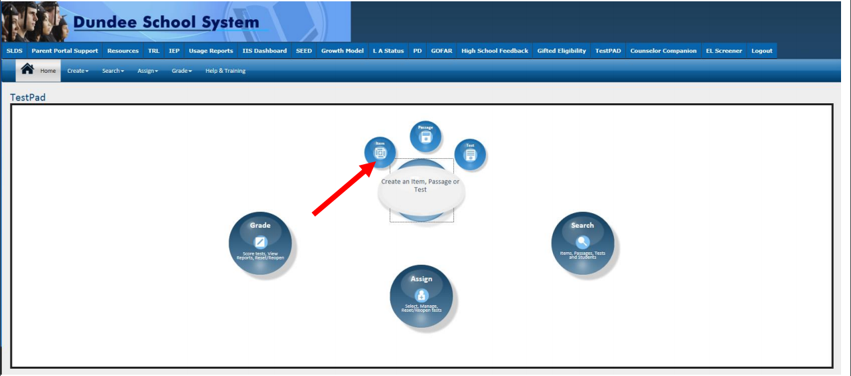
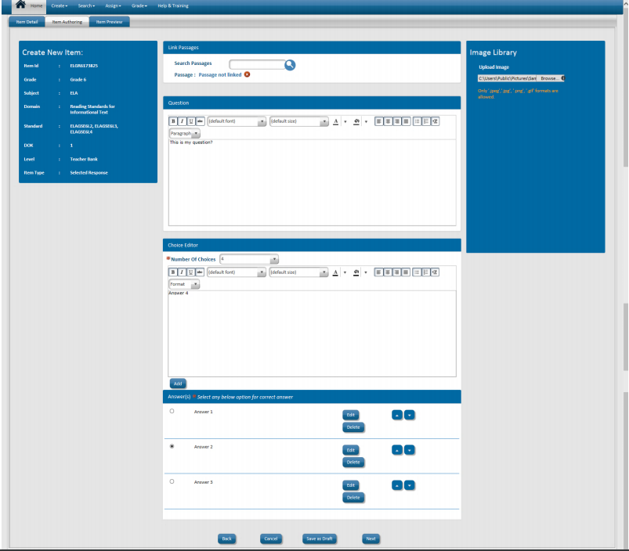
TestPad
Create and manage tests
Create Test Items, Passages and Rubrics
Notes:
TestPad allows teachers and administrators to create custom assessments for formative purposes and is available to teachers through the SLDS portal. There is a bank of test items aligned to state standards. Users can create their own items. Students can take assessments through the student backpack in the SLDS portal.

Slide 81
Introducing DRC BEACON as a Formative Assessment Resource
Notes:
Now I would like to shift to providing an overview of DRC BEACON, Georgia’s new formative assessment resource which will be available through the DRC INSIGHT portal once the preparation work has completed, which is the same for Georgia Milestones and WIDA ACCESS assessments.

Slide 82
Key Features
Aligned to GSE standards
Ongoing field testing of newly-developed DRC BEACON items allows for future alignment to standards, when the GSE are revised.
Truly formative – not high-stakes or used for accountability
The shortened Georgia Milestones continues to fulfill state and federal testing and accountability requirements.
Aligned with Georgia Milestones – standards, item types, delivery platform, accessibility tools and accommodations, estimated performance
Immediate and detailed results to inform instruction
Can administer full content area assessments or “testlets”
Provided free to all Georgia districts and schools as an optional formative assessment resource
Window opens September 9, 2020
Notes:
There are several key features of DRC BEACON that I would like to highlight. As I mentioned, BEACON is aligned to the GSE standards. Ongoing field testing of newly-developed BEACON items allows for future alignment to our standards when the GSE are revised. This tool will be truly formative – it will not be used for high-stakes purposes such as student or school accountability. The shortened Georgia Milestones end of year assessment will continue to fulfill state and federal testing and accountability requirements.
BEACON is aligned with Georgia Milestones in multiple ways, including the standards assessed, item types administered, delivery platform used, and tools and accommodations available. In year 2 it will also provide estimated performance on the end-of-year Georgia Milestones assessment.
BEACON will provide immediate and detailed results to inform instruction. It may be administered as full content area assessments in ELA and/or mathematics or as “testlets” in specified domains. It can be administered to a full class, in small groups, or to individual students as needed.
BEACON is being provided free to all Georgia districts and schools as an optional formative assessment resource.

Slide 83
Possible Scheduling Ideas
Option 2
Option 1
Instruction
Remediate based on need
Accelerate based on mastery
ELA Testlets
Instruction
Remediate based on need
Accelerate based on mastery
Administer based on Domain
Mathematics Testlets
Administer based on Domain
Cycle 1
ELA/Math Fall
Review data
Accelerate
Cycle 2
ELA/Math Winter
Review progress
Accelerate
Georgia Milestones
Review successes
Inform instructional program
Remediate
Remediate
Notes:
DRC BEACON provides timely, detailed data to inform instruction for individual students as instruction is occurring. BEACON is truly a formative assessment and is designed to be used by educators as needed to support instruction and student learning.
Districts have flexibility in determining how best to utilize BEACON. Using one possible idea on the left, teachers can administer full content area assessments 2-3 times per year to track student understanding and progress. This data would be used to adjust instruction as it is still occurring.
The second idea shown on the right allows teachers the ability to utilize domain-specific testlets in between instruction to assess learning as frequently as needed. This approach allows for some progress monitoring and can support students who may need remediation or acceleration individually or in small groups within the classroom.
The two approaches can also be combined to work-in individual or small group testlets between full cycles, as needed, to provide remediation or acceleration.
The final assessment would then be the spring Georgia Milestones, which provides end of year summative data on student mastery. Data from these assessments may be used to review successes and inform the instructional program for the following school year.
With any schedule, districts and schools must consider the total amount of time they want to spend on such testing as well as their capacity in terms of time and devices.

Slide 84
Important Dates and Training
DRC BEACON
Date | Event | Targeted Audience
Tues., 7/21/2020 | Technology Director Training to Successfully Connect to All Online Assessment Platforms | Tech Directors and STCs
Tues., 8/25/2020 | DRC BEACON Overview & Pre-Administration Training | STCs, District, and School-level leadership
Tues., 9/8/2020 | DRC BEACON Launch | All Districts
Tues., 9/15/2020 | DRC BEACON Overview & Pre-Administration Training (Live Repeat) | STCs, District, and School-level leadership
Tues., 11/10/2020 | Using DRC BEACON to Inform Instruction Training | STCs, District, and School-level leadership
Tues., 1/12/2021 | Technology Director Training to Successfully Connect to All Online Assessment Platforms (Live Repeat) | Tech Directors and STCs
Tues., 2/2/2021 | DRC BEACON Training - Mid-Year Guidance & Reporting | STCs, District, and School-level leadership
Tues., 5/25/2021 | Post-Assessment Training | STCs
Notes:
We will be providing a variety of training sessions for BEACON beginning in July and continuing throughout the 2020-2021 school year. All training dates and links will be posted in the Assessment Updates each month as well as posted on the training calendar found on the GaDOE Assessment webpage under the For Educators link.

Slide 85
Contacts
FIP Kelli Harris-Wright, Ed.S. Assessment Specialist – GA FIP 404.463.5047 kharris-wright@doe.k12.ga.us | Questions Regarding TestPad Content & School/System Usage Joe Blessing Program Manager - GA Milestones, TestPad 404.232.1208 jblessing@doe.k12.ga.us
TestPad Web Site http://www.gadoe.org/Technology-Services/SLDS/Pages/TestPAD-Training-and-Support.aspx | DRC BEACON Joe Blessing, Program Manager 404.232.1208 jblessing@doe.k12.ga.us
TestPad Training Site http://sldstrn.gadoe.org/SLDSDemoWeb/TP.aspx | Taiesha Adams, Ed.D., Assessment Specialist 404.656.5975 taadams@doe.k12.ga.us
Questions Regarding TestPad Functionality/Technical Support 1-800-869-1011 slds@doe.k12.ga.us

Slide 86
Keenville
Overview
Keenville is Georgia’s game-based formative assessment in literacy and mathematics for first and second grade students.
Keenville is accessible via the Statewide Longitudinal Data System (SLDS).
Notes:
Read slide.

Slide 87
Keenville
Purpose
Provide
educators a formative measure on essential literacy and numeracy skills in the early grades.
Promote
teaching and learning by guiding differentiated instructional practices to maximize student learning.
Engage
young learners through a series of interactive challenges that directly align to Georgia content standards.
Notes:
Read slide.

Slide 88
Keenville
English Language Arts Games
Notes:
The ELA games assess students’ knowledge and skills related to phonics and word recognition, vocabulary acquisition and use, and reading comprehension of both literary and informational texts.

Slide 89
Keenville
Mathematics Games
Notes:
The Keenville math games assess students’ knowledge and skills in many areas, as shown here.

Slide 90
Keenville
Access
Keenville is accessed by all users via the Statewide Longitudinal Data System (SLDS).
Accessing SLDS requires users to log into the district’s Student Information System (SIS).
All users will need SIS login credentials to access Keenville via the SLDS.
Contact your district SIS Administrators for further access, logins, and passwords as these are directed by your local district.

Slide 91
For additional information and resources, visit keenville.gadoe.org
Lisa Hardman, Ed.S., Assessment Specialist
K-5 Assessment
404.651.9405
lhardman@doe.k12.ga.us
Notes:
Additional information and resources, including the Keenville User Guide, can be found at keenville.gadoe.org.

Slide 92
Creating a School Testing Plan
Notes:
Joe

Slide 93
Testing Plan
Testing Plan
Completed Plan Template
Copies of Communications
Training Materials and sign-ins
Testing Schedule
Notes:
A Testing Plan includes many resources. A sample school assessment plan template can be found on the Resources page of the Assessment website. This optional template can be used to shepherd schools and districts through planning for state testing. Communications to parents, and staff members regarding assessment should be maintained. Schools should keep copies of all training materials and sign ins. Schools should create an annual testing schedule that should be shared with all parties.

Slide 94
School Testing Plan
Before > During > After
Communications | Test Security | Technology | Training
Audiences: Staff, Parents, Students Testing Dates Testing Rules Communications during testing Remediation and Retest Reports | Testing materials Forms Hallways Plans for irregularities Emergency protocols | Testing devices Software on testing devices Centralized software (if needed) Wired and wireless networks Firewalls and security | Training for test examiners Training for accommodations Training for other school staff Maintaining records Training students on testing tools
Notes:
Schools should focus on what happens Before, during and after testing. The major categories for the school testing plan include Communications, Test Security, Technology and Training.

Slide 95
Sampling the Tests
ACCESS for ELLs 2.0 sample items
https://wbte.drcedirect.com/WIDA/portals/wida
DRC BEACON Online Tools Training
https://drcbeacon.com/online-tools-training/
GAA 2.0 Sample Tasks
http://www.gadoe.org/Curriculum-Instruction-and-Assessment/Assessment/Pages/GAA-2.0-Sample-Tasks.aspx
Georgia Milestones Technology Enhanced Items
http://www.gaexperienceonline.com/
Keenville
MyGaDOE portal in the SLDS
TestPad
http://sldstrn.gadoe.org/SLDSDemoWeb/
Let’s Go
Notes:
Teachers, parents and students can access sample items using at the following websites.

Slide 96
Accountability
Notes:
August

Slide 97
Accountability
Point of Contact
Named by school superintendent
Receives key communications from GaDOE accountability team
Participates in monthly Accountability Lunch and Learn webinars
Relays key information to administration at local level
Needs district level CCRPI access in the MyGaDOE portal

Slide 98
2020 Accountability Lunch and Learns
Date | Time | Link
Wed., July 15, 2020 | 12 – 1 p.m. | July 2020 Accountability Lunch and Learn
Wed., August 19, 2020 | 12 – 1 p.m. | August 2020 Accountability Lunch and Learn
Wed., September 16, 2020 | 12 – 1 p.m. | September 2020 Accountability Lunch and Learn
Wed., October 21, 2020 | 12 – 1 p.m. | October 2020 Accountability Lunch and Learn
Wed., November 18, 2020 | 12 – 1 p.m. | November 2020 Accountability Lunch and Learn

Slide 99
2020 CCRPI Applications Calendar
Start | Deadline | Meeting Date | Time | Link
February 10 | July 30 | Meeting Has Occurred | Recording Available | Assessment Matching Window #1
July 2 | July 30 | Meeting Has Occurred | Recording Available | 2020 CCRPI Non-Participation Application Webinar
July 14 * | August 20 | Meeting Has Occurred | Recording Available | 2020 CCRPI Cohort Withdrawal Update Application and Summer Graduate Collection Webinar
* High Schools Only

Slide 100
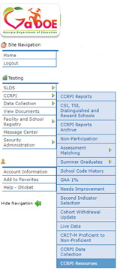
CCRPI Resources in MyGaDOE Portal
• Webinar recordings, PPTs, and user guides are available in the CCRPI Resources section of the MyGaDOE portal.
User guides
Webinar recordings
Other resources not appropriate
for the public site

Slide 101
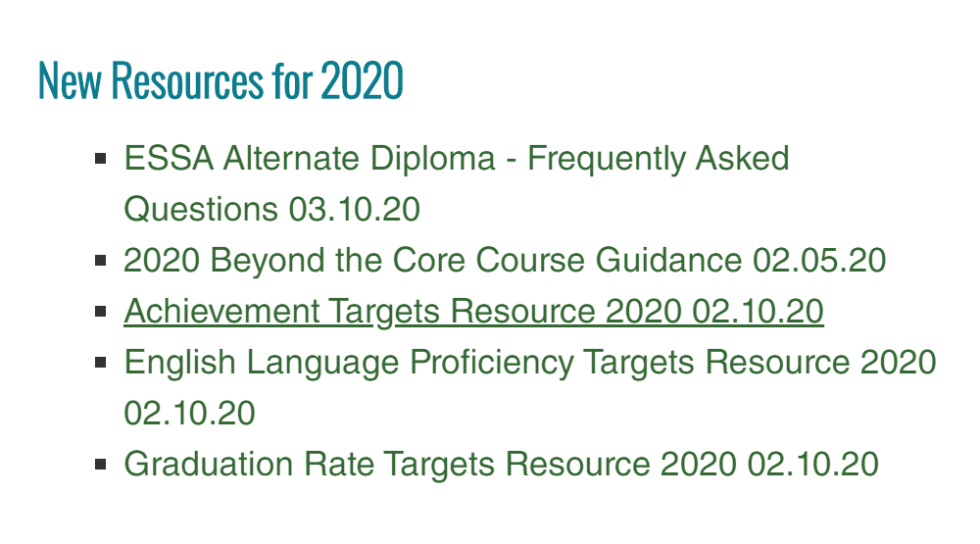
CCRPI Resources on Public Site
Accountability webpage
CCRPI Resources for Educators webpage

Slide 102
GaDOE Assessment and Accountability Specialist Contacts
Assessment Specialists
Taiesha Adams, Ed.D., (404) 656-5975; taadams@doe.k12.ga.us
Bobbie Bable, (404) 657-6168; babble@doe.k12.ga.us
Joe Blessing, (404) 232-1208; jblessing@doe.k12.ga.us
Lisa Hardman, (404) 651-9405; lhardman@doe.k12.ga.us
Kelli Harris-Wright, (404) 463-5047; harris-wright@doe.k12.ga.us
Mary Nesbit-McBride, Ph.D., (404) 232-1207; mnesbit@doe.k12.ga.us
Accountability Specialists
August Ogletree, Ph.D., (404) 463-6675; aogletree@doe.k12.ga.us
Notes:
Sandy

Slide 103
How Did We Do?
Survey Link
State Charter School Presentation Evaluation

Slide 104
Thank you!
Allison Timberlake, Ph.D. Deputy Superintendent for Assessment & Accountability atimberlake@doe.k12.ga.us (404) 463-6666
Jan Reyes, Ed.D. Director of Assessment Development jreyes@doe.k12.ga.us (404) 463-6665
Sandy Greene, Ed.D. Director of Assessment Administration sgreene@doe.k12.ga.us (404) 656-0478
Paula Swartzberg
Director of Accountability
pswartzberg@doe.k12.ga.us
(404) 463-1539
testing.gadoe.org
accountability.gadoe.org

