Slide 1

PRE-ADMINISTRATION WORKSHOP
END OF GRADE (EOG)
Spring Main & Summer Retest 2017
END OF COURSE (EOC)
Spring Main, Summer Main, & Fall Mid-Month 2017
February 28 – March 2, 2017

Slide 2
AGENDA
Georgia Milestones Program Overview
Administration Considerations
  Paper and Pencil Administrations
  Online Administrations
Testing Accommodations
Test Security and Irregularities
Before, During, and After Testing
Important Dates, Resources, and Contacts
Supplemental Slides for Local Training
Examiners &
Students

Slide 3
Georgia Milestones
Program Overview

Slide 4
Content Tested
EOG | EOC
Grades 3–8 English Language Arts Mathematics Grades 5 and 8 Science Social Studies | 9th Grade Literature & Composition American Literature & Composition Coordinate Algebra Analytic Geometry Algebra I Geometry Biology Physical Science United States History Economics/Business/Free Enterprise
Link to detailed list of EOC courses

Slide 5
Georgia Milestones
Test Construction – EOG/EOC
Content Area and Number of Sections | Selected Response | Constructed Response | Extended Constructed Response | Extended Writing Response | Technology Enhanced Evidence -Based/Multiple Part Items
 | 1 point | 2 points | 4 points | 7 points | 2 points
English Language Arts (3) |  |  |  |  | 
Mathematics (2) |  |  |  |  | 
Science (2) |  |  |  |  | *
Social Studies (2) |  |  |  |  | *
*Field Test Slots
Notes:
5

Slide 6
Reading &
Evidence-Based Writing
Spring 2017
Beginning in Spring 2017, students will take the 5-question section of the ELA test that contains the extended writing prompt on day 1 of testing.
  Within this section, students read two short passages, answer 3 multiple-choice and 1 constructed-response items, and then answer an extended-writing prompt.
  The structure of this section remains the same – only the order of administration has changed.
  This decision was made based on feedback as well as to allow additional time for scoring.
  If a student does not complete Section 1 ELA on the day it is started due to illness or another situation, please contact DOE for guidance before testing ELA Sections 2 and 3.
Remember: Four of the items contribute to the Reading and Vocabulary domain, with only the extended writing task contributing to the Writing and Language domain.

Slide 7
Administration Times
EOG/EOC
ELA Order Revised 2016–2017
Content Area/Course | Test Section(s) | Minimum Time Per Section(s) | Maximum Time Per Section(s)
English Language Arts, Reading and Evidence-Based Writing | 1 | 70 | 90
English Language Arts | 2 and 3 | 60 | 75
Mathematics | 1 and 2 | 60 | 85
Science | 1 and 2 | 45 | 70
Social Studies | 1 and 2 | 45 | 70
Note: These maximum time limits do not apply to those students who have the accommodation of extended time.

Slide 8
Test Windows
Spring and Summer 2017
EOG | EOC
Spring Main: April 3 – May 5 9 consecutive school day window for paper and pencil administrations 12 consecutive school day window for online/mixed mode administrations | Spring Main: April 24–June 2 System can use entire state testing window The test day for each particular EOC should be consistent throughout the system; however, the actual time of day for test administration may vary from school to school.
Summer Retest: May 15–July 21 5 consecutive school day window; up to two local windows (i.e.; Grades 3 and 5 one week, and Grade 8 another week) | Summer Main (Retests allowed) June 19–July 21*
*Test-out administrations allowed.

Slide 9
Scheduling Consideration Reminders
EOG | EOC
The EOG must be given in this order – ELA, Mathematics, Science, and Social Studies. | The school district can set the order of the EOC administration.
Section 1 English Language Arts should be scheduled exclusively on a day separate from English Languages Arts Sections 2 and 3 or any other content. ELA Sections 2 and 3 and Sections 1 and 2 of other content must be scheduled such that both will be completed in a single day or over the course of two consecutive days.
The break between sections administered on the same day should be 10 minutes and not used as a break for lunch.
Administrations for an EOG grade level content or EOC subject must be completed within the same week. The exception is ELA Section 1 which can start the week before ELA Sections 2 and 3.
The last day of the local window should be a scheduled makeup day.

Slide 10
Participants EOG*
Spring and Summer 2017
Students to be Tested
Makeup Testing
Retest
Testing includes all students enrolled in grades 3 through 8, except for those participating in the GAA or who have an EL deferment for English Language Arts and Social Studies. EL deferred students MUST have participated in the 2017 ACCESS for ELLs.
Make-up tests must be given within the system’s scheduled local administration window; the last day of the local window should be scheduled as a makeup day.
Students who are not on Grade Level for Reading in Grades 3,5,8
Students who score in the Beginning Learner achievement level in mathematics in Grades 5,8
For Grades 3, 5, or 8 – a new student who has not tested should participate in the required promotion/retention EOG content assessment(s) for that grade level if the state window is still open
Strategic Waivers are managed locally.
Advanced middle school students enrolled in an EOC course MUST take the required EOC.
- If they are taking an ELA or a Social Studies EOC they MUST also take the grade level ELA and Social Studies EOG.
- They must NOT be administered the grade level mathematics or science EOG if taking a mathematics or science EOC.

Slide 11
Participants EOC*
Spring Main and Summer Main 2017
Enrolled in EOC Course(s) – Spring and Summer
Enrolled in specified courses/programs – Spring and possibly Summer
Validation of Credit – Spring and Summer
Counts as 20% of grade.
AP/IB Course enrollees in EOC associated courses
GAVS **
Credit Recovery
Transfer students from home school, non-accredited entities
Includes: Students with Disabilities (SWD) and English Learners (EL)
No First Year in US School deferrals for EL students on EOCs
Students simultaneously enrolled in a GA public school and a private school or non-traditional entity
Move on When Ready/Dual Enrollment students
*See Student Assessment Handbook (SAH) ** Coordinators must bubble 30 in SDU-A for GAVS students.

Slide 12
Participants EOC*
Summer Main 2017
Retest (Summer)
Test Out (Summer)
Make up from Previous Administration (Summer)
An eligible middle or high school student may test-out of any course that has an associated EOC.
The Summer 2017 EOC Administration can be a makeup opportunity for students who missed the Spring 2017 EOC Administration
If the student reaches the Distinguished Learner achievement level, the local board of education shall award the student associated course credit.
May be made available to, but not required for, students who received a Grade Conversion Score below 70 on the Spring 2017 Administration. The Fall 2017 Mid-Month can be another option for retesting these students as well.
*See Student Assessment Handbook (SAH) pages 61-65.

Slide 13
MOWR EOC
Required vs Exemptions
Required of All Students | Allowed Exemption
9th Grade Literature & Composition | American Literature & Composition
Coordinate Algebra/Algebra I | Physical Science
Analytic Geometry/Geometry | United States History
Biology | Economics
To ensure high schools are not negatively impacted, use the college-issued grade in the CCRPI for remaining EOC-related courses, for example:
  A = Distinguished Learner
  B = Proficient Learner
  C = Proficient Learner
  D/F = Beginning Learner

Slide 14
Report Distribution
Report Type/Data File | eDIRECT | MyGaDOE Portal | Paper
Individual Student Report (ISR) | X |  | X
Class Roster | X
Student Labels |  |  | X
Remediation/Retest Rosters (EOG Only) | X
Content Area Summary - School Level |  | X
Content Area Summary - System Level |  | X
Content Area Summary - State Level |  | X
Summary Report of All Student Populations - School Level |  | X
Summary Report of All Student Populations - System Level |  | X
Summary Report of All Student Populations - State Level |  | X
Student Data File – System (.xlsx only) | X
Student Data File - System (.txt and .xlsx) |  | X
Rosters and data files will populate by content as scores become available, refreshing overnight; all students testing in a common session might not post at the same time

Slide 15
Scoring and Reporting Timelines
ELA/Mathematics | TEST MODE
 | Online (from submission of online test) | Paper-Pencil (from receipt of scorable documents at scoring center)
EOC | 12 business days | 15 business days
EOG (Grades 3, 5, and 8) | 11 business days | 15 business days
EOG (Grades 4, 6, and 7) | 16 business days | 20 business days
EOC/EOG Science and Social Studies | 5 business day | 5 business days
Important Note: Failure to follow protocols and/or notify GaDOE and DRC of local testing windows will impact (delay) reporting dates.
Enrollment Guide:
https://ga.drcedirect.com/Documents/Unsecure/Doc.aspx?id=09311f26-bef9-49d1-8516-8cbd33180302

Slide 16
Test Dates: Implications for Scoring and Reporting
Example 1:
5/2/17 Complete Testing ONLINE
9th Grade Lit EOC
Scoring proceeds as sections are completed
Reporting does not proceed until all sections are complete for a student
Preliminary reports post no later than Friday, 5/19/17
Example 3:
4/14/17 Complete Testing PAPER
Grade 3 ELA and Math
Return answer documents by UPS-RS 4/17/17
Material arrives DRC 4/19/17
Example 4:
4/28/17 Complete Testing PAPER
EOC Economics
Return answer documents by UPS-RS 5/1/17
Material arrives DRC 5/3/17
Preliminary reports post no later than Thursday, 5/11/17
Example 2:
5/1/17 Complete Testing ONLINE
Grade 5 ELA and Math
Scoring proceeds as sections are completed
Reporting does not proceed until all sections are complete for a student
Preliminary reports post no later than Wednesday, 5/17/17
Preliminary reports post no later than Thursday, 5/11/17
Adequate time for grades to be entered prior to report cards being issued?
Adequate time for remediation and retest?
Adequate time for graduation decisions to be made?

Slide 17
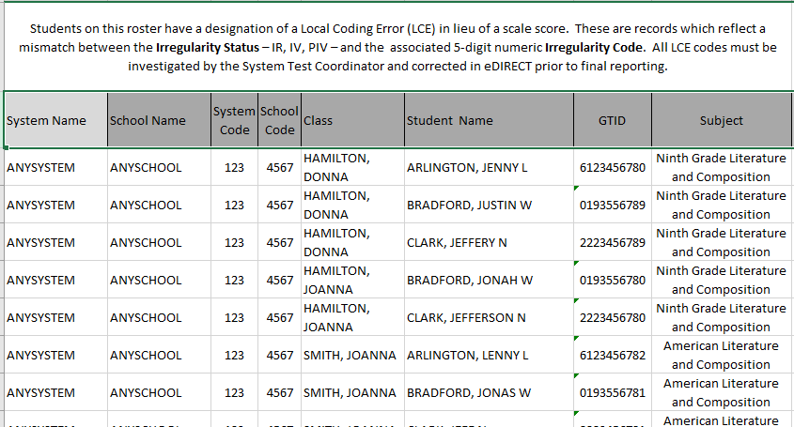
Report in eDIRECT for Local Coding Error (LCE)
If there is an error with the entry of a Testing Irregularity, a scoring designation of Local Coding Error (LCE) – will appear for the affected content on all reports
Please check the LCE report and correct this error immediately
Online Test Takers - login to eDIRECT and correct the irregularity coding for affected students
Paper and Pencil Test Takers – Guidance to come
LCE also reports on Class Rosters and Individual Student Reports

Slide 18
Administration Considerations

Slide 19
Scratch Paper
REVISED 2015–2016
Examiners
ENGLISH/LANGUAGE ARTS
  Allowed in all Sections:
  Section 1 – start with two sheets
  Section 2 and 3 – start with one sheets
MATHEMATICS
  Allowed in both Sections – start with two sheets
  EOG – no graph paper
  EOC – ¼” graph paper may be provided FOR EOC MATHEMATICS ONLY http://www.gadoe.org/Curriculum-Instruction-and-Assessment/Assessment/Pages/Georgia-Milestones-Assessment-System.aspx
SCIENCE
  Allowed in both Sections – start with one sheet
SOCIAL STUDIES
  Allowed in both Sections – start with one sheet
Applies to paper-pencil & online settings.
Follow instructions in the test administration manuals regarding the distribution and return of scratch paper.
Students may write in their test booklet (but no highlighters).
Students can request additional scratch paper
** Scratch paper is considered SECURE once used **

Slide 20
Calculator Policy
Examiners
Content Area | Grade Level/Course | Type of Calculator
Mathematics | Grades 3-5 | Not Allowed
 | Grade 6 | Basic¹
 | Grades 7 and 8 | Basic¹ or Scientific
 | Coordinate Algebra | Scientific or Graphing
 | Analytic Geometry | Scientific or Graphing
 | Algebra I | Scientific or Graphing
 | Geometry | Scientific or Graphing
Science | Physical Science | Basic¹ or Scientific
Social Studies | Economics | Basic¹ or Scientific
¹ The online calculator will be a basic four function calculator; a hand-held basic calculator can have square root and percentage functions
Calculators are not permitted on Section 1, Part A, of each mathematics test in grades 6–8 and high school. Calculators are not permitted at all in grades 3–5 mathematics.

Slide 21
Calculator Policy
System Test Coordinators, School Test Coordinators, and Test Examiners must ensure all calculator policies are implemented and followed.
Given that many models of graphing calculators and some scientific calculators possess the ability to store text, and may prevent that feature from being disabled, it is required that System and School Test Coordinators, and Test Examiners, confirm prior to testing and immediately after testing (before dismissing students) that all graphing calculators are cleared of any stored text.
  A failure to confirm that text is cleared may raise school-wide (and possibly system-wide) security concerns.
  A failure to take these steps constitutes an irregularity that must be reported to GaDOE.
  Failure to clear memory both BEFORE and AFTER may result in an invalidation.
Examiners

Slide 22
Paper and Pencil Administrations
Guidance for Student Answer Documents and Student Test Booklets
Coding Student Answer Documents
Application of Labels to Student Answer Documents

Slide 23
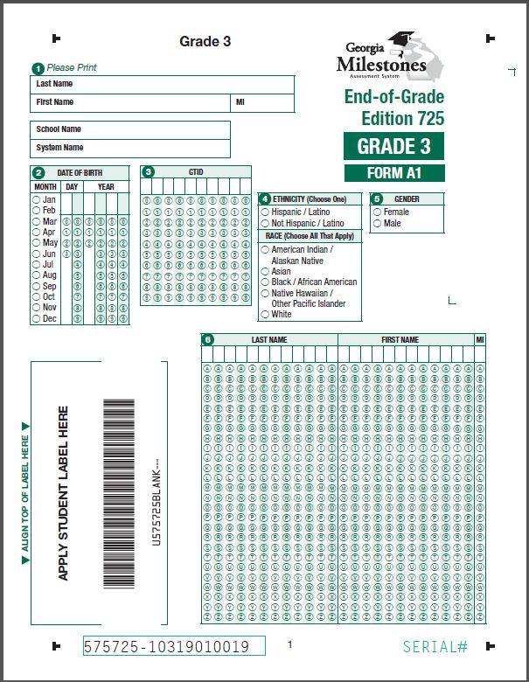
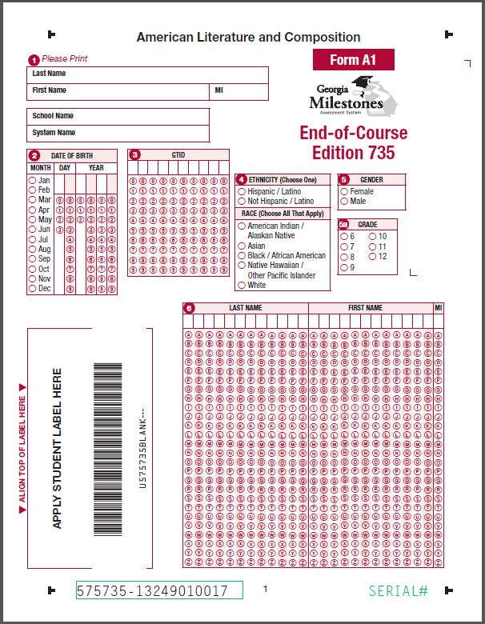

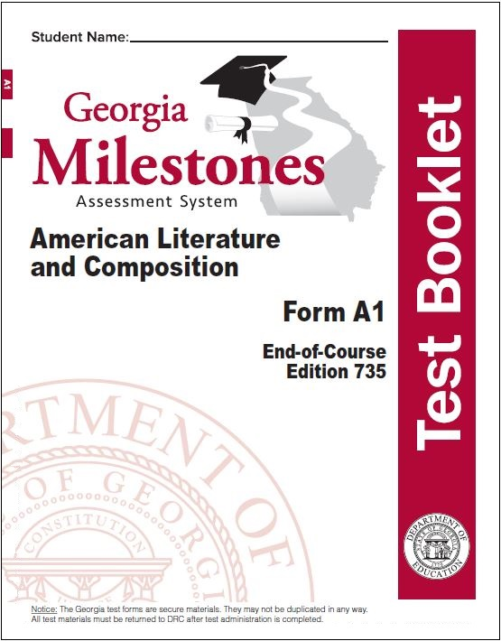
Test Forms
For paper administrations, only Form A1 and one answer document for each EOG grade level content and EOC subject.
Examiners

Slide 24
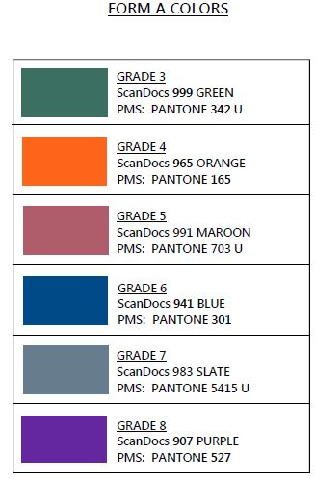
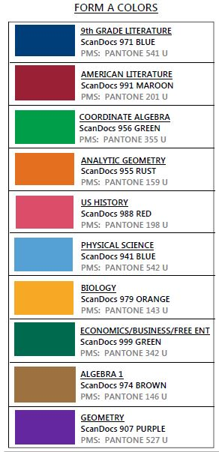
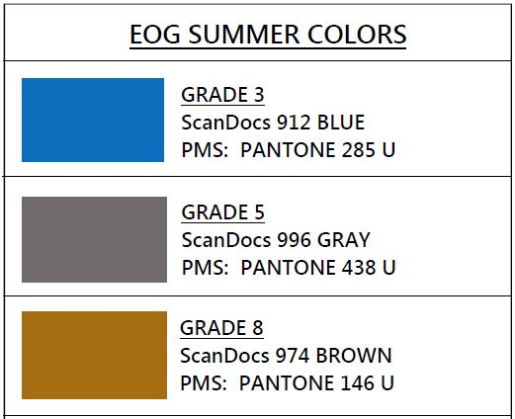
Paper and Pencil
Color Scheme
EOG
EOC
EOG Summer
Examiners

Slide 25

Answer Document
Use #2 pencils ONLY on Georgia Milestones.
Ink pens are NOT allowed on Georgia Milestones.
This includes ELA Section 1.
Responses written in ink cannot be scored.
Examiners

Slide 26
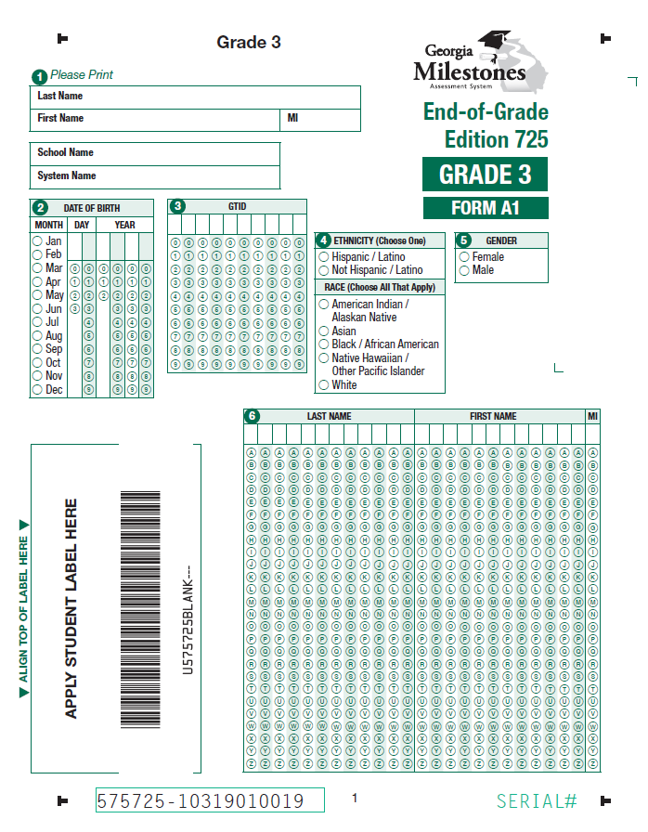
Answer Document – EOG
Print Name, School
and System
Affix:
Student Label or
District/School Label
Do not submit documents to be scored without a Pre-ID or District/School label.
Critical If you do not have a Pre-ID label for a student, place a District/School label on the document and bubble all demographic information.

Slide 27
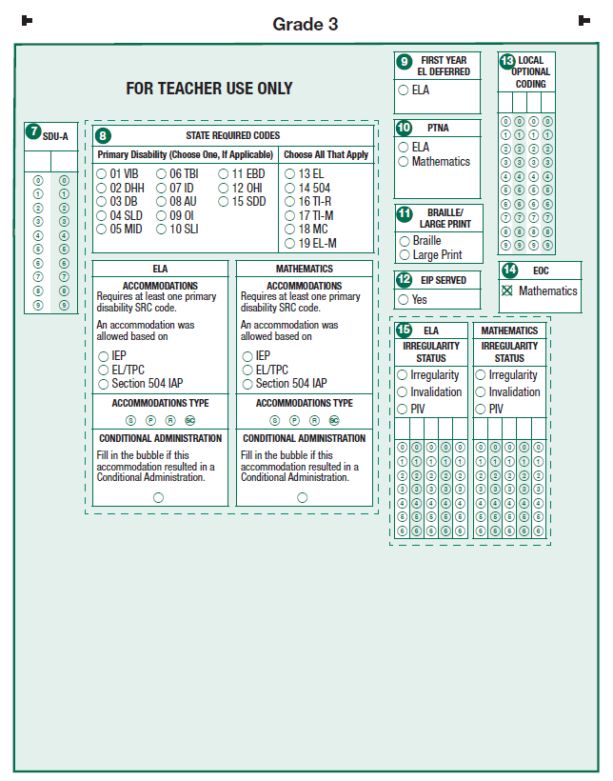
Answer Document – EOG
Districts have the option of coding for local analysis
Required if accommodation type is selected
GNETS
Present, Test Not Attempted by content
More than one can be selected
Must be completed for each content for which student received an accommodation
Complete for Grades 6–8 if student took EOC in lieu of EOG
Complete with guidance from GaDOE

Slide 28
Answer Document – EOC
Print Name, School,
and System
Affix:
Student Label or
District/School Label
Do not submit documents to be scored without a Pre-ID or District/ School label.
Critical: If you do not have a Pre-ID label for a student, place a District/School label on the document and bubble all demographic information.

Slide 29
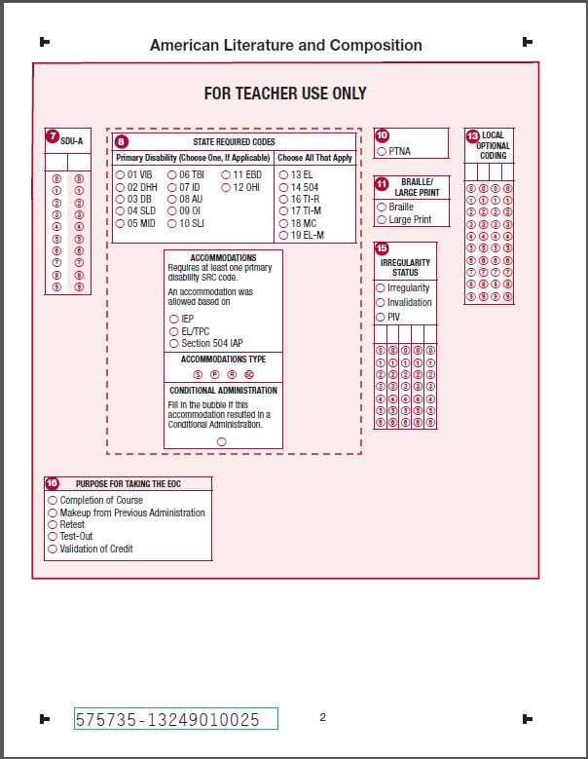
Answer Document – EOC
Required if accommodation type is selected
More than one can be selected
Present, Test Not Attempted
GNETS
GAVS
Complete with guidance from GaDOE
Bubble Purpose for Taking the EOC
Additional detail on subsequent slides

Slide 30
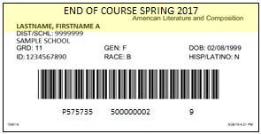
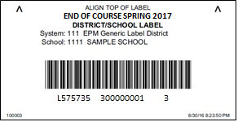
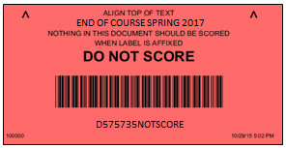
Labels
Pre-ID Label
Links the answer document to the student in eDIRECT.
Two labels provided for each EOG student enrolled for paper or online test.
One label provided for each EOC student enrolled for paper test.
EOG: White with a horizontal stripe of BLUE at the top. EOC: White with a horizontal stripe of YELLOW at the top
District School Label
For who were not in students the Pre-ID file.
Indicates that the answer document is scorable and links to the specific system and school.
Labels are WHITE.
Do Not Score Label
Use for answer documents with Pre-ID or District/School labels affixed but should not be scored.
Should also include voided answer sheets that contain student responses but might not have a label applied
Labels are fluorescent RED.

Slide 31
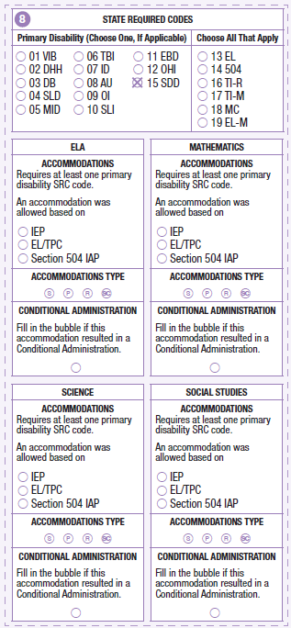
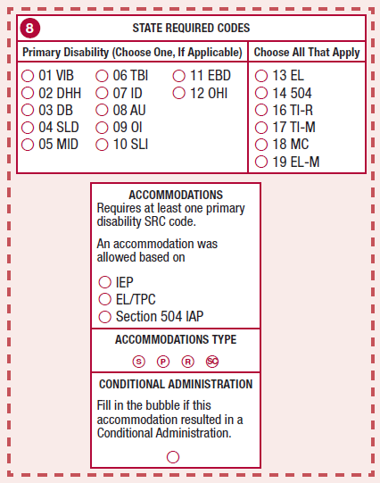
Answer Documents
FOR TEACHER USE ONLY
SRC and Accommodations
EOG
Complete Following Sections Only if Applicable
SRC must be coded for students with IEP, EL/TPC, or 504 IAP, with or without accommodations
Types of accommodations (more than one can be selected):
  S – Setting
  P – Presentation
  R – Response
  SC – Scheduling
Identify basis of accommodations:
  IEP, EL/TPC, or 504 IAP
EOC

Slide 32
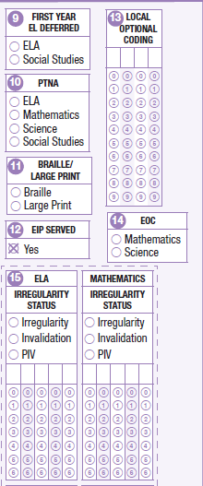
Answer Documents
FOR TEACHER USE ONLY
Additional Coding – EOG
Students must have participated in ACCESS for ELLs
The PTNA option should only be bubbled by the Examiner if a student is present and can not or will not take a test. If a student answers one question on any section of the test, PTNA should NOT be bubbled.
If applicable, code Braille or Large Print.
Complete for Grades 6–8 if student will take EOC in lieu of EOG
Bubble one Irregularity Status and enter 5 digit Irregularity Code as provided by GaDOE. Note: All content areas will be on the EOG Student Answer Document

Slide 33
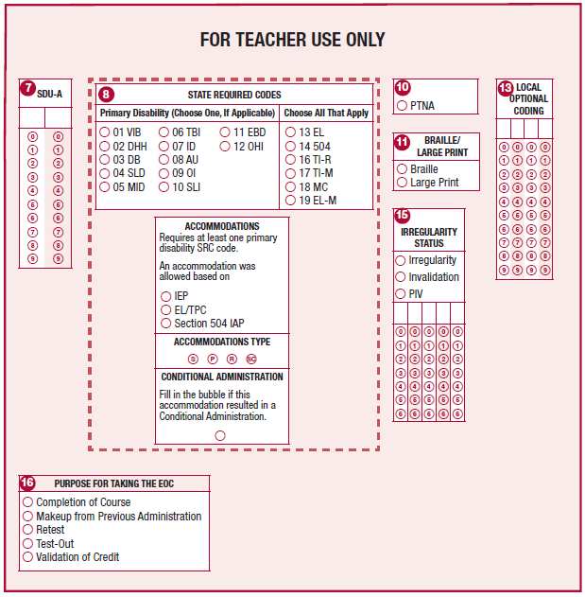
Answer Documents
FOR TEACHER USE ONLY
Additional Coding – EOC
The PTNA option should only be bubbled by the Examiner if a student is present and can not or will not take a test. If a student answers one question on any section of the test, PTNA should NOT be bubbled.
If applicable, code Braille or Large Print
State Required Codes and Accommodations addressed on a previous slide
Bubble one Irregularity Status and enter 5 digit Irregularity Code if directed by GaDOE

Slide 34
Orient Students and Examiners Prior to Testing and Monitor Carefully During the Test Session
Paper and Pencil
Examiners &
Students

Slide 35
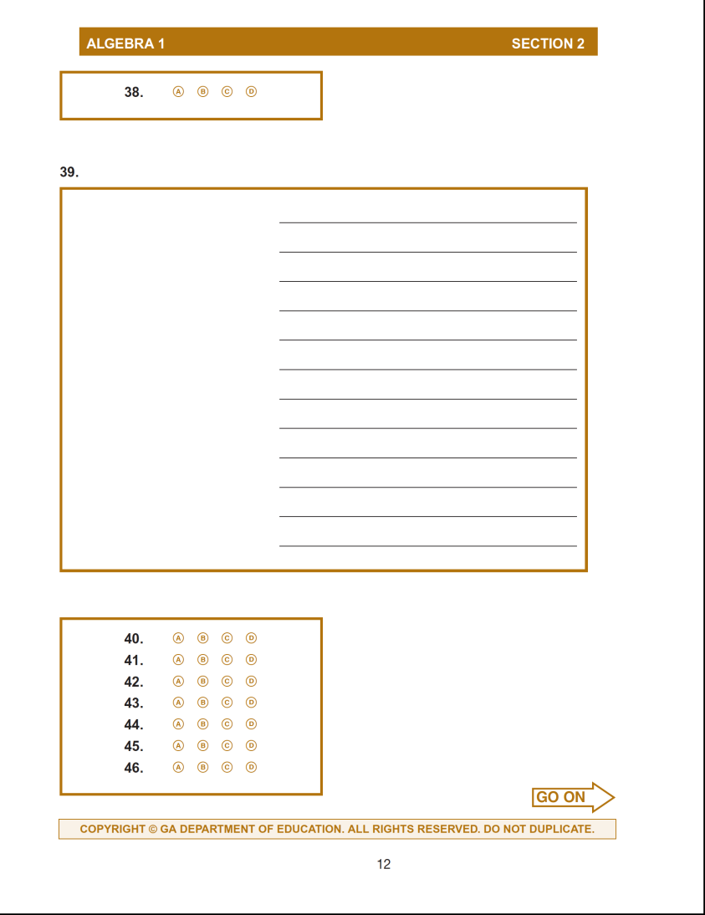

Answer Document
Course name banner across the top of document
Stop signs
All item numbers to assist item answer clarity
Go-on arrows
Examiners &
Students

Slide 36
Section Breaks in Student Test Booklet
Paper and Pencil Administration Only
Examiners &
Students

Slide 37
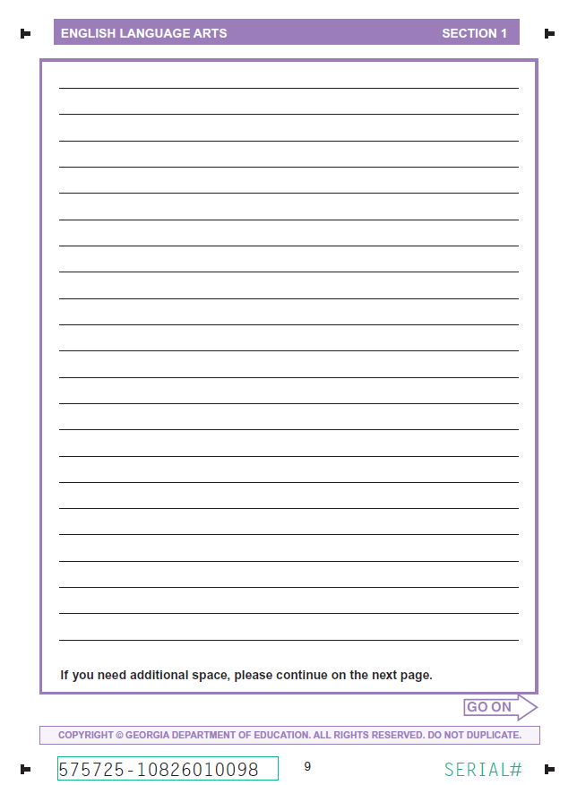
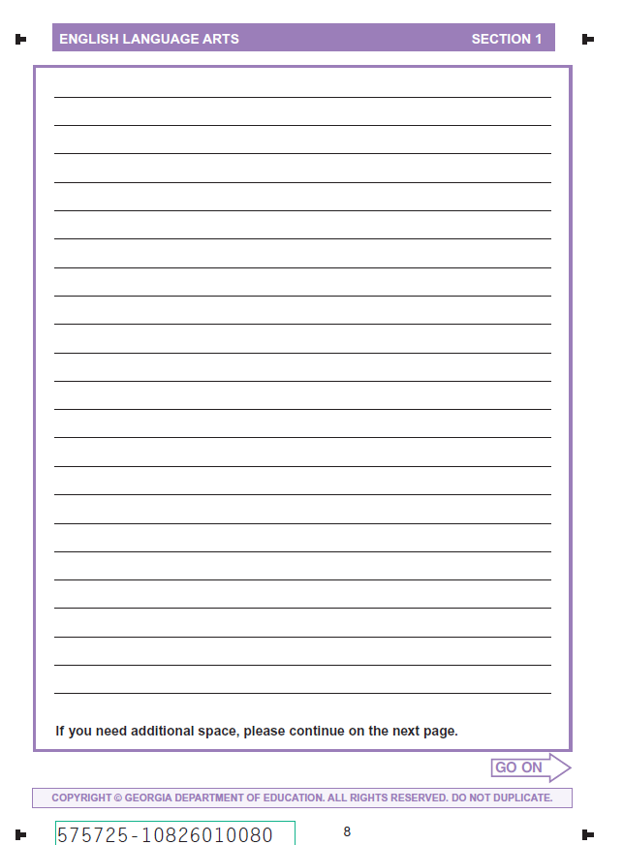
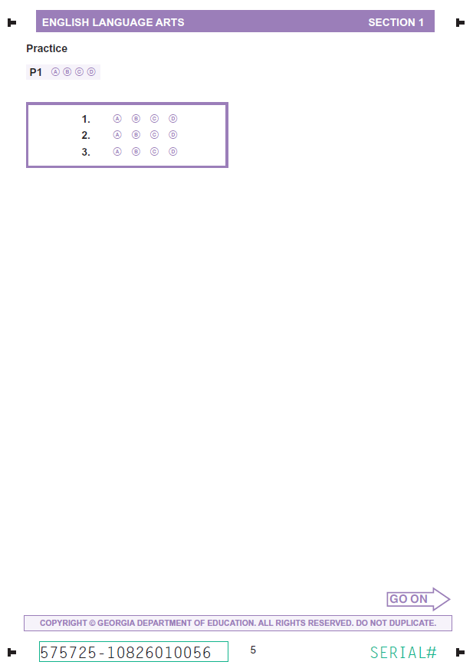
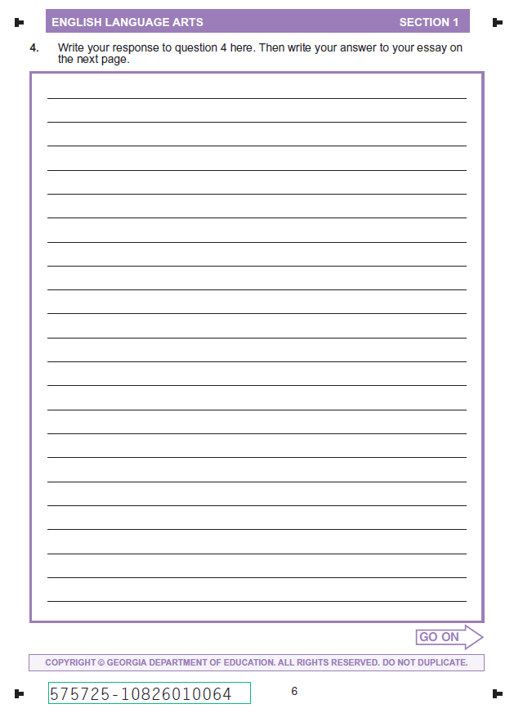
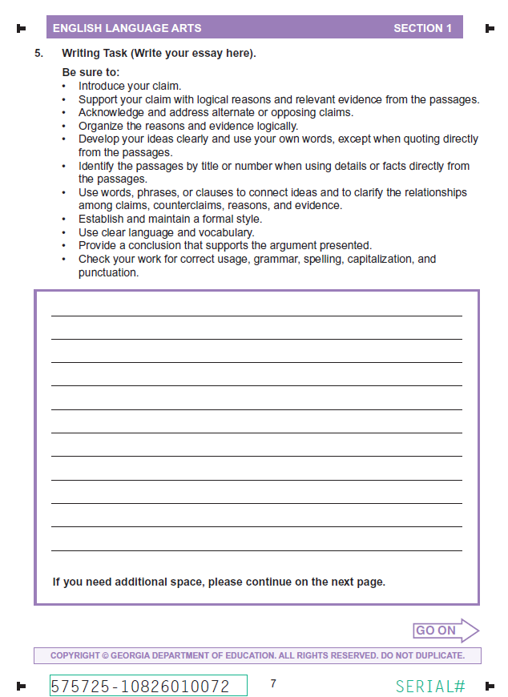
ELA, Reading and Evidence-Based Writing
Section 1 for ELA
Comparable layouts for EOG and EOC
Item 5 is the 7 point Extended Writing Task
Items 1-3 selected response
section
Item 4 constructed response section
Item 5 extended response section
Examiners &
Students

Slide 38
Mathematics
Section 1, Part A
Paper and Pencil Administration Only
All pages in Mathematics in Section 1, Part A will have a similar unique heading for Grades 6-8 EOG and EOC.
This heading should be readily visible from a distance.
The script in the Examiner’s Manual will also identify the item numbers that comprise the Section 1, Parts A.
Examiners &
Students

Slide 39
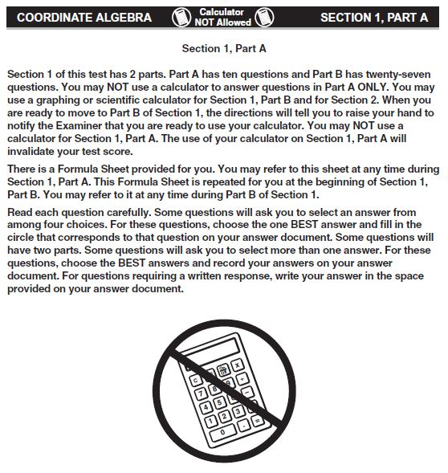
Mathematics
Grades 6–8 and EOC
No-Calculator Subsection
This language will appear at the beginning of Section 1, Part A, of the paper and pencil test.
Do NOT distribute calculators until Section 1, Part B, to students taking Grades 6–8 and EOC Mathematics
Examiners &
Students

Slide 40
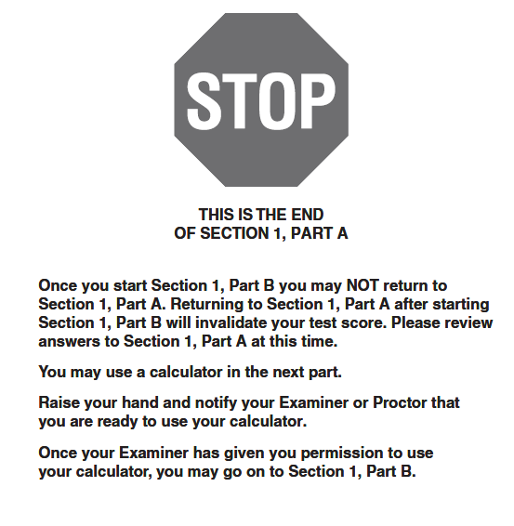
Mathematics
Grades 6–8 and EOC Transition to Calculator Subsection
Stop sign and guidance to not return to Section 1, Part A, from paper-and-pencil answer document and transition page.
Note: Student is prompted to raise hand to receive a calculator
Examiners &
Students

Slide 41
Online Test Administration

Slide 42
eDIRECT contains…
Students will be loaded from the State Pre-ID File.
  This includes students who were marked as “Yes” in the Online Field and paper testers.
  Students will be loaded into online Test Sessions only if they were marked as “Yes” in the Online Field.
  All other students will be loaded into Paper/Pencil test sessions.
Students loaded manually via the Manage Students function in eDIRECT Test Setup
Students bulk loaded via the Multiple Student Uploads function in eDIRECT Test Setup.
Students testing on paper once their answer documents have been scanned (if they were not previously loaded).
Details will be provided in the upcoming eDIRECT Test Setup training sessions (March 6 & March 13, 2017).

Slide 43
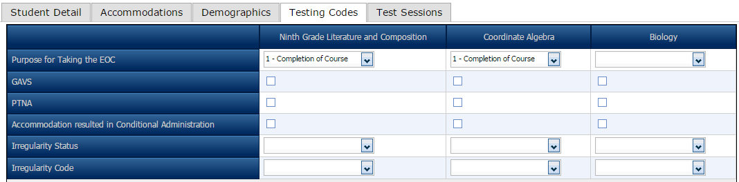
Edit Student Information EOC Online
Directions in subsequent slide
Test Setup Training, March 6 and 13




Directions in subsequent slide

Slide 44
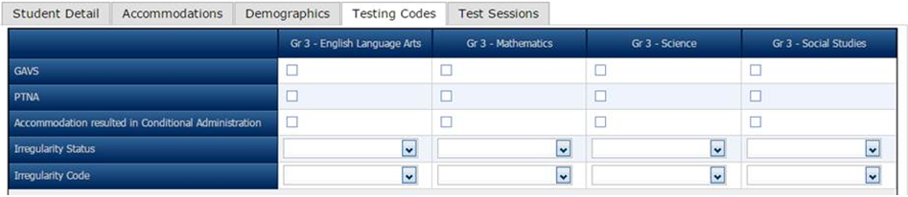
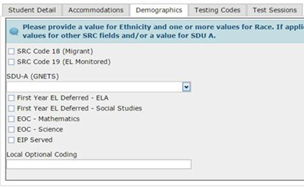
Edit Student Information
EOG – Coding EOC in lieu of EOG
Directions in subsequent slide
EOC Only


Directions in subsequent slide
Test Setup Training, March 6 and 13

Slide 45
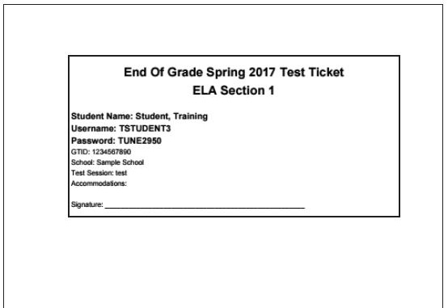
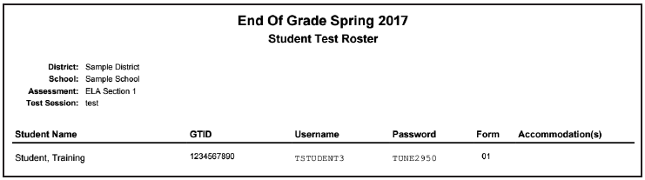
Test Tickets Test Rosters
Test Tickets will print one to a page, and Each Test Ticket contains the student’s username and password for the test session. Note that the student will have a separate Test Ticket for each section of the test.
The Student Test Roster contains a list of students and the usernames and passwords for each student.
Note: Paper Test Booklet Form A1 is equivalent to online Form 01
To avoid a student testing under another student’s GTID, you must:
Print ALL Student Tickets.
Have students verify their name and test name are correct and sign the ticket next to their name.
If a change is made to a student record (e.g., adding an accommodation), create a new test ticket for that student, which will have a new login/password.
Examiners &
Students

Slide 46
Orient Students Prior to Testing and Monitor Carefully During the Test Session
Online

Slide 47









Online Tools
All Students
TOOL | ICON | CONTENT AREA
Periodic Table |  | EOG and EOC Science
Reference/Formula Sheet |  | EOG and EOC Math, EOC Science
Highlighter |  | ALL
Sticky Note |  | ALL
Flag |  | ALL
Line Guide |  | ALL
Online Calculator |  | Grades 6–8 and EOC Mathematics; EOC Science; EOC Economics
Graphing Tool |  | EOC Mathematics only
Cross-off Tool |  | ALL
Examiners &
Students

Slide 48
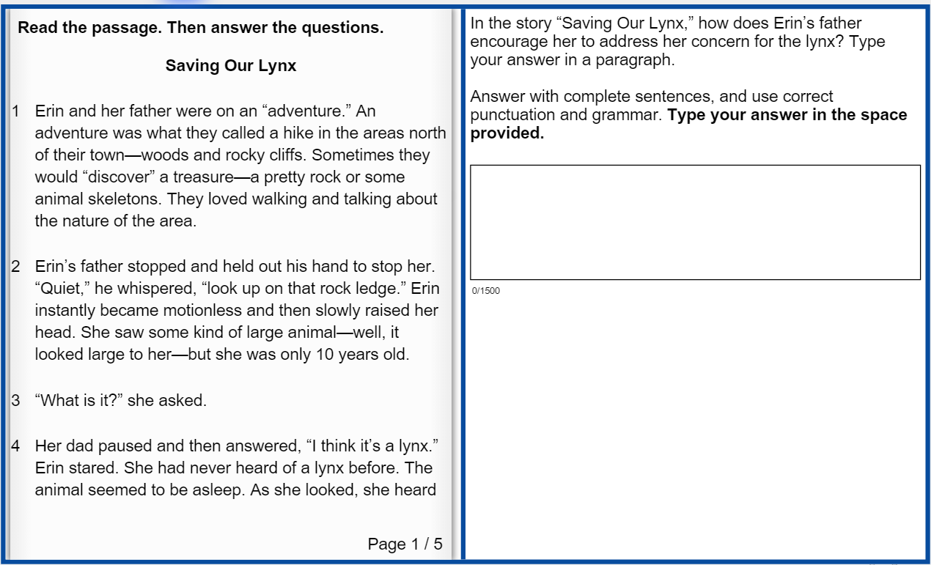
ELA Section 1 Online Item 4, 2 point Constructed Response
ELA Section 1, Reading and Evidence-Based Writing
Online Test Takers
The left side of the screen with the Reading Passage and the right side of the screen with the test items and Writing Task function independently.
Students can refer to either passage or Writing Task while typing a response.
Short cut keys for Text Entry Boxes
Ctrl + C = Copy
Ctrl + X = Cut
Ctrl = V = Paste
Examiners &
Students

Slide 49
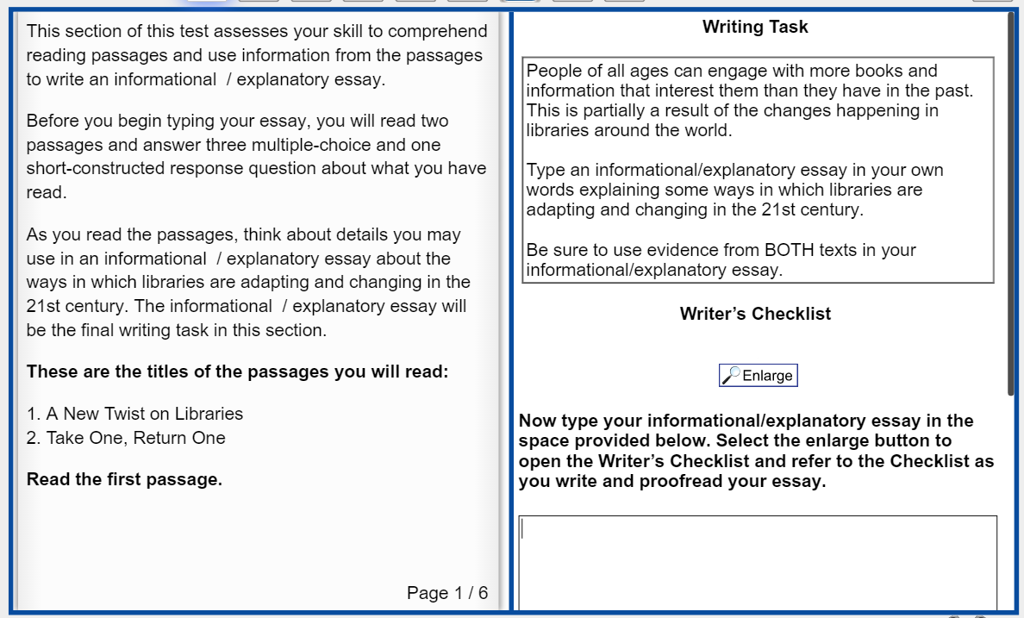

ELA Section 1, Reading and Evidence-Based Writing - Item 5
The Extended Writing Task is displayed on right side of the screen.
Turning pages requires clicking on the left or right side of the Reading Passage
Top of response field displays at bottom of screen
Examiners &
Students

Slide 50
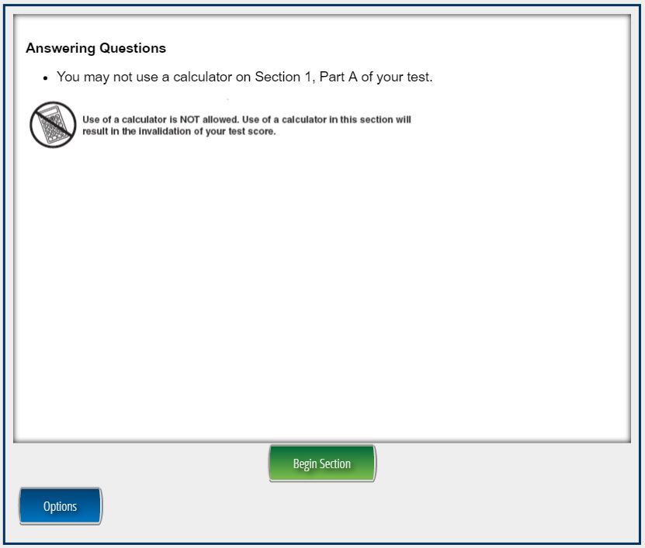
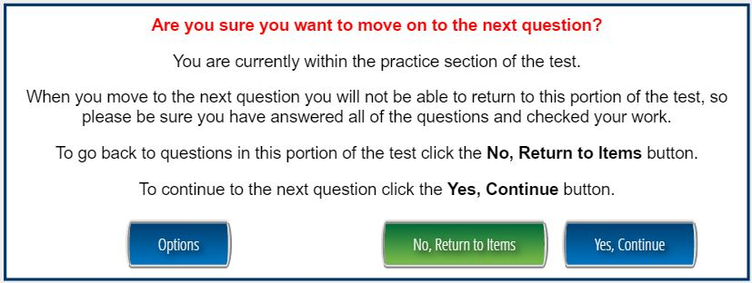
Mathematics
Section 1, Part A , Online
The Examiner’s Manual will identify the item numbers that comprise the Section 1, Part A.
The section is preceded by instructions indicating that calculator use is not allowed in this section.
At the end of the section, the student will be stopped before proceeding to the calculator use section.
Examiners &
Students

Slide 51
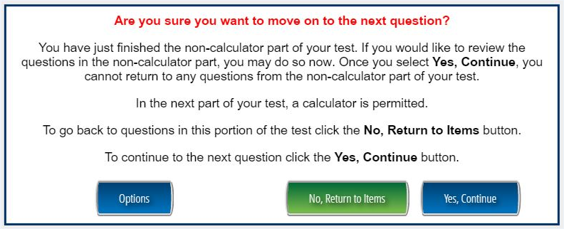
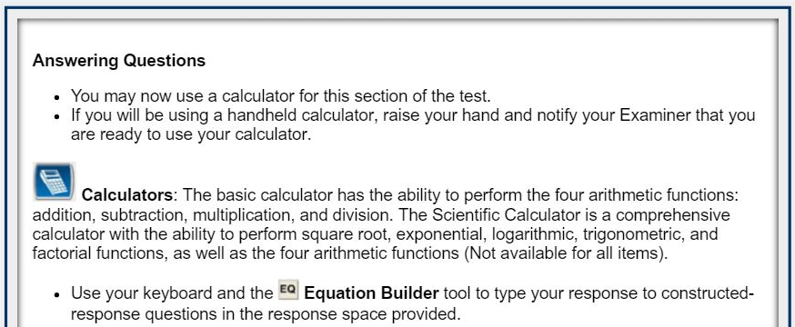
Mathematics
EOG – Grades 6–8
Transition to Section 1, Part B
Examiners &
Students

Slide 52
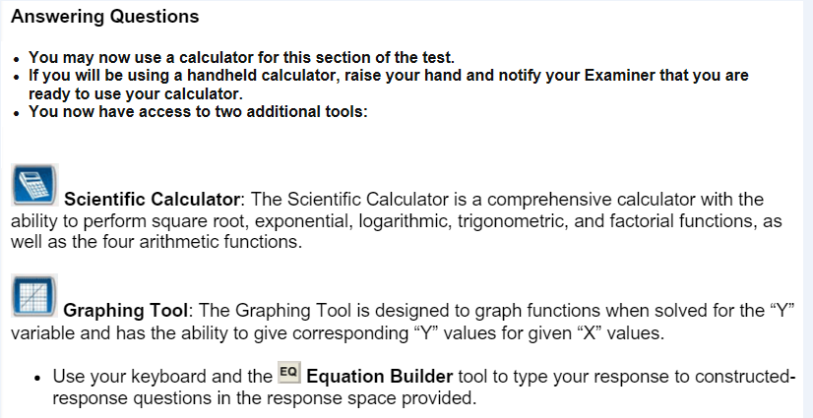
Mathematics
EOC
Transition to Section 1, Part B
Examiners &
Students

Slide 53
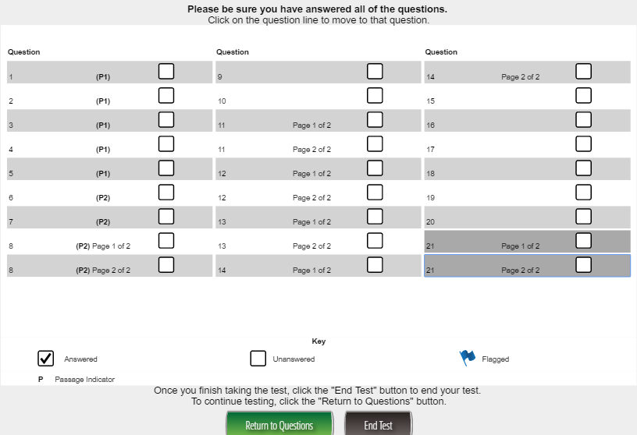
To Correctly Close Out a Section
After the last question in a section the Next button displays this screen; select End Test
Examiners &
Students

Slide 54
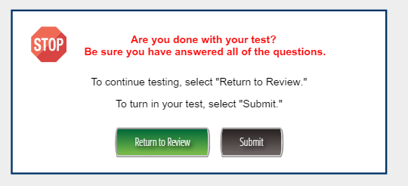
To Correctly Close Out a Section
Submit button sets the section to complete
Examiners &
Students

Slide 55

In order for student responses to automatically export for scoring
All sections of a test must be in completed status
Using the Student Status option, the School and/or System Testing Coordinators should verify that test sections believed to be complete are not in “in progress”, “locked”, or “not started” status.
Sections believed to be complete but not in completed status can be logged into by the student and under supervision set to Completed status using the End Test and Submit buttons.

Slide 56
Different Item Types
Orient Students and Examiners
Paper and Pencil and Online www.gaexperienceonline.com

Slide 57

Item Types
Orient Students Prior to Testing
  Multiple-Part Items
  Operational test items in ELA and mathematics, Field test items in science and social studies
  Evidence-Based Selected-Response (EBSR) Items for English Language Arts – a two-part multiple-choice item that requires students to complete both parts
    First part answers inferential or key concept question related to text. Includes one correct response
    Second part is evidence from the text used to support the inference or idea. May include one or more correct response(s)
    Two-point score value with opportunity for partial credit. Part One and Two must be correct to receive 2-Points. One-Point if only Part One is correct.

Slide 58
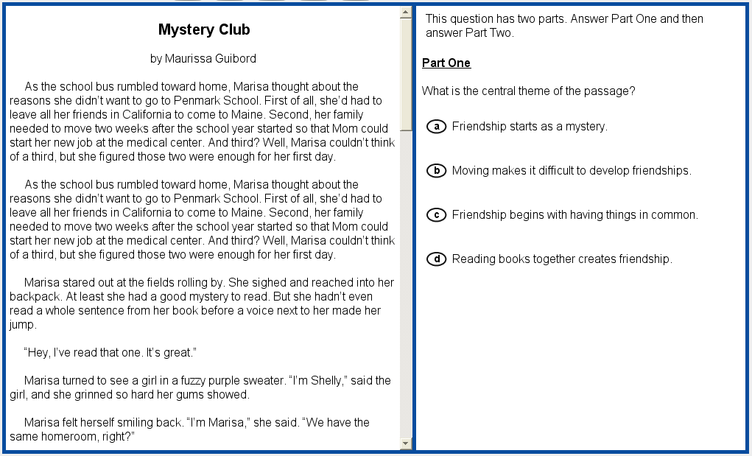
Evidence-Based Selected Response – Part I Online
Examiners &
Students

Slide 59
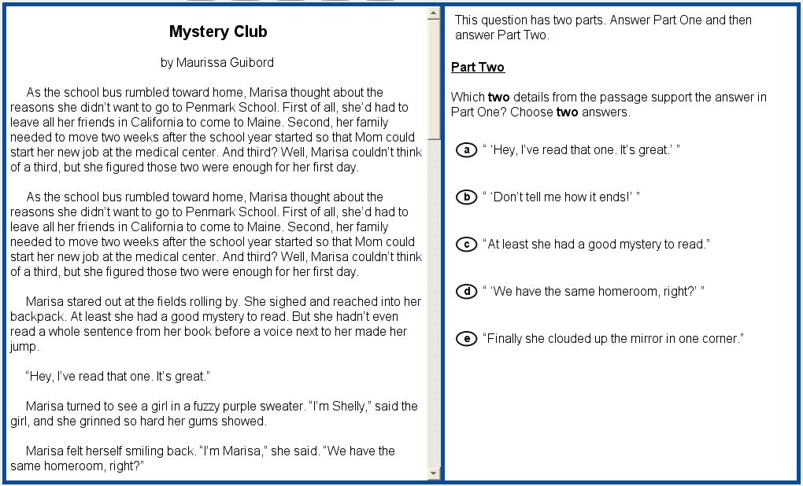
Evidence-Based Selected Response – Part 2 Online
Examiners &
Students

Slide 60
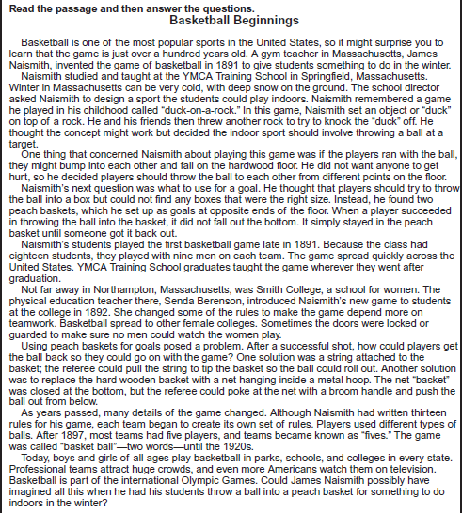
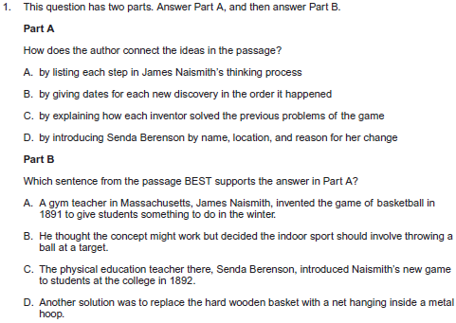

Evidence-Based Selected Response – Paper and Pencil
Examiners &
Students

Slide 61
Item Types
Orient Students Prior to Testing
  Multiple-Select Items
  Operational test items in ELA and mathematics, Field test items in science and social studies
  Allows for more than one correct answer
  There are five or six options listed
  Number of selections are limited to the number of correct responses
  Provides students with the opportunity to show fluency and/or multiple representations
  2 points for all correct or 1 point for a specific combination(s).
Examiners &
Students

Slide 62
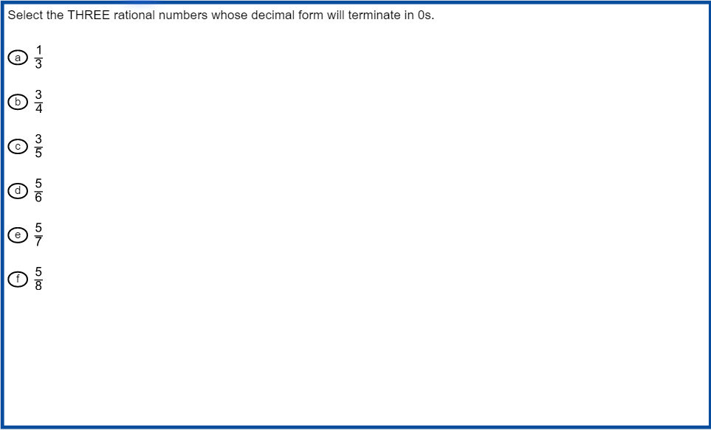
Multi-Select Item
Online
Examiners &
Students

Slide 63
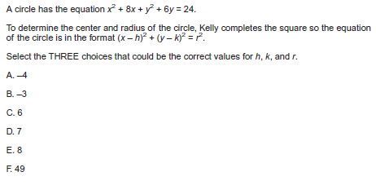
Multi-Select Item
Paper and Pencil
Examiners &
Students

Slide 64
Testing Accommodations

Slide 65
Accommodations
Follow accommodations guidance from the Accommodations Manual and the Student Assessment Handbook.
Oral reading/signing of reading passages is an accommodation that results in a Conditional Administration for English Language Arts EOG and EOC content and requires specific coding
Students responses not collected directly on a paper and pencil Student Answer Document or in an online test form will require transcription. Student responses printed from a word processor must be transcribed and not inserted into the Student Answer Document
Georgia Milestones scribing and transcribing procedures can be found in the Student Assessment Handbook and the Coordinator’s Manuals

Slide 66
Accommodations
Mode of administration (online/paper-and-pencil) should be considered – some accommodations are not applicable for a particular mode.
  For example, Braille students should test via paper-and-pencil instead of through an online administration.
  Note that accommodations that require the use of a scribe are likely to require that student responses are transcribed to an answer document or an online test form
To avoid an irregularity, please ensure that students who should receive accommodations are properly identified prior to testing.
If a student is provided an accommodation for which they are not eligible, and it results in a Conditional Administration, this will result in a Participation Invalidation (PIV).

Slide 67
Accommodations
Oral Reading
Students receiving a read-aloud accommodation from a Human Reader must have a Form A1 Student Test Booklet or be assigned the Human Reading/Human Signer online Form 01 form prior to logging in to the test
Students receiving the read-aloud accommodation from the Text-to-Speech online accommodation must have this accommodation assigned in eDIRECT prior logging in to the online form.

Slide 68
Accommodations
Online
Assigning the Human Reader/Signer Form
Logins
  Examiners will be able to access an online test form utilizing INSIGHT.
  The School Test Coordinators will obtain a test login for the human readers from the eDIRECT Documents tab.
  Login should remain secure and returned to the School Test Coordinator immediately following the administration. DO NOT EMAIL THE LOG-IN TO USERS.
  Directions for downloading Examiner Test Tickets are in the Online section of the School and Test Coordinator’s Manual and on the following slide.

Slide 69
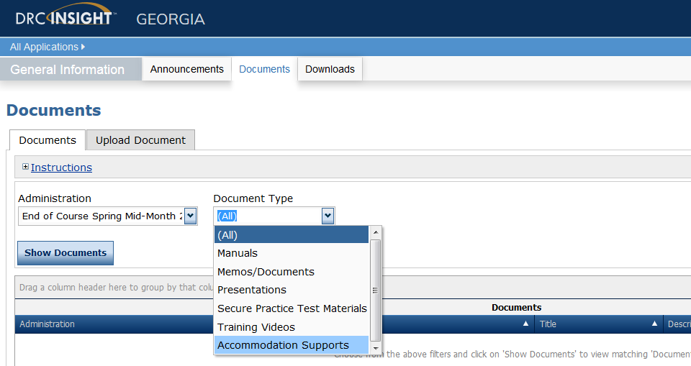
Examiner Test Tickets for Online Human Reader Administration
Requires logging in to eDIRECT and selecting administration window

Slide 70
Accommodations
Transcribing Options
Transcribe to | Transcription guidance
Standard paper answer document | Assign Form A1 for the test booklet Braille and Large Print test booklets are Form A1 by default Be sure the standard answer document is Form A
Online test form | Assign the appropriate online form prior to logging in Braille or Large Print/Marks Answers in Test Booklet

Slide 71
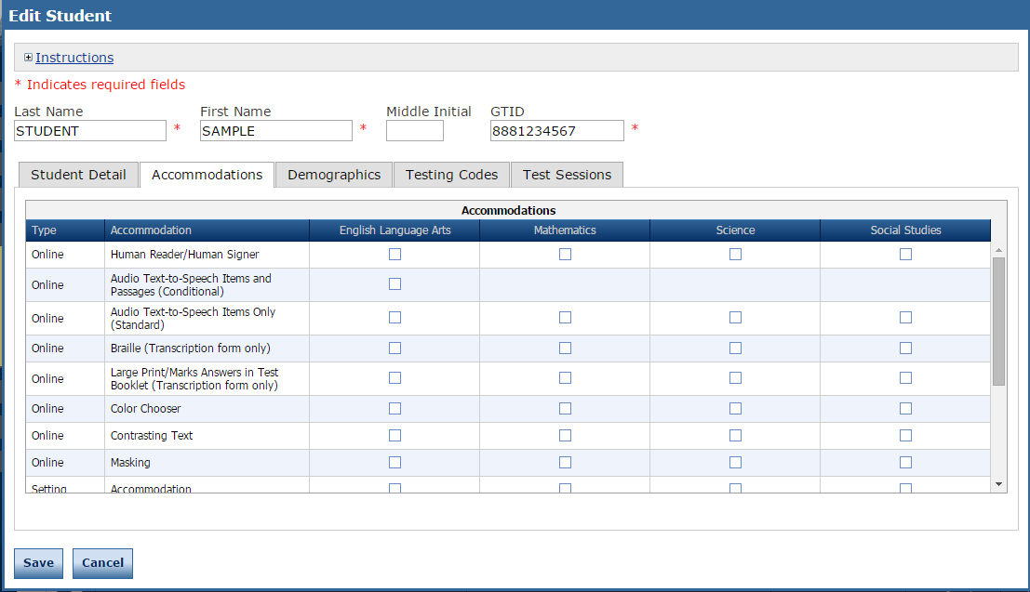
Accommodations
Online
Assigning Oral Reading and Transcription Forms eDIRECT Test Set-Up
Assign/Activate Accommodation and Form for Student Use
Assign Form for Transcribing – No Student Interaction

Slide 72
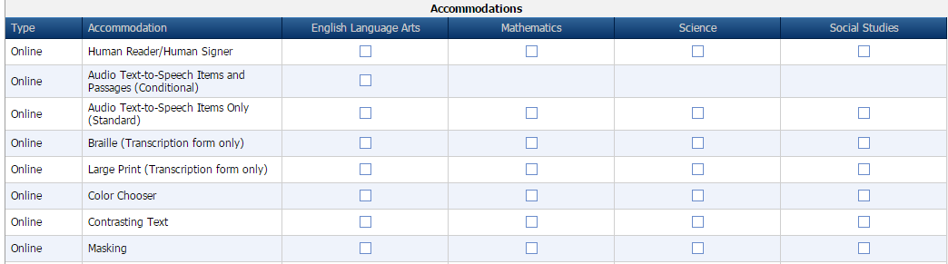
Accommodations Online
Assigning Contrasting Text and Masking
Assign Accommodation for Student Use

Slide 73
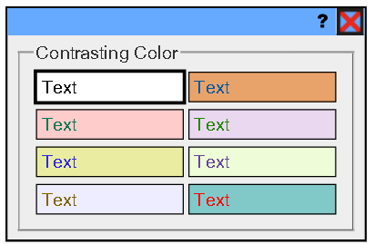
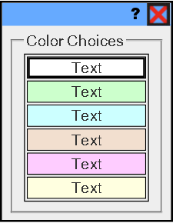
Accommodations
Online
Contrasting Background and Text Color Options
Background Color Options

Slide 74


Accommodations
Online Audio
Pre-recorded computer voice.
Audio plays automatically for each page.
Can be restarted for the whole page or at Start Points.
  Each passage contains at least one Start Point per page
Online audio requires Content Caching from Testing Site Manager (TSM)
  Be sure to check the TTS check box in the TSM prior to testing
  Be sure TTS content has been downloaded to TSM prior to student logging in to test

Slide 75

Online Tools
Magnifier for Large Print Accommodation
INSIGHT uses Scalable Vector Graphics
Allows for students to use many sizes of monitors, including larger monitors
No distortion of the content
The Magnifier Tool increases the size of selected items 1.5x or 2x the standard size.

Slide 76

Coding Accommodations Online
Coding Accommodation for Data File
By Content
Select Accommodation Type
Basis of Accommodation

Slide 77
Security and Irregularities

Slide 78
Security and Irregularities
As a part of SchTC and Examiner training, review the Student Assessment Handbook starting on Pages 17–40 - Security and Accountability.
Signed acknowledgements of Roles and Responsibilities and Examiner’s Certificate.
Materials Management & Security and Irregularities from the Fall Assessment Conference General Session August 2015.
Common causes of security breaches and irregularities
  Examiners must hold a valid certificate issued by the Georgia PSC
  Accessing/sharing secure test content
  Untrained Coordinators, Examiners, Proctors, and other personnel who help manage secure testing materials
  Failure to establish sound accounting procedures for secure testing materials
  Unsecured (lock and key) testing materials
  Poor management and monitoring of the testing site by Examiners and Coordinators
  Student failure to follow directions
  Prohibited devices and materials in the testing site
  Detailed slides for local delivery of security and irregularity guidance included in Appendix A of this presentation
Note: Probably the most common, preventable irregularity involves the student moving ahead or back a test section during a paper and pencil test session
Notes:
.

Slide 79
Managing Security Breaches and Testing Irregularities
Signs of any testing irregularity/security breach must be dealt with immediately.
  Test Examiner > School Test Coordinator > Principal > System Test Coordinator > GaDOE Assessment Specialist
A SchTC or SysTC seeking guidance through email, should not include identifiable student information such as, social security numbers, GTID, or FTE numbers in emails.
If guidance from GaDOE is obtained by phone or email for any incident is deemed an irregularity, the SysTC should follow with an “official” report on the MyGaDOE Portal Irregularity Survey Form
Detailed slides for local delivery of irregularity management guidance are included in Appendix B of this presentation

Slide 80
Reporting and Coding Irregularities

Slide 81
Testing Irregularities
Reporting and Coding
All irregularities must be coded, documentation completed and submitted on the Testing Irregularity Form in the MyGaDOE Portal.
When entering the documentation into the Portal, please:
  Select the appropriate “Administration Cycle” –
  For example, Spring 2017.
  Select the appropriate “Administration” –
  For example, EOC Main.
  Include the form number of the test that needs to be coded as an Irregularity or Invalidation.

Slide 82
Testing Irregularities
Reporting and Coding
When entering the documentation into the Portal, please:
  Clearly indicate if a score should be invalidated (DOE must authorize) by setting the Invalidation field to “Yes” or “No”.
    If tests needs to be invalidated, describe in detail the circumstances surrounding the reason for invalidating the test in the Reason for Invalidation field.
  Use the Comments field to provide any other pertinent information

Slide 83




Entering IRs into the MyGaDOE Portal
In the MyGaDOE Portal, find the “Surveys” section and click on “More”
https://portal.doe.k12.ga.us/login.aspx
Click on “View Summary” next to Testing Irregularity Form
Click on “Add New Record”
Click on “Start”
83

Slide 84
Testing Irregularities
Reporting and Coding
In addition to entering irregularities into the Portal once Irregularity, Invalidation, or Participation Invalidation codes are received, you MUST:
  Grid and bubble student answer documents (if the test was administered via paper-and-pencil).
  Enter code into eDIRECT Test Setup (if the test was administered online).
Once received, codes can be used on all future irregularities but documentation must be entered into the Portal.
Only the GaDOE may invalidate assessments.

Slide 85

Testing Irregularities
Coding a Paper and Pencil Answer Document
If directed by GaDOE, the System Testing Coordinator or designee:
Fill-in the appropriate irregularity or invalidation field.
Grid the 5-digit irregularity code.
Irregularities reported incorrectly will result in a score designation of Local Coding Error (LCE) that will require investigation by the System Testing Coordinator and a correction in eDIRECT.
Incorrect coding may result in delayed reports.

Slide 86

Testing Irregularities
Coding Online
If directed by GaDOE, the System Testing Coordinator or designee will for the affected course:
From the Student List in eDIRECT Test Set-Up, select the student to be coded.
Access the Testing Codes tab.
Select the Irregularity Status.
Select the Irregularity Code provided by GaDOE from the dropdown option.
Note: Correct Local Coding Errors (LCE) here for both paper and online administrations.
Incorrect coding may result in delayed reports.

Slide 87
Before, During, and After Testing

Slide 88
Before Testing
System Test Coordinator Receives and Accounts for:
System Test Coordinator’s Kit
  System Packing List
  Return Shipping Labels
  Coordinator’s Manuals
  School Packages
  Overage materials
Administration Materials for Distribution to Schools
  School Packing List
  School Security Checklist
  Examiner’s and Coordinator’s Manuals
  Test Booklets and Answer documents
  Pre-ID, School/System, and Do Not Score labels

Slide 89
Before Testing
System Test Coordinator
Receipt of Materials
Materials will be delivered approximately 2 weeks before test administration dates.
Use the packing list(s) to inventory materials.
  Braille and Large-Print test booklets will ship separately.
  For any discrepancies, contact DRC at GAHelpDesk@datarecognitioncorp.com.
Store all test materials in a secure/locked area.
Sufficient overage will be packed in each school’s boxes.
The shipping labels and the original boxes are to be used when returning test materials.
Additional orders will not be approved and shipped until the system has received their initial shipment.
Develop a process to account for all test booklets and answer documents at each testing site on a daily basis and at the close of test administration.
Contact your Assessment Specialist if you want a sample of an inventory resolution sheet

Slide 90
Before Testing
System Test Coordinator Responsibilities | Paper | Online
Review Test Coordinator’s Manual (TCM) Test Examiner’s Manuals, both Paper-and-Pencil (P/P TEM) and Online (OL TEM) |  | 
Review the Secure Practice Test examiner’s script |  | 
Organize training sessions for School Test Coordinators |  | 
Organize system security plan |  | 
Receive Paper-and-Pencil (P/P) administration materials and verify that all boxes have been received and develop a process to verify that all numbers from System and School Packing Lists are correct | 
Review technology readiness and district testing windows with Technology Director |  | 

Slide 91
Before Testing
System Test Coordinator Responsibilities | Paper | Online
Training sessions should include Adding/Editing Students and Test Sessions (Test Setup) (PP & online) Printing and distributing Test Tickets (Test Setup) Review of the Online Examiner's Manual Managing and coding accommodations (Test Setup) |  | 
Distribute P/P materials and Pre-ID labels to School Test Coordinators Training sessions for P/P administrations should include a review of the administration procedures from the P/P TEM | 

Slide 92
Before Testing
System Test Coordinator Responsibilities | Paper | Online
Distribute EOC P/P materials and Pre-ID labels to School Test Coordinators If needed, please order additional materials as soon as possible once you have received your initial shipment. Additional Materials can be ordered after systems have received and inventories the initial shipment. | 
Verify School Test Coordinators have scheduled Online Tools Training Tests OTT Directions from Georgia Milestones Website and eDIRECT Examiners will find directions to help familiarize students with the TTS in the TCM. |  | 

Slide 93

Before Testing
Additional Materials
Additional Materials can be ordered after systems have received and inventoried the initial shipment

Slide 94
Before Testing
GNETS Students – Paper-and-Pencil
System Test Coordinators within the area served should coordinate the source of paper-and-pencil testing materials with the GNETS School Test Coordinator.
GNETS sites who manage their own materials should coordinate with their students’ home school systems regarding the shipping of scorable materials.
Ideally, scorable materials for GNETS students will be returned with those of the student’s home system.

Slide 95
Before Testing
GNETS Students – Online
Each GNETS site testing online will need to have DRC INSIGHT installed on workstations that students will use for testing.
The School Test Coordinator at each online GNETS site should be familiar with the contents of this Pre-Admin Webinar and the upcoming Online Test Set-Up training though collaboration with a designated System Test Coordinator within the service area.
Test sessions (including the Secure Practice Test/Online Tools Training) for GNETS students testing online will need to be setup by the System Test Coordinator from the students’ home school/system.

Slide 96
Before Testing
GNETS Students – Online
The GNETS School Test Coordinator should collaborate with the students’ home districts for assigning testing accommodations and coding program and accommodation information.
The GNETS School Test Coordinator should work with the System Test Coordinator within the service area to receive by a secure means the Student Test Tickets (ex. return receipt mail, UPS/FEDEX, courier, hand delivery, attachment in MyGaDOE email, transfer via secure FTP folder).

Slide 97
Before Testing
School Test Coordinator
Receive Paper and Pencil Materials
Complete School Inventory Checklist provided in TCM; when School Testing Coordinators verify their school’s packing list, a signed copy should be provided to the System Test Coordinator.
Boxes are labeled for each school and include:
  School Packing List and School Security Checklist
  Test Coordinator’s Manual and Test Examiner’s Manuals
  Test booklets and answer sheets
Schools receive an overage of materials:
  If additional materials are needed, School Test Coordinators contact the System Test Coordinator
Retain boxes for return shipping.
Notes:
97

Slide 98
Before Testing
Pre-ID Labels
School Test Coordinator Kit.
One label for each student and course.
Visible information includes:
  Student name and GTID
  School and System names and codes
  Grade
  Student Date of Birth and gender
  Ethnicity and race
  Barcode number
Retain a copy of the Pre-ID File from Cycle 1 Data Collections as a resource for all student information collected but not visible on the label, ex. Title I, EL.
Apply to the Student Answer Document prior to testing.
Notes:
98

Slide 99
Before Testing
School Test Coordinator
Online
Verify that all online test takers are in a Test Session
Assign online accommodations, especially read-aloud/text-to-speech in the Accommodations Form in eDIRECT prior to testing
Verify that students whose responses from a paper and pencil administration will be transcribed into an online form:
  are coded correctly in the appropriate Accommodations Form in eDIRECT
  Paper Braille and Large Print are forms are A1 by default and are equivalent for online Form 01
Prior to testing print and sort Student Test Tickets
Verify that Insight and the Testing Site Manager are installed and that online testing devices are ready for testing
Be sure online test takers are oriented to ELA Section 1, Items 59 and 60, and the Grades 6-8 and EOC Mathematics transition from the no-Calculator Section 1, Part A, to the calculator-allowed Section 1, Part B.
Notes:
99

Slide 100
Before Testing
School Test Coordinator Responsibilities | Paper | Online
Read Test Coordinator’s Manual (TCM) and Test Examiner’s Manuals (TEM) |  | 
Organize training sessions for Test Examiners Prepare the testing site and organize testing materials for distribution |  | 
Organize training for assessment of students with accommodations |  | 
Organize school security plan and monitor test administration |  | 
Manage students and test sessions in eDIRECT Assign and code accommodations in eDIRECT Print and sort by testing location Student Test Tickets and Student Test Rosters |  | 
Administer the Secure Practice Test to students. |  | 
Review technology readiness and school testing windows with local technology support |  | 

Slide 101
Training Test Examiners
Review Test Examiner’s Manual with School Test Coordinators
Share targeted slides in this presentation with School Test Coordinators who should then share them with Examiners and Students as appropriate
Require that School Test Coordinators train Examiners directly from the Examiner’s script in the Test Examiner’s Manual

Slide 102
During Testing
Examiners should check to see if students are responding in correct spaces.
For ELA, examiners should check to see if students are responding to Section 1, Item 5 in the correct location.
For paper and pencil administrations, examiners should check to be sure students are in the correct section of the test; not going ahead or going back.
Examiners should check to be sure students have completed Mathematics Section 1, Parts A and B.
For Mathematics, examiners should check to ensure students do not have a calculator in Section 1 Part A and should distribute Calculators (if necessary) starting in
Section 1 Part B.
Examiners should check to see if online students click Review, End Test and Submit after each section.
School and system test coordinators should monitor “In Progress” sessions to ensure that all students end test sessions correctly.
    Note: During the state window; responses for students “In Progress” will not export. At the close of the state window, student responses unless invalidated by DOE will be exported and scored “as is.”

Slide 103
After Testing
School Test Coordinator
Verify that Test Examiners have returned all materials.
  The System Test Coordinator must order make-up test materials administered outside of the system’s scheduled window.
Inventory scorable and non-scorable materials separately.
Complete the School Security Checklist and place in the first box of scorable materials.
System Test Coordinators must make copies of any pages that indicate missing or non-returned materials and place these copies in the security checklist envelope for each school; System Coordinators will retain all original school security checklists.
Verify that a Do Not Score label is placed on any USED Student Answer Document that that were labeled with Pre-ID or District/School labels but should not be scored; return voided/Do Not Score documents with non-scorables.

Slide 104
After Testing
School Test Coordinator
Record any biohazard materials on the School Security Checklist.
Account for ALL Student Answer Documents and Student Test Booklets
Arrange all scorable documents with the student name face-up.
Follow instructions for packing materials for return on the following slides and in the Test Coordinator’s Manual

Slide 105
After Testing
School Test Coordinator
Online
Check daily for students who are In Progress or Locked. Follow procedures for students who did not end a section correctly.
  See Sessions In Progress QuickStart Guide on eDIRECT
Confirm with technology coordinator that all responses have been cleared from each TSM used during testing.
Note: During the state window; responses for students “In Progress” will not export. At the close of the state window, student responses unless invalidated by DOE will be exported and scored “as is.”

Slide 106

After Testing – Paper and Pencil
Packing Scorable Materials
Ensure that all scorable Student Answer Documents have a Pre-ID label applied, or a District/School label applied along with the appropriate demographic information coded.
Place all scorable Student Answer Documents in plastic return bags provided by DRC, seal the bags tightly, and place them in the scorable return boxes.
Fill any empty space in boxes with crumpled paper or bubble wrap to ensure test material does not shift during transit. Make sure to fill voids to the top of the box.
106

Slide 107
After Testing
School Test Coordinator
Use original shipping boxes for return shipment; if additional boxes are required, notify the System Test Coordinator to order them through Additional Materials in eDIRECT.
Pack scorable and nonscorable materials separately.
All nonscorable materials must be returned to the System Test Coordinator within one week of the last day of the system’s scheduled test window.

Slide 108

After Testing – Paper and Pencil
Packing Scorable Materials
School and System Test Coordinator
Boxes contain single stack of materials.
System Test Coordinator’s Kit arrives in the last box of shipment – e.g., Box 120 of 120.
Box Dimensions:
10” UPS (brown) = 11 ^{1/4} x 8 ^{3/4} x 11 ^{1/8}
5” UPS (brown) = 11 ¼ x 8 ^{5/8} x 5 ¼
Large Print/Braille (brown) = 17 ¾ x 11 ¼ x 5 ½

Slide 109



DRC Applied Identification Labels by Test Administration Window

Slide 110
After Testing
System Test Coordinator
Return Scorable Materials to DRC in boxes
Return test booklets to DRC.
Test booklets (used and unused) are bar-coded and scanned upon receipt.
Check each test booklet to ensure there are no Answer Documents in the books.
It is critical to the success of the EOG/EOC that all documents are returned immediately after test administration. Promptly returning your materials helps ensure timely results can be returned to your system.
  Scoreable materials may be shipped in multiple shipments immediately following the completed administration of an EOC course and/or completed grade level for EOG.
  Failure to return secure testing materials may result in referral to the Georgia Professional Standards Commission (PSC).

Slide 111
After Testing
System Test Coordinator
  Do NOT return the following materials to DRC:
      Manuals and scratch paper.
      These must be securely destroyed AT THE SYSTEM LEVEL immediately following the end of your local window.
  Destroy any biohazard materials following the system’s hazardous materials procedures; record as soiled on the School Security Checklist.
  Please KEEP the test booklet Security Checklist for your records. Return only copies of pages that reflect missing or locally retained materials
  Please be sure School Test Coordinators retain student-signed test tickets and student test rosters SECURELY until electronic reports have been received for students.

Slide 112
After Testing
System Test Coordinator
Packing Return Shipment
System Test Coordinators prepare materials for pick-up; details in the School and System Test Coordinator’s Manual
Reminders:
Do not consolidate materials from more than one school in the same box.
Use one label per box.
  Use BLUE Return Shipping Labels for EOG scorable materials grades 4, 6, 7.
  Use GREEN Return Shipping Labels for EOG scorable materials grades 3, 5, 8.
  Use PURPLE Return Shipping Labels for EOC scorable materials.
  Use WHITE Return Shipping Labels for all nonscorable materials.
Identify the sequence of boxes by filling in the line on the blue or purple scorable label that reads “BOX __ OF __ .”
Identify the sequence of boxes by filling in the line on the yellow nonscorable label that reads “BOX __ OF __ .”
Securely seal all boxes.

Slide 113
After Testing
System Test Coordinator
Scorables and Nonscorables
For the EOC, If your local window extends beyond 7 days you have the option to schedule weekly shipments.
Scorable materials may be shipped in multiple shipments, but nonscorable materials should be returned in one shipment.
Shipments received via UPS will be returned using UPS.
Shipments received via ADS will be returned using either UPS or ADS for scorable materials, and ADS for nonscorables.
  Palletize materials returned via ADS according to instructions on page 41 of the School and System Test Coordinator’s Manual.
  If your system received materials via ADS, ADS will contact you to schedule a pickup.

Slide 114

Answer Document Tracking
System Test Coordinator
Available on eDIRECT under Materials—Answer Document Tracking
This report provides systems and schools with the following information:
  Quantity of answer documents sent to systems by DRC
  Quantity of answer documents received by DRC
  Quantity of answer documents checked in as “used”
Available on a summary screen, with more detail available as a file export
View this data after returning materials to DRC
Reports are updated daily
Systems will be responsible for reporting any discrepancies between what they returned and what DRC checked in as used

Slide 115

Answer Document Tracking
System Test Coordinator
Sample Report – Summary

Slide 116

Answer Document Tracking
System Test Coordinator
Sample Report – Export Detail
“Check-in Date” is blank if document is not yet checked in by DRC.

Slide 117
Georgia Milestones EOG
Key Dates 2016-2017
Practice Test with Response Transmission available: March 6
Availability of DRC eDIRECT for EOG spring test session creation, etc.: March 6
Spring EOG Paper Materials Delivery Begin: March 15
Availability of DRC eDIRECT for EOG summer re-test session creation, etc.:
  No later than April 24
EOG Main State Testing Window: April 3 – May 5
Summer EOG Retest Paper Materials Delivery Begins: Late April TBD
EOG Summer Retest Administration Window: May 15 – July 21

Slide 118
Georgia Milestones EOC
Key Dates 2016-2017
Practice Test with Response Transmission available: March 6
Availability of DRC eDIRECT for EOG spring test session creation, etc.: March 6
Materials Delivery Begin: April 12
Summer EOC Enrollment Counts Collected: April 10–21
EOC Main State Testing Window: April 24–June 2
Availability of DRC eDIRECT for EOC summer test session creation, etc.:
No later than May 22
Summer 2016 EOC Paper Materials Delivery Begins: June 6
EOC Summer Main Administration: June 19–July 21
  Retests & “Test-Outs” allowed

Slide 119
Georgia Milestones
Training Dates 2016-2017
INSIGHT Installation/eDIRECT Training
February 14 (1:00 PM) Recording available; use link below
  https://attendee.gotowebinar.com/register/323127055407195140
February 21 (10:00 AM) Recording available; use link below
  https://attendee.gotowebinar.com/register/1310046493475746052
End-of-Grade/End-of-Course Spring Pre-administration Webinars
February 28 (10:00 AM)
  https://attendee.gotowebinar.com/register/3283341111356985860
March 1 (1:00 PM) – Live repeat of February 28
  https://attendee.gotowebinar.com/register/7975645521356198404
March 2 (10:00 AM) – Live repeat of March 1
  https://attendee.gotowebinar.com/register/5309566218999420420
  eDIRECT Test Setup Training
March 6 (1:00 PM)
  https://attendee.gotowebinar.com/register/1141721158868018180
March 13 (9:00 AM) – Live repeat of March 6
  https://attendee.gotowebinar.com/register/7396686678634567940

Slide 120
Resources
Student Assessment Handbook
Administration Manuals
Secure Practice Tests
Practice Test with Response Transmission
Assessment Guides
Mathematics Formula Sheets (4)
Graph Paper (1/4”) – sample posted
Physical Science Periodic Table & Reference Sheet
Accountability Content Completer Presentation
Allowable Accommodations Charts (SWD and EL)
Technology Guidelines
eDIRECT (https://ga.drcedirect.com/default.aspx)
Experience Online Testing Georgia (http://www.gaexperienceonline.com/)
NEW Georgia Milestones Training (http://www.gadoe.org/Curriculum-Instruction-and-Assessment/Assessment/Pages/Milestones_Training.aspx)

Slide 121
Test Practice for Online Administrations
Secure Practice Test
Tickets found in pdf format in General Information of eDIRECT
Test taken through INSIGHT platform
Available year-round
Practice Test with Response Transmission
Students scheduled and tests printed through Test Administration of eDIRECT
Test taken through INSIGHT platform
Responses are sent through TSM
Available March 6-March 31
Experience Online Testing Georgia
No tickets needed
Test taken online at www.gaexperienceonline.com
Students, parents and teachers can all access this website
Sample of Section One ELA is presented
Available year-round from anywhere on the web

Slide 122
Contact Information
DRC Customer Service Team
  Phone: (866) 282-2249
  Email: GAHelpDesk@datarecognitioncorp.com
  Hours: 7:00am to 8:00pm (Eastern)
  Georgia Department of Education
  Director of Assessment
    Sandy Greene (404) 656-0478; sgreene@doe.k12.ga.us
  Assessment Specialists (by district assignment)
  Joe Blessing (404) 232-1208; jblessing@doe.k12.ga.us
  Mary Nesbit-McBride (404) 232-1207; mmcbride@doe.k12.ga.us
  Robert McLeod (404) 656-2589; rmcleod@doe.k12.ga.us
  Special Testing Accommodations
  Mary Nesbit-McBride (404) 232-1207; mmcbride@doe.k12.ga.us
  INSIGHT Platform Questions
  Joe Blessing (404) 232-1208; jblessing@doe.k12.ga.us
  EOG Scheduling
  Robert McLeod (404) 656-2589; rmcleod@doe.k12.ga.us

Slide 123
Appendix A:
Detailed Test Security Slides for Local Training

Slide 124
Security
Maintaining test security and test integrity is critical.
All Examiners who administer a state assessment must hold a valid Georgia PSC-issued certificate.
  Use of an uncertified examiner will result in invalidation.
Everyone involved in the testing process must be properly trained and informed of their roles and responsibilities for test security.
  Attendance at training must be mandatory and well-documented.
  Untrained examiners must not be allowed to test.
Students and teachers need to understand test protocols and the ramifications of not following testing procedures.
The school principal must be made aware of any issues involving testing or test security.
Violations may result in invalidation of students’ tests and/or referral to the Georgia Professional Standards Commission for disciplinary action.
Notes:
.

Slide 125
Security
Student test booklets and online test tickets must be kept stored in a secure place accessible only by the principal and the test coordinator except when actually in use for test administration.
Test materials must not be removed from their secure storage location for reasons other than the preparation of materials for testing, actual test administration, and the completion of tasks as prescribed by test manuals.
Student test booklets must remain in their shrink-wrapped packages as late as possible to avoid security concerns prior to the first day of testing. The only exception is where a pack must be broken to count out for a class when an intact package is not sufficient to create read-aloud groups. In those cases, this must occur as late as possible to avoid security concerns.
Distribute testing materials as close to the actual testing time as possible.
Testing materials should only be issued to persons who have been carefully advised of their responsibilities for test security.
  Only staff members who have been trained on the proper management of secure test materials should handle such materials.

Slide 126
Security
All persons receiving testing materials must sign a checkout sheet when they receive the materials. This sheet should show date and time.
All testing materials issued to persons administering tests must be counted carefully when given out and when returned.
  If a problem occurs, School Test Coordinator should be notified immediately.
Test Coordinators and/or Examiners should keep a record of all students tested for each test administration.
  In addition to student’s name and test administered, please remember to include form numbers for each student in your documentation. Please be sure to keep copies of these records.
Students must write their names on the cover of their test booklet and any scratch paper.

Slide 127
Security
Please follow all instructions in the test manuals exactly.
  Do not add anything to, or delete anything from, the directions in the test manual. This violates standardized test conditions and may invalidate scores.
All testing materials must be collected and returned immediately after the testing session.
  Please be reminded that test tickets and used scratch paper are considered secure materials and must be handled as such.
  Examiners are responsible for turning in test tickets and used scratch paper and coordinators are responsible for verifying that they do.
    For example, if an examiner is administering tests multiple times during a day, the collection/checking-in of secure materials should occur multiple times during that day. In other words and by way of this example, examiners should not be in possession of their morning session materials until the end of the school day.
Please see Pages 17–39 of the Student Assessment Handbook for additional information.

Slide 128
Cell Phones & Electronic Devices
Students are not permitted to use, or bring into the testing environment, any electronic device that could allow them to access, retain, or transmit information (e.g., cell phone, smartphone, PDA, electronic recording device, camera, playback device, etc.). Announcements must be made prior to testing that such devices are not allowed in the testing environment and that possession or improper use of such devices during testing may result in disciplinary action in accordance with the system's student code of conduct and/or test invalidation.
A script has been added to the Examiner’s Manual regarding this topic. This script, as with all scripts, MUST be read to students.

Slide 129
Cell Phones & Electronic Devices
In the event an examiner confirms during testing that a student is using a device to access, retain, or share information, the examiner, must with minimal disruption:
  collect the device,
  stop testing that student,
  remove the student from the testing session, and
  notify the School Test Coordinator immediately.
In the event such actions are suspected, but not yet confirmed, the examiner must with minimal disruption:
  collect the device,
  allow the student to complete testing,
  notify the School Test Coordinator immediately, and
  as soon as it is appropriate attempt to confirm whether or not the device has been used in violation of the guidelines above.
Simple possession of a device (including the ringing of a phone during test administration) may be addressed in keeping with the system’s code of conduct and does not require an irregularity report to the GaDOE.

Slide 130
Appendix B:
Testing Irregularities

Slide 131
Testing Irregularities
Some examples of irregularities:
Cheating
  Following an investigation and confirmation, student test scores will be invalidated by GaDOE.
  If the incident involves improper conduct on the part of staff, a referral to the Georgia Professional Standards Commission for disciplinary action may result.
Using a prohibited device will result in an invalidation by GaDOE.

Slide 132
Testing Irregularities
Sickness during testing administration
  Student gets sick prior to starting the test.
    Upon return to school student will complete the test in its entirety and test is scored as is; does not require Portal entry.
  Student gets sick after having completed Section 1 but before starting Section 2.
    Upon return to school, student will complete Section 2 of the test and test is coded as an irregularity; requires Portal entry.
  Student gets sick while testing in either Section 1 or 2.
    Test scores maybe invalidated by GaDOE; requires Portal entry.

Slide 133
Testing Irregularities
Some examples of irregularities:
Accommodations
  Examiners give students the wrong accommodation or do not provide students with the correct accommodation.
    Test scores may be invalidated by GaDOE.
    School or system notifies parent (as soon as possible).
    System Test Coordinators must make a Portal entry.
  Students refuse their accommodations.
    School or system notifies parent (prior to the beginning of testing, if at all possible).
    Test scores are coded as an irregularity; requires Portal entry.
    Please fill in the Accommodations code on student answer document or in the Test Administration System since the school attempted to provide the accommodation.
    These irregularities might be prevented by involving students in the discussion of their accommodations.

Slide 134
Testing Irregularities
Some examples of irregularities:
A student takes the wrong test.
    Test scores are invalidated by GaDOE; requires Portal entry.
A student tests under wrong GTID.
    Contact GaDOE as soon as possible.
      Much easier to fix during the administration or within the first 48 hours after the close of the administration.

Slide 135
Avoiding Testing Irregularities
Adhere to test security policies, protocols and procedures.
Reinforce the use of active monitoring in testing environments.
Immediately report any possible testing irregularities.
Properly identify all students who should receive accommodations prior to testing.
Students’ IEP/IAP/TPC plans should be regularly reviewed to determine if accommodations are still appropriate or needed.
If a student is suspected of cheating, but there is no proof of his or her action, allow the student to complete the section and/or entire test.
  An invalidation can always occur after all of the facts are collected.
In the event of an evacuation or other unexpected event, have a plan in place to quickly secure testing environments and/or materials. However, student safety should always be the primary concern.

Slide 136
Avoiding Testing Irregularities
For Online Testing
Systems must complete all suggested readiness checks prior to and, where applicable, during testing.
If you encounter connectivity issues
  prior to the start of testing, use the appropriate troubleshooting tools available to correct the issues. If problems persist, use your best judgment as to whether or not to allow students to begin testing
  during testing, use the appropriate troubleshooting tools available to correct the issues. If problems persist use your best judgment as to whether or not to allow students to continue testing.
  Student Test Tickets must be used to verify student name and GTID prior to testing.
Never take a picture/screenshot of any part of a test.
DRC Customer Service: 866-282-2249

