Slide 1
A New School Year: GKIDS 2.0, Keenville, Georgia Milestones, and GAA 2.0!
2018 GACIS Fall Conference
September 27, 2018

Slide 2
Assessment Philosophy
The primary purpose of schools is teaching and learning.
Assessment and accountability play a significant role, but importantly – that role is supporting, with the primary focus being teaching and learning.

Slide 3
GKIDS 2.0

Slide 4
GKIDS 2.0
GKIDS 2.0 is a progression-based formative assessment, integrated into classroom work, that is aligned to the state content standards.
A big idea describes the integration of concepts and skills from the kindergarten standards that are most important for success in first grade.
A learning progression shows where the student is in the learning continuum of content and reasoning development regarding the big idea from the GSE.
Provides the big picture of what is to be learned across the year, relates standards across grades and increased reasoning of standards within the grades, and supports instructional planning.
Provides teachers with one source of real-time information to adjust instruction
Identifies what a student already knows, what the student needs next, and allows teachers to monitor growth

Slide 5
Learning Progression – Counting Objects

Slide 6
Keenville

Slide 7
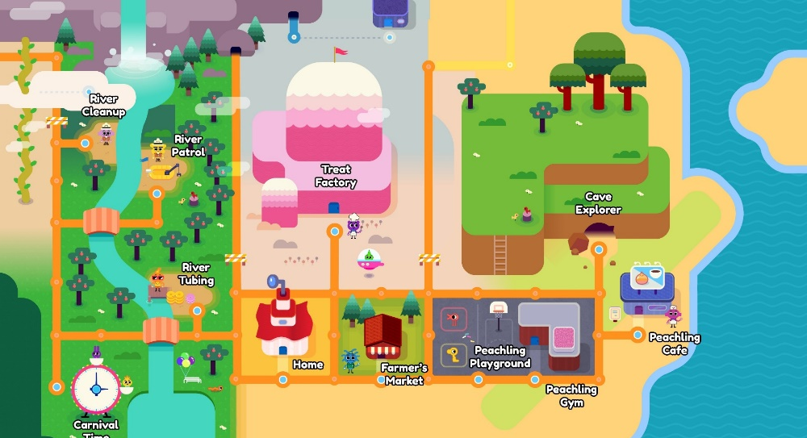
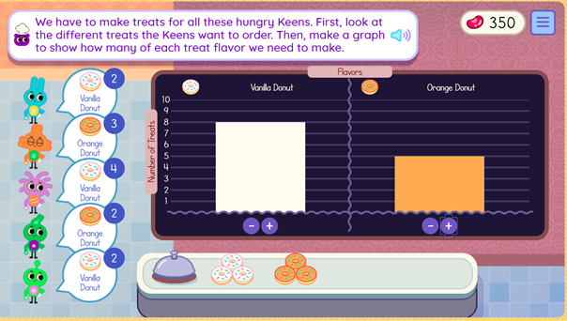
Keenville
Keenville is a game-based, formative assessment in literacy and mathematics for grades 1 and 2.
Students will explore Keenville and help the Keens by engaging in challenges.
Keenville is designed to be integrated alongside instruction, supporting teachers with real-time feedback to differentiate instruction and improve learning.
Learn more at keenville.gadoe.org!

Slide 8
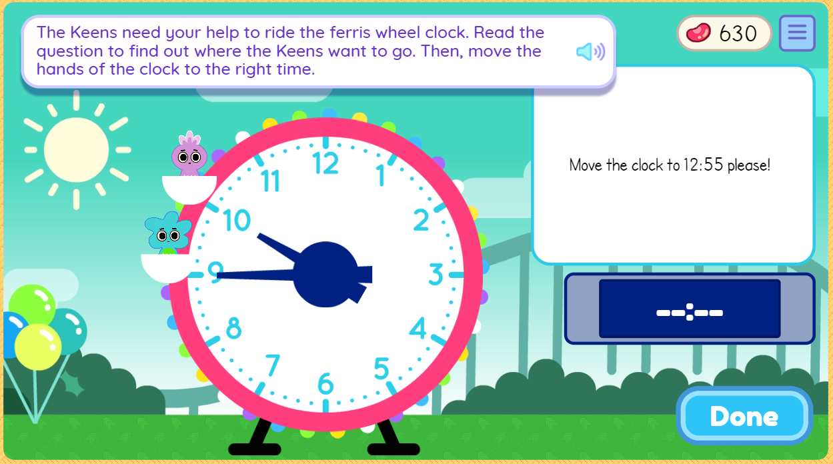
Keenville Games
Fall 2018 Games
River Clean-Up
River Patrol
Cave Explorer
Peachling Playground
River Tubing
Treat Factory
Peachling Gym
Carnival Time
Peachling Café
Farmers Market
ELA Skills Assessed
Reading comprehension (literary and informational)
Phonics and word recognition
Math Skills Assessed
Addition and subtraction
Interpreting data with tables and graphs
Comparing numbers (<, >, =)
Time
Place value
Money
An additional 21 games will become available throughout 2019!

Slide 9
Keenville Features
Designed to engage students
Avatar builder; earning beans and Peachlings; decorating their house; fun sights, sounds and reactions
Tutorials orient students to the world and each game
Students receive ongoing support through motivational prompts and feedback
Games often include Georgia-specific themes and integrate other GSE standards and initiatives
Nutrition, health, science, social studies, PE, and the arts
Each game is designed with multiple levels to
allow students of varying levels of ability to engage with challenges
identify students’ current level of knowledge, skill, and concept development

Slide 10
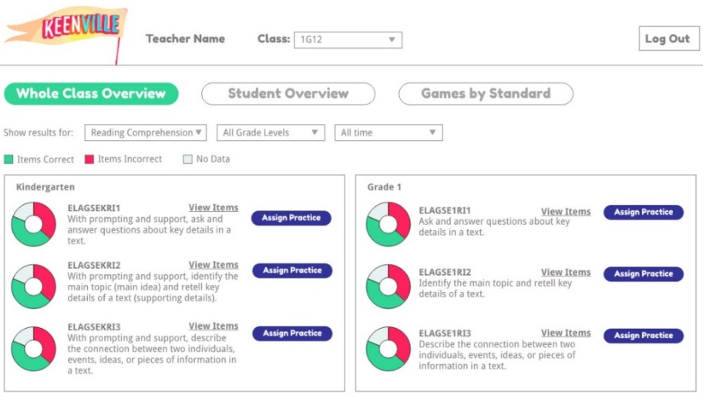
Keenville Dashboard
Keenville games and real-time, interactive dashboards will be accessible through the Statewide Longitudinal Data System (SLDS)
Teachers will be able to drill down to individual students, reporting categories, standards, and games to analyze progress
Dashboards will report Lexile and Quantile scores
Class-level data will be available to inform instructional decision making and planning

Slide 11
Keenville Resources
Keenville User Guide
Overview of Keenville
Game Descriptions
How to Play the Games
Access to Keenville
Pre-recorded Introduction to Keenville webinar for teachers
Coming soon….additional pre-recorded webinars:
Keenville Dashboard and Reporting
keenville.gadoe.org

Slide 12
Georgia Milestones

Slide 13
Scheduling Flexibility
New for 2018-2019: Spring EOG Scheduling Flexibility
The local testing calendar can encompass the entire state testing window.
Individual grade-level content assessments must maintain the same testing dates across all schools within the district.
All sections of a grade-level content assessment must be completed on the same day or on consecutive days during the same week.
Section 1 of ELA must be administered on a separate day from (and prior to) Sections 2 and 3 of ELA.
The local district sets the order of administration for EOG grade-level content.
See the Student Assessment Handbook for more details.

Slide 14
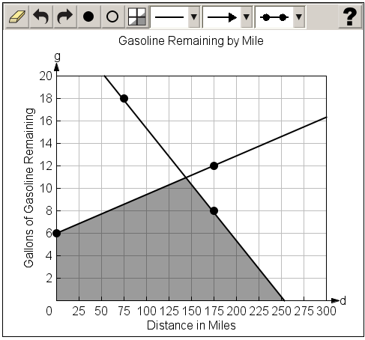
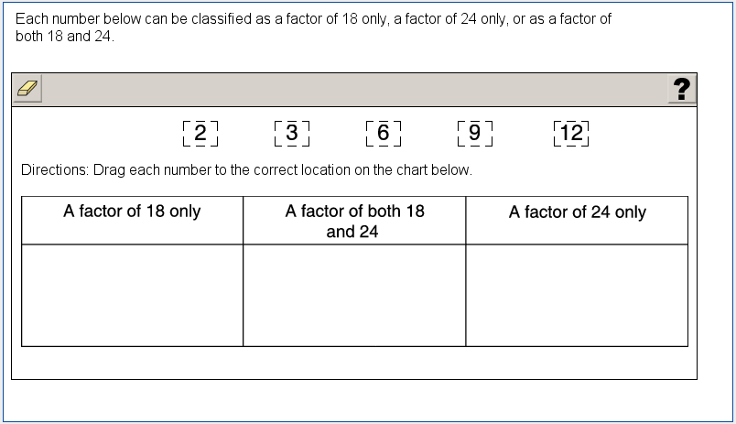
New TE Item Types
New for 2018-2019: Two new types of technology-enhanced items will be field-tested.
Graphing (mathematics)
Allows students to graph and label points and lines and shade regions
Allows students to demonstrate depth of understanding and ability through performance on math tasks
Drag and drop (mathematics, science, social studies)
Response choices (such as numbers, words, or phrases) can be moved and placed in another location (such as a chart or map)
Allows students to demonstrate depth of understanding by identifying, classifying, comparing, or organizing information

Slide 15
Educator Involvement
Educator Involvement
Test Planning and Specifications
Blueprint (number of items, item types, content weights)
Achievement Level Descriptors (ALDs)
Item Review
Review newly-developed test items for alignment to standards, depth of knowledge, bias and sensitivity
Rangefinding
Review sets of student responses from recently field-tested constructed-response items, assess rubric effectiveness, recommend anchor papers to be used in handscoring
Data Review
Review flagged items from recent field test
Accepted items added to item bank
Standard Setting/Standards Validation
Inform cut scores for the achievement levels
300-400+ Georgia educators, including higher education, participate in test development activities for Georgia Milestones every year!

Slide 16
Resources
Georgia Milestones scores and resources can be used to understand student performance, inform instructional practice, and continuously improve the instructional program.
Scale scores, achievement level descriptors (ALDs), domain scores, reading indicator (Lexiles)
Assessment guides and blueprints, range ALDs, released items and student samples
Lexiles describe students’ reading ability and can describe books’ reading demand or difficulty.
Together, Lexiles can help match a reader with reading material at the appropriate level of difficulty and suggest how well a reader will comprehend a text.

Slide 17
Resources
Updated ELA and mathematics resources
Assessment Guides are provided to acquaint Georgia educators and other stakeholders with the structure of and content assessed on the Georgia Milestones assessments
Study/Resource Guides are intended to serve as a resource for parents and students. They contain practice questions and learning activities for each content area. The standards identified in the guides address a sampling of the state-mandated content standards.
Item and Scoring Samplers provide examples of CR items along with annotated student responses.

Slide 18
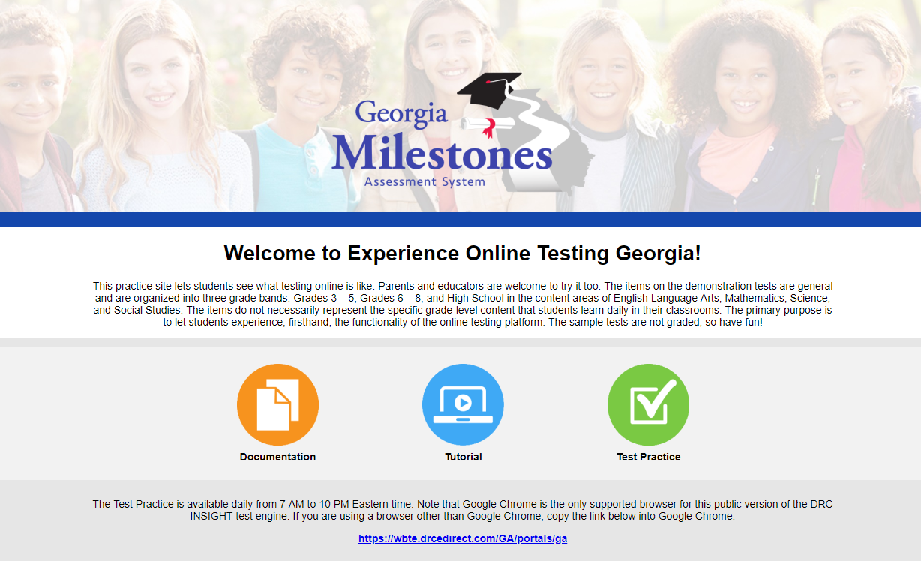
Georgia Milestones
Experience Online Testing Georgia
Provides students, parents, and educators with an opportunity to experience the online testing platform, allowing users to view and practice different item types, use available tools, and experience available accommodations.
www.gaexperienceonline.com
Will be updated to include new item types in November

Slide 19
Analyses
The following slides present findings from a preliminary state-level analysis of spring 2018 Georgia Milestones results.
Research questions include:
Q1: How did students perform on Georgia Milestones in 2018?
Q2: What trends are observed over time with Georgia Milestones results?
Q3: What differences are observed in the performance between subgroups of students?
Q4: What trends are observed over time with reading and writing performance?

Slide 20
Q1: Spring 2018
The percentage of students achieving Developing Learner or Above ranged from 61% to 84%.
EOG: Grades 3 and 4 mathematics had the highest percentages at 83% and 84%, respectively.
EOC: American Literature and 9th Grade Literature had the highest percentages at 80% and 82%, respectively.
The percentage of students achieving Proficient Learner or Above ranged from 30% to 52%.
EOG: Grades 3 and 4 mathematics had the highest percentages at 46% and 47%, respectively.
EOC: Economics, Biology, and 9th Grade Literature had the highest percentages at 49%, 49%, and 52%, respectively.

Slide 21
Q2: Trends
Greatest gains from 2016 to 2018
Grade 3 Mathematics
Grade 4 Mathematics
9th Grade Literature & Composition
American Literature & Composition
Physical Science
Biology
Losses from 2016 to 2018
Losses were limited to 1-2 percentage points, with the exception of Analytic Geometry.
Analytic Geometry had a decrease of 7 percentage points in the Developing Learner & Above category; however, the N size decreased from 80,713 in 2016 to 20,250 in 2018.
Greatest gains is defined as 4 percentage points or more in both Developing Learner & Above and Proficient Learner & Above.

Slide 22
Q3: Subgroups
The largest subgroup differences exist between:
SWD compared with non-SWD
EL compared with non-EL
Black and Hispanic students compared with White students
In general, females performed better than males on ELA assessments. No gender differences were observed in other content areas.
It is important to note that subgroup differences are not indicative of item and test bias.
Note: The subgroup analysis was limited to SWD and non-SWD; EL and non-EL; and Black, Hispanic, and White.

Slide 23
Q4: Reading and Writing
Reading and Vocabulary
Writing and Language
# Item Type | # Points
23 Selected Response | 23
1 Evidence-Based Selected Response | 2
2 Constructed Response (2 points each) | 4
Total Points | 29
# Item Type | # Points
15 Selected Response | 15
1 Extended Writing Prompt | 7
Idea Development, Organization, and Coherence (4 points) Language Usage and Convention (3 points)
1 Extended Constructed Response Narrative | 4
Total Points | 26
Lexile
Reading Status Designation

Slide 24
Q4: Reading and Writing
For each grade, overall median Lexile values have remained stable for the past three years.
Median Lexile values, by achievement level on the ELA Georgia Milestones test, correspond with grade-level text bands as expected.
Median Lexile values for Beginning Learners fall below the text bands for all grade levels and courses.
Median Lexile values for Developing Learners fall within the text bands for all grade levels and courses.
Proficient Learners and Distinguished Learners gradually perform increasingly better than the expected grade-level text bands.

Slide 25
Q4: Reading and Writing
Median Lexile for Georgia Students by Grade Level/Course
Grade Level/ Course | 2016 | 2017 | 2018 | Suggested Text Demand: Lower Limit | Suggested Text Demand: Upper Limit
3 | 645 | 655 | 655 | 520 | 820
4 | 795 | 810 | 810 | 740 | 940
5 | 940 | 940 | 950 | 830 | 1010
6 | 980 | 990 | 975 | 925 | 1070
7 | 1115 | 1100 | 1100 | 970 | 1120
8 | 1175 | 1170 | 1165 | 1010 | 1185
9th Grade Lit. & Comp. | 1230 | 1265 | 1255 | 1050 | 1260
American Lit. & Comp. | 1345 | 1370 | 1360 | 1185 | 1385

Slide 26
Q4: Reading and Writing

Slide 27
Q4: Reading and Writing
Reading and Vocabulary
Writing and Language
# Item Type | # Points
23 Selected Response | 23
1 Evidence-Based Selected Response | 2
2 Constructed Response (2 points each) | 4
Total Points | 29
# Item Type | # Points
15 Selected Response | 15
1 Extended Writing Prompt | 7
Idea Development, Organization, and Coherence (4 points) Language Usage and Convention (3 points)
1 Extended Constructed Response Narrative | 4
Total Points | 26
Lexile
Reading Status Designation

Slide 28
Q4: Reading and Writing
Extended Writing Genres
Extended
Writing
Prompt
Informational/
Explanatory
Opinion/
Argumentative
Extended
Constructed Response
Narrative
OR

Slide 29
Q4: Reading and Writing
Extended Writing Prompt Trait 1: Idea Development, Organization, and Coherence (4 points)
A smaller percentage of students scored 3 or 4 points in 2018 compared to 2016, with the exception of grade 4.
Extended Writing Prompt Trait 2: Language Usage and Conventions (3 points)
Grade 4 and American Literature had a higher percentage of students scoring 3 points in 2018 compared to 2016. Other grades had a smaller percentage of students scoring 3 points over this time period.
Extended Constructed Response Narrative (4 points)
Grades 7 and 8 showed increases in the percentage of students scoring 2, 3 and 4 points in 2018 compared to 2016.
Minor differences are explainable by the slight variations in the difficulty of individual writing items across years. To address this limitation, future research is needed to account for differences in difficulty among items.

Slide 30
Q4: Reading and Writing
Extended Writing Prompt Noteworthy Trends
Some students followed a format that was so formulaic that their responses appeared to be plagiarized.
Some students copied large blocks of the passage(s) while providing little original work.
A positive trend shows that some students who rewrite passage information in their own words to fit the purpose of the prompt are now able to create more effective, higher-scoring essays.

Slide 31
Q4: Reading and Writing
Narrative Prompt Noteworthy Trends
Particularly for items with an informational passage, some students struggled to write a response in a narrative mode.
Students may be aware of the need to use narrative elements, but are unable to effectively use the element(s) to advance the plot or enhance the story.
A positive trend is that some students did smoothly integrate details from the passage into their responses.

Slide 32
What do teachers need to know?
A few comments from ELA teachers who attended item/data review:
That passages/questions are vetted by real teachers and their perspectives, and that they try to ensure equity for the ELA part.
That students need to be able to see a variety of texts, and need to show their knowledge in more than one way.
We need to focus on critical reading and thinking skills (not content alone), and we need to ensure that students are prepared to add depth to their writing.

Slide 33
What do teachers need to know?
A few comments from ELA teachers who attended rangefinding:
Students often provided cursory responses where more detail is needed.
How a one-sentence answer can qualify as a 2 better than an entire paragraph depending on what the answer contains.
Emphasis for students to respond to all parts of the question. They also should encourage students to answer straight to the point and not encourage fluff.
Many students are simply picking out quotes and not doing much explaining. The students are getting better at answering the questions. However, many students simply rely on pulling details from the text with little or no support.

Slide 34
What do teachers need to know?
A few comments from ELA teachers who attended rangefinding (continued):
I did not realize how much students struggled with ‘how’ questions.
Students are answering the prompts but are still not as developed in providing relevant textual evidence with clear elaboration or connection to their claims.
Most questions require students to explain something and provide details. Selecting quality support and tying that support to the explanation is a key skill.
The constructed-response items are directly correlated to the standards. Don’t box students in with framed responses – there is wide room for success if students have been taught the standard to understand the task.

Slide 35
Georgia Alternate Assessment 2.0

Slide 36
GAA 2.0
The Georgia Alternate Assessment is being redesigned to better ensure that students with significant cognitive disabilities are provided access to the state academic content standards and given the opportunity to demonstrate achievement of the knowledge, concepts, and skills inherent in the standards.
The new GAA 2.0 will:
align to the Georgia Standards of Excellence;
reduce teachers’ burden related to selecting or developing tasks;
bring greater standardization to the administration;
improve scoring reliability;
have standardized and scripted tasks with multiple access points;
have one assessment window in the spring; and
be administered statewide in 2018-2019.

Slide 37
GAA 2.0
Structure
Discrete tasks developed for each grade and content area.
Tasks written to three levels of complexity, starting with the least complex part and increasing in complexity.
A scenario or passage is provided at the beginning of each task and serves as an introduction.
Support (scaffolding) is built into the task to increase a student’s ability to access various levels of complexity within a task.

Slide 38
GAA 2.0
Features
Use of scenarios to engage student interest and activate background knowledge
Large simple graphics
Accessible font size
Short simple sentences
Avoids extraneous wording
Use of common proper nouns (names)
Directive questions
Additional information is available through GaDOE trainings and will be coming soon to the GAA website.

Slide 39
Presentation of Task
Presentation Format
Scripted Tasks
Test Examiner has scripted “say” and “do” statements
Test Examiner presents in mode most accessible for the individual student.
Scaffolding (if needed)
Test Examiner will have access to assessment materials in advance to determine most accessible presentation and response modes
Advance Preparation
If the student does not provide the response as outlined in the test examiner script, additional scaffolding may be provided. All scaffolding instructions are provided.
Stimulus Cards
There are student facing stimulus cards with the information needed to answer a question. Usually graphics or words/short sentences.

Slide 40
Resources
Resources currently available on the GAA 2.0 website:
Test design training
Eligibility criteria
Test blueprints
Extended content standards

Slide 41
Innovative Assessment Pilot Program
The State of Georgia established an Innovative Assessment Pilot Program that allows up to 10 school districts or groups of districts to develop alternate assessment and accountability systems aligned with state academic content standards beginning in 2018 (SB 362).
The State Board of Education (SBOE) held two rounds of applications, due August 1 and September 1, for the 2018-2019 school year.
Per SB 362, the SBOE and GaDOE will pursue maximum flexibility from the U.S. Department of Education in support of the state’s Innovative Assessment Pilot Program.
Georgia will submit an intent to apply for the federal Innovative Assessment Demonstration Authority (IADA). Applications are due December 17, 2018.

Slide 42
Innovative Assessment Pilot Program
At its August meeting, the SBOE approved one application:
The Putnam County Consortium proposed using Navvy, a diagnostic assessment system created by Navvy Education, LLC.
At its September meeting, the SBOE is considering three applications:
The Cobb County School District has proposed utilizing Cobb Metrics, a district-developed formative assessment system.
The Georgia MAP Assessment Partnership has proposed utilizing MAP Growth for Georgia created by NWEA.
The Newton County School System has proposed utilizing a combination of Iowa Assessments, The Cognitive Abilities Test, and FAST assessments.

Slide 43
Assessment Philosophy
The primary purpose of schools is teaching and learning.
Assessment and accountability play a significant role, but importantly – that role is supporting, with the primary focus being teaching and learning.

Slide 44
Thank you!
testing.gadoe.org
accountability.gadoe.org
Allison Timberlake, Ph.D.
Deputy Superintendent for Assessment & Accountability
atimberlake@doe.k12.ga.us
(404) 463-6666

