Slide 1
Technical Tips for Districts
in Preparing for Online Administrations of Georgia Milestones
November 7, 2018

Slide 2
Welcome!
GaDOE
Chris Shealy, Director, Technology Services
Joe Blessing, Assessment Specialist
DRC
Dirk Austin, Field Support Engineering
Missy Shealy, Program Management

Slide 3
Georgia Milestones
EOG | EOC
Grades 3–8 English Language Arts Mathematics Grades 5 and 8 Science Social Studies | Ninth Grade Literature & Composition American Literature & Composition Coordinate Algebra Analytic Geometry Algebra I Geometry Biology Physical Science United States History Economics/Business/Free Enterprise

Slide 4
Georgia Milestones
Georgia Milestones will be administered 100% online this school year.
Paper forms are available for those students who cannot access the online assessment due to their disability.
Central Office Services (COS) will be used for content caching.
The TSM will no longer be supported.

Slide 5
Advantages of Online Testing
Improved student experience
Increased interactivity
Standard administration of accommodations
Reduced irregular test administration
Reduced stress on district, school, and teachers
Improved test security
Matches Georgia Standards of Excellence for use of technology in writing
Example: ELAGSE3W6: With guidance and support from adults, use technology to produce and publish writing (using keyboarding skills) as well as to interact and collaborate with others.
Reflects technology use found in college and career

Slide 6
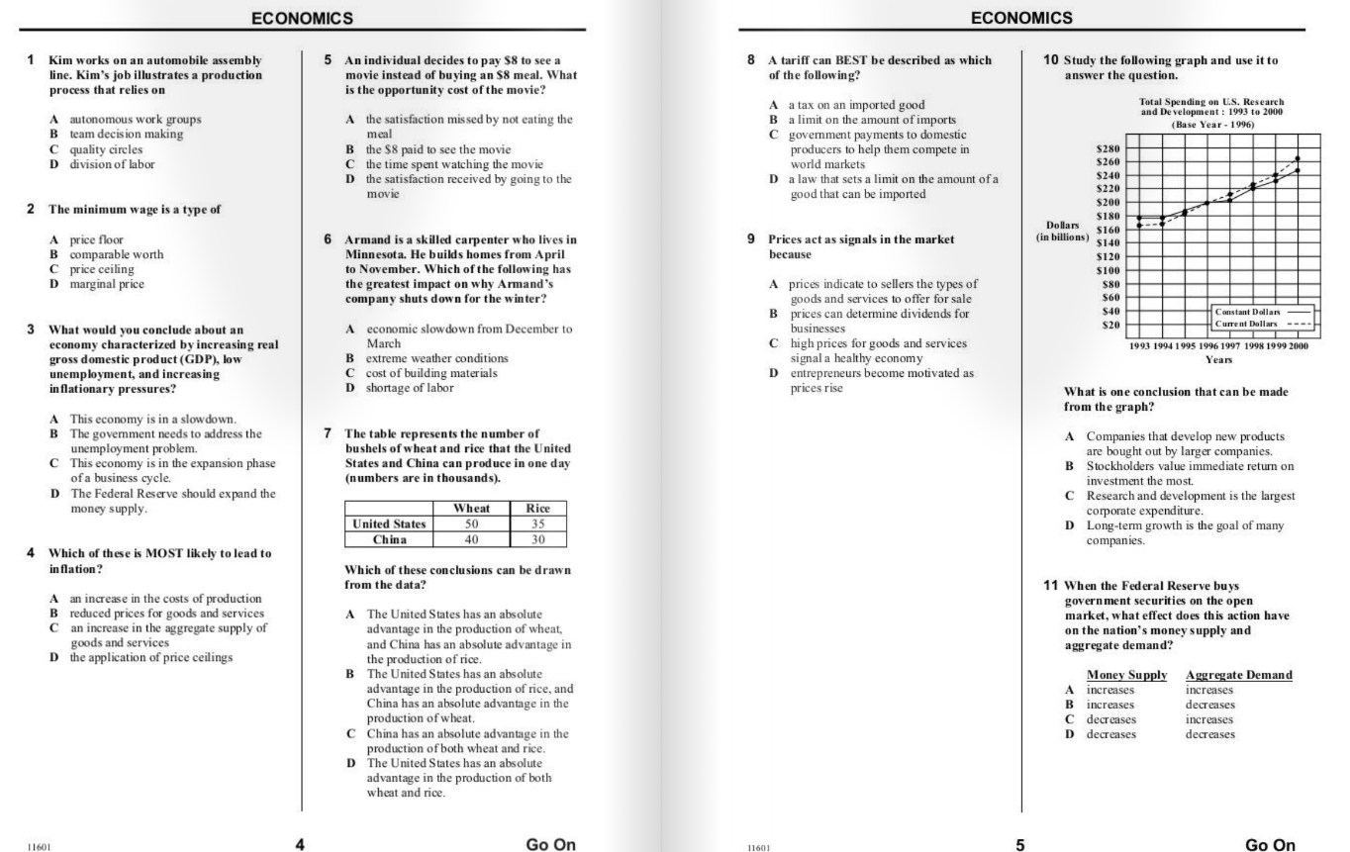
Paper/Pencil
Multiple items on page
Transfer of responses to answer document

Slide 7
Online
Zoom available for all students
Calculators and reference documents
Interactive supports
Different item types
One test item per page

Slide 8
Universal Tools: Milestones
Tool | Icon | Content Area
Periodic Table |  | Science
Reference/Formula Sheet |  | Math, Science
Highlighter |  | ALL
Sticky Note |  | ALL
Flag |  | ALL
Line Guide |  | ALL
Online Calculator |  | Mathematics; Science; Economics
Graphing Tool |  | Mathematics only
Cross-off Tool |  | ALL
Magnifier |  | ALL

Slide 9
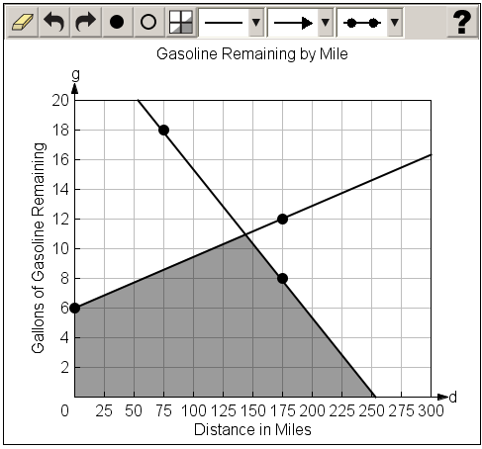
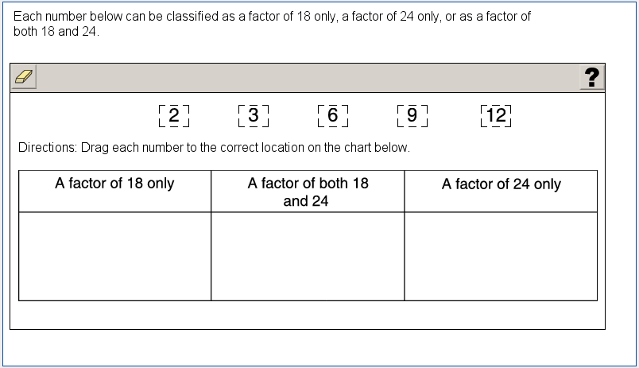
New Item Types Field Tested Spring 2019
Graphing
mathematics
Drag and drop
mathematics, science, social studies

Slide 10
Status of Georgia Milestones

Slide 11
Georgia Milestones Online Testing

Slide 12
Total tests taken online Spring 2018 (EOC and EOG)
EOC and EOG by Test
 | Total | Online | Paper | % Online
EOC | 768,827 | 761,489 | 7,338 | 99%
EOG | 2,139,858 | 1,767,408 | 372,450 | 83%
Totals | 2,908,685 | 2,528,987 | 379,788 | 87%
EOC by Test and EOG by Student
Total Tested | Online Tested | Paper Tested
1,570,750 | 1,415,333 | 155,417
 | 90% | 10%

Slide 13
EOG and EOC Online Tests completed by Week Spring 2018

Slide 14
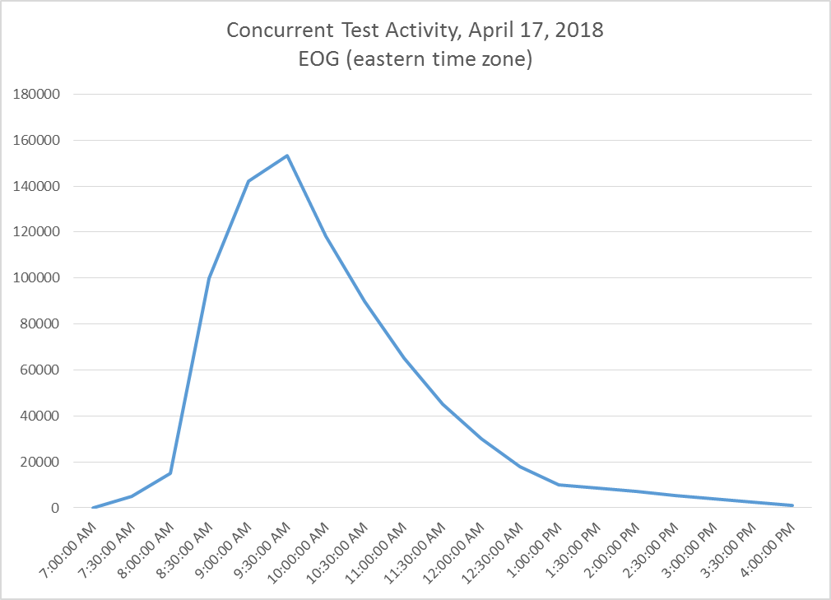
Concurrent Test Activity, April 17, 2018 EOG Spring 2018

Slide 15
OS Breakdown EOG and EOC Spring 2017

Slide 16
Getting Ready for Milestones and ACCESS for ELLs 2.0
System Test Coordinator | Technology Coordinator | Student Information Coordinator
Develop and communicate the system testing calendar Provide test management and administration training Coordinate adding local user profiles into eDIRECT or AMS Coordinate setting up student test sessions in eDIRECT Establish a process to verify testing infrastructure functions correctly | Install and configure Central Office Services for content management Install and configure INSIGHT on student testing devices Coordinate with System Test Coordinator a process to verify testing infrastructure functions correctly | Verify student information is correct and up to date Coordinate providing student demographic information to Data Collections during the Pre-ID transmission window

Slide 17
Available Technology Resources

Slide 18
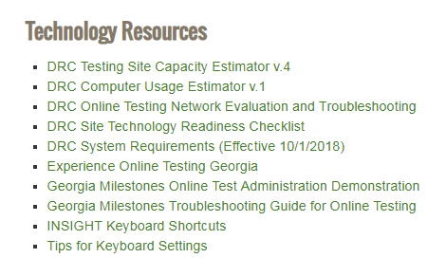
Available Technology Resources
DRC Testing Site Capacity Estimator v.4
DRC Computer Usage Estimator v. 1
DRC Online Testing Network Evaluation and Troubleshooting
DRC Site Technology Readiness Checklist
DRC System Requirements (Effective 10/1/2018)
Experience Online Testing Georgia
Georgia Milestones Online Test Administration Demonstration
Georgia Milestones Troubleshooting Guide for Online Testing
INSIGHT Keyboard Shortcuts
Tips for Keyboard Settings
http://www.gadoe.org/Curriculum-Instruction-and-Assessment/Assessment/Pages/Georgia-Milestones-EOG-Resources.aspx

Slide 19
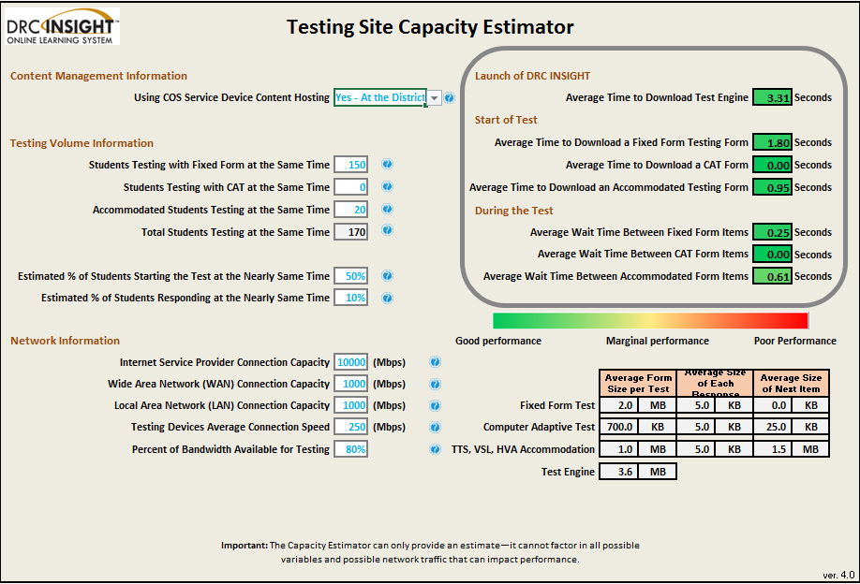
DRC Testing Site Capacity Estimator v.4

Slide 20
DRC Computer Usage Estimator v.1

Slide 21
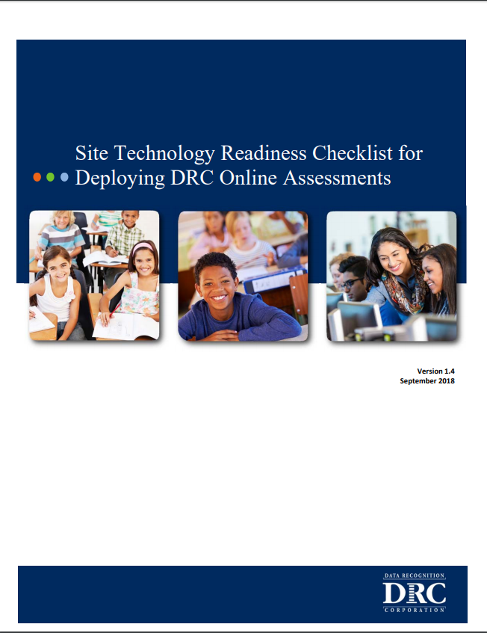
Resource Materials

Slide 22
DRC System Requirements (Effective 10/1/2018)

Slide 23
Test Practice for Online Administrations – Georgia Milestones
Secure Practice Test
Tickets found in pdf format in General Information of eDIRECT
Test taken through INSIGHT platform
Will include a single, sample TE item form (November target)
Available year-round
Secure Practice Test with Response Transmission
Students scheduled and tests printed through Test Administration of eDIRECT
Records Network and Bandwidth usage during a simulated test administration
Test taken through INSIGHT platform
Extended Retry Logic
Available August 6, 2018 – May 31, 2019
Experience Online Testing Georgia
No tickets needed
Test taken online at www.gaexperienceonline.com
Students, parents and teachers can all access this website
Sample of Section One ELA is presented
Will include a single, sample TE item form (November)
Available year-round from anywhere on the web

Slide 24
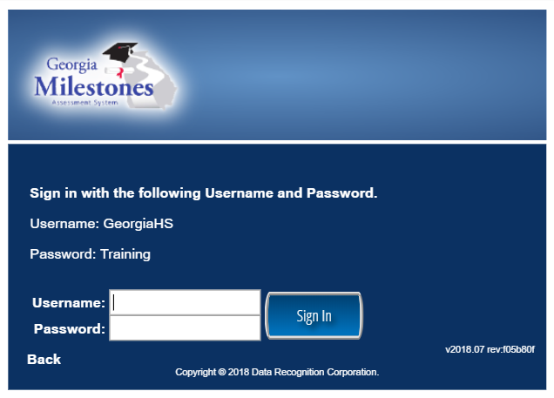
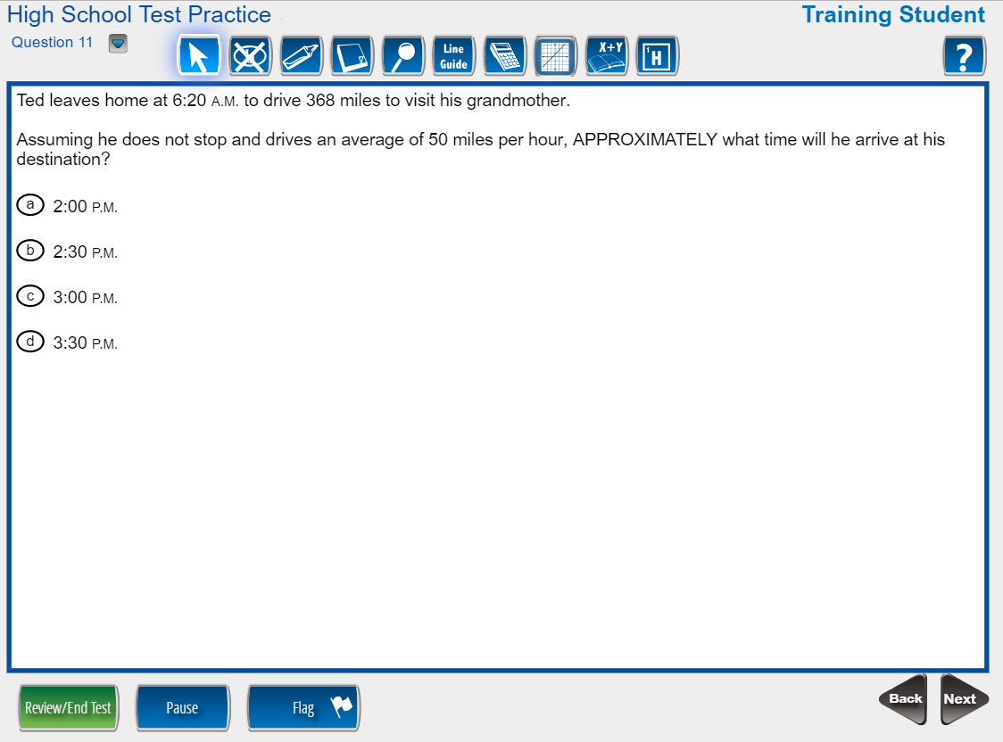
Georgia Milestones Experience Online Testing Georgia
www.gaexperienceonline.com

Slide 25
Georgia Milestones Online Test Administration Demo

Slide 26
Tips for Keyboard Settings

Slide 27
What’s New

Slide 28
What’s New – Extended Retry Logic
Provides solution to avoid a network connection error that disconnected students from testing or caused error flags on the TSM
Results in fewer students disconnected from testing
Functions for Georgia Milestones
Continues attempting to connect for five minutes
Does not work with Response Caching

Slide 29
What’s New – Extended Retry Logic
INSIGHT attempts to send the test response to DRC for five minutes. During this time, the following scenarios may occur:
Scenario I: A connection is re-established quickly.
In this situation, the error message closes and the tester continues testing. Note that this situation could occur very quickly, even before a test proctor has had time to contact the tester.
Scenario II: The tester is directed to close the message (clicks Exit the Test).
In this situation, a test proctor directs the tester to click Exit the Test, INSIGHT closes, and testing ends for the tester.
Note: All test information is saved and tester can resume testing at same point in the test when they re-enter the test.

Slide 30
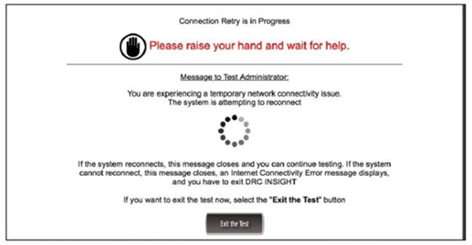
What’s New – Extended Retry Logic
If INSIGHT cannot send a test response to DRC due to connectivity issues, it displays the following error message.

Slide 31
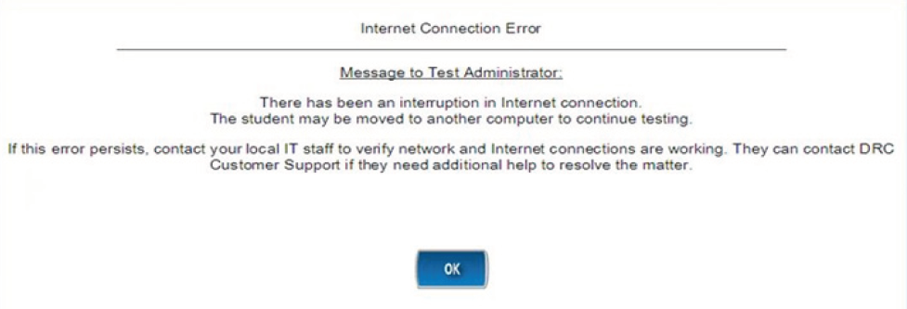
What’s New – Extended Retry Logic
Scenario III: The tester is directed to wait and to leave the message displayed.
In this situation, one of two things occur:
If a network connection is re-established within five minutes, the test response is sent to DRC, the message closes automatically, and the tester can continue testing.
If a network connection is not re-established within five minutes, the message closes and an Internet Connection Error message displays, requiring the tester to exit INSIGHT by clicking OK.

Slide 32
What’s New – COS
All districts were instructed to complete the transition from the TSM to COS Service Devices by the EOC August Mid-Month (August 6, 2018).
DRC is no longer supporting the TSM for Content Caching.
Extended Retry Logic removes the need for Response Caching.

Slide 33
Getting Started – The Basics

Slide 34
Online Readiness
Meeting with Technology Director and Site Technology Technicians
Ensure technology staff is aware of the local assessment calendar
Determine Site Readiness
Review Bandwidth and Network Needs
Ensure installation of Central Office Services (COS)
Ensure installation of INSIGHT
Along with technology staff, participate in training webinars
Establish and review technology troubleshooting protocols

Slide 35
Technology and Testing
Testing and Technology teams should work closely together
Review training dates and times
Review testing schedule, number of testers, amount of time testing
Capacity Estimator
Computer Use Estimator
Readiness Checklist
Plan for Secure Practice Test sessions
Verify that any new district technology works with INSIGHT
Check Firewall Settings and Whitelisting

Slide 36
Network Requirements
All testing devices should have access to the Internet and DRC servers using HTTP/HTTPS protocols on ports 80 and 443
All firewalls should allow connectivity on ports 80, 443, and 55222-55225
Whitelist the following file types, both internally and externally: enc, exe (for updates), gif, html, jar, jpeg, xml
Prioritize/whitelist INSIGHT traffic on: firewalls, internet packet shaper, routers, switches, proxies, other network devices
Whitelist these URLs on content filtering systems or other proxy/firewall software that is used locally:
https://drc-centraloffice.com https://dtk.drcedirect.com
https://ga-insight-client.drcedirect.com https://api-gateway-cloud.drcedirect.com
https://ga-insight.drcedirect.com https://api-gateway.drcedirect.com
https://ga.drcedirect.com https://cdn-content-prod.drcedirect.com
https://www.drcedirect.com https://cdn-download-prod.drcedirect.com
https://wbte.drcedirect.com

Slide 37
System Requirements
DRC provides updates of system requirements every 3-4 months
Goal to provide guidance based on device/operating system vendor support plans
Please note – If you experienced satisfactory performance from the hardware you used for online testing in 2017-2018, you should experience the same performance, or better, this year using the updated DRC INSIGHT secure browser and COS Service Device software – IF the device/operating system vendor still supports the device/operating system
Details of the System Requirements are located in eDIRECT
https://ga.drcedirect.com
General Information/Documents/
Document Type of Manuals

Slide 38
Getting Started – The Basics
Think about how you will group your testing machines
Local Testing Schedule – New Scheduling Flexibility
Computer Usage Estimator
COS Service Device
Capacity Estimator
Decide where and how you will deploy it
Install it
Setup Configurations in the Central Office Services – Device Toolkit (COS-DTK) for each group
Install DRC INSIGHT
One installation for Milestones (EOC and EOG), WIDA Screener, and ACCESS for ELLs 2.0

Slide 39
Grouping Machines
Consider the local testing calendar and work with the System Test Coordinator to determine any scheduling flexibility options to maximize devices and bandwidth.
Think about how you will group your testing machines
Location
Lab/Cart
Device OS
Grade
Other
Consider using an organized naming convention
You will use this information later in the COS-DTK to set up configurations.

Slide 40
COS Service Device
COS includes two major components:
COS-Device Toolkit (COS-DTK) Interface
Configuration User Interface replaced stand-alone Device Toolkit
Enhanced integration into eDIRECT for improved security and usability
COS Service Devices
Content Management and Content Hosting services that replace TSM
Service device software is installed locally on one or more dedicated devices at testing sites

Slide 41
Overview of COS
Central Office Services Service Devices (COS Service Device) replace the content caching feature currently found in the Testing Site Manager (TSM) software. These features in the COS Service Device are called Content Management and Content Hosting.
Content Management (CM) is the service that manages the download of test content to each site.
Content Hosting (CH) is the service that provides content to student testing devices.

Slide 42
Benefits of COS Service Devices
Creating separate features, referred to as Content Management and Content Hosting, allows for additional flexibility.
Download only the content appropriate for a specific testing site.
Download content once for use by multiple COS Service Devices.
More testing devices supported per service device without manipulating settings on machine
500 testing devices per TSM
900+ testing devices per COS Service Device
All configuration and management of COS Service Devices completed in the COS-DTK page in eDIRECT
Ability to manage multiple testing programs on a single device.
Can support Georgia Milestones and WIDA ACCESS on the same device
Supports silent installations.

Slide 43
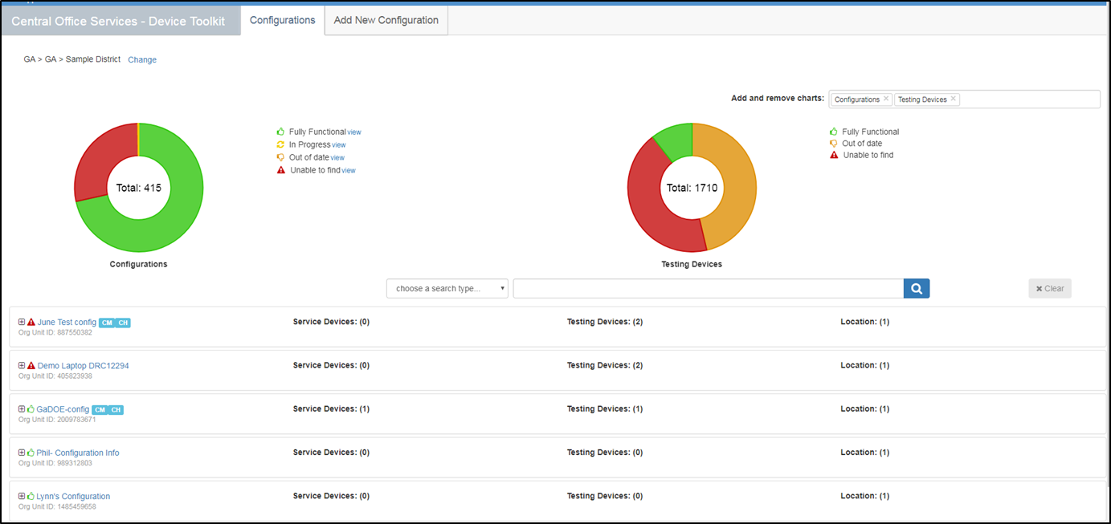
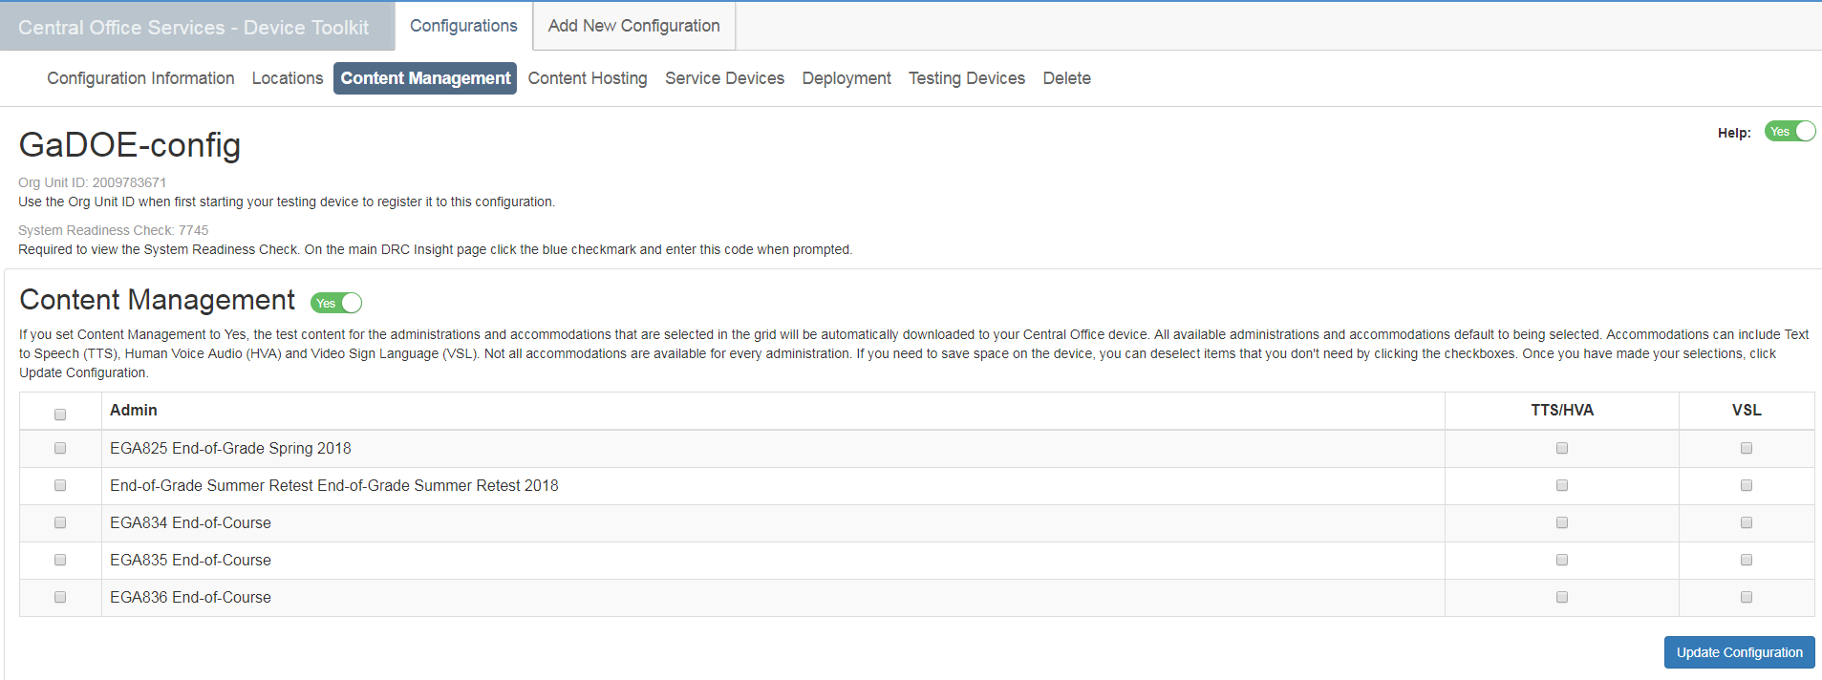
COS-DTK Dashboard

Slide 44
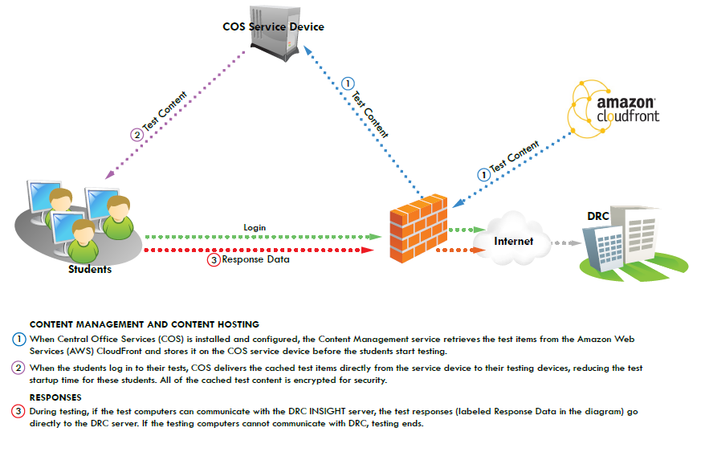
COS Service Device

Slide 45
Technology

Slide 46
Testing and the Hardware Puzzle
Peripherals
Labs
Laptops
Servers
One-to-One
Tablets

Slide 47
Testing and the Hardware Puzzle
Laptops
Labs
Peripherals
Tablets
One-to-One
Servers

Slide 48
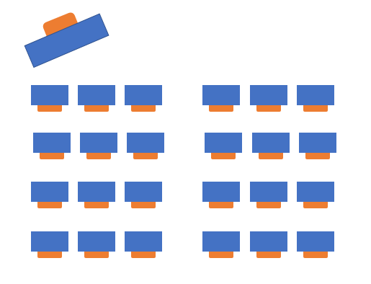
Testing Environment – Setup
Space and/or dividers between computers
Cover instructional materials
INSIGHT software on devices
Enough power to testing devices
Notes:
Each testing setup is unique so make sure to preview your test environment before test day. Test administrators should consider how desks, tables or computers are distributed and the proximity of students. Physical barriers limit distractions and discourage cheating. Make sure all instructional materials are covered. If there is a question about whether materials should be covered, it is best to be safe and cover them. Make sure that INSIGHT is functioning on testing devices. You can check the system using the Secure Practice Test or Secure Practice Test with Response Transmission. Schools should have a plan to minimize background noise and for test monitors in the halls to manage any students. Make sure that there is a Do Not Disturb and No Electronic Devices Sign for the Door. You should also have a plan for gathering cell phones and other electronic devices so students do not use them during testing.

Slide 49
Wireless Considerations
If the site is using wireless connectivity, complete a wireless site survey to assess sufficient wireless coverage in testing areas. The areas to review in this survey include:
Device Density
Radio Frequency Interference
Connection Consistency
2.4 GHz vs. 5 GHz Bands

Slide 50
Network Considerations
Connection and bandwidth requirements are greatest at the beginning of the test .
Are the firewall and filters on the computer network configured correctly?
Verify that there is available capacity for the number of students taking the test at the same time.
Take into account competing network bandwidth.
Estimated available bandwidth needed from testing client to COS Service Device
Up to 450 Concurrent Testers: 200 Mb
Up to 900 Concurrent Testers: 400 Mb
Over 900 Concurrent Testers: 800 Mb
Consider using traffic shaping to give DRC INSIGHT testing traffic priority over other network traffic

Slide 51
Administration

Slide 52
Georgia Milestones Administration Windows
Secure Practice Test with Response Transmission
Secure Practice Test with Response Transmission | August 6, 2018 – May 31, 2019
End of Course (EOC)
EOC November 2018 Mid-Month | November 5-16, 2018
EOC Winter 2018 Administration | November 26, 2018 – January 4, 2019
EOC Spring 2019 Mid-Month | January 14-25, 2019; February 11-22, 2019; March 11-22, 2019
EOC Spring 2019 Main Administration | April 22 – May 31, 2019
EOC Summer 2019 Administration | June 17 – July 19, 2019
End of Grade (EOG)
EOG Spring 2019 Main Administration | April 8 – May 17, 2019
EOG Grades 3, 5, and 8 EOG Summer Retest | May 13 – July 19, 2019

Slide 53
Spring/Summer 2019 Testing Overlap
Spring 2019 GAA 2.0
Spring 2019 EOG
Spring 2019 EOC
Summer Retest 2019 EOG
Nov 7
Summer 2019 EOC
Dec 20
6 days
Today
2019
February
March
April
May
June
July
August
2019
18 days
24 days
16 days
Spring 2019 GAA 2.0
March 25 – May 3, 2019
25 days
Spring 2019 EOG
April 8 – May 17, 2019
Spring 2019 EOC
April 22 – May 31, 2019
Summer Retest 2019 EOG
May 13 – July 19, 2019
Summer 2019 EOC
June 17 – July 19, 2019

Slide 54
Monitoring Online Test Sessions

Slide 55
COS Monitoring During Testing

Slide 56
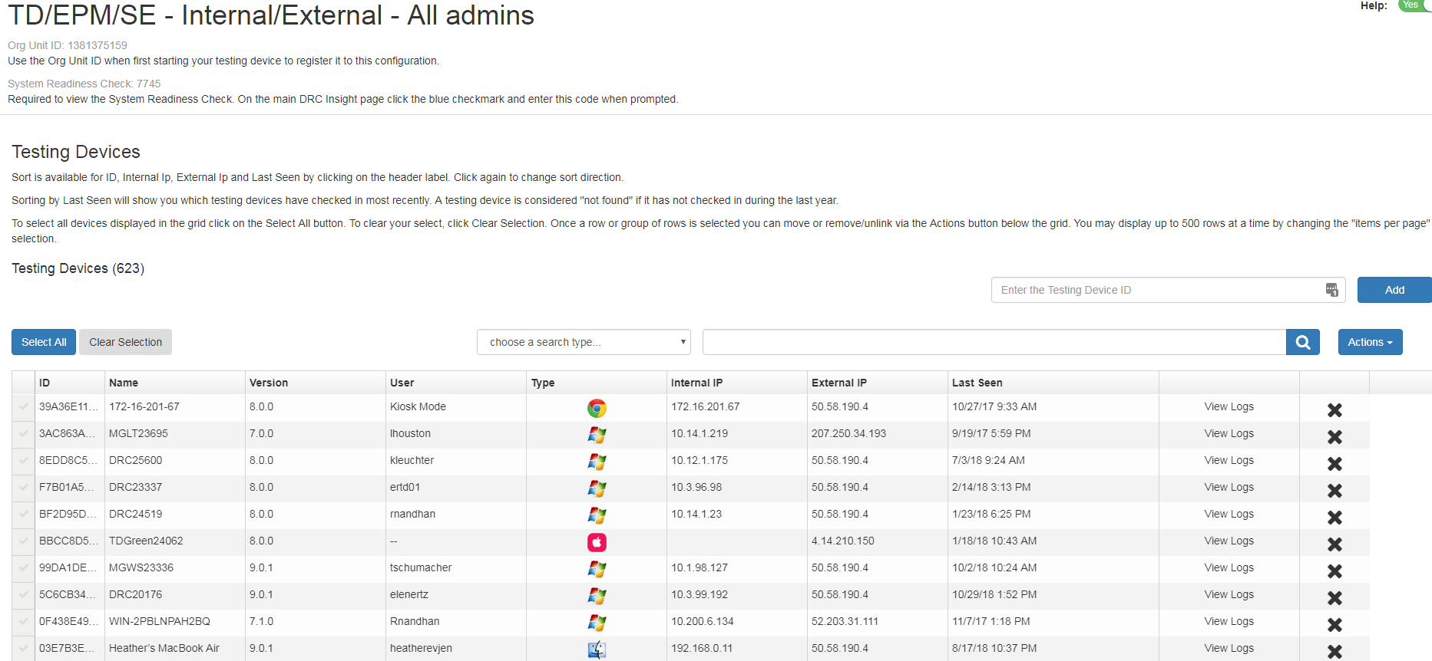
COS Monitoring During Testing

Slide 57
Technology-Related Webinars
9/25/2018 | INSIGHT/eDIRECT Training; COS Install/Q&A | 10:00 am - 12:00 pm | https://attendee.gotowebinar.com/register/342256370918720514
9/27/2018 | INSIGHT/eDIRECT Training; COS Install/Q&A - LIVE Repeat | 1:00 pm - 3:00 pm | https://attendee.gotowebinar.com/register/979773003912609794
2/19/2019 | INSIGHT/eDIRECT Training Webinars | 10:00 am - 12:00 pm | https://attendee.gotowebinar.com/register/7971554250801720066
2/21/2019 | INSIGHT/eDIRECT Training Webinars - LIVE Repeat | 1:00 pm - 3:00 pm | https://attendee.gotowebinar.com/register/7243752320004708098

Slide 58
Thank you!
Helpful Documents
Central Office Services (COS) – Device Toolkit Transition Guide
DRC INSIGHT System Requirements
Technology User Guide (Volumes I-V)
All found on eDIRECT: https://ga.drcedirect.com under General Information/Documents/Manuals
DRC Georgia Customer Care
Hours of Operation: 7 am – 8 pm ET
Phone: (866) 282-2249
Email: gahelpdesk@datarecognitioncorp.com

