Slide 1
Georgia Milestones Update Georgia Education Leadership Institute September 2016
Melissa Fincher, Ph.D. Deputy Superintendent, Assessment & Accountability mfincher@doe.k12.ga.us

Slide 2
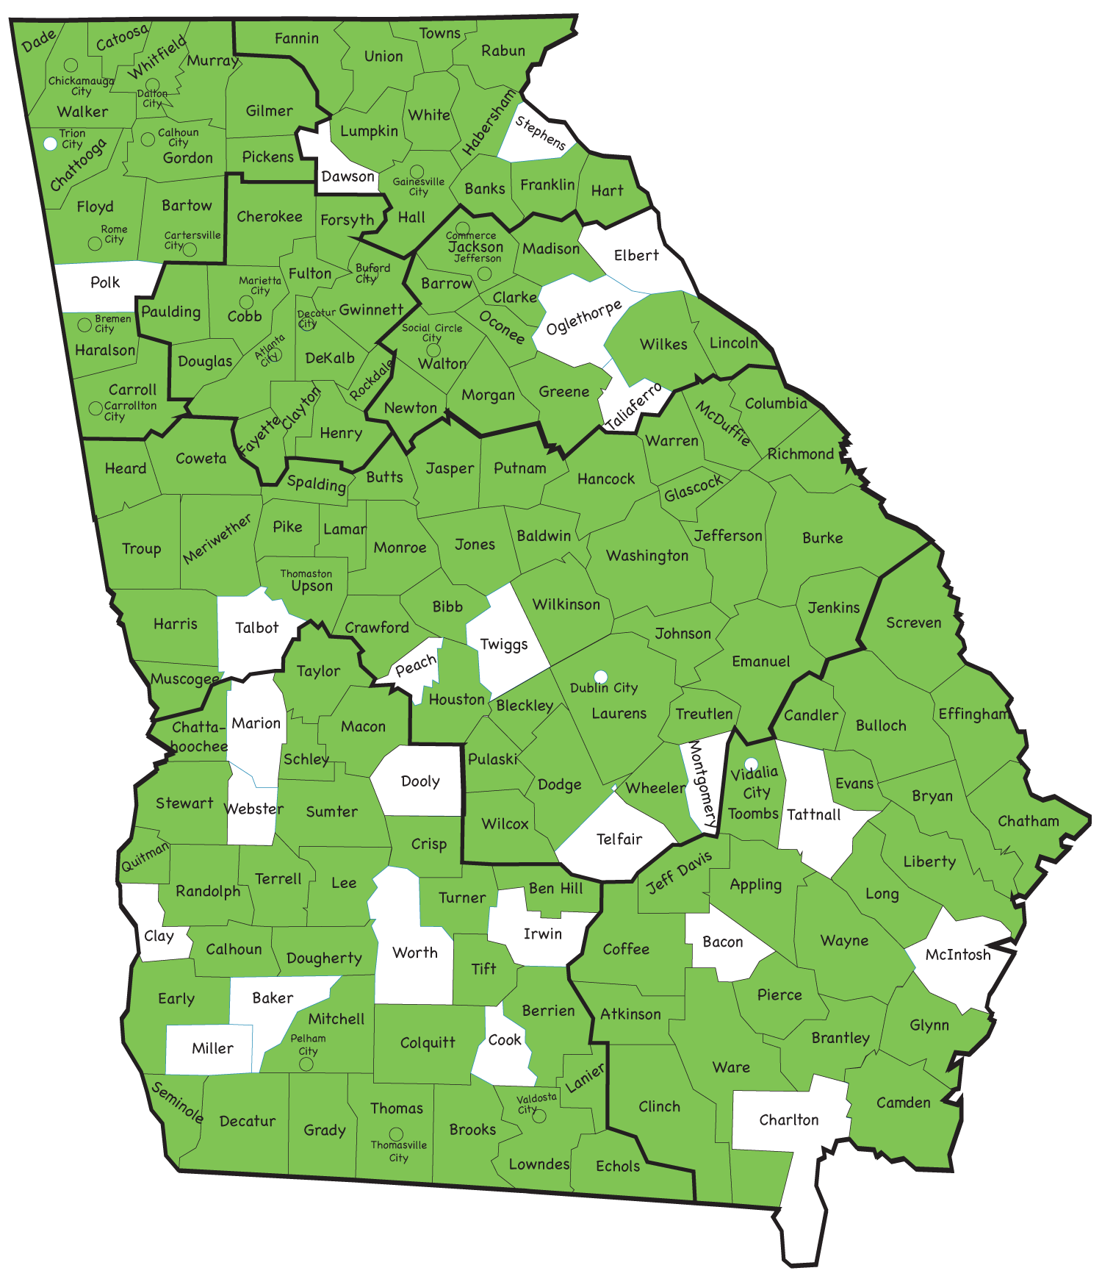
Educator Participation in Georgia Milestones Meetings
Statewide Schools
Georgia Cyber Academy
Georgia Virtual School (GaVS)
State Schools
Higher Ed
Technical College System of Georgia
University System of Georgia

Slide 3
2015-2016

Slide 4
Georgia Milestones by the Numbers….
Spring 2016
Approximately 3. 9 million tests administered, scored and reported.
Remember, each grade-level EOG consists of 4 tests.
Online Administrations
When including the Winter 2015 EOC administration, 75% of tests were administered online during the 2015-2016 administration.
Georgia Milestones | Spring 2015 | Spring 2016
End of Grade | 30% | 55%
End of Course | 71% | 91%
Total | 53% | 73%

Slide 5
Online Interruptions by the Numbers….
End of Grade [Each student has 9 sections across the 4 content area tests]
Number of test sections without interruption: 93.5%
Number of test sections interrupted: 6.5%
Number of test sections interrupted more than once: 1.98%
End of Course [Each test has 3 (ELA) or 2 (math, science, social studies) sections]
Number of test sections without interruption: 97.3%
Number of test sections interrupted: 2.7%
Number of test sections interrupted more than once: 0.39%
It is important to note the cases quantified above include test-administration errors that were not due to some type of software or hardware malfunction.
While improvements must be made, it is highly likely that there will always be some, hopefully small, number of interruptions.

Slide 6
EOG Preliminary Interruption Analysis
The preliminary interruption analysis controlled for
achievement (2015 & 2016)
gender
ethnicity
students with disabilities
region
Effect sizes (magnitude of differences) were negligible and were not always negative
Also examined item and person fit statistics – interrupted vs uninterrupted
Finding: Preliminary analyses did not uncover any systemic impact.

Slide 7
Spring 2016 v Spring 2015
Comparison 2015 to 2016 |  | EOG | EOC | Combined
Developing & Above | increased | 11 | 7 | 18
 | same | 9 | 0 | 9
 | decreased | 4 | 1 | 5
Proficient & Above | increased | 16 | 7 | 23
 | same | 5 | 0 | 5
 | decreased | 3 | 1 | 4
32 tests administered

Slide 8
Spring 2016 v Spring 2015 Proficient & Above
Increase: Proficient & Above |  |  |  | Same
Grade 3 Mathematics | +2 | Grade 8 ELA | +5 | Grade 3 Social Studies
Grade 3 Science | +1 | Grade 8 Mathematics* | +3 | Grade 4 Mathematics
Grade 5 ELA | +2 | Grade 8 Science* | +2 | Grade 4 Science
Grade 5 Science | +3 | Grade 8 Social Studies | +5 | Grade 5 Mathematics
Grade 5 Social Studies | +1 | 9th Grade Literature | +2 | Grade 6 ELA
Grade 6 Mathematics | +2 | American Literature | +7
Grade 6 Science | +1 | Analytic Geometry | +3 | Decrease: Proficient & Above
Grade 6 Social Studies | +1 | Biology | +5
Grade 7 ELA | +1 | Physical Science | +3 | Grade 3 ELA | -2
Grade 7 Mathematics | +5 | US History | +6 | Grade 4 ELA | -2
Grade 7 Science | +3 | Economics | +9 | Grade 4 Social Studies | -1
Grade 7 Social Studies | +3 |  |  | Coordinate Alg | -3
 |  | *includes grade 8 students who took EOC in lieu of math and/or science EOG

Slide 9
Spring 2016 v Spring 2015 Developing & Above
Increase: Developing & Above |  |  |  | Same
Grade 3 Social Studies | +1 | Biology | +5 | Grade 3 ELA
Grade 5 ELA | +2 | Physical Science | +1 | Grade 3 Mathematics
Grade 6 Science | +1 | US History | +4 | Grade 3 Science
Grade 7 ELA | +3 | Economics | +5 | Grade 4 Mathematics
Grade 7 Mathematics | +1 |  |  | Grade 4 Science
Grade 7 Science | +2 |  |  | Grade 5 Science
Grade 7 Social Studies | +2 |  |  | Grade 5 Social Studies
Grade 8 ELA | +4 |  |  | Grade 6 Mathematics
Grade 8 Mathematics* | +4 |  |  | Grade 6 Social Studies
Grade 8 Science* | +3 | Decrease: Developing & Above
Grade 8 Social Studies | +5
9th Grade Literature | +1 | Grade 4 ELA | -1 | Grade 6 ELA | -1
American Literature | +1 | Grade 4 Social Studies | -1 | Coordinate Algebra | -1
Analytic Geometry | +5 | Grade 5 Mathematics | -1
*includes grade 8 students who took EOC in lieu of math and/or science EOG

Slide 10
Domain Signals
All Content Areas/Courses
Remediate Learning
Monitor Learning
Accelerate Learning
Domain Performance:
What is the likelihood the student would achieve proficiency on the test given his/her performance in the domain?
Domain performance is reported in terms of the Proficient Learner achievement level.

Slide 11
Promotion & Retention
Reading – Grades 3, 5, and 8
Student performance on the reading portion of the ELA test will be used to provide a grade level reading determination:
Below Grade Level or On/Above Grade Level
The determination is based on the linkage of the Lexile scale to Georgia Milestones. To be eligible for promotion, students must demonstrate reading skill at the beginning of the grade-level stretch-band. The stretch-bands were developed to signal the reading level at each grade students need to achieve to be college and career-ready upon graduation.

Slide 12
Promotion & Retention
Reading – Grades 3, 5, and 8
Generally speaking, students in the Beginning Learner achievement level and some at the lower end of Developing Learner will need reading remediation and are eligible to retest.
Students who achieve the beginning range of Developing Learner demonstrated sufficient writing and language skills to increase their achievement level but may still be reading below grade level.
Conversely, some students who achieve the upper range of Beginning Learner may be reading on grade level (although they may not be strong readers); their writing and language skills have decreased their achievement level.

Slide 13
Promotion & Retention
Spring Reading Performance
Grade/Course | Below Grade Level |  | Grade Level or Above
 | 2015 | 2016 | 2015 | 2016
3 | 31% | 28% | 69% | 72%
4 | 41% | 42% | 59% | 58%
5 | 34% | 32% | 66% | 68%
6 | 40% | 41% | 60% | 59%
7 | 29% | 26% | 71% | 74%
8 | 29% | 24% | 71% | 76%
9th Grade Literature | 27% | 22% | 73% | 78%
American Literature | 30% | 27% | 70% | 73%

Slide 14
Lexile Results for Georgia Students: 2008 - 2016
Median Lexile for Georgia Students by Grade Level/Course
Grade Level/ Course | 2008 | 2009 | 2010 | 2011 | 2012 | 2013 | 2014 | 2015 | 2016 | Suggested Text Demand: Lower Limit | Suggested Text Demand: Upper Limit
3 | 670 | 645 | 685 | 720 | 740 | 790 | 755 | 650 | 645 | 520 | 820
4 | 770 | 790 | 810 | 805 | 840 | 860 | 915 | 790 | 795 | 740 | 940
5 | 870 | 840 | 885 | 925 | 935 | 940 | 965 | 920 | 940 | 830 | 1010
6 | 955 | 980 | 980 | 1000 | 1025 | 1070 | 1075 | 975 | 980 | 925 | 1070
7 | 995 | 1020 | 1020 | 1040 | 1065 | 1095 | 1120 | 1095 | 1115 | 970 | 1120
8 | 1080 | 1110 | 1150 | 1170 | 1180 | 1210 | 1265 | 1130 | 1175 | 1010 | 1185
9th Lit |  |  |  |  | 1205 | 1215 | 1225 | 1205 | 1230 | 1050 | 1260
Am. Lit |  |  |  |  | 1220 | 1240 | 1270 | 1305 | 1345 | 1185 | 1385
The median Lexiles obtained from the Georgia Milestones Assessments are not comparable to prior years because the new test is more rigorous with different performance standards than its predecessors.

Slide 15
Spring Median Lexiles
Median Lexile Score by Grade/Course and Achievement Level
Grade/Course | Lower Bound of Text Band | Beginning Learner |  | Developing Learner |  | Proficient Learner |  | Distinguished Learner
 |  | 2015 | 2016 | 2015 | 2016 | 2015 | 2016 | 2015 | 2016
3 | 520 | 390 | 425 | 635 | 645 | 810 | 820 | 985 | 1015
4 | 740 | 545 | 535 | 765 | 795 | 940 | 975 | 1105 | 1135
5 | 830 | 690 | 685 | 885 | 880 | 1085 | 1075 | 1300 | 1330
6 | 925 | 730 | 750 | 955 | 945 | 1135 | 1140 | 1360 | 1370
7 | 970 | 870 | 850 | 1080 | 1080 | 1280 | 1280 | 1510 | 1475
8 | 1010 | 870 | 875 | 1095 | 1105 | 1285 | 1295 | 1490 | 1470
9th Grade Literature | 1050 | 925 | 940 | 1165 | 1170 | 1370 | 1400 | 1600 | 1630
American Literature | 1185 | 1025 | 1015 | 1275 | 1290 | 1505 | 1510 | 1785 | 1785

Slide 16
2016 Median Lexile within each Achievement Level & Suggested Text Bands

Slide 17
Promotion & Retention
Mathematics – Grades 5 and 8
Students must achieve the Developing Learner achievement level to be considered eligible for promotion.
These students have demonstrated partial proficiency of the grade level concepts and skills and can proceed to the next grade level when provided focused instructional support in the needed areas; their learning should be actively monitored to ensure their success.
Student who achieve the Beginning Learner should receive remediation and be provided the opportunity to retest. These students need substantial academic support.

Slide 18
Promotion & Retention
Spring Mathematics Performance
Grade/Course | Beginning Learner |  | Developing Learner & Above
 | 2015 | 2016 | 2015 | 2016
3 | 21% | 21% | 79% | 79%
4 | 20% | 20% | 80% | 80%
5 | 25% | 26% | 75% | 74%
6 | 25% | 25% | 75% | 75%
7 | 25% | 24% | 75% | 76%
8 | 25% | 24% | 75% | 76%
Coordinate Algebra | 31% | 32% | 69% | 68%
Analytic Geometry | 35% | 30% | 65% | 70%
Algebra I | -- | 30% | -- | 70%
Geometry | -- | 30% | -- | 70%

Slide 19
EOG Median National Percentile Ranks
Grade | English Language Arts* |  | Mathematics |  | Science |  | Social Studies
 | 2015 | 2016 | 2015 | 2016 | 2015 | 2016 | 2015 | 2016
3 | 35 | 34 | 51 | 52 | 58 | 60 | 48 | 49
4 | 42 | 39 | 59 | 58 | 46 | 45 | 50 | 47
5 | 40 | 43 | 53 | 53 | 52 | 52 | 55 | 55
6 | 54 | 53 | 58 | 59 | 66 | 68 | 59 | 59
7 | 46 | 50 | 62 | 66 | 60 | 62 | 66 | 65
8 | 60 | 68 | 72 | 68 | 64 | 60 | 57 | 59
*ELA NPR reflects Reading subtest
Based on Georgia student performance on 20 NRT items embedded on the Georgia Milestones EOG.

Slide 20
EOC Median National Percentile Ranks
Course | Winter |  | Spring
 | 2014 | 2015 | 2015 | 2016
9th Grade Literature** | 63 | 58 | 65 | 63
American Literature** | 56 | 56 | 60 | 62
Coordinate Algebra | 64 | 60 | 63 | 65
Analytic Geometry | 83 | 84 | 65 | 68
Algebra I | -- | 76 | -- | 77
Geometry | -- | 82 | -- | 75
Physical Science | 55 | 52 | 62 | 62
Biology | 63 | 65 | 65 | 68
U.S. History | 46 | 47 | 52 | 55
Economics | 55 | 53 | 51 | 55
**ELA NPR reflects Language subtest
Based on Georgia student performance on 20 NRT items embedded on the Georgia Milestones EOC.

Slide 21
Spring Median NPRs for Beginning Learners in ELA
Grade | English Language Arts* |  | 9th Grade Literature** |  | American Literature**
 | 2015 | 2016 | 2015 | 2016 | 2015 | 2016
3 | 9 | 9 | 21 | 20 | 25 | 28
4 | 8 | 7
5 | 8 | 7
6 | 11 | 11
7 | 11 | 14
8 | 14 | 15
*EOG ELA NPR reflects Reading subtest **EOC ELA NPR reflect Language subtest
Based on Georgia student performance on 20 NRT items embedded on the Georgia Milestones EOG or EOC.

Slide 22
Spring Median NPRs for Beginning Learners in Mathematics
Grade | Mathematics |  | Coordinate Algebra |  | Analytic Geometry |  | Algebra I |  | Geometry
 | 2015 | 2016 | 2015 | 2016 | 2015 | 2016 | 2015 | 2016 | 2015 | 2016
3 | 8 | 8 | 26 | 30 | 28 | 27 | -- | 35 | -- | 30
4 | 11 | 10
5 | 13 | 13
6 | 17 | 16
7 | 21 | 21
8 | 25 | 24
Based on Georgia student performance on 20 NRT items embedded on the Georgia Milestones EOG or EOC.

Slide 23
Spring Median NPRs for Beginning Learners in Science
Grade | Science |  | Physical Science |  | Biology
 | 2015 | 2016 | 2015 | 2016 | 2015 | 2016
3 | 8 | 9 | 27 | 27 | 24 | 23
4 | 11 | 11
5 | 15 | 15
6 | 19 | 19
7 | 20 | 20
8 | 31 | 32
Based on Georgia student performance on 20 NRT items embedded on the Georgia Milestones EOG or EOC.

Slide 24
Spring Median NPRs for Beginning Learners in Social Studies
Grade | Social Studies |  | U.S. History |  | Economics
 | 2015 | 2016 | 2015 | 2016 | 2015 | 2016
3 | 10 | 9 | 18 | 18 | 19 | 21
4 | 13 | 11
5 | 15 | 16
6 | 17 | 17
7 | 20 | 18
8 | 28 | 28
Based on Georgia student performance on 20 NRT items embedded on the Georgia Milestones EOG or EOC.

Slide 25
Achievement Level Descriptors
Achievement Level Descriptors:
are critical to test score interpretation, helping to give meaning to the scale scores and achievement classifications;
represent the progression of understanding, thinking, and reasoning in each content area; and
can be viewed as stages of thinking and learning, providing insight into not only the content, but also the cognitive demand and context within which students are able to demonstrate mastery.

Slide 26
Achievement Level Descriptors
Sample Grade 3 Mathematics
ALD | Standard | Beginning Learner | Developing Learner | Proficient Learner | Distinguished Learner
Policy |  | Beginning Learners do not yet demonstrate proficiency in the knowledge and skills necessary at this grade level/course of learning, as specified in Georgia’s content standards. The students need substantial academic support to be prepared for the next grade level or course and to be on track for college and career readiness. | Developing Learners demonstrate partial proficiency in the knowledge and skills necessary at this grade level/course of learning, as specified in Georgia’s content standards. The students need additional academic support to ensure success in the next grade level or course and to be on track for college and career readiness. | Proficient Learners demonstrate proficiency in the knowledge and skills necessary at this grade level/course of learning, as specified in Georgia’s content standards. The students are prepared for the next grade level or course and are on track for college and career readiness. | Distinguished Learners demonstrate advanced proficiency in the knowledge and skills necessary at this grade level/course of learning, as specified in Georgia’s content standards. The students are well prepared for the next grade level or course and are well prepared for college and career readiness.
Range |  | A student who achieves at the Beginning Learner level demonstrates minimal command of the grade-level standards. | A student who achieves at the Developing Learner level demonstrates partial command of the grade-level standards. | A student who achieves at the Proficient Learner level demonstrates proficiency of the grade-level standards. | A student who achieves at the Distinguished Learner level demonstrates advanced proficiency of the grade-level standards.
 | 3.NBT.1 3.NBT.2 3.NBT.3 | Understands place value to 1000 and multiplies single-digit numbers. | Adds and subtracts within 1000. | Uses place value relationships to round numbers, multiplies whole numbers by multiples of ten, adds and subtracts fluently, and explains arithmetic patterns. | Recognizes that each place value, left to right, is ten times the one before it, rounding to specific whole-number place values, and multiplies multiples of ten by each other.

Slide 27
Frequently Asked Questions
Q: How can two students with the same scale score and achievement level in ELA have different Lexile scores?
A: The Lexile is based on how each student performed on the items measuring reading. The ELA test also includes items that measure language and research skills, as well as writing. The two students performed differently on the sets of items that comprise the ELA test.
Higher performance on one domain can compensate for lower performance on the other domain.

Slide 28
English Language Arts
Reading and
Vocabulary
Writing and
Language

Slide 29
Frequently Asked Questions
Q: How can a student who is classified as reading on/above grade level achieve ‘Remediate Learning’ in the Reading and Vocabulary domain?
A: Remember that the domain designation comes from the student’s performance on the questions within the domain in relation to the overall ELA test. While reading on-grade level is required to be a Proficient Learner, it is not sufficient in and of itself.
Students reading at the lower boundary of the suggested text band for their grade are not necessarily strong readers. We would expect students to be reading at the upper end of the suggested text band at the end of the school year when the test is administered.

Slide 30
Frequently Asked Questions
Q: How can two students with the same scale score and achievement level in a content area have different NRT scores?
A: There are two sets of items that comprise the Georgia Milestones tests – criterion references (those aligned to our state content standards) and norm-referenced (those that come from the TerraNova). The two students performed differently on the NRT items.

Slide 31
Frequently Asked Questions
Q: How does one make sense of the domain signals?
Remediate Learning / Monitor Learning / Accelerate Learning
Domain Performance: What is the likelihood the student would achieve proficiency on the test given his/her performance in the domain?
A: Use the Achievement Level Descriptors; the ALDs present the progression of student learning by achievement level and are organized by standard, group of standards, or concept.
Note: Domain signals now take into account the difficulty of the items that comprise the domain; this is important and was lacking in our previous domain reporting (percent correct).

Slide 32
Balancing Act
Regardless of the content area, good instruction balances content coverage in order to avoid….

Slide 33
2016-2017

Slide 34
Spring 2017 Scoring and Reporting Timelines
We are continuing to work through the challenges encountered in Spring 2016.
There were a multitude of factors that contributed to the delays.
It is imperative we know when each district is testing so that we can plan accordingly.
In scheduling local windows, it is critical to factor in return of paper documents.
The clock begins when documents arrive at the scoring center.
As soon as we have details, we will share.

Slide 35
Spring 2017
Technology Enhanced (TE) Items
As planned and communicated, TE items will be included on the 2016-2017 operational forms in ELA and Mathematics
these include multi-part/multi-select items
examples are included as part of the Experience Online Testing website
Assessment Guides are being updated
TE items will be field tested in Science and Social Studies (grades 5 and 8 and EOC)

Slide 36
Technology Enhanced Items
English Language Arts
Evidence-Based Selected-Response (EBSR) items
Mathematics
Multiple-select items
Multi-part/multi-select items

Slide 37
Evidence-Based Selected Response
A two-part multiple-choice item that requires students to complete both parts
First part answers inferential or key concept question related to text. Includes one correct response
Second part is evidence from the text used to support the inference or idea. May include one or more correct response(s)
Provides opportunity for increased cognitive rigor
Students support key ideas and concepts with textual evidence
2-point score value with opportunity for partial credit
Part One and Two must be correct to receive 2-Points. 1-Point if only Part One is correct.

Slide 38
Evidence-Based Selected Response Student View Page 1

Slide 39
Evidence-Based Selected Response Student View Page 2

Slide 40
Mathematics Two-Part Items
Items are a combination of multiple-choice or multiple-select
Can be two different types or two of the same type
The student receives 1 point for each part

Slide 41
Mathematics Multiple-Select Items
Allows for more than one correct answer
There are five or six options listed
Number of selections are limited to the number of correct responses
Provides students with the opportunity to show fluency and/or multiple representations
2 points for all correct or 1 point for a specific combination(s).

Slide 42
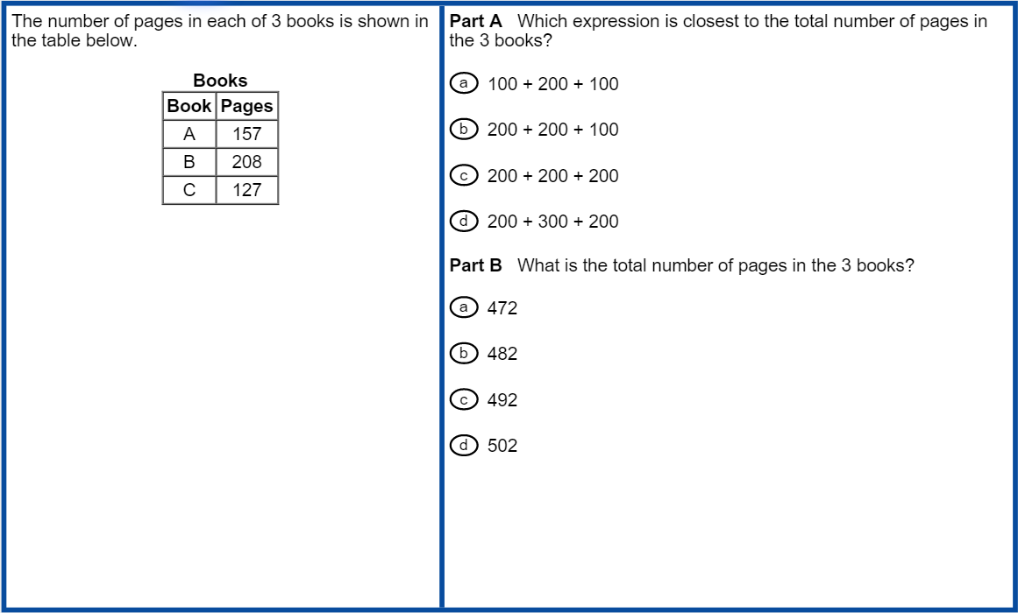
Mathematics Two-Part Items

Slide 43
Mathematics Multiple-Select Item

Slide 44
Benefits of TE Items
Provides scaffolding for multi-step responses
Meets demands of new standards for analysis
Provides evidence of close reading/mathematical processes
Drives deeper instruction

Slide 45
Senate Bill 364
Eliminates the Science and Social Studies EOG measures in grades 3, 4, 6, and 7 beginning in the 2016-2017 school year.
Grade 3: ELA – Mathematics
Grade 4: ELA – Mathematics
Grade 5: ELA – Mathematics – Science – Social Studies
Grade 6: ELA – Mathematics
Grade 7: ELA – Mathematics
Grade 8: ELA – Mathematics – Science – Social Studies
Science and Social Studies items in grades 3, 4, 5, and 7 will be loaded into GOFAR for formative use.
Timing TBD due to logistics

Slide 46
Senate Bill 364
Eliminates the Science and Social Studies EOG measures in grades 3, 4, 6, and 7 beginning in the 2016-2017 school year.
Student Growth Percentiles cannot be calculated for science and social studies beginning in 2016-2017, given there are no prior assessments
Given the reduction, there is additional flexibility for district testing schedules – but, districts should carefully consider implications for scoring and reporting.

Slide 47
Senate Bill 364
Calls for formative assessments in grades 1 and 2
“…each local school system shall administer, with state funding, a research based formative assessment with a summative component that is tied to performance indicators in English, language arts/reading, and mathematics in grades one and two, subject to available appropriations.”
“Each local school system is strongly encouraged to develop and implement a program of multiple formative assessments in reading and mathematics for kindergarten through fifth grade to ensure students entering sixth grade are on track to meet grade-level expectations, including mastery in reading by the end of third grade to prepare for the infusion of literacy in subsequent grades and master in basic mathematics skills by the end of fifth grade....’
…GaDOE is conceptualizing the development of these resources, ensuring integration with GKIDS and Georgia Milestones…
In the interim, districts may use local measures and/or GaDOE-provided resources such as the Grades 1 and 2 benchmarks and items housed in GOFAR.

Slide 48
Senate Bill 364
Directs the State Board of Education “to study and adopt policies beginning with the 2017-2018 school year, that will move the End of Grade (EOG) and EOC state testing windows as close to the end of the school year or semester as possible.”
The published state testing windows for the EOG in 2016-2017 will not change.
The state testing windows for the EOC already meet this requirement.
We will keep districts updated on all discussions and considerations.

Slide 49
Testing Rule
SBOE Rule 160-3-1-.07
TESTING PROGRAMS – STUDENT ASSESSMENT
The rule will be amended to
Remove references to the Georgia High School Graduation Tests (GHSGT) and Georgia High School Writing Test (GHSWT)
To remove the requirements for the grades 3, 4, 6, and 7 assessments in science and social studies
Extends the EL-M period from 2 to 4 years (per ESSA)
Provision of accommodations remains limited to 2 years
Adds requirement for formative assessments in grades 1 and 2, subject to appropriations

Slide 50
Testing Rule Considerations
Current EOC Requirements
All students enrolled in a course associated with an EOC must take the EOC.
The EOC contributes 20% to the student’s final course grade.
The EOC is used in CCRPI calculations
Proposed Flexibility for MOWR Students
All students participate in certain EOCs (9th Grade Literature; Algebra I/Coordinate Algebra; and Biology)
MOWR students enrolled in post-secondary courses in other EOC-related courses would not be required to take EOCs

Slide 51
Testing Rule Considerations
Amend the Testing Rule to ‘exempt’ MOWR students from the EOC other than those required by ESSA (suggest 9th Grade Literature; Algebra I/Coordinate Algebra; Biology)
To ensure high schools are not negatively impacted, use the college-issued grade in the CCRPI for remaining EOC-related courses, for example:
A = Distinguished Learner
B = Proficient Learner
C = Developing Learner
D/F = Beginning Learner

Slide 52
Testing Rule
SBOE Rule 160-3-1-.07
TESTING PROGRAMS – STUDENT ASSESSMENT
Rule Amendment Timeline
Initiate Rule Amendment: September 2016
Public Review/Comment
Adopt Rule Amendment: November 2016
Changes would go into effect prior to the Winter 2016 EOC administration.

Slide 53
Georgia’s ESSA Plan
State Advisory Committee
Comprised of forty stakeholders representing a variety of organizations, agencies, and advocacy groups across the state of Georgia
Five Working Committees (20 members each)
Accountability
Assessment
Education of the Whole Child
Federal Programs
Teacher & Leader Development
Superintendent Woods has scheduled 8 ESSA Listening Sessions across the state:
August 24: Columbia County
August 29: Habersham County
September 14: Fulton County
September 19: Muscogee County
October 6: Dougherty County
October 12: Laurens County
October 13: Chatham County
October 17: Gordon County

Slide 54
Assessment & Accountability
The primary purpose of school is teaching and learning.
Assessment and accountability plays an important role, but importantly – that role is supporting, with the primary focus being teaching and learning.

Slide 55
Teaching & Learning
It’s important to remember that knowledge and understanding within each content area is multifaceted; students must know content but also:
understand the thinking and reasoning that undergird each content area; and
draw conclusions and make connections across information and concepts rather than recite discrete facts and skills.

Slide 56
Questions & Answers
GaDOE Customer Service Survey:
http://gadoe.org/surveys/AsAc-H8PBVZM

