Slide 1
Assessment & Accountability
Georgia Educator Leadership Institute
September 2016
Melissa Fincher, Ph.D. Deputy Superintendent, Assessment & Accountability mfincher@doe.k12.ga.us

Slide 2
Assessment Foundations
Assessment is the systematic observation and evaluation of student performance.
In simple words, assessment helps answer the following questions:
Do students know?
Can students do?
How well do students know and can do?
What do students not know?
All assessments rely on a relatively small number of exercises to permit the user to draw inferences about a student’s mastery of larger domains of knowledge and skill.

Slide 3
Assessment Foundations
Bottom Line
What we assess, how we assess, and how we communicate the results sends a clear message to students about
what is worth learning,
how it should be learned,
what elements of quality are most important, and
how well we expect them to perform/achievement.
This applies across all types and forms of assessment –
from classroom quizzes to state-mandated.

Slide 4
Assessment Foundations
Comprehensive Assessment System
a coordinated and articulated system of multiple assessments
sometimes also referred to as a balanced assessment system
Components of a Comprehensive Assessment System
Formative: takes place during instruction to provide feedback to teaching and learning; used by both students and teachers
Interim: takes place after a sequence of instruction to evaluate students’ knowledge and skills relative to a specific set of academic goals, typically within a limited timeframe; typically used to report at a broader level than formative assessments
Summative: take place at the end of instruction to certify mastery or assign grades; typically used for accountability

Slide 5
Assessment Foundations
Criterion-Referenced Test
Norm-Referenced Test

Slide 6
Norm Referenced Test
Comparison Score
National Sample
Population
Representative Sample
Student

Slide 7
Norm-Referenced Tests
1 = Content Standards
2 = Typical Text Book
3 = Norm-Referenced Test
2
1
3

Slide 8
Criterion Referenced Test
Achievement Standard
Student

Slide 9
Criterion-Referenced Tests
1 = Content Standards
2 = Typical Text Book(s)
3 = Criterion-Referenced Test
2
1
3

Slide 10
Georgia Milestones
In designing and developing Georgia Milestones, the articulated goals included:
be of sufficient rigorous to ensure Georgia students are well positioned to compete with other students across the United States and internationally;
be intentionally designed across grade levels to send a clear signal of student preparedness for the next level, be it the next grade level, course, or college or career;
be accessible to all students, including those with disabilities or limited English proficiency, at all achievement levels;
support and inform educator effectiveness initiatives, ensuring items and forms are appropriately sensitive to quality instructional practices; and
accelerate the transition to online administration, allowing – over time – for the inclusion of innovative technology-enhanced items.

Slide 11
Georgia Milestones
To accomplish this, Georgia worked to:
continue the strong partnership with the University System of Georgia and the Technical College System of Georgia;
transition from assessments that are solely multiple-choice to assessments that also include test questions that require students to demonstrate their understanding by showing what and how they know;
increase the rigor of its assessments and expectations for student achievement, while also ensuring the assessment system is accessible to all students at all levels of the achievement continuum; and
create an assessment system that accurately measures the full continuum of achievement and progress over time for all students.

Slide 12
Georgia Milestones
Articulated purposes of the EOG:
provide a valid measure of student achievement of the state content standards across the full achievement continuum;
provide a clear signal of the student’s preparedness for the next educational level;
be suitable for use in promotion and retention decisions at grades 3 (reading), 5 (reading and mathematics), and 8 (reading and mathematics);
support and inform educator effectiveness measures; and
inform state and federal accountability measures at the school, district, and state levels.

Slide 13
Georgia Milestones
Articulated purposes of the EOC:
provide a valid measure of student achievement of the state content standards across the full achievement continuum;
serve as the final exam for the course, contributing 20% to the student’s final course grade;
provide a clear signal of the student’s preparedness for the next course and ultimately post-secondary endeavors (college and career);
support and inform educator effectiveness measures; and
inform state and federal accountability measures at the school, district, and state levels.

Slide 14
Peer Review of State Assessments
Evidence-based review of critical elements, grouped into six main areas
Statewide System of Standards and Assessments
Assessment System Operations
Technical Quality – Validity
Technical Quality – Other
Inclusion of All Students
Academic Achievement Standards and Reporting
Guiding principles: Standards for Educational and Psychological Testing
(developed and published by the American Educational Research Association, American Psychological Association, and National Council on Measurement in Education)

Slide 15
Federal Peer Review

Slide 16
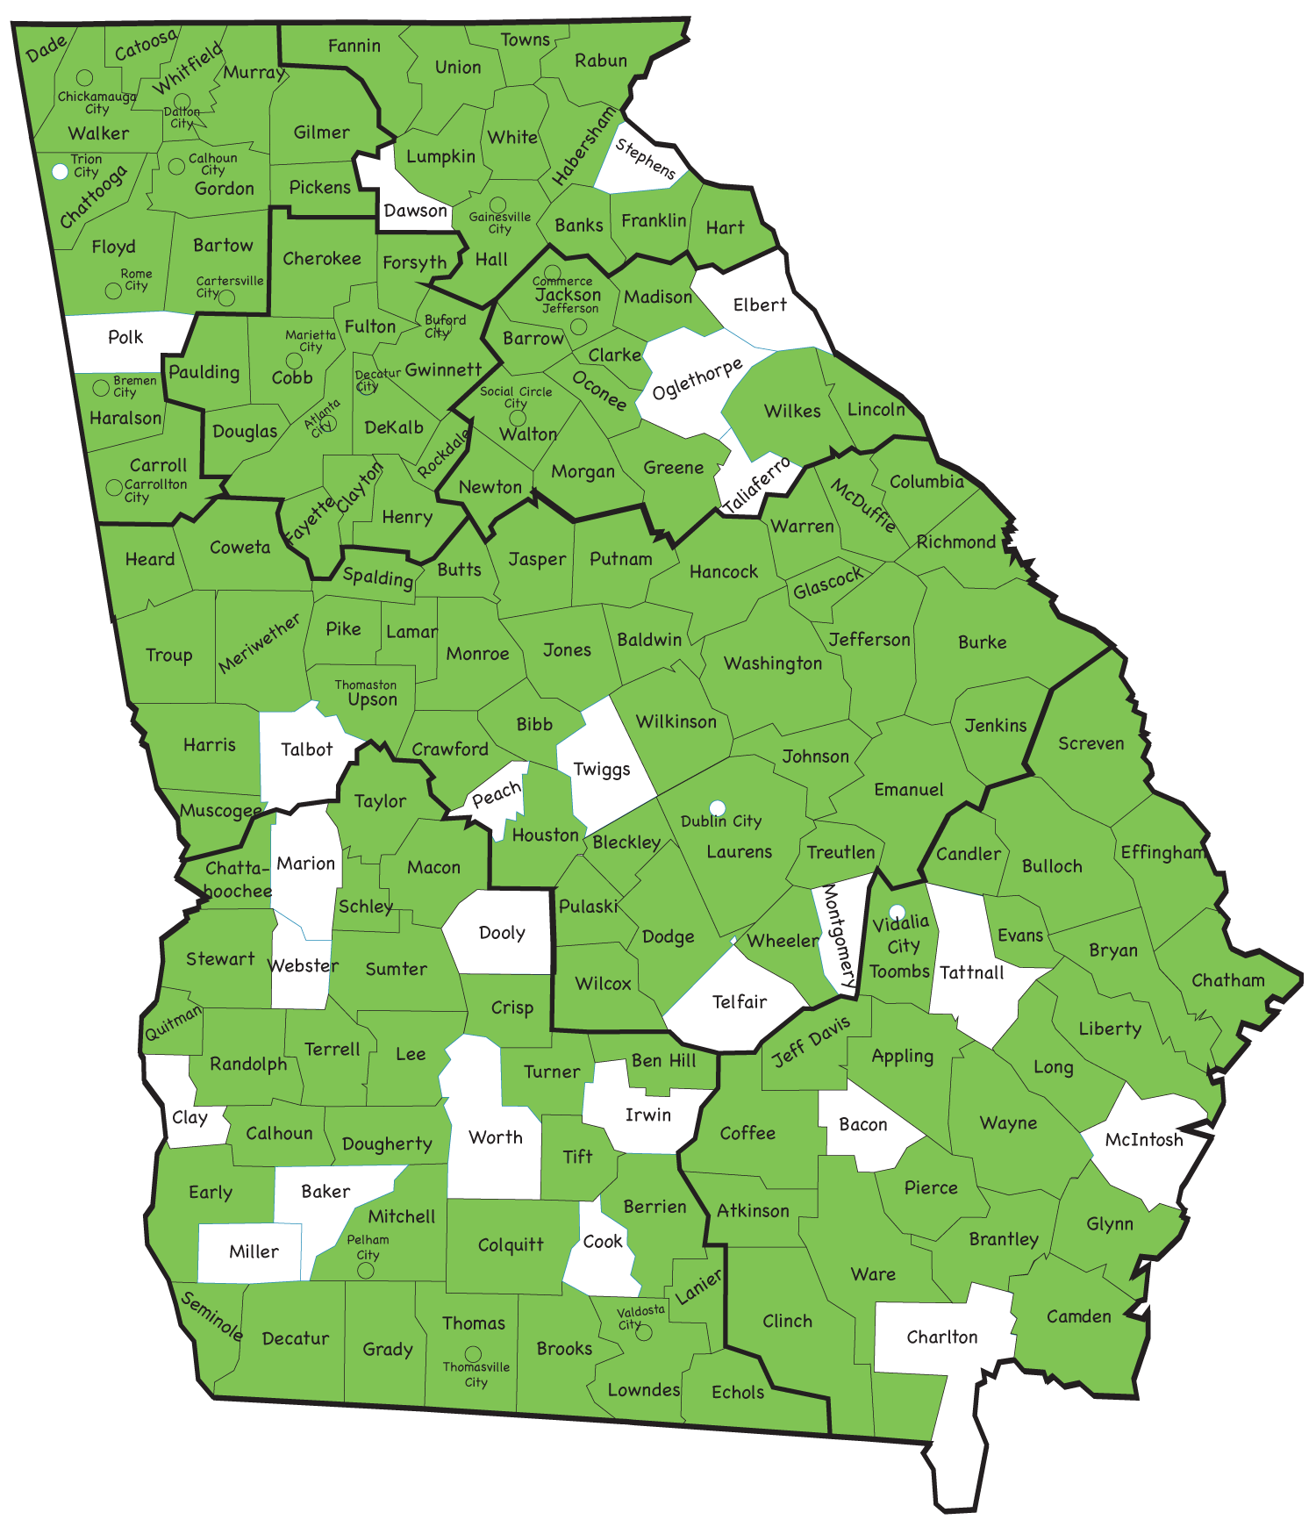
Educator Participation in ALL Georgia Milestones Meetings
Statewide Schools
Georgia Cyber Academy
Georgia Virtual School (GaVS)
State Schools
Higher Ed
Technical College System of Georgia
University System of Georgia

Slide 17
Types of Scores

Slide 18
Types of Scores
Scale Scores
Range varies depending on grade level and content area
Achievement Level Cut Scores
Developing Learner: 475
Proficient Learner: 525
Distinguished Learner: varies from 555 to 610
Grade Conversion Scores (EOC Only)
Grade Conversion Score Ranges
Beginning Learner: 0-67
Developing Learner: 68-79
Proficient Learner: 80-91
Distinguished Learner: 92-100

Slide 19
Achievement Levels
Beginning Learners do not yet demonstrate proficiency in the knowledge and skills necessary at this grade level/course of learning, as specified in Georgia’s content standards. The students need substantial academic support to be prepared for the next grade level or course and to be on track for college and career readiness.
Developing Learners demonstrate partial proficiency in the knowledge and skills necessary at this grade level/course of learning, as specified in Georgia’s content standards. The students need additional academic support to ensure success in the next grade level or course and to be on track for college and career readiness.
Proficient Learners demonstrate proficiency in the knowledge and skills necessary at this grade level/course of learning, as specified in Georgia’s content standards. The students are prepared for the next grade level or course and are on track for college and career readiness.
Distinguished Learners demonstrate advanced proficiency in the knowledge and skills necessary at this grade level/course of learning, as specified in Georgia’s content standards. The students are well prepared for the next grade level or course and are well prepared for college and career readiness.

Slide 20
Developing Learners
Developing Learners demonstrate partial proficiency in the knowledge and skills necessary at this grade level/course of learning, as specified by in Georgia’s content standards. The students need additional academic support to ensure success in the next grade level or course and to be on track for college and career readiness.
The Developing Learner achievement level consists of students who have demonstrated partial proficiency; they have a partial command of the knowledge and skills inherent in their grade level or course content standards. These students can be successful in future learning but will likely need some type of focused remediation in their weaker areas; they do not, necessarily, need a support class. Their learning should be monitored to ensure their success and to increase their opportunity to reach proficiency.
In short, this achievement level allows for the recognition of those students who have demonstrated some command, albeit partial, of the grade-level expectations but have not yet reached the full command necessary to signal proficiency. Proficient students demonstrate a strong, solid command of the grade-level or course content and skills.

Slide 21
EOG Scale Score Range
Content Area | Grade | Lowest Obtainable Scale Score (LOSS) | Developing Learner Cut Score | Proficient Learner Cut Score | Distinguished Learner Cut Score | Highest Obtainable Scale Score (HOSS)
English Language Arts | Grade 3 | 180 | 475 | 525 | 581 | 830
 | Grade 4 | 210 | 475 | 525 | 574 | 775
 | Grade 5 | 210 | 475 | 525 | 587 | 760
 | Grade 6 | 140 | 475 | 525 | 599 | 820
 | Grade 7 | 165 | 475 | 525 | 592 | 785
 | Grade 8 | 225 | 475 | 525 | 581 | 730
Mathematics | Grade 3 | 290 | 475 | 525 | 580 | 705
 | Grade 4 | 270 | 475 | 525 | 585 | 715
 | Grade 5 | 265 | 475 | 525 | 580 | 725
 | Grade 6 | 285 | 475 | 525 | 580 | 700
 | Grade 7 | 265 | 475 | 525 | 580 | 740
 | Grade 8 | 275 | 475 | 525 | 579 | 755
Science | Grade 3 | 275 | 475 | 525 | 566 | 695
 | Grade 4 | 230 | 475 | 525 | 578 | 730
 | Grade 5 | 160 | 475 | 525 | 595 | 780
 | Grade 6 | 175 | 475 | 525 | 610 | 780
 | Grade 7 | 215 | 475 | 525 | 589 | 745
 | Grade 8 | 165 | 475 | 525 | 593 | 785
Social Studies | Grade 3 | 275 | 475 | 525 | 560 | 680
 | Grade 4 | 250 | 475 | 525 | 570 | 700
 | Grade 5 | 290 | 475 | 525 | 555 | 665
 | Grade 6 | 295 | 475 | 525 | 560 | 670
 | Grade 7 | 280 | 475 | 525 | 564 | 685
 | Grade 8 | 240 | 475 | 525 | 572 | 715

Slide 22
EOC Scale Score Range
Content Area | Lowest Obtainable Scale Score (LOSS) | Developing Learner Cut Score | Proficient Learner Cut Score | Distinguished Learner Cut Score | Highest Obtainable Scale Score (HOSS)
9th Grade Literature & Composition | 220 | 475 | 525 | 587 | 735
American Literature & Composition | 190 | 475 | 525 | 590 | 750
Coordinate Algebra | 215 | 475 | 525 | 594 | 790
Analytic Geometry | 185 | 475 | 525 | 596 | 810
Algebra I | 200 | 475 | 525 | 594 | 785
Geometry | 180 | 475 | 525 | 596 | 815
Biology | 140 | 475 | 525 | 609 | 820
Physical Science | 145 | 475 | 525 | 604 | 815
U. S. History | 215 | 475 | 525 | 590 | 765
Economics | 140 | 475 | 525 | 610 | 830

Slide 23
Domain Signals
All Content Areas
Remediate Learning
Monitor Learning
Accelerate Learning
Domain Performance:
What is the likelihood the student would achieve proficiency on the test given his/her performance in the domain?
Domain performance is reported in terms of the Proficient Learner achievement level.

Slide 24
Additional Information
English Language Arts
Reading Status
Below Grade Level
Grade Level or Above
Writing Scores
Extended Writing Task – by trait
Ideas, Organization & Coherence – number of points earned out of 4
Language Usage and Conventions – number of points earned out of 3
Narrative Writing – number of points earned out of 4
Lexile

Slide 25
Norm-Referenced Scores
National Percentile Rank (NPR)
NPR Range (based on SEM)
Norm Curve Equivalencies (NCE)
Provided on summary reports only
Remember:
A sample of norm-referenced items were administered, not an intact form.
Norm-referenced Testing (NRT) data should be utilized as an indicator or barometer of student performance relative to their peers nationally.
NPRs may not be used for gifted program identification.

Slide 26
Georgia Milestones Reports

Slide 27
Types of Reports
Individual Student Report (ISR)
Both electronic and paper copies
Electronic via eDIRECT, paper via shipment
Class Roster
Electronic only via eDIRECT
Remediation/Retest Roster (EOG grades 3, 5, 8 only)
Electronic only via eDIRECT
Student Labels
Content Area Summaries (School, System, State)
Electronic only via MyGaDOE Portal
Summary Report of All Student Populations (School, System, State)
Electronic only via MyGaDOE Portal
System Student Data File
Electronic only via eDIRECT and MyGaDOE Portal
Both .txt and .xlsx formats (no Extraction tool required)

Slide 28
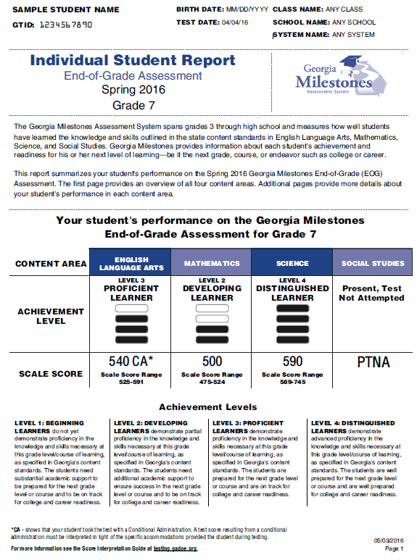
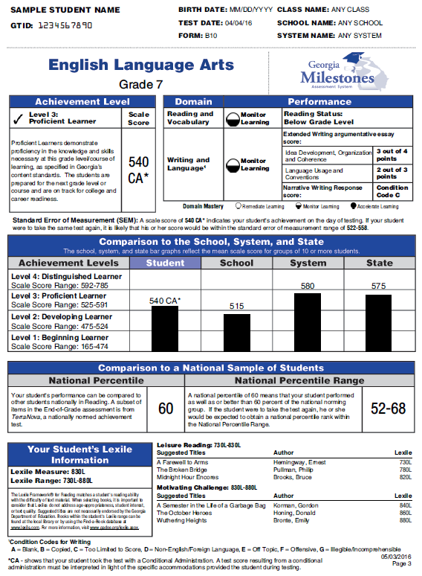
End of Grade - Individual Student Report (ISR) Sample
** Illustration purposes only **

Slide 29
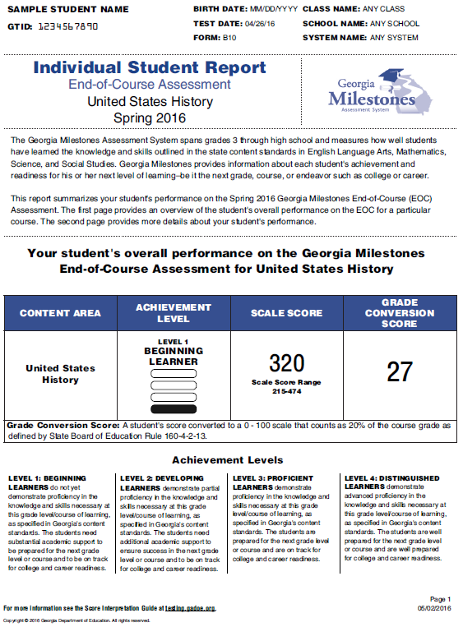
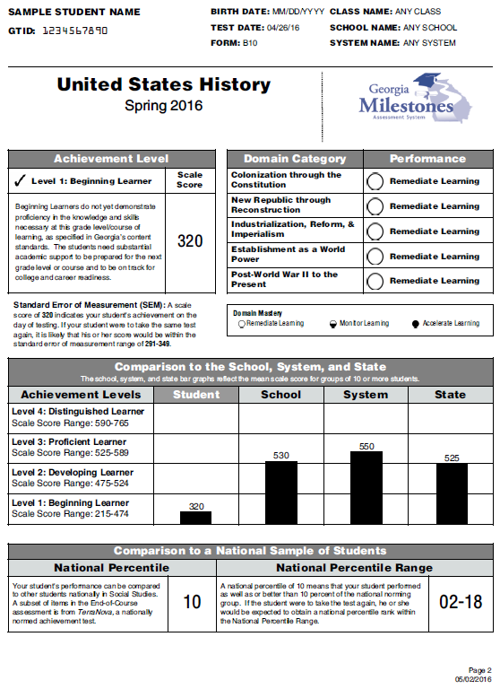
End of Course - Individual Student Report (ISR) Sample
** Illustration purposes only **

Slide 30
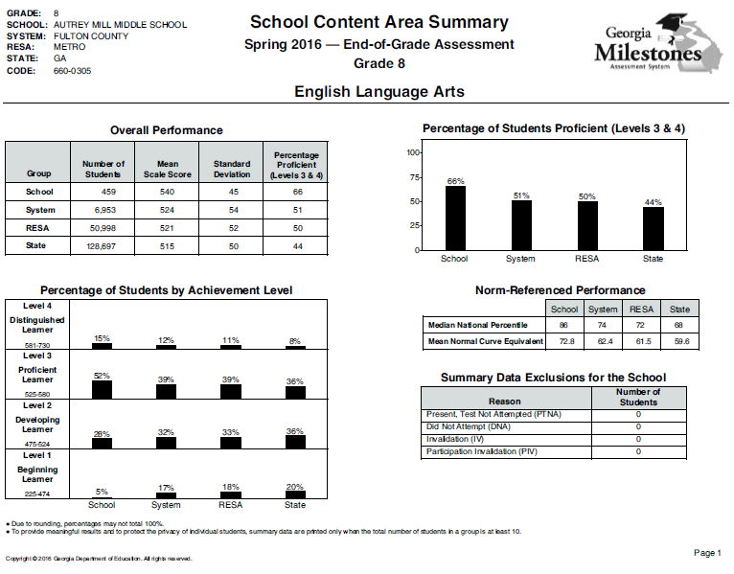
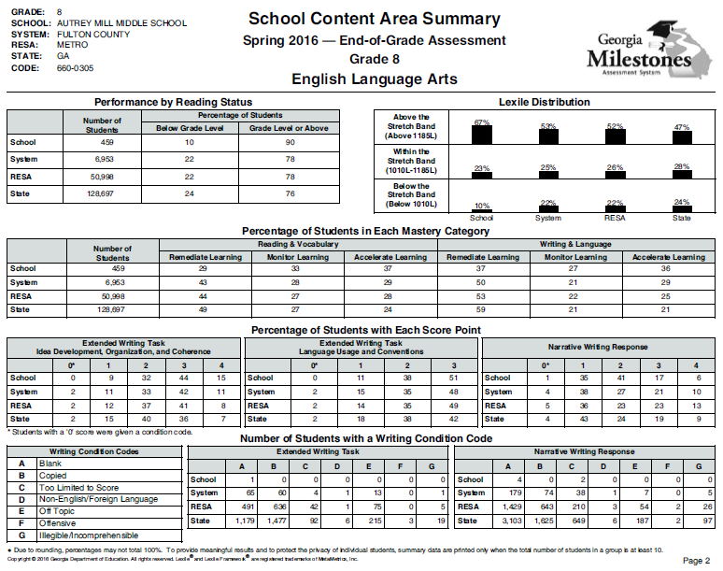
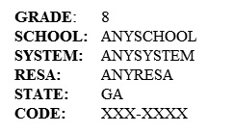
Content Area Summary Report Sample
** Illustration purposes only **
Use the Class Rosters and Content Area Summaries to help pinpoint instructional strengths and weaknesses; multiple years are required to establish a trend.

Slide 31
How are reports received?
Report Type/Data File | eDIRECT | MyGaDOE Portal | Paper
Individual Student Report (ISR) | X |  | X
Class Roster | X
Remediation/Retest Roster | X
Student Labels |  |  | X
Content Area Summary - School Level |  | X
Content Area Summary - System Level |  | X
Content Area Summary - State Level |  | X
Summary Report of All Student Populations - School Level |  | X
Summary Report of All Student Populations - System Level |  | X
Summary Report of All Student Populations - State Level |  | X
Student Data File - System (.xlsx) | X | X
Student Data File - System (.txt) |  | X

Slide 32
Promotion & Retention
Reading – Grades 3, 5, and 8
Student performance on the reading portion of the ELA test will be used to provide a grade level reading determination:
Below Grade Level or On/Above Grade Level
The determination is based on the linkage of the Lexile scale to Georgia Milestones. To be eligible for promotion, students must demonstrate reading skill at the beginning of the grade-level stretch-band. The stretch-bands were developed to signal the reading level at each grade students need to achieve to be college and career-ready upon graduation.

Slide 33
Promotion & Retention
Reading – Grades 3, 5, and 8
Generally speaking, students in the Beginning Learner achievement level and some at the lower end of Developing Learner will need reading remediation and are eligible to retest.
Students who achieve the beginning range of Developing Learner demonstrated sufficient writing and language skills to increase their achievement level but may still be reading below grade level.
Conversely, some students who achieve the upper range of Beginning Learner may be reading on grade level (although they may not be strong readers); their writing and language skills have decreased their achievement level.

Slide 34
Promotion & Retention
Spring Reading Performance
Grade/Course | Below Grade Level |  | Grade Level or Above
 | 2015 | 2016 | 2015 | 2016
3 | 31% | 28% | 69% | 72%
4 | 41% | 42% | 59% | 58%
5 | 34% | 32% | 66% | 68%
6 | 40% | 41% | 60% | 59%
7 | 29% | 26% | 71% | 74%
8 | 29% | 24% | 71% | 76%
9th Grade Literature | 27% | 22% | 73% | 78%
American Literature | 30% | 27% | 70% | 73%

Slide 35
Lexile Results for Georgia Students: 2008 - 2016
Median Lexile for Georgia Students by Grade Level/Course
Grade Level/ Course | 2008 | 2009 | 2010 | 2011 | 2012 | 2013 | 2014 | 2015 | 2016 | Suggested Text Demand: Lower Limit | Suggested Text Demand: Upper Limit
3 | 670 | 645 | 685 | 720 | 740 | 790 | 755 | 650 | 645 | 520 | 820
4 | 770 | 790 | 810 | 805 | 840 | 860 | 915 | 790 | 795 | 740 | 940
5 | 870 | 840 | 885 | 925 | 935 | 940 | 965 | 920 | 940 | 830 | 1010
6 | 955 | 980 | 980 | 1000 | 1025 | 1070 | 1075 | 975 | 980 | 925 | 1070
7 | 995 | 1020 | 1020 | 1040 | 1065 | 1095 | 1120 | 1095 | 1115 | 970 | 1120
8 | 1080 | 1110 | 1150 | 1170 | 1180 | 1210 | 1265 | 1130 | 1175 | 1010 | 1185
9th Lit |  |  |  |  | 1205 | 1215 | 1225 | 1205 | 1230 | 1050 | 1260
Am. Lit |  |  |  |  | 1220 | 1240 | 1270 | 1305 | 1345 | 1185 | 1385
The median Lexiles obtained from the Georgia Milestones Assessments are not comparable to prior years because the new test is more rigorous with different performance standards than its predecessors.

Slide 36
Spring Median Lexiles
Median Lexile Score by Grade/Course and Achievement Level
Grade/Course | Lower Bound of Text Band | Beginning Learner |  | Developing Learner |  | Proficient Learner |  | Distinguished Learner
 |  | 2015 | 2016 | 2015 | 2016 | 2015 | 2016 | 2015 | 2016
3 | 520 | 390 | 425 | 635 | 645 | 810 | 820 | 985 | 1015
4 | 740 | 545 | 535 | 765 | 795 | 940 | 975 | 1105 | 1135
5 | 830 | 690 | 685 | 885 | 880 | 1085 | 1075 | 1300 | 1330
6 | 925 | 730 | 750 | 955 | 945 | 1135 | 1140 | 1360 | 1370
7 | 970 | 870 | 850 | 1080 | 1080 | 1280 | 1280 | 1510 | 1475
8 | 1010 | 870 | 875 | 1095 | 1105 | 1285 | 1295 | 1490 | 1470
9th Grade Literature | 1050 | 925 | 940 | 1165 | 1170 | 1370 | 1400 | 1600 | 1630
American Literature | 1185 | 1025 | 1015 | 1275 | 1290 | 1505 | 1510 | 1785 | 1785

Slide 37
2016 Median Lexile within each Achievement Level & Suggested Text Bands

Slide 38
Promotion & Retention
Mathematics – Grades 5 and 8
Students must achieve the Developing Learner achievement level to be considered eligible for promotion.
These students have demonstrated partial proficiency of the grade level concepts and skills and can proceed to the next grade level when provided focused instructional support in the needed areas; their learning should be actively monitored to ensure their success.
Student who achieve the Beginning Learner should receive remediation and be provided the opportunity to retest. These students need substantial academic support.

Slide 39
Promotion & Retention
Spring Mathematics Performance
Grade/Course | Beginning Learner |  | Developing Learner & Above
 | 2015 | 2016 | 2015 | 2016
3 | 21% | 21% | 79% | 79%
4 | 20% | 20% | 80% | 80%
5 | 25% | 26% | 75% | 74%
6 | 25% | 25% | 75% | 75%
7 | 25% | 24% | 75% | 76%
8 | 25% | 24% | 75% | 76%
Coordinate Algebra | 31% | 32% | 69% | 68%
Analytic Geometry | 35% | 30% | 65% | 70%
Algebra I | -- | 30% | -- | 70%
Geometry | -- | 30% | -- | 70%

Slide 40
EOG Median National Percentile Ranks
Grade | English Language Arts* |  | Mathematics |  | Science |  | Social Studies
 | 2015 | 2016 | 2015 | 2016 | 2015 | 2016 | 2015 | 2016
3 | 35 | 34 | 51 | 52 | 58 | 60 | 48 | 49
4 | 42 | 39 | 59 | 58 | 46 | 45 | 50 | 47
5 | 40 | 43 | 53 | 53 | 52 | 52 | 55 | 55
6 | 54 | 53 | 58 | 59 | 66 | 68 | 59 | 59
7 | 46 | 50 | 62 | 66 | 60 | 62 | 66 | 65
8 | 60 | 68 | 72 | 68 | 64 | 60 | 57 | 59
*ELA NPR reflects Reading subtest
Based on Georgia student performance on 20 NRT items embedded on the Georgia Milestones EOG.

Slide 41
EOC Median National Percentile Ranks
Course | Winter |  | Spring
 | 2014 | 2015 | 2015 | 2016
9th Grade Literature** | 63 | 58 | 65 | 63
American Literature** | 56 | 56 | 60 | 62
Coordinate Algebra | 64 | 60 | 63 | 65
Analytic Geometry | 83 | 84 | 65 | 68
Algebra I | -- | 76 | -- | 77
Geometry | -- | 82 | -- | 75
Physical Science | 55 | 52 | 62 | 62
Biology | 63 | 65 | 65 | 68
U.S. History | 46 | 47 | 52 | 55
Economics | 55 | 53 | 51 | 55
**ELA NPR reflects Language subtest
Based on Georgia student performance on 20 NRT items embedded on the Georgia Milestones EOC.

Slide 42
Spring Median NPRs for Beginning Learners in ELA
Grade | English Language Arts* |  | 9th Grade Literature** |  | American Literature**
 | 2015 | 2016 | 2015 | 2016 | 2015 | 2016
3 | 9 | 9 | 21 | 20 | 25 | 28
4 | 8 | 7
5 | 8 | 7
6 | 11 | 11
7 | 11 | 14
8 | 14 | 15
*EOG ELA NPR reflects Reading subtest **EOC ELA NPR reflect Language subtest
Based on Georgia student performance on 20 NRT items embedded on the Georgia Milestones EOG or EOC.

Slide 43
Spring Median NPRs for Beginning Learners in Mathematics
Grade | Mathematics |  | Coordinate Algebra |  | Analytic Geometry |  | Algebra I |  | Geometry
 | 2015 | 2016 | 2015 | 2016 | 2015 | 2016 | 2015 | 2016 | 2015 | 2016
3 | 8 | 8 | 26 | 30 | 28 | 27 | -- | 35 | -- | 30
4 | 11 | 10
5 | 13 | 13
6 | 17 | 16
7 | 21 | 21
8 | 25 | 24
Based on Georgia student performance on 20 NRT items embedded on the Georgia Milestones EOG or EOC.

Slide 44
Spring Median NPRs for Beginning Learners in Science
Grade | Science |  | Physical Science |  | Biology
 | 2015 | 2016 | 2015 | 2016 | 2015 | 2016
3 | 8 | 9 | 27 | 27 | 24 | 23
4 | 11 | 11
5 | 15 | 15
6 | 19 | 19
7 | 20 | 20
8 | 31 | 32
Based on Georgia student performance on 20 NRT items embedded on the Georgia Milestones EOG or EOC.

Slide 45
Spring Median NPRs for Beginning Learners in Social Studies
Grade | Social Studies |  | U.S. History |  | Economics
 | 2015 | 2016 | 2015 | 2016 | 2015 | 2016
3 | 10 | 9 | 18 | 18 | 19 | 21
4 | 13 | 11
5 | 15 | 16
6 | 17 | 17
7 | 20 | 18
8 | 28 | 28
Based on Georgia student performance on 20 NRT items embedded on the Georgia Milestones EOG or EOC.

Slide 46
Score Use & Interpretation

Slide 47
Reminder of Policy Uses: Georgia Milestones
Determines promotion/retention status in grade 3 (reading only), grade 5 (reading and mathematics), and grade 8 (reading and mathematics)
Reading: a student who has a Below Grade Level Reading status will require remediation and retesting in ELA
Mathematics: a student who is classified as a Beginning Learner will require remediation and retesting in mathematics
The End of Course (EOC) measures serve as the final exam and comprise 20% of a student’s final course grade
Eligible students may seek to demonstrate subject area competency (“test-out”) before enrolling in a course with an associated EOC
Informs Georgia’s accountability measures (CCRPI/TKES/LKES)

Slide 48
Achievement Level Descriptors
Achievement Level Descriptors:
are critical to test score interpretation, helping to give meaning to the scale scores and achievement classifications;
represent the progression of understanding, thinking, and reasoning in each content area; and
can be viewed as stages of thinking and learning, providing insight into not only the content, but also the cognitive demand and context within which students are able to demonstrate mastery.

Slide 49
Achievement Level Descriptors
Sample Grade 3 Mathematics
ALD | Standard | Beginning Learner | Developing Learner | Proficient Learner | Distinguished Learner
Policy |  | Beginning Learners do not yet demonstrate proficiency in the knowledge and skills necessary at this grade level/course of learning, as specified in Georgia’s content standards. The students need substantial academic support to be prepared for the next grade level or course and to be on track for college and career readiness. | Developing Learners demonstrate partial proficiency in the knowledge and skills necessary at this grade level/course of learning, as specified in Georgia’s content standards. The students need additional academic support to ensure success in the next grade level or course and to be on track for college and career readiness. | Proficient Learners demonstrate proficiency in the knowledge and skills necessary at this grade level/course of learning, as specified in Georgia’s content standards. The students are prepared for the next grade level or course and are on track for college and career readiness. | Distinguished Learners demonstrate advanced proficiency in the knowledge and skills necessary at this grade level/course of learning, as specified in Georgia’s content standards. The students are well prepared for the next grade level or course and are well prepared for college and career readiness.
Range |  | A student who achieves at the Beginning Learner level demonstrates minimal command of the grade-level standards. | A student who achieves at the Developing Learner level demonstrates partial command of the grade-level standards. | A student who achieves at the Proficient Learner level demonstrates proficiency of the grade-level standards. | A student who achieves at the Distinguished Learner level demonstrates advanced proficiency of the grade-level standards.
 | 3.NBT.1 3.NBT.2 3.NBT.3 | Understands place value to 1000 and multiplies single-digit numbers. | Adds and subtracts within 1000. | Uses place value relationships to round numbers, multiplies whole numbers by multiples of ten, adds and subtracts fluently, and explains arithmetic patterns. | Recognizes that each place value, left to right, is ten times the one before it, rounding to specific whole-number place values, and multiplies multiples of ten by each other.

Slide 50
Frequently Asked Questions
Q: How can two students with the same scale score and achievement level in ELA have different Lexile scores?
A: The Lexile is based on how each student performed on the items measuring reading. The ELA test also includes items that measure language and research skills, as well as writing. The two students performed differently on the sets of items that comprise the ELA test.
Higher performance on one domain can compensate for lower performance on the other domain.

Slide 51
English Language Arts
Reading and
Vocabulary
Writing and
Language

Slide 52
Frequently Asked Questions
Q: How can a student who is classified as reading on/above grade level achieve ‘Remediate Learning’ in the Reading and Vocabulary domain?
A: Remember that the domain designation comes from the student’s performance on the questions within the domain in relation to the overall ELA test. While reading on-grade level is required to be a Proficient Learner, it is not sufficient in and of itself.
Students reading at the lower boundary of the suggested text band for their grade are not necessarily strong readers. We would expect students to be reading at the upper end of the suggested text band at the end of the school year when the test is administered.

Slide 53
Frequently Asked Questions
Q: How can two students with the same scale score and achievement level in a content area have different NRT scores?
A: There are two sets of items that comprise the Georgia Milestones tests – criterion references (those aligned to our state content standards) and norm-referenced (those that come from the TerraNova). The two students performed differently on the NRT items.

Slide 54
Frequently Asked Questions
Q: How does one make sense of the domain signals?
Remediate Learning / Monitor Learning / Accelerate Learning
Domain Performance: What is the likelihood the student would achieve proficiency on the test given his/her performance in the domain?
A: Use the Achievement Level Descriptors; the ALDs present the progression of student learning by achievement level and are organized by standard, group of standards, or concept.
Note: Domain signals now take into account the difficulty of the items that comprise the domain; this is important and was lacking in our previous domain reporting (percent correct).

Slide 55
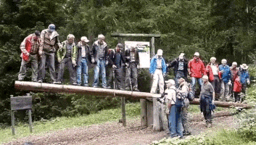
Balancing Act
Regardless of the content area, good instruction balances content coverage in order to avoid….

Slide 56
Every Student Succeeds Act

Slide 57
Georgia’s ESSA Plan
State Advisory Committee
Comprised of forty stakeholders representing a variety of organizations, agencies, and advocacy groups across the state of Georgia
Five Working Committees (20 members each)
Accountability
Assessment
Education of the Whole Child
Federal Programs
Teacher & Leader Development
Superintendent Woods has scheduled 8 ESSA Listening Sessions across the state:
August 24: Columbia County
August 29: Habersham County
September 14: Fulton County
September 19: Muscogee County
October 6: Dougherty County
October 12: Laurens County
October 13: Chatham County
October 17: Gordon County

Slide 58
Assessment & Accountability
The primary purpose of school is teaching and learning.
Assessment and accountability plays an important role, but importantly – that role is supporting, with the primary focus being teaching and learning.

Slide 59
Teaching & Learning
It’s important to remember that knowledge and understanding within each content area is multifaceted; students must know content but also:
understand the thinking and reasoning that undergird each content area; and
draw conclusions and make connections across information and concepts rather than recite discrete facts and skills.

Slide 60
Questions & Answers
GaDOE Customer Service Survey:
http://gadoe.org/surveys/AsAc-H8PBVZM

