Slide 1
Understanding and Leveraging Georgia’s K-12 Student Assessment Program to Improve Instruction and Student Outcomes
Georgia Education Leadership Institute
Pre-Institute Learning Session
September 16, 2018

Slide 2
Purpose
Provide an overview of Georgia’s current K-12 student assessment program
Discuss how assessment and supporting resources can be used to improve instruction and student outcomes
Questions and discussion

Slide 3
Topics
Overview
GKIDS Readiness Check
GKIDS 2.0
Keenville
Georgia Milestones
Updates
Test Development Process
Resources
Analyses
Georgia Alternate Assessment (GAA) 2.0

Slide 4
Assessment Philosophy
The primary purpose of schools is teaching and learning.
Assessment and accountability play a significant role, but importantly – that role is supporting, with the primary focus being teaching and learning.

Slide 5
Overview

Slide 6
Overview
Historically, Georgia’s student assessment program consisted of a series of summative assessments.
Georgia High School Graduation Tests, CRCT, EOCT, Writing Assessments (3, 5, 8, HS), etc.
With Georgia Milestones, an effort was made to build toward a comprehensive summative assessment program that sends a similar signal of student performance across grade levels.
More recently, efforts are being made to develop and/or enhance the use of formative assessments to provide more timely feedback and to support instruction prior to the summative assessment system.

Slide 7
Overview
Formative
GKIDS Readiness Check
GKIDS 1.0 and 2.0
Keenville
GOFAR
FIP
K
Summative
ACCESS for ELLs
GAA 1.0 and 2.0
Georgia Milestones EOG/EOC
12

Slide 8
GKIDS Readiness Check

Slide 9
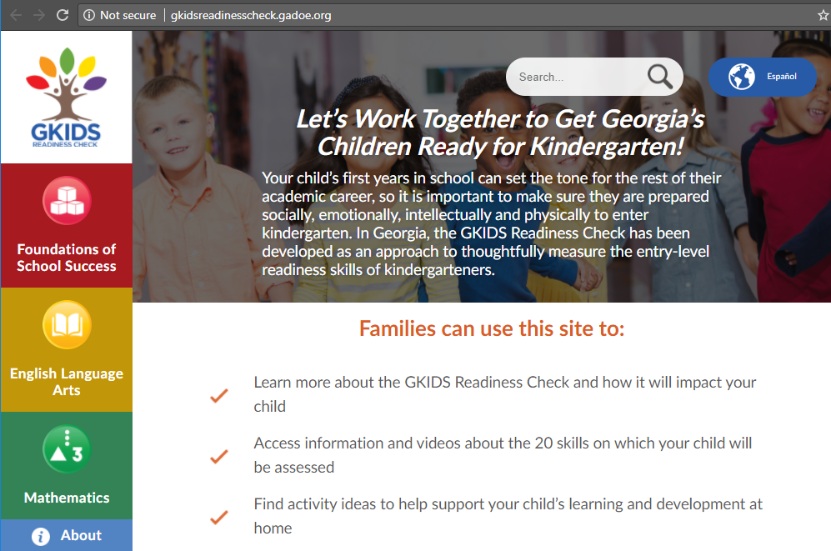
GKIDS Readiness Check
A component of GKIDS, the purpose of the GKIDS Readiness Check is to provide information about the knowledge and skills of students entering kindergarten – solely to guide instruction
Administered during the first six weeks of kindergarten
Aligned to the Georgia Early Learning and Development Standards (GELDS) and correlated to the kindergarten Georgia Standards of Excellence (GSEs)
There are three domains of learning:
Foundations of School Success – approaches to learning, social and emotional development, and physical development and development of motor skills
English Language Arts – early language and literacy development
Mathematics – understanding of shapes and spatial relationships, problem solving, identifying similarities and differences, and basic numeracy concepts
Parent Resources Website – GKIDSReadinessCheck.GaDOE.org

Slide 10
GKIDS Readiness Check
Timeline for Test Development
Phase 1 – Essential Skills, Blueprint, and Development committee meetings
Phase 2 – Pre-K pilot to assess usability
Phase 3 – Kindergarten field test to assess task performance
Phase 4 – Pre-K field test to assess implementation and training effectiveness
Phase 5 – Inaugural Launch
Phase 6 – Operational Launch (2017-2018)
Prior to administration, certified teachers/paraprofessionals must complete six training modules
Readiness Check includes 10 direct and 10 indirect activities
Individual Student Reports and Activity Level Summary Reports provided within the GKIDS platform

Slide 11
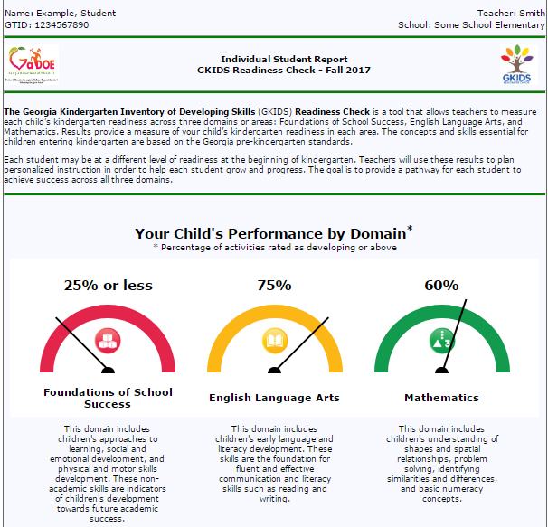
GKIDS Readiness Check
The Individual Student Report provides information on student performance for the three domains of learning.
Page 1 shows the percentage of activities for which performance was rated at developing or above for each domain.

Slide 12
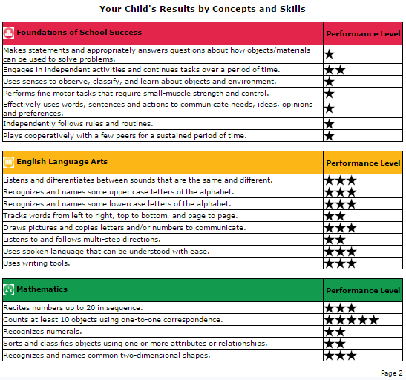
GKIDS Readiness Check
Page 2 of the Individual Student Report provides the performance levels for an individual student on each activity by each of the three domains of learning.

Slide 13
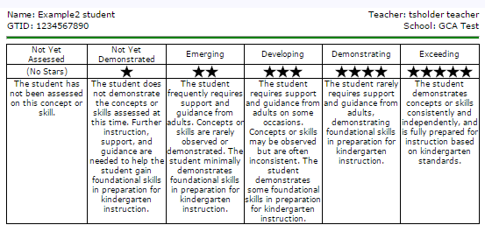
GKIDS Readiness Check
The number of stars for each activity corresponds to the performance level rating for the student.
A general description of the knowledge and skills for each performance level is also provided on the report.

Slide 14
GKIDS 2.0

Slide 15
GKIDS 2.0
GKIDS 2.0 is a progression-based formative assessment, integrated into classroom work, that is aligned to the state content standards.
A big idea describes the integration of concepts and skills from the kindergarten standards that are most important for success in first grade.
A learning progression shows where the student is in the learning continuum of content and reasoning development regarding the big idea from the GSE.
Provides the big picture of what is to be learned across the year, relates standards across grades and increased reasoning of standards within the grades, and supports instructional planning.
Provides teachers with one source of real-time information to adjust instruction
Identifies what a student already knows, what the student needs next, and allows teachers to monitor growth

Slide 16
English Language Arts
Big Idea 1: A kindergarten student will independently write more than one complete thought on a single topic, using phonetic spelling and key print conventions.
Progression 1: Conventions of Writing
Progression 2: Spelling
Progression 3: Communication of Ideas

Slide 17
English Language Arts
Big Idea 2: A kindergarten student will independently read grade-level texts of different genres with accuracy and demonstrate comprehension by answering text dependent questions.
Progression 1: Comprehension

Slide 18
English Language Arts
Big Idea 3: A kindergarten student will understand the relationship between letters and sounds and recognize high-frequency words with speed and accuracy.
Progression 1: Phonemic Awareness
Progression 2: Phonics
Progression 3: High Frequency Words

Slide 19
Learning Progression – Phonemic Awareness

Slide 20
Mathematics
Big Idea 1: A kindergarten student will model real world problems by composing 2- and 3- dimensional shapes.
Progression 1: Shapes
Big Idea 2: A kindergarten student will count using multiple strategies.
Progression 1: Counting-Number
Progression 2: Counting-Objects

Slide 21
Mathematics
Big Idea 3: A kindergarten student will compare objects and numbers represented in different ways to solve real world problems.
Progression 1: Compare
Big Idea 4: A kindergarten student will apply multiple strategies to solve real world problems using addition and subtraction.
Progression 1: Addition and Subtraction

Slide 22
Learning Progression – Counting Objects

Slide 23
Sample Performance Task

Slide 24
Sample Performance Task (continued)

Slide 25
GKIDS 2.0 Online Platform

Slide 26
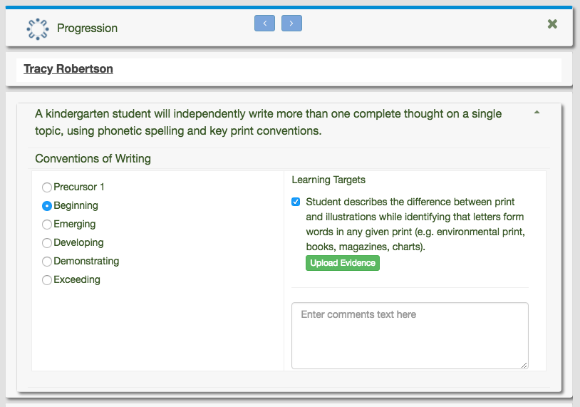
GKIDS 2.0 Online Platform
Student performance can be entered by class…
or by student
Notes:
After clicking on the progression on the ELA landing page, users are able to enter progression levels for an entire class at one time. At any time, the user can click on the individual student to access his/her specific records as well.
On this page, the user can also adjust the progression levels. Any time the “radio” button is changed, the associated tasks will populate. If teachers want to mark that a student has completed the task, they can enter the check mark under the learning targets. If they wish to upload evidence, they may do so by clicking on the green button. This will pull up the files on their computer. Evidence can be entered via various formats: photos, sound clips, videos, scanned classwork, etc. If the teacher wishes to add comments (think RTI, etc.) they may do so in this text field. These comments do not populate on any reports.

Slide 27
Progression Overview Report
Provides a list of students at each level for each progression
Notes:
This report allows teachers/administrators to filter by progression level for easy grouping and acceleration/remediation.

Slide 28
Progression Analysis Report
Provides the total count of students at each level for each progression
Notes:
This report allows users to view the total students at each stage per progression. The items that are underlined are clickable and will provide the list of students associated with the number.

Slide 29
Progression Progress Report
Provides student performance for selected dates
Notes:
The progression progress report allows the user to run reports on a monthly or weekly basis. The user may also enter custom dates from a calendar to mirror reporting deadlines associated with progress reports/conferences/report cards, etc.

Slide 30
Additional Reports
Individual Student Report
Student level progression progress report

Slide 31
Keenville

Slide 32
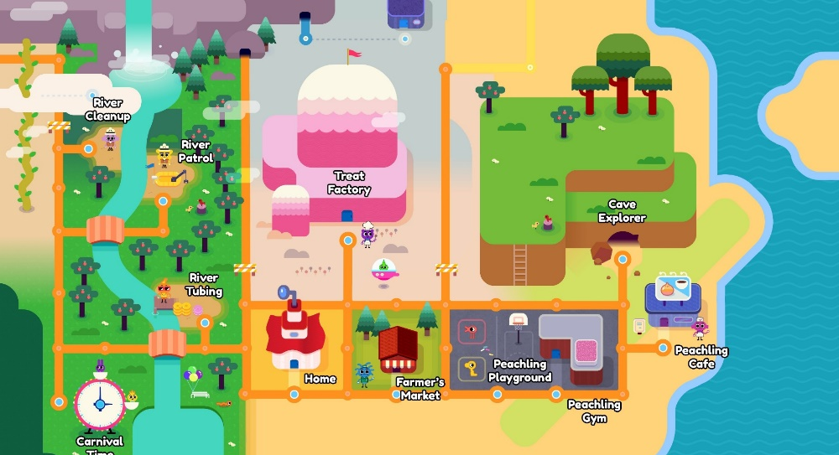
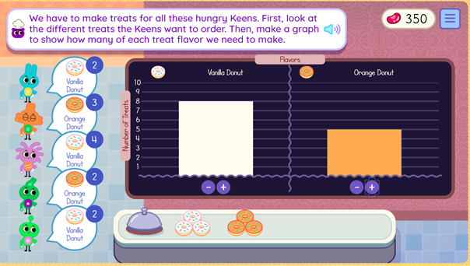
Keenville
Keenville is a game-based, formative assessment in literacy and mathematics for grades 1 and 2.
Students will explore Keenville and help the Keens by engaging in challenges.
Keenville is designed to be integrated alongside instruction, supporting teachers with real-time feedback to differentiate instruction and improve learning.
Learn more at keenville.gadoe.org!

Slide 33
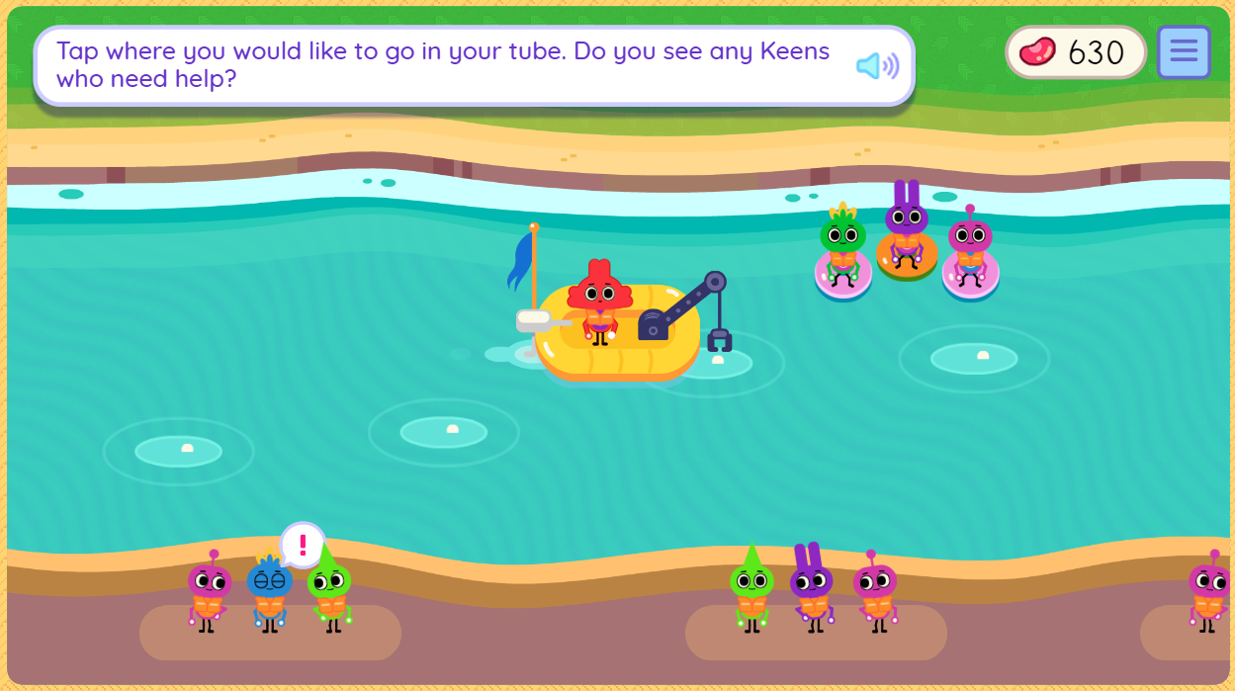
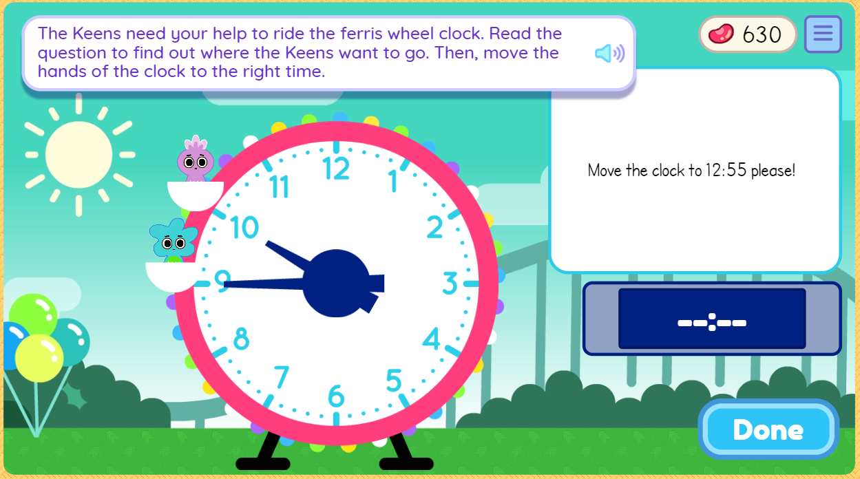
Keenville Games
Fall 2018 Games
River Clean-Up
River Patrol
Cave Explorer
Peachling Playground
River Tubing
Treat Factory
Peachling Gym
Carnival Time
Peachling Café
Farmers Market
ELA Skills Assessed
Reading comprehension (literary and informational)
Phonics and word recognition
Math Skills Assessed
Addition and subtraction
Interpreting data with tables and graphs
Comparing numbers (<, >, =)
Time
Place value
Money
An additional 21 games will become available throughout 2019!

Slide 34
Keenville Features
Designed to engage students
Avatar builder; earning beans and Peachlings; decorating their house; fun sights, sounds and reactions
Tutorials orient students to the world and each game
Students receive ongoing support through motivational prompts and feedback
Games often include Georgia-specific themes and integrate other GSE standards and initiatives
Nutrition, health, science, social studies, PE, and the arts
Each game is designed with multiple levels to
allow students of varying levels of ability to engage with challenges
identify students’ current level of knowledge, skill, and concept development

Slide 35
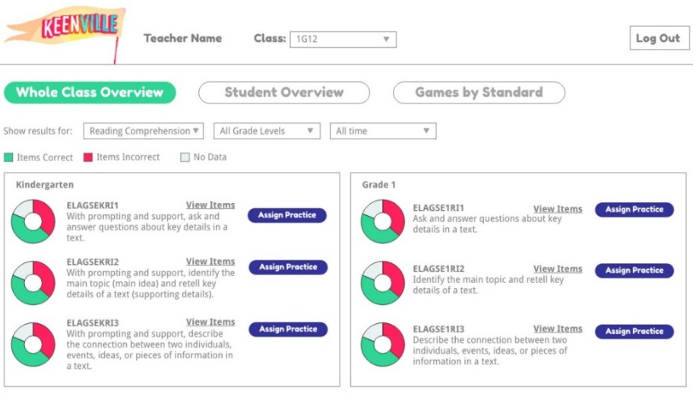
Keenville Dashboard
Keenville games and real-time, interactive dashboards will be accessible through the Statewide Longitudinal Data System (SLDS)
Teachers will be able to drill down to individual students, reporting categories, standards, and games to analyze progress
Dashboards will report Lexile and Quantile scores
Class-level data will be available to inform instructional decision making and planning

Slide 36
Keenville Resources
Keenville User Guide
Overview of Keenville
Game Descriptions
How to Play the Games
Access to Keenville
Coming soon….additional pre-recorded webinars:
Keenville Dashboard and Reporting
keenville.gadoe.org

Slide 37
Georgia Milestones
Updates

Slide 38
Georgia Milestones
Spring 2018 Testing Volume
EOG: 801,000+ students
EOC: 433,000+ students (tests)
Combined: 1,234,000+ students
Online Testing
This spring, districts assessed approximately 88% of students online (83% EOG and 99% EOC).
Peak concurrency was than 153,303 students testing simultaneously (Tuesday, April 17).
No Major Statewide Issues
There were some small, localized issues in some areas, primarily due to connectivity/bandwidth issues.

Slide 39
Georgia Milestones
Transition to 100% Online Testing
In 2015, Georgia began its transition to 100% online testing by 2018-2019.
Statewide Online Actual
(Expected)
Benefits of Online Testing
Improved student experience
Innovative item types
Standardized accommodations (read aloud, video sign language, etc.)
Reduced irregularities
Features available to all students (large print, masking tool, highlighter, etc.)
Increased test security
More efficient administration
Faster score returns
Increased flexibility in scheduling
Decreased costs
Goal
Paper/pencil will continue to be available for accommodated students who cannot interact with a computer due to their disability and are not included in the 100% online requirement in 2018-2019.

Slide 40
Georgia Milestones
New for 2018-2019: Spring EOG Scheduling Flexibility
The local testing calendar can encompass the entire state testing window.
Individual grade-level content assessments must maintain the same testing dates across all schools within the district.
All sections of a grade-level content assessment must be completed on the same day or on consecutive days during the same week.
Section 1 of ELA must be administered on a separate day from (and prior to) Sections 2 and 3 of ELA.
The local district sets the order of administration for EOG grade-level content.
See the Student Assessment Handbook for more details.

Slide 41
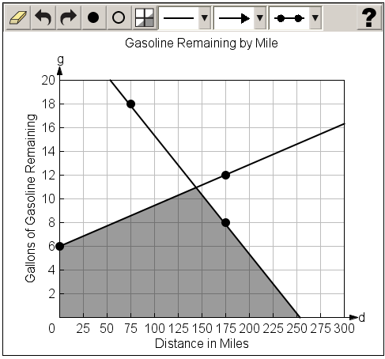
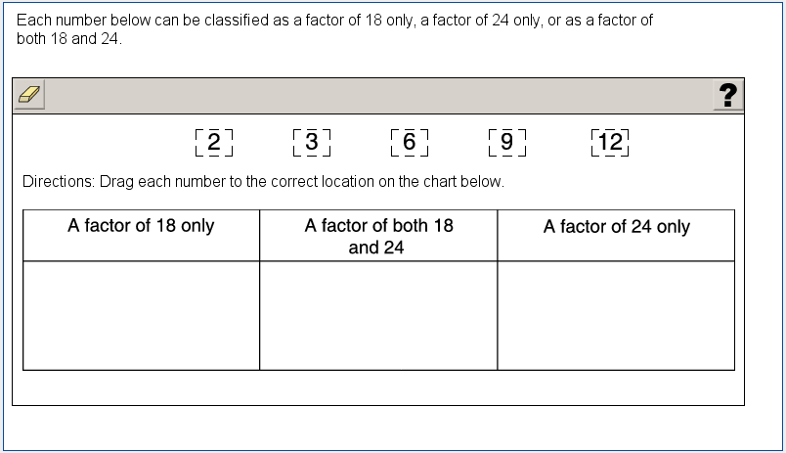
Georgia Milestones
New for 2018-2019: Two new types of technology-enhanced items will be field-tested.
Graphing (mathematics)
Allows students to graph and label points and lines and shade regions
Allows students to demonstrate depth of understanding and ability through performance on math tasks
Drag and drop (mathematics, science, social studies)
Response choices (such as numbers, words, or phrases) can be moved and placed in another location (such as a chart or map)
Allows students to demonstrate depth of understanding by identifying, classifying, comparing, or organizing information

Slide 42
Georgia Milestones
Test Development Process

Slide 43
Test Development Process
Test Planning and Specifications
Item Development
GaDOE
Reviews
Item Review
Field Testing
Initially and as needed
Spring 2017
Spring 2017
Summer 2017
Spring 2018
Rangefinding (Constructed-Response Items)
Handscoring (Constructed-Response Items)
Data Review
Operational
Testing
Standard Setting/
Validation
Spring/Summer 2018
Summer 2018
Summer 2018
Winter 2018/ Spring 2019
Initially and as needed

Slide 44
Educator Involvement
Educator Involvement
Test Planning and Specifications
Blueprint (number of items, item types, content weights)
Achievement Level Descriptors (ALDs)
Item Review
Review newly-developed test items for alignment to standards, depth of knowledge, bias and sensitivity
Rangefinding
Review sets of student responses from recently field-tested constructed-response items, assess rubric effectiveness, recommend anchor papers to be used in handscoring
Data Review
Review flagged items from recent field test
Accepted items added to item bank
Standard Setting/Standards Validation
Inform cut scores for the achievement levels
300-400+ Georgia educators, including higher education, participate in test development activities for Georgia Milestones every year!

Slide 45
Committee Selection Process
District Nominations (January)
Memo sent to Assessment, Curriculum, and Special Education Directors and posted to GaDOE website
 | Content Area | Grade Levels/Courses | # of nominees requested
End of Grade | English Language Arts | 3, 4, 5, 6, 7, 8 | 4
 | Mathematics | 3, 4, 5, 6, 7, 8 | 4
 | Science | 5, 8 | 2
 | Social Studies | 5, 8 | 2
End of Course | English Language Arts | Ninth Grade Literature, American Literature | 4
 | Mathematics | Coordinate Algebra, Analytic Geometry, Algebra I, Geometry | 4
 | Science | Biology, Physical Science | 2
 | Social Studies | United States History, Economics | 2
Total |  |  | 24

Slide 46
Committee Selection Process
Educator Application and Availability Survey (February)
Initial Committee Invitations (February – April)
Rolling schedule based on meeting dates
6-10 participants per grade/content area or course
Balanced representation
Gender
Ethnicity
Region
Experience
Special populations

Slide 47
Expense Reimbursement
Expenses paid directly (by testing contractor)
Hotel accommodations (participants 50+ miles from the meeting location)
Parking, if applicable
Breakfast, lunch, and snacks are provided at the meeting
Expenses reimbursed to participant (by testing contractor)
Dinner (up to $31) for those staying overnight
Mileage (reimbursement at current state rate)
Expenses reimbursed to school or district (by testing contractor)
Substitute teacher expense, if applicable
Participants are provided a reimbursement form to return to their school/district
Participants are paid an honorarium if a meeting occurs during off-contract time (e.g., spring break, summer break, etc.)
Typically $125 per day
In lieu of substitute reimbursement

Slide 48
Test Development Process
Test Planning and Specifications
Item Development
GaDOE
Reviews
Item Review
Field Testing
Rangefinding (Constructed-Response Items)
Handscoring (Constructed-Response Items)
Data Review
Operational
Testing
Standard Setting/
Validation

Slide 49
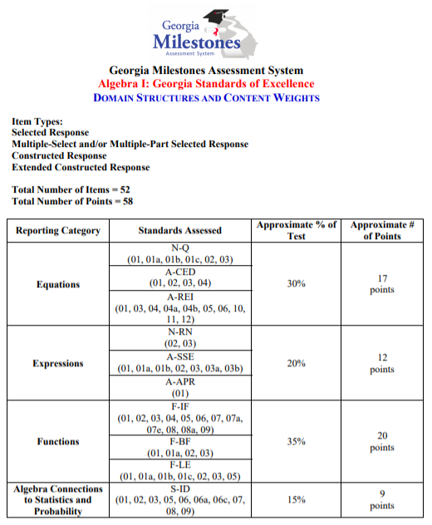
Test Blueprints
Test blueprints define the structure of the assessment, including
types of items
number of items
number of points possible
reporting categories
associated content standards
approximate percentage of points allocated to each reporting category

Slide 50
Achievement Level Descriptors
What are they?
ALDs are narrative descriptions of the knowledge and skills expected at each of the four achievement levels that have been established for Georgia Milestones.
ALDs are based on the state-adopted academic content standards.
The ALDs lay the ground work for setting achievement standards.

Slide 51
Policy ALDs
Beginning Learners do not yet demonstrate proficiency in the knowledge and skills necessary at this grade level/course of learning, as specified in Georgia’s content standards. The students need substantial academic support to be prepared for the next grade level or course and to be on track for college and career readiness.
Developing Learners demonstrate partial proficiency in the knowledge and skills necessary at this grade level/course of learning, as specified in Georgia’s content standards. The students need additional academic support to ensure success in the next grade level or course and to be on track for college and career readiness.
Proficient Learners demonstrate proficiency in the knowledge and skills necessary at this grade level/course of learning, as specified in Georgia’s content standards. The students are prepared for the next grade level or course and are on track for college and career readiness.
Distinguished Learners demonstrate advanced proficiency in the knowledge and skills necessary at this grade level/course of learning, as specified in Georgia’s content standards. The students are well prepared for the next grade level or course and are well prepared for college and career readiness.

Slide 52
Range ALDs
The skills contained in each content standard become more sophisticated across achievement levels.
Range ALDs describe the increasing content-based expectations, cognitive demand, and contextual evidenced needed to be categorized in a given achievement level.

Slide 53
Range ALDs
Example from Grade 5 Social Studies

Slide 54
Test Development Process
Test Planning and Specifications
Item Development
GaDOE
Reviews
Item Review
Field Testing
Rangefinding (Constructed-Response Items)
Handscoring (Constructed-Response Items)
Data Review
Operational
Testing
Standard Setting/
Validation

Slide 55
Item Development
Item Development Plan (November – December)
Number and types of items to develop per standard
Items developed in batches and submitted to GaDOE for review (January – May)
Items reviewed by GaDOE Curriculum Specialists and Assessment Specialists

Slide 56
Test Development Process
Test Planning and Specifications
Item Development
GaDOE
Reviews
Item Review
Field Testing
Rangefinding (Constructed-Response Items)
Handscoring (Constructed-Response Items)
Data Review
Operational
Testing
Standard Setting/
Validation

Slide 57
Item Review
Educators review newly-developed test items for:
Content
Alignment to state-adopted academic content standards
Appropriate grade difficulty
Appropriate content accuracy
Cognitive complexity (depth of knowledge)
Sensitivity issues
Linguistic and visual accessibility

Slide 58
Item Review
All items should:
measure the content of the standard;
use clear, precise, and concise language;
pose a complete question or problem (SR/TE);
state a task to be performed and elicit a wide rage of student responses (SR/ECR/WP);
avoid unnecessary negative language;
avoid ill-defined terms or ambiguous words;
be free of grammatical errors or clues;
be free of clues to the correct response; and
be free of stereotypes or other sources of bias.

Slide 59
Item Review
Depth of knowledge (DOK) consistency between standards and tests indicates alignment if what is elicited from students on the test is as demanding cognitively as what students are expected to know and do as stated in the standards.
DOK is not about item difficulty. Each level of DOK will include items representing a range of difficulty.
Range of Difficulty | Range of DOK
Enables the test to capture information about the largest possible number of students. | Ensures the test is sufficiently rigorous
Together: allows the test to differentiate among students all along the scale-score range, especially around the cut scores

Slide 60
Item Review
All items must be free of stereotypes or other sources of bias.
Items must reflect community standards.
Bias in test items is
caused by language or context that prevents members of a group from demonstrating the knowledge or skill being measured.
a systematic error in the measurement process.
detected through judgmental and statistical procedures.

Slide 61
Test Development Process
Test Planning and Specifications
Item Development
GaDOE
Reviews
Item Review
Field Testing
Rangefinding (Constructed-Response Items)
Handscoring (Constructed-Response Items)
Data Review
Operational
Testing
Standard Setting/
Validation

Slide 62
Field Testing
After items have successfully progressed through content and bias review, they must be field tested.
Georgia Milestones uses embedded field testing to minimize the need for stand-alone field test events.
Each grade level/content area assessment includes approximately 10 embedded field test items.
Field test items do not count toward a student’s score.

Slide 63
Test Development Process
Test Planning and Specifications
Item Development
GaDOE
Reviews
Item Review
Field Testing
Rangefinding (Constructed-Response Items)
Handscoring (Constructed-Response Items)
Data Review
Operational
Testing
Standard Setting/
Validation

Slide 64
Rangefinding
Rangefinding is the initial step in scoring.
Sets of student responses are reviewed along with the item rubric from recently field-tested constructed-response items.
Committees assess rubric effectiveness, determine score point boundaries, and record score point rationales.
Rangefinding papers are developed into training, practice, and qualifying sets which are used to train/qualify scorers. They may also be used as validity papers to monitor scoring quality.

Slide 65
Rangefinding
Rubrics provide the descriptive requirements of each score point and the platform for evaluating student-created work.
The rubric is the primary tool used in making scoring decisions and in selecting anchor papers.

Slide 66
Rangefinding
In preparation for rangefinding, student responses are:
produced by Georgia students during the test administration;
selected to assure the diversity of Georgia is represented;
selected to exemplify score levels on Georgia scoring rubrics; and
assembled into sets for rangefinding committees.

Slide 67
Rangefinding
For each item, committees:
review the associated scoring rubric (and passage for ELA items);
review any scoring philosophy associated with the item type or task;
evalute student responses and determine the most appropriate score point for each response; and
provide input to the scoring rationale that will be the foundation of training materials development.

Slide 68
Test Development Process
Test Planning and Specifications
Item Development
GaDOE
Reviews
Item Review
Field Testing
Rangefinding (Constructed-Response Items)
Handscoring (Constructed-Response Items)
Data Review
Operational
Testing
Standard Setting/
Validation

Slide 69
Handscoring
Multiple choice and technology-enhanced items are auto-scored.
Constructed response items are hand-scored.
Anchor sets, training sets, and qualifying sets (from rangefinding) are used to ensure scoring fidelity and select qualified scorers.
Scorers are trained using these materials and must qualify to be allowed to score.
Responses are scored based on the materials from rangefinding.

Slide 70
Handscoring
Anchor sets are examples of student responses that represent typical ways that students meet the requirements of each score point in the rubric.
Anchor sets clarify and exemplify the scoring criteria set forth in the rubric.
ELA Anchor sets include a range of responses – designated as low, medium, or high – for each score level in the rubric.
Math Anchor sets include different ways that responses can achieve each score level in the rubric.

Slide 71
Handscoring
Anchor Set
Scorers study and discuss all papers in the anchor set
Training Set
Practice set of 10+ papers
Qualifying Set
Each scorer must qualify on each individual item by passing the qualifying set
Monitoring
Validity papers, inter-rater reliability, read-behinds, GaDOE site visits

Slide 72
Test Development Process
Test Planning and Specifications
Item Development
GaDOE
Reviews
Item Review
Field Testing
Rangefinding (Constructed-Response Items)
Handscoring (Constructed-Response Items)
Data Review
Operational
Testing
Standard Setting/
Validation

Slide 73
Data Review
Committees of Georgia educators review flagged items from the most recent field test administration.
Field-test analyses provide quantitative information regarding the functioning of each item.
This process addresses questions such as the following:
Is the item too difficult?
Is the item functioning properly?
Is there any evidence of potential bias?
General guidelines are presented but should never overrule the expertise of professional educators.
Accepted items are added to the item bank and become eligible to be placed on an operational assessment.

Slide 74
Test Development Process
Test Planning and Specifications
Item Development
GaDOE
Reviews
Item Review
Field Testing
Rangefinding (Constructed-Response Items)
Handscoring (Constructed-Response Items)
Data Review
Operational
Testing
Standard Setting/
Validation

Slide 75
Test Development Process
Test Planning and Specifications
Item Development
GaDOE
Reviews
Item Review
Field Testing
Rangefinding (Constructed-Response Items)
Handscoring (Constructed-Response Items)
Data Review
Operational
Testing
Standard Setting/
Validation

Slide 76
Standard Setting
Standard setting is an iterative process by which panels of content experts recommend cut scores, by grade and content area or course, for each of the achievement levels on the Georgia Milestones assessments.
Achievement levels give meaning and context to scale scores.
What knowledge and skills must a student demonstrate to be proficient?
What scale score must a student earn to be proficient?

Slide 77
Achievement Levels
Achievement levels refer to levels of mastery of the content standards, as demonstrated on the test.
Each achievement level is described by an achievement level descriptor (ALD).
Beginning Learner
Developing Learner
Proficient Learner
Distinguished Learner

Slide 78
Cut Scores
The test scale represents student achievement.
Cut scores separate students into achievement levels on the test scale.
Beginning Learner
Developing Learner
Proficient Learner
Distinguished Learner
Developing Cut Score
Proficient Cut Score
Distinguished Cut Score

Slide 79
Test Development Process
Test Planning and Specifications
Item Development
GaDOE
Reviews
Item Review
Field Testing
Initially and as needed
Spring 2017
Spring 2017
Summer 2017
Spring 2018
Rangefinding (Constructed-Response Items)
Handscoring (Constructed-Response Items)
Data Review
Operational
Testing
Standard Setting/
Validation
Spring/Summer 2018
Summer 2018
Summer 2018
Winter 2018/ Spring 2019
Initially and as needed

Slide 80
Georgia Milestones
Resources

Slide 81
Test Blueprints
Domains/Reporting Categories
Associated content standards
Approximate percentage and number of points allocated to each domain
Types of items
Number of items
Number of points possible

Slide 82
Assessment Guides
These guides include:
Description of test format and organization
Content measured
Domain structures and content weights
Item types
Example items by DOK
Sample items and keys
Example scoring rubrics and exemplar responses
Writing rubrics (ELA)

Slide 83
Study/Resource Guides for Students and Parents
These guides include:
Description of test format and organization
Content measures
Types of items
Example items by DOK
Content description/Key terms
Additional sample items and keys
Scoring rubrics and exemplar responses
Writing rubrics (ELA)

Slide 84
Item and Scoring Samplers
These documents provide examples of the types of constructed-response items that appear on Georgia Milestones.
The items may be used for classroom instructional purposes.
Teachers may use the rubrics and sample student responses as a guide to score responses written by their own students.

Slide 85
Item and Scoring Samplers
A Reading and Evidence-Based Writing section has been added to model Section 1 of the ELA assessment.
This section includes three annotated student responses per score point for each item.
The Item and Scoring Sampler Supplement is designed to be printed for ease of use with students.

Slide 86
REBW Directions

Slide 87
Passage 1

Slide 88
Passage 2

Slide 89
Selected-Response Items

Slide 90
Selected-Response Items

Slide 91
Scoring Guide

Slide 92
Constructed-Response Item

Slide 93
Constructed- Response Scoring Rubric

Slide 94
Constructed- Response Scoring Rubric

Slide 95
Student Response 2 points (high)

Slide 96
Student Response 2 point (mid)

Slide 97
Student Response 2 points (low)

Slide 98
Student Response 1 point (high)

Slide 99
Student Response 1 point (mid)

Slide 100
Student Response 1 point (low)

Slide 101
Student Response 0 points

Slide 102
Student Response 0 points

Slide 103
Student Response 0 points

Slide 104
Writing Task

Slide 105
Writing Checklist

Slide 106
Scoring Guide

Slide 107
Writing Rubric Idea Development, Organization, and Coherence

Slide 108
Writing Rubric Language Usage and Conventions

Slide 109
Student Response Idea Development, Organization, and Coherence: 4 Language Usage and Conventions: 3

Slide 110
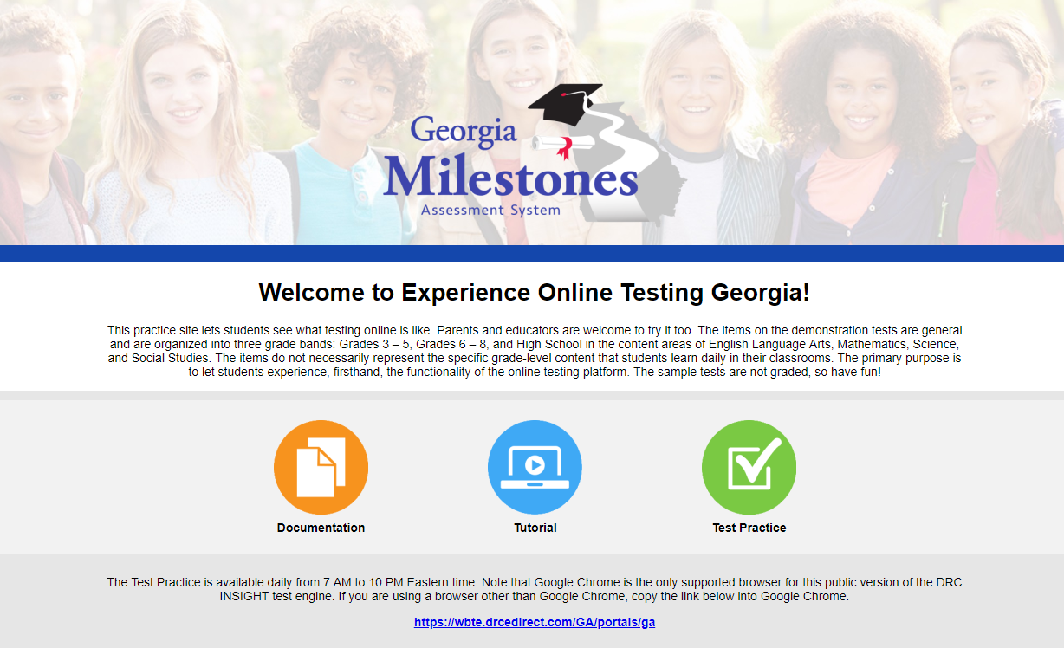
Georgia Milestones
Experience Online Testing Georgia
Provides students, parents, and educators with an opportunity to experience the online testing platform, allowing users to view and practice different item types, use available tools, and experience available accommodations.
www.gaexperienceonline.com

Slide 111
Georgia Milestones
Score reports
Districts receive a variety of reports, including individual student reports (ISR), class rosters, remediation and retest rosters, local coding error rosters, school/system/state content area summaries, school/system/state all student summary reports, and system student data files.
EOG and EOC reporting includes:
Scale scores
Achievement levels
Domain scores
Norm-referenced scores
Lexile/on-grade-level reading indicator
District and state comparisons
Score interpretations guides are available to provide support.

Slide 112
Achievement Level Descriptors (ALDs)
ALDs are narrative descriptions of the knowledge and skills expected at each of the four achievement levels.
The Georgia Milestones ALDs were developed for each grade level, content area, and course by committees of Georgia educators in 2015 and updated for Science and Social Studies in 2017.
The ALDs are based on the state-adopted content standards.

Slide 113
Achievement Level Descriptors (ALDs)
ALDs show a progression of knowledge and skills for which students must demonstrate competency across the achievement levels.
A student should demonstrate mastery of the knowledge and skills within his/her achievement level as well as all content and skills in any achievement levels that precede his/her own, if any.
For example, a Proficient Learner should also possess the knowledge and skills of a Developing Learner and a Beginning Learner.

Slide 114
Achievement Level Descriptors (ALDs)
Range ALDs describe the knowledge and skills, at the standard level, that students demonstrate at each level of proficiency.
Example: Physical Science

Slide 115
Georgia Milestones
Analyses

Slide 116
Georgia Milestones
The following slides present findings from a preliminary state-level analysis of spring 2018 Georgia Milestones results.
Research questions include:
Q1: How did students perform on Georgia Milestones in 2018?
Q2: What trends are observed over time with Georgia Milestones results?
Q3: What differences are observed in the performance between subgroups of students?
Q4: What trends are observed over time with reading and writing performance?

Slide 117
Q1: Spring 2018
The percentage of students achieving Developing Learner or Above ranged from 61% to 84%.
EOG: Grades 3 and 4 mathematics had the highest percentages at 83% and 84%, respectively.
EOC: American Literature and 9th Grade Literature had the highest percentages at 80% and 82%, respectively.
The percentage of students achieving Proficient Learner or Above ranged from 30% to 52%.
EOG: Grades 3 and 4 mathematics had the highest percentages at 46% and 47%, respectively.
EOC: Economics, Biology, and 9th Grade Literature had the highest percentages at 49%, 49%, and 52%, respectively.

Slide 118
Q2: Trends
Greatest gains from 2016 to 2018
Grade 3 Mathematics
Grade 4 Mathematics
9th Grade Literature & Composition
American Literature & Composition
Physical Science
Biology
Losses from 2016 to 2018
Losses were limited to 1-2 percentage points, with the exception of Analytic Geometry.
Analytic Geometry had a decrease of 7 percentage points in the Developing Learner & Above category; however, the N size decreased from 80,713 in 2016 to 20,250 in 2018.
Greatest gains is defined as 4 percentage points or more in both Developing Learner & Above and Proficient Learner & Above.

Slide 119
Q3: Subgroups
The largest subgroup differences exist between:
SWD compared with non-SWD
EL compared with non-EL
Black and Hispanic students compared with White students
In general, females performed better than males on ELA assessments. No gender differences were observed in other content areas.
It is important to note that subgroup differences are not indicative of item and test bias.
Note: The subgroup analysis was limited to SWD and non-SWD; EL and non-EL; and Black, Hispanic, and White.

Slide 120
Q4: Reading and Writing
Reading and Vocabulary
Writing and Language
# Item Type | # Points
23 Selected Response | 23
1 Evidence-Based Selected Response | 2
2 Constructed Response (2 points each) | 4
Total Points | 29
# Item Type | # Points
15 Selected Response | 15
1 Extended Writing Prompt | 7
Idea Development, Organization, and Coherence (4 points) Language Usage and Convention (3 points)
1 Extended Constructed Response Narrative | 4
Total Points | 26
Lexile
Reading Status Designation

Slide 121
Q4: Reading and Writing
For each grade, overall median Lexile values have remained stable for the past three years.
Median Lexile values, by achievement level on the ELA Georgia Milestones test, correspond with grade-level text bands as expected.
Median Lexile values for Beginning Learners fall below the text bands for all grade levels and courses.
Median Lexile values for Developing Learners fall within the text bands for all grade levels and courses.
Proficient Learners and Distinguished Learners gradually perform increasingly better than the expected grade-level text bands.

Slide 122
Q4: Reading and Writing
Median Lexile for Georgia Students by Grade Level/Course
Grade Level/ Course | 2016 | 2017 | 2018 | Suggested Text Demand: Lower Limit | Suggested Text Demand: Upper Limit
3 | 645 | 655 | 655 | 520 | 820
4 | 795 | 810 | 810 | 740 | 940
5 | 940 | 940 | 950 | 830 | 1010
6 | 980 | 990 | 975 | 925 | 1070
7 | 1115 | 1100 | 1100 | 970 | 1120
8 | 1175 | 1170 | 1165 | 1010 | 1185
9th Grade Lit. & Comp. | 1230 | 1265 | 1255 | 1050 | 1260
American Lit. & Comp. | 1345 | 1370 | 1360 | 1185 | 1385

Slide 123
Q4: Reading and Writing

Slide 124
Q4: Reading and Writing
Grade 3 – Reading Status
Due to rounding, percentages may not total 100%.

Slide 125
Q4: Reading and Writing
Grade 5 – Reading Status
Due to rounding, percentages may not total 100%.

Slide 126
Q4: Reading and Writing
Grade 8 – Reading Status
Due to rounding, percentages may not total 100%.

Slide 127
Q4: Reading and Writing
American Literature & Composition – Reading Status
Due to rounding, percentages may not total 100%.

Slide 128
Q4: Reading and Writing
Reading and Vocabulary
Writing and Language
# Item Type | # Points
23 Selected Response | 23
1 Evidence-Based Selected Response | 2
2 Constructed Response (2 points each) | 4
Total Points | 29
# Item Type | # Points
15 Selected Response | 15
1 Extended Writing Prompt | 7
Idea Development, Organization, and Coherence (4 points) Language Usage and Convention (3 points)
1 Extended Constructed Response Narrative | 4
Total Points | 26
Lexile
Reading Status Designation

Slide 129
Q4: Reading and Writing
Extended Writing Genres
Extended
Writing
Prompt
Informational/
Explanatory
Opinion/
Argumentative
Extended
Constructed Response
Narrative
OR

Slide 130
Q4: Reading and Writing
Extended Writing Prompt Trait 1: Idea Development, Organization, and Coherence (4 points)
A smaller percentage of students scored 3 or 4 points in 2018 compared to 2016, with the exception of grade 4.
Extended Writing Prompt Trait 2: Language Usage and Conventions (3 points)
Grade 4 and American Literature had a higher percentage of students scoring 3 points in 2018 compared to 2016. Other grades had a smaller percentage of students scoring 3 points over this time period.
Extended Constructed Response Narrative (4 points)
Grades 7 and 8 showed increases in the percentage of students scoring 2, 3 and 4 points in 2018 compared to 2016.
Minor differences are explainable by the slight variations in the difficulty of individual writing items across years. To address this limitation, future research is needed to account for differences in difficulty among items.

Slide 131
Q4: Reading and Writing
Extended Writing Prompt Noteworthy Trends
Some students followed a format that was so formulaic that their responses appeared to be plagiarized.
Some students copied large blocks of the passage(s) while providing little original work.
A positive trend shows that some students who rewrite passage information in their own words to fit the purpose of the prompt are now able to create more effective, higher-scoring essays.

Slide 132
Q4: Reading and Writing
Narrative Prompt Noteworthy Trends
Particularly for items with an informational passage, some students struggled to write a response in a narrative mode.
Students may be aware of the need to use narrative elements, but are unable to effectively use the element(s) to advance the plot or enhance the story.
A positive trend is that some students did smoothly integrate details from the passage into their responses.

Slide 133
What do teachers need to know?
A few comments from ELA teachers who attended item/data review:
That passages/questions are vetted by real teachers and their perspectives, and that they try to ensure equity for the ELA part.
That students need to be able to see a variety of texts, and need to show their knowledge in more than one way.
We need to focus on critical reading and thinking skills (not content alone), and we need to ensure that students are prepared to add depth to their writing.

Slide 134
What do teachers need to know?
A few comments from ELA teachers who attended rangefinding:
Students often provided cursory responses where more detail is needed.
How a one-sentence answer can qualify as a 2 better than an entire paragraph depending on what the answer contains.
Emphasis for students to respond to all parts of the question. They also should encourage students to answer straight to the point and not encourage fluff.
Many students are simply picking out quotes and not doing much explaining. The students are getting better at answering the questions. However, many students simply rely on pulling details from the text with little or no support.

Slide 135
What do teachers need to know?
A few comments from ELA teachers who attended rangefinding (continued):
I did not realize how much students struggled with ‘how’ questions.
Students are answering the prompts but are still not as developed in providing relevant textual evidence with clear elaboration or connection to their claims.
Most questions require students to explain something and provide details. Selecting quality support and tying that support to the explanation is a key skill.
The constructed-response items are directly correlated to the standards. Don’t box students in with framed responses – there is wide room for success if students have been taught the standard to understand the task.

Slide 136
Georgia Alternate Assessment 2.0

Slide 137
GAA 2.0
The Georgia Alternate Assessment is being redesigned to better ensure that students with significant cognitive disabilities are provided access to the state academic content standards and given the opportunity to demonstrate achievement of the knowledge, concepts, and skills inherent in the standards.
The new GAA 2.0 will:
align to the Georgia Standards of Excellence;
reduce teachers’ burden related to selecting or developing tasks;
bring greater standardization to the administration;
improve scoring reliability;
have standardized and scripted tasks with multiple access points;
have one assessment window in the spring; and
be administered statewide in 2018-2019.

Slide 138
GAA 2.0
Structure
Discrete tasks developed for each grade and content area.
Tasks written to three levels of complexity, starting with the least complex part and increasing in complexity.
A scenario or passage is provided at the beginning of each task and serves as an introduction.
Support (scaffolding) is built into the task to increase a student’s ability to access various levels of complexity within a task.

Slide 139
GAA 2.0
Features
Use of scenarios to engage student interest and activate background knowledge
Large simple graphics
Accessible font size
Short simple sentences
Avoids extraneous wording
Use of common proper nouns (names)
Directive questions
Additional information is available through GaDOE trainings and will be coming soon to the GAA website.

Slide 140
Blueprints

Slide 141
Blueprints

Slide 142
Extended Standards

Slide 143
Presentation of Task
Presentation Format
Scripted Tasks
Test Examiner has scripted “say” and “do” statements
Test Examiner presents in mode most accessible for the individual student.
Scaffolding (if needed)
Test Examiner will have access to assessment materials in advance to determine most accessible presentation and response modes
Advance Preparation
If the student does not provide the response as outlined in the test examiner script, additional scaffolding may be provided. All scaffolding instructions are provided.
Stimulus Cards
There are student facing stimulus cards with the information needed to answer a question. Usually graphics or words/short sentences.

Slide 144
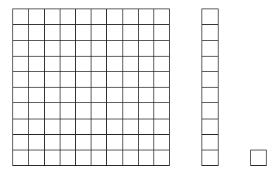
Sample Task - Scenario
Let’s talk about numbers. Each number has a different place value. We can use blocks to show the place value for each number.
Point to each block as you refer to it.
For the hundreds place we use a hundreds block, which has one hundred ones blocks. For the tens place, we use a tens block, which has ten ones blocks. For the ones place we use a ones block, which is just one block.

Slide 145
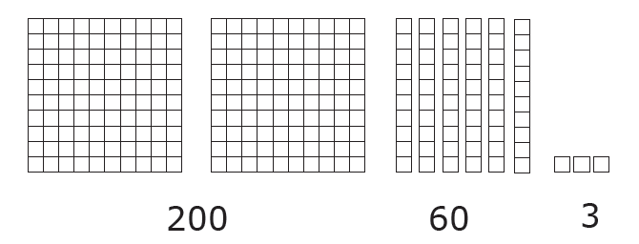
Sample Task – Scenario (Cont.)
Let’s take a look at the number two hundred sixty-three.
Point to 263.
263
We can use the blocks to show the place values for two hundred sixty-three.
Point to the number 2 and the hundreds blocks.
The number two is in the hundreds place, so we use two hundreds blocks.
Point to the number six and the tens blocks.
The number six is in the tens place, so we use six tens blocks.
Point to the number three and the ones blocks.
The number three is in the ones place, so we use three ones blocks.

Slide 146
Part A
Low complexity content
The most basic presentation of the GSEs and Extended Standards
May assess pre-requisite skills
Basic text and simplified graphics help to support understanding at this level
Two answer options are provided at this level; most answer options include graphics

Slide 147
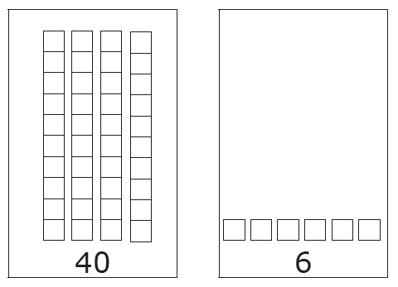
Part A
Part A: Low complexity content
Point to 46.
Here is the number forty-six.
46
Point to each number and the blocks as you read the numbers.
We can show this number with these blocks. Forty, six. Show me the blocks that represent the number in the tens place.
Point to the four tens blocks then the six ones blocks.
Four tens blocks, or six ones blocks.

Slide 148
Part A - Scaffolding
Part A: Scaffolding Example
The number forty-six is made up of tens and ones. You can count by tens to get to the number forty. You can count by ones to get to the number six. Show me the blocks that represent the number in the tens place.
Point to the four tens blocks then the six ones blocks.
Four tens blocks, or six ones blocks.

Slide 149
Part B
Moderate complexity content
Represents an entry-level skill
Features simple text with some academic language
Graphics may be more academic in nature than those provided for Part A

Slide 150
Part B
Part B: Moderate complexity content
Point to each tens blocks.
Here are three tens blocks.
Show me the number that these blocks represent.
Point to the answer options as you read them.

Slide 151
Part B
Part B: Scaffolding Example
You can count each block to find out the number that three tens blocks represents. Show me the number that these blocks represents.
Point to the answer options as you read them.

Slide 152
Part C
High complexity content
May include multiple parts, require the student to make inferences, or require the application of previous learning
Graphics for Part C may require the student to interpret or make an inference
Graphics not included for all activities in Part C

Slide 153
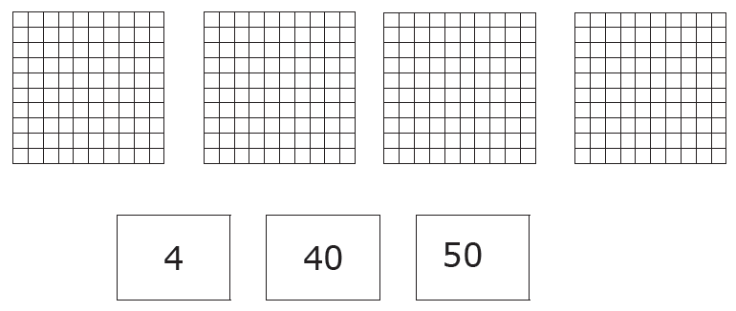
Part C
Part C: High complexity content
Point to each hundreds block.
Each hundreds block is made up of ten, tens blocks. Show me how many tens there are in four hundred.
Point to the answer options as you read them.

Slide 154
Part C
Part C: Scaffolding Example
Remember, you can find out how many tens there are by counting each column in the hundreds blocks. Show me how many tens there are in four hundred.
Point to the answer options as you read them.

Slide 155
Resources
Resources currently available on the GAA 2.0 website:
Test design training
Eligibility criteria
Test blueprints
Extended content standards

Slide 156
Assessment Philosophy
The primary purpose of schools is teaching and learning.
Assessment and accountability play a significant role, but importantly – that role is supporting, with the primary focus being teaching and learning.

Slide 157
Thank you!
Jan Reyes, Ed.D.
Director of Assessment Development
jreyes@doe.k12.ga.us
(404) 463-6665
Allison Timberlake, Ph.D.
Deputy Superintendent for Assessment & Accountability
atimberlake@doe.k12.ga.us
(404) 463-6666

