Slide 1
Using GOFAR to Create Test Items and Formative Assessments
GAETC 2018
Joe Blessing

Slide 2
Formative Assessment Toolbox
Item and Test bank from Georgia’s Online Formative Assessment Resource (GOFAR)
TestPad tool in SLDS for creating, administering, scoring and reporting formative assessments
  TestPad allows users to create their own test items.
An assessment literacy professional learning opportunity that focuses on implementation of evidence-based Formative Instructional Practices (FIP)

Slide 3
Item Bank Content

Slide 4
Item Formats
Multiple Choice
Constructed-Response
  Extended Response
  Scaffolded
Constructed-response items require students to provide explanations/rationales, provide evidence, and/or to show work
Provide teachers with evidence of true student understanding of content and process

Slide 5
GOFAR State Developed Assessments
Formative Benchmarks (20 benchmarks with 2 parts each)
  ELA Grades 3-8, 9th Grade Lit, American Lit
  Mathematics Grades 3-8, Coordinate Algebra, Analytic Geometry

Slide 6
Example of Extended Response Item
ELA—Grades 9 – 10
9th/10th Grade ELA Standards RI.9.8; RI9.1; L9.1; L9.2; DOK 4
Passage Title: Juliette Gordon Lowe
Part A
Identify at least two arguments Juliette Gordon Low used as reasons to begin the Girl Scouts.
Part B
Evaluate whether or not these arguments are valid and whether there is enough evidence in the article to support them.
Be sure to complete ALL parts of the task. Use details from the text to support your answer. Answer with complete sentences, and use correct punctuation and grammar.

Slide 7
Example of Extended Response Item
Math—Advanced Algebra
Advanced Algebra, Standards A.REI.2; A.REI.4; A.APR.6, A.REI.1; DOK 3

Slide 8
Example of Rubric
Mathematics—Grade 5
Rubric
Score | Designation | Description
4 | Thoroughly Demonstrated | The student successfully completes all elements of the item by demonstrating knowledge and application of measuring volumes by counting unit cubes, using cubic cm, cubic in, cubic ft, and improvised units (5.MD.4), applying the formulas V = l × w × h and V = b × h for rectangular prisms to find volumes of right rectangular prisms with whole number edge lengths in the context of solving real world and mathematical problems (5.MD.5b), and adding, subtracting, multiplying, and dividing decimals to hundredths, using concrete models or drawings and strategies based on place value, properties of operations, and/or the relationship between addition and subtraction; relating the strategy to a written method and explain the reasoning used (5.NBT.7).
3 | Clearly Demonstrated | The student shows clear understanding of the standards listed above, but one of the explanations or work shown is insufficient or weak Or All parts of the item are correctly done except for a minor computational error Or The student successfully completes two of the three parts of the item and partially completes the other part.
2 | Basically Demonstrated | The student shows basic understanding of the standards listed above, but two of the explanations or work shown are insufficient or weak Or The student successfully completes one of the three parts of the item and partially completes the other parts.
1 | Minimally Demonstrated | The student shows minimal understanding of the standards listed above and completes only one of the three parts Or The student partially completes two of the three parts.
0 | Incorrect or irrelevant | The response is incorrect or irrelevant to the skill or concept being measured.

Slide 9
Exemplar Papers
Prototype answer – the “ideal” response
Set of responses from actual Georgia students, collected during item pilots
Samples scored by trained raters using rubric
Papers allow teachers to review and compare their own students’ work to the sample responses for each score point
  Helps standardize expectations of the standards
Score point and annotations provided for each sample item response
Note: The pilot was conducted using standard administration procedures in order to ensure that results were comparable across the state. When items/tasks are used during instruction, these administration rules do not have to apply and student results may vary; thus, teachers may want to modify the rubrics and even raise expectations. Rubrics and exemplars should remain focused on high expectations.

Slide 10
Exemplar Papers
Mathematics – Grade 5

Slide 11
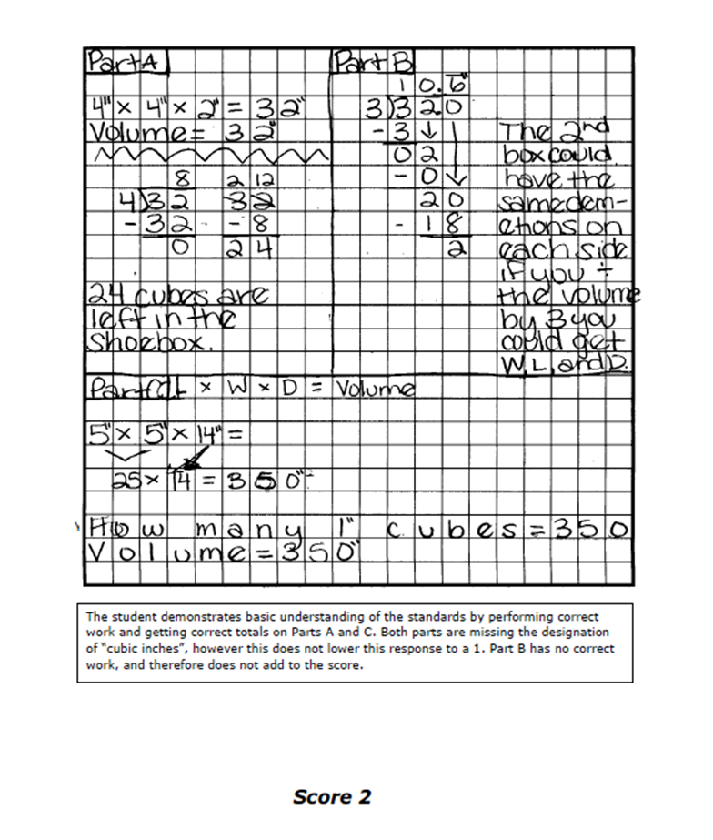
Student Anchor Papers
Student Response
Scorer’s Annotation
Score based upon rubric

Slide 12
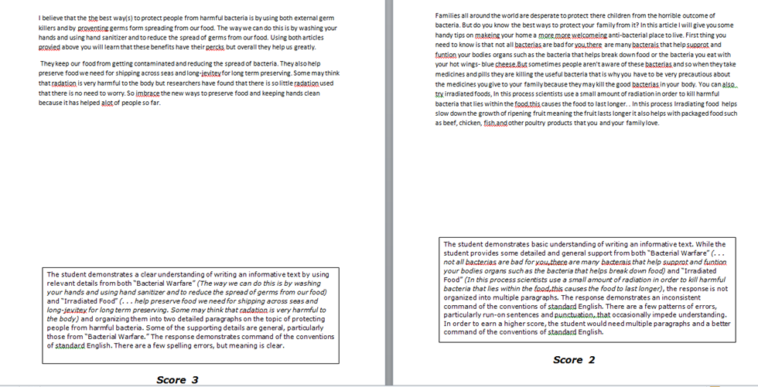
Student Anchor Papers

Slide 13
TestPad

Slide 14
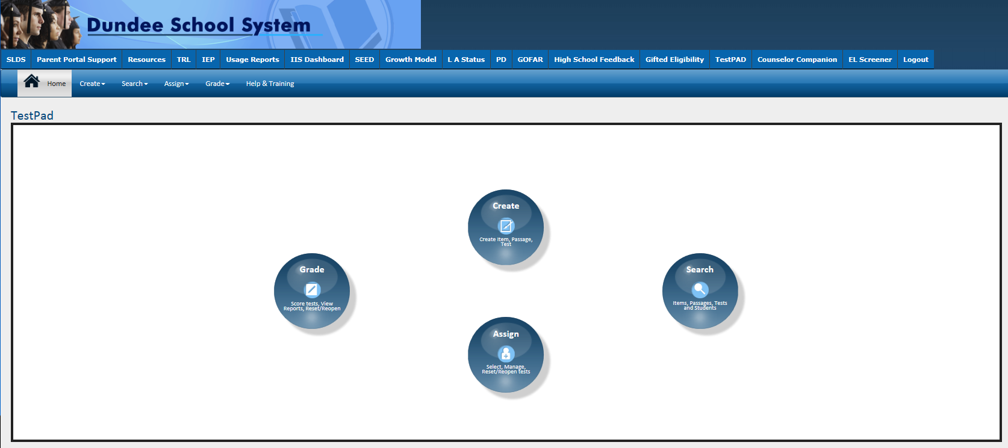
TestPad Landing Page
Create, Search, Assign and Grade all in one location

Slide 15
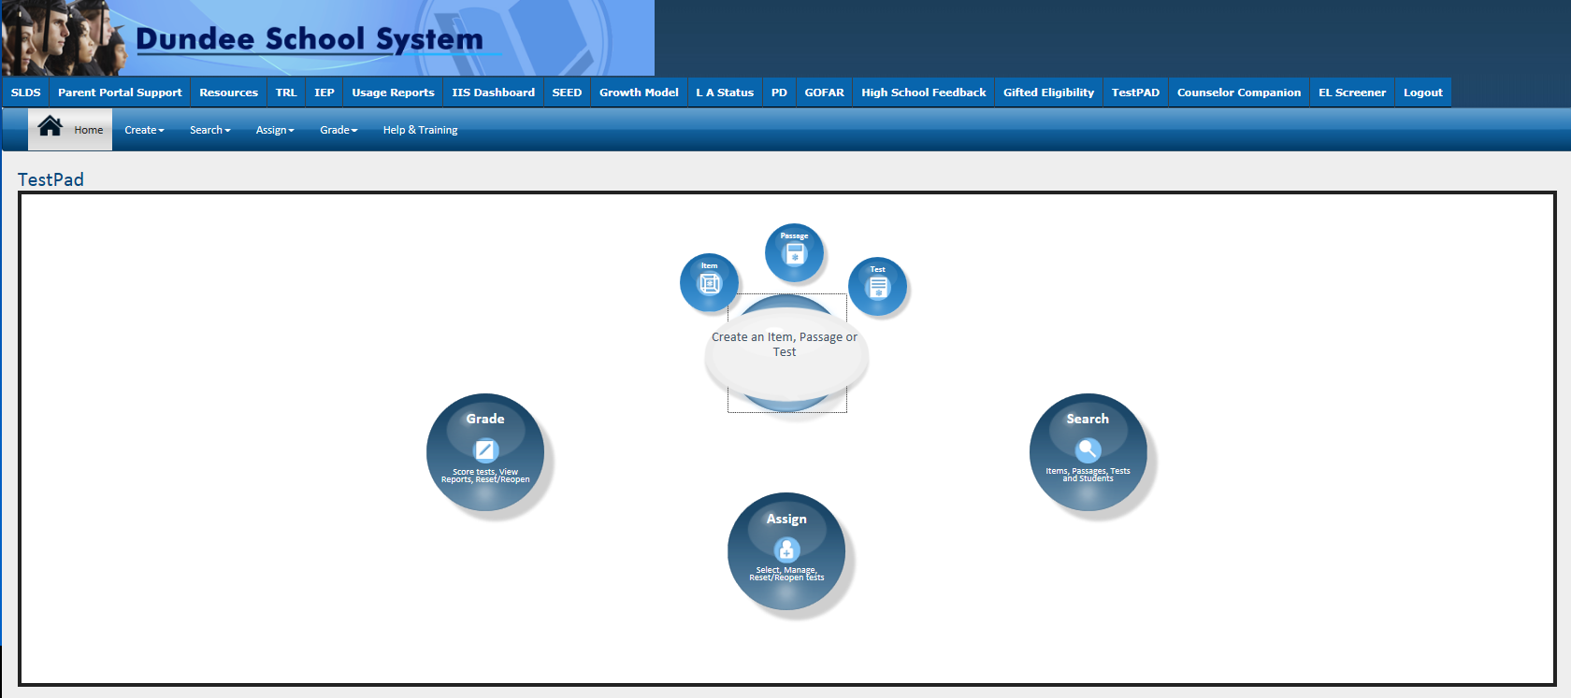
Create an Item

Slide 16
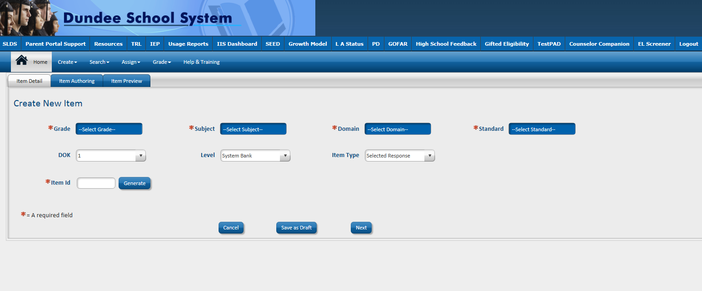
Item Creation – Item Detail Screen

Slide 17
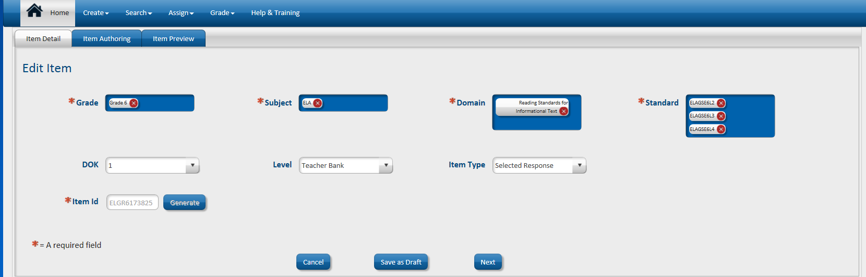

Item Detail Screen

Slide 18
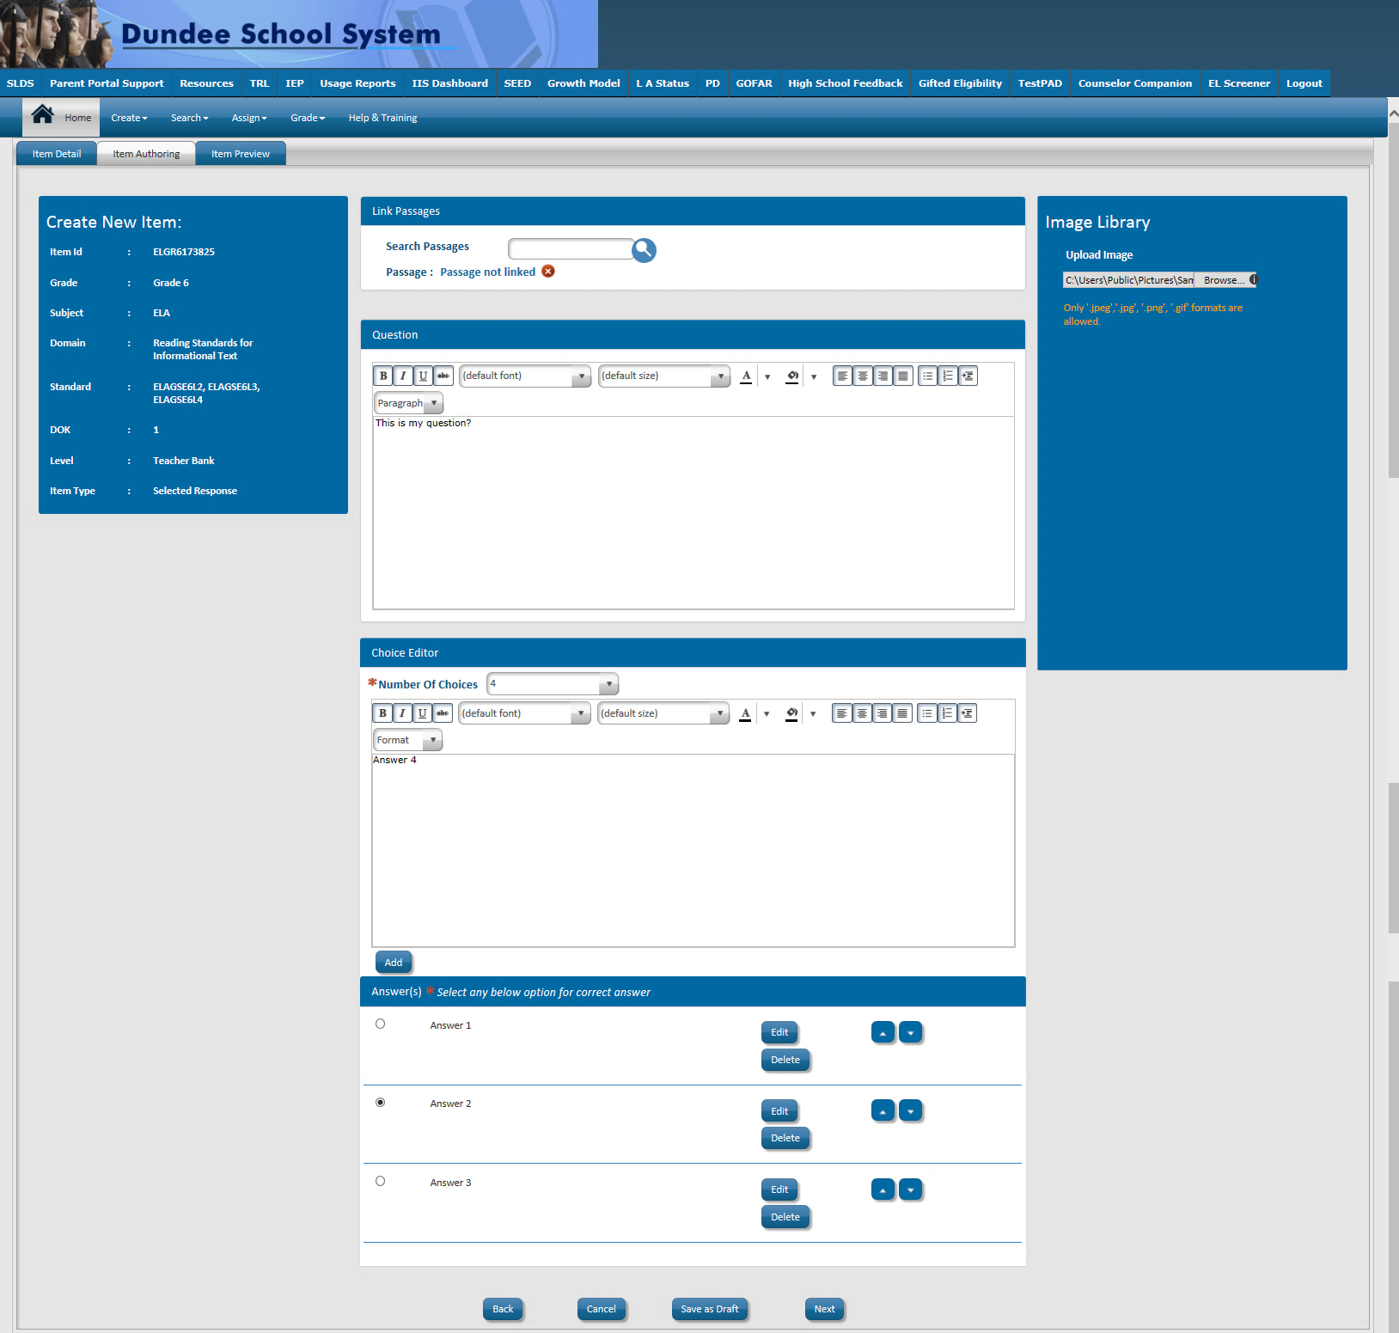
Item Creation – Item Authoring Screen
Attach Passages
Include Images
Enter Stem
Select Correct Answers

Slide 19
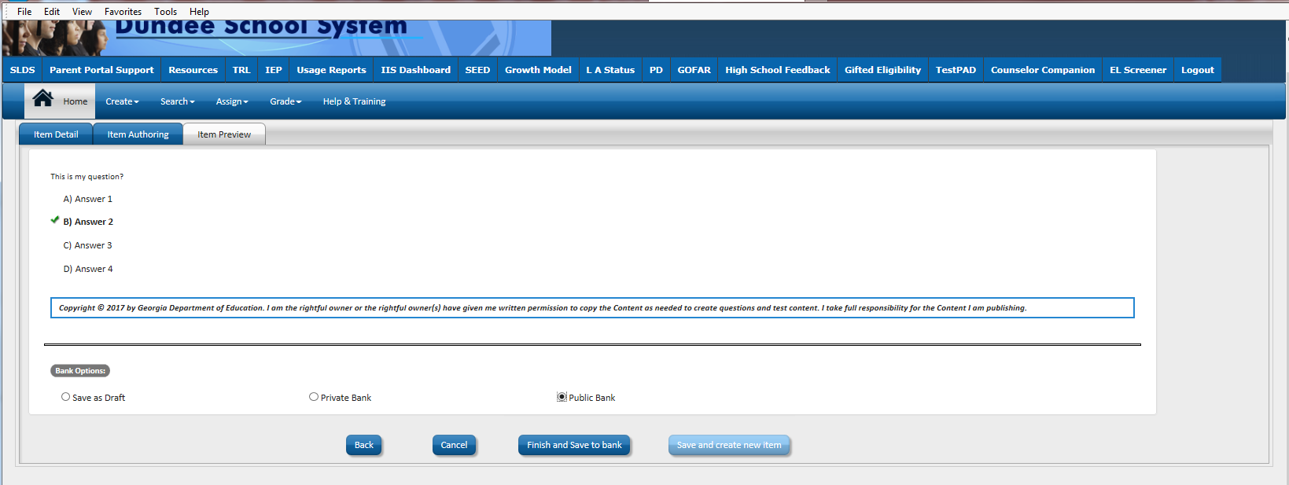
Item Creating – Item Preview Screen
Save as Draft, Private and Public Banks

Slide 20
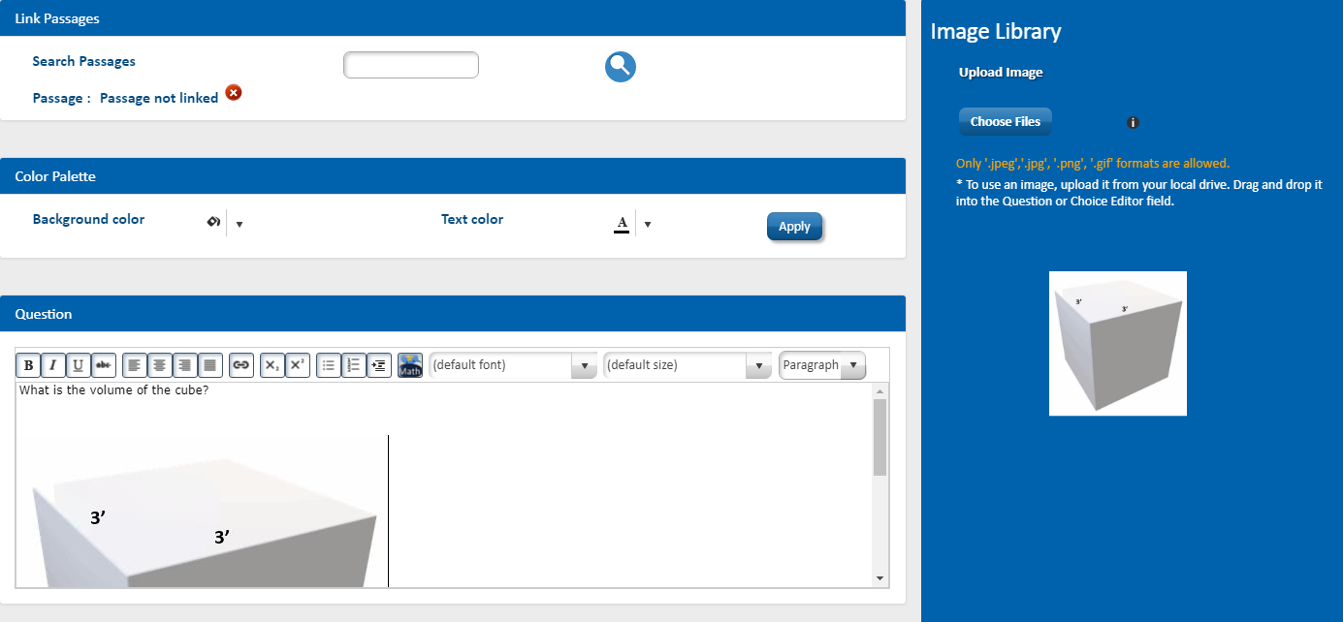
Item Creating – Insert Image
Click Choose Files
Select your file from your computer
Drag and drop the image to the Question

Slide 21
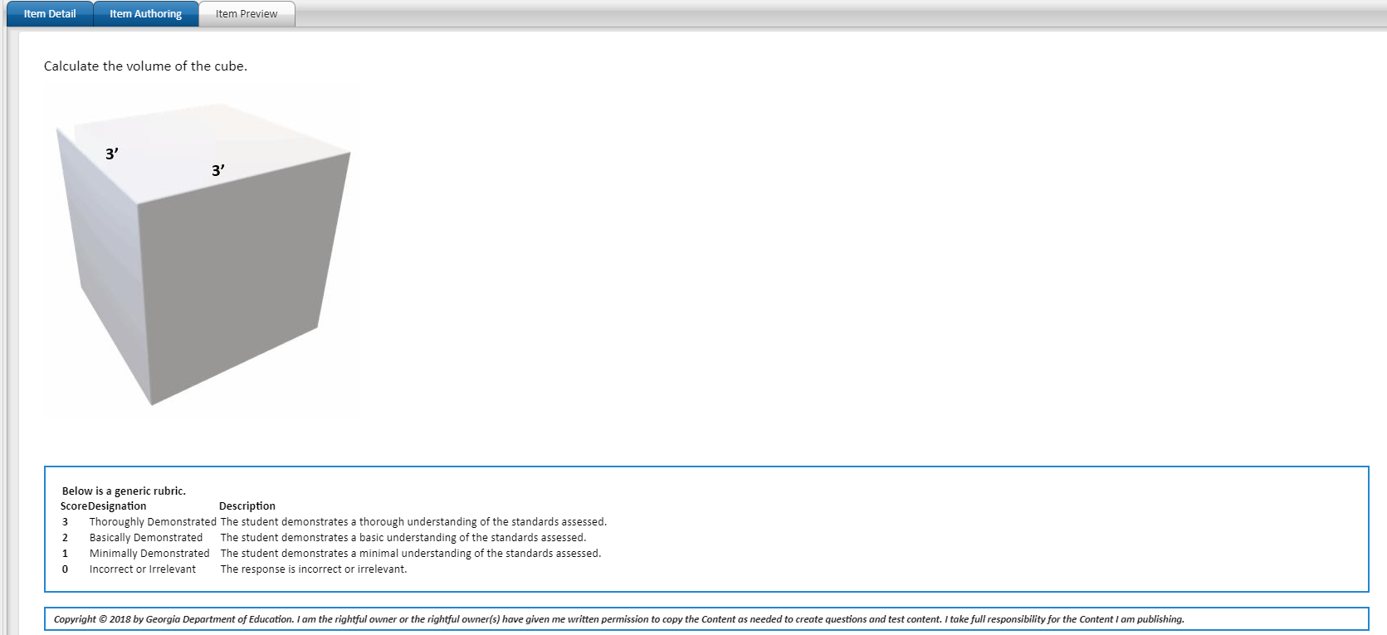
Item Creating – Item Preview Screen
Constructed Response Item

Slide 22
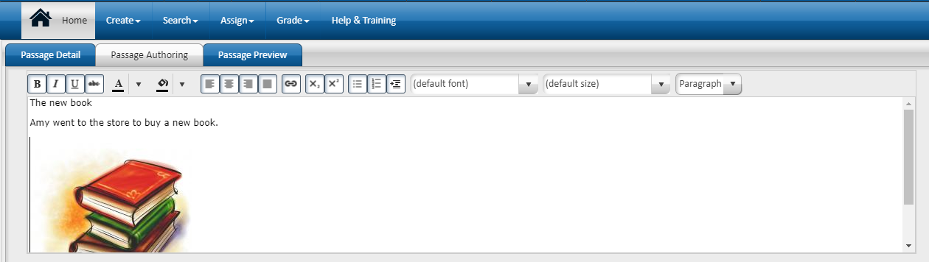
Create a Passage – Passage Authoring Screen

Slide 23
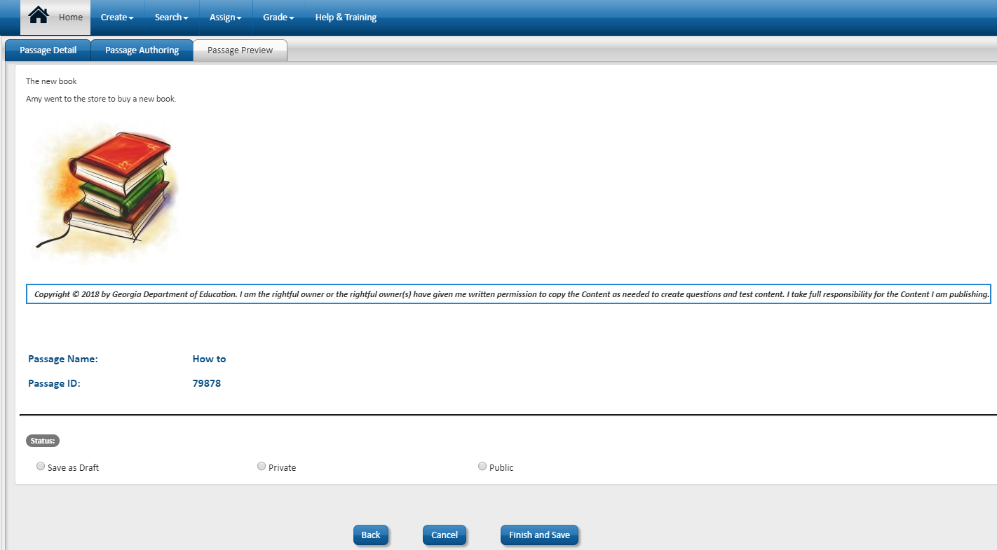
Create a Passage – Passage Preview Screen
Remember your Passage ID and Name
Save as Draft, Private or Public

Slide 24
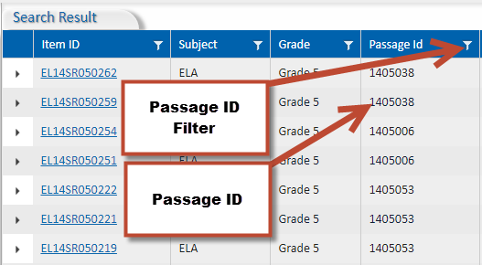
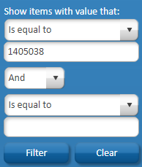
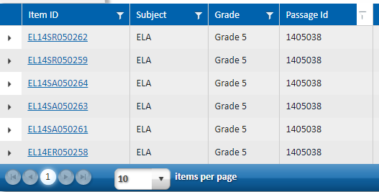
Passages in TestPad
To find more items with a passage, click on the Passage ID filter. Enter the Passage ID into the Is equal to box. Then click Filter.
You can now easily assign test items attached to the passage

Slide 25
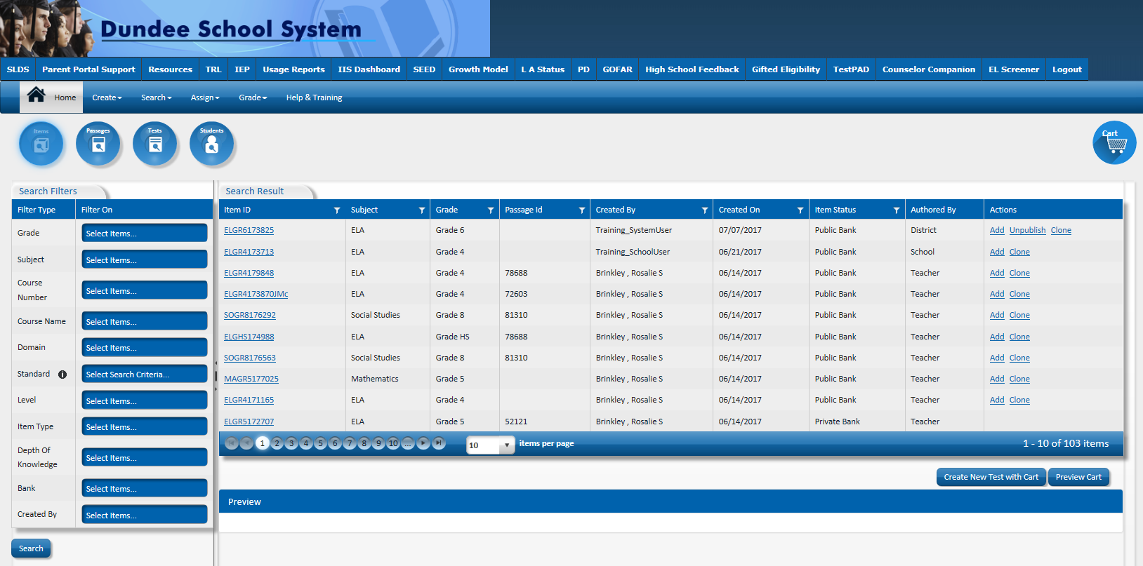
Item bank
Standards for tested and non-tested courses
Items Created by state and users

Slide 26
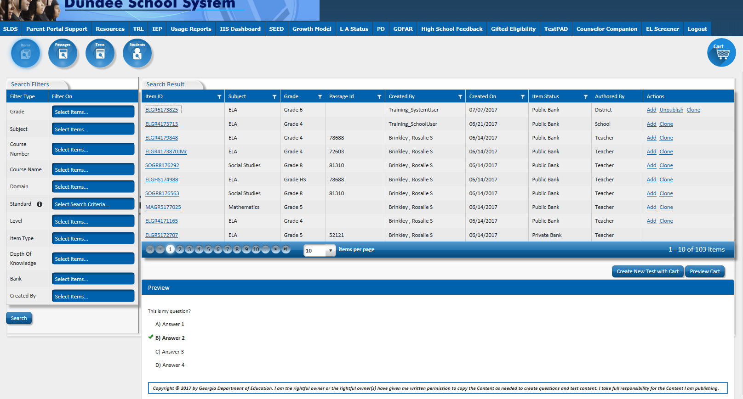
Preview an Item by Clicking on the Item ID

Slide 27
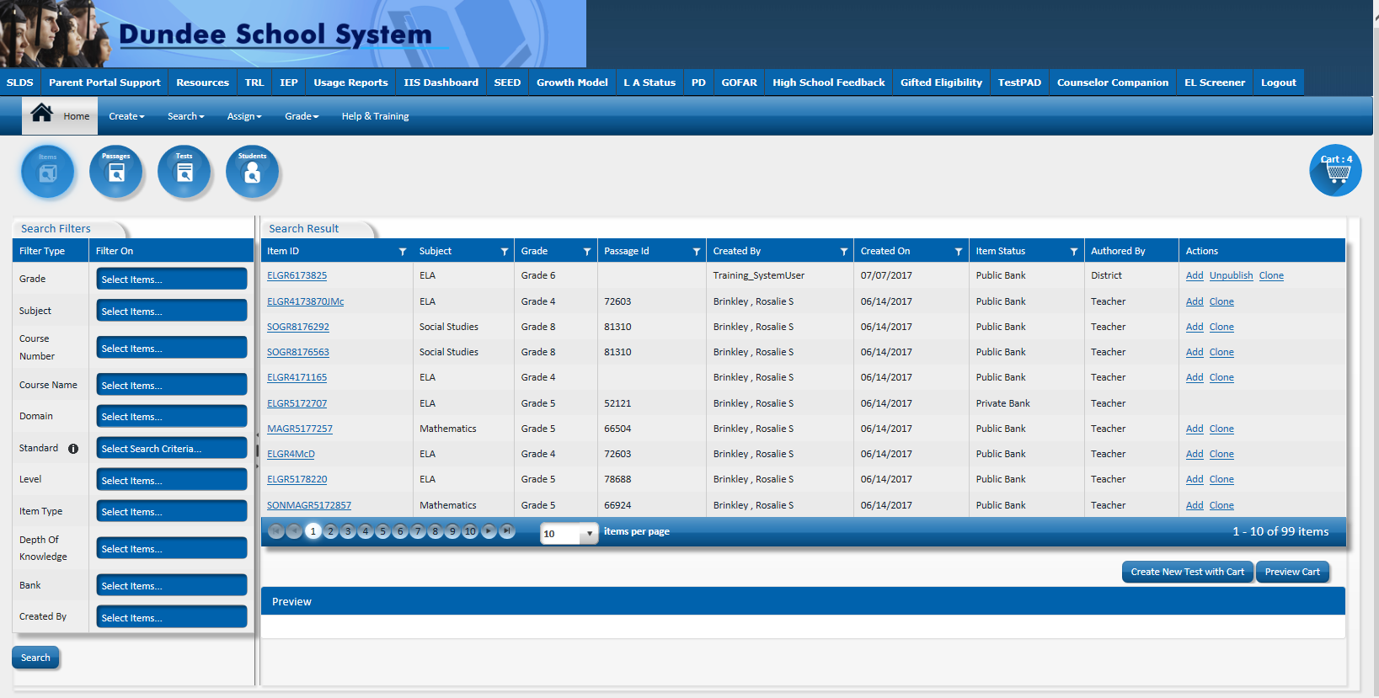
Add Items to a New Test

Slide 28
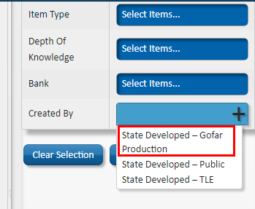
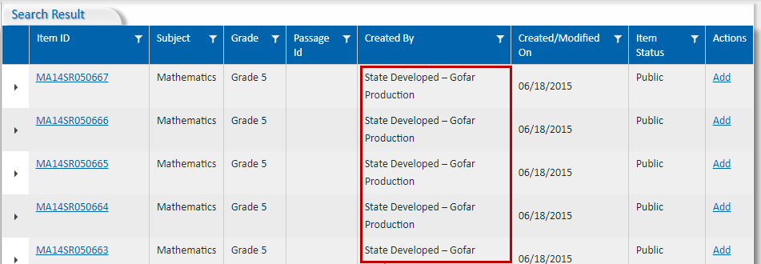
Using the GOFAR Item Bank

Slide 29
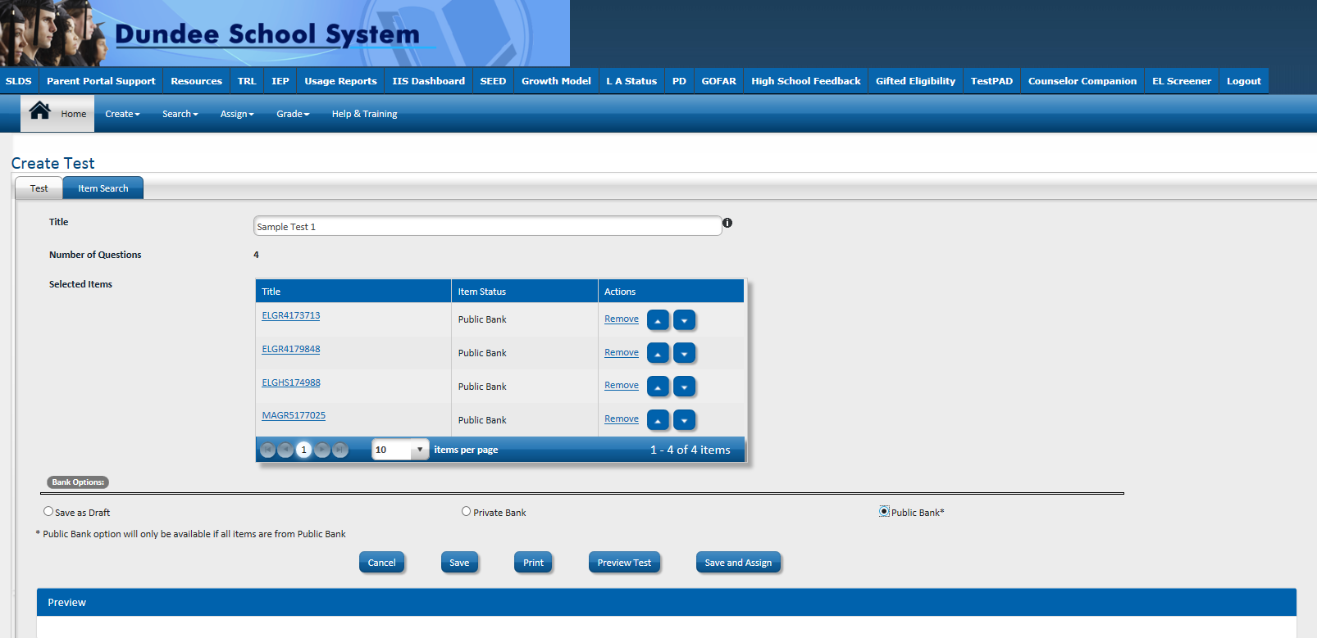
Create Test Screen

Slide 30
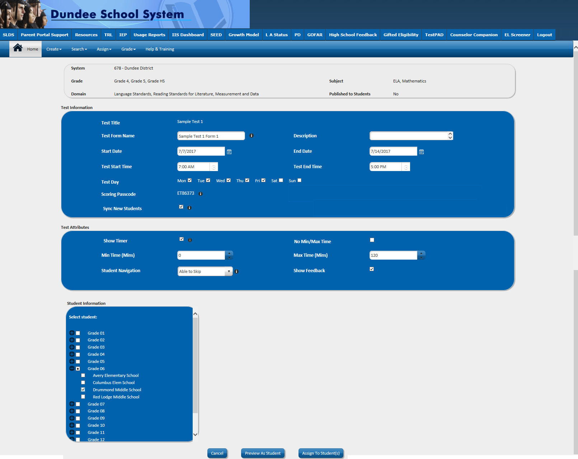
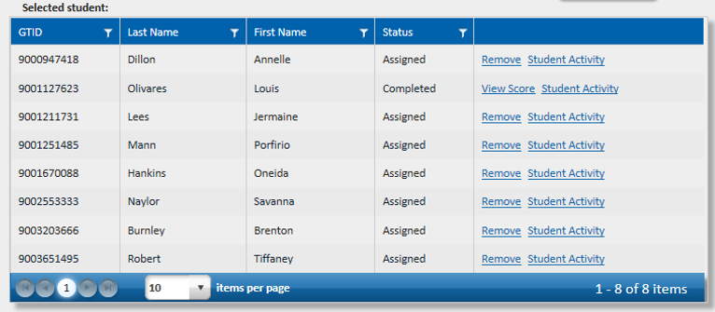
Assign Test Screen

Slide 31
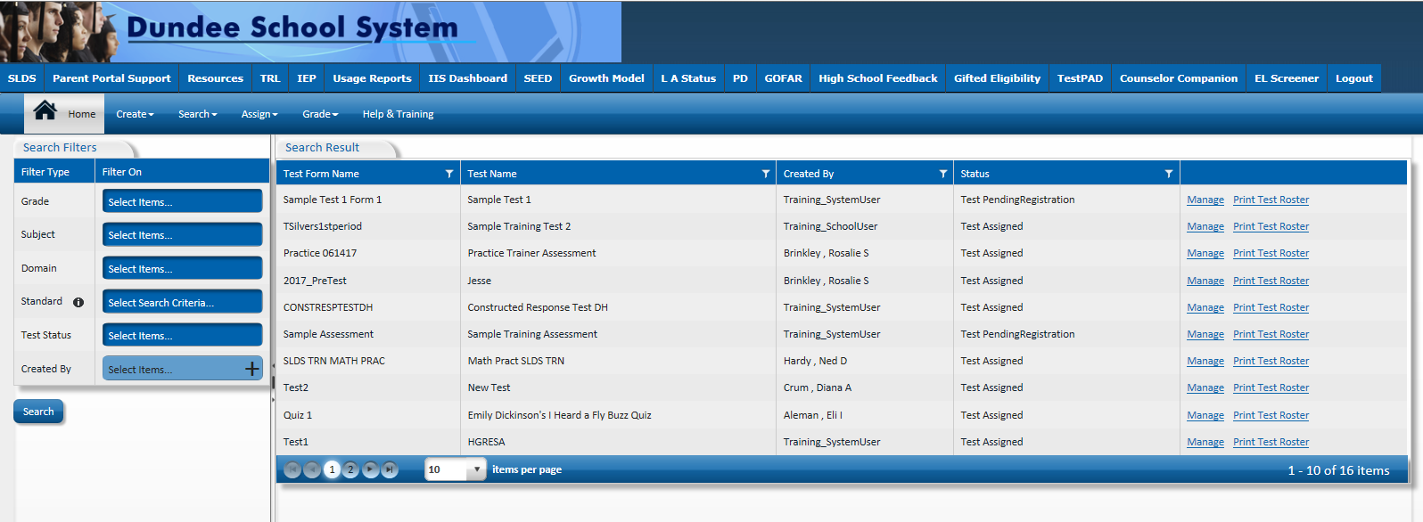
Manage Assigned Tests

Slide 32
Create a Passage

Slide 33
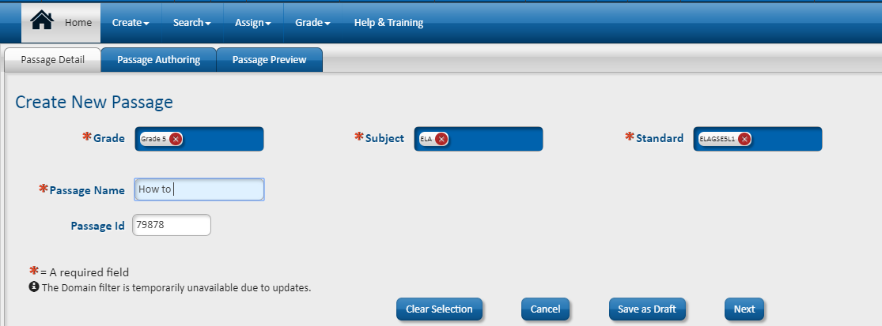
Create a Passage – Passage Detail Screen

Slide 34

Students access TestPad via the SLDS Student Portal

Slide 35
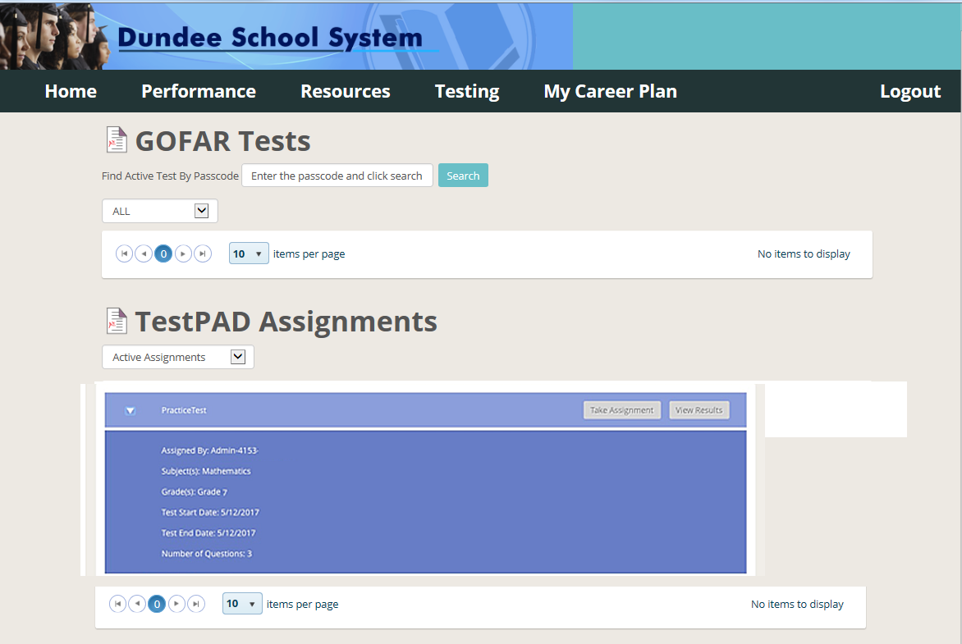
Students will see available TestPad assignments and can click “Take Assignment”

Slide 36
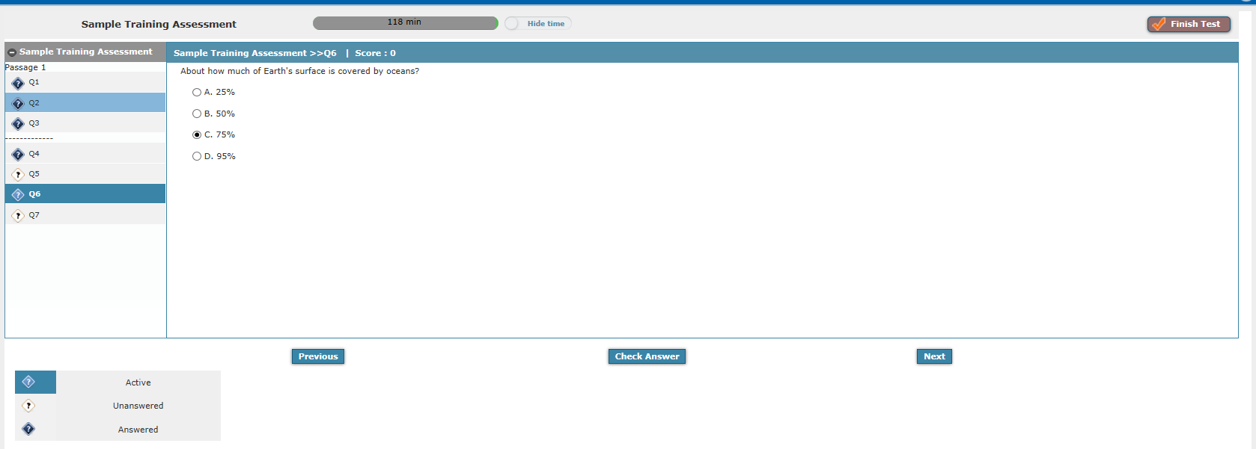
Student view of TestPad assignment

Slide 37
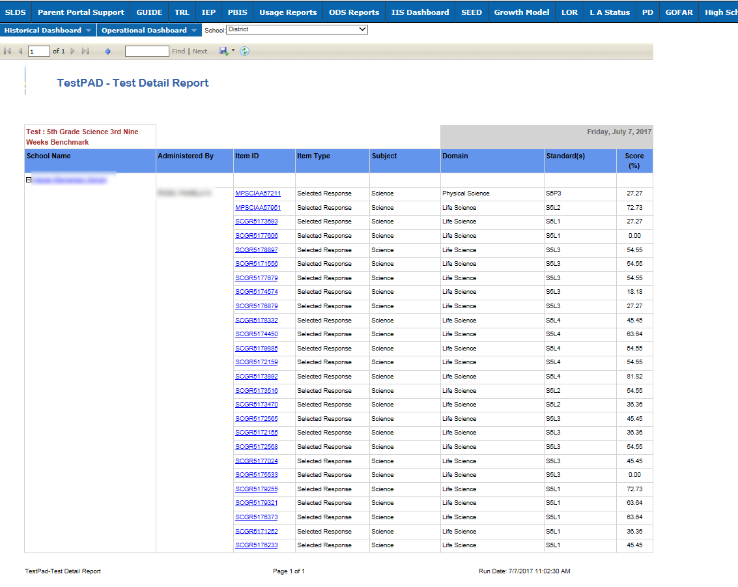
Reports are automatically generated as students turn in tests
Constructed Response items will need to be scored by teachers
TestPad Reports

Slide 38
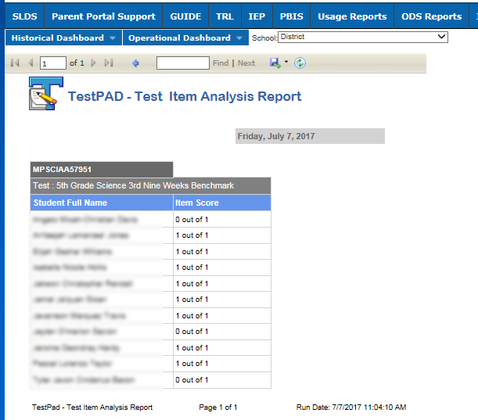
TestPad Reports

Slide 39
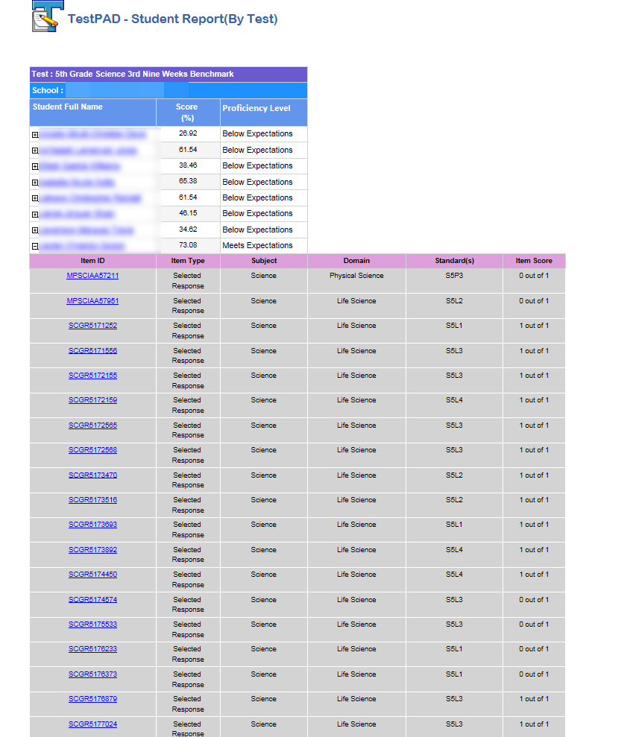
TestPad Reports

Slide 40
Let’s Talk about GA FIP
Blended Model of Professional Learning for Effective Use of Formative Assessment

Slide 41
Today’s Topics
GA FIP Online Learning
Define GA FIP Online Professional Learning as Evidence-Based Practice
Share the available course content in GA FIP
Communicate how to access the original GA FIP online learning modules and resources in the SLDS, and the revised GA FIP modules and resources at http://www.gadoe.org/Curriculum-Instruction-and-Assessment/Assessment/Pages/GeorgiaFIP.aspx
Communicate GaDOE Portal location of FIP Access Codes
Share how FIP supports educators with the PSC professional learning rule
Share results from 2017-2018 FIP Teacher Feedback Survey
Respond to your questions

Slide 42
Purpose of GA FIP Online Professional Learning

Slide 43
Formative Instructional Practices Defined
It is not the instrument that is formative; it is the use of the information gathered. (Chappuis, 2009)
Formative Instructional Practices (FIP) are intentional behaviors that teachers and students use to gather and respond to evidence of student learning.
Georgia FIP is a blended model for professional development about formative instructional practices.
The four major components of GA FIP are:
Creating and using clear learning targets
Collecting and documenting evidence of student learning
Using evidence and feedback to increase learning
Preparing students to take ownership of their learning through reflection, peer feedback, self- assessment

Slide 44
The most important question to ask before deciding how the formative assessment will be used:
Instructional
Predictive
Evaluative
Tell me how well students are learning each day and where to adjust teaching to close gaps or offer more challenging learning activities?
Tell me how students are likely to perform on the end-of-year assessment?
Tell me which instructional program, approach or teacher was most successful?
Formative
Formative
Summative
Adapted from: Gong, B., Marion, S. & Perle, M. (2007). A framework for considering interim assessments. Denver, CO: National Center for the Improvement of Educational Assessment.

Slide 45
GA FIP Courses

Slide 46
FIP Foundations Courses
(Begin with the 5 core courses and take them in sequence)
1. Introducing Formative Instructional Practices
Creating and Using Clear Learning Targets
Collecting and Documenting Evidence of Student Learning
Using Evidence and Feedback to Increase Learning
Fostering Student Ownership of Learning
Leading Formative Instructional Practices
Core for Teachers, Coaches &
Leaders
Leaders & Coaches

Slide 47
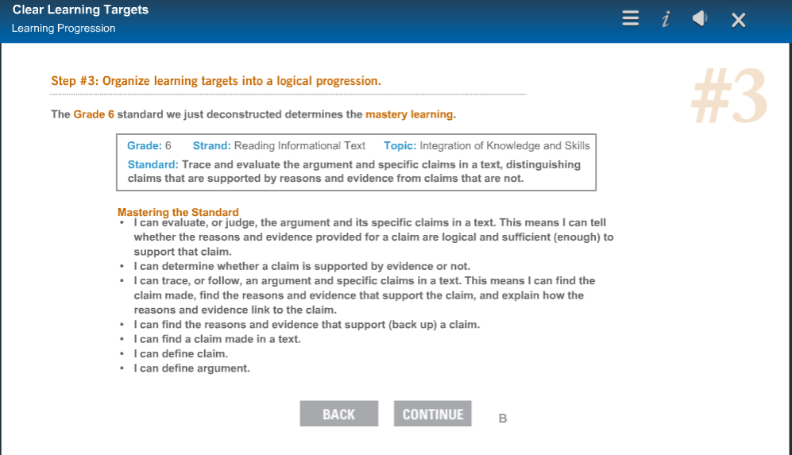
Example of FIP Content from: Clear Learning Targets
Standard ELAGSE6RI8
Learning targets and progressions come from the standards. Student learning is assessed for each learning target.
Each target is intentionally planned for teaching and formative assessment.
Note: Green text added by Kelli Harris-Wright

Slide 48
FIP and TestPad could be used to gather information about student learning for this standard
Standard ELAGSE6RI8
Grade 6
Strand: Reading Informational Text
Topic: Integration of Knowledge and Skills
Standard: Trace and evaluate the argument and specific claims in a text, distinguishing claims that are supported by reasons and evidence from claims that are not.

Slide 49
Additional GA FIP Courses
after the Foundations Series

Slide 50
Creating Clear Learning Targets and Reaching Every Student Course Series
Clear Learning Targets
Creating Clear Learning Targets for ELA in Elementary School
Creating Clear Learning Targets for ELA in Middle School
Creating Clear Learning Targets for ELA in High School
Creating Clear Learning Targets for Math in Elementary School
Creating Clear Learning Targets for Math in Middle School
Creating Clear Learning Targets for Math in High School
Non-Core: Creating Clear Learning Targets in Physical Education
Reaching Every Student Courses
Formative Instructional Practices: Reaching Students with Disabilities
Formative Instructional Practices: Reaching English Language Learners
Formative Instructional Practices: Reaching Gifted Students

Slide 51
Designing Sound Assessment Course Series
Designing Sound Assessments Overview
Creating and Using Rubrics
Creating and Using Master Rubrics
Creating and Using Assessment Blueprints
Creating and Using Written Response Assessments
Creating and Using Verbal Response Assessments
Creating and Using Performance Assessments
Creating and Using Selected Response Assessments
Designing and Critiquing Sound Assessments: Putting the Pieces Together
Stand-alone Course: Implementing Evidenced-Based Grading

Slide 52
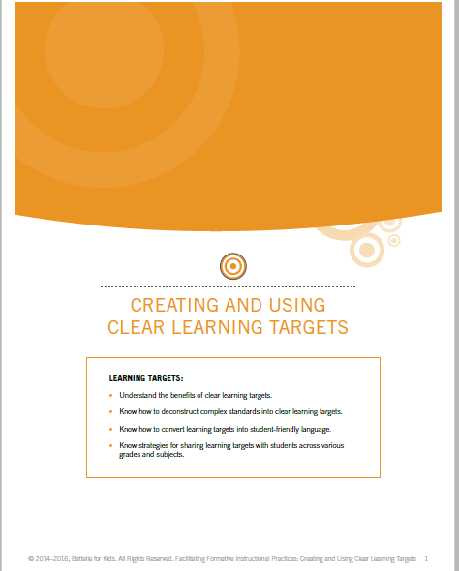
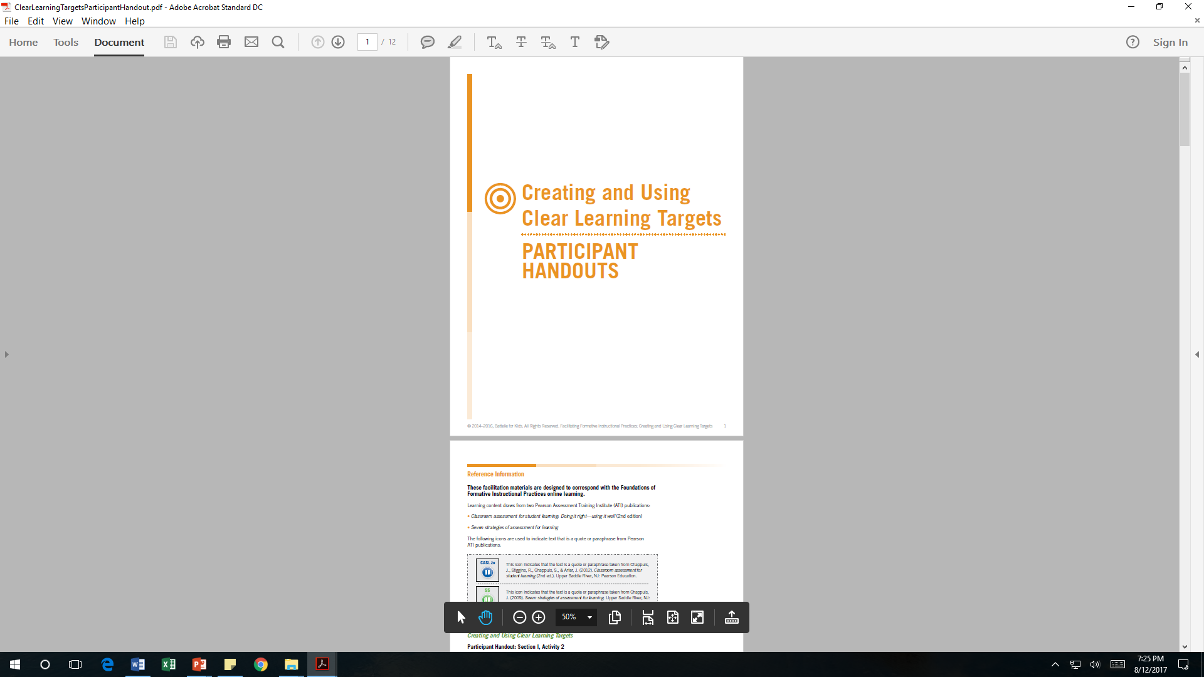
Downloadable PLC Facilitation Guides and Participant Handouts for FIP Courses

Slide 53
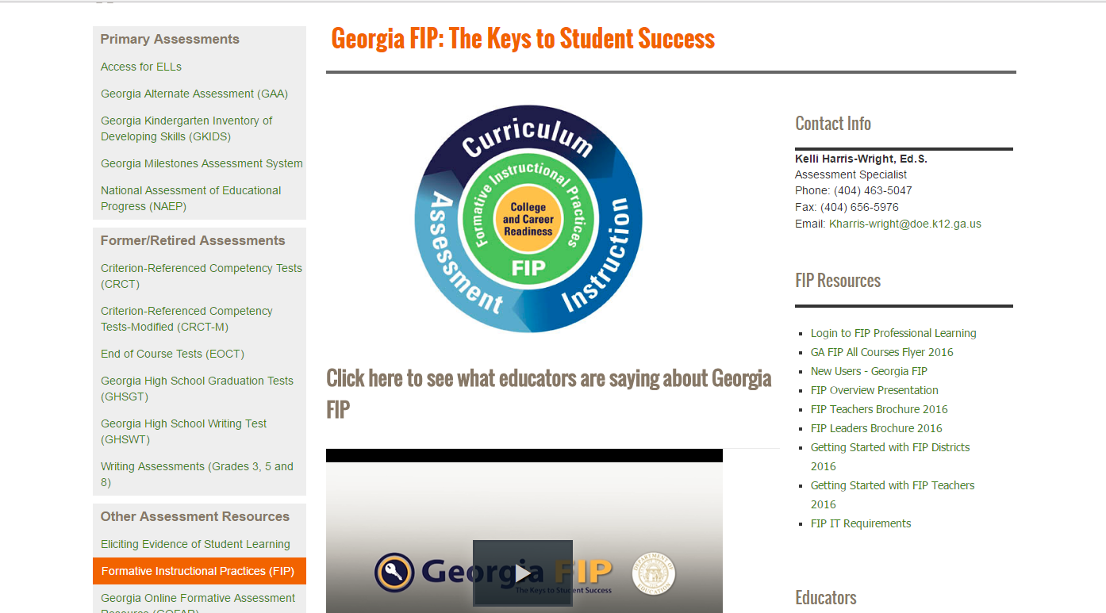
Note: Requires a unique district or school access code http://www.gadoe.org/Curriculum-Instruction-and-Assessment/Assessment/Pages/GeorgiaFIP.aspx

Slide 54
Two Types of FIP Access Codes
(FIP portal populates when accounts are created with the appropriate role-based access code and the educator’s district email address)
•FIP Access codes are unique to each district and each school.
•Access codes include the three-digit district identifier number and the four-digit school identifier number embedded in the location-specific FIP code.
•Administrative Access Codes end with “-P” (999-0575-P)
•Administrative accounts allow the leader to take FIP courses and engage in online monitoring of the faculty’s course progress through the “Management and Reports” tab. This function IS NOT available in FIP Learner accounts.
•Learner Access Codes end with “-FP” (999-0575-FP)
•Central Office has a FIP Administrative Access Code, and a Learner Access Code.

Slide 55
Contact Information
TestPad Web Site
  http://www.gadoe.org/Technology-Services/SLDS/Pages/TestPAD-Training-and-Support.aspx
TestPad Training Site
  http://sldstrn.gadoe.org/SLDSDemoWeb
Request for face to face TestPad training
  http://www.gadoe.org/Technology-Services/SLDS/Pages/Contact-and-Connect.aspx
Questions Regarding TestPad Content & School/System Usage
  Joseph Blessing
  404-232-1208
  jblessing@doe.k12.ga.us
Questions Regarding TestPad Functionality/Technical Support
  slds@doe.k12.ga.us
Questions Regarding GA FIP Online Professional Learning
  Kelli Harris-Wright
  404-463-5047
  kharris-wright@doe.k12.ga.us

Slide 56
Questions

