Slide 1
GOFAR and Formative Assessment Practices (FIP)
Data Conference
August 22, 2018

Slide 2
Combining Resources
Formative Assessment Toolbox: Item and test content in GOFAR
GOFAR: Benchmark Development Tool for use with GaDOE test items
TestPad: Tool for item creation
Formative Instructional Practices (FIP): online professional learning for teachers

Slide 3
Formative Assessment Toolbox
An expansive bank of formative instructional assessment items/tasks in ELA and Mathematics as a teacher resource
A set of benchmark assessments in ELA and Math for grades 3 through HS
An assessment literacy professional learning opportunity that focuses on implementation of evidence-based formative instructional practices (FIP)
  http://www.gadoe.org/Curriculum-Instruction-and-Assessment/Assessment/Pages/GeorgiaFIP.aspx

Slide 4
Item Formats
Multiple Choice
Constructed-Response
  Extended Response
  Scaffolded
Constructed-response items require students to provide explanations/rationales, provide evidence, and/or to show work
Provide teachers with evidence of true student understanding of content and process

Slide 5
Example of Extended Response Item
ELA—Grades 9 – 10
9th/10th Grade ELA Standards RI.9.8; RI9.1; L9.1; L9.2; DOK 4
Passage Title: Juliette Gordon Lowe
Part A
Identify at least two arguments Juliette Gordon Low used as reasons to begin the Girl Scouts.
Part B
Evaluate whether or not these arguments are valid and whether there is enough evidence in the article to support them.
Be sure to complete ALL parts of the task. Use details from the text to support your answer. Answer with complete sentences, and use correct punctuation and grammar.

Slide 6
Example of Extended Response Item
Math—Advanced Algebra
Advanced Algebra, Standards A.REI.2; A.REI.4; A.APR.6, A.REI.1; DOK 3

Slide 7
Example of Rubric
Mathematics—Grade 5
Rubric
Score | Designation | Description
4 | Thoroughly Demonstrated | The student successfully completes all elements of the item by demonstrating knowledge and application of measuring volumes by counting unit cubes, using cubic cm, cubic in, cubic ft, and improvised units (5.MD.4), applying the formulas V = l × w × h and V = b × h for rectangular prisms to find volumes of right rectangular prisms with whole number edge lengths in the context of solving real world and mathematical problems (5.MD.5b), and adding, subtracting, multiplying, and dividing decimals to hundredths, using concrete models or drawings and strategies based on place value, properties of operations, and/or the relationship between addition and subtraction; relating the strategy to a written method and explain the reasoning used (5.NBT.7).
3 | Clearly Demonstrated | The student shows clear understanding of the standards listed above, but one of the explanations or work shown is insufficient or weak Or All parts of the item are correctly done except for a minor computational error Or The student successfully completes two of the three parts of the item and partially completes the other part.
2 | Basically Demonstrated | The student shows basic understanding of the standards listed above, but two of the explanations or work shown are insufficient or weak Or The student successfully completes one of the three parts of the item and partially completes the other parts.
1 | Minimally Demonstrated | The student shows minimal understanding of the standards listed above and completes only one of the three parts Or The student partially completes two of the three parts.
0 | Incorrect or irrelevant | The response is incorrect or irrelevant to the skill or concept being measured.

Slide 8
Exemplar Papers
Prototype answer – the “ideal” response
Set of responses from actual Georgia students, collected during item pilots
Samples scored by trained raters using rubric
Papers allow teachers to review and compare their own students’ work to the sample responses for each score point
  Helps standardize expectations of the standards
Score point and annotations provided for each sample item response
Note: The pilot was conducted using standard administration procedures in order to ensure that results were comparable across the state. When items/tasks are used during instruction, these administration rules do not have to apply and student results may vary; thus, teachers may want to modify the rubrics and even raise expectations. Rubrics and exemplars should remain focused on high expectations.

Slide 9
Exemplar Paper
Mathematics—Grade 5

Slide 10
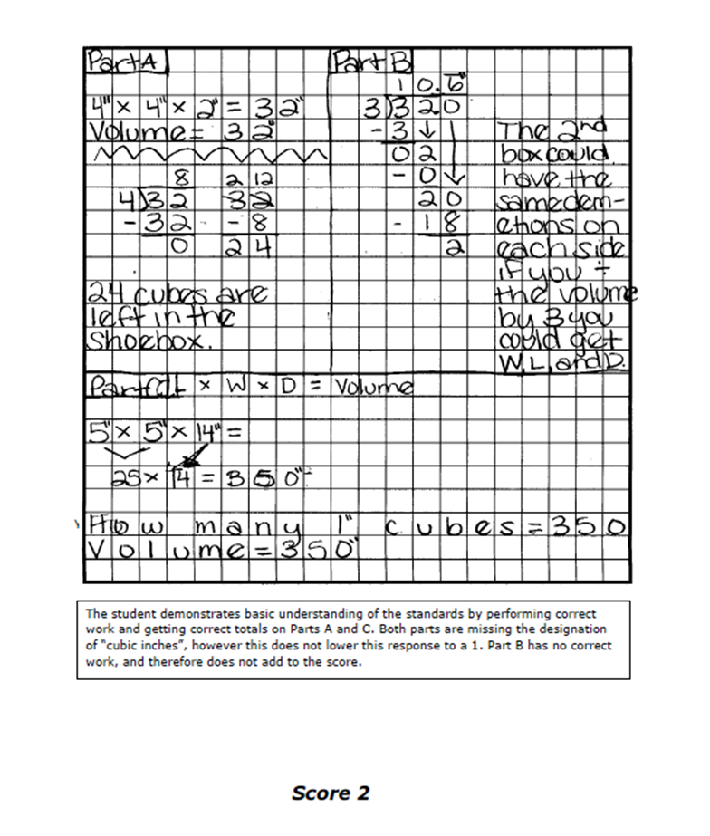
Student Anchor Papers
Student Response
Scorer’s Annotation
Score based upon rubric

Slide 11
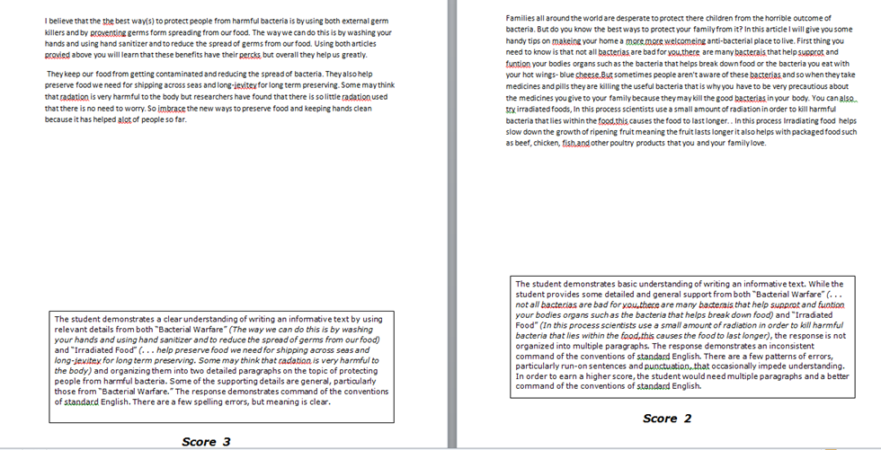
Student Anchor Papers

Slide 12
District, School and Teacher Functions

Slide 13

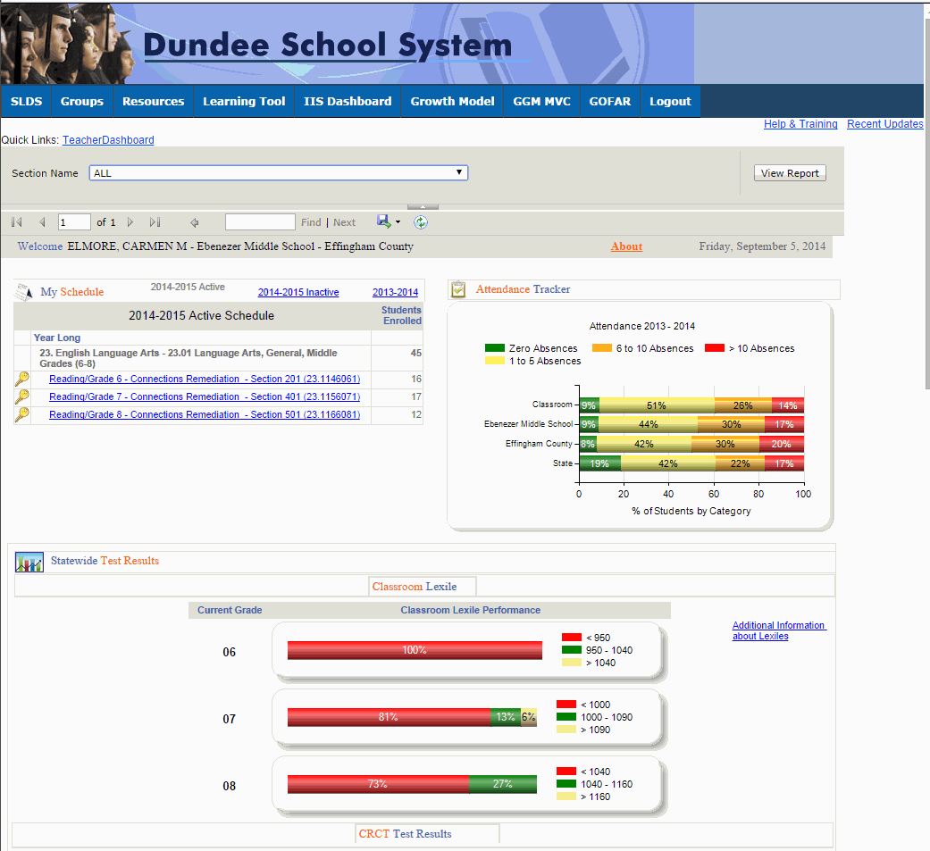


GOFAR Access for District,
School and Teacher
Log on to your Student Information System (SIS). Select the State Longitudinal Data System (SLDS) link. The SLDS main window opens. Click GOFAR on the menu. The GOFAR main window appears.
 | This is the default view for the Teachers dashboard. The Teacher may view a variety of reports related to the test assessments in this window.

Slide 14
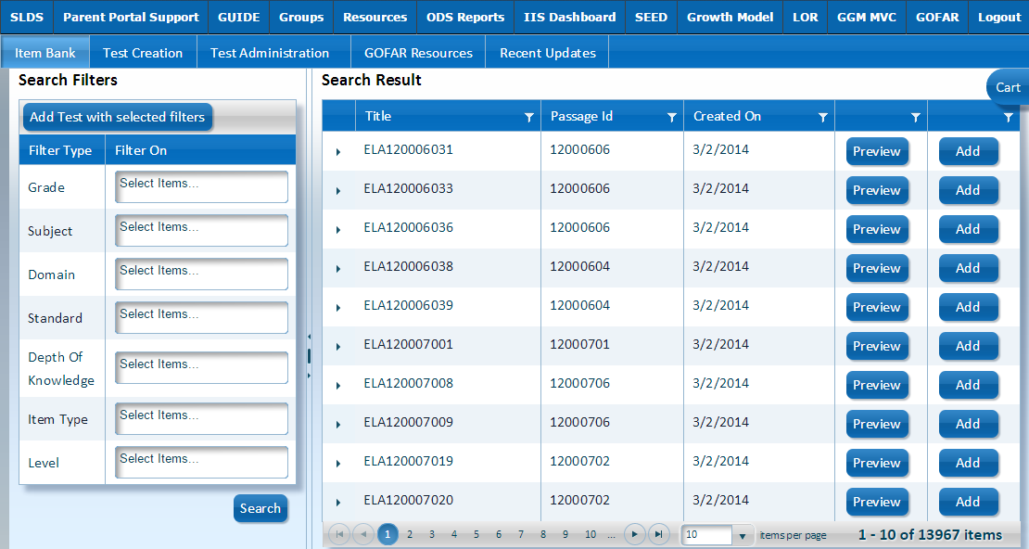
GOFAR Main Window
The Item Bank contains all the items available for a teacher to create a student test. The Item Bank tab is the default view when accessing the GOFAR system.
 | This is the landing page for teachers using the GOFAR system.

Slide 15
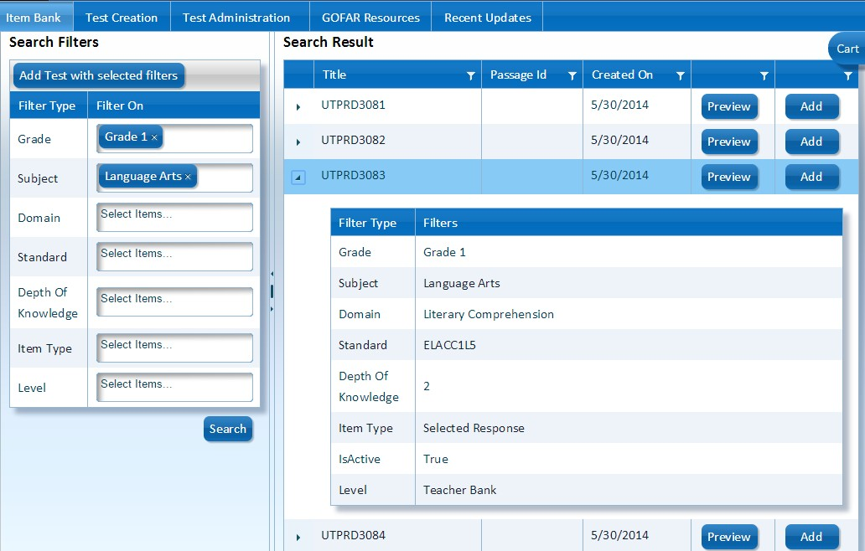
Viewing the Metadata in the Item Bank
Click the arrow next to the item title to expand and view the metadata for that item. Click the arrow again to collapse the filter information.
Click the arrow to expand or collapse the filter data for the test item.

Slide 16

Viewing a Test Item
Click Preview to view a test item. The test item appears in the Question Preview box.
Click Preview to view the test item.

Slide 17
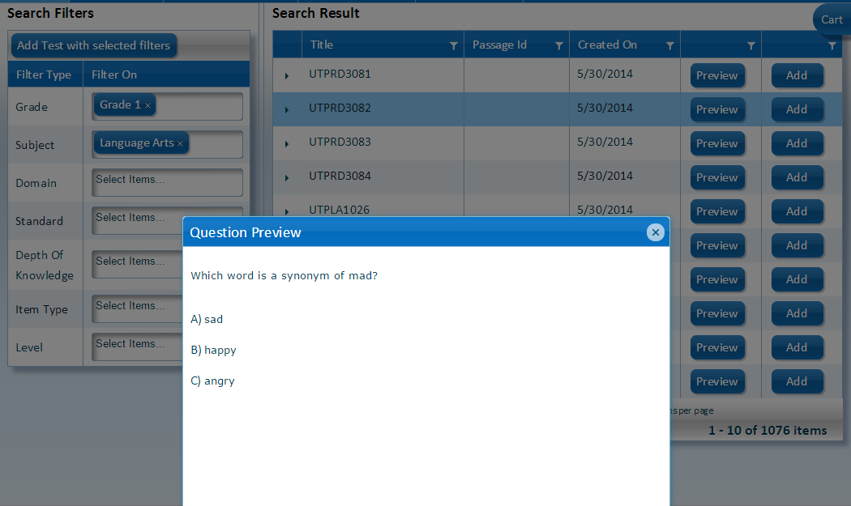
Preview a Selected Response Test Item
View the contents of Question Preview box to see the test item. Click the X to close the Question Preview box.
Click the X to close the Question Preview window.

Slide 18
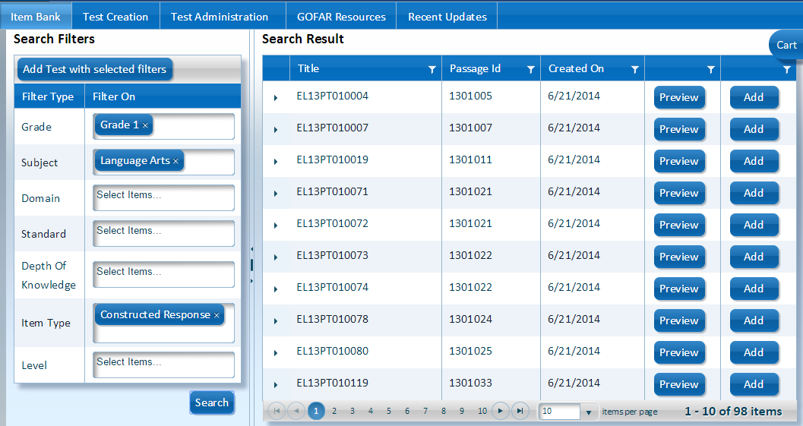
Preview a Constructed Response Test Item
From the Item Bank under Search Filters, select Constructed Response from the Item Style list. Click Search. Under the Search Result list, click Preview in the desired row.
Click Preview to view the Constructed Response item.

Slide 19
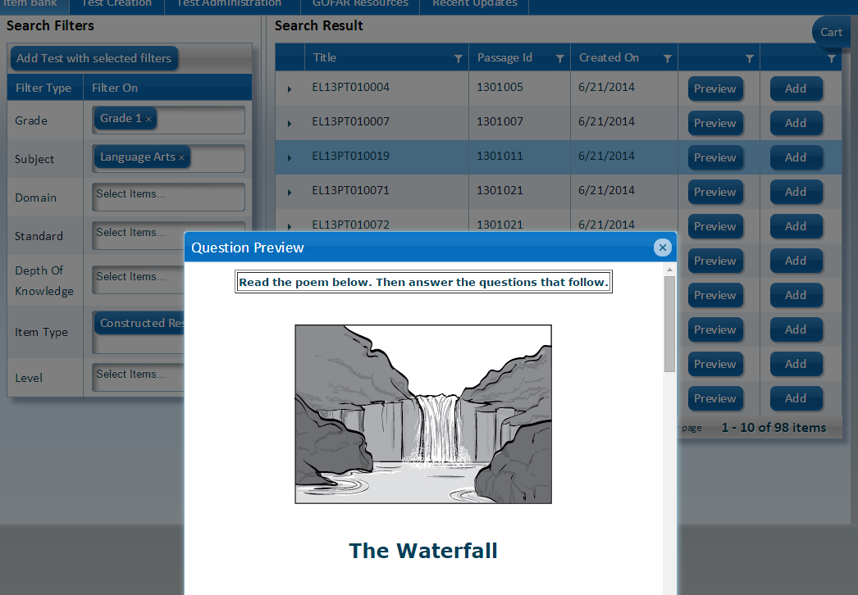
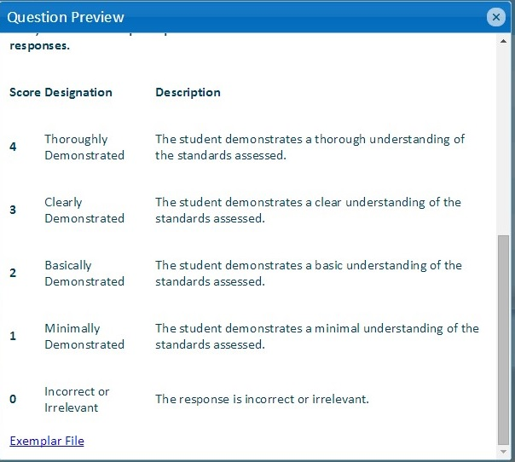
Preview a Constructed Response Item (cont’d)
The Constructed Response question is shown in the Question Preview box. | Scroll down to view the rubric. Click the X to close the Question Preview box.

Slide 20
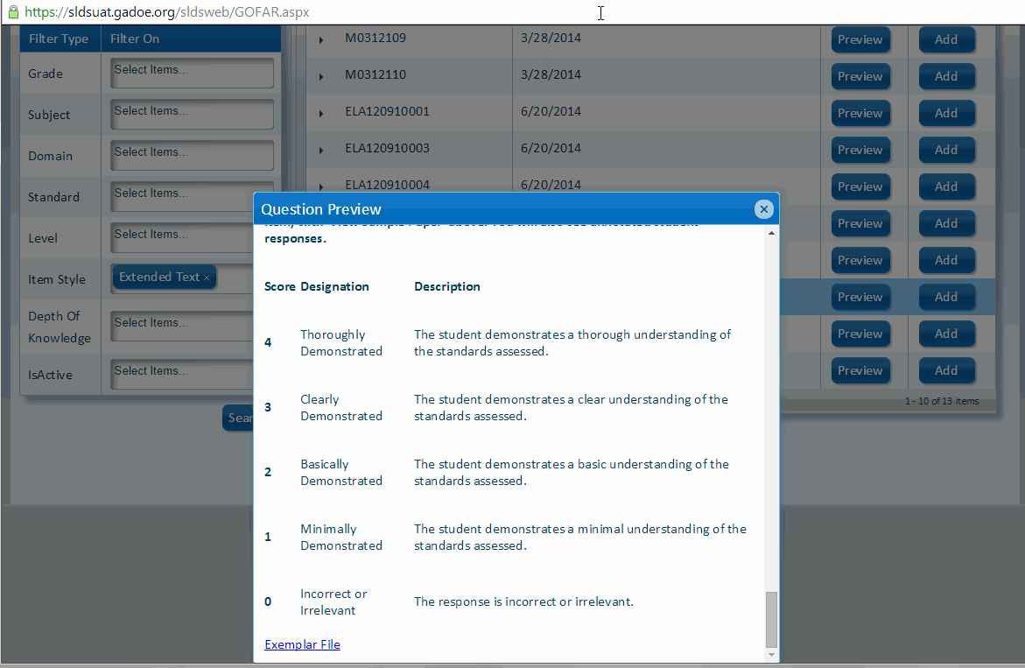
View Exemplar File
An Exemplar file contains a set of responses from actual Georgia students, that were scored by trained raters using the rubric posted. These papers allow teachers to review and compare their own students’ work to the sample responses for each score point which will help standardize expectations of the standards.
To view an Exemplar File, perform the following tasks. From the Item Bank window, under Search Filters, select the Constructed Response option from the Item Style. Click Search. Click Preview in any row of the Search Results list. The Question Preview window appears. Scroll down to the bottom of the question until you see a link for the Exemplar File. Click the Exemplar File link. A window opens with the Exemplar file.

Slide 21
Create a Test using TestPad

Slide 22
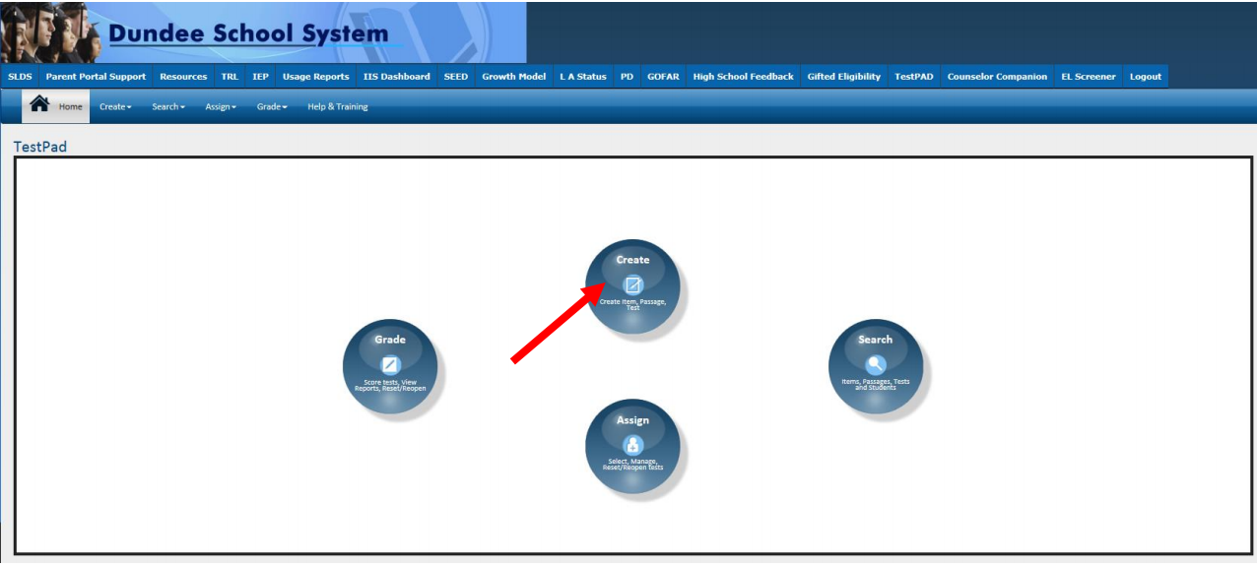
Landing Page

Slide 23
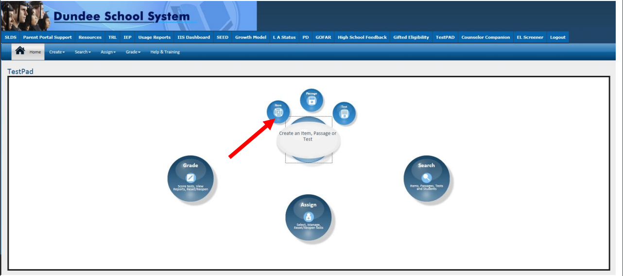
Create an Item

Slide 24
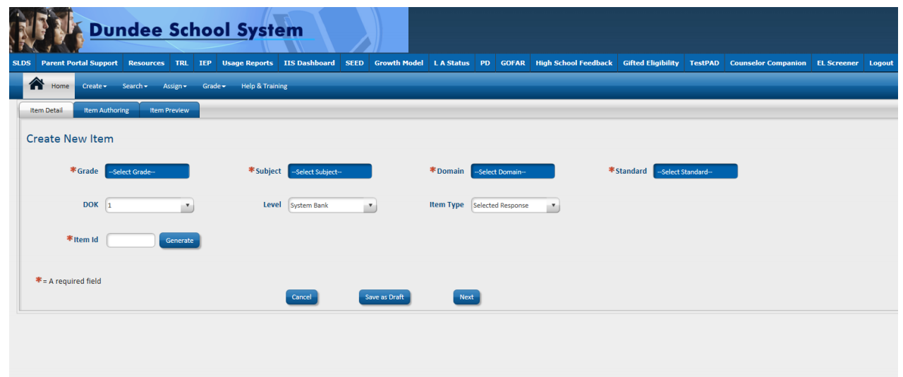
Item Detail Screen

Slide 25
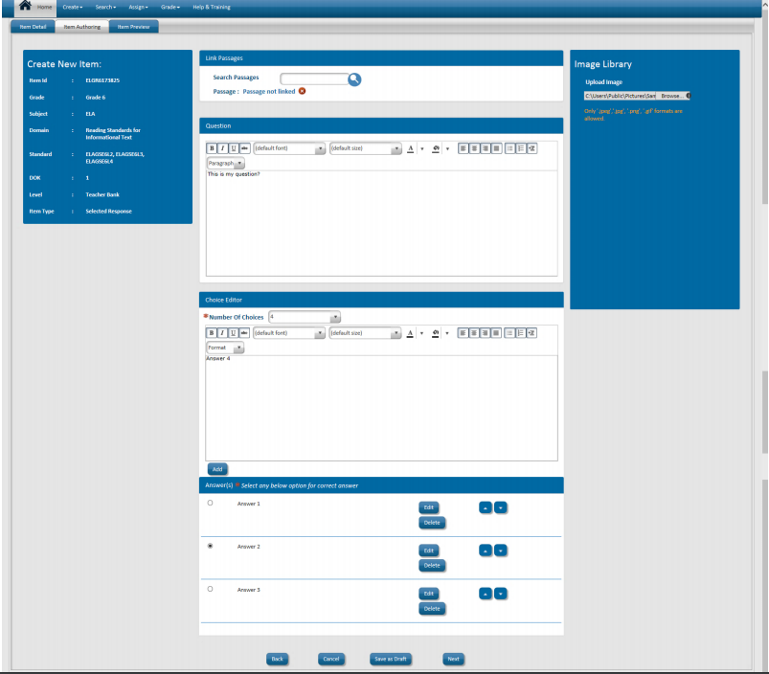
Item Authoring Screen

Slide 26
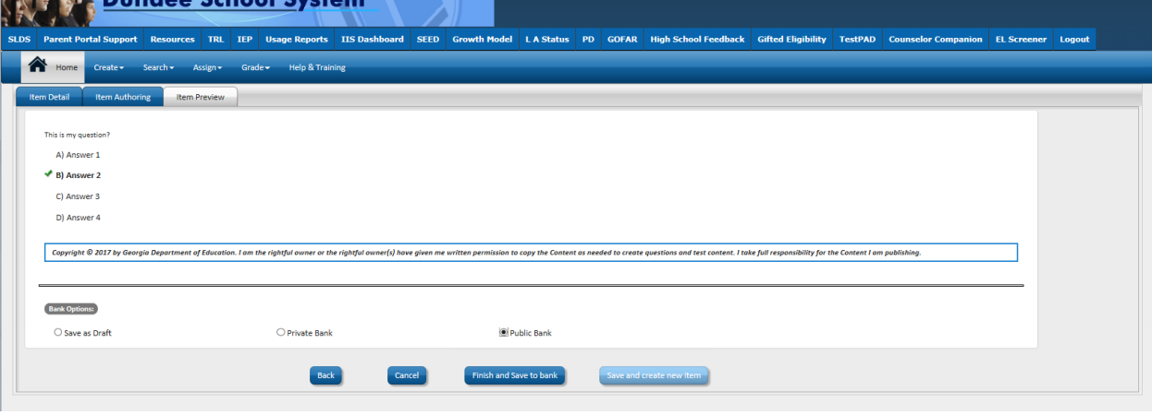
Item Preview Screen

Slide 27
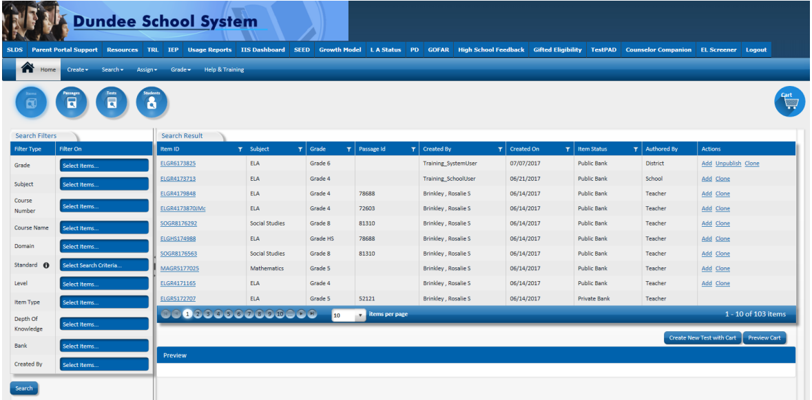
Item Bank

Slide 28
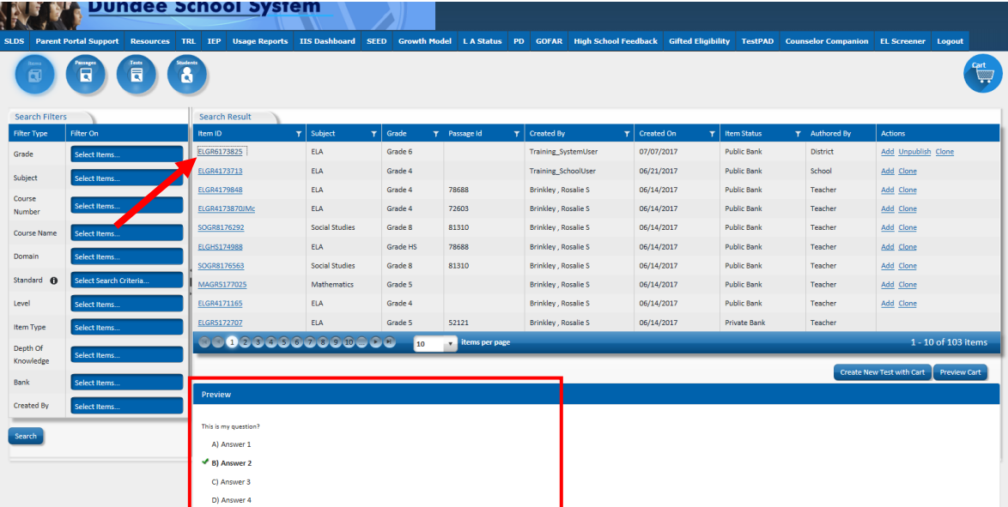
Preview Item

Slide 29
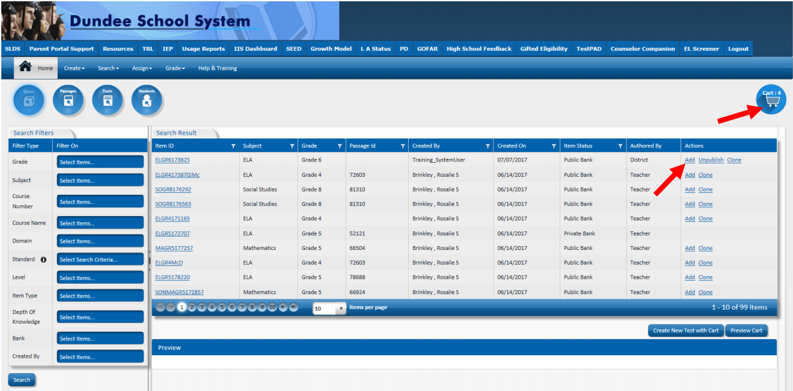
Add Items to Test

Slide 30
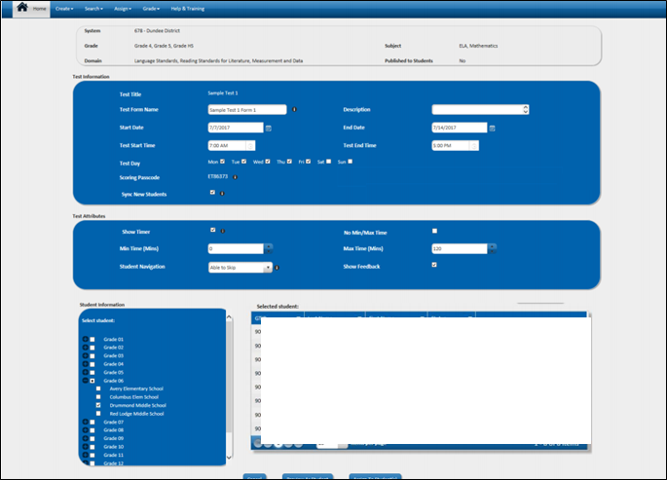
Assign Test

Slide 31
Finding Assessment Resources

Slide 32
Assessment Resources
Georgia Milestones Item and Scoring Samplers
  www.gadoe.org/milestones
EngageNy – Released test items
  https://www.engageny.org/resource/released-2017-3-8-ela-and-mathematics-state-test-questions
  Terms of use
    https://www.engageny.org/terms-of-use

Slide 33
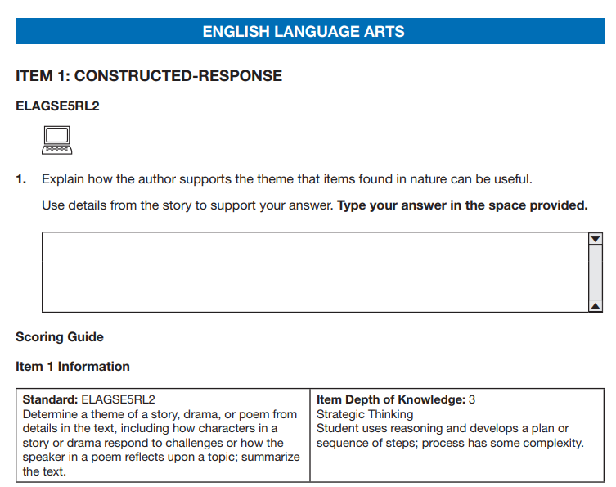
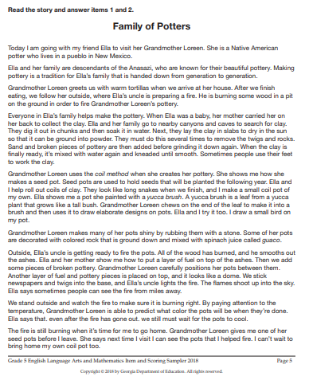
Item and Scoring Sampler

Slide 34
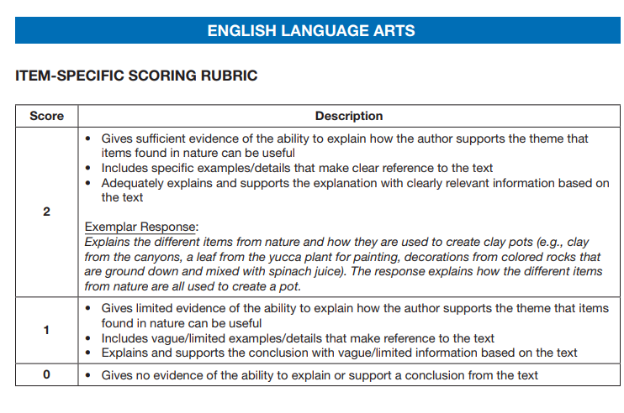
Item and Scoring Sampler

Slide 35
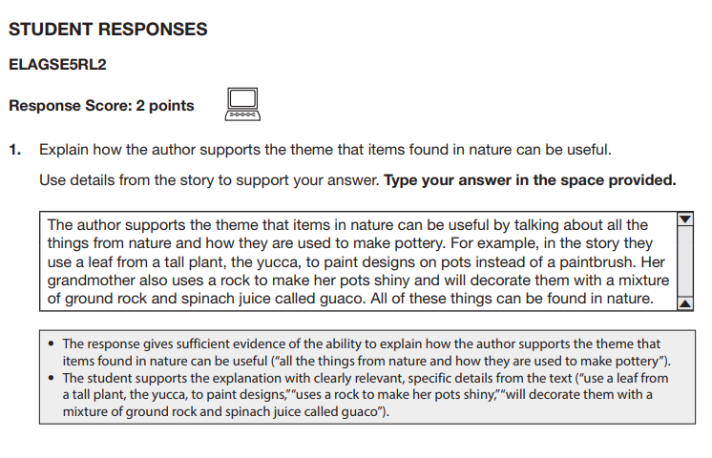
Item and Scoring Sampler

Slide 36
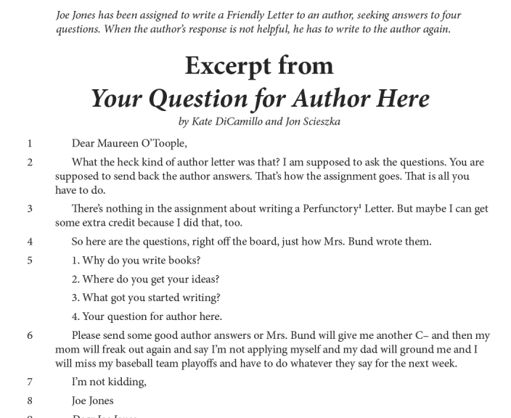
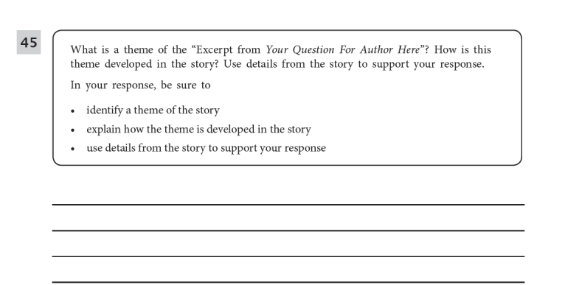
EngageNY Item

Slide 37
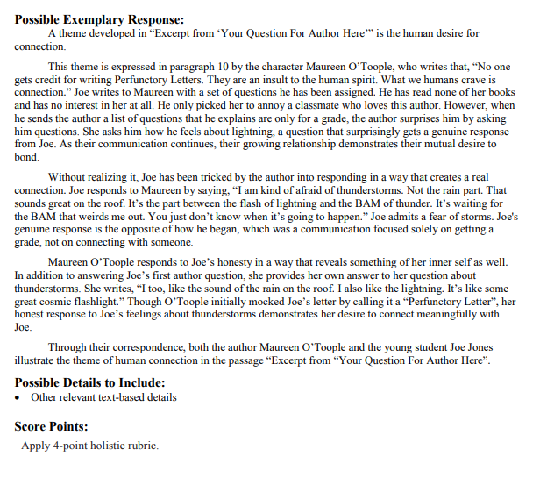
EngageNY Item

Slide 38
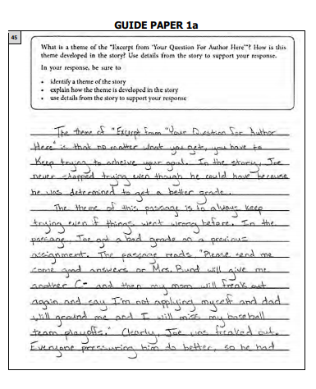
EngageNY Item

Slide 39
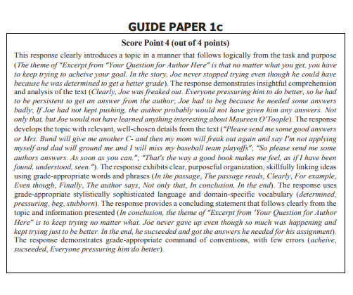
EngageNY Item

Slide 40
Released Item Activities
Share with students
Create mini benchmarks
Create your own test items
Develop standard schoolwide scoring
Design and develop rubrics

Slide 41
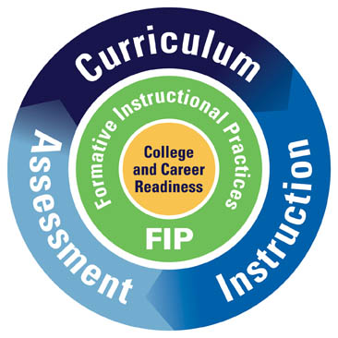
GA FIP:
Online Professional Learning
Classroom-based Formative Assessment
2018 GaDOE Data Collections Conference
August 22, 2018

Slide 42
Today’s Topics
Engaging Scenario - Video
Define GaDOE’s Formative Instructional Practices(FIP) online professional learning
State location to download district and school FIP access codes
Discuss options for implementing FIP so leaders and teachers can improve their practice to increase student learning
Share that the appendix section of this PPT provides data and anecdotal feedback from Georgia teachers who participated in FIP professional learning in 2017-2018

Slide 43
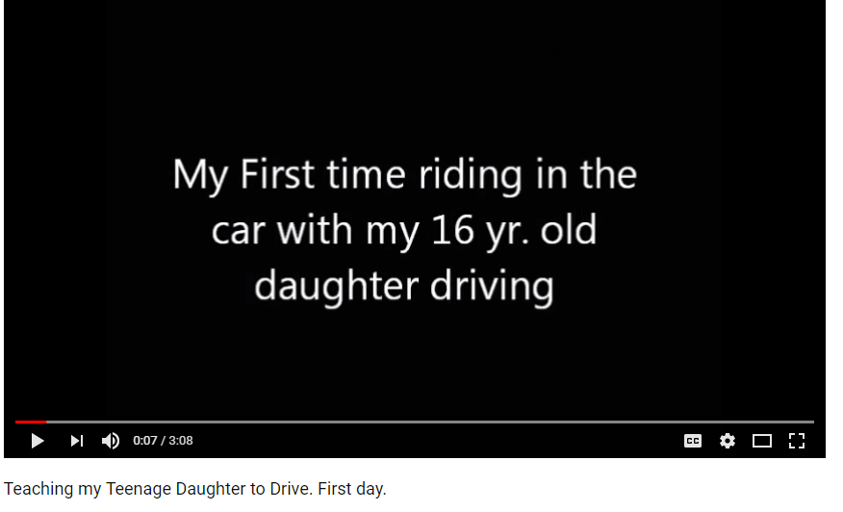
Take mental notes when you watch the clip …
Link to Video: Learning How To Drive

Slide 44
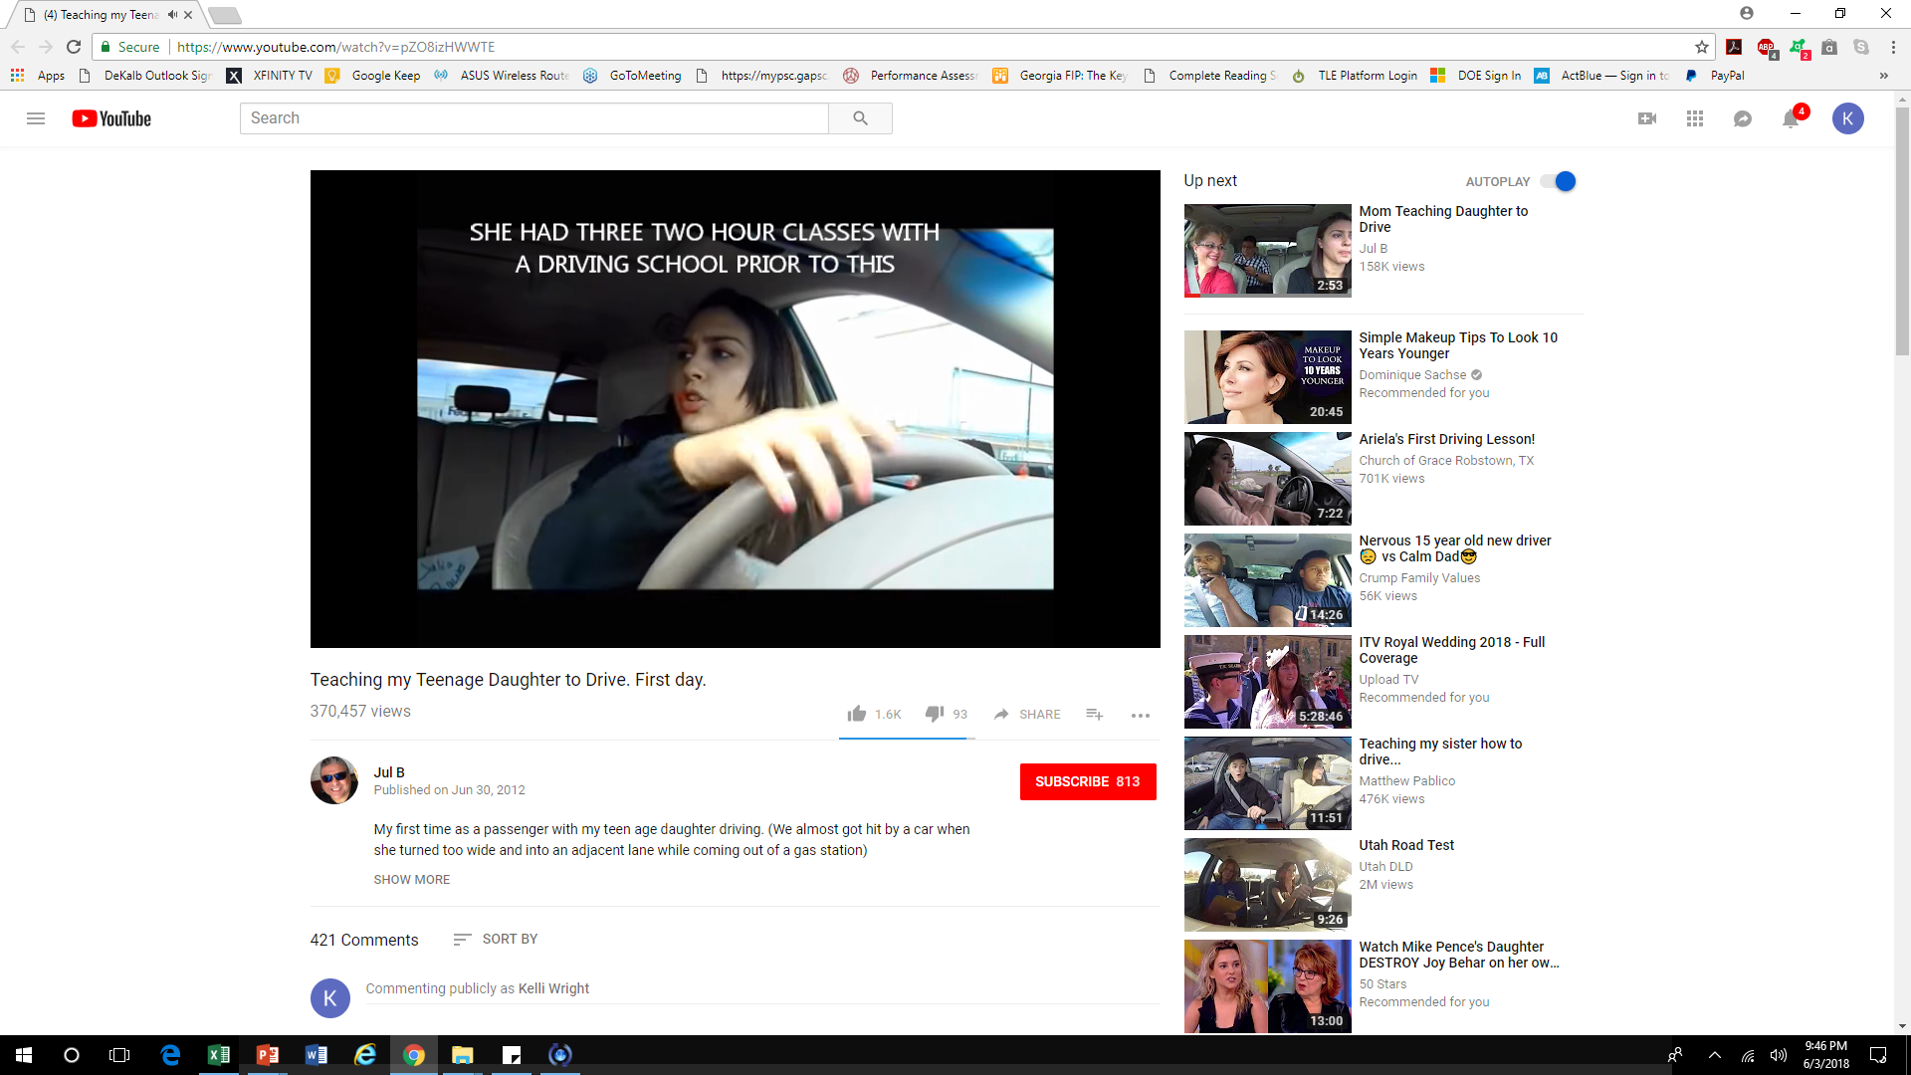
Is this video a good example of formative assessment?

Slide 45
Key Observations from Video
What aspects make this video a good example of formative assessment?
Dad: “Brake…you’re doing good.”
Daughter: “I’m going, like zero.”
Dad: “See the car on the left.”
Dad: “Turn a little slower.”
Dad: “Stay on the other side of the divider.”
Daughter: “I am scared to go and dip into that lane.”
Dad: “Go into that lane.”
Daughter: “I can’t.”
Dad: “You can’t go so wide.” “Relax a little bit.”
Dad: “Nothing happened, it was close…they have breaks too.”
Dad: “Give it a little gas…you’re almost home, girl!”

Slide 46
What is GA FIP?

Slide 47
GA FIP Online Professional Learning
GA FIP (formative instructional practices) is an online professional learning resource with 26 individual course options for K-12 educators and USG faculty and students to learn how to use the practices with students.
FIP refers to the formal and informal ways that both teachers and students collect and respond to evidence of student learning during instruction and use the evidence to facilitate greater student learning.
Key professional learning content includes: (1) using clear learning targets, (2) collecting, analyzing and using evidence of student learning, (3) using effective feedback, and (4) developing student ownership of learning.
FIP Participation from July 2013 to April 2018
Organization | Individual Online Learning Accounts | Accounts with Actual Course Enrollments
K-12 Districts | 53,340 | 53,545
Colleges of Education | 1,631 | 1,632
GaDOE | 106 | 120

Slide 48
How will the assessment results be used?
Instructional
Predictive
Evaluative
Tell me how students are likely to perform on the end-of unit or end-of year assessment?
GOFAR
Tell me how well my students are learning and how to improve my next lesson?
GA FIP
Tell me which instructional program, approach or teacher was most successful this year?
GA Milestones Assessment System
Formative
Formative
Summative
160 days 10 days Your Testing Window
Adapted from: Gong, B., Marion, S. & Perle, M. (2007). A framework for considering interim assessments. Denver, CO: National Center for the Improvement of Educational Assessment.

Slide 49
GA FIP
All Course Series Flyer http://www.gadoe.org/Curriculum-Instruction-and-Assessment/Assessment/Pages/GeorgiaFIP.aspx

Slide 50
Dylan Wiliam’s final comment… http://www.dylanwiliamcenter.com/webinars/
Where is the “HOW?” Many of my fellow
teachers and I understand the need for
more rigor and challenging our students
to help them achieve. We get it. What
is lacking is the “how.” How is teaching
with the new standards different from
teaching with the old?
Teachers need models and training to
help them step back to the role of skilled
facilitators, to guide students to take
ownership of their own learning.
Source: Marzano, R. J. and Toth, M. D. (2014). Teaching for rigor: A call for a critical instructional shift. West Palm Beach, FL: Learning Sciences International.
http://www.marzanocenter.com/essentials/mini-whitepaper-dl/?mkt_tok=3RkMMJWWfF9wsRokv63BZKXonjHpfsX54%2BwoXKe0lMI%2F0ER3fOvrPUfGjI4CSMNmI%2BSLDwEYGJlv6SgFQrbFMbRh0LgKXhY%3D
10 years of deliberate practice is required to become expert for other domains as well as teaching
Even the best teachers need to practice to become better
Most teachers make exponential improvement in years 1 to 3, and often go into auto-pilot mode if not pushed and encouraged to get better
Some teachers are motivated to get better on their own
Create the conditions for teachers continue to improve well beyond their current levels

Slide 51
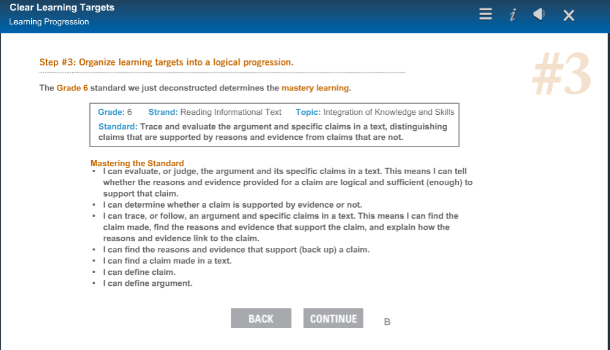
Deeper Look at Example of FIP Online Learning Content:
Creating, Using and Assessing Clear Learning Targets
ELAGSE6RI8
Learning targets and the learning sequence come from the standards.
Each learning target is intentionally planned for instruction and formative assessment.

Slide 52
FIP Course Participation Data
From July 1, 2017 to May 30, 2018, there were 14,078 course completions out of 15,086 course enrollments (93%).
Note: Each year since 2015, the annual FIP course completion rate has increased.

Slide 53
Accessing FIP Online Learning

Slide 54
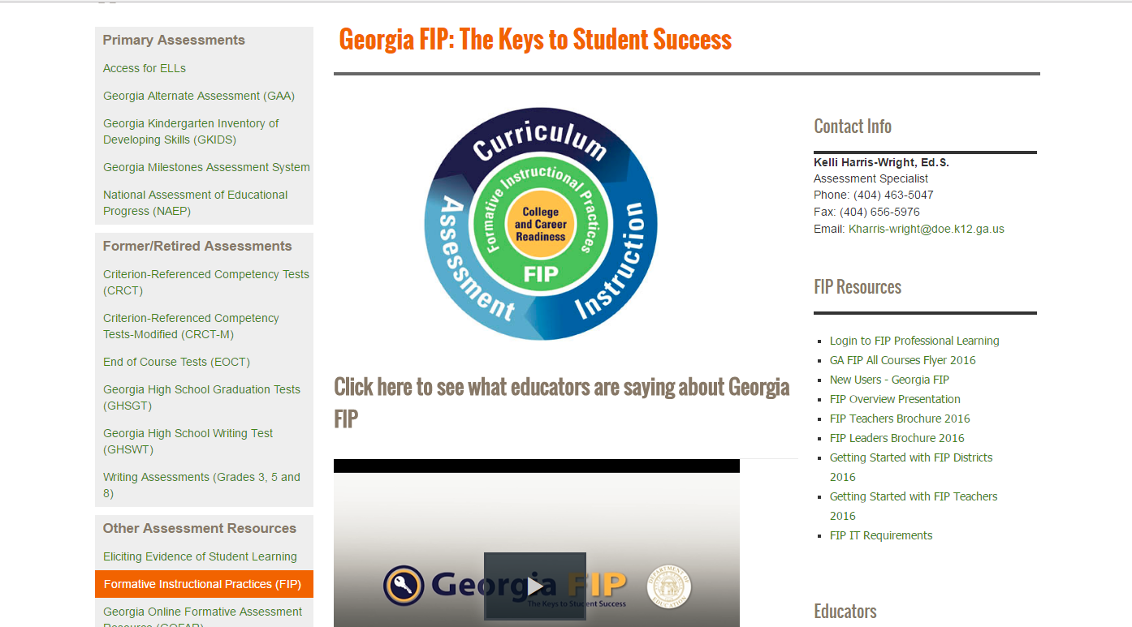
Revised FIP Courses http://www.gadoe.org/Curriculum-Instruction-and-Assessment/Assessment/Pages/GeorgiaFIP.aspx
(unique access codes per district and school (in the GaDOE Portal account of the district’s Test Coordinator of record with GaDOE), and for each College of Education in the USG system)

Slide 55
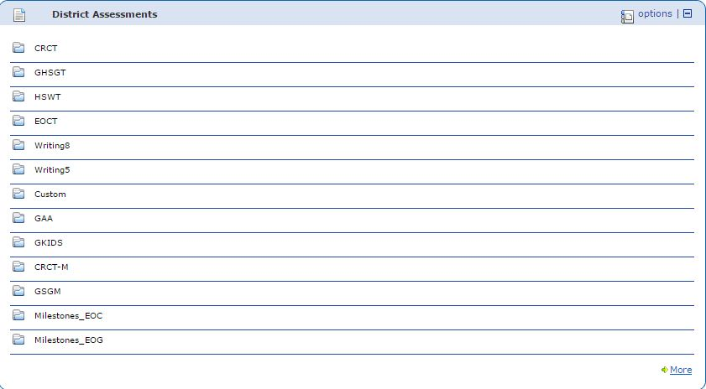
Where are My FIP Access Codes?
GaDOE Portal Account
Go to District Assessment. Look in the “Custom Folder” for zip files of FIP Administrative and Learner Access Codes.

Slide 56
Two Types of FIP Access Codes
(FIP portal populates when accounts are created with the appropriate role-based access code and the educator’s district email address)
FIP Access codes are unique to each district and each school.
Codes have the three-digit district code and/or the four-digit school code embedded in the location-specific FIP access code.
Administrative Access Codes end with “-P” (999-0575-B81-P)
Administrative accounts allow the leader to take FIP courses and engage in online monitoring of the faculty’s course progress through the “Management and Reports” tab that IS NOT available FIP Learner accounts.
Learner Access Codes end with “-FP” (999-0575-FP)
Central Office has a FIP Administrative Access Code, and a Learner Access Code.

Slide 57
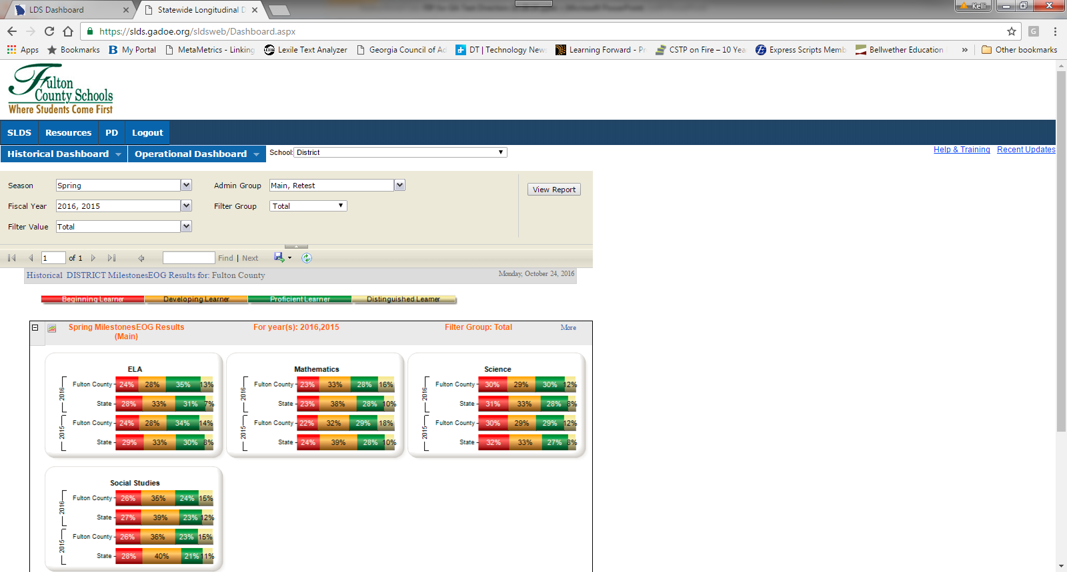
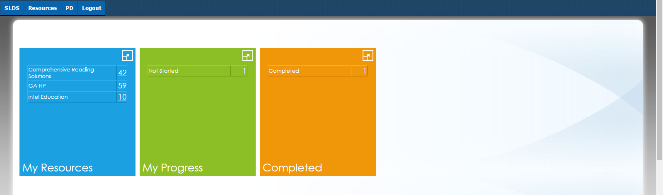
Original 2013-2015 FIP Modules can also be accessed through the PD tab in the SLDS without using unique access codes.

Slide 58
GA FIP - “How to do it”

Slide 59
Implementing FIP
Option 1: RESA-facilitated:
14 RESAs opted to partner with GaDOE in 2018-2019 for FIP professional learning using PLCs. Educators take and complete online courses prior to PLC meetings with RESA FIP Facilitators. RESA-led discussions and group activities clarify and deepen FIP course content for teachers, coaches and leaders. Goal setting allows educators the opportunity to plan use of FIP processes in their district or school. Contact your RESA regarding this option. RESAs most often facilitate the five (5) FIP Foundations Courses, but also embed content from any of the other 21 course options into PLCs as needed. RESAs can also support targeted PLCs, such as, Gifted and TAPP teachers.
Option 2: District or School-Determined:
The district and/or school independently plans an implementation based on needs. GaDOE can provide guidance and feedback about the plan, if requested.

Slide 60
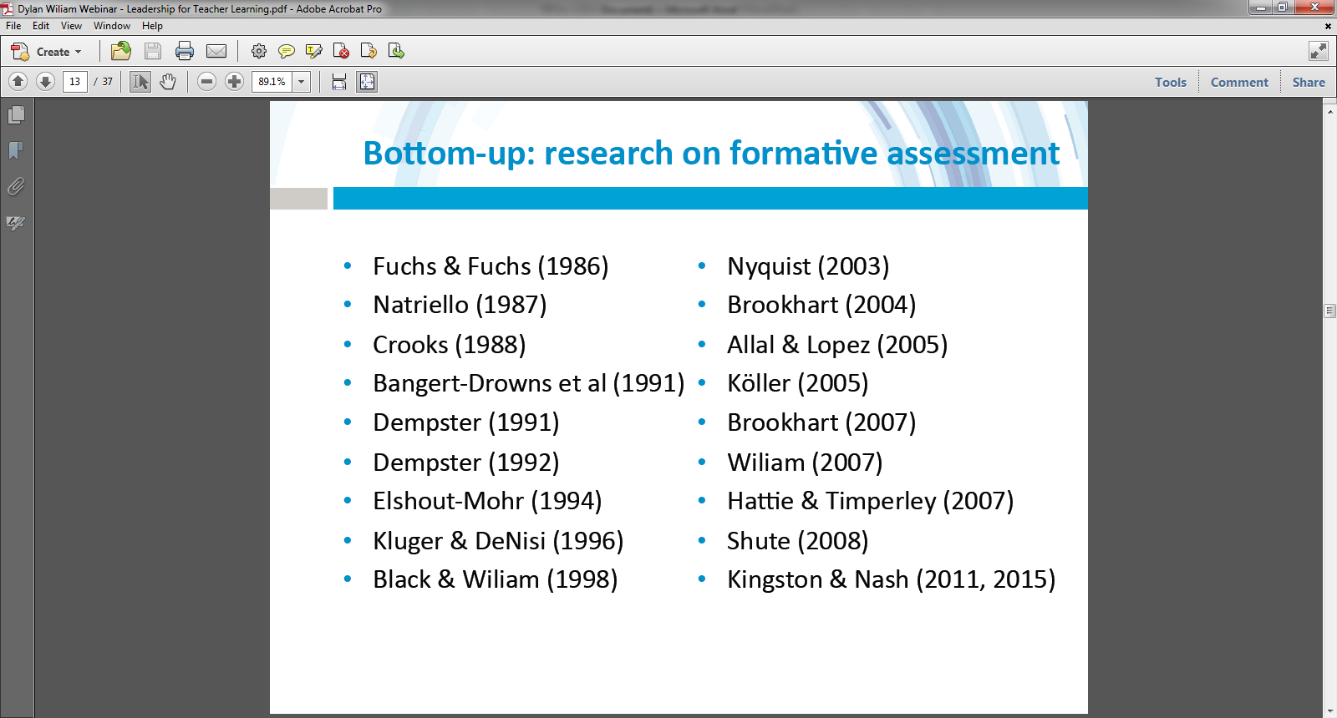
Tier 1 evidenced-based research tells us that the best way to improve student learning is to help teachers learn to use formative instructional processes well.
http://www.dylanwiliamcenter.com/webinars

Slide 61
Georgia Department of Education FIP Team
Dr. Allison Timberlake
Deputy Superintendent
Assessment and Accountability
404.651.9405
atimberlake@doe.k12.ga.us
Dr. Sandy Greene, Director
Assessment and Accountability
404.656.0478
sgreene@doe.k12.ga.us
Kelli Harris-Wright, Ed.S.
Assessment Specialist - GA FIP
404.463.5047
kharris-wright@doe.k12.ga.us

Slide 62
Appendix
2017-2018
FIP Teacher Feedback Survey

Slide 63
2017-2018 FIP Teacher Feedback Survey (10 Questions)
Please identify the Regional Education Service Agency (RESA) that supports your school district.
Please select one answer choice below that best describes your role as an educator.*
How were you initially made aware of Georgia FIP online professional learning?
Please check the appropriate box to indicate your current status in GA FIP professional learning OR identify ALL GA FIP online learning courses that you have completed.*
Please rate your perception of the usefulness of the content in Georgia FIP to your classroom work with students. *
Please rate your perception of the usefulness of learning about FIP through a professional learning community (PLC)?
Please list any changes that you've made in your work that is a direct result of participating in Georgia FIP professional learning. If you have not made any changes to your teaching practice, write N/A. *
If you serve as the Instructional Coach/Teacher-leader for Georgia FIP professional learning, please rate your experience using the Facilitators' Guides and Resources.
Please share any additional feedback about your experience with Georgia FIP professional learning in the comment box below. If you have not taken FIP courses, enter N/A.
What suggestions can you share that would enhance GA FIP professional learning?

Slide 64
Teacher Participation in 2017-2018 FIP Feedback Survey (in progress)
N = 460
Q2: Please select one answer choice below that best describes your role as an educator.*
Answer Choices | Responses
Pre-Kindergarten Teacher | 4 (0.89%)
Elementary Teacher | 164 (36.61%)
Middle School Teacher | 79 (17.63%)
High School Teacher | 120 (23.18%)
Special Education Teacher | 47 (10.49%)
Special Area Teacher (Title I, Intervention, Gifted, Music, CTAE) | 22 (4.91%)
Instructional Coach or Teacher-Leader | 12 (2.68%)
Total: | 448 (97%)
Note: 12 other educators used the comment field to self-identify as either a
District Administrator, Curriculum Director, ELL Teacher, RESA Staff, CTI Coordinator, Media Specialist or Paraprofessional.

Slide 65
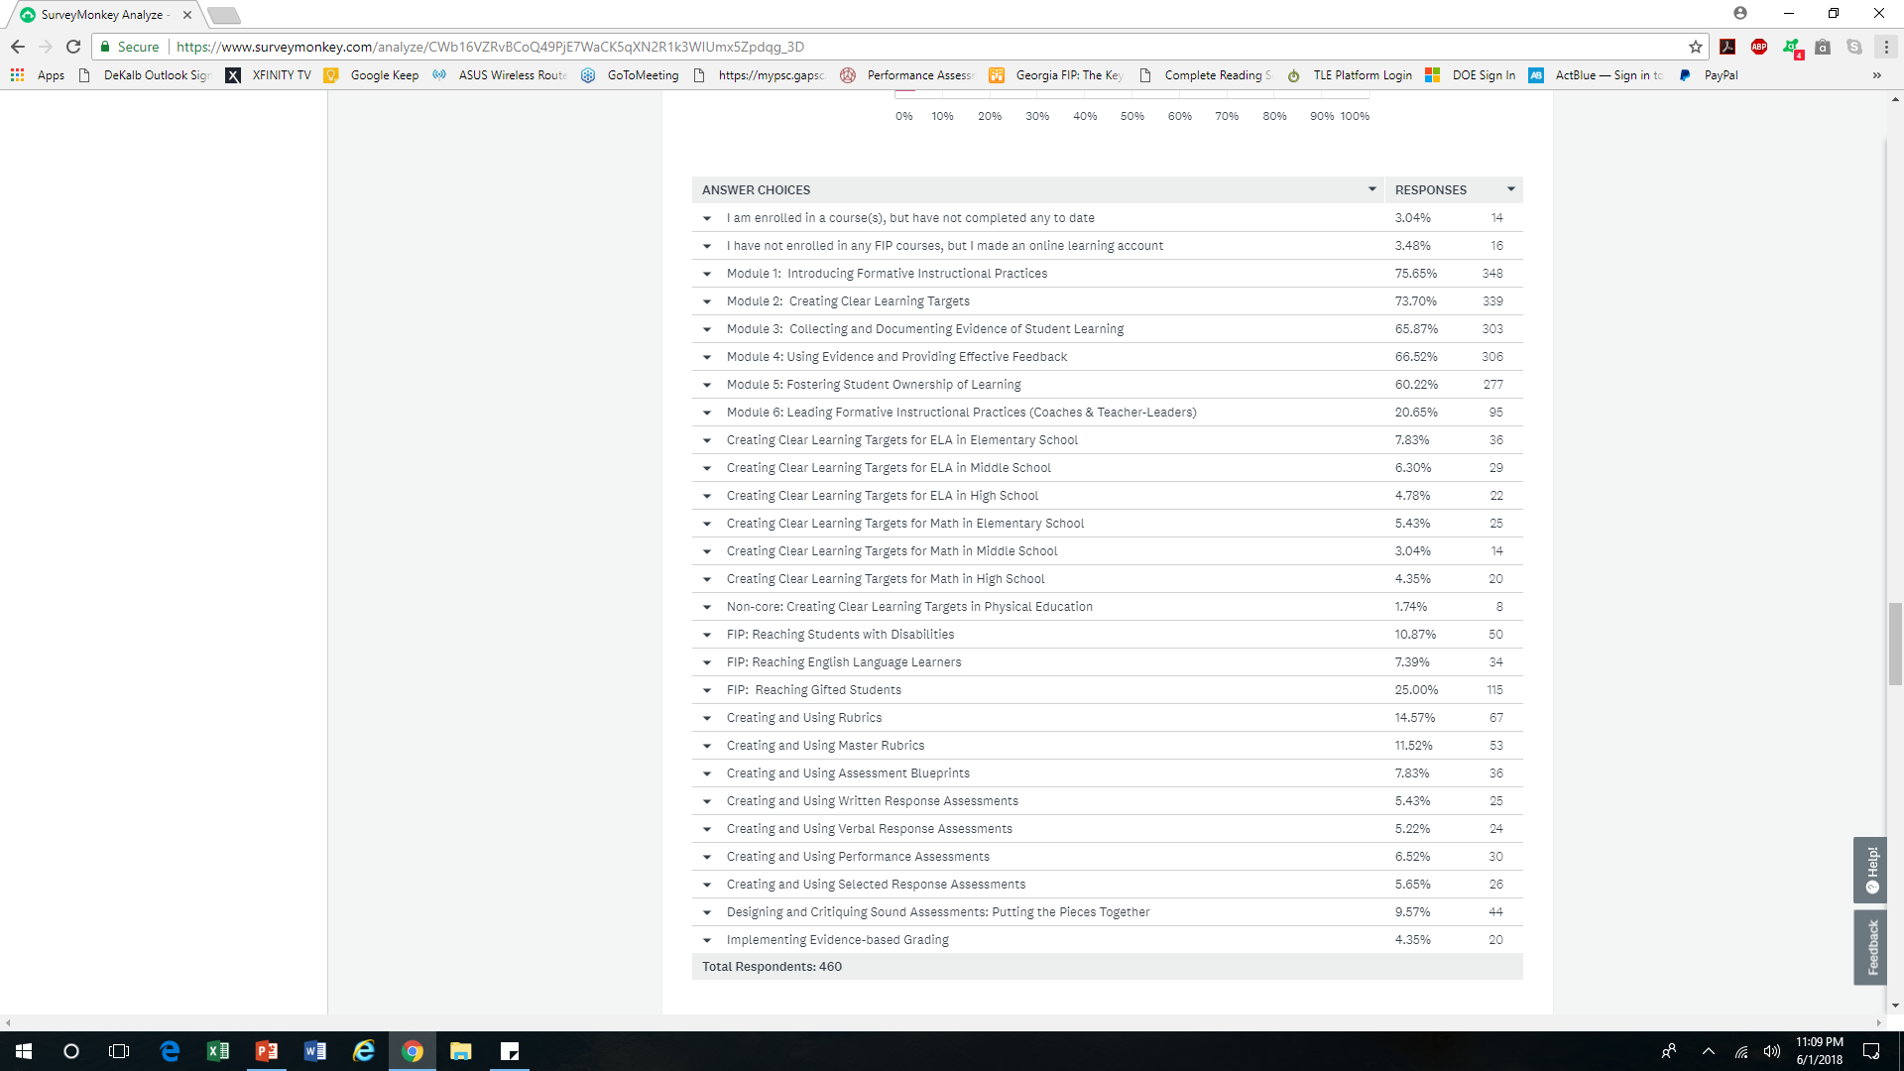
Q4: Please check the appropriate box to indicate your current status in GA FIP professional learning OR identify ALL GA FIP online learning courses that you have completed. *

Slide 66
2017-2018 Teacher Survey about FIP (still in progress)
Q5: Please rate your perception of the usefulness of the content in Georgia FIP to your classroom work with students. *
91% of 460 teachers reported that FIP professional learning has been useful to their classroom work with students as of 5-31-18.
Answer Choices | Responses | Number
Highly useful to my classroom practice | 41.30% | 190
Moderately useful to my classroom practice | 49.78% | 229
Not useful to my classroom practice | 6.96% | 32
Not applicable because I serve in another role | 1.96% | 9
Total | 100% | 460

Slide 67
Sample Teacher Comments Q5
My students were able to see how they were going to be scored in a real life situation. They are served in an MID classroom and are on a modified rubric for their grades.
The information was excellent, presented in a quality manner, and directly applicable to what I am doing. Now, I just have to incorporate it into my teaching practices.
By using formative practices, I am able to tell how successful the students are with the current standard/element which is being taught. By providing effective feedback, the students are able to learn from their mistakes and we are able to discuss what they do not understand. Students are able to show ownership in what they have learned by verbalizing their reasons for choosing their answers which allows for discussion with effective feedback being utilized.
This course should be presented before a new teacher steps into the classroom. Great material.

Slide 68
Sample Teacher Comments Q5
I made a rubric for a semester project using the three column style, and it is very clear on where I should grade.
I have used what I learned in FIP to write student friendly Learning Targets that I use everyday. In addition, I wasn't sure how to collect or use data. I have created a tracking sheet for students to track their data, but for me to use to guide instructions. Furthermore, I would not create rubrics for assignments but find them extremely helpful when assigning projects.
I found the content in Georgia FIP to be useful in my classroom practice; however, with co-teaching I also have to adapt and work with the general education teacher (who may not be as receptive to new ideas).
I found the information very helpful, but am still struggling to find a way to incorporate the use of rubrics in high school mathematics with my students. My students have issues with communication and social interactions and therefore, peer assessment and self-assessment are also difficult for them.
The information is good, but we do not have time to plan and use the modules correctly. Our time only allows for compliance.
I wish there was more time to implement.

Slide 69
Q7: Please list any changes that you've made in your work that is a direct result of participating in Georgia FIP professional learning. If you have not made any changes to your teaching practice, write N/A. *
Of the 460 responses received as of 5-31-18 for Q7, 35 participants or 6% indicated that they have not made changes in their teaching practice as a direct result of participating in FIP online professional learning.
Response | Number
N/A | 13
“None” | 21
“Not Much” | 1

Slide 70
Q7: Please list any changes that you've made in your work that is a direct result of participating in Georgia FIP professional learning. If you have not made any changes to your teaching practice, write N/A.
I have created more specific learning targets. Scaffold learning targets for SPED students.
I have including more opportunities for student to self assess their work.
I make sure my students are aware of the learning targets and what goals we are trying to achieve. I am also trying to do a better job about making the students think and reflect on their learning.
Students in my class often peer and self assess their work because FIP has taught me the importance of student buy in.
I changed the way I created rubrics and what assignments needed rubrics.
Returned assignments more promptly with more appropriate and detailed feedback
I have modified my formative assessments to be more explicitly aligned with learning targets.
Better helping students to take ownership of learning, also a better understanding of student friendly learning targets, documenting evidence of student learning.
I am looking into changing the way I create assessments. I plan to start grouping questions by learning target to help myself and students see what they know and what they need help with.
It has made me more aware of how decisions in my lessons affect my students.
After participating, I have made sure to really break down my standards to the students and place a greater role on each one to track their understanding.

Slide 71
Contact Information
Questions Regarding GA FIP Online Professional Learning contact:
  Kelli Harris-Wright
  404-463-5047
  kharris-wright@doe.k12.ga.us
Questions Regarding GOFAR’s Content & School/System Usage contact:
Joseph Blessing
  404-232-1208
  jblessing@doe.k12.ga.us
Questions Regarding GOFAR’s Functionality/Technical Support contact:
GaDOE Help Desk
  1-800-869-1011
  gofar.support@doe.k12.ga.us​ ​

Slide 72
Questions

