Slide 1
Georgia Student Assessment Program
2019-2020
Fall Assessment Conference August 6, 2019
Fall Assessment Conference August 8, 2019
Notes:
Welcome to the Fall Assessment Conference, Part 1. We welcome you to this new school year and hope that all goes well as your students return.
We are adding a new feature to our PowerPoints. The links to each session have been added to the title page. Those who have registered for sessions will receive a recording link. Please note that the PowerPoint may be downloaded from the Testing/Assessment website. Please feel free to share this with your colleagues.

Slide 2
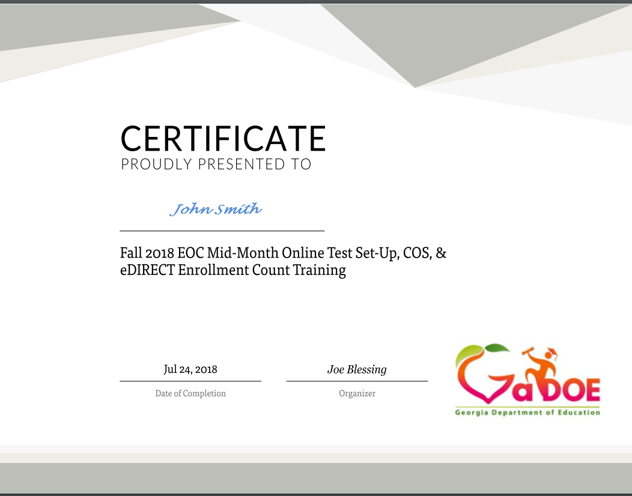
Webinar Series
System Test Coordinator (STC)
All webinar recordings are available the day after the presentation. Click on the original registration link for any Assessment webinar to access the recording.
  August 6 (9 – 11 a.m.): https://attendee.gotowebinar.com/register/6459895095400454403
  August 8 (1 – 3 p.m.): https://attendee.gotowebinar.com/register/1593028920840745987
Certificates are sent from GoToWebinar after live training sessions. Those watching recordings will not receive a certificate.
Notes:
As a reminder, the webinar recordings are available the day after each presentation. You may click on the original registration link for any assessment webinar to access the recording. As noted, we will be embedding the recording link in the date on the title slides as well for convenience. As a reminder, certificates are sent from GoToWebinar to the individual who registered for the session but only after live training sessions. Those watching the recordings and not the live sessions will not receive a certificate.

Slide 3
Agenda
Overview of State Assessments
Formative Assessment Resources
Duties and Responsibilities of a System Test Coordinator (STC)
Test Security
Questions
Notes:
As many of you know and to you new test coordinators, the Fall Conferences are divided up into three parts. Fall Assessment Conference, Part 1, is focused on an overview of the state assessments; formative assessment resources and tools, duties and responsibilities of a System Test Coordinator, and a review of test security and related best practices across the assessments. Part 2 will primarily focus on developing and implementing your district assessment plan, and Part 3 will focus on accessibility and accommodations with special populations and issues surrounding those tools and supports intended to allow students access to assessments. All three of these sessions are intended to support you as the System Test Coordinator in preparing for and implementing the state mandated assessments across the academic year.
You have the opportunity to enter questions from the tool bar, and we will be answering those questions as we work through the presentation; however, remember, that this presentation will provide you with quite a bit of abbreviated information and it is highly recommended that you take time to review the documents we discuss, and in particular, also have a thorough understanding of the Student Assessment Handbook. Much of what is presented here comes from that document, and it should be used throughout your decision-making process.

Slide 4
Overview of
State Assessments
Notes:
Let’s begin with a brief overview of required state assessments.

Slide 5

ACCESS for ELLs 2.0 & Alternate ACCESS for ELLs
Notes:
Presenter: Mary Nesbit-McBride, Assessment Specialist

Slide 6
ACCESS for ELLs 2.0
Overview
Administration Window
January 15 – March 6, 2020
Program Description
Assesses the language proficiency of students in kindergarten through 12th grade who have been identified as English language learners
Assesses each of four language domains separately:
  Listening
  Speaking
  Reading
  Writing
For 2019-2020, all domains for grades 4-5 will be administered online, including the Writing domain.

Slide 7
Alternate ACCESS for ELLs
Overview
Program Description
Assesses the language proficiency of students with significant cognitive disabilities that are severe enough to prevent meaningful participation in ACCESS for ELLs 2.0.
Decisions regarding a student’s participation in the ACCESS Alternate assessment must be made by an IEP team and should include a member with expertise and/or responsibility for EL students.

Slide 8
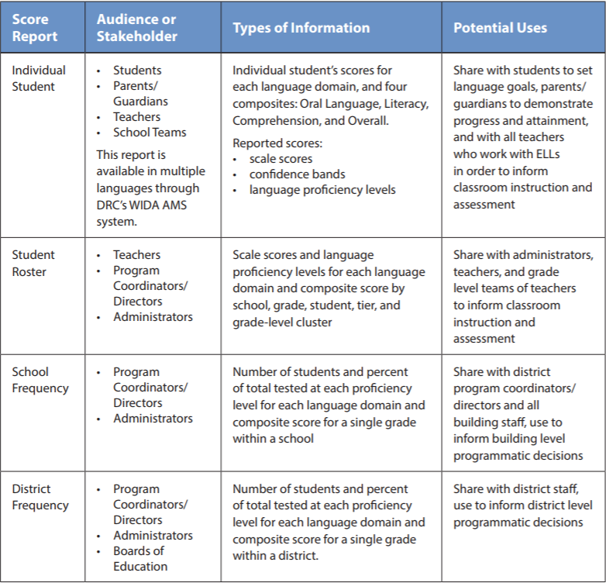
Stakeholders, Info, and Uses
ACCESS for ELLs 2.0
Interpretive Guide for Score Reports
Page 14
Notes:
In the ACCESS for ELLs Interpretive Guide for Score Reports on page 14, you will find this table, which gives information about who is the intended audience or stakeholder, what types of information is included, and potential uses for each of the reports.

Slide 9
Additional Scoring Information
Scores will…
  give information on a student’s English language proficiency
Scores will not…
  give information on a student’s academic achievement or knowledge of the content areas
Scores should be considered one of multiple criteria used in educational decision making
Notes:
Overall, the Score Report gives information on a student’s English language proficiency, the language needed to access content and succeed in school; it does not give information on a student’s academic achievement or knowledge of the content areas.
The scores found on the Score Report should be considered one of multiple criteria used in education decision making. Ideally, these scores will be referenced and utilized in developing annual Individualized Education Program (IEPs) for all students with disabilities.

Slide 10
ACCESS for ELLs 2.0 & Alternate Access
Preparation
Test Administrators must:
Obtain a WIDA user account from district staff.
Complete training course within WIDA Secure Portal and certification requirements.
Familiarize yourself with online test demos.
Hold a valid PSC certificate.
Be familiar with ACCESS Accessibility features and accommodations.

Slide 11
ACCESS for ELLs 2.0 & Alternate ACCESS
Resources
WIDA Secure Portal
  ACCESS test training manuals and resources, and Online Professional Learning modules.
    Contact the WIDA Client Services Center at help@wida.us or call (866) 276-7735
WIDA Assessment Management System
  Order ACCESS materials, manage your student and test information, and find technology resources and testing software
    Contact wida@datarecognitioncorp.com or
    call (855) 787-9615

Slide 12
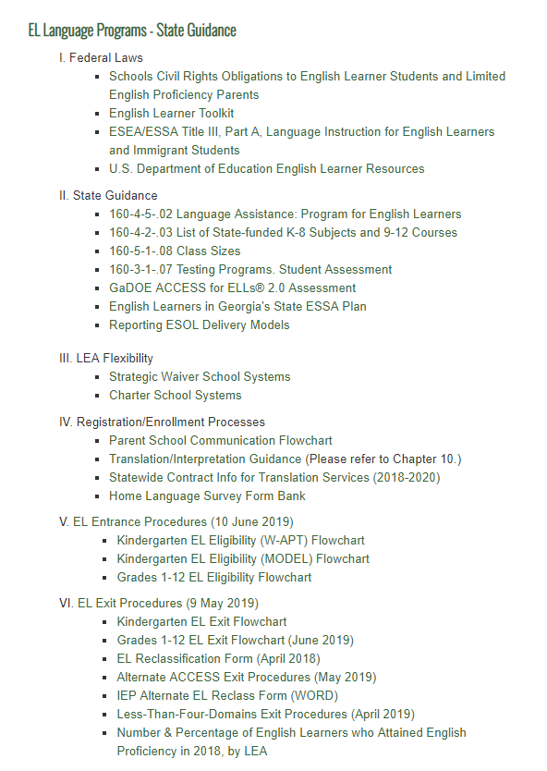
ESOL Program Website Resources

Slide 13

Georgia Alternate Assessment 2.0 (GAA) 2.0
Notes:
Presenter: Mary Nesbit-McBride, Assessment Specialist

Slide 14
Georgia Alternate Assessment 2.0
(GAA 2.0)
Overview
The purpose of the GAA 2.0 is to ensure that students with significant cognitive disabilities are:
  provided access to the state-mandated content standards.
  given an opportunity to show what they know and can do.
Educators should use the GSE Extended Content Standards in planning and instruction.
Only students meeting GAA 2.0 Eligibility Criteria may participate in the assessment.
GAA 2.0 webpage

Slide 15
GAA 2.0
Test Design
The GAA 2.0 has fewer identified accommodations than other state-mandated.
  These types of supports are built into the assessment to give examiners the latitude needed to create an optimal testing experience for students.
    Examiners are given an opportunity to review tasks prior to the assessment,
      Select the appropriate manipulatives for students.
      Determine where they will schedule breaks.
    Examiners can use various reinforcement and refocusing strategies to help students complete tasks.

Slide 16
GAA 2.0
Grades/Courses Assessed
Elementary/Middle | High School (Grade 11)
Grades 5 & 8 English Language Arts Mathematics Science Social Studies Kindergarten, Grades 3, 4, 6, and 7 English Language Arts Mathematics | Ninth Grade Literature & Composition American Literature & Composition Coordinate Algebra or Algebra I Analytic Geometry or Geometry Biology Physical Science US History Economics/Business/Free Enterprise
GAA 2.0 Assessment Window: March 23 – May 1, 2020

Slide 17
GAA 2.0
Reporting and Scoring
Teacher and Parent Resources

Slide 18

National Assessment of Educational Progress (NAEP)
Notes:
Presenter: Bobbie Bable, Assessment Specialist

Slide 19
NAEP
Program Description and History
Congressionally mandated project of the National Center for Education Statistics (NCES) under the umbrella of the U.S. Department of Education
Given since 1969
Overseen by the National Assessment Governing Board (NAGB)
Given in a variety of subjects each year determined by NAGB
Referred to as The Nation's Report Card
Transitioned to digitally based in 2017
Resources
Results: https://nces.ed.gov/nationsreportcard/
NAEP Data Explorer: https://nces.ed.gov/nationsreportcard/naepdata/
NAEP Questions Tool: https://nces.ed.gov/nationsreportcard/nqt/

Slide 20
NAEP
Sampling
Assess 4th, 8th, and 12th grades (Main NAEP) or 9-, 13- and 17-year-olds (Long Term Trend)
Select a representative sample of schools in each state
Select a random sample of students in each sampled school
Assessment Administration
Complete the testing in one day
Test each selected student in only one subject
Train a contracted staff to administer the test
Bring all required assessment materials (including tablets or laptops) to the school
Results
Maintain student privacy for all responses to cognitive and background information questions
Calculate results for states, selected districts, and subgroups only
Compare student performance among states

Slide 21
NAEP
2019-2020 Program – Long-Term Trend (LTT) Description
Measures students’ educational progress since 1971 in reading and since 1973 in mathematics
Nationally representative sample of 9-, 13- and 17-year-olds (age-based)
Paper-based assessment in mathematics and reading

Slide 22
NAEP
Long-Term Trend (LTT) Assessment Windows
Three distinct testing windows:
Age 13: October 14 - December 20, 2019
Age 9: January 6 - March 13, 2020
Age 17: March 16 - May 22, 2020
Georgia sample is 55 schools from 31 districts
  16 - Age 9 schools
  16 - Age 13 schools
  23 - Age 17 schools

Slide 23

Georgia Kindergarten Inventory of Developing Skills 2.0
(GKIDS 2.0)
Notes:
Presenter: Bobbie Bable, Assessment Specialist

Slide 24
GKIDS 2.0
GKIDS has been revised based on results of surveys and focus groups with kindergarten and first grade teachers and system leaders.
ALL students enrolled in a public school kindergarten class are required to be included in this assessment.

Slide 25
GKIDS 2.0
Overview
There are two main purposes for the main GKIDS 2.0 assessment:
  Provide teachers with ongoing formative information about kindergarten students' developing skills
  Provide a summative component to serve as one indicator of first grade readiness
The Readiness Check (RC) is a required component of GKIDS 2.0 whose purpose is to highlight the knowledge and skills critical for student success in learning, solely to guide instruction.

Slide 26
GKIDS 2.0
Program Description
Big Idea
Learning Progression
Learning
Target

Slide 27
GKIDS 2.0
Platform Access
GKID 2.0 platform is now open.
The email address of each district's primary STC has been programmed
  Login into https://gkids.gadoe.org
  Choose Activate Your Account
  Link to setup password will be sent
  STC will set up logins for school coordinators and other district staff who require access
District should decide, and communicate to all their schools, if they will choose the Roster Upload option for enrolled students.

Slide 28
GKIDS 2.0
Administration Schedule
The administration for the main 2.0 assessment is throughout the year
  Districts may require regular reporting checkpoints throughout the school year
  Teachers should generate individual student reports at the end of the school year
  All data should be entered prior to the end of year state reporting deadline
  Website will be unavailable for data entry after the year end close date
o
February 11, 2020 | Mid-year checkpoint (webinar only, data file pulled by districts)
May 18, 2020 | Deadline for entry of main student assessment data by teachers.
June 12, 2020 | GKIDS Website closes for the 2019-2020 school year.

Slide 29
GKIDS 2.0
Readiness Check Program Description
Readiness Check assesses the Pre-K Georgia Early Learning and Development (GELDS)
20 activities measuring all five essential early learning domains
10 direct activities which may include teacher instructions and detailed administration procedures
10 indirect activities which are observational in nature
Teachers will be unable to enter student RC data after the closing date for your district
o
October 21, 2019 | Deadline for entry of GKIDS Readiness Check data by teachers. Note: Schools must complete GKIDS Readiness Check input in the first 6 weeks of the school calendar. District calendars must be reported to the GaDOE Policy Division.

Slide 30
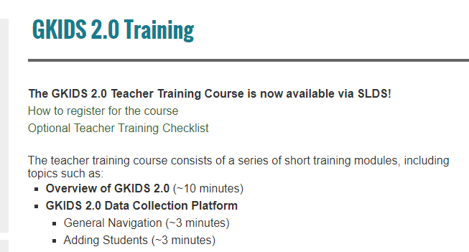
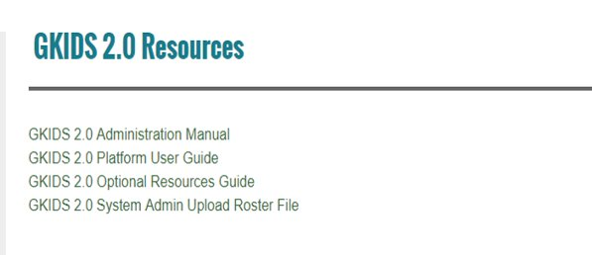
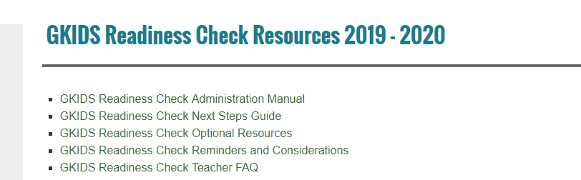
GKIDS 2.0
Resources
GKIDS 2.0 Training
GKIDS 2.0 Resources
GKIDS 2.0 Readiness Check Resources 2019-2020

Slide 31

Georgia Milestones gadoe.org/milestones
Notes:
Presenter: Robert McLeod

Slide 32
Georgia Milestones
Overview
The Georgia Milestones Assessment System is a comprehensive summative assessment pro​gram spanning grades 3 through high school.
Georgia Milestones measures how well students have learned the knowledge and skills outlined in the state-adopted content standards in English language arts, mathematics, science, and social studies.

Slide 33
Georgia Milestones
Assessments
EOG | EOC
Grades 3–8 English Language Arts Mathematics Grades 5 and 8 Science Social Studies | Ninth Grade Literature & Composition American Literature & Composition Coordinate Algebra Analytic Geometry Algebra I Geometry Biology Physical Science United States History Economics/Business/ Free Enterprise

Slide 34
Georgia Milestones
Administration Windows
End of Course
Fall Mid-Month | August 5 | August 23
 | September 9 | September 20
 | October 7 | October 18
 | November 4 | November 15
Winter | November 18 | January 8
Spring Mid-Month | January 13 | January 24
 | February 10 | February 21
 | March 9 | March 20
Spring | April 20 | May 29
Summer | June 15 | July 17
End of Grade
Spring | April 6 | May 15
Summer Retest | May 11 | July 17

Slide 35
Georgia Milestones
Participants EOG
Students to be Tested
Makeup Testing
Retest
Testing includes all students enrolled in grades 3 through 8, except for those participating in the GAA. Test must correspond to FTE grade level.
Make-up tests must be given within the system’s scheduled local administration window; the last day of the local window should be scheduled as a makeup day.
Students who are not on Grade Level for Reading in Grades 3,5,8
Students who score in the Beginning Learner achievement level in mathematics in
Grades 5, 8
For Grades 3, 5, or 8 – a new student who has not tested should participate in the required promotion/retention EOG content assessment(s) for that grade level if the state window is still open
Strategic Waivers are managed locally.
Advanced middle school students enrolled in an EOC MUST take the required EOC assessment.
Those middle school students enrolled in an ELA, mathematics or science EOC course should not take the corresponding grade-level EOG.

Slide 36
Georgia Milestones
Participants EOC
Enrolled in EOC Course(s)
Enrolled in Specified Courses/Programs
Validation of Credit
Counts as 20% of grade.
AP/IB Course enrolles in EOC associated courses
Transfer students from home school, non-accredited entities
Includes: Students with Disabilities (SWD) and English Learners (EL)
Dual Enrollment students*
GaVS**
Credit Recovery
Students concurrently enrolled in a Georgia public school and a private school or non-traditional entity
*Dual Enrollment Students are exempt from designated EOCs. See Student Assessment Handbook (SAH) for guidance.
** Coordinators must tag GaVS students under Testing Codes in eDIRECT.

Slide 37
Georgia Milestones
Participants EOC – Continued
Retest
Demonstrating Subject Area Competency (“Testing-Out”)
Grade conversion score less than 70 on previous administration
Students must meet eligibility requirements
Available during Mid-Month and Summer Main administrations only
See Student Assessment Handbook (SAH) for administration parameters
Testing-Out is available during the August, September, and March Mid-Month administrations and the Summer Main administration
See SAH for guidance

Slide 38
Georgia Milestones
Dual Enrollment
Required of All Students | Allowed Exemption
Ninth Grade Literature & Composition | American Literature & Composition
Coordinate Algebra/Algebra I | Physical Science
Analytic Geometry/Geometry | US History
Biology | Economics
Note: For exempt EOCs, the college grade is factored into CCRPI.

Slide 39
Georgia Milestones
Spring 2019 Update
Spring 2019 Testing Volume
  Approximately 2.82 million tests administered, scored, and reported
Online Testing
  This spring, districts assessed 100% of students online.
  Peak concurrency saw 205,417 students testing simultaneously.
  We topped last year’s peak concurrency on 10 different days.
There were no major statewide issues.
Georgia Milestones | Peak Concurrency Date | Peak Concurrency Simultaneous Students
Spring 2019 | Tuesday, April 23, 2019 | 205,417 = 45.69% increase
Spring 2018 | Tuesday, April 24, 2018 | 141,000

Slide 40
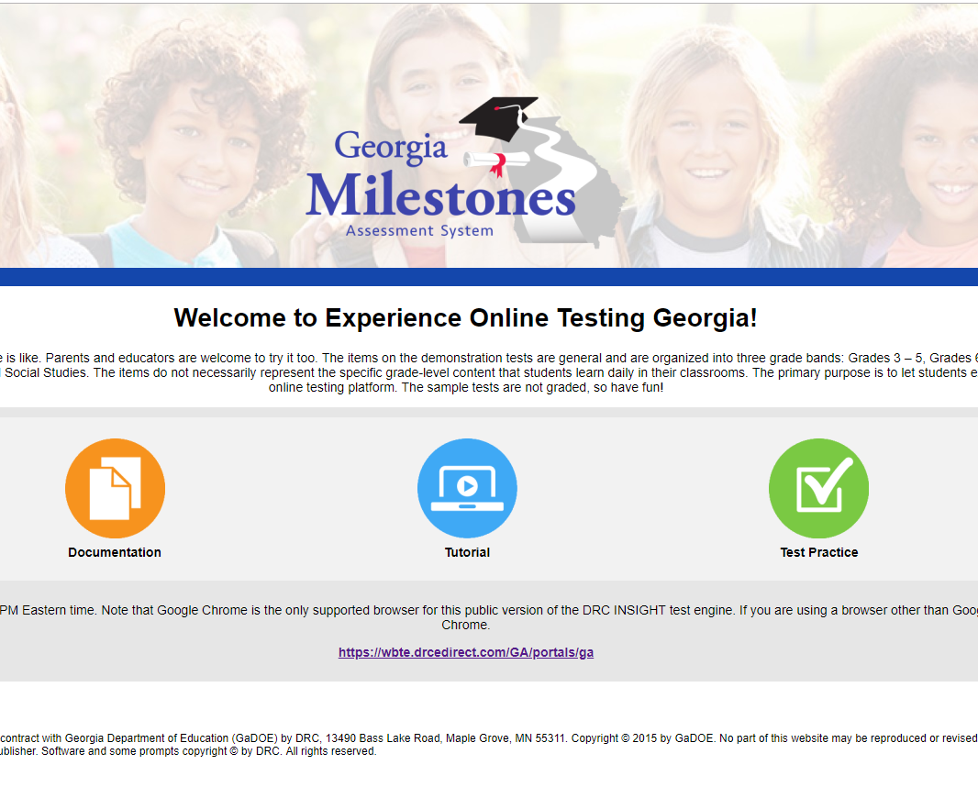
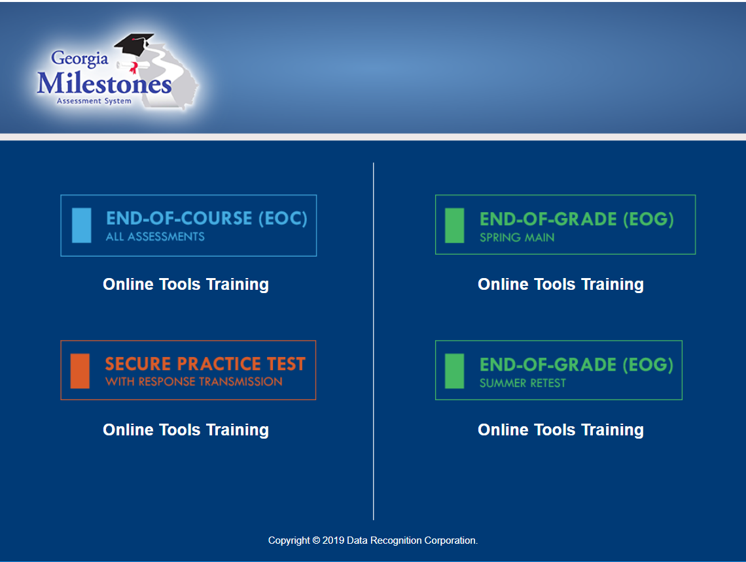
Georgia Milestones
Preparation – Students AND Teacher Readiness
Orient students and teachers to testing via an online platform:
  Experience Online Testing Georgia: http://www.gaexperienceonline.com
  Secure Practice Tests in INSIGHT

Slide 41
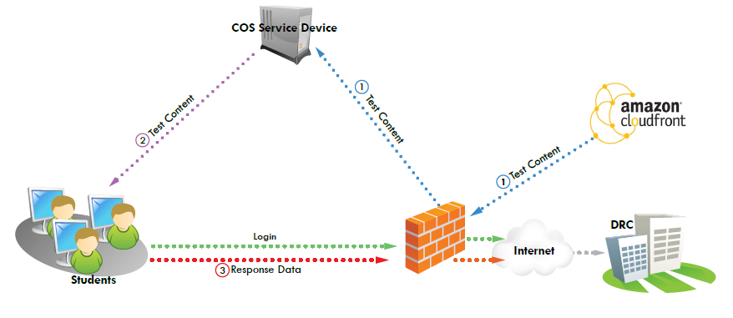
Georgia Milestones
INSIGHT, COS and eDIRECT Georgia Milestones and WIDA ACCESS
INSIGHT
Test Content including Text to Speech and Video Sign Language (VSL) is hosted on a COS Service Device
Students test using the INSIGHT client
COS and INSIGHT devices are managed through eDIRECT
Testing Site Managers (TSM) and Response Caching are discontinued, and testing will no longer function as of August 15

Slide 42
Georgia Milestones
Review of EOG Scheduling Flexibility
Georgia Milestones is administered online.
Local testing calendars may encompass the entire state testing window
Grade-Level Content Assessments
Grade-level content assessments must be scheduled on the same dates and times
Applies to the summer retest administrations
Section Completion
Districts may elect a one-day or a multiple-day administration.
All sections must be completed on the same day or on consecutive days during the same week.
At no time, should some students in the same grade complete a test one week and another group of students in the same grade complete the same test the following week.
Order of administration for EOG grade level content is set locally
Each grade level can be scheduled independent of other grades
Section 1 of ELA must be administered on a separate day from (and prior to) the two following sections of ELA (make-ups excluded) (may not be scheduled on a Friday)
Local calendars can be scheduled around spring break; however, if a grade-level content test starts before spring break, it must be completed before spring break

Slide 43
Georgia Milestones
Resources
Georgia Milestones
EOG Resources
EOC Resources
Milestones Presentations
Milestones Training Videos
TestPad
eDIRECT

Slide 44
Formative Assessment Resources
Notes:
Opening Presenter: Jan Reyes

Slide 45
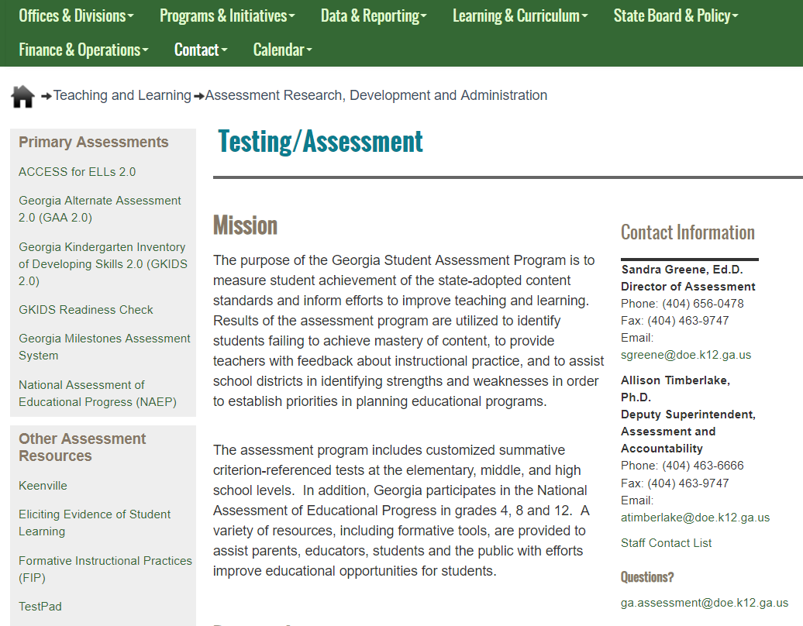
Formative Assessment Resources
Keenville, FIP, and TestPad
Other Formative Assessment Resources
Keenville
Formative Instructional Practices (FIP)
TestPad

Slide 46

Keenville

Slide 47


Keenville
Overview
Keenville is Georgia’s game-based formative assessment in literacy and mathematics for grades 1 and 2.
Keenville is accessible via the Statewide Longitudinal Data System (SLDS).
keenville.gadoe.org

Slide 48

Keenville
Purpose
Provide
educators a formative measure on essential literacy and numeracy skills gained in the early grades.
Promote
teaching and learning by guiding differentiated instructional practices to maximize student learning.
Engage
young learners through a series of interactive challenges that directly align to Georgia content standards

Slide 49



What Keenville IS NOT:
Keenville is not designed to be an instructional tool.
Keenville should not be considered or used as a tool for accountability or high-stakes purposes.
Keenville data should not be used to prevent student entry to a subsequent grade level.
Notes:
Keenville is not designed to be an instructional tool, as it is meant to assess what students have learned after instruction has taken place. Also, Keenville should not be considered or used as a tool for accountability or high-stakes purposes, such as evaluating teachers. And finally, Keenville data should not be used to prevent student entry to a subsequent grade level.

Slide 50
Keenville
English Language Arts Games
Game | Grade(s) | Skills Assessed
Harbor Phonics | 1 and 2 | Phonics & Word Recognition
Museum of Mysteries | 1 and 2 | Phonics & Word Recognition
Peachling Playground | 1 and 2 | Phonics & Word Recognition
Downhill Skiing | 1 and 2 | Vocabulary Acquisition and Use
Junkbot | 1 and 2 | Vocabulary Acquisition and Use
Classroom Detective | 1 and 2 | Reading Literary
Hometown Heroes | 1 and 2 | Reading Literary
Peachy Acres Farm | 1 and 2 | Reading Literary
River Clean-Up | 1 and 2 | Reading Literary
Up the Beanstalk | 2 | Reading Literary
Cave Explorer | 1 and 2 | Reading Informational
Keenbot | 1 and 2 | Reading Informational
Island Adventure | 1 and 2 | Reading Informational
River Patrol | 1 and 2 | Reading Informational
Swamp Explorer | 1 and 2 | Reading Informational
Keenville Action News | 2 | Reading Informational

Slide 51
Keenville
Mathematics Games
Games | Grade(s) | Skills Assessed
Cloud Hopper | 1 and 2 | Reading and Writing Numerals
Treat Factory | 1 and 2 | Interpreting Data with Tables and Graphs
Farmers Market | 1 and 2 | Money
Keenville Sheriff | 1 and 2 | Solving Word Problems
High-Rise Builders | 1 and 2 | Solving Equations
Captain Peachbeard | 1 and 2 | Addition and Subtraction
River Tubing | 1 and 2 | Addition and Subtraction
Carnival Time | 1 and 2 | Telling Time
Bargain Hunters | 1 and 2 | Measurement
Peachling Gym | 1 and 2 | Comparing Numbers using <, >, & =
Peachling Café | 1 and 2 | Place Value
Guitar Maker | 1 and 2 | Shapes
Ski Lodge | 2 | Interpreting Data with Line Plots
Lunch Munch | 2 | Fractional Parts to Whole
Intergalactic Fair | 2 | Using Repeated Addition

Slide 52
Keenville
Resources
Pre-administration webinars are scheduled for August 7 and August 14.
Training courses for teachers and leaders will be available via SLDS during August.
Resources will be posted to keenville.gadoe.org
Available resources will include:
  User Guide
  Dashboard User Guide

Slide 53
Keenville
Lexile and Quantile Linking Study
A linking study is necessary to provide Lexile and Quantile measures within Keenville.
Volunteer districts were notified of selected schools on July 29.
Lexile and Quantile ranges will be reported in Keenville beginning in the 2020-2021 school year.

Slide 54
Formative Assessment Resources
TestPad and FIP
TestPad (in SLDS)
  Item and test content in TestPad
    All content and reports have been moved to TestPad. GOFAR is no longer active.
  Benchmark development tool
  Item and passage creation
Formative Instructional Practices (FIP): online professional learning for teachers, coaches, and leaders
Notes:
Presenter: Joe Blessing and/or Kelli Wright-Harris

Slide 55

FIP Online Professional Learning
Note: Unique access codes are in the STC’s MyGaDOE Portal Account
Webpage: https://www.gadoe.org/georgiafip

Slide 56
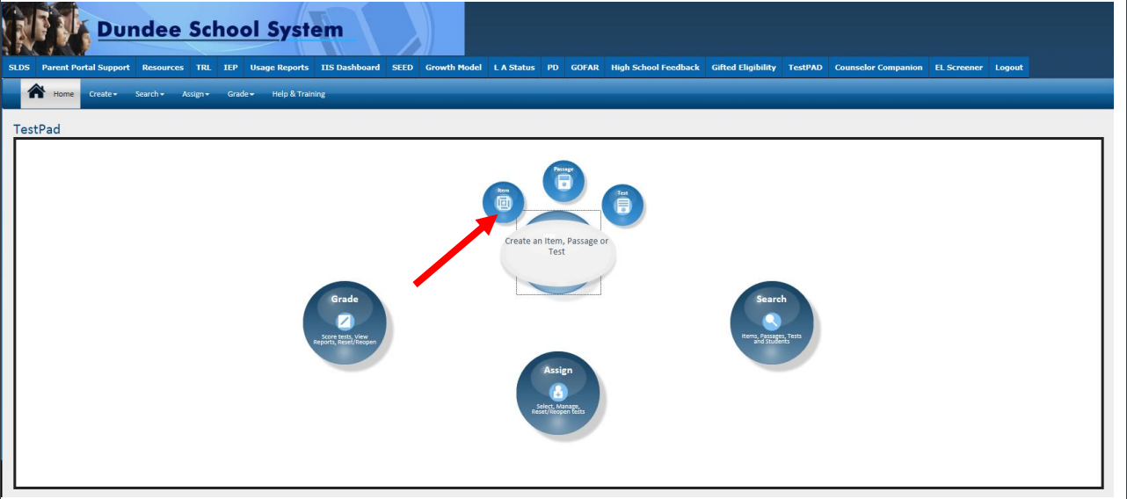

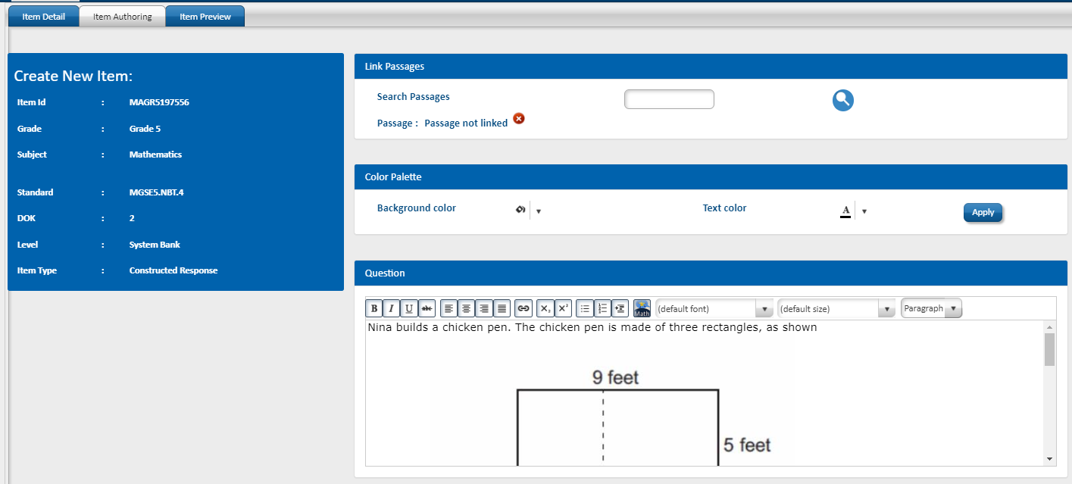
Formative Assessment Resources
TestPad
Click on TestPad in SLDS
Create Test Items, Passages and Rubrics

Slide 57
Duties and Responsibilities of a System Test Coordinator (STC)
Notes:
Presenter: Joe Blessing

Slide 58
Duties and Responsibilities
Notifications to GaDOE of New System Test Coordinators
Superintendent emails GaDOE Director of Assessment Administration identifying the
New System Test Coordinator including contact information.
Sandra Greene (email: sgreene@doe.k12.ga.us)
District security officer, under the direction of the district Superintendent, assigns the
System Test Coordinator the role of Assessment Director in the MyGaDOE portal.
State Charter Schools security officers must assign the role of Charter School Administrator to New System Test Coordinators in the MyGaDOE portal.
GaDOE will notify vendors of the addition and deletion of new System Test Coordinators.
New accounts will be created, and login credentials will be sent via email directly from the vendors.
Notes:
Generally speaking, over the summer and into the early fall, changes are made regarding the appointment of the System Test Coordinator for districts. It is important to emphasize that the Superintendent of a district or charter school must make the appointment and notify Sandra Greene of the new System Test Coordinator. In addition, the Superintendent must contact the security officer for the district to request the additional role of Assessment Director in the MyGaDOE portal for the new System Test Coordinator. State Charter School roles are requested differently. State Charter School Superintendents must direct the security officer to request the role of Charter School Administrator for the new System Test Coordinator. In both cases, this will allow the new System Test Coordinator to receive information and emails from this office through the listserv. It is important to note that issues of FERPA must be considered when assigning this role due to the level of access to confidential student data across the district and required for this individual through the MyGaDOE portal. It is recommended that only those directly related to assessment and assessment-related activities should maintain this role. A frequent review by the security officer may be needed to purge those who may no longer be associated with the district or who may no longer be associated with district-level student assessment.

Slide 59
Duties and Responsibilities
System Test Coordinator - State Board Rules
State Board Rules relating to assessment include:
160-3-1-.07 Testing Programs – Student Assessment
160-4-2-.11 Promotion, Placement, and Retention
160-4-2-.13 Statewide Passing Score
160-4-2-.20 List of State-Funded K-8 Subjects and 9-12 Courses
160-4-2-.31 Hospital/Homebound (HHB) Services
160-4-2-.34 Dual Enrollment and Move On When Ready
160-4-2-.06 through 160-4-2-.48 (IHF) High School Graduation Requirements
160-4-5-.02 Language Assistance: Program for English Learners (ELs)
160-4-8-.12 Alternative Education Programs
160-4-9-.07 Charter Systems
160-5-1-.07 Student Data Collection
160-5-1-.14 Transfer of Student Records
160-5-1-.15 Awarding of Units of Credit and Acceptance of Transfer Credit and/or Grades
160-5-1-.33 Strategic Waivers and Title 20/No Waivers School Systems
160‐7‐1‐.01 Single Statewide Accountability System
Link to State Board Rules
Notes:
A list of State Board rules related to assessment activities has been provided along with a link to those rules.

Slide 60
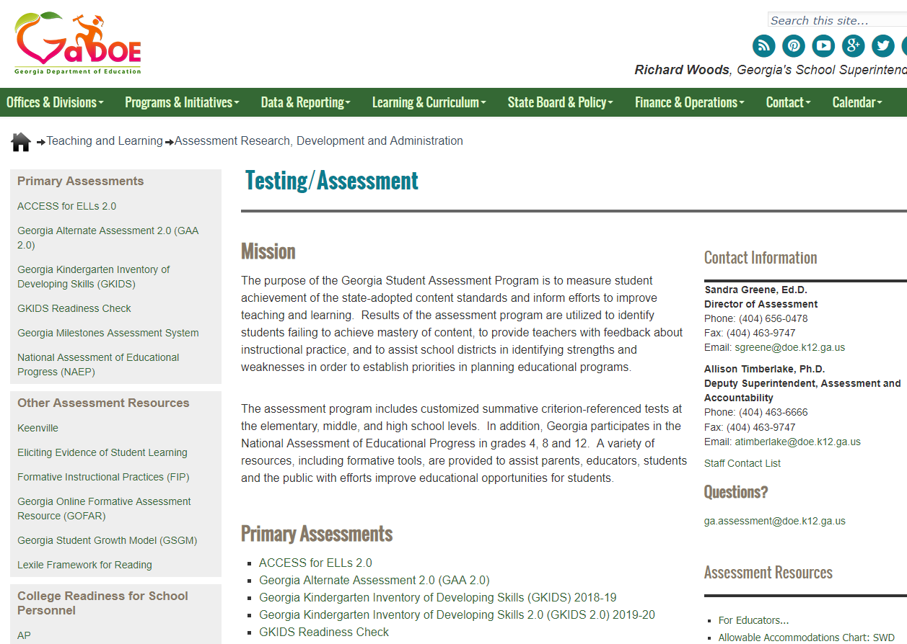
Duties and Responsibilities
System Test Coordinator - For Educators Resources
Assessment Webinar memos posted at: testing.gadoe.org (then select For Educators...)
Notes:
Information and resources specific to System Test Coordinators is found beginning on the Testing/Assessment webpage and clicking on the For Educators link circled in red.

Slide 61
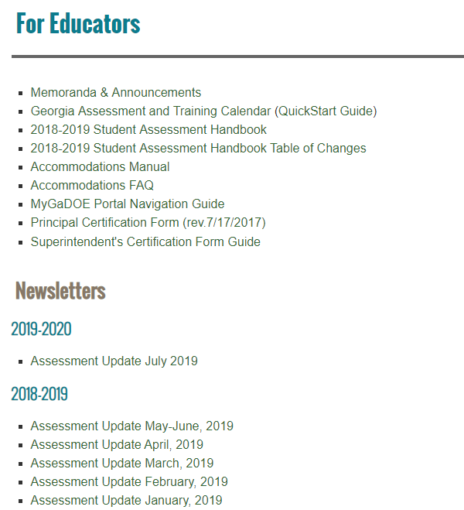
Duties and Responsibilities
System Test Coordinator – For Educators Resources
Notes:
The For Educators link lists a variety of important resources. We will be discussing several of these in the next few slides beginning with the Memoranda & Announcements, followed by the Georgia Assessment and Training Calendar, Student Assessment Handbook, and Assessment Update links.

Slide 62
Duties and Responsibilities
System Test Coordinator Webinar Series
Date | Topic | Time
Tuesday, August 6, 2019 | Fall Assessment Conference Webinar – Part 1 | 9 – 11 a.m.
Thursday, August 8, 2019 | Fall Assessment Conference Webinar – Part 1 (Live repeat of August 6) | 1 – 3 p.m.
Tuesday, September 3, 2019 | Fall Assessment Conference Webinar – Part 2 | 9 – 11 a.m.
Thursday, September 5, 2019 | Fall Assessment Conference Webinar – Part 2 (Live repeat of September 3) | 1 – 3 p.m.
Tuesday, September 10, 2019 | Fall Assessment Conference Webinar – Part 3 | 9 – 11 a.m.
Thursday, September 12, 2019 | Fall Assessment Conference Webinar – Part 3 (Live repeat of September 10) | 1 – 3 p.m.
Assessment training webinars are posted in the Assessment Update Newsletters found at: testing.gadoe.org (then select For Educators...)
Notes:
Recently, the Fall Conference, Part 1, dates and registration links were posted in the July Assessment Update. A memorandum was also posted that documents all the Fall Conference sessions with the pre-registration links. Once you have landed on the For Educators page, click on the Memoranda and Announcements link to open the document. Also found there is the listing of all upcoming trainings with dates and times for all assessments. It should be expected that at times an additional session may be needed or a change in date or time might be required. These changes will be noted in the Assessment and Training calendar as well as in the Assessment Updates each month, if required.

Slide 63
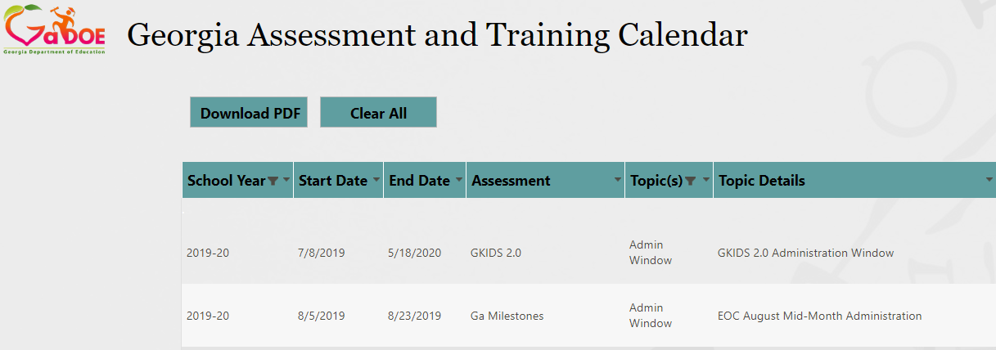
Duties and Responsibilities
System Test Coordinator – Assessment and Training Calendar
Link to Training Calendar
Notes:
The Georgia Assessment and Training Calendar is also found on the For Educators site. It is updated when needed directly to the calendar and includes test windows, training and key administration tasks.

Slide 64
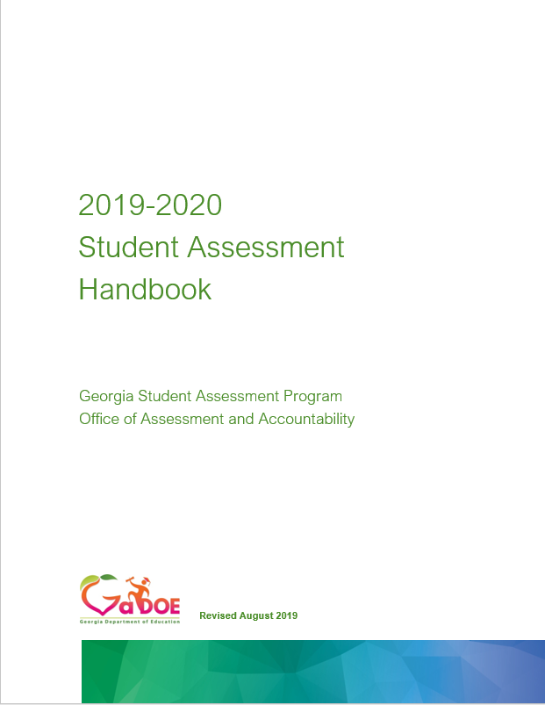
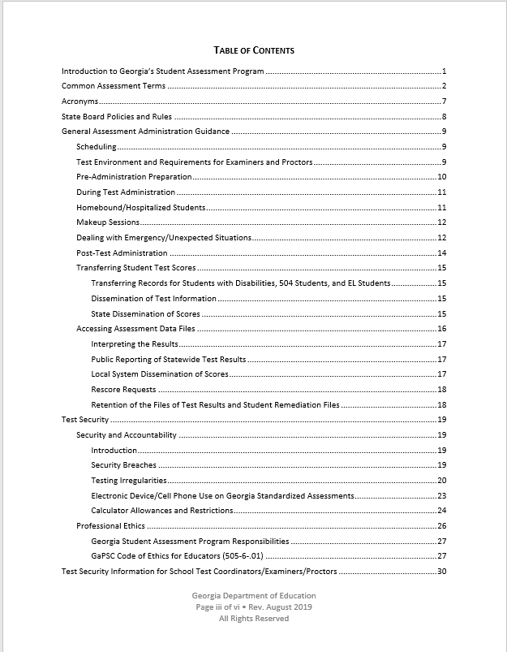
Duties and Responsibilities
System Test Coordinator – Student Assessment Handbook
Notes:
The Student Assessment Handbook is also found on the For Educator’s site. This document contains guidance and policy information regarding assessment administration, test security and details surrounding each assessment along with additional assessment resources. This document must be reviewed and forms the basis for many assessment decisions when planning across the academic year. Most questions may be answered through this document.

Slide 65
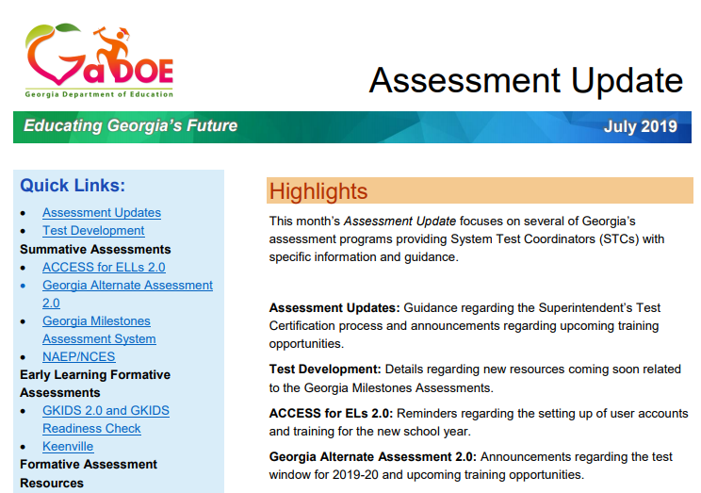
Duties and Responsibilities
System Test Coordinator – Assessment Update
Provides monthly assessment updates
Provides training links and dates
Provides assessment tasks to remember and act upon
Provides accountability updates
Notes:
The Assessment Update is posted to the For Educators site monthly. It contains current information regarding all programs as well as assessment policy updates and notifications. It is intended to take the place of multiple emails that were sent in the past and compile them in to a comprehensive document. System Test Coordinators must review this document once posted to ensure tasks and trainings have been communicated to the appropriate personnel. All registration links to training webinars are posted to this document and are not typically sent in separate emails.

Slide 66

Duties and Responsibilities
System Test Coordinator Resources
Notes:
The MyGaDOe portal is the method we use at the GaDOE to communicate confidential information to System Test Coordinators. You may access the portal by going to the GaDOE webpage and scrolling down to the bottom of the opening page. The MyGaDOE portal link in in the footer of that page.

Slide 67
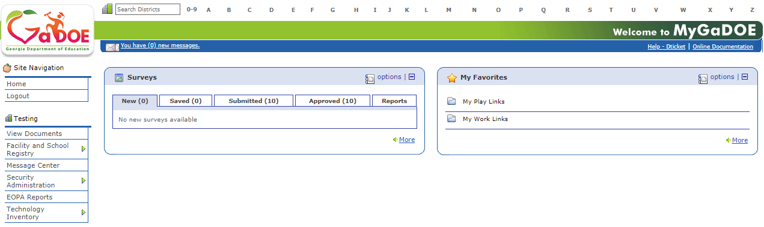
Duties and Responsibilities
System Test Coordinator – Student PPI Information Guidelines
All confidential/secure information, including student identifying information must be shared through the MyGaDOE Portal’s secure email function.
Types of information that must be shared through the MyGaDOE Secure Portal include, but are not limited to:
  Student identifying information (e.g. GTID numbers, student names, etc.)
  Confidential personnel information
  Secure test content
  Confidential student documents
  Alert paper responses
Notes:
All confidential/secure information, especially student identifying information must be shared through the MyGaDOE portal secure email function or one of the forms previously shown. Work emails should not contain any student identifying information.

Slide 68
Duties and Responsibilities
System Test Coordinator – MyGaDOE Portal
Assessment Online Forms
Testing Irregularity Form
  IMPORTANT: Email/call appropriate Assessment Specialist, when needed, to discuss possible invalidations or significant irregularities
Assessment Rescore Request Form
  Also used for transcription requests
  IMPORTANT: Email/call appropriate Assessment Specialist to discuss applicable fees and notify GaDOE of request
Special Accommodations Request Form
  Guidance appears in Student Assessment Handbook
  IMPORTANT: Email/call Taiesha Adams to notify GaDOE of request
Superintendent’s Certification Form
  Tests administered Jan. 1 – June 30: Submit no later than July 31
  Tests administered July 1 – Dec. 31: Submit no later than January 31
  IMPORTANT: Email/call Sandy Greene with questions or concerns

Slide 69
Duties and Responsibilities
System Test Coordinator – Data Collections Reminders
GaDOE Data Collections Pre-ID Cycles 2019-2020
  Cycle #1: No longer used
  Cycle #2: September 5-19, 2019 – EOC Winter Main
  Cycle #3: January 7-23, 2020 – EOC & EOG Spring Main
Program Codes (such as the four-digit 6000 series) may not be used as the four-digit state school number
Correct course numbers must be assigned to students to ensure proper coding related to Participation and Non-Participation
Multiple Student Upload in eDIRECT uses the same format as Pre-ID and can be used to update and/or replace Pre-ID content
All students meeting eligibility criteria for the alternate assessment (GAA 2.0) through the IEP process, regardless of whether the alternate assessment occurs during the current school year, should have the GAA data element flagged ‘Y’ in FTE.

Slide 70
Duties and Responsibilities
MyGaDOE Portal and Vendor Contacts
Assessment | Vendor | Contact
MyGaDOE Portal/All | Georgia Department of Education https://portal.doe.k12.ga.us/login.aspx | Local System Technology Coordinator (STC)
ACCESS for ELLs 2.0 | WIDA (for WIDA.us) Data Recognition Corporation (DRC) (for the WIDA Assessment Management System, WIDA AMS) | WIDA Customer Service (866) 276-7735 help@wida.us DRC Customer Service (855) 787-9615 WIDA@datarecognitioncorp.com
GAA 2.0 | Questar | Questar Customer Service GA@QuestarAI.com (866) 997-0698
GKIDS 2.0 | Georgia Center for Assessment (GCA) https://gkids.gadoe.org | Georgia Center for Assessment (GCA) (888) 392-8977
Georgia Milestones | Data Recognition Corporation (DRC) | Data Recognition Corporation (DRC) (866) 282-2249 gahelpdesk@datarecognitioncorp.com

Slide 71
Test Security
Guiding Principles
The primary goal of assessment security is to protect the integrity of the assessment and to assure that results are accurate and meaningful.
State assessments are an important and a required tool used to monitor state, district, school, and student achievement results.
For assessments to yield fair, accurate, and valid results, they must be administered under the same standardized conditions to all students.
Notes:
Presenter: Sandy Greene
Understanding the guiding principles related to test security help to STCs plan for training activities and support school test coordinators and test examiners in understanding assessments in the district.
Review the slide contents.

Slide 72
Test Security
Code of Ethics for Georgia Educators
Standard 10: Testing – An educator shall administer state-mandated assessments fairly and ethically.
Unethical conduct includes but is not limited to:
committing any act that breaches Test Security; and compromising the integrity of the assessment.
GaPSC Ethics Division (Jan, 2018):
Notes:
The Georgia Professional Standards Commission includes as part of the Code of Ethics for Educators, Standard 10 which is specific to testing. An educator shall administer state-mandated assessment fairly and ethically. Local training should include a discussion of this standard and should focus on supporting examiners in administering, managing and monitoring assessment appropriately.
There are occasions that an incident occurs that warrants an investigation and referral to GaPSC. The GaDOE has made referrals to the GaPSC; however, we do support investigations by district Human Resource departments and the decision to refer to the GaPSC.

Slide 73
Test Security
Assessment Administration
Readiness
Detection
Investigation
Remediation
Notes:
Test Security is achieved through collaborative planning that involves a team of individuals at the district and local school level. If the focus for training is in readiness through a thorough knowledge of administration of any assessment, the valid and reliable results may be achieved to support the classroom teacher and leaders in making quality instructional and programmatic and/or resource-related decisions. Much less time will be needed for detection, investigation, or remediation of issues that may occur if a view focusing on readiness is taken.

Slide 74

Test Security
Security Hierarchy
Superintendent
Test Examiner
Student
School Test Coordinator
Principal
System Test Coordinator (STC)
The successful implementation of the statewide student assessment program requires a concerted effort by many individuals at the local level.
Notes:
The successful implementation of the statewide student assessment program requires a concerted effort by many individuals at the local level. We will spend time reviewing several targeted roles and responsibilities of the Superintendent, System Test Coordinator, Principal, School Test Coordinator, and Test Examiner. I will add the Student as well as a System Technology Director should also be included to bring together in collaboration for planning for local and state tests across the academic year.

Slide 75
Test Security
Readiness – Roles and Responsibilities
Superintendent
Superintendent has ultimate responsibility for all testing activities within the local school system.
System Test Coordinator (STC)
STC shares the responsibility for all testing activities within the local district or charter school as the Superintendent’s designee.
Principal/Administrator
Principal has ultimate responsibility for all testing activities within the school.
System Technology Coordinator
Acquires and maintains current information on the statewide testing program, including technology requirements for testing programs, training manuals, and testing schedules.
Coordinates with the STC for the appropriate implementation of computer-based test administrations.
Additional roles and responsibilities are found in the SAH.
Notes:
Each of the roles indicated here carry certain responsibilities. If you have been a STC for some time you have recognized that your responsibilities go beyond what is listed here and in the Student Assessment Handbook. It is strongly recommended that you review your roles as listed there, but you should also review the roles of your colleagues to determine how you and your team may best work collaboratively together.
The SAH is in final review and should be posted by the end of this week; however, the currently posted 2018-2019 SAH contains the same information as will be presented once the 2019-2020 clears review. You will see some changes, but primarily those changes are to clarify information already contained in the handbook.

Slide 76
Test Security
Readiness – Roles and Responsibilities
School Test Coordinator
Must hold a GaPSC-issued certificate
Test Examiner
Must hold a GaPSC-issued certificate
Proctor
Participates in all training and follows procedures for monitoring the test environment
Shares responsibility with the Principal for all testing activities within the school as the Principal’s designee.
Participates in all training and follows procedures for testing as given in specific Examiner’s Manual’s and documentation related to all state-mandated assessments
Responsible for the correct delivery of assigned accommodations
With examiner supervision, ensures that students are managing test materials appropriately
Ensures only GaPSC-certified personnel manage or handle secure test materials
Additional roles and responsibilities are found in the SAH.
Notes:
Review the slide.

Slide 77
Test Security
Readiness – Local Testing Calendar Scheduling Considerations
All local district testing windows must be within posted state testing windows and must be consistent with guidance found in the Student Assessment Handbook.
  Requests for exceptions outside of allowed flexibility must have prior approval by the GaDOE.
The order of administration is determined by the guidance provided in the System Test Coordinator’s or Test Administration Manual for each assessment.
In scheduling each assessment, districts/schools must adhere to the testing times prescribed in the Examiner’s Manuals.
Determine the plan for communication of local testing windows to parents/guardians and other stakeholders, including school-level leaders and educators.
Notes:
One of the ideas needed to prepare for assessments across the school year, both local and state assessments, would be the idea that test security is not an event but an ongoing process of readiness and preparation for administering a tool designed to provide the district, school, classroom teacher, and parents with information to better serve students. You testing calendars for state assessments must be compliant with the calendars posted in the Georgia Assessment and Training calendar as well as guidance found in the Student Assessment Handbook. Because of the time allowed in the state windows and flexibility allowed for some of the state assessments, careful consideration by the STC and the assessment team should support a meaningful testing calendar that allows for the administration and quality results.

Slide 78
Test Security
Readiness – Student Assessment Handbook
Security Breaches
Staff or student interference in student responses
Testing Irregularities
Irregularities in Security Procedures
Irregularities in Test Administration
Invalidations related to Student Behavior
Staff or Student sharing of any secure test material (social media, texting, email, etc.)
Failure to follow security regulations for distribution and return of secure test materials. Lost test materials are considered a breach of test security
Staff failure to follow assessment administration directions from the Examiner’s Manual, including an exact word-for-word reading of the Examiner’s script
Cell Phones/ Electronic Devices
Students are not permitted to use, or to bring any electronic device that could allow them to view, access, retain, or transmit information
Districts and schools must have a plan to collect and secure such devices, so they are not accessible during testing.
Additional guidance is found in the SAH.
Notes:
A quality assessment plan should include training to minimize the occurrence of security breaches and testing irregularities. Security Breaches are any action that compromises test security or leads to the invalidation of an individual student’s or a group of students’ test scores. Please not the examples given in this slide are by no means all that could happen. For instance, in the first box, examples of security breaches include staff or student sharing of secure test materials via social media, texting, email, etc. There is also a bullet regarding staff failure to follow assessment administration directions from the Examiner’s manual including an exact word-for-word reading of the Examiner’s script. In each of the cases listed across this slide, security breaches and testing irregularities may be avoided with a thorough understanding through training of your staff about test security issues. It is important to note, these principles apply to local testing as well as state assessments when at least one of the goals of an assessment is to provide fair, valid and reliable results.

Slide 79
Test Security
Readiness – Student Assessment Handbook
Distribution/ Storage of Secure Test Materials
All online or paper/pencil test materials must be stored in a secure, locked location with restricted access when not in use.
Test Security Information for School Test Coordinators
Test security information provided for test coordinators, examiners, and proctors.
General Assessment Administration Guidance
Provides general guidance for the following:
System Test Coordinator must implement an accounting and inventorying system between the central location and the schools for all secure test materials.
Consult the Test Coordinator’s Manual for each test regarding details in managing secure test materials.
May be copied and included as part of the documentation for local test security training.
Scheduling, Test Environment
Pre-Administration, During and Post-Test Preparation
Homebound/Hospitalized Students
Make-up Sessions, Emergency/Unexpected Situation
Transferring Student Records, Accessing Assessment Data Files
Additional guidance is found in the SAH.
Notes:
Review the slide information.

Slide 80
Test Security
Readiness – Local Training Plan
System Test Coordinator
Participation in all GaDOE webinars and training sessions
Review of resources available for System Test Coordinators
School Test Coordinator
Participation in all District-level training sessions
Test Examiners, Proctors
Participation in all School-level training sessions
Test Security
Test Security
Test Administration
Pre-, During, and Post-Test Administration Activities
Test Administration
Pre-, During, and Post-Test Administration Activities
Student Test Preparation Training
All training documentation including presentations, handouts, and sign-in sheets must be kept on file locally.
The state may request copies of these materials to ensure that the training was appropriate and adequate.
Provide professional ethics and security training to all staff, both veteran and new staff.
School Test Coordinators are responsible for training of all test examiners and proctors.
Notes:
Depending on the resources available locally, the development of a local training plan should include each of the levels of authority – from the System Test Coordinator, to the School Test Coordinator, and down to the Test Examiners and Proctors. Each level must understand their role and the required training in order to foster readiness and minimize issues of test security during assessment administrations.

Slide 81
Test Security
Readiness – Local Training Plan
Training Considerations
System Test Coordinators (STCs) in collaboration with System Technology Coordinators must develop and implement a district plan regarding training and technology needs for each assessment program.
All personnel involved in test administration must be trained in a manner appropriate to their role; this includes all staff who are involved in the handling of secure test materials (receipt, distribution, pre/post administration activities, return shipment, computer hardware management, etc.).
Paraprofessionals, custodial staff, and others in the school who may be in classes during testing or may be near the area where tests are stored (even though they do not have direct access to tests) should be aware of security rules.
Volunteers may receive training as a Proctor, front office support, hall monitor, etc., but they may not be assigned as a Test Examiner and should not manage test materials or manage testing logistics.
Notes:
Review the slide materials.

Slide 82
Test Security
Readiness – Accommodations
Test Preparation Activities – Accommodations
Eligible Students Student with Disabilities IEP IAP/504
Allowable Accommodations for Students with Disabilities (includes EL Students with Disabilities) Student Assessment Handbook Accommodations Manual
Allowable Accommodations for English Learners Student Assessment Handbook Students who have exited language assistance services in the last two years (EL-1 and EL-2). EL-1 and EL-2 students are ineligible for conditional accommodations based on language proficiency EL students are required to participate in the language proficiency assessment until exited from ESOL services.
Notes:
Presenter: Mary Nesbit-McBride

Slide 83
Test Security
Readiness – Accommodations
Planning for Accommodations – Team Collaboration
Collaborate to prepare list of students requiring accommodations per IEP, IAP, or EL/TPC plan.
Collaborate to prepare appropriate testing schedule to allow for extended time and/or small group settings.
Collaborate to verify accommodations have been entered properly into testing platforms and/or required documents.
Collaborate to determine the local protocol for transcription of student answer documents into online testing platforms. Review information found in the Student Assessment Handbook.
Collaborate to determine specific training plans and test preparation for the Georgia Alternate Assessment 2.0.
Collaborate to determine a monitoring and reporting system for the verification of student accommodations utilized properly in test sessions.

Slide 84
Test Security
Readiness – Accommodation Guidance
Testing accommodations are assigned to students based on decisions made by the IEP team. Assigned accommodations are required by the student in order to access the assessment due to the student’s disability.
Accommodations must be provided during, and be informed by, routine instruction and assessment in the classroom (both before and after the state tests are administered)
  For instance, the amount of extended time a student is given for a state assessment should be informed by the amount given during routine, daily instruction and classroom/local assessment experiences.
Specifying testing mode (online or paper) is not allowed as an accommodation. Paper forms are available for those students who cannot access the online assessment due to their disability.
Neither accommodations or assessment designations (such as a student’s assignment to the GAA 2.0) should be influenced by accountability concerns or influences.
Additional guidance may be found in the Accessibility and Accommodations Manual

Slide 85
Test Security
Readiness – Special Accommodation Requests
In rare instances, the GaDOE will consider a request for use of an accommodation that is not included in the Student Assessment Handbook, on a student by student basis.
Include detailed information for each student.
See the SAH for the required information that must be submitted.
Should be based upon the needs of individual students, requests that are identical for multiple students are not appropriate and will not be reviewed.
STC should screen requests prior to submitting to GaDOE
Submit in one batch six (6) weeks or more prior to test administration
Use the Online Special Accommodations Request in the MyGaDOE Portal
Additional guidance is found in the SAH.

Slide 86
Test Security
Readiness – Training Considerations
Test Preparation Activities to Consider
All students should be familiar with test-taking strategies and with the types of formats and scoring used on the tests (writing prompts; multiple-choice questions; extended-response questions; technology-enhanced items; and online tools, etc.)
Use of items from Assessment Guides, Study Guides, and other GaDOE posted Resources that are parallel to state assessment items should be part of an instructional program that leads to long-term learning
Communicate to students, parents, and the public what state assessments entail, when and how the tests will be administered, and how the results will be appropriately used.
All rooms used for test administrations must be conducive to a proper test environment. For example, the room should be quiet, orderly, comfortable, and have adequate lighting and ventilation.
Notes:
Presenter: Sandy Greene
Review slides

Slide 87
Test Security
Readiness – Training for Test Examiners
Training Considerations for Test Examiners
Test Examiners must be GaPSC certified.
Test Examiners must adhere to protocols for management of secure test materials.
Test Examiners are responsible for the review of rosters and secure test tickets for: Verification of student names and GTID Verification of student accommodations
Test Examiners are responsible for the administration of the assessment: Thorough Review of the Examiner’s Manual and Script Word-for-Word reading of the Script directly from the Examiner’s Manual Account for time allowed for test section completion Verification of student accommodations Verify Text-to-Speech applied in online sessions prior to starting Verify hand-held calculators are not available to students during no-calculator section
Notes:
Review slide information.

Slide 88
Test Security
Readiness – Training for Test Examiners
Training Considerations for Test Examiners
Unless expressly permitted to do so in the test administration manual, test Examiners may NOT review test content.
Test Examiners may NOT discuss test content with students before, during, or following test sessions.
Test Examiners may NOT memorize, post or discuss any portion of a test item or writing prompt to social media, email, or text.
Test Examiners are responsible for reporting irregularities to the School Test Coordinator.
In the event of an evacuation or other unexpected event, the safety and well being of students takes priority.
Notes:
Review slide information.

Slide 89

Readiness – Are Students AND Teachers Ready?
Orient students and teachers to testing via an online platform:
  Experience Online Testing Georgia: http://www.gaexperienceonline.com
  Secure Practice Tests in INSIGHT
Ensure all examiners are trained on test administration:
  District training
  Test Examiner Training
Notes:
When we think about test security, we do not often consider the readiness of students; however, this is one of the most important aspects of test security in that student interaction with an assessment is at least in part connected to their understanding of how to take the test. This would include a review of the tools available for students in online platforms where available. STCs should include a review of the Experience Online Testing Georgia site with School Test Coordinators and Test Examiners. These adults should spend time reviewing the tools as well as the technology-enhanced items contained in this site. Much of the worry about online testing comes from adults who are uncertain how students will respond in these settings – even in a time when students have had the advantage over most of us in working with technology most or all of their lives. Giving Test Examiners the opportunity to explore and work with the item types as well as the tools available to all students as well as accommodated students provides greater insight into the experience. As well, the Assessment Division has developed a Test Examiner Training to support your local training that includes information valuable to Test Examiners in understanding their role as an Examiner in supporting students.
I will add that teachers should be given the links and resources for using the Experience Online Testing Georgia in their classrooms with students. Videos have been developed surrounding many of the Technology Enhanced items that could be used in as part of an instructional session with students helping to familiarize students with the items. All students should have the opportunity to review and work through sessions in Experience Online Testing Georgia and/or the Secure Practice Tests in the eDirect platforms to support readiness.

Slide 90
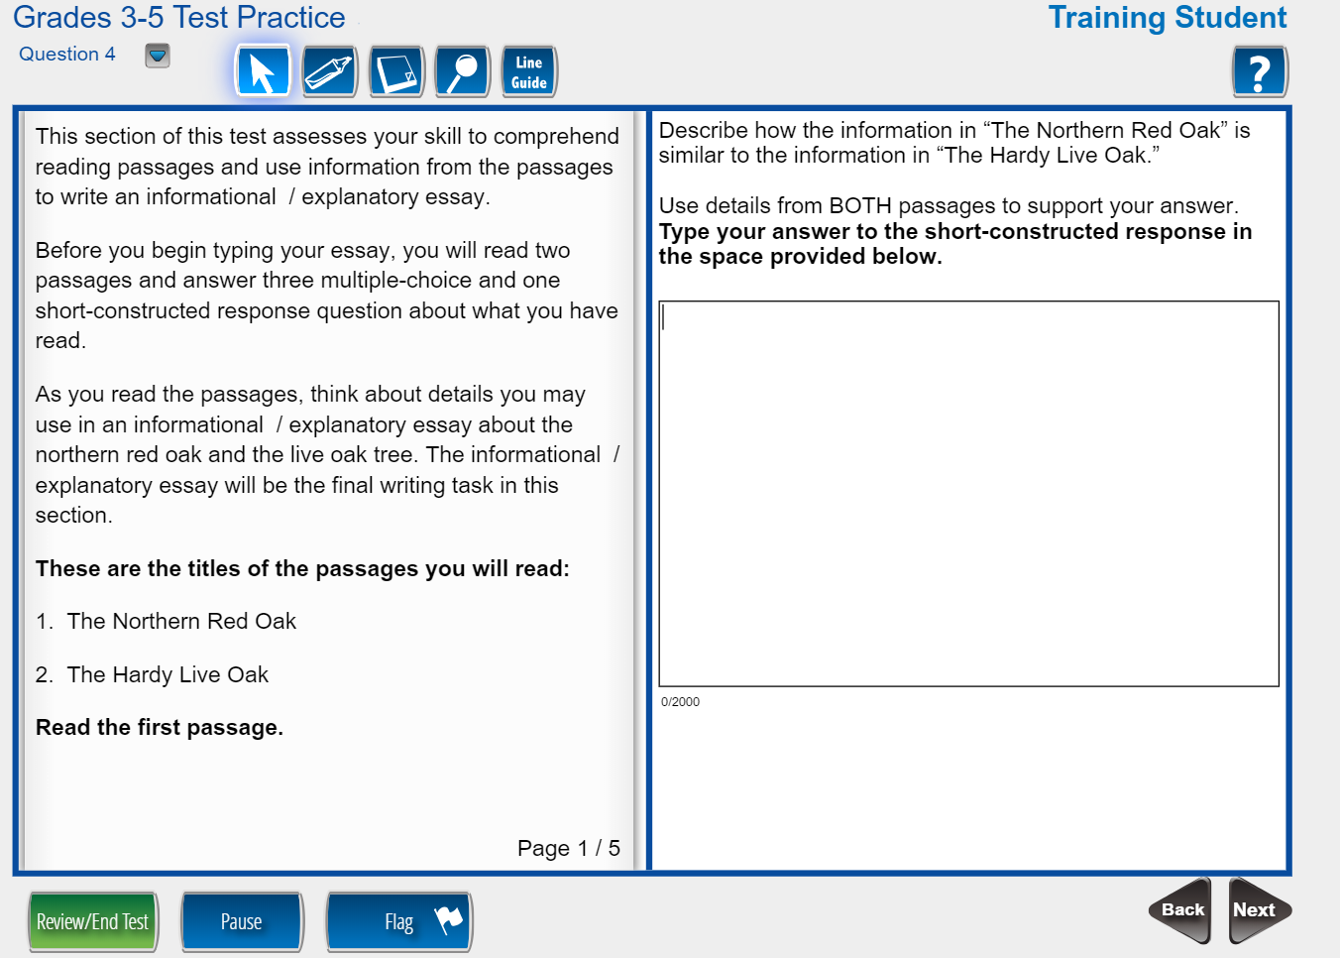

Test Security
Readiness – Are Students AND Teachers Ready?
Format of the test
Testing tools
Time and date of test
Different item types
Online calculators
Cut, copy, paste, undo, redo
Online reference Documents
Accommodations
Familiarity with device for testing
Closing out the test
Notes:
Review the slide information.

Slide 91
Test Security
Readiness – Practices to Avoid
Test Preparation Practices to Avoid
Use of secure test questions or questions that are similar to or altered versions of secure test questions
Reveal, copy, or reproduce any secure state assessment questions, materials, or student responses to secure questions
Copies, reproduces, or uses in any manner (including social media sites, texting, and/or email) inconsistent with test security regulations all or any portion of secure online testing forms, test tickets, passwords, or test booklets
Reads, reviews, notates, photographs, shares, transmits test items whether online or paper, before, during (unless specified in the IEP, IAP, or EL/TPC), or after testing
Questions students about test content after the test administration
Notes:
Review the slide information.

Slide 92

Test Security
Irregularity Type
Testing Interruption
Other*
Accommodations Error
Examiner/Proctor Failure to Follow Instructions/Error
Online Testing/Internet Interruption
Student Failure to Follow Instructions/Error
Materials being distributed inappropriately
Directions not being followed
Accommodation Refusal by Student
Cheating
Detection – Spring 2019
Notes:
Review the slide information. 10 top irregularities Spring 2019.

Slide 93
Test Security
Detection – Examples of Security Breaches
Before, During, and After
Lost or stolen materials
Educators logging into tests to view questions or change responses
During
Students giving or receiving unauthorized assistance from other students during test administration
Teachers providing answers or providing assistance to students during testing
After
Changing responses on the computer
Reconstructing assessment materials through memorization
Memorized test items or answers being posted online
Students accessing non-allowable resources (notes, textbooks, the internet)
Taking photos of test items and sharing them on the internet or social media
Obtaining unauthorized access to secure assessment materials
Hacking into computers
Notes:
Review the slide information.

Slide 94

Test Security
Investigation – Irregularities
Irregularity (IR): Testing anomaly that warrants a report and coding, but test scores stand. An invalidation may be necessary following the review of a reported irregularity.
All personnel in the local system must follow protocol as they become aware of testing irregularities
Signs of any testing irregularity must be dealt with immediately
All irregularities must be reported to the GaDOE by completing the Testing Irregularity Form (TIF) in the MyGaDOE Portal.
Test Examiner
System Test Coordinator
GaDOE
School Test Coordinator
Keep Principal Informed
TIF
Notes:
Discuss the process of investigating an irregularity.

Slide 95
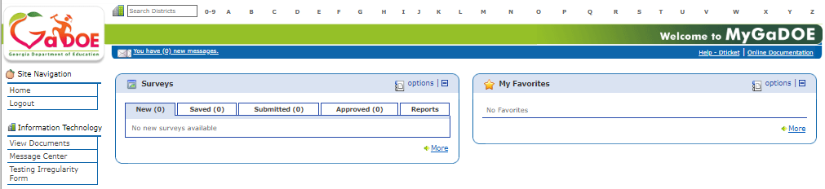
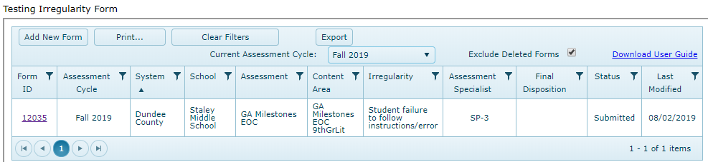
Test Security
Investigation – Entering Irregularities into the MyGaDOE Portal
Testing Irregularity Form Summary Page
Refer to User Guide
Open for form review
Defaults to current active administration
Link to User Guide
Link to Training Video
Notes:
Review the process of entering a Testing Irregularity Form in the MyGaDOE portal.

Slide 96

Test Security
Remediation – Avoiding Test Irregularities
Training
Test Administration policies, protocols, and procedures
  Student Assessment Handbook
  Accessibility Manual
  System Test Coordinator and Test Examiner Manuals
  GaDOE Webinar and Local Training Sessions
Student Accessibility and Accommodations
  Student Assessment Handbook
  Accessibility Manual
  System Test Coordinator and Test Examiner Manuals
  Review of IEP/IAP and EL/TPC plans
Notes:
Discuss general remediation options.

Slide 97
Assessment Administration
Contact Information
http://testing.gadoe.org
Toll-Free (800) 634-4106 and (404) 656-2668
Sandy Greene, Ed.D., Director of Assessment Administration
404-656-0478; sgreene@doe.k12.ga.us
Taiesha Adams, Ed.D., Assessment Specialist, Georgia Milestones
404-656-5975; taadams@doe.k12.ga.us
Bobbie Bable, Assessment Specialist, National Assessment of Educational Progress (NAEP), Georgia Kindergarten Inventory of Developing Skills (GKIDS)
404-657-6168; bbable@doe.k12.ga.us
Joe Blessing, Assessment Specialist, Georgia Milestones, TestPad
404-232-1208; jblessing@doe.k12.ga.us
Kelli Harris-Wright, Assessment Specialist, Formative Instructional Practices (FIP)
404-463-5047; kharris-wright@doe.k12.ga.us
Robert McLeod, Ed.D., Assessment Specialist, Georgia Milestones
404-656-2589; rmcleod@doe.k12.ga.us
Mary Nesbit-McBride, Ph.D., Assessment Specialist, ACCESS for ELLs 2.0, Georgia Alternate Assessment (GAA)
404-232-1207; mnesbit@doe.k12.ga.us
Missy Shealy, Project Manager,
Georgia Milestones
404-657-7651; mshealy@doe.k12.ga.us
Notes:
Contact Information.

Slide 98
Questions

